Slide 1

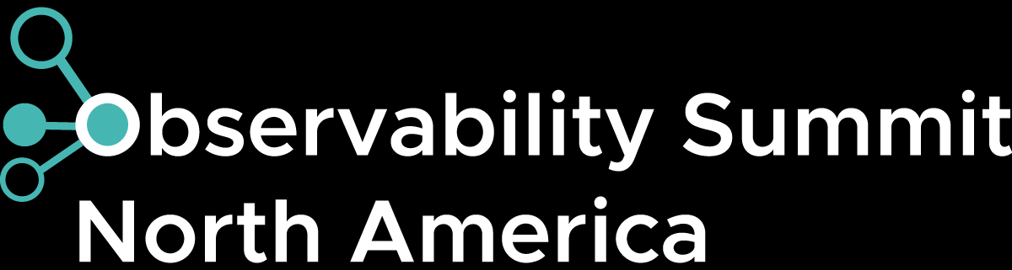
Unified End-to-End Observability
Why your P99 may be wrong and how we fixed it at scale
350+ critical applications • 400+ telemetry streams • deterministic routing • reusable RED dashboards
Migration journey: legacy APM to OpenTelemetry SpanMetrics at Comcast scale
Raghu Vamshi Challa
Comcast Observability Platform
May 21, 2026

Slide 2
What this talk gives you
A migration journey story: what broke, why it mattered, and the controls that made the OTel stack trustworthy.
01
02
03
04
Why we migrated
What failed at scale
How we fixed it
What you can reuse
Cost, platform lock-in, tool flexibility, and dashboards that should not be tied to one backend.
Trace-derived p99 can look correct while being globally wrong if service streams are split.
Opinionated OTel deployment: scrubbing, normalization, load-balancing exporter, single writer.
Dashboard label contracts, backend-portable queries, migration gates, and RED-to-trace workflow.
Audience question: Where do your teams lose trust today: missing dashboards, noisy alerts, expensive cardinality, or trace-to-metric gaps?

Slide 3
Migration Goals:
WHY SPANMETRICS
During an incident, operators usually need a reliable service-level view before they need an individual request trace.
1. Why migrate?
2. Migration goals
3. Backend Portability
• Reduce black-box dependency
• Improve cost control
• Standardize on OTel signals
• Avoid dashboard lock-in
• Make incidents easier to explain
• Normalize metric names
• Normalize labels and attributes
• Scrub noisy and sensitive fields
• Build reusable dashboards
• Preserve RED-to-trace drilldown
Same dashboard logic should work when teams use different stores, such as metrics-compatible backends, analytical views, trace/log stores, or trace drilldown UIs
Explainable
Reusable
Portable
Audience question: Have you ever seen a polished dashboard that nobody trusted during an incident?

Slide 4
Operator workflow: RED first, trace evidence second
WHY SPANMETRICS
During an incident, operators usually need a reliable service-level view before they need an individual request trace.
1. Detect
2. Localize
3. Prove
Requests
Errors
Duration
Service
Operation
Status
Trace
Logs
Evidence
Global RED view tells the operator where to start.
Same labels let the operator stay in one context.
Trace details support the RED signal instead of replacing it.
Key point: SpanMetrics is not “metrics instead of traces.” It is a fast operator surface backed by trace evidence for drilldown.
Audience question: When your teams troubleshoot, do they start with service-level health or individual traces?

Slide 5
What SpanMetrics gives operators
TRACE-DERIVED RED METRICS
A trace is one request journey. SpanMetrics turns many journeys into service-level signals.
Trace
SpanMetrics
RED
frontend → checkout → payment
aggregate spans by service
+ bounded dimensions
Requests: any anomaly?
Errors: any spike?
Duration: any latency shift?
one request journey
many journeys → service signal
operator health surface
Example: A checkout latency spike appears first as a duration panel change, then the operator drills into checkout traces using the same service context.

Slide 6
Challenge 1: split streams break percentile truth
CORRECTNESS FAILURE MODE
When one service stream is divided across writers, each writer sees only a local distribution.
Writer A
500 requests
local p99 = 480 ms
1000 requests
checkout-service
→
True global p99
≠
of all 1000 requests
unknown from local p99s
Writer B
500 requests
local p99 = 620 ms
Takeaway: aggregate first by deterministic ownership, then publish metrics. You cannot average two p99s and call it global p99.
Audience question: If your incident review depends on p99, can you defend how that p99 was computed?

Slide 7
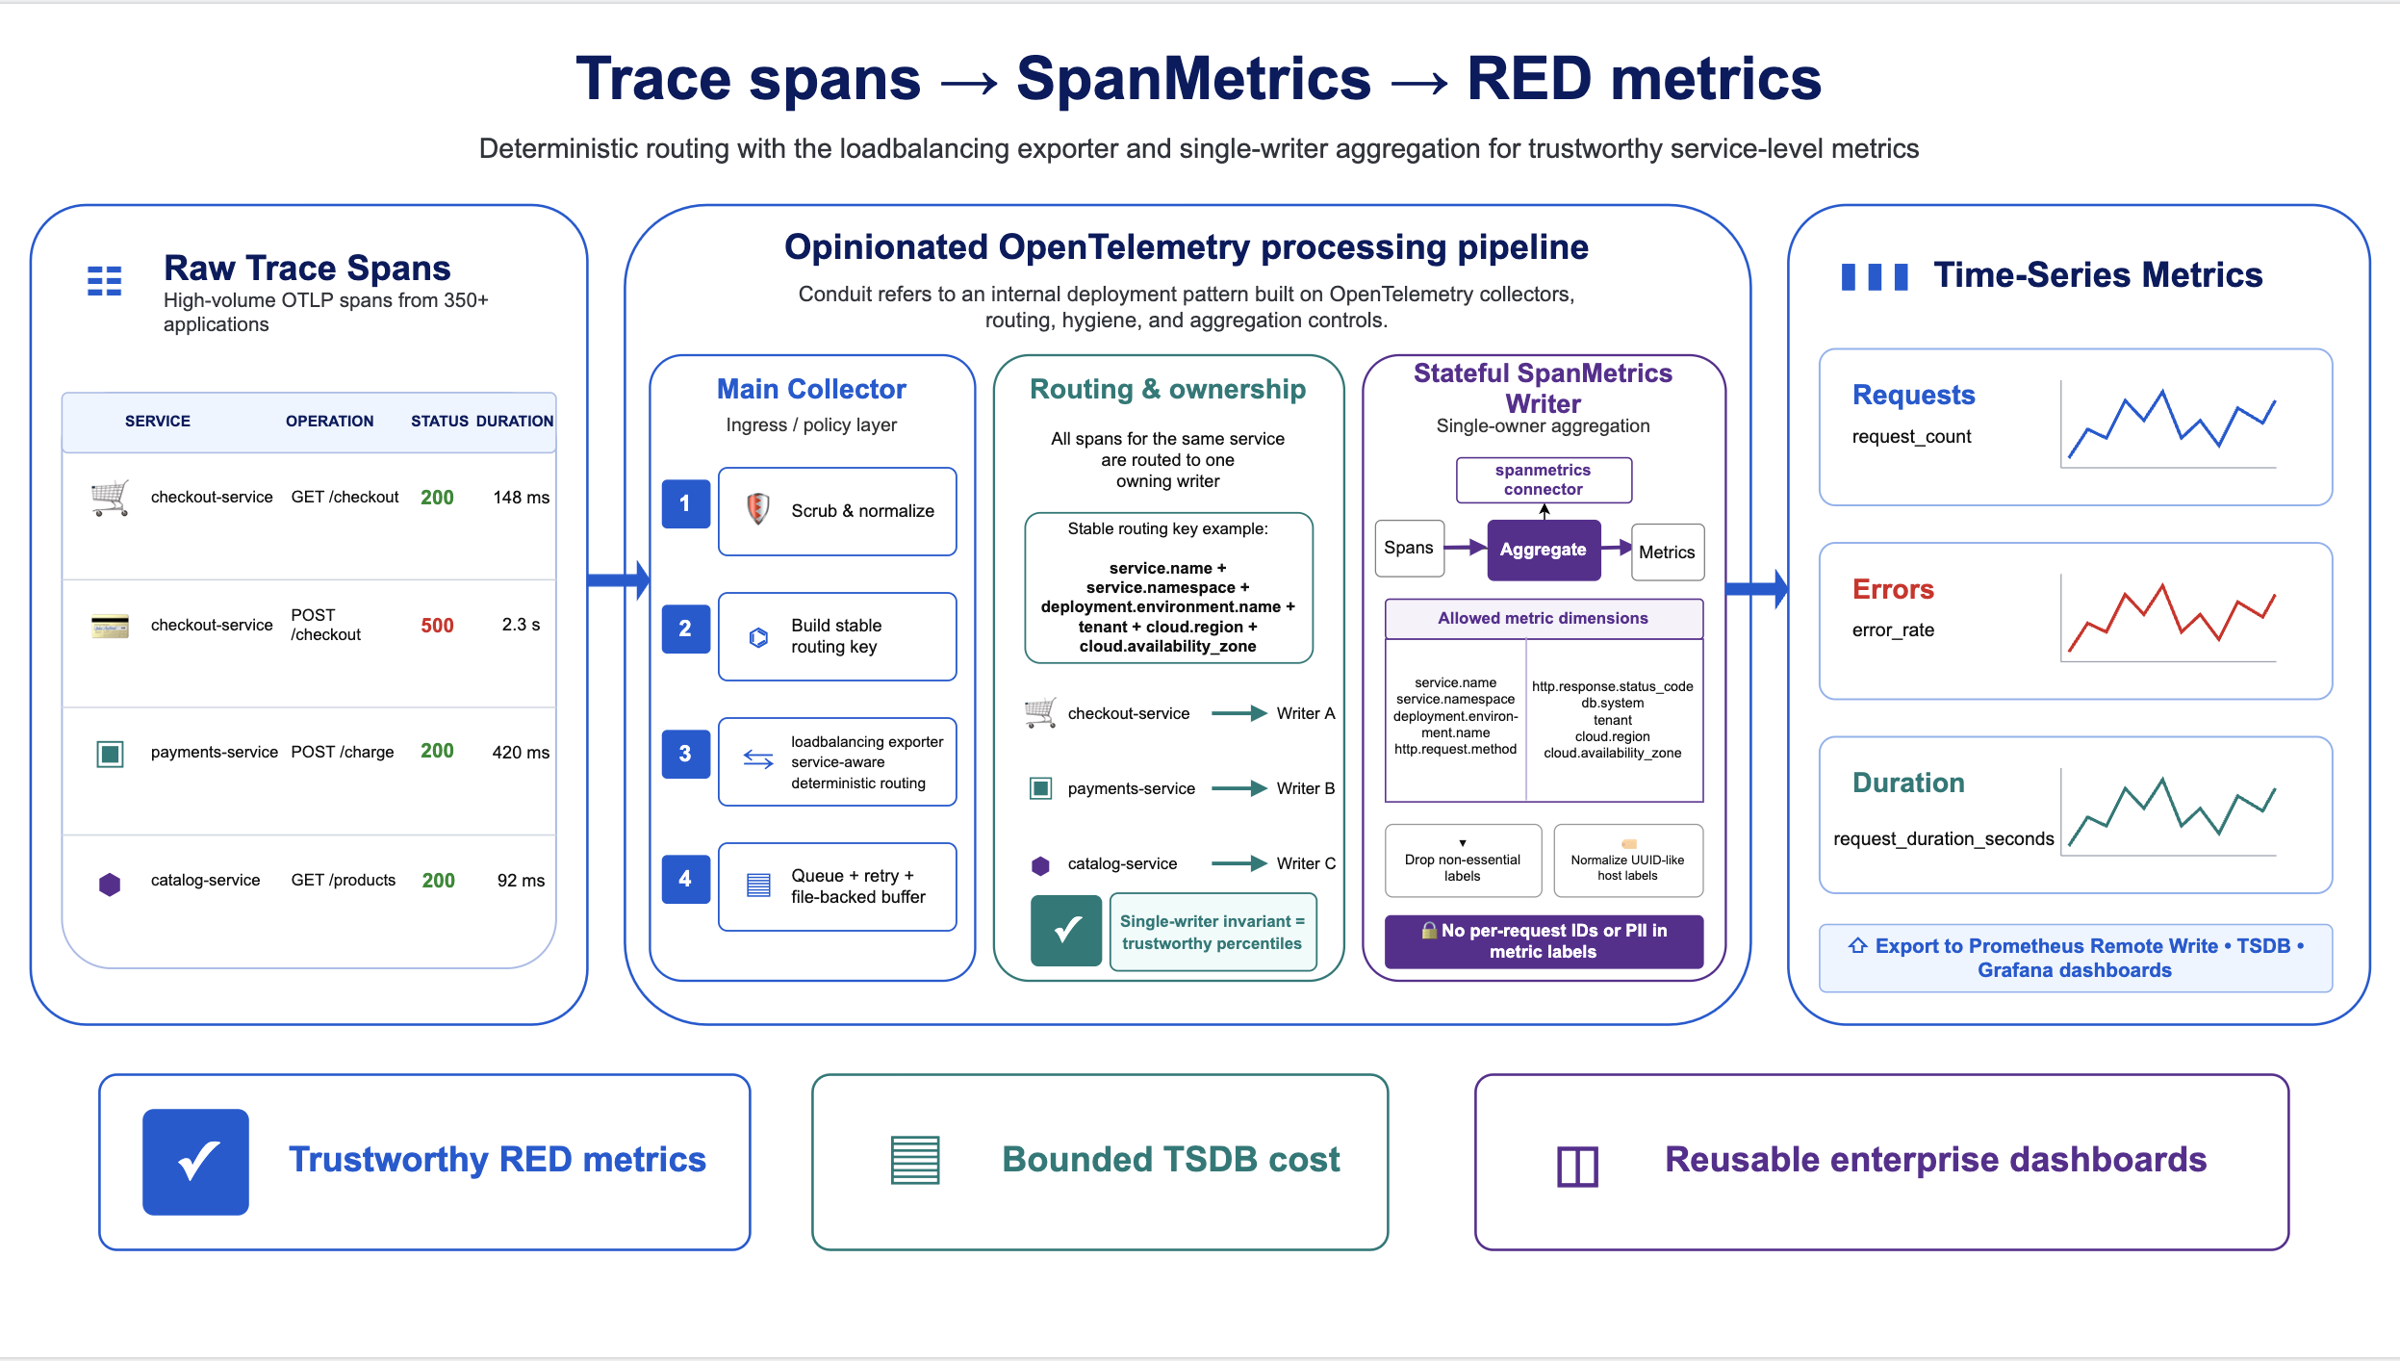
Challenge 1 solution: deterministic routing invariant
LOADBALANCING EXPORTER

Slide 8
Challenge 2: Conduit separates scale and correctness
OPINIONATED OTEL
Conduit is our internal, opinionated Open-Telemetry deployment pattern.
Telemetry
sources
apps • gateways • services
Ingress
collectors
stateless scale-out
Policy +
hygiene
scrub • normalize • enrich
load-balancing
exporter
stable key → owning writer
Stateful
writer tier
single-owner aggregation
RED metrics
+ traces
dashboards + evidence
Why this matters for scale
Many collectors can receive spans from hundreds of applications.
The load-balancing exporter routes by a stable service identity key, not random fan-out.
Queueing and retry absorb backend turbulence without changing ownership.
Why this matters for trust
One writer sees the full-service distribution for the aggregation window.
Scrubbing and allow-lists remove PII and high-cardinality labels before export.
Dashboards stay reusable because labels are normalized and governed.
Audience takeaway: when I say Conduit, I mean an opinionated Open-Telemetry pattern — not a separate closed product.

Slide 9
Comcast scale snapshot: Conduit + SpanMetrics pressure
SCALE EVIDENCE
Scale is not only request volume. It is spans, bytes, series, and the cost of every label choice.
Span total — tracing
Conduit processed volume
70.26B
1.34 PB
total spans seen in the tracing view
total volume through the Conduit pattern
SpanMetrics cluster indicators from the earlier scale dashboard
923K
25
388.62M
854M
0
0B
samples ingested / sec
scrape targets up
hourly series
daily series
targets down
persistent queue
At this scale, one label change can create millions of new time series.
Audience question: Who approves a new metric label before it reaches your TSDB?

Slide 10
Challenge 3: the collector.instance.id cardinality trap
WHY COMMON FIX FAILS
Adding collector identity avoids collisions, but it pushes fleet size into every metric key.
What the operator asks
What collector ID stores
What the TSDB pays
“What is checkout-service p99?”
service + method + status
+ collector.instance.id
one logical RED signal
× collector replicas
If 25 targets emit a label-expanded copy of the same logical signal, adding one replica adds another full set of service × method × status × span-kind × tenant × bucket series.
Better pattern: deterministic ownership keeps correctness without expanding the metric key by collector fleet size.

Slide 11
Scale check: OTel config must prove ownership and safety
MIGRATION GATES
Before declaring a service migrated, verify receive, protect, normalize, route, aggregate, export, and health.
1
Receive
2
Protect
3
Normalize
4
Route
OTLP receiver accepts spans
memory_limiter + batch
scrub + standardize labels
load-balancing exporter:
stable key → owner
5
Aggregate
6
Export
7
Health
spanmetrics RED histograms
remote write + trace path
checks, telemetry, release readiness
Scale test: increase collector replicas and load, then confirm the same service still maps to one SpanMetrics writer and dashboards stay populated.

Slide 12
Governance: keep useful dimensions, drop explosive values
PRIVACY + COST + REUSE
The same rules that remove sensitive data also prevent runaway time-series growth.
Keep
Drop
Optimize
service and namespace
environment, region, AZ
http.request.method
http.response.status_code
bounded tenant or test_batch_id
db.system only when bounded
service.instance.id if per-pod
user IDs and session IDs
auth headers, cookies, tokens
raw SQL in db.statement
request IDs and UUID paths
rollout-generated host labels
/orders/8f3d5b55 → /orders/{id}
url.full?token=... → token removed
host.name=uuid → stable host label
db.statement raw SQL → db.system only
Recommended guardrail: aggregation_cardinality_limit = 20000 + allow-list filtering before export.

Slide 13
Enterprise hardening: reliability plus governance
PRODUCTION CONTROLS
Trustworthy math is necessary, but production readiness needs predictable failure behavior.
Queue + retry
Buffering
Memory limits
Protect delivery during backend issues
Absorb bursts without losing stability
Protect collectors under pressure
Batch behavior
Health checks
Governance
Predictable flush and export patterns
Safer demos, releases, and operations
Correctness + privacy + cost + dashboards
Reliability is complete only when the pipeline is correct, stable under load, and governed for privacy and cost.
Notes:
Slide 13 - Enterprise hardening: reliability plus governance
Line 01: Trustworthy math is necessary.
Line 02: But production readiness also needs predictable failure behavior.
Line 03: Queue and retry protect delivery during backend issues.
Line 04: Buffering absorbs bursts without changing ownership.
Line 05: Memory limits protect collectors under pressure.
Line 06: Batch behavior makes flush and export patterns predictable.
Line 07: Health checks make demos, releases, and operations safer.
Line 08: Governance keeps correctness, privacy, cost, and dashboards connected.
Line 09: Incidents do not happen only when the system is calm.
Line 10: They happen when the pipeline is under pressure.
Line 11: So the reliability bar is not only: did data arrive?
Line 12: The reliability bar is: can the signal stay correct, stable, affordable, and safe under load?
Punchline: Reliability is complete only when the pipeline is correct, stable under load, and governed for privacy and cost.
Transition: Now I will show the same story in the live demo.

Slide 14
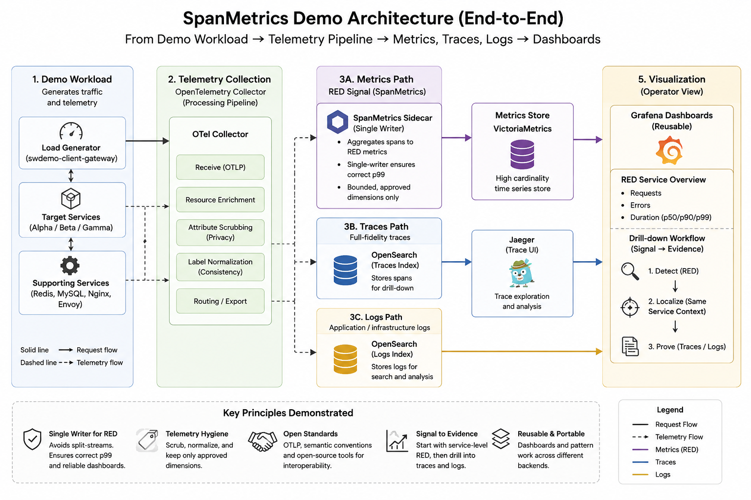

Slide 15
Blueprint: when is a migration really complete?
ADOPTION CRITERIA
A service is migrated only when the signal is explainable, queryable, repeatable, drillable, affordable, and safe.
1
Explainable
Can the team explain receive → scrub → route → aggregate → export?
2
Queryable
Do dashboard variables and query filters match the label contract?
3
Repeatable
Does the same service map to the same owner during load and replica changes?
4
Drillable
Can an operator move from RED signal to trace evidence with the same context?
5
Affordable
Are cardinality and series growth
bounded before export?
6
Safe
Are user IDs, credentials, tokens, and raw payloads removed?
Audience question: Which gate would fail first in your environment: ownership, labels, cardinality, or drilldown?

Slide 16

What to remember
1
One owner preserves percentile correctness
2
Mandatory labels make dashboards reusable
3
Hygiene keeps enterprise scale affordable and safe
If we cannot explain how a signal is computed, we do not yet have observability. We only have telemetry.
Questions?
Raghu Vamshi Challa • Comcast Engineering

Slide 17
Appendix

