Slide 1
Running OpenSearch in the Real World: Migration, Mistakes and Maturity
Marco Arts
Tom Snuverink
Notes:
Introduction

Slide 2
Introduction
Introduction
Starting point
Our journey
Learnings
Q&A

Slide 3



Introduction
Who are we?
Introducing Schuberg Philis
Notes:
Important/national-level companies: National Post service, railways, Banks.
Mission Critical

Slide 4



Starting point
Our environment & constraints
Tooling we're using
  Terraform for deploying
  Chef for configuration
  Ansible for upgrades & maintenance
Notes:
Environment:
Linux and Windows VMs
Local S3 provider
No production-ready kubernetes

Slide 5
Starting point – April 2024
Cause of migration: Splunk licensing cost increase
Research-time
  OpenSearch vs Elasticsearch
Notes:
Two years ago.
Joke: … guess which one we picked?

Slide 6
Our Journey – Research – April 2024
No experience within the team
Found internal teams already using AWS OpenSearch
What we learned:
  Use Datastreams
  Use Index State Management
    Rollover after primary of 35GB (20-50GB)
    Make it read only

Slide 7


Our Journey – Research – April 2024
How to get data in?
Picking log collectors
  vector
  fluentbit
Vector
Linux & Windows
Lightweight
High Throughput
Lots of Sources & Sinks
VRL is powerful and flexible
Fluentbit
Linux & Windows
Lightweight
Ships windows event log
Lots of Inputs & Outputs
Notes:
Vector doesn’t support Windows Event Logs

Slide 8
Our Journey – Crisis Phase – April 2024
Goals:
  Reach deadline of beginning of May
  Running OpenSearch cluster
  80 GB of log data ingestion per day
Notes:
2 weeks to go!

Slide 9
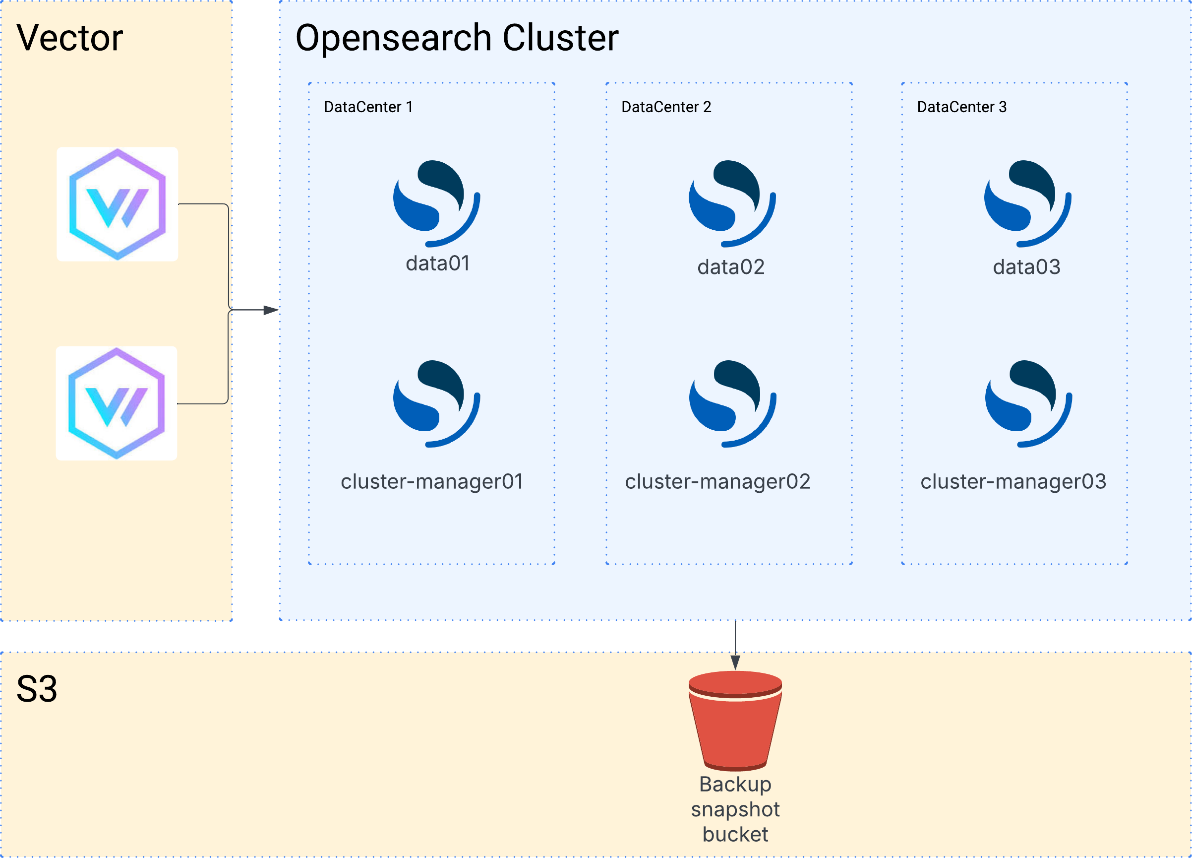
Our Journey – Crisis Phase – April 2024

Slide 10
Our Journey – Crisis Phase – May 2024
Migration completed - crisis averted!
Pain points:
  Manual bootstrapping
  Log parsing was tough
  Learning terminology
Notes:
Parsing was not needed with Splunk, because Splunk agent did most of the parsing
Main pain was TIME
Terminology:
Sharding
ISM
Datastreams
Index Templates and patterns

Slide 11
Our Journey – “Maturing” Phase – May 2024
Time to build a service
Goals:
  Safeguarding data coming in
  Adding tiering
  Ansible playbooks for maintenance
  Documentation
Notes:
Operational stuff: Backups, patching, rolling restarts for changing config
Safeguarding data – we didn't feel like we could rely on our parsers.
Tiering was recommended everywhere we read.

Slide 12
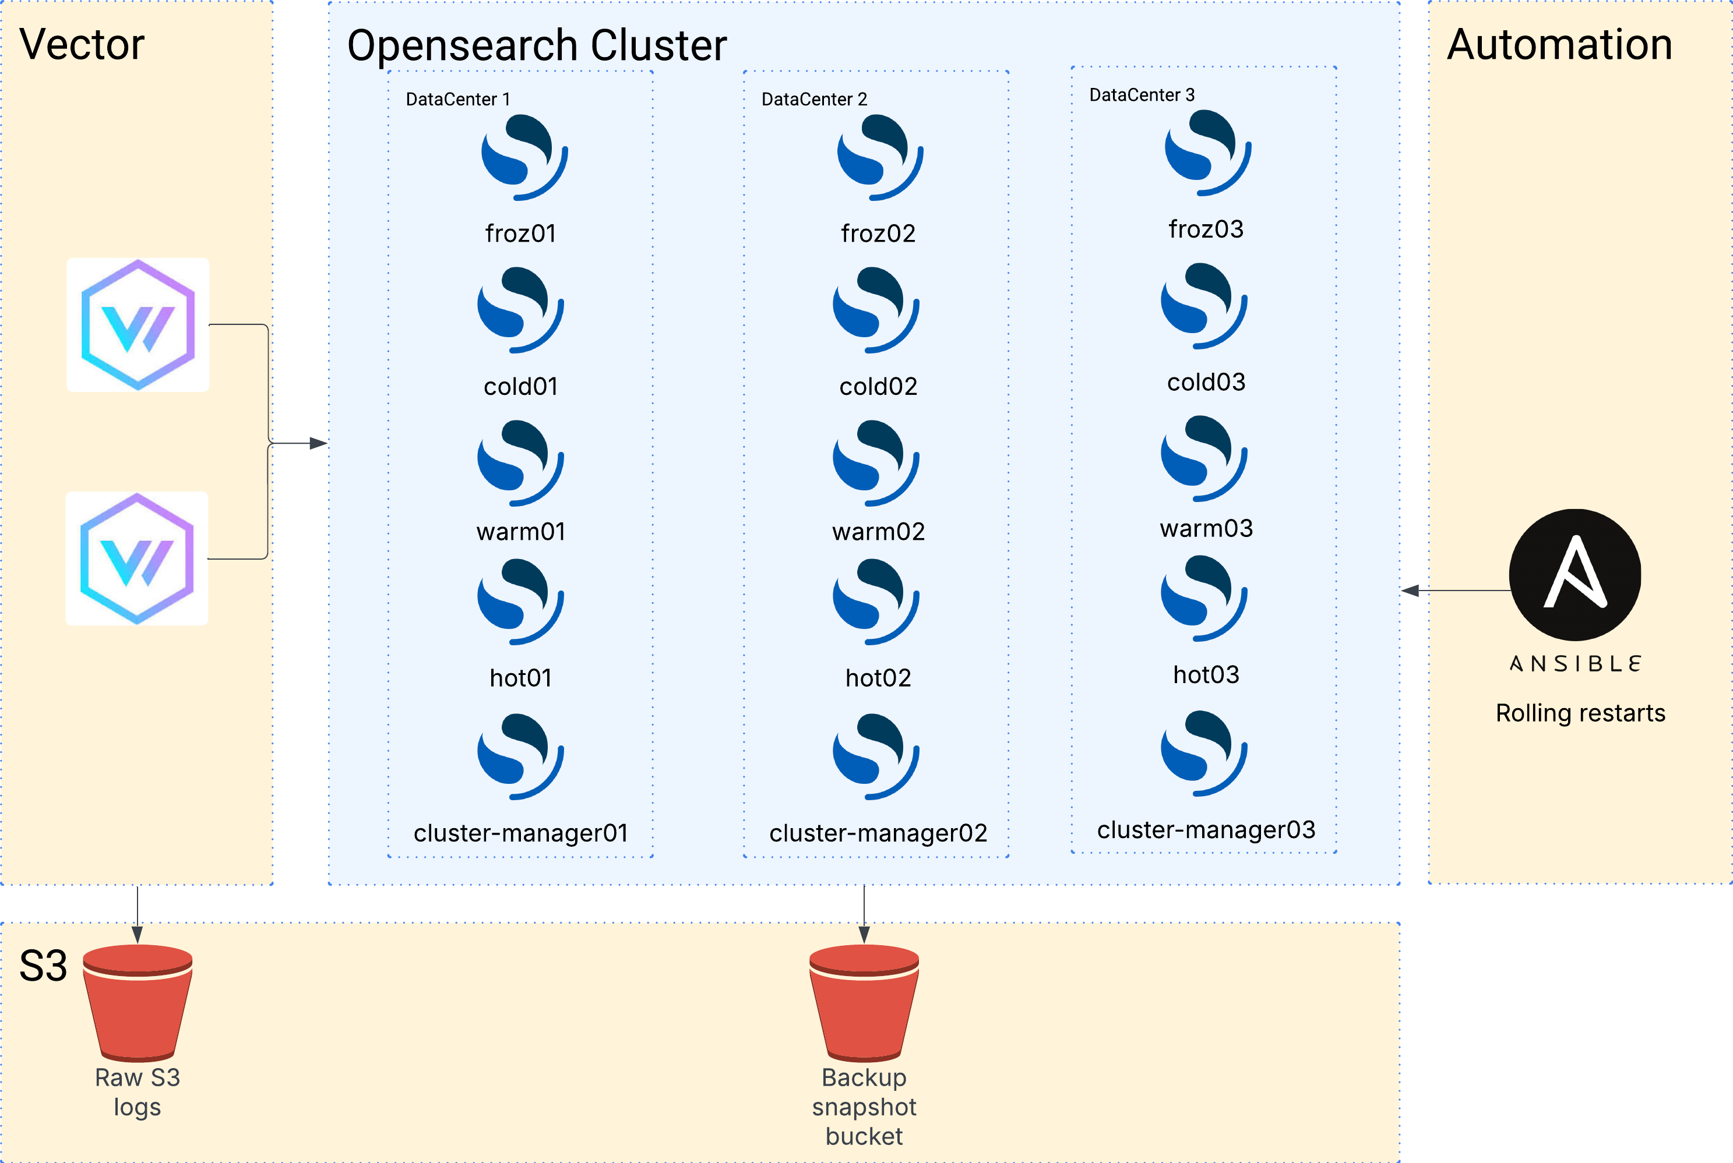
Our Journey – “Maturing” Phase – July 2025
Notes:
Added: S3 raw logs bucket
Ansible Playbook for rolling restarts and OS patching.

Slide 13
Our Journey – “Maturing” Phase – July 2025
What do we have now?
  Automated bootstrapping, cluster creation
  All of the tiers
  ISM Policy rolls over after 35GB, removes data after 90 days
  S3 bucket for raw-logs
  Ansible Playbooks for rolling restarts & OS patching
Pain-points:
  Overhead because of tiering
  Unfinished and interrupted
Notes:
Limited gain with so much overhead of tiering
Did it feel more mature?
We could bootstrap faster / happy flow.
TF OpenSearch configuration as code?
Felt more in control than before

Slide 14
Our Journey – Service Phase – July 2025
Business opportunity – building an MDR solution
Goals:
  Simplify the architecture
  Cost-saving
Notes:
Expecting many customers to join
Speed-up onboarding
Keeping 90 days of logs in cluster was not feasible in terms of storage costs
An MDR-solution uses OpenSearch, but not relevant for this conference

Slide 15
Our Journey – Service Phase – July 2025
Cost-saving:
  Offloading data to local S3
Two options:
  Remote-backed storage
  Searchable Snapshots

Slide 16
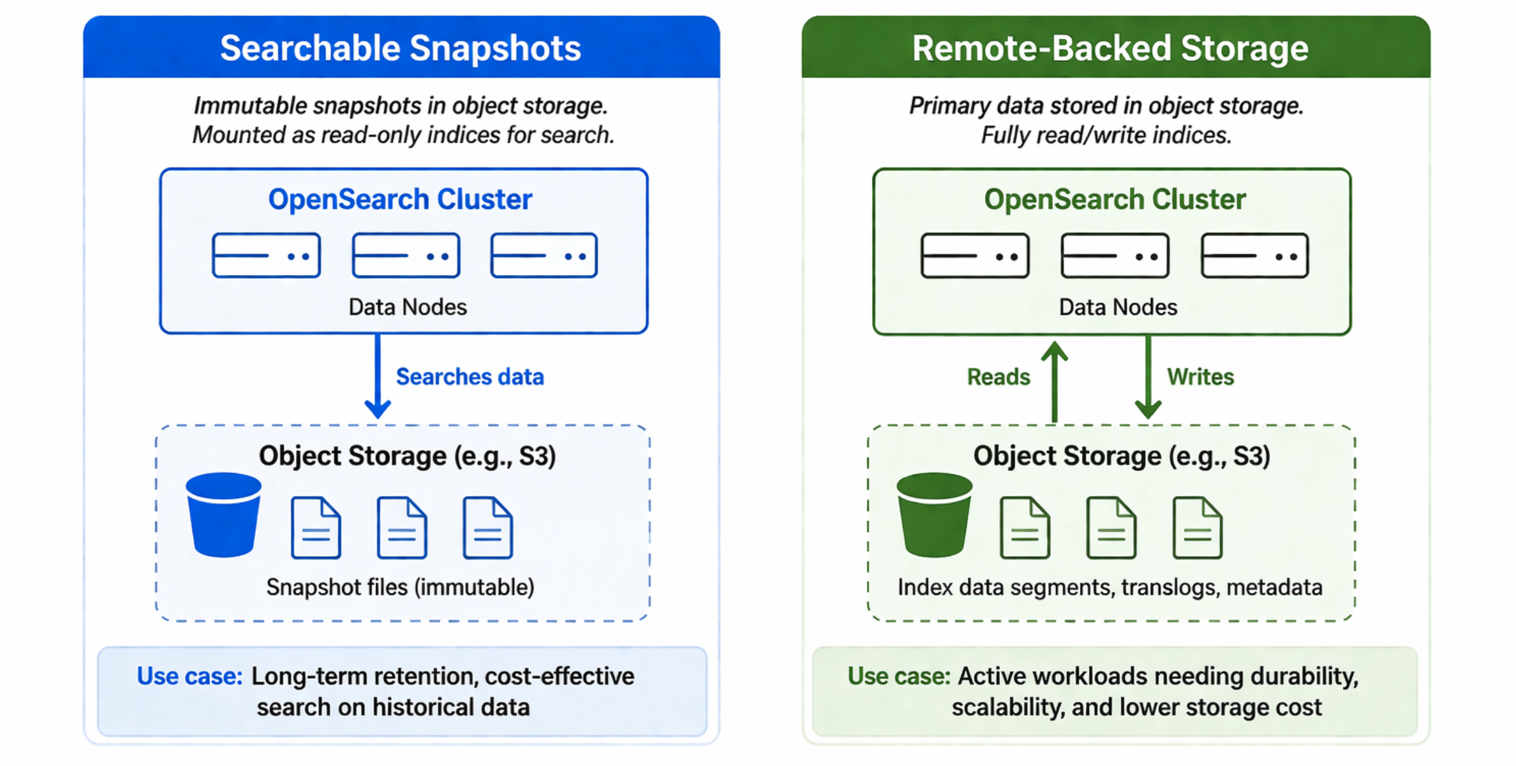
Our Journey – Service Phase – November 2025
Searchable Snapshots
  Read only
  Only on Frozen-type nodes
  Only searched, cache data
Remote-backed storage
  Read/Write
  Resiliency-focused
  Allows faster node-recovery
Notes:
Initially seemed the same and confusing
Remote-backed storage is focused more on DR, faster node recovery and resilience.
Picked Searchable Snapshots to reduce data cost for longer retention times. Most things act on previous 7 days.

Slide 17
Our Journey – Service Phase – July 2025
Searchable snapshots it is!
  Decision to keep 7 days of data on disk
Problems:
  ConvertIndexToRemote is not available in ISM
  How to manage searchable-snapshot indices?
Notes:
No way to manage the lifecycle of offloaded indices
Was only able to create snapshot and delete the index after
No option to restore as searchable snapshot

Slide 18

Our Journey – Service Phase – July 2025
Solution?
Notes:
What does our team do when we have a problem?
We use our Python hammer

Slide 19
Our Journey – Service Phase – July 2025
The solution:
  A custom operator running in a scheduled pipeline
What did we build?
  ISM rolls over daily or at 35GB and creates a snapshot
  Operator takes over
ISM
Rollover
ISM
Snapshot
Operator
Restores snapshot
Operator
Deletes index
Operator
Deletes snapshot
Notes:
Changed logic to Time-based
Shared responsibility between ISM and Operator
Keep as native as possible
Future OpenSearch might have this solution
Split the steps of into two parts
One part was still ISM
daily rollovers
snapshots
One part is the operator
restoring as searchable snapshot
delete old hot index
Cleaning up searchable snapshot after retention period

Slide 20
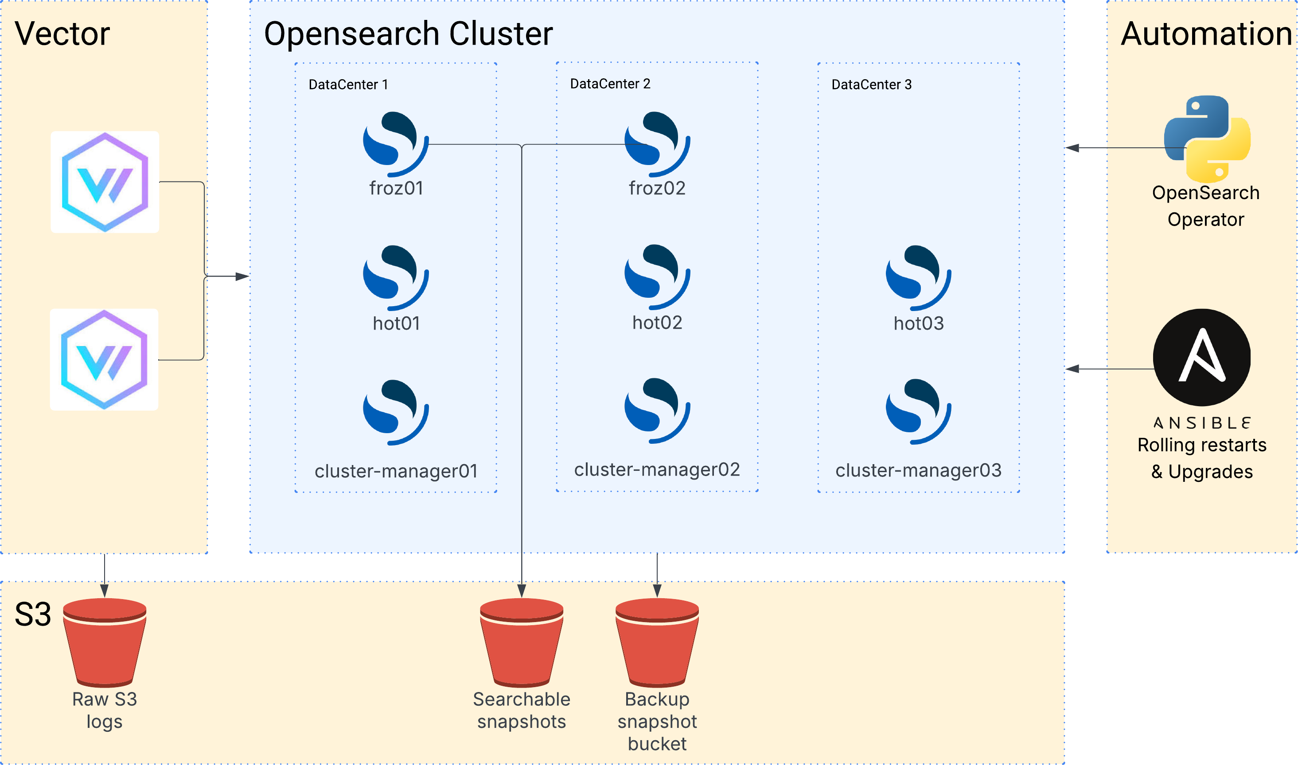
Our Journey – Service Phase – November 2025
Notes:
Added OpenSearch Operator
Therefore, simplified architecture
Added searchable snapshot bucket
Snapshots are done by ISM
OpenSearch operator talks with OpenSearch API
Additionally, we added an Ansible Upgrade playbook
What’s new:
OpenSearch Operator
S3 searchable-snapshot bucket
Simplified architecture / tiering
Ansible upgrades

Slide 21
Our Journey – Service Phase – April 2026
What do we have now?
  Two tiers ( hot + frozen which is remote-backed by S3)
  ISM Policy rolls over daily or at 35GB
  An operator pipeline
  Cost-savings by offloading to S3
Notes:
Only two tiers: hot and frozen
ISM policy for rollover and making snapshot
An operator that handles the searchable snapshots
Cost-saving achieved because of S3 offloading

Slide 22
Our Journey – Future
Goals:
  Kubernetes
    Speed-up scaling and onboarding new customers
  Upgrade to 3.x

Slide 23
Lessons Learned
Disaster story
  Migration failure
Helpful Settings
  Cluster setting: "indices.recovery.max_bytes_per_sec": "500mb"
  Index setting: "index.unassigned.node_left.delayed_timeout": "30m"
Cluster won't rebalance/run other tasks when it's red.
Notes:
Disaster story:
Migration between phases, to simplified architecture
Migration policy that was snapshotting indices older than 7 days
Cluster was stable for a brief moment, then went red. This kept repeating
Our biggest datastream/datasource started sending double
It was hard to pinpoint what the exact problem was
We outscaled to 12 nodes and upscaled our nodes which stabilized the cluster
Now we had the time to find out the source of the problem
Cluster red:
No snapshots
No rollovers
No recoveries/rebalancing

Slide 24
Lessons Learned
Snapshot policy for cluster state!
  Cluster state contains all internal/system indices
During our journey we changed it as follows:
  snapshot pattern: *
  snapshot pattern: .ds-* (doesn’t match datastreams)
  snapshot pattern: logs-*
  snapshot pattern: logs-*,-logs-*-searchable-snapshot
Notes:
Snapshots were made every 30min on *
Too big
Less often
Searchable snapshots were again In snapshot in bucket
Logs-* matches all indices, including the searchable-snapshot ones (not needed because of operator)
Negative matching on searchable-snapshots

Slide 25
Helpful tools
Elasticsearch Exporter
Custom Grafana dashboards
In-house OpenSearch CLI

Slide 26
Questions?
Notes:
This was our talk.
- If there is still time for questions, please feel free

