Slide 1
Vendor-Agnostic Analytics: Querying Open Columnar Formats with OpenSearch
Bharathwaj G
Software Engineer – AWS
Arpit Bandejiya
Software Engineer – AWS
Notes:
Welcome everyone. Today we're talking about how OpenSearch is introducing support for open columnar formats — Parquet, Vortex, Lance — natively, while still using Lucene where it shines. I'll cover the architecture and search flow, then hand over for ingestion, performance, and the roadmap.

Slide 2
The Landscape — Open Formats & Interoperability
The analytics world is converging on open columnar formats — Parquet, Iceberg, Arrow
Spark, Trino, Athena — all query Parquet natively
Users want portable data — query from anywhere, no ETL pipelines
Open source communities are building shared ecosystems around these formats
OpenSearch is powerful for search — but its data is stored as Lucene’s default storage formats such as doc values, BKD index, inverted index etc.
Other systems lack the ability to read the above Lucene formats.
Notes:
The analytics world is converging on open columnar formats. Parquet has become the lingua franca — Spark, Trino, DuckDB, Athena all read it natively. Users want their data portable. But OpenSearch stores everything in Lucene's proprietary format. No other system can read it. If you want to share data with your analytics team, you need ETL pipelines. That's the gap we're closing.

Slide 3
Lucene's Storage Model
Every field → up to 4 data structures
Inverted Index — full-text search
BKD Tree — range queries on numbers/dates
Doc Values — sorting, aggregations
Stored Fields — source document retrieval
Great for search flexibility
Higher storage cost overhead for analytics workloads
The cost
10GB of raw logs data
5.7GB in OpenSearch (Lucene)
~350MB in Parquet + Zstd
~10x difference in storage
Notes:
Lucene stores every field in up to 4 data structures — inverted index for text search, BKD tree for range queries, doc values for aggregations, stored fields for source retrieval. That's great for search flexibility, but for analytics workloads it's massive overhead. 10GB of logs becomes 5.7GB in OpenSearch. The same data in Parquet with Zstd compression? About 350MB. And Lucene's format is completely opaque — no other system can read it.

Slide 4
The Journey So Far — Incremental Wins Within Lucene
Zstd Compression
30% storage reduction
Star Tree Index (STIX)
2x–50x faster aggregations
Derived Source
Eliminate stored fields, reconstruct from doc values
ABC Templates
Auto-apply optimizations per use case (OpenSearch 2.17+)
Notes:
We didn't jump straight to a new engine. We spent two years optimizing within Lucene. Zstd compression gave us 30% storage reduction. Star Tree Index gave 2x to 50x faster aggregations. Derived Source let us eliminate stored fields. ABC templates bundled these per use case. These are real shipped features. But the fundamental problem remained — Lucene's format itself is the bottleneck. We needed a new approach.

Slide 5
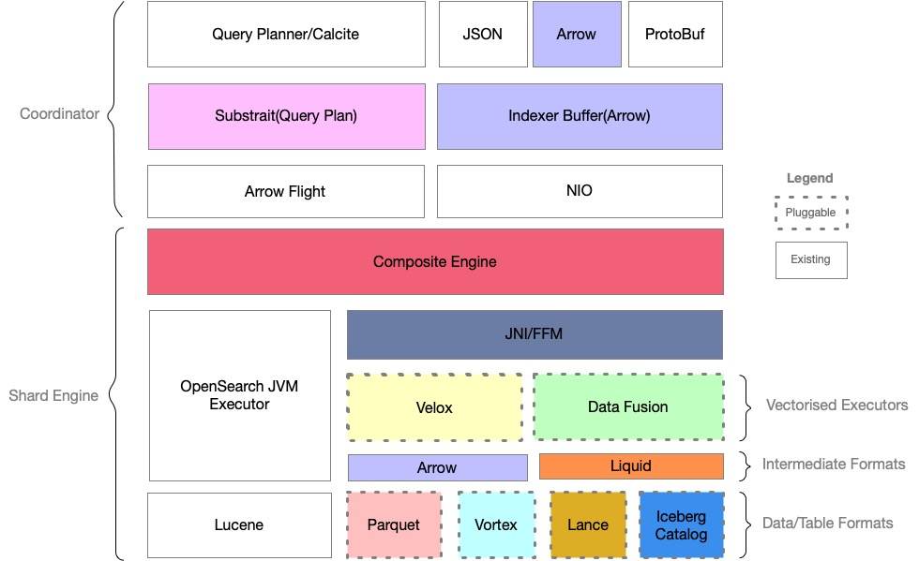
The Solution — Composable Multi-Engine Architecture
Composite Engine
Orchestrates multiple format engines per index
Vectorized query Executor
DataFusion — Rust, SIMD, Arrow compute kernels
Storage Formats
Parquet today — Vortex, Lance, ORC etc pluggable later
Apache Arrow
Intermediate format — zero-copy across language boundaries
Substrait
Open standard for query plan interchange
Notes:
Here's the architecture. At the center is the Composite Engine — it orchestrates multiple format engines per index. DataFusion is our vectorized executor — Rust-based, SIMD-optimized, Arrow compute kernels. Storage formats are pluggable — Parquet today, Vortex and Lance tomorrow. Apache Arrow is the intermediate format for zero-copy data interchange. The cache layer is pluggable. Substrait is the open standard for query plan interchange. And the committer is pluggable — Lucene-based today, Iceberg tomorrow for table-format semantics.

Slide 6
Why DataFusion?
Datafusion is one of the fastest engines for querying parquet based on clickbench benchmarks.
But performance isn't the only reason
Highly extensible query engine - The "LLVM of databases"
Custom table providers & plan nodes
External index support (Lucene, Tantivy) with custom execution plans
Filter pushdown, late materialization
Pluggable cache, pluggable data sources
Lance, Vortex — supported on DataFusion
Uses Apache Arrow as its in-memory format.
Notes:
We benchmarked everything — ClickHouse, DuckDB, Arrow-Java, Polars, custom arrow-rs, Velox. DataFusion was the fastest parquet query engine on ClickBench. But speed isn't the main reason we chose it. It's the extensibility. Custom table providers, physical plan nodes, external index support, filter pushdown, late materialization, pluggable cache and data sources. Lance and Vortex are both built on DataFusion. It's been called the LLVM of databases — a composable engine you build on top of. We also use arrow-rs object-store so the same code reads from local disk, S3, GCS, or Azure.

Slide 7
How Search Works — Three Query Shapes
Parquet-only
DataFusion scans columnar data — predicate / filter pushdown, page pruning, late materialization
Lucene-only
Traditional inverted index path — unchanged, full-text search
Dual mode
Lucene acts as an acceleration index on top of open formats
Query planner routes each predicate to the right engine
Text queries → Lucene (returns bitsets of matching doc IDs)
Range / numeric → DataFusion (native columnar scan)
Composed into a boolean filter tree, executed per row group
Bitsets intersected with columnar results
Notes:
Three query shapes. Parquet-only: DataFusion scans columnar data with predicate pushdown and page pruning. Lucene-only: the traditional inverted index path, unchanged. And dual mode — the interesting one. The query planner analyzes each predicate and routes it to the right engine. Text queries go to Lucene, which returns bitsets of matching doc IDs. Range and numeric queries go to DataFusion for native columnar scan. These are composed into a boolean filter tree and executed per row group. The key insight: Lucene acts as an acceleration index on top of open formats — not the primary store.

Slide 8
Pluggability — Swap Anything
Layer | Today | Tomorrow
Storage format | Parquet, Lucene | Vortex, Lance, ORC
Query engine | DataFusion (Rust) | Velox, custom engines
Index provider | Lucene inverted index | Tantivy, custom
Commit protocol | Lucene SegmentInfos | Iceberg, Delta Lake
Cache | Pluggable | Format-specific caches
Object store | Local, S3 | GCS, Azure Blob
Same query, same API — swap the underlying format or engine
The architecture is designed for the ecosystem to evolve around it
Notes:
Every layer is pluggable. Swap Parquet for Vortex — same query API. Swap DataFusion for Velox. Swap Lucene for Tantivy as the index provider. Swap the committer for Iceberg. Same query, same API. The architecture is designed for the ecosystem to evolve around it. With that, I'll hand over for ingestion, performance, and the roadmap.

Slide 9
How Indexing Works — Field Mapping
Not every field needs every data structure — that's the key insight
Field | Type | Parquet | Lucene Inverted Idx | Doc Values | Stored Fields
backend_port | integer | ☑ | ☐ | ☐ | ☐
timestamp | long | ☑ | ☐ | ☐ | ☐
status_code | integer | ☑ | ☐ | ☐ | ☐
http_version | keyword | ☑ | ☑ | ☐ | ☐
client_ip | keyword | ☑ | ☑ | ☐ | ☐
___row_id | long | ☑ | ☐ | ☑ | ☐
Numeric/date fields → Parquet only (no BKD, no doc values, no stored fields)
Text/keyword → Parquet + Lucene inverted index for fast text filtering
Common row ID links the same document across formats
Notes:
Here's the key insight. Not every field needs every data structure. Numeric fields like port, timestamp, status code — they go to Parquet only. No BKD tree, no doc values, no stored fields. Text and keyword fields like http_version and client_ip go to both Parquet and Lucene's inverted index — so you still get fast text filtering. A common row ID links the same document across formats. This is why storage drops so dramatically.

Slide 10
How Indexing Works — The Flow
① Document arrives
Standard Bulk API — no client changes required
② Composite Engine
Assigns common row ID, fans out to format engines
③ Parquet engine
Buffers in Apache Arrow → flushes as Parquet row groups (arrow-rs, Rust)
④ Lucene engine
Inverted index for text/keyword fields only — secondary index
⑤ Refresh
All engines flush → CatalogSnapshot created atomically
⑥ Commit
Pluggable committer — crash-recoverable durability across all formats
Notes:
The flow. Document arrives via the standard Bulk API — no client changes. The Composite Engine assigns a common row ID and fans out to all registered format engines. The Parquet engine buffers in Apache Arrow and flushes as Parquet row groups using arrow-rs in Rust. The Lucene engine only builds inverted index for text and keyword fields — it's a secondary index now. On refresh, all engines flush and we create a CatalogSnapshot atomically. The committer is pluggable — ensures crash-recoverable durability across all formats.

Slide 11
Ingestion Performance
2.5x throughput · 87% less storage · 84% lower p99
Metric | Lucene (source) | Lucene (derived) | Parquet Engine
Throughput | ~49.6K docs/s | ~55.6K docs/s | ~122.3K docs/s
p50 latency | 55.3ms | 50.3ms | 22.8ms
p99 latency | 582ms | 381ms | 90.3ms
p99.9 latency | 3,942ms | 2,038ms | 142ms
Storage | 27GB | 17.5GB | 3.5GB
big5 workload · r6g.2xlarge · single node · 5 runs averaged
With Arrow-based ingestion format: up to 6x throughput (experimental)
Notes:
The ingestion numbers. big5 workload, r6g.2xlarge, single node, averaged over 5 runs. Parquet engine hits 122K docs/sec — 2.5x standard Lucene. p99 drops from 582ms to 90ms. Storage goes from 27GB to 3.5GB — 87% reduction. And with Arrow as the ingestion format instead of JSON, we've seen up to 6x throughput in experiments — because you skip the entire JSON parsing overhead. That's experimental but shows the potential of native Arrow ingestion.

Slide 12
Search Performance
Where DataFusion shines
Complex aggregations: 7–23x faster
Ultra-high cardinality operations
Multi-column aggregations
SUM, COUNT, AVG across full dataset
58% of ClickBench queries improved
Where Lucene still dominates
Low-selectivity term queries (random access)
Pattern matching & text search
Metadata-driven queries (count, min)
Extremely selective filters
The dual-mode architecture lets you
get the best of both
Notes:
Let's be honest about the search performance picture. DataFusion shines on complex aggregations — 7 to 23x faster than Lucene. Ultra-high cardinality, multi-column aggregations, full-dataset scans. 58% of ClickBench queries show improvement. But Lucene still dominates on low-selectivity term queries, pattern matching, and metadata-driven queries. That's exactly why we built the dual-mode architecture — you get the best of both. Text queries go to Lucene, analytical queries go to DataFusion, and they compose together.

Slide 13
Vortex — Pluggability in Action
Compressed columnar format, built on the DataFusion / Arrow ecosystem
Same pluggable DataFormat interface — swap Parquet for Vortex, same query API
Early results (42M rows):
Scenario | Parquet | Vortex | Lucene | Vortex vs Parquet
High sel., 50% scan | 351ms | 253ms | 475ms | -28%
High sel., 10% scan | 105ms | 75ms | 137ms | -29%
High sel., 2.5% scan | 50ms | 42ms | 45ms | -16%
28–62% faster than Parquet · Matches or beats Lucene on wide scans
Lance for vector workloads — same story, different format
The format is a choice, not a constraint
Notes:
Vortex is a compressed columnar format built on the DataFusion and Arrow ecosystem. Same pluggable interface — swap Parquet for Vortex, same query API. Early results on 42 million rows: Vortex is 28 to 62% faster than Parquet consistently. For wide scans, Vortex at 253ms matches or beats Lucene at 475ms. Lance is another format for vector workloads — same pluggable architecture. This demonstrates the power of the design — the format is a choice, not a constraint.

Slide 14
Roadmap & Community
What's next
Iceberg committer — time travel, schema evolution
More formats — Lance (vectors), ORC
Arrow based ingestion
Materialized views
Get involved
All open source — Apache 2.0
Community contributions welcome
Notes:
Roadmap. Iceberg committer for table-format semantics with time travel and schema evolution. Native DataFusion aggregations — currently some aggs still go through the Java layer. Sorting support and bloom filters for further search acceleration. More formats — Lance for vector workloads, ORC. DSL query support alongside PPL and SQL. All of this is open source under Apache 2.0. The engine RFC is issue 20644, implementation tracking is issue 20876. PRs are actively being merged. We welcome community contributions.

Slide 15
Thank You! Questions?
Notes:
OpenSearch is no longer locked to a single format. Choose the format that fits your workload — Parquet, Vortex, Lance. They compose together with Lucene as an acceleration index. 2.5x ingestion throughput, 87% storage reduction, Vortex matching Lucene on scans. All open source. Thank you — happy to take questions.

