Slide 1
We need to walk before we run with CDM
“If we build it, they will come” only works if we’re building something that helps

Slide 2

Before we begin: A quick “hands up”
Raise your hand if:
  You don’t know what CDM is
  You’re keeping up to date with CDM with a view to implement in the future
  You have a production case of CDM in your company
  You are actively contributing to CDM
  You’re wondering when the tide might start to turn

Slide 3

Let’s take a real world example
Teaching a complicated movement requires a breakdown of steps, and a meaningful return on each step
You can’t go from nothing to everything in a single step, but if step one feels like you are barely closing the gap, it can quickly get demoralizing.

Slide 4
Numbers
As it stands, 64 firms are either in considered analysis, implementation or adoption of CDM (across collateral and DRR cases)
(Thanks to ISDA for the figures!)
A good proportion of those have been in analysis or implementation for years, without yet reaching adoption.
Considering the number of total financial companies that are in this system, this is still less than 0.1% of the potential ‘global’ adoption.
Even if we were to realistically look at that as 1% (so 1 in 10 COULD realistically use CDM), it’s a very low number.
Why is there such a gap, and for those already on the CDM journey, such a lag between maturity stages?

Slide 5
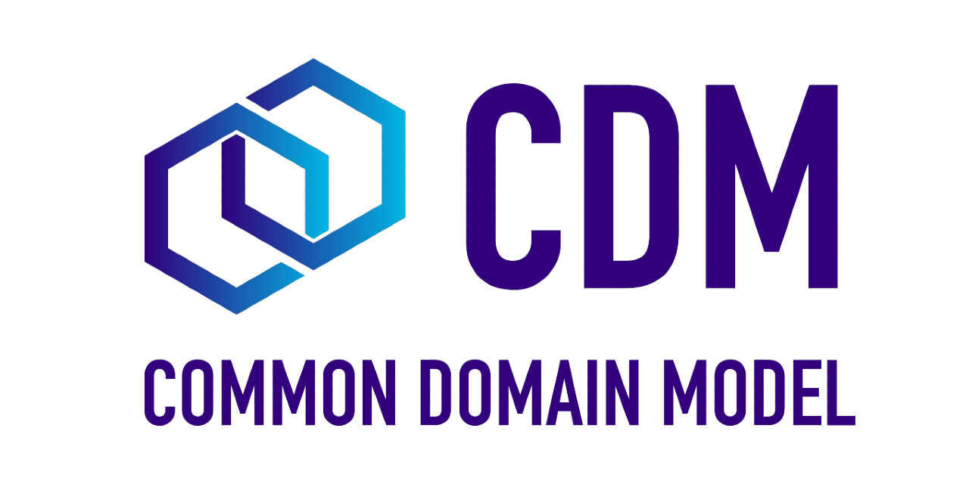


CDM is getting more complicated

Slide 6



CDM is getting more complicated
Multiple complicated changes to CDM are proposed most months for the Contribution Review Working Groups to consider.
Most of these are additions, rather than removals or consolidations.
Great in theory – more CDM means more functionality – means it can do more than it could before.

Slide 7

CDM is getting more complicated
In practice, this means that the code released quickly becomes outdated.
“Keeping up” with CDM changes is fast becoming a full time occupation, if a company is heavily in a production use case
(On the basis they aren’t using CDM natively!)
And still, adoption rates are low across the industry
(Less so for DRR)

Slide 8
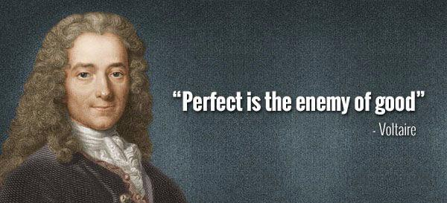
What can we do as ‘Champions’ of CDM?

Slide 9
What can we do as ‘Champions’ of CDM?
Find a single use case that could work with CDM
Get it working in an end-to-end flow
Adopt it fully to production
Move from there to other use cases once the back is broken
Encourage an ecosystem where ‘some’ is still better than ‘none’, even if it’s not as good as ‘full’!

Slide 10


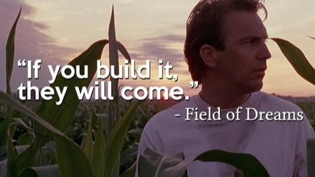
What should CDM (and the community) do?
Better communication about changes
What’s missing that is stifling adoption? Is it more functionality? Or something deeper?

Slide 11


What should CDM (and the community) do?
Maybe we need to walk a bit with CDM development
Easy to run away with more and more use cases and enhancements.
Does “bigger CDM” = “more progress with CDM”?
Do we need to think more on where we focus our efforts as an open-source community to encourage adoption?

Slide 12

Shameless plug
We are production ready with CDM
Also working closely with the governing bodies to populate the sparse data representations for legal agreements
(…if that’s what people want!)
Direct collaborators with ISDA for CDM adoption, so if you DO want to get started and don’t know where to start, please reach out!

Slide 13

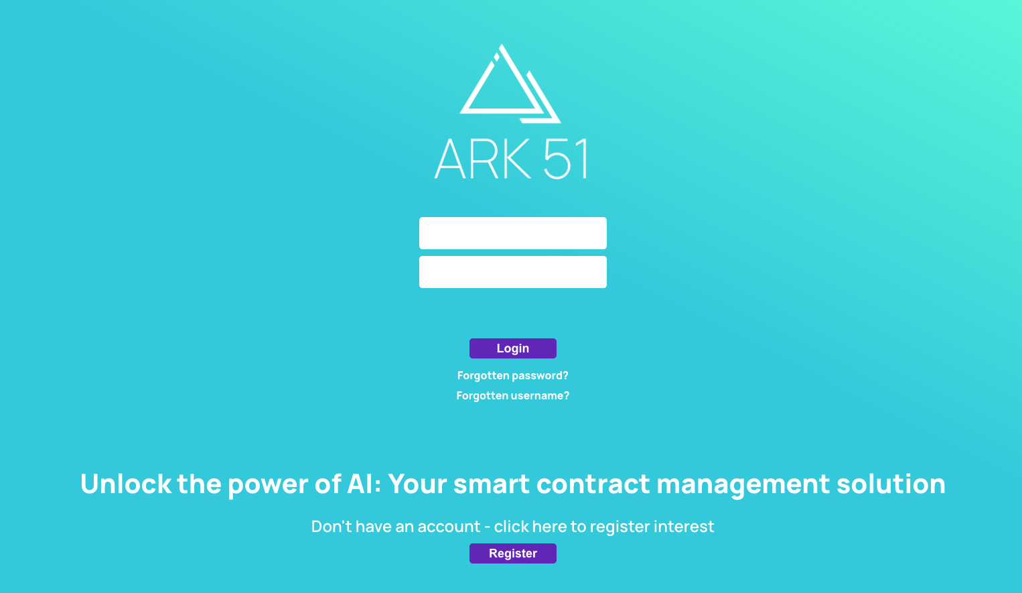

Paul Hands
Chief Technology Officer
Happy to answer any questions or queries, please get in touch!
E: paul.hands@ark-51.com

