Slide 1

Brewing
in the Dark
Homebrew & Software Supply Chain Security in Financial Services
BILLY MCGEE
Account Executive
Workbrew
Notes:
Thanks for having me.
Quick show of hands — who here has installed open source software using Homebrew?
(pause)
Almost everyone. Good.
Today we are going to discuss pressure on Homebrew and for FINOS members that rely on open source, that gap matters
This is not a warning that open source is dangerous. It's the opposite. Open source is a vital asset worth protecting. And protecting it starts with understanding what's actually happening in the dark behind the scenes.

Slide 2


HOMEBREW
Homebrew, the #1 app store for devs
Open Source with a thriving community of contributors and maintainers.
Industry Standard with over 15 years of history, it’s the default choice for developers.
Notes:
What is homebrew? It’s the missing package manager for MacOS. Loved by developers for making it simple to install, manage, and update software from the command line with a thriving community of contributors and maintainers.
Think of it like the App Store — but for developer tools used in the command line. The real Mac App Store does not contain most developer tools and probably never will.

Slide 3

HOMEBREW
Homebrew is everywhere
35M
Devices
Trusted by tens of millions of developers daily.
Default package manager for macOS.
Multi-platform runs on Linux and Windows under WSL.
Notes:
Found on 35 million devices. 250 million install events last year alone. Default package manager for macOS and runs on Linux and Windows under WSL too.
It's so embedded that Apple reaches out to the Homebrew project before every major OS release — because they want to make sure it works on day one.
Homebrew is the last mile of your software supply chain. It's how open source actually lands on your developers' machines.

Slide 4

$> brew install python
Notes:
Whatever a developer needs — a CLI, a security tool, a language runtime — it's one command away. brew install <tool>.
That simplicity is the value. And it's also what we need to talk about.

Slide 5

HOMEBREW
But there are problems
Single-player design lacks team collaboration and causes repeated work.
No visibility for IT or security teams, they’re left in the dark.
No guardrails means anyone can install anything on any device at any time.
Notes:
Because there are Problems. Homebrew was built as a single-player tool. Designed by developers for an individual developer who owns their own machine.
That means three problems your security and IT teams must overcome
No collaboration model — every developer manages their own environment independently. No visibility — IT and security can't see what's installed across the fleet. No guardrails — anyone can install anything, at any time, on any device.
There’s are not flaws, these are design choices because Homebrew is built for developer freedom and not corporate oversight. A control layers that would limit Homebrew rubs against the ethos of making open source software available and accessible, even software like bittorrents, system modifiers, dnsmasks, vpns or redteam tools.

Slide 6
SECURITY TOOLING
Your tools
can't see it
Detection Gaps
EDR infers from process paths — misses packages installed but never run. Network monitoring watches for GitHub traffic — bypassed by cached bottles. Privilege monitoring expects sudo — Homebrew installs without it. The MDM doesn’t give direct visibility into Homebrew package installs
Notes:
And here's why this is harder to solve than it looks — your existing security stack has specific blind spots around Homebrew. Your tools simply can’t see Hoembrew easily on the developer’s machines.
EDR infers from process paths. It misses packages installed but never run. A vulnerable library sitting on a machine, never executed — your EDR has no idea it's there.
Network monitoring watches for GitHub traffic. But Homebrew serves cached bottles from its own CDN. Different traffic pattern. Gets bypassed.
Privilege monitoring expects sudo. Homebrew installs without it. So privilege-based alerting sees nothing.
And your MDM — Jamf, Intune, whatever you're running — gives you no direct visibility into Homebrew package installs.

Slide 7
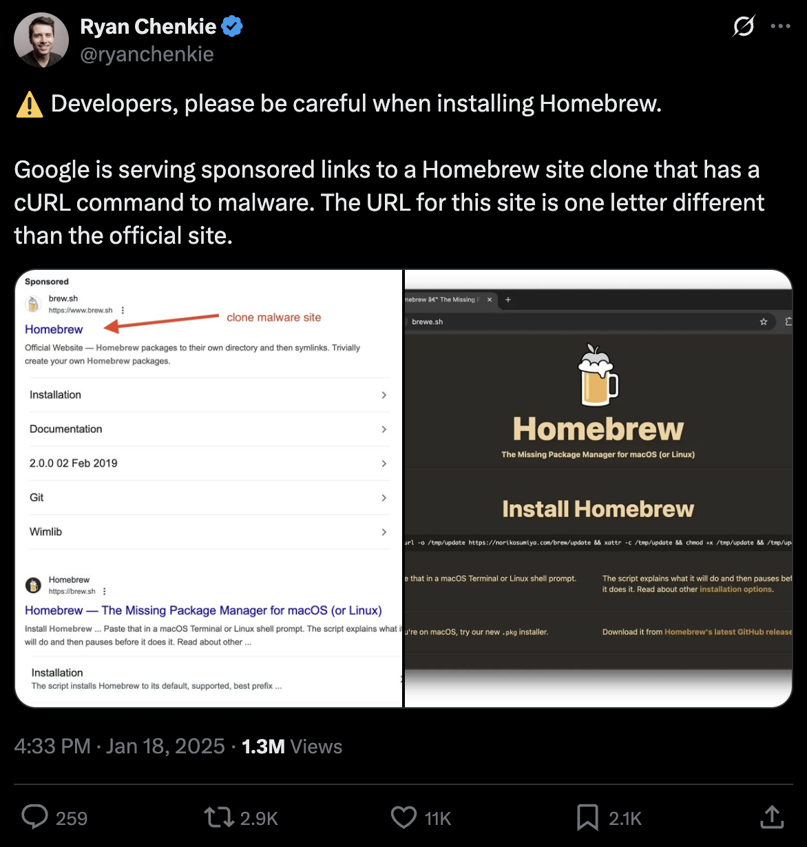
ATTACKERS
Homebrew is an attack vector
Bad actors have always targeted Homebrew as a way to install malware.
Notes:
Because Homebrew is so trusted — developers don't think twice when they see a brew command — it's become a target.
What you're looking at is real. A Google-sponsored ad. Fake Homebrew site. One letter off. But it’s harbringer of a larger problem, that malicous actors know that Homebrew is primary software package delivery channel - and getting their malware on employee machines is their game.

Slide 8
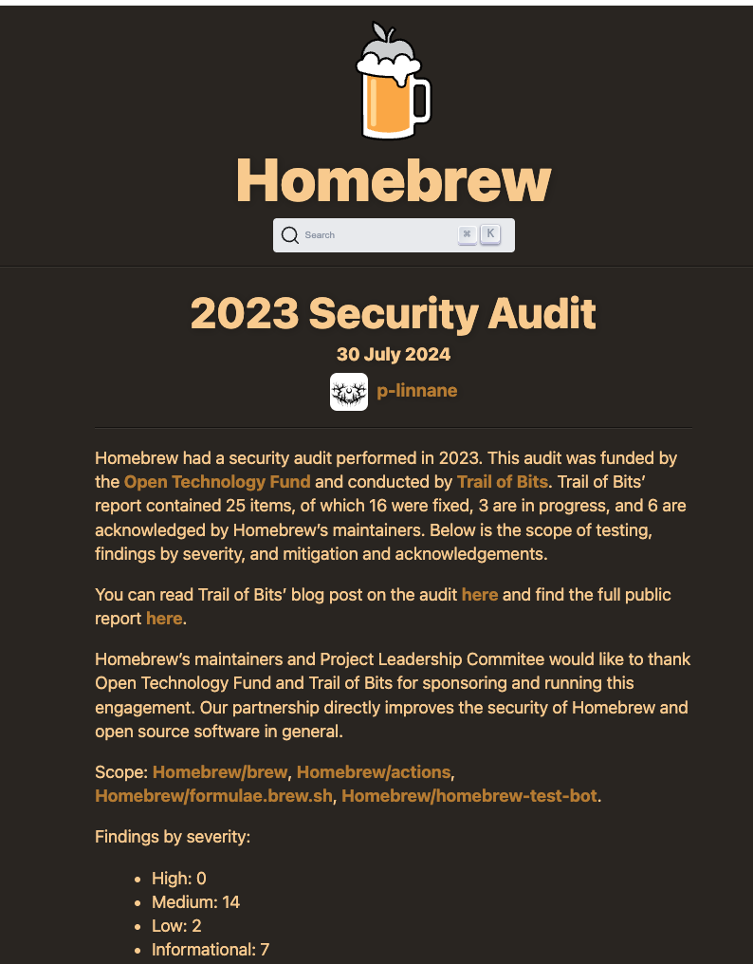
DEFENDERS
In 2023 Homebrew Responded with Audit and Fixes
Homebrew-Core
Sandboxing
Privilege escalation
Sigstore cryptographic signing
GitHub artifact attestations
SLSA Build L2
Notes:
However, the Homebrew project leaders not only are aware, they are detailed and determined to make the community safe. So 2023 Independent security audit was commissioned to improve supply chain security for every open source projects in Homebrew-Core. This now includes, sandboxing with privilege escalation so that every Bottle is cryptographically signed in Sigstore with GitHub artifact attestations and SLSA Build Level 2 provenance.
That means every package Homebrew distributes comes with a cryptographic proof that it was built from this source code, from this commit, on this date, by this workflow. The build was not tampered with, not swapped, trusted and verified by the community policies.
Put a pin in that because we will come back to this point later…

Slide 9

ATTACKERS
Third-party taps are unregulated
$ brew tap risky/business
A developer can add any tap with one command — and install whatever's in it with the same trust they give homebrew-core.
Notes:
But here's what that audit didn't fix because it was out of scope.
Third Party Taps which can be created with any git URL and any code. One command. This is important for individual developers that write new open source software that they want to make available to the public… however, the Homebrew-core security rules don’t apply be default, and so you need to vet these taps carefully.
So the next time a developer gets a message in Slack — "hey, just brew tap our repo and install the tool." Often they will just run it. Trusrust the brew command. They don't think twice. But they should. Because these third-party taps are the wild west far outside the regulated “safe zone” of the Homebrew universe and so install at your own risk.
And some legitimate vendor taps bypass Homebrew's signed bottle entirely — they go straight to the vendor's pre-compiled binary. And while you might think you can trust vendor just as much as Homebrew? Think again.
We're about to see why.

Slide 10
$> brew info XZ
$> brew info xz xz 5.6.0 (OUTDATED)
CVE-2024-3094 — CVSS 10.0
The open source community found and fixed it within hours.
New Problem → Patch Management
Which machines in your fleet were running the vulnerable version?
How do you prove to your auditors they're clean now?
Source: CISA Advisory / Andres Freund, OSS Security Mailing List, March 2024
Notes:
A contributor spent two years building trust as an open source maintainer — then inserted a backdoor into a compression library sitting underneath SSH. CVSS 10.0. The maximum.
The open source community caught it. A developer noticed SSH logins were 500 milliseconds slower than expected. Pulled the thread. Found the backdoor. The patch was out within hours. Homebrew updated the formula within hours.
But then every regulated organization faced the same question — and it had nothing to do with the open source community.
Your 12-hour SLA clock was already running. Which machines in your fleet were still exposed on day two?

Slide 11
$> brew info trivy
$> brew install trivy ✅ Safe $> brew install aquasecurity/trivy/trivy ❌ Compromised
The vulnerability scanner was the vulnerability.
Trivy v0.69.4 was backdoored with a credential stealer distributed via Vendor’s own tap. Developers who installed through Homebrew-core were never exposed because Homebrew verifies a cryptographic checksum of the source, not the vendor's binary distributed through it’s own taps and other CI automations.
Source: Aqua Security / StepSecurity, March 2026
Notes:
March 2026. Trivy. Aqua Security's vulnerability scanner. The tool your security team points to as evidence that controls are in place.
Attackers used stolen credentials to trigger Trivy's own official release pipeline and publish a backdoored binary — v0.69.4 — across GitHub Releases, Docker Hub, Amazon ECR. All the official channels. It ran the real scan first. Showed clean results. Your pipeline said it passed.
Here's what I want you to take from this.
brew install trivy — Homebrew-core — safe.
brew install aquasecurity/trivy/trivy — the vendor's own tap — compromised.
Same tool. Same version number. Different trust model. Different outcome.
Homebrew-core verifies a cryptographic checksum of the source, not the vendor's binary. If the content doesn't match the hash, Homebrew refuses. You get an error — not malware.
The developers who were exposed trusted a tag. The ones who were safe trusted a checksum.
Which route did your developers use? Do you know?

Slide 12

THE REACTION
"Block it."
The reality:
If you don't provide a paved path for open source usage, developers will just find ways to hide it from you.
Notes:
When security teams hear all this, the first instinct is block it.
Lock down Homebrew. Restrict installs. Control the perimeter.
The reality: if you don't provide a paved path for open source usage, developers find another way. They install tools somewhere your tooling doesn't watch. The software is still there — on the machines, in the builds. You've just moved it somewhere darker.
You haven't removed Homebrew. You've lost visibility of it.

Slide 13
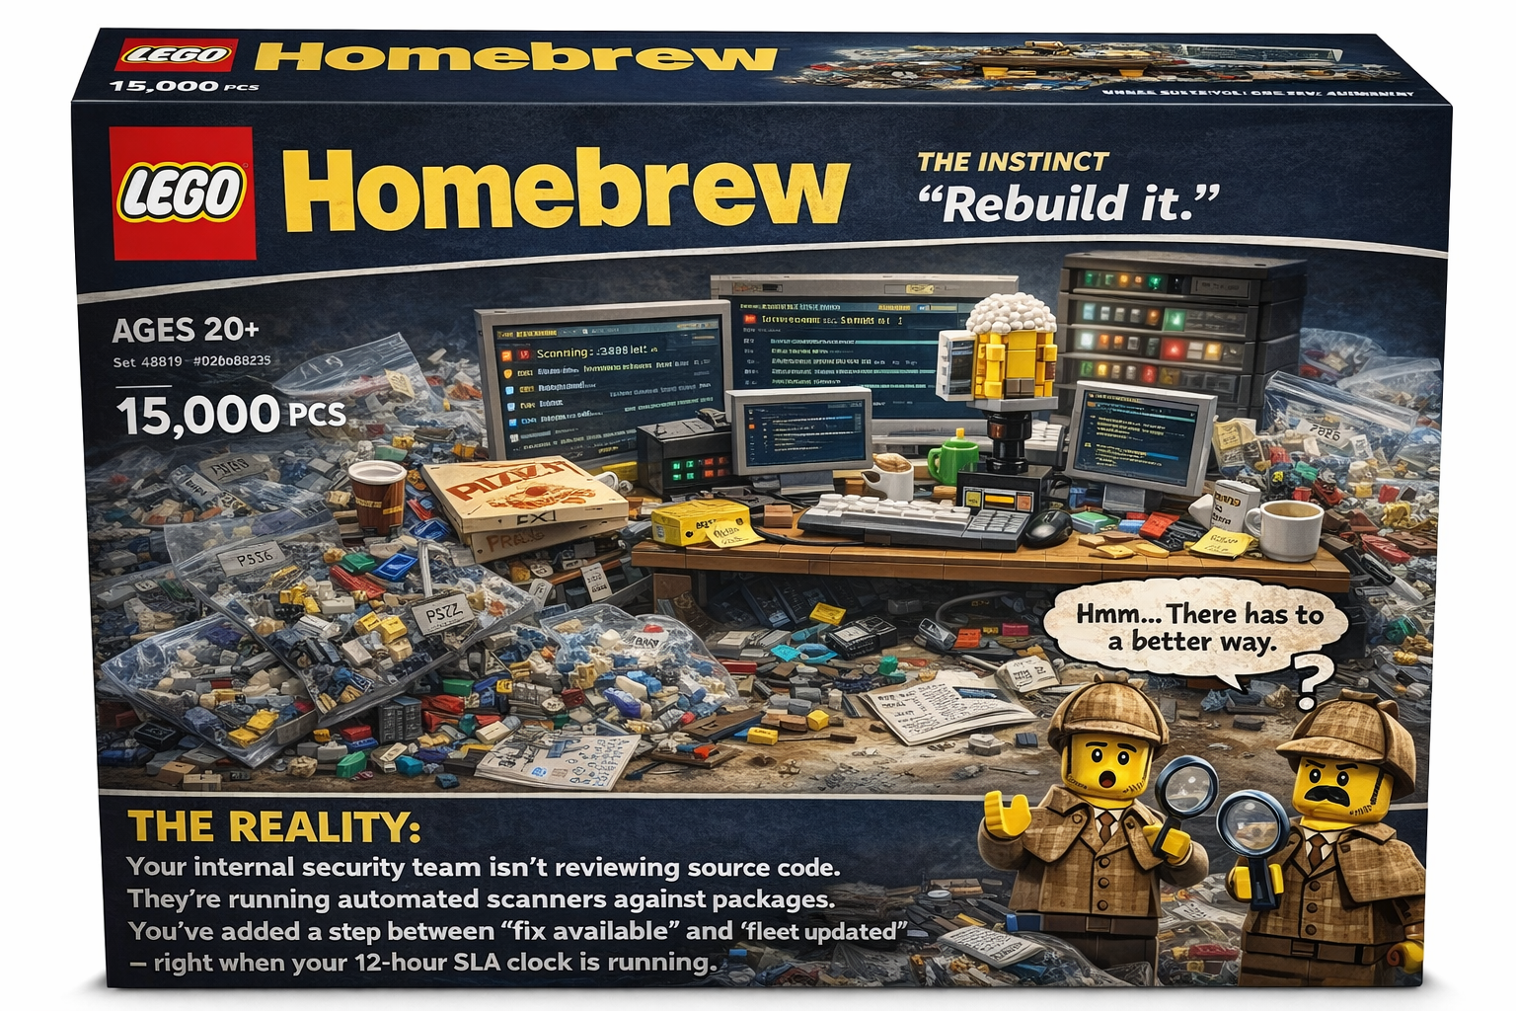
THE INSTINCT
"Rebuild it."
The reality:
Your internal security team isn't reviewing source code. They're running automated scanners against packages.
You've added multiple steps between "fix available" and "fleet updated" when your 12-hour SLA clock is running.
Notes:
The second instinct — especially in financial services where the engineering muscle exists — is rebuild it. Mirror Homebrew internally. Route everything through Artifactory for example.
The reality: your internal security team isn't reviewing source code. They're running automated scanners against 15,000 packages they didn't write and don't deeply understand. When CVE’s are detected in open source, it is almost always by the community - which by the way is using the same or similar scanning tools themselves at the point of their CI build - therefore what does rolling your own actually accomplish other than time delay of package release to your review and production. This helps explain why so many teams have variety of versions, it’s not just a developer preference, its that the security team is lagging and overwhelmed. Because this path is complicated and hard, especially if you have hundreds of software to manage. The org is now silo’d away from the biggest asset the Open Source Community.
Did Artifactory catch XZ? No. Would it slow down the response when the patch was available? Yes — because every update now has multiple automations and human approval steps between "fix available" and "fleet updated” and more often not they are still relying on the open source project’s source code.
So rebuilding it has added friction to your SLA response right when the clock is running fastest. And taps? Still uncontrolled. The mirror does nothing about them.
You still don't know what's installed. You've just made it harder to find out.

Slide 14

WHAT’S THE ALTERNATIVE?
Compliance-
aware controls
Blocking removes visibility, not Homebrew. SBOMs & audit trails are non-negotiable in regulated environments. Engineering teams need open source.
The question is how you govern it.
Notes:
Blocking removes visibility, not Homebrew.
Rebuilding adds friction without closing the gap.
In regulated environments SBOMs and audit trails aren't optional. Engineering teams need open source. The question has never been whether to use it.
The question is how you govern it.

Slide 15

THE THIRD WAY
"Govern it."
with a Control Layer
The new reality:
+ Know what's installed across every machine. + Enforce which taps are approved before anything runs. + Get CVE alerts connected to actual endpoint data. + Push the patch automatically, across the entire fleet
Notes:
With a control layer that provides four things:
Know what's installed across every machine in your fleet — in real time, not at audit time.
Enforce which taps are approved before anything runs. The tap is where the trust model breaks down. It needs a policy.
Get CVE alerts connected to actual endpoint data — not just the published list, but which machines in your fleet have the vulnerable version right now.
And push the patch automatically, across the entire fleet, before the SLA window closes. Not waiting for sixty developers to each remember to run brew upgrade. When Homebrew updates the formula, the fleet moves with it.
The open source community does its job in hours. Govern it so your organization can too. The Open Source community has security hardening, make sure your developers are accessing packages that have scrict review and CI processes in Homebre-core. Audit the Third-Party taps, learn more about the vendor supplychain.

Slide 16
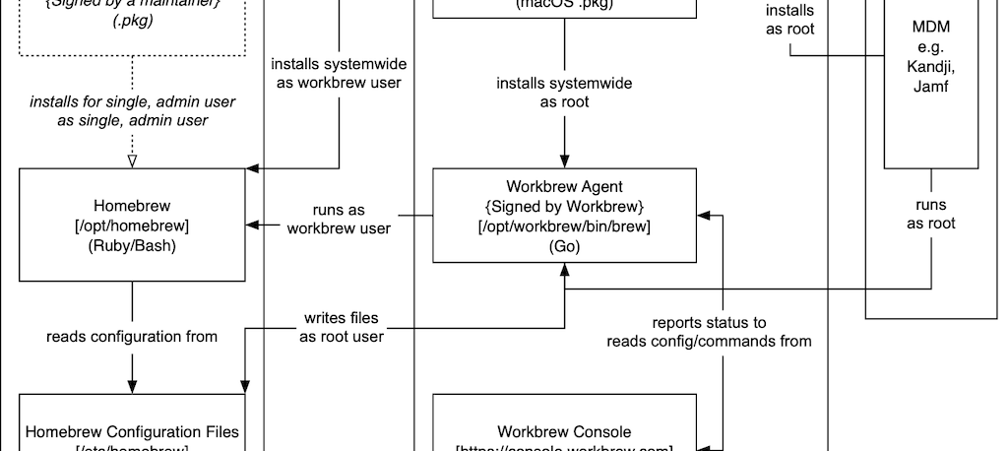
CONTRIBUTE BACK
The result is a better Homebrew for all
Notes:
To govern Homebrew required that we contribute back. What you're looking at is how Workbrew fits into the existing Homebrew infrastructure. Workbrew was made possible because it levergaed the community of Homebrew maintainers who spent a decade hearing what large enterprises needed — and what Homebrew, as a community project, couldn't and shouldn't have to provide. MDM compatibility. Compliance controls. A security-enhanced permissions model.
Building those solutions didn't just create Workbrew. It made Homebrew itself better.
The installer that plays nicely with MDMs. The security-hardened agent. The permissions model that separates the workbrew user from the end user. These weren't just product decisions — they were contributions back to the project that every organization running Homebrew benefits from.
That's the model. Solve the enterprise layer. Contribute the improvements back. Make the open source project stronger in the process.
A healthier Homebrew is better for every developer and every organization in this room.

Slide 17
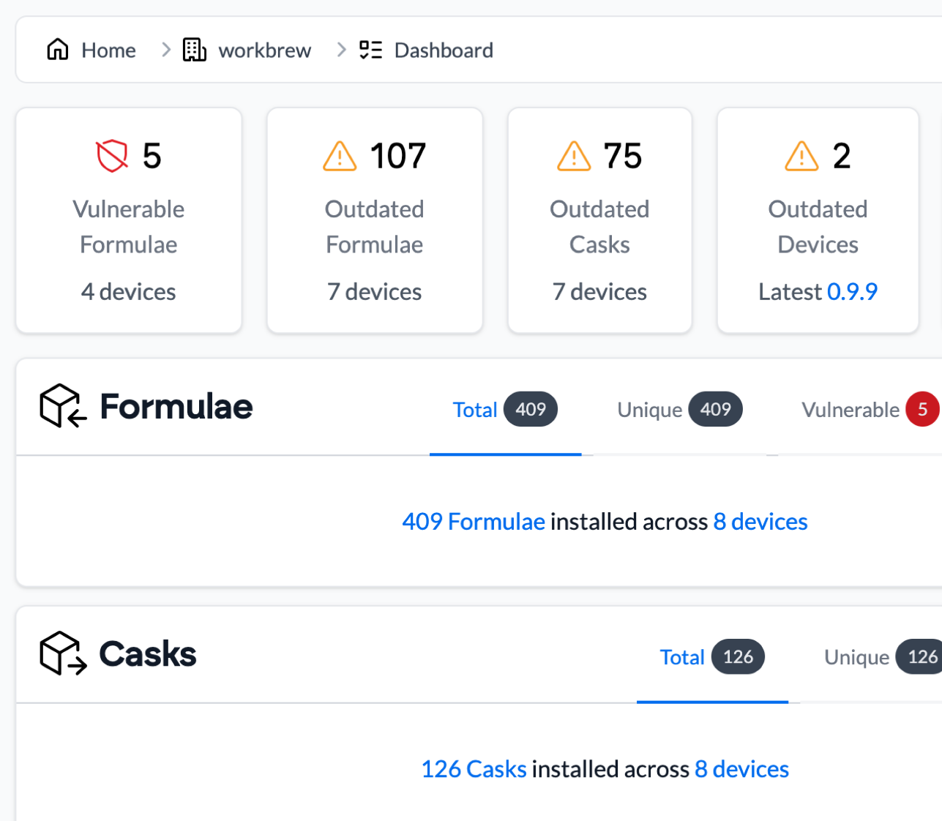
THE THIRD WAY
Homebrew governance options
Workbrew - free plan gives instant visibility, audit trails and vulnerability reporting.
Carafe - a (fancy) wrapper for Homebrew runs via management tools by dropping to the logged-in user.
Intune Script - self-maintained bash script that audits Homebrew security and reports to Intune custom attributes.
workbrew.com/free
Notes:
Homebrew's missing control layer.
Visibility — every installed package across your fleet, not just what ran.
Policy controls — approved packages and taps only, enforced at install time. Not after. Before.
Audit trails — what versions were running when, who downloaded what, every command logged. The paper trail your compliance team needs for SOC 2, FedRAMP, and financial regulators.
This isn't a replacement for Homebrew. It's the enterprise layer it was never designed to have — built by the people who understand what sits underneath it.

Slide 18


THANK YOU
Stay up to date
workbrew.com/free
Notes:
Enterprise Homebrew management for regulated industries.
workbrew.com/free
If you want to talk about what this looks like at your organization — come find me after. I'd genuinely like to compare notes.

