Slide 1

Bootph: A Swiss Army Knife for Boot-Time Optimization
Gokul Praveen
Beleswar Padhi
Keerthy J

Slide 2
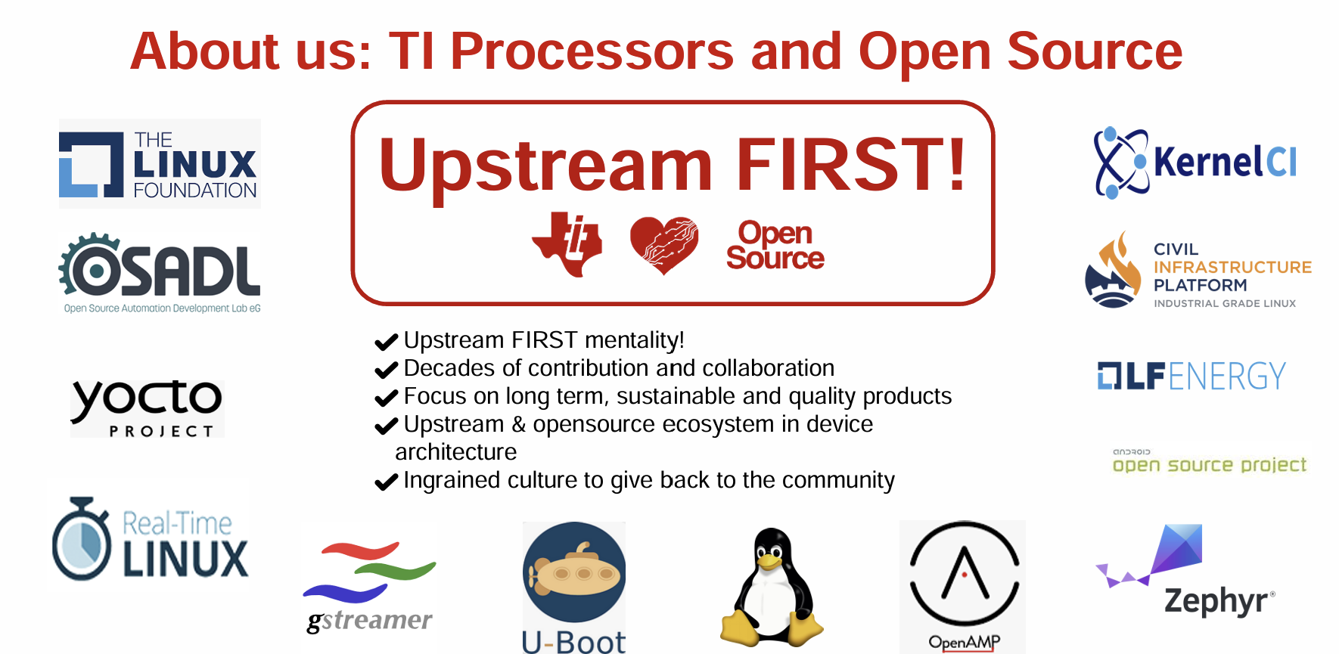

Slide 3
Introduction to the Speakers
Gokul Praveen
  Software Applications Engineer at Texas Instruments
    Mainly focused on boot time optimizations, board bring ups with Linux, U-Boot, and handling platform-specific drivers for connectivity peripherals.
Beleswar Padhi
  Senior Software Engineer at Texas Instruments
    Mainly focused on Remoteproc, RPMsg, Mailbox, Virtio subsystems, as well as boot-time optimizations.
Keerthy Jagadish
  Jacinto Apps Manager at Texas Instruments, Bengaluru
    Mainly focused on boot time optimizations & board bring ups with Linux

Slide 4
Disclaimers
This is a technology presentation, not product-readiness or roadmap commitment.
Opinions presented here are that of the speakers and may not reflect that of Texas Instruments Inc.
All the boot-time profiling is _NOT_ done on production binaries, and only done on default upstream offerings. The aim is to highlight how a upstream codebase can be optimized heavily by the use of appropriate bootph tags. Users who are working on production binaries can also adopt this approach for boot-time optimization.

Slide 5
AGENDA
This session will cover the following :
  Generic UBOOT Bootflow
  Intro into Device Tree and how it came up
  A practical, in-depth look at the bootph (boot phase) device tree tags in U-Boot,(How, when and where)
  Using Texas Instruments SoCs as a real-world example, we will share concrete boot-time and memory usage statistics demonstrating the impact of bootph tagging.
  Some Lessons learned and common pitfalls encountered when introducing bootph tags into existing device trees.
  The session concludes with some modern optimizations on device trees.

Slide 6
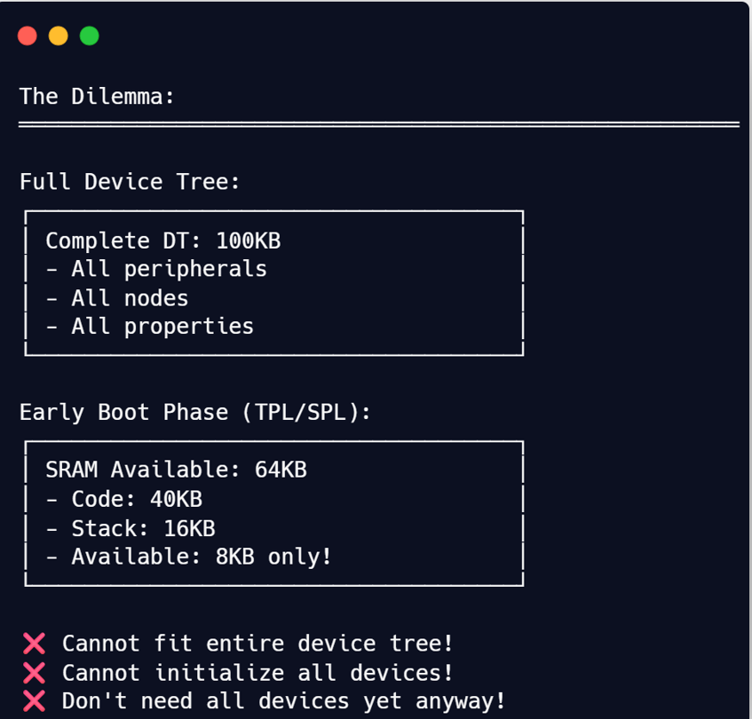
Problem Statement
Core Problem :
  Time constraint
    With more stringent regulations for automotive use-cases, every millisecond of boot time is critical. Safety features like rear-view camera and surround view must start working quickly to meet regulations.
Memory Constraint
    This becomes more important for bootloaders like U-Boot which cannot use the entire device tree in early phases due to memory constraints.
Solution :
  This is where the bootph tags come into the picture, by including and initializing only the required hardware in each phase of boot.

Slide 7
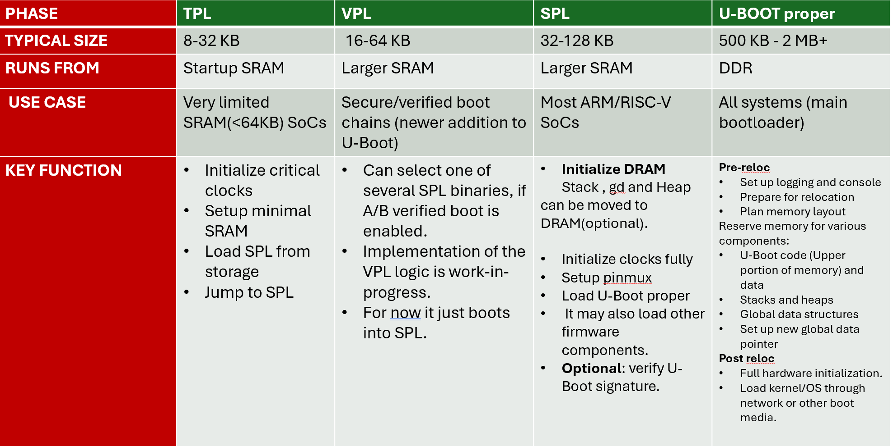
Overview of U-Boot boot phases(TPL, VPL, SPL, and U-Boot proper)

Slide 8
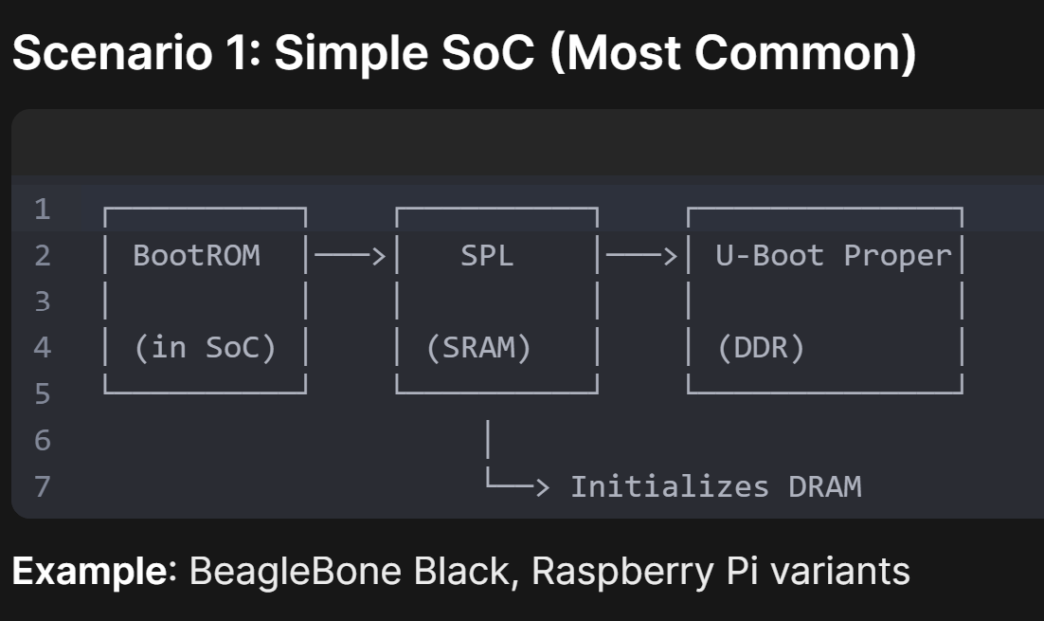
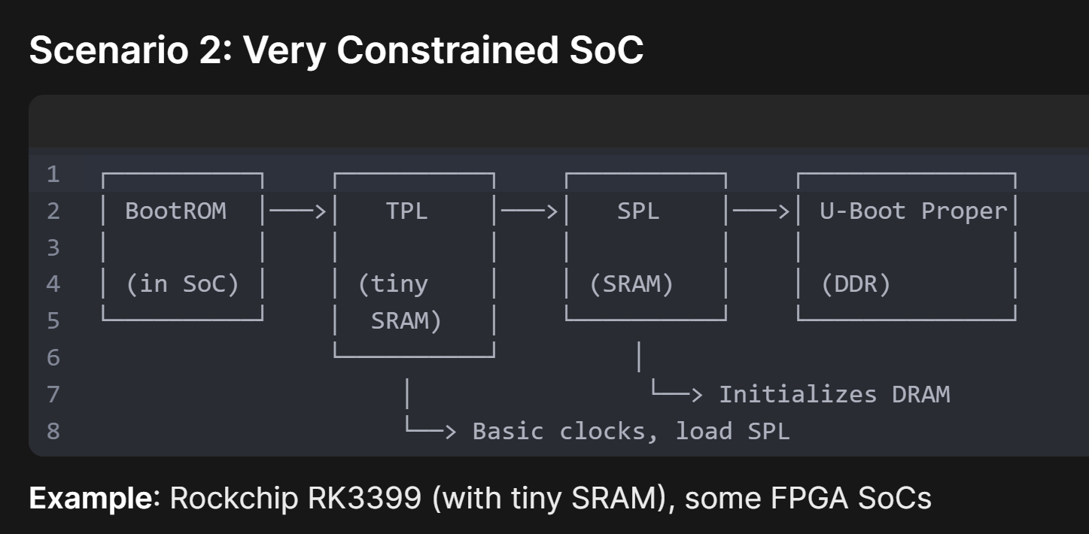
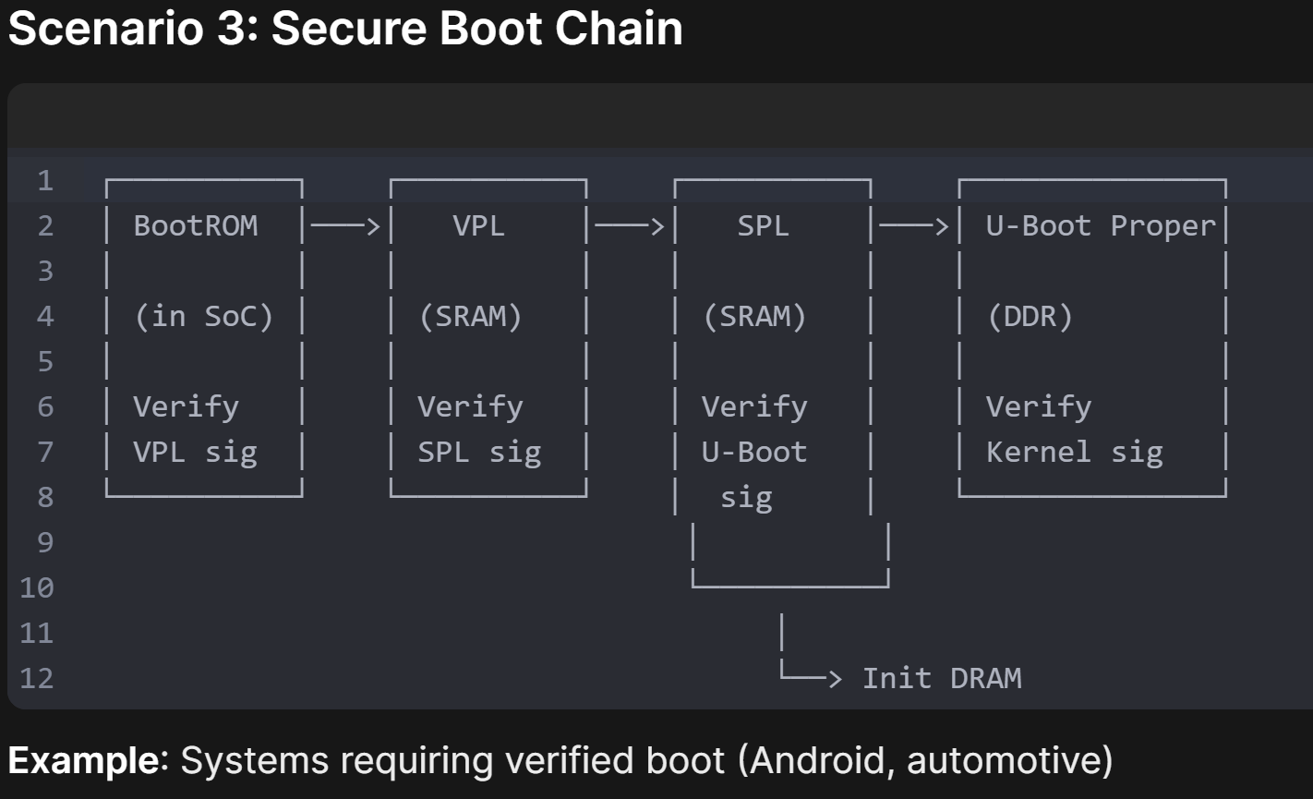
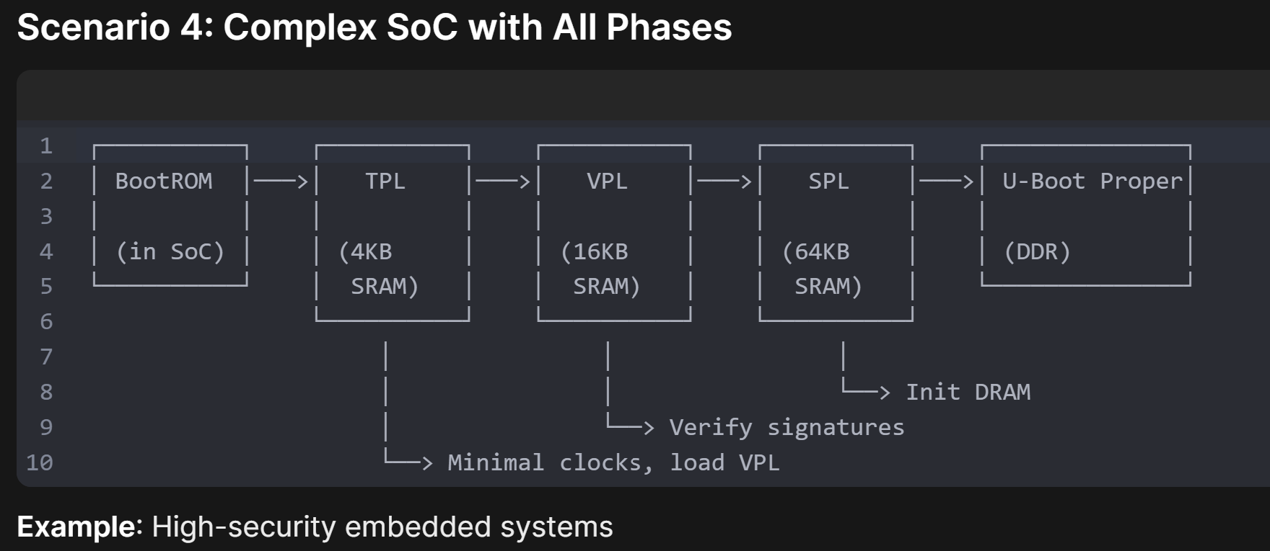

Slide 9
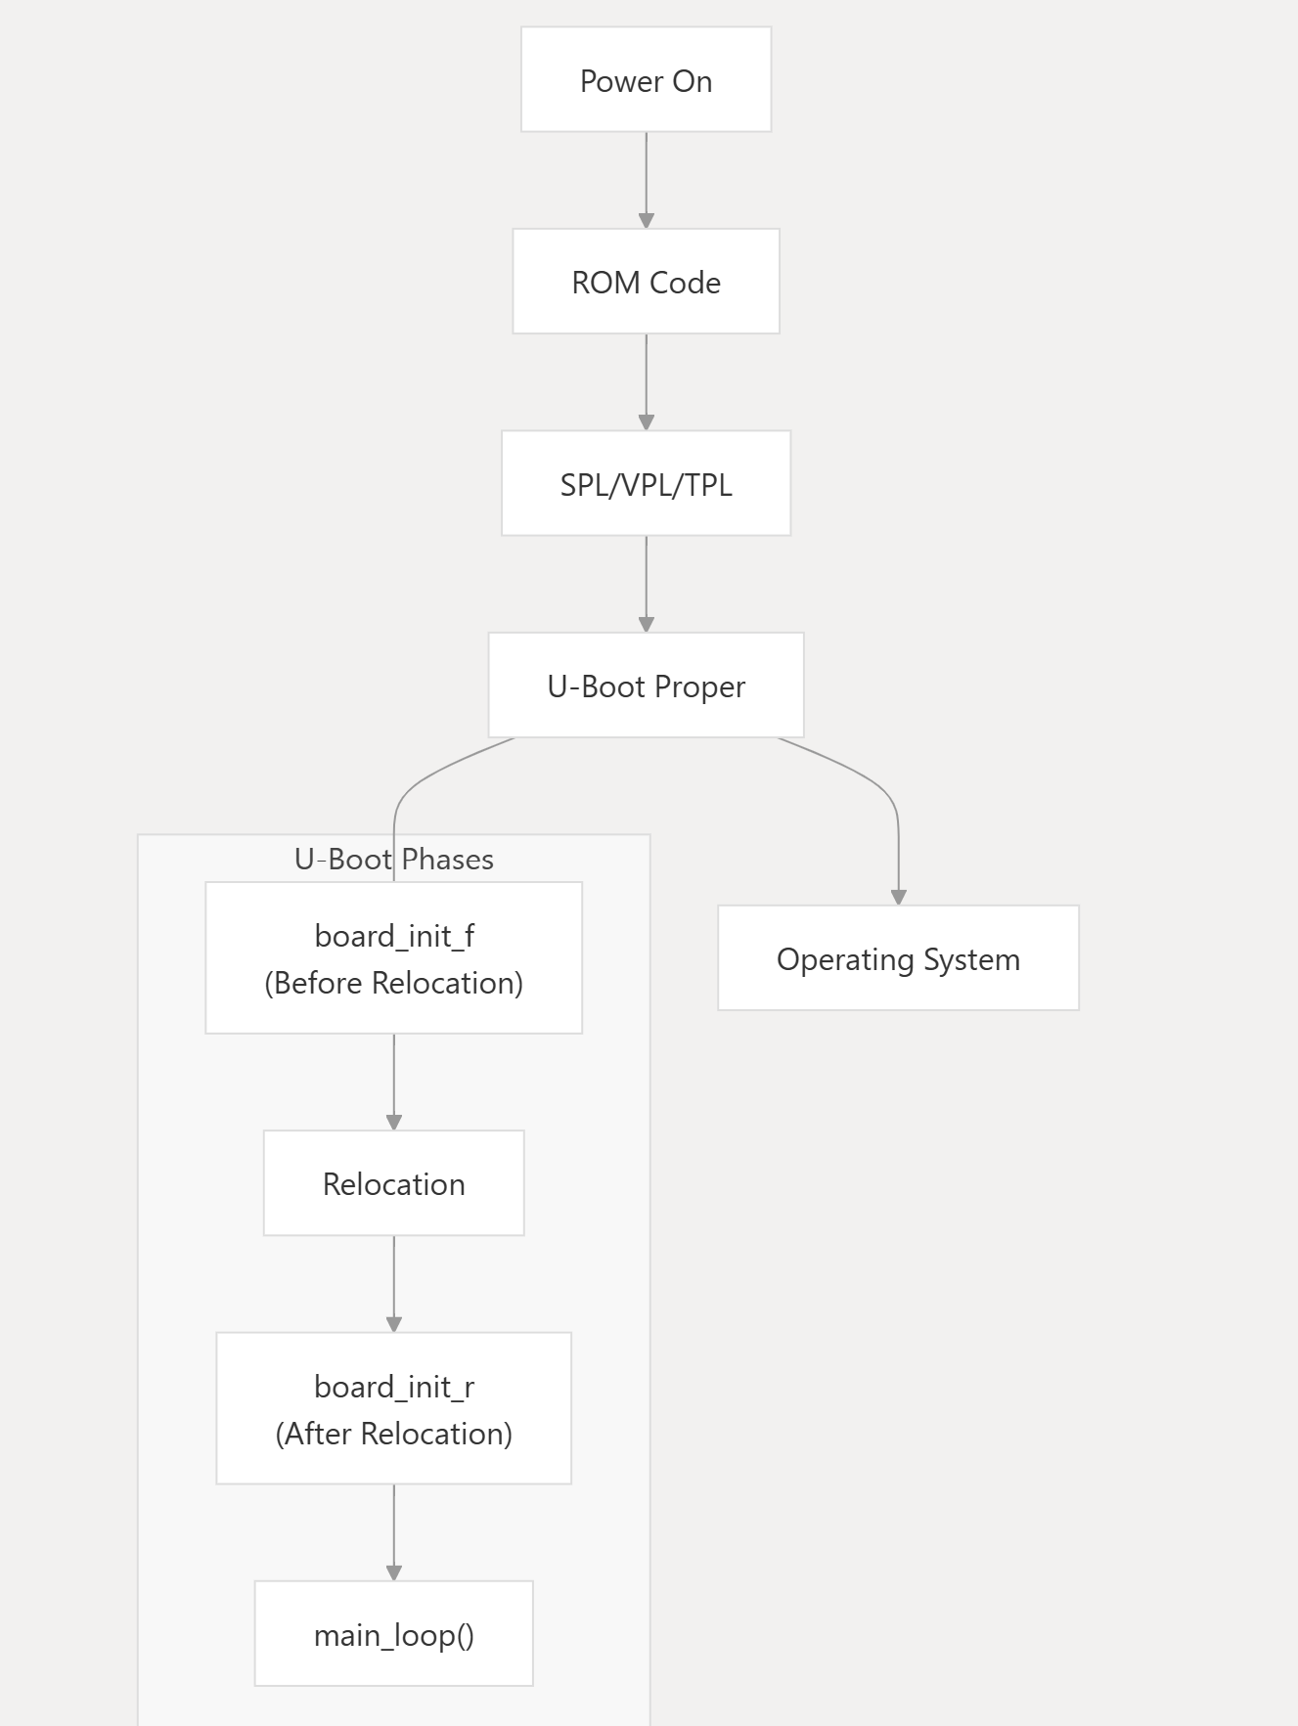
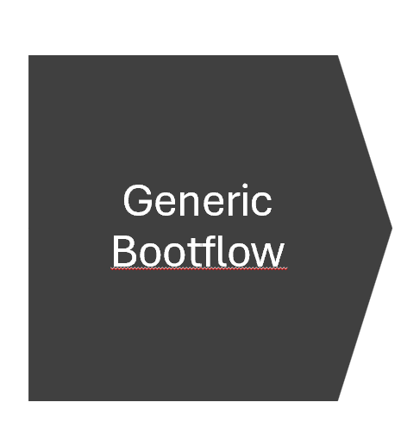

Slide 10
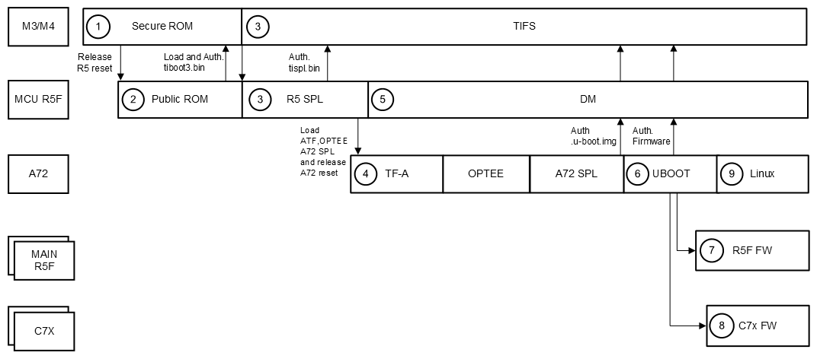
DRA821(Heterogenous SoC BOOT FLOW)

Slide 11
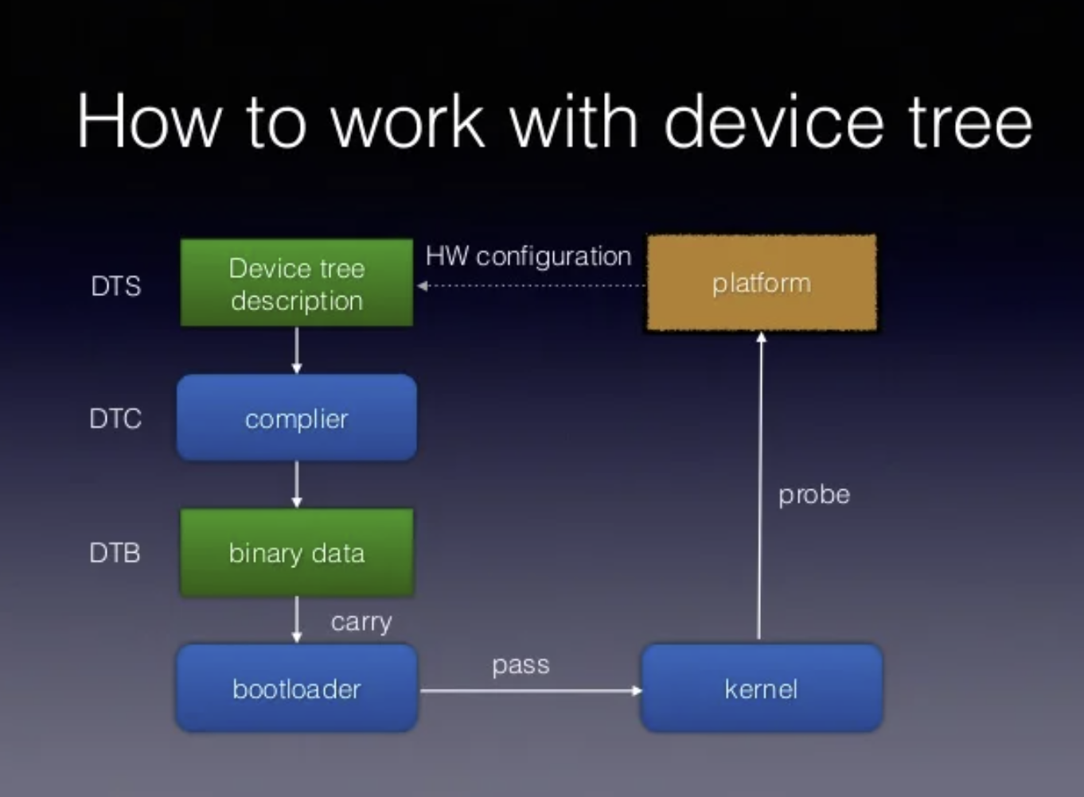
Device tree
What is a device tree ?
A devicetree is a data structure describing the hardware components of a particular computer/board so that the
Flattened device tree(fdt)
Compiled Binary form of the DT(.dtb format).
The fdt is a convenient vehicle for implementing run-time configuration for three reasons:
    A compiler(dtc: device tree compiler) checks the dts file and converts it to a compact binary format,
    A library is already available in U-Boot (libfdt) for reading, writing or modifying .dtb files programmatically.
    It is extensible since it consists of nodes and properties in a nice hierarchical format.

Slide 12
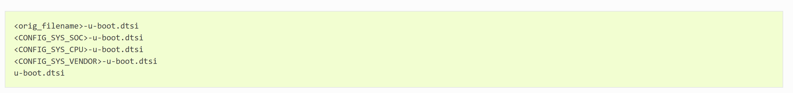
Device Tree : Configuration in UBOOT
Configuration
U-Boot rather maintains a Git subtree as dts/upstream/ sub-directory. It is regularly synced with the Linux kernel and hence no need for manual devicetree sync.
You may find that the dts/upstream/ already has a suitable devicetree file for your board. Look in dts/upstream/src/<arch>/<vendor>.
SoC/board maintainers are encouraged to migrate to use synced copies from dts/upstream/src/<arch>/<vendor>.
To do that:
add imply OF_UPSTREAM for the SoC being used via Kconfig
set DEFAULT_DEVICE_TREE=<vendor>/<name> when prompted by Kconfig.
Adding tweaks for U-Boot
In addition to the dts/upstream Git subtree, U-Boot automatically looks for and includes a file with updates to the standard devicetree for your board, searching for them in arch/<arch>/dts/ in this order.
Only one of these is selected, but, of course, you can #include another one within that file, to create a hierarchy of shared files.
Why are these tweaks needed?
U-Boot is, of course, a very different project from Linux, e.g. it operates under much more restrictive memory and code-size constraints.
For SPL, constraints are even more extreme and the devicetree is shrunk to remove unwanted nodes, or even turned into C code to avoid access overhead.

Slide 13
How the idea of Device tree came up?
Earlier, the hardware configuration was passed to the drivers via C structures compiled into UBOOT/kernel to tell the drivers about platform-specific settings like the address of its registers, bus speed, etc.
Why device tree won over the earlier method?
Reduced Maintenance overhead
  Before: Bloated U-Boot binary containing hardware info of all platforms.
  After: One U-Boot binary + different DTBs = support multiple hardware configs
  Impact: Dramatically reduced build/maintenance overhead for SoC vendors
Runtime Hardware Detection and modification
  Before: Required recompilation of bootloader/kernel in cased of modifications.
  After :
    U-Boot can detect hardware at runtime and select/modify appropriate DTB
    Example: Detect RAM size, board revision, attached peripherals
    Load different DTBs based on the detected configuration.
Reduced Code Duplication
  Before: Hardware config duplicated in U-Boot AND kernel
  After:
    Single source of truth (DTB) shared between both
    Avoids Bloating of bootloader and kernel
    Less code to maintain and fewer places for bugs

Slide 14
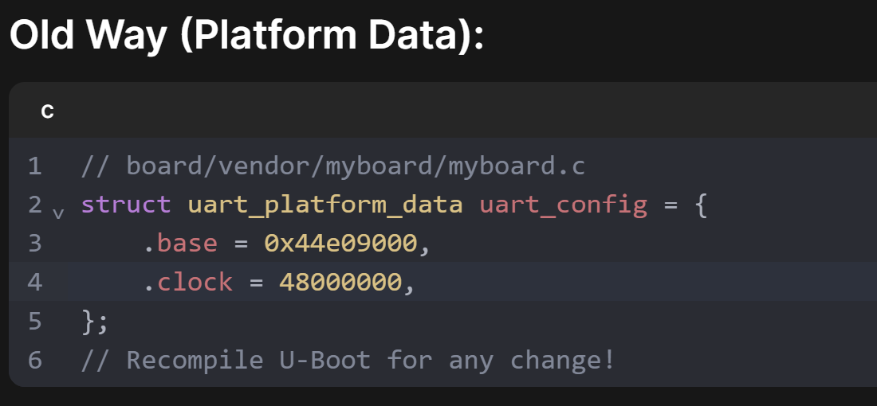
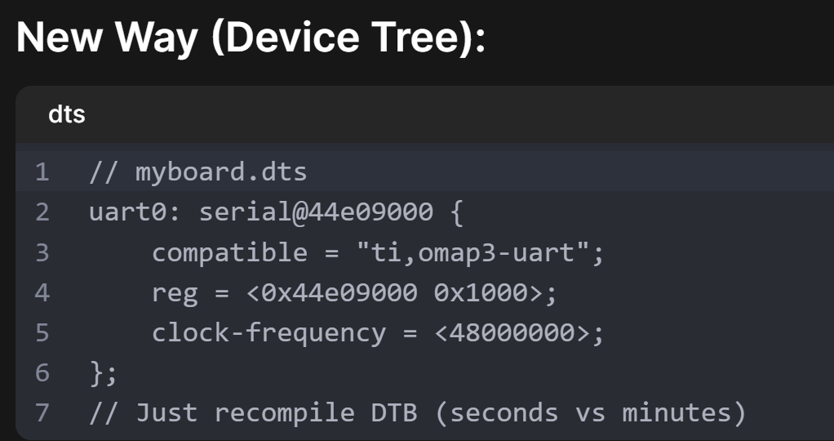

Slide 15

What are bootph tags?
Bootph tags are used in device trees to manage which device nodes should be included during the boot process.
They help in limiting the nodes that are present in different phases of boot, ensuring that only necessary nodes are included based on the available memory.

Slide 16
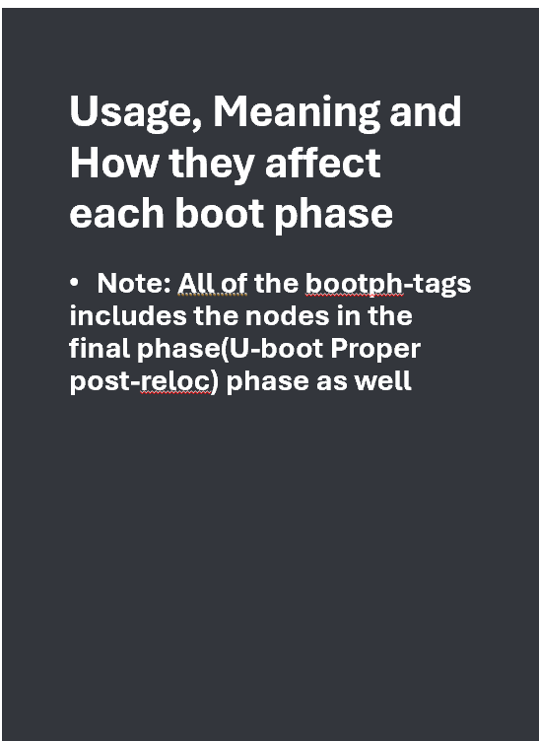
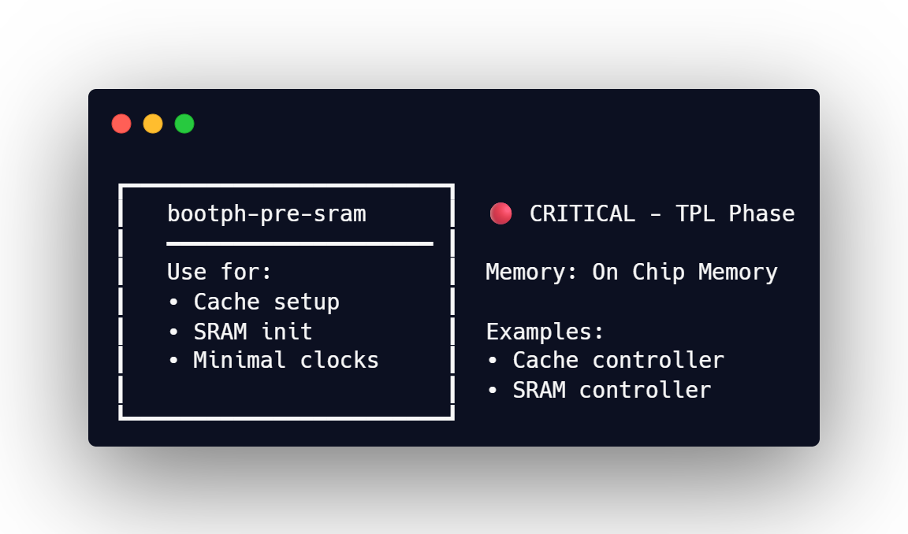

Slide 17
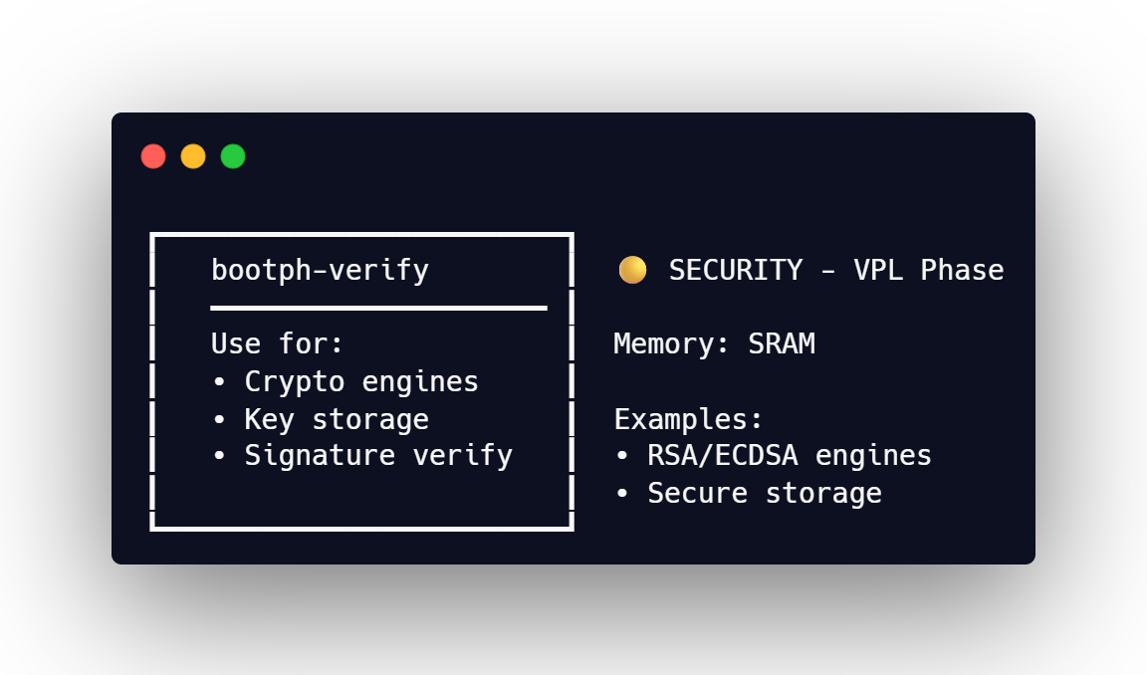

Slide 18
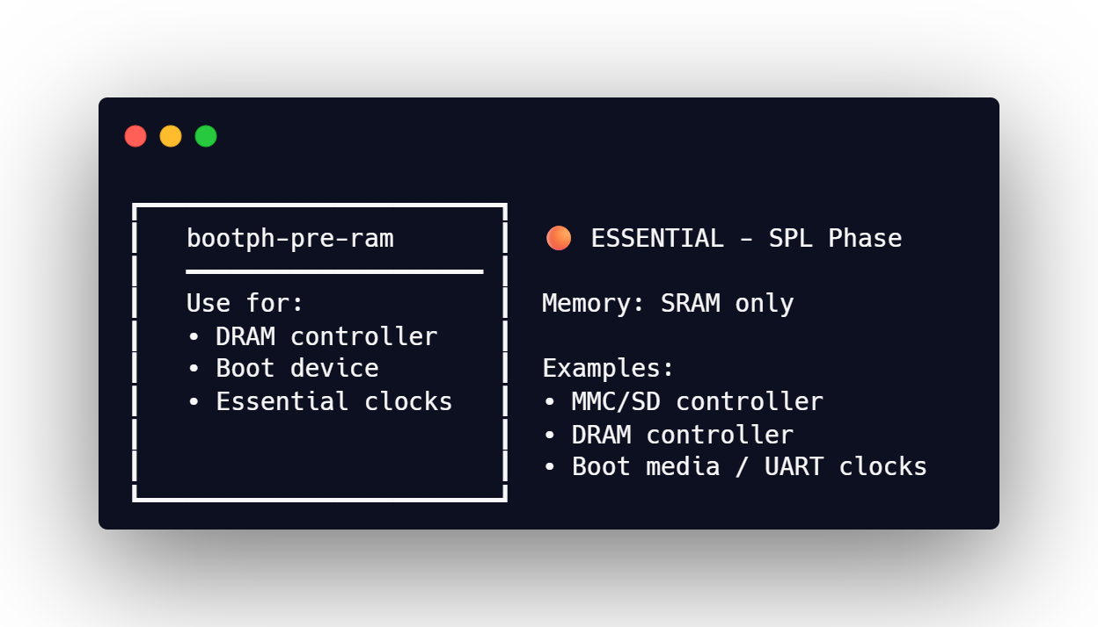

Slide 19
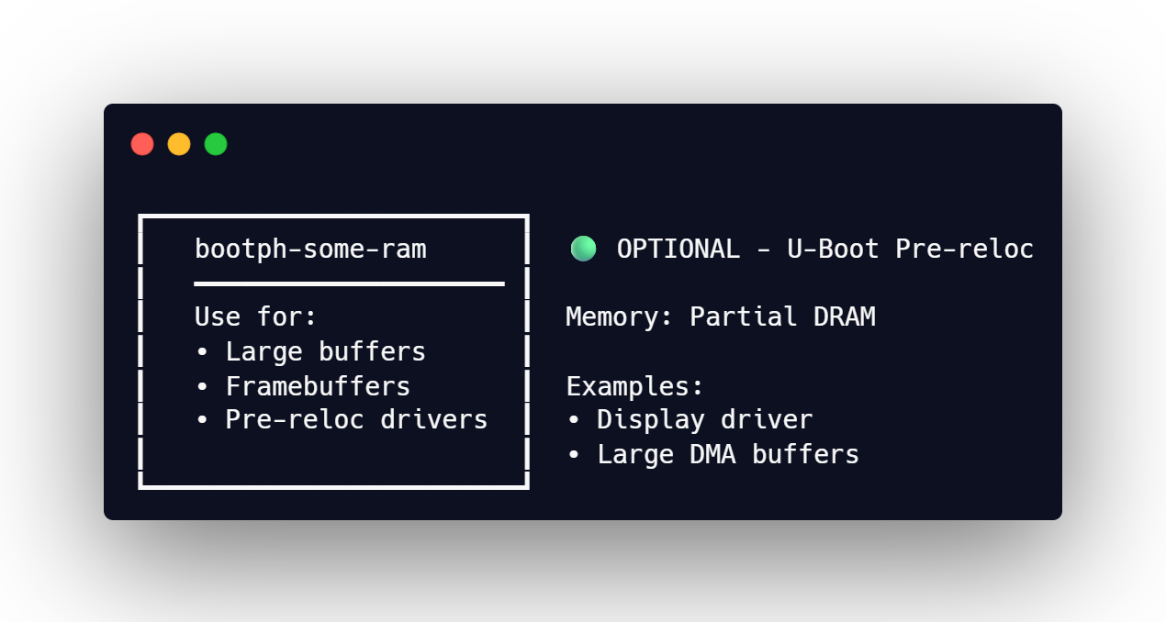

Slide 20
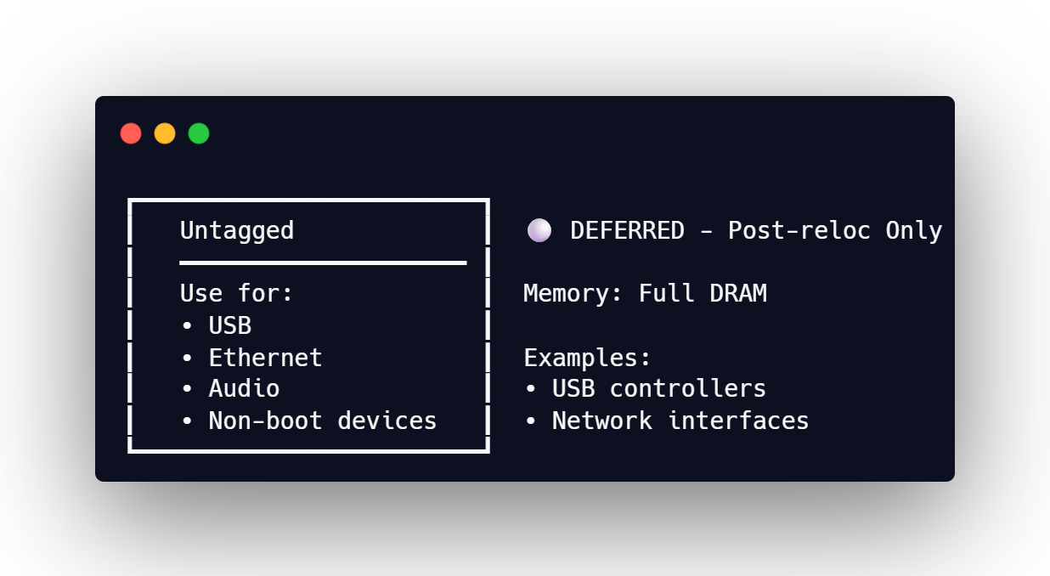

Slide 21
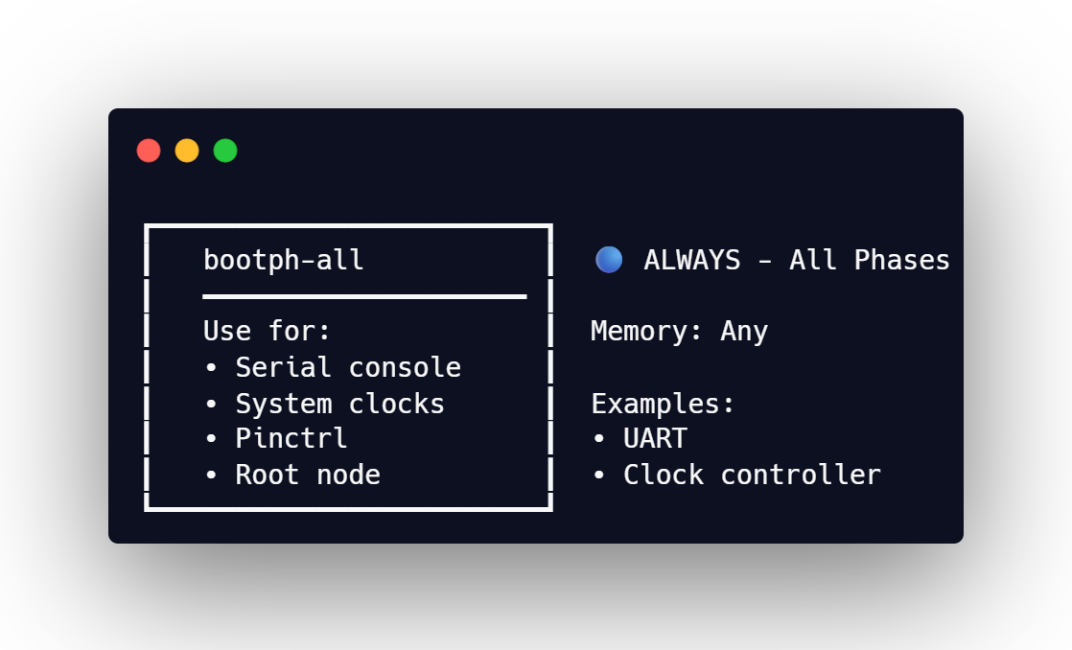

Slide 22
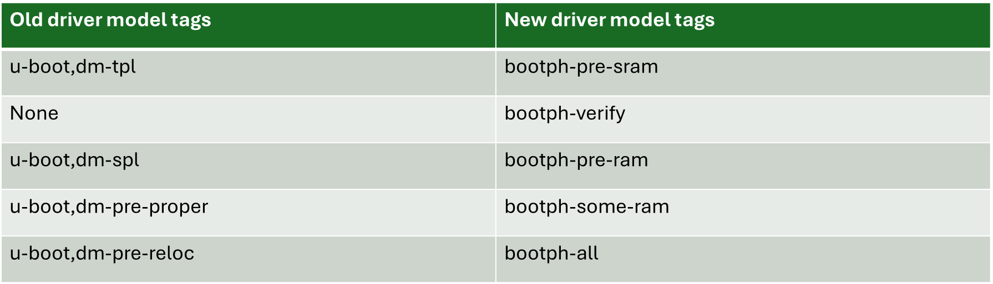
Evolution of bootph-tags over time
Why was this done?
Since Linux accepted these bindings later on, it became non-specific to U-Boot even though U-Boot introduced it.
Modern practice is to have single device tree source that both the bootloader and Linux kernel use.
This means that now any project that makes use of DT can use these tags.
  Eg: The Zephyr bootloader MCUboot can also make use of this property
Hence, these tags were renamed to be generic.

Slide 23
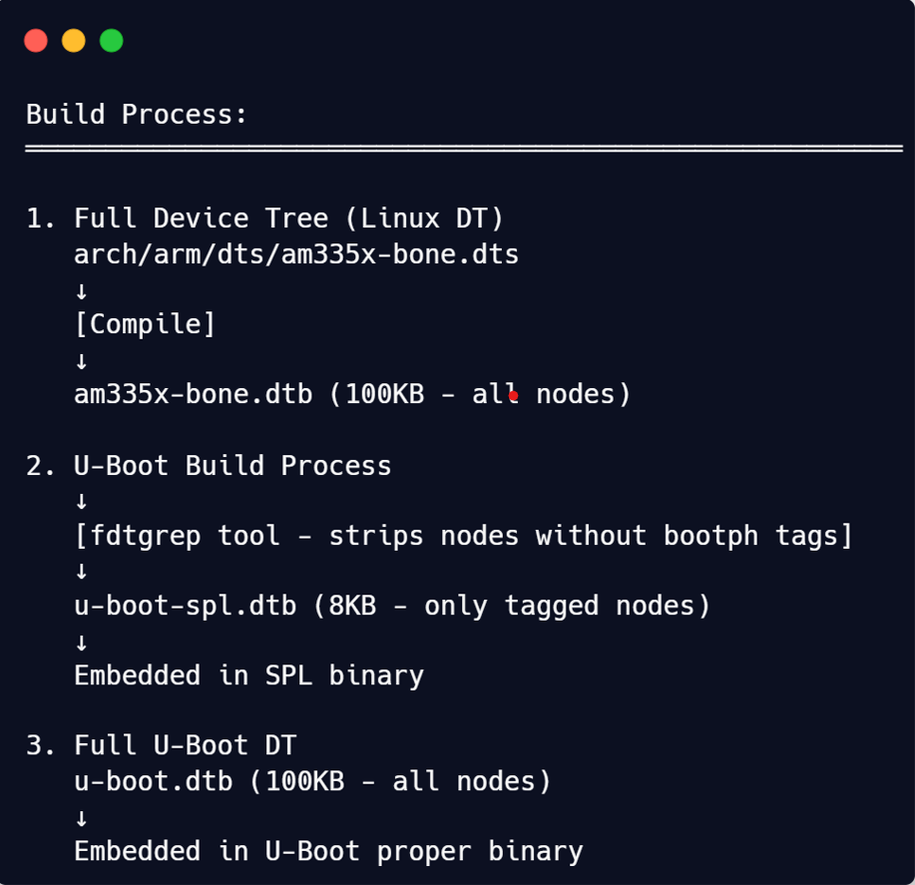
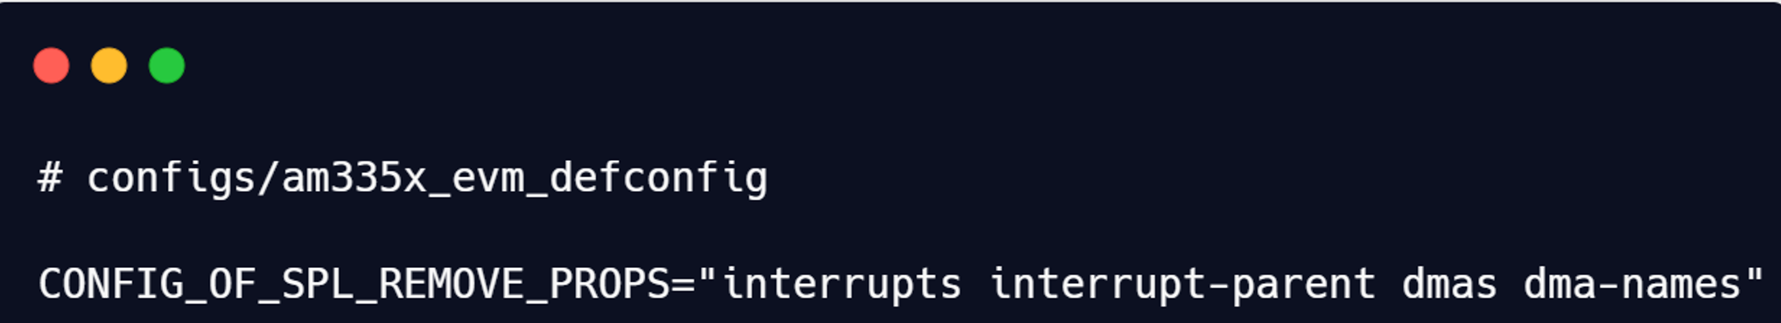
Processing of bootph tags
Fdtgrep is a utility within UBoot that allows users to perform a greplike search of a flattened device tree (fdt) file.
The fdtgrep tools filter the U-Boot device tree during the build process to generate a much smaller device tree used in SPL (spl/u-boot-spl.dtb) with:
  The mandatory nodes (/alias, /chosen, /config)
  The nodes with one pre-relocation property: ‘bootph-all’ or ‘bootph-pre-ram’ )
    Uses the -b flag to find these properties.
    Uses -u to ensure parent nodes are included too
All the pre-relocation properties (‘bootph-all’, ‘bootph-pre-ram’ (SPL), ‘bootph-pre-sram’ (TPL) and ‘bootph-verify’ (VPL))
fdtgrep is also used to remove:
  The properties defined in CONFIG_OF_SPL_REMOVE_PROPS

Slide 24
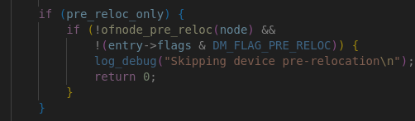
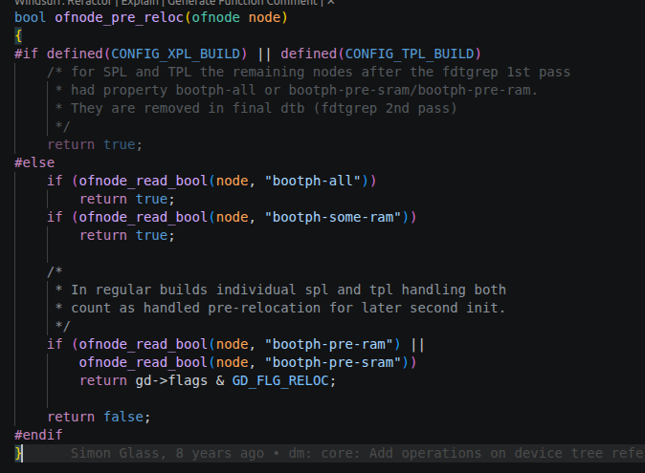
Core code logic of bootph : TPL/SPL
Caller of ofnode_pre_reloc function
Indirectly called by board_init_f function.
ofnode_pre_reloc() returns true for all nodes in TPL/SPL phase
Why?
  The device tree has already been filtered at build time by the fdtgrep tool
  fdtgrep removes all nodes that don't have bootph-pre-ram, bootph-pre-sram, or bootph-all.
  So by the time SPL runs, only the relevant nodes remain in the TPL/SPL DTB

Slide 25
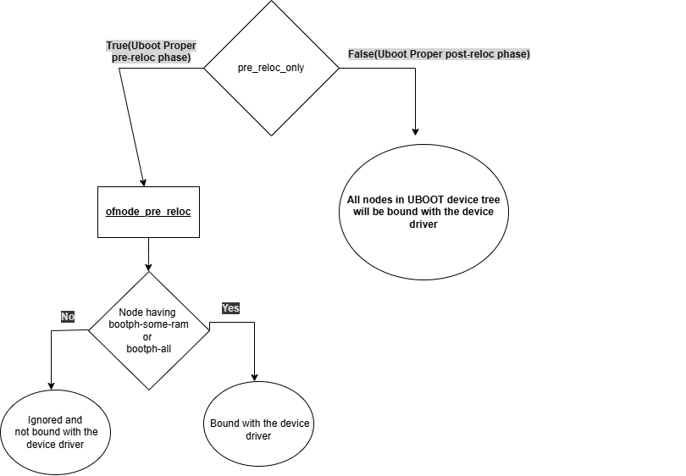
Core code logic of bootph : UBOOT Proper
UBOOT Proper pre-relocation phase:
  Only Nodes with bootph-all and bootph-some-ram are included.
  Why?
    GD_FLAG_RELOC flag is not set
UBOOT Proper post-relocation phase:
  All nodes are bound.
  Why?
    pre_reloc_only flag is false.
      Hence ofnode_pre_reloc function is not called.
      Hence, device_bind_with_driver_data is called for each node which binds the node to the driver.

Slide 26
DRA821 : Boot time and Memory footprint comparison
BOOTFLOW | BOOT MEDIA | MEMORY(DTB) | BOOT TIME | Patch
SPL(BOOTPH-ALL) | SD | 55 KB | 4.4 sec
SPL(Optimized) | SD | 9.4 KB(85% reduced) | 2.34 sec(~50% reduced)
SPL(BOOTPH-ALL) | eMMC | 55 KB | 3.46 sec
SPL(Optimized) | eMMC | 9.3 KB(85% reduced) | 1.79 sec(~50% reduced)
SPL(BOOTPH-ALL) | OSPI NOR | 55 KB | 3.42 sec
SPL(Optimized) | OSPI NOR | 9.6 KB(85% reduced) | 1.75 sec(~50% reduced)
SHA ID: U-Boot 2026.04- 0a7e2a90ad4df

Slide 27
DRA821U : How this optimality was achieved?
  Bootph-pre-ram
    MCU Domain Timer
    MCU Domain Secure Proxy
    MCU Domain Temperature Sensor
    MCU Domain ESM
    Boot media from which UBOOT is booted
  Bootph-all
    Clock controller
    Power controller
    Pinmux
    Serial console
  Bootph-some-ram
    Display and Remote-proc driver nodes
  Rest of the nodes untagged(included only in final phase of UBOOT(uboot post-reloc phase)

Slide 28
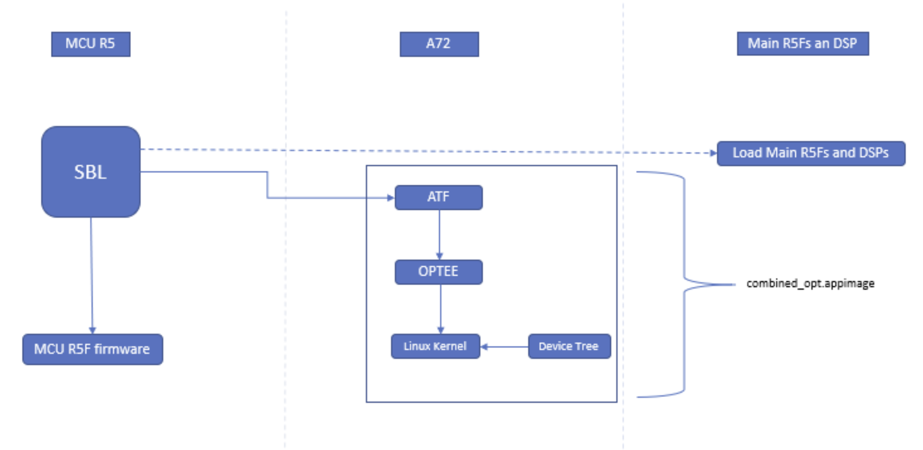
RTOS BOOTLOADER BOOTFLOW

Slide 29
DRA821 : RTOS vs UBOOT bootloader :Boot time comparison
BOOTLOADER | BOOT MEDIA | BOOT TIME
RTOS BOOTLOADER | eMMC | 1.981 sec
UBOOT(default upstream) | eMMC | 2.14 sec
UBOOT(Optimized) | eMMC | 1.79 sec
SHA ID: U-Boot 2026.04- 0a7e2a90ad4df

Slide 30
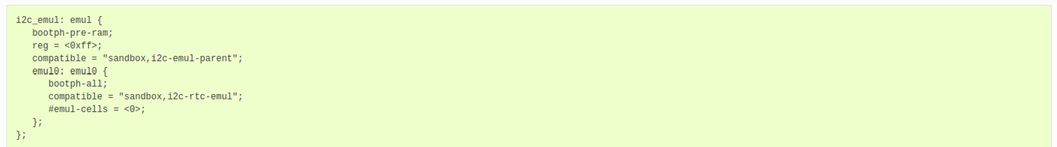
Lessons Learned: Parent-Child Dependency for bootph.
  Parent and child have a different scope

Slide 31
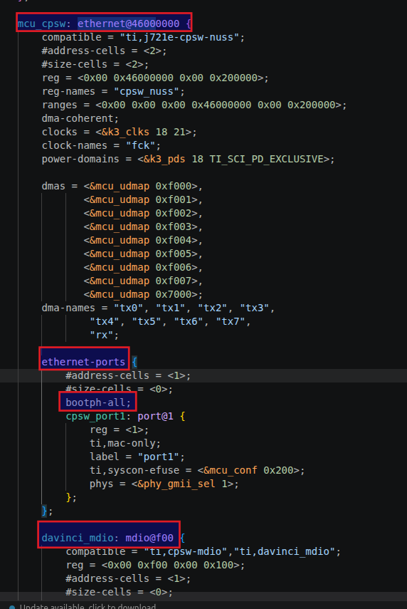
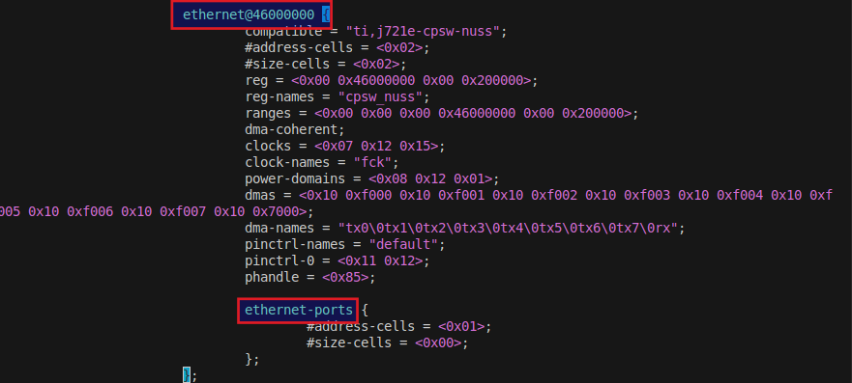
Parent-Child Dependency for bootph.
Child has a scope but parent does not
  The bootph of child gets propagated to the parent.
Decompiled SPL DTB
Device tree source(dts)

Slide 32
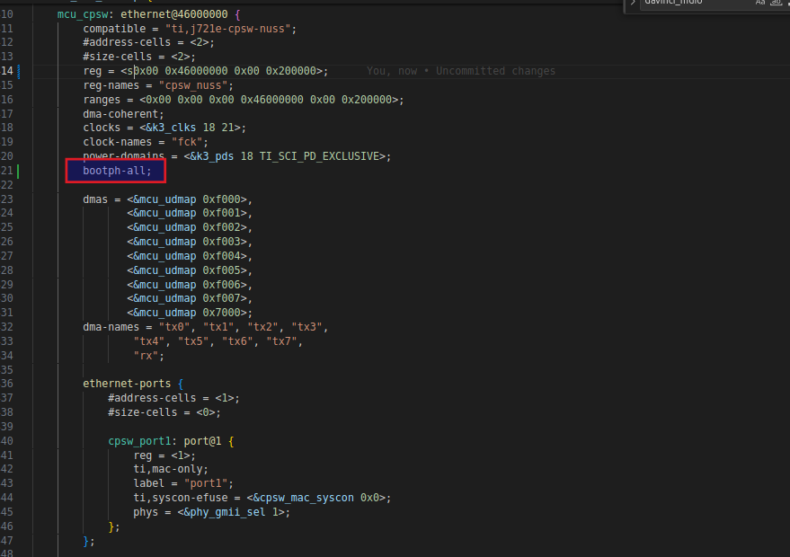
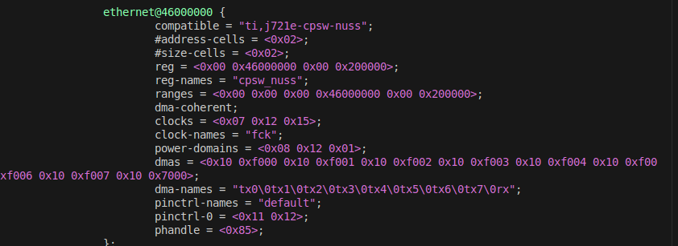
Parent-Child Dependency for bootph.
  Parent has a scope but child does not
    Child gets excluded
Decompiled SPL DTB
Device tree source(dts)

Slide 33
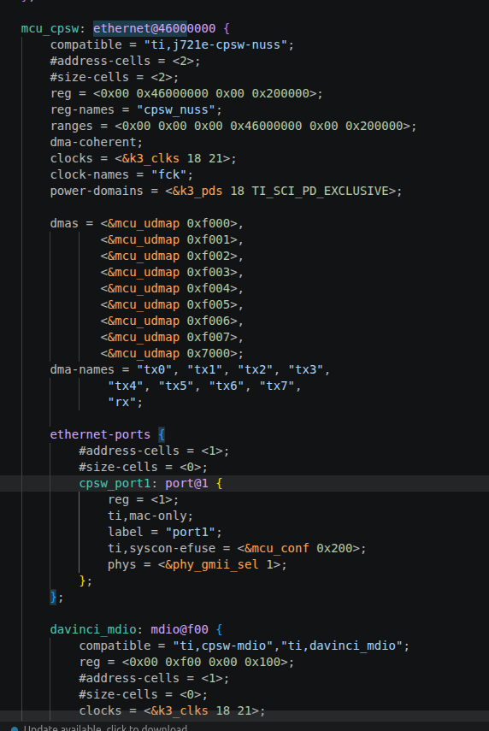
Parent-Child Dependency for bootph.
Both parent and child nodes is untagged
Parent and child node will only be included in the post relocation phase of U-BOOT-proper.
Device tree source(dts)

Slide 34
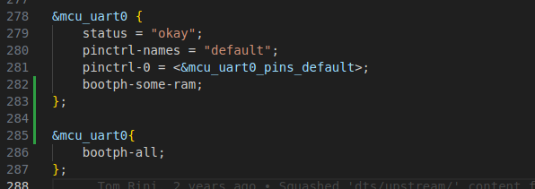
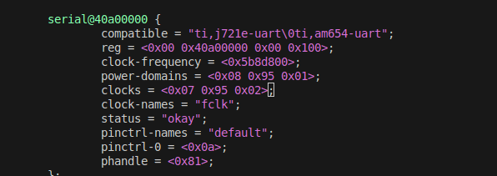
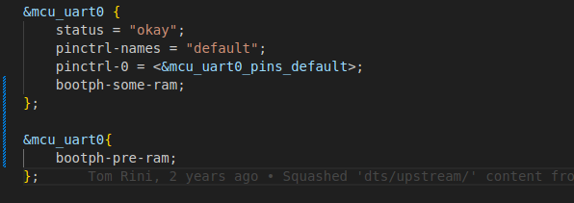
Common Pitfalls
Adding tags in the wrong way causing it to get overridden
  Case 1(Same dts file): Adding different tags to the same node one after the other in the same file.
Output : Set Union of both tags
Example 1(dts)
Decompiled SPL DTB
Example 2(dts)

Slide 35
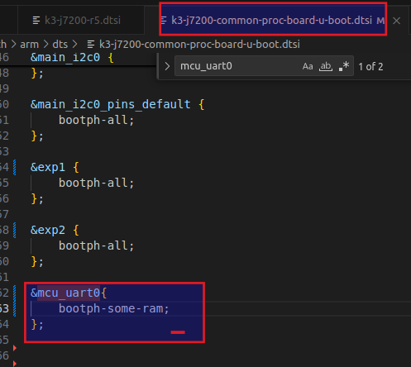
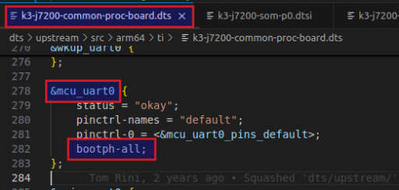
Common Pitfalls
Adding tags in the wrong device tree file causing it to get overridden
  Case 2(Different file): Adding one tag in the dtsi and another tag in the dts causing it to be overridden
Output : Set Union of both tags
<board>-u-boot.dtsi
Decompiled SPL DTB
<board>.dts

Slide 36
Common Pitfalls
Ignoring tags
  Without tags, nodes are included only in the final phase, where all memory is available.
Using bootph-all tags everywhere
DTB | SIZE(KB)
UPSTREAM DRA821 SPL DTB | 15.14
DRA821 SPL DTB (BOOTPH-ALL) | 54.96
UPSTREAM DRA821 U-BOOT DTB | 77.14
DRA821 UBOOT DTB (BOOTPH-ALL) | 79.86

Slide 37
Generic steps the vendor can use to profile/audit their bootph usage
Identify the device tree nodes required in each phase of the bootloader and accordingly tag them.
Avoid over tagging a device tree node.
Ensure that you understand the parent-child dependency

Slide 38
Other possible Optimizations : Compiled-in Device Tree
This feature converts the devicetree contents into C code at build time , which can be compiled into the SPL binary.
How does it optimize?
  No need to change the source code.
  Avoids runtime parsing of device tree.
  This saves the overhead of storing device tree code and the libfdt library code(~3-10KB), thus leading to more efficient storage of data.
  Device is instantiated at runtime without converting the device tree data(in the form of C structures) to platform data in the driver, thus reducing the code overhead of that conversion logic as well. The of_to_plat() method should therefore do nothing in such a driver.

Slide 39
Other possible Optimizations : Compiled-in Device Tree
How it works?
  The feature is enabled by CONFIG OF_PLATDATA
    This feature is only available in SPL/TPL
  A tool called ‘dtoc’ converts a devicetree file into the following:
    A set of struct declarations, one for each compatible node
    The actual platform data for each device.
    A set of U_BOOT_DRVINFO() declarations for each node.
  The device is then instantiated at run-time and the platform data can be accessed using:
  The platform data is then matched with a driver at runtime, the ‘name’ property of the U_BOOT_DRVINFO() declaration has to match a driver declared via U_BOOT_DRIVER()/ DM_DRIVER_ALIAS()macro.

Slide 40
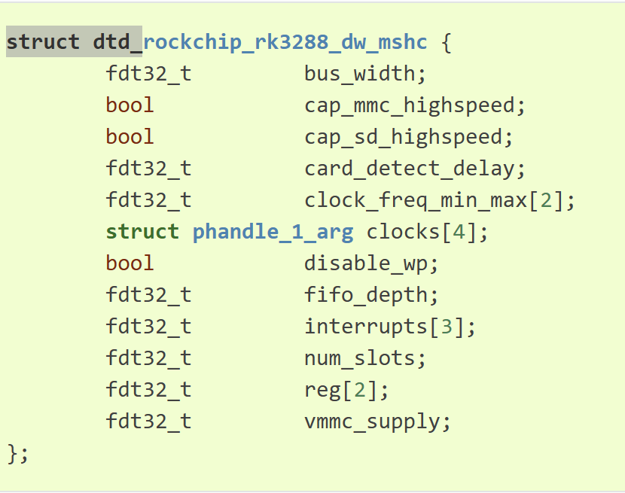
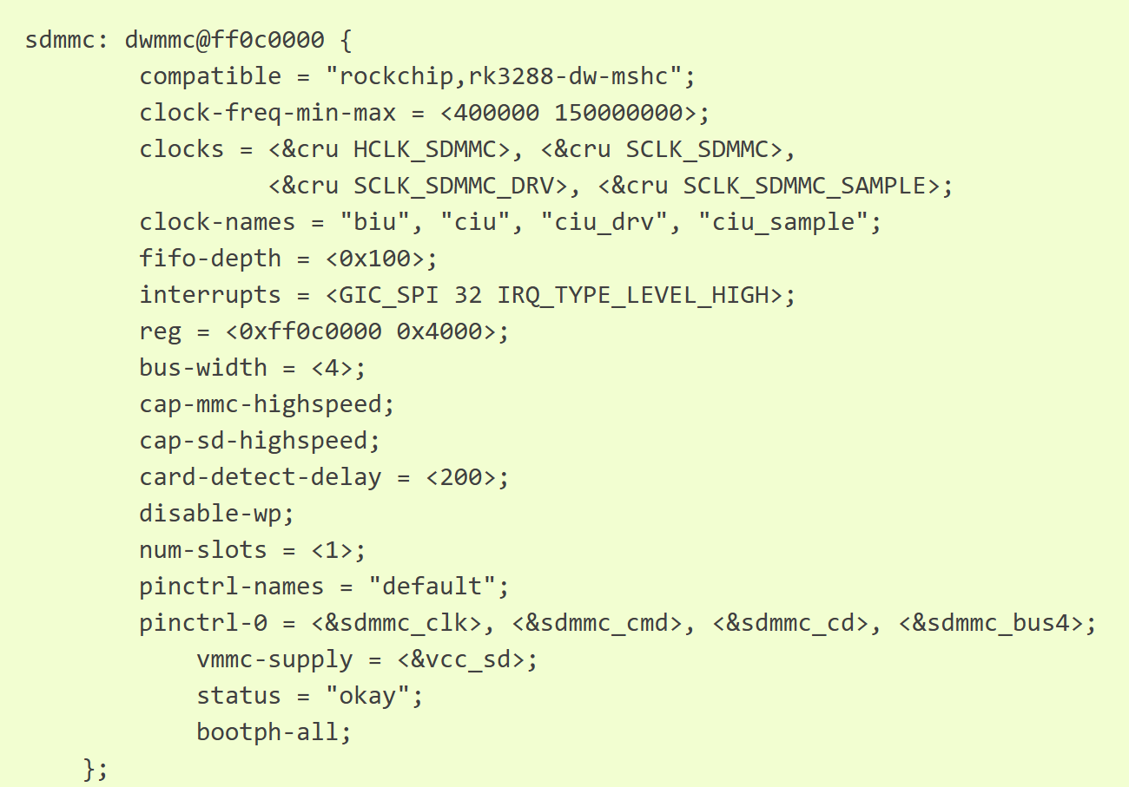

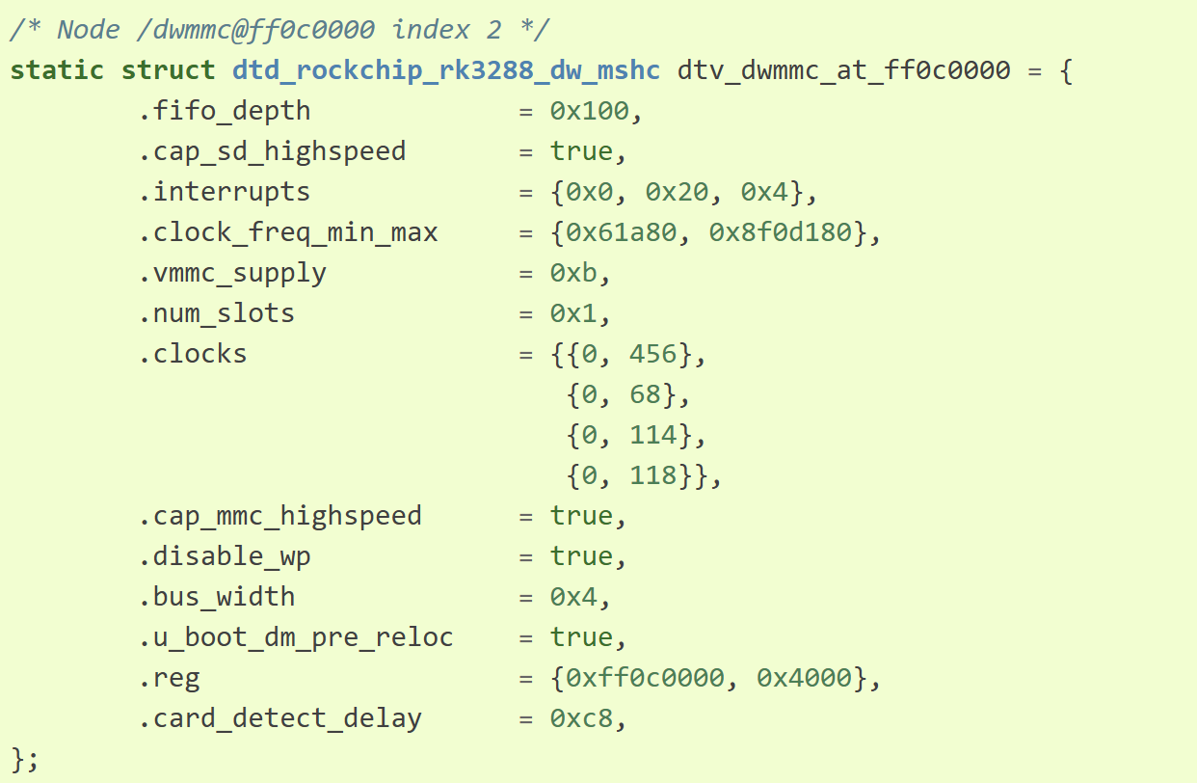
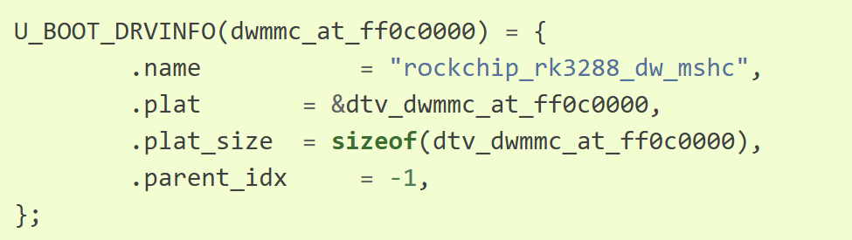

Slide 41
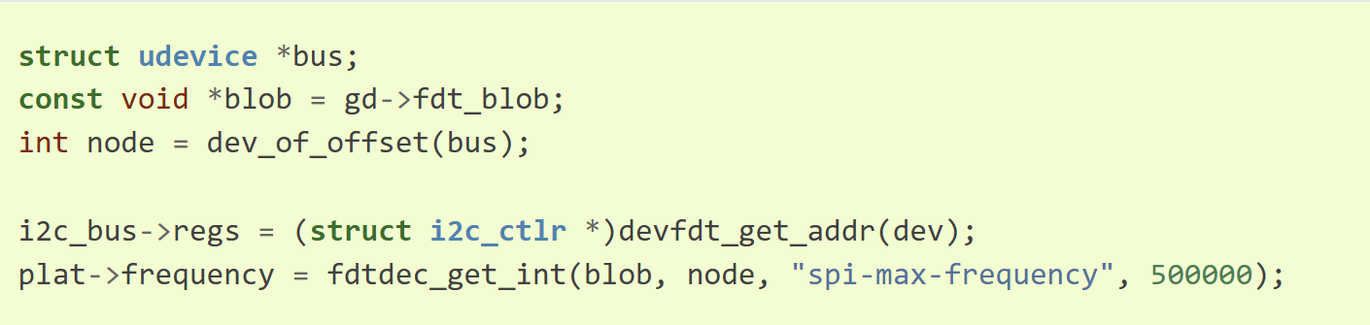
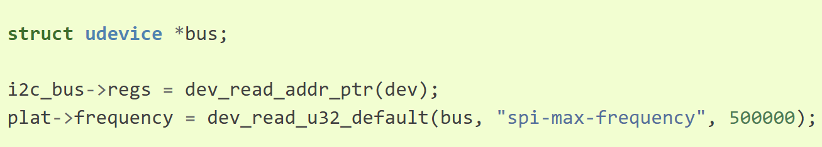
Other possible Optimizations : Live Tree
An alternative to Flat device tree in UBOOT proper post relocation phase
An unpacked, hierarchical pointer-based structure (similar to Linux).
This is enabled via CONFIG_OF_LIVE
Use case:
  Run time modification of device tree

Slide 42
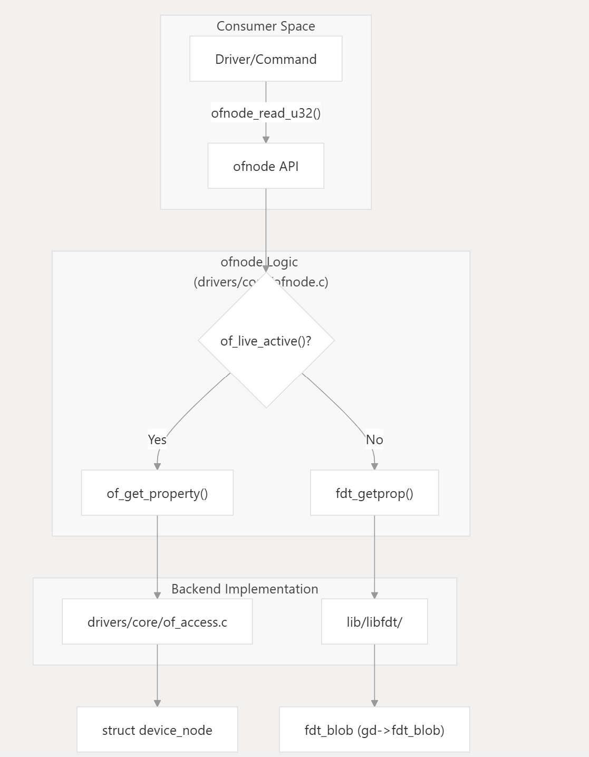
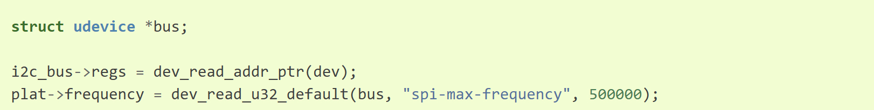
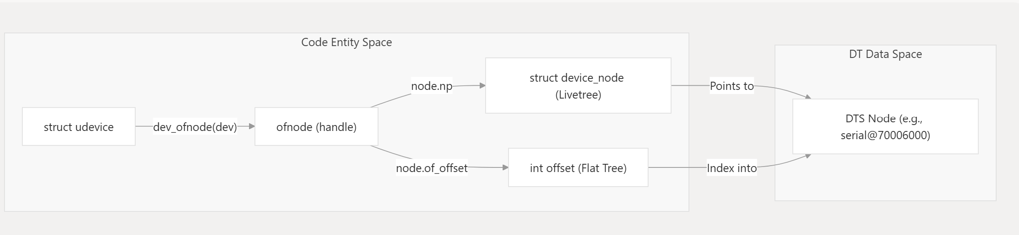
Other possible Optimizations : Live Tree

Slide 43
Other possible Optimizations : Live Tree
How this feature helps:
  Adding new properties can involve copying large amounts of data around to make room.
  The overall tree has a fixed maximum size so sometimes the tree must be rebuilt in a new location to create more space.
  Even if not adding new properties or nodes, scanning the tree can be slow.
    For example, finding the parent of a node is a slow process. Reading from nodes involves a small amount parsing which takes a little time.

Slide 44
Reference links
UBOOT Bootflow:
  https://docs.u-boot.org/en/stable/usage/spl_boot.html
  https://deepwiki.com/u-boot/u-boot/3-boot-process
  Memory Management — Das U-Boot unknown version documentation
Device tree:
  https://docs.u-boot.org/en/latest/develop/driver-model/design.html#:~:text=tree)%20and%20probe.-,Platform%20Data,%EF%83%81,-Note%3A%20platform%20data
  https://docs.u-boot.org/en/latest/develop/driver-model/design.html#device-tree
  Devicetree Control in U-Boot — Das U-Boot unknown version documentation
Compiled in Device tree
  Compiled-in Device Tree / Platform Data — Das U-Boot unknown version documentation

Slide 45
Credits and Acknowledgement
Texas Instruments Inc.
The Linux Foundation.

Slide 46
E-mail:
Keerthy J <j-keerthy@ti.com>
Gokul Praveen <g-praveen@ti.com>
Beleswar Padhi <b-padhi@ti.com>

