Slide 1
Scaling LLM Inference With Tiered Caching: Extending LMCache With Amazon SageMaker HyperPod
Yihua Cheng & Ziwen Ning

Slide 2
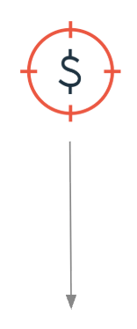
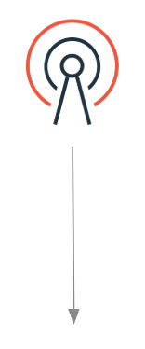
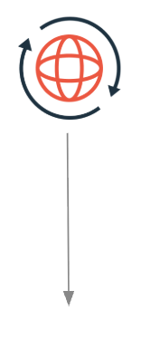
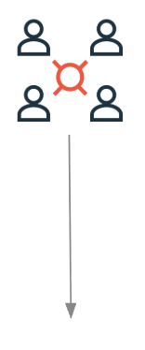
AI Inference Hits a Wall
Rising GPU Costs
Latency Bottlenecks
Redundant Computations
Scale Limitations

Slide 3



KV Cache: Key To Efficient LLM Inference
Request
Cut GPU Costs
Better Scalability
LLM
Reduce Request
Latency
Avoid Redundant
Computation
KV Cache
Model’s understanding of the context

Slide 4

People want to do more and more things on KV cache to improve inference
Save KV cache to remote storage
Observe KV cache lifecycle
Share KV cache across different serving engines
Compress/update KV cache

Slide 5

People want to do more and more things on KV cache to improve inference
However, it’s painful to land it in real production
KV Cache operations incurs overhead in inference
Serving engine is very difficult to hack
Interface for KV cache operations is so limited

Slide 6
People want to do more and more things on KV cache to improve inference
However, it’s painful to land it in real production
KV Caches need a separated software stack to manage.

Slide 7
LMCache provides most mature open-source solution that connects inference engines and tiered storages with KV caches.

Slide 8







LMCache Today
Distributed serving
framework
LLM inference engines
KV Caching Stack
160+ contributors
PyTorch Ecosystem Project
From global AI community
Standardization path via PyTorch (2025)

Slide 9
Key features in LMCache
Distributed CPU offloading & sharing
Async storage Support (local, remote, GDS)
Multi-tier memory management
Cloud native deployment (operator + helm chart; OpenShift support)
Enhanced fault tolerance
KV cache tracing & observability
Basic Functionality
Production Support
Non-prefix KV cache reuse
KV cache quantization
KV cache compression
(e.g., TurboQuant)
Supports mainstream serving engines (vLLM, SGLang, TRTLLM, Modular)
Support mainstream accelerators (Nvidia, AMD, Ascend, Intel)
Advanced Features
Ecosystem

Slide 10
KV caches in the wild
How large the KV caches are
How much KV cache we should save
 | DeepSeek V4 Pro | MiniMax M2.5
Prefill speed | 18K tokens/s/GPU | 22K tokens/s/GPU
KV cache size | 9.6 GB / 1M tokens | 256 GB / 1M tokens
In real-world coding agent traces
Context length: 300~800K
Concurrent user sessions: 100~300
Need to keep 1~10 TBs KV cache per node to achieve good hit rate
A single 8xB300 node will generate 10~500 TBs KV cache every day
Data sources:
https://inferencex.semianalysis.com/inference
https://huggingface.co/datasets/sammshen/lmcache-agentic-traces

Slide 11
KV caches in the wild
How large the KV caches are
How much KV cache we should save
 | DeepSeek V4 Pro | MiniMax M2.5
Prefill speed | 18K tokens/s/GPU | 22K tokens/s/GPU
KV cache size | 9.6 GB / 1M tokens | 256 GB / 1M tokens
In real-world coding agent traces
Context length: 300~800K
Concurrent user sessions: 100~300
Storing and reusing KV cache requires a multi-tier storage system!
Need to keep 1~10 TBs KV cache per node to achieve good hit rate
A single 8xB300 node will generate 10~500 TBs KV cache every day
Data sources:
https://inferencex.semianalysis.com/inference
https://huggingface.co/datasets/sammshen/lmcache-agentic-traces

Slide 12
Hierarchical memory management in LMCache
Serving engine instance
LMCache -- an “infinite” KV cache pool
From serving engine’s perspective, LMCache provides a large pool of KV cache. Serving engines don’t need to care about any distributed management.

Slide 13
Hierarchical memory management in LMCache
Serving engine
Serving engine
Serving engine
Serving engine
RDMA
Node-local CPU RAM
Node-local CPU RAM
Memory controller
Node-local storage
Node-local storage
Memory controller
Remote/Shared Storage

Slide 14
Storage Optimizations in LMCache
I/O operations happens fully in the background, 0 overhead in the serving engine hot path.
Asynchronous I/O
KV caches are looked up from different storage backends at the same time, including in the peer’s memory.
Distributed Lookup
Dynamically determine the load plan and load from different locations concurrently to maximize the throughput.
Concurrent Loading

Slide 15
LMCache L2 interface
Primitives | Submit tasks | Query task status
Store | submit_store_task() | pop_completed_store_tasks()
Load | submit_load_task() | query_load_status()
Lookup | submit_lookup_task() | query_lookup_results()
LMCache core
L2 interface
Storage vendor
io-uring-like interface to support async I/O operations

Slide 16








LMCache L2 storage ecosystem
LMCache core
L2 interface
Storage vendors
Local Storages

Slide 17
Amazon SageMaker HyperPod
Helps you provision resilient clusters for running ML workloads and developing state-of-the-art models — LLMs, diffusion models, foundation models
Removes the undifferentiated heavy-lifting of building and maintaining large-scale compute clusters
Resiliency features automatically detect and replace faulty hardware on the fly
Integrates with Amazon EKS for orchestrating containerized ML workloads

Slide 18
Tiered Storage on every node
A per-node tiered storage service running in the background
Tiers:
  Shared memory on the host (RAM, zero-copy)
  Node-local SSD (larger capacity, persistent)
Daemon moves entries between tiers transparently
Control API over HTTP — small, structured metadata messages
Data path via shared memory — zero-copy, no network hop

Slide 19
A great L2 fit
Larger ✓ — capacity tier is hundreds of GB per node
Cluster-shared ✓ — every node has a service; routing keeps requests local
Persistent ✓ — outlives the engine process; survives restarts
+ High-bandwidth local data path — cache hits are memory copies
+ Zero extra ops — already running, nothing to deploy

Slide 20
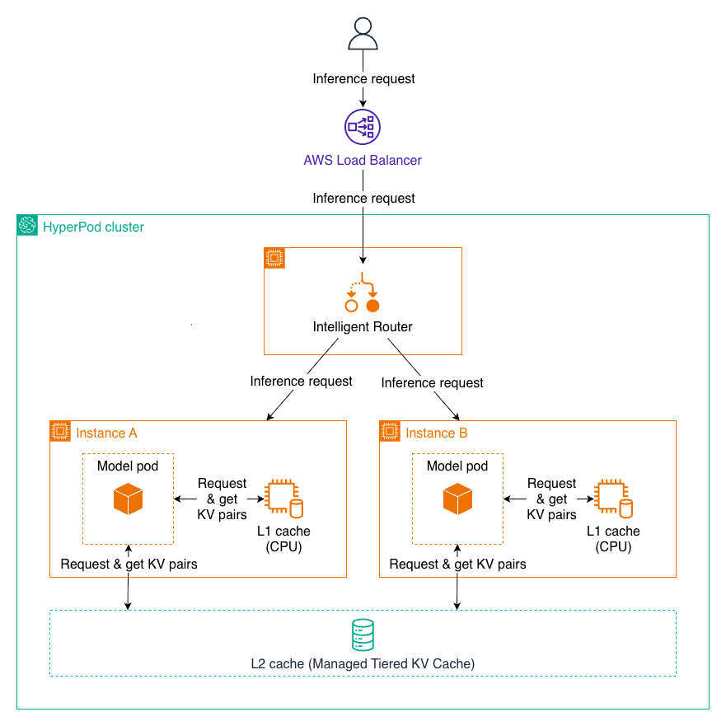
The connector - bridging LMCache and HyperPod Storage
Implements LMCache's L2 backend interface for HyperPod storage
Control plane → HTTP requests for metadata (lookups, reservations)
Data plane → reads / writes via shared memory (zero-copy)
Enable with one URL: sagemaker-hyperpod://... in your LMCache config

Slide 21
End-to-end: read and write paths
Write: engine → L1 (sync) → background drain → HyperPod (async)
Read: GPU miss → L1 miss → control-plane lookup → shared-memory load → engine resumes
Reads have priority over background writes — interactive latency is protected
A returning user's L2 hit feels just like an L1 hit

Slide 22
Setup: zero extra infrastructure
Add one URL to your LMCache config: sagemaker-hyperpod://<host>:<port>
Mount the host shared-memory directory into the LMCache container
That's it — no new services, no new credentials, no extra cost line
Tuning knobs available; defaults work for most workloads

Slide 23
Benchmark setup
Component | Configuration
Model | Llama-3.1-70B-Instruct
Hardware | 2× ml.p5.48xlarge (8× H100 80GB / node)
Tensor parallel | 8 per server
LMCache / vLLM | v0.4.3 / v0.19.0
L1 budget | 20 GB CPU RAM / server
L2 (HyperPod) | 100 GiB / node
Workload | 100 concurrent multi-round chats, 12K tokens / session, QPS = 8
Comparison | L1-only vs L1+L2

Slide 24
Results: 1.67× faster ITL P50 · 1.27× more throughput
Metric | L1 only | L1 + L2 | Δ
TTFT P50 | 4,506 ms | 5,030 ms | 0.90×
TTFT P90 | 8,253 ms | 6,833 ms | 1.21×
ITL P50 | 63.4 ms | 38.0 ms | 1.67×
ITL P90 | 164.9 ms | 116.8 ms | 1.41×
Output throughput | 844 tok/s | 1,071 tok/s | 1.27×
Requests served | 1,016 | 1,200 | 1.18×

Slide 25
When L2 helps most
Large models — recompute cost per token is high
Long contexts — prefill cost grows superlinearly
High concurrency — L1 evicts more aggressively
Returning sessions — chat, agents, retrieval pipelines
Less impact for small models / short single-turn requests

Slide 26
Takeaways
Amazon SageMaker HyperPod managed tiered storage is a viable, even ideal, L2 for KV caching
Open source, upstream in LMCache — one config line to enable
Real wins on real workloads — 1.67× ITL P50, 1.27× throughput on Llama-3.1-70B

Slide 27
Thank you
LMCache: github.com/LMCache/LMCache
LMCache blog
  LMCache on Amazon SageMaker HyperPod: Accelerating LLM Inference with Managed Tiered KV Cache
    https://blog.lmcache.ai/en/2026/04/22/lmcache-on-amazon-sagemaker-hyperpod-accelerating-llm-inference-with-managed-tiered-kv-cache/
Setup docs: https://docs.lmcache.ai/kv_cache/storage_backends/sagemaker_hyperpod.html
Questions?

