Slide 1

Practical Strategies for Reducing Build System and Host Technical Debt
Joe Schneider, Dojo Five CEO

Slide 2
Agenda
Meet Joe Schneider, Dojo Five CEO
The Anatomy (and Impact) of Technical Debt
Case Study: Technical Debt in Real Life
Practical Strategies for Managing Technical Debt
A Fresh Pair of Eyes
Q&A

Slide 3

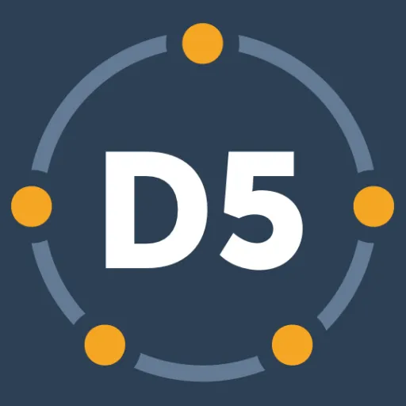
Meet Joe Schneider and Dojo Five
Joe Schneider, Founder & CEO, Dojo Five
20+ years of embedded development experience
200+ projects
Goal: To make embedded projects more successful and enjoyable to develop
Let’s chat about your project: hello@dojofive.com
About Dojo Five
Mission: To modernize embedded firmware
Expert embedded firmware services
EmbedOps®: DevOps for Device Teams

Slide 4
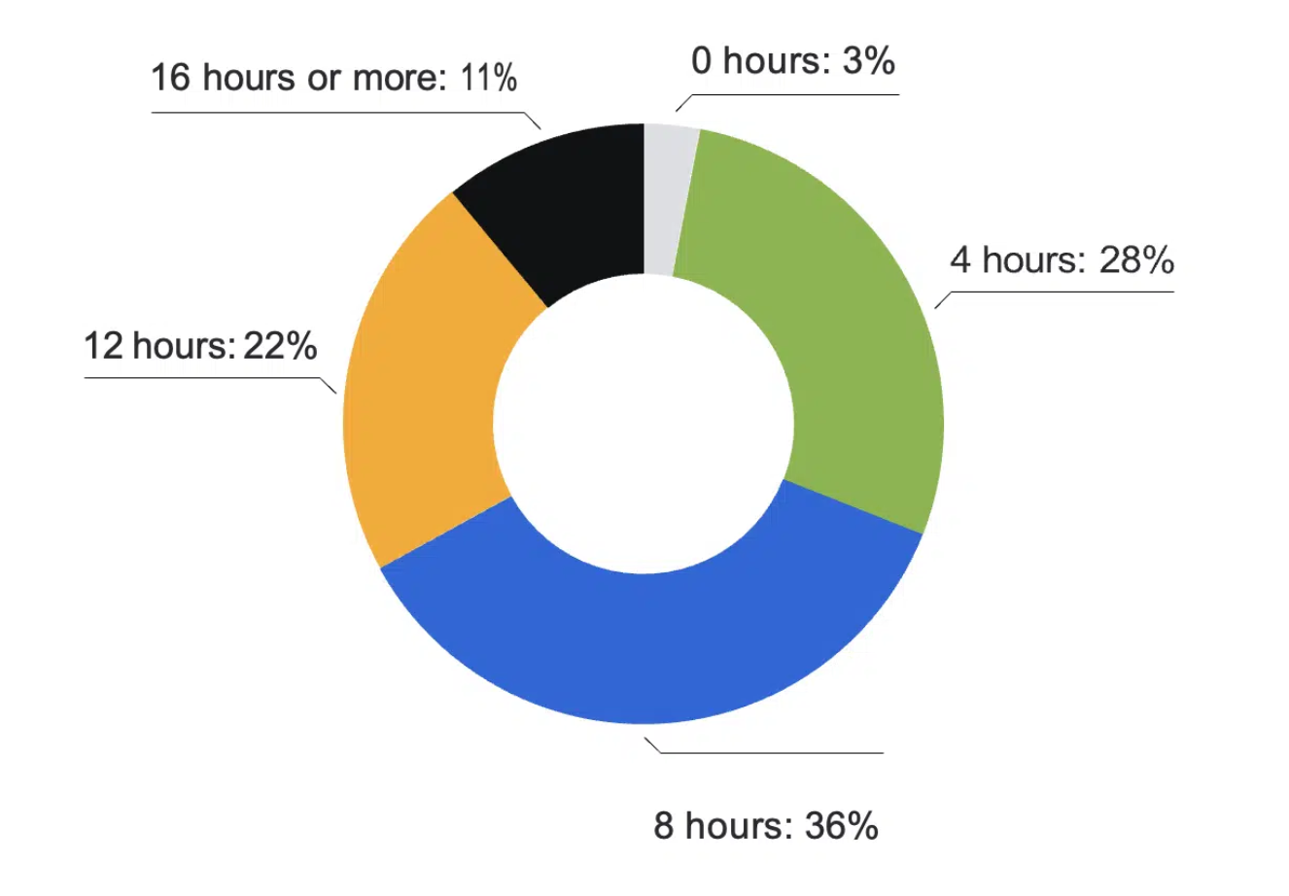
The Anatomy (& Impact) of Technical Debt
Embedded build systems are a complex interdependency of tools that convert source code into firmware images:
Cross-compilers
Build scripts
Continuous integration (CI) pipelines
Dependency handlers
A build system pairs with a host environment that can consist of:
Hardware interfaces
Virtualization
Operating system
If left unmanaged, a build system and/or host environment can quickly accrue crippling technical debt.
A Shiftmag survey showed that 69% of developers lose more than eight hours per week to technical debt.

Slide 5
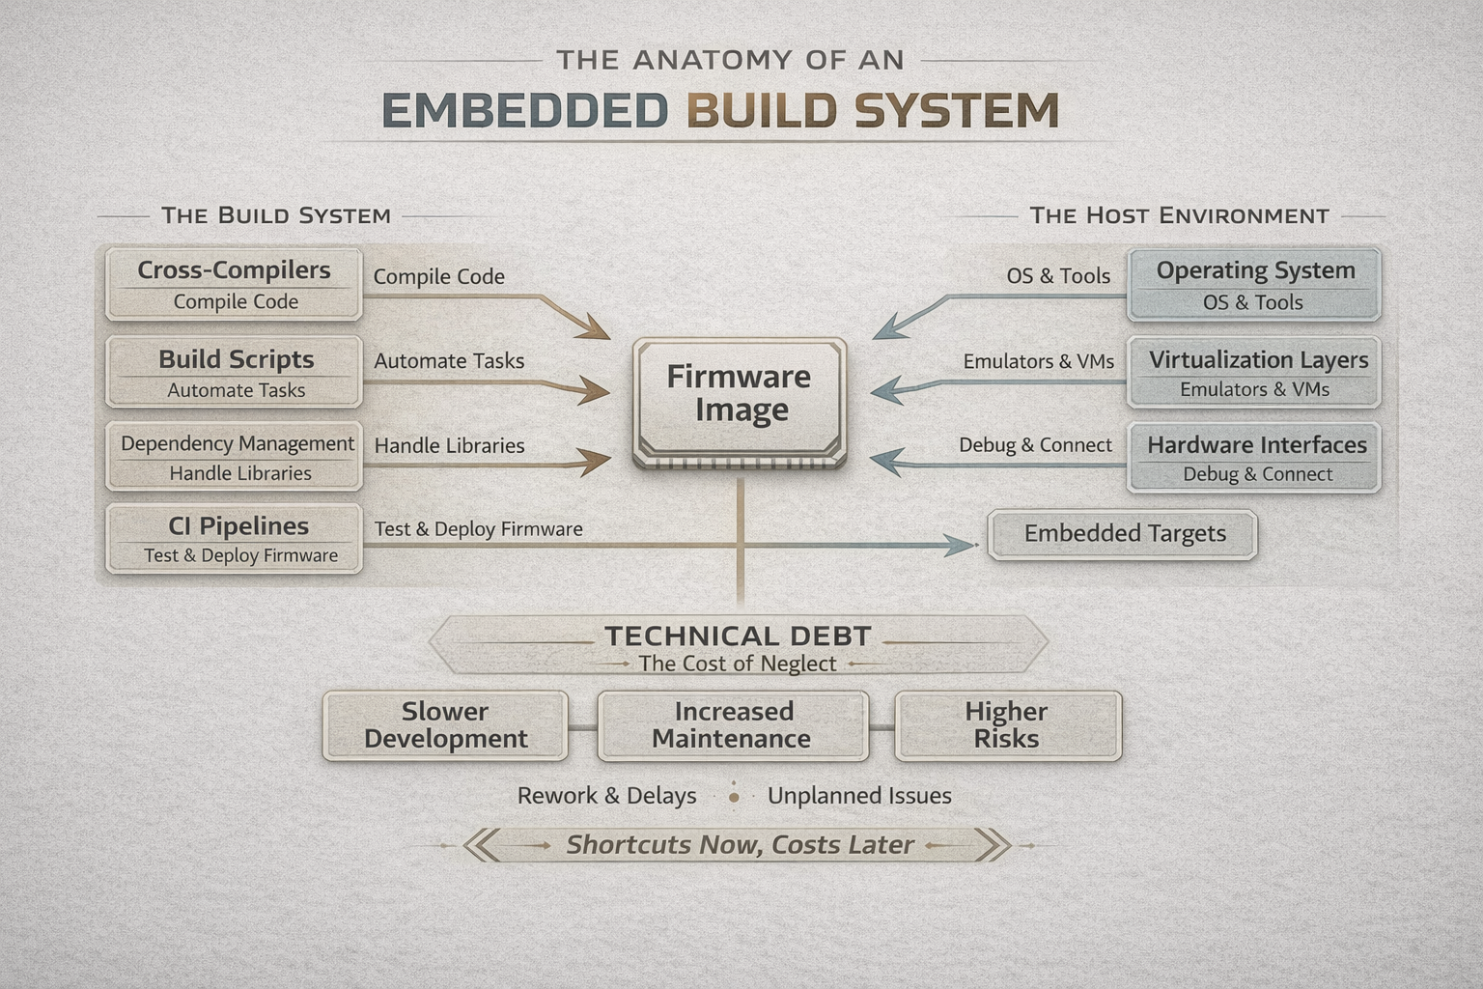
The Anatomy (& Impact) of Technical Debt
Technical debt is the cost of shortcuts and mistakes that accrue throughout the lifecycle of a project or engineering organization. The cost is paid in slower development, increased maintenance, and higher risk.
In embedded systems development, technical debt can be found in build system debt or host debt.
Build system debt often results from outdated build scripts, Makefiles, CI pipelines, and dependency management. It can manifest in long build times and fragile tooling.
Host debt from operating systems, virtualization layers (Docker, virtual machines), peripheral drivers, and other tooling is usually the product of misconfigurations and slow virtualization that degrade performance.
Paying off technical debt occurs through refactoring, bug fixing, and maintenance.

Slide 6
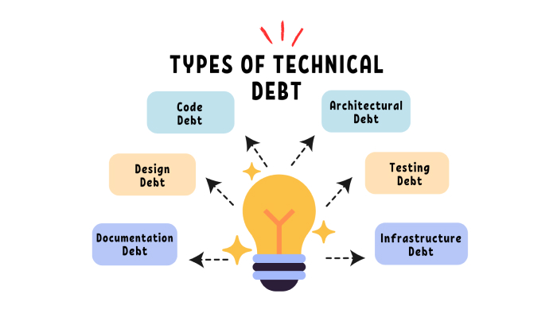
The Anatomy (& Impact) of Technical Debt
Technical debt manifests in a number of ways for embedded development teams:
HW Constraints: Misconfigured drivers and virtualization layers can prevent tools from accessing hardware.
Slow Builds: Build rot and unoptimized scripts mean long compilation times. Reducing 10-minute builds by two minutes could save 1 hour/developer/day (21 hours/month!).
Inefficient Testing: Ineffective build systems translate into unreliable automated testing, which quickly becomes manual testing or no testing at all.
Debugging Bottlenecks: Friction when reproducing issues can slow debugging and disrupt development flows.
Poor Documentation and Knowledge Silos: When build scripts are undocumented or in developers’ heads, days can be spent reverse-engineering commands and flags.

Slide 7

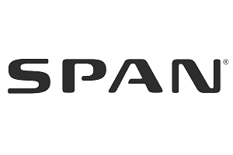
Case Study: Technical Debt in Real Life
Dojo Five was engaged by a smart energy company who had become bogged down by technical debt.
A smart panel development project was challenged by a complex architecture with multiple modules, different MCU families, limited I/O pins, and unhandled error conditions in vendor code. It resulted in:
1102 seconds (almost 20 minutes!) per clean firmware build
389 seconds per incremental firmware build
1.5 MHz SPI bandwidth that bottlenecked OTA testing
Technical analysis revealed unoptimized build scripts, inefficient or non-existent caching, and SPI driver issues all contributing to the system’s technical debt and poor overall performance.

Slide 8
Case Study: Technical Debt in Real Life
Dojo Five addressed inefficiencies in the smart panel project by hardening the SPI drivers inhibiting test performance, then introducing processes that optimized the customer’s build environment for future development.
SPI Driver Hardening: Debugging and rewriting SPI drivers accelerated flashing on the primary system module from 1.5 MHz to 50 MHz (3.125 MHz on downstream modules).
Increased SPI bus speeds cut OTA transfer times 10-15 minutes per test, freeing 40+ hours per week of time.
Build Speed Optimization: A restructured build system, better caching, and parallelization across hardware configurations delivered the following improvements:
1.4-1.9x speedup for clean builds
10x speedup for incremental builds
Saved 1.35 hours per developer per day
Long-term Process Improvement: Installing a consistent build system, filling testing gaps, and automating build processes provided a sustainable development environment.
Besides getting the project back on track, Dojo Five’s work saved the client at least $200,000+ in annualized labor costs.

Slide 9
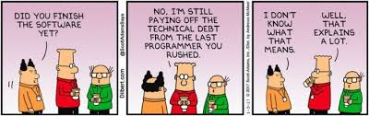
Root Causes of Technical Debt
Three sources:
Engineering: Quick fixes that ship, outdated tools, sample code copied without understanding, thin testing.
Management: Revenue-first prioritization, no visibility into what failures actually cost, shifting schedules.
Vendor SDKs: Version on the vendor's schedule, want to be the root of your build, break HAL APIs without semver. The largest source of host debt for most embedded teams.
For organizations suffering from diffuse ownership of build infrastructure (engineering vs DevOps/IT) or large, complex projects, technical debt can be even more difficult to overcome.

Slide 10
Practical Strategies for Managing Technical Debt
1. Adopt Modern Tools That Standardize Build Environments
Advanced build management solutions subdivide builds into smaller targets and track dependencies. Adopting a containerized build environment to manage compilers, SDKs, and build tools can streamline development.
Use Dev Containers to containerize the entire toolchain and dependencies, guaranteeing dependency trees assemble anywhere.
Ties developers to CI and ensures CI/CD pipelines run the same image
Treats dependencies as versioned, trackable components
Eliminates manual tool setup and “works on my machine” issues

Slide 11
Practical Strategies for Managing Technical Debt
2. Configure Your Environment for Speed & Performance
A standardized and sustainable build environment can be architected for speed and performance. Staged builds and a robust caching architecture deliver noticeable improvements.
Dependency caching, artifact caching, and parallelization can accelerate build times and maintain environment consistency.
Remote caching saves artifacts in a central location. Any system that subsequently builds an artifact can check if it already exists via a hash, saving time and avoiding unnecessary re-builds.
Multi-stage builds use multiple FROM stages to separate the build toolchain from the runtime image. Compilers, SDKs, and intermediate objects stay in the build stage; only the final binaries are copied into a slim runtime stage. Smaller images, fewer attack-surface bytes, faster CI pulls.

Slide 12
Practical Strategies for Managing Technical Debt
3. Scripting Hygiene & Documentation Best Practices
Build systems are garbage in, garbage out systems that require good process and hygiene for long-term success. Adopting command runners and implementing strong documentation practices can be the difference in accruing technical debt.
Command runners set environment variables and help when deciding to use or skip dependencies.
Command runners are essential to ensuring tasks run consistently in different shells.
Minimize build rot by avoiding one-off hacks, unnecessary conditionals, and custom logic wherever possible.
Also limit hardcoding paths
Build scripts and configuration files should be treated like production code. As such, they must be versioned, reviewed, and comprehensively documented.
Document how inputs are validated, list corner cases, define prerequisites, etc.
Encourage build system knowledge sharing and training to reduce complexity and promote effective use of tools.

Slide 13
Practical Strategies for Managing Technical Debt
4. Baseline and Monitor Your Build System
Maintaining a robust and efficient build system means monitoring your builds. Again, build scripts and associated components should be treated like production code that undergoes review and testing.
Regularly review and refactor build scripts.
Measure the right layer: ccache -s for compile cache effectiveness, ninja -d stats for build-graph overhead, cmake --profiling-format for configure-phase cost. Each one diagnoses a different class of slowness.
Perform code reviews and linting
Monitor for incremental improvements and regressions.
CI pipelines can automate the collection of system metrics and improve overall visibility.
Use monitoring data to target the longest compiling modules first when caching.
Regularly review tool versions and dependencies, pruning as necessary to keep the build system lean.
Track code size, RAM, and stack usage per commit. Flash budget regressions are silent until you can't fit changes into the OTA delta!

Slide 14
Practical Strategies for Managing Technical Debt
5. Present Data Management Can Understand
Technical teams are routinely disillusioned by leadership that doesn’t “get it”. When struggling with technical debt related to an unoptimized build environment, present management with information they understand.
Rather than presenting findings on task durations, cache hit rates, and test turnaround times, discuss the cost of technical debt in terms of hours saved, dollars saved, and risk mitigated.
Look to justify investment and demonstrate ROI around key management care abouts, such as:
Faster feature delivery
Reduced maintenance costs
Higher quality
Time-to-onboard

Slide 15
Takeaways
1. Understand your tech debt
2. Consider build debt vs. host debt
3. Learn how to talk to leadership about tech debt
4. Adopt practical strategies for your company

Slide 16
Come Check Us Out!
Next Steps
Dojo Five
Visit Our Booth
B6
Contact me!
Joe Schneider, Dojo Five CEO
Email: hello@dojofive.com
Book a Call
https://dojofive.com/book-a-call
See a Demo
https://dojofive.com/demo

Slide 17
Thank you! Any questions?
Sign Up for Free Today
Visit us at DojoFive.com or contact us at Hello@DojoFive.com

