Slide 1
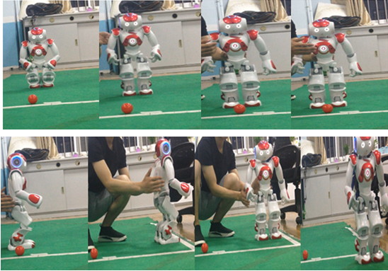
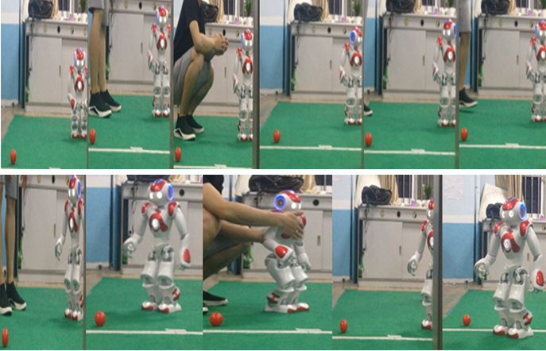
Computer Vision, Motion Control and Communication Design of Autonomous Robots based on Embedded Linux
Chloe Zhu
5/20/26
Chloe.Zhu@Schaeffler.com
https://chloezhu1.github.io/

Slide 2
Agenda
Computer Vision
Motion Control
Communication (Precise Synchronous Frequency Offset Apparatus)
Embedded Linux Application in Robotics

Slide 3
Embedded Linux in NAO Humanoid
The NAO robotics platform, originally developed by Aldebaran and SoftBank, and now by Maxtronics.
OpenNAO operating system is based on the Gentoo embedded Linux OS, and uses the NAOqi API for autonomous robot control.
We also used the OpenCV computer vision library as part of our open source software stack to program our NAO humanoid robot.

Slide 4
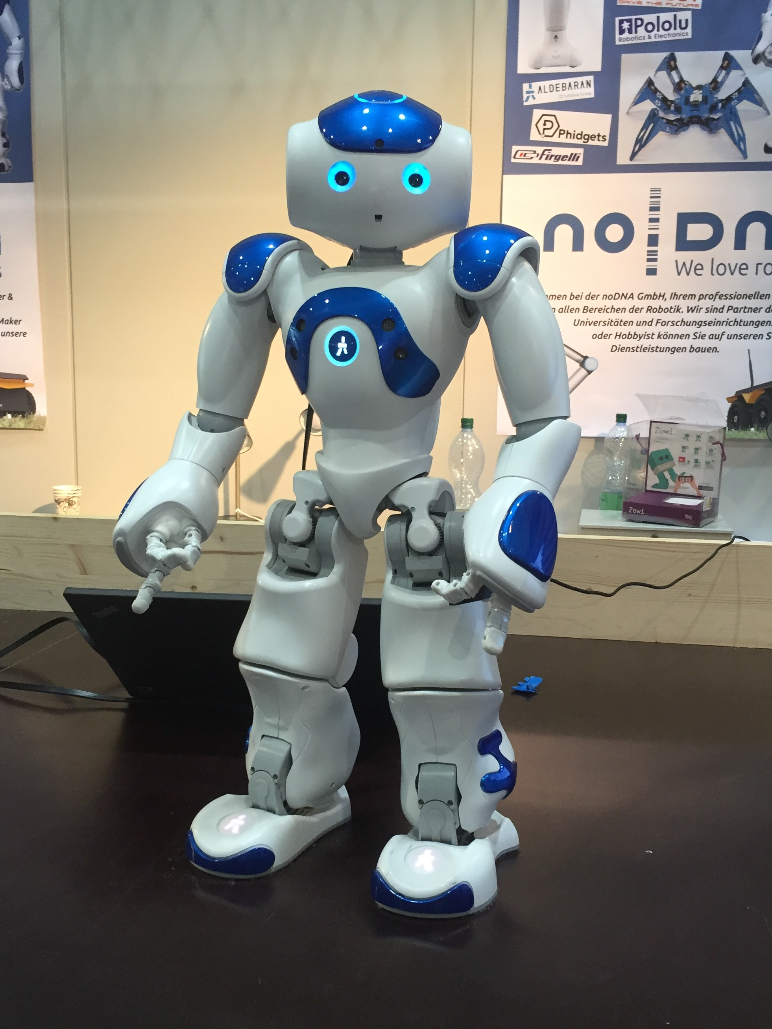
Robot Golfing Competition
YouTube Link of our robot
Nao humanoid robot is an autonomous, programmable humanoid robot.

Slide 5
Complete Technical Pipeline
Image Acquisition
resolution: 640×480 frame rate: 30 FPS
monocular vision
Image Preprocessing
RGB, HSV
Robot Motion & Golfing
Ball Detection — Hough Circle Transform
Kalman Filter Tracking
Ball Recognition Decision
Ball Localization (Distance & Position)
image pixels → real-world position

Slide 6
Full Coordinate Transformation Pipeline
Ball Detection → World Position
Image Coordinate System (Pixels)
(center_x, center_y, radius)
Image Frame
Pixels (u, v)
image center = (W/2, H/2)
intrinsics
Pixel Offset → Camera Angles
img_pitch = (center_y − img_center_y)/H * cameraPitchRange
img_yaw = (img_center_x − center_x)/W * cameraYawRange
Optical frame
(camera center)
head yaw/pitch+mount tilt
Add Head + Camera Mount Angles
camera_pitch = head_pitch + camera_mount_tilt
ball_pitch = camera_pitch + img_pitch
ball_yaw = head_yaw + img_yaw
camera frame
ray angles
pitch, yaw
Camera pose transform
Polar → Robot XY Coordinates
disX = distance * cos(ball_yaw)
disY = distance * sin(ball_yaw)
World frame
Camera Frame → World Frame
ball_world_X = cameraX + disX
ball_world_Y = cameraY + disY

Slide 7
camera
Geometry
For quick illustration, I set the x-axis along the pitch distance direction in this example. In general, it’s not true. We need to consider X_camera as well.
h-r
dyaw
Converting camera frame to world frame.
yaw
Golf ball
dpitch
Pitch
y
X (Forward)

Slide 8
Compensating y-coordinate in world frame
Physics model
+
Empirical model
angles → tan → cos → geometry
ky polynomial correction
4th-degree polynomial correction factor applied to Y (lateral distance)
data-driven error compensation
ky = a*ballX**4 - b*ballX**3 + c*ballX**2 - d*ballX + e
ballY = ky * ballY
In real robots, geometric model has systematic errors:
camera tilt not exact
head angle offsets
lens distortion
FOV scaling not perfectly linear
camera mount flex
joint encoder bias
ground plane not perfectly flat
image center not perfectly calibrated
1. Collect calibration data: trueX, trueY (measured by tape / motion capture). Run vision system →compute: estX, estY
2. Compute Y error ratio: ky_needed = trueY / estY, as a function of distance: ky_needed = f(estX)
3. Fit polynomial: regression

Slide 9
Computer Vision: How to select the red ball from the detection?
Area_ball/area_square = 0.196
rRatio = rScore / total_pixels
gRatio = gScore / total_pixels
r
4r
Selection Criteria:
if rRatio >= 0.12
and gRatio >= 0.1
and abs(rRatio-0.19) < abs(rRatioMin-0.19):
Condition A — enough red pixels
Condition B — enough green pixels
Condition C — red ratio close to target value
Image Processing flow
Build a “ball-likelihood” grayscale/binary image
Grab the latest camera frame
Set circle detection constraints
Handle “no ball found”
Select the best circle candidate
Detect circles in that processed image
store ball data and compute position

Slide 10
Computer Vision:
Red ball detection:
Crop the image
Convert BGR → HSV: frameHSV = cv2.cvtColor(frameArray, cv2.COLOR_BGR2HSV)
HSV threshold (binarization): frameBin = cv2.inRange(frameHSV, minHSV, maxHSV)
Erosion: frameBin = cv2.erode(frameBin, kernelErosion, iterations=1)
Dilation: frameBin = cv2.dilate(frameBin, kernelDilation, iterations=1)
Gaussian blur: frameBin = cv2.GaussianBlur(frameBin, (9,9), 0)
Return processed mask
remove small noise while preserving shape
Yellow Stick detection:
Capture and crop the image
Find contours in the binary image: _, contours, _ = cv2.findContours(frameBin, cv2.RETR_EXTERNAL, cv2.CHAIN_APPROX_NONE)
Loop through contours and filter by size: Compute perimeter and area, and filter by Size (Only keep contours large enough to be real objects). Get their bounding rectangles.
Shape filter — stick-like aspect ratio: rects = [rect for rect in rects if (1.0*rect[3]/rect[2]) > 0.8]. Recall: rect = [x, y, w, h]
Convert to numpy array

Slide 11
Continued:
Choose the “most stick-like” rectangle: Selects the rectangle with largest height/width ratio → most vertical
Adjust Y coordinate back to full-frame space

Slide 12
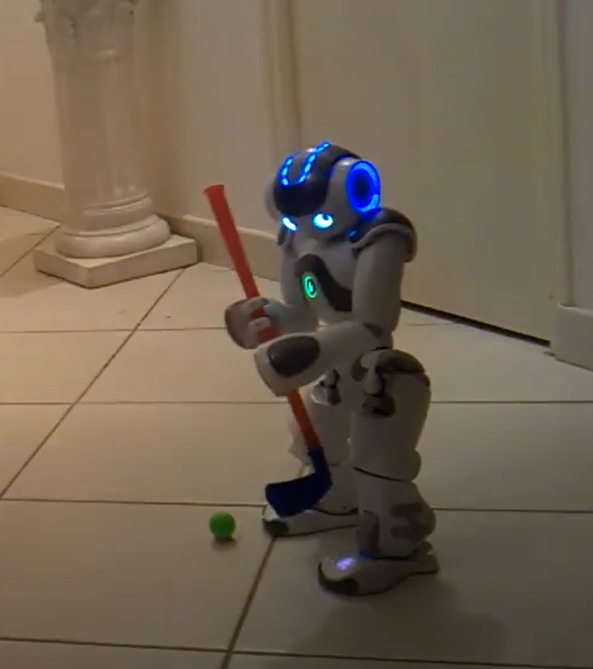
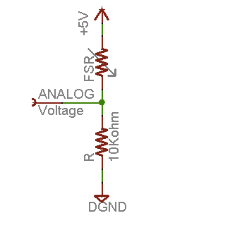
Closed-loop feedback control using Force-sensitive Resistor (FSR)
Principle: find the robotic I/O layout of analog, GND and 5V (as power). Connect FSR from 5V output, in serial to 10K resistor, then ground. Having analog (ADC) trace the voltage.
Via the circuit and Nao’s Arduino data logger, I could record FSR voltages at regular intervals, thus having pressure information at self-defined sampling rate, to control and adjust the coordinates of the robotic arm hitting the golf ball.

Slide 13
Correlation between the coordinates and the Force (Voltage/Resistance)
Voltage – pressure
We transfer pressure to a corresponding visible parameter – coordinate. We have x,y,z 3D coordinate in this application. We can break down the coordinates each direction. For simplicity, we take x-direction for demonstration, so we can control x coordinate to control the pressure applied when playing golf.

Slide 14
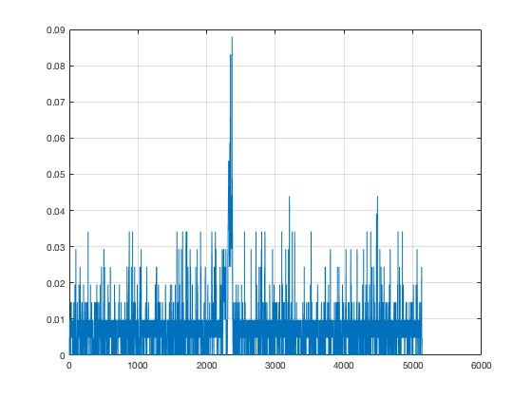
Measurement and Data Logging of the Output Voltage
The analog ADC input to Arduino Uno board of Nao for voltage reading. I used the same Arduino Uno board as in the robotic system, and wrote the Matlab script to plot and analyze the relative ADC counts (y-axis) wrt time (x-axis/ms):
a=arduino('/dev/cu.wchusbserial1420','uno');
interval=10000;
passo=0.05;
x=[];
t=1;
while (t<interval)
b=readVoltage(a,'A0');
x=[x,b];
plot(x);
grid
t=t+passo;
drawnow;
end
By setting passo value, I could manage the interval of the sampling.

Slide 15
Communication Design
What is an effective way to use RF communication without interference with other transmitters?
How do we get precise synchronous frequency signal?
In robotics competition/robotics stage performance, if we use RF communication module, there might be more than 10 robotic teams communicating with robots at the same time, and each team might have multiple robots to control (think of a football team).

Slide 16
Precise Synchronous Frequency Offset Apparatus in Robotics Application
The Precise Synchronous Frequency Offset Apparatus is an intelligent RF calibration system for robotic communication modules. Using a microcontroller-based architecture and real-time frequency measurement/control, it replaces traditional analog Phase-Locked Loop (PLL) synchronization methods to achieve high-precision synchronous frequency calibration.
Solution:
Frequency calibration: Standard Frequency (SF) signal 1(MHz) from China Central Television (CCTV).
Interlaced scan
Phase-Alternating Line (PAL) – based TV (First scan odd-numbered lines, then even-numbered lines, in total 625H, 312.5H each.)
At 16H and 329H of any CCTV programs, they contain 20 synchronous pulses from cesium atomic clock whose precision can reach 10^{-11} – 10^{-15}.
Extract 20 synchronous pulses to get SF
calibrate Voltage-Controlled Crystal Oscillator (VCXO) against SF
transmit
processing frequency

Slide 17
Thus, we can assign the frequency to each robot from 200 MHz, step size as 1 MHz increment, e.g. the second robot RF communication can be set as 201 MHz, the third 202MHz, etc.

Slide 18
Connection to Embedded Linux
Architecture Diagram
Embedded Linux OS
(OpenNAO/NAOqi)
Embedded Linux System
NAOqi Middleware
Camera drivers
Actuator motors
Python Robot Control + Computer Vision
NAOqi API
Camera / Motors / Sensors
Autonomous Robot Behavior
Python/OpenCV App
HSV segmentation
Hough circles
Localization
Motion planning

Slide 19
NAO Robot Runs an Embedded Linux OS: OpenNAO / NAOqi OS (based on Gentoo)
Vision Pipeline Uses Embedded Linux Camera Interfaces:
Camera Sensor
↓
Linux camera driver
↓
NAOqi camera API
↓
Python/OpenCV
↓
Vision algorithms
Motion Control Uses Embedded Middleware + Hardware Drivers
The Linux-based robot OS handles:
actuator communication
scheduling
sensor polling
safety constraints
synchronization
Python API
↓
NAOqi middleware
↓
Embedded motor controllers
↓
Servo actuators
motionProxy.setAngles(...)
motionProxy.moveTo(...)
These are high-level calls into:

Slide 20
Real-Time Sensor Fusion on Embedded Hardware
Resource-Constrained Embedded Computing:
HSV thresholding
Used because:
lightweight
efficient
low compute cost
Hough circles
Optimized circle detection:
avoids heavy deep learning models
suitable for embedded CPU
Middleware Architecture
Networking & Inter-Process Communication:
Application Layer
Python vision/motion logic
--------------------------------
Middleware Layer
NAOqi APIs
--------------------------------
Linux OS Layer
scheduling / networking / drivers
--------------------------------
Hardware Layer
cameras / IMU / motors / sensors
NAOqi modules communicate over:
TCP/IP
proxies
shared middleware APIs
ALMotion
ALVideoDevice
ALMemory

Slide 21
Thank you so much!
Chloe.Zhu@Schaeffler.com
https://chloezhu1.github.io/
YouTube Link of our robot

