Slide 1

Building Virtual Drivers with RPMsg:
Key Design Principles, Challengs & Trade-offs
Date: 2026-05-18
Beleswar Prasad Padhi

Slide 2
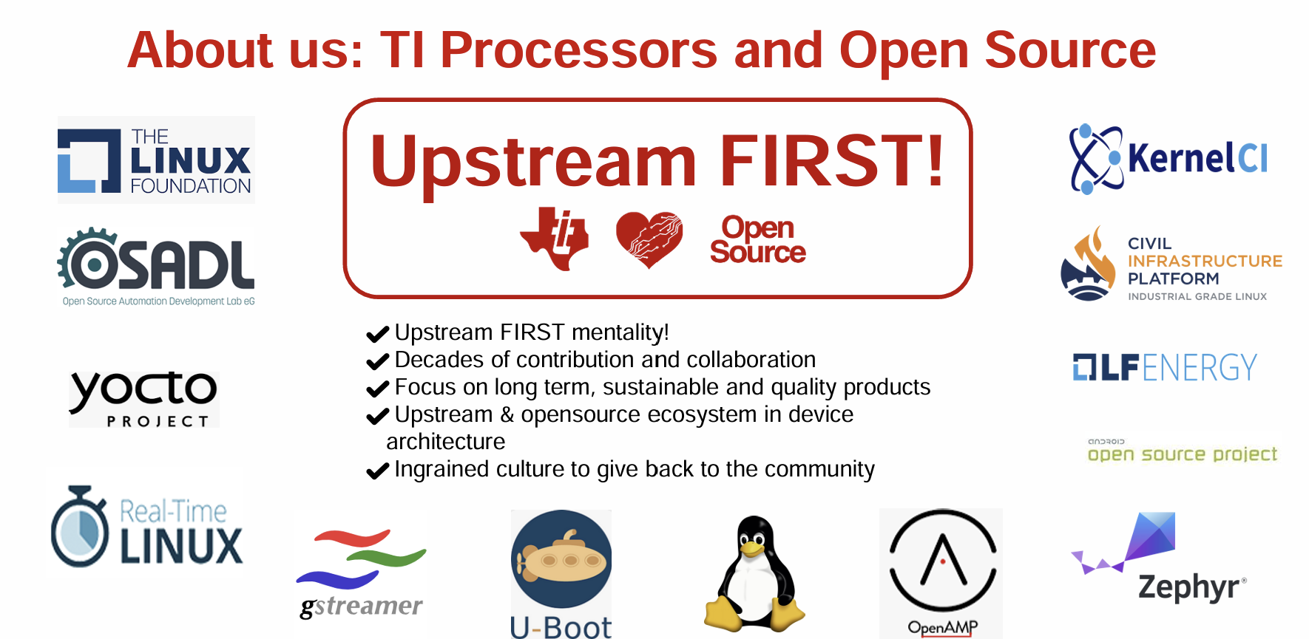

Slide 3
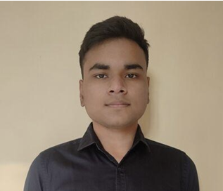
Introduction to the Speakers
Beleswar Prasad Padhi, Senior Software Engineer at Texas Instruments
Beleswar is a Senior Software Engineer at Texas Instruments, actively working on Upstream Linux Kernel and U-Boot. His work mainly focuses on Remoteproc, RPMsg, Mailbox, Virtio subsystems, as well as boot-time optimizations. He was listed among the top contributors for Linux 6.18 LTS release. He is a FOSS Enthusiast and has contributed to several Open Source projects like Linux, U-Boot, ZephyrRTOS, Vim, Armbian, Metasploit and Mandiant. He was a mentee under Google Summer of Code program twice.

Slide 4
Overview
Problem Statement
Primer on RPMsg and VirtIO
  Channel vs Endpoint
  Static and Dynamic Channels/Endpoints
Design Principles
Comparison with VirtIO
  Latency
  Resource usage
  Usecase suitability
Challenges
Upstreaming Lessons

Slide 5
Problem Statement
Peripheral sharing is becoming more important in Heterogenous SoCs
Automotive use cases
  Safety oriented: Require to run on safety core
  Time critical: Require to run on real-time core
  Complex: 3D surround view, EdgeAI can not be run standalone from a single core
Increasing need of driving the same peripheral by a safety component and a non safety component

Slide 6
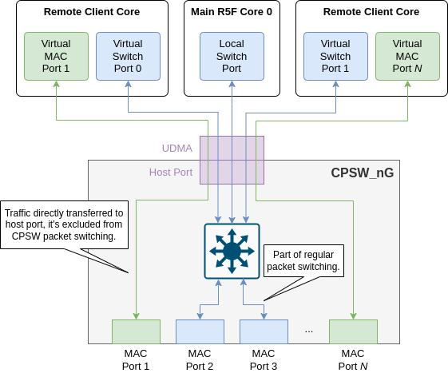
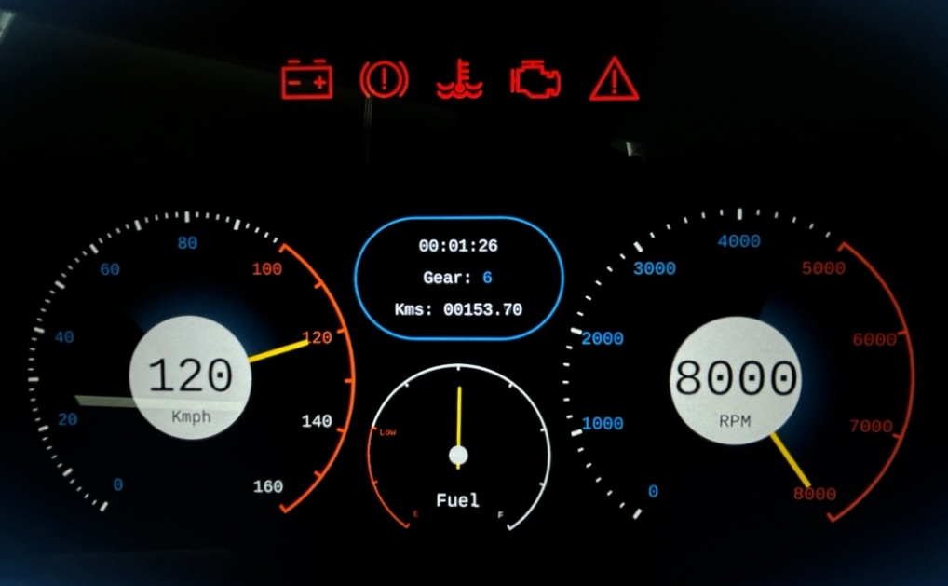
Problem Statement
Fig.2: Automotive cluster tell-tales
Fig.1: Ethernet traffic tunelling

Slide 7
Problem Statement
Peripheral sharing is becoming more important in Heterogenous SoCs
Automotive use cases
  Safety oriented: Require to run on safety core
  Time critical: Require to run on real-time core
  Complex: 3D surround view, EdgeAI can not be run standalone from a single core
Increasing need of driving the same peripheral by a safety component and a non safety component
How can this be enabled in an efficient way ensuring synchronization, promising throughput and error handling?

Slide 8
Solutions for Peripheral Sharing
Build Virtual drivers with a communication mechanism between Heterogeneous cores
Backend transport mechanism can be via VirtIO or RPMsg
What is VirtIO?
  Raw & efficient transport mechanism to move data from point A to point B
  Works with (atleast) a pair of virtqueues in shared memory, TX and RX VRINGs
  Data buffer sizes can be as huge as 2¹⁶ bytes
  Cannot differentiate between multiple services
  Requires separate set of VRINGs for each service/device

Slide 9
Solutions for Peripheral Sharing
Build Virtual drivers with a communication mechanism between Heterogeneous cores
Backend transport mechanism can be via VirtIO or RPMsg
What is RPMsg?
  Protocol layer built on top of VirtIO for IPC in AMP systems
  Appends a metadata to each message to achieve multiplexing
  Data buffer sizes are fixed to 512 bytes by design
  Can differentiate between multiple services over the single set of VRINGs

Slide 10
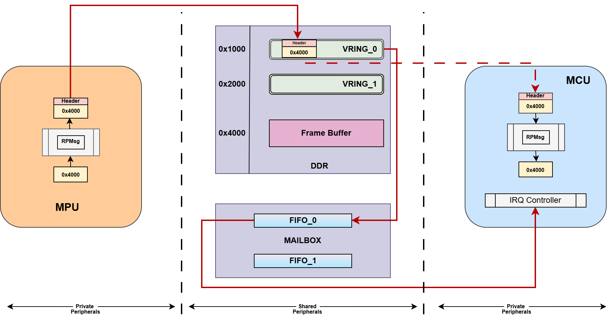
Solutions for Peripheral Sharing | RPMsg
Fig.3: Data flow with RPMsg from MPU to MCU

Slide 11
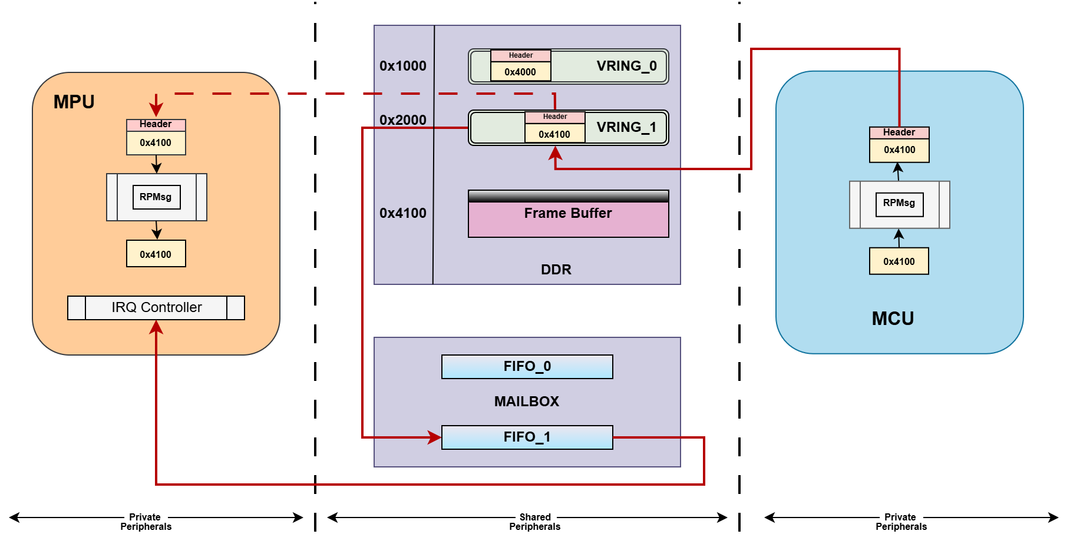
Solutions for Peripheral Sharing | RPMsg
Fig.4: Data flow with RPMsg from MCU to MPU

Slide 12
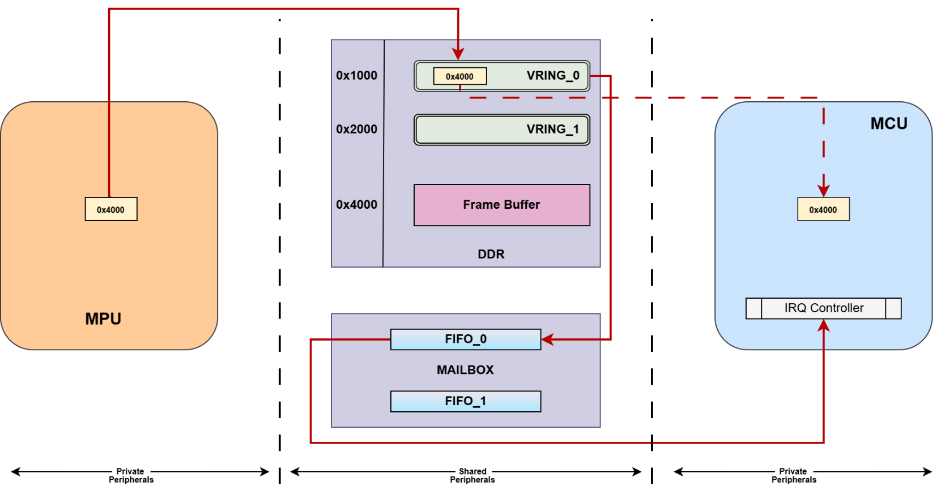
Solutions for Peripheral Sharing | Virtio
Fig.5: Data flow with Virtio from MCU to MPU

Slide 13
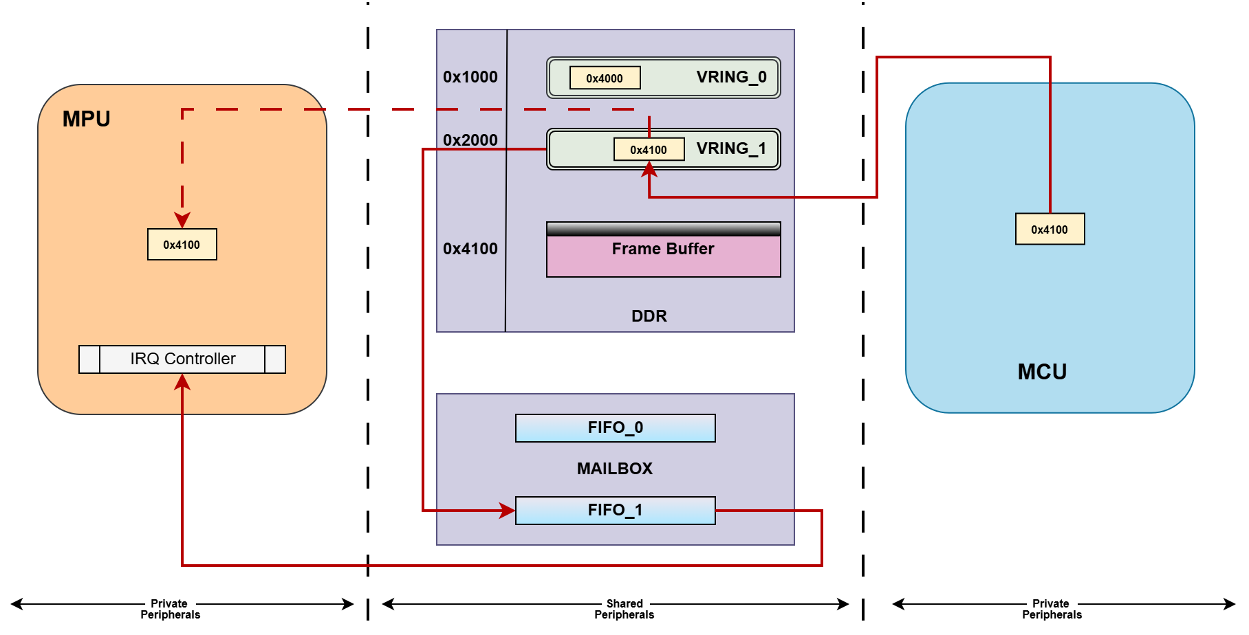
Solutions for Peripheral Sharing | Virtio
Fig.6: Data flow with Virtio from MPU to MCU

Slide 14
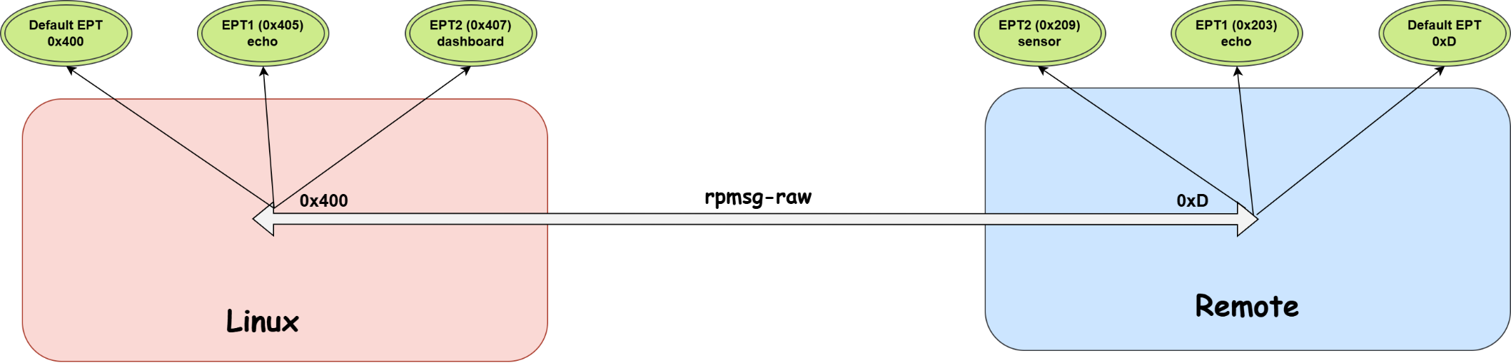
RPMsg Channel vs Endpoint
Channel is the logical link between two communicating entities
Endpoint is the final port through which data transfers happen
Each endpoint is assigned a unique address and bound to a callback function
Fig. 7: RPMsg channels and endpoints

Slide 15
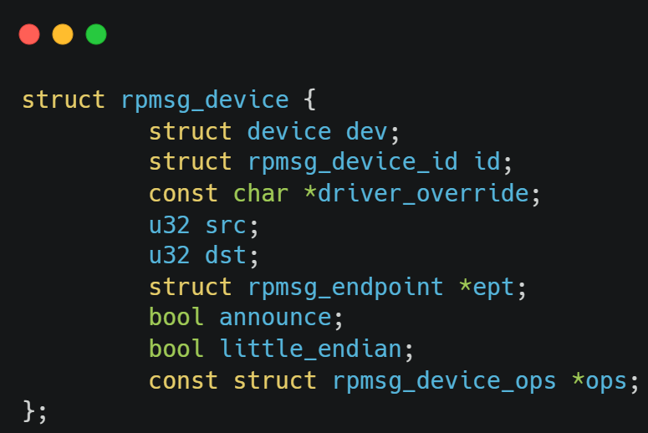
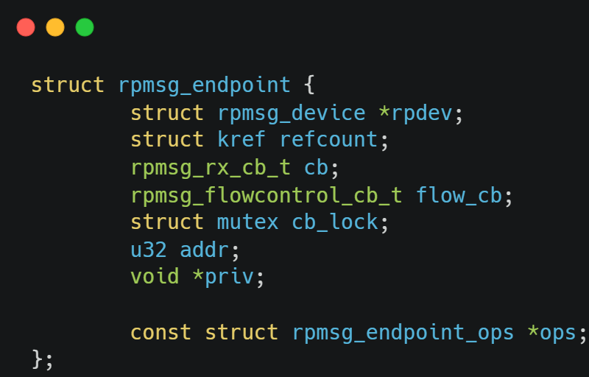
RPMsg Channel vs Endpoint
Fig. 8: Data Structure of RPMsg channel
Fig. 9: Data Structure of RPMsg endpoint

Slide 16
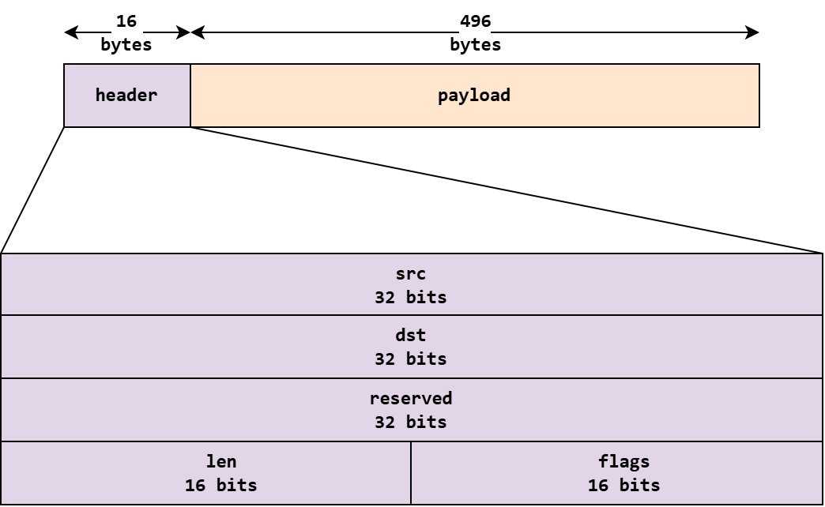
RPMsg Packet layout
Fig. 10: RPMsg Packet layout

Slide 17
Timing Diagram

Slide 18
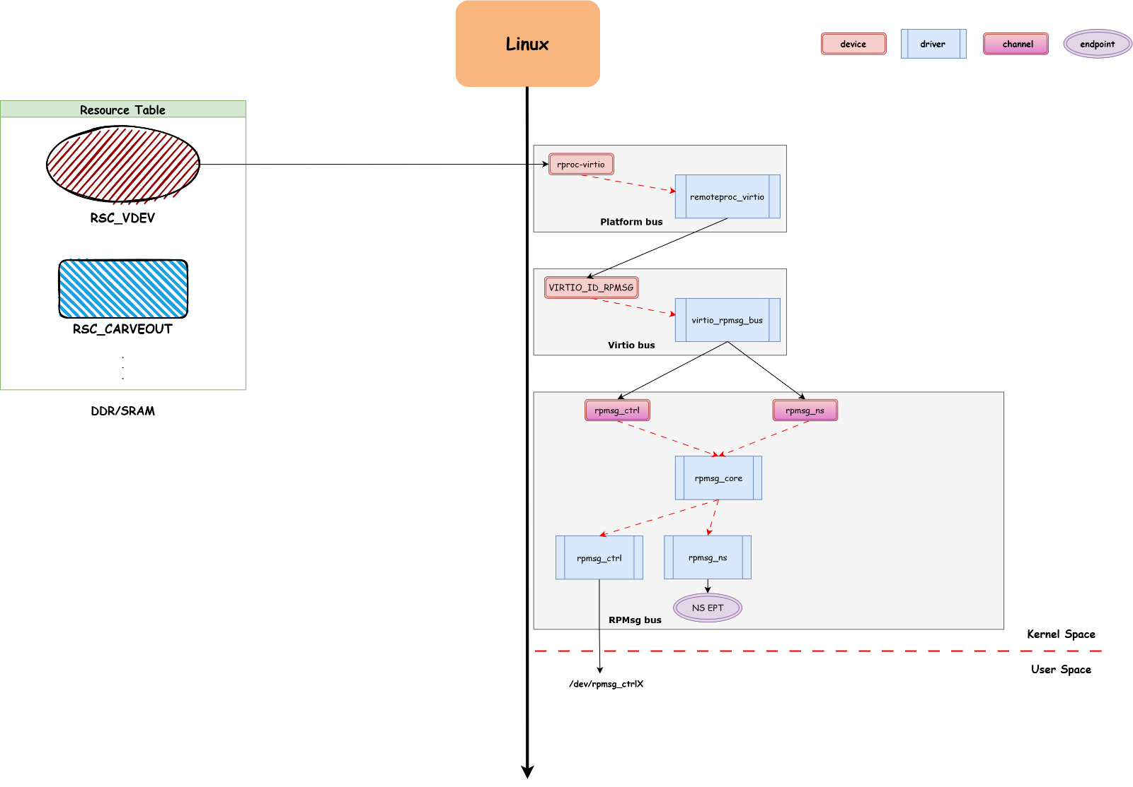
remoteproc_core
Fig. 11: Creation of static endpoints and channels from RSC table

Slide 19
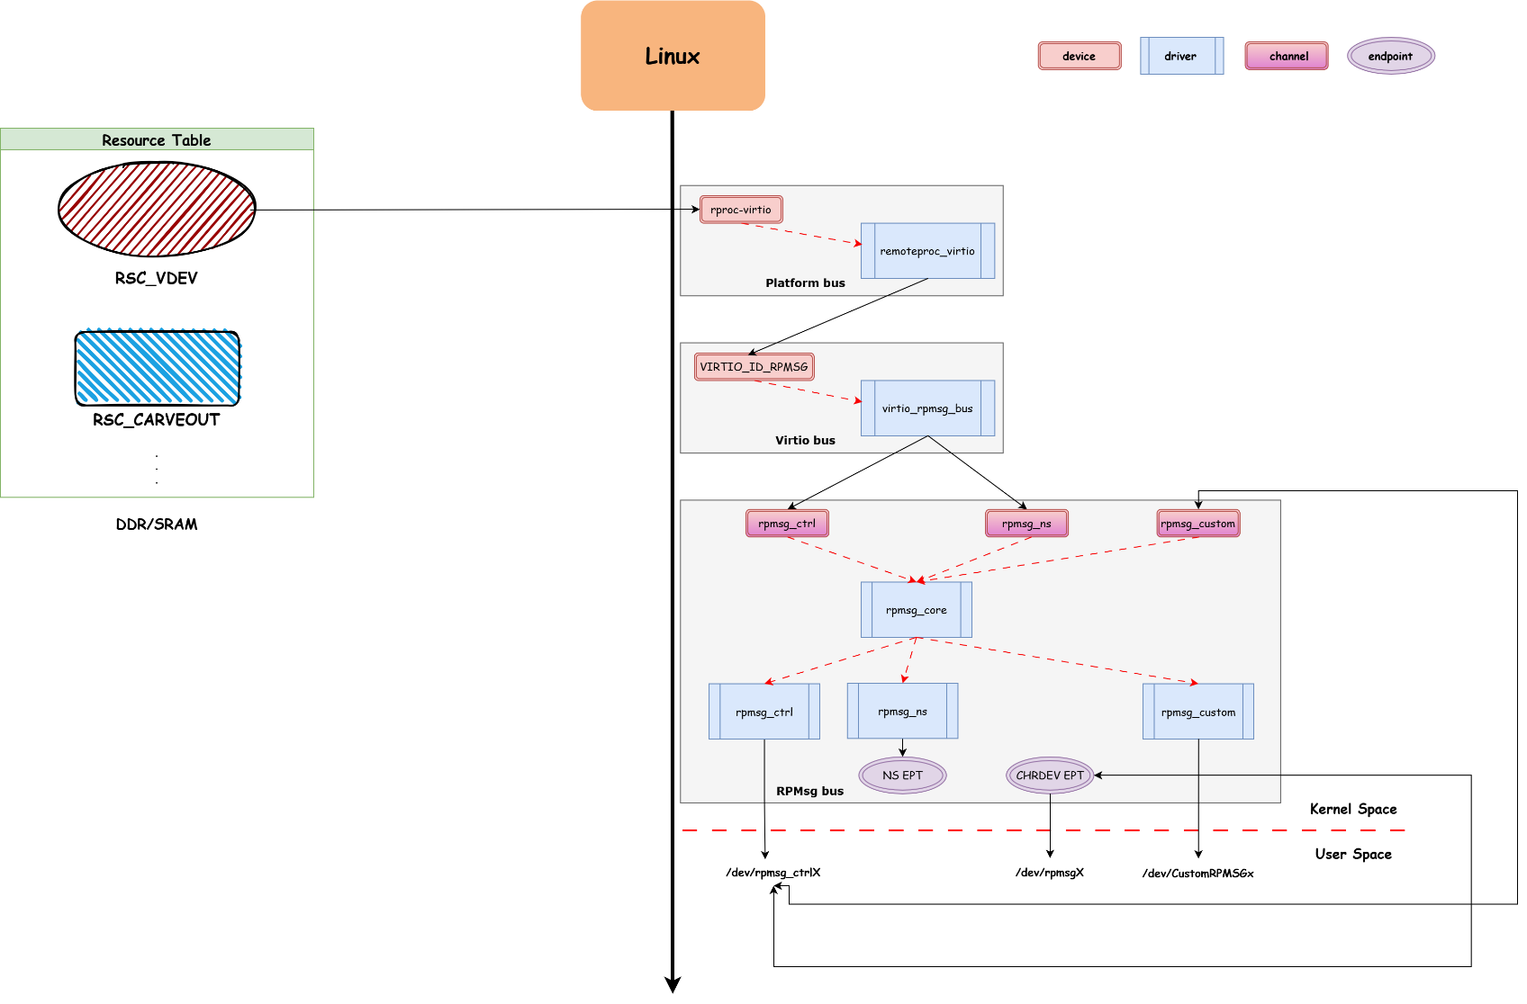
remoteproc_core
Fig. 12: Creation of endpoints and channels from userspace

Slide 20
remoteproc_core
Fig. 13: Creation of static endpoints and channels from RSC table

Slide 21
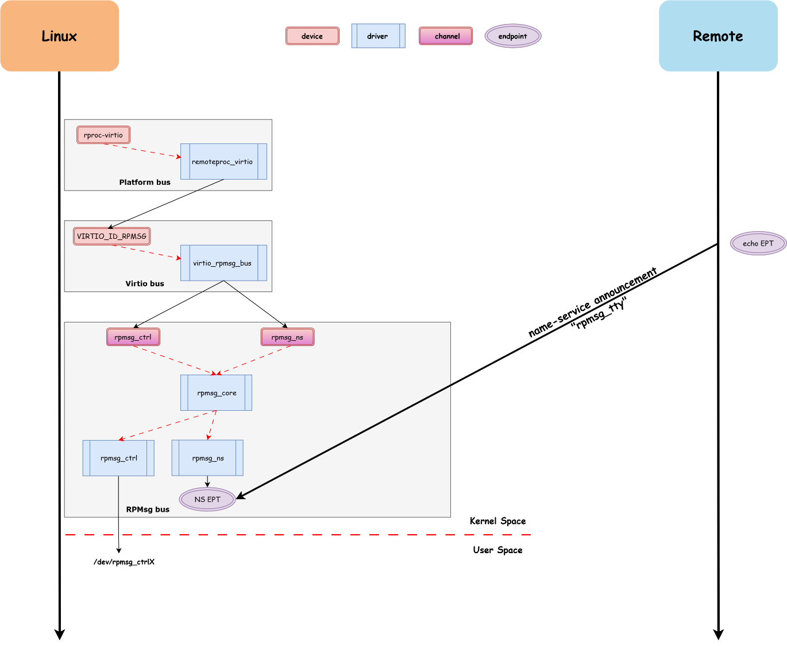
Fig. 14: Remote processor announcing RPMsg channel

Slide 22

Fig. 15: rpmsg_ns creating RPMsg device

Slide 23

Fig. 16: rpmsg_core creating a default endpoint and binding the driver

Slide 24
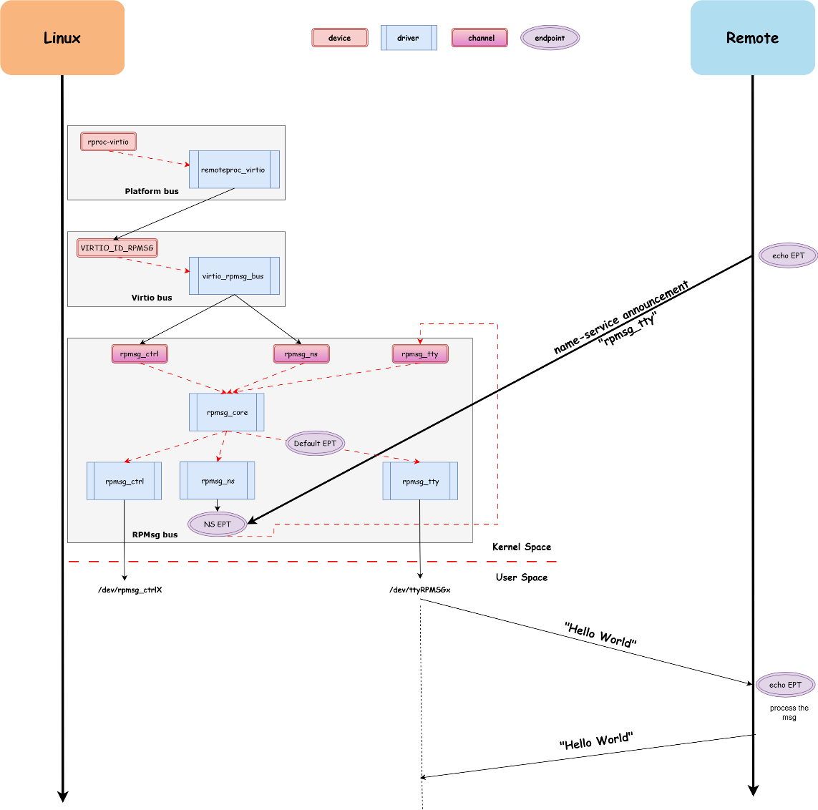
Fig. 17: IPC through virtual device exposed to userspace

Slide 25
Static & Dynamic Endpoints/Channels
Dynamic Endpoints
  Created at runtime
  Dynamic address allocation
  Pass RPMSG_ADDR_ANY flag while creating ept
  Ex: Default ept of RPMsg channel,
  epts created through rpmsg_ctrl device
Static Endpoints
  Hardcoded in source
  Fixed address allocation
  Pass u32 addr while creating ept
  Ex: Name service reserved ept (53)
Dynamic Channel
  Announced at runtime
  Dynamic address allocation
  Ex: rpmsg-tty, channels created through rpmsg_ctrl device
Static Channel
  Hardcoded in source
  Fixed address allocation
  Ex: rpmsg_ctrl, rpmsg_ns

Slide 26
Design Principles

Slide 27
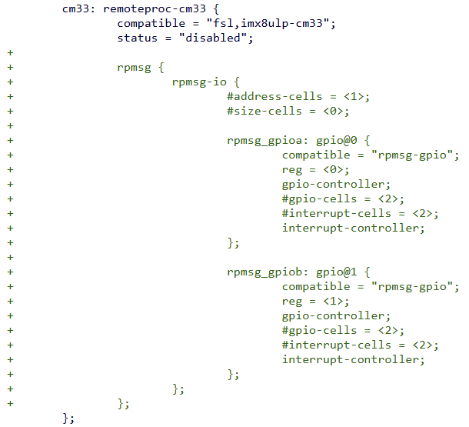
Design Principles #1 | DT Enumeration
Only needed so other nodes can take a reference
Do not enumerate devices in DT if the peripheral
is not a provider (e.g. serial)
  This allows to make the name service
  completely dynamic
For provider devices (e.g. gpio, i2c), create
a topology of rpmsg -> channel -> devices
under remote processor node
Fig. 18: Devicetree topology for provider peripherals

Slide 28
Design Principles #2 | Decouple Remoteproc from RPMsg
remoteproc -> should only be responsible to power on the remote processor
Should not have any knowledge of the services offered by the remote processor
Don’ts
Do’s
Peripheral specific initialization in remoteproc
Registering remoteproc in the rpmsg bus and the actual rpmsg driver in the platform bus
Binding application running on the remote processor to the remoteproc driver
Forces to make the remoteproc driver as a “server” of all its bound rpmsg drivers
Model everything in individual RPMsg drivers
Remoteproc driver has no knowledge of
services offered by application

Slide 29
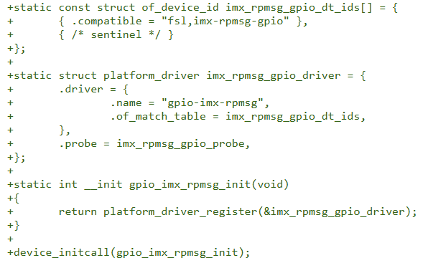
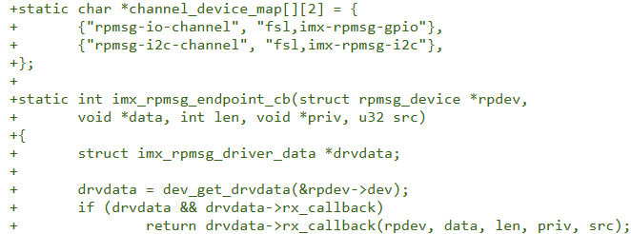
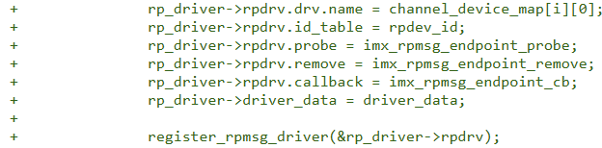
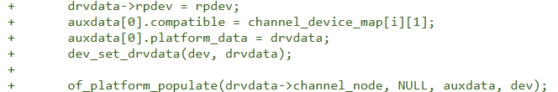
Design Principles #2 | Decouple Remoteproc from RPMsg
Example of bad design:
Fig. 19: rpmsg-gpio driver registered on the platform bus
Fig. 20: remoteproc driver registered on the rpmsg bus

Slide 30
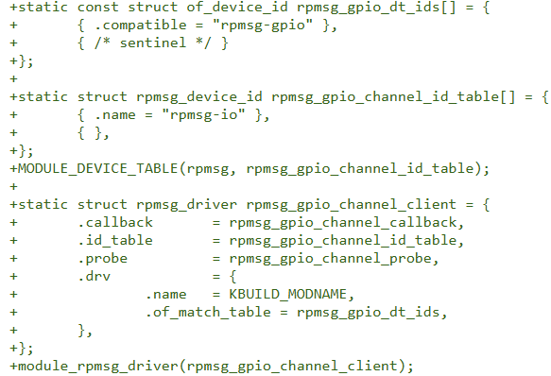
Design Principles #2 | Decouple Remoteproc from RPMsg
Example of good design:
Nothing in remoteproc
Fig. 21: rpmsg-gpio driver registered on the rpmsg bus

Slide 31
Design Principles #3 | Channels
Don’ts
Do’s
Announcing a single name service for all types of peripherals controlled by remote processor. Ex- rpmsg-remoteproc
Tight coupling of services offered by remoteproc
Forces to maintain redundant info in message payload: msg_type
Announce a name service for each device type supported. Ex-
  rpmsg-gpio
  rpmsg-tty
  rpmsg-i2c
Loosely coupled system
Allows lifecycle of each device type to be controlled independently

Slide 32
Design Principles #4 | Endpoints
Don’ts
Do’s
Having a single endpoint for multiple instances of the same device
Forces to maintain redundant info in message payload: device index
Forces to maintain redundant info in internal driver structures: map of instance index to per device pointer
Forces to maintain separate IDR in driver for indexes
One dedicated endpoint per device instance
Endpoint address can be re-used as device index
Firmware can announce new channel request per device instance as a default endpoint gets created per request:
  rpmsg-tty1
  rpmsg-tty2

Slide 33
Design Principles #4 | Endpoints
How does multiple name service announcements work?
  rpmsg bus does not allow the creation of duplicate name-service
  Traditionally, firmware needs to announce “rpmsg-tty1”, “rpmsg-tty2”
  Which can lead to hardcodings in Linux driver
diff --git a/drivers/tty/rpmsg_tty.c b/drivers/tty/rpmsg_tty.c
index c5fd6d9b380fc..9513b71b95c6b 100644
--- a/drivers/tty/rpmsg_tty.c
+++ b/drivers/tty/rpmsg_tty.c
@@ -215,7 +215,9 @@ static void rpmsg_tty_remove(struct rpmsg_device *rpdev)
}
static struct rpmsg_device_id rpmsg_driver_tty_id_table[] = {
- { .name = "rpmsg-tty" },
+ { .name = "rpmsg-tty0" },
+ { .name = "rpmsg-tty1" },
+ { .name = "rpmsg-tty2" },
{ },
};
Fig. 22: Traditional way of channel enumeration in rpmsg driver

Slide 34
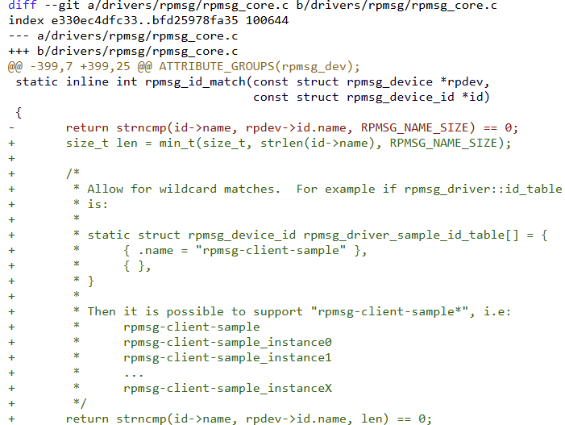
Design Principles #4 | Endpoints
How does multiple name service announcements work?
  Ongoing discussions to introduce
  wildcard matching for name service
  Allows to match any instance of the name
  service without driver hard-codings
Fig. 23: Patch showing wildcard name service matching

Slide 35
Design Principles #5 | Send Function
Send Functions can be invoked in interrupt context and time-sensitive paths
Don’ts
Do’s
Using rpmsg_send() functions
Blocking call which can wait upto 15s for a TX buffer
Using rpmsg_trysend() functions
Non blocking call, returns immediately with error

Slide 36
Design Principles #6 | Receive Function
The rpmsg receive callback function is invoked in interrupt context
As soon as this function returns, the sent buffer is recycled and ready to be used again for TX/RX
Don’ts
Do’s
Storing a pointer to received message and waking up sleeping task and returning from cb()
Doing entire processing in this function.
memcpy the received buffer into a local var and wake up the sleeping thread with pointer to the local var.

Slide 37
Design Principles #7 | Synchronization
RPMsg packets can arrive out of order at destination due to various reasons like
  Availability of virtqueue
  Roundtrip message latency
  Task wakeup time etc.
Without synchronization, it is possible a dependent message gets processed before its parent message leading to wrong programming.
2 ways to implement that:
  Maintaining seq numbers in the payloads
  Acquiring a lock before sending a message and releasing it after receiving &
  Acquiring a lock before processing a message in rpmsg_cb and releasing it after processing

Slide 38
Design Principles #7 | Synchronization
Example scenario without locking:
  T1: rpmsg_send()
  T1: virtqueue_get_buf()
    T2: rpmsg_send()
    T2: virtqueue_get_buf()
    T2: virtqueue_add_outbuf() // Message is inserted in available queue
  T1: virtqueue_add_outbuf() // Message is inserted in available queue
  T1: virtqueue_kick()
    T2: virtqueue_kick()
T2’s message gets processed first at remote side which can lead to erroneous programming.

Slide 39
Design Principles #8 | Sharing Addresses OTW
Different processors may have different memory maps
Don’ts
Do’s
Sending Physical Addresses over the wire
Can be sniffed to leak Physical Addresses
Remote processor is not to be trusted to access all the DDR
Sending Device Addresses over the wire
Remoteproc framework has helpers to convert DA to VA and vice versa
Ensures each processing entity receives addresses corresponding to its own memory map

Slide 40
Design Principles #9 | Re-using virtio design
A virtio counterpart already exists for almost all of the peripherals
Don’ts
Do’s
Re-invent new stuff in RPMsg-based design
Adopt almost everything from virtio counterpart, including message and error formats
Keeps the maintenance relatively easier

Slide 41
Design Principles #10 | Logging
Incase the remote processor crashes, printing error messages can cause lot of prints
Don’ts
Do’s
Excessive logging (like msg drop)
Using dev_info(), dev_dbg() versions
Risk of DoS and log flooding
Logging only necessary events
Using the ratelimited() version for logging to avoid printing same thing and filling the kernel buffer.

Slide 42
Comparative Study with VirtIO | Application
rpmsg-tty was already upstreamed in both Linux and Zephyr
virtio_console driver interface was available in Linux, but not in Zephyr
Implemented a virtio_console device interface in Zephyr:
  Registers VIRTIO_ID_RPROC_SERIAL VDEV in resource table
  16 descriptors per VRING
  Receive a msg from Linux, memcpy into TX Vring and echo back.

Slide 43
Comparative Study with VirtIO | Tracing latencies
Platform: TI AM62x SK running Zephyr on Cortex M4
Kernel space:
  Get timestamp in rpmsg/virtio_send() function after doing copy_from_user()
  Get timestamp in rpmsg_recv_single()
  Calculate difference and expose to userspace
User space:
  Open the console port device for read and write
  Write 1000 messages to fd
  Read fd and validate echo responses of all 1000 messages
Ensures we are capturing only the roundtrip latency for message transmission

Slide 44
Comparative Study with VirtIO | Latencies
Roundtrip latency in µS
Message size in Bytes
Trend: virtio-console is almost constant, overhead is memcpy

Slide 45
Comparative Study with VirtIO | Latencies
Roundtrip latency in µS
Message size in Bytes
Trend: rpmsg-tty grows linearly with msg size

Slide 46
Comparative Study with VirtIO | Latencies
Roundtrip latency in µS
Message size in Bytes
Fig. 25: Chart showing virtio vs rpmsg latencies

Slide 47
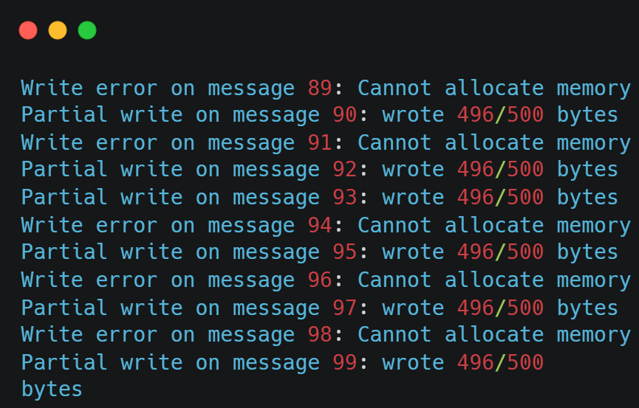
Comparative Study with VirtIO | Starvation in RPMsg
RPMsg can introduce a risk of starvation incase of heavy traffic flow
Bottleneck = fragmentation of descriptor due to small size (512 bytes)
Fig. 26: Logs showing no available buffer for TX

Slide 48
Comparative Study with VirtIO | Resources
Virtio requires atleast a pair of VRINGS per device instance
  Can be more depending on the specific virtio implementation
  The VRINGs can not be re-used for other devices and must be dedicated to a singe instance
Virtio requires a dedicated mailbox instance as well for each device instance
RPMsg consumes less resources and provides multiplexing
RPMsg always requires only a single pair of VRINGs and a single mailbox instance regardless of the number of device instances it services

Slide 49
Comparative Study with VirtIO | Trade-offs
Trade-offs | Virtio | RPMsg
Speed | Faster | Slower
Throughput | High | Less
Memory | High | Less
Starvation | Unlikely | Possible

Slide 50
Comparative Study with VirtIO | When to use what?
Higher performance? -> Virtio
Low latency requirement? -> Virtio
Robustness? -> Virtio
No memory constraint? -> Virtio
Maintainability? -> Virtio
Re-usability? -> Virtio
Low memory constraint? -> RPMsg
Single remote processor servicing multiple other things? -> RPMsg

Slide 51
Challenges #1 | Service dormant until remoteproc
The name service is only announced by the remote processor when the IPC stack has been setup by Linux:
  Registering the VIRTIO_RPMSG device
  Allocating the VRINGs
  Pre-filling half of the descriptors for RX VRING so remote processor can send messages
This can be a blocker for Early Boot requirements:
  Early Ethernet
  Early Splash
“Early Boot & Late Attach” can help here, but the service has to be driven by remote processor

Slide 52
Challenges #2 | Static Configuration for providers
Defining RPMsg nodes in DT makes it a static configuration, tightly coupling Linux with that specific firmware.
What happens if the remote processor is brought down?
Or decide to run another firmware from userspace which does not advertise this service?
At the same time, we do need this supplier device to be available in DT so that it can be referenced by other consumer nodes. Circular problem?

Slide 53
Upstreaming Lessons
Evaluate virtio-interface for the usecase with latency and memory constraints
If RPMsg interface is really needed:
  Submit an RFC first with Upstream Linux
  Expect firmware rework
  Propose vendor-agnostic generic drivers!
  Implies less places to fix bugs
  Easier to maintain in long-term than maintaining individual drivers

Slide 54
Improvements
Explore the usage of chained descriptors in RPMsg
Instead of returning 512 as the MTU, allow chaining multiple descriptors next to each other.
This allows to transfer larger memory buffers upto 2¹⁶ (64KiB) size
Explore configuring the size of RPMsg packets, currently hardcoded to 512 Bytes, can be increased?

Slide 55
References
rpmsg-gpio implementation - https://lore.kernel.org/all/20260422212849.1240591-4-shenwei.wang@nxp.com/
rpmsg-tty implementation - https://lore.kernel.org/all/20211008153446.23188-1-arnaud.pouliquen@foss.st.com/
rpmsg-net implementation - https://lore.kernel.org/all/20250911113612.2598643-1-danishanwar@ti.com/
rpmsg-char implementation - https://github.com/torvalds/linux/blob/master/drivers/rpmsg/rpmsg_char.c
virtio-console implementation - https://github.com/torvalds/linux/blob/master/drivers/char/virtio_console.c
Notes:
Inclusive terminology : review entire presentation.

Slide 56
Credits and Acknowledgement
Texas Instruments Inc.
The Linux Foundation.
Mathieu Poirier
Bjorn Andersson
Arnaud Pouliquen
Andrew Lunn
Shenwei Wang
Md Danish Anwar
Ravi Gunasekaran
Yojita Mallik

Slide 57

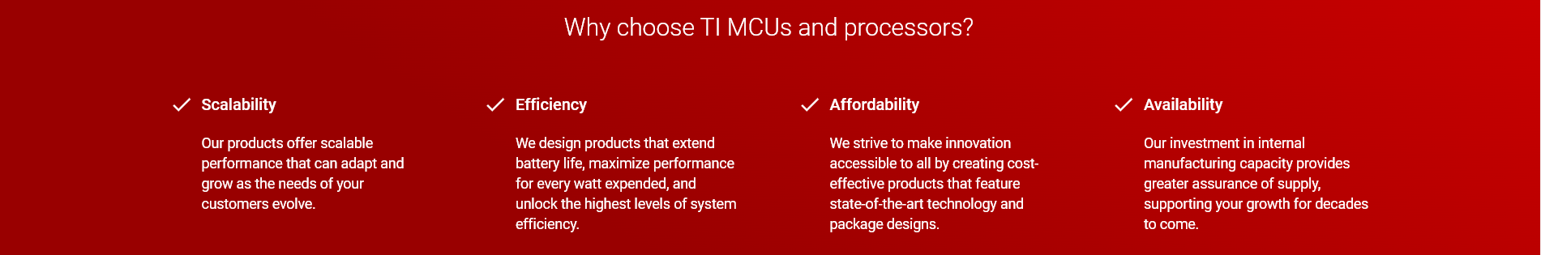
Q&A
Learn more about TI products
https://www.ti.com/linux
https://www.ti.com/processors
https://www.ti.com/edgeai
Contact Information:
  Beleswar Padhi <b-padhi@ti.com>
Also on IRC @ libera.chat #linux-ti

