Slide 1
Small Government
Big Problems
Utilizing Open Source to Serve our Citizens
Notes:
Basic intro, joke around, you know how this works. Set the tone.

Slide 2

Who am I?
Big Nerd
20+ years in Public Service
Never had a budget
1 man shop to ND Largest County
Notes:
Go over who you are, experience, etc. Set your bonafides.

Slide 3
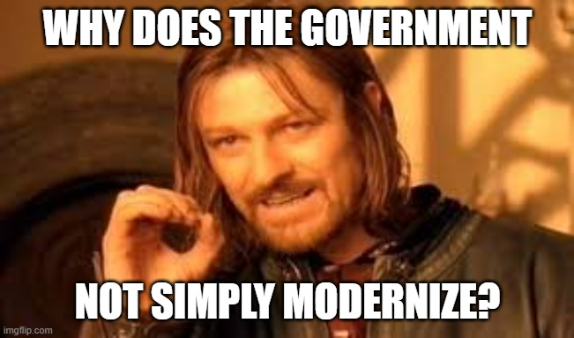
Notes:
IT isn’t just another customer. Frame the question on why. Focus on frustrations.

Slide 4
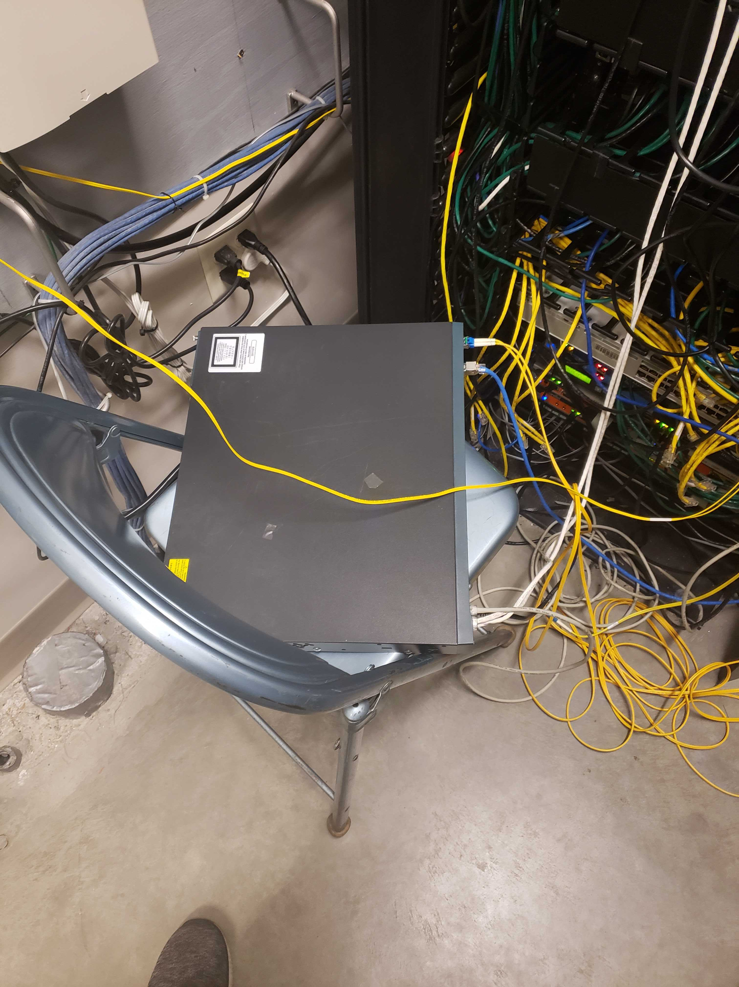
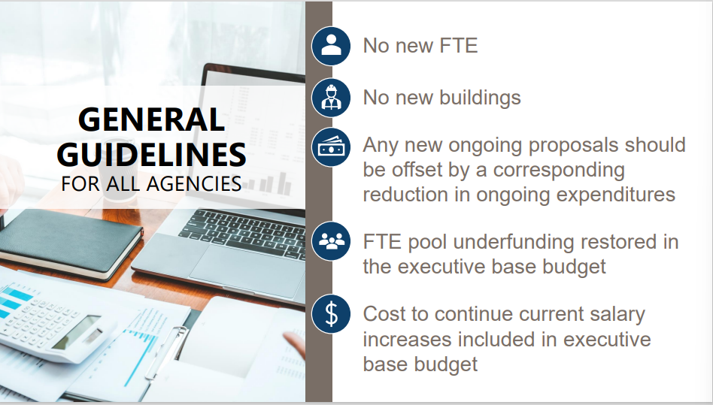
Notes:
Lets talk reality. Limited staff. Wide-spread systems geographically and performance. Public (no one wants to be in the paper). Downtime not an option/life safety. Tell switch story. Infra cannot fail with no margin for error (tax dollars)

Slide 5
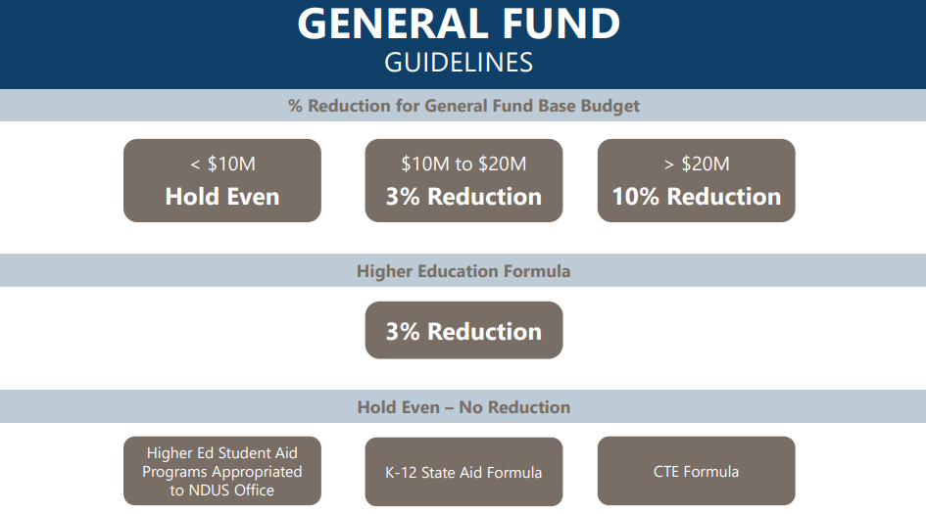
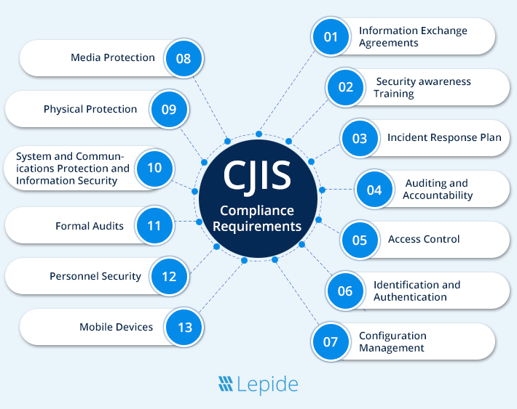
Notes:
Talk constraints. Budget. Political. Staffing. Compliance. Failure is public

Slide 6
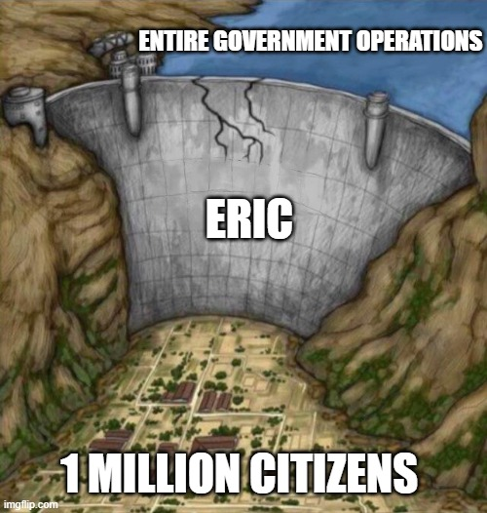
Can’t leave vendors
Can’t adapt systems
Can’t move quickly
Notes:
Everything is stable, until it’s not. Silos exist and are fiercely protected. No merit increases push lack of drive. Vendor lockin. Supportability. Lack of flexibility. Change is even more difficulty due to staff.

Slide 7

Time
Expertise
Specialization
Flexibility
Notes:
We don’t lack capacity. We lack excess capacity, and get around it by paying for the privilege. But this is a never ending cycle.
Assumptions slide

Slide 8

Expensive
Rigid
Lock-in
YoY Uplift
Notes:
Lock-in Lock-in Lock-in. Not a lot of competition in space. Very rigid, but bespoke coding available at cost. Scope set by others. Operational costs.
Vendor slide

Slide 9

Engineer Mindset
Documentation
Clear Support
Complexity
Notes:
Designed by engineers, for engineers. Lots of assumptions in documentation. Support is there, maybe. Options/modules/etc create complexity. No lock in.
Open Source Slide

Slide 10
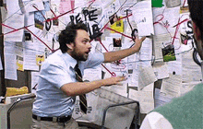
Can’t Change
Can’t Leave
Can’t Improve
Notes:
Chicken and egg problem. How, where, when, why.
Cycle of dependency.
Talk about what open source gives. Transparency and ability to be flexible, but not too flexible. Portable, open standards, collaborative development. Communication structures. Supportable. Transistion to control.

Slide 11

Notes:
Control is top tier. If we control it, we can adapt it. We can decide how resilient we need it. We can make sure it is sustainable from our resources. When we can understand it, support it, change it, develop it.

Slide 12

Notes:
Open source core. Share and share alike. Vendor support optional, but available. Outsource work, not outsource control. Collaboration at scale, as 1 county doesn’t need to recreate the wheel. Share tools, share improvements, share cost.
Not anti-vendor, anti-dependency.
“Government doesn’t need to solve the same problem thousands of times.
Open source is how that collaboration actually becomes real.”

Slide 13
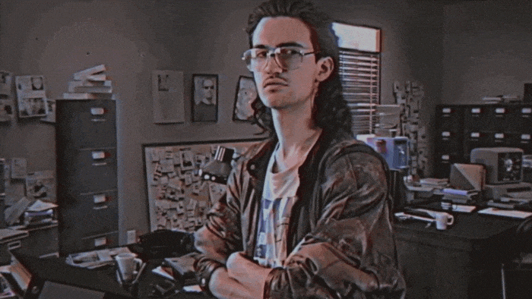
Notes:
Small teams, not highly experienced. Either rapid turnover, or no turnover. Incomplete knowledge.
Design for an everyman vs a specialist.

Slide 14
What’s worked?
Netbox
GLPI
Snipe-IT
CheckMK
Grafana
Prometheus
Keycloak
Docker Swarm
Oxidized
SSLH
Powershell
Python
Go
Nginx
Traefik
OPNSense
Proxmox
XCP-NG
TrueNas
OSTicket
Ollama
Ansible
Ceph
RustFS
PostFix
MatterMost
Nextcloud
Notes:
Go through real world examples. Don’t read the slide. People can read.
Talk Visibility. Getting actual data/metrics on things that matter leads to good decisions.
Monitoring is critical for the same, but can’t require constant tuning. Constant tuning isn’t helping, it’s adding one more thing. Alert fatigue, etc.
Identity is somewhere that many forget. SaaS is expensive, etc. Resiliency important.
Communications, support, etc. Hit the same options here.

Slide 15

Notes:
Every configuration option is a decision someone has to make under pressure, potentially without the info to make it.

Slide 16
Rules of Engagement
Reduce Decisions/Options
Opinionated Defaults
Excellent documentation
Design for turnover
Real support – as an option
Notes:
Go into each one, and why. Repeat playbook

Slide 17
FUD
Notes:
It’s not wrong. It’s just incomplete.
Support may or may not matter, depending on the team. Investing in practices, documentation, skills can make this a non-issue.
Security is relevant more than ever before. Discussion on how we need to make sure, through control, that we can take risks that are acceptable to us, and know how ot fix them if they aren’t.
Staffing is difficult regardless. We’re critically understaffed. Focus on the documentation, repairability, transparency, etc to allow staff to be familiar with it. Lack of lock in, etc.
“Tools should reduce cognitive load, not consume it.”
“If your system needs a full-time caretaker, that’s a staffing decision whether you admit it or not.”
“You don’t need more people to run simpler systems.”
“Every hidden process becomes a future outage.”
“The goal isn’t to do more with less. It’s to need less to operate.”
Support:
“Open source doesn’t remove support.
It gives you options.”
Security:
“Transparency doesn’t weaken security.
It strengthens it.”
Staffing:
“The question isn’t whether you have enough staff.
It’s whether your systems make them more effective.”

Slide 18

Notes:
Open source doesn’t solve bureaucracy. “Bureaucracy isn’t the problem. Fragile systems inside bureaucracy are the problem. Open source makes those systems inspectable, repeatable, and survivable.” bureaucratic systems more observable, more adaptable, and less dependent on external gatekeepers

Slide 19
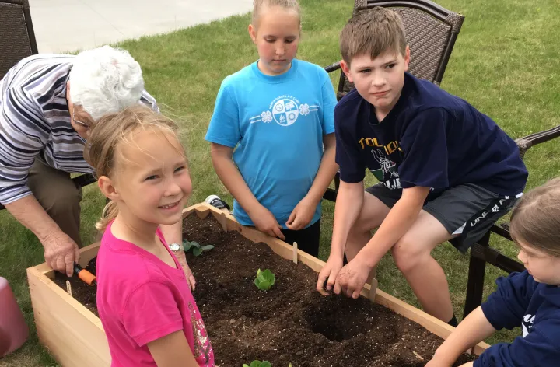

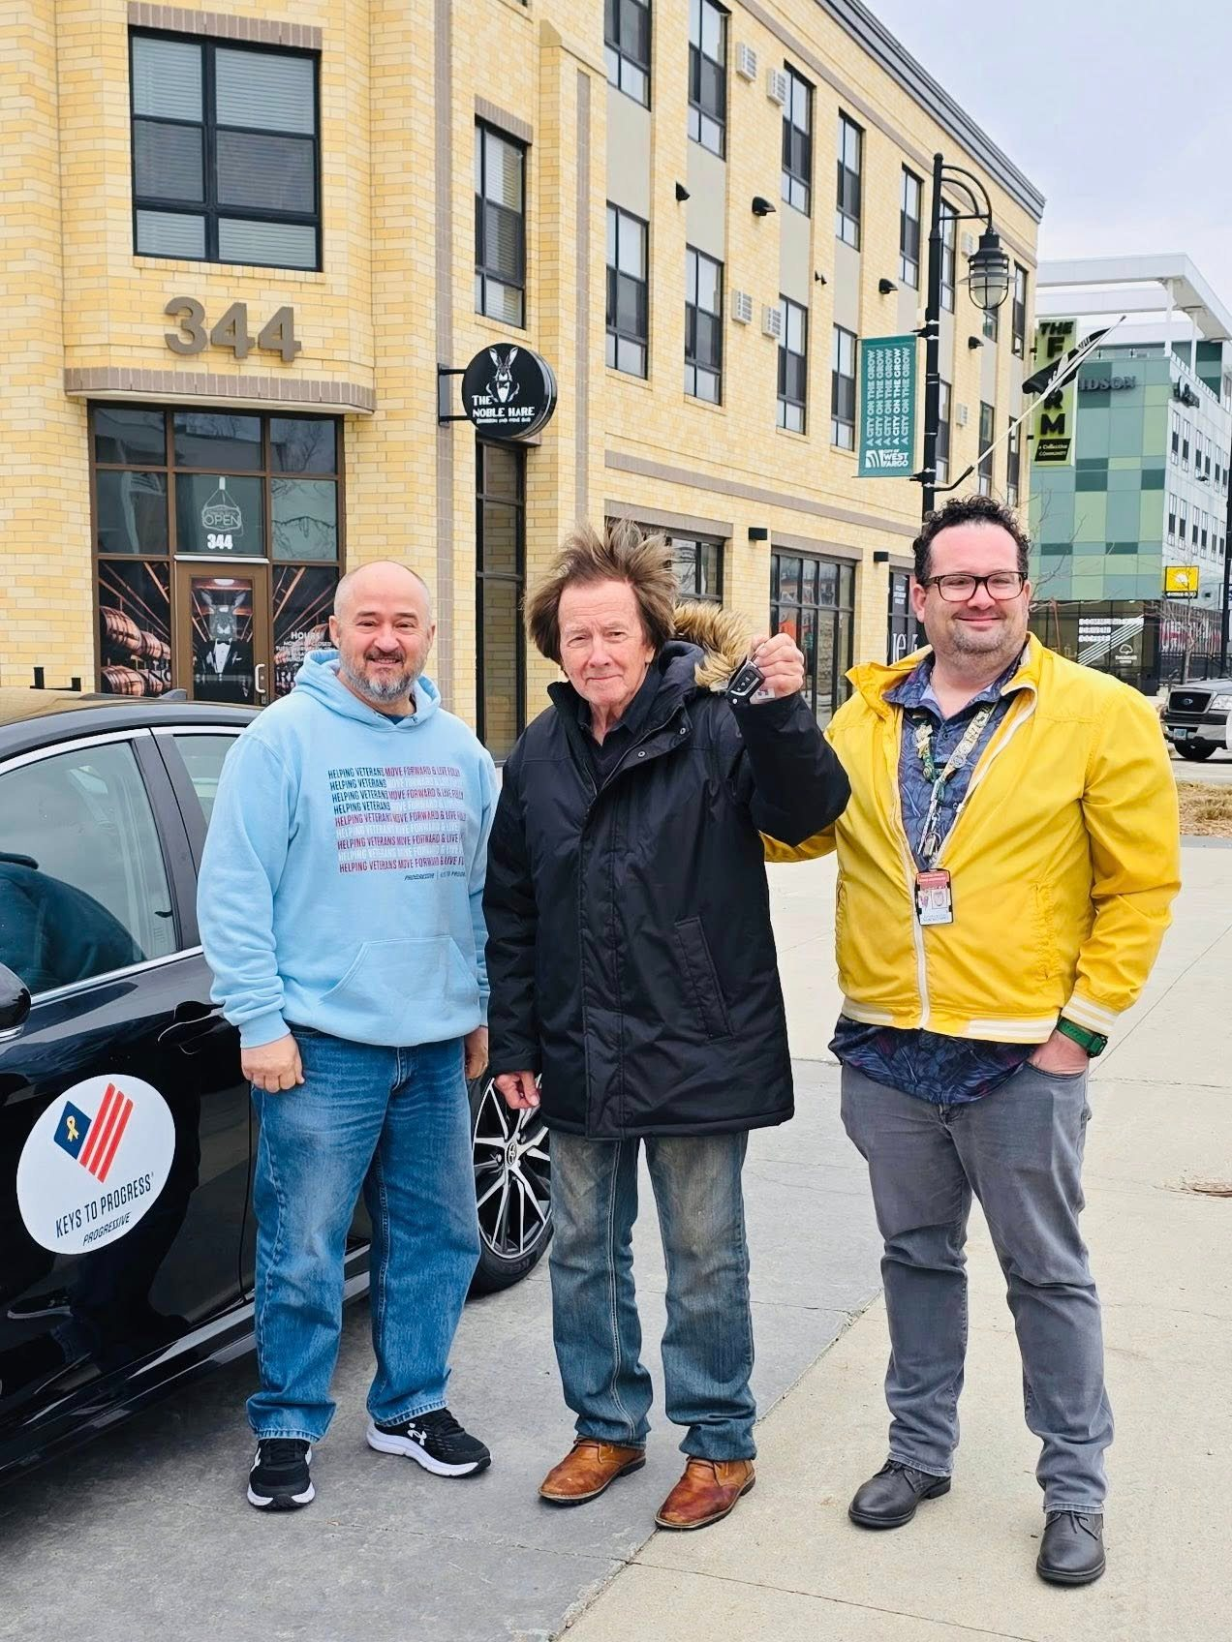
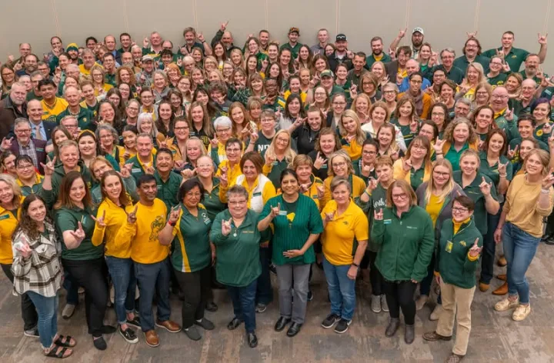
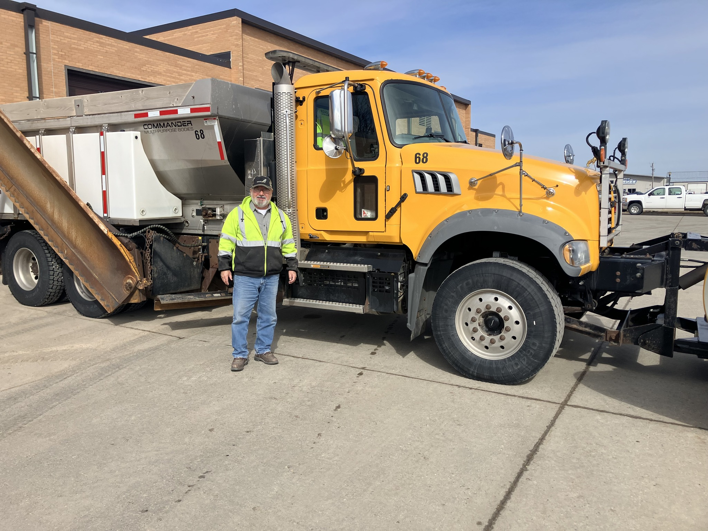
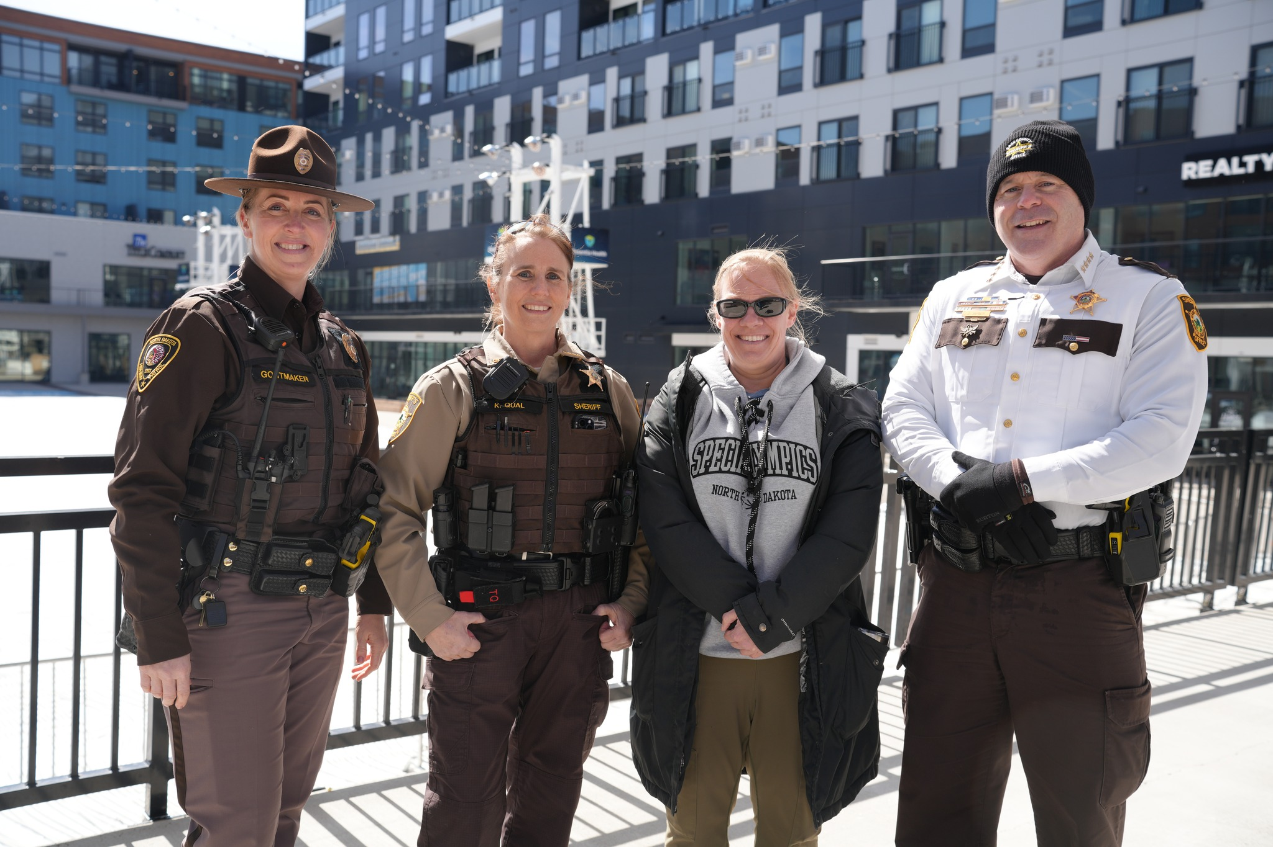
Notes:
Remember what we’re here for.
We don’t have small responsibilities. We’re delivering reliable, modern services with limited staff, budgets, no room for failure, in the public eye. For our citizens.
Open source isn’t a technical model. It’s a operating model.
When it happens, the outcome isn’t better IT.
It’s better service for our citizens, who depend on it for their day to day lives.

Slide 20

Contact
hendersonb@casscountynd.gov
701.241.5723
https://linkedin.com/in/bob-Henderson-fargo-moorhead/

