Slide 1


Untangling Secure Key Provisioning in U-Boot: Scalable eFuse Programming in Production
2026-05-20, Minneapolis
Harsha Vardhan V M
Kavitha Malarvizhi

Slide 2














About us: TI Processors and Open Source
Upstream FIRST!
Upstream FIRST mentality!
Decades of contribution and collaboration
Focus on long term, sustainable and quality products
Upstream & opensource ecosystem in device architecture
Ingrained culture to give back to the community

Slide 3

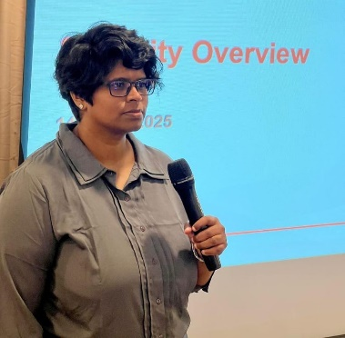
About Speakers
Security Software Engineer, Texas Instruments
Silicon root-of-trust configuration, cryptographic key management and lifecycle state enforcement
Harsha Vardhan V M
Security Architect, Texas Instruments
System Security, Secure boot, Cybersecurity
Kavitha Malarvizhi

Slide 4
Why eFuse Provisioning Matters
eFuse (Electronic Fuse) - a single non-volatile memory bit that can be blown only once.
The programming operation is irreversible.
eFuses control:
  various permanent configurations and data
  boot configurations, security settings, MAC addresses
  secure boot enablement, silicon identity, cryptographic keys
Factory provisioning of thousands of devices must be reliable and repeatable

Slide 5
How eFuses are Programmed today (in U-boot)
Low-level, command-driven interface
eFuses organized as:
Words - smallest group of efuses
Banks - smallest group of fuse words
eFuses accessed via: Bank + Word addressing
Programming flow:
fuse prog – mention exact location and value
Supports contiguous writes only
❗No structure, no flexible non-linear batching

Slide 6
U-Boot’s Existing Fuse Subsystem Commands
1. fuse read
- Read fuse words from shadow cache
2. fuse readm
- Read fuse words into memory
3. fuse sense
- Read fusebox directly (bypasses shadow cache)
4. fuse cmp
- Compares the fuse value to a hex value
5. fuse override
- Modify shadow cache (non-permanent)
6. fuse prog
- Permanently program fuse words (irreversible)

Slide 7

The Reality of Traditional eFuse Programming
Most teams use long, manual U-Boot fuse prog <bank> <word> <hexval> [<hexval>…] cmd sequences
Works for bring-up but breaks down in production
Typical pain points:
  Difficulty handling vendor-specific, non-linear fuse maps
  Repititive, manual cmd-by-cmd programming that doesn’t scale
  Increased risk of typing mistakes or sequence errors
  Hard to integrate into automated workflows

Slide 8
The Reality of Traditional eFuse Programming
Even a small OTP layout change -> rewrite entire command sequences
Example:
Risky and incompatible with factory automation tools
Programming a complex non-linear OTP region.
Run multiple fuse prog operations manually, in the right order & offsets
One mistake can:
  Lock a device prematurely
  Burn the wrong lifecycle state
  Misprogram a key region
  Leave secure boot half-enabled

Slide 9
Introducing Buffer-Based Fuse Programming – fuse writebuff
Program OTP fuses using a structured buffer in memory – fuse writebuff <addr>
Buffer containing all necessary details for programming fuses
High-level idea:
Construct a single buffer representing the OTP map
Load the buffer into memory
Let U-Boot program it
One command, deterministic result
Fuse writebuff upstreamed into U-boot in 2025 - https://docs.u-boot.org/en/latest/usage/cmd/fuse.html

Slide 10
From Imperative Commands -> Data-Driven Provisioning
❌ Imperative model (fuse prog):
  “How & What to program” encoded in commands
✅ Declarative model (fuse writebuff):
  “What to program” defined as structured data
  “Consistent mechanism” to apply across platforms
Enables:
  Batch programming
  Strict validation before execution
  Automation-friendly workflows
Changed the model and redesigned the abstraction

Slide 11
Towards Scalable, Production-Ready eFuse Provisioning
Solves several long-standing issues
Makes non-linear and change in OTP maps manageable
No command-scripting errors
Easy integration with flashing automation flows
Production Considerations
Version-control buffers
Validate buffer boundaries
Lock bits written last
Capture failures & fallback paths
Eliminates manual sequencing and misalignment
Reduces programming time
Enables reproducible provisioning across devices
Always verify after programming

Slide 12
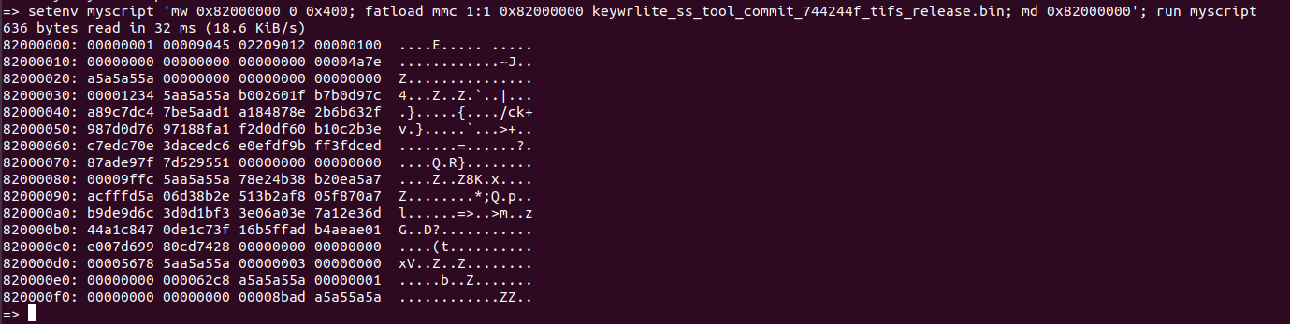

TI’s AM62L Processor Case Study
Step 1: Prepare the buffer and load into memory
Step 2: Program using fuse writebuff

Slide 13
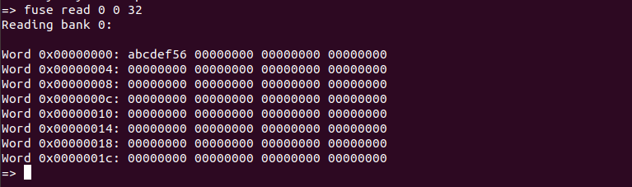
TI’s AM62L Processor Case Study
Secure boot enabled
Fuse read user readable OTP data

Slide 14

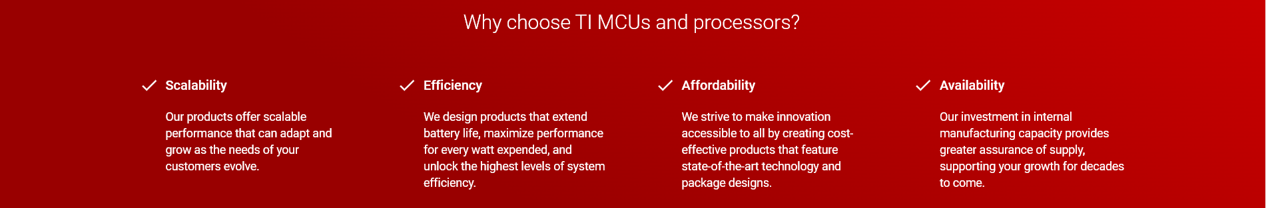
Q&A
Learn more about TI products
https://www.ti.com/linux
https://www.ti.com/processors
https://www.ti.com/edgeai
Contact Information:
  Harsha Vardhan V M <h-vm@ti.com>
  Kavitha Malarvizhi <k-malarvizhi@ti.com>
Also on IRC @ libera.chat #linux-ti

