Slide 1
AI in CI/CD Without the Hype
Practical Patterns for Platform Engineers
Jennifer Mulford, Okta

Slide 2
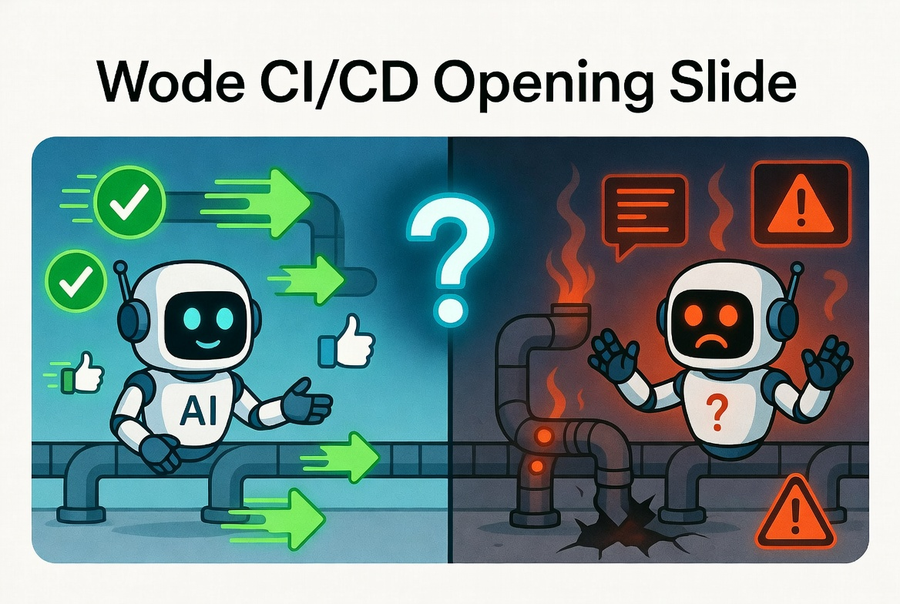
Notes:
Opening

Slide 3



Jennifer Mulford
Senior Software Engineer, Security Engineering
CISSP, CKA
11 years experience
  DevOps
  Platform Engineering
  Cloud Automation
  Security Engineering
Notes:
Intro

Slide 4

Meet your new team member!

Slide 5
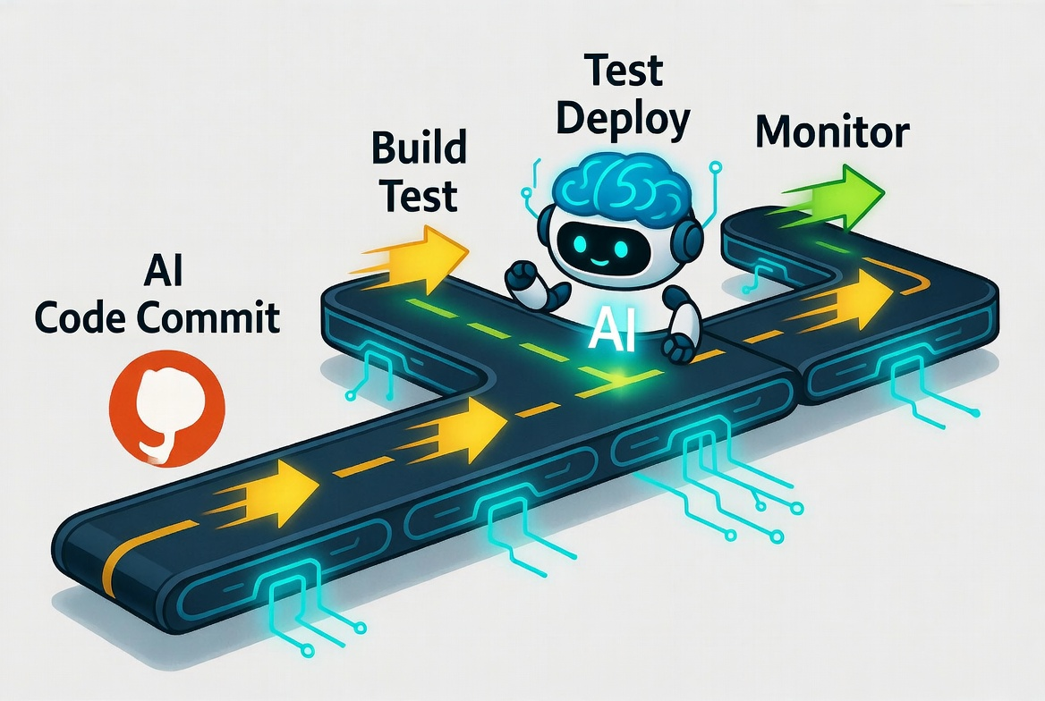
The Hype

Slide 6

What could possibly go wrong?

Slide 7


Slide 8
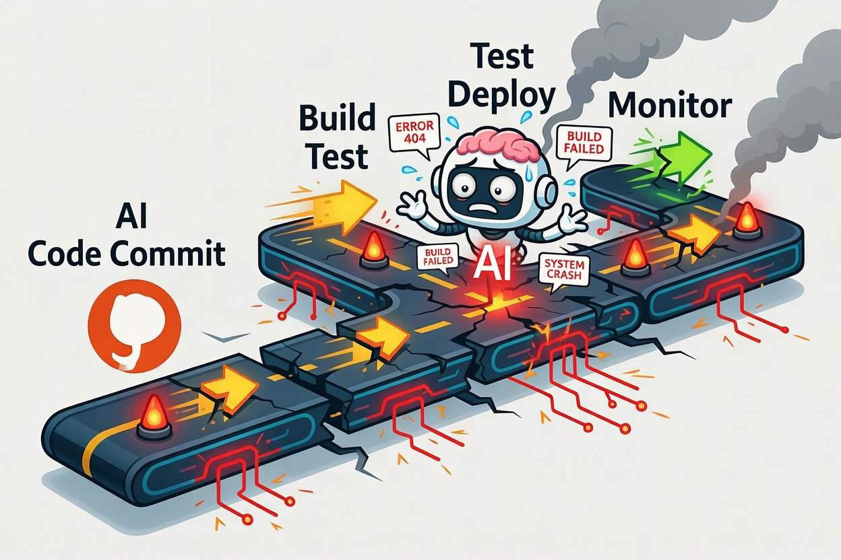

Slide 9
The Answer?
Monitor
Require Approvals
Guard Elevated Privileges
Implement Guardrails

Slide 10
🧠 Humans | 🤖 AI
Understand meaning and why something matters | Predicts the most likely next word or pattern
Learn from lived experience, emotions, and consequences | Learns from large datasets (no real-world experience)
Reason through new or ambiguous situations | Relies on pattern recognition; struggles outside training data
Have intent, goals, and ethical judgment | Has no intent—only generates outputs based on prompts
Can question, doubt, and apply judgment | Can confidently produce incorrect answers
Create with purpose and imagination | Recombines existing ideas (“remixes”)

Slide 11

The Copilot Model: AI Assists, Humans Decide

Slide 12

Pattern 1 — Pull Request Summaries and Testing
Pattern | Why It Works
Reads the diff and generates a summary | Faster understanding of changes
Reviewer reads and makes final decision | Human stays in control
Works well for large or async PRs | Saves significant time

Slide 13

Pattern 2 — Rubber Ducky
Pattern | Benefits
Primary AI generates code or summary | Fast initial output
Second AI reviews or questions code | Catches gaps
Output is surfaced to a human reviewer | Human stays in control

Slide 14

Pattern 3 — CI Failures
Pattern | Benefits
AI reads failed job logs | Turns noise into signal
AI returns root cause and solution | Time saved troubleshooting
Engineer reviews and investigates | Human stays in control

Slide 15

Pattern 4 — Security Signals
Pattern | Benefits
Analyzes findings from security scanners | Reduces noise from raw alerts
Flags likely false positives with reasoning | Cuts alert fatigue
Summarizes and groups related issues | Improves prioritization and duplicates

Slide 16
Important common traits
✅ Read-only access to pipeline context
✅ Output surfaces as information, not action
✅ Human gate before anything changes

Slide 17


Slide 18
All it Took, Was an npm Install

Slide 19
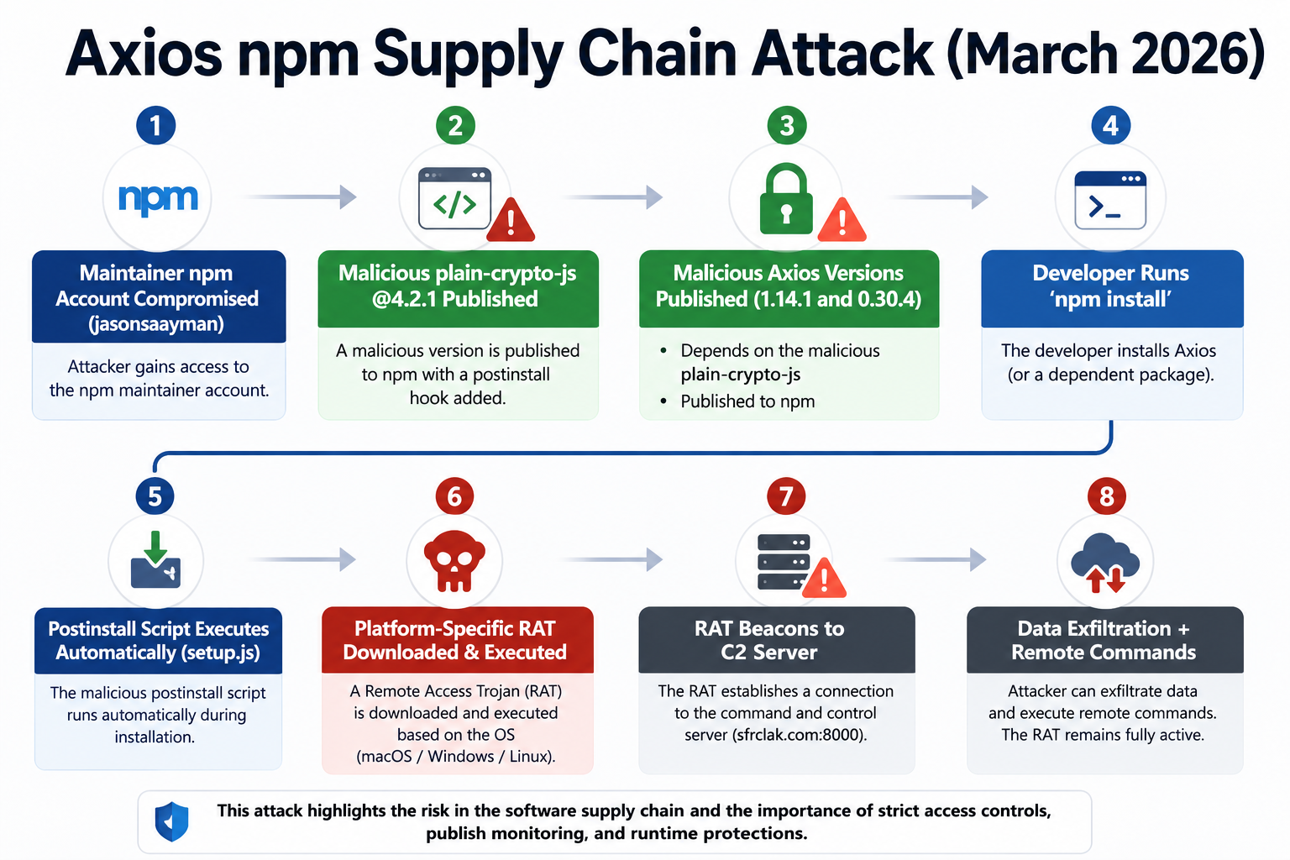

Slide 20
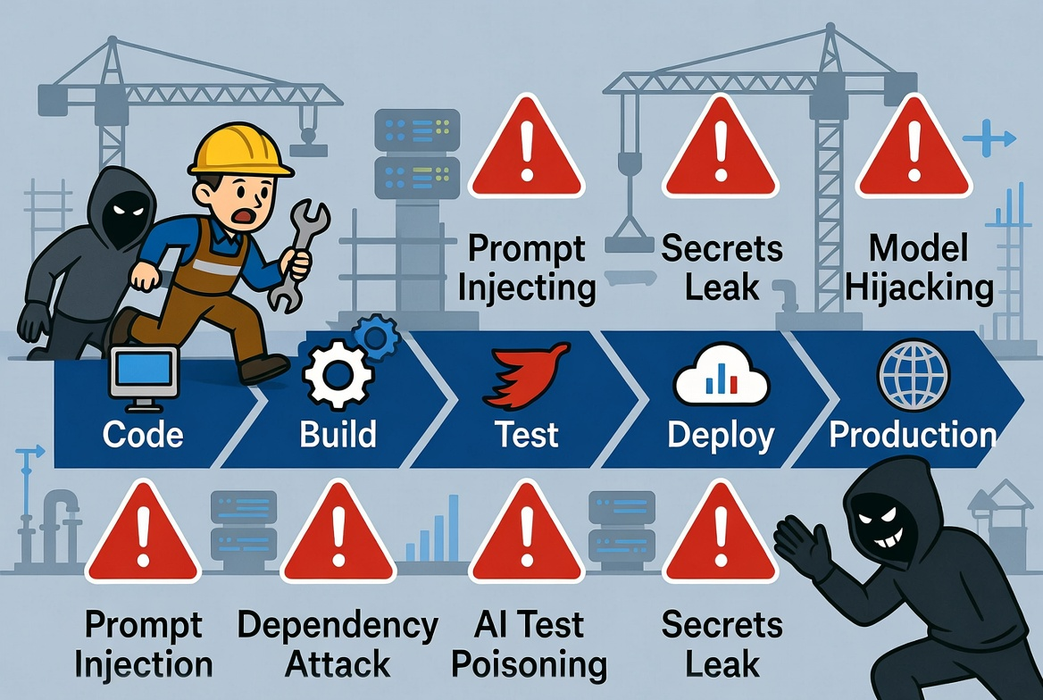

Slide 21
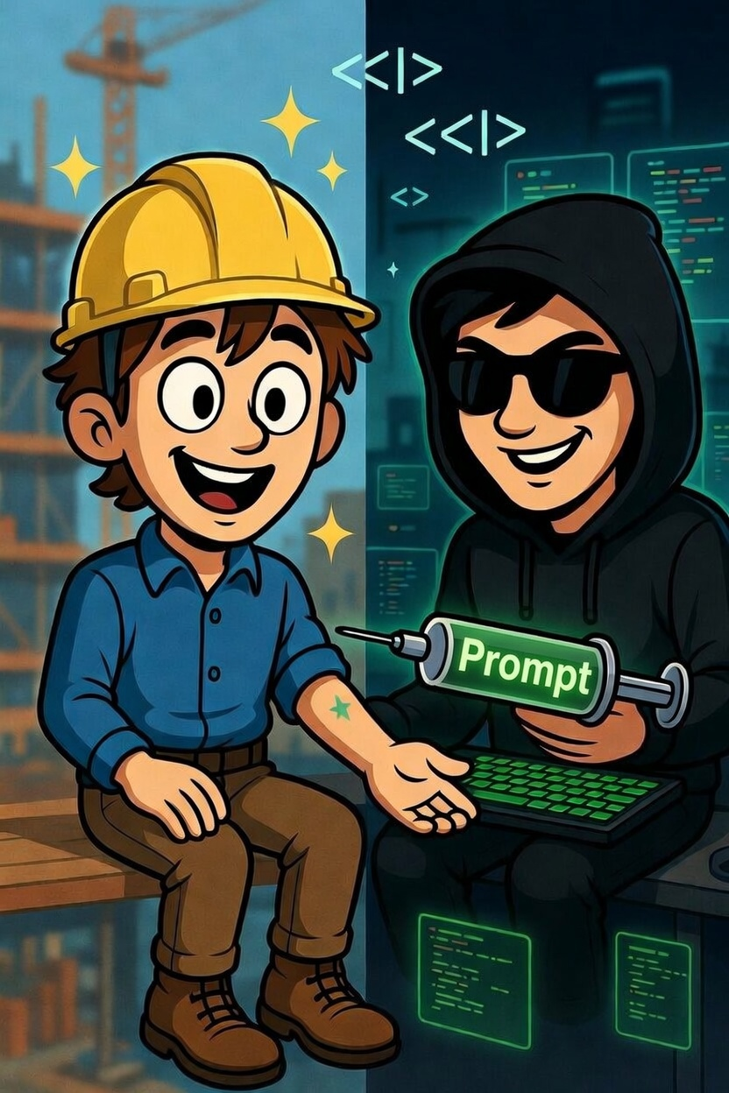
Prompt Injection

Slide 22
Secrets Exposure
What goes into your AI prompt?
Even 'anonymized' context can reveal architecture details

Slide 23
Treat AI Output as Untrusted Input
AI output is a suggestion, not a fact!

Slide 24
Third-Party vs. Self-Hosted
Third-party APIs: easier to start, data leaves your environment
Self-hosted / open-source models: more control, more operational overhead
Self-hosted with a managed identity provider: more control with added identity security*
Consider: what's in your prompts? What's your data classification?

Slide 25

Guardrails
Read-Only Workflows First
Explicit Human Review Steps
Choose the right tools for the job
Log Everything the AI Was Asked and Said

Slide 26
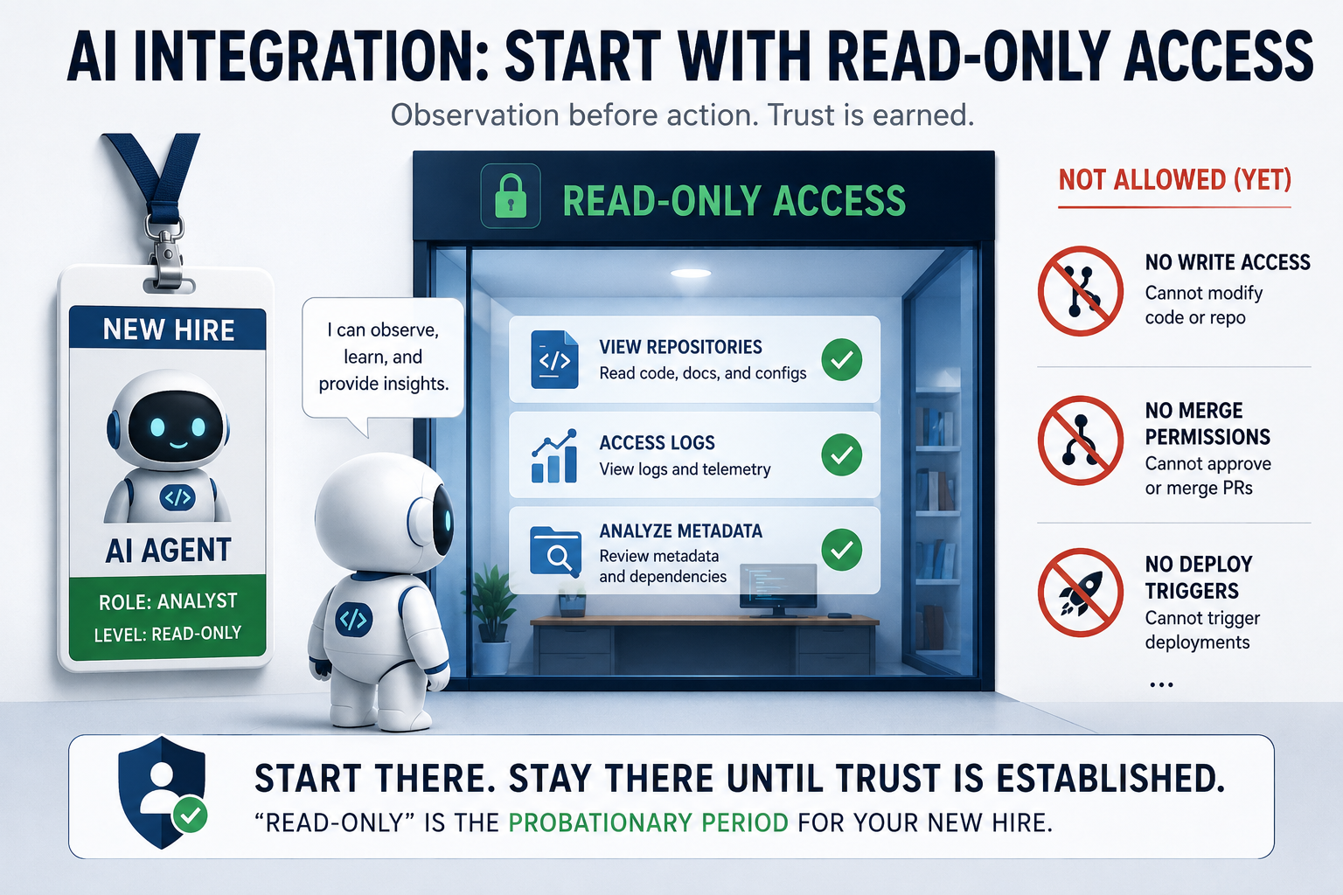

Slide 27
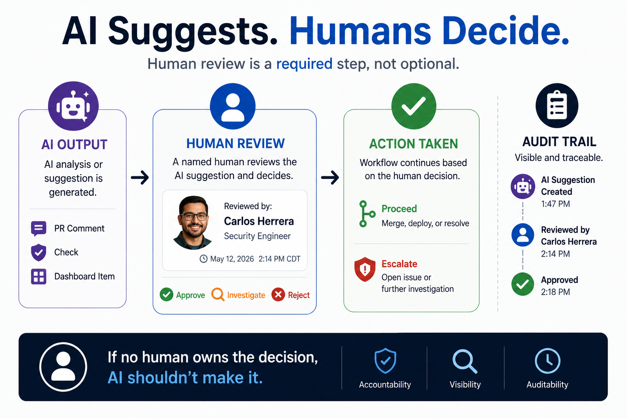

Slide 28
Least-Privilege Identity for AI Integrations
Treat your AI integration like any other service account
Scope repo access to what it actually needs
Rotate credentials. Audit usage. Apply the same hygiene as any bot.

Slide 29
Log Everything the AI Was Asked and Said
Log the full prompt (sanitized of secrets) and the full response
Retain logs long enough to investigate incidents
Include in your incident review process: what did the AI tell us?
Helps identify prompt injection attempts after the fact

Slide 30
A Simple Checklist for Any AI Use Case
☐ Is the AI's access read-only?
☐ Is there an explicit human gate before action?
☐ Is AI output validated before use?
☐ Is data scoped — no unnecessary secrets or IP in the prompt?
☐ Is there an audit trail?
All five: safe to experiment. Any missing: understand why before proceeding.

Slide 31

What "Earning the Crane Keys" Looks Like
Start with scoped, read-only, low-blast-radius tasks
Measure outcomes: is the AI actually helping? Are the suggestions accurate?
Expand scope incrementally — each expansion is a deliberate decision
Build a track record before granting autonomy
The goal is earned trust, not assumed trust

Slide 32
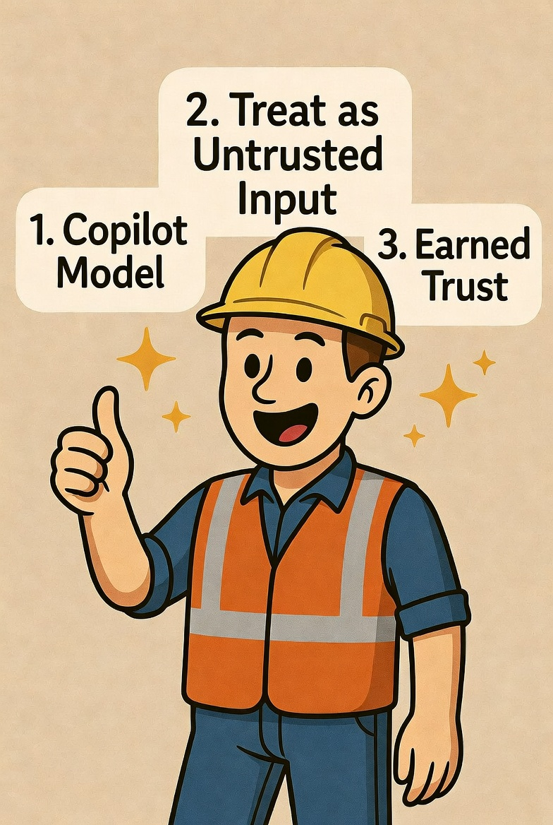
Three Things to Take Home

Slide 33
Thank you!
Sources and Useful Links
https://blog.gitguardian.com/ghostaction-campaign-3-325-secrets-stolen/
https://auth0.com/blog/product-architecture-behind-trusted-ai-experiences/
https://www.elastic.co/security-labs/detecting-cicd-pipeline-abuse-with-llm-augmented-analysis
https://www.elastic.co/security-labs/axios-one-rat-to-rule-them-all
https://www.elastic.co/security-labs/axios-supply-chain-compromise-detections
https://www.elastic.co/security-labs/claude-code-cowork-monitoring-otel-elastic
https://www.forbes.com/councils/forbestechcouncil/2026/03/23/closing-the-ai-trust-gap-with-strong-identity-and-guardrails/
https://www.forbes.com/councils/forbestechcouncil/2026/04/28/identity-as-the-backbone-of-scalable-and-responsible-ai/

