Slide 1
Don’t Trash it, Hack it: Reverse Engineering Secrets & Repurposing ISP Routers
Dheeraj Reddy Jonnalagadda​
Open Source Summit, Mumbai, India
June 16-17, 2026
​
​

Slide 2
$whoami
Senior Flight software engineer at PixxelSpace, India.
Working on the onboard computers (OBC) for earth observation satellites
Budding Linux kernel enthusiast and just started contributing to the mainline kernel.
LinkedIn
Personal Website
Hackster

Slide 3
Agenda
- The Break-in: Manipulating U-Boot args to hijack the Linux boot process
- Forensics: Analyzing the Management Information Base (MIB) to recover hidden passwords.
- The Realtek Flash tool: Understanding how the router stores state and using flash get/set to bypass restrictions.
- Going Dark: Permanently disabling the TR-069 daemon to stop the router from "phoning home" to the ISP.
- Extracting passwords: Binary analysis to get hardcoded admin passwords.
- Building an Ad blocker: Build a pi-hole style Ad blocker and analysis of the results.
- Persistence: Enabling the Telnet daemon via a config hook to replace hardware UART access.
- Q&A

Slide 4
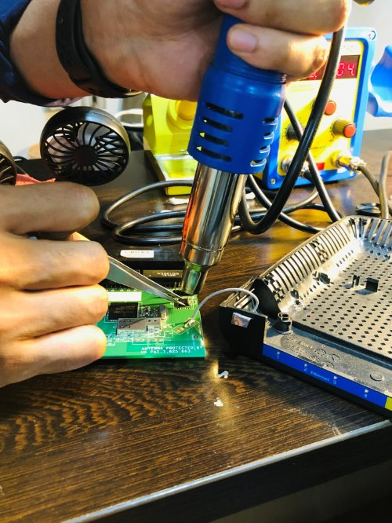
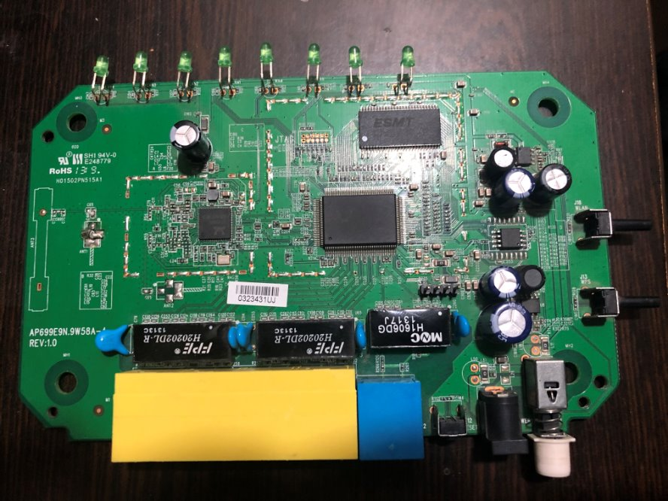
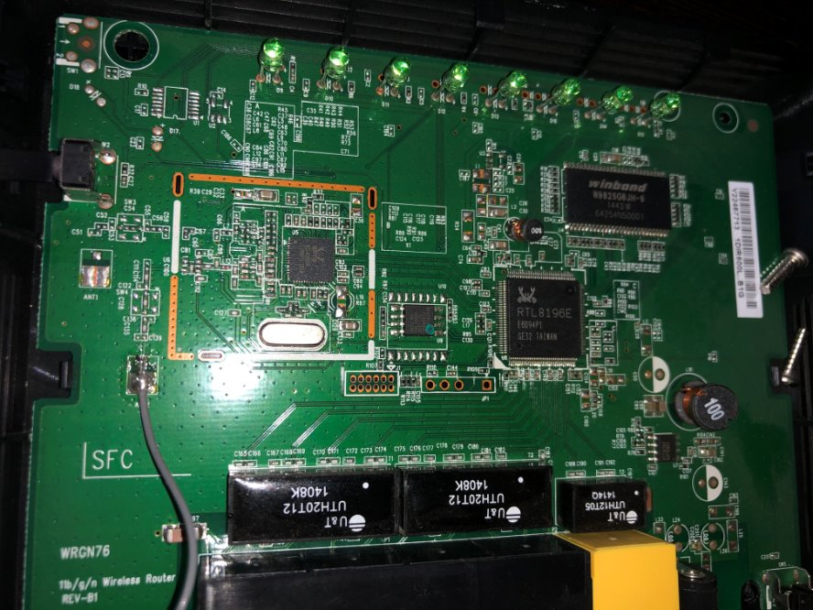
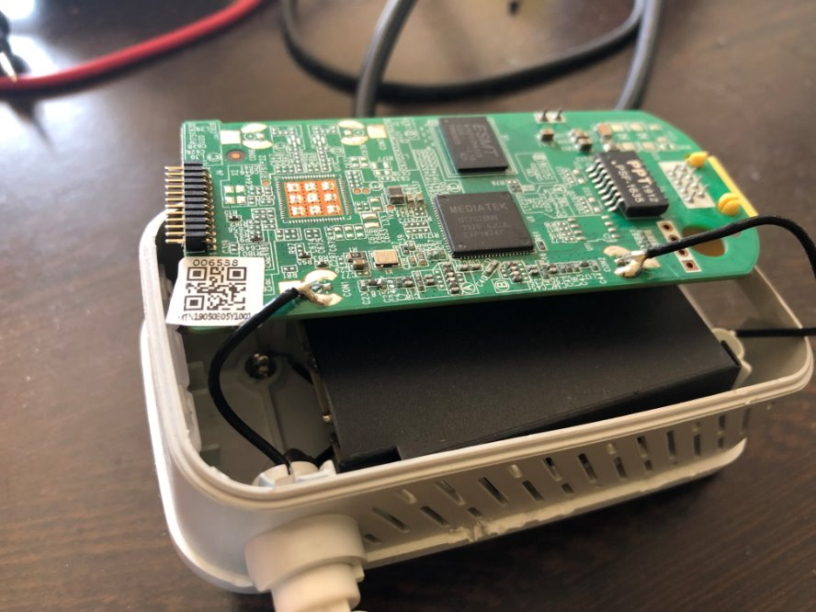
The
beginnings

Slide 5
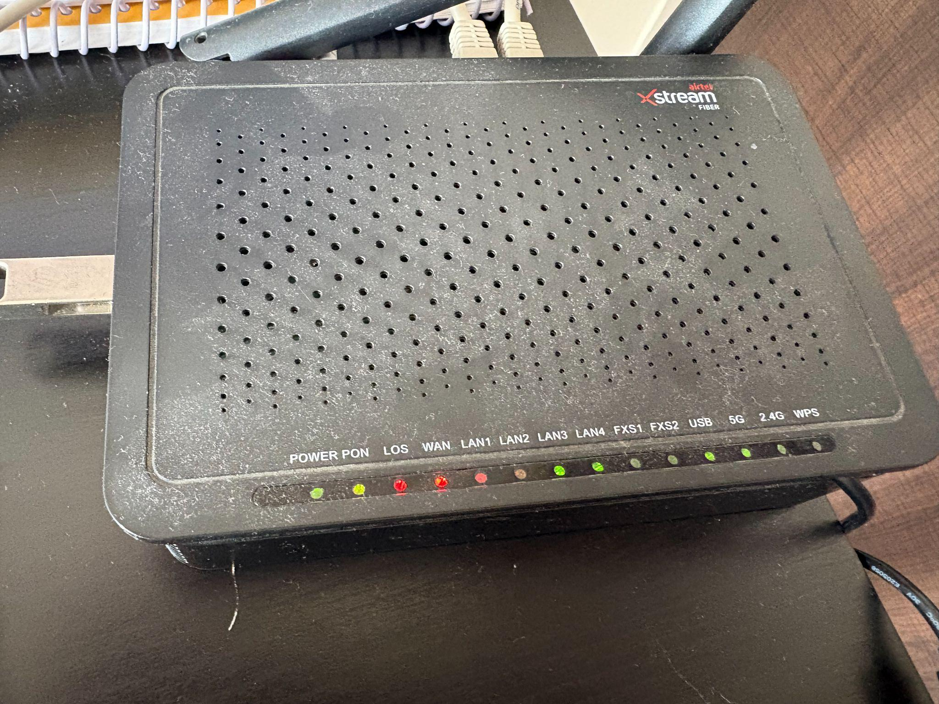
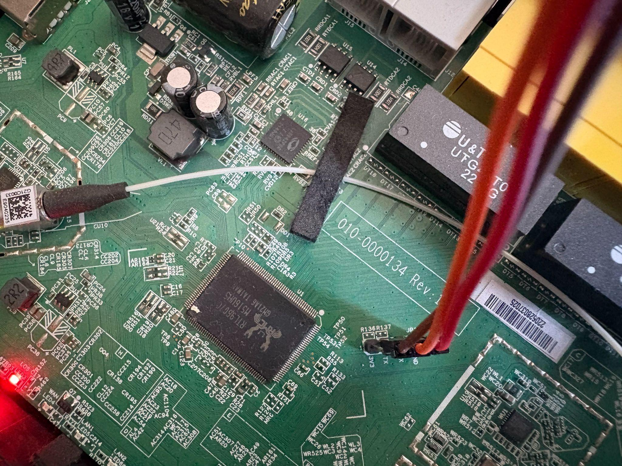
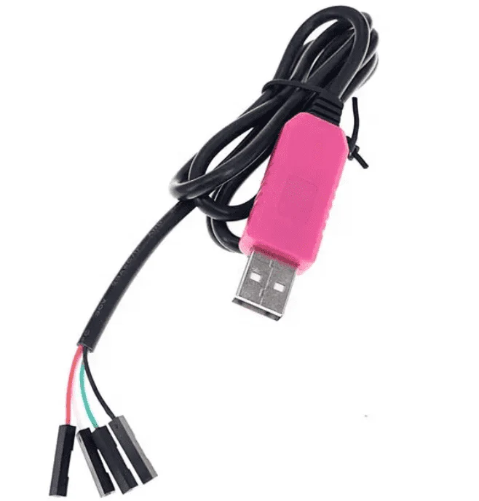
The Black box – Alphion ASEE 1447
Alphion ASEE 177
USB-TTL Converter

Slide 6
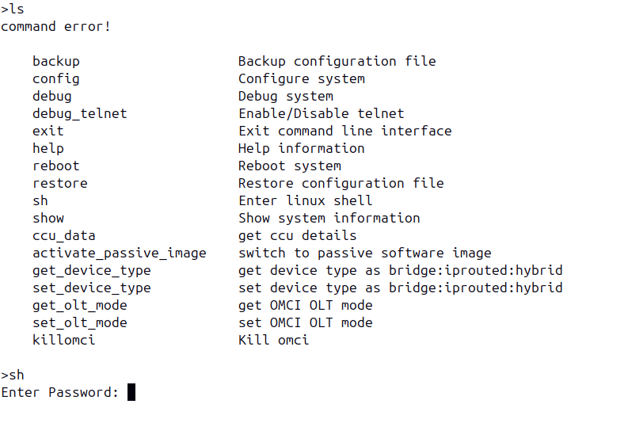
Default login through UART
We land on this page once the bootup completes.
Can only access the login page using admin/admin creds
Linux shell has a different password.

Slide 7
The breaking in

Slide 8
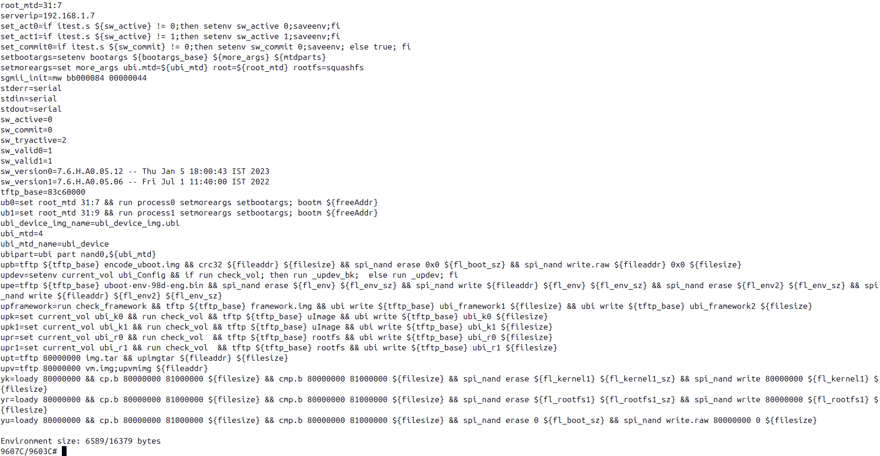
U-Boot Expeditions: Mapping the Path to Root Access
Halt boot flow by interrupting U-Boot timeout.
# printenv

Slide 9
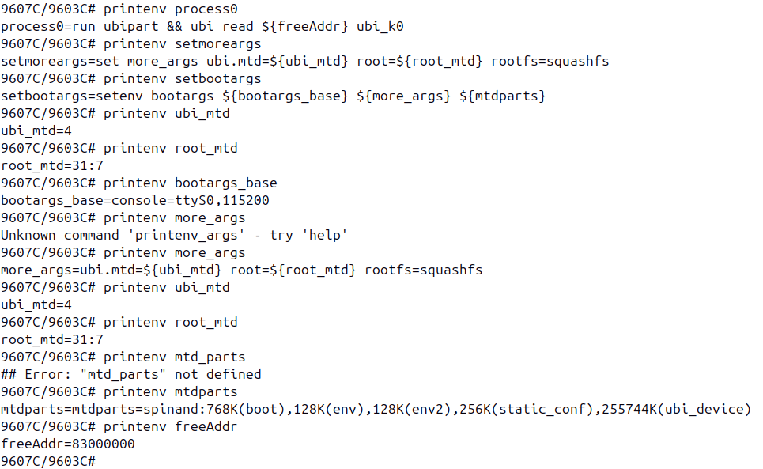
Print the good stuff
Print each variable starting with the familiar ‘bootm’
Expand until we print all variables

Slide 10
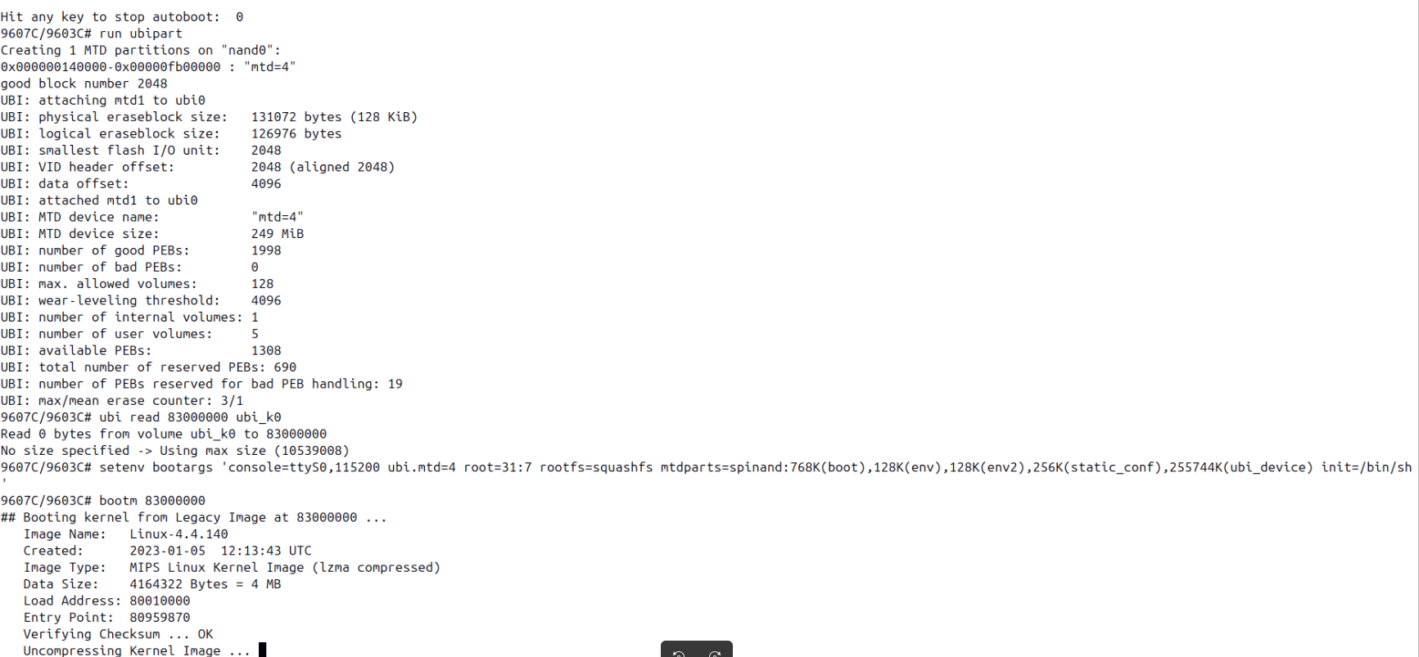
Combine and boot!

Slide 11
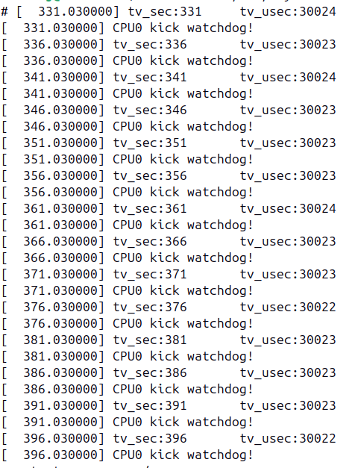
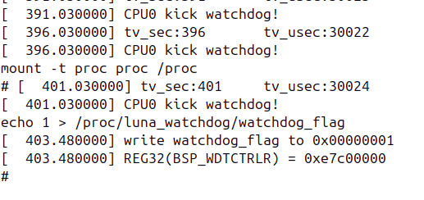
Not in yet: Resetting the watchdog timer

Slide 12
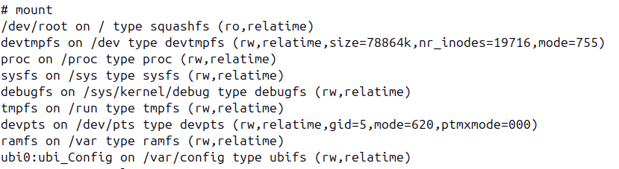
The challenge: Read only file system

Slide 13
Forensics

Slide 14
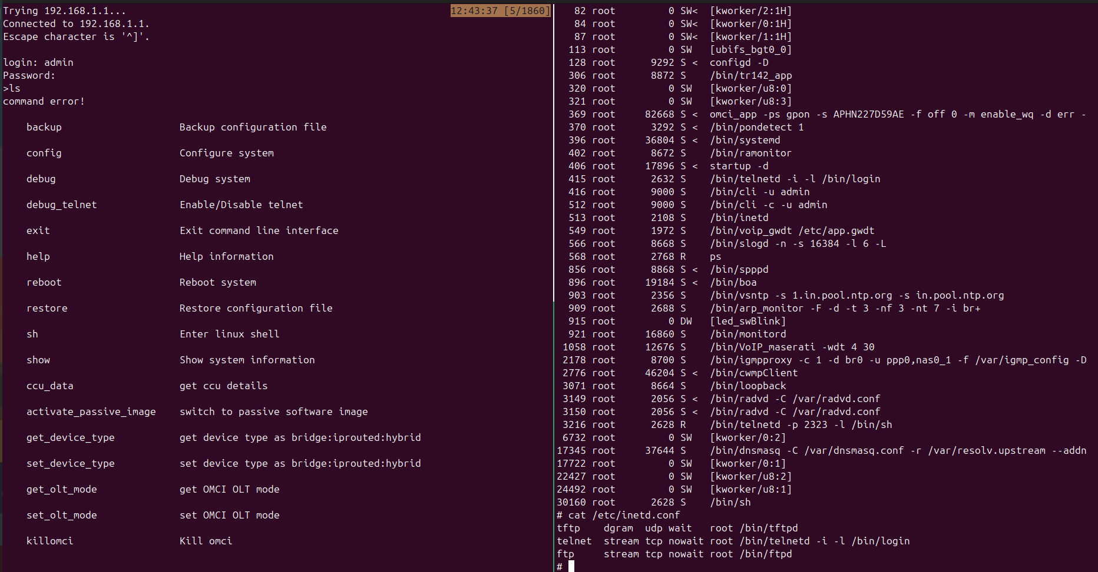
Default telnet access: The door they forgot to lock

Slide 15
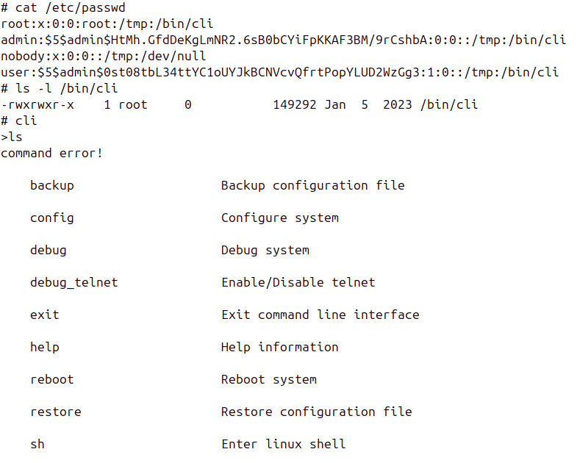
The restricted shell
Exploring the /etc/passwd file gives us a clue on what shell is used.
Executing ‘cli’ confirms this idea
Copy over the ‘cli’ binary over to PC using tftp for further analysis.

Slide 16
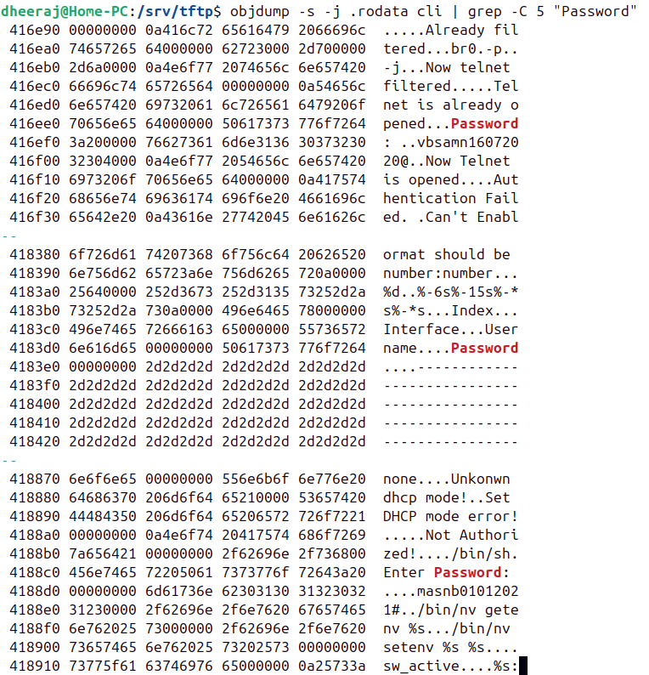
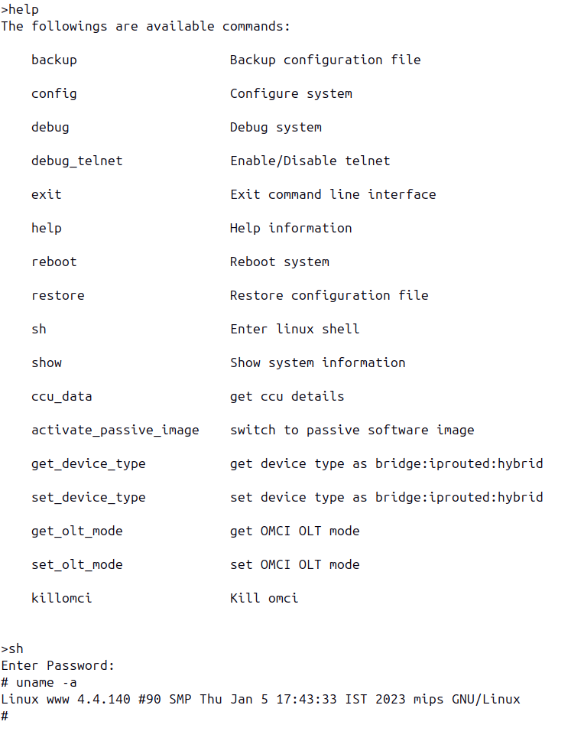
Passwords: Now in plaintext for your convenience

Slide 17
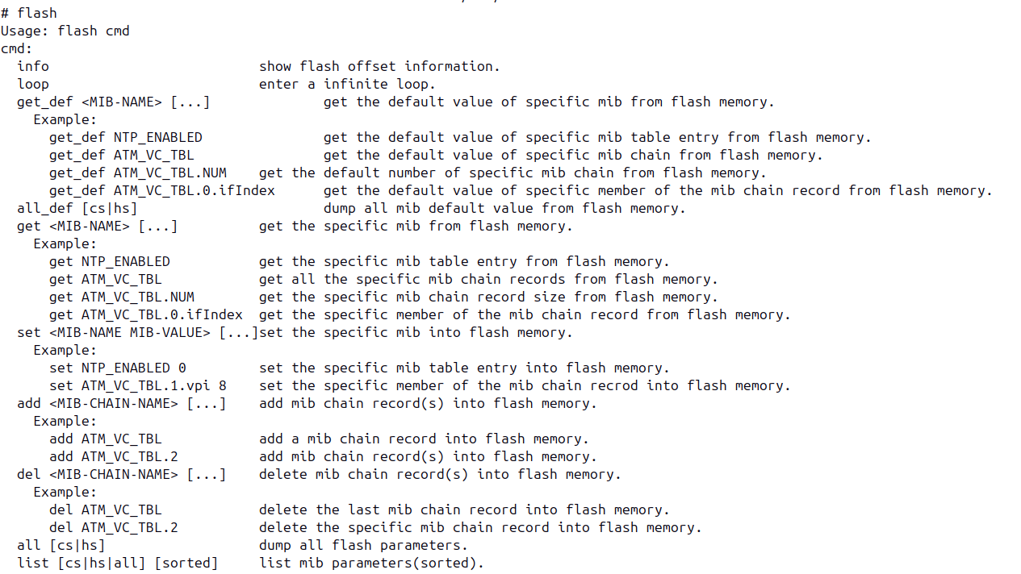
The Flash tool

Slide 18
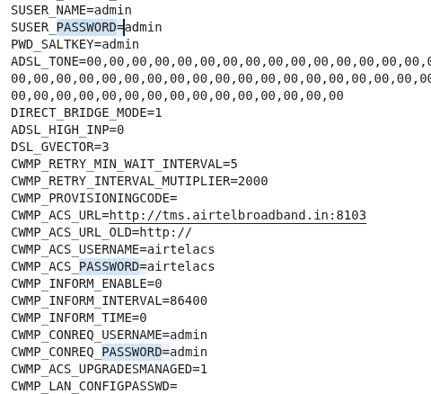
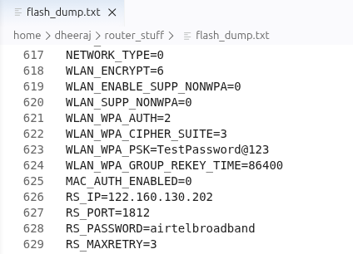
Flash dump
# flash all > flash_dump.txt

Slide 19
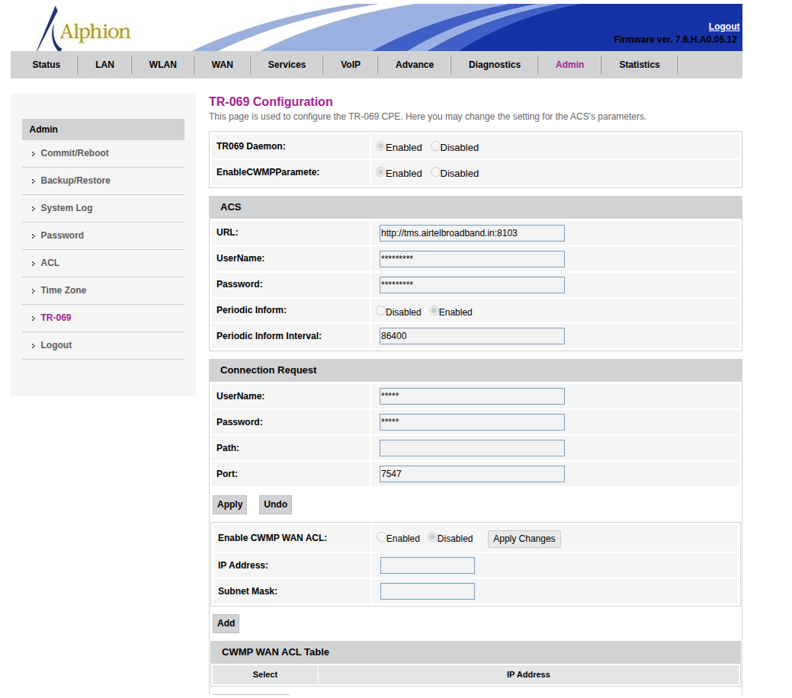
When ‘Admin’ isn’t really Admin - Locked out settings

Slide 20
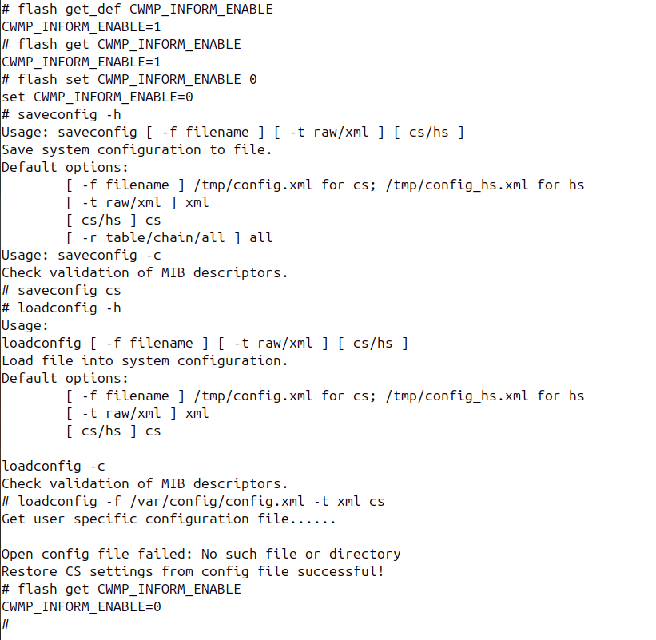
Flash tool to the rescue!
# flash set CWMP_INFORM_ENABLE 0 # saveconfig cs
# loadconfig -f /var/config/config.xml -t xml cs

Slide 21
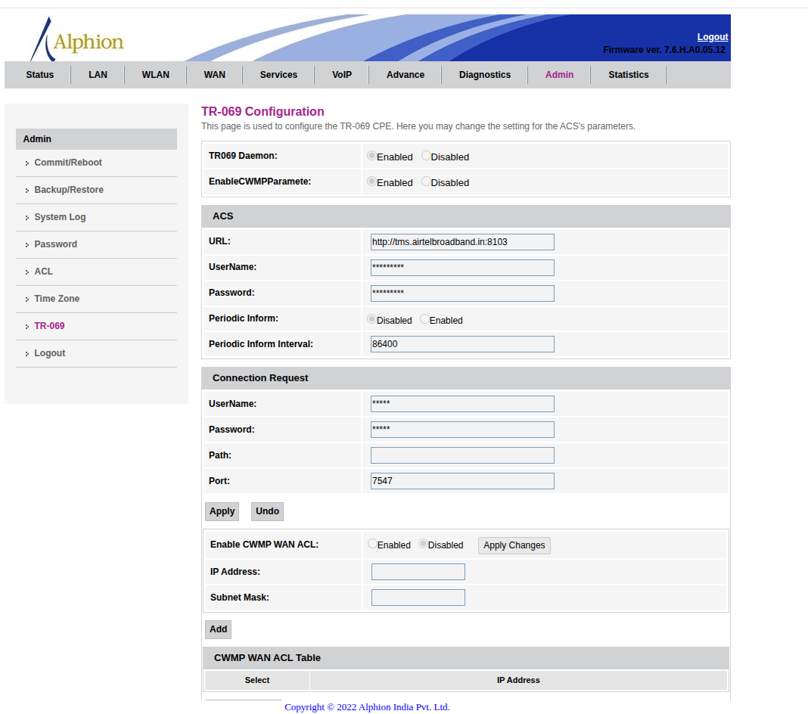
The locked out Admin - Not anymore!

Slide 22
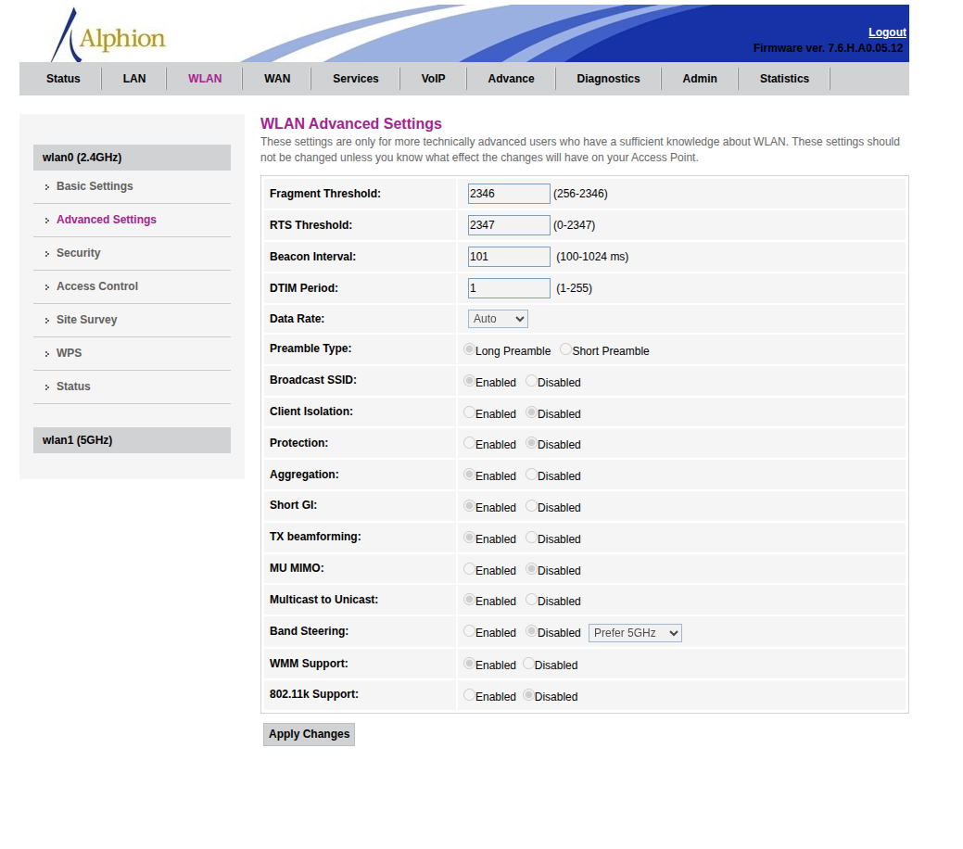
Updating the beacon interval - Because, why not?
# flash all | grep -i "beacon"
BEACON_INTERVAL=100
# flash set BEACON_INTERVAL 101 # saveconfig cs
# loadconfig -f /var/config/config.xml -t xml cs

Slide 23
Building an Ad Blocker

Slide 24
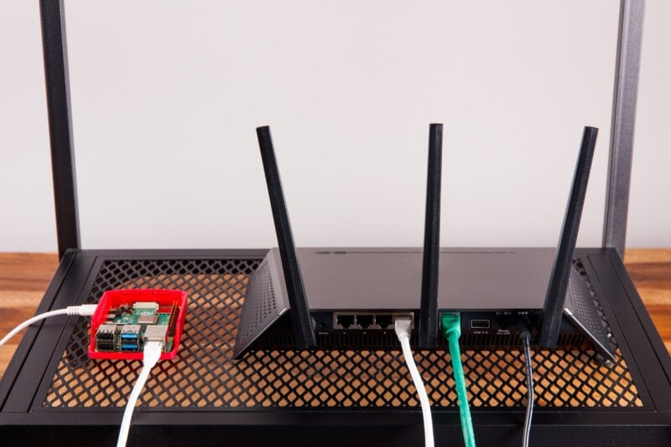

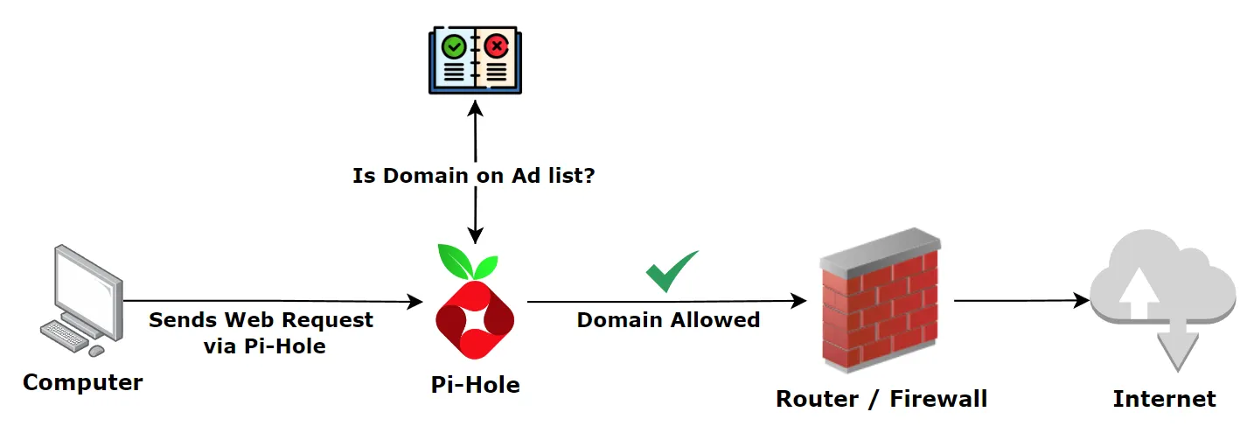
The Pi Hole
Source: Build your own Ad Blocking tool for your home using Pi-Hole

Slide 25
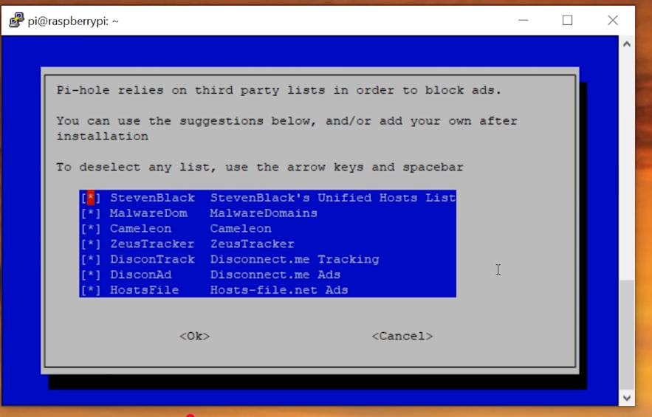
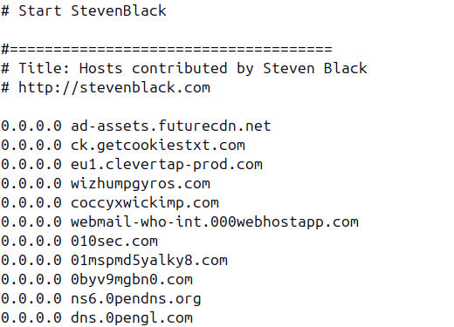
The pi hole block lists

Slide 26
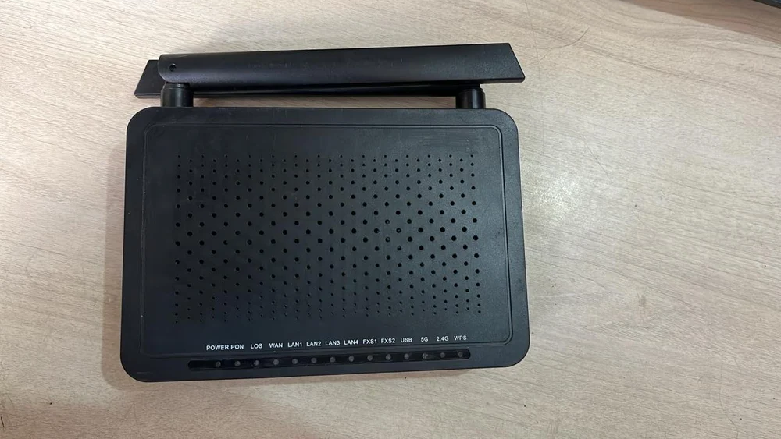
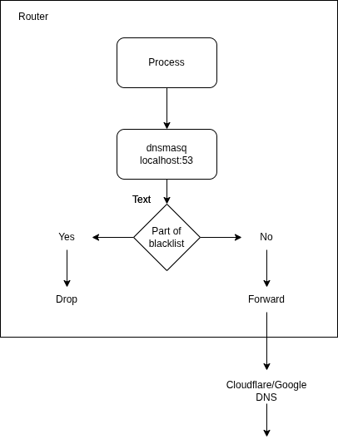
The Black Hole: Lightweight and fast Adblocker
Alphion ASEE-1477
Reroute DNS queries to localhost
Pointed dnsmasq to the unified list using the addn-hosts
Forward unknown queries to external servers

Slide 27
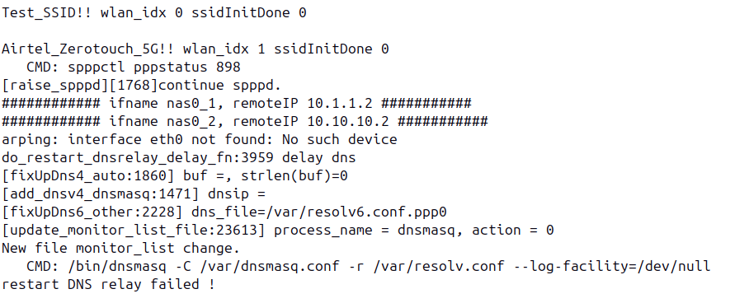
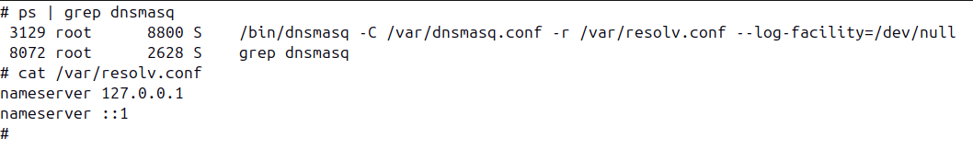
But first, where do we get the DNS server list from?

Slide 28
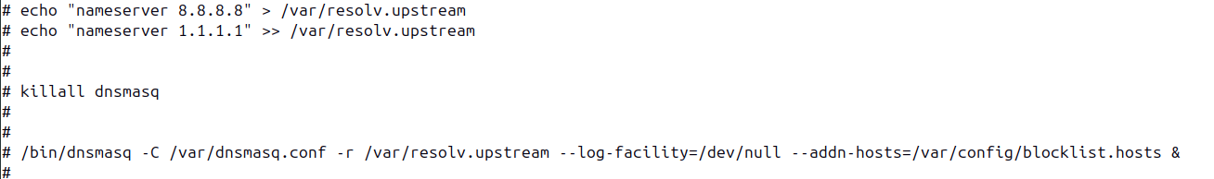
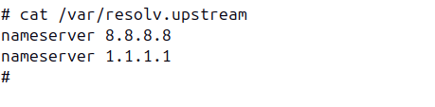
Adding our own nameservers and blocklists

Slide 29
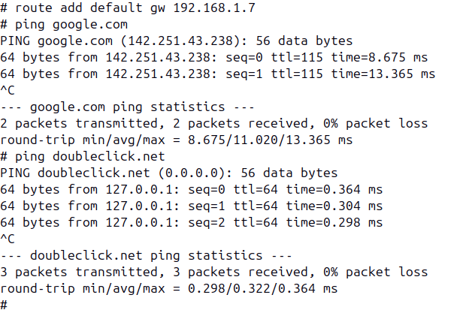
A simple ping test

Slide 30
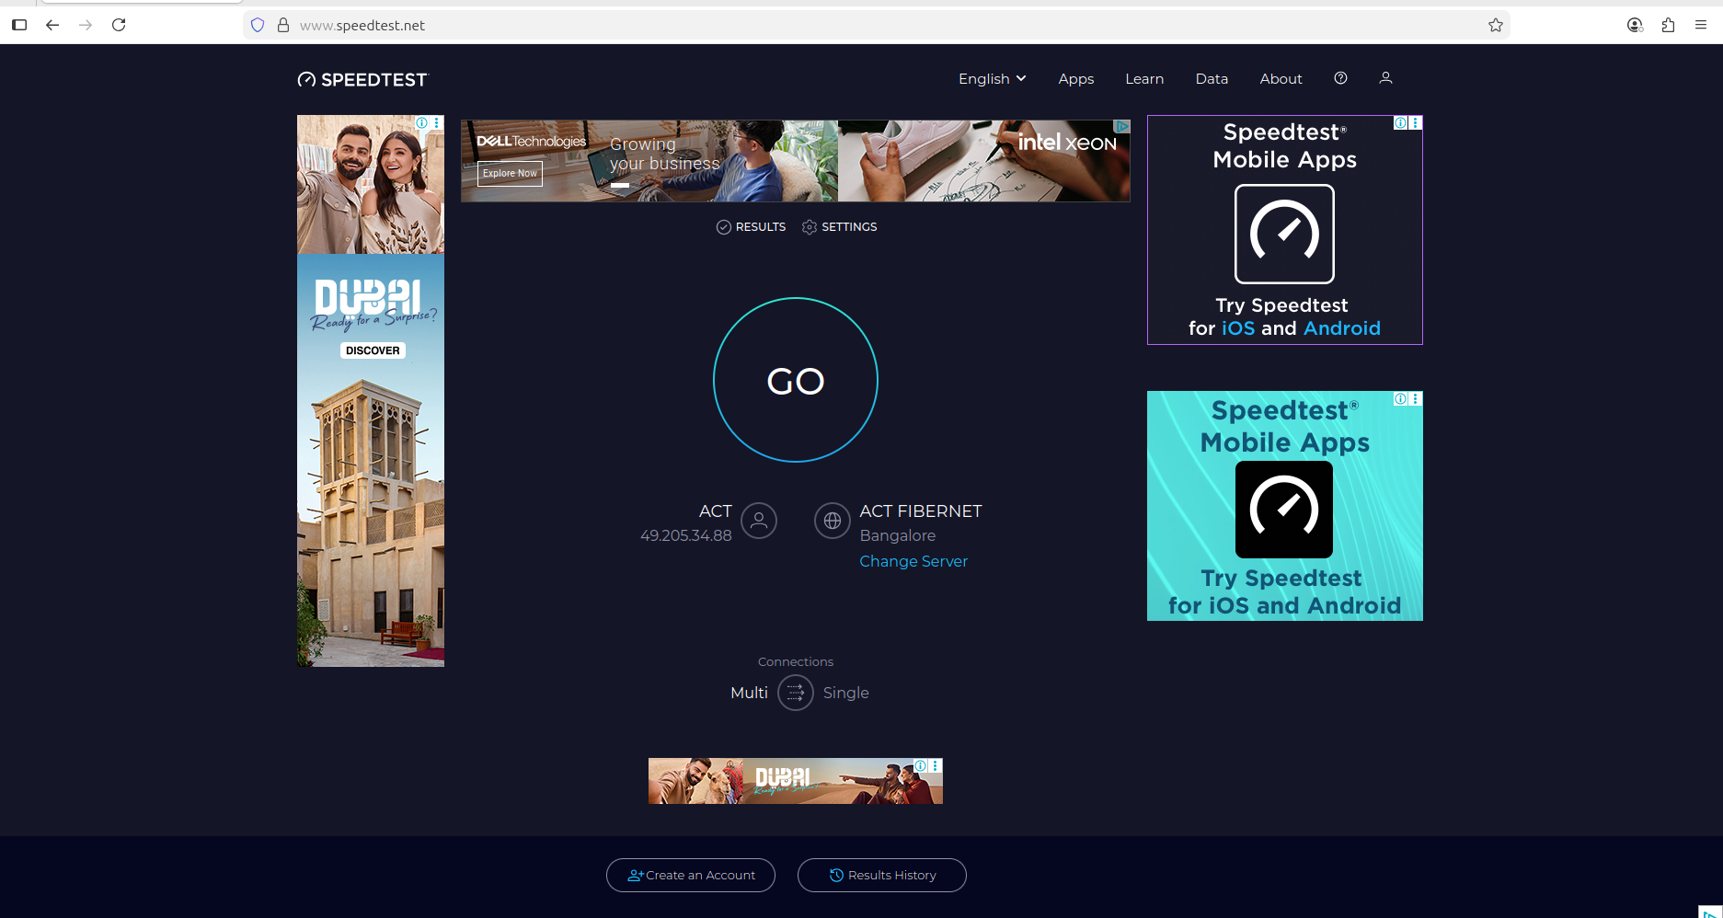
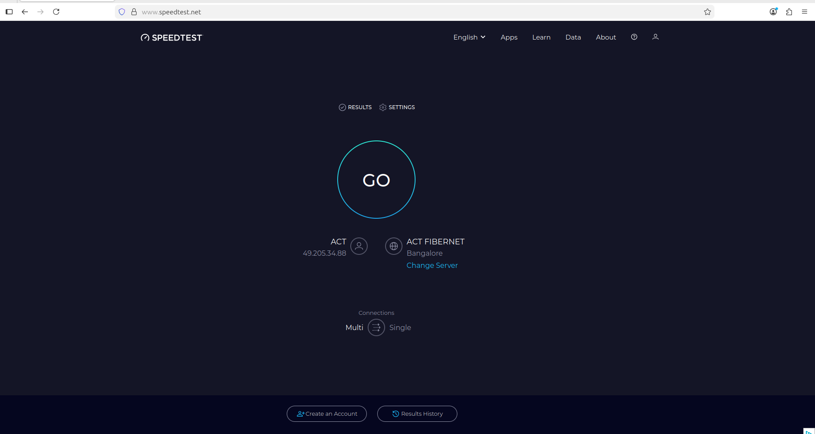
Ad block tests
Before
After

Slide 31
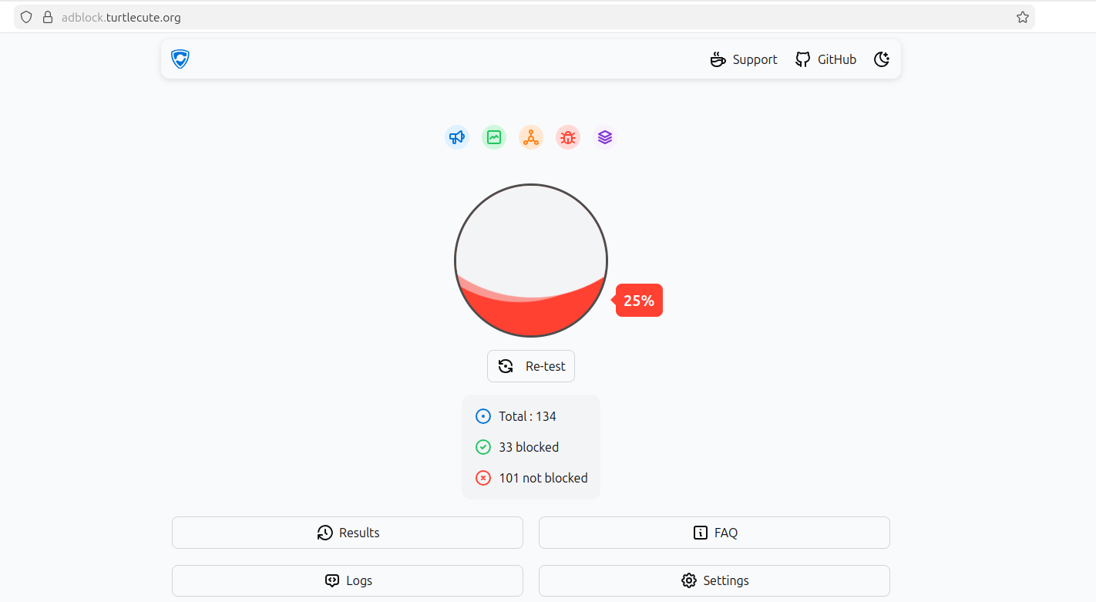
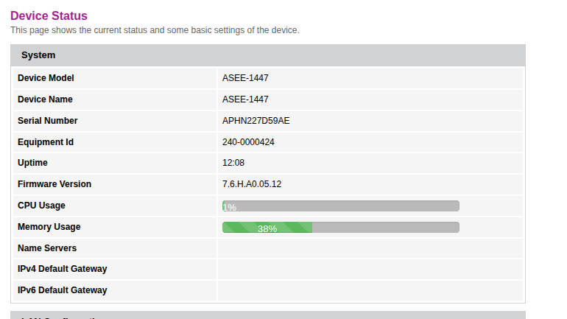
Ad block tests
Using Steven Black’s Unified hosts list containing ~85000 entries Ad test website : Toolz

Slide 32
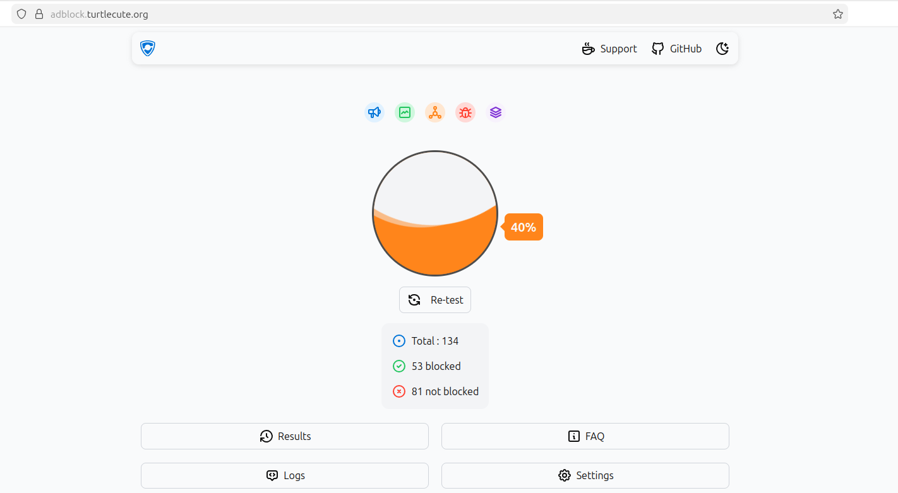
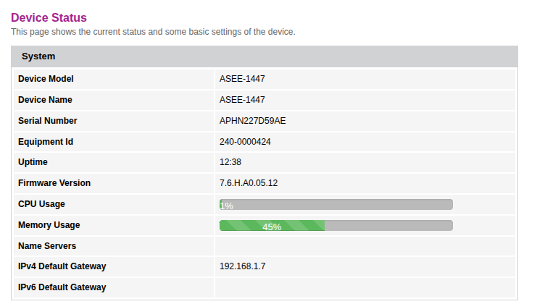
Ad block tests
Using Steven black’s Unified hosts + fakenews + gambling + social list containing ~174000 entries Ad test website : Toolz

Slide 33
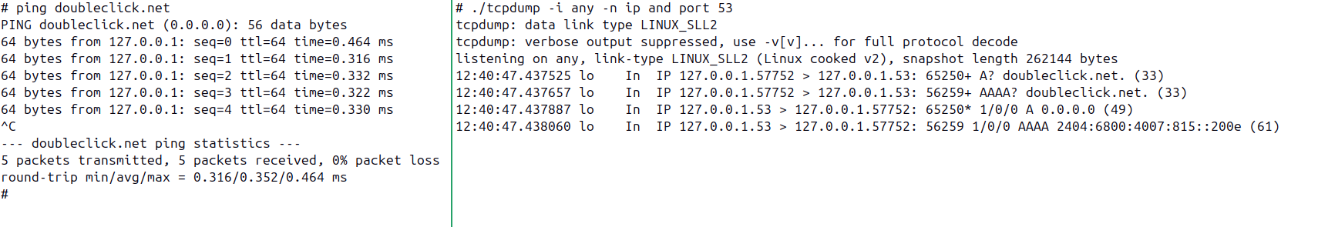
tcpdump of the DNS queries - Not good enough, IPV6 queries pass through

Slide 34
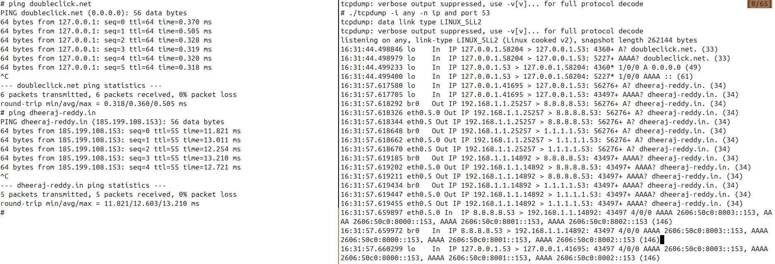
tcpdump of the DNS queries – with the updated blocklist

Slide 35
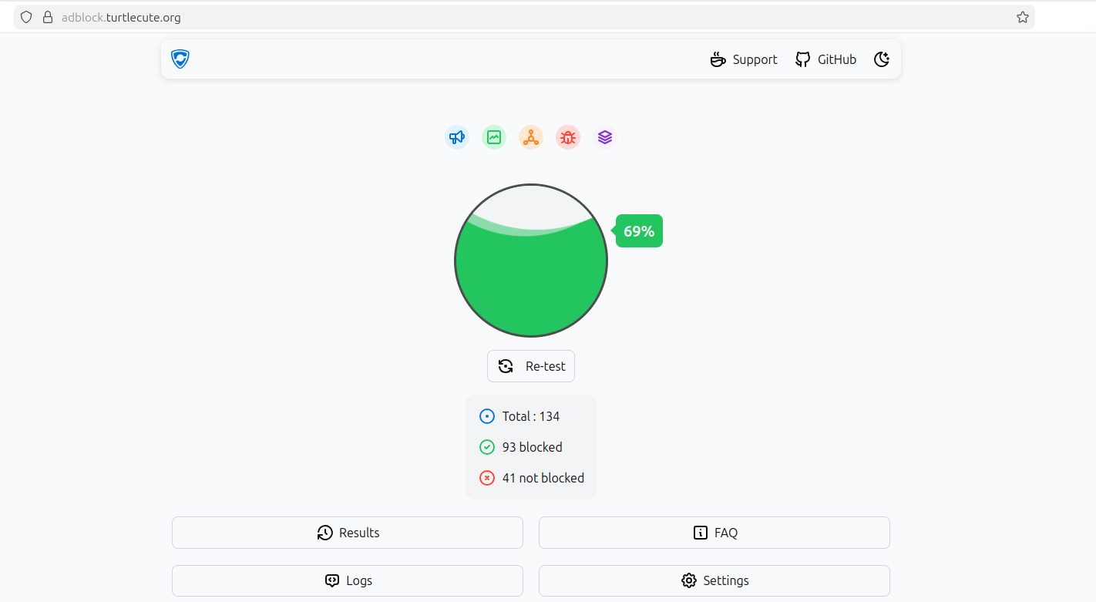
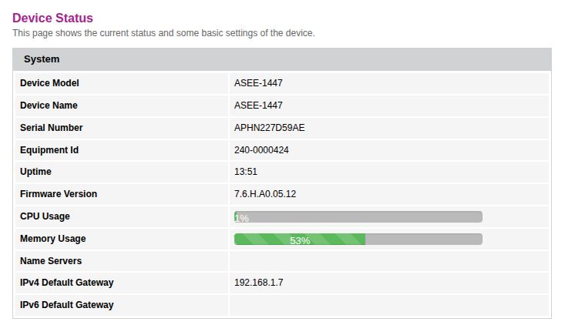
Ad block tests
Using updated list combining ipv4 and ipv6 records containing ~350000 entries

Slide 36
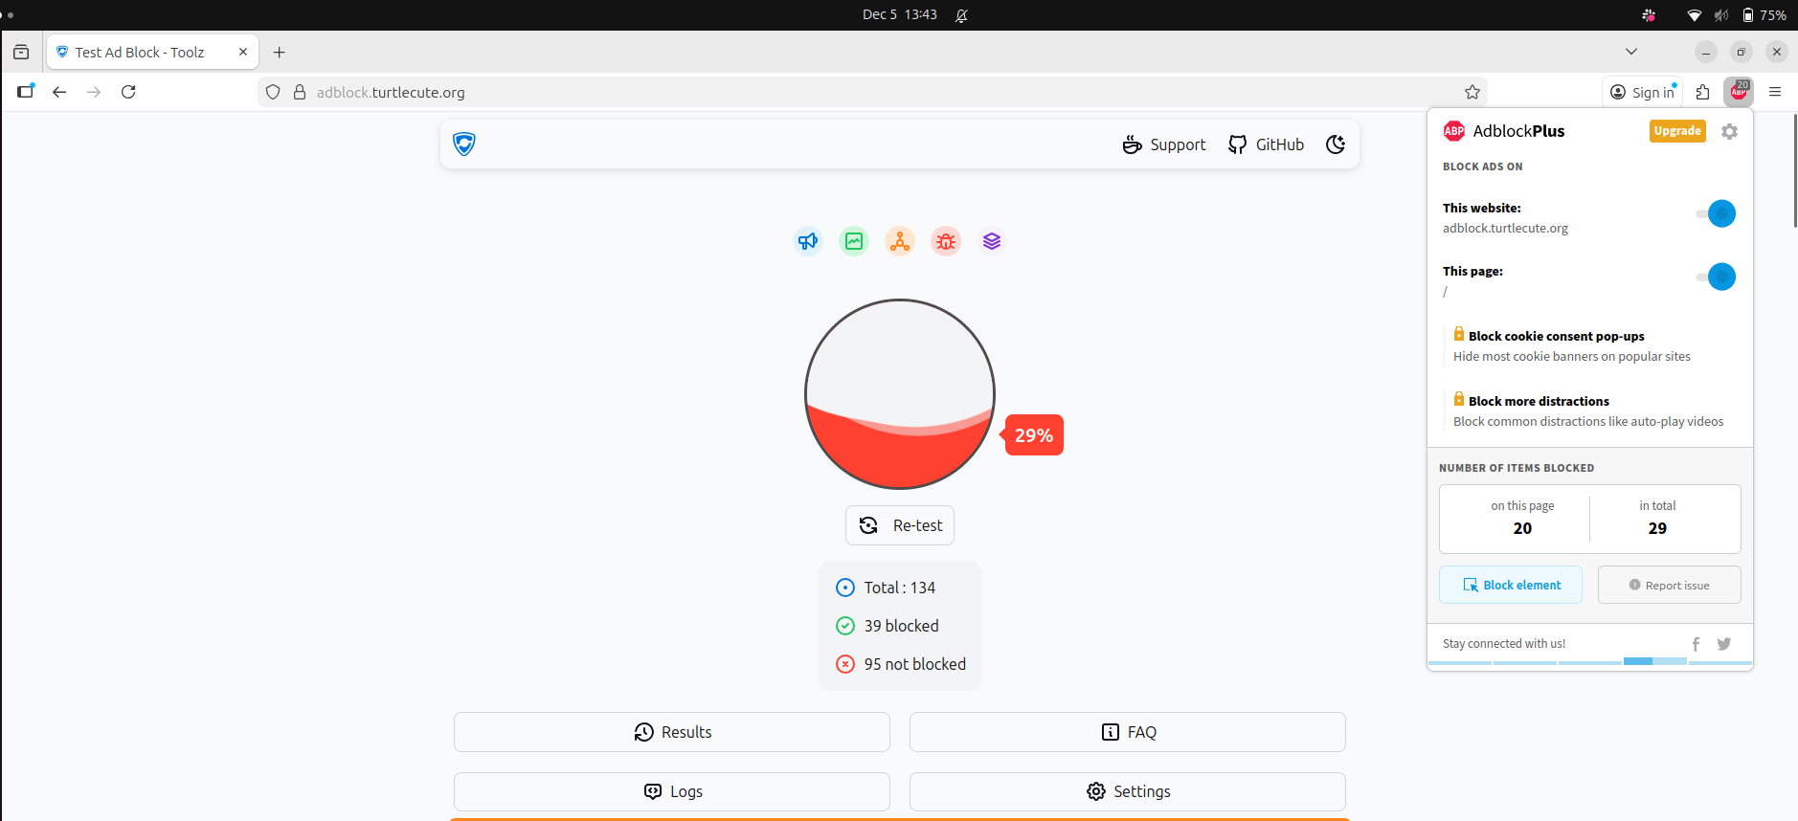
Browser with AdblockPlus extension

Slide 37
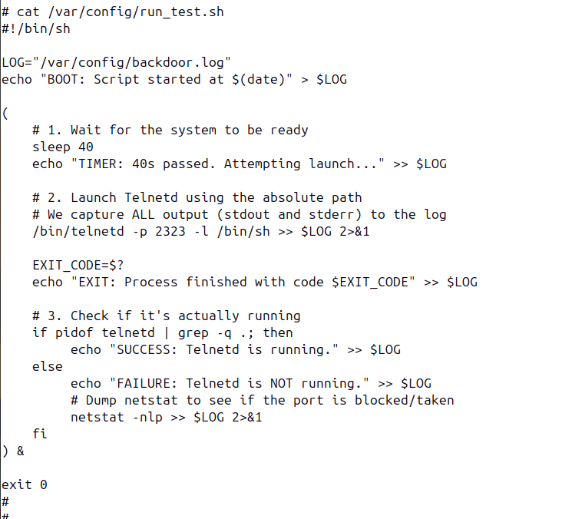
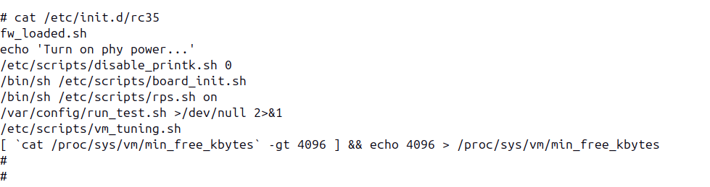
Persistence through an overlooked init script

Slide 38
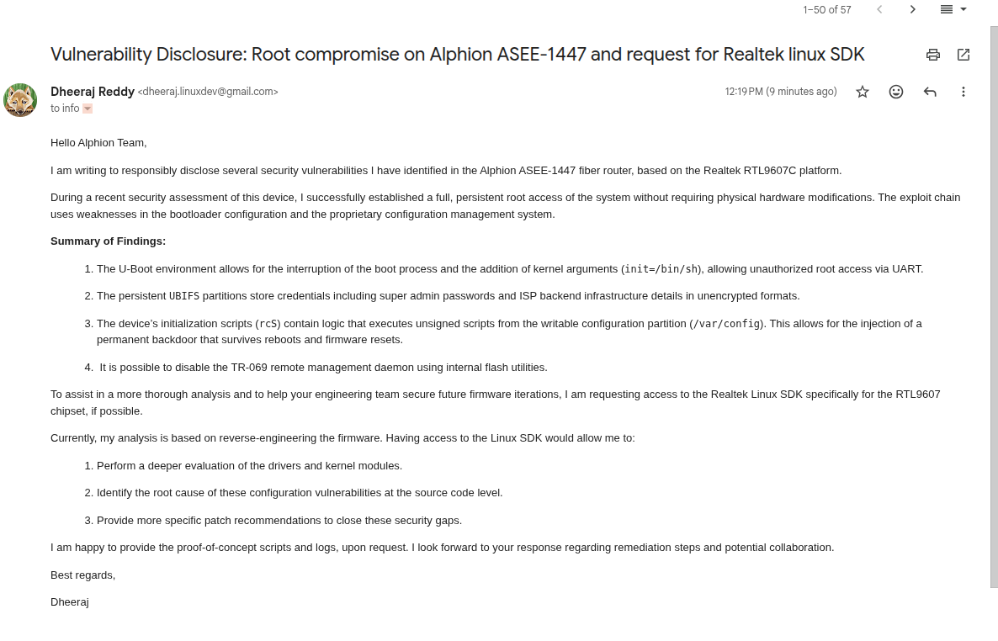

Vendor Disclosure: Free QA work

Slide 39



Thank You
Website
Hackster
LinkedIn

