Slide 1
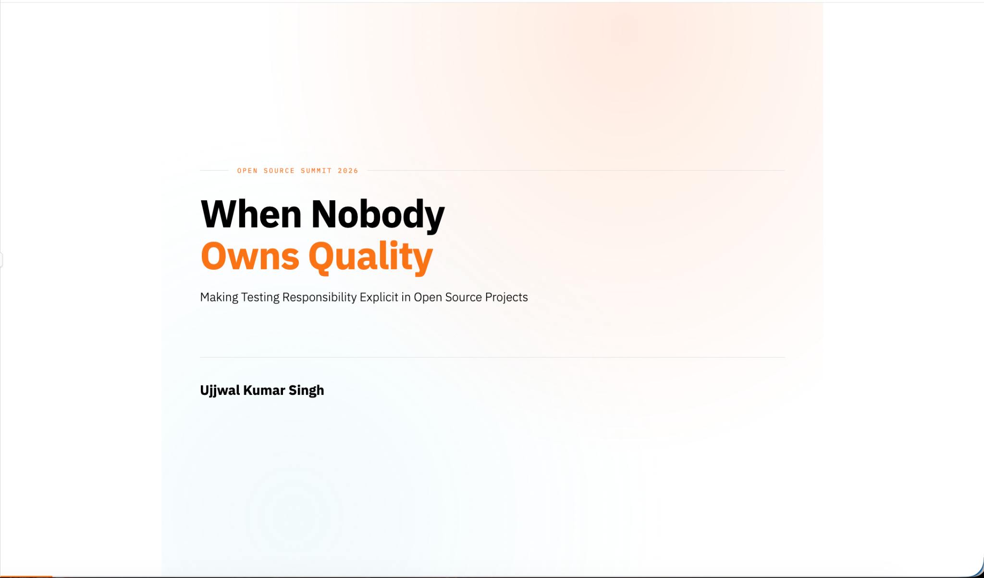

Slide 2
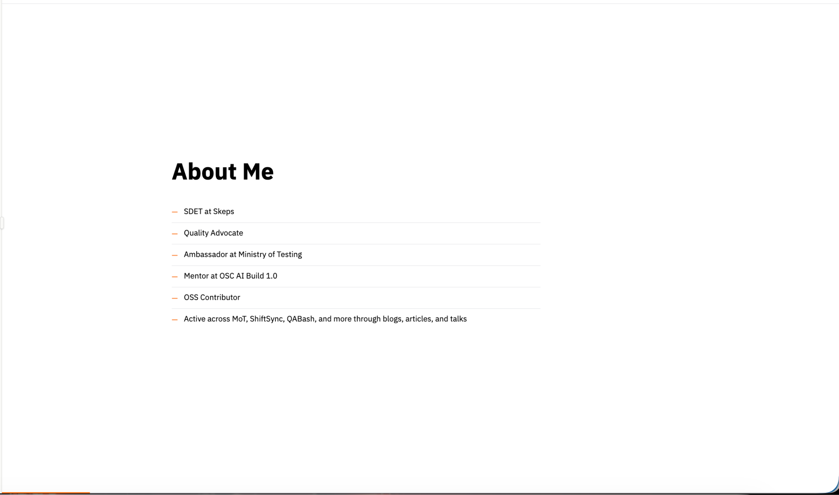
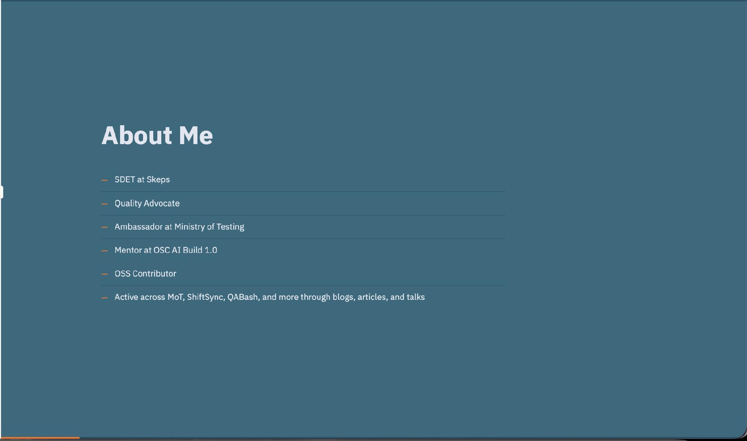

Slide 3
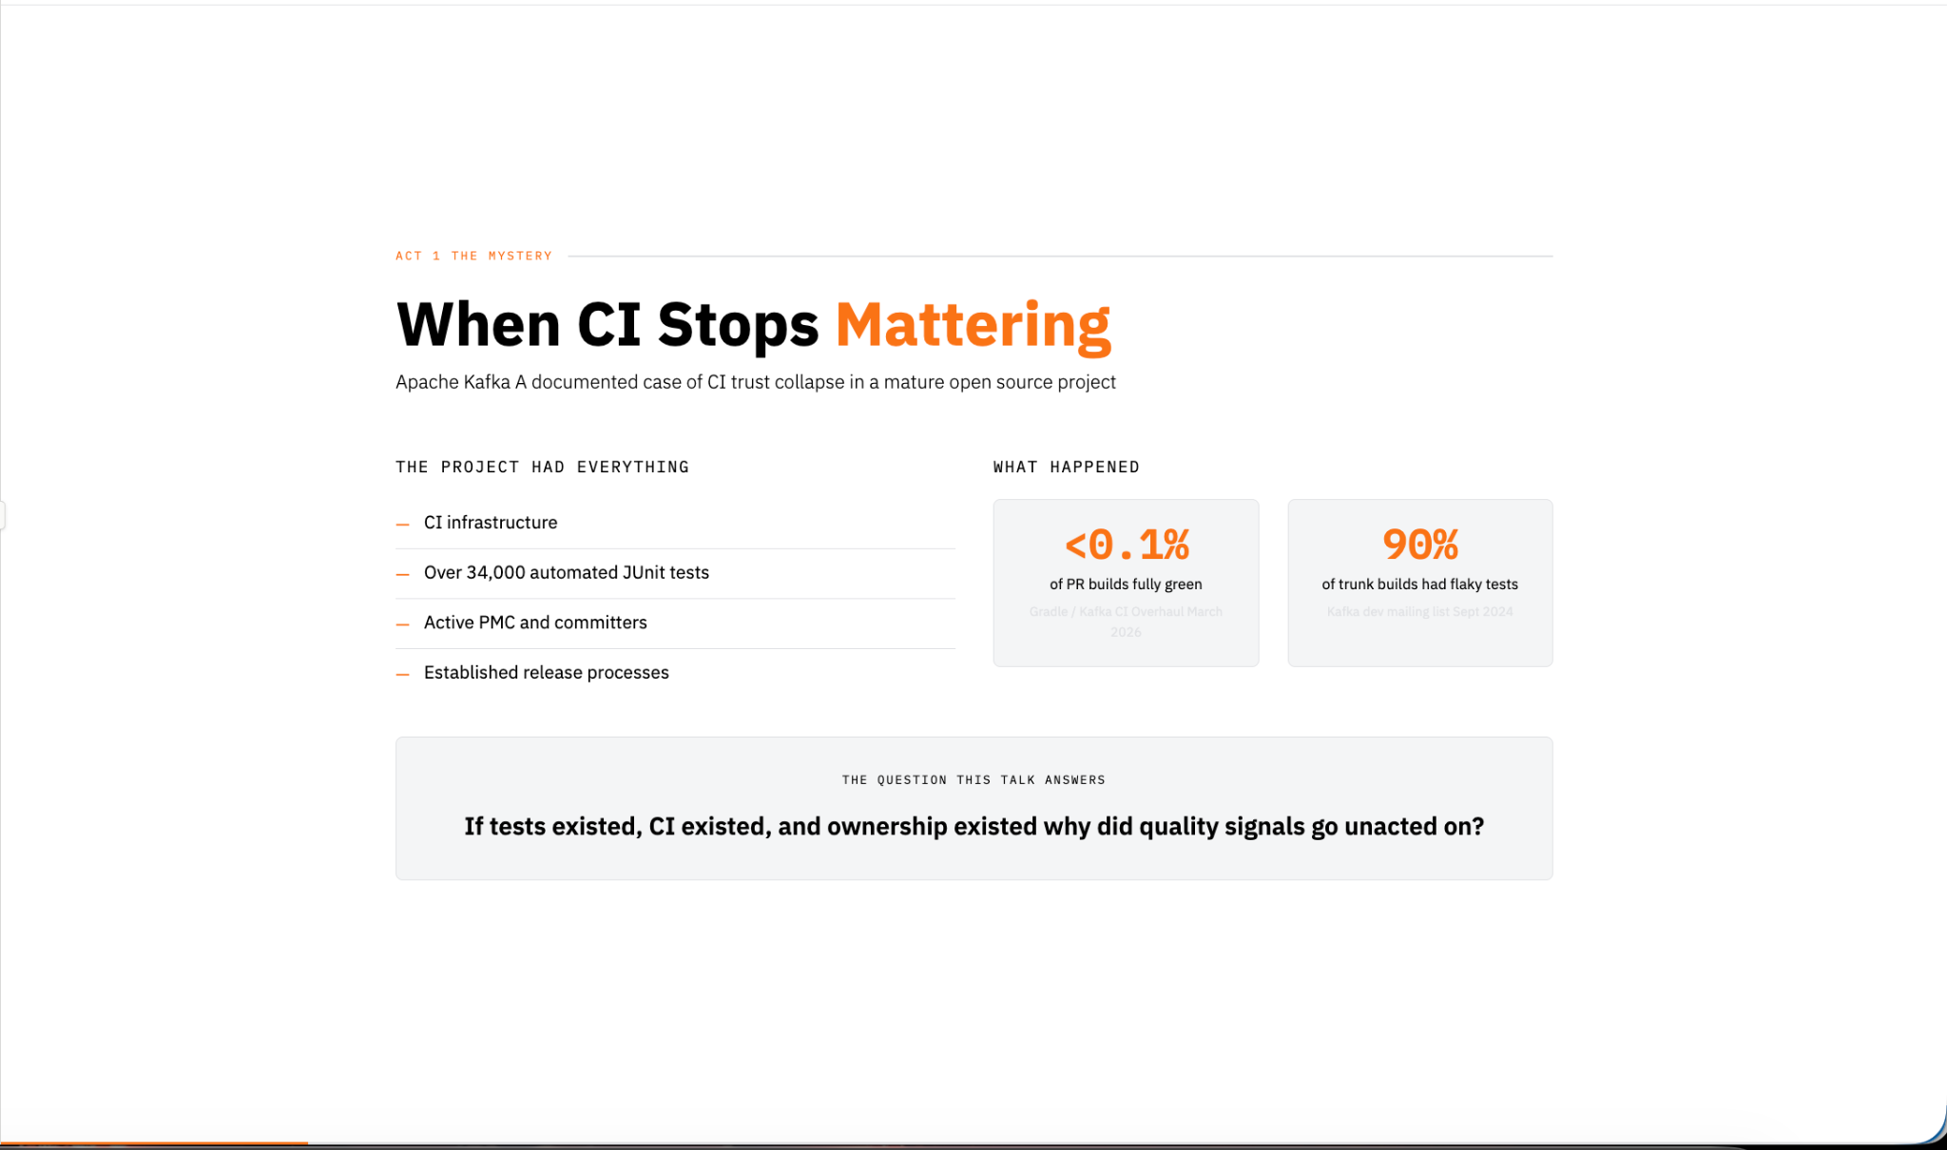
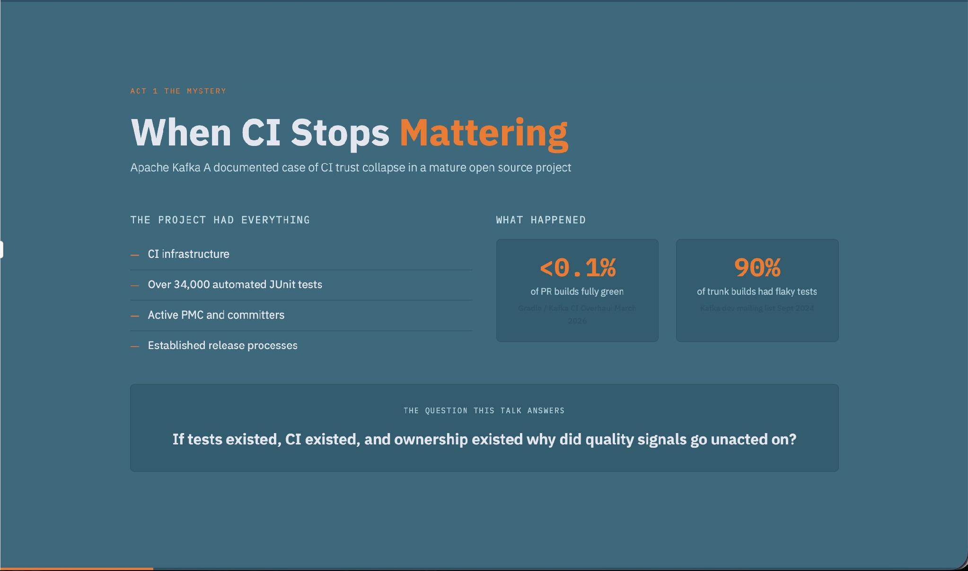
Notes:
Apache Kafka is one of the most successful open source projects in the world.
It had mature CI infrastructure.
It had more than thirty thousand tests.
It had active committers, PMC members, and established release processes.
In other words, it already had everything we normally associate with quality.
And yet something strange happened.
According to Kafka's CI overhaul retrospective, fewer than 0.1% of pull requests achieved three consecutive green CI runs.
At the same time, around 90% of build failures were caused by flaky tests.
Think about that for a moment.
Not 10%.
Not 20%.
Ninety percent.
At that point, the problem wasn't that failures were invisible.
The problem was that failures had become normal.
And that led me to a research question:
If tests existed, CI existed, and ownership existed, why did the signal stop mattering?
To answer that, I looked beyond Kafka.

Slide 4
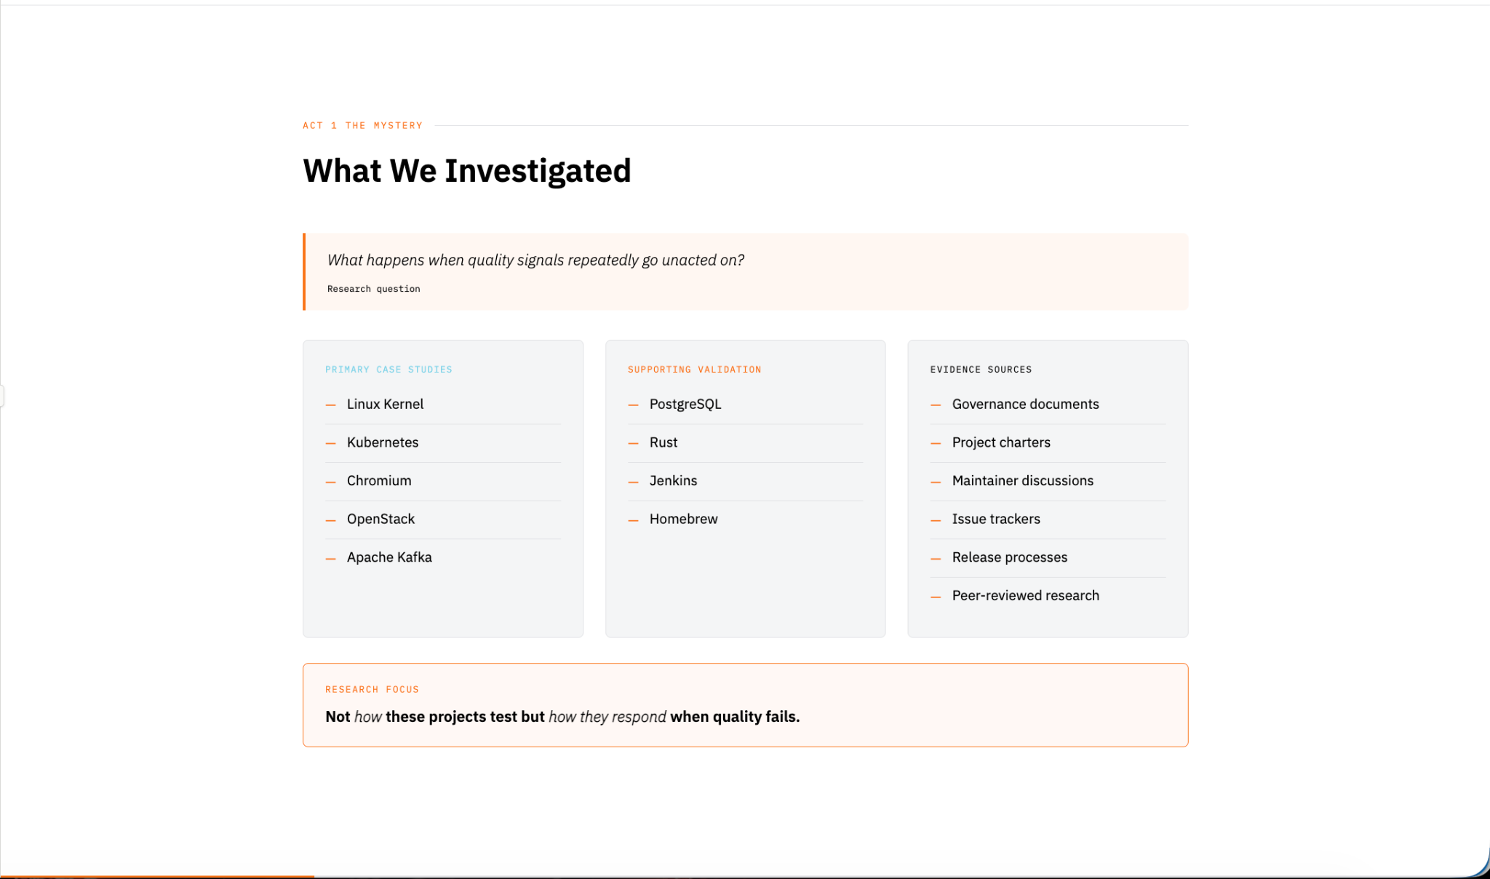
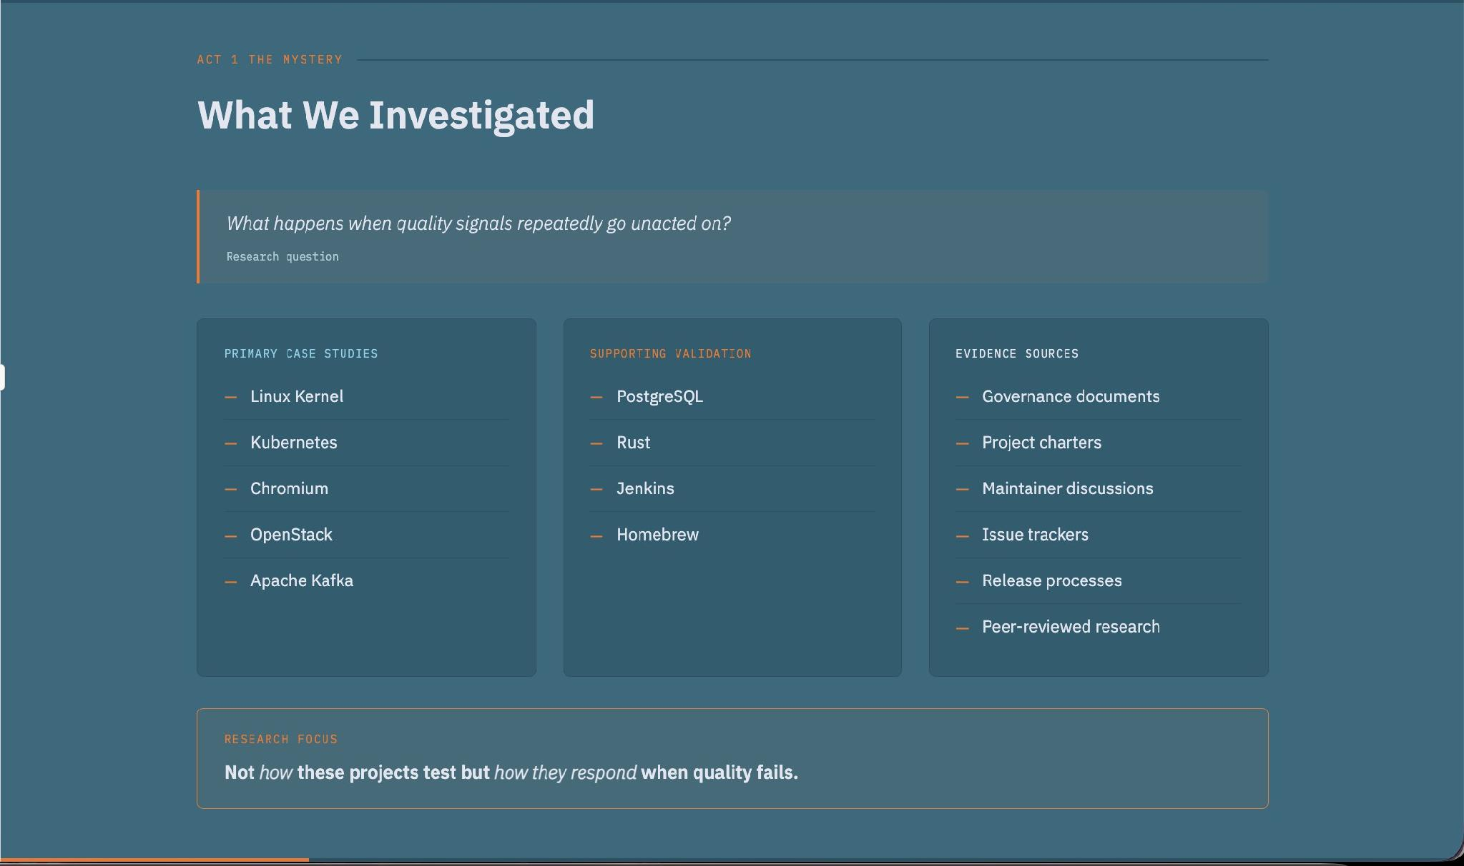
Notes:
I examined publicly available governance documents, maintainer discussions, project charters, postmortems, and technical documentation across several mature open source ecosystems.
The projects included Kafka, Chromium, Linux, Kubernetes, and OpenStack.
I wasn't trying to compare testing frameworks.
I wasn't trying to evaluate automation tools.
I was looking for something different.
I wanted to understand what happens after a quality signal appears.
Who sees it?
Who owns it?
Who acts on it?
And what happens if nobody does?
As I reviewed the evidence, a pattern started to emerge.

Slide 5
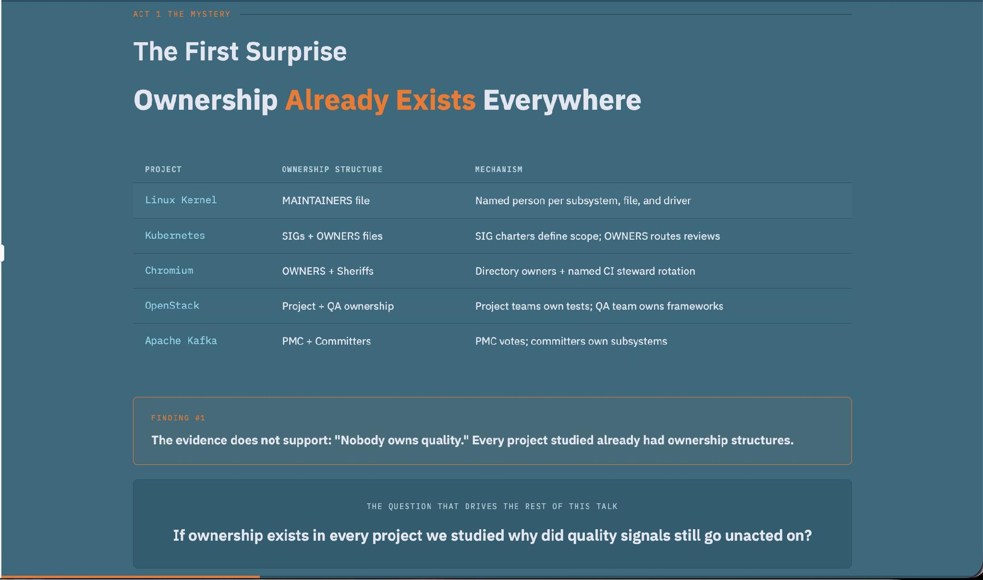
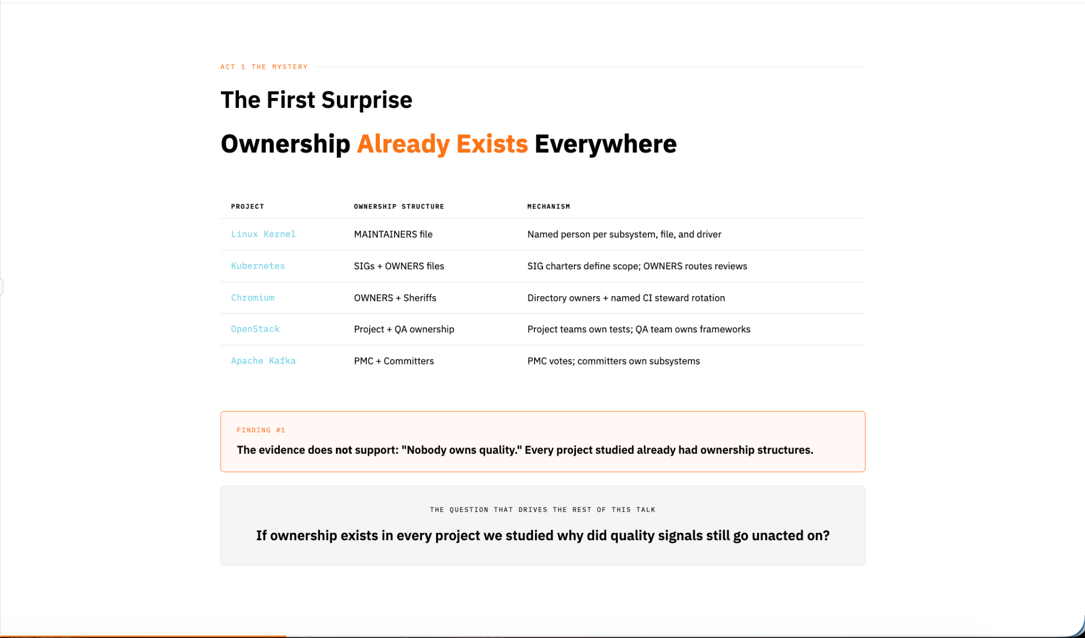
Notes:
One of the most surprising findings was that the common statement "nobody owns quality" isn't really true.
Most mature open source projects already have ownership structures.
They have maintainers.
They have subsystem owners.
They have SIGs, working groups, release teams, and governance models.
Ownership exists.
The real question isn't whether ownership exists.
The real question is:
Why do quality problems persist even when ownership exists?
Across the projects I studied, the answer appeared repeatedly in three recurring failure modes.

Slide 6
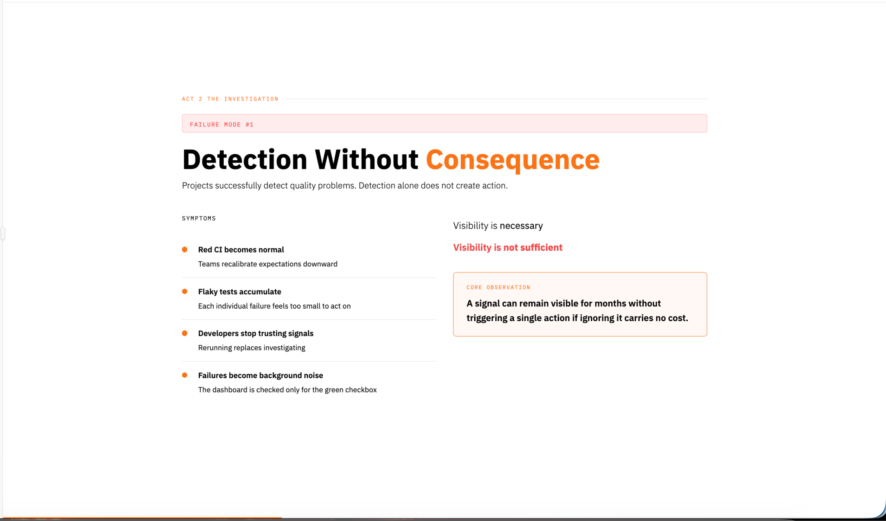
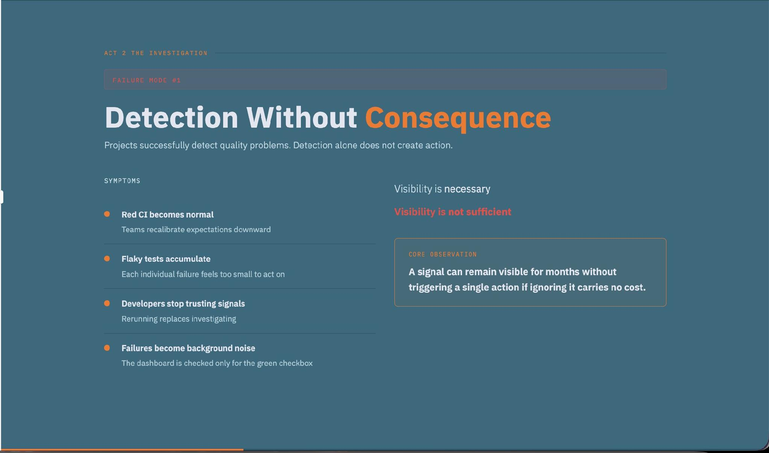
Notes:
The first failure mode is Detection Without Consequence.
Projects successfully detect quality problems.
Dashboards show failures.
CI reports issues.
Alerts are generated.
Everyone can see the problem.
But visibility alone does not create action.
Over time, red builds become normal.
Flaky tests accumulate.
Developers stop trusting the signal.
Failures become background noise.
The key observation is this:
A signal can remain visible for months if ignoring it carries no meaningful cost.
Kafka and Chromium both provide examples of this pattern.

Slide 7
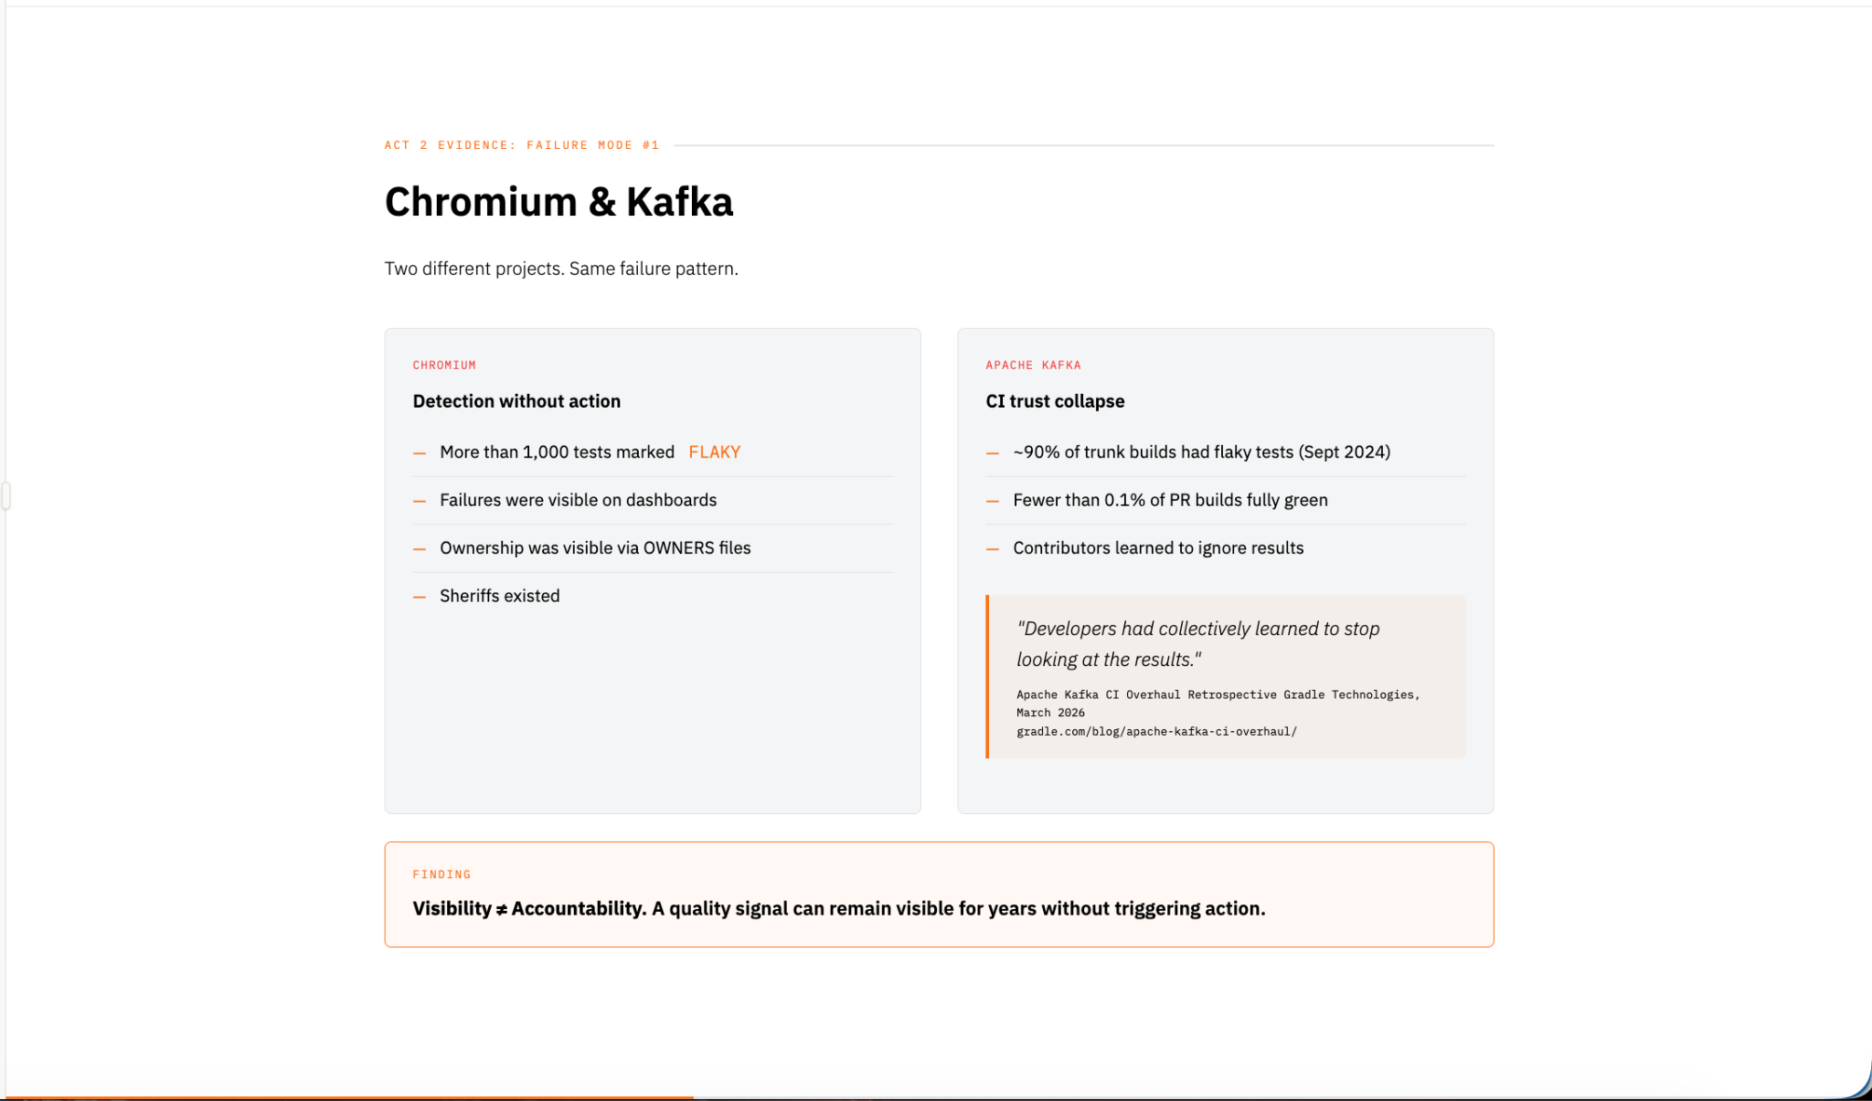
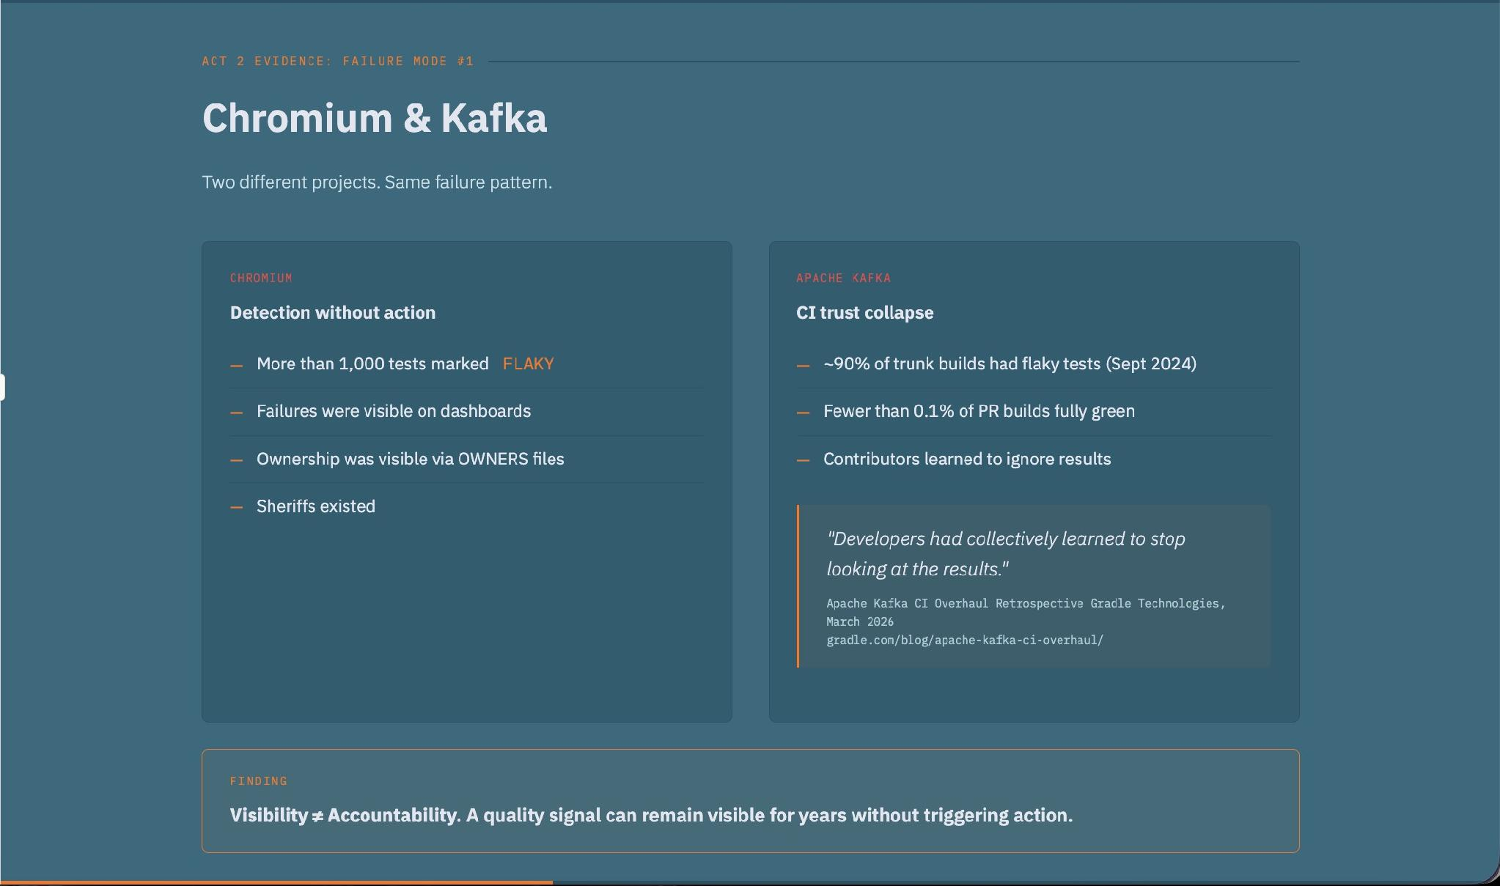
Notes:
Let's start with Kafka.
David Arthur described a situation where developers had collectively learned to stop looking at CI results.
The signal existed.
The problem was visible.
But the signal had lost credibility.
Chromium experienced something similar with a large backlog of flaky tests.
Again, the issue wasn't detection.
The issue wasn't monitoring.
The issue wasn't visibility.
The issue was consequence.
The projects could see the problem.
The challenge was creating a system where the signal actually triggered action.
So what changed?
Linux provides an interesting answer.

Slide 8
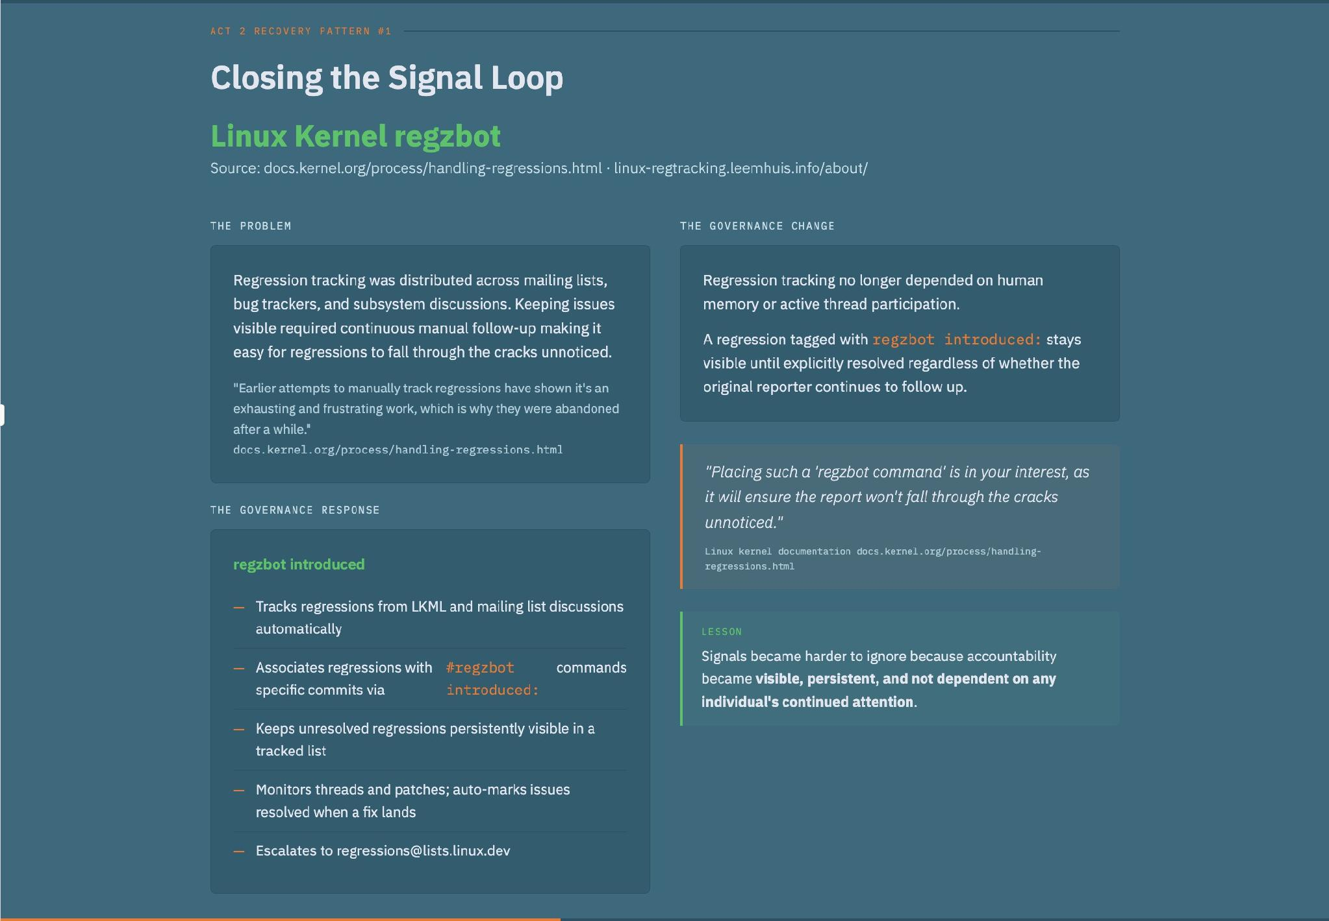
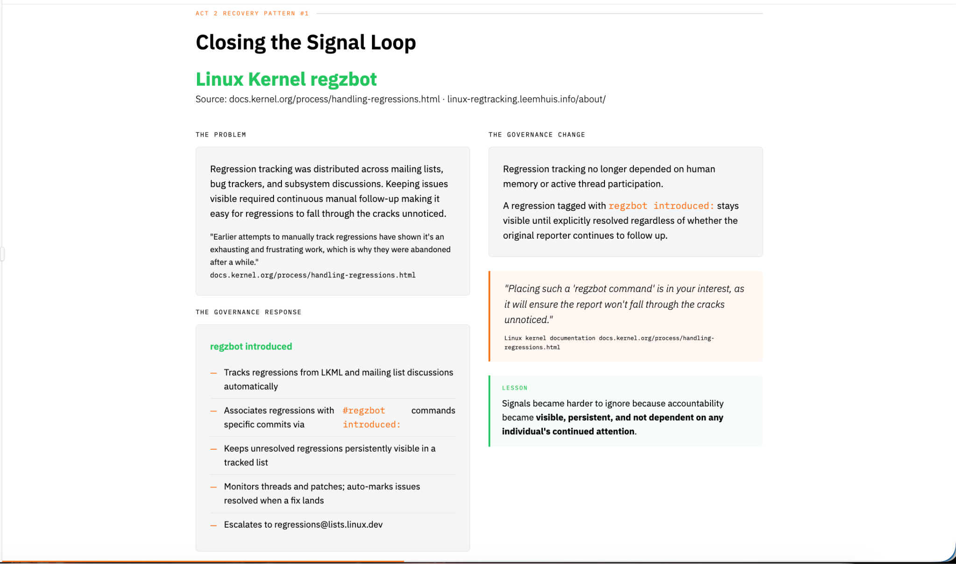
Notes:
Before regzbot, regression tracking in Linux was distributed across mailing lists, bug trackers, and subsystem discussions.
Keeping regressions visible required continuous manual follow-up.
In a project as large and distributed as Linux, that becomes difficult to sustain.
The innovation wasn't a new testing framework.
The innovation was governance.
regzbot continuously tracked regressions, associated them with commits, kept them visible, and routed accountability.
The key change was that regression tracking no longer depended on human memory or active thread participation.
Linux didn't solve this by writing more tests.
It changed how accountability was tracked.
That leads us to the second failure mode.

Slide 9
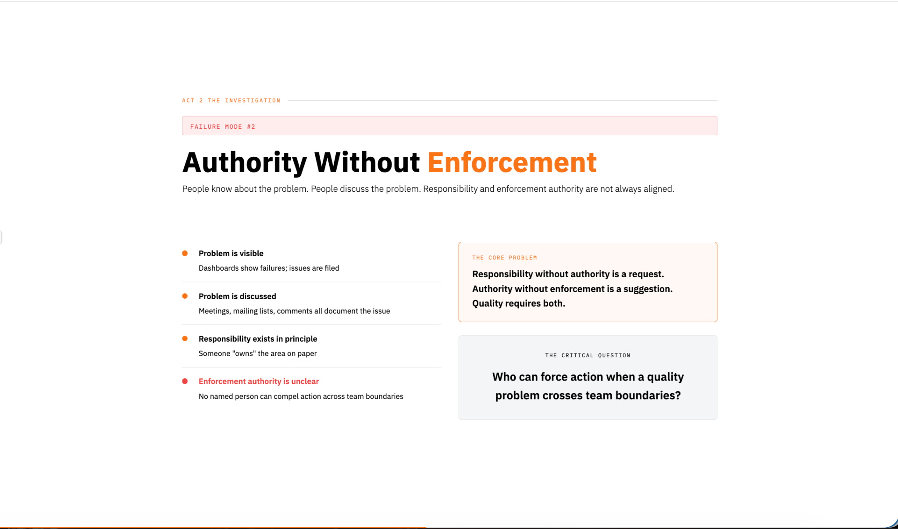
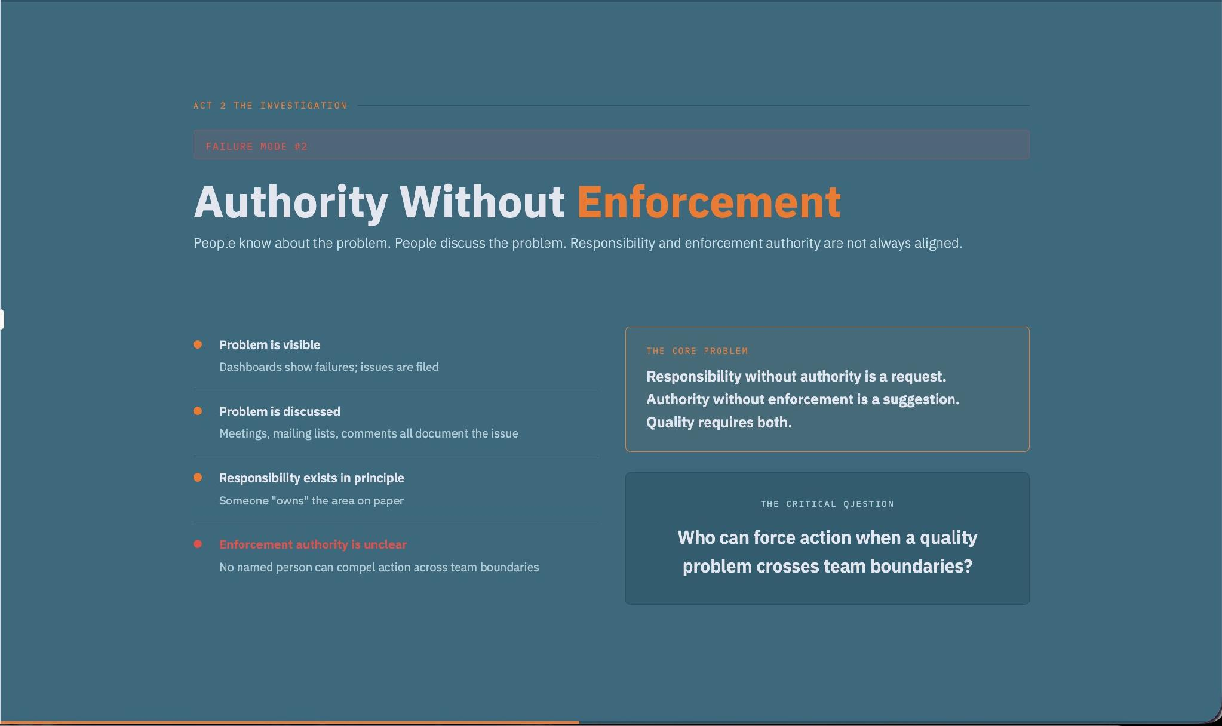
Notes:
Sometimes people know about the problem.
Sometimes people discuss the problem extensively.
Yet responsibility and enforcement authority are not aligned.
Someone may be responsible for reporting an issue.
Someone else may own the affected component.
A third group may maintain the infrastructure.
The result is that everyone knows the problem exists, but nobody has clear authority to enforce action.
Knowing about a problem is not the same as being able to resolve it.
Kubernetes and Chromium illustrate this difference very well.

Slide 10
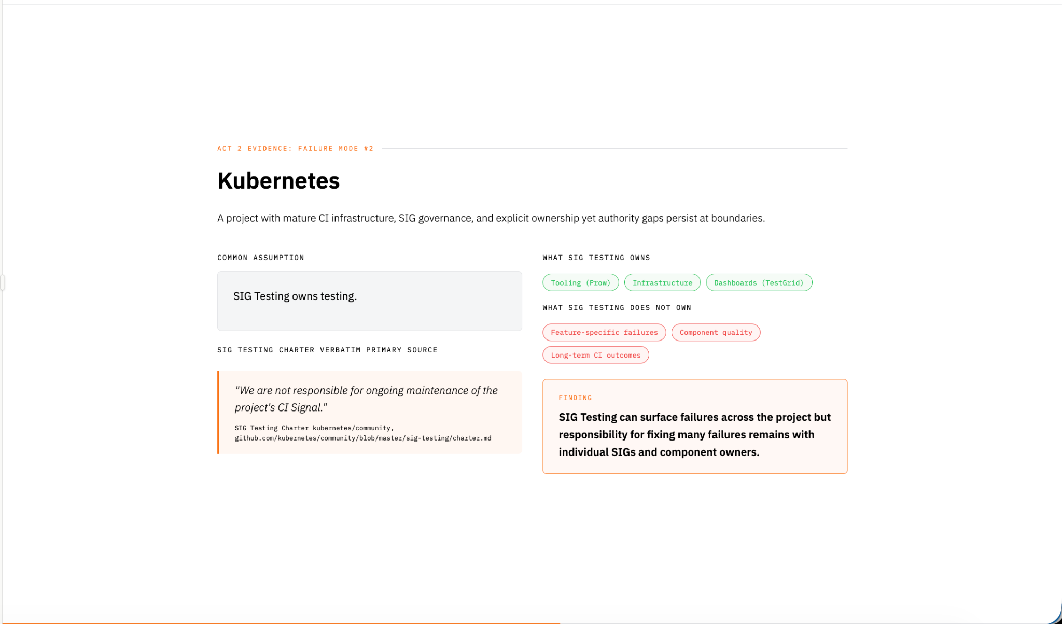
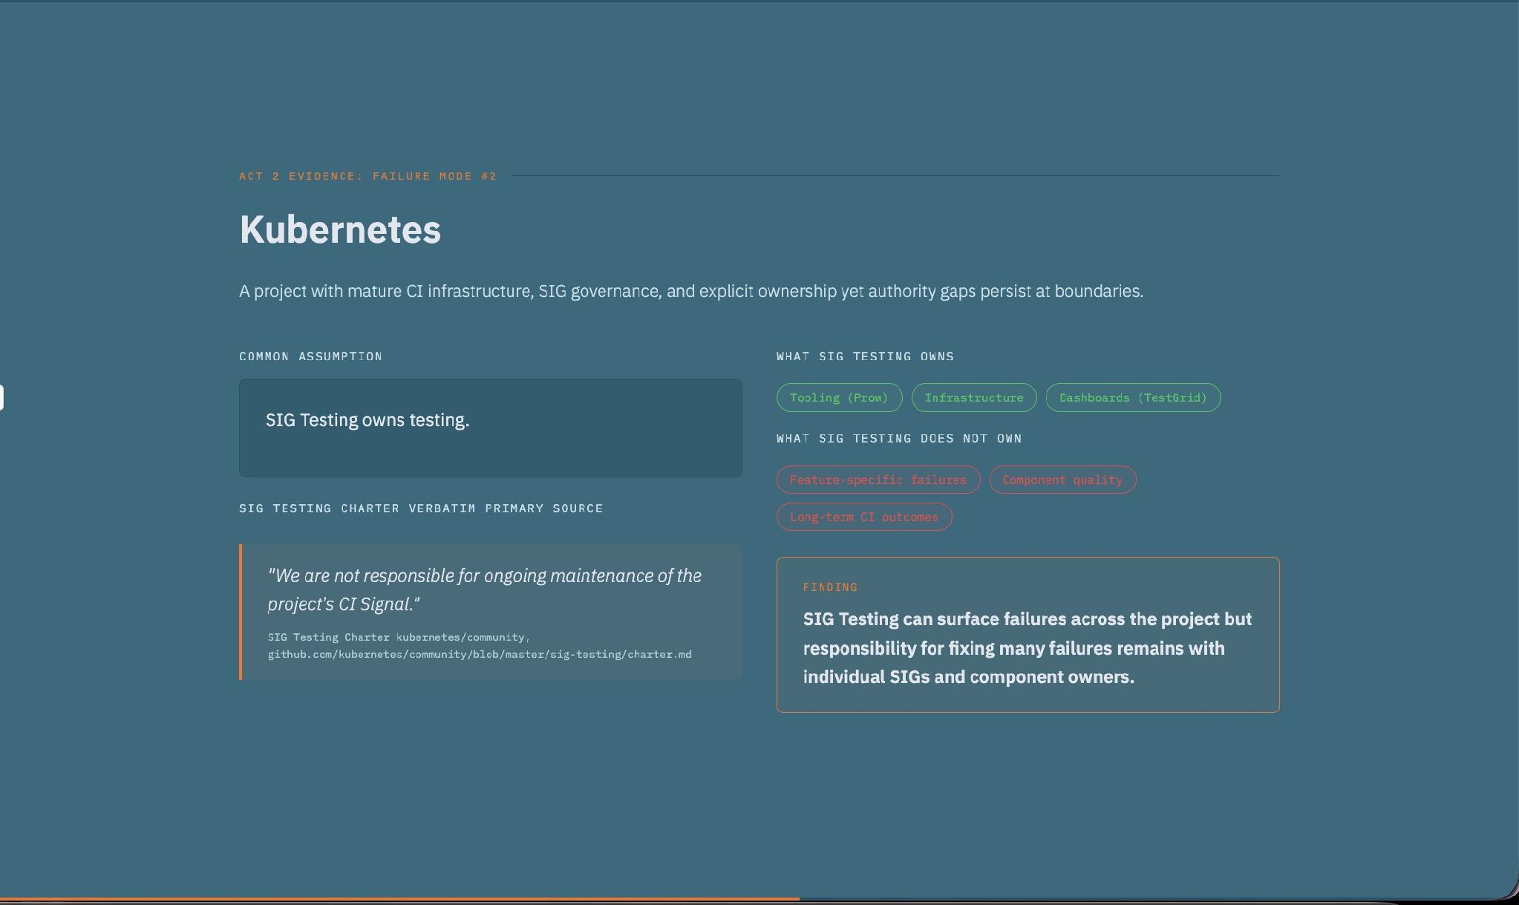
Notes:
Many people assume that Kubernetes SIG Testing owns testing quality across the project.
The reality is more nuanced.
SIG Testing owns infrastructure, tooling, and visibility.
It operates systems like Prow and TestGrid.
But as the charter explicitly states, SIG Testing is not responsible for ongoing maintenance of the project's CI signal.
This creates an interesting governance structure.
Visibility is centralized.
Remediation authority is distributed.
The lesson here is that seeing a problem and fixing a problem are not necessarily owned by the same group.
Chromium approaches this differently.

Slide 11
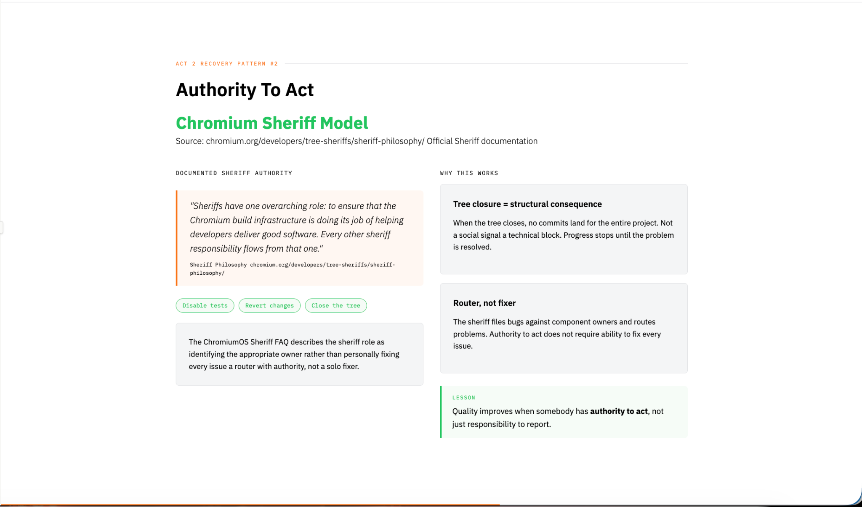
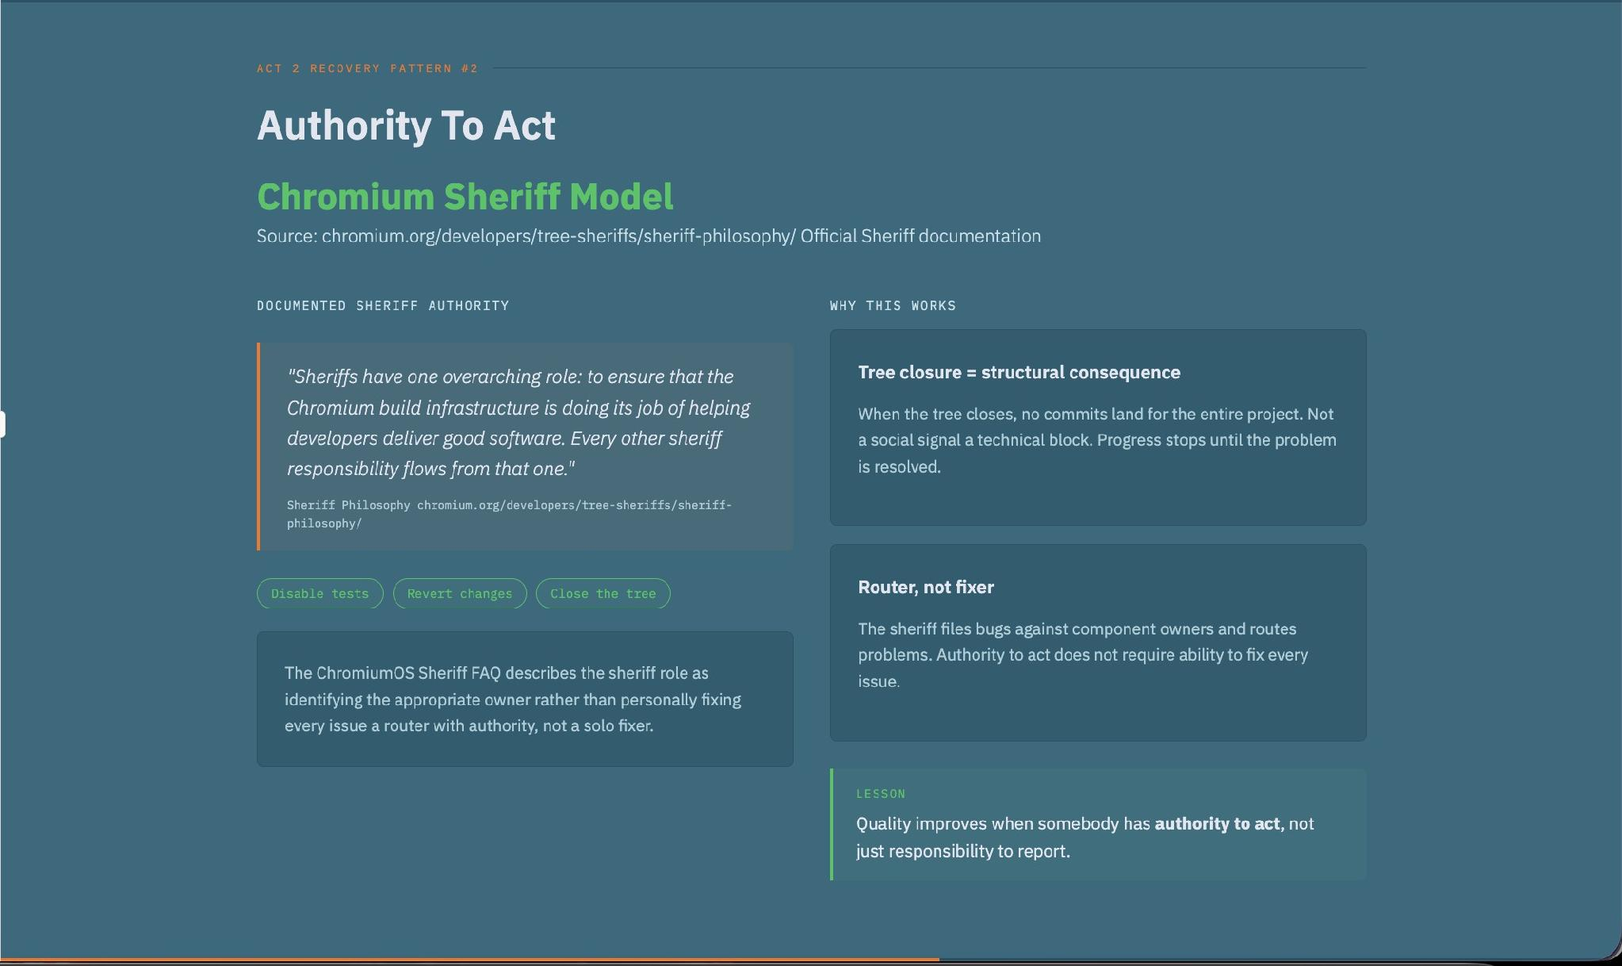
Notes:
Chromium created a role called the Sheriff.
The Sheriff has explicit authority.
They can disable tests.
They can revert changes.
They can close the tree.
What's important is that the Sheriff doesn't have to personally fix every issue.
Their job is to ensure that quality problems become somebody's responsibility.
The Sheriff acts as an enforcement mechanism.
This is a key governance insight.
Quality improves when somebody has authority to act, not just responsibility to report.
The third failure mode appears when ownership crosses organizational boundaries.

Slide 12
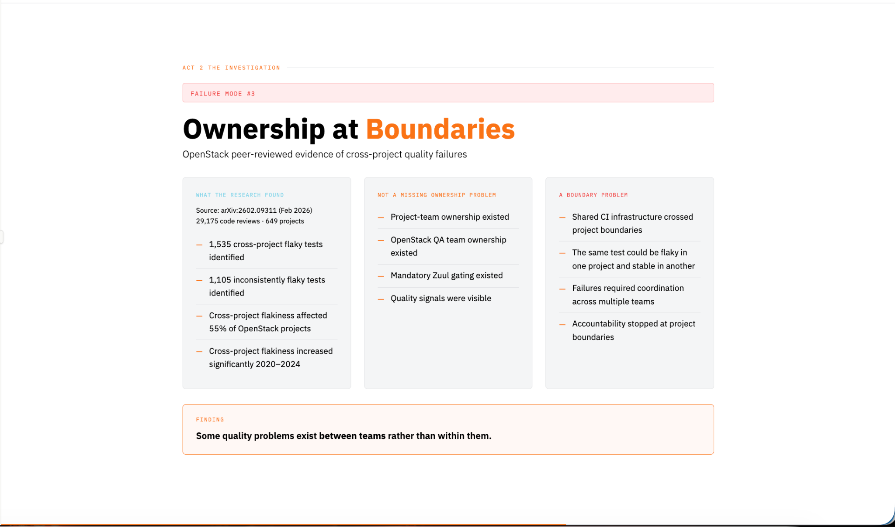
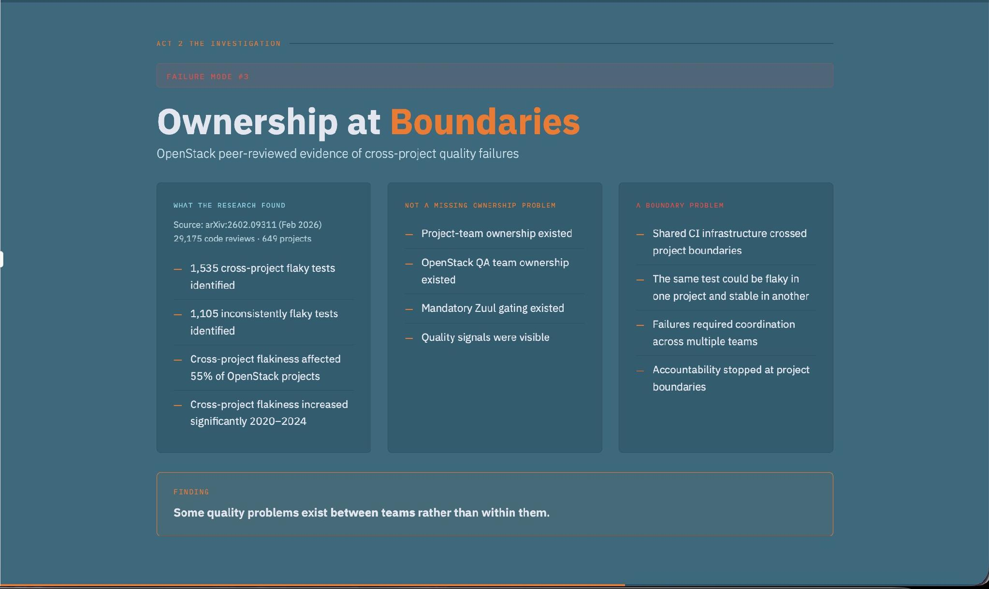
Notes:
Ownership usually works well within a team.
Problems become more difficult when multiple teams share responsibility.
OpenStack provides a useful example.
Researchers found shared CI jobs affecting multiple projects simultaneously.
The same quality signal crossed project boundaries.
Everyone owned part of the problem.
Nobody owned the whole problem.
This is one of the hardest governance challenges to solve because technical systems rarely align perfectly with organizational structures.

Slide 13
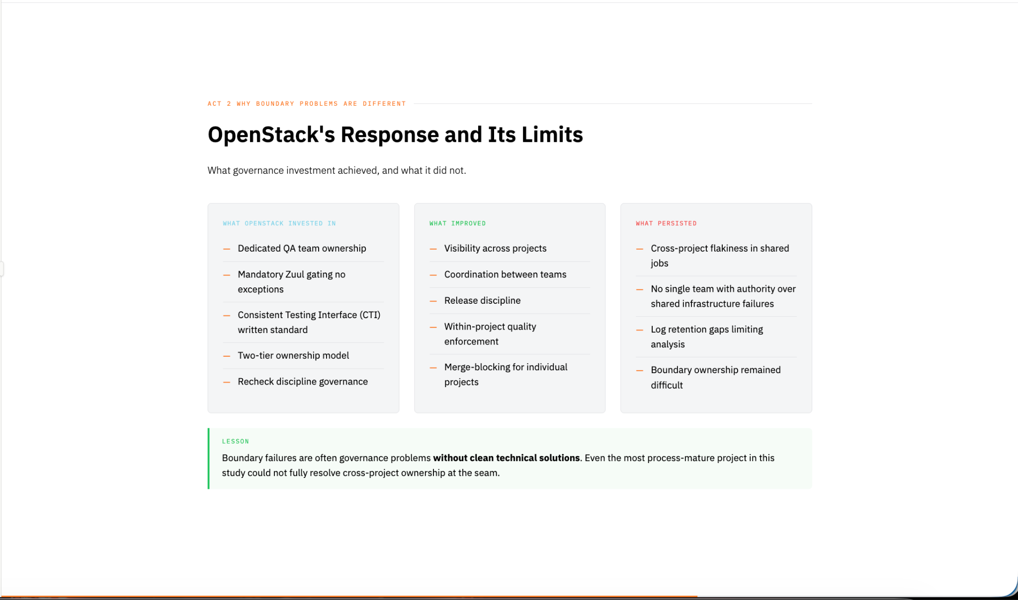
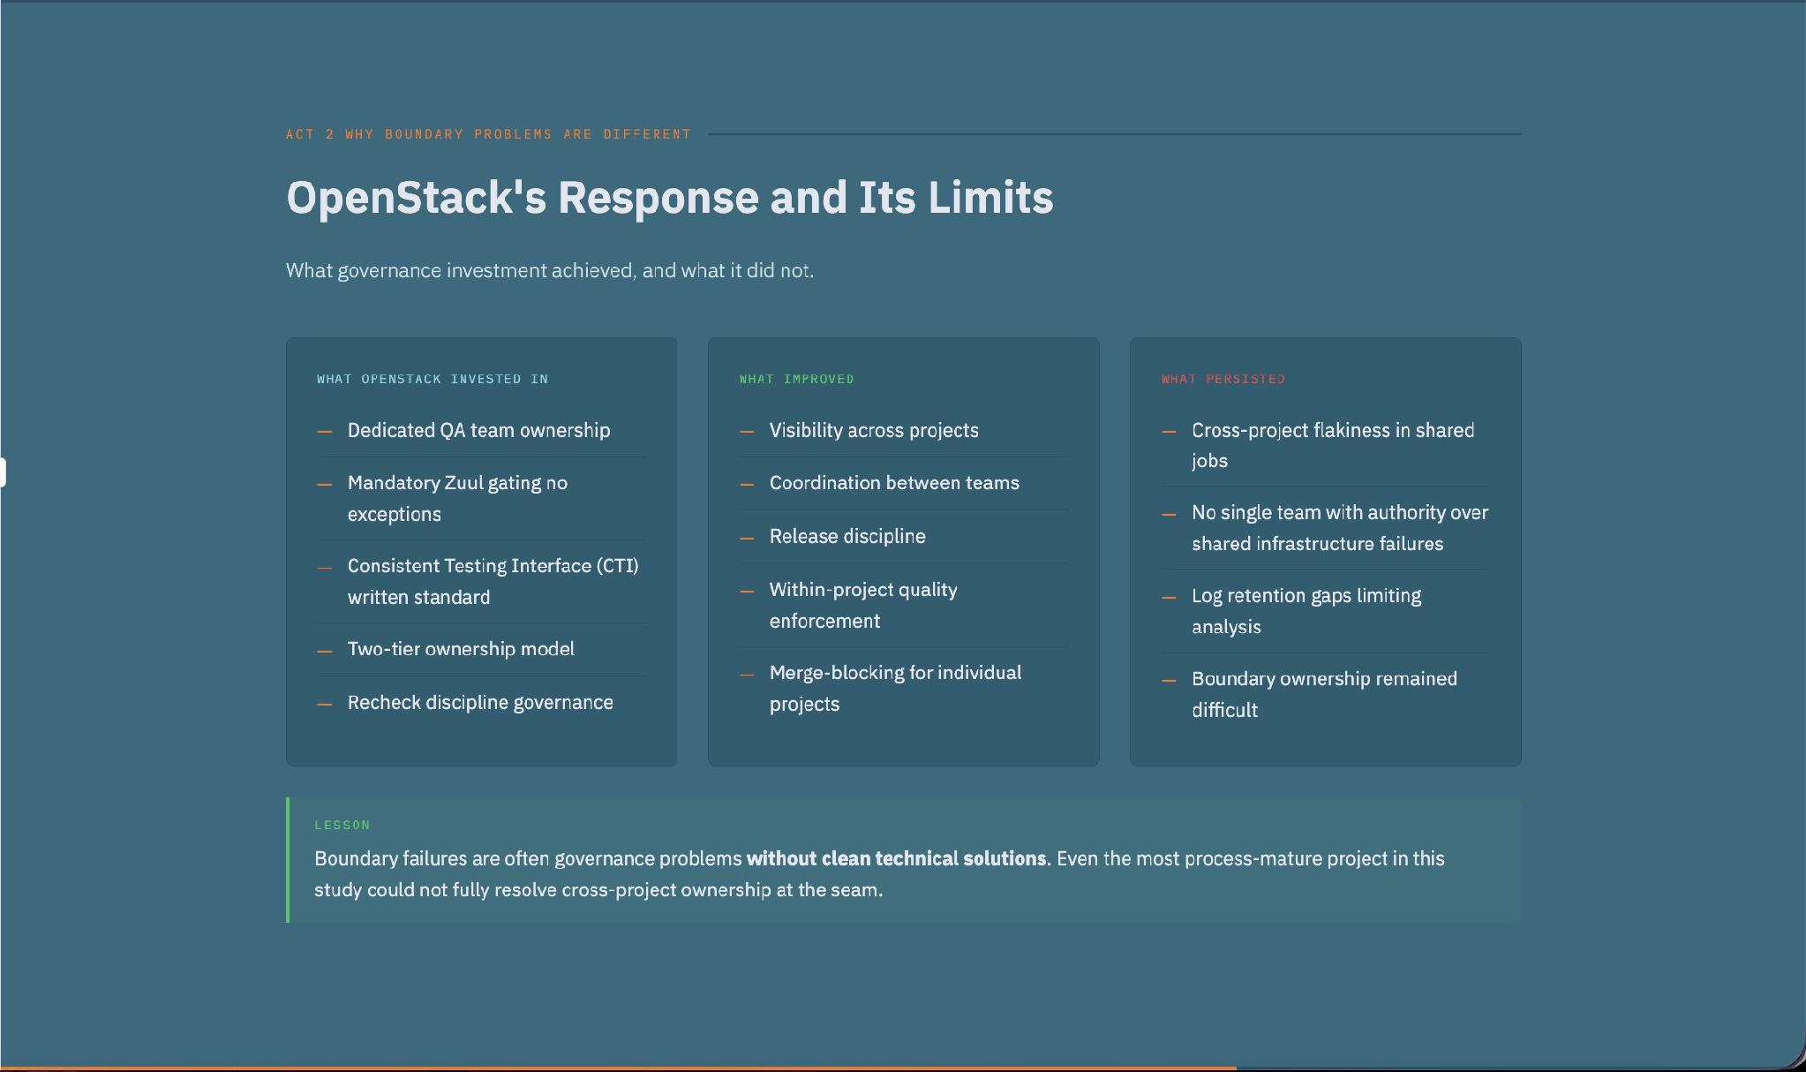
Notes:
OpenStack introduced coordination mechanisms and governance structures to address these issues.
But the interesting finding is that boundary problems didn't disappear completely.
Unlike the previous two failure modes, there isn't a clean success story here.
Boundary failures remain difficult because ownership becomes fragmented.
The lesson is important:
Some quality problems are governance problems without purely technical solutions.

Slide 14
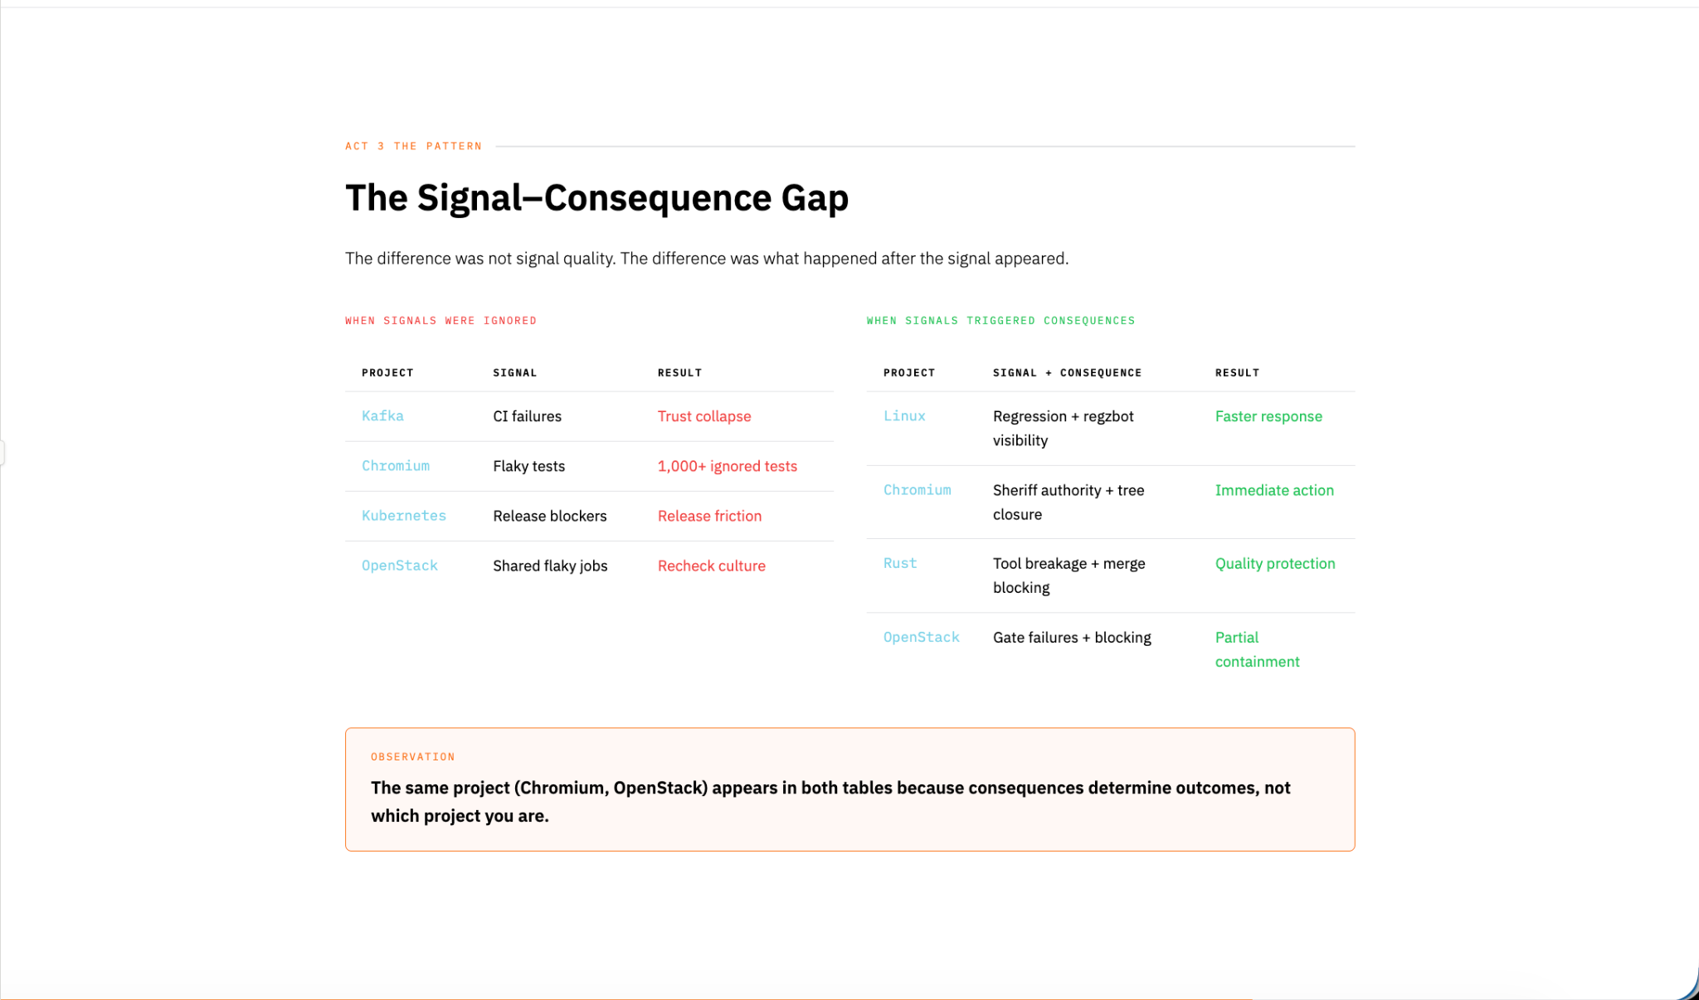
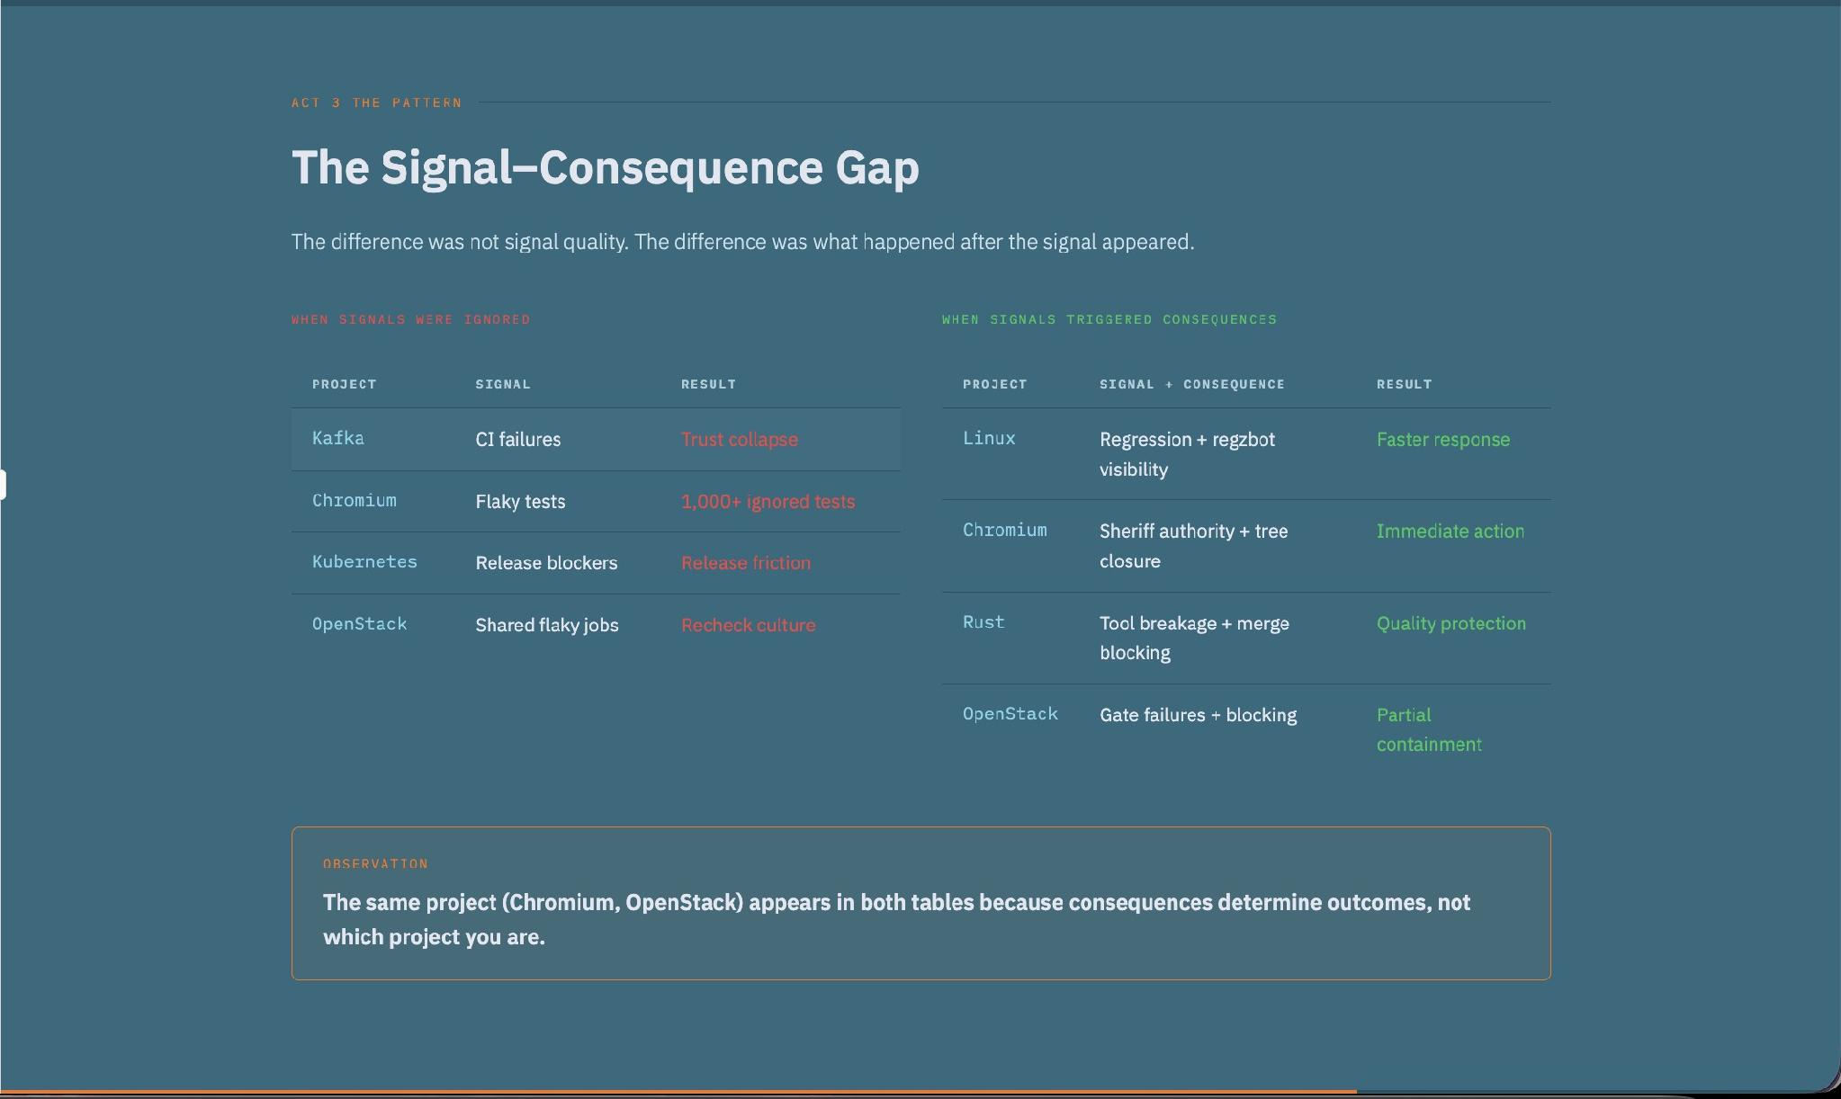
Notes:
At this point, the pattern became visible.
Across multiple projects, the same gap appeared.
Signals were detected.
Failures were visible.
Ownership structures existed.
But consequences were inconsistent.
The critical question isn't whether a signal exists.
The critical question is what happens after the signal appears.
That gap between signal and response became the central pattern across all the projects studied.

Slide 15
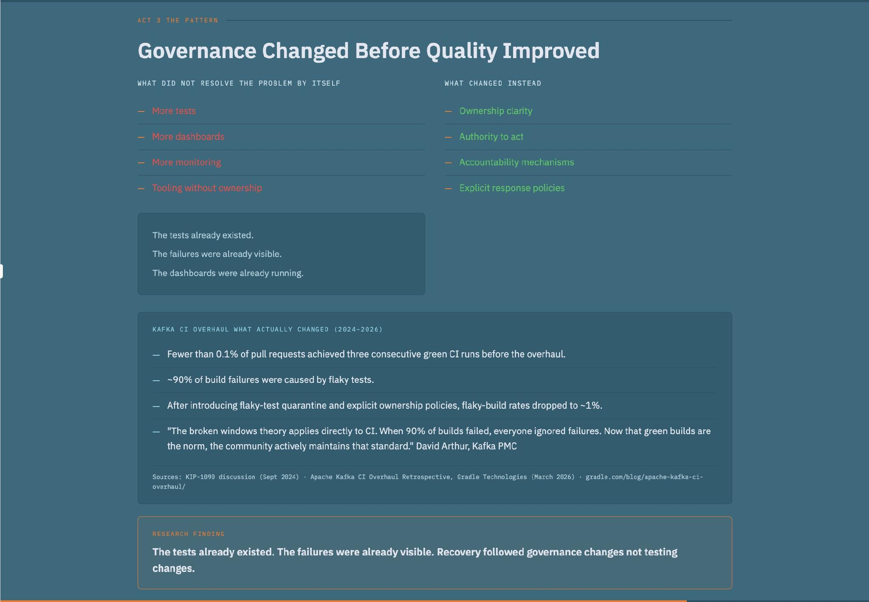
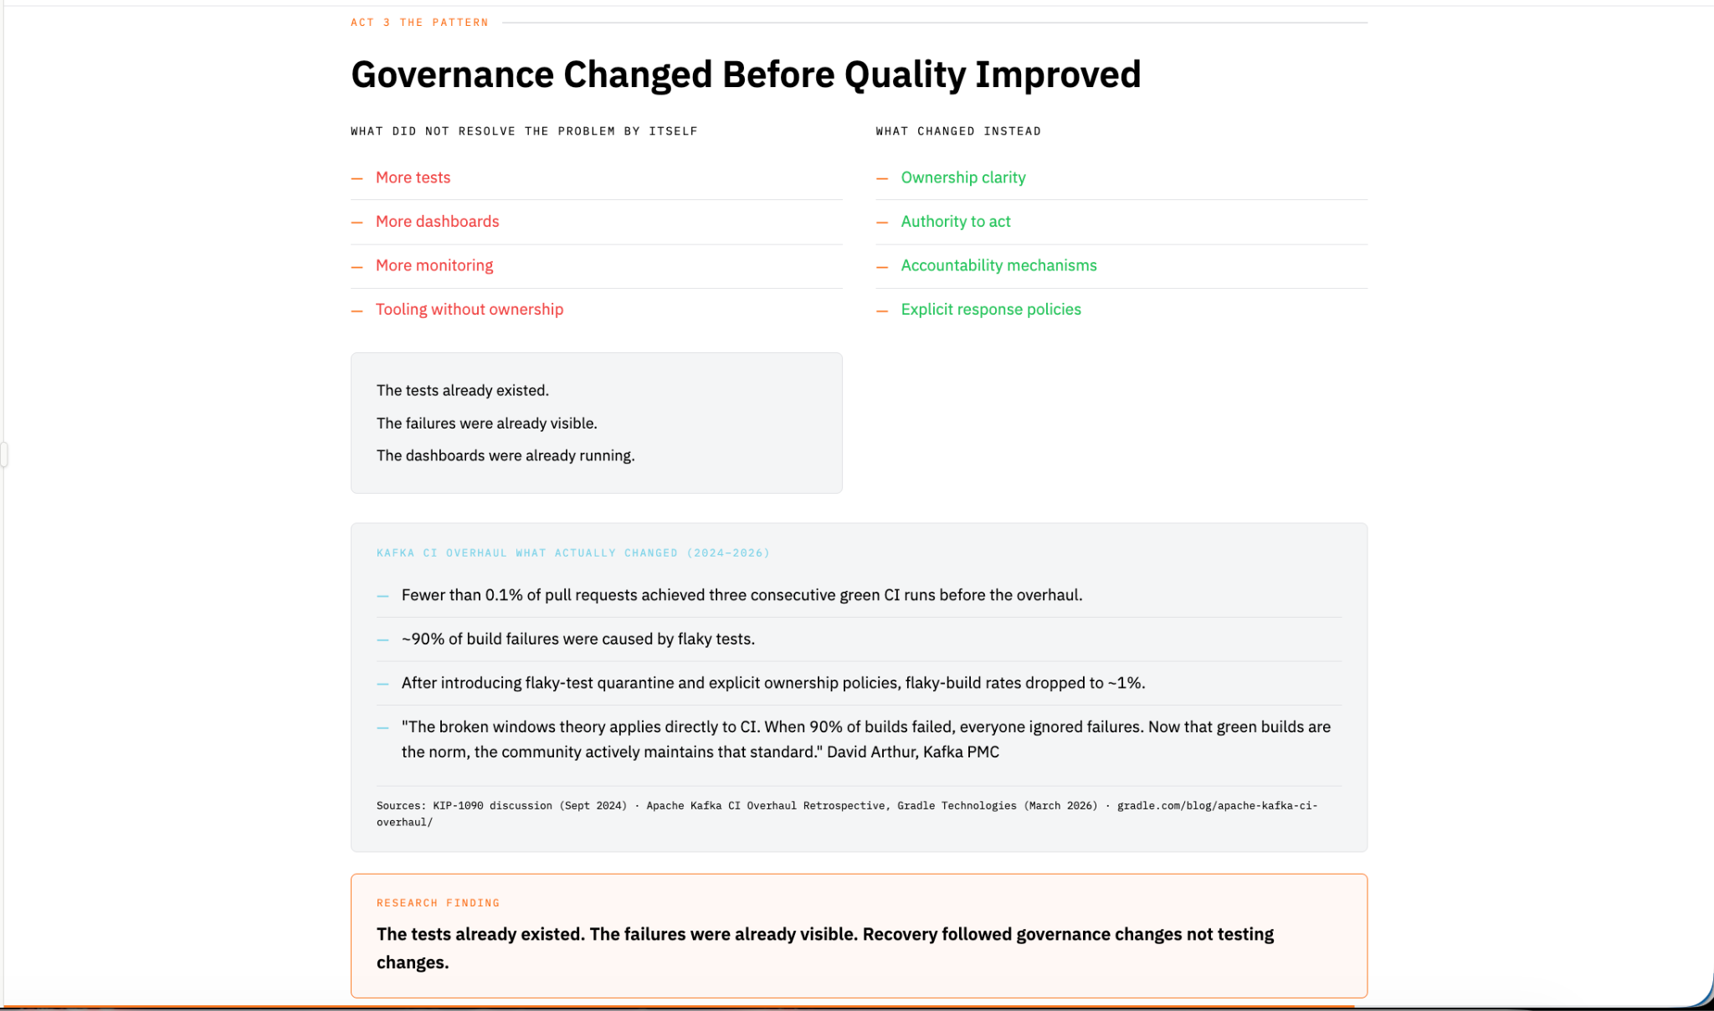
Notes:
The tests already existed.
The failures were already visible.
The dashboards were already running.
What changed wasn't detection.
What changed was ownership, authority, accountability, and response mechanisms.
Kafka improved tooling.
Linux introduced regzbot.
Chromium formalized enforcement through Sheriffs.
Each project made governance changes that helped connect signals to action.
The important observation is not that testing improvements were irrelevant.
The observation is that governance changes consistently appeared alongside successful recovery efforts.

Slide 16
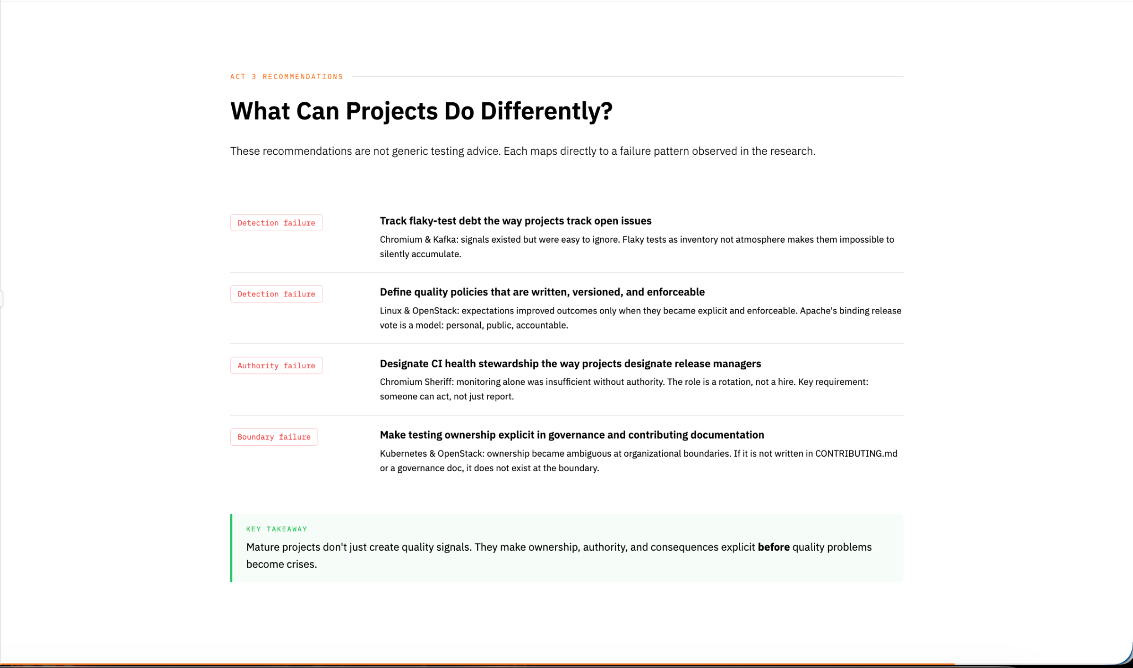
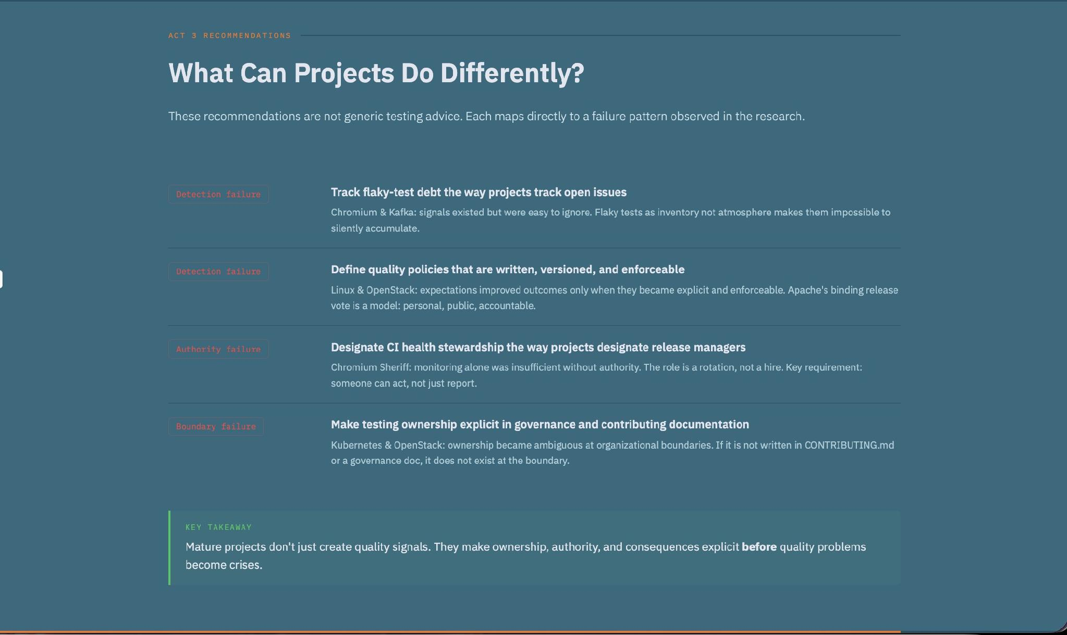
Notes:
Based on these patterns, I have four recommendations.
First, track flaky-test debt the way projects track open issues.
Second, define quality policies that are written, versioned, and enforceable.
Third, designate CI health stewardship the way projects designate release managers.
And fourth, make testing ownership explicit in governance and contributing documentation.
Notice that none of these recommendations require a new testing framework.
They require clearer ownership and stronger response mechanisms.

Slide 17
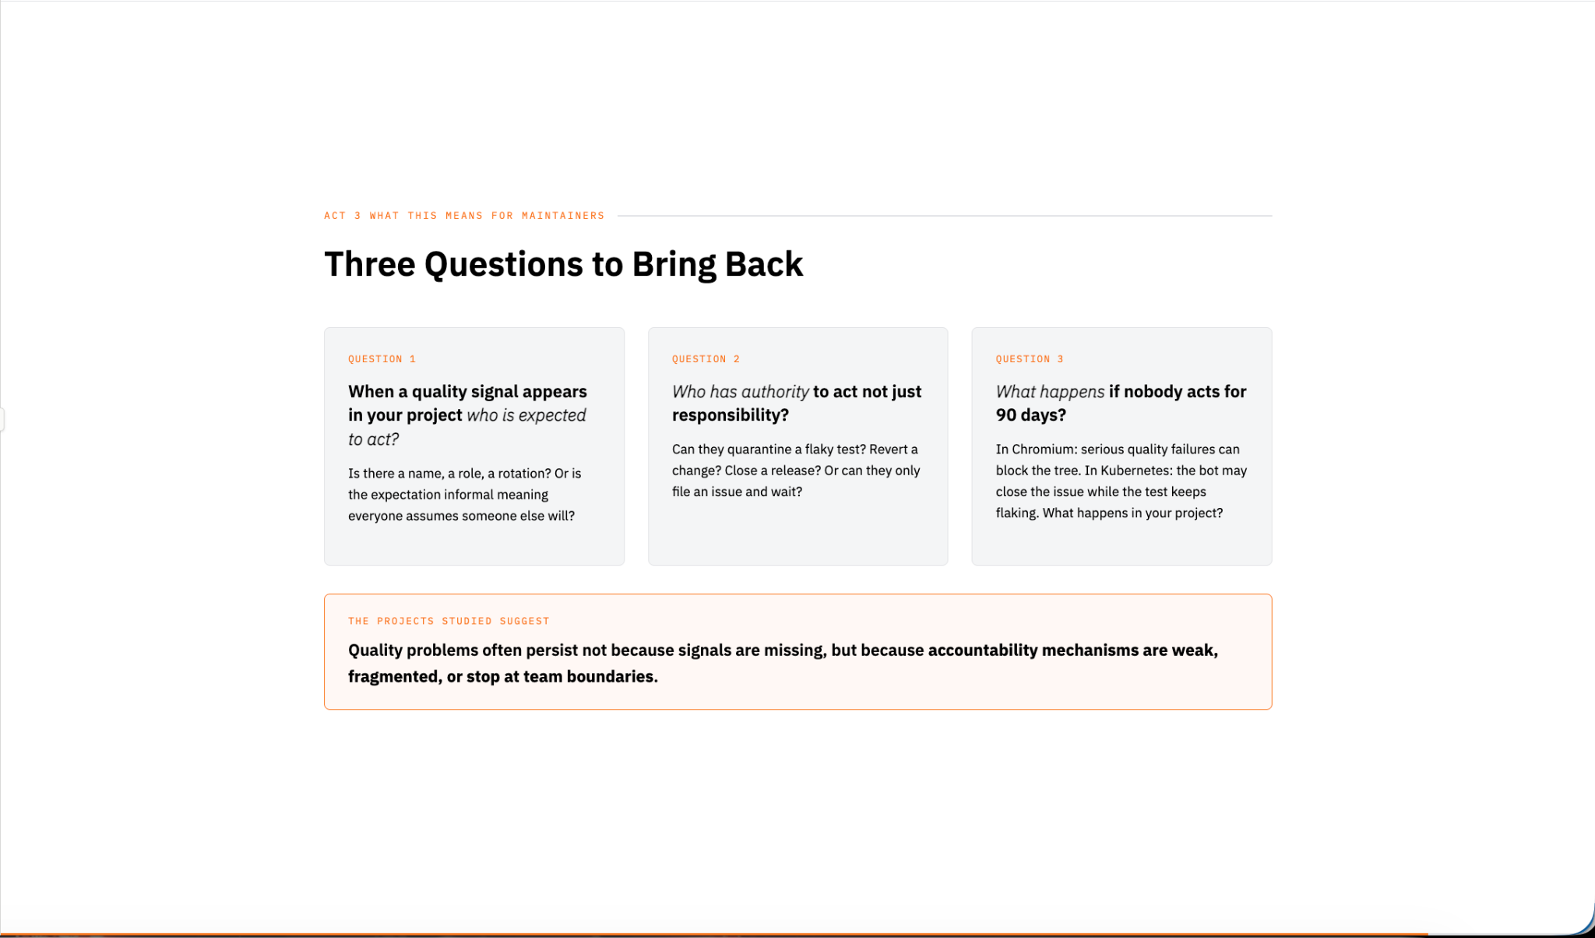
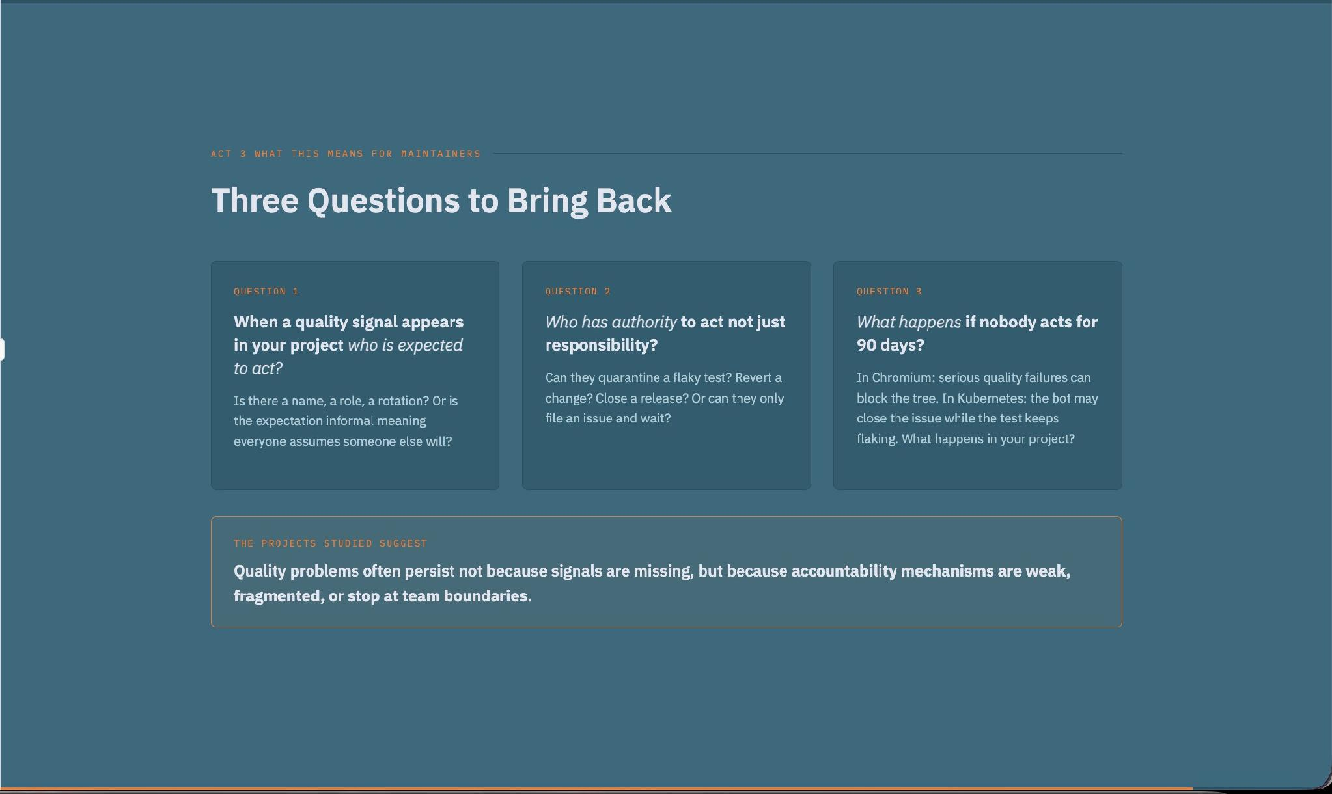
Notes:
I'd like to leave you with three questions.
When a quality signal appears in your project, who is expected to act?
Who has authority to act, not just responsibility?
And what happens if nobody acts for ninety days?
Most persistent quality problems can be traced back to an unclear answer to at least one of these questions.

Slide 18
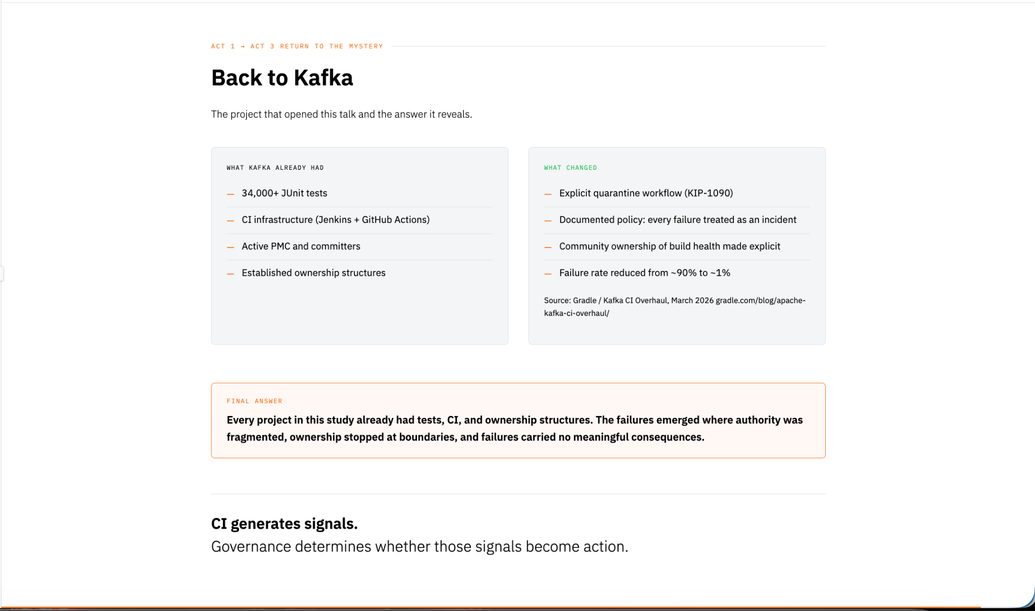
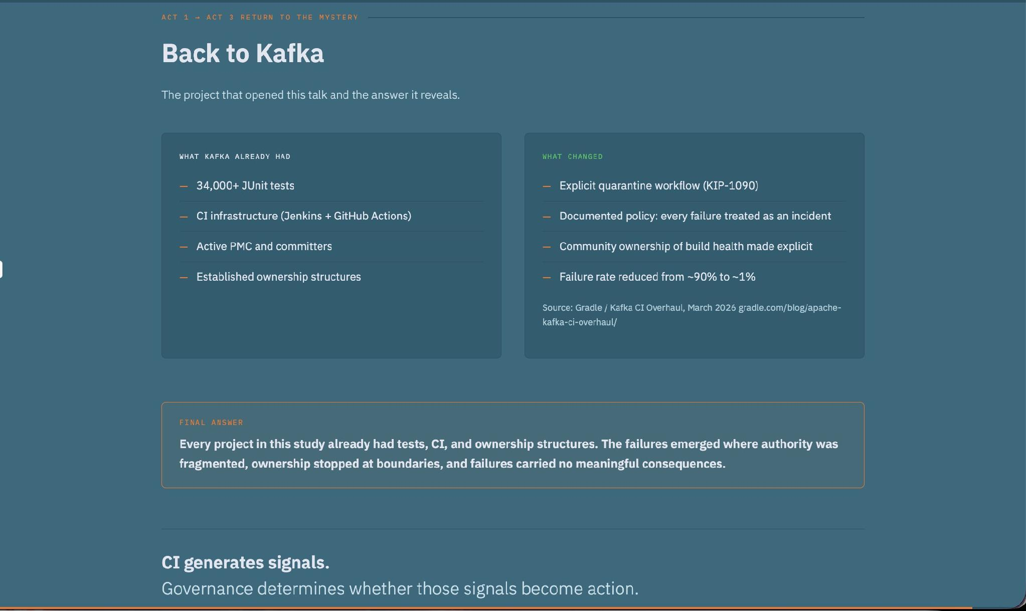
Notes:
Let's return to where we started.
Kafka already had tests.
Kafka already had CI.
Kafka already had ownership.
The problem wasn't missing signals.
Across the projects studied, quality problems rarely persisted because testing was absent.
They persisted when signals were easy to ignore, authority was fragmented, ownership became unclear at boundaries, and response mechanisms were weak.
The lesson is simple:
When nobody owns the response, eventually nobody owns the quality.
Thank you.

Slide 19
