Slide 1





Scientific Machine Learning With NVIDIA PhysicsNeMo
Samudyata Minasandra
Software Engineer at Curlscape Solutions
Aniket Kulkarni
Founder at Curlscape Solutions | OSS India 2026
#OSSUMMMIT

Slide 2

Contents
I. Foundations & Simulation
02 Every Product was Tested Before Built
03 When Simulation Didn't Exist
04 What Simulations Changed
05 Simulation Types
06-09 Simulation is Everywhere! (EVs, Phones, etc.)
10 The Bottleneck
II. AI & Neural Operators
11 Train Once, Predict Forever
12 Solving physics - PINNs
13 From Solutions to Operators
14 NVIDIA PhysicsNeMo
15 Transformer Surrogates for CFD
III. FlowForge Platform
16 FlowForge: All-in-One CFD Platform
17-18 Ingest: Get solver data in
19-20 Datasets: Inspect what you have
21-22 Train: Launch run in clicks
23-24 Monitor: Watch training live
25-26 Inference: Trained model, any Geometry
IV. Comparison & Summary
27-28 Performance Comparison
29 Conclusion
30 Thank You / Q&A
#OSSUMMIT

Slide 3
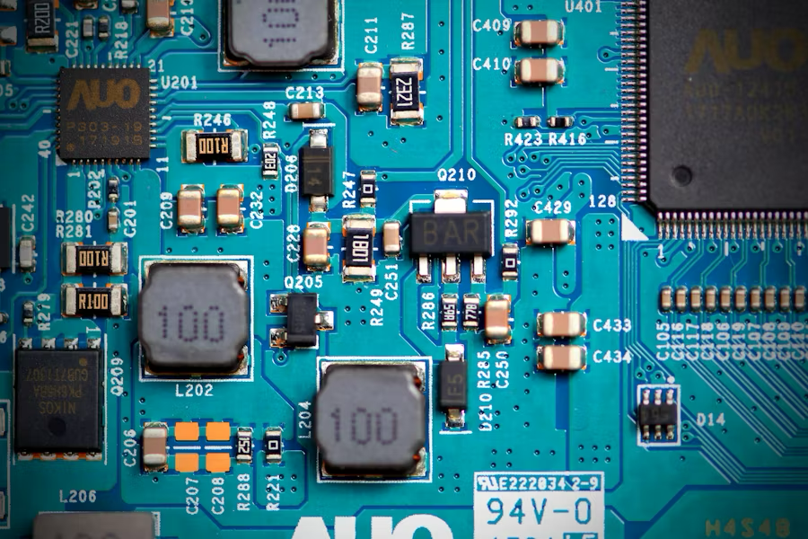

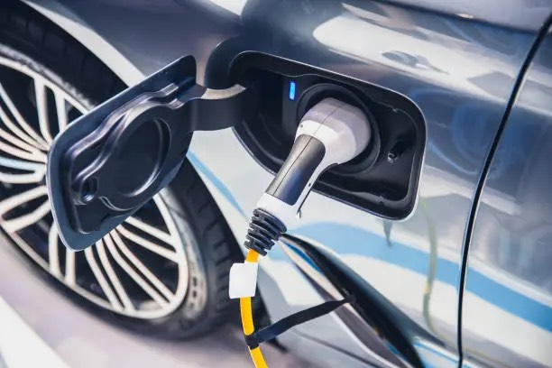
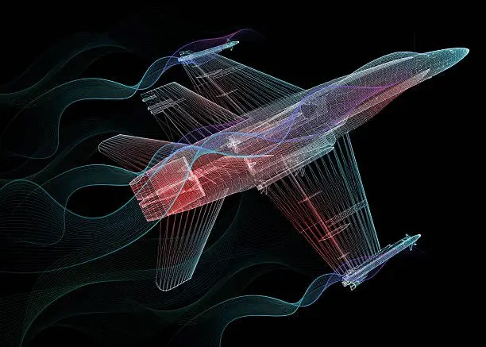


Every Product You Use was Tested Before It was Built
Electronics
Preventing overheating before a phone ships.
Data Centers
Optimizing thermal airflow management.
EV Batteries
Sizing cooling channels for sealed packs.
Aerospace
Shaping wings for minimum drag efficiency.
The Answer is Simulation!
Simulation solves the physics on a computer so you don't have to build and fail physically
But simulation is slow. That's where this story begins!
Notes:
Almost every engineered product you use today was simulated before it was physically built.
Before a phone ships, engineers need to know it won't overheat.
Before a data center goes live, engineers need to know that cool air can reach every rack.
Before an EV battery pack is sealed, cooling channels need to be designed correctly.
And before an aircraft flies, engineers need to know how air will flow around the wings.
Instead of building hundreds of prototypes and hoping for the best, we solve the physics on a computer first.
That's simulation.
And to appreciate why simulation is so valuable today, let's briefly look at a world where it didn't exist.

Slide 4
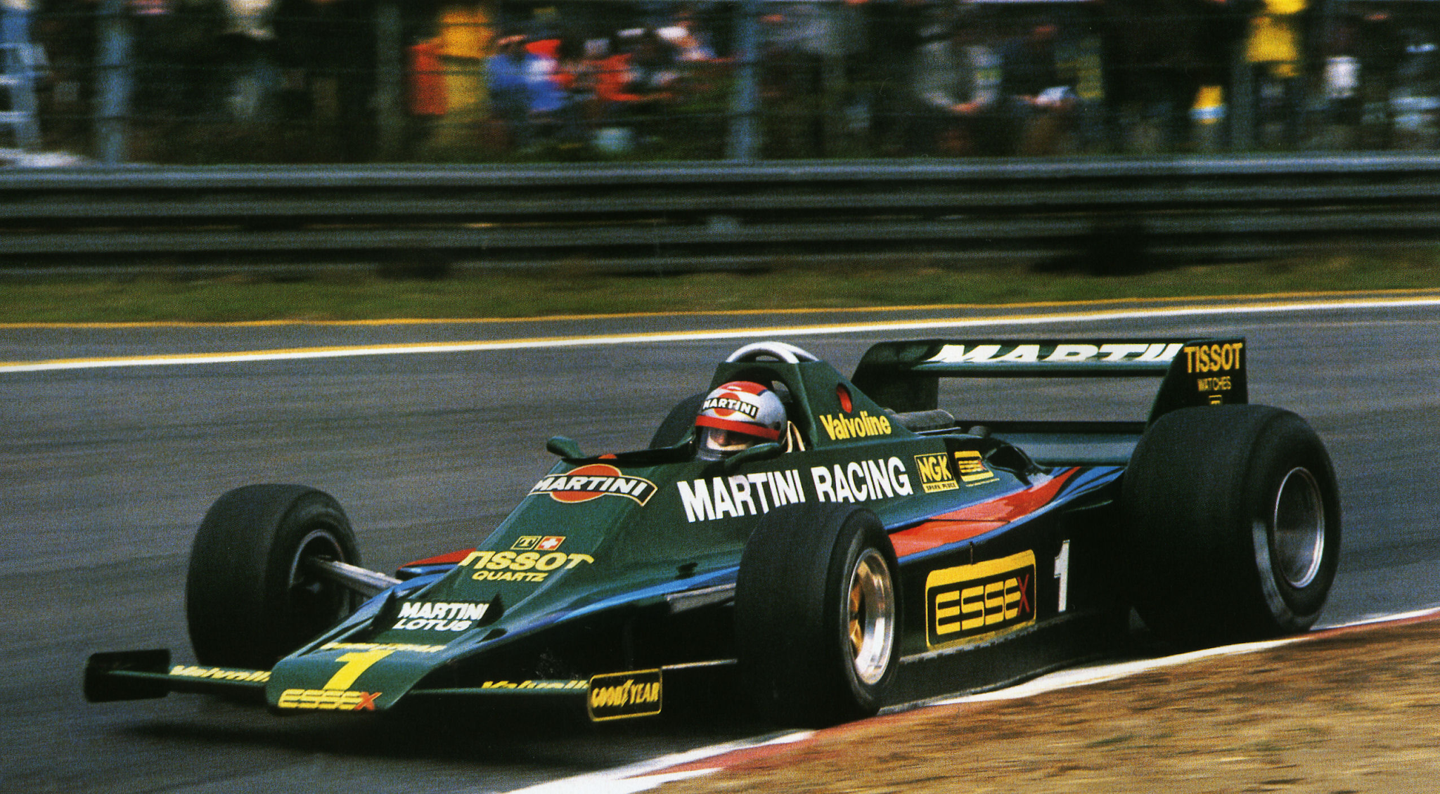
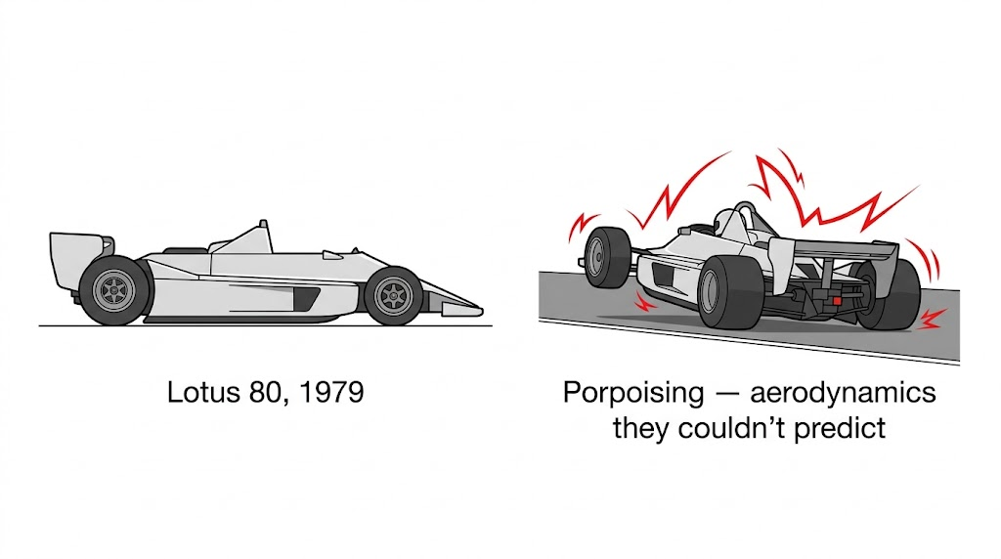
When Simulation Didn't Exist
F1 Racing (Pre-Simulation)
Teams relied on physical intuition and trial-and-error, often leading to dangerous and unpredictable car behavior.
Lotus 80, 1979
Porpoising: Aerodynamics they couldn't predict without modern computational tools.
#OSSUMMIT
Notes:
I want to take you back to Formula 1 in 1979.
One of the greatest engineers in motorsport history, Colin Chapman, designed a car called the Lotus 80.
To understand why this mattered, you need to know one thing about Formula 1 engineering:
At high speeds, engineers are essentially trying to glue the car to the road.
The harder you can push the car into the track, the faster it can corner, brake, and accelerate.
Chapman's idea was brilliant. He designed the entire underside of the car to act like an upside-down wing, using what is called ground effect to generate enormous downforce.
In theory, the car should have been incredibly fast.
The problem was that there was no practical CFD workflow available to predict what would happen when the car's ride height changed at 150 miles per hour.
So they built it and tested it on the track.
And what they discovered was terrifying.
As the car got closer to the ground, it generated more downforce. But that downforce pulled the car even closer to the ground, which changed the airflow underneath it. Suddenly the downforce would disappear, the car would rise again, the airflow would recover, and the cycle would repeat.
The result was violent oscillations known as porpoising — the car repeatedly lifting and slamming back onto the track at high speed.
Drivers lost confidence in it, the concept was abandoned, and the car became one of Formula 1's most famous engineering failures.
Today, we'd simulate thousands of operating conditions before the car ever touched a racetrack.
Back then, engineers had to discover those problems physically.
That is exactly what CFD changed.

Slide 5
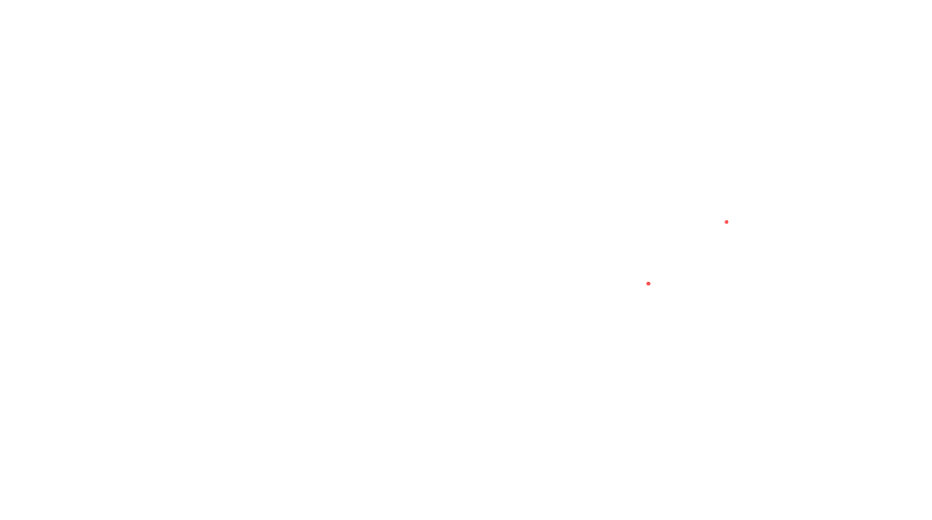
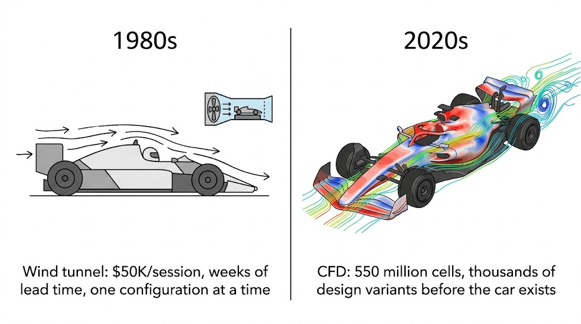
What Simulations Changed:
Notes:
CFD stands for Computational Fluid Dynamics.
It moved engineering from physical trial-and-error to virtual experimentation.
Instead of building one design and testing it, engineers can evaluate hundreds or even thousands of designs on a computer.
What you're seeing here is a comparison between traditional testing approaches and modern CFD workflows.
Today we can visualize airflow, temperature distribution, turbulence, and pressure fields long before anything is manufactured.
Engineering decisions that once took months can now happen in days.

Slide 6
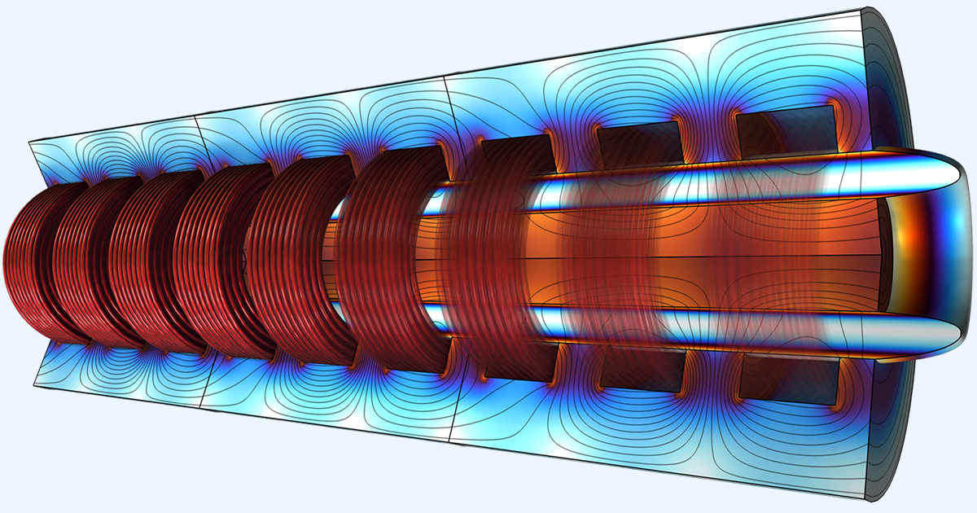
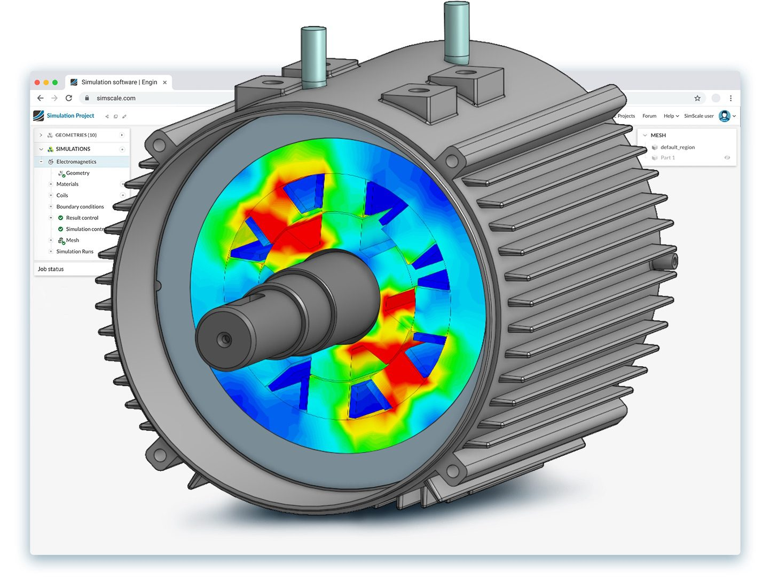
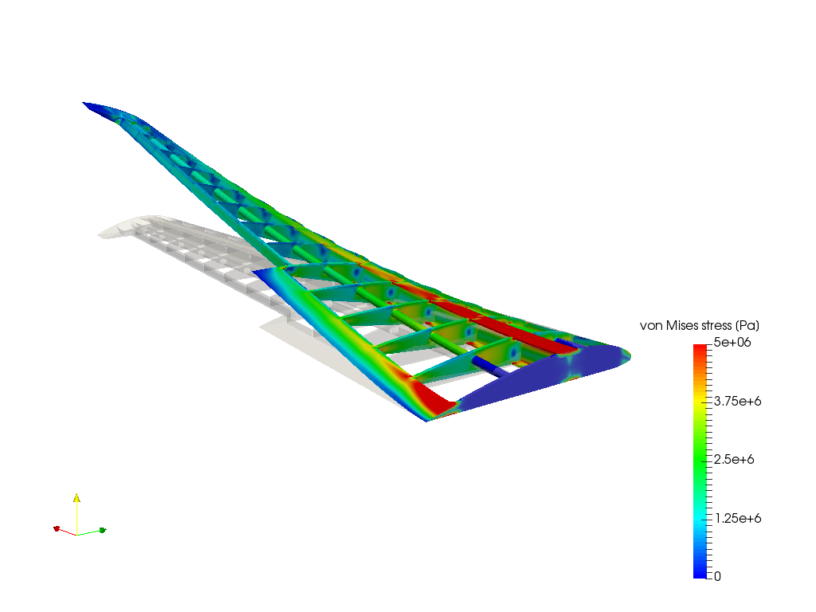
Simulation types
Magnetohydrodynamics
Electromagnetics
Structural Simulations
#OSSUMMIT
Notes:
At its core, CFD is simply a computational method for predicting how fluids move and how heat is transferred.
Fluids can mean air, water, coolant, or gases.
The colorful images you see here are examples of CFD results.
The colors represent quantities such as velocity, pressure, or temperature.
Engineers use these visualizations to understand what is happening inside a system before it is physically built.
Here are a few examples:

Slide 7
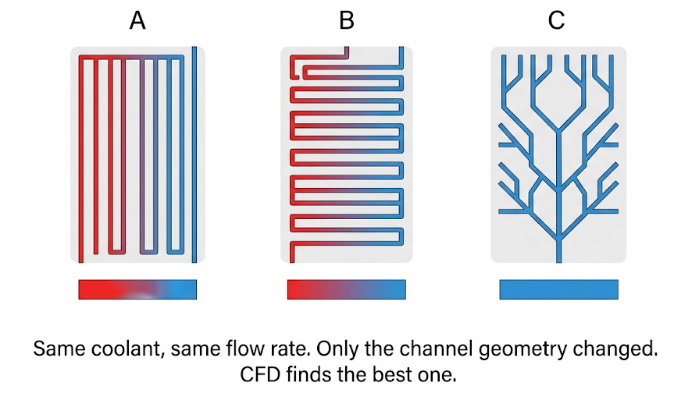
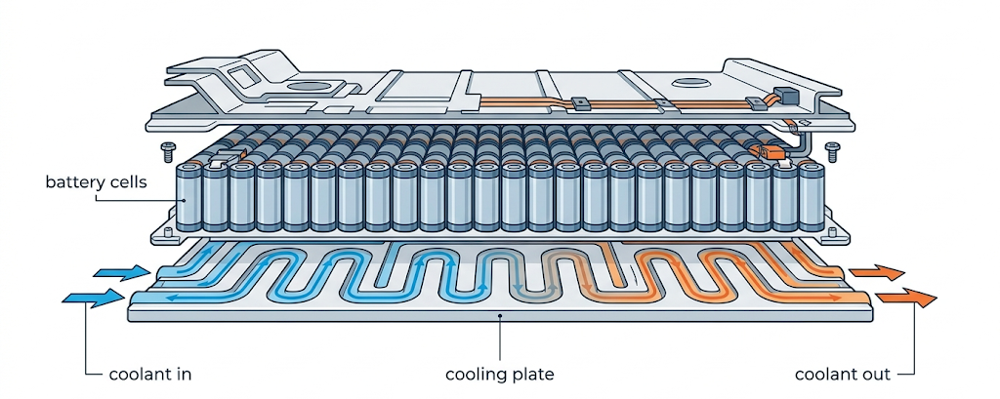
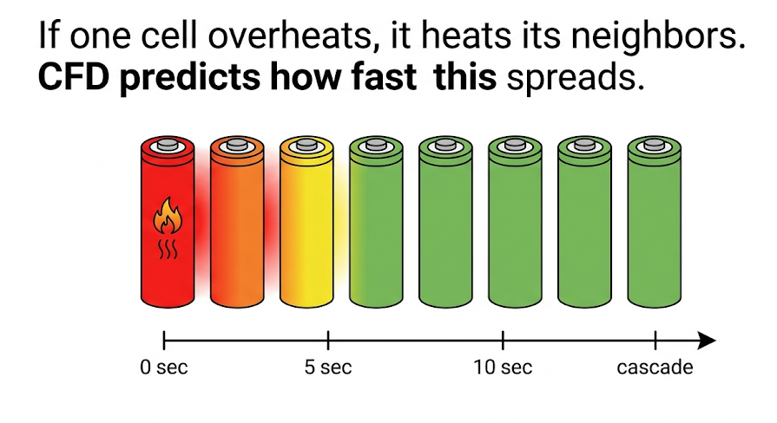
Simulation is Everywhere! - EVs:
EV BATTERY PACK LIQUID COOLING SYSTEM
Battery Thermal Management
Coolant flow simulation through serpentine cooling plates
Thermal runaway propagation modeling between cells
Channel geometry optimization for uniform temperatures
Notes:
Battery performance depends heavily on temperature.
If batteries get too hot, they degrade faster.
If they get too cold, performance suffers.
Engineers use CFD to design cooling channels that circulate coolant throughout the battery pack.
The goal is to keep every battery cell at roughly the same temperature.
They also simulate worst-case scenarios such as thermal runaway, where heat from one failing cell spreads to neighboring cells.
These simulations help engineers design safer and longer-lasting battery packs.

Slide 8
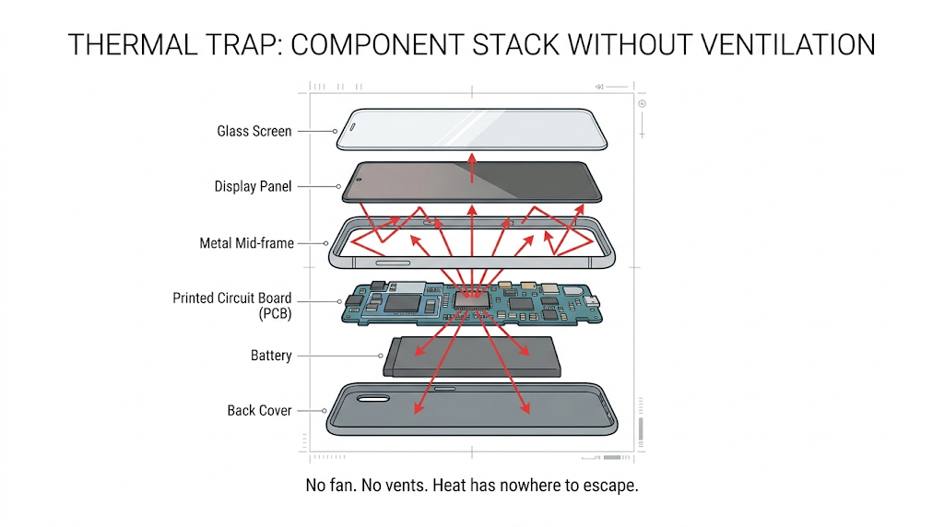
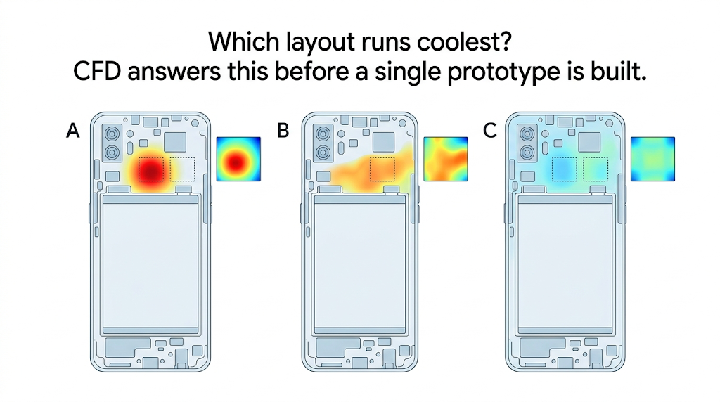
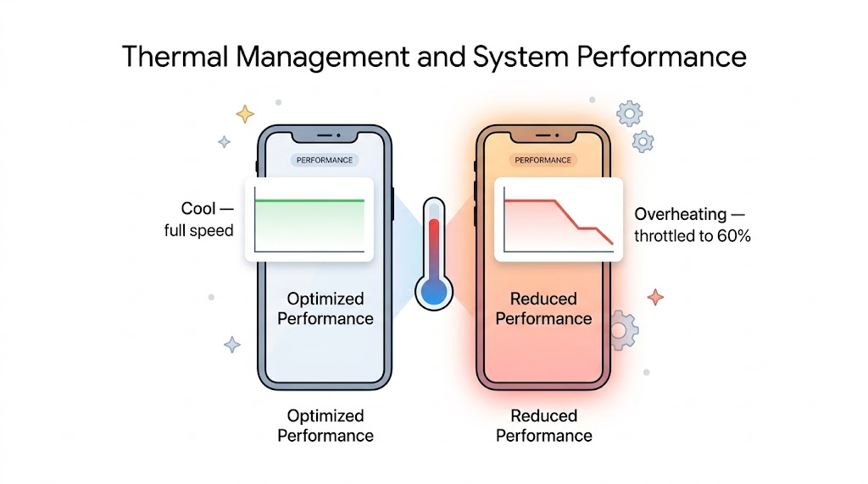
Simulation is Everywhere! - Smart Phones:
Notes:
Let's start with something everyone has in their pocket.
Modern smartphones generate a surprising amount of heat.
Processors, graphics chips, and batteries all produce heat during operation.
Engineers use simulation to understand where that heat goes.
They optimize chip placement, heat pipes, and internal thermal paths to prevent overheating and performance throttling.
Without this type of simulation, manufacturers would be relying on expensive trial-and-error testing.
Now let's scale up from a smartphone to an entire building.

Slide 9
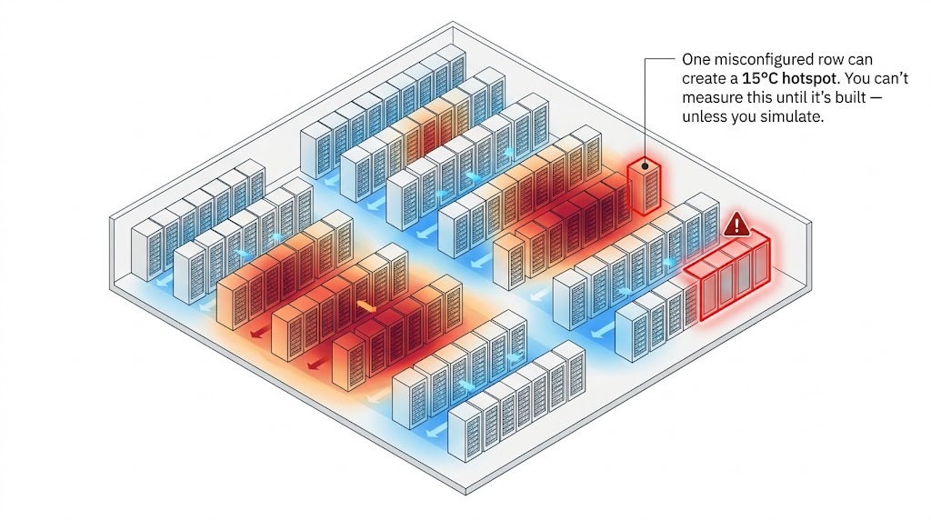
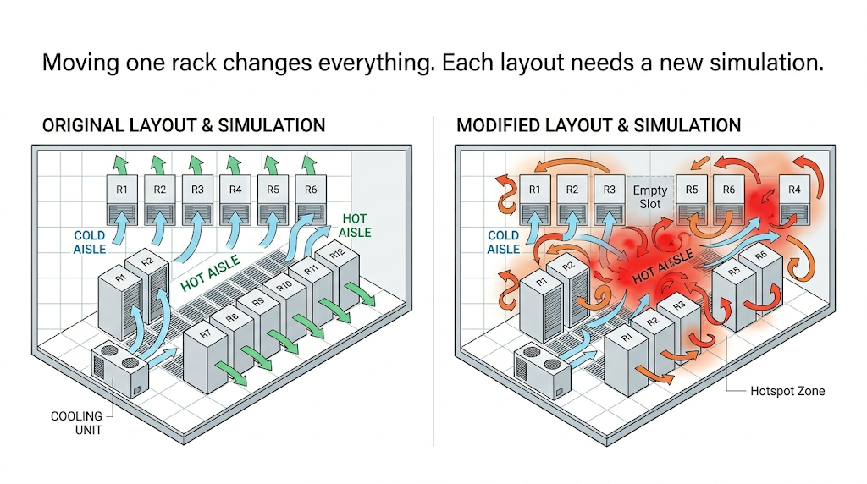
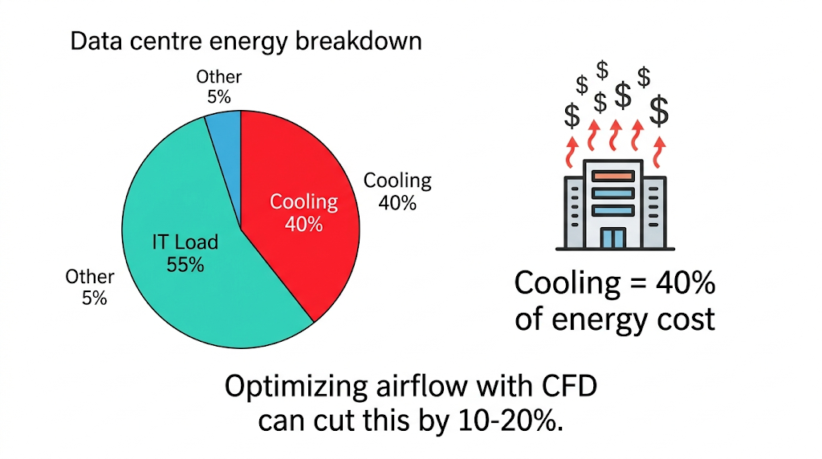
Simulation is Everywhere! - Data Centres:
Notes:
Data centers are essentially giant rooms full of computers.
Those computers generate enormous amounts of heat.
The challenge is making sure cool air reaches every rack efficiently.
This is where concepts like hot aisles and cold aisles come in.
Cold air is delivered to the front of server racks.
Hot air is exhausted from the back.
Engineers simulate airflow to decide where racks should be placed and where cooling units should be installed.
The goal isn't just preventing overheating.
It's preventing wasted energy and avoiding extremely expensive cooling mistakes.
The same idea applies to another industry where temperature is absolutely critical.

Slide 10
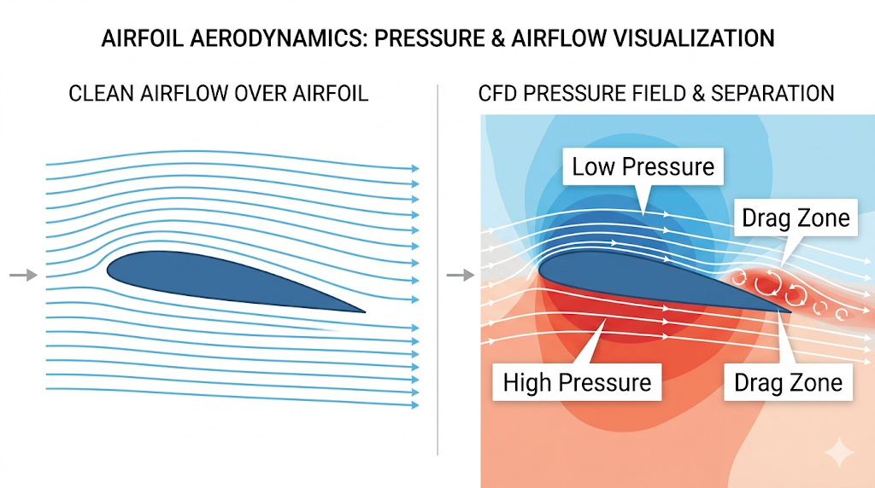
Simulation is Everywhere! - Aircrafts:
Aerodynamics
Wing profile optimization for lift-to-drag ratio
CFD PRESSURE FIELD & SEPARATION
Propulsion
Engine nacelle airflow and turbulence interaction
Safety & Simulation
Ice accretion simulation on leading edges at altitude
#OSSUMMIT
Notes:
Aircraft design is fundamentally an airflow problem.
One of the most important goals is maximizing lift while minimizing drag.
Lift is the force that keeps the aircraft in the air.
Drag is the air resistance pushing against the aircraft as it moves forward.
Engineers use CFD to optimize wing shapes, study airflow around engines, and even predict how ice buildup affects flight performance.
A small improvement in aerodynamic efficiency can save airlines millions in fuel costs over the lifetime of an aircraft.
So CFD is incredibly valuable. But it comes with a major limitation.

Slide 11




The Bottleneck
A single simulation takes 2 to 8 hours on high-performance clusters
Engineers only get 5 to 10 design iterations before the deadline
They end up shipping the first design that works, not the best one
Better designs exist, but there is no time to find them
The bottleneck is time.
Notes:
This is the challenge.
A single high-fidelity simulation can take anywhere from two to eight hours.
Sometimes even longer.
And that's on specialized hardware.
Now imagine you're an engineer trying to optimize a design.
You don't want to evaluate one design.
You want to evaluate hundreds.
But if each simulation takes hours, you quickly run out of time.
So engineers often end up shipping the first design that works rather than the best design.
And this is where the open-source angle becomes important.
The tools already exist.
OpenFOAM is free and open source.
Access isn't the bottleneck.
The bottleneck is time.
So the obvious question becomes:
What if simulation didn't take hours?
What if it took seconds?

Slide 12
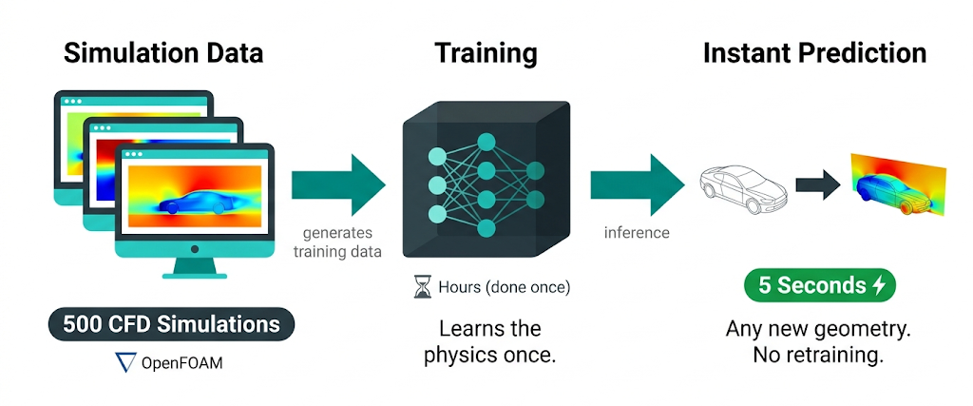
The Idea - Train Once, Predict Forever:
Notes:
This slide captures the entire idea in one sentence:
Train once. Predict forever.
Traditionally, every new design means running another simulation.
With surrogate models, we do something different.
We generate a large collection of simulation results once.
That becomes our training data.
The model learns the relationship between geometry, operating conditions, and the resulting physical behavior.
After that, evaluating a new design becomes almost instantaneous.
The expensive work happens once during training.
The speed comes later during prediction.
The first major breakthrough in this area came from something called Physics-Informed Neural Networks.

Slide 13


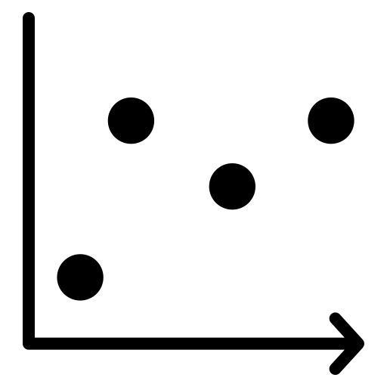
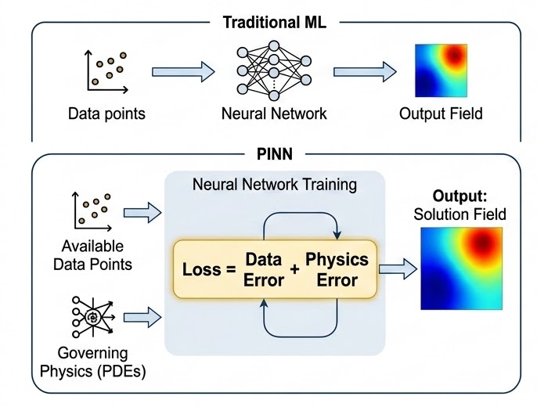
Teaching Machines to solve physics - PINNs
PINNs learn from both:
The PINN Paradigm
Governing physics equations
Available data points
Physics-Informed Loss Function
A PDE is added directly into the loss function.
Loss = Data Error + Physics Error
The model is penalized when its prediction violates known physics.
Output: solution field for a specific PDE, geometry, and boundary condition.
Limitation: major geometry or condition changes usually require retraining.
Notes:
Most machine learning models learn purely from data.
You show them examples and they try to find patterns.
Physics-Informed Neural Networks, or PINNs, take a different approach.
They learn from both data and physics.
The governing equations themselves become part of the training process.
You can see that in the loss function shown on the slide.
If the model predicts something that violates known physics, it gets penalized.
That means the model doesn't just fit the data.
It also respects the laws of nature.
This was a huge step forward for scientific machine learning.

Slide 14
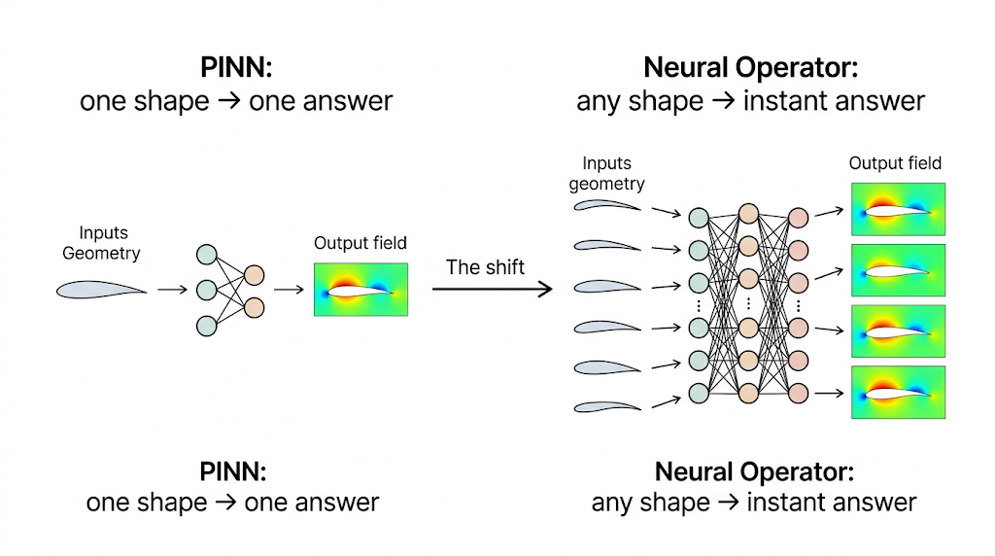
From Solutions to Operators - Neural operators
PINNs: Learn a solution for one specific problem.
Neural Operators: Learn the mapping from inputs to solution fields.
Input & Output Pipeline
Input: Geometry + Boundary Conditions
Output: Full predicted field across the domain
The Core Shift:
Not learning one simulation result — learning the simulator-like behavior.
For similar problem families, new geometries can be evaluated without retraining.
Once trained, the model can predict results for new geometries in seconds.
Notes:
PINNs are powerful, but they generally learn one problem at a time.
Engineers don't solve one geometry.
They solve thousands.
Every design change creates a new problem.
Researchers started asking a different question.
Instead of teaching a model one solution, can we teach it the behavior of the simulator itself?
That's the shift shown on this slide.
We move from learning individual answers to learning how the physics behaves across an entire family of designs.

Slide 15
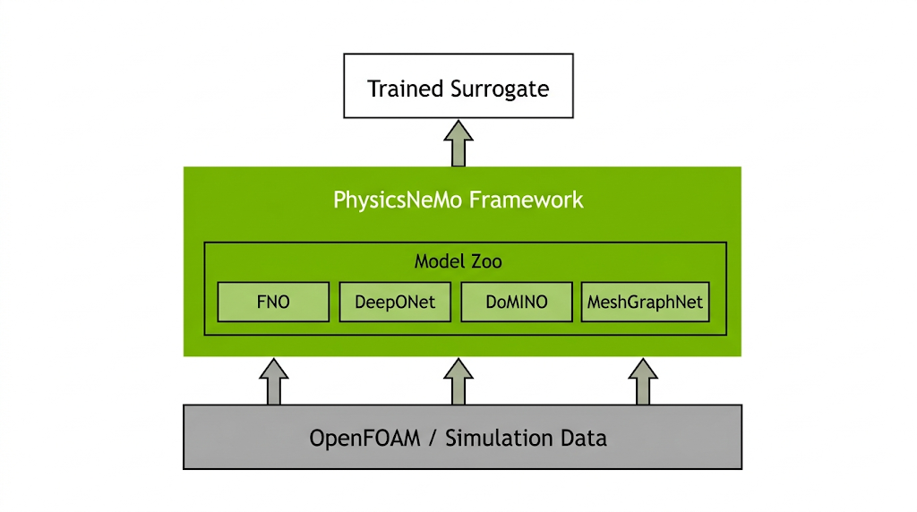
NVIDIA PhysicsNeMo
Open-Source Framework (Apache 2.0)
Provides ready-to-use neural operator architectures by NVIDIA for physics-ML.
Used in Production
Automotive aero, weather forecasting, energy, and semiconductor design.
#OSSUMMIT
Notes:
This is where open source becomes a central part of the story.
Building these systems from scratch is incredibly difficult.
You need data pipelines.
Training infrastructure.
Validation workflows.
Distributed GPU support.
PhysicsNeMo provides all of that.
It's NVIDIA's open-source framework for physics machine learning, released under Apache 2.0.
It gives us ready-to-use neural operator architectures and the tooling needed to train them efficiently.
Rather than reinventing the wheel, we were able to build on top of an existing open-source ecosystem.

Slide 16
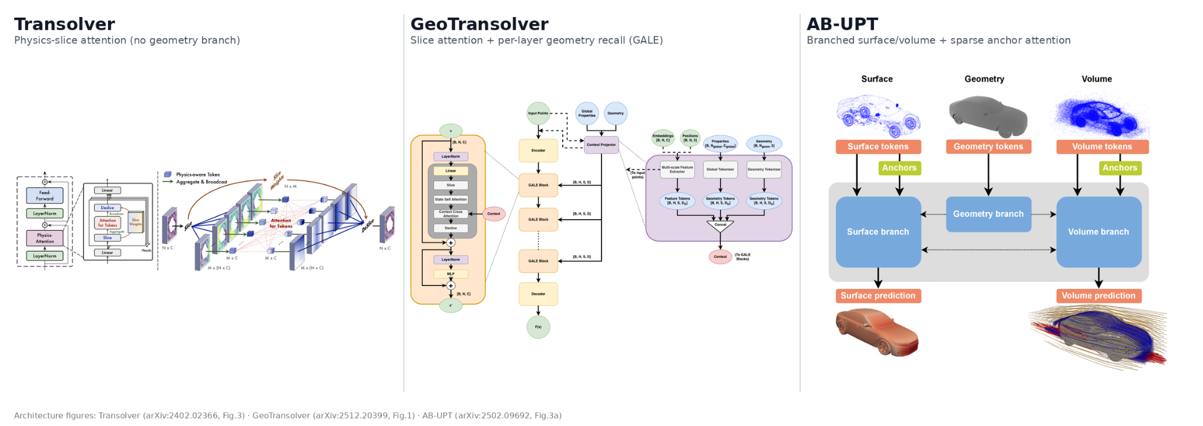
Transformer Surrogates for CFD Fields

Slide 17
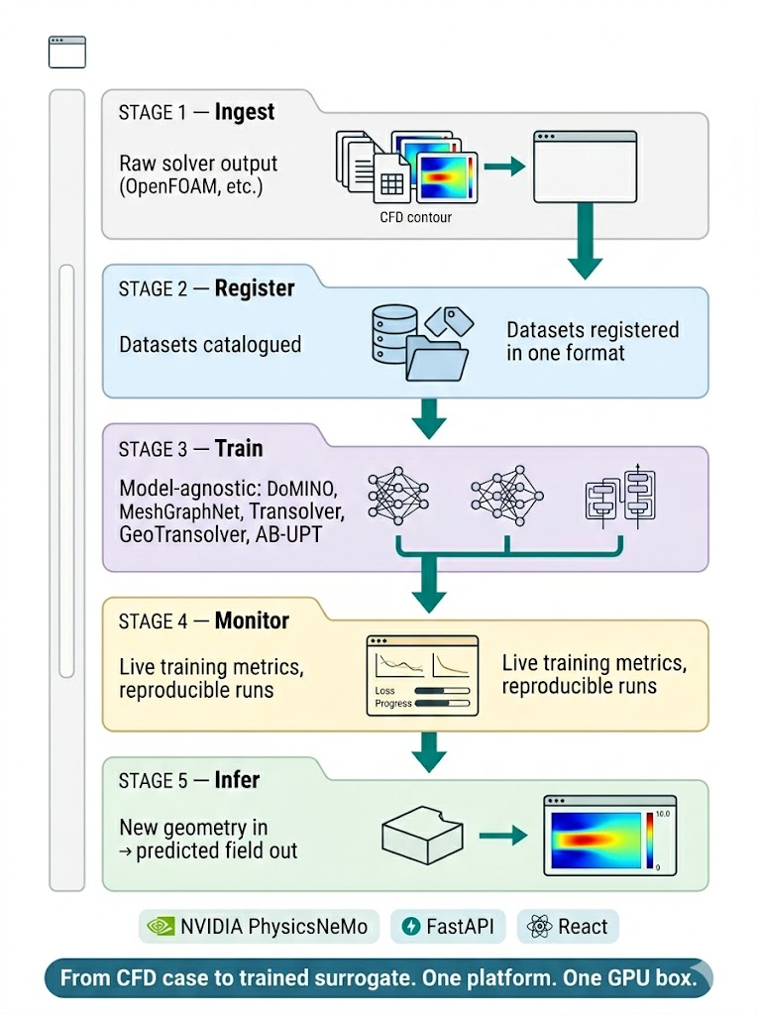
FlowForge: The All-in-One CFD Platform
End-to-End CFD Surrogate Workspace
Streamlined Workflow: Ingest → Register → Train → Monitor → Infer, all in-browser with no scripts or notebooks.
Model-Agnostic: Unified pipeline for DoMINO, MeshGraphNet, etc
Open-Source Core: Built on NVIDIA PhysicsNeMo, FastAPI, and React; optimized for single GPU boxes.
From CFD case to trained surrogate, in one platform
Notes:
Everything we've discussed so far — OpenFOAM, Neural Operators, PhysicsNeMo, DoMINO — is powerful.
But most engineers are not machine learning engineers.
They shouldn't need to write training scripts.
They shouldn't need to manage datasets manually.
And they definitely shouldn't need to learn distributed PyTorch just to train a surrogate model.
That's why we built FlowForge.
FlowForge is an end-to-end platform that takes an engineer from CFD data all the way to trained surrogate models through a browser interface.
The goal is simple:
Make advanced physics AI accessible to engineers.
So let's walk through the workflow.

Slide 18
Ingest: get solver data in
1. Upload & Browse
Upload geometry/case files (VTP/VTU/STL) or browse cases already on the GPU volume.
2. Parameter Attachment
Attach global parameters via CSV (geometry dims, inlet velocity, etc.).
3. Automated Conversion
Converts raw CFD output → the platform's per-case .npy format automatically.
4. Reusable Dataset
One ingest = one registered, reusable dataset.
Notes:
Every workflow starts with data.
Engineers already have simulation outputs from OpenFOAM or other CFD tools.
FlowForge allows them to upload those files directly or browse existing simulation data stored on the server.
Global parameters such as dimensions or operating conditions can also be attached.
The platform then automatically converts the solver outputs into a format suitable for machine learning.
At the end of this process, the data becomes a reusable registered dataset.

Slide 19
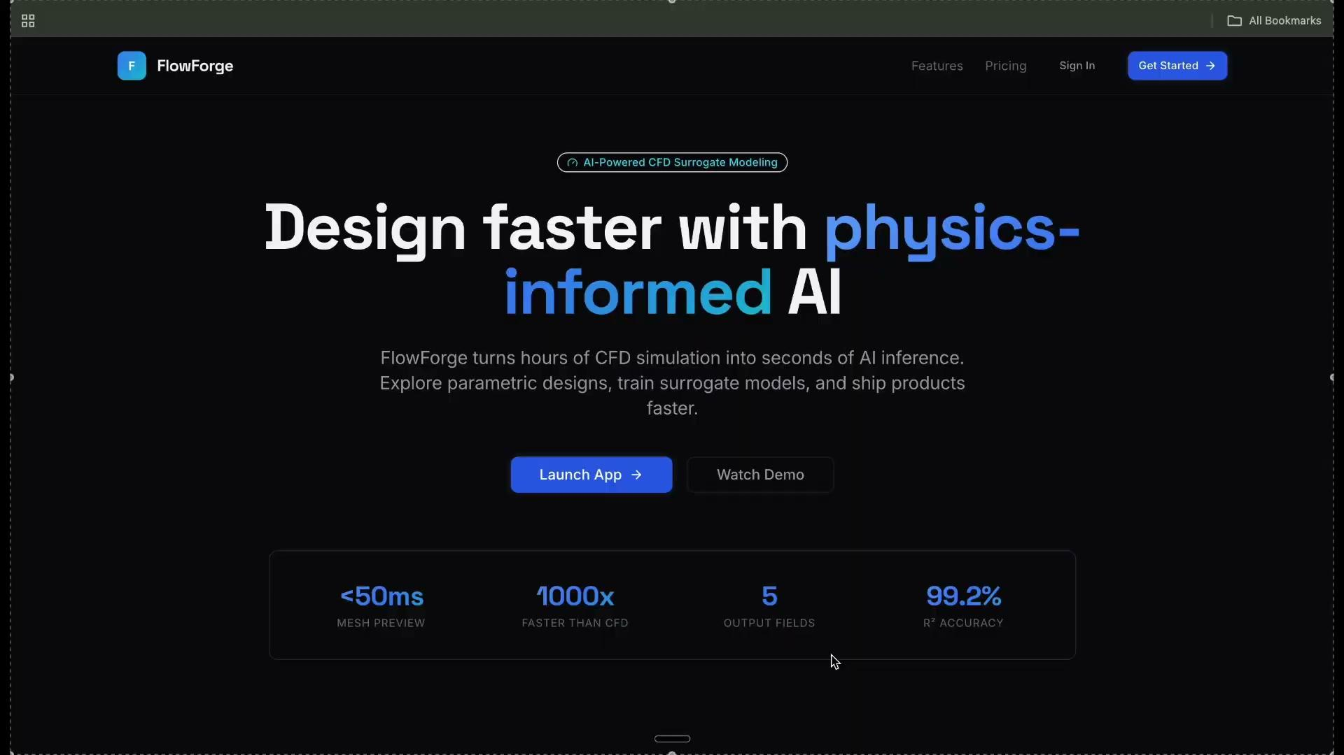
Ingest - Get Solver Data in
Notes:
Once the data is available, we need a way to explore it.

Slide 20
Datasets — inspect what you have
Comprehensive Browsing
Browse every registered dataset and its associated cases with ease.
Interactive Quick View
Renders actual 3D geometry and fields in-browser via ParaView server-side.
Instant Analysis
View parameter distributions and correlations across the entire dataset at a glance.
Reproducible Results
Immutable and versioned datasets ensure runs stay reproducible once registered.
#OSSUMMIT
Notes:
Before training anything, engineers need confidence in their data.
FlowForge allows them to browse datasets, inspect individual cases, and visualize 3D geometry directly in the browser.
Parameter distributions and correlations can also be explored.
This helps identify gaps in coverage before training begins.
Everything is versioned and reproducible, which is critical in engineering workflows.
Once we're satisfied with the dataset, training becomes straightforward.

Slide 21
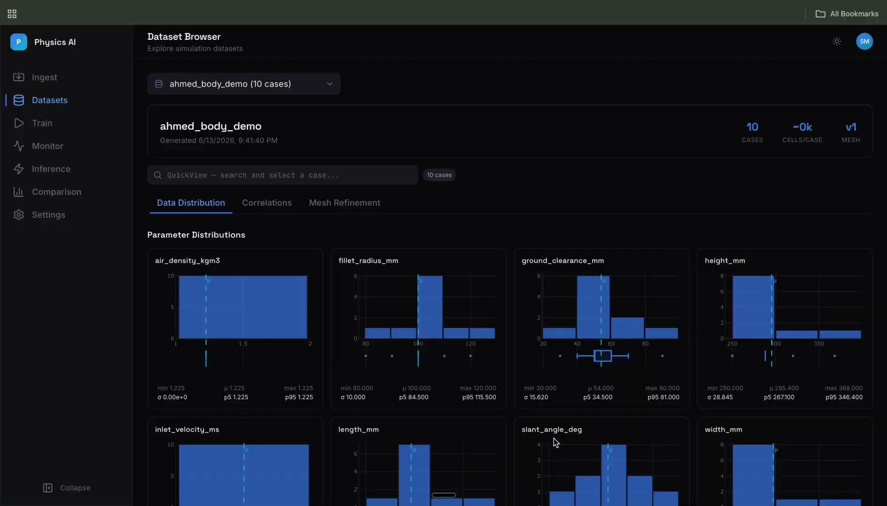
Datasets — inspect what you have

Slide 22
Train — launch a run in a few clicks
Configuration
Pick dataset, model family (DoMINO / MeshGraphNet), and mode (volume/surface).
Smart Defaults
Set train/val/test split, epochs, batch size, and field weights — sensible defaults are pre-filled.
Data Organization
Automatically splits the dataset and writes a self-contained, append-only run folder.
High Performance
Multi-GPU training via torchrun, kicked off straight from the user interface.
#OSSUMMIT
Notes:
Traditionally, launching a training job involves configuration files, scripts, and command-line tools.
FlowForge reduces that process to a few clicks.
The user selects a dataset, chooses a model such as DoMINO, configures a few parameters, and launches training.
Behind the scenes, the platform handles dataset splitting, run management, and distributed execution.

Slide 23
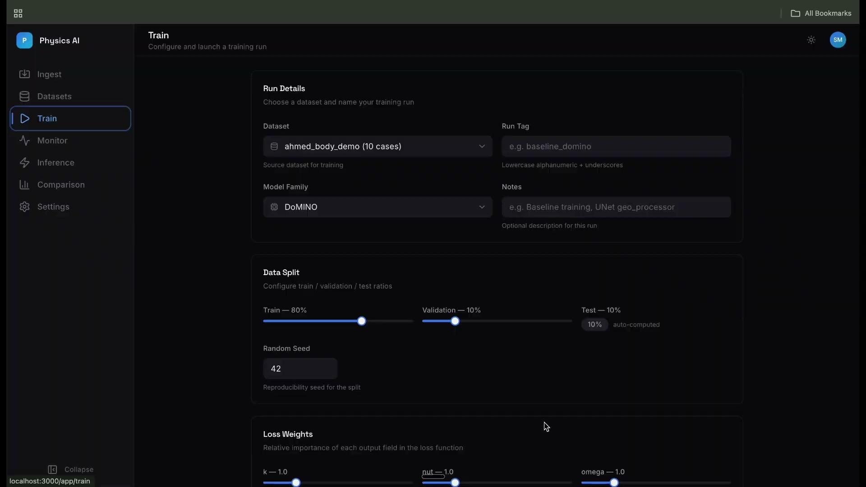
Train — launch a run in a few clicks
Notes:
After training starts, visibility becomes important.

Slide 24
Monitor — watch training live
Loss Curves
Real-time visualization of train and validation curves as epochs complete.
Live Streaming
Run status, GPU/hardware info, and full logs streamed directly to your browser.
Side-by-Side Analysis
Compare multiple runs simultaneously to identify the best performing models.
Lifecycle Tracking
Clear visibility of run states: initialized → running → completed / failed.
#OSSUMMIT
Notes:
Training isn't useful if it's a black box.
Engineers need to know whether a run is progressing correctly.
The monitoring dashboard provides real-time loss curves, logs, hardware utilization, and run status.
Multiple runs can also be compared side-by-side.
This helps teams identify the best-performing models and track experiments systematically.
And that's really the bigger picture.

Slide 25
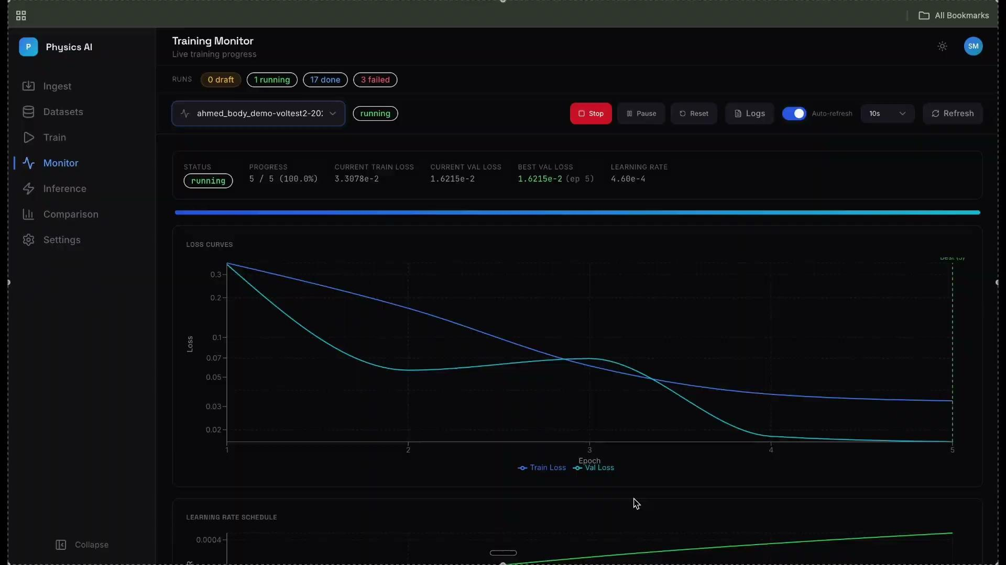
Monitor — watch training live

Slide 26
Inference - Once trained model, any Geometry
Three views in one tab
Validation results, Training results, and Infer on brand-new geometry
Run model on new inputs
No retraining; seconds per case instead of hours of CFD
Per-field metrics
MAE, RMSE, and relative error computed automatically
Visual Diagnostics
Interactive 3D viewer & 2D diagnostics (midplane, parity, histograms)
Works with every model
DoMINO, MeshGraphNet, Transolver, GeoTransolver, AB-UPT
Fast navigation
Searchable case list, aggregate metrics, and summary plots
#OSSUMMIT

Slide 27
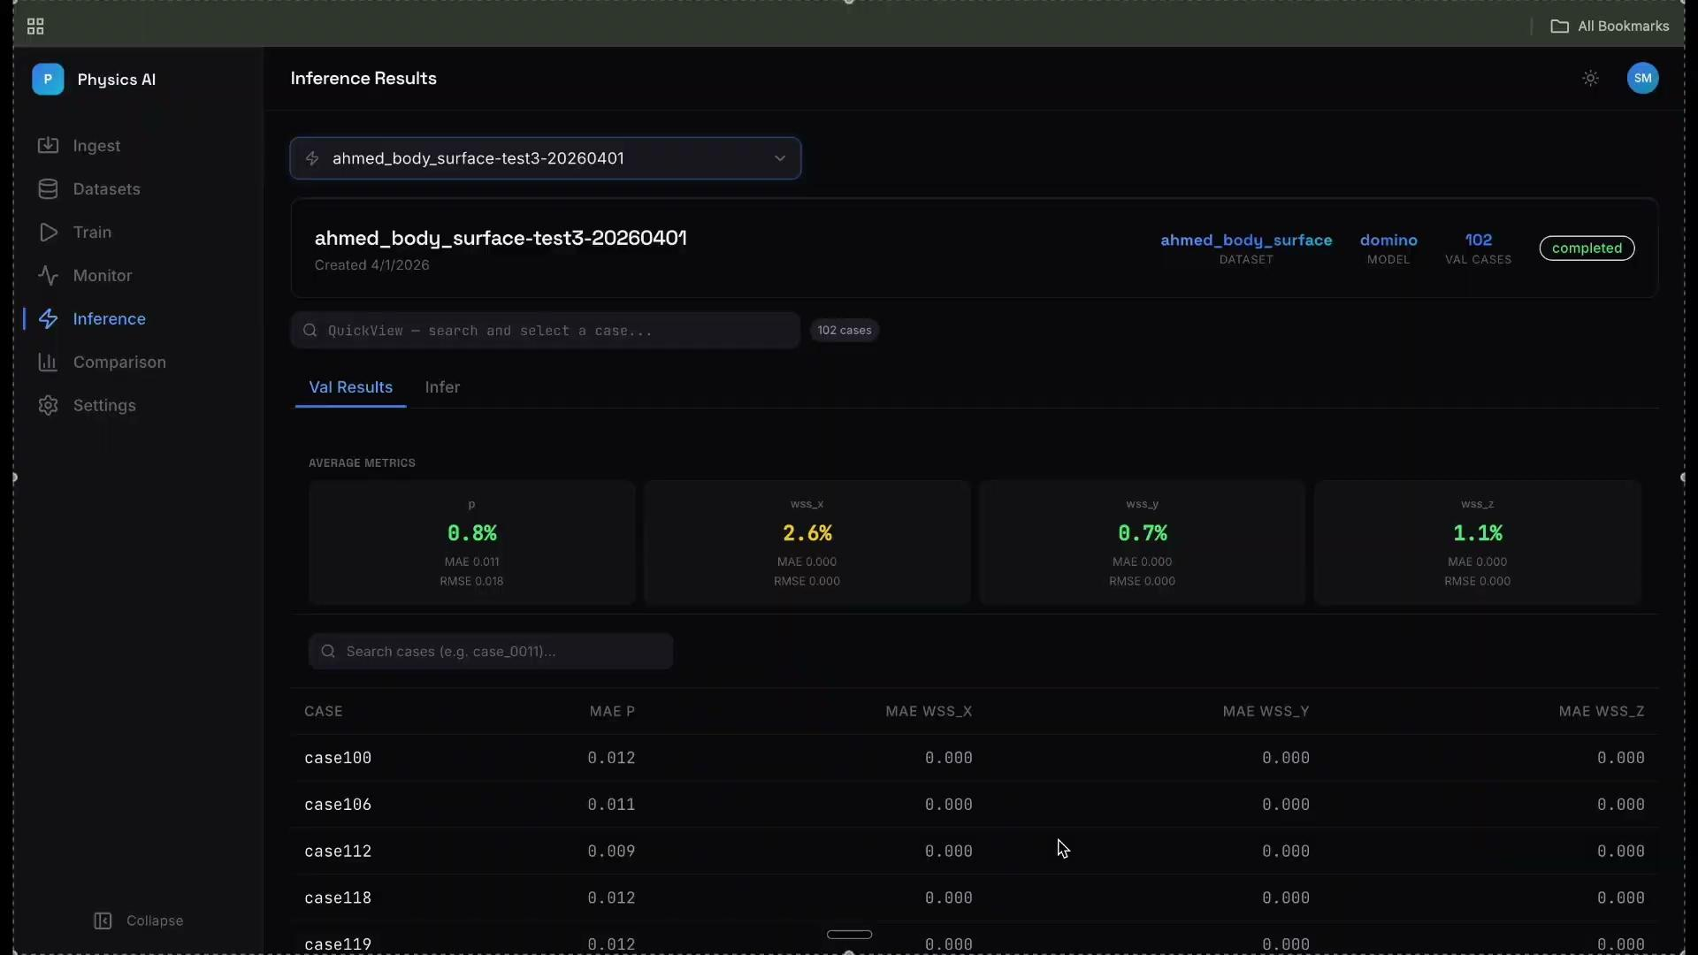
Inference - Once trained model, any Geometry

Slide 28
Comparison
Run Comparison Setup
Pick Run A and Run B side-by-side to compare shared training sets.
Per-Field Metrics
Analyzes RMSE field by field: Ux, Uy, Uz, p, T across every case.
Visual Overlays
Bar charts overlay performance at a glance for rapid assessment.
Sortable Analytics Table
Lists RMSE A, B, and Delta (A−B). Color-coded: Green (A is better) vs Red (B is better).
Interactive Side-by-Side Viewer
Slices, contours, and parity scatters with click-to-zoom for detailed Run A vs Run B inspection.
Data Split Validation
Automatic flags for "only in A / only in B" cases to reveal mismatched training splits immediately.

Slide 29

Comparison

Slide 30
Results
Ahmed Body Benchmark
Standard CFD benchmark for external automotive aerodynamics. DoMINO surrogate trained on geometries with slant angles 0–40°.
Model Architecture
9.6M parameters. Predicts surface pressure and wall shear directly from point clouds (~63k points). No remeshing required.
Training & Convergence
130 min training on 2× RTX 3090. Peak 2.3 GB GPU. Converged to 7.1×10⁻⁴ loss in 50 epochs (best at epoch 47).
Inference Performance
Processes 102 cases in ~90s on a single GPU. Achieves sub-1 second inference time per case.
Accuracy & Relative Error
Surface Pressure: 0.84% mean error (worst case 1.6%)
Wall-Shear-Stress: ~1.5% mean error (range: 0.7–2.6%)
#OSSUMMIT

Slide 31
Conclusion
Open Source All The Way Down
Leveraging OpenFOAM, NVIDIA PhysicsNeMo, PyTorch, FastAPI, React, and other community-driven technologies.
code
From Solver Output to AI-Powered Predictions
Making advanced physics-ML workflows accessible to engineers, not just machine learning specialists.
insights
#OSSUMMIT

