Slide 1
Detecting and Defusing the Ticking Time Bomb: Understanding CVEs and Upstreaming in Yocto
Siddharth Doshi, Montavista Software LLC

Slide 2



Who am I ?
Senior Software Engineer at Montavista Software.
Mainly work on Yocto Ubuntu and Redhat distributions. Userspace, Toolchain and Kernel and bug fixes.
Enjoy running, swimming, hiking and other outdoor sports, and movies

Slide 3


CVE DESCRIPTION ANALYSIS
Package name and architecture
CVSS score
Things to look for in CVE-description
Attack vector
Attack Type
How to Fix

Slide 4

USN
DSA
RHSA
GHSA
CVE-x
Bugz
CGA
ALSA
SUSE
DLA

Slide 5





Tripartite Scoring Structure of CVSS 3.1
Base Score
Temporal Score
Environmental
The intrinsic qualities of a vulnerability that are constant over time and across environments.
Metrics that change over time, such as exploit code availability and remediation status.
Context-specific metrics that reflect the vulnerability impact on a unique environment.

Slide 6
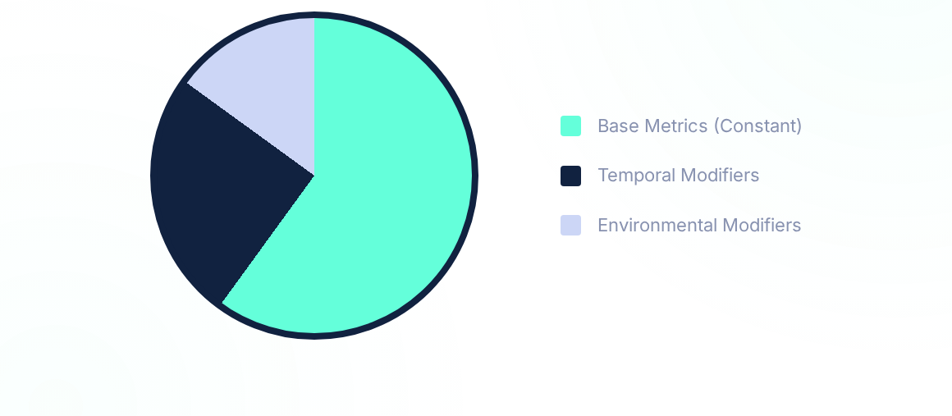
Dynamic Scoring Proportions
The final score is a refinement. While the Base score provides the foundation, Temporal and Environmental factors can significantly shift the severity rating for internal risk management.

Slide 7
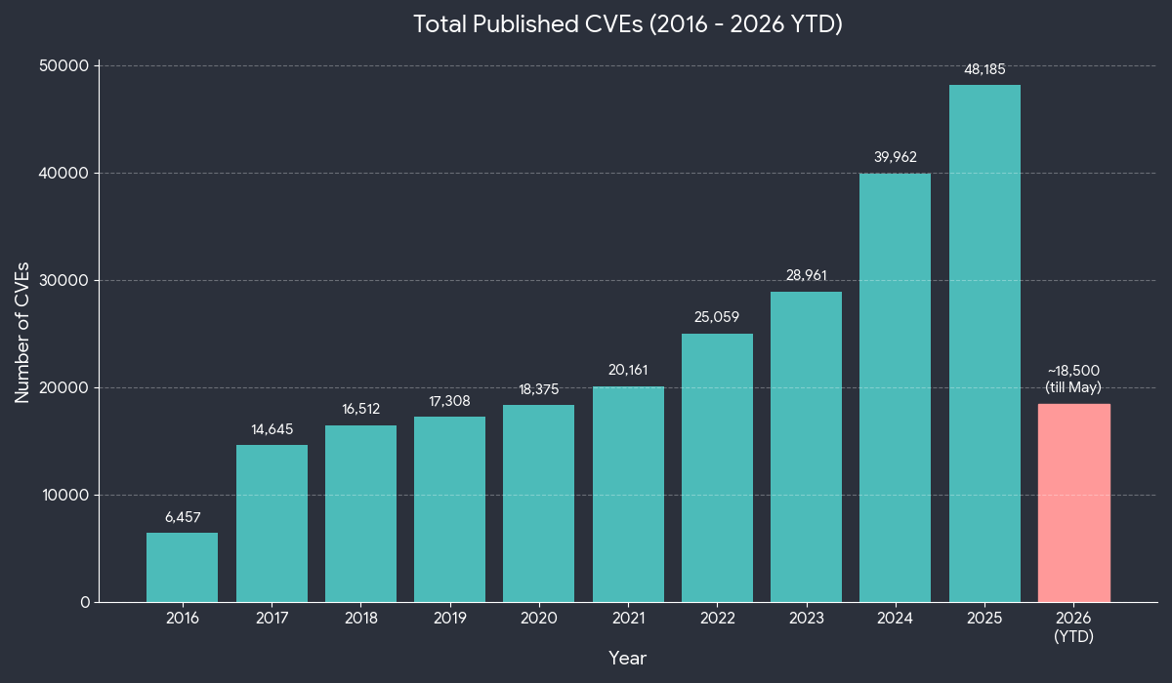

Slide 8
The Detection Landscape
Analyzing organizational approaches to vulnerability scanning and manual investigation methodologies.

Slide 9

CORE DETECTION METHODOLOGIES
Manual Investigation
Automated Detection
Organizations often employ manual filtering of CVEs for specific monitored systems. This high-touch approach ensures context-aware analysis but creates significant resource overhead as database volume swells.
Modern workflows leverage specialized CVE-detection tools to scan infrastructures. These range from broad system-wide monitors to deep-dive inspectors focused on specific binary footprints.
Expert-driven precision filtering
High-speed bulk scanning
Context-aware risk assessment
Scalable monitoring capabilities
High resource and time cost
Consistency across environments

Slide 10

TOOL ARCHITECTURES & DEPTH
General System Analysis
Root Filesystem Scanning
Tools using general systems as a base evaluate vulnerabilities based on the expected OS environment. These are ideal for rapid, surface-level assessment of standard deployments.
Advanced tools perform a granular scan of the root filesystem to generate an exhaustive list of CVEs affecting the actual binaries and libraries residing on disk.
Best for: Enterprise IT and general server fleets where configurations follow standard patterns.
Best for: Embedded systems, custom Linux distributions, and hardened environments.

Slide 11
MODERN SBOM-BASED CHECKING
The Software Bill of Materials (SBOM) approach is rapidly gaining popularity as the standard for transparency and security in the software supply chain.
By maintaining a comprehensive inventory of components, organizations can proactively map vulnerabilities to their specific software builds before deployment.
Build-time vulnerability mapping
Reduced runtime scanning overhead
Improved supply chain visibility
Standardized compliance reporting

Slide 12






YOCTO PROJECT "CVE-CHECK"
Recipe Scanning
NVD Comparison
Manifest Output
The "cve-check" class scans project recipes and images for known vulnerabilities by comparing package names against the NVD.
Automated comparison of package versions against the National Vulnerability Database to identify matches.
Generates a detailed log in the deploy directory identifying patched, unpatched, and ignored vulnerabilities.

Slide 13
THE EVOLUTION OF EXCLUSIONS
Legacy: CVE_CHECK_IGNORE
Modern: CVE_STATUS
The new standard forces a mapped status string (e.g., Patched, Not-applicable).
The old method relied on a simple list: CVE_CHECK_IGNORE += "CVE-xxx-xx".
The Pain Point: It provides zero audit trail. If a developer ignored a CVE years ago, a future auditor has no idea why. Because of this, it was deprecated, forcing difficult migrations.
The Pain Point: High transition overhead and strict syntax requirements. Developers must justify why a CVE is handled a certain way. Good for auditing, but increase lot of burden.

Slide 14


THE cve-extra-exclusions.inc DILEMMA
Blind spots
Layer Conflicts
Triage Debts
Blindly including upstream exclusion files means you might inherit exceptions that actually do apply to your specific creating dangerous false negatives.
Automated comparison of package versions against the National Vulnerability Database to identify matches.
Generates a detailed log in the deploy directory identifying patched, unpatched, and ignored vulnerabilities.

Slide 15
UPSTREAM DISCONNECTS
Recipe name & versioning vs. NVD
Backports & False Positives
NVD tracks vulnerabilities using strict CPE Yocto recipes frequently use custom PV schemas (e.g. 1.2.3+git${SRCPV})
NVD tracks NodeJS but Yocto recipe may be named node.js
Result: There are false positives.
Developers must manually maintain CVE_VERSION and CVE_PRODUCT to "translate" Yocto versions and package for the NVD
Yocto's scanner automatically clears CVEs if the patch is named exactly CVE-2023-12345.patch. However, if upstream named it different, it won't be recognized.
The scanner sees the older base version and warns that the system is vulnerable—despite the code fix sitting right there in the recipe. This generates endless manual CVE_STATUS overrides.

Slide 16
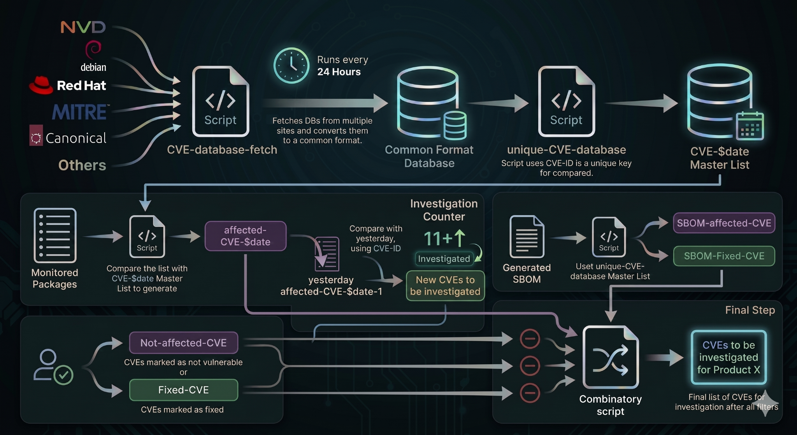
CVE-Detection System

Slide 17
Core Remediation Paths
Identifying the two primary mechanisms for addressing Common Vulnerabilities and Exposures.

Slide 18



THE TWO MAIN WAYS
1. Identify and Apply
2. Update or Upgrade
Identify and apply the Patch: Focuses on surgical application of fixes directly to the vulnerable codebase without altering major functionalities.
Update/upgrade to the version: Move to the specific version where the issue was fixed, inheriting all changes and improvements in that release.
Which approach to choose obviously remains a user’s choice but here is a highlight which could be better.

Slide 19





VERSION UPDATE PREFERENCES
Comprehensive Fixes
Feature Integration
Ecosystem Alignment
Version upgrades have one advantage over CVE-fixes as version upgrades not only fix a certain CVE but also would fix other CVES and bugs.
Beyond security, version upgrades would also introduce new features, adding functional value to the environment.
Version upgrades ensure you are in line with the community so any issues that are faced could be reported and Open-source community can help.

Slide 20
The Upgrade Dilemma
Analyzing the operational risks associated with version upgrades and library changes.

Slide 21


API AND ABI STABILITY
Addition of API/ABI
Removal of API/ABI
However, many a times version upgrade comes with addition or removal of API and ABI and soname changes.
Removal can break the system if those API or ABI are being used by dependent applications or services.
This often leads to runtime errors or failed builds in production environments.
Addition of API/ABI is not an issue in 99% of cases as it usually maintains backward compatibility.

Slide 22

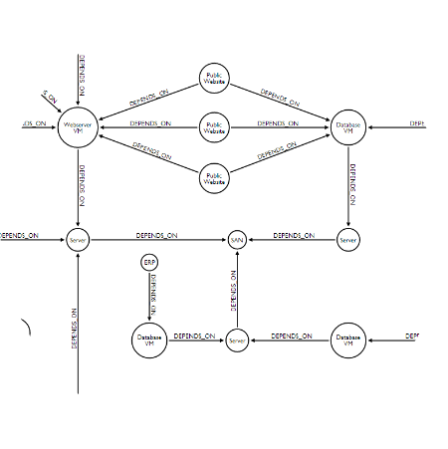

LIBRARY SONAME COMPLEXITY
Library Linkage Risks
Similarly, library so name changes won't have an issue if they are linked with a generic library name.
If system is using absolute library name, it would break and all the dependent packages needs to be rebuilt.
Rebuilding dependent packages introduces significant overhead and requires full environment validation.

Slide 23
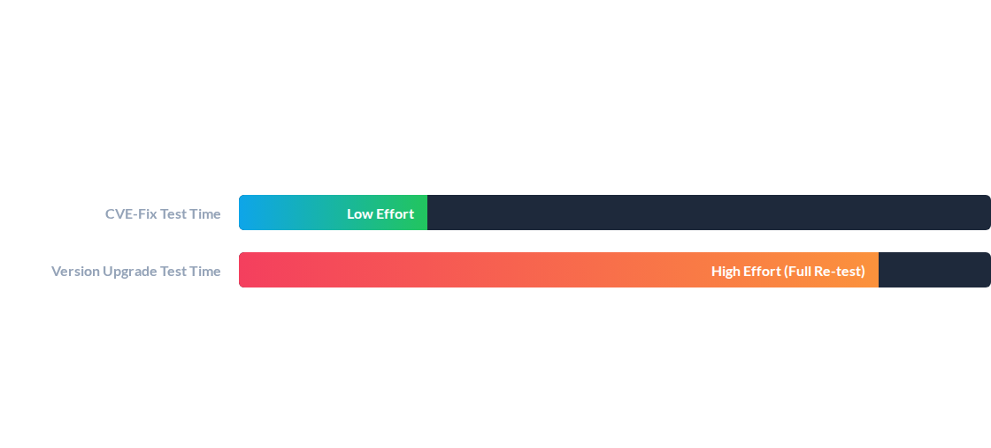
TESTING EFFORT COMPARISON
Also, version upgrades require a thorough re-testing of all the built packages which takes more time as compared to just CVE-fix test.
*Comparison based on relative man-hours and compute resources required for validation.

Slide 24




LICENSING & PRODUCT STATUS
License Renewal
Product Classification
Version upgrades with newer features/functionalities also needs renewal of licenses as they would be considered a new product.
Upgraded versions are often seen as new products rather than simple maintenance products, impacting procurement cycles.
Strategic Note: Consider licensing implications before initiating major version bumps in enterprise environments.

Slide 25

THE "GO-TO" DECISION
In such cases CVE-fix is the go-to method
When the risks of API/ABI removal, dependency breakage, or extensive re-testing overhead outweigh the benefits of new features, a targeted patch-fix remains the preferred selection.
CASE
Specific Choice
○
Critical legacy systems stability.
○
Strict maintenance windows.
○
Limited licensing budgets.

Slide 26


Slide 27
Upstreaming in
the Yocto Project

Slide 28

The Philosophy of Mailing Lists
Values Peer Scrutiny
Preserving Expertise
Contributions are reviewed through traditional mailing lists to ensure comments are visible to the entire community, not just a few maintainers. This archival system preserves the rationale behind every line of code.
Core developers are accustomed to this robust asynchronous system. Moving away from mailing lists risks losing the deep expertise of long-time maintainers who value the rigor and transparency of email-based review.

Slide 29

MODERN ONBOARDING
While the approach may seem traditional, we are actively modernizing the entry points for new contributors.
Efforts are underway to provide automated feedback and CI results directly to your inbox, bridging the gap between lists and modern PRs.

Slide 30

THE SUBMISSION PROTOCOL
git send-email --to="[list-name]" -M -[n]
--subject-prefix="[layer][branch][PATCH]"
Subject Clarity: Clearly identify the target branch and layer in the prefix. Ensure your subject accurately reflects the technical change.
Patchtest validation: check for common formatting errors “patchtest --patch”
Dry Run: Do a complete build and send patches to yourself first to verify formatting and whitespace.
Consistency: Ensure one git commit per change for easier atomic reviews.

Slide 31

REFINING THE SUBMISSION
Finding Your List
Iteration is Key
Subscribe to the relevant mailing list before sending. Use meta-oe for general Open Embedded additions that don't fit into specific layers.
Address all feedback immediately. Use version tags like [PATCH v2] to track revisions and simplify the maintainer's workflow.
Pro Tip: Bug-triage is a fantastic way to dive deep into project internals while earning community merit.

Slide 32
Master vs. Stable Branch
Branch Type | Master Branch | Stable/LTS Branch
Version updates | Accepts all verified upgrades and features. | Bug-fixes & security only
Compatibility | Bleeding-edge development. | Production-ready reliability; No breaks allowed
Priority | Always submit here first | Backport after Master acceptance

Slide 33
FINAL COMPLIANCE CHECKLIST
Atomic Commits: Keep changes separated. Squash CVEs together, but never mix different recipes in one commit.
Status Metadata: Add Upstream-Status inside the patch file, not the main git commit message.
CVE Referencing: Cite explicit CVE numbers and reference links to aid security tracking.
Reject Monitoring: Proactively check for rejects. Clean patch-links are highly preferred by maintainers.

Slide 34
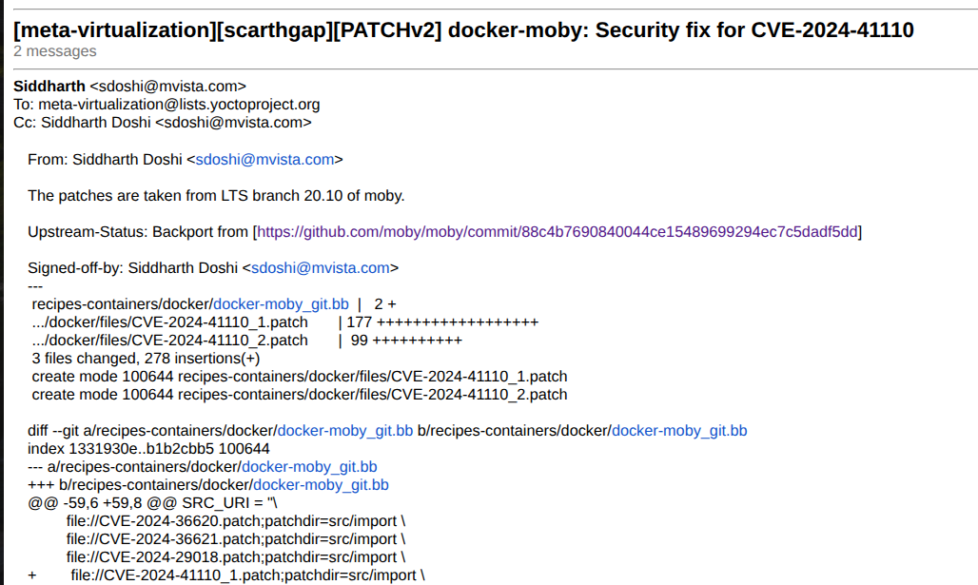
CVE-fix patch format

Slide 35
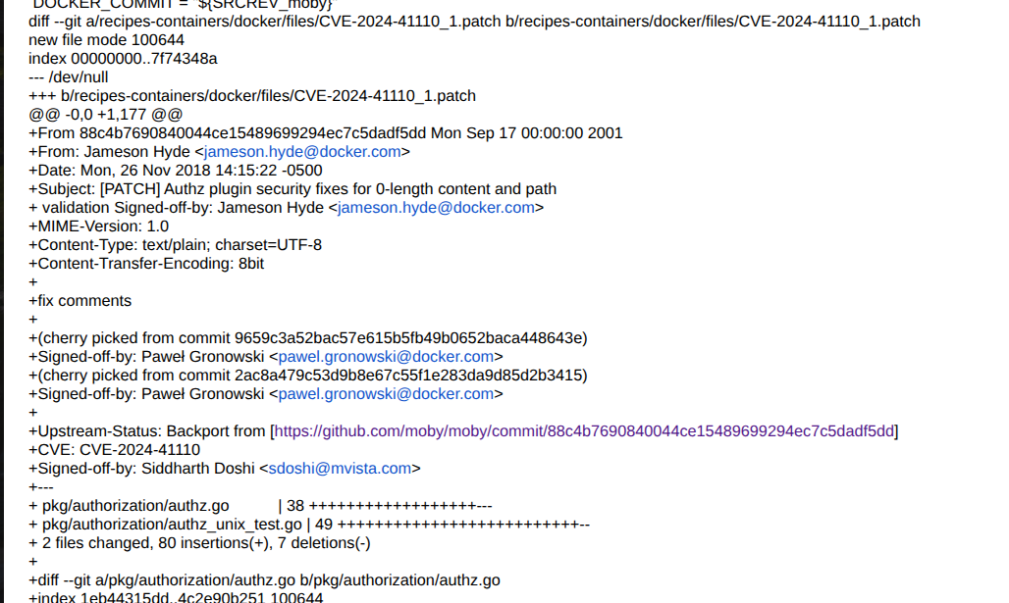





CVE-fix patch format

Slide 36
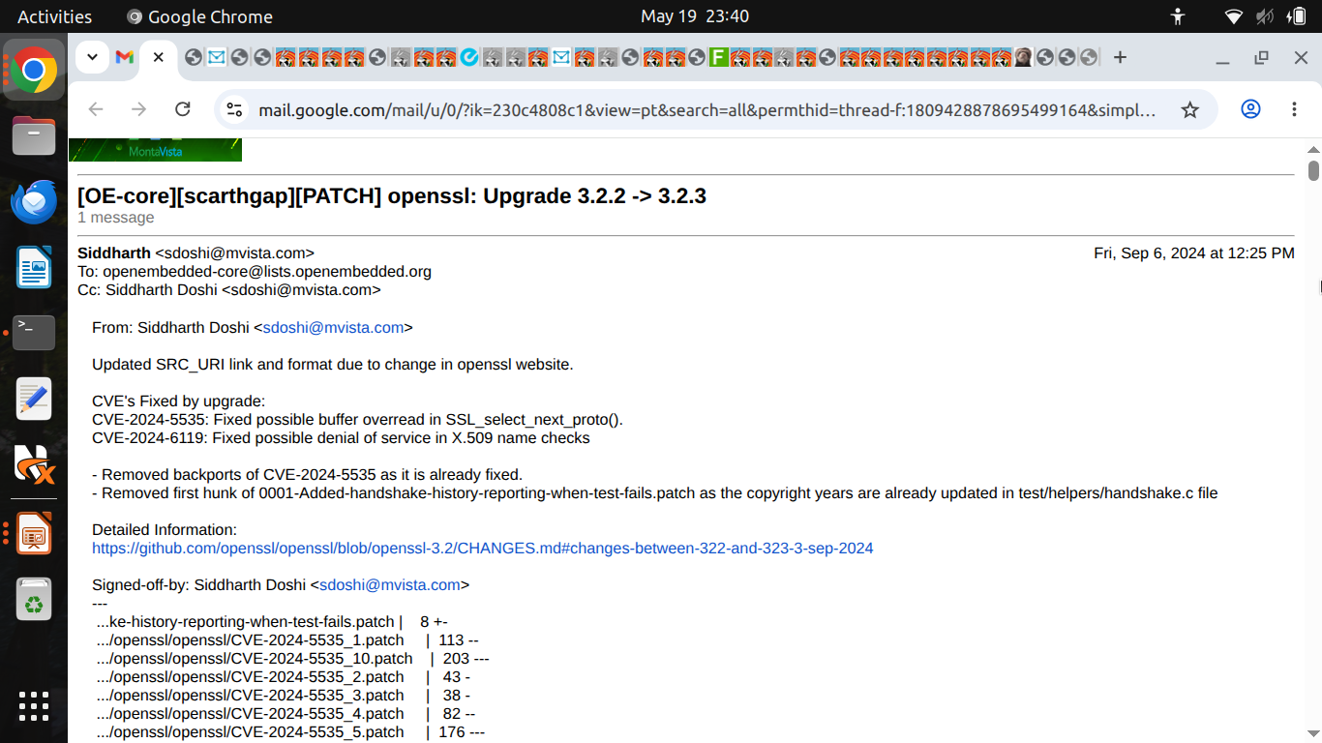


Version up patch format

Slide 37

Why is there a need for
UPSTREAMING

Slide 38
THE HESITATION GAP
Addressing why developers wait to push upstream

Slide 39

COMMON BARRIERS TO UPSTREAMING
Perceived Complexity: Fears of long, multi-stage review cycles.
Privacy Concerns: Desire to keep optimizations proprietary.
The Result ?
Internal patches become technical debt. Every line of code kept private is a line you must maintain yourself as the ecosystem moves forward without you.
Security Fears: Misconception that open code attracts more attackers.
Maintenance Fatigue: Laziness or "good enough for now" mindset.

Slide 40
THE MAINTENANCE TRAP
Private patches range from KB to MB, but the real cost is overhead. Maintaining multiple divergent packages leads to a "death by a thousand rebases."
Upstreaming transfers that maintenance burden to the community, ensuring your feature evolves with the project core.

Slide 41
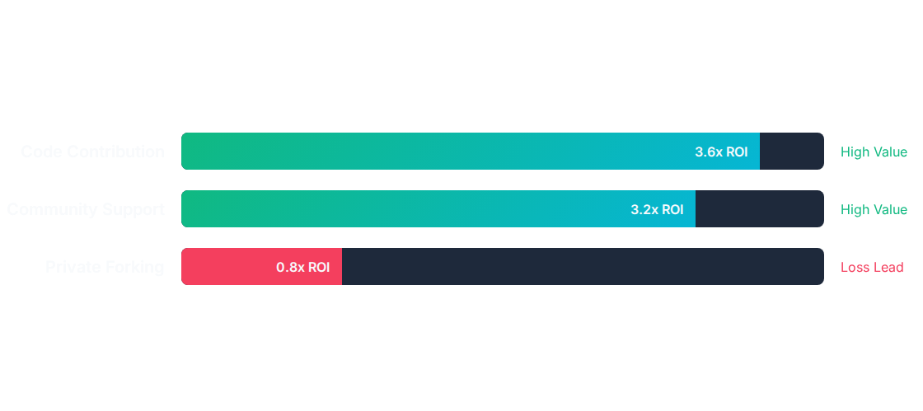
ECONOMICS OF UPSTREAMING
Return on Investment (ROI) of Contribution vs. Internal Maintenance
Source: Linux Foundation "Economic Value of Open Source" Report

Slide 42



PRIVACY VS. TRANSPARENCY
Security Through Scrutiny
Community Recognition
Upstreaming subjects patches to diverse architectures and expert maintainers. Public review catches regressions that internal labs might miss.
Building your personal and organizational brand. Recognized contributors hold influence over project roadmaps and technical decisions.

Slide 43

PEER REVIEW: THE QUALITY CATALYST
Faster innovation & Technical responsibility: Your contributions helps the community you thrive on and also helps you focus on other issues and not rebasing
Regression Prevention: Community schedules ensure long-term stability across versions.
Standardized API Usage: Guards against using deprecated or non-standard interfaces.

Slide 44
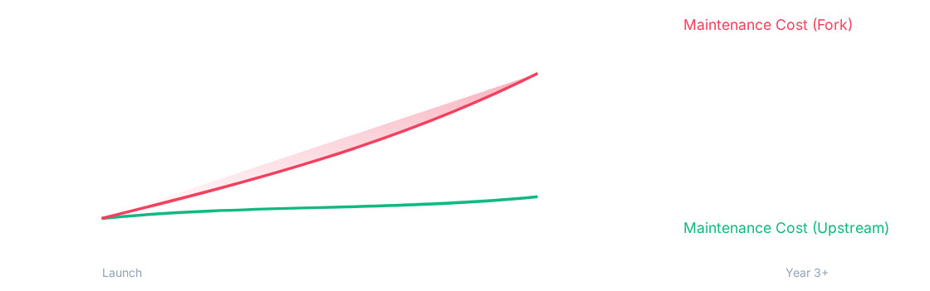
LONG-TERM SUSTAINABILITY
The "Hidden" cost of diverging from mainline support.

Slide 45
Thank-you
Queries ?

Slide 46

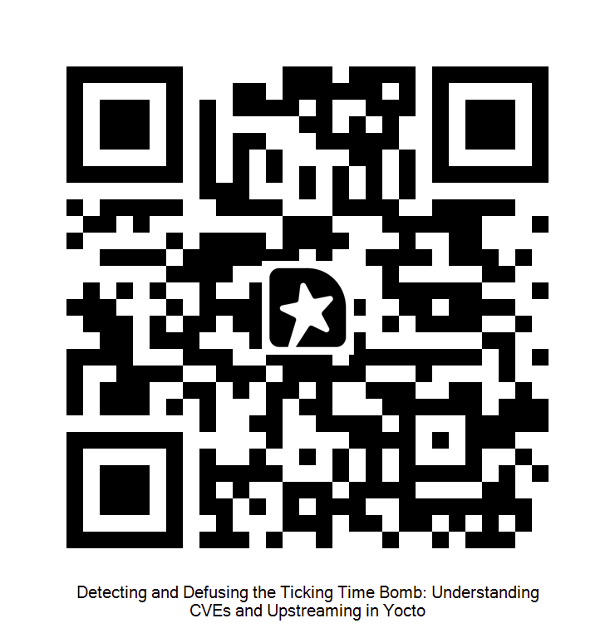

Feedback for the session
Get in touch
siddharth.doshi.oss@gmail.com
Linktree

Slide 47
Appendix

Slide 48
Basics of CVE

Slide 49

WHAT IS CVE?
THE DEFINITION
CORE PURPOSE
CVE stands for Common Vulnerabilities and Exposures. It is a list of publicly disclosed cybersecurity flaws that have been assigned a unique ID.
The goal is to provide a standardized identification system for software vulnerabilities so that security teams can communicate accurately using a "common language."
Managed by the MITRE Corporation, it provides a reference point for sharing data across separate security tools and databases.
It acts as the "Aadhar cards or social security number" for software bugs.

Slide 50

THE ANATOMY OF A CVE-ID
CVE-2024-1111
IDENTIFIER FORMAT
Every ID consists of the prefix "CVE", followed by the year of assignment, and a unique sequence number assigned by a CNA.
YEAR
SEQUENCE
The year the vulnerability was identified or public.
A 4-to-7 digit unique identifier for that specific year.

Slide 51







THE ROLE OF THE CNA
VENDORS
RESEARCHERS
ROOT CNAS
Large tech companies (Microsoft, Google, Apple)
Trusted cybersecurity firms and bug hunting companies authorized to validate third-party bugs.
Organizations like MITRE or CISA that manage blocks of IDs for others.
There are over 300+ organizations acting as CNAs across 35+ countries.

Slide 52
CVE ALLOCATION PROCESS
DISCOVERY
REPORTING
VALIDATION
RESERVATION
PUBLICATION
Researcher finds a security flaw.
CNA is notified of the bug.
CNA verifies the bug is real.
ID assigned (Draft status).
Record becomes public.

Slide 53
History of CVSS

Slide 54
The Evolution of CVSS
CVSS v2.0
CVSS v4.0
Became the global standard for nearly 15 years of security analysis.
The next frontier: Fine-grained metrics and OT/IoT considerations.
CVSS v1.0
CVSS v3.0/3.1
Initial release focusing on base metrics for vulnerability severity.
Modern framework refining accuracy and environmental context.

Slide 55
Retirement of CVSS v2.0
The Legacy Era Ends
2022
As of July 13, 2022, the National Vulnerability Database (NVD) officially ceased generating new scores for CVSS v2.0.
While existing data remains, all new CVEs are now exclusively scored using modern frameworks to ensure alignment with CISA policies and global industry shifts.
July 13th Support End

Slide 56
The Current Standard: v3.1
Widespread Adoption
CVSS v3.1 is now the most widely utilized framework across the globe. It provides a more granular approach to scoring than its predecessors.
It addresses the complexities of modern software architectures, including user interaction requirements and the critical concept of "Scope" changes.

Slide 57

The Foundation: Base Score
Exploitability Metrics
Impact Metrics
Focuses on the "how" of the attack. Includes Attack Vector (AV), Complexity (AC), Privileges Required (PR), and User Interaction (UI).
Focuses on the "what" of the result. Measures the impact on Confidentiality (C), Integrity (I), and Availability (A).

