Slide 1

Event-Driven Platform Engineering
From Reactive Ops to Autonomous Control Loops
A deep dive into how platform teams can evolve from ticket-driven, human-in-the-loop operations to self-adaptive, policy-driven systems that detect, decide, and act—without manual intervention.
PLATFORM ENGINEERING
CLOUD-NATIVE
EVENT-DRIVEN IDP
Josephine Eskaline Joyce, STSM, IBM Cloud
Prashanth Bhat, Lead Architect, IBM Cloud

Slide 2

The Reality of Reactive Platforms
Most platform teams today are trapped in a cycle that hasn't fundamentally changed in a decade. Alerts fire, humans investigate, runbooks are consulted, and tickets are resolved — only for the same failure mode to re-emerge next week.
How Ops Works Today
The Resulting Impact
Alert → human → action loop
Ticket-driven escalation chains
Fragmented scripts, pipelines, and runbooks
Knowledge siloed in individuals
High MTTR
Minutes to hours lost to human triage before remediation begins
SLA Violations
Delayed response translates directly to broken reliability commitments
Developer Friction
Blocked deployments and context-switching erode platform trust
"We've automated execution — but not decision-making."

Slide 3
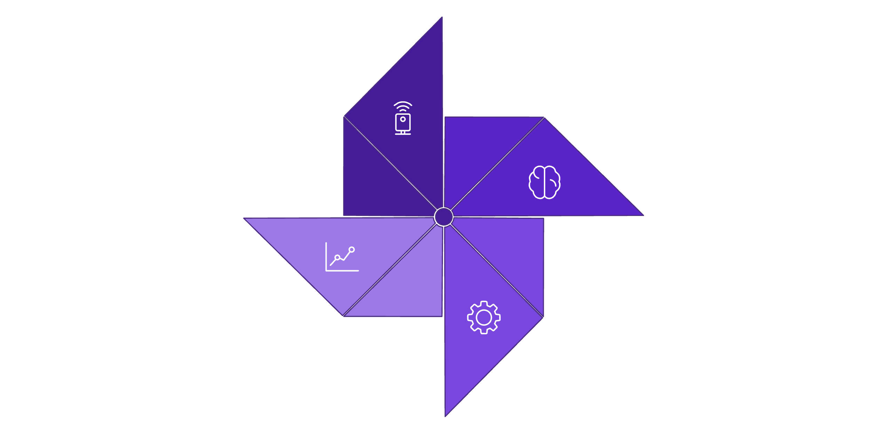

The Paradigm Shift: Event-Driven Platforms
Platforms should be continuous systems — not reactive ones.
Decide
Detect
Act
Learn
This transforms platforms from passive infrastructure into continuous, self-regulating systems—capable of operating safely and intelligently without constant human supervision.

Slide 4

Events as First-Class Citizens
An event is a signal that something meaningful happened in your platform that can trigger action. —A metric spike, a failed deployment, a policy violation, a pod crash—becomes a typed, routable event that triggers structured platform behavior.
Metrics
Deployments
Prometheus SLO breaches, latency spikes, and throughput anomalies emit actionable signals in real time.
Argo CD pipeline events — completions, rollbacks, failures — feed directly into the control loop.
Policy Violations
Runtime Events
Kyverno and OPA emit structured events when admission rules or compliance guardrails are breached.
Kubernetes pod lifecycle events — CrashLoopBackOff, OOMKilled, pending scheduling — trigger immediate evaluation.

Slide 5
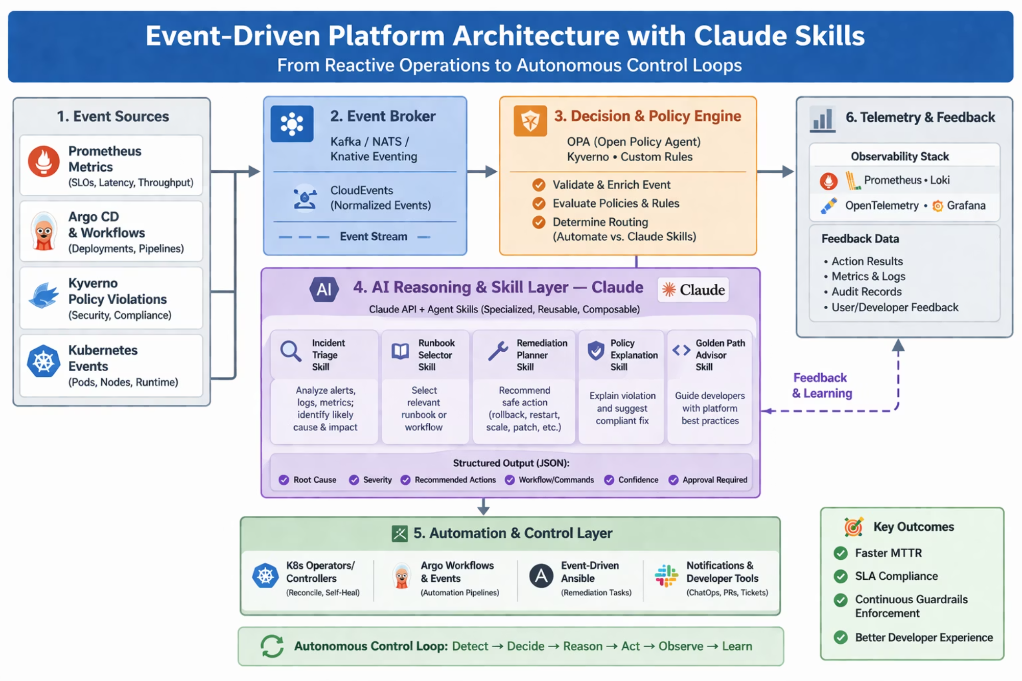
Architecture Deep Dive
The reference arch has six integrated layers, with the first three transforming raw infrastructure noise into structured, actionable events.
Event Sources
Prometheus, Argo CD, Kyverno, and Kubernetes emit the raw signals.
Event Broker
Kafka, NATS, or Knative Eventing normalizes and routes events via CloudEvents.
Decision & Policy Engine
OPA or Kyverno decides whether to remediate, escalate, or invoke AI reasoning.

Slide 6
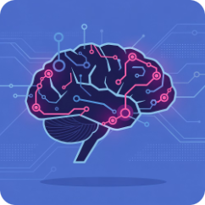
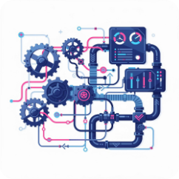
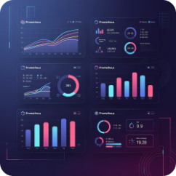
Architecture Deep Dive
Reasoning, Execution & Feedback
Once an event has been routed and policy-evaluated, it enters the intelligence and execution layers that make autonomous action possible.
AI Reasoning Layer — Claude Skills
Automation & Control Layer
Telemetry & Feedback
Prometheus, Loki, and OpenTelemetry capture outcomes — action results, metrics deltas, audit records, and user feedback — feeding results back into the system to close the learning loop.
Specialized, reusable Claude Skills act as a context-aware reasoning layer. Skills handle incident triage, runbook selection, remediation planning, and policy explanation — enhancing decision quality under uncertainty, not replacing deterministic automation.
Kubernetes Operators, Argo Workflows, and Event-Driven Ansible execute the decisions made upstream. This layer is fully idempotent and audit-logged, ensuring safe, repeatable actions at scale.

Slide 7

The AI Differentiator: Claude Skills Integration
The AI Reasoning Layer is what distinguishes an event-driven platform from a merely automated one. Claude Skills are specialized, composable agents invoked only when deterministic rules are insufficient — keeping the system fast by default and smart when it matters.
Incident Triage Skill
Runbook Selector Skill
Analyzes logs, metrics, and deployment history to surface root cause and severity assessment with confidence scores.
Matches enriched incident context to the most relevant runbook or workflow from a curated library.
Remediation Planner Skill
Policy Explainer Skill
Recommends safe action sequences — rollback, restart, scale, patch — ranked by confidence and blast radius.
Translates policy violations into plain-language guidance with remediation steps for developers in context.
Key Principle: Deterministic systems act fast. AI-enhanced systems act smart. Use each where it excels — never substitute AI for a rule that can be codified deterministically.

Slide 8




End-to-End Flow: CrashLoopBackOff Scenario
Theory crystallizes in production. Walk through a real failure scenario to see how every architectural layer contributes to an autonomous, intelligent response — from signal to resolution in under 90 seconds.
1. Signal Generated
2. Policy Evaluated
Kubernetes emits a pod failure event. Prometheus records a SLO breach. Both are published to the event broker as normalized CloudEvents.
OPA evaluates the enriched event. Rule matches: severity high, affected service tier-1. Decision: invoke Claude Skill before executing automation.
3. Claude Skill Invoked
4. Action Executed
The Incident Triage Skill analyzes recent logs and deployment history. It surfaces a bad config change 12 minutes prior and recommends a targeted rollback with 94% confidence.
Workflow triggers the rollback. Kubernetes Operator validates the healthy state. Telemetry confirms SLO recovery. The loop closes — no ticket created.

Slide 9
Responsibility Model in Event-Driven Platforms
Platform teams provide control and safety; service teams provide intent and context.
Platform Team
Service / Product Teams
Shared Responsibility
Control Plane Ownership
Data Plane Ownership
Critical Alignment Layer
Event Infrastructure (Kafka / NATS / Event Bus)
Policy-as-Code (OPA / Guardrails / Compliance)
Control Loop Orchestration (Event → Decision → Action)
Golden Paths (Reusable event-driven templates)
Observability & Audit (Decision tracing, event lineage)
Multi-tenancy & Safety (rate limits, blast radius control)
Emit Domain Events (business + service signals)
Define SLOs (latency, error rates, thresholds)
Expose Custom Metrics (e.g., inference time, tokens/sec)
Extend Golden Paths (custom tuning, domain logic)
Handle Domain-specific Automation (optional consumers)
Event Schema Contracts (CloudEvents, payload structure)
Policy Inputs (metrics, labels, contextual signals)
Feedback Loop Validation (did action improve outcome?)
Observability Correlation (event → policy → action tracing)
Ensures coordination between platform and services
Defines what matters and when to act
Builds the system, enforces guardrails

Slide 10






Use Cases in Platform Engineering
Event-driven autonomous platforms unlock a new class of platform capabilities — from self-healing infrastructure to runtime-adaptive feature delivery.
Autonomous Scaling
Self-Healing Infrastructure
Continuous Compliance Enforcement
CI/CD Event Automation
Use real-time inference latency or token throughput instead of static thresholds
Trigger scaling dynamically (aligns with HPA + custom metrics)
Deployment events trigger canary analysis, rollback on failure, and feature flag toggles
Fully automated pipeline response
Detect CrashLoopBackOff automatically
Restart or redeploy without human intervention
Escalate only if repeated failures occur
Detect policy violations at runtime
Trigger deployment rejection, resource quarantine, or audit logging automatically
Event-Driven Feature Flags
Toggle features based on system load, error rates, or user segmentation
Enables runtime adaptability without redeployment

Slide 11
Maturity Model: Reactive → Autonomous
Platform evolution toward autonomy is not a binary switch — it is a deliberate progression across four stages. Each stage delivers compounding returns on reliability and developer experience, while introducing new engineering challenges to manage.
Stage 2: Automated
Stage 1: Reactive
Scripts and pipelines handle known failure modes. Humans still own decision logic.
Alerts route to humans. Runbooks executed manually. High MTTR, high toil.
Stage 4: Autonomous
Stage 3: Event-Driven
Closed-loop systems with AI-enhanced reasoning. Continuous guardrails. Self-healing with audit-complete transparency.
Events trigger structured workflows. Policy engines gate execution. Human oversight reserved for escalations.

Slide 12
Design Principles for Event-Native Platforms
Building event-native platforms that remain maintainable, safe, and evolvable over time requires deliberate engineering discipline from the start. These practices encode hard-won lessons from teams operating at scale.
Use Event Contracts
Design for Idempotency
Adopt CloudEvents spec across all producers. Schema-validated, versioned event contracts prevent silent coupling failures as your source topology grows.
Every automated action must be safely re-executable. Idempotent automation tolerates at-least-once delivery semantics from brokers like Kafka and NATS without causing duplicate side effects.
Keep Policy Deterministic
Separate Decision from Execution
Codify all known decision paths in OPA or Kyverno. Reserve AI invocation exclusively for ambiguous, context-heavy scenarios where rule-based systems have genuine blind spots.
The decision layer (policy engine + AI skills) must be architecturally decoupled from the execution layer (operators, workflows). This separation enables independent testing, rollback, and audit.

Slide 13
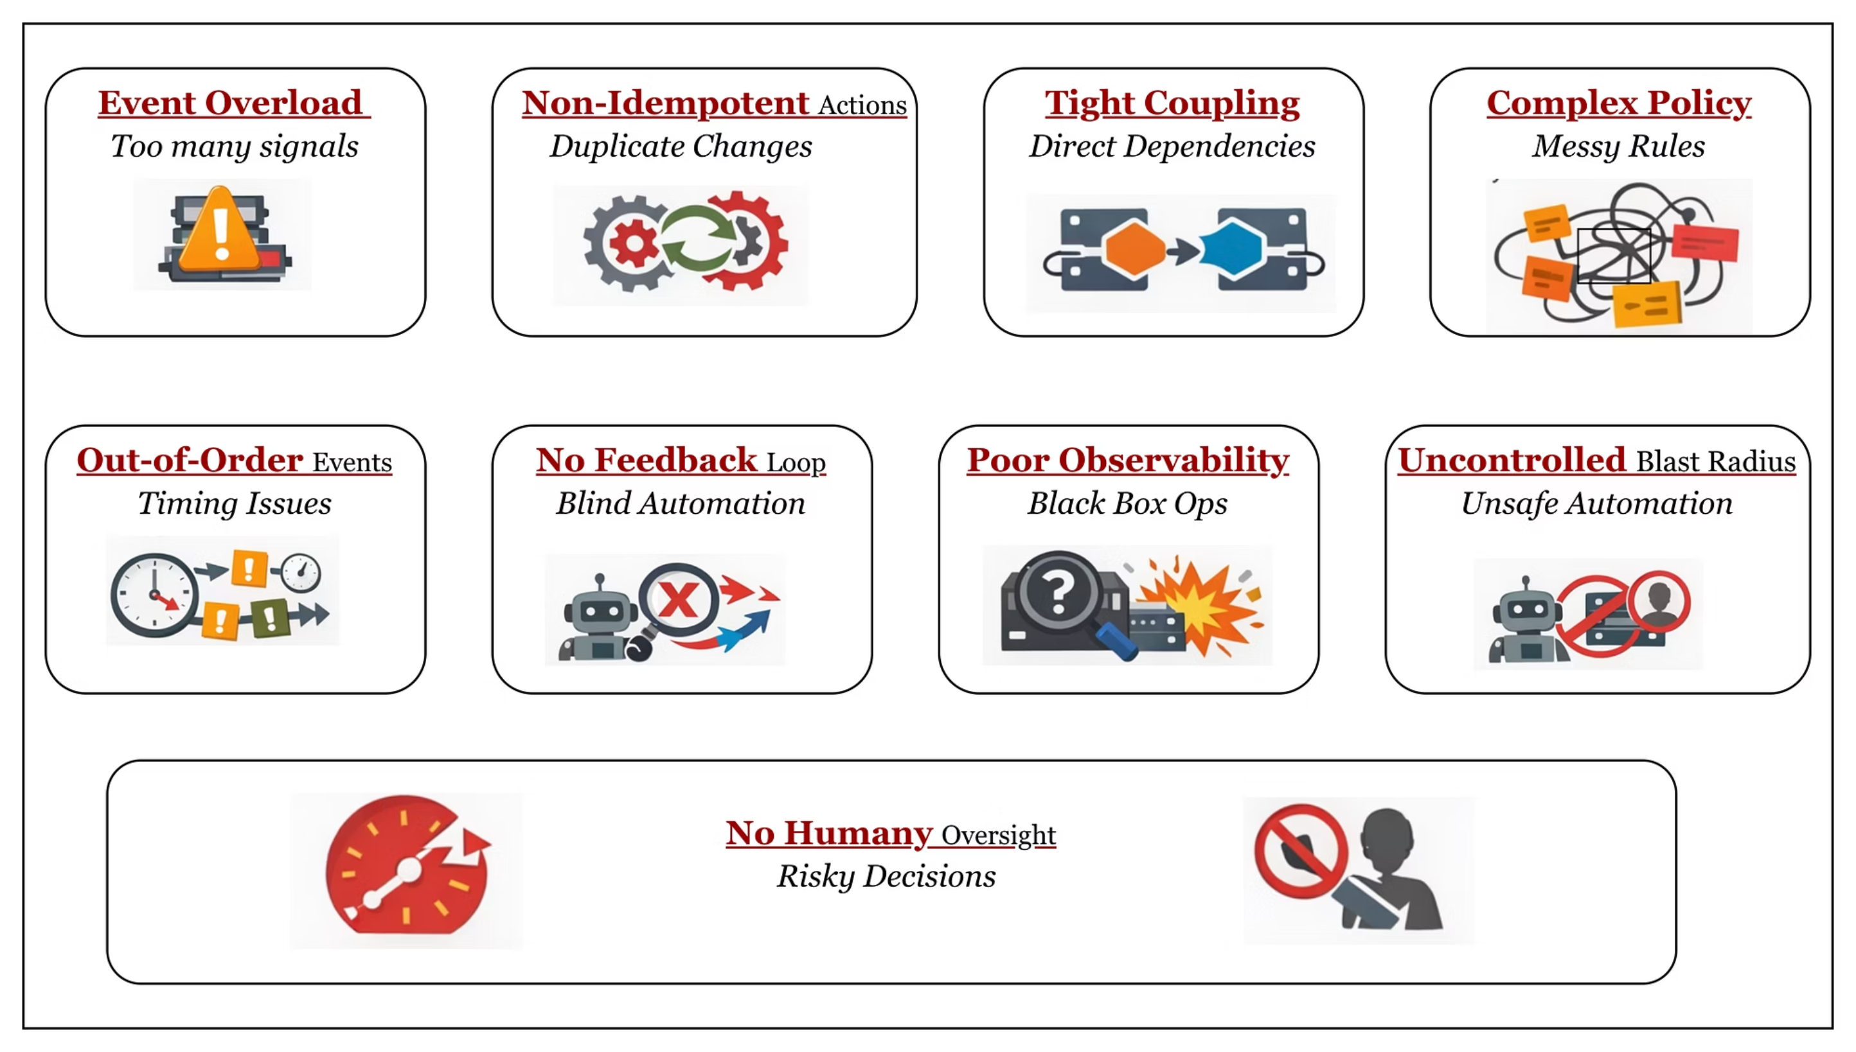
WATCH OUT
Anti-Patterns to Avoid
Even well-intentioned event-driven platforms fail when these common anti-patterns go unaddressed.

Slide 14
Challenges & Guard Rails
Autonomous control loops introduce real operational risks. Engineering teams must design explicitly for failure modes in the automation layer itself — not just the systems being controlled.
Key Challenges
Where AI Should NOT Be Used
Actions with irreversible blast radius (e.g., data deletion, firewall rule removal)
Compliance-gated decisions requiring human sign-off
Scenarios where a deterministic rule already exists — codify it, don't infer it
Any action where confidence score falls below your defined safety threshold
Event Noise & Storm Handling
Control Loop Stability
Feedback loops that act too aggressively can oscillate. Apply exponential backoff, circuit breakers, and cooldown periods to prevent remediation storms.
Cascading failures can generate thousands of correlated events per second. Without deduplication and correlation windows, the automation layer becomes the amplifier of an outage rather than its resolver.
Safety Mechanisms
Dry-run mode for all new automation paths
Mandatory approval gates for Tier-1 services
Full audit log of every AI skill invocation and recommendation
Trust in AI Decisions
Policy vs. Flexibility
AI skill outputs must carry structured confidence scores and be subject to policy gates. Low-confidence recommendations should always escalate rather than execute.
Overly rigid policies block legitimate developer workflows. Use graduated enforcement — warn, then block — with clear exception paths and audit trails.

Slide 15
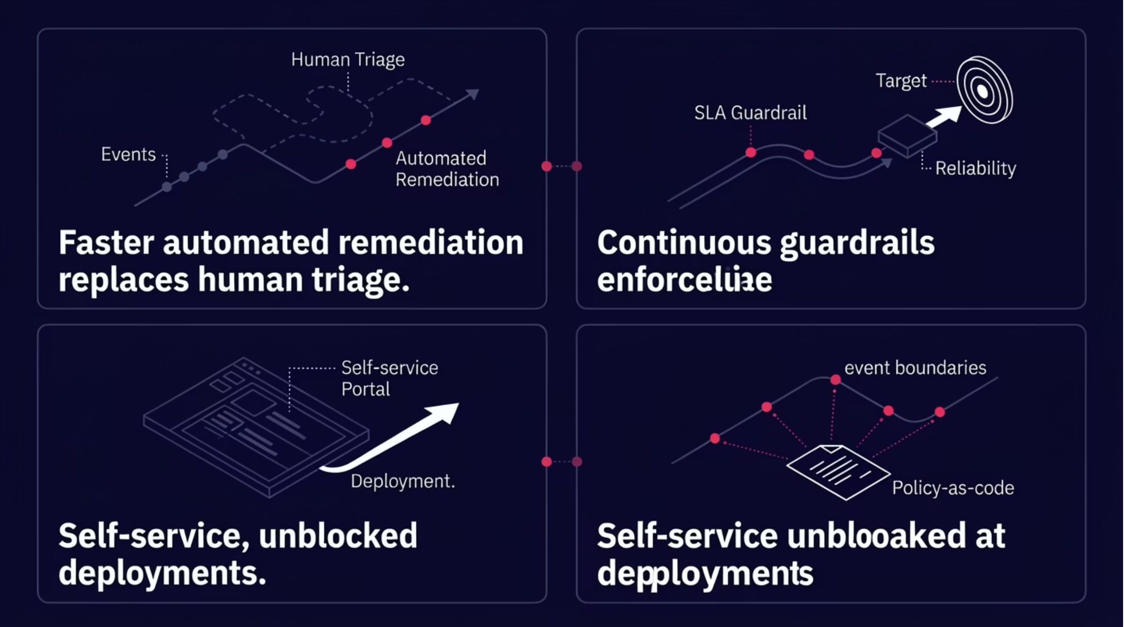
Key Outcomes & Business Impact
Event-driven platforms with autonomous control loops deliver measurable improvements across the metrics that matter most to platform engineering leaders and their stakeholders.
↓80%
99.9%
0
↑DX
MTTR Reduction
SLA Compliance
Toil Tickets
Developer Experience
Automated triage and remediation eliminate the human latency that dominates mean time to recovery in reactive systems.
Continuous policy guardrails and proactive scaling maintain reliability commitments without manual intervention windows.
Known failure patterns handled by the control loop never surface as tickets — engineering capacity shifts to platform improvement.
Faster deployments, inline policy guidance, and self-healing infrastructure remove the friction that erodes platform trust over time.

Slide 16
Closing: The Event-Native Future
"The future of platform engineering is not just automated — it is event-native, policy-driven, and intelligently adaptive."
The path from reactive operations to autonomous control loops is an engineering journey, not a product purchase. It requires investing in event contracts, policy codification, and deliberate AI integration — but the compounding returns in reliability, developer velocity, and operational leverage are transformational.
01
02
Start with Event Contracts
Codify Your First Policy
Instrument one domain (e.g., deployments) with CloudEvents and a lightweight broker before expanding your event topology.
Implement a single OPA or Kyverno rule that auto-remediates a known, high-frequency failure — prove the loop works end-to-end.
03
04
Introduce AI at the Edges
Close the Feedback Loop
Add a Claude Skill to one ambiguous escalation path. Measure confidence score distribution and refine before expanding coverage.
Instrument telemetry on every automated action. Use outcome data to continuously improve policy rules and AI skill quality.

Slide 17

Thank You
Questions? Let's continue the conversation.
Josephine Eskaline Joyce
Prashanth Bhat
STSM, IBM Cloud
Lead Architect, IBM Cloud
📧 jojustin@in.ibm.com
📧 prashabh@in.ibm.com
🔗 linkedin.com/in/josephine-joyce/
🔗 linkedin.com/in/prashanth-bhat-bg/
Event-Driven Platform Engineering

