Slide 1

Pull Once, Scale Everywhere
Fixing image pull bottlenecks with Dragonfly

Slide 2

About Me
DevOps Developer at Motorola Solutions. I work extensively around Kubernetes and CNCF ecosystem and have a passion for exploring and implementing CNCF tools that drive infrastructure scalability and reliability.

Slide 3


Agenda
How a node pulls an image The silent killer in Kubernetes deployments Anatomy of a pull at 100x Why mirrors and caches fall short Dragonfly architecture deep-dive P2P image distribution in action Zero-touch integration Preheat — decoupling distribution from deployment Real performance numbers AI/ML model distribution on the same infra
Our Market

Slide 4
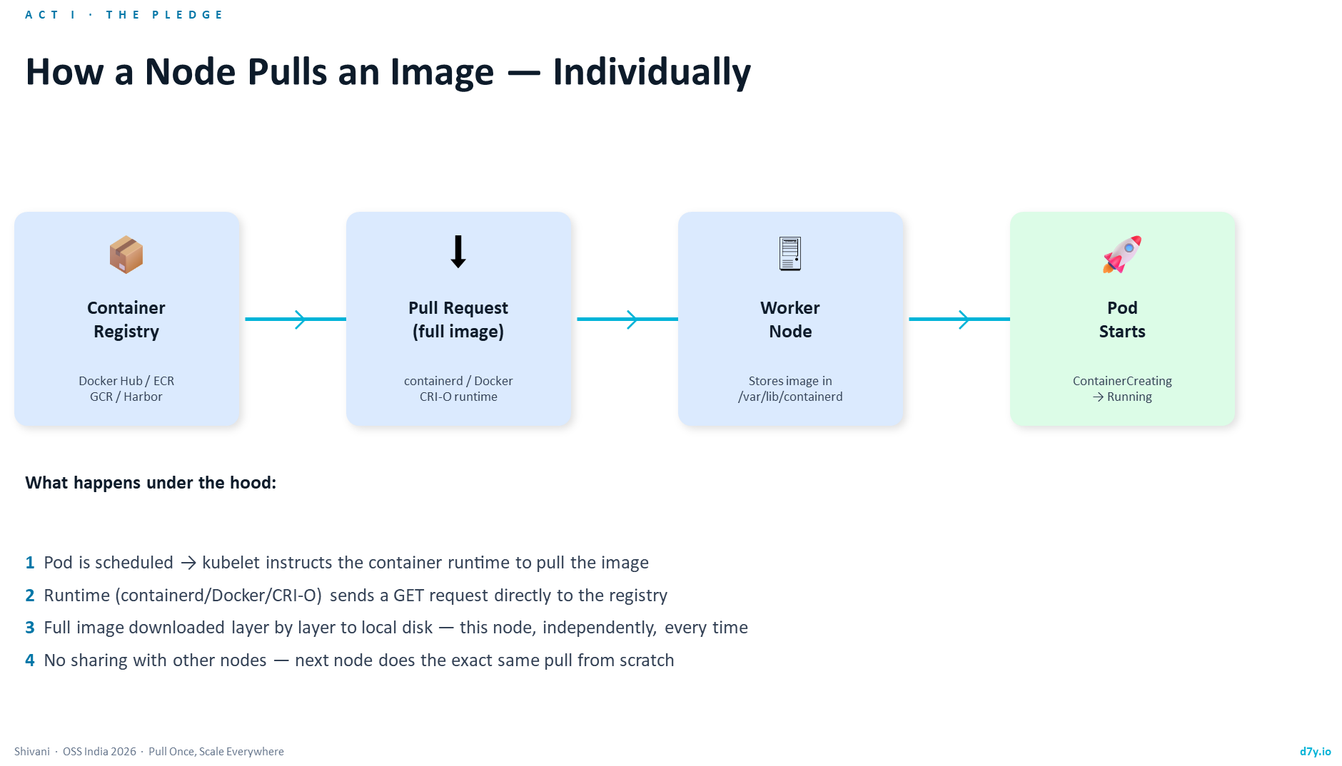

Slide 5
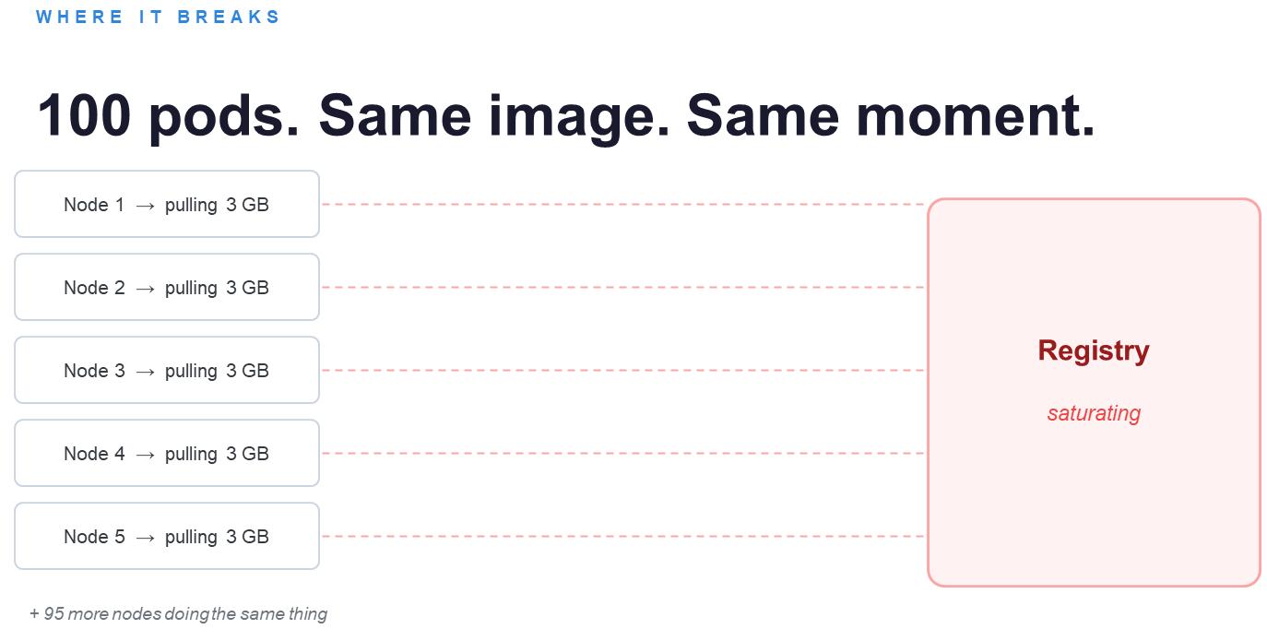

Slide 6

The window between 'pod scheduled' and 'pod running' is where the problem hides.

Slide 7

"What if the first node that downloaded the image could help the next node?"

Slide 8
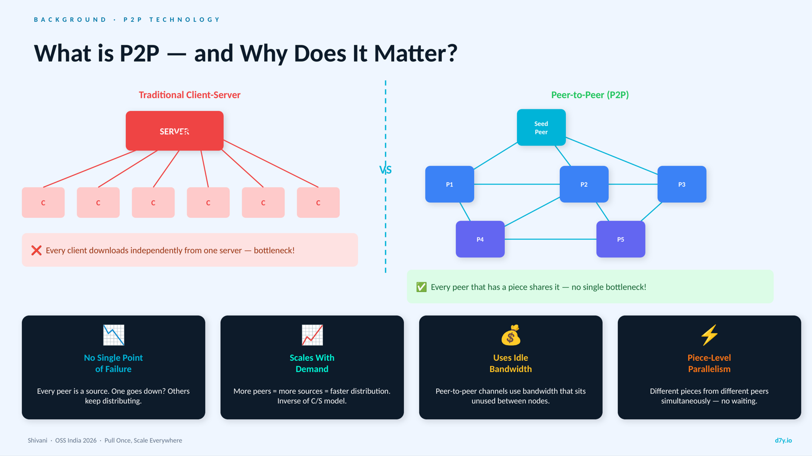

Slide 9

Delivers efficient, stable, and securedata distribution and acceleration powered by P2P technology
2018
2020
2021
2025
Dragonfly joined the CNCF as a sandbox project.
The CNCF Technical Oversight Committee (TOC) voted for Dragonfly to became an Incubating Project.
v2.0 was released after architectural optimization and code refactoring
The CNCF Technical Oversight Committee (TOC) voted for Dragonfly to became a Graduated Project.

Slide 10
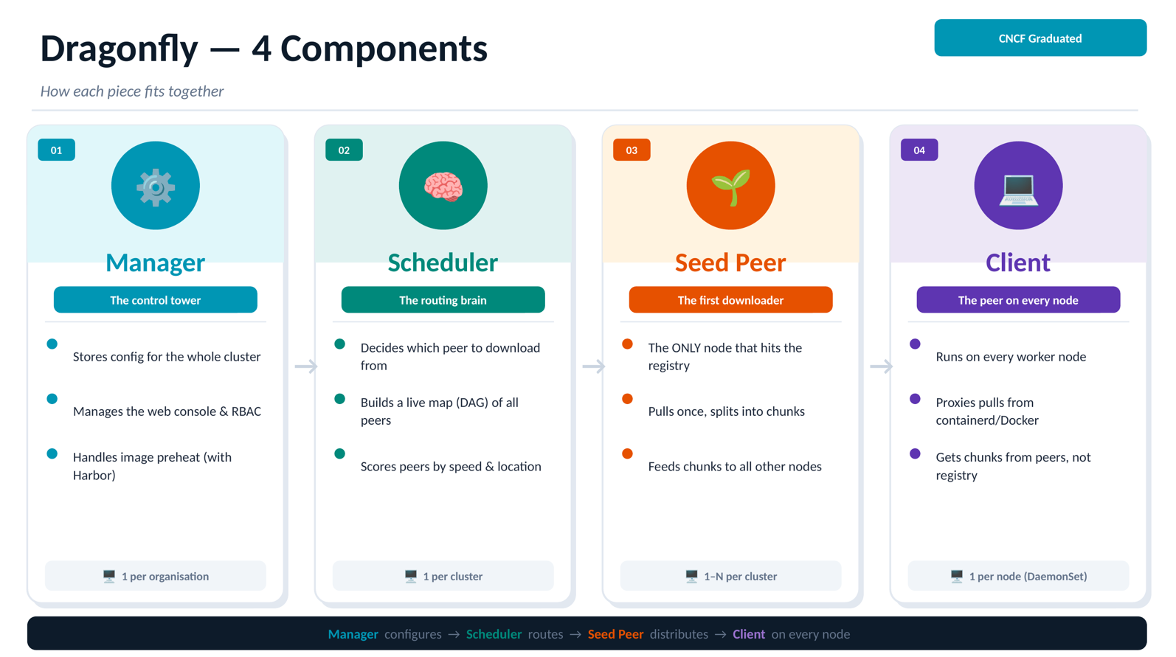

Slide 11
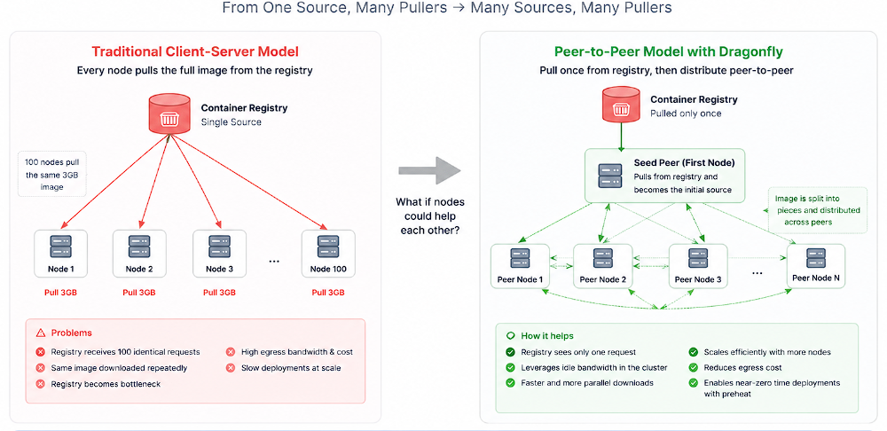

Slide 12
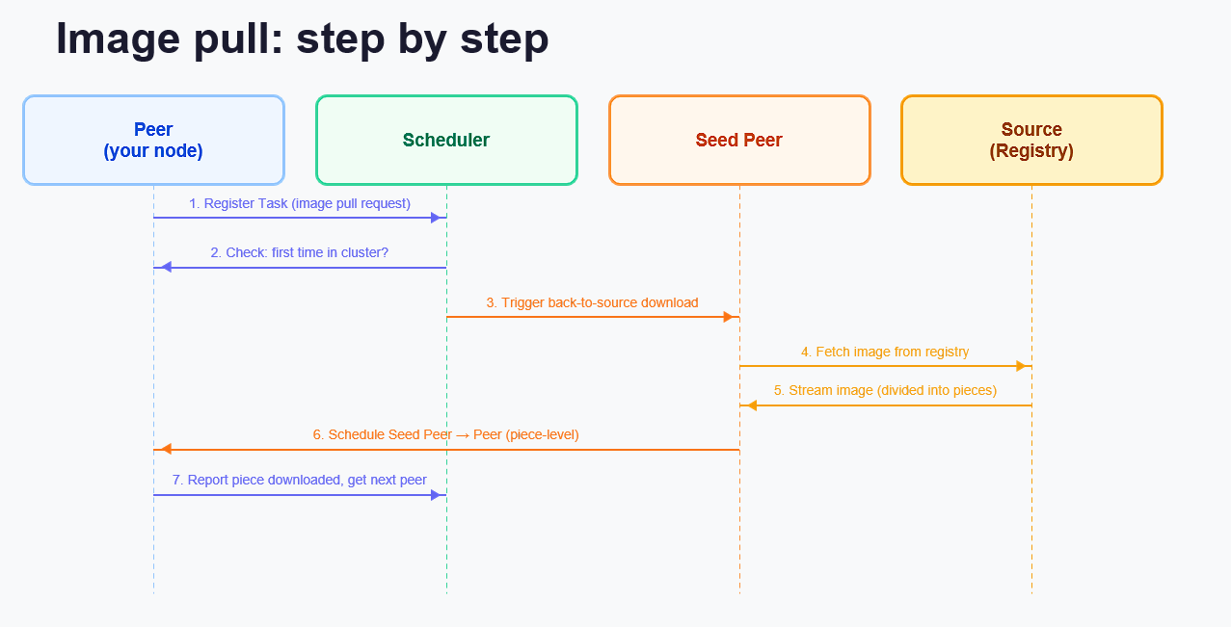

Slide 13
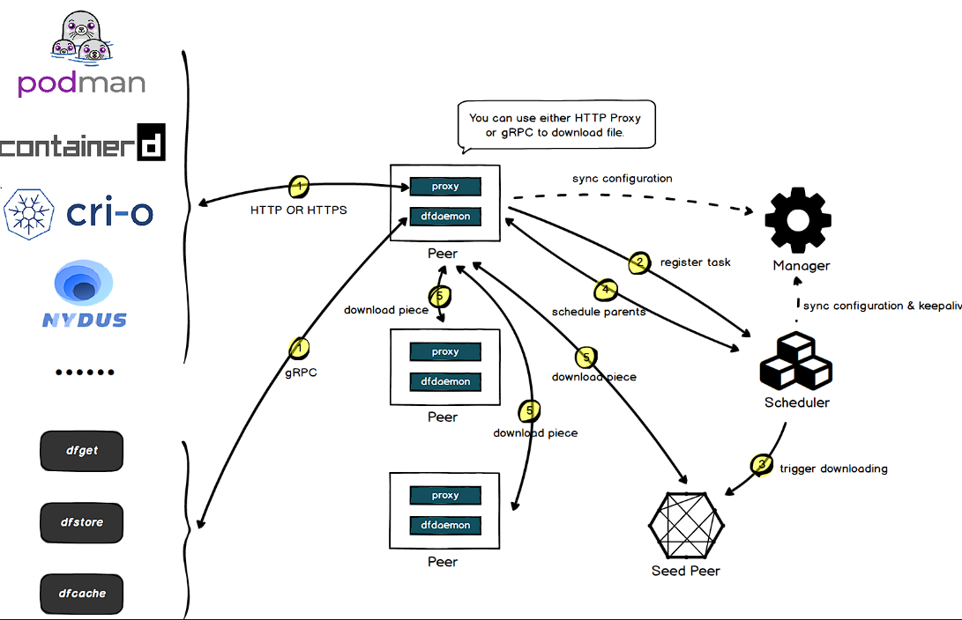

Slide 14
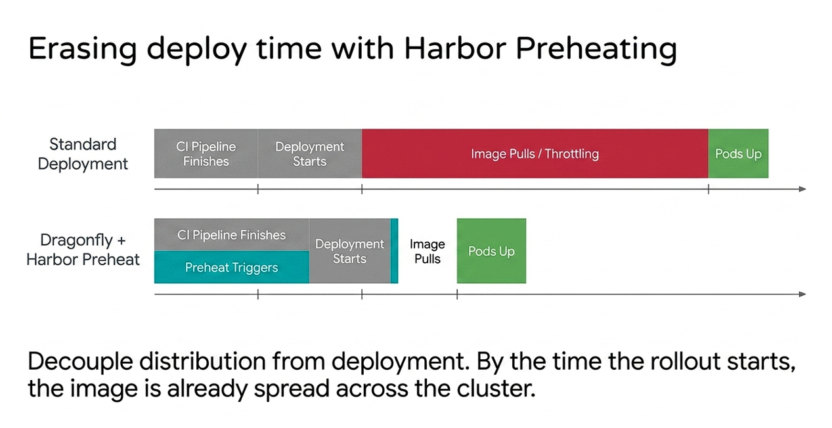

Slide 15
Dragonfly Resource & Cache Management
Lightweight Peer Process: Runs on every node with minimal CPU and memory overhead.
Uses Existing Node Storage: Caches image pieces on local disk—no additional storage system required.
Leverages Idle Network Bandwidth: Distributes data between peers using the cluster's internal network.
Automatic Garbage Collection: Removes stale cache and reclaims space without manual intervention.
Prevents Disk Exhaustion: Configurable TTLs and disk-usage thresholds keep cache growth under control.

Slide 16


Connect with Me
Email
shivanirathod126@gmail.com
Social Media
www.linkedin.com/in/shivani-rathod-08a599232

