Slide 1
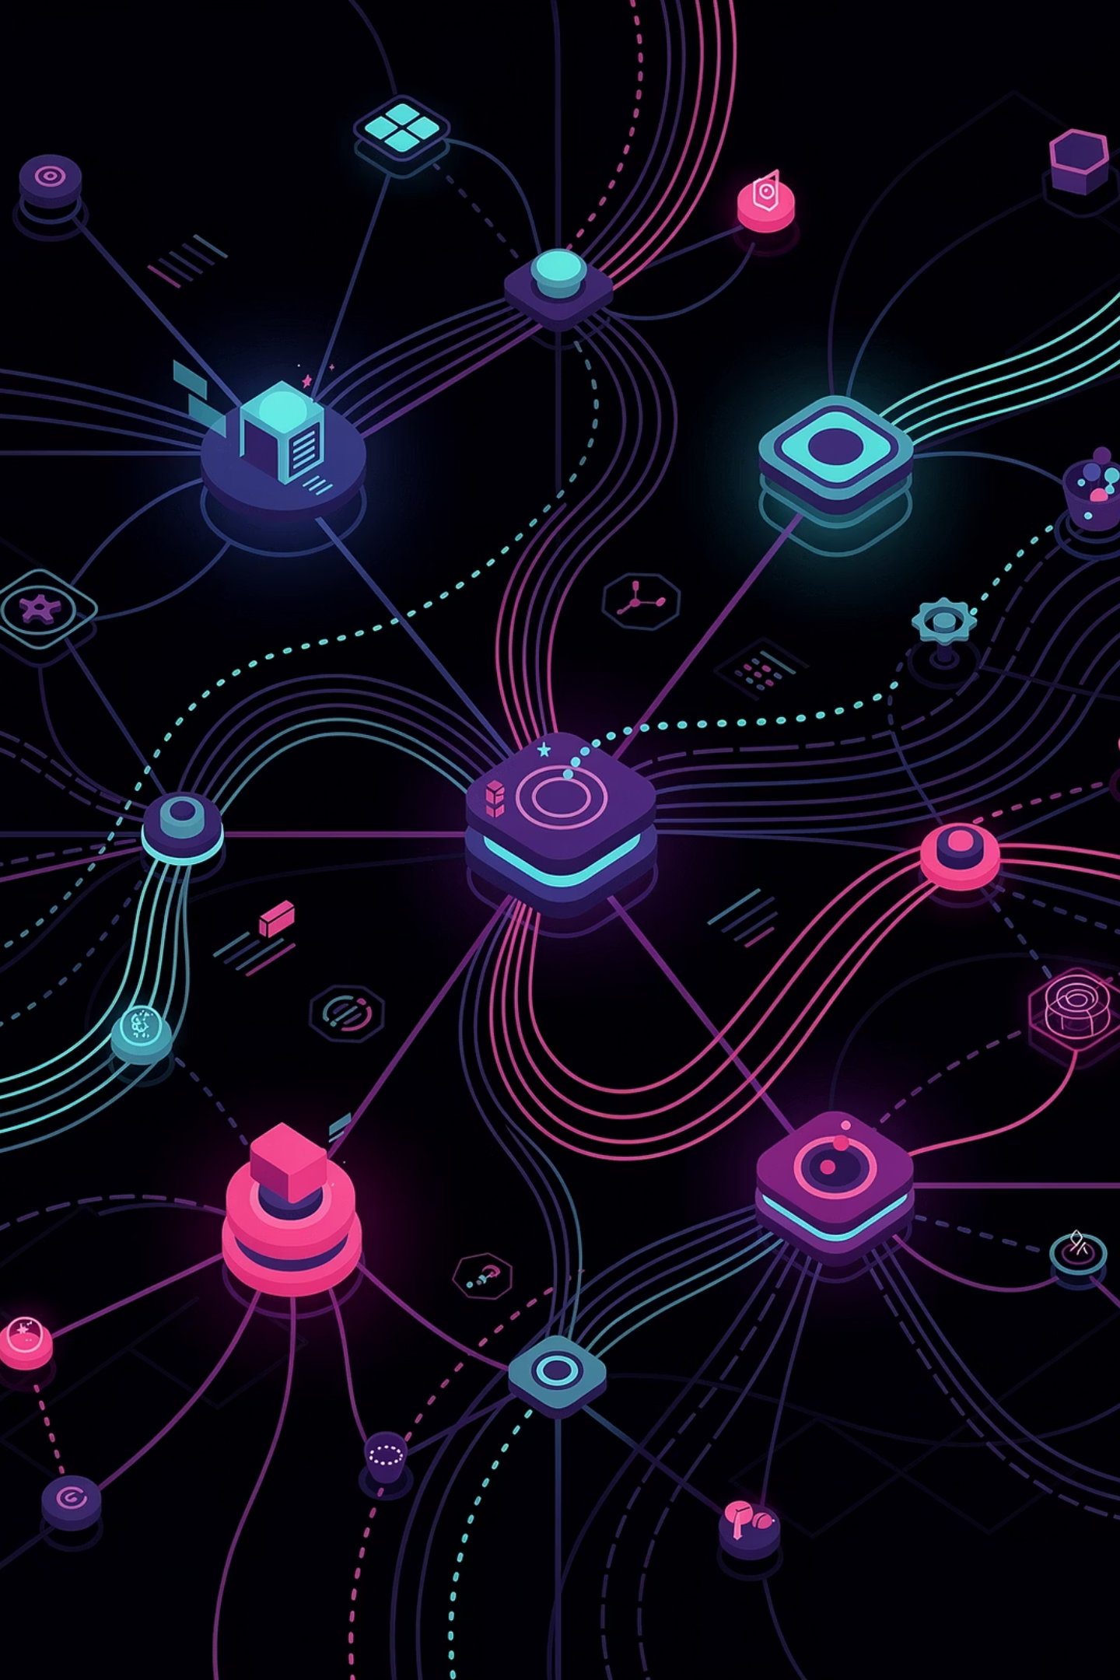
Event-Driven Platform Engineering
From Reactive Ops to Autonomous Control Loops
A deep dive into how platform teams can evolve from ticket-driven, human-in-the-loop operations to self-adaptive, policy-driven systems that detect, decide, and act—without manual intervention.
PLATFORM ENGINEERING
CLOUD-NATIVE
EVENT-DRIVEN IDP
Josephine Eskaline Joyce, STSM, IBM Cloud
Prashanth Bhat, Lead Architect, IBM Cloud

Slide 2

Problem
The Reality of Reactive Platforms
Most platform teams today are trapped in a cycle that hasn't fundamentally changed in a decade. Alerts fire, humans investigate, runbooks are consulted, and tickets are resolved — only for the same failure mode to re-emerge next week.
Modern platforms generate thousands of events, deployments, policy evaluations, and telemetry signals every minute.
Scaling Bottlenecks
Alert Fatigue
Thousands of events compete for attention
How Ops Works Today
Human Bottlenecks
Alert → human → action loop
Ticket-driven escalation chains
Fragmented scripts, pipelines, and runbooks
Knowledge siloed in individuals
Humans become the slowest component
Operational Toil
Repeated manual remediation consumes engineering time
"Cloud-native systems operate at machine speed. Operations still run at human speed."
The challenge is no longer automating tasks. It is automating decisions.

Slide 3
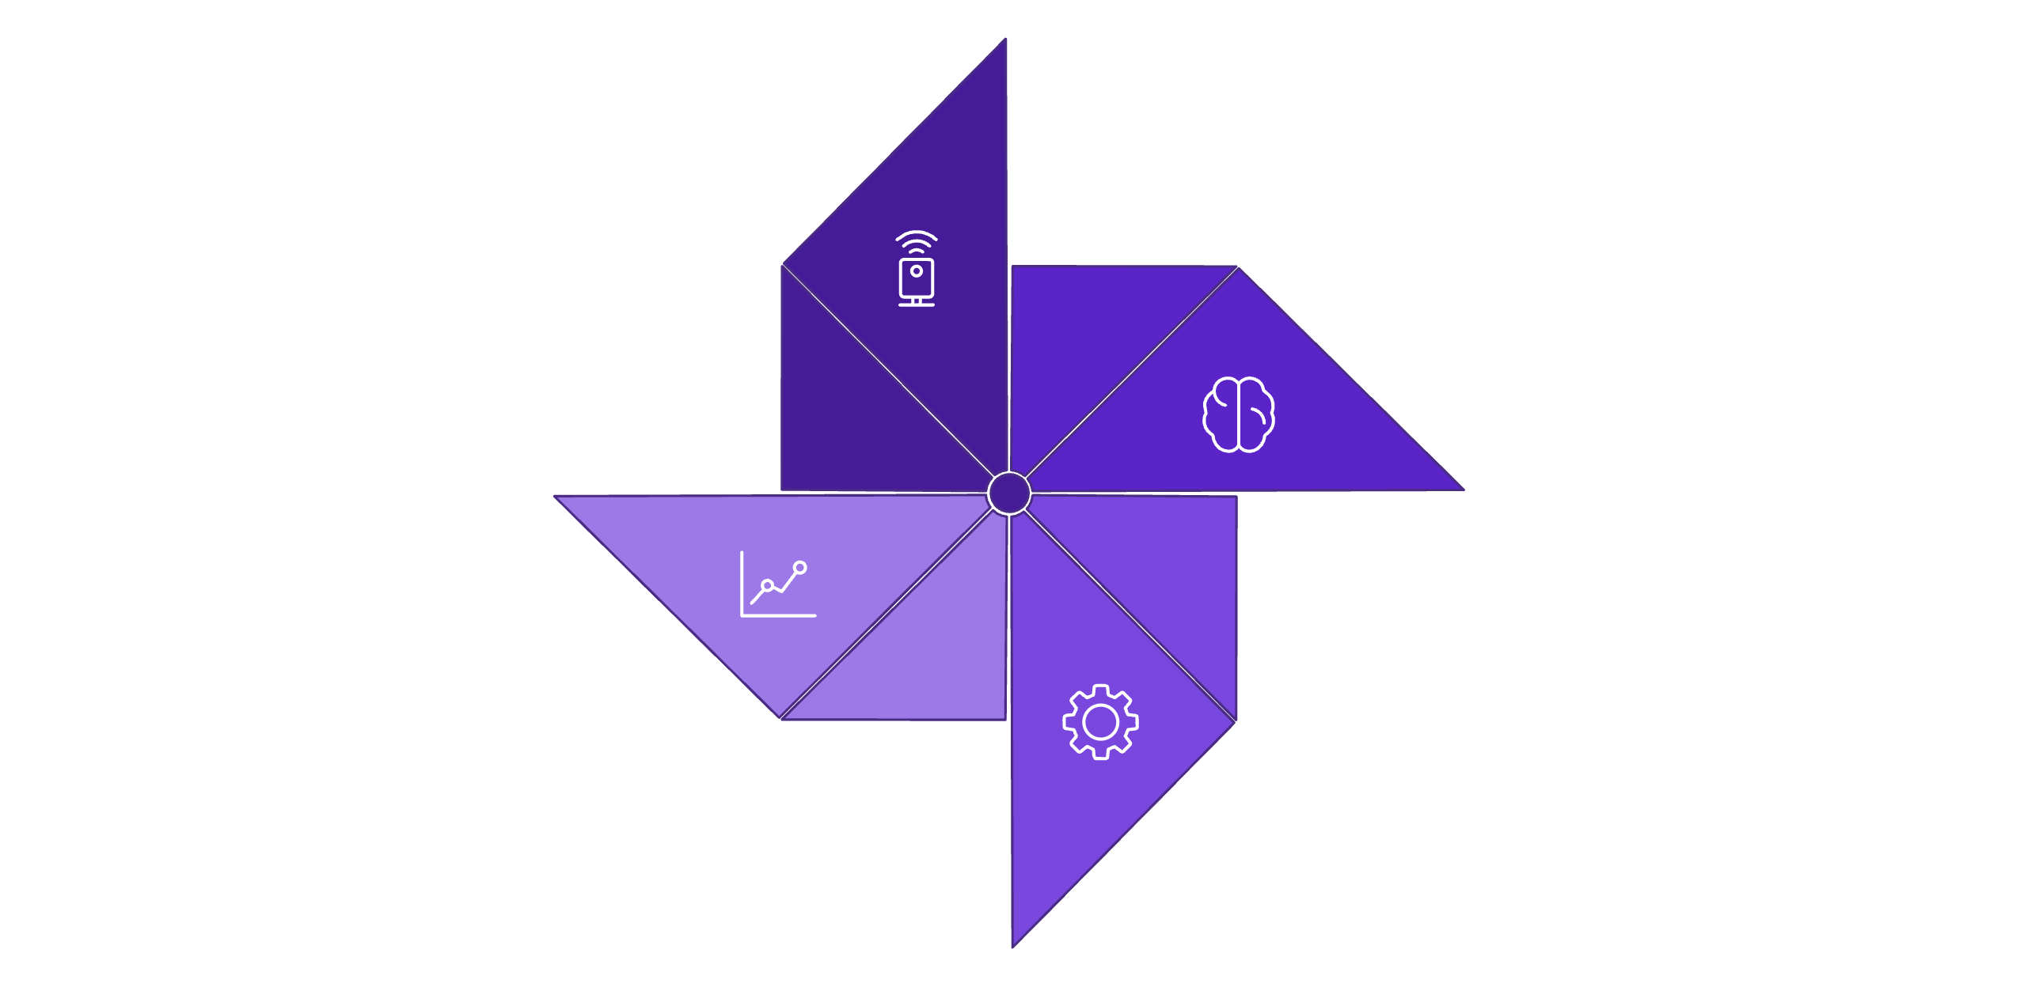
Solution
Event-Driven Platform Control Loop
Platforms should continuously adapt—not wait for human intervention.
Analyze
Policies, Rules, AI
Observe
Metrics, Logs, Events
Automate
Remediation, Scaling
Optimize
Feedback & Learning
Events trigger platform decisions—enabling detection, remediation, policy enforcement, and continuous optimization.

Slide 4
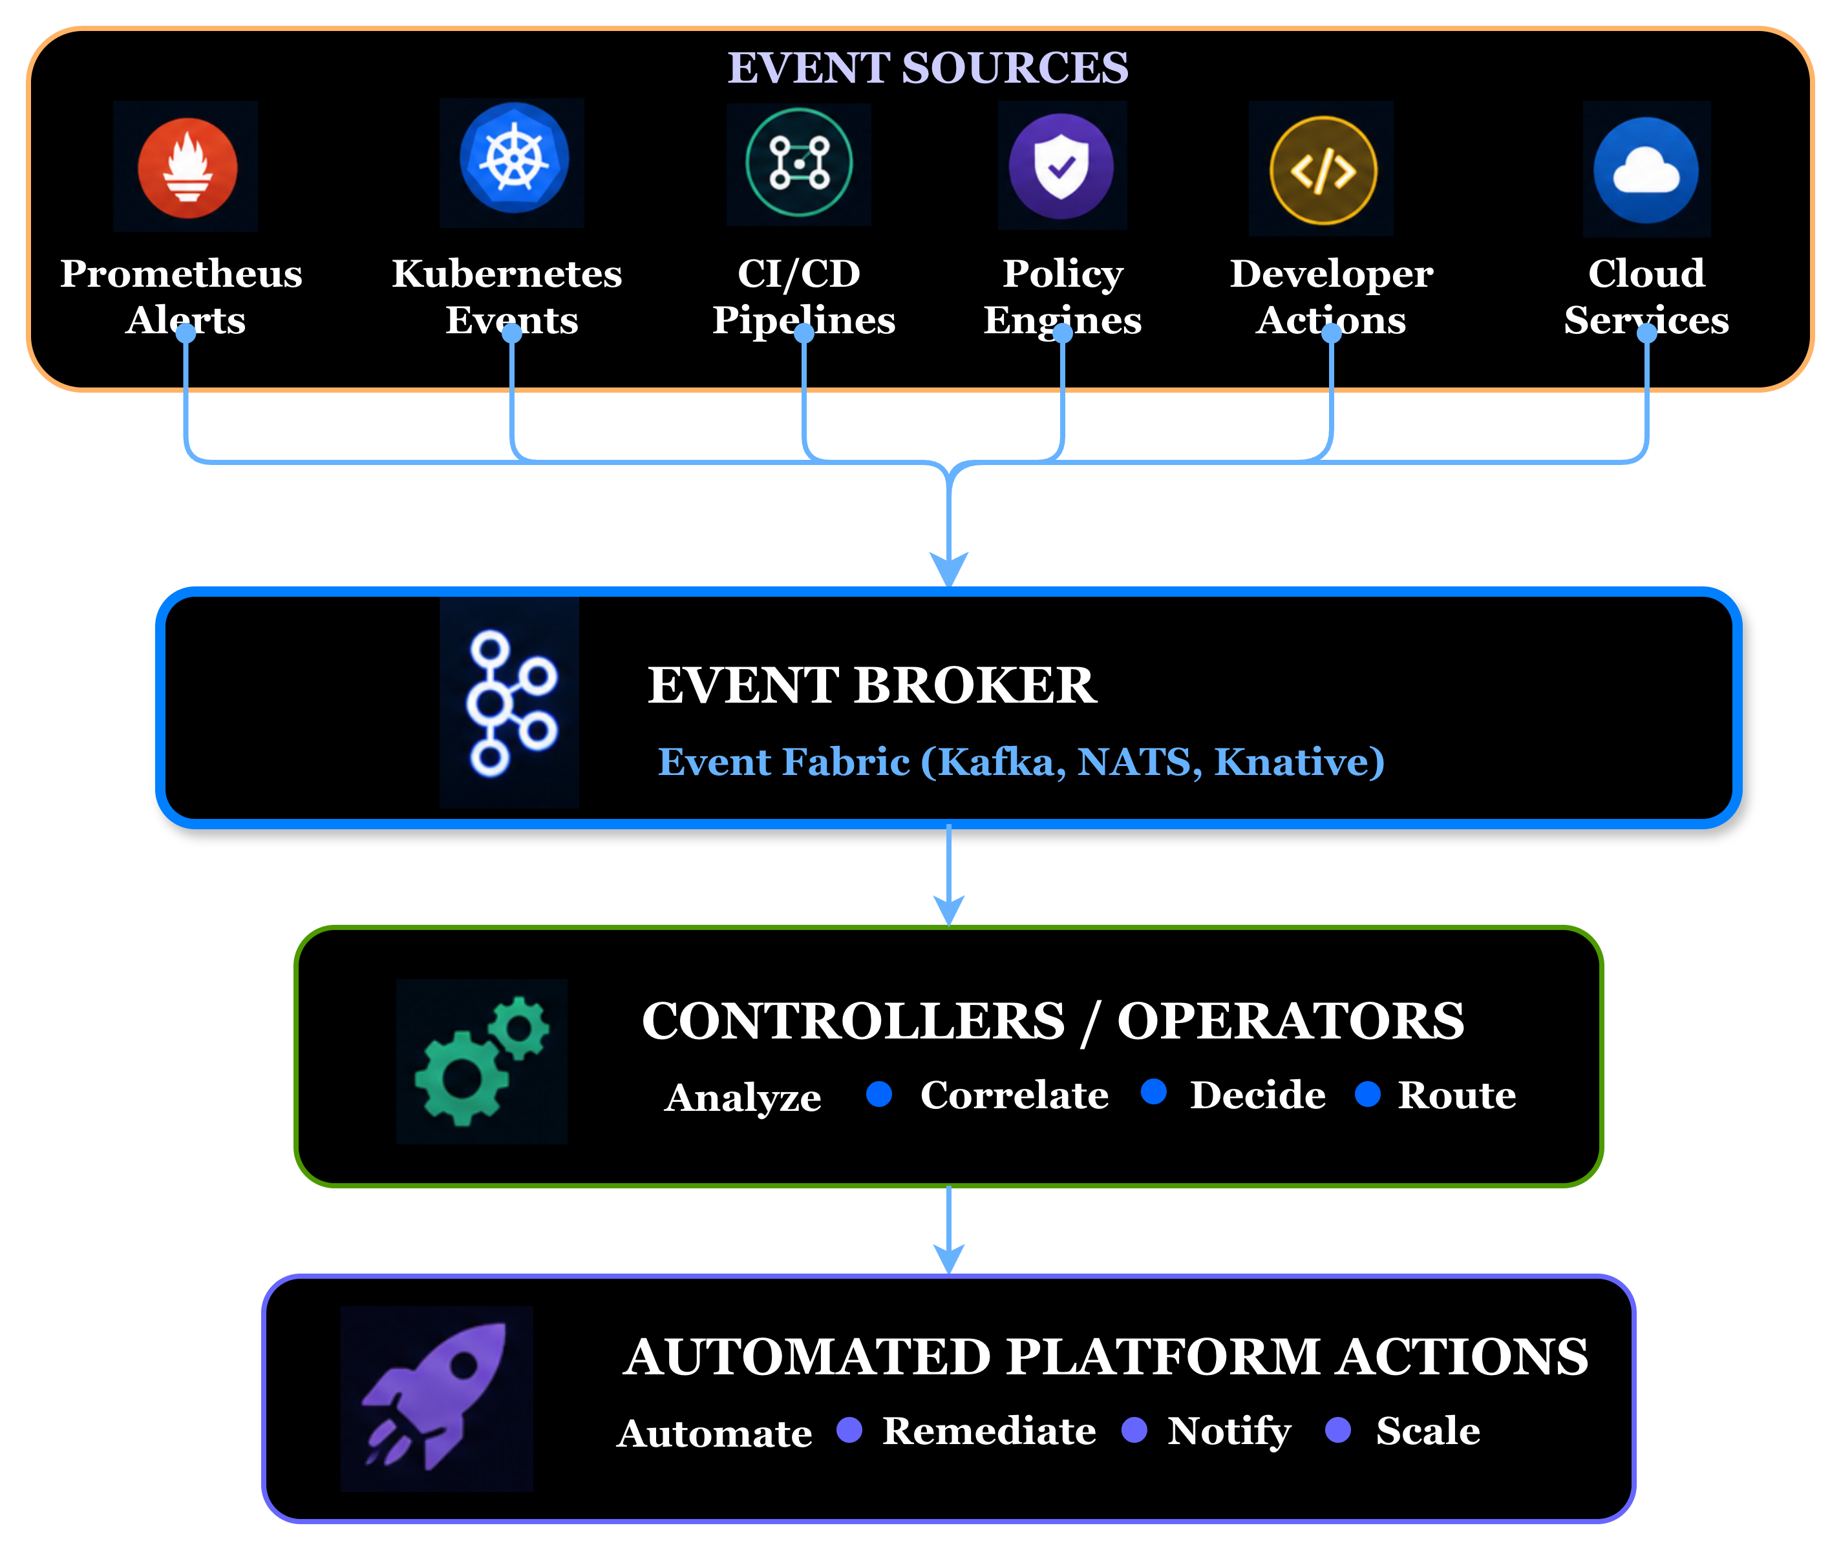
Solution
Sources of Platform Events
A unified event fabric that transforms platform signals into automated actions.
Observe
→
Decide
→
Act

Slide 5

Solution
Events as First-Class Citizens
An event is a structured signal that represents a meaningful platform state change and can trigger automated action.
A metric spike, a failed deployment, a policy violation, a pod crash—becomes a typed, routable event that triggers structured platform behavior.
Metrics
Deployments
Prometheus SLO breaches, latency spikes, and throughput anomalies emit actionable signals in real time.
Argo CD pipeline events — completions, rollbacks, failures — feed directly into the control loop.
Policy Violations
Runtime Events
Kyverno and OPA emit structured events when admission rules or compliance guardrails are breached.
Kubernetes pod lifecycle events — CrashLoopBackOff, OOMKilled, pending scheduling — trigger immediate evaluation.
Events transform platform operations from polling to autonomous action

Slide 6
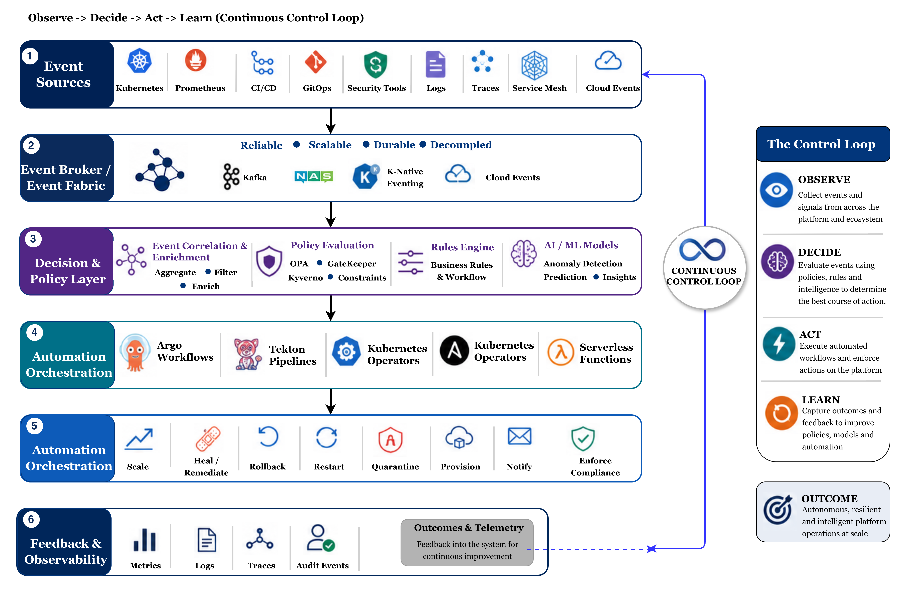
Solution
Event-Driven Platform Control Loop Architecture
Events become the platform's nervous system, enabling autonomous detection, decision-making, and remediation.

Slide 7
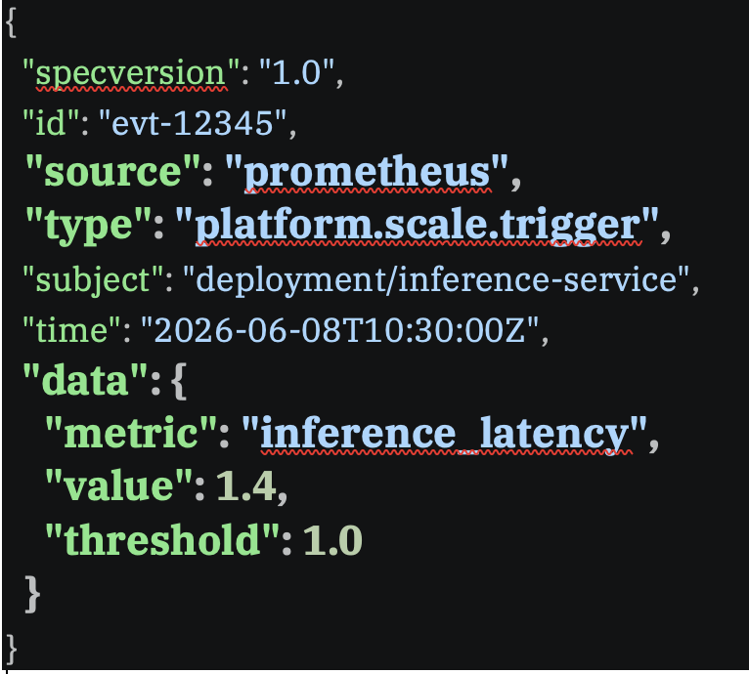

Solution
CloudEvents: The Contract Behind the Control Loop
CloudEvents provides a vendor-neutral event specification that enables consistent event exchange across platform components.
Why Cloud Events?
Attributes
Standardizes event metadata across producers and consumers
id - Unique event identifier
source - Origin of the event
type - Event classification
subject - Resource affected
time – Event timestamp
datacontenttype – Payload format
data – Event payload
Eliminates custom event parsing logic
Enables interoperability between observability, CI/CD, policy, and runtime systems
Provides a consistent event envelope for automation workflows
Event classification
Event classification
Simplifies event routing, filtering, and correlation
CloudEvents turns platform signals into actionable automation triggers.
Refer https://cloudevents.io/ for more details

Slide 8
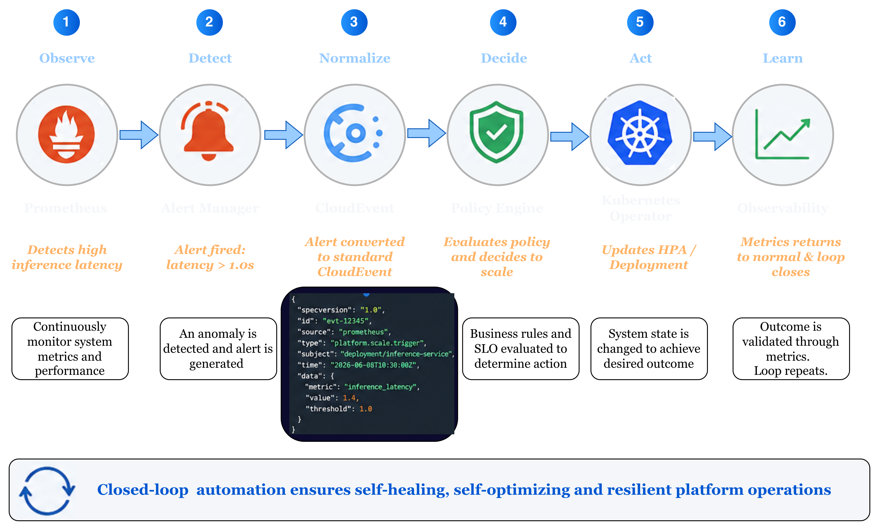
Solution
From Signal to Action: An Event-Driven Control Loop
Automated Scaling in response to an inference latency spike

Slide 9




Implementation
Event-Driven Platform Engineering Patterns
Common platform capabilities built using the same event-driven control loop
1
Auto-Remediation
2
Elastic Scaling
Trigger:
CPU utilization, latency threshold, queue depth, custom metrics
Trigger:
CrashLoopBackOff event, Node Pressure, Failed Deployment
Action:
Scale pods
Scale infrastructure
Adjust resource quotas
Action:
Restart Workloads
Rollback releases
Recreate infrastructure resources
Outcome:
Performance stability
Cost optimization
Outcome:
Reduced MTTR
Improved Availability
3
Policy Enforcement
4
Developer Self-Service
Trigger:
Policy violation event
Trigger:
PR opened, Service Request, API Call
Action:
Block deployment
Apply guardrails
Enforce configuration policies
Action:
Provision environments
Create databases
Configure networking
Outcome:
Continuous governance
Reduced risk
Outcome:
Faster delivery
Better developer experience

Slide 10






Implementation
Real-World Platform Use Cases
Event-driven autonomous platforms unlock a new class of platform capabilities — from self-healing infrastructure to runtime-adaptive feature delivery.
Intelligent Scaling
Self-Healing Infrastructure
Continuous Compliance Enforcement
CI/CD Event Automation
Use real-time inference latency or token throughput instead of static thresholds
Trigger scaling dynamically (aligns with HPA + custom metrics)
Deployment events trigger canary analysis, rollback on failure, and feature flag toggles
Fully automated pipeline response
CrashLoopBackOff event triggers remediation
Restart or redeploy without human intervention
Escalate only if repeated failures occur
Policy violations events trigger enforcement
Trigger deployment rejection, resource quarantine, or audit logging automatically
Event-Driven Feature Flags
Toggle features based on system load, error rates, or user segmentation
Enables runtime adaptability without redeployment
Events drive scaling, remediation, governance, delivery, and runtime adaptation.

Slide 11
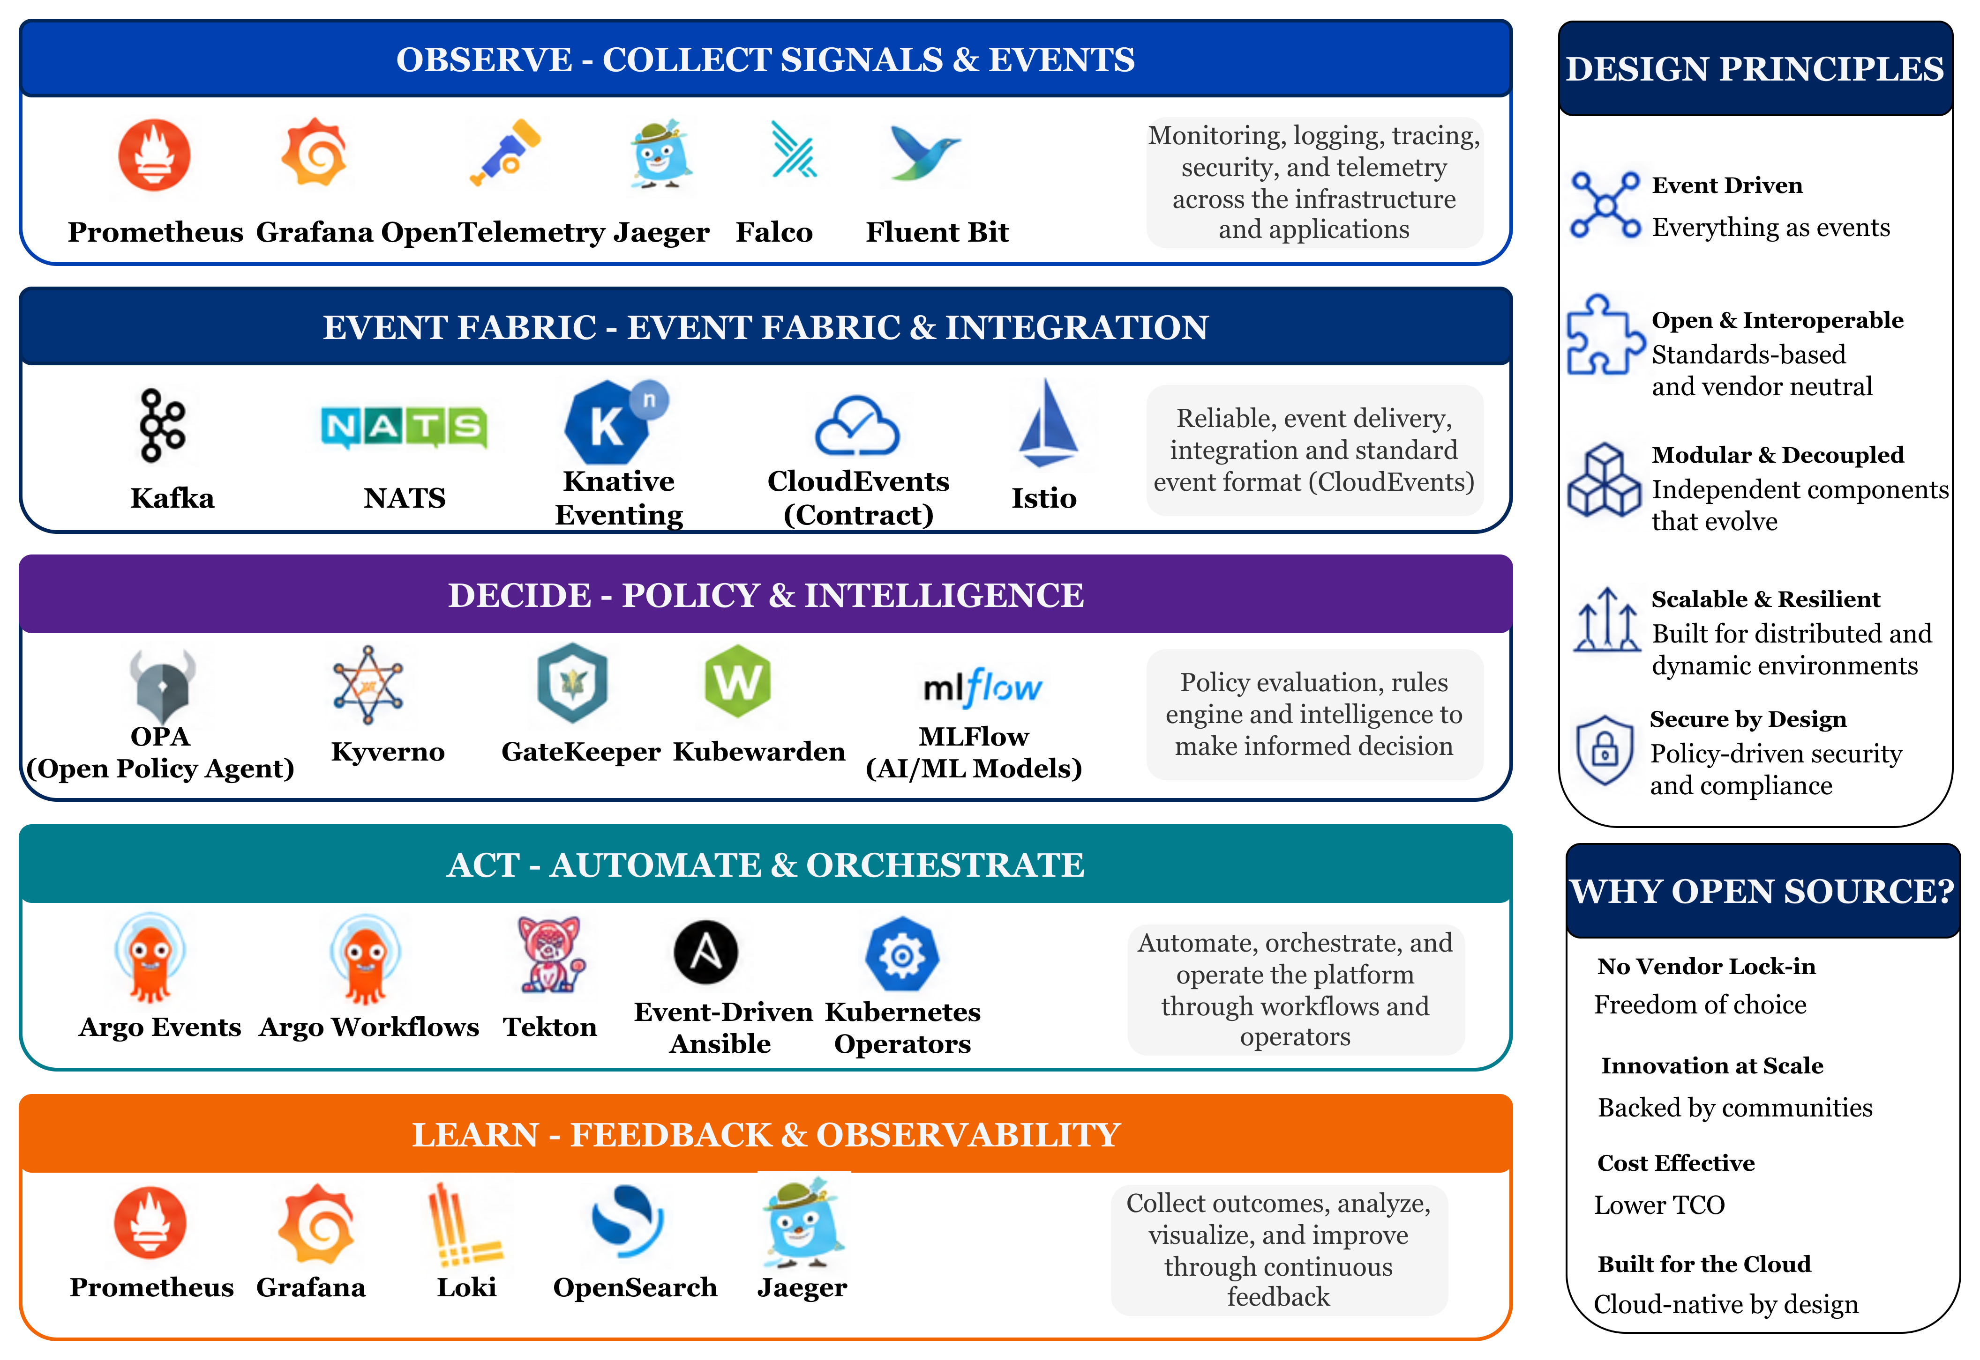
Adoption
Open Source Building Blocks for Event-Driven Platforms
Reference architecture - Powered by Cloud-native Open Source

Slide 12
Governance
Responsibility Model in Event-Driven Platforms
Platform teams provide control and safety; service teams provide intent and context.
Platform Team
Service / Product Teams
Shared Responsibility
Control Plane Ownership
Data Plane Ownership
Critical Alignment Layer
Event Infrastructure (Kafka / NATS / Event Bus)
Policy-as-Code (OPA / Guardrails / Compliance)
Control Loop Orchestration (Event → Decision → Action)
Golden Paths (Reusable event-driven templates)
Observability & Audit (Decision tracing, event lineage)
Multi-tenancy & Safety (rate limits, blast radius control)
Emit Domain Events (business + service signals)
Define SLOs (latency, error rates, thresholds)
Expose Custom Metrics (e.g., inference time, tokens/sec)
Extend Golden Paths (custom tuning, domain logic)
Handle Domain-specific Automation (optional consumers)
Event Schema Contracts (CloudEvents, payload structure)
Policy Inputs (metrics, labels, contextual signals)
Feedback Loop Validation (did action improve outcome?)
Observability Correlation (event → policy → action tracing)
Ensures coordination between platform and services
Defines what matters and when to act
Builds the system, enforces guardrails

Slide 13
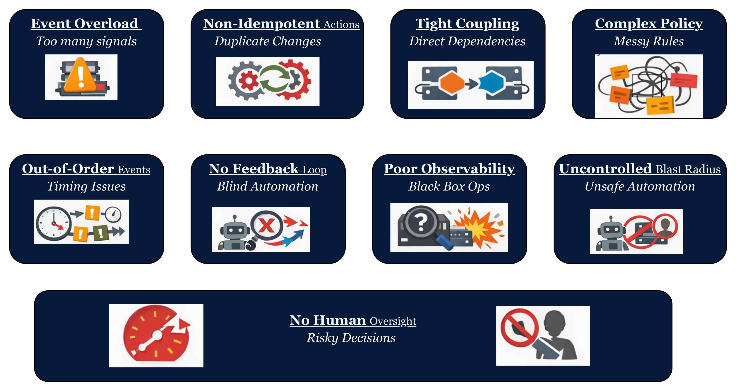
Governance
Anti-Patterns to Avoid
Even well-intentioned event-driven platforms fail when these common anti-patterns go unaddressed.

Slide 14
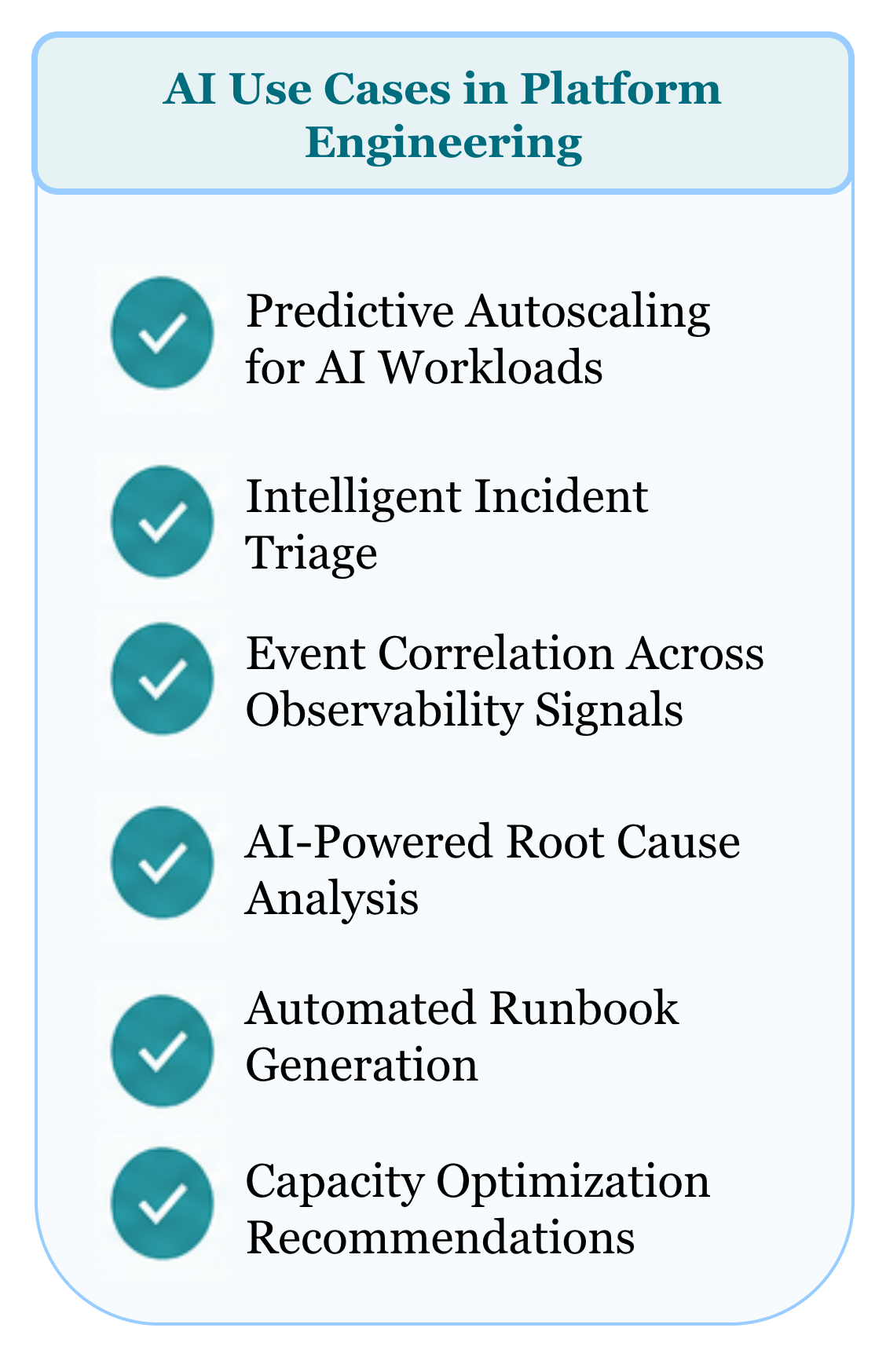
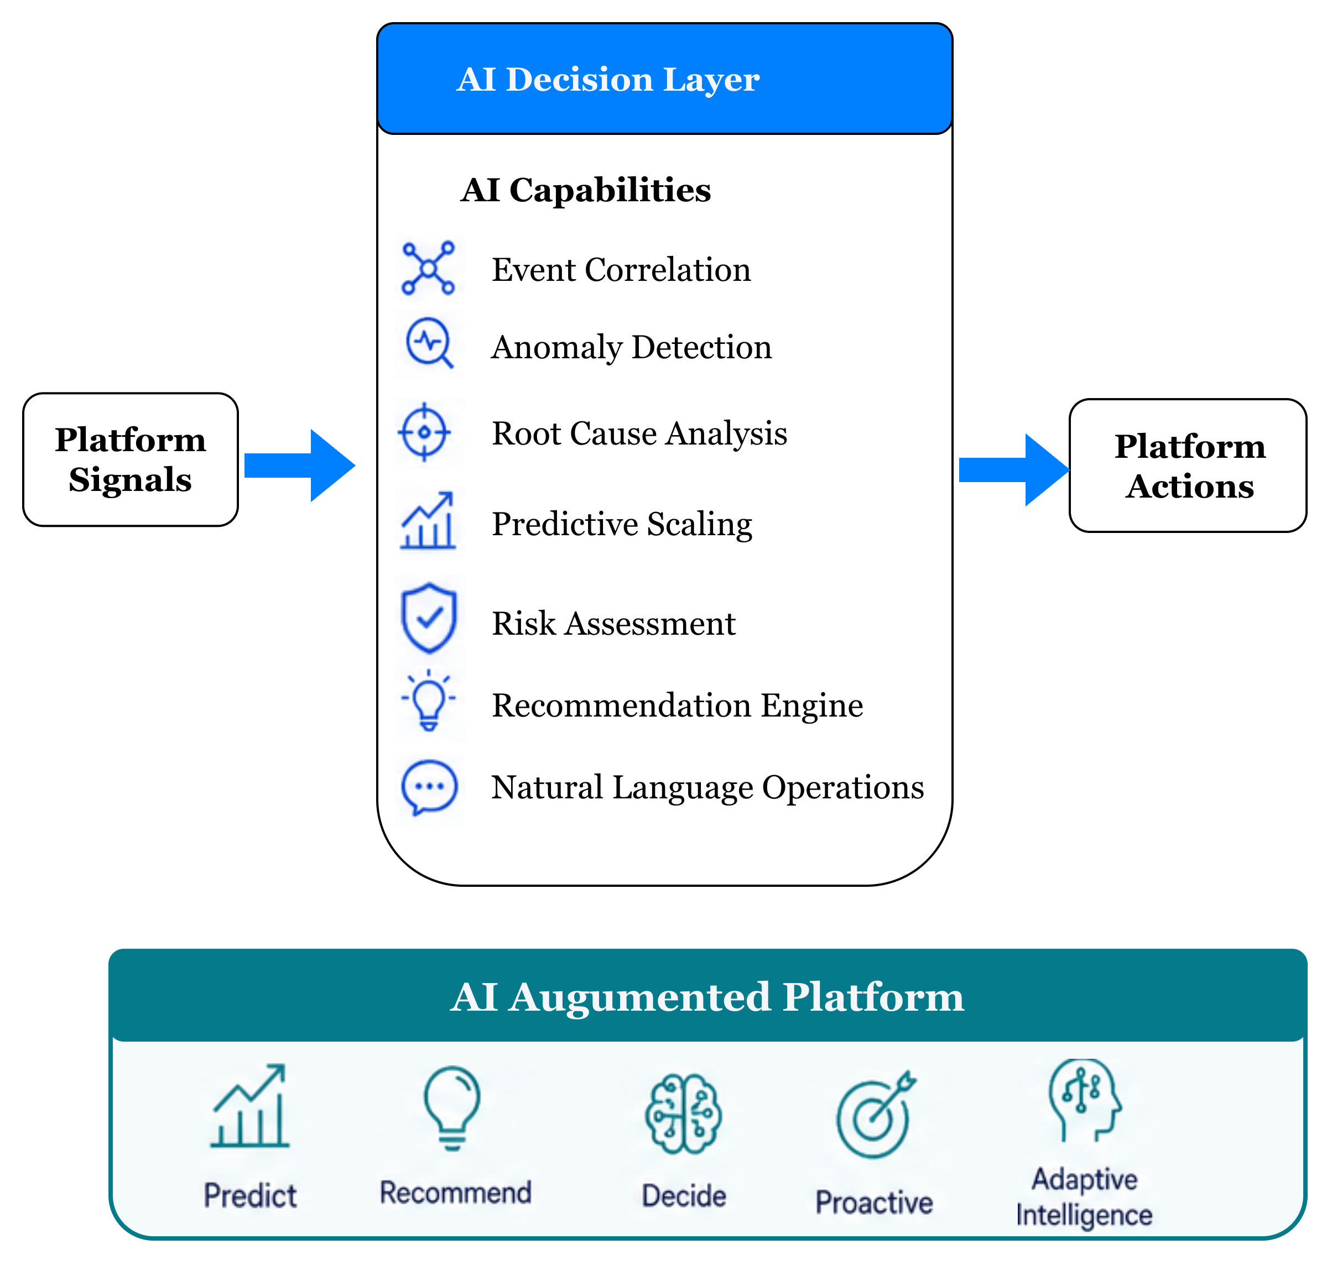
AI
AI-Augmented Platforms

Slide 15
Challenges & Guard Rails
Autonomous control loops introduce real operational risks. Engineering teams must design explicitly for failure modes in the automation layer itself — not just the systems being controlled.
Key Challenges
Where AI Should NOT Be Used
Actions with irreversible blast radius (e.g., data deletion, firewall rule removal)
Compliance-gated decisions requiring human sign-off
Scenarios where a deterministic rule already exists — codify it, don't infer it
Any action where confidence score falls below your defined safety threshold
Event Noise & Storm Handling
Control Loop Stability
Feedback loops that act too aggressively can oscillate. Apply exponential backoff, circuit breakers, and cooldown periods to prevent remediation storms.
Cascading failures can generate thousands of correlated events per second. Without deduplication and correlation windows, the automation layer becomes the amplifier of an outage rather than its resolver.
Safety Mechanisms
Dry-run mode for all new automation paths
Mandatory approval gates for Tier-1 services
Full audit log of every AI skill invocation and recommendation
Trust in AI Decisions
Policy vs. Flexibility
AI skill outputs must carry structured confidence scores and be subject to policy gates. Low-confidence recommendations should always escalate rather than execute.
Overly rigid policies block legitimate developer workflows. Use graduated enforcement — warn, then block — with clear exception paths and audit trails.

Slide 16
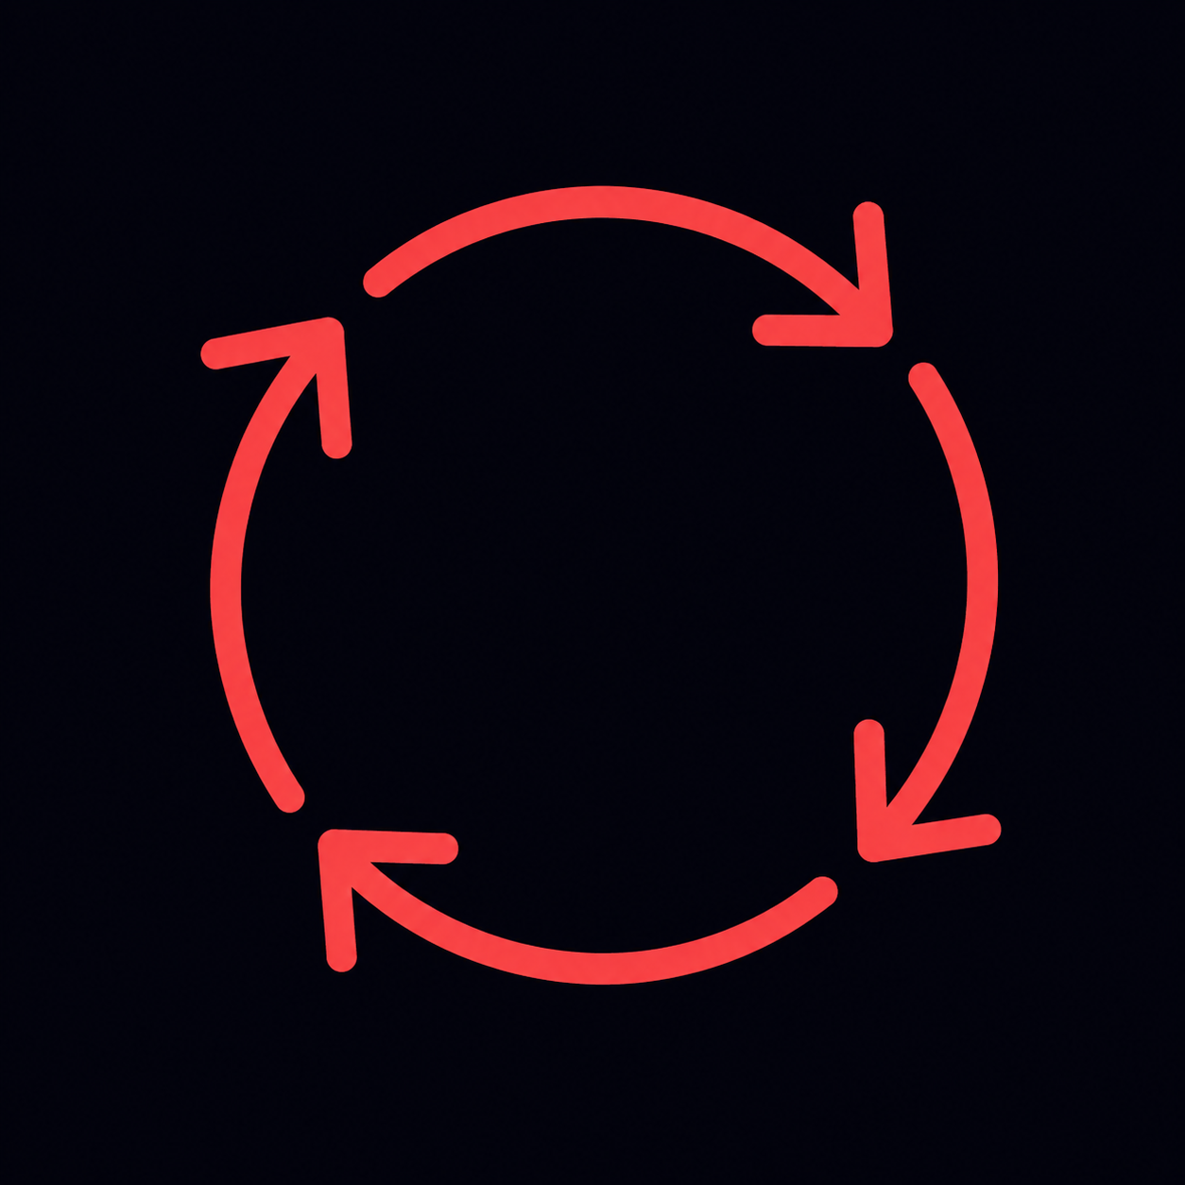
Adoption
Design Principles for Event-Native Platforms
Building event-native platforms that remain maintainable, safe, and evolvable over time requires deliberate engineering discipline from the start. These practices encode hard-won lessons from teams operating at scale.
Use Event Contracts
Design for Idempotency
Standardize events with CloudEvents and versioned schemas to prevent producer–consumer coupling.
Automation must tolerate duplicate event delivery and safe re-execution.
Keep Policy Deterministic
Separate Decision from Execution
Use policy-as-code for predictable decisions. Reserve AI for ambiguous scenarios.
Keep policy evaluation independent from workflows and operators for auditability and control.
Build Closed Feedback Loops
Every action should generate telemetry that validates outcomes and drives continuous adaptation.

Slide 17






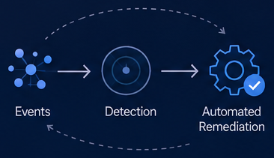
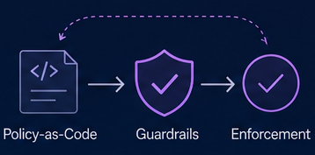
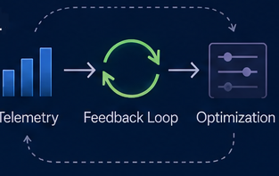
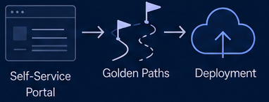
Outcome
Event-Driven Platforms Deliver Measurable Outcomes
Autonomous control loops turn events into actions that drive reliability, speed and trust across your platform and organization
MTTR
Reliability
Toil
DX
Faster Recovery
Continuous Compliance
Reduce Operational Toil
Better Developer Experience
Automated detection and remediation reduce mean time to recovery.
Policies are enforced continuously improving reliability and reducing risk.
Automation eliminates repetitive tasks so teams can focus on impact.
Self-service, visibility and guardrails accelerate delivery with confidence.
1
Faster Recovery
2
Continuous Compliance
Events -> Detection -> Automated Remediation
Policy-as-code -> Guardrails -> Enforcement
Control loop detect issues early and remediate automatically – reducing time to restore services.
Governance embedded and enforced continuously – ensuring compliance and reducing risk.
3
Developer Self-Service
4
Continuous Platform Learning
Portal -> Golden Paths -> Deployment
Telemetry -> Feedback Loop -> Optimization
Self-service workflows and golden paths empower teams to help faster – safely and independently.
Every event improves the platform. Insights feed back into policies, automation and experience.

Slide 18
Closing: The Event-Native Future
"The future of platform engineering is not just automated — it is event-native, policy-driven, and intelligently adaptive."
The path from reactive operations to autonomous control loops is an engineering journey, not a product purchase. It requires investing in event contracts, policy codification, and deliberate AI integration — but the compounding returns in reliability, developer velocity, and operational leverage are transformational.
01
02
Start with Event Contracts
Codify Your First Policy
Instrument one domain (e.g., deployments) with CloudEvents and a lightweight broker before expanding your event topology.
Implement a single OPA or Kyverno rule that auto-remediates a known, high-frequency failure — prove the loop works end-to-end.
03
04
Introduce AI at the Edges
Close the Feedback Loop
Add a Claude Skill to one ambiguous escalation path. Measure confidence score distribution and refine before expanding coverage.
Instrument telemetry on every automated action. Use outcome data to continuously improve policy rules and AI skill quality.

Slide 19

Thank You
Questions? Let's continue the conversation.
Josephine Eskaline Joyce
Prashanth Bhat
STSM, IBM Cloud
Lead Architect, IBM Cloud
📧 jojustin@in.ibm.com
📧 prashabh@in.ibm.com
🔗 linkedin.com/in/josephine-joyce/
🔗 linkedin.com/in/prashanth-bhat-bg/
Event-Driven Platform Engineering

