Slide 1
Introduction to coreboot and LinuxBoot: Building Modern Open Boot Stack
Manish Baing & Arun Mahendran, Lenovo

Slide 2
Agenda
Getting Started
coreboot
  Introduction
  Architecture
  Boot stages
  Payload
LinuxBoot
  Introduction
  Architecture
  Components
Build steps
References

Slide 3
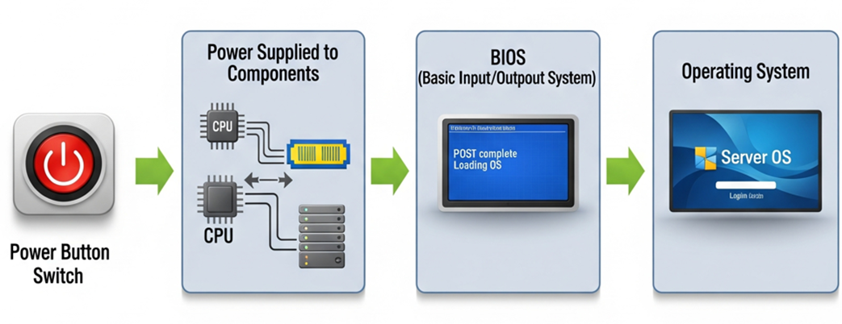
Getting Started

Slide 4



BIOS-UEFI
BIOS
UEFI
BIOS is an acronym for Basic Input/Output System.
UEFI stands for “Unified Extensible Firmware Interface”
It acts as interface between Operating System and Platform Firmware.
Extensive network capabilities.
Designed to work with Multi-Processor system.
UEFI Specifications :
ACPI Specification
UEFI Shell Specification
UEFI Platform Specification

Slide 5
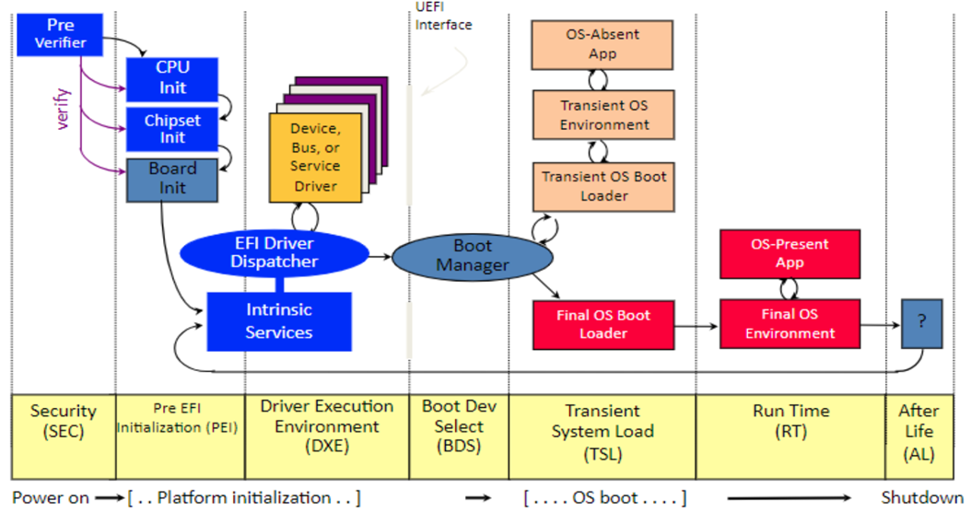
UEFI Boot Flow

Slide 6
Problem with Current UEFI
Vendor consumed firmware :
  Most OEMs ship closed, vendor-customized builds of the UEFI reference implementation, so end users receive closed firmware derived from a common codebase they cannot inspect or modify.
  Vendors consumes EDK II reference code, build their closed firmware by wrapping it in proprietary changes and then ship the result as a closed “black box” firmware.
  EDK II uses a permissive BSD‑style license so you can modify and ship it without being forced to publish your changes.
Security :
  When vulnerabilities are fixed upstream in EDK II, systems remain at risk until each vendor takes the fix and releases a new firmware update, which can take a long time or never happen for older devices.
Boot Time :
  The DXE part of UEFI loads a huge number of drivers and protocols, which slows down boot and makes the overall behavior difficult to understand and debug.
  All these DXE drivers share the same environment, so the code becomes tightly coupled and complex, and a single bug can often be turned into a serious exploit.

Slide 7
Solution …?

Slide 8

Solution …?

Slide 9
coreboot History
  coreboot was created in 1999 by Ron Minnich.
  Initially it was known as LinuxBIOS meaning using Linux as the BIOS.
  Early LinuxBIOS combined small boot code with a payload as the Linux kernel,
  i.e LinuxBIOS = (core boot code ) + (Linux 2.6 kernel).
  In the early config there was no 'payload' keyword: since only “Linux Kernel” payloads were supported.
  As Linux kernels grew larger, LinuxBIOS plus Linux 2.4 no longer fit in the available flash space.
  At the same time, flash sizes on target systems shrank, making Linux-based payloads impossible to fit on
  some systems. The project then moved to other payloads like Etherboot, GRUB 2, and WinCE.
  This showed that LinuxBIOS was not limited to Linux; it could boot different systems through different
  payload.
  To reflect that scope, the project was renamed coreboot in 2008, meaning “core boot code”
  Over time, coreboot evolved from a research project into a community-driven firmware project and now
  supporting over a 100 mainboards.

Slide 10
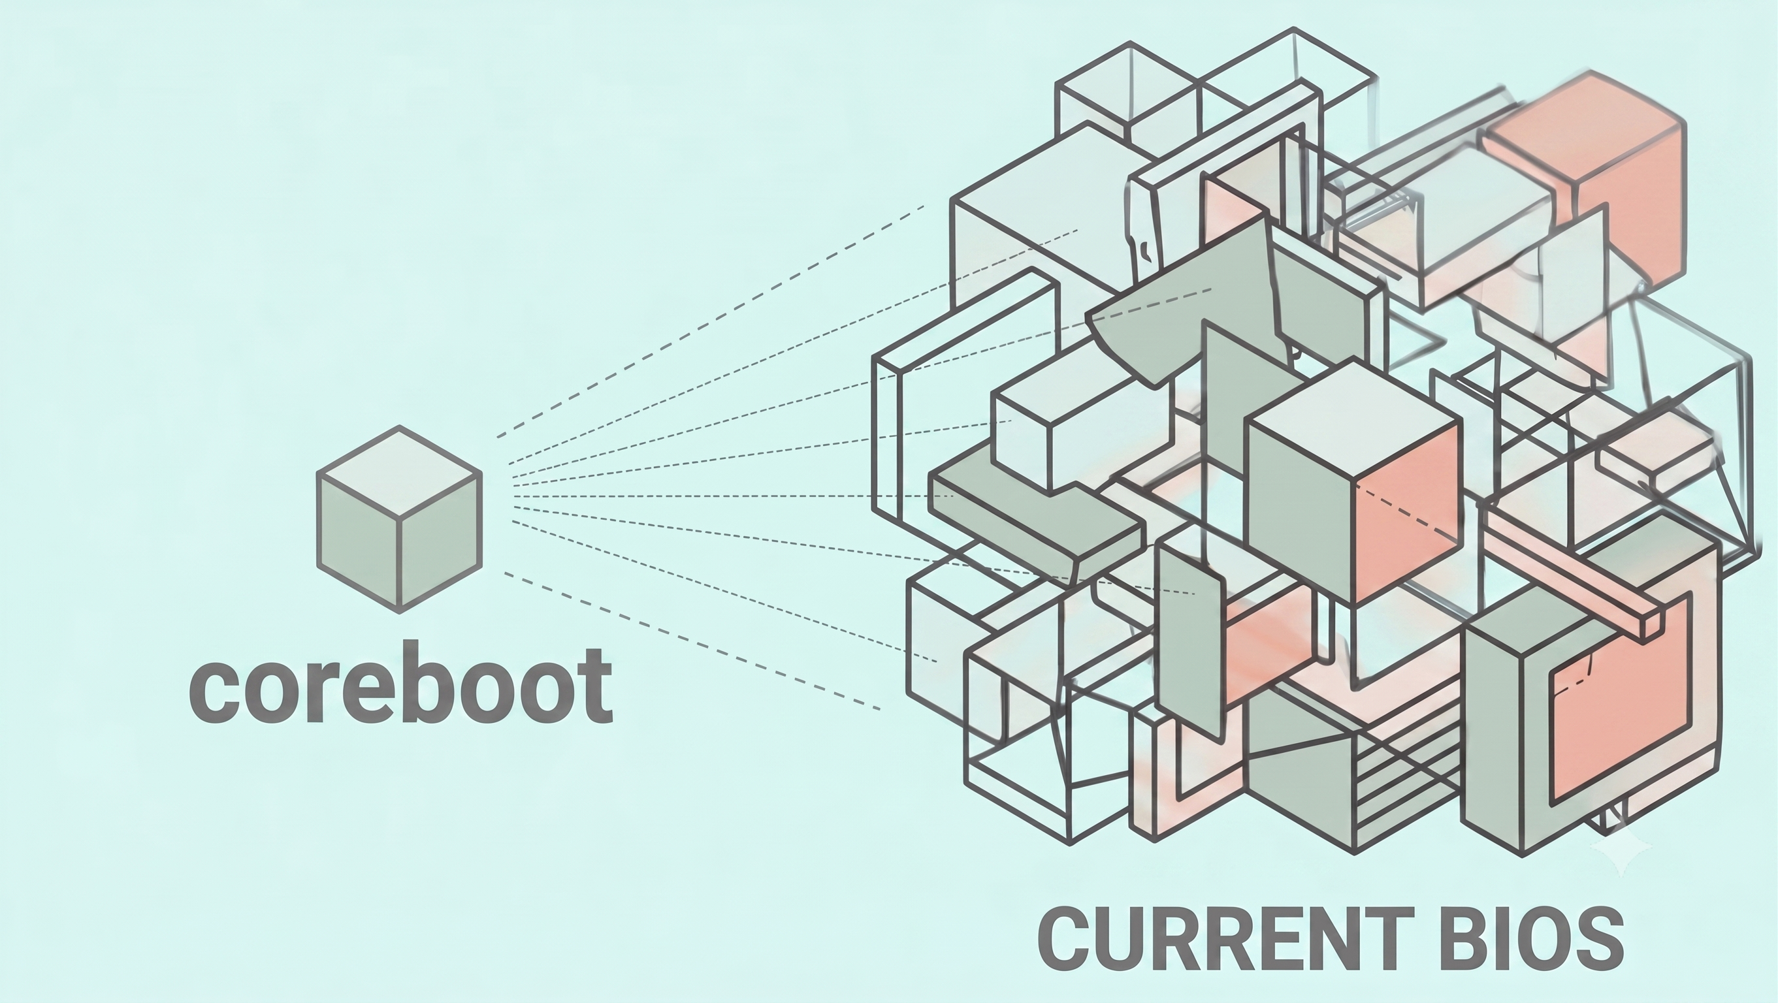
What is coreboot ..?
  coreboot is an open-source replacement for proprietary BIOS / UEFI with a strong focus on boot speed, security and flexibility.
  It was originally designed for large super-computers with thousands of nodes, but today it also runs on desktops, headless servers, laptops, tablets, and many IoT devices.
  It is designed to boot operating system as fast as possible while keeping the system secure and free from hidden functionality.
  Its design emphasizes a small, focused codebase and clear separation between hardware bring‑up and higher‑level policy, making the boot path easier to analyze, test, and debug compared to a monolithic DXE stack.

Slide 11


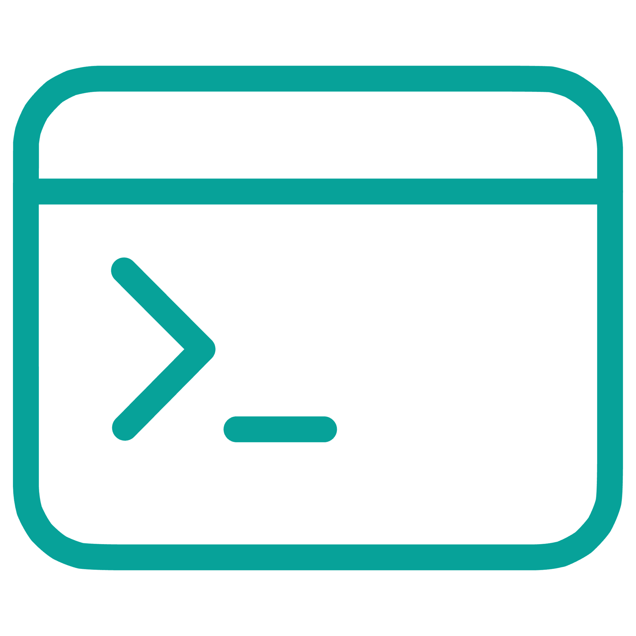
coreboot : One Firmware, Many Possibilities
FLEXIBLITY
Coreboot is flexible because it supports different payloads, such as SeaBIOS for legacy boot, iPXE for
network boot, or a UEFI payload.
You can customize the boot experience by adding your own splash screen.
You can customize the system, so it boots quickly and retrieve the entire boot log once your operating
system is up and running.
It provides several ways to debug boot, including logs over serial, USB, SPI etc.
Payloads
Customization
Debug Console
SeaBIOS, iPXE network boot, UEFI or custom payloads via the BSD-licensed libpayload toolkit.
Add your own boot splash screen in JPG format or boot so fast there's no time to show one.
Get your boot log over serial ports, USB, SPI — or retrieve it after the OS is up.

Slide 12
coreboot : Security
SECURITY
Fast security fixes: Because coreboot is open source, bugs can be reviewed and patched publicly instead of
waiting for each vendor to release a closed update.
coreboot keeps security simple and tight by using a very small amount of code that must be trusted, which
cuts down the attack surface.
coreboot is GPLv2‑licensed, so if you distribute a product that contains modified coreboot code, you must
give recipients the corresponding source code for the GPL‑covered parts.
Smaller attack surface
Fast security fixes:
Shared improvements:
keeps the trusted code base small, which reduces the chance of security issues in the boot firmware.
bugs can be reviewed and patched publicly instead of waiting for each vendor to release a closed update.
Security fixes shared across project which benefits to all system instead replying on vendors specific firmware.

Slide 13
coreboot : Performance
SPEED
It is designed to boot operating system as fast as possible while keeping the system secure and free from
hidden functionality.
On desktops and laptops, it can reach the OS in under few second.
On servers it can cut boot time by minutes, with some vendors seeing a decrease in boot time by more
than 70% compared to the OEM BIOS.
Fast boot
Server boot improvement
Secure by design
It can reach the operating system very quickly, often in under a second on laptops and desktops.
It can reduce server boot time by several minutes.
It aims to boot fast while staying secure and avoiding hidden functionality.

Slide 14
coreboot distributions
coreboot community provides many binary distributions which are ready to flash on to your system.
coreboot distribution is a ready to use firmware image built on top of coreboot that bundles coreboot itself, one or more payloads (like GRUB, SeaBIOS, or U‑Boot), and supporting tools, so users can flash and use it without building everything from source.
Canoeboot
Libreboot
Heads
Blob-free, based on Libreboot. GRUB/U-Boot/SeaBIOS on x86 & ARM64.
Free/libre distribution removing binary blobs. GRUB/SeaBIOS/U-Boot payloads
Advanced security features using Linux as a payload.
MrChromebox
Skulls
Dasharo
Custom firmware and utilities for Chromebook/Chromebox.
Easy-to-install coreboot images for Thinkpad laptops.
Clean code, long-term maintenance, privacy-respecting, trustworthy.

Slide 15
Firmware Support Package (FSP)
FSP is a closed-source binary firmware provided by vendors - usually under NDA, since platform bring-up
code is not released publicly.
FSP is generally provides processor, chipset and memory Initialization .
On many x86 platforms, FSP is divided into multiple parts:
  FSP-T: Temporary RAM initialization / Cache-as-RAM setup, often implemented in ASM.
  FSP-M: Memory controller initialization and DRAM training.
  FSP-S: Broader silicon initialization.
coreboot typically integrates FSP as a binary silicon-initialization component.
coreboot
FSP
API

Slide 16
Coreboot boot stages
coreboot consists of multiple stages compiled as separate binaries and inserted into the CBFS (coreboot File System) with custom compression. The bootblack usually doesn’t have compression while the ramstage and payload are compressed with LZMA.
bootblock:
  The first stage executed after CPU reset. It is written in assembly language, and its main task is to set up everything for a C-environment:
  It sets up Cache-As-RAM (CAR), CAR needs to be activated using vendor specific CPU instructions, then loads the next stage.
verstage : The root of trust for verified boot, enables fail-safe recovery mode.
romstage: Initializes the DRAM and prepares for device initialization.
postcar: Tears down the Cache-As-RAM setup and loads the ramstage.
ramstage: Performs the main device initialization (PCI, CPU, on-chip devices) and writes hardware tables.
    It also does hardware & firmware lockdown i.e Write-protects boot media, locks security registers.
payload: The final software run by coreboot, which then takes over to load your operating system.

Slide 17
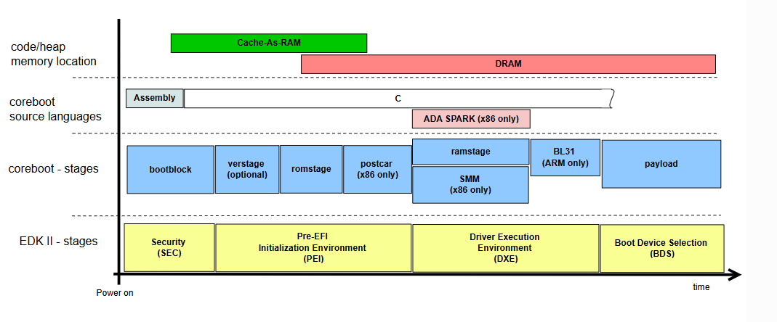
coreboot architecture

Slide 18
coreboot payloads
SeaBIOS
Provides PCBIOS services, enabling compatibility with traditional BIOS-based operating systems and bootloaders on x86 hardware.
edk2
Provides UEFI services, offering a modern firmware interface for systems requiring the UEFI specification.
GRUB2
The bootloader used by many Linux distributions, capable of loading a wide variety of operating systems.
.
depthcharge
A custom boot loader used on Chromebooks, designed for the specific requirements of Chrome OS devices.
LinuxBoot
Uses Linux kernel and initramfs as a bootloader.

Slide 19
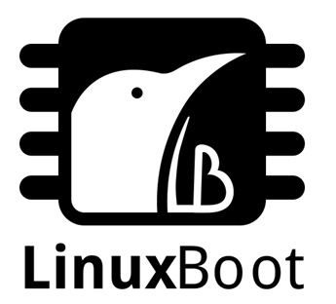
LinuxBoot

Slide 20
LinuxBoot - Introduction
  LinuxBoot is the concept of using a Linux kernel and initramfs as a bootloader.
  LinuxBoot is the idea of replacing proprietary or corporate-driven late-stage boot firmware with the Linux kernel and a community-based user-space.
  Started as NERF in 2017 at Google.
    Non-Extensible Reduced Firmware
  Replaces proprietary, closed-source, vendor-supplied firmware drivers with Linux drivers.
  Reduces the need for writing multiple drivers for Eg. Uboot/UEFI drivers and can use same driver for both OS and
  Pre-OS
The Core Concept
LinuxBoot replaces many Driver Execution Environment (DXE) modules used by Unified Extensible Firmware Interface (UEFI) and other firmware — particularly the network stack and file system modules — with Linux applications. LinuxBoot brings up the Linux kernel as a DXE in flash ROM instead of the UEFI shell. The Linux kernel, with a provided Go-based user-space, can then load the runtime kernel.

Slide 21
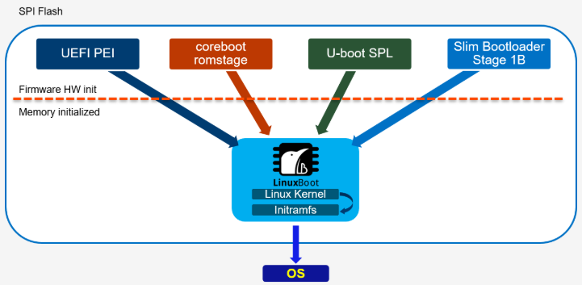
Boot Firmware Architecture

Slide 22
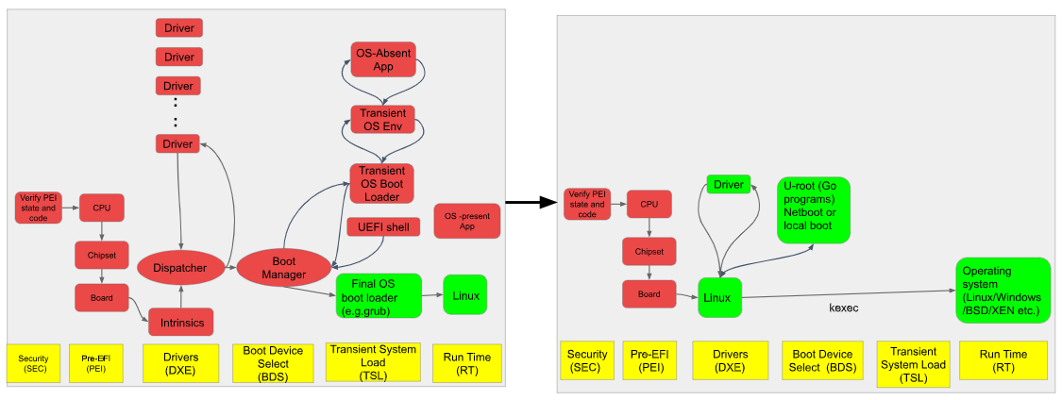
UEFI and LinuxBoot
UEFI
LinuxBoot

Slide 23
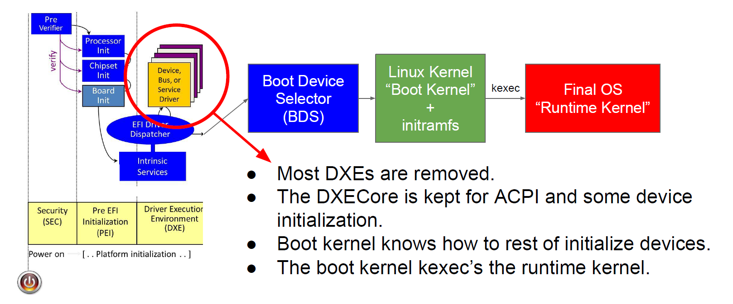
Boot Flow

Slide 24
LinuxBoot Components
BIOS
Does not have a specific BIOS
Currently LinuxBoot supports UEFI and Coreboot.
Linux Kernel
LinuxBoot uses a minimal Linux kernel to replace selected UEFI firmware functions, then hands off control to the actual production kernel.
Specialized kernel config files remove unnecessary drivers and features to keep the firmware (BIOS) footprint small and efficient.
These configs also include required patches and enable only the essential capabilities needed for LinuxBoot operation.

Slide 25
LinuxBoot Components
Initramfs/u-root
LinuxBoot embeds the root file system as an initramfs inside the firmware image, packaged together with the Linux kernel in flash storage.
The initramfs is a cpio archive containing essential directories, binaries, and startup utilities required for boot.
During boot, the firmware or bootloader (e.g., coreboot) loads both the kernel (bzImage) and initramfs into memory.
The Linux kernel detects and unpacks the initramfs, mounting it as the root filesystem (/).
After mounting, the kernel executes the /init program, which initializes the system and continues the boot process.
u-root can create an initramfs in two different modes:
Source mode, which contains:
  Go toolchain binaries
  A simple shell
  Go source for tools to be compiled on the fly by the shell
Busybox mode: This is one busybox-like binary comprising all the requested utilities.

Slide 26
LinuxBoot Components
SystemBoot
SystemBoot is a set of bootloaders written in Go. It is meant to be a distribution for LinuxBoot to create a system firmware + bootloader.
All of these use kexec to boot. The commands are in cmds/boot. Parsers are availablefor GRUB, syslinux.
pxeboot: a network boot client that uses DHCP and HTTP or TFTP to get a boot configuration which can be parsed as PXELinux or iPXE configuration files to get a boot program.
boot: finds all bootable kernels on local disk, shows a menu, and boots them. Supports (basic) GRUB, (basic) syslinux, (non-EFI) BootLoaderSpec, and ESXi configurations.

Slide 27
LinuxBoot Components
kexec
The Linux kernel feature known as ‘kexec‘ allows you to boot from the currently running kernel into a new kernel – effectively turning a Linux distribution into a feature-rich bootloader.
This capability has been around since 2005 (2.6.13) and is now available on most architectures.
2 steps
  $ kexec -l /mnt/Image
  $ kexec -e --dtb /mnt/<dtdb_file.dtb>--reuse-cmdline

Slide 28
Why to use Linux and Go as Firmware
  Linux simplifies firmware development: by allowing engineers to use familiar tools, drivers, filesystems, and syscalls instead of proprietary UEFI/firmware environments.
  Large open-source ecosystem: Linux benefits from contributions by many developers, leading to better reliability, faster innovation, and fewer bugs compared to proprietary firmware code.
  Strong security practices: Linux undergoes continuous review and testing by a global community, making it more secure and transparent than closed-source firmware.
  Rich hardware and networking support: Linux already includes mature drivers and networking stacks, reducing the need to reimplement complex functionality in firmware.
  Go improves safety over C: It provides strong typing, memory safety, runtime checks, and garbage collection, reducing risks like buffer overflows and memory corruption.
  Built-in concurrency and modern features: Go supports threads, channels, and safe inter-process communication, making it easier to write robust firmware utilities.
  Reduced vulnerability surface: Many firmware components (e.g., web servers, SSH tools) are traditionally written in C and prone to exploits, while Go eliminates or detects many of these issues.
  Better reliability for network-connected firmware: Since firmware is hard to patch and secure, Go’s runtime safety helps prevent critical failures and exploits at a low level.

Slide 29
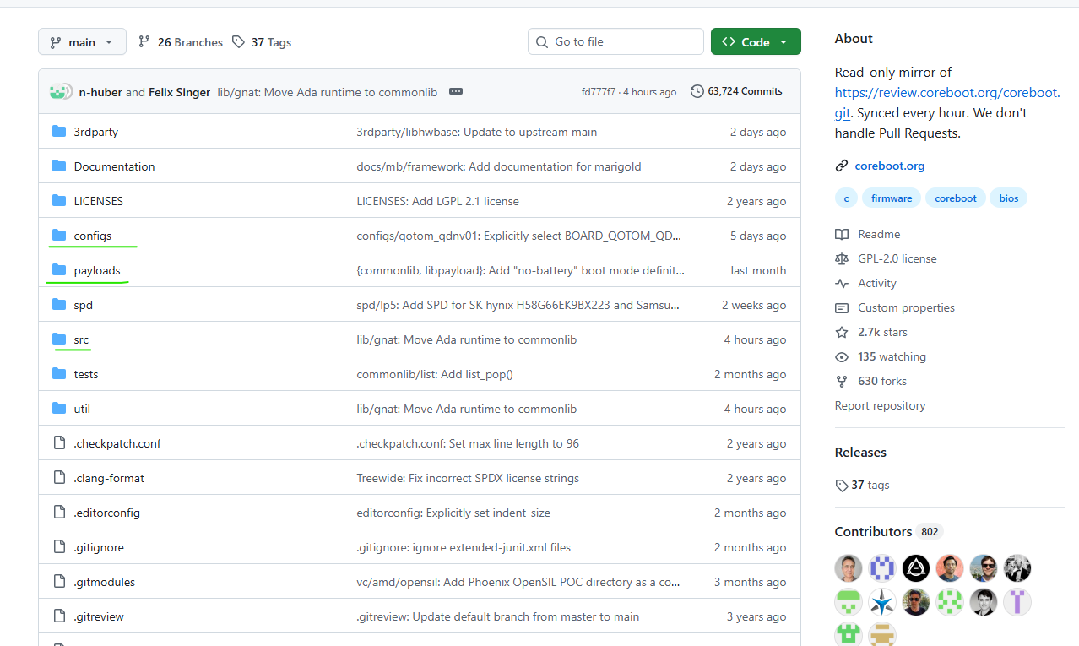
Directory Structure of coreboot

Slide 30
coreboot build steps
Download coreboot source tree
git clone https://review.coreboot.org/coreboot.git
Install tools and libraries needed for coreboot
Build the coreboot toolchain
Build the payload
Configure the build to choose your board, payload, and options.
make menuconfig
Build the firmware image
make
You should see build/coreboot.rom generated to your board which indicate build is successful.
Test your boot with above image

Slide 31
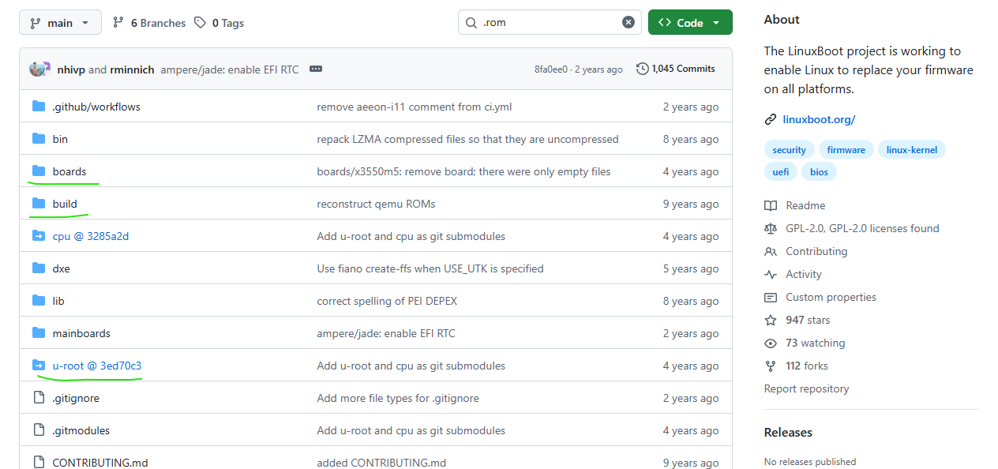
Directory Structure of LinuxBoot

Slide 32
LinuxBoot build steps
LinuxBoot
u-root/intramfs
Dependencies uuid-dev, nasm, and acpica-tools
You need to provide following for build:
  The vendor UEFI firmware for the mainboard( Intel FSP/ AMD PI)
  A Linux kernel built with the CONFIG_EFI_BDS option enabled.
  An initrd.cpio file with enough tools to kexec the rest of the system.
Commands to build:
  $ cp path/to/s2600wf.rom boards/s2600wf/
  $ make \
  BOARD=s2600wf \
  KERNEL=../path/to/bzImage \
  INITRD=../path/to/initrd.cpio.xz \
  config
  $ make
Result
  write the values into the .config file
  build/$(BOARD)/linuxboot.rom that can be flashed to your machine.
Download and install u-root
  go install github.com/u-root/u-root@latest
u-root command to build initremfs
  $ git clone https://github.com/u-root/u-root
  $ cd u-root
  # Build an initramfs of all the Go cmds in ./cmds/core/... (default)
  $ u-root
  # Generate an archive with bootloaders
  #core and boot are templates that expand to sets of commands
  $ u-root core boot
  #Generate an archive with only these given commands
  $ u-root ./cmds/core/{init,ls,ip,dhclient,wget,cat,gosh}
  #Generate an archive with all of the core tools with some exceptions
  $ u-root core -cmds/core/{ls,losetup}

Slide 33
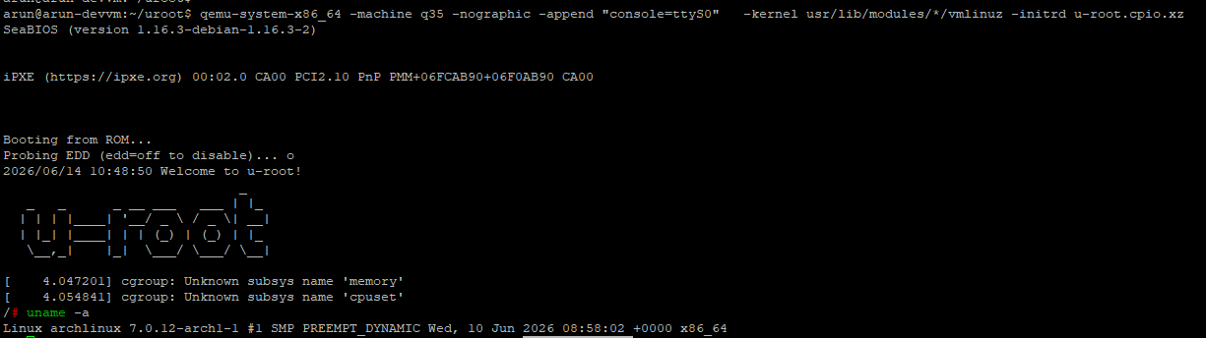
LinuxBoot - Using Qemu
First, get the initramfs image and kernel
$ curl -L -o u-root.cpio.xz https://github.com/linuxboot/u-root-builder/releases/download/v0.0.1/u-root_amd64_all.cpio.xz
$ curl -L -o linux.tar.zst https://archlinux.org/packages/core/x86_64/linux/download/
$ tar -xf linux.tar.zst
Start LinuxBoot,
$ qemu-system-x86_64 -machine q35 -nographic -append "console=ttyS0" -kernel usr/lib/modules/*/vmlinuz -initrd u-root.cpio.xz

Slide 34
References
CoreBoot
LinuxBoot
Source : https://github.com/coreboot/coreboot
Documentation : https://doc.coreboot.org
Getting Started : https://www.coreboot.org/end_users.html
Code Review : https://review.coreboot.org/
News : https://blogs.coreboot.org/
Source : https://github.com/linuxboot/linuxboot
Documentation : https://book.linuxboot.org/intro.html

