Slide 1
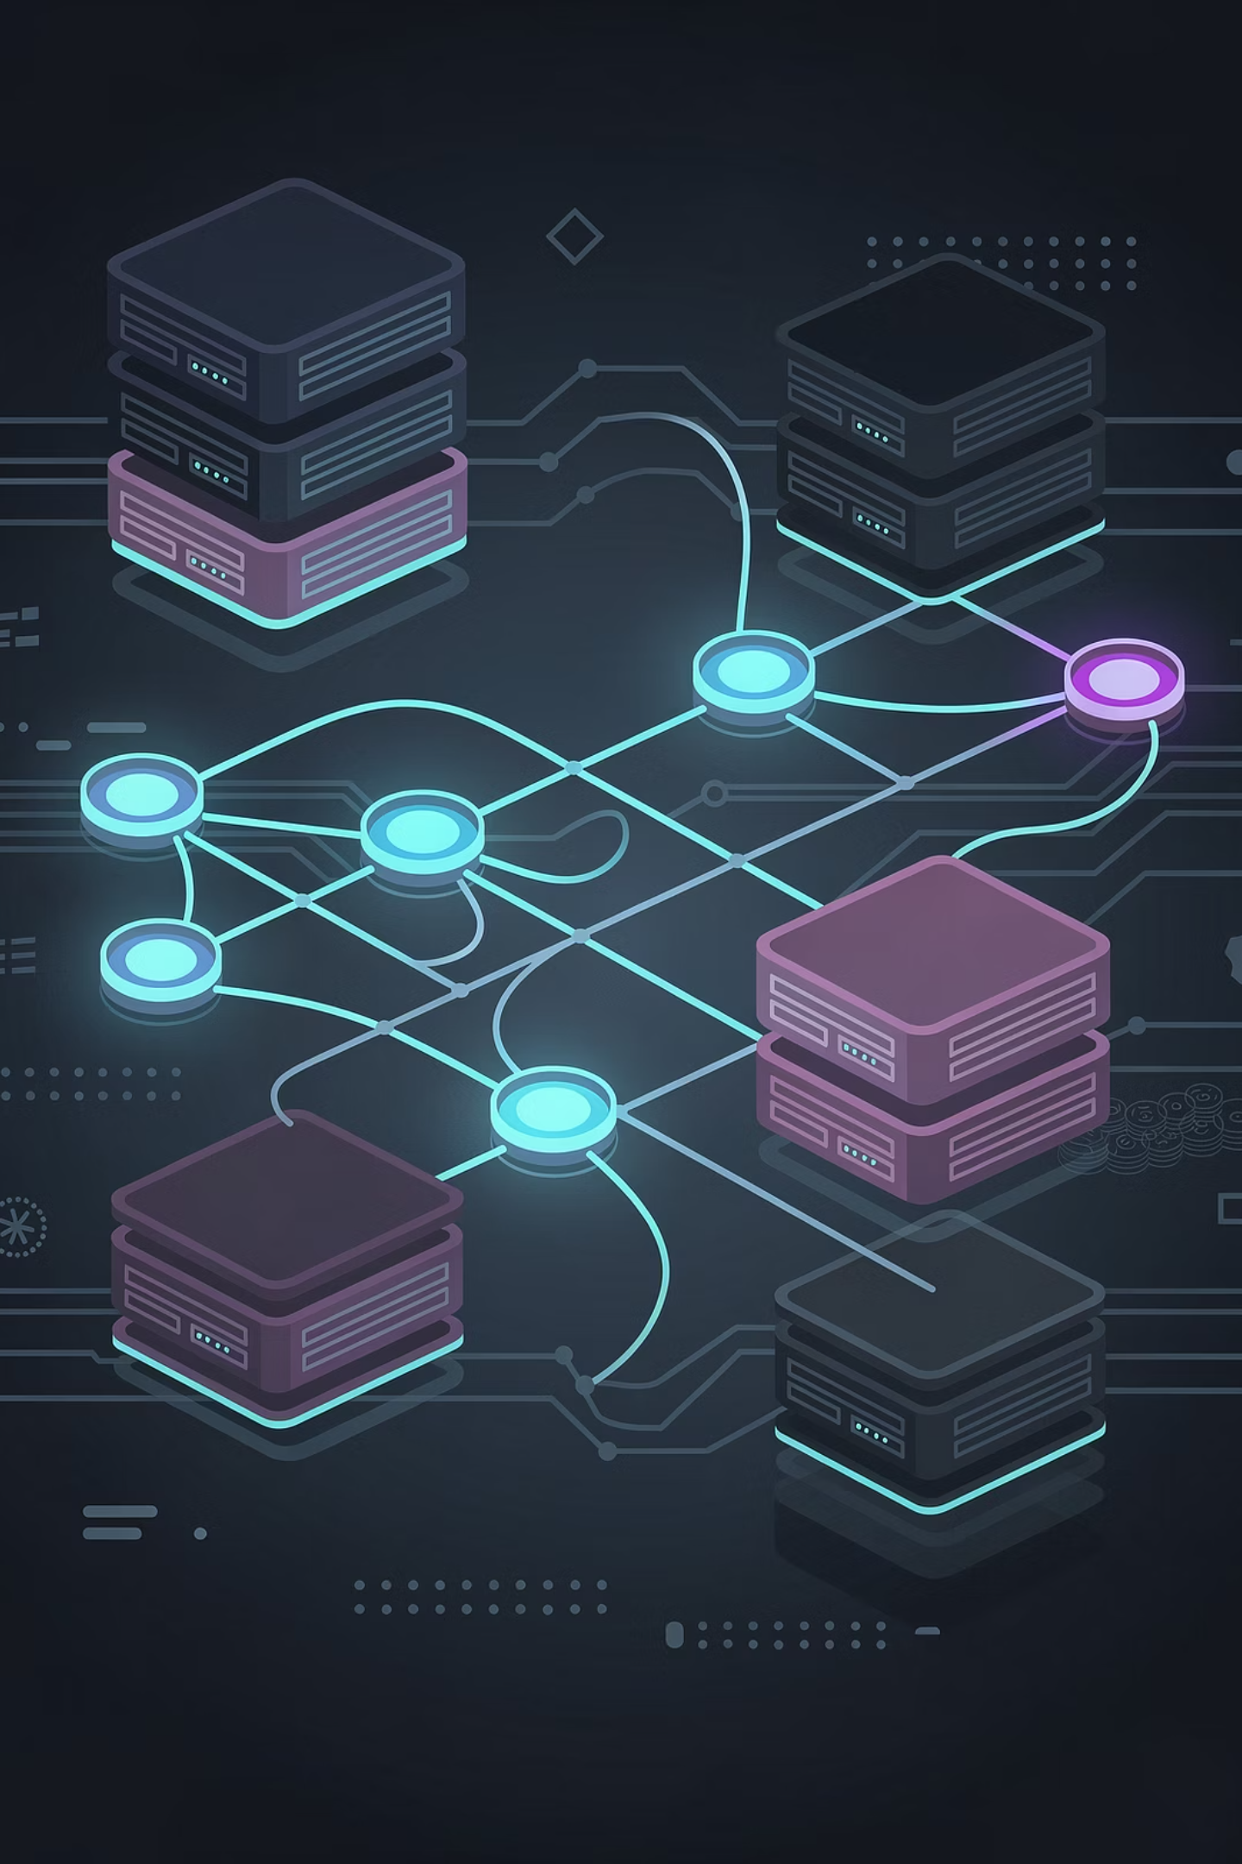
Performance-by-Design
Embedding Intelligent Scaling and Guardrails into Platform Engineering
Josephine Eskaline Joyce, STSM, IBM Cloud
Tanya Shankar, Cloud Engineer, IBM Cloud
PLATFORM ENGINEERING
CLOUD-NATIVE
PERFORMANCE

Slide 2
The Problem: Performance as an Afterthought
Most engineering organizations today treat performance as a fix rather than a design principle.
🔥 Reactive Fire-Fighting
💸 Resource Waste
🧩 Fragmented Ownership
Users detect failures → teams react late
Over-provisioning ≠ reliable performance
No shared view across dev & platform teams

Slide 3

What Is Performance-by-Design?
Performance is built into the platform — not added later
Traditional Approach
Performance-by-Design
Performance tested after deployment
Manual tuning (SRE-driven)
Reactive scaling
Performance debt grows
SLOs defined upfront
Guardrails enforced by policy
Scaling driven by real-time metrics
Best practices built into golden paths
practices by default

Slide 4

Key Design Principles
Performance as a Platform Capability
Metrics-Driven Decision Making
Policy-Enforced Safety Boundaries
Closed-Loop Automation
Performance is built into the platform, not bolted on.
Scaling and remediation decisions are driven by real user-facing signals.
Guardrails are codified in policy, not tribal knowledge.
Observe → Decide → Act
Golden Path Standardization
Best practices = default experience

Slide 5

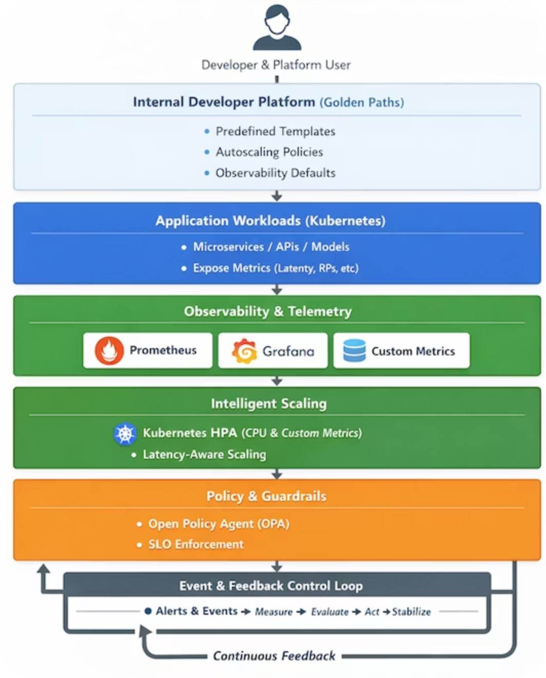
Reference Architecture
IDP — Golden Paths
1
Templates with built-in scaling, SLOs, observability
2
ArgoCD + Tekton — GitOps Delivery
Policy-validated deployments (OPA + ArgoCD) .
Application Workloads
3
Apps expose latency, throughput, errors.
4
Observability & Telemetry
Metrics → Prometheus → dashboards
Intelligent Scaling
5
HPA driven by custom + SLO metrics
6
Feedback Loop
Measure → Evaluate → Act → Stabilize

Slide 6
The Shared Responsibility Model for Performance
Performance by design starts with clearly defined ownership between platform teams and application teams.
Platform Team Owns
Application Teams Own
Autoscaling & resource orchestration
Performance-aware deployment templates
SLO baselines & scaling policies
Guardrails (CPU, memory, custom metrics)
Observability platform
Application-level performance characteristics
Load patterns & SLAs
Efficient code & resource usage
Performance testing
→ The platform provides safe defaults. Teams operate within guardrails.

Slide 7

Golden Paths: Performance as a Default
Performance is inherited, not engineered every time
What Golden Paths Include
Developer Experience Impact
Pre-configured autoscaling (HPA)
SLO-ready observability
Resource templates (requests/limits)
Built-in policy guardrails (OPA)
Grafana dashboard templates auto-provisioned on deploy
Production-ready from day one
No need to tune HPA / metrics
Focus on business logic
Path of least resistance = path of best performance

Slide 8

Pre-Baked Performance Patterns
Templates encode workload-specific scaling strategies:
Microservice
AI/ML Inference Service
Batch Workloads
HPA by default
Right-sized resources
Readiness and liveness probes tuned for latency
Custom metrics (latency, tokens/sec)
Pre-set scaling thresholds
Circuit breakers for overload
Priority-based scheduling
Resource quotas
Controlled concurrency

Slide 9
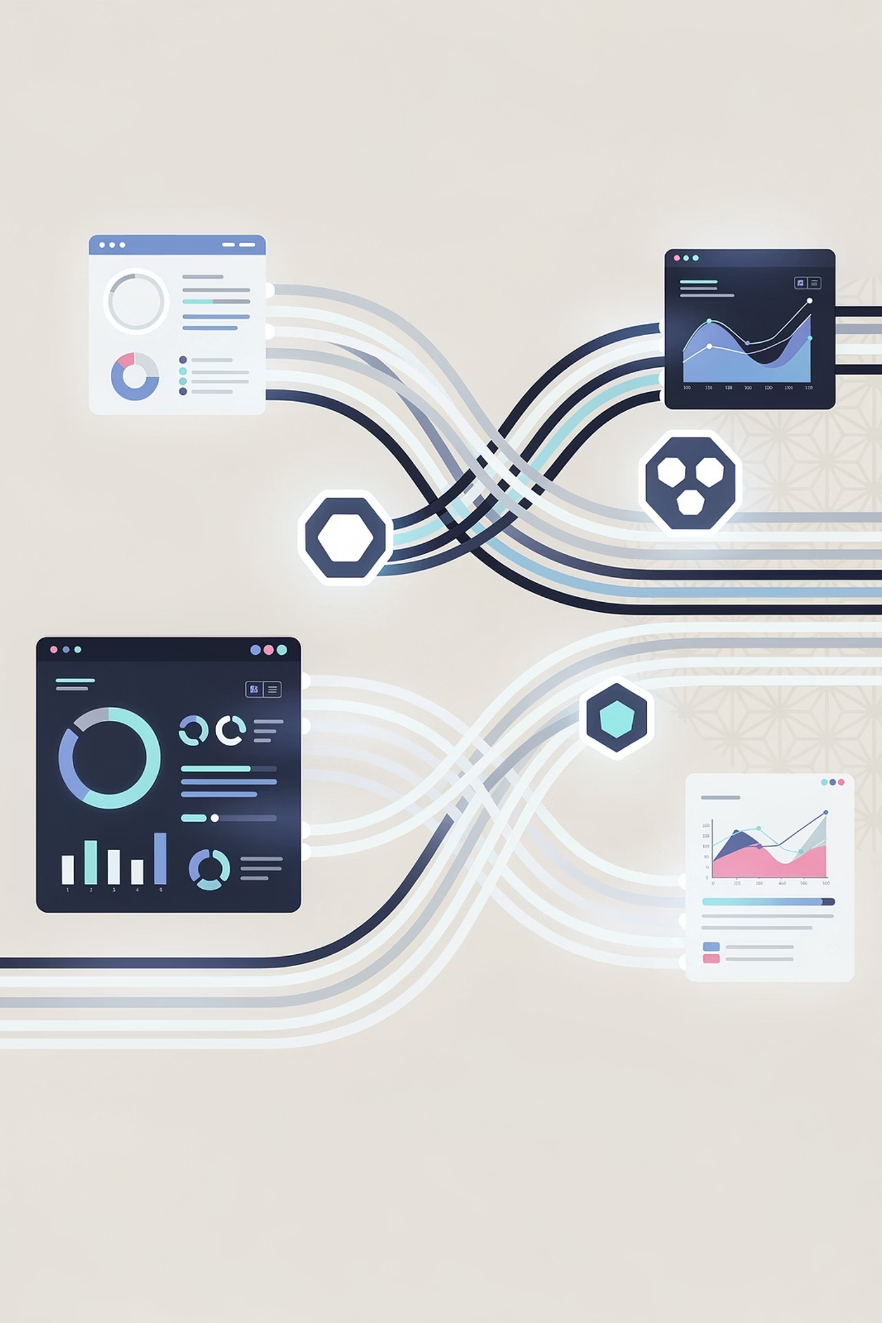
SLO-Aware Metrics: The Foundation
Effective autoscaling depends on measuring the right signals.
Request Latency (p95/p99)
Scale before users feel it
Throughput & Error Rate
Load + failures = real pressure.
Custom Business Metrics
Queue depth, backlog, processing time.

Slide 10
Policy-Driven Autoscaling with Kubernetes HPA
→ Scale on SLO signals—not just CPU
HPA Configuration Pattern
Why Custom Metrics Win
minReplicas / maxReplicas → bounds
Stabilization windows → avoid thrashing
Custom metrics → latency, throughput
CPU reacts after impact
SLO metrics react before a breach.
Enables predictable performance

Slide 11

Policy-as-Code Guardrails with OPA
Enforce performance and cost before deployment
Open Policy Agent (OPA) enforces performance and cost guardrails at admission time.valid
Scaling Constraints
Min / max replicas enforced, Valid HPA configs required, resource ratios checked.
Cost Controls
Replica caps, quotas to prevent overuse, and budget declared: limits as policy.
SLO Enforcement
SLOs must be declared, No SLO → no deploy, compliance by default.

Slide 12



Tenant Isolation: The Foundation of Fair Performance
Without isolation → contention, failures, unpredictability
Resource Isolation
CPU and memory guarantees
Dedicated node pools for critical workloads
Priority and preemption policies
Logical Isolation (Namespaces)
Separate environments or teams
Individual quotas
Network policies
Performance Isolation
Per-tenant autoscaling policies
Custom metrics per workload class
Fair queuing for ingress traffic
Isolation creates predictable, independent performance domains

Slide 13
Multi-Tenancy Models: Isolation & Operational Overview
Choose your isolation model based on workload criticality, cost tolerance, and operational maturity.
Shared Cluster + Shared Namespace
Shared Cluster + Per-Tenant Namespace
Shared Cluster + Strong Resource Boundaries
Dedicated Node Pools per Tenant
Isolation: Low
Predictability: Poor
Cost Efficiency: Very High
Complexity: Low
Isolation: Medium
Predictability: Moderate
Cost Efficiency: High
Complexity: Medium
Isolation: High
Predictability: High
Cost Efficiency: Medium
Complexity: Medium–High
Isolation: Very High
Predictability: Very High
Cost Efficiency: Lower
Complexity: High
Usage: Dev, test, prototypes
Usage: Most enterprise IDPs
Usage: Performance-sensitive SaaS
Usage: AI/critical workloads
Dedicated Cluster per Tenant
Isolation: Maximum
Predictability: Maximum
Cost Efficiency: Lowest
Complexity: Very High
Usage: Regulated/high isolation

Slide 14
Multi-Tenancy Models: Performance Comparison
A performance-focused comparison of multi-tenancy models used in modern platforms. IDPs can follow a mix of these models.
🔴 High Risk / None
🟡 Medium Risk / Partial
🟢 Low Risk / Strong
Model
Latency Stability
Scaling Accuracy
Noisy Neighbor Risk
Resource Utilization Efficiency
Fault Isolation
Shared Cluster + Shared Namespace
Highly unstable — direct contention and uncontrolled bursts
Poor: HPA signals affected by unrelated workloads
Extremely high: any tenant can starve others
High but unsafe, frequent overcommit
None
Shared Cluster + Per-Tenant Namespace
More stable but affected by node-level pressure
Moderate: per-tenant scaling with some interference
Medium: contained logically but not physically
High with basic quotas
Partial
Shared Cluster + Strong Resource Boundaries
Predictable with guaranteed resources
High: tenant-specific metrics drive scaling
Low: guardrails prevent resource abuse
Moderate due to reservations
Strong
Shared Cluster + Dedicated Node Pools
Near-constant and low latency
Very high: scaling isolated to pool
None: physical separation
Lower due to idle pool capacity
Very strong
Dedicated Cluster per Tenant
Fully deterministic
Perfect: fully independent scaling
None
Lowest: duplicate infrastructure
Complete

Slide 15
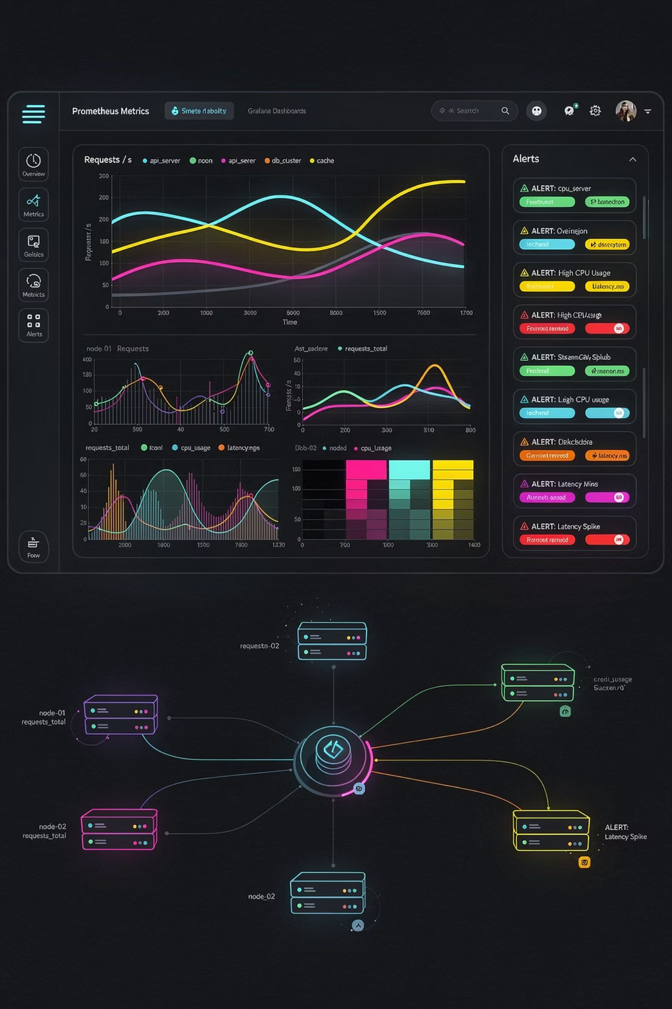

Custom Observability Pipelines
From signals → decisions → scaling
Prometheus Telemetry
Custom Metrics API
Collects latency, throughput, errors
Bridges metrics → HPA
Event Bus (Kafka/NATS)
Scaling events, SLO breach signals, and policy violations are published as events.

Slide 16
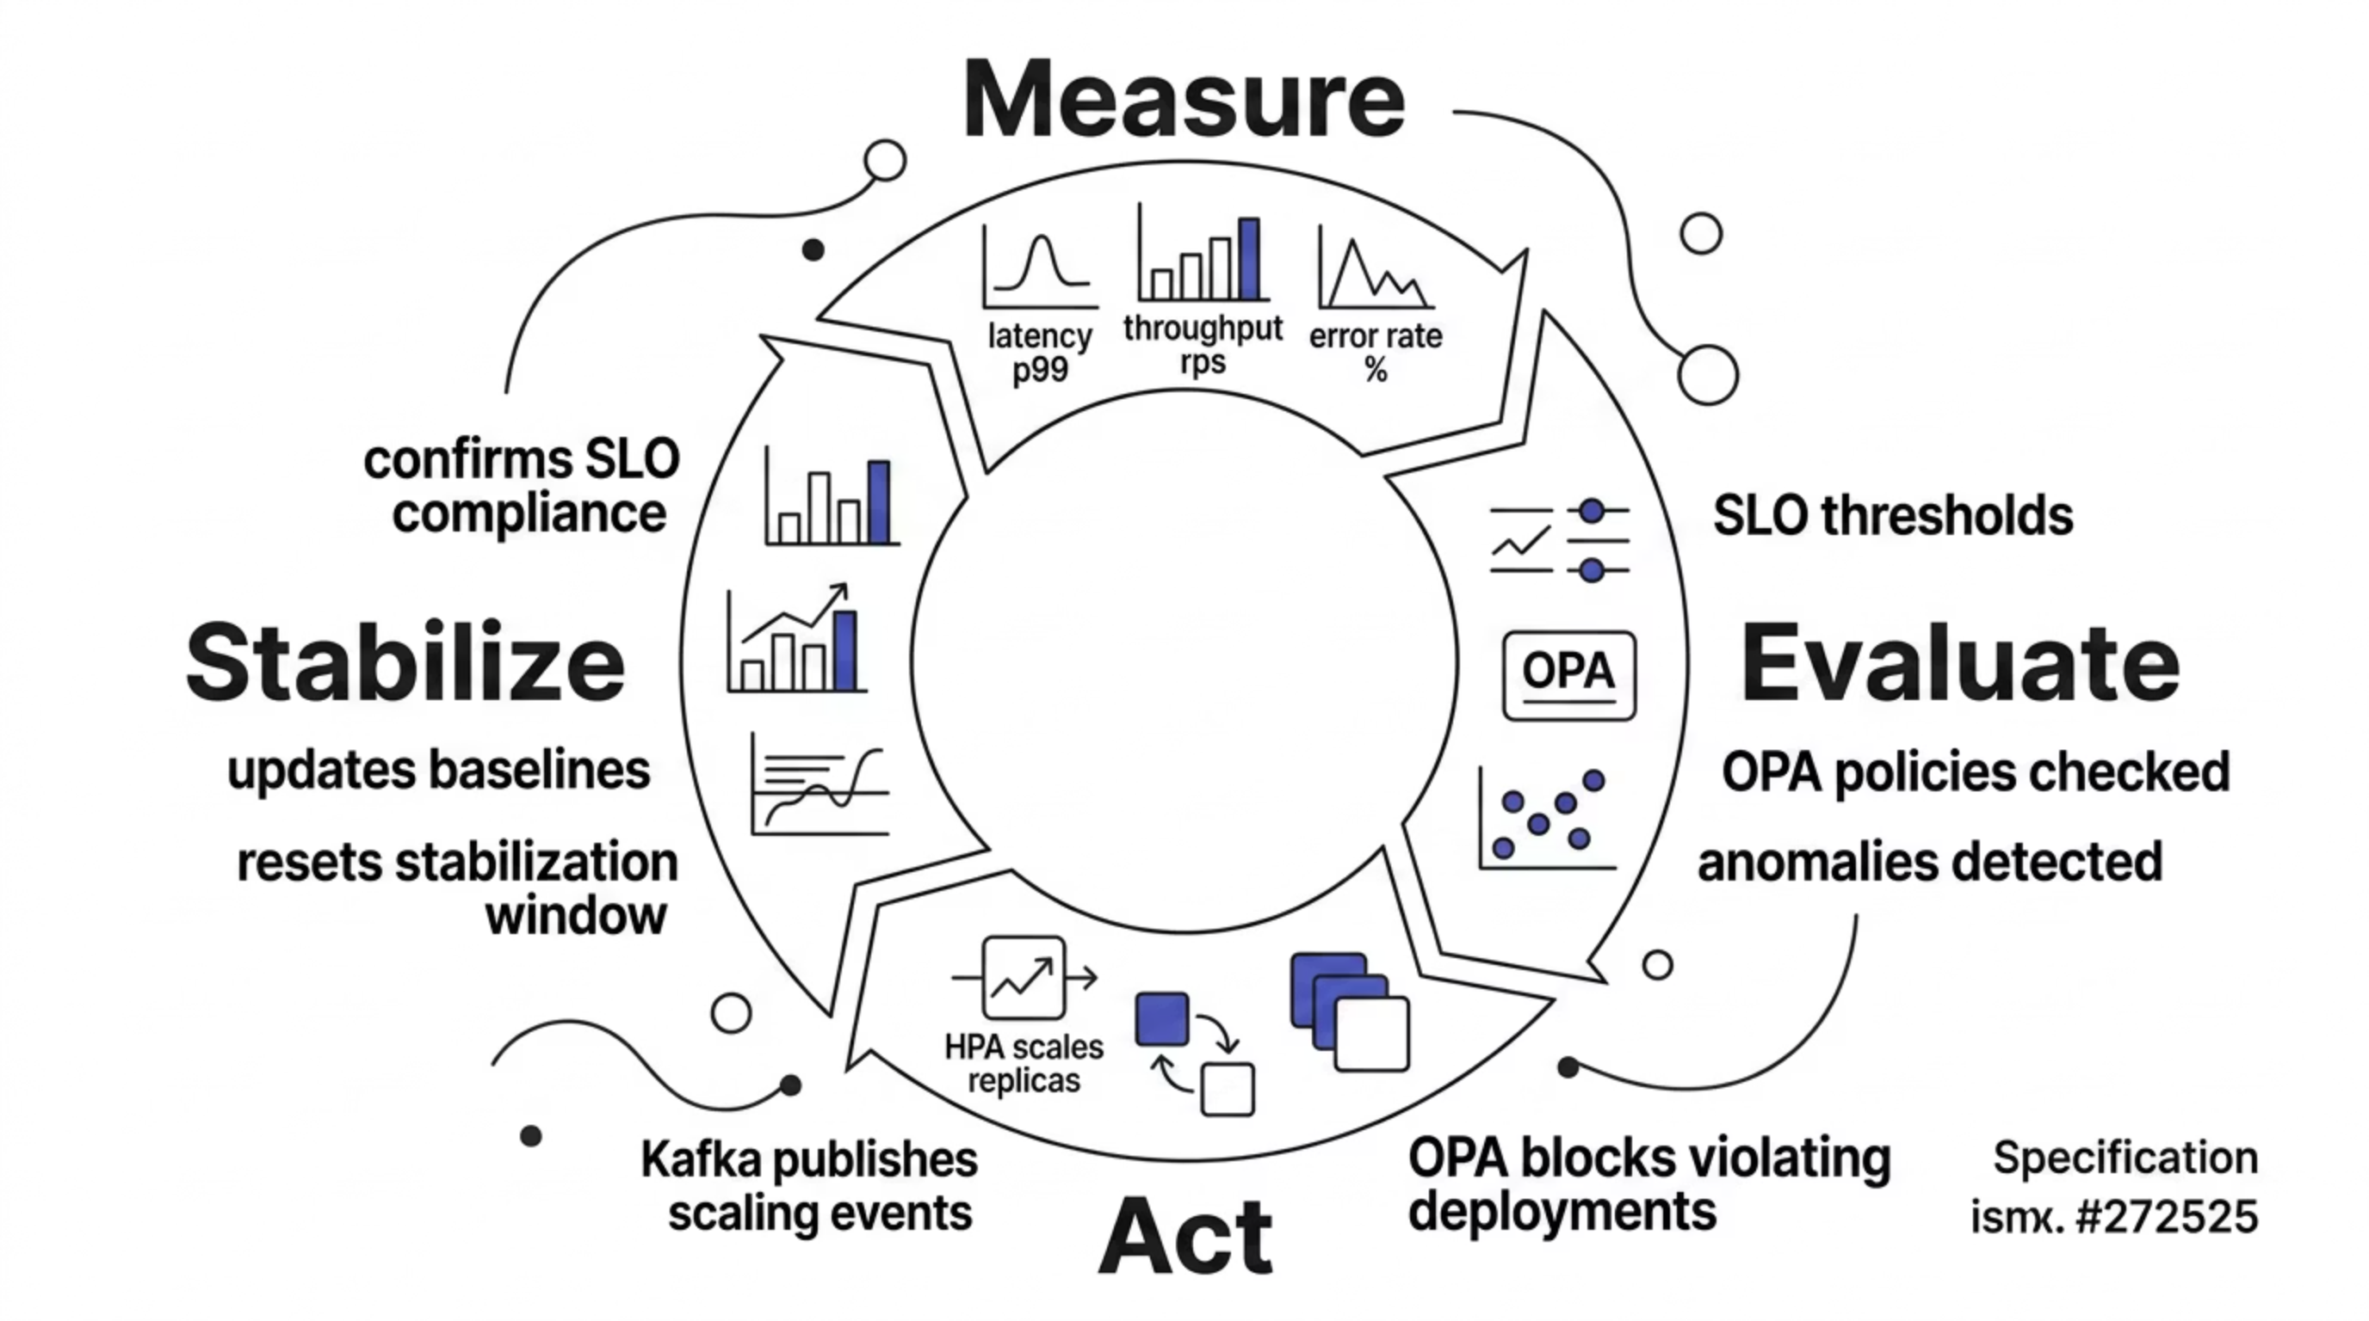

The Event-Driven Feedback Control Loop
The feedback control loop is the mechanism that makes the platform self-regulating.
This loop operates continuously in the background. Platform teams define the rules once; the system enforces them perpetually — reducing mean time to recovery and eliminating the performance regression cycle.

Slide 17
Real-World Impact: What This Unlocks
Measurable Improvements
↓ MTTR
↑ SLA/SLO
Reduced MTTR
Better SLA/SLO Compliance
Faster detection and automated response shrink the time it takes to recover from performance issues.
Proactive scaling and policy guardrails help workloads stay within agreed service objectives.
↓ Cost
✓ Steady
Lower Infrastructure Cost
Stable Scaling Behavior
Right-sized resource usage reduces waste while preserving the capacity needed for peak demand.
Control loops avoid thrashing, keeping workloads responsive without constant oscillation.
Organizational Impact
Platform Teams
Developers
Ticket-driven → Capability-driven
Features, not performance tuning

Slide 18
Platform Maturity Model
Level 1: Reactive Scaling
Teams respond to incidents manually. Scaling decisions are made after performance degrades.
Level 2: Metrics-Driven Scaling
Prometheus and dashboards provide visibility. Scaling is informed by data but still requires human action.
Level 3: Policy-Driven Scaling
HPA with custom metrics automates scaling decisions within guardrails defined by OPA policies.
Level 4: Autonomous Control Loops
The platform self-regulates. Event-driven feedback loops continuously measure, evaluate, act, and stabilize without human intervention.

Slide 19

Key Takeaways
Performance is not something you fix — it's something you design into your platform.
Performance is an architectural decision, not a tuning exercise
Design for SLOs, scaling, and observability from day one.
Custom metrics unlock proactive, user-centric autoscaling
Scale on latency, throughput, and queue depth.
Policy-as-code makes guardrails automatic and auditable
Enforce performance guardrails before bad configs reach production.
Golden paths democratize performance engineering
Make best practices the default for every team.

Slide 20
Thank You & Let's Continue the Conversation
We'd love to hear how your organization is approaching performance in platform engineering — and what challenges you're running into. Find us after the session or connect online.
Josephine Eskaline Joyce
Tanya Shankar
STSM, IBM Cloud
Cloud Engineer, IBM Cloud
Platform Engineering | Cloud-Native Architecture | Developer Productivity
Cloud-Native Development | DevSecOps | IaC
tanya.shanker@ibm.com
jojustin@in.ibm.com
https://www.linkedin.com/in/tanya-shanker/
https://www.linkedin.com/in/josephine-joyce/

