Slide 1

Performance-by-Design
Embedding Intelligent Scaling and Guardrails into Platform Engineering
Josephine Eskaline Joyce, STSM, IBM Cloud
Tanya Shanker, Cloud Engineer, IBM Cloud
PLATFORM ENGINEERING
CLOUD-NATIVE
PERFORMANCE

Slide 2

Performance-by-Design: Built Into the Platform
Not a test phase. Not a tuning exercise. A platform capability.
Traditional Approach
Performance-by-Design
Performance tested after deployment
Manual SRE-led tuning
Reactive scaling
Performance debt grows
SLOs and capacity targets defined upfront
Guardrails enforced through policy
Scaling driven by workload signals
Golden paths encode performance defaults

Slide 3


The Problem: Performance is Still an Afterthought
In Platform Engineering, performance should be a design principle.
Yet in many platforms, it is addressed only after latency, scaling inefficiency, or cost issues appear.
Late Performance Signals
Reactive Control Loops
Post-Deployment Guardrails
Critical indicators such as latency, queue depth, throughput, and workload complexity are not modeled early. Teams react after lagging metrics surface the issue.
Autoscaling and capacity policies are often driven by static thresholds, delaying response to bursty or AI-driven workloads.
SLOs, resource budgets, and performance policies are enforced too late instead of being embedded into platform design.
Problem Statement: Platform engineering must treat performance as a design-time concern, not a runtime fix.
Example: A traffic spike increases queue depth, and p95 latency, but CPU-based autoscaling reacts late - causing slow responses, excess replicas and higher cost.

Slide 4
The Design Gap in Platform Engineering
Performance breaks down when telemetry, scaling, and guardrails operate as separate systems instead of one platform control loop.
Signals Are Observed, Not Operationalized
Scaling Is Reactive, Not Workload-Aware
Telemetry exists, but latency, queue depth, saturation, and workload complexity are not always converted into scaling or policy decisions.
Autoscaling often depends on static thresholds and infrastructure metrics, which struggle with bursty, variable, or AI-driven workloads.
Guardrails Are Defined, Not Enforced
SLOs, resource budgets, and scaling limits are defined separately but not consistently enforced through CI/CD and runtime workflows.
Performance-by-design requires connecting telemetry, scaling, and guardrails into the platform engineering lifecycle.

Slide 5
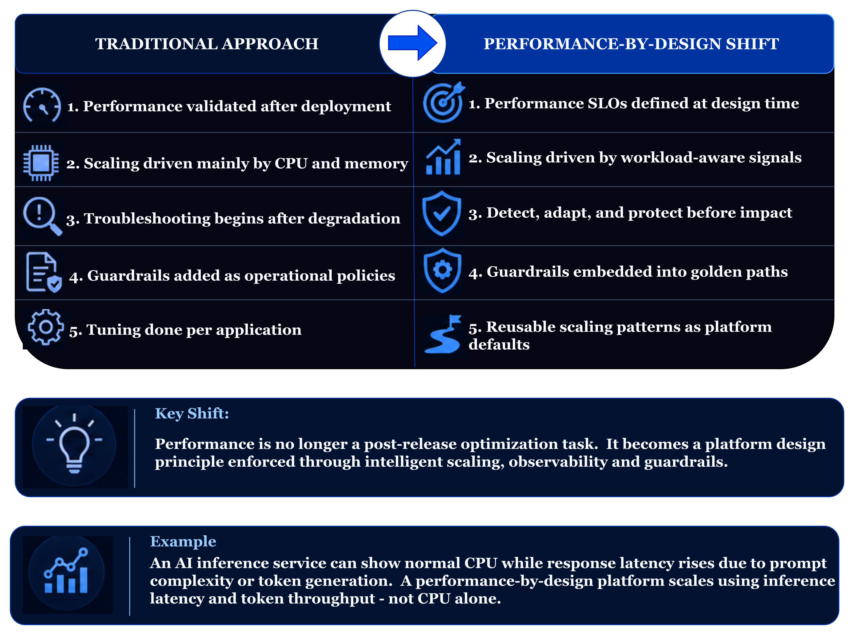
Performance-by-Design: The Shift Required
From reactive performance tuning to intentional platform architecture

Slide 6






Embedding Performance into the Platform Lifecycle
Operationalizing performance-by-design across the platform lifecycle.
1
Design
2
Build
3
Deploy
4
Runtime
5
Improve
Define SLOs & latency budgets
Classify workload profile
Set scaling intent
Validate resource profiles
Automate performance tests
Enforce policy-as-code
Apply scaling defaults
Add rollout gates & quotas
Enforce safe guardrails
Scale on latency & throughput
Protect against saturation
Observe workload behavior
Feed insights into templates
Refine golden paths
Tune platform standards
Performance-by-design means every platform stage includes an explicit performance control – not just monitoring after deployment

Slide 7
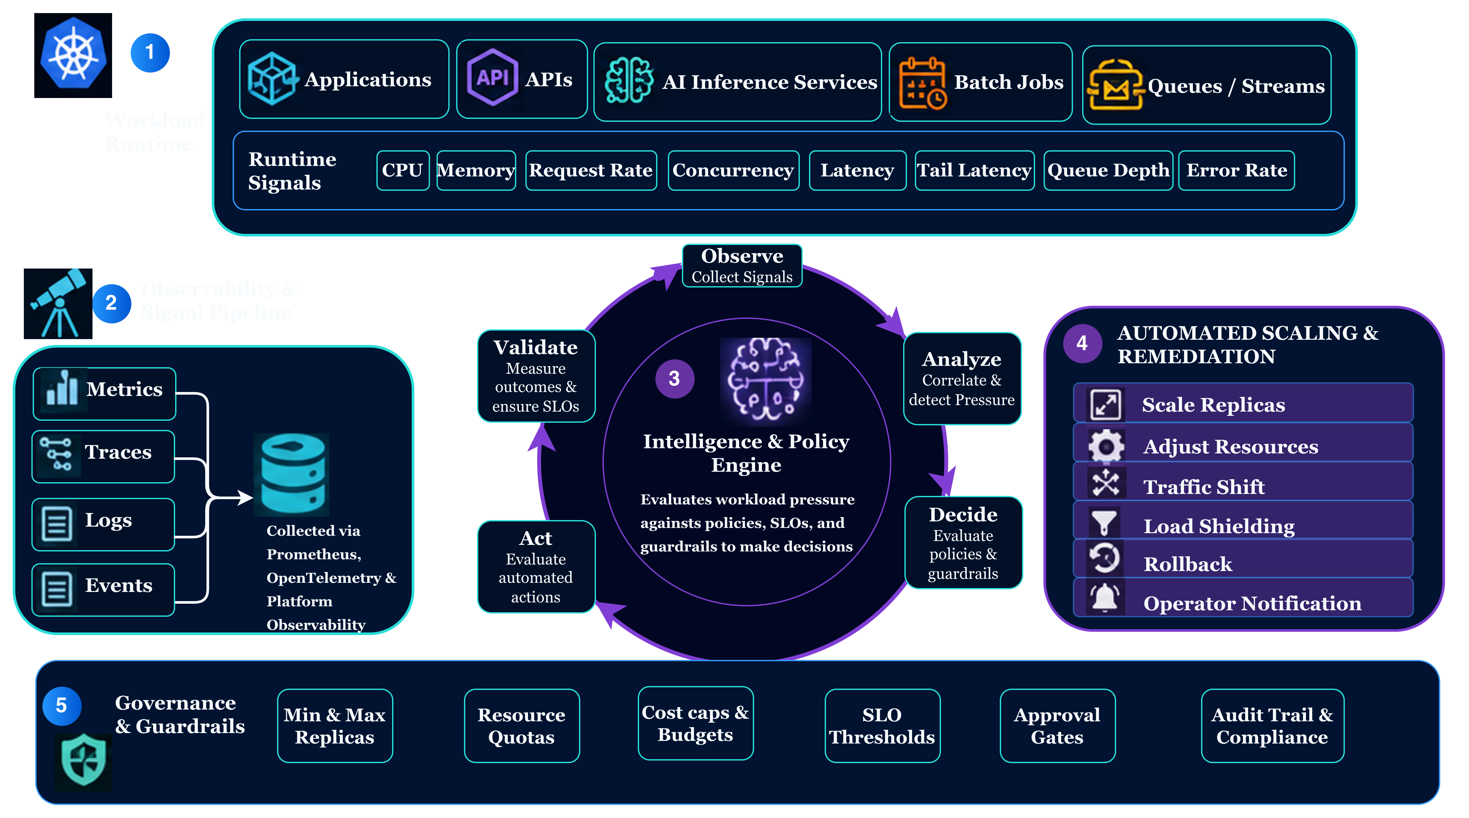

Reference Architecture: Intelligent Scaling & Guardrails
Embedding performance-aware automation into the platform runtime
Performance-by-design turns autoscaling into governed, workload-aware control loop.

Slide 8











From Architecture to Implementation
Operationalizing performance-by-design through telemetry, policy, and automated action
1
2
3
4
5
Instrument
Process Signals
Evaluate Policy
Actuate
Validate & Learn
Expose workload-aware runtime signals
Transform raw telemetry into usable control signals
Apply SLOs, thresholds, and guardrail logic
Trigger automated runtime actions
Measure outcomes and refine decisions
Implementation Building Blocks
Observability Stack – Prometheus, OTel, platform telemetry
Signal Layer – recording rules, adapters, custom metrics
Decision Layer –
SLO Policies, guardrails, evaluation logic
Execution Layer –
HPA, KEDA, controllers, rollout actions
Governance Layer –
Budgets, quotas, approvals, audit
Implementation turns observability into a governed, closed-loop platform capability.

Slide 9
The Shared Responsibility Model for Performance
Performance by design starts with clearly defined ownership between platform teams and application teams.
Platform Team Owns
Application Teams Own
Autoscaling & resource orchestration
Performance-aware deployment templates
SLO baselines & scaling policies
Guardrails (CPU, memory, custom metrics)
Observability platform
Application-level performance characteristics
Load patterns & SLAs
Efficient code & resource usage
Performance testing
→ The platform provides safe defaults. Teams operate within guardrails.

Slide 10



Golden Paths: Performance as a Default
Performance is inherited, not engineered every time
What Golden Paths Include
Developer Experience Impact
Pre-configured autoscaling policies (HPA / KEDA)
SLO-ready metrics, alerts, and dashboards
Workload templates with resource requests and limits
Policy-as-Code guardrails using OPA / Gatekeeper
Auto-provisioned Grafana dashboards
Production-ready from day one
Less manual tuning of HPA and metrics
Consistent performance standards across teams
Developers focus on product logic
Path of least resistance = path of best performance

Slide 11
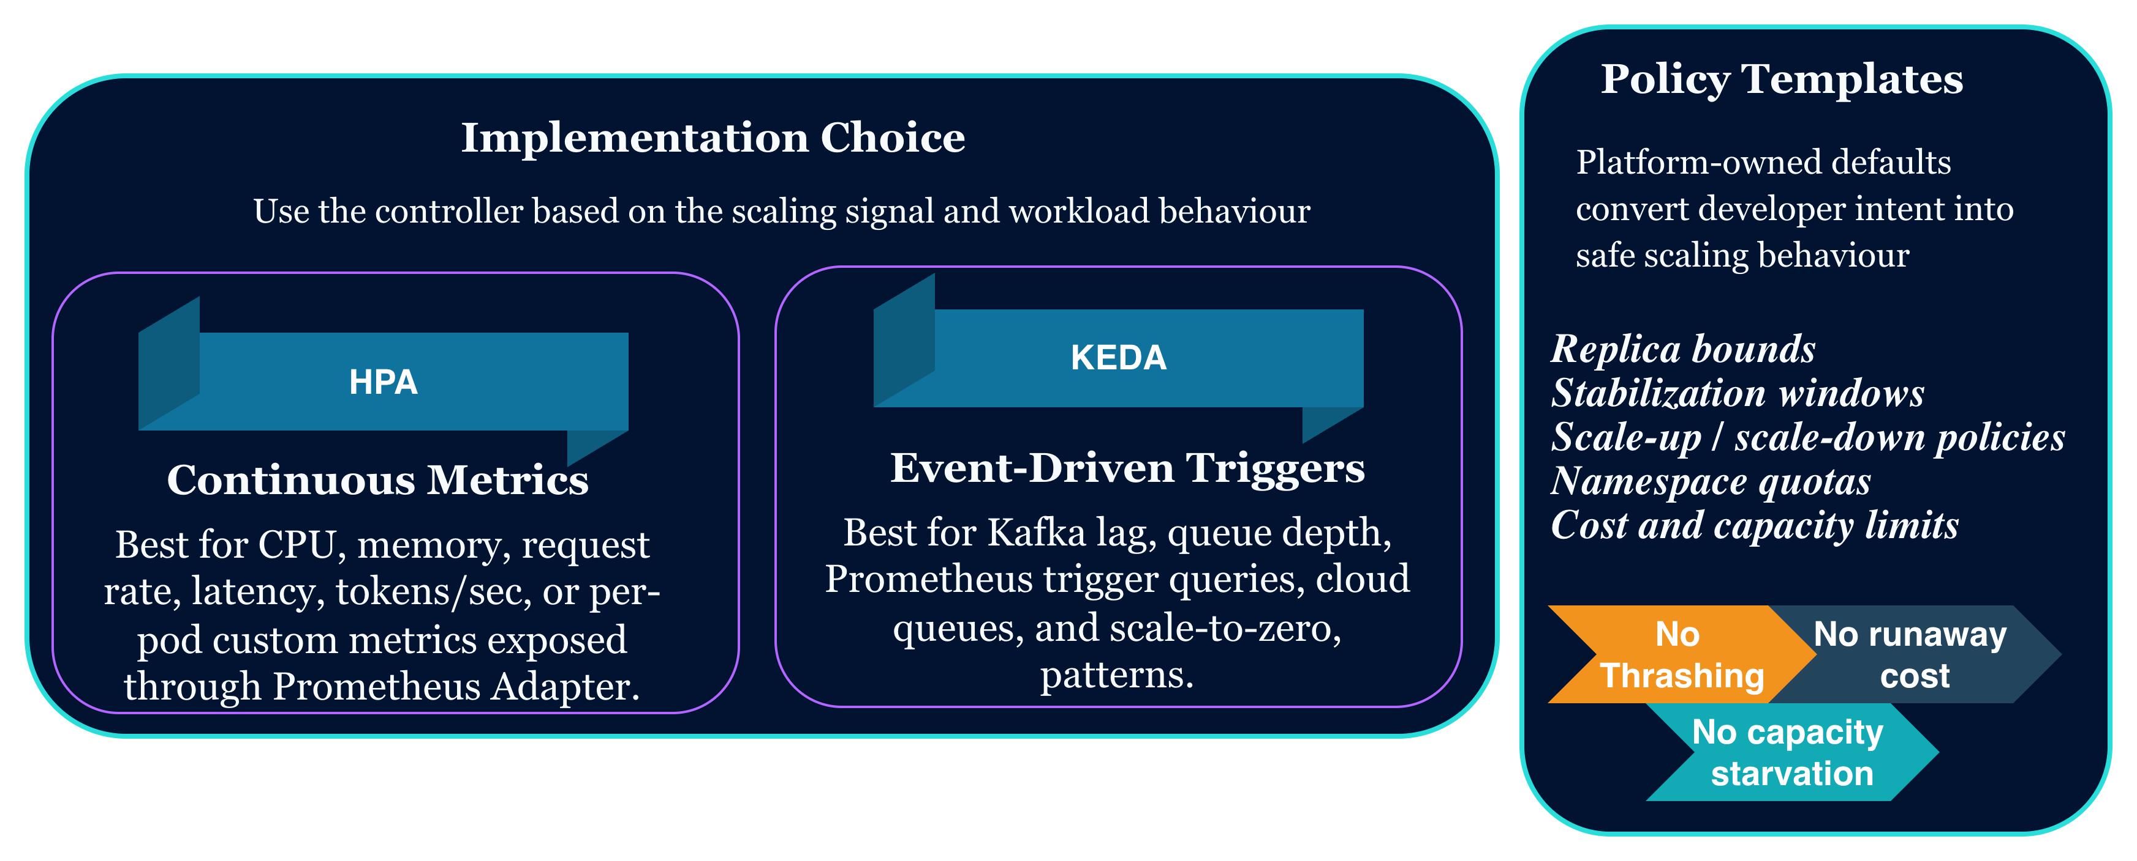
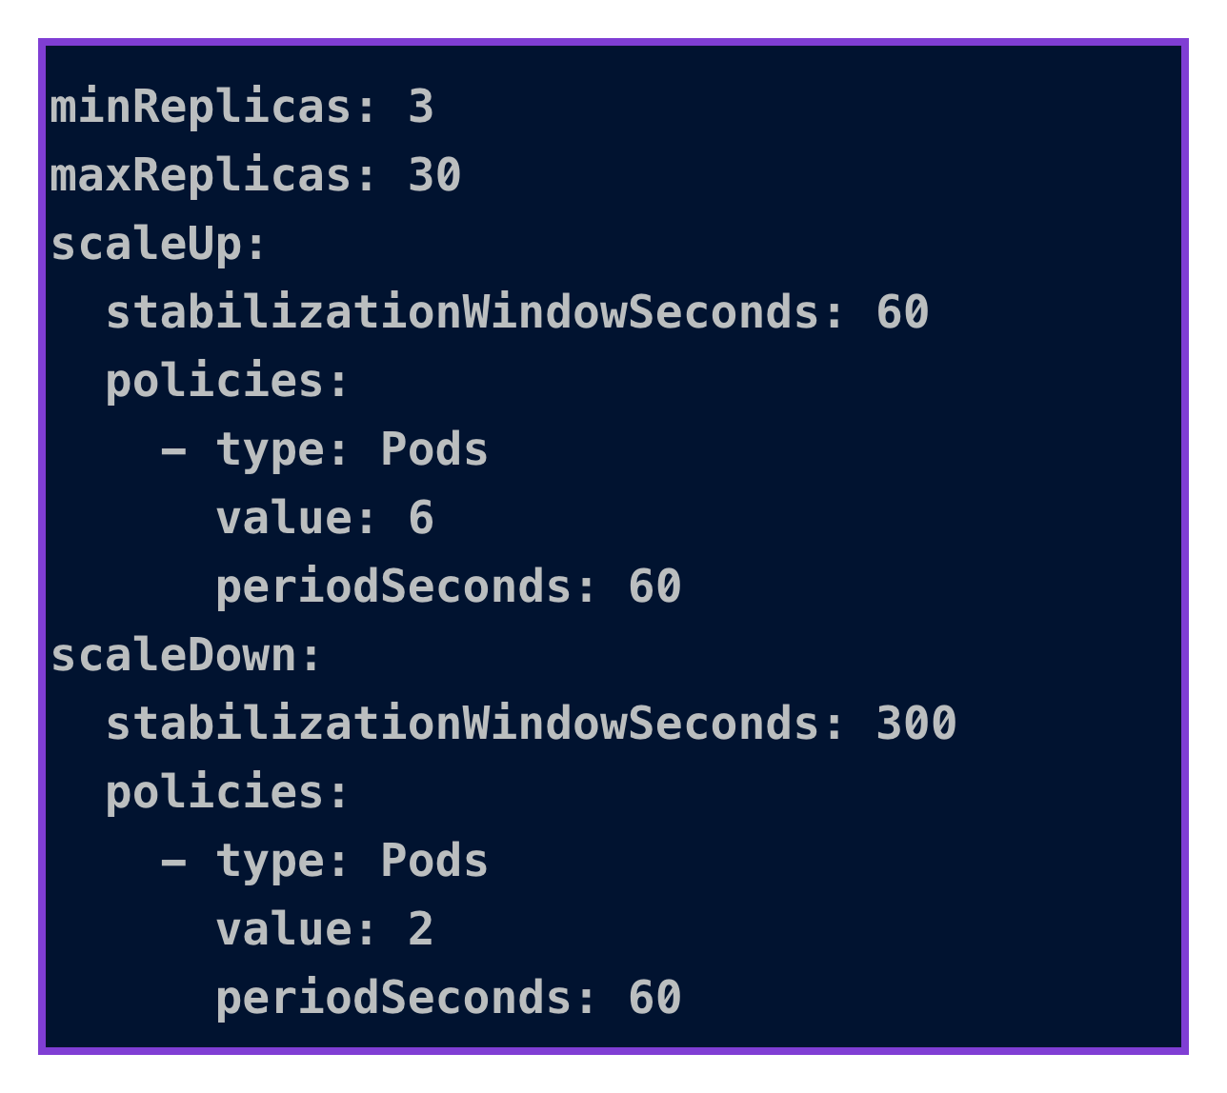
Policy-Driven Autoscaling with Kubernetes
Turning SLOs, workload signals, and guardrails into enforceable scaling behavior
Signal Layer
Controller
Scaling Intent
Controller
Replica Action
Guardrails
SLO Target
Workload profile
Operating limits
CPU / Memory
RPS / Concurrency
P95 latency / queue depth
HPA for continuous metrics
KEDA for event-driven triggers
Scale out / Scale in within approved bounds
HPA for continuous metrics
KEDA for event-driven triggers
Min / max replicas
Stabilization
Quota limits
Cost Controls

Slide 12

Policy-as-Code Guardrails with OPA
Enforce performance, reliability and cost before deployment
Open Policy Agent (OPA) evaluates performance and runtime configuration policies at control points across the delivery lifecycle and blocks unsafe configurations before they reach production.
Scaling Constraints
Minimum and maximum scaling boundaries enforced, approved autoscaling policies required, and resource ratios validated.
Cost Controls
Capacity caps, quota policies, and budget-aware limits declared as enforceable policy.
SLO Enforcement
Workloads must declare SLOs, scaling intent, and ownership metadata. No SLO, no deployment.
Policy Checkpoints : CI/CD Validation Deployment-time policy enforcement
Continuous runtime enforcement

Slide 13



Tenant Isolation: The Foundation of Fair Performance
Without isolation → contention, failures, unpredictability
Resource Isolation
CPU and memory guarantees
Dedicated node pools for critical workloads
Priority and preemption policies
Logical Isolation (Namespaces)
Separate environments or teams
Individual quotas
Network policies
Performance Isolation
Per-tenant autoscaling policies
Custom metrics per workload class
Fair queuing for ingress traffic
Isolation creates predictable, independent performance domains

Slide 14
Multi-Tenancy Models: Isolation & Operational Overview
Choose your isolation model based on workload criticality, cost tolerance, and operational maturity.
Shared Cluster + Shared Namespace
Shared Cluster + Per-Tenant Namespace
Shared Cluster + Strong Resource Boundaries
Dedicated Node Pools per Tenant
Isolation: High
Predictability: High
Cost Efficiency: Medium
Complexity: Medium–High
Isolation: Very High
Predictability: Very High
Cost Efficiency: Lower
Complexity: High
Isolation: Low
Predictability: Poor
Cost Efficiency: Very High
Complexity: Low
Isolation: Medium
Predictability: Moderate
Cost Efficiency: High
Complexity: Medium
Usage: Performance-sensitive SaaS
Usage: Dev, test, prototypes
Usage: Most enterprise IDPs
Usage: AI/critical workloads
Dedicated Cluster per Tenant
Isolation: Maximum
Predictability: Maximum
Cost Efficiency: Lowest
Complexity: Very High
Usage: Regulated/high isolation

Slide 15
Multi-Tenancy Models: Performance Comparison
A performance-focused comparison of multi-tenancy models used in modern platforms. IDPs can follow a mix of these models.
🔴 High Risk / None
🟡 Medium Risk / Partial
🟢 Low Risk / Strong
Model
Latency Stability
Scaling Accuracy
Noisy Neighbor Risk
Resource Utilization Efficiency
Fault Isolation
Shared Cluster + Shared Namespace
Highly unstable — direct contention and uncontrolled bursts
Poor: HPA signals affected by unrelated workloads
Extremely high: any tenant can starve others
High but unsafe, frequent overcommit
None
Shared Cluster + Per-Tenant Namespace
More stable but affected by node-level pressure
Moderate: per-tenant scaling with some interference
Medium: contained logically but not physically
High with basic quotas
Partial
Shared Cluster + Strong Resource Boundaries
Predictable with guaranteed resources
High: tenant-specific metrics drive scaling
Low: guardrails prevent resource abuse
Moderate due to reservations
Strong
Shared Cluster + Dedicated Node Pools
Near-constant and low latency
Very high: scaling isolated to pool
None: physical separation
Lower due to idle pool capacity
Very strong
Dedicated Cluster per Tenant
Fully deterministic
Perfect: fully independent scaling
None
Lowest: duplicate infrastructure
Complete

Slide 16
Real-World Impact: What This Unlocks
Measurable Improvements
↓ MTTR
↑ SLA/SLO
Reduced MTTR
Better SLA/SLO Compliance
Faster detection and automated response shrink the time it takes to recover from performance issues.
Proactive scaling and policy guardrails help workloads stay within agreed service objectives.
↓ Cost
✓ Steady
Optimized Infrastructure Cost
Stable Scaling Behavior
Right-sized resource usage reduces waste while preserving the capacity needed for peak demand.
Control loops avoid thrashing, keeping workloads responsive without constant oscillation.
Organizational Impact
Platform Teams
Developers
Ticket-driven → Capability-driven
Features, not performance tuning

Slide 17
Performance-by-Design Maturity Model
Level 1: Reactive Scaling
Teams respond to incidents manually. Scaling decisions are made after performance degrades.
Level 2: Metrics-Driven Scaling
Metrics pipelines and dashboards provide visibility. Scaling is informed by data but still requires human action.
Level 3: Policy-Driven Scaling
Autoscaling with custom metrics automates scaling decisions within policy guardrails.
Level 4: Autonomous Control Loops
The platform self-regulates. Event-driven feedback loops continuously measure, evaluate, act, and stabilize without human intervention.
Goal: Move from reactive scaling to governed, automated, and self-regulating performance control.

Slide 18

Key Takeaways
Performance is not something you fix — it's something you design into your platform.
Performance is an architectural decision, not a tuning exercise
Design for SLOs, scaling, and observability from day one.
Golden paths democratize performance engineering
Make best practices the default for every team.
Policy-as-code makes guardrails automatic and auditable
Enforce performance guardrails before bad configs reach production.
Custom metrics unlock proactive, user-centric autoscaling
Scale on latency, throughput, and queue depth.
Tenant isolation protects fair performance in shared platforms
Prevent noisy-neighbor effects through quotas, boundaries, and placement strategy.

Slide 19
Thank You & Let's Continue the Conversation
We'd love to hear how your organization is approaching performance in platform engineering — and what challenges you're running into. Find us after the session or connect online.
Josephine Eskaline Joyce
Tanya Shanker
STSM, IBM Cloud
Cloud Engineer, IBM Cloud
Platform Engineering | Cloud-Native Architecture | Developer Productivity
Cloud-Native Development | DevSecOps | IaC
tanya.shanker@ibm.com
jojustin@in.ibm.com
https://www.linkedin.com/in/tanya-shanker/
https://www.linkedin.com/in/josephine-joyce/

