Slide 1

Facing Extinction: The Fight To Keep Hardware Crypto Engines in Embedded Linux
2026-06-17
Kamlesh Gurudasani
T Pratham

Slide 2














About us: TI Processors and Open Source
Upstream FIRST!
Upstream FIRST mentality!
Decades of contribution and collaboration
Focus on long term, sustainable and quality products
Upstream & opensource ecosystem in device architecture
Ingrained culture to give back to the community

Slide 3


Introduction to the Speakers
Kamlesh Gurudasani, Embedded Security Architect, Texas Instruments
Kamlesh Gurudasani works as an Embedded Security Architect at Texas Instruments. He has a decade of experience in software development ranging from open-source bootloaders to the Linux kernel, middleware frameworks and applications. His expertise lies in Linux crypto subsystem, Linux media subsystems, OP-TEE, U-boot and TF-A. He is TSC member of TF-A and security work group member of Civil Infrastructure Platform project.
T Pratham, Embedded Software Engineer, Texas Instruments
Pratham is an embedded software engineer working at Texas Instruments' Sitara Processors team. His work focuses on Linux security on K3 devices, with significant experience with the Linux crypto layer. He is the author of the DTHEv2 Crypto Engine driver. He also has worked with OP-TEE, TF-A, and U-Boot.

Slide 4
Overview
Problem statement
What are crypto accelerators?
Are accelerators really accelerating?
If not accelerating, why even use them?
What maintainers see
Are we getting the full picture?
  Certification
  Side channel resistance
Start of extinction
Can we do something about this?

Slide 5
Problem Statement
Maintainers are systematically removing hardware crypto engine support from Linux
Both approaches used: delete the driver, or block it from every real caller
Decision driven by benchmark regressions on server-class workloads
Embedded threat model, never examined
No proposed path forward for vendors who need these engines upstream
The gap: upstream policy is written for data-centre crypto. Embedded security requirements are a different problem entirely.

Slide 6
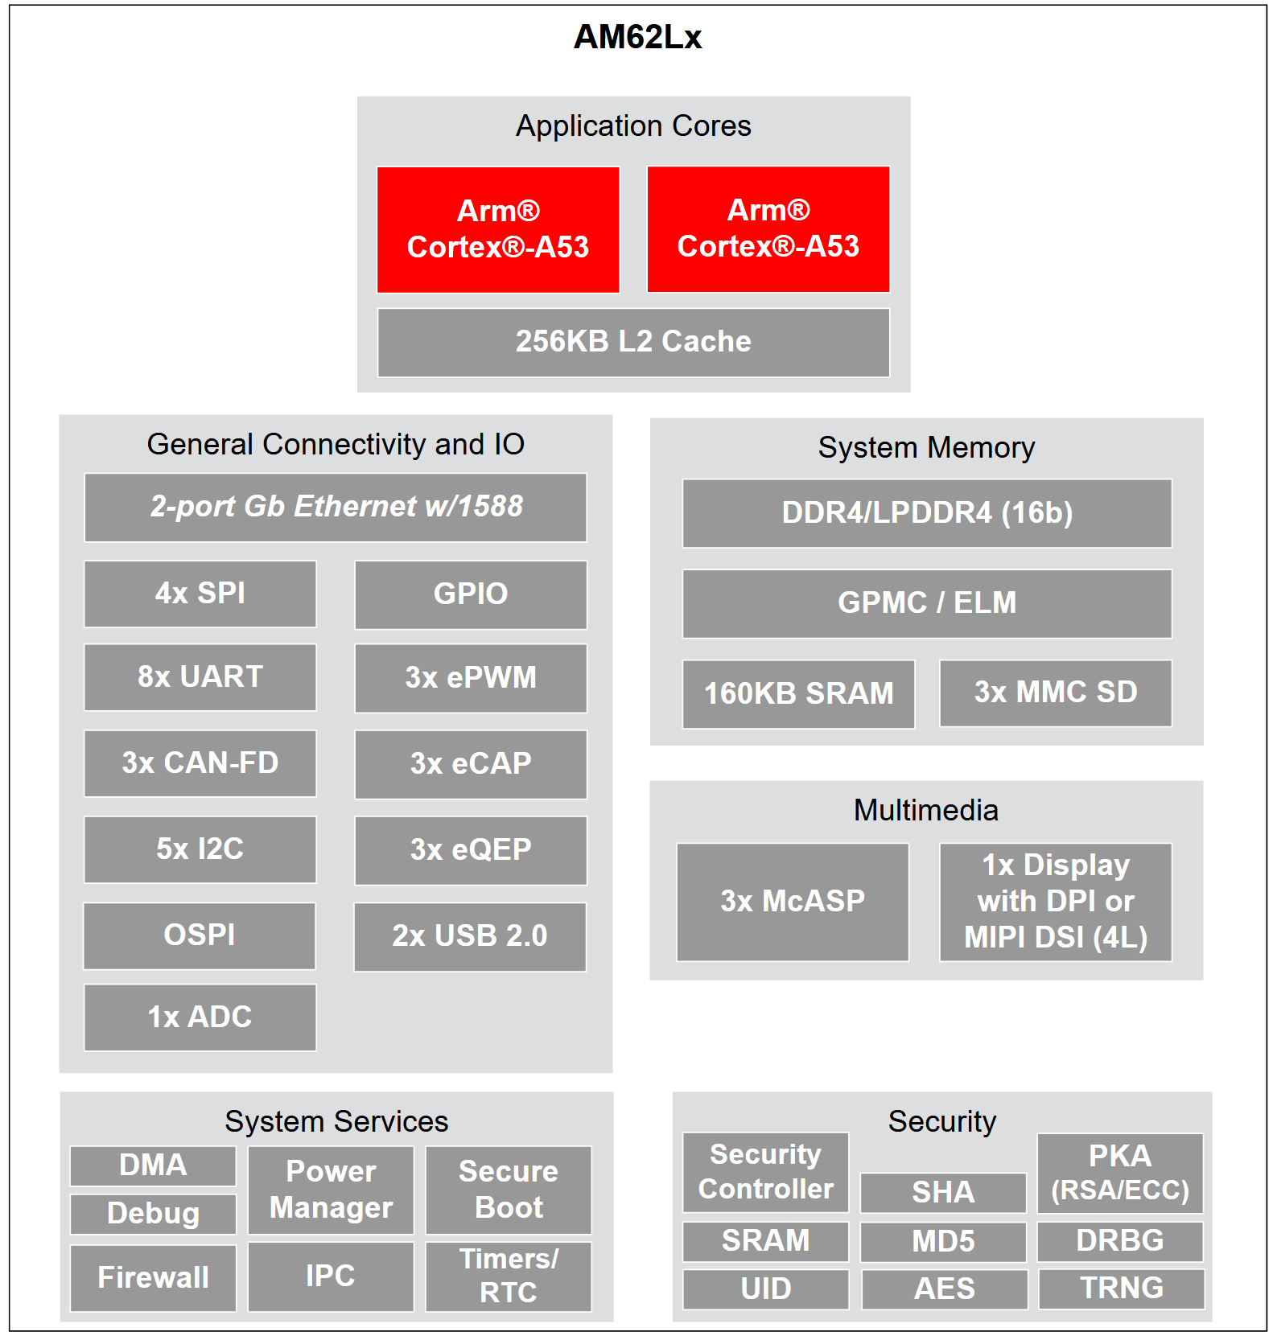
What Are Cryptographic Accelerators?
Dedicated Si block inside SoC
Performs cryptographic operations
Very different from CPU crypto instructions
Industry examples:
TI: SA2UL, DTHEv2
NXP:CAAM
Qualcomm: QCE
STMicro: STM32 Cryp
Marvell: CESA (Armada)
Intel: QAT
AM62L Device Block Diagram

Slide 7
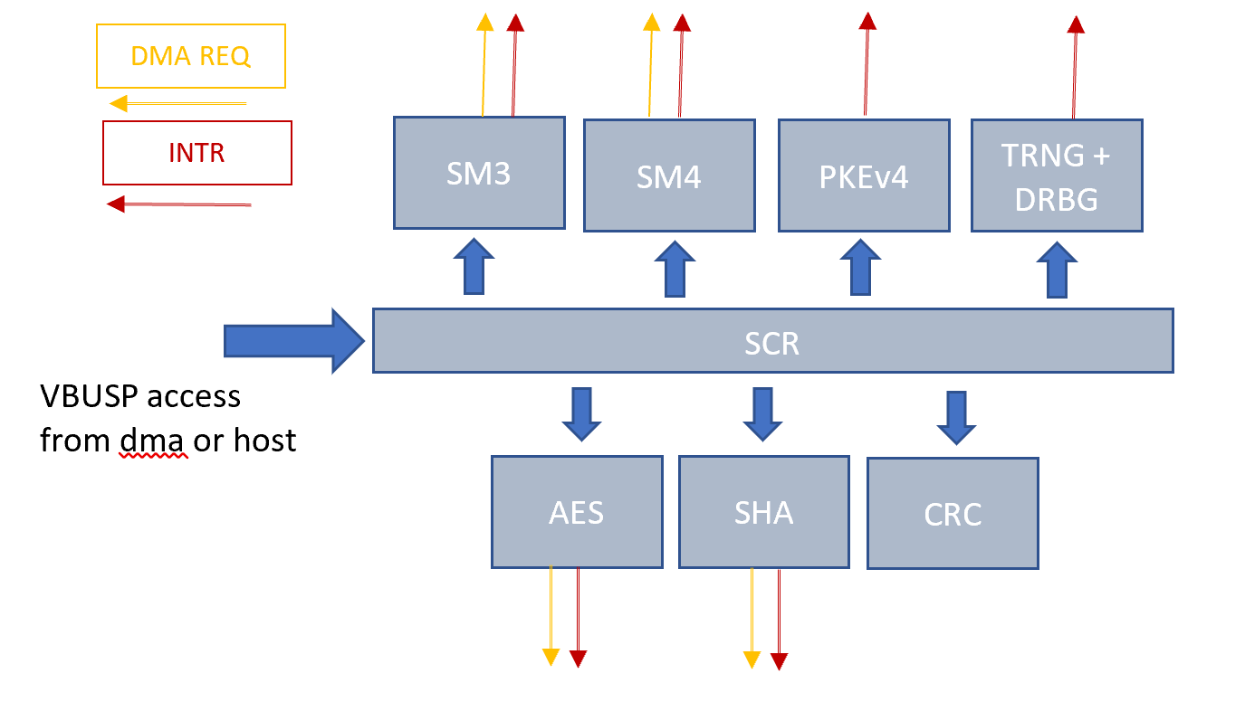
What Are Cryptographic Accelerators?
Connected to SoC via dedicated bus
Own DMA engine + bus
Dedicated power domain and clock gating
Hardware key storage slots
Side channel countermeasures
Requires a driver to expose functionalities
DTHEv2 Block Diagram
CPU instructions ≠ Hardware accelerators.
ARMv8 Crypto Extensions (AES, SHA, PMULL) run on the application core - same power domain, same addressable memory, no hardware isolation. That is a different thing entirely.

Slide 8
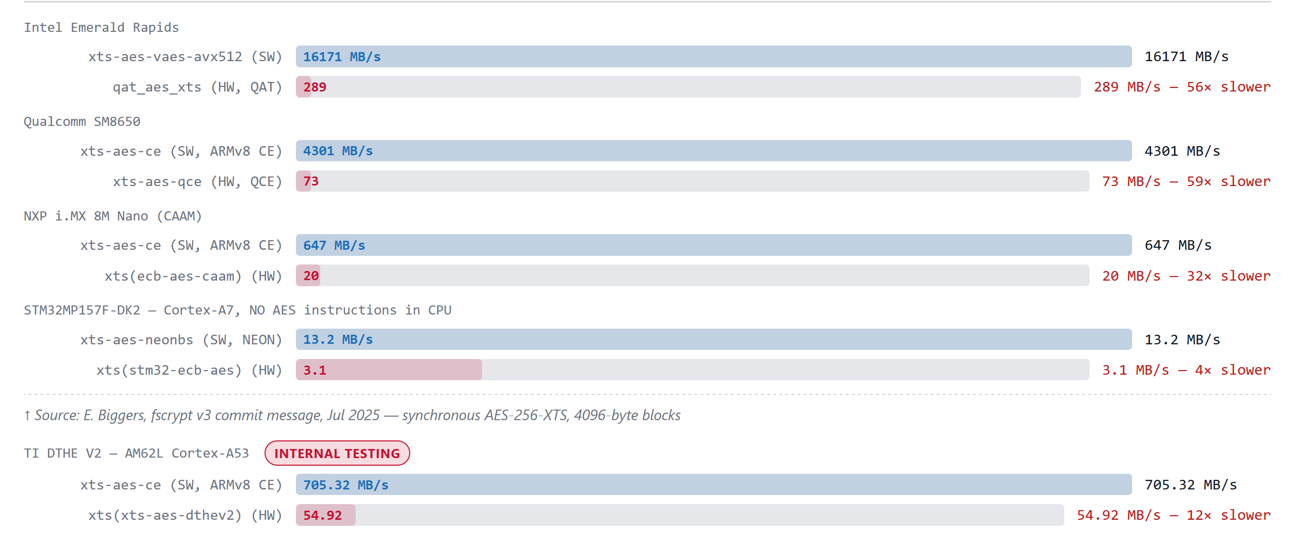
Crypto Accelerators: Are They Really Accelerating?
⚠ SW is 32–59× faster in this benchmark. Even on STM32 (no AES CPU instructions), NEON is ~4× faster than HW.

Slide 9
"Accelerator" - For Which Core?
These engines are genuine accelerators — for the cores they were designed for:
  Secure boot runs on Cortex-M4 @ 200–400 MHz — no AES hardware instructions
  Generic C AES on M4 @ 266 MHz → ~14 MB/s
  Hardware crypto engine → ~100–300 MB/s → real 10–30× acceleration
Linux runs on the application core — Cortex-A53/A72 with ARMv8 Crypto Extensions:
  AES-CE on A53 @ 1.4 GHz → 4,301 MB/s in the CPU pipeline, no DMA needed
  Same hardware engine → 73–647 MB/s → bottleneck, not accelerator
The M-class core calls the engine directly from its own firmware
(TI-TIFS, NXP SECO/EdgeLock) — never through the Linux crypto API.
Same silicon. Wrong caller.
The name "accelerator" is accurate for its intended original target.
It was never designed to accelerate Linux.

Slide 10
ARM Crypto - What Moved the Needle
All vs generic C (AES: ~19 cpb · AES-GCM: ~35–40 cpb)
Feature | Since | AES | AES-GCM
Generic C | Pre-2013 | 1x | 1x
+ NEON | ARMv7, 2009 | None | ~1.3x
+AES-CE | ARMv8, 2013 | ~20x | ~10x
+AES-CE + PMULL | ARMv8, 2013 | ~20x | ~14x
All three land on the same die (Cortex-A53/A57, ~2013). Mainstream by 2015.
Source:
AES cpb: Ard Biesheuvel [10]
GCM cpb: [11][12] · GCM baseline estimated

Slide 11
What Maintainers See?
Performance: hardware is slower than the CPU it is supposed to offload
Silent priority override: drivers self-promote, displace faster code
Correctness bugs: wrong output, crashes, data corruption shipped to users
Maintenance cost: async DMA drivers are harder to test, harder to review
  "Fundamentally much more error-prone … often don't get tested before releases"
Attack surface: AF_ALG gave unprivileged userspace access to every buggy driver
  Removed May 2026: hardware engines excluded from AF_ALG entirely
Use case: "show a real kernel caller, not a vendor benchmark"
  fscrypt (2025) and dm-crypt (2020) both opted out
  "Almost always coming from hardware vendors, not actual users"

Slide 12
If not accelerating, why even use them?
1
CPU Offload
2
Power Efficiency
3
Lower Jitter
Free the CPU for other tasks: better overall system performance. “Often the consideration is more about getting good enough performance while freeing the CPU” — Gilad Ben-Yossef (ARM), Jun 2021
“Better power consumption when the lower performance engine is used” — Gilad Ben-Yossef.
“Lower jitter is more important than peak performance — I’ve seen this with encrypted video decoding” — Gilad Ben-Yossef, Jun 2021
4
DPA/EMA Resistance
5
Hardware Key Isolation
6
True RNG (TRNG)
Hardware masking/shuffling countermeasures against power and EM side-channel attacks. Cannot be replicated in software — requires dedicated silicon.
Keys loaded from TrustZone to HW slot — never in software memory. STM32MP2x, IBM s390 secure key architecture. “Secure key ops can’t by definition run on the CPU” — IBM, Jun 2026
Physical entropy source (thermal noise / ring oscillators) built into the engine. Higher quality than software PRNG. Present in TI DTHE V2, NXP CAAM, others.

Slide 13
Why Hardware Matters: Side-Channel Resistance
Embedded devices are physically exposed:
  Industrial controller on the factory floor
  Automotive ECU under the hood
  Smart meter on the side of a building
  Edge gateway in an unlocked cabinet
  Medical device in a hospital corridor
Attacker toolkit (< $500, commercially available):
  Oscilloscope + current probe → DPA
  Near-field EM probe → EMA
  Voltage glitcher → fault injection
  JTAG / debug port extraction
  Time - the device isn't going anywhere
ARMv8 CE:
  Constant time
  But power correlates with key data → DPA directly applicable
Power/EM side-channels (DPA/EMA): ~40 power traces sufficient to extract AES key from unprotected implementation
Hardware countermeasures require silicon: masking (random shares), shuffling (op reorder), noise injection. These are circuits, not algorithms. Cannot be done in software.

Slide 14
Why Hardware Matters: The Certification Wall
Standards that require hardware crypto - software cannot substitute:
Standard | Domain | Requirement
FIPS 140-3 Level 3 | Government/regulated | Physical tamper resistance, active side-channel resistance
IEC 62443-4-2 SL2+ | Industrial automation | Tamper resistance, hardware-isolated key storage
ISO/SAE 21434 | Automative cybersecurity | Hardware root of trust, SHE/HSM compliance
Common Criteria EAL4+ | Security products | Formal security boundary enforcement
PSA Certified Level 2+ | Arm IoT platform | Secure hardware-backed key storage
GSMA IoT Security | IoT devices | Hardware-backed credential storage
The business consequence:
Certifications require hardware crypto
Vendor forks from mainline
Fork falls behind on security patches
Upstream removes hardware crypto
Everybody loses
This is not hypothetical; it is the choice vendors are making right now.

Slide 15
Why Hardware Matters: PQC Transition - Hardware Becomes More Critical
Linux is already adding PQC: ML-DSA merged Nov 2025, ML-KEM in progress. The transition amplifies every hardware crypto argument.
Hardware's role in the PQC era:
  Next-gen SoCs already designing PQC accelerators
  Constrained cores (<600MHz) need offload for signing
  ML-KEM-768 ciphertext = 1184 bytes - DMA matters more than ever
  Side-channel on PQC is an active research area
  Lattice-based crypto has its own DPA vulnerabilities
Algorithm | Operation | Cost
ML-KEM-768 | Encapsulate | ~1ms on Cortex-A53 (manageable)
ML-DSA-65 | Sign | 2-5x more than RSA-2048
SLH-DSA | Sign | 100-1000x more expensive
Hybrid: Classical + PQC | Any | Double all operations
PQC algorithm costs on embedded cores
If we eliminate the async crypto API pathway now, the PQC hardware accelerators being designed today will have no upstream home in Linux tomorrow.
We are cutting the branch we'll need to stand on.

Slide 16
What Benchmarks Miss: Secure Key Isolation - What Software Cannot Do
Hardware Key Isolation Model
Software Crypto Key Exposure
Key loaded into hardware slot from TrustZone / HSM
Key never appears in software memory
Privilege escalation cannot extract key material
Key slot cleared on power-off / tamper detect
Hardware enforces access control — not just permissions
Key must exist in addressable RAM
Kernel memory is readable by privileged code
Cold-boot attacks can read residual key material
No hardware enforcement of access control
Any kernel bug = potential key exposure

Slide 17
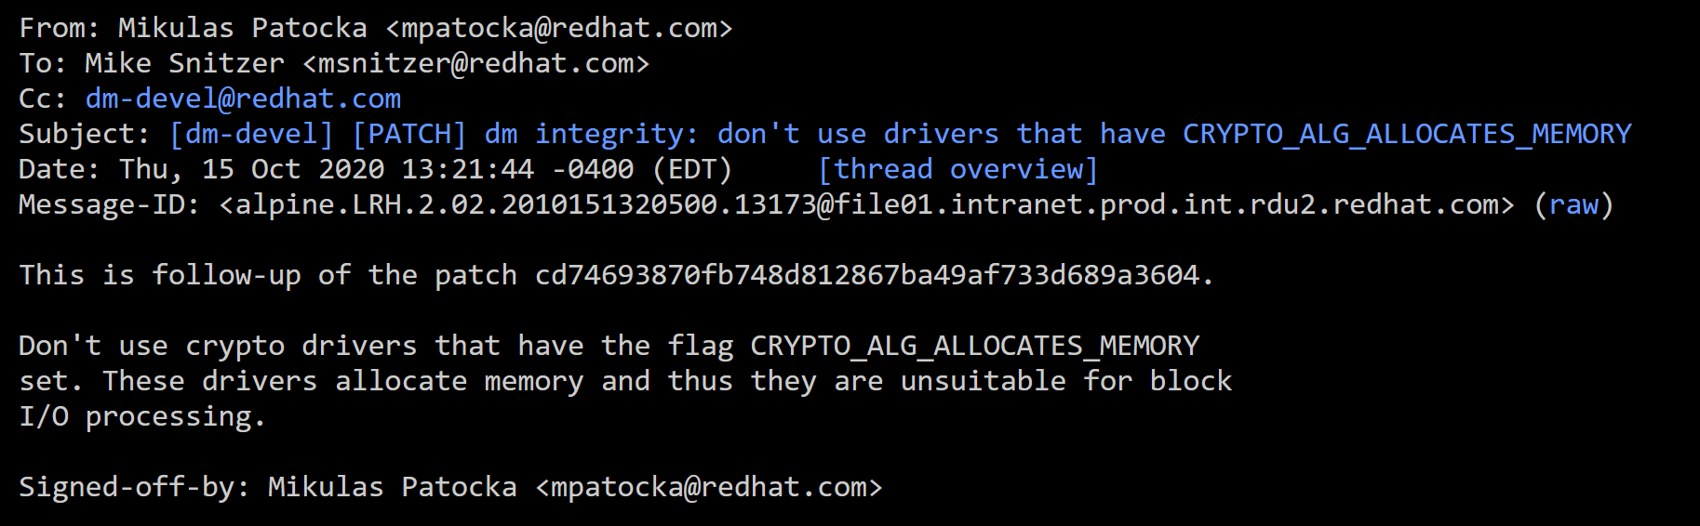
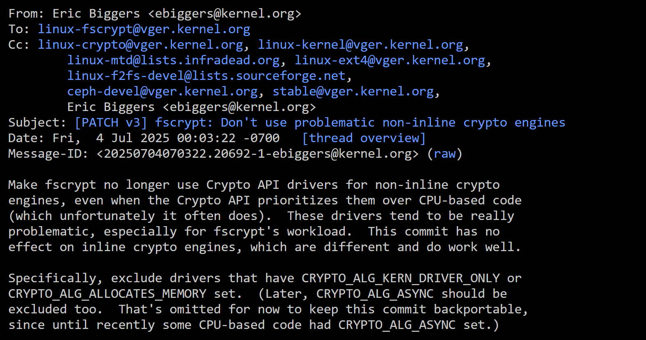
Start of extinction
dm-crypt blocks all ALLOCATES_MEMORY drivers
v5.10 / 2020
fscrypt blocks all hardware crypto engines
Jul 2025

Slide 18
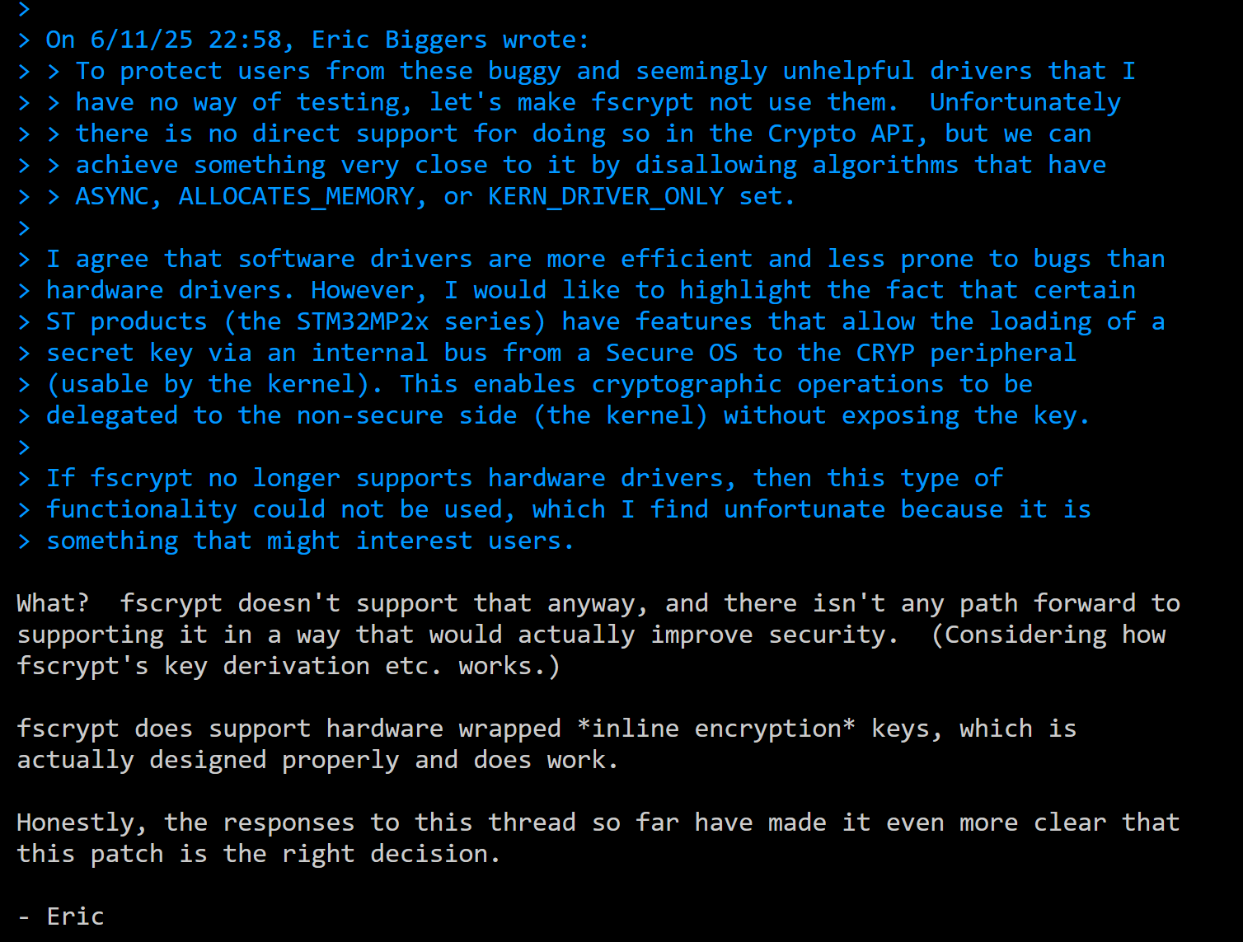
Start of extinction
STM vendor pushback against fscrypt blocking hardware crypto dismissed
Jun 2025

Slide 19
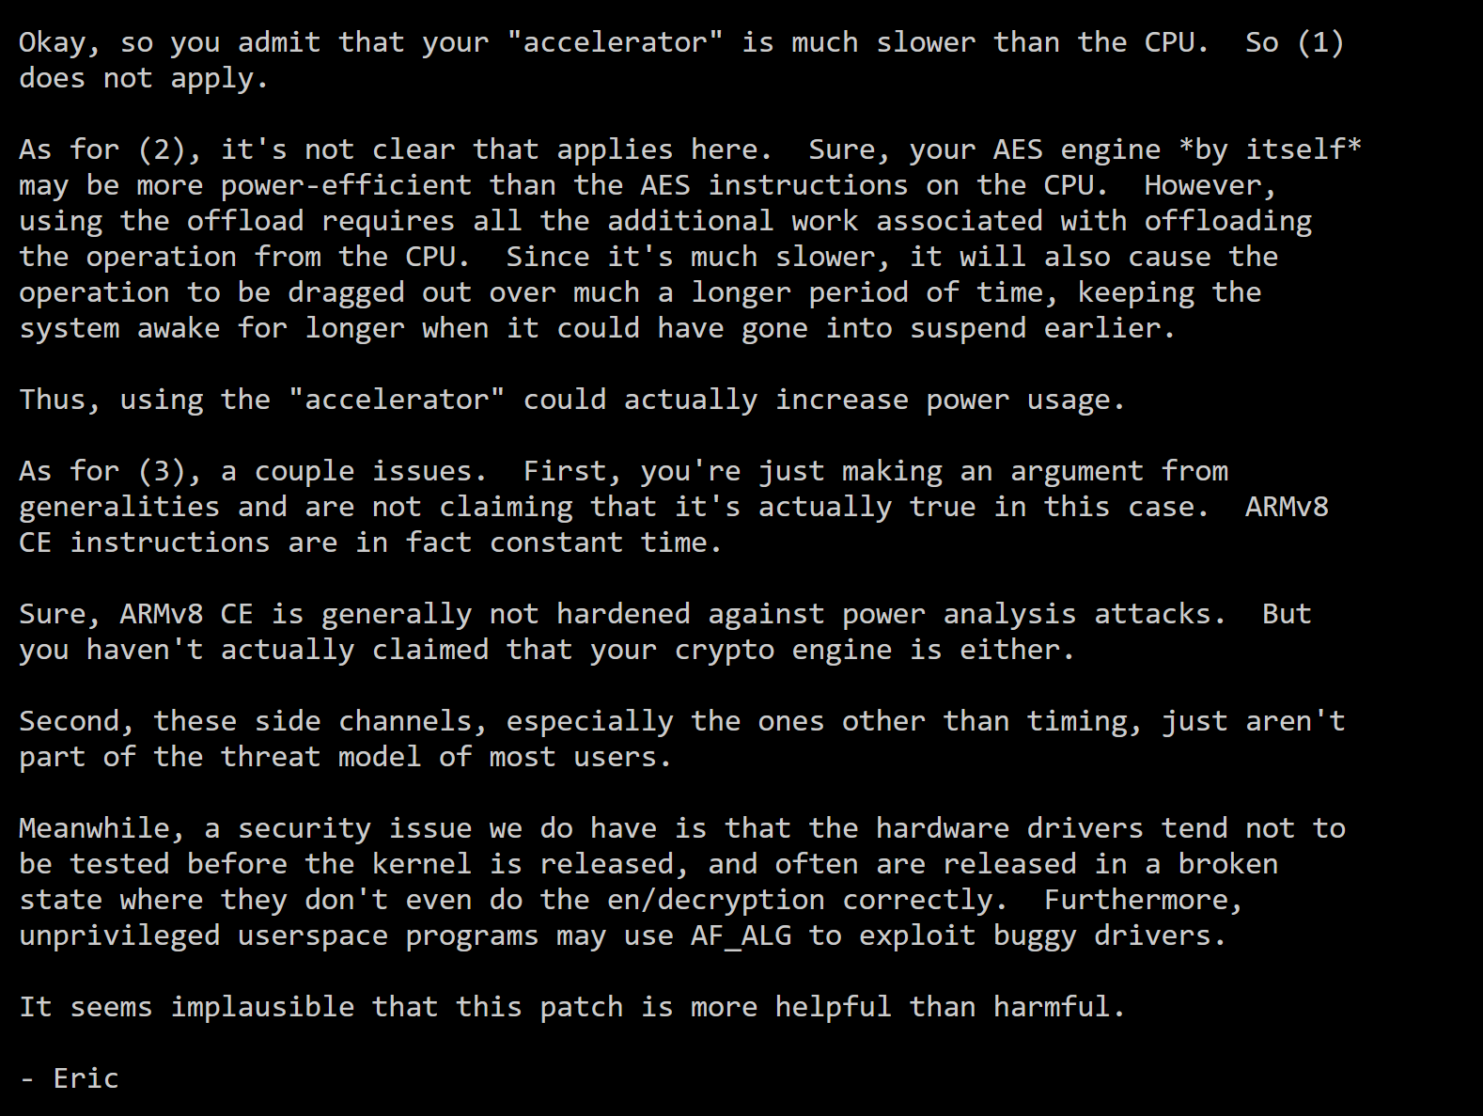
Start of extinction
DTHEv2 driver pushed-back
Jun 2025

Slide 20
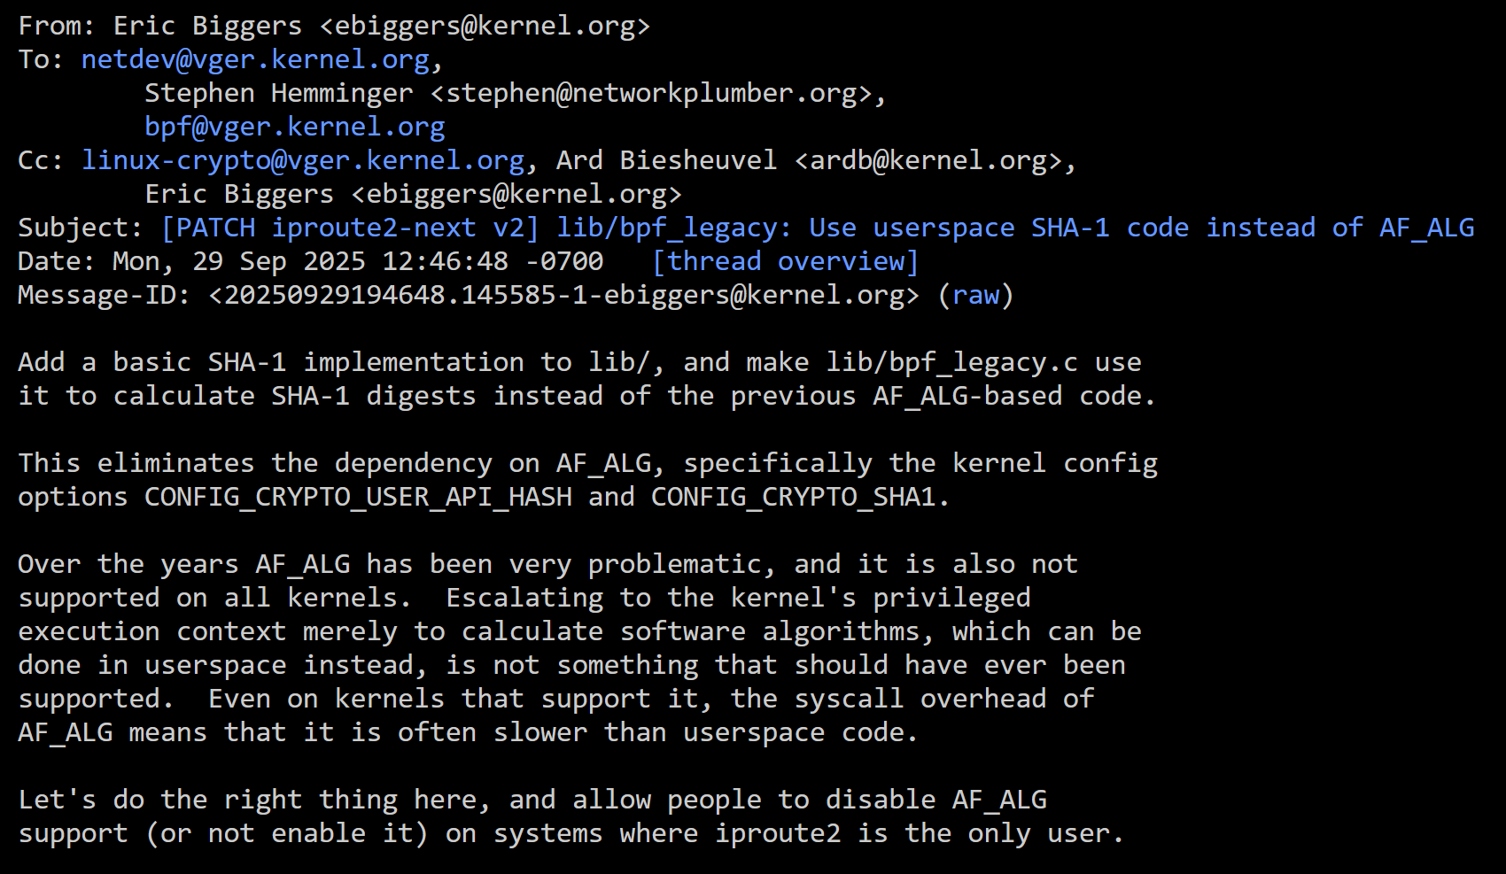
Start of extinction
iproute2 removes AF_ALG support
Sep 2025

Slide 21
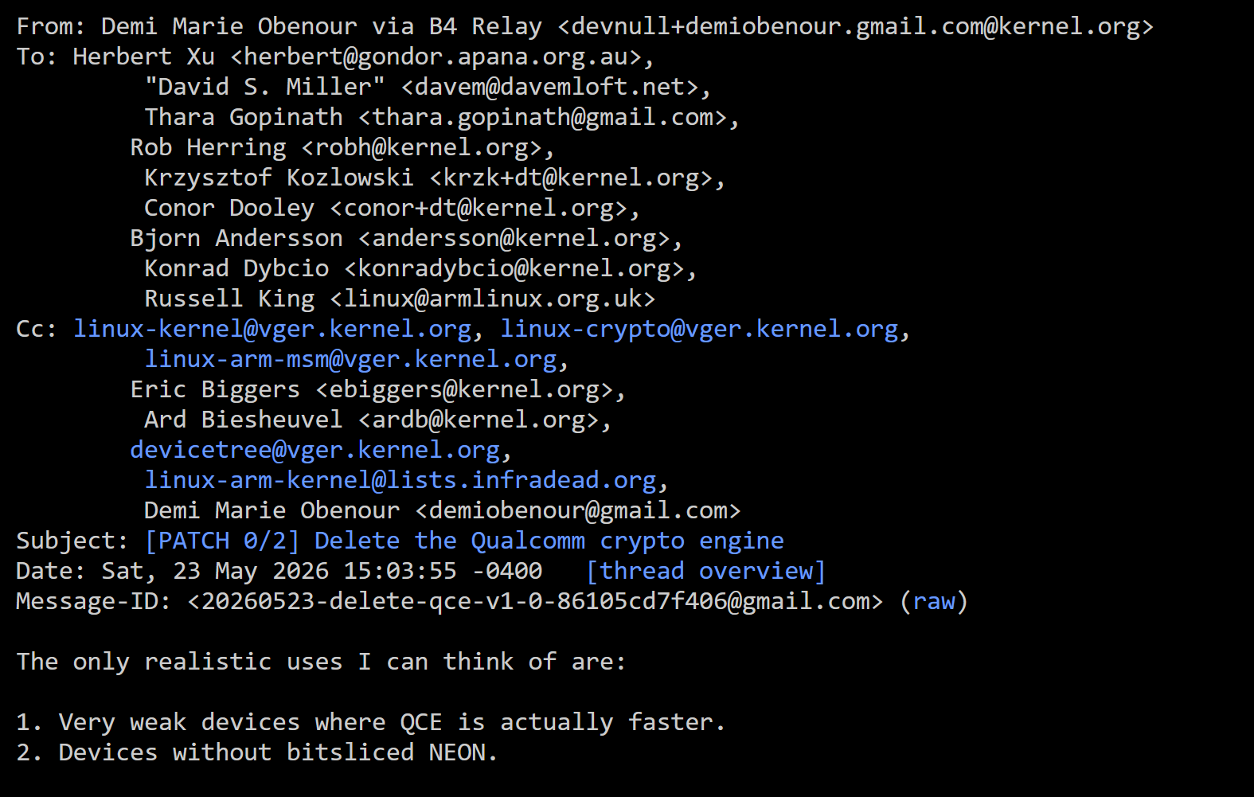
Start of extinction
Qualcomm QCE driver proposed to be removed
May 2026

Slide 22
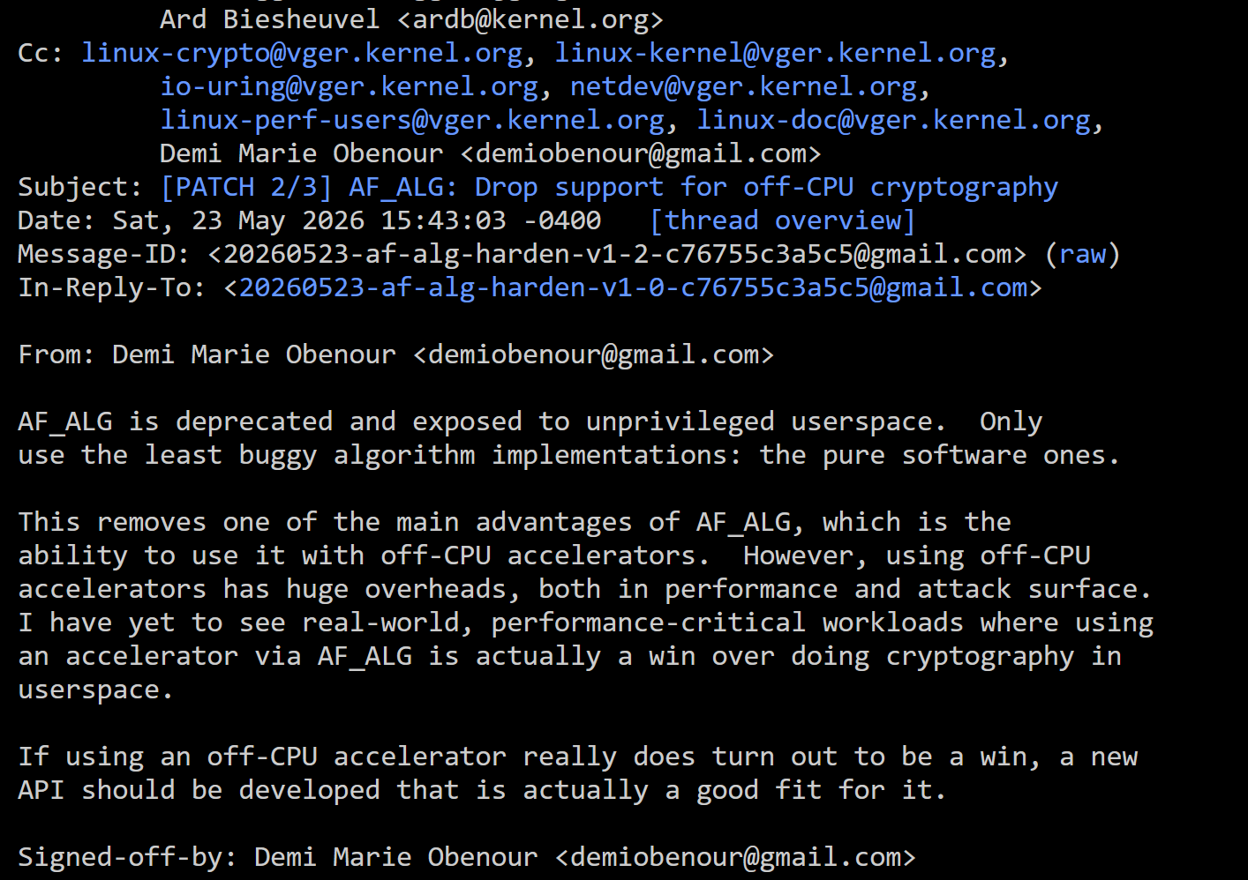
Start of extinction
AF_ALG removed support for hardware engines
May 2026

Slide 23
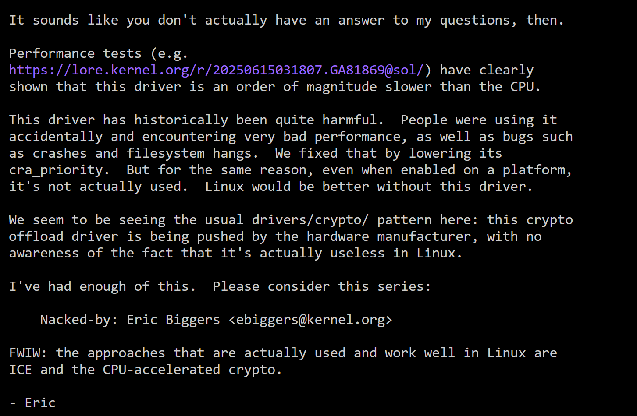
Start of extinction
Qualcomm qcrypto on shikra Nacked directly
May 2026

Slide 24
Can we do something about this?
Maintain the drivers (keep your driver bug free)
Contribute to the framework, don’t branch out
Actively test your drivers via KernelCI (or any means possible)
Make the maintainers job easy (and they’ll make your job easy)
Be active on the mailing list, let your voice be heard
Understand the threat modelling of your device and put out the specific use cases
Make sure to put the security relevant documentation out in public
Understand the level of security certification that your clients need
Fight Back!!!

Slide 25
Finding Common Ground: A Path Forward
What Should Be Removable
What Needs Separate Evaluation
Performance-only drivers slower than software
Drivers with unresolved correctness bugs
Unmaintained code - no responsive maintainer
Drivers failing crypto self-tests
We agree on raising the bar for driver quality
Drivers with documented DPA/EMA resistance
Hardware key isolation (TrustZone provisioning)
Certification-path hardware (FIPS / IEC / ISO)
PQC-capable engines in next-gen SoCs
Concrete Asks To The Community
Define a 'security hardware' driver class: documenting DPA resistance and key isolation as qualifying properties
Security review before removal: Mandatory security@ CC for any async crypto removal targeting drivers with security properties
Establish CI path for hardware drivers
Extend blk-crypto wrapped key model to non-storage offload

Slide 26
References
[1] https://lore.kernel.org/all/20250708181313.66961-2-ebiggers@kernel.org/
[2] https://lore.kernel.org/all/20250704070322.20692-1-ebiggers@kernel.org/
[3] https://lore.kernel.org/linux-fscrypt/20250613144239.GA1287@sol/
[4] https://lore.kernel.org/all/20250618175847.GA1639822@google.com/
[5] https://lore.kernel.org/all/20260523-delete-qce-v1-0-86105cd7f406@gmail.com/
[6] https://lore.kernel.org/all/20260515-shikra_qcrypto-v1-0-80f07b345c29@oss.qualcomm.com/
[7] https://lore.kernel.org/linux-crypto/20250929194648.145585-1-ebiggers@kernel.org/
[8] https://lore.kernel.org/linux-crypto/20260523-af-alg-harden-v1-2-c76755c3a5c5@gmail.com/
[9] https://lore.kernel.org/linux-crypto/CAOtvUMf3r0oT6w=mgQyykX_RHDDmebm_q-TqV61jSmo5x0bweQ@mail.gmail.com/
[L40] — AES-CE <1 cpb, NEON ~25 cpb, bit-sliced ~20 cpb
Ard Biesheuvel, Dec 2017
https://lore.kernel.org/all/CAKv+Gu9e+JWKeHPpgudsJbNPh1sczPBr5SX1jm7h_wmqQ6NPVw@mail.gmail.com/
[L44] — AES-GCM 58→29 cpb on A53; NEON GHASH 4× faster than table
Ard Biesheuvel, Jul 2017
https://lore.kernel.org/linux-crypto/20170724102820.16534-17-ard.biesheuvel@linaro.org/
[L45] — AES-GCM 3.5→2.6 cpb on A57 (+37%); benchmark data included
Ard Biesheuvel, Jun 2017
https://lore.kernel.org/linux-crypto/CAKv+Gu8oefmV9iWWgno_oFB_ts9EPy3o=po5owVxca+f3M_ZLQ@mail.gmail.com/
Notes:
Inclusive terminology : review entire presentation.

Slide 27
References
[1] “[PATCH 1/3] fscrypt: Don't use asynchronous CryptoAPI algorithms”
https://lore.kernel.org/all/20250708181313.66961-2-ebiggers@kernel.org/ [Jul 2025]
[2] “[PATCH v3] fscrypt: Don't use problematic non-inline crypto engines”
https://lore.kernel.org/all/20250704070322.20692-1-ebiggers@kernel.org/ [Jul 2025]
[3] “Re: [PATCH] fscrypt: don't use hardware offload Crypto API drivers”
https://lore.kernel.org/linux-fscrypt/20250613144239.GA1287@sol/ [Jun 2025]
[4] “Re: [PATCH v5 0/2] Add support for Texas Instruments DTHE V2 crypto accelerator”
https://lore.kernel.org/all/20250618175847.GA1639822@google.com/ [Jun 2025]
[5] “[PATCH 0/2] Delete the Qualcomm crypto engine”
https://lore.kernel.org/all/20260523-delete-qce-v1-0-86105cd7f406@gmail.com/ [May 2026]
[6] “[PATCH 0/3] Add support for qcrypto on shikra”
https://lore.kernel.org/all/20260515-shikra_qcrypto-v1-0-80f07b345c29@oss.qualcomm.com/ [May 2026]
[7] “[PATCH iproute2-next v2] lib/bpf_legacy: Use userspace SHA-1 code instead of AF_ALG”
https://lore.kernel.org/linux-crypto/20250929194648.145585-1-ebiggers@kernel.org/ [Sep 2025]
[8] “[PATCH 2/3] AF_ALG: Drop support for off-CPU cryptography”
https://lore.kernel.org/linux-crypto/20260523-af-alg-harden-v1-2-c76755c3a5c5@gmail.com/ [May 2026]
Notes:
Inclusive terminology : review entire presentation.

Slide 28
References
[9] “Re: Qualcomm Crypto Engine performance numbers on mainline kernel”
https://lore.kernel.org/linux-crypto/CAOtvUMf3r0oT6w=mgQyykX_RHDDmebm_q-TqV61jSmo5x0bweQ@mail.gmail.com/ [Jun 2021]
[10] Ard Biesheuvel. AES-CE <1 cpb, NEON ~25 cpb, bit-sliced ~20 cpb
https://lore.kernel.org/all/CAKv+Gu9e+JWKeHPpgudsJbNPh1sczPBr5SX1jm7h_wmqQ6NPVw@mail.gmail.com/ [Dec 2017]
[11] Ard Biesheuvel. AES-GCM 58→29 cpb on A53; NEON GHASH 4× faster than table
https://lore.kernel.org/linux-crypto/20170724102820.16534-17-ard.biesheuvel@linaro.org/ [Jul 2017]
[12] Ard Biesheuvel. AES-GCM 3.5→2.6 cpb on A57 (+37%); benchmark data included
https://lore.kernel.org/linux-crypto/CAKv+Gu8oefmV9iWWgno_oFB_ts9EPy3o=po5owVxca+f3M_ZLQ@mail.gmail.com/ [Jun 2017]
Notes:
Inclusive terminology : review entire presentation.

Slide 29
Credits and Acknowledgement
Texas Instruments Inc.
The Linux Foundation.

Slide 30

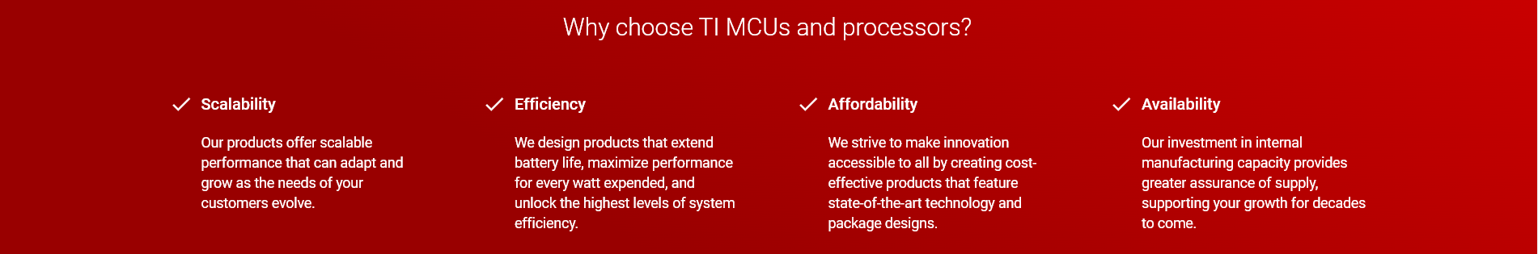
Q&A
Learn more about TI products
https://www.ti.com/linux
https://www.ti.com/processors
https://www.ti.com/edgeai
Contact Information:
  Kamlesh Gurudasani <kamlesh@ti.com>
  T Pratham <t-pratham@ti.com>

