Slide 1
The Containerization of the Operating System: Exploring BootC and the Future of Linux Deployment
Presenter: Hema Arun,
RHCA, Senior Linux Platform Engineer,
Emirates National Bank of Dubai

Slide 2
The Evolution of System Delivery
1990s: Package Managers (yum, apt)
Managed individual files.
Problem: Created "Snowflake" servers and configuration drift.
2000s: VM Templates (OVA, QCOW2)
Cloned entire disks.
Problem: Heavy, opaque, and hard to version-control.
2013: Application Containers (OCI/Docker)
Packaged apps with libraries. Light weight.
Problem: The app was modern, but the Host OS was still managed "the old way.“
Today: bootc (Bootable Containers)
The entire OS is an OCI image.
Result: The Host OS finally adopts application deployment semantics.

Slide 3

The Creators
The Lead: Colin Walters (Red Hat), maintainer of libostree and rpm-ostree.
Core Team: Developed by key engineers behind Fedora CoreOS and RHEL, including Dan Walsh and Stef Walter.
Home: A CNCF Sandbox project as of January 21, 2025, ensuring a vendor-neutral future for the technology.

Slide 4
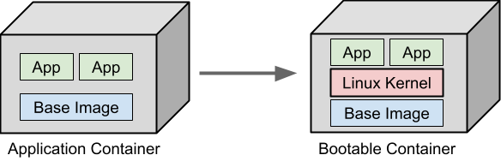
What is a BootC Image?
A specialized OCI image that includes the Linux kernel, initramfs, and bootloader configuration.
BootC is a service that runs on the host to bridge the gap between "container layers" and "disk partitions."

Slide 5
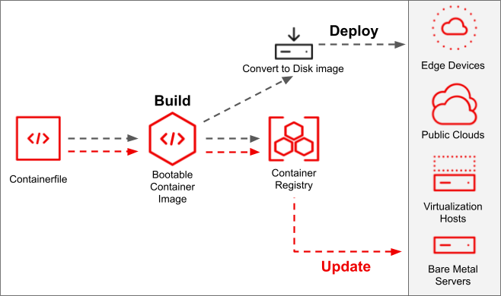
Why BootC and How?
Why:
Same tooling as Containers for OS
One source of truth – the container file and the image in registry
Immutable and low surface of attack
How:
Define in a Containerfile
Build Image
Push Image to Registry
Pull to Deploy
Boot to run

Slide 6
Demo
Build and Deploy
Convert to a Disk Image
Update
Roll back

Slide 7
Conclusion
Simplified Infrastructure: When consistency matters more than manual tweaking.
The Shift: From managing "servers" to managing "image lifecycles“.
Final Thought: bootc makes the operating system as portable and predictable as a hello-world container.
Getting started: Use Podman and test your Container images
Refer: https://github.com/bootc-dev/bootc https://bootc.dev/bootc

Slide 8
Thank You!

