Slide 1




Identity and
Access Management
for the Decade Ahead
Open Source Summit India - 2026

Slide 2




Thivaharan
Kalyanasundaram
Software Engineer
WSO2
Maintainer
ThunderID
thivaharan@wso2.com
linkedin.com/in/thivaharan-k

Slide 3
Everything in IAM Is Moving at Once
Identity is shifting on many fronts — scale, governance, privacy, lifecycle, etc. Two redraw the foundation: who holds an identity, and where its trust is anchored.
PAST
PRESENT
FUTURE
+ Machines & workloads
services, scripts, CI/CD
+ Autonomous AI agents
act & decide on their own
Entity type
who holds the identity
Humans
one identity per person
The network boundary
inside the firewall = trusted
Identity providers & federation
a shared IdP vouches
Portable verifiable credentials
proof travels with the identity
Trust model
where trust is anchored
Notes:
Three eras, four pillars. Past: one human, passwords, static roles, a network perimeter. Present: services and workloads, MFA and SSO, scoped tokens, cross-org federation. Future — the orange column, what this talk is about: AI agents as first-class identities, attested credentials, on-behalf-of delegation, and decentralized verifiable trust. The two acts are the top and bottom of that future column.

Slide 4
The Arc of This Talk
Each is a limit we long took for granted and the talk is built in two acts around them.
Identity Outgrows Humans
1
Act I. Identity stops being human-shaped. Every actor, not just humans, becomes a first-class principal with its own identity, scope, and audit trail.
Trust Outgrows the Provider
2
Act II. Trust no longer lives in a central provider. It travels with the identity itself, proven by a signed credential anyone can verify.
Notes:
Two moves, deliberately parallel — both 'identity outgrows X'. Move one: it outgrows the human — services, workloads, devices, agents all need first-class identity, agents being the sharp edge. Move two: it outgrows the provider — once trust must cross org boundaries, it has to travel with the identity, verifiable on its own. Same sentence shape lets me hand off cleanly from part one to part two.

Slide 5
01
Identity Outgrows Humans
The human is no longer at the center of identity and agents are its sharpest edge.

Slide 6
The Identity Imperative
144 : 1
97%
1 in 8
NHIs outnumber humans
in enterprises
of NHIs have
excessive privileges
breaches now involve
an agentic system
Sources: Entro Labs H1 2025 · Entro Security 2025 · CrowdStrike/Mandiant 2025–2026
Notes:
TRANSITION → next: The numbers and these breaches all point at one new actor. Before we can secure it, we need to be precise about what it actually is — so: what is an AI agent?

Slide 7





What Is an AI Agent?
More than a chatbot, an autonomous software entity that perceives, decides, and acts.
KEY CHARACTERISTICS
Autonomous Execution
Operates independently with varying degrees of human oversight
Core Agent
Tool Usage
Connects to databases, APIs, MCP servers, and external services
Memory
Learn from past interactions, maintain context across sessions, and execute multi-step tasks reliably.
Memory
Tools
Skills
Guardrails
Multi-Step Reasoning
Breaks complex tasks into sub-tasks, sometimes delegating to other agents
Powered by LLM / Foundation Model
Notes:
TRANSITION ← from Imperative: 'We just saw agents are everywhere and already being exploited. So let's define exactly what we're securing.'

Slide 8
Why Agents Must Be First-Class Identities
HOW AGENTS ARE MODELED TODAY
WHY FIRST-CLASS IDENTITY MATTERS
✓
Independent Accountability: Traceable identity with a liable owner for every action.
✕
As Users: No separate accountability or permission boundary.
✕
As Service Accounts: Shared static credentials with no link to a responsible human.
✓
Granular Permission Boundaries: Permissions scoped independently from the user.
✕
As Workloads: Lacks identity design for autonomous decision-making.
✓
Lifecycle Governance: Rotate or revoke agents without affecting human users.
✕
As Browser Extensions: Plugins with broad permissions, invisible to IAM systems.
✓
Delegation Transparency: Visibility into who delegated and who acted.

Slide 9



The Four Fundamentals of Agent IAM
A comprehensive framework for the complete lifecycle of AI agent identity and access management.
ADMINISTER
AUTHENTICATE
Identity Lifecycle
Secure Credentials
Agent IAM
AUTHORIZE
AUDIT
Access Control
Visibility & Compliance

Slide 10
The Unsecured View
Without IAM, every connection boundary is an open attack surface.
LLMs / AI Models
Internal Systems
No Auth
Databases, APIs
Knowledge Bases
MCP Servers
No Auth
Initiators
Users
Applications
Schedulers
No Auth
AI Agent
No Auth
External Services
Gmail, Slack
Salesforce, GitHub
No Auth
Sub-Agents

Slide 11
Step 1: Establish the Agent Identity
Every agent and sub-agent gets a unique, verifiable identity with a liable owner — the foundation for all security.
LLMs / AI Models
ADMINISTER
Internal Systems
Databases, APIs
Knowledge Bases
MCP Servers
Initiators
Users
Applications
Schedulers
Identity
AI Agent
External Services
Gmail, Slack
Salesforce, GitHub
Identity
Sub-Agents

Slide 12
Step 2: Secure Every Boundary
Authenticate, Authorize, and Audit at every connection — the Four Fundamentals applied to the architecture.
LLMs / AI Models
ADMINISTER
Internal Systems
Authenticate
Authorize
Audit
Databases, APIs
Knowledge Bases
MCP Servers
Authenticate
Authorize
Audit
Initiators
Users
Applications
Schedulers
Identity
Authenticate
Authorize
Audit
AI Agent
Authenticate
Authorize
Audit
External Services
Gmail, Slack
Salesforce, GitHub
Authenticate
Authorize
Audit
Identity
Sub-Agents

Slide 13
DEMO
An agent acting autonomously and on a user’s behalf
WayFinder chat agent's identity is securely managed on ThunderID.
ThunderID
scoped token
User
Agent
Tool / API
delegates
Acts on it's own or OBO, audited
1
AUTONOMOUS
Check flights
2
ON-BEHALF-OF
Book a flight
3
BLOCKED
Cancel booking
4
AUDITED
Every call traced
Agent uses its own assigned permissions, no user involved
User logs in & consents to a permission; agent books for the user
No consent for cancel_booking by user, the agent simply can’t
OBO Token carries subject (user) + actor (agent)

Slide 14
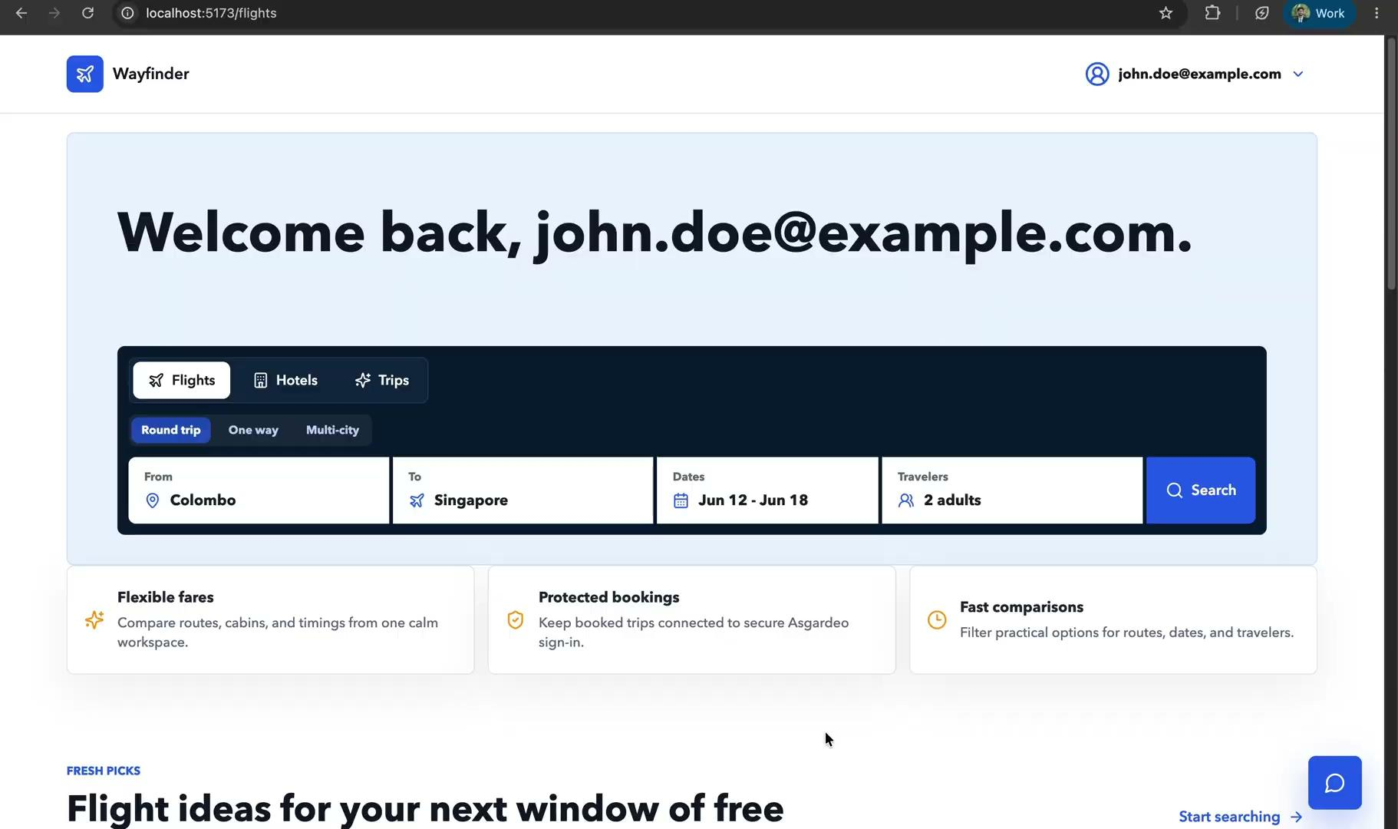

Slide 15
The Agent Reaches Beyond Your World
Everything so far works because it lives inside your organization, the agent and user have identities managed by a central, trusted IdP.
YOUR ORG
OTHER ORG
Agent
Your IdP
?
Their API
known · trusted
never heard of your agent or IdP
how do they trust it?
There's no shared IdP to call back to. The agent has to carry verifiable proof of who it is and what it may do, the same identity problem, one step beyond your walls.

Slide 16
02
Trust Outgrows the Provider
The second limit — trust that travels with the identity

Slide 17
When Centralized Trust Hits a Wall
Why let IdPs broker your identity, when you can hold it yourself?
FEDERATION TODAY
DECENTRALIZED
Org A
Issuer
VC
Org B
Org C
Org D
Verifier
Verifier
Verifier
✕
The IdP controls the identity data and mediates every login, it sees who, where, and controls the attributes released
✓
Holder controls the identity and discloses selectively, no central party sees the transaction
✕
Pre-registered — every relying party is registered with the IdP in advance, and the IdP must be live to mint a token at each login.
✓
Issued once, in advance — the issuer signs ahead of time for no specific verifier and isn't contacted when the credential is later presented.
Notes:
The wall in concrete terms. Today, cross-org trust means federation — every pair of orgs pre-negotiates a SAML or OIDC relationship. That's N-by-N, and it simply doesn't exist for an agent the other org never onboarded. Decentralized identity flips it: the holder carries one signed credential that any verifier can check on its own, with no prior relationship. That's what lets trust travel.

Slide 18
The Trust Triangle
Three roles, one signature: the issuer signs, the holder carries, the verifier checks, each connected only by the verifiable credential itself.
Issuer
trusts issuer's DID
Verifier
signs the claim
checks the signature
issues
presents
Holder
DID — resolves issuer's public key
Wallet — stores & presents the credential
keeps it in a wallet
Notes:
The model is a triangle. The issuer signs a claim; the holder keeps it in a wallet; the verifier checks the signature. What makes it work without a callback: the issuer's DID — a decentralized identifier the verifier resolves to a public key — the wallet that holds and presents credentials, and revocation so a compromised credential can be invalidated and checked. The verifier only needs the issuer's DID; it never calls the issuer live.

Slide 19
Step 1 — Issuing: An Org Signs a Credential
Way Finder signs a credential with a key whose public half is published as a DID. It signs once, in advance, for no specific verifier and isn't contacted when the credential is presented.
VERIFIABLE CREDENTIAL
Agent X, built by Way Finder
cleared for: billing.read
owned by: Y
valid until 2026-09-01
⎯⎯⎯⎯⎯⎯⎯⎯
✔ signed by Way Finder's DID
signs
issues
Way Finder · Issuer
Agent's Wallet · Holder
Signs the claims with its private key. Its public key lives in a DID anyone can resolve, no pairwise setup with each verifier.
Holds a self-contained proof. Carries it anywhere and reuses it across many verifiers.
ISSUED ONCE. Self-contained, reusable, verifier-agnostic.
Notes:
The model is a triangle. The issuer signs a claim; the holder keeps it in a wallet; the verifier checks the signature. What makes it work without a callback: the issuer's DID — a decentralized identifier the verifier resolves to a public key — the wallet that holds and presents credentials, and revocation so a compromised credential can be invalidated and checked. The verifier only needs the issuer's DID; it never calls the issuer live.

Slide 20
Step 2 — Verifying: The Other Org Checks It
The agent crosses into a partner org and presents its credential with only selected attributes. The partner verifies it directly — no shared IdP, and no prior setup with your org or your agent.
PRESENTED · selective
✔ cleared for billing.read
✔ valid until 2026-09-01
✔ signed by Way Finder DID
⎯⎯⎯⎯⎯⎯⎯⎯
✕ internal config — hidden
✕ owner email — hidden
presents
verifies
Agent's Wallet · Holder
Partner Org · Verifier
Presents a self-contained proof with selectively-disclosed attributes.
Resolves Way Finder’s DID and verifies it via a shared trust registry.
VERIFIED LOCALLY. No login through a shared IdP, no pairwise setup.
Notes:
The model is a triangle. The issuer signs a claim; the holder keeps it in a wallet; the verifier checks the signature. What makes it work without a callback: the issuer's DID — a decentralized identifier the verifier resolves to a public key — the wallet that holds and presents credentials, and revocation so a compromised credential can be invalidated and checked. The verifier only needs the issuer's DID; it never calls the issuer live.

Slide 21
Two Aspects of One Bigger Picture
Agent identity and decentralized trust look like separate problems. They're two faces of the same thing: identity that has outgrown the human and the trust boundary.
ACT I
ACT II
When identities aren't human
When trust leaves your walls
Agents become first-class identities in their own right — modelled like any principal, not bolted on as an afterthought.
Trust goes portable — verifiable credentials prove a claim with no shared IdP and no callback.
ONE CONVERGED IDENTITY CORE
Same primitives underneath: identifiers, credentials, entitlements, claims, and audit.
Notes:
This is the convergence point — earned, not asserted. The two shifts we covered pull on the SAME core: agent identity needs principals, policy and audit; decentralized trust needs the same. Put them on ten disconnected tools and both fall apart. So they have to converge into one identity core — shared principals, consistent policy, one provable audit trail. That's the platform problem, and it's exactly what we're building toward.

Slide 22
The Need for Converged Identity Platforms
Agents and portable trust are just two aspects. They sit alongside everything modern IAM needs and the surface keeps growing.
Agent Identity
Decentralized Trust
Post-Quantum Readiness
Zero-Trust Access
First-class non-human principals
Portable verifiable credentials
Crypto-agility for the quantum era
Verify and audit every request, in real time
Identity Governance
Privileged Access
Directory
+ More Emerging
Lifecycle, joiners & leavers (IGA)
Just-in-time admin rights (PAM)
The system of record for identity of entities
New aspects keep arriving
Every discipline draws on the same foundation which is why fragmenting them across tools breaks down.
Notes:
This is the convergence point — earned, not asserted. The two shifts we covered pull on the SAME core: agent identity needs principals, policy and audit; decentralized trust needs the same. Put them on ten disconnected tools and both fall apart. So they have to converge into one identity core — shared principals, consistent policy, one provable audit trail. That's the platform problem, and it's exactly what we're building toward.

Slide 23
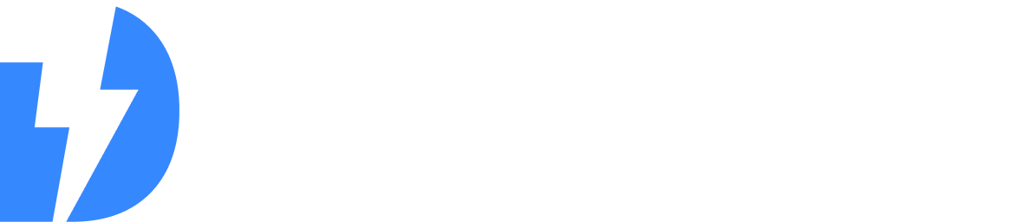
Lightweight, open-source IAM for humans, agents & machines.
Built for the next Decade
Agent-Native Identity
Decentralized Identity
AI agents as first-class identities — delegated authority, consent & traceability, with verifiable credentials issued to agents.
Issue, verify & trust DIDs, verifiable credentials, wallets & trust registries — bridging the relying-party gap.
Cloud-Native IAM
Post-Quantum-Safe
Lightweight, containerized runtime with declarative flows & config — built for automation, versioning & GitOps.
Crypto-agile foundation — algorithms, keys & token protection evolve, with PQ-safe & hybrid transitions built in.

Slide 24
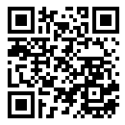

Try It Yourself
Join the Effort for the next Decade
Star us on GitHub
Fully open-source.
Contributions, partnerships, and critique are welcome.
Or visit thunderid.dev
ThunderID will be contributed to
Hosted at the Linux Foundation EU

Slide 25
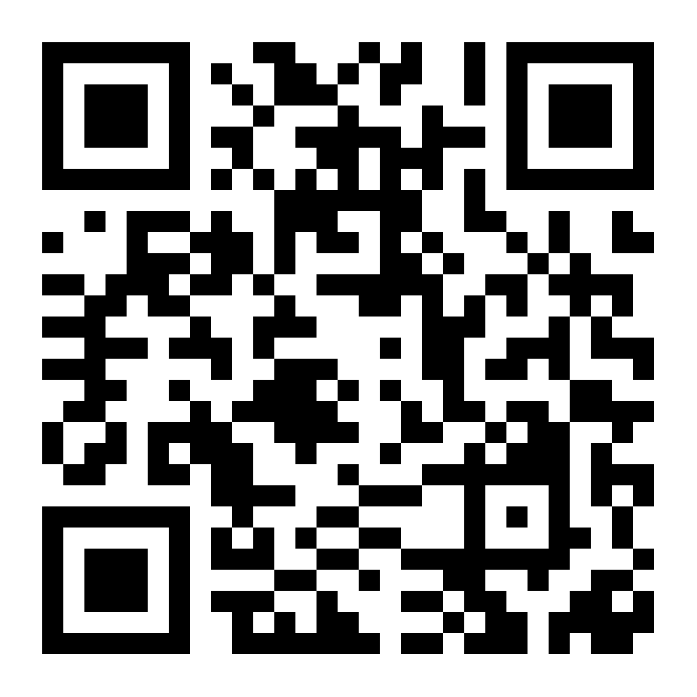
Thank You!
Questions & Discussion
thivaharan@wso2.com
linkedin.com/in/thivaharan-k
Notes:
Built for Agents. Ready for Quantum. Lightning fast. Open by design.

