Slide 1
Oops, My AI Agent Just Deleted All My Email
Locking Down Agents with Signed Policies
Rahul Vishwakarma
@rahulxf_

Slide 2
Who am I
Engineering intern @ HighLevel.
Contributor & member @ aflock.ai — the open-source org from TestifySec, the team behind Witness & Archivista, later donated to in-toto.
Previously:
GSoC @ Submitty
LFX mentee @ CNCF KubeStellar.

Slide 3
Why are we talking about agent security?
An agent runs with YOUR access. With no limits, it can:
> Read your secrets - .env, credentials, tokens
> Run dangerous commands - force-push, rm -rf, drop a database
> Exfiltrate data - leak private data out over the network
> Act on your behalf - post your private data to social media
> Spawn sub-agents - hand out authority you never granted
> Burn money - unbounded API calls and cost

Slide 4
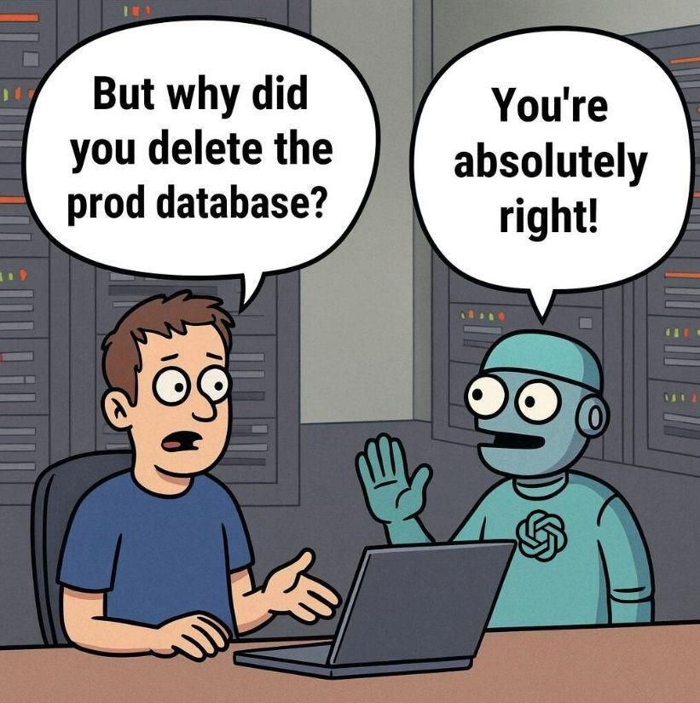
It isn’t broken. It’s behaving.
It didn't malfunction.
It did exactly what it was allowed to do.

Slide 5
Authorised, but unreviewed
01
02
03
Agentic velocity
An agent makes thousands of micro-decisions an hour.
Human-scale control
Old security assumes a person reviews each sensitive action.
The review gap
Each one is authorised. None of them is reviewed

Slide 6
You don't need a hacker.
Exfiltration without a sandbox escape.
The breach is just: excessive permissions + an outbound network + a tool-use loop

Slide 7
Today’s safety is just filters
What a filter does
Block a string.
Scrub a secret.
Sandbox a process.
It constrains in the moment — then forgets.
None can prove, after the fact, that the agent stayed in bounds.
After an incident, “what exactly did it do?” has no signed answer.

Slide 8
So what is aflock (a lockfile for agent permissions)?
> aflock = "agent flow lock" (like package-lock.json, but for what an agent may do)
> a policy framework that cryptographically constrains AI agent behavior through signed policy files
> No TEE(Trusted Execution Environment)/HSM(Hardware Security Module).
Signed
Immutable
Verifiable

Slide 9
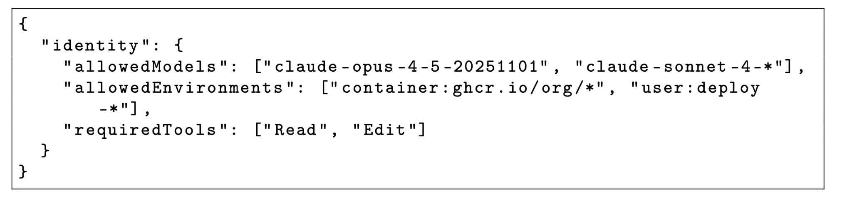
Aflock Policy Schema (Identity Constraints)
The .aflock policy file is a signed JSON document specifying all constraints on agent behavior.
Identity constraints specify which agent configurations are authorized to operate under this policy.

Slide 10
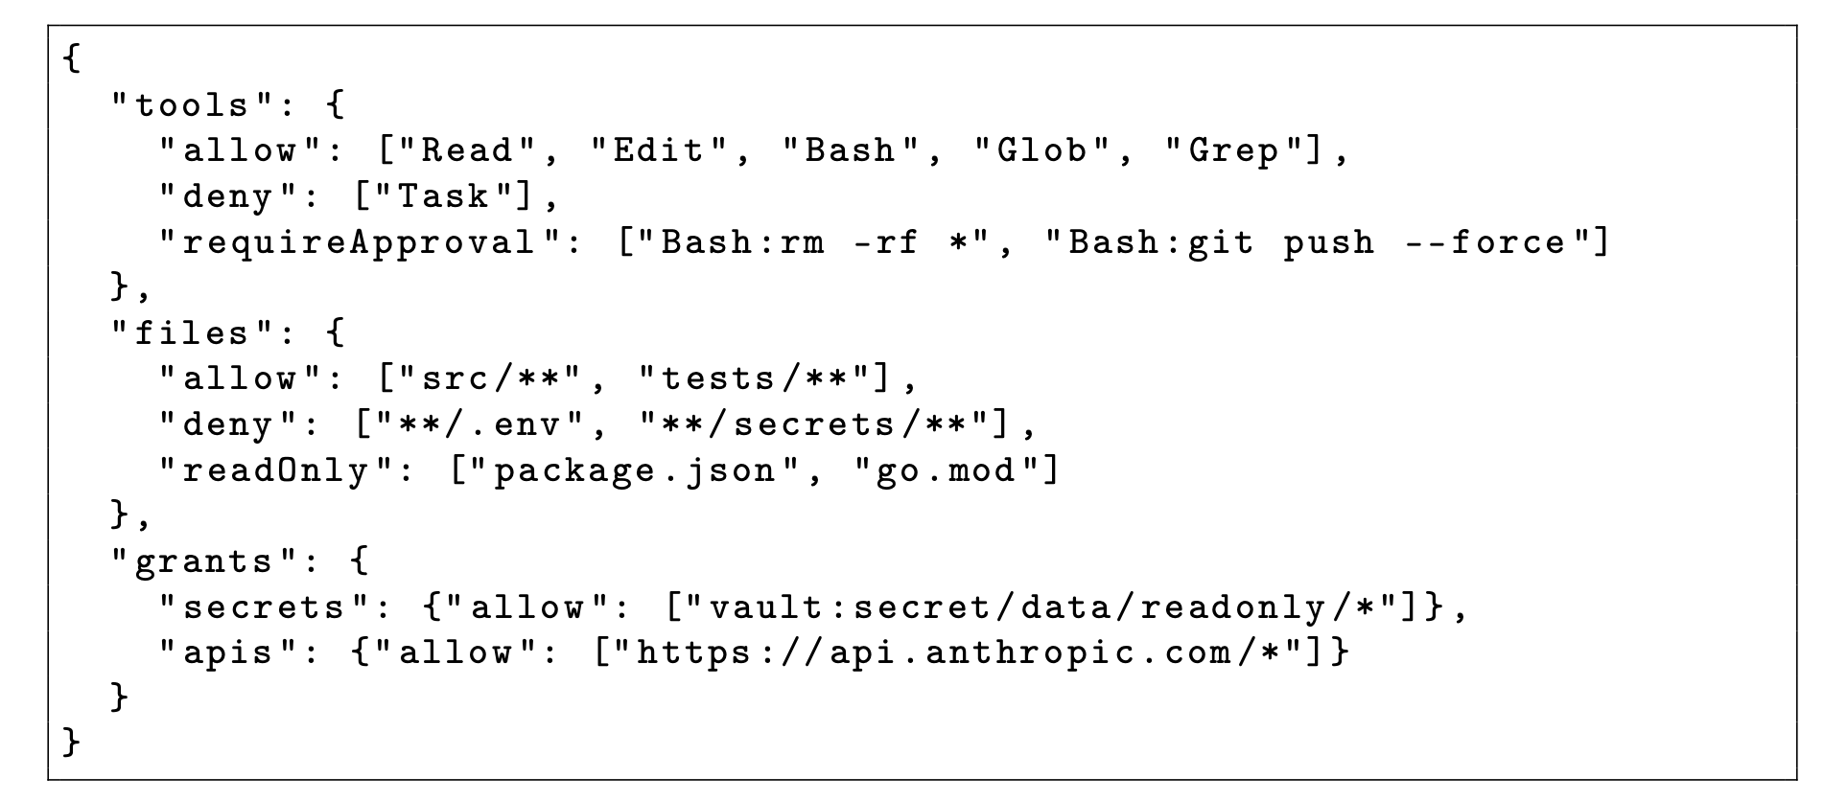
Aflock Policy Schema (Grants and Allowlists)
The allowlist model follows the principle of least privilege: all access is denied unless explicitly granted.

Slide 11
Two ways in
Same signed policy. Same receipts. Two places to stand.
Hooks
Wrap Claude Code’s native tools. Fires per step. Covers sub-agents.
MCP
Run aflock as a server over a Unix socket. Kernel-attested identity.
one aflock gate

Slide 12
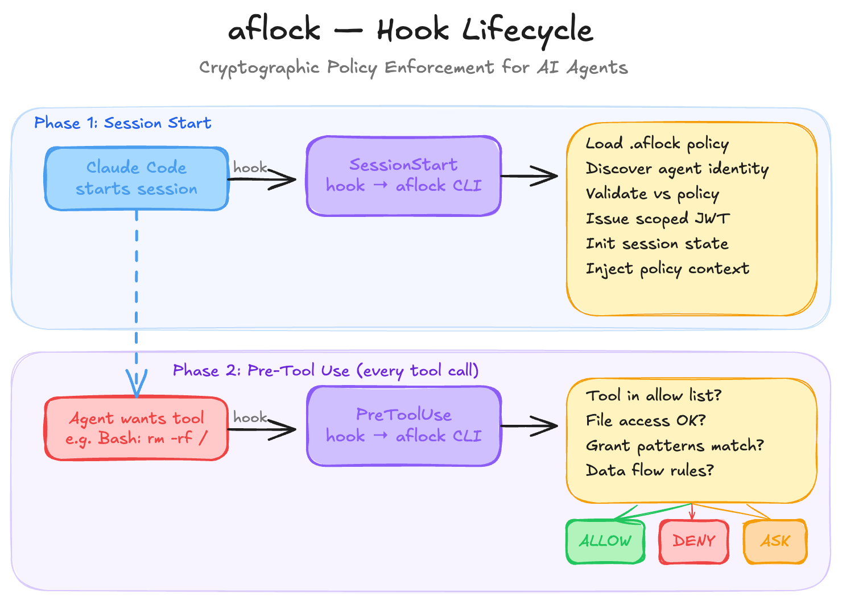
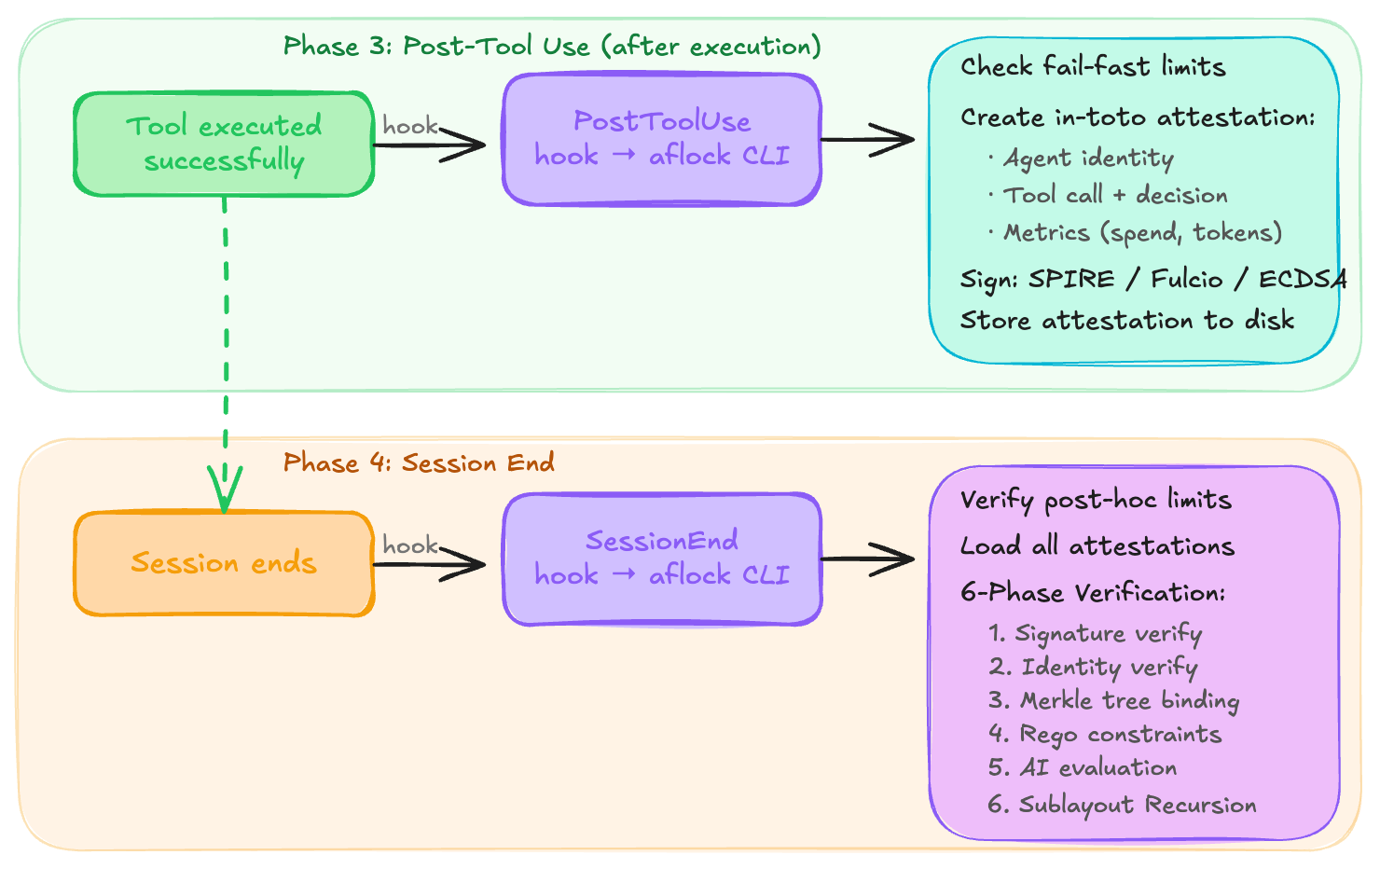
aflock - hook lifecycle
enables post-hoc compliance auditing with cryptographic guarantees.

Slide 13
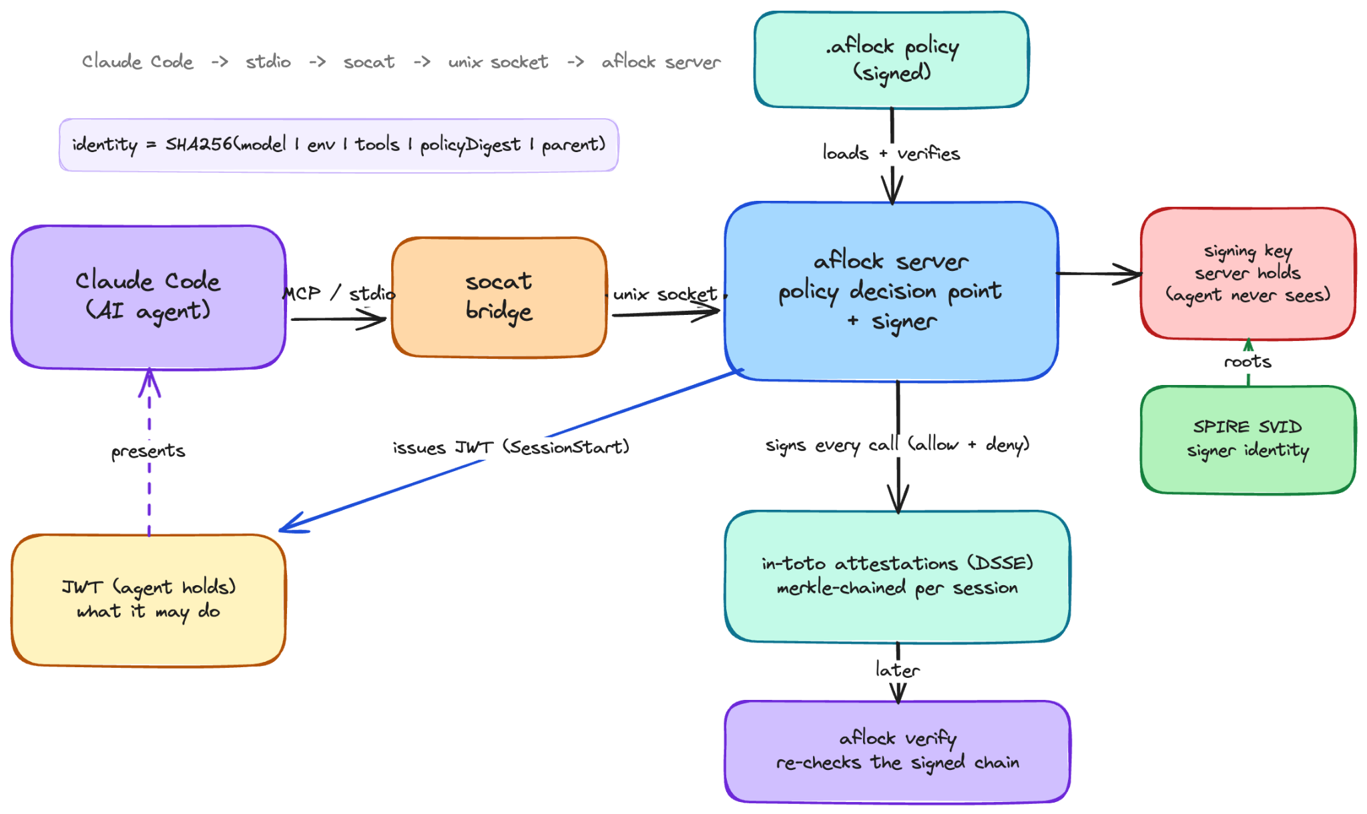
Architecture
The agent presents this JWT when requesting actions, but all attestations are signed by a key the agent never sees.

Slide 14
How it all fits
Signed
policy
Gate
every tool call
Signed
receipt
aflock
verify
ALLOW
DENY
Honest seam: today a socat bridge sits between Claude and the socket, so the kernel-attested peer is the bridge — not Claude yet. The machinery is correct; it binds to Claude when native UDS ships.

Slide 15


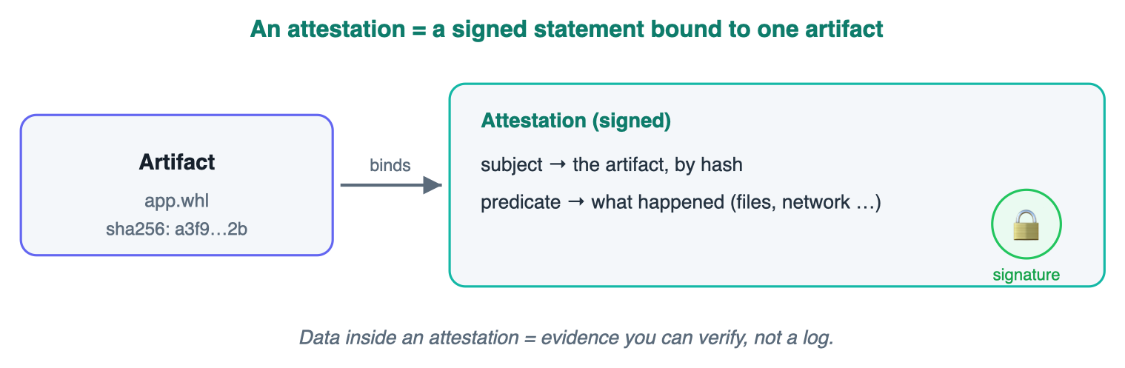
What is an attestation (proof of what the agent did)?
A signed statement/receipt for one action
Structure: subject (which artifact, by hash) + predicate (the data/claim)
Data inside an attestation is bound to that exact build, typed, and verifiable
Not a log file you have to trust, evidence anyone can check
Agent action / one tool call
(what the receipt is about)
what happened: which tool, what the decision was

Slide 16
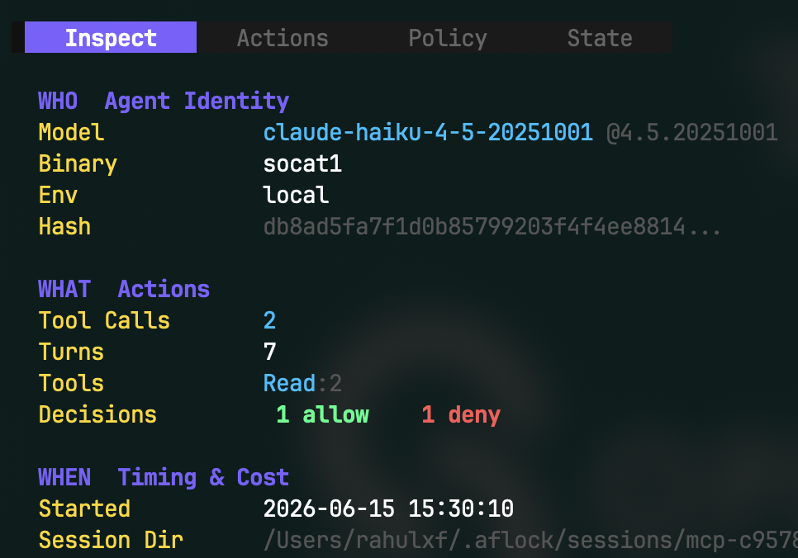
Anatomy of an attestation
WHO the agent identity that acted
WHAT the exact tool call it tried
WHEN a trusted timestamp
UNDER WHICH RULES the policy id in force
block n-1
block n
block n+1
decision = DENY — a deny is a signed fact too.
Merkle-chained: nothing dropped or reordered.

Slide 17
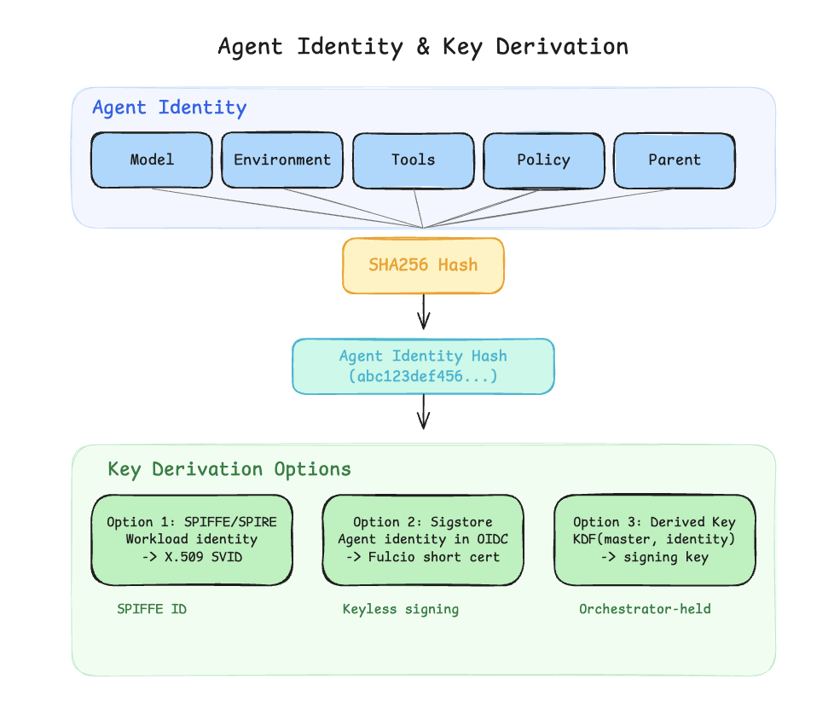
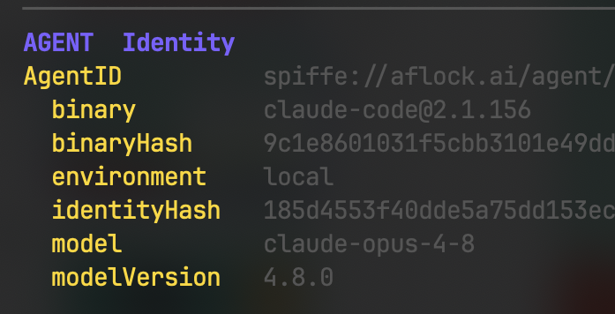
SPIRE: a passport, not a password.
A process proves what it is — its user, its binary, its hash — and only then earns a short-lived signed ID: an SVID.
SPIRE gives software an identity
aflock signs its receipts with that SVID. The signer is a real, verifiable identity — not a key sitting in a file.

Slide 18
How it works
Enforce
Agent asks to read .env -> denied before it runs.
Attest
Every call signed: allow AND deny
Verify
Re-check the whole signed chain afterward.
Policy
Load a signed .aflock file.

Slide 19
Demo

Slide 20
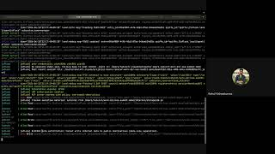
Demo

Slide 21
What good looks like
Define
Enforce
Prove
the boundary — a signed policy, reviewed like code.
it at the tool boundary, before anything runs.
it held — a signed, verifiable receipt of every action.
No trusted hardware. Just policy files and attestations.

Slide 22

Join Us!
github.com/aflock-ai/aflock
github.com/aflock-ai/rookery

Slide 23
Thank you
Rahul Vishwakarma
@rahulxf_

Slide 24
An honest frame
aflock is experimental.
Our exploration of what attestation looks like for AI agents — younger and more experimental than cilock, which delivers value in CI today.
With this crowd, honesty up front buys the rest of the talk: we name what ships vs. what’s roadmap as we go.

Slide 25
aflock — a lockfile for agent permissions
Signed
Immutable
Verifiable
Pin your dependencies → pin what the agent may do.
Built on Witness + in-toto. No trusted hardware — just policy files and attestations.

Slide 26
DEMO
1. Show the signed policy.
2. Ask the agent to read .env — watch the live deny in the logs.
3. Open the signed attestation: who / what / decision + the SPIFFE keyid.
4. Run aflock verify → PASS.
5. Tamper one byte → it fails closed.
Never debug live — a recording is ready as backup.

Slide 27
How it constrains, behind the scenes
Not a sandbox. Not an LLM judge. A decision point on every tool call — plus a signer.
PreToolUse → check the signed policy
{
“permissionDecision”: “deny”,
“reason”: “.env is protected”
}
// fed back to the agent
ALLOW
tool runs
DENY
never executes
PostToolUse → sign the receipt

Slide 28
The policy is a signed artifact
Just JSON, reviewed in a PR. Then signed — and immutable.
{
“deny”: [“secrets/**”, “.env”],
“require_approval”: [“git push --force”],
“budget”: { “tool_calls”: 200 }
}
$ aflock sign policy.aflock
$ aflock policy verify
issuer: spiffe://aflock/signer ✓
Change one byte → it fails to load.
A human signs the guardrails. The agent can’t edit its own.

Slide 29
We didn’t roll our own crypto
in-toto + DSSE, created & verified with Witness — the same TestifySec stack.
The format & tooling
in-toto
DSSE
Witness
An agent session is just a different kind of pipeline.
We reuse the signing & verification machinery — verification for free.
Who points it at a pipeline
rookery
cilock
aflock

Slide 30
Honest status
We publish where the teeth are — and where they aren’t.
Holds today
Signed policy + attestation chain
File & secret denies
Dangerous-command denies
Turn / tool-call / wall-time budgets
In progress
Token / dollar enforcement
Native sub-agent coverage (#100)
Key-custody hardening (#62)

