Slide 1
The Process of Exploration in AI Research
A Researcher’s Perspective
Bibekananda Hati
ExperQuick.org

Slide 2
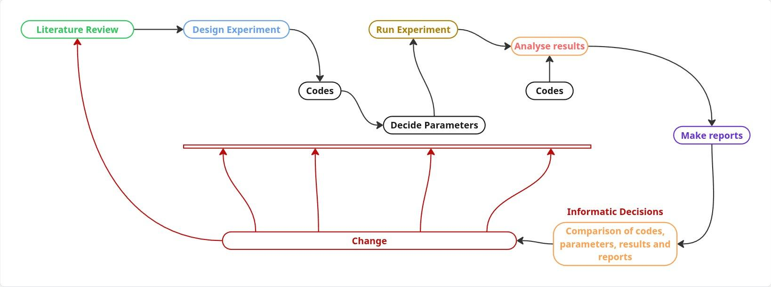
AI Research Process
AI research does not follow a fixed sequence of steps.
It is a continuous loop of exploration, failure, and refinement.

Slide 3
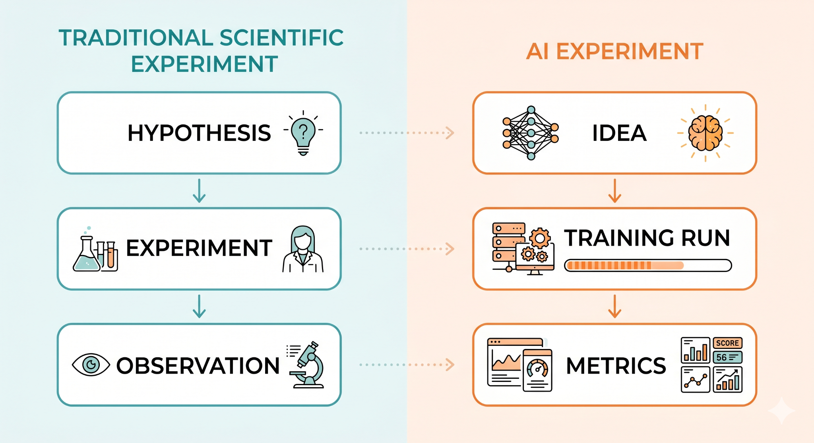
Understanding an Experiment

Slide 4
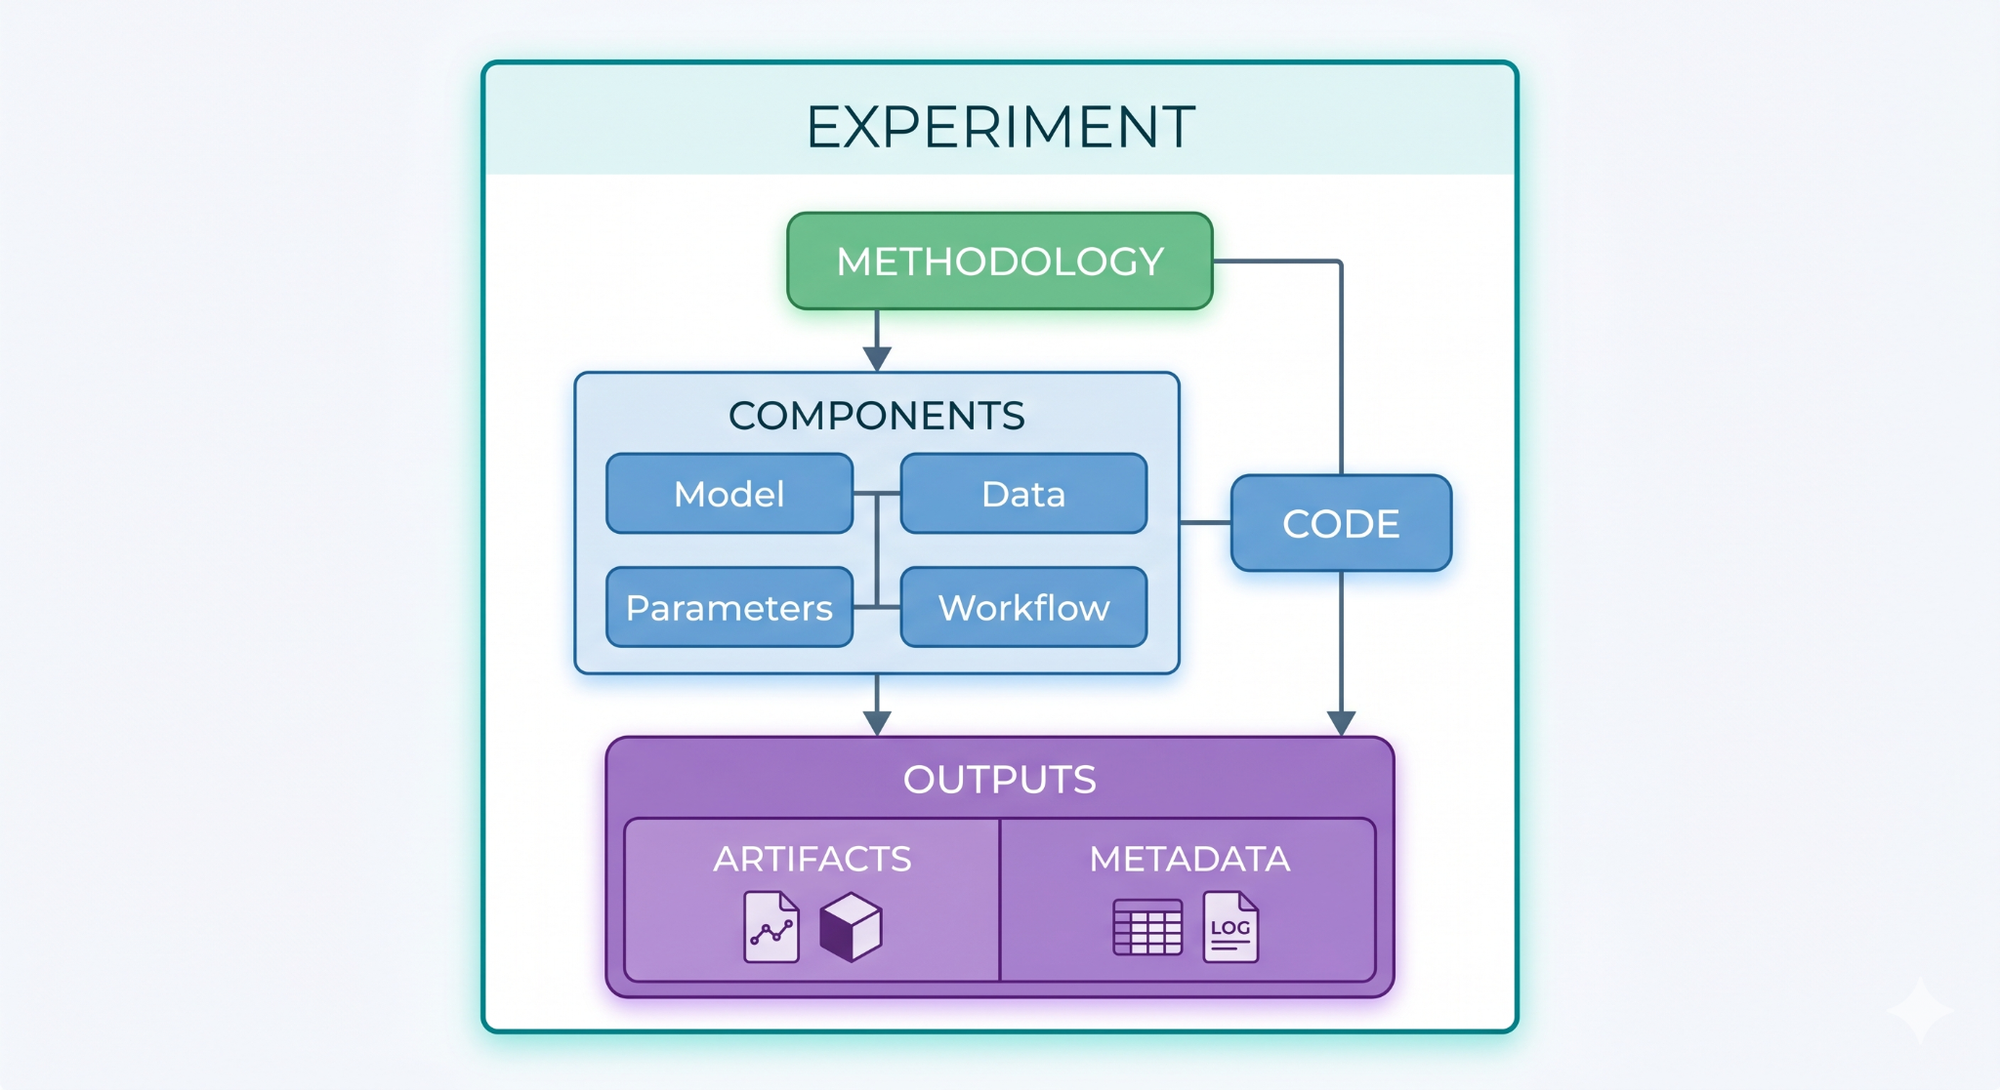
Zooming Into an Experiment

Slide 5
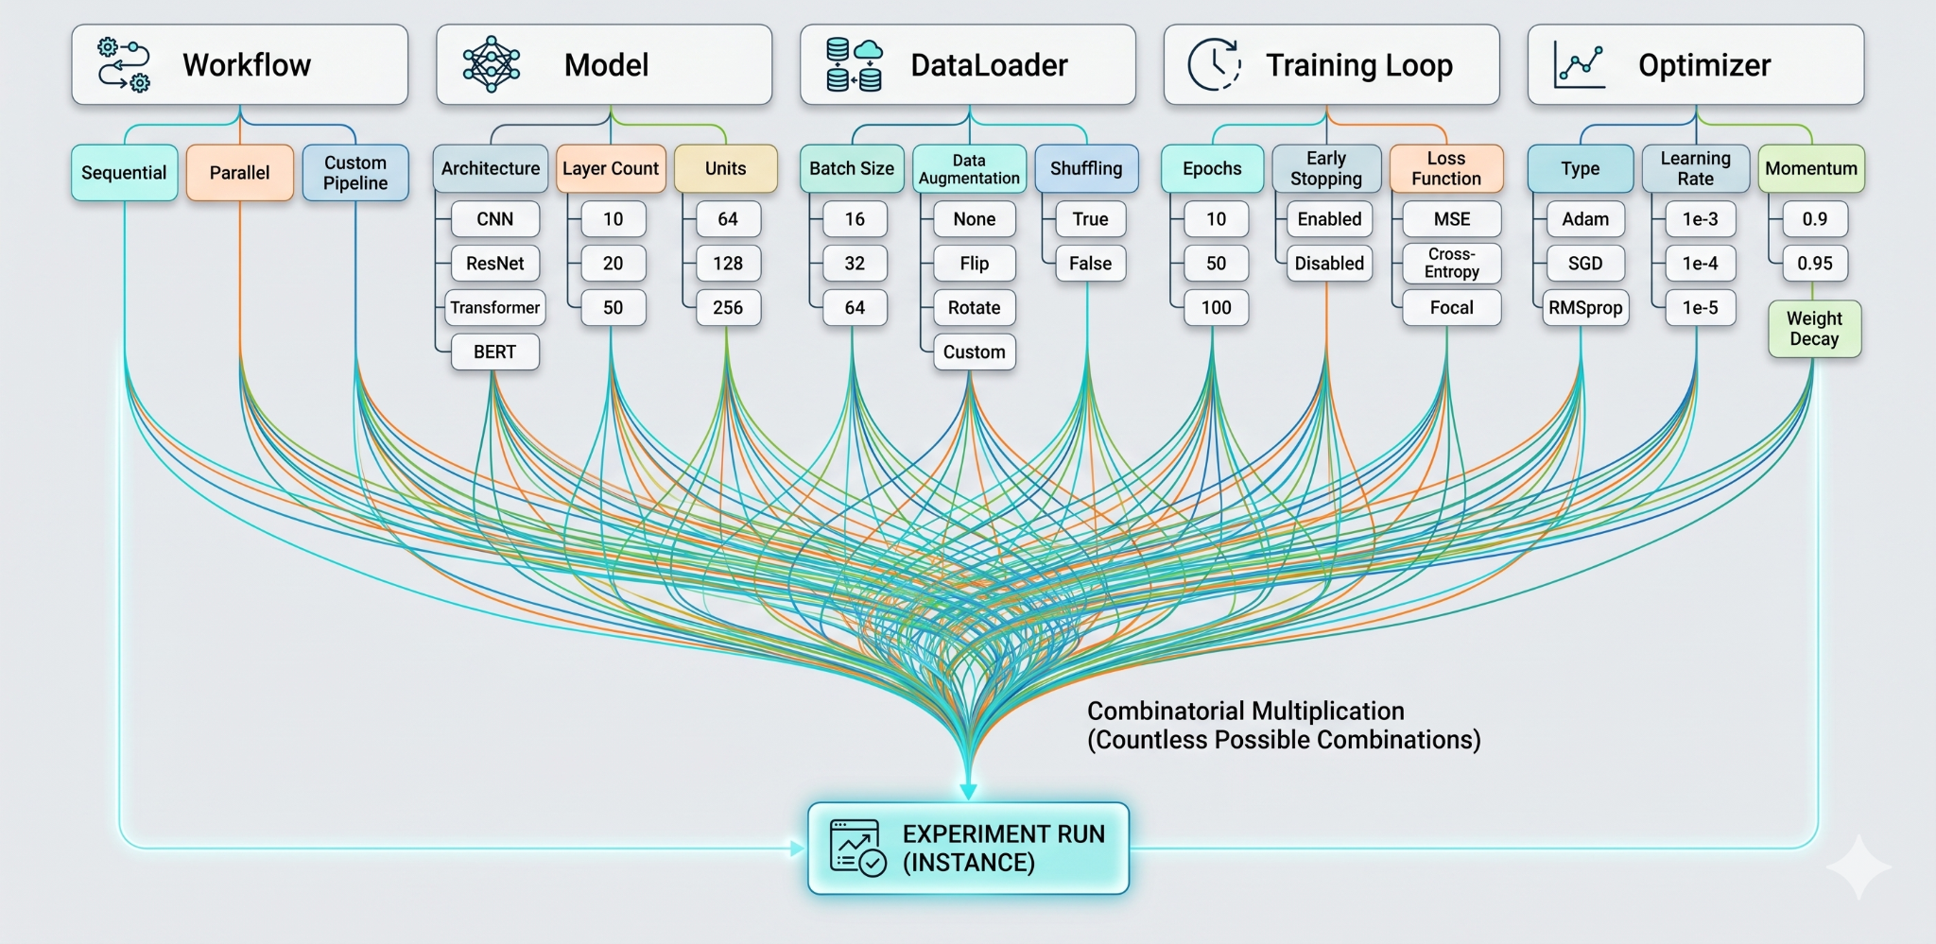
Components in an Experiment

Slide 6
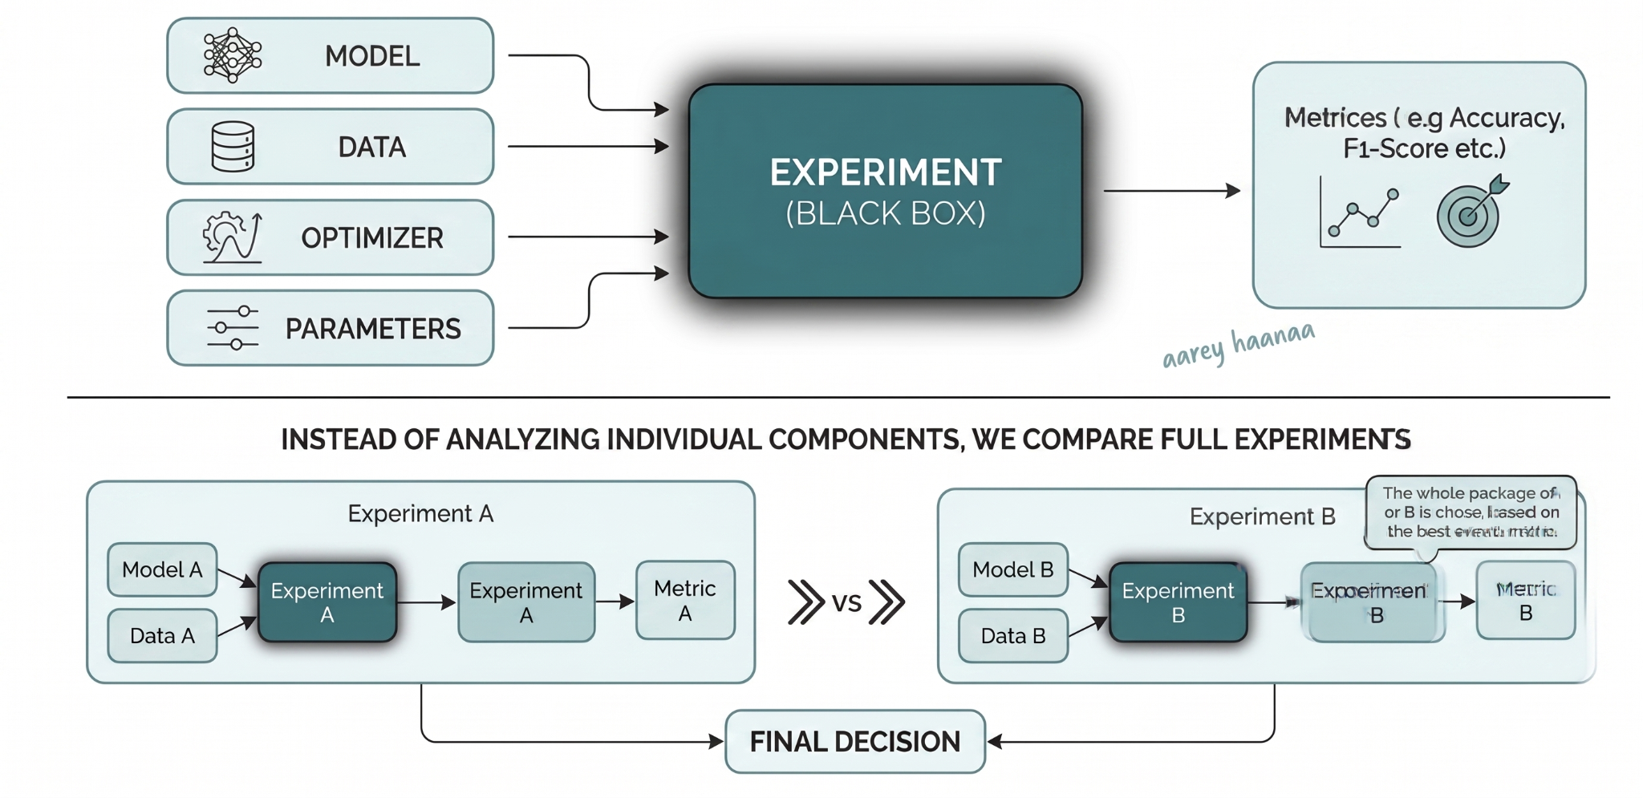
How Decisions Are Made

Slide 7
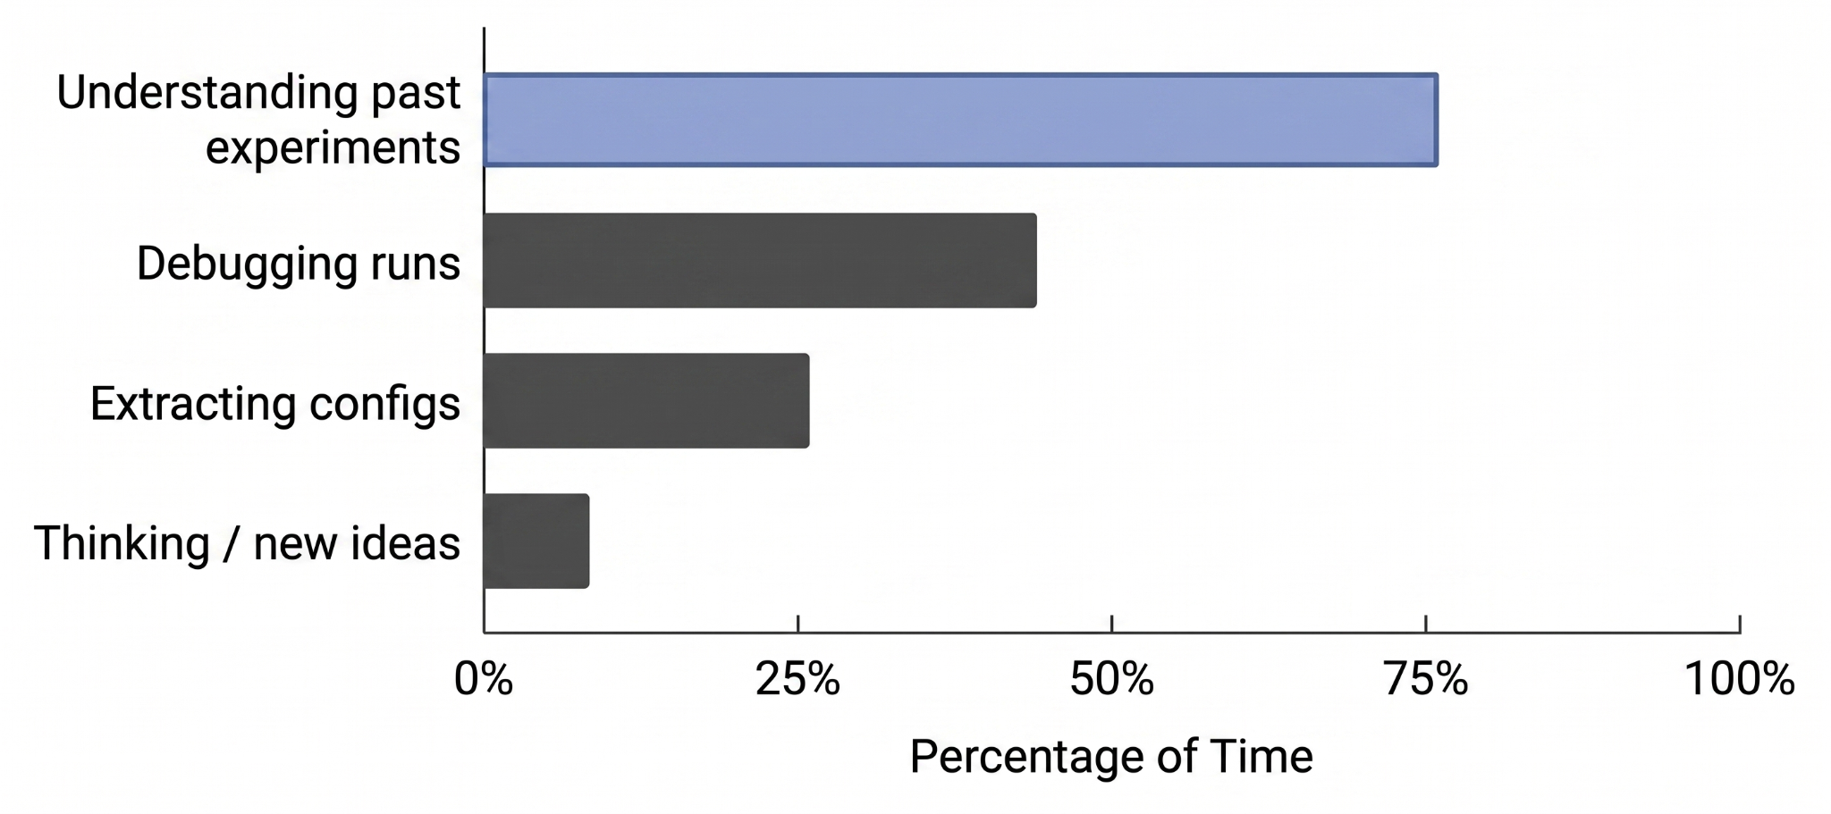
Where Actually Time Goes

Slide 8
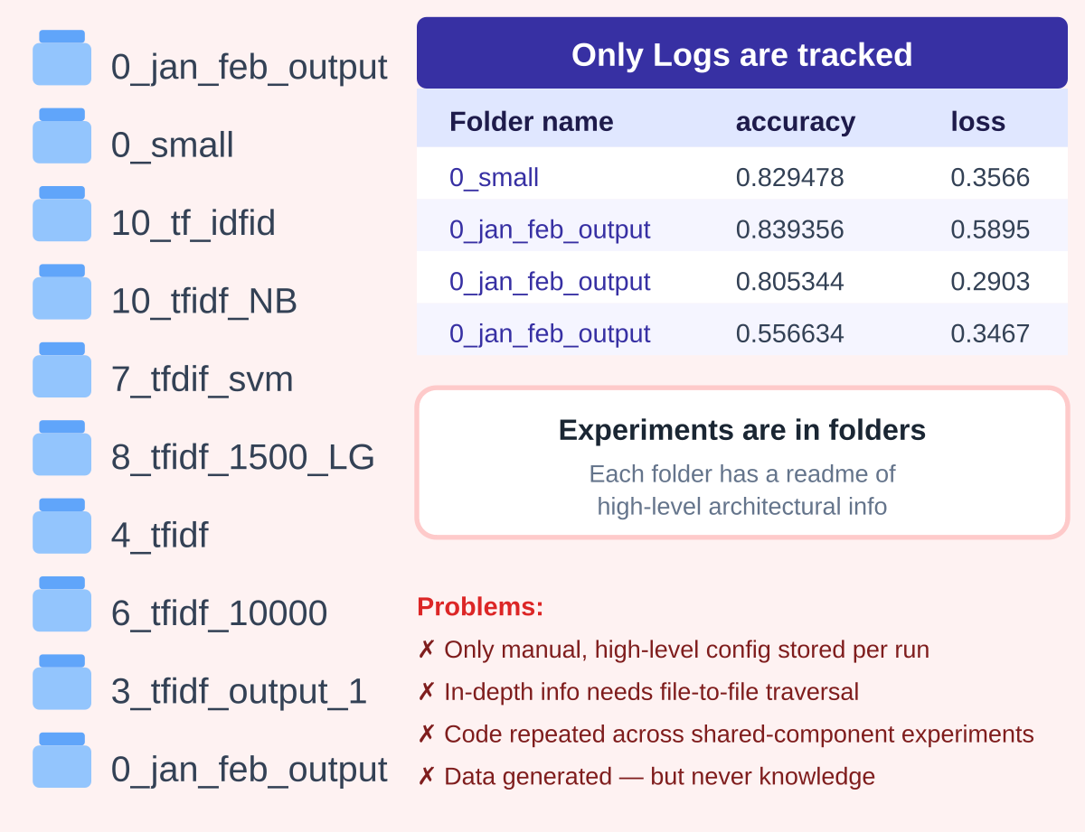
The Mess of Experimentation

Slide 9
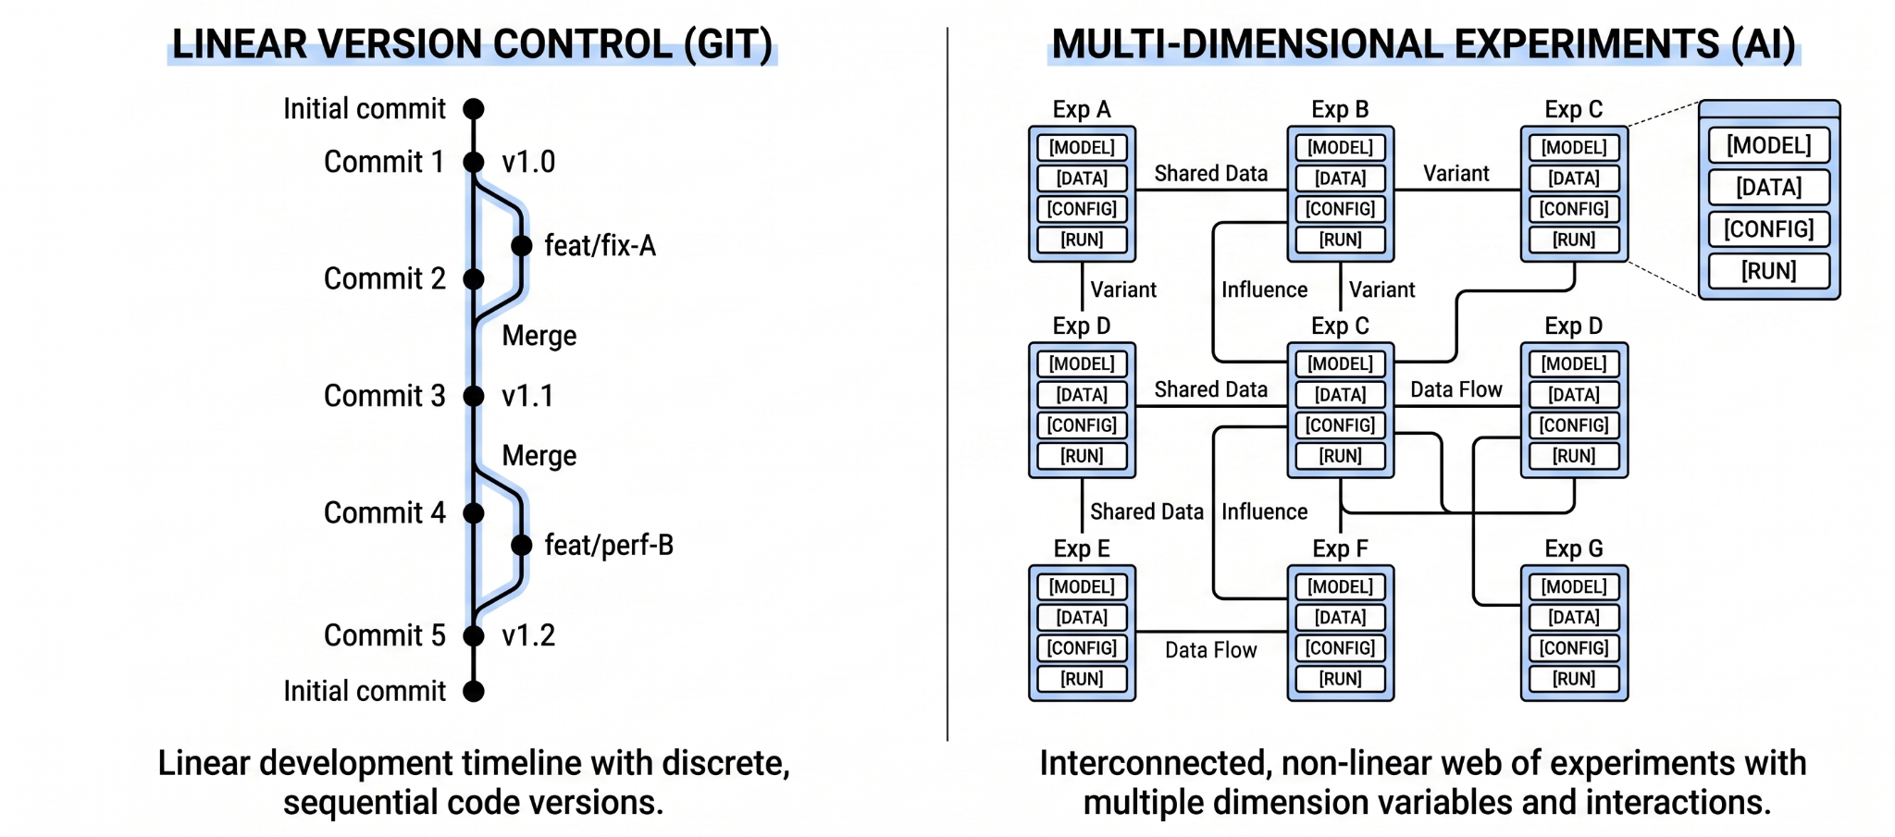
Why Git Fails To Solve The Mess

Slide 10
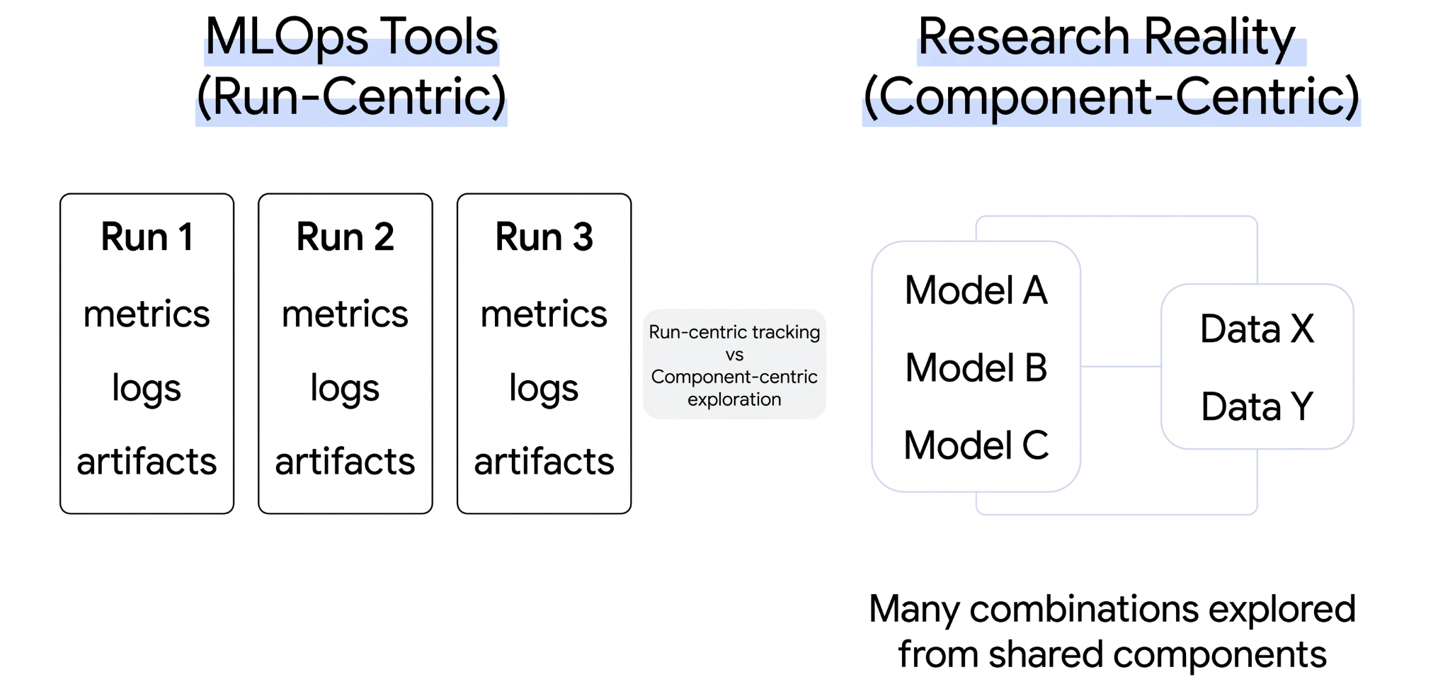
Why MLOps Tools Don’t Fully Solve It

Slide 11
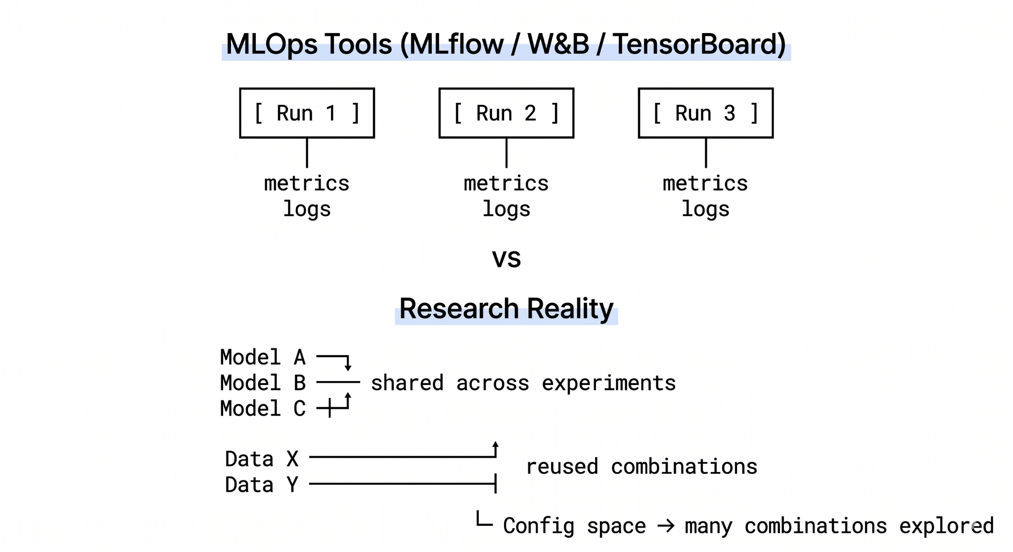
Why MLOps Tools Don’t Fully Solve It

Slide 12
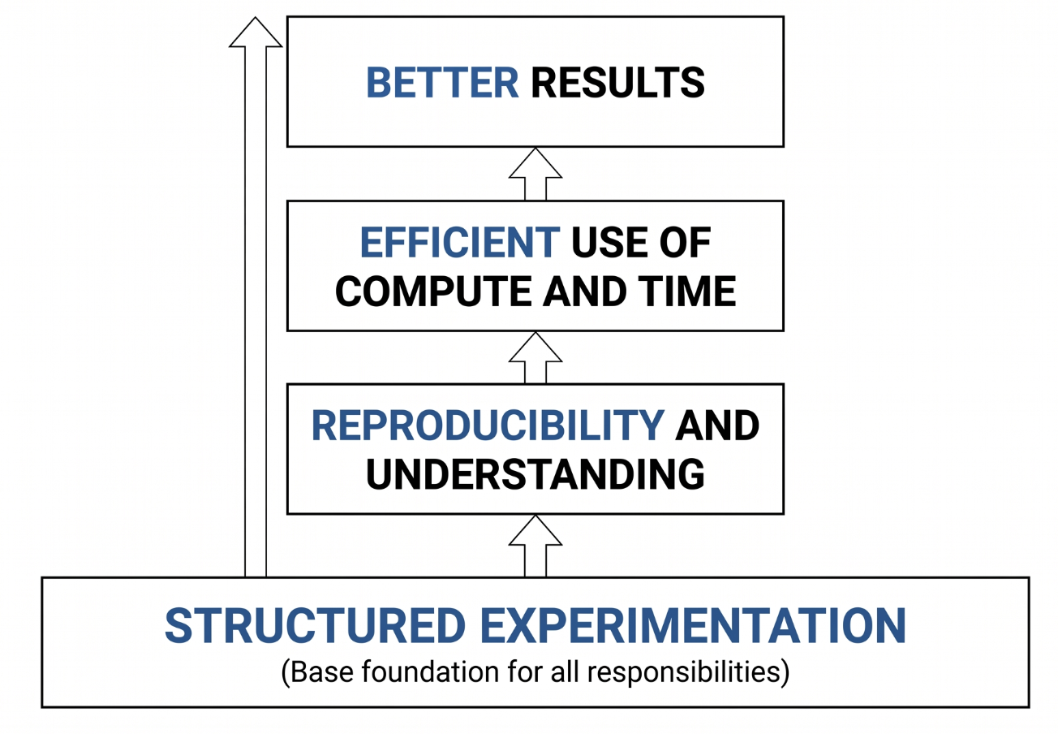
Researchers’ Responsibility

Slide 13
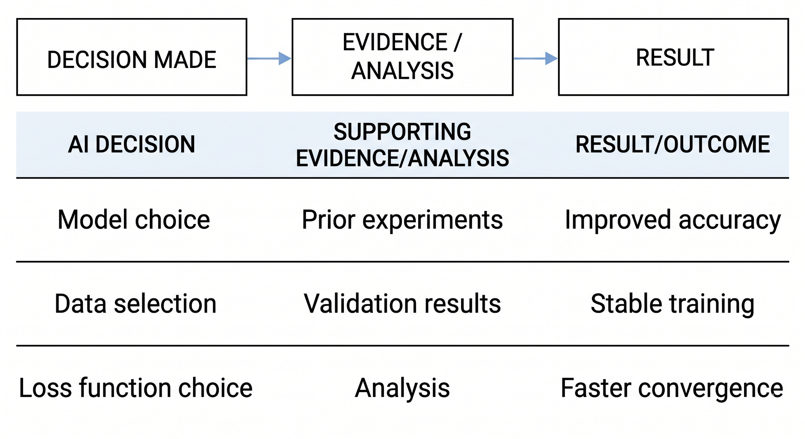
Tracking Decisions & Accountability

Slide 14
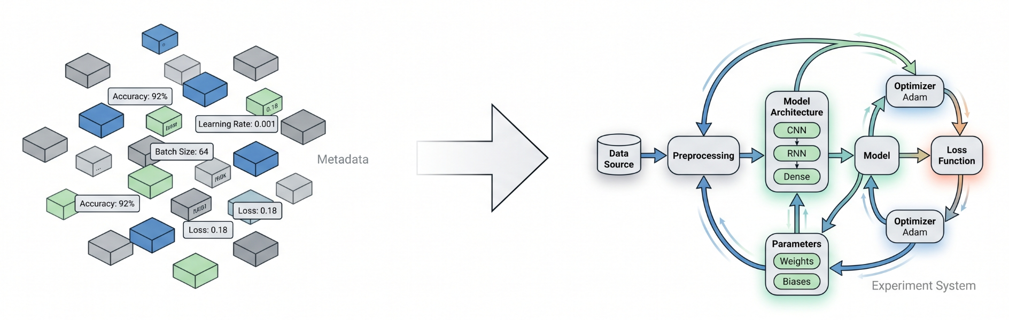
Experiment vs Its Metadata

Slide 15
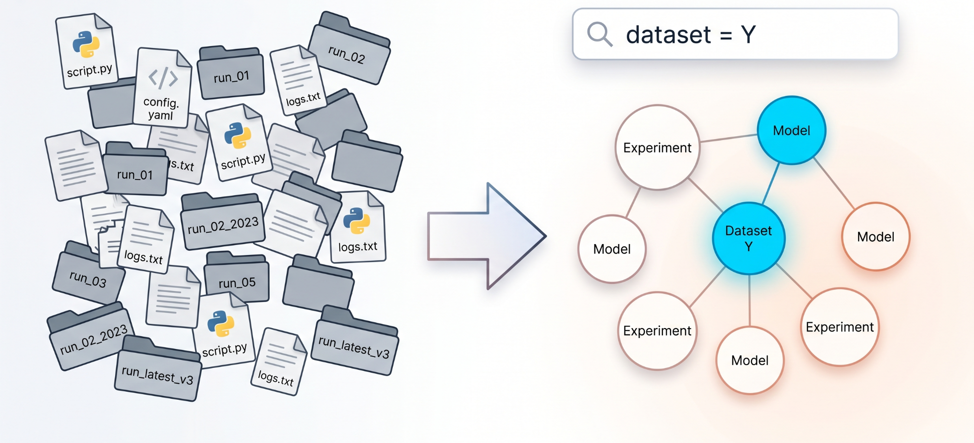
What If Experiments Were Queryable?

Slide 16
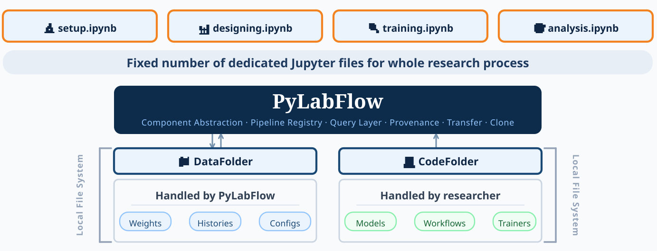
PyLabFlow: The Missing Structural Layer

Slide 17

About PyLabFlow
Open-source, Local-first, Domain-independent Python framework
For experiment management.
Developed by BBEK-Anand (ExperQuick)
Published Work:
PyTorchLabFlow: A Local-First Framework for Reproducible Deep Learning (Journal of Applied Bioanalysis, 2025)
GitHub.com/ExperQuick/PyLabFlow

Slide 18
THANK YOU
github.com/ExperQuick/PyLabFlow
ExperQuick.org/learn

