Slide 1
Userspace Reboot: Updating Linux Userspace at the Speed of a Service Restart
Nandakumar Raghavan, Linux Systems Group, Microsoft
Prasanna Kumar TSM, Linux Systems Group, Microsoft

Slide 2
Agenda
The problem with a normal reboot
What a soft reboot actually is
How it works, end to end
Live demo

Slide 3
A Normal Reboot Wastes Time on Things That Aren't Broken
shutdown → firmware POST → bootloader → kernel init → systemd → services
Firmware handshake, kernel decompression, hardware re-probe —
this is most of the wait
None of that has anything to do with userspace being broken or updated
If only your services need a clean slate... why redo all of it?

Slide 4
What Is a Soft Reboot?
shutdown → PID 1 relaunches itself → systemd → services
^^^^^^^^^^^^^^
this is the entire "reboot"
All services, daemons, and processes restart
The kernel never stops — same kernel, same modules, same hardware state
PID 1 comes back up as if it were a fresh boot, underneath nothing changed

Slide 5
Why It Matters
Benefits
Minimal-downtime OS updates
Much faster — no firmware, no bootloader
Clean recovery from a wedged userspace
Opt-in: sockets/connections can survive
Trade-offs
Doesn't apply kernel updates
Kernel/module/sysctl state carries over unchanged

Slide 6
How It Works — The Big Picture
trigger soft-reboot
→ stop all services gracefully (same as a normal shutdown)
→ save what we want to keep (state + a few chosen file descriptors)
→ force-kill anything left over
→ reset the console
→ (optional) point at a new root filesystem
→ PID 1 relaunches itself
→ new PID 1 loads the saved state back in
→ starts all services again
Every step here is something systemd already does for a normal shutdown.
The only new part is the last relaunch — instead of powering off.

Slide 7
The Core Trick: One Process Relaunches Itself
Every process on Linux can replace its own code and memory with a different program — while keeping the same process ID.
systemd asks the kernel to do exactly this to itself.
// what PID 1 does instead of powering off
replace_myself_with("systemd", options = [ "I am restarting after a switch",
"here is a handle to my saved state" ])
 | Before | After (same PID)
Code & memory | old | brand new
Kernel & hardware | — | untouched

Slide 8
What the Kernel Actually Changes on exec()
The syscall is execve() — the exact same one used to run ls.
Only the calling process's code and memory are replaced.
Destroyed:
All memory mappings — replaced with the new binary's
All other threads in the process — only the calling thread survives
Handlers for caught signals — reset to default
File descriptors marked close-on-exec (O_CLOEXEC)

Slide 9
Why PID 1 Can exec() Safely
The kernel gives PID 1 exactly one special rule: if its main thread
ever exits, that's fatal — there's no init left to reap orphans,
so the kernel typically panics
execve() never triggers that rule — the process doesn't exit,
it just starts running different code
That's why exec is the mechanism, not "start a second copy and hand
off PID 1" — PID 1 isn't something you can transfer, only re-execute

Slide 10
The Kernel Has No "Soft Reboot" Concept
There is no soft-reboot syscall, no special kernel mode, no flag
the kernel checks
Everything the kernel observes is completely ordinary:
processes exiting, one execve() call, a few mount/pivot_root calls
Every part that feels like "the reboot" — deciding what to keep,
serializing state, the shutdown ordering — is pure userspace logic
inside systemd
The kernel's entire contribution: keep running, apply normal exec
semantics, and don't tear down anything nobody asked it to tear down

Slide 11
Preserving State & Sockets
Stay alive — survive the whole shutdown, never actually stop
Hand off your socket — stop yourself, but let PID 1 hold the listening socket open and hand it back to your replacement
How the handoff avoids a drop:
while running: service hands its listening socket to PID 1 (the socket stays OPEN — PID 1 just holds it)
service exits: socket is still open, kernel keeps queuing new connections against it exactly like normal new service: asks for its sockets back at startup

Slide 12
Why Not Just kexec?
kexec already skips the slowest part — the firmware handshake by loading a new kernel straight from the running one.
But it still restarts the kernel: every driver re-probes, every
network device re-initializes, mostly one after another
That sequential re-init is most of what was left of the "slow" part

Slide 13
Some Services Don't Even Notice
A service marked to "SurviveFinalKillSignal=yes" doesn't just survive from its own point of view, nothing happened:
Network and disk are untouched, so it keeps talking to both, uninterrupted, the whole way through
The only thing it can notice: calls to a service that did restart queue up for a moment and arrive late — indistinguishable from that other service just being briefly slow
Best fit for this: Portable Services attached by systemd-portabled/portablectl they already run from their own filesystem image, not the OS's root, so surviving is natural rather than a special case.

Slide 14
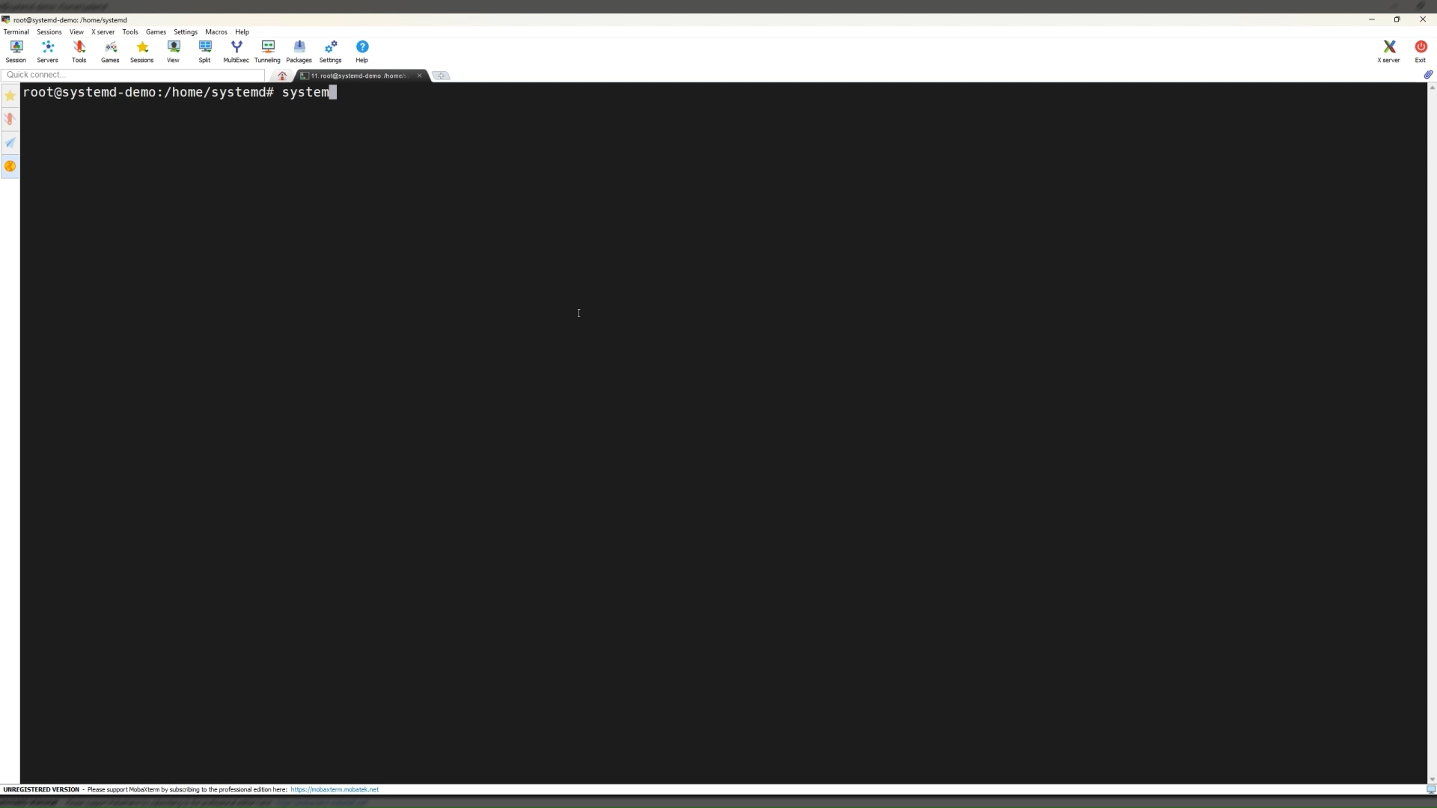
Demo — Real Root Filesystem Swap, Live
Everything on this machine right now is the real on-disk root. In a
moment we soft-reboot it into a live-built new root an actual second filesystem tree.
Before: kernel version, boot ID, PID 1's start time, /etc/os-release
The switch: /run/nextroot is an overlay — the current root as a read-only base, plus a small writable layer holding just the changes
The change: a bumped OS version, and a package installed that didn't exist a second ago
After same three kernel proofs, unchanged — but the OS version and the new package are both there

Slide 15
Thank you

