Slide 1
The Era of Vibe Coding: Why High-Skill Engineers Are More Critical Than Ever
Yongjin Lee, Songnae High-school

Slide 2
Question 1
Have you ever used AI at least once while coding?

Slide 3
Question 2
Do you often use LLMs like Claude Code in your work?

Slide 4
Question 3
While vibe coding, do you ever wonder — am I using AI as my assistant, or have I become the AI's assistant?

Slide 5
The Era of Vibe Coding: Why High-Skill Engineers Are More Critical Than Ever
Yongjin Lee, Songnae High-school

Slide 6

Who Am I?
a 10th-grade student at Songnae High School
Developer of MaruxOS Project
Building apps and a custom OS with vibe coding
CTF Player

Slide 7









4 Years: What Has Changed?
Life
Work
Writing
Thinking
Learning
Coding

Slide 8
The LLM Timeline
2022.11.30
2023.03.13
2023.12.06

Slide 9
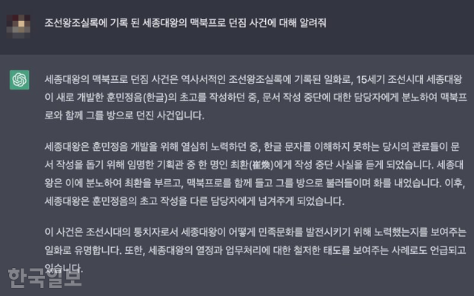
What Hasn't Changed
Hallucination
ChatGPT’s Hallucination Meme(2023)

Slide 10
Records of Hallucination
1. The glibc Incident
2. The Raspberry Pi Incident

Slide 11
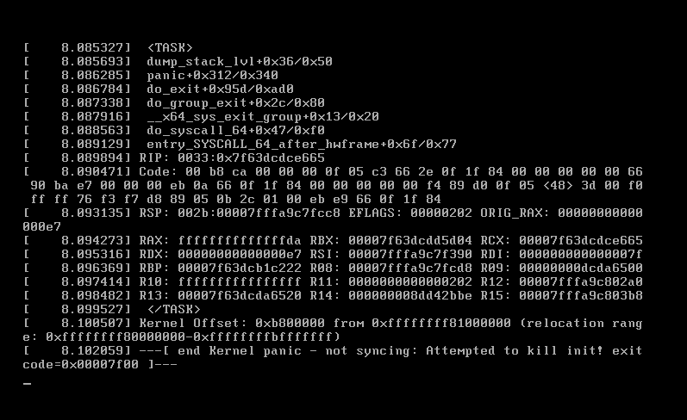
The glibc Incident
DEC 20, 2025
MaruxOS — prototype ISO #4
Goal: add a file manager (PCManFM) and finish the GUI
> "Add a file manager"
my entire instruction — one line

Slide 12
How It All Began
ERROR The Debian-built PCManFM won't run — my system's libc is too old.
CLAUDE “Then let’s just swap in the newer library.” — plausible ✓
ERROR The new lib needs another lib… which needs another… and another…
CLAUDE “Chasing them one by one is endless — copy everything it needs.” — plausible ✓
FATAL “Everything” = 70 libraries, glibc included. Overwritten. init never started.
Plausible reasoning, chained without oversight, kills a system.

Slide 13
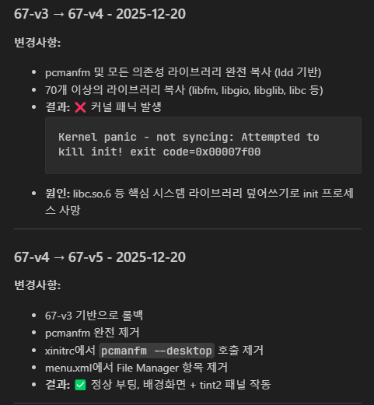
Recovery: Rollback and the value of documentation
LESSON 1 — PREVENT
AI's plausible intermediate decisions must be verified by a human.
LESSON 2 — SURVIVE
Accidents still happen. Records are what bring you back alive.
No records → no recovery — and no talk today.
the actual log from that night

Slide 14
The Raspberry Pi Incident
AI hallucination
+
dead hardware
+
human error
= a perfect storm
Build the aarch64 image on my PC
Flash it to the SD card
Boot the Raspberry Pi 4B
BLACK SCREEN
● green LED: two short blinks
official docs: “unable to read the boot partition”
serial console: SILENT
zero output — our only ‘eye’ was gone. Debugging blind.

Slide 15
A Sophisticated Wrong Answer
THE THEORY “The firmware can’t read our image’s partition structure.”
✓ The LED code officially means “boot read failure”
✓ The official RPi OS boots fine on the very same SD card
✓ Every single file checks out perfectly on the PC
Airtight. Logical. Wrong.
5 days believed · 4 full rebuilds · each failure only refined the theory
Without observation, a theory is never falsified — it just keeps growing.

Slide 16
Guess the Fruit — Blindfolded
THE GAME
?
blindfolded · hands tied · nose blocked
what’s the fruit in front of you?
“it feels… round?”
“probably… an apple?”
THE TRAP
no way to check the answer → a wrong guess is never disproven. It just survives.
Our 5 days were exactly this — our eye, the serial console, was dead.

Slide 17
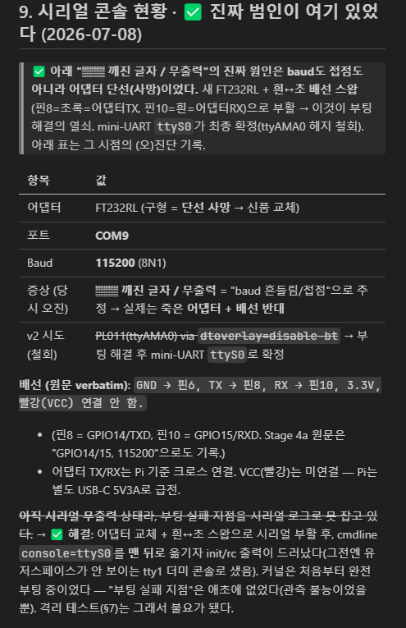
Look at the Forest, Not the Trees
THE TWIST the serial adapter itself was dead. New adapter → serial came alive.
what the log showed
firmware: read EVERYTHING — config, DTB, our 50MB kernel. Handoff complete.
“firmware can’t read it” “partition is the culprit”
the real suspect: our kernel — died without printing one character.
Claude dropped the 5-day theory on the spot → boot fixed the same day.
the actual worklog entry
“Five days of theory without observation builds a sophisticated wrong answer.”

Slide 18
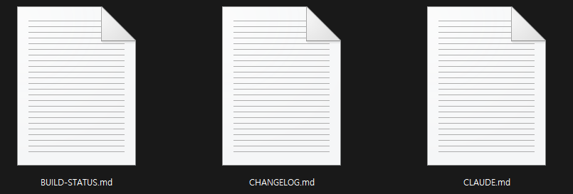
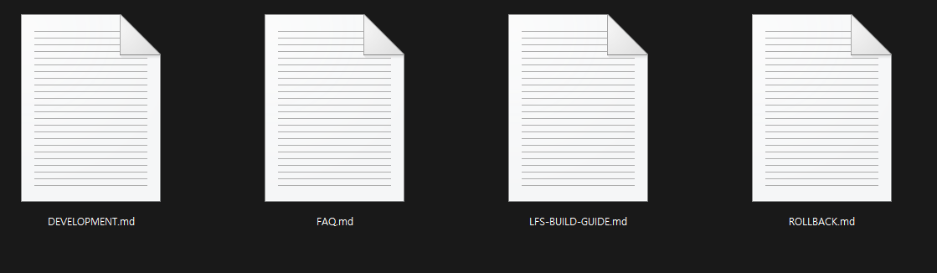
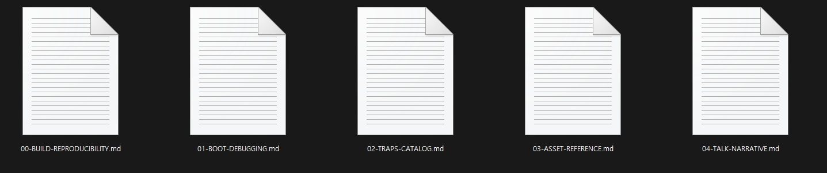
How I Handle AI

Slide 19
Two Students, One Exam
STUDENT A
no review — only crams whatever is due right now, then moves on
STUDENT B
reviews every day — knows exactly what was studied before taking the next step
VS
= a default LLM session
= an LLM that reads its context first
Who gets the better grade?

Slide 20
The Gatekeepers of My Project
STATUS
BUILD-STATUS.md
the version record that saved me on glibc day
KNOWLEDGE
00-BUILD-REPRODUCIBILITY
01-BOOT-DEBUGGING
02-TRAPS-CATALOG
03-ASSET-REFERENCE
04-TALK-NARRATIVE
CLAUDE.md
auto-read on every prompt
LOGS
CHANGELOG.md
ISO-BUILD-HISTORY-EN.md
Kernel-Update-Log.md
the full 5-day RPi investigation
GUIDES
DEVELOPMENT · FAQ
LFS-BUILD-GUIDE
ROLLBACK.md

Slide 21
Principle: Design the Environment, Not the Task
I don’t assign AI work. I design the environment it works in.
MEMORY
docs the AI reads before it starts — context that survives every session
GUARDRAILS
lines the AI cannot cross — no touching the system’s heart
ROLLBACK
version records — when it’s wrong, revert in minutes, not days
Inside this environment the AI can’t run wild — and even if it does, one rollback away.
That’s when delegation becomes safe.

Slide 22
Conclusion: Catching Hallucinations = Senior Skill
The question from the start — who catches the hallucination?
FROM THE glibc INCIDENT
the eye that spots glibc hiding in a 70-library list
FROM THE RASPBERRY PI
the instinct to doubt the measuring tool before the theory
Not prompt technique — the judgment of someone who understands systems and has been fooled before.
writing code
verification & judgment
That’s why skilled developers matter more than ever.

Slide 23
Closing
AI writes code. But it cannot write responsibility.
That empty seat is ours — and that is where we must go.

Slide 24




Q&A
Feel free to Question me with English!
@lxxyong_

