Slide 1
Flexible paging in Linux: Per Process Page Size
Dev Jain
11/08/2026

Slide 2
Agenda
A primer on memory, pagetables, TLB
Performance vs fragmentation tradeoff
Existing mTHP mechanism
​Per Process Page Size (Running 4K, 16K, 64K processes on the same kernel)
Towards better mTHP support

Slide 3
VA->PA translation
Notes:
TLB: 1-3 CPU cycles
Pagetable walk – 200 – 300 cycles

Slide 4
The pagetable tree (48 bit VA space, 4K pages)
Notes:
Explain here: 48 bit VA, 4K page. Then explain here only, this will collapse to 3 levels on 64K. On next slide you say 64K page size, so come back here.

Slide 5
Performance vs fragmentation tradeoff
arm64 has 3 page sizes – 4K, 16K, 64K
If page size 64K - The number of pages reduce by 16x => the kernel needs to
keep track of less pages, kernel overhead reduces (LRU list, Page Cache, etc)
VA = {x, x + 1, x + 2, …. x + 64K - 1}, where x is divisible by 64K, is translated by the same
pagetable entry => higher probability of getting a TLB hit
But – memory waste (internal fragmentation)
Our objective: how close can we bring 64K kernel performance to 4K?

Slide 6
Multi-sized Transparent Hugepages (mTHP)
Write policy into /sys/kernel/mm/hugepages-xxkB/enabled
hugepages-2048kB: kernel will allocate 512 contiguous 4K pages
Get a PMD leaf mapping: a single TLB entry translates 2M worth physical memory, TLB reach increases
hugepages-64kB: kernel will allocate 16 contiguous 4K pages
16 PTE entries point to consecutive pages of the same large page
arm64 contiguous bit can collapse this into a single TLB entry

Slide 7
Performance gap
Moving from 4K to 64K Base Page Size
Performance Improvement vs 4K

Slide 8
Reasons for Performance Gap
Solved by 4K-cont (64K mTHP + contpte)
Moving from 4K to 64K Base Page Size
SW Effects
HW Effects
16x Fewer Page Faults
16x Less contention on LRU
…
TLB Reach
  Caches VA -> PA
  16x more fits in TLB: 4K -> 64K
Walk Cache Reach
  Caches VA -> last level table PA
  256x more fits in walk cache: 2M -> 512M
Page Table Levels
  4K/48bit: 4 levels
  64K/48bit: 3 levels
Data Cache Efficiency
  Page tables are 16x more compact
TLB hit chance improved with mTHP
Upon TLB miss, pgtable walk is faster on 64K kernel

Slide 9
Per Process Page Size
On a 4K kernel, can we run processes with 4K, 16K and 64K ABIs?
Small processes like shell scripts etc can use 4K page size to avoid memory wastage
Compute-hungry processes can use 64K mode to allocate 64K chunks, and use a 64K pgtable for
memory accesses
Android has been working to transition to 16K pages
  Some apps may not work well on 16K for various reasons; still need 4K
  Need to run 4K and 16K processes on the same kernel

Slide 10
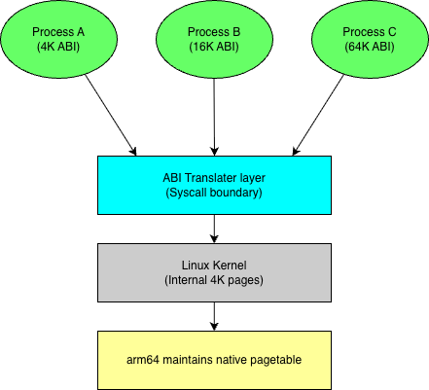
Overall Design
ABI adapter – ABI conforms to what a 16K/64K process would see on a 16K/64K kernel
Linux MM enablement - ensures physical memory is handed out in contiguous kernel pages of process granularity
Linux MM operates on the Linux pagetable – translate each operation onto arm64 native pagetable, with a native geometry. MM enablement ensures such a translation exists
The native pagetable is used by HW for userspace memory
accesses (TTBR0_EL1)
In case MM fails, arm64 falls back to Linux pagetable

Slide 11
ABI adapter
Process page size stored in mm_struct
  Sysconf(_SC_PAGESIZE) = 16K/64K
Syscall layer – validate/align size and address to process page size
  mmap, mremap, munmap etc align length to process page size
  mmap() will always return process-page aligned address
If 64K process opens a procfs file on 4K kernel, view should be consistent with 64K ABI
  Many tricky corner cases

Slide 12
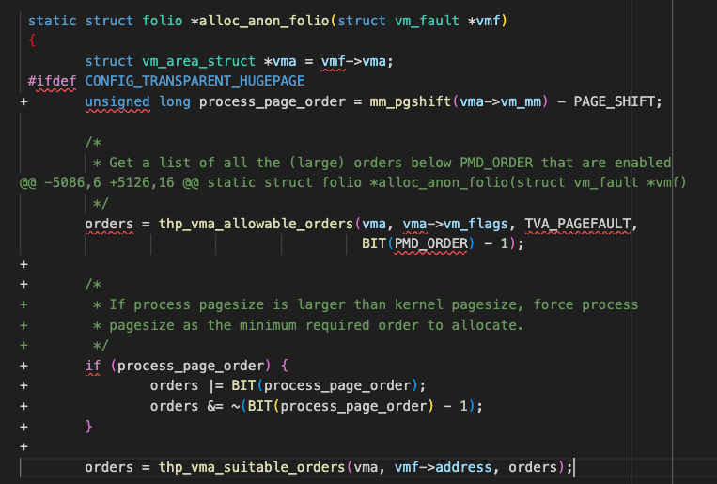
Linux MM enablement for process page size (64K process, 4K kernel)
Thankfully a lot of mTHP paths can be reused
Anonymous private memory: Must allocate a set of page constituting 64K granularity
  Allocate mTHP with hard minimum as process page size

Slide 13
Linux MM enablement for process page size (64K process, 4K kernel)
If process writes to a file, Linux fills the ”pagecache” with pages backing that section of the file
Writes go into the pages; the pages are then read back to the disk in intervals
On a 64K kernel, small files waste memory
  Linux will install a 64K page backing the file even if we are writing 1 byte of the file
Hence for the PPPS design, we want to keep 4K pages in the pagecache
File memory (Pagecache): Suppose 4K process mmap()’s a 128K file, and writes [0-8192) bytes
  Linux maps it with two 4K pages, not necessarily contiguous
  Now a 64K process mmap()’s the same file
  When it writes the same section of the file, the fault handler will find the 4K pages in the pagecache
The problem: when a 64K process mmap()’s a file, it should get at least a 64K contiguous block, but a 4K process
may have already filled in the pagecache with 4K pages
Solution: Most files are not mmapped
  Bump up the min_order field for the filesystem to use 64K folios always, when the file is mmapped
  for the first time
  Drop the existing 4K pages from the pagecache (and trigger readahead): any new pages will be at least 64K

Slide 14
64K pgtable mappings on 4K kernel
Now that all allocations are multiples of 64K, we need to set up mappings on the 64K pgtable
Either teach all pgtable walkers in Linux about the process page size: huge code churn expected
Let Linux MM code still operate on the 4K table. arm64 code will then translate the mappings onto the 64K table

Slide 15
Linux pgtable to native pgtable
Scenario: 64K process faults, Linux needs to map memory
Double fault mechanism
  MMU sees empty entry in the 64K pgtable
  Linux kernel handles the fault. Since Linux MM is operating on 4K pgtable, it maps 16 contiguous pages into this table
  Linux fault handler returns
  MMU faults again since the fault hasn’t actually been resolved
  Linux handles the fault, finds that the 4K pgtable is already filled
  Transfer control to arm64 native fault handler
  arm64 code builds the 64K pgtable hierarchy, then extracts the PA mapped into the 4K pgtable, maps that here
    Need a quick way to lookup the PA mapped in the 4K pgtable
    Native pgtable allocation cannot be under sleepable context
    If mprotect(), need quick way to lookup from 4K entry to corresponding 64K entry
Key complexity: pagetable geometry differs, and pagetable creation needs to be dynamic​

Slide 16
Challenges
Upstream community concerned on code churn
Large change to core Linux MM
Difficult to implement the native translation layer elegantly
Not all code paths can understand groups of contiguous pages
4K allocations mixed with 64K allocations causes fragmentation
Putting PPPS on the back burner for now
But – worth looking at the last two points for the longer direction of the kernel
  Additionally: mTHP is not fully supported yet!

Slide 17
Folios
Each page is represented by a struct page {}
Struct folio {} introduced to consolidate single page and multiple page allocations
into a single data structure
The page -> folio conversion is not complete yet

Slide 18
mTHP support
mTHP supported for anon-private and anon-shared allocations
File pages can get mTHP via readahead, but that is not deterministic
  Concerns of memory waste, fragmentation, regressing workloads dependent
  on readahead behaviour
Copy on Write copies into 4K pages always
mTHP size determined by sysadmin, not kernel
  Can kernel smartly figure out the best size for a process?

Slide 19
Compaction
Defragmenting memory
Costly – increased power consumption on Android for instance
Two pointers running from left and right of physical memory – migrate alloced pages to the free slots
Perhaps we can have a more targeted compaction to freeing a particular size?

Slide 20
Resources
https://gitlab.arm.com/linux-arm/linux-rr/-/tree/features/per-process-page-size-v0.1
https://lwn.net/Articles/1071484/

