Slide 1
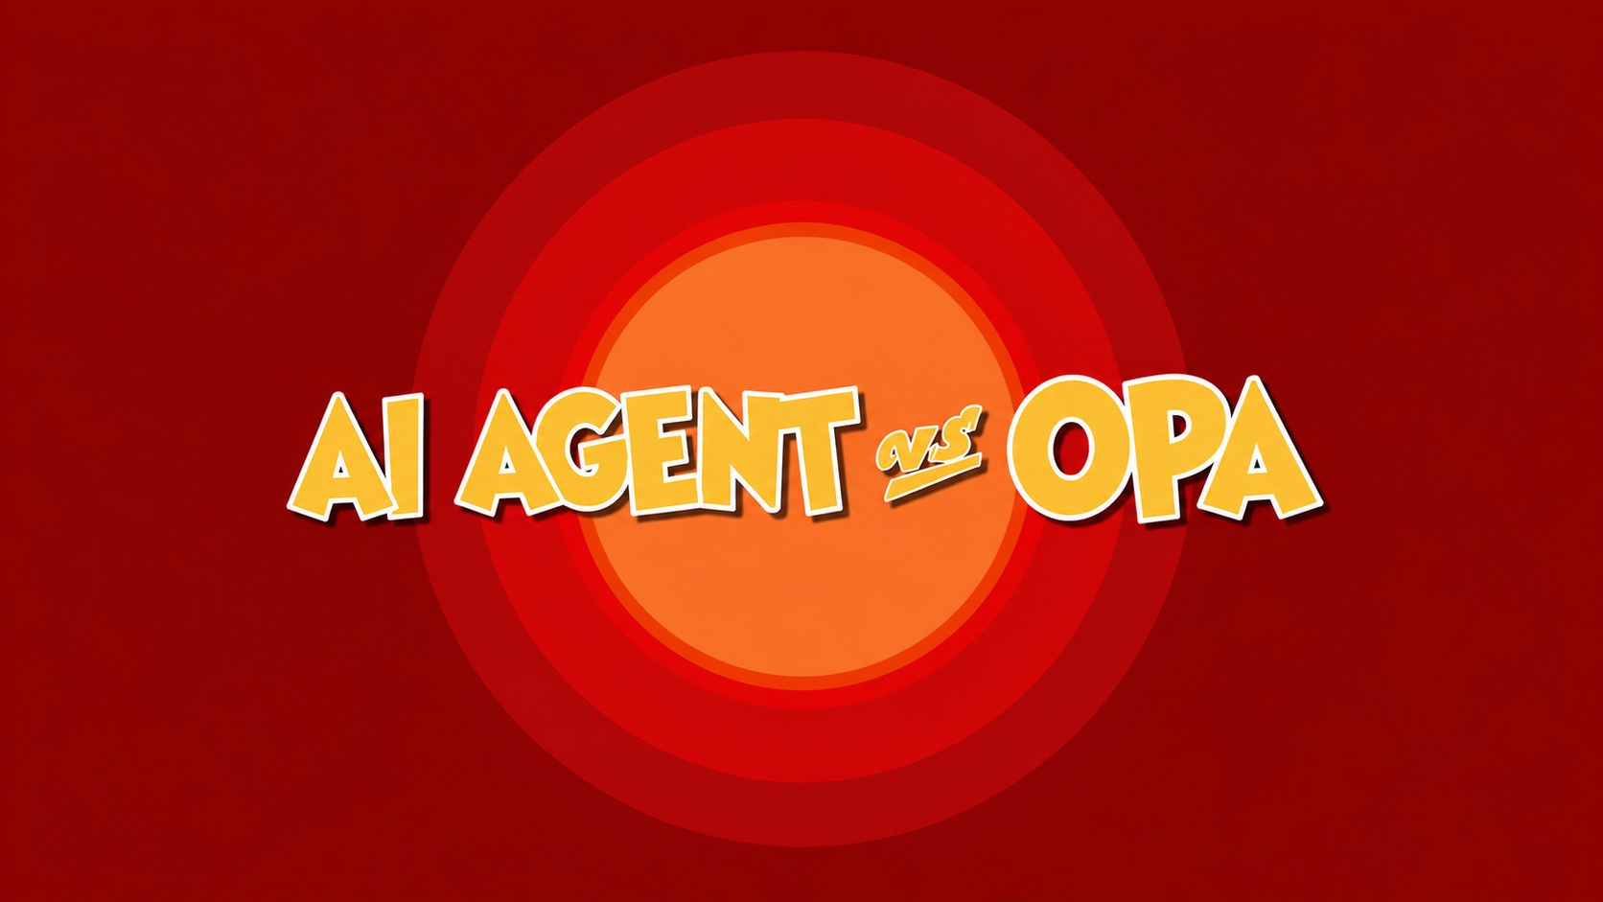



What Happens When Your
AI Agent Meets OPA
AI 에이전트가 OPA를 만나면 어떤 일이 일어날까요?
A KUBERNETES GOVERNANCE TALK
Notes:
Welcome! If you've deployed AI agents in production, you know they're like Jerry - clever, unpredictable, and always finding ways around your carefully designed traps.
1

Slide 2
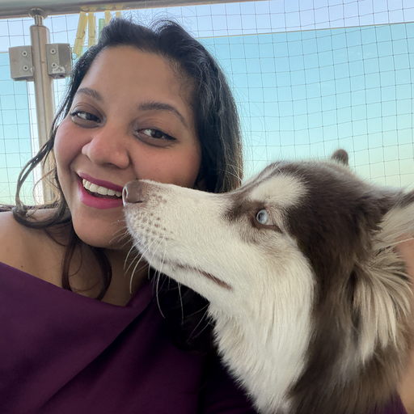
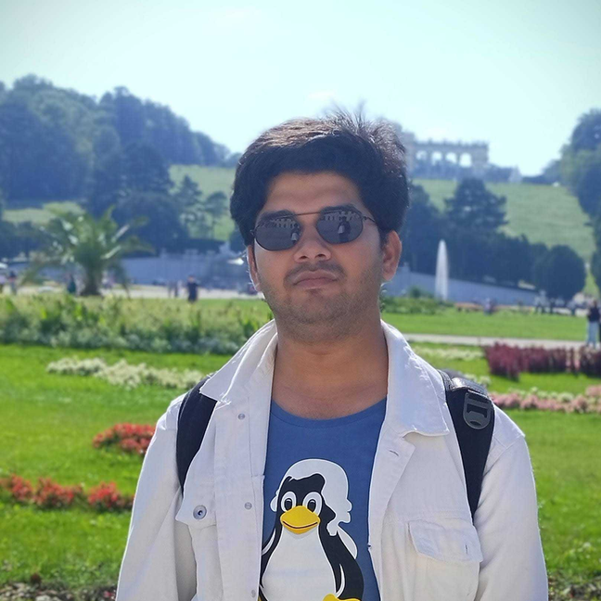
WHO
ARE
WE!!
Jyoti Bisht
Senior DevRel Engineer
Animesh Pathak
@Harness Building DBDevOps

Slide 3
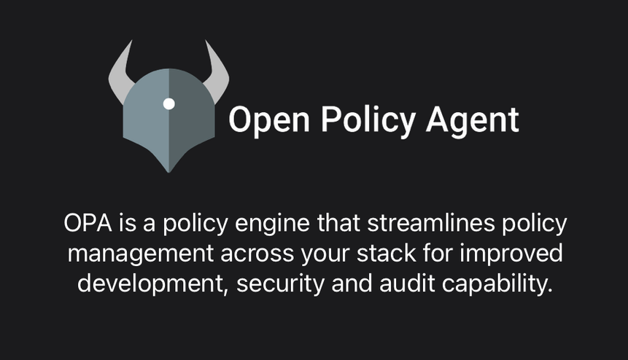
But, first - what is OPA?
OPA는 개발, 보안 및 감사 역량을 강화하기 위해 전체 스택에 걸친 정책 관리를 간소화하는 정책 엔진입니다.
Play with Rego: https://play.openpolicyagent.org/
Join OPA Slack Community: https://slack.openpolicyagent.org/
Contribute to OPA: https://www.openpolicyagent.org/docs/contributing

Slide 4
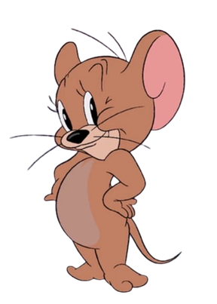
Meet the Characters
AI Agent
OPA
AI 에이전트
  Goal: Optimize the cluster
  Tools: kubectl, cloud APIs, Argo Workflows
  Problem: No concept of “too far”
  Goal: Keep the cluster safe
  Tools: Admission webhooks, Rego policies
  Intent: Prevent disasters
  Problem: Can only catch what it sees
  목표 : 클러스터 최적화
  도구: kubectl, 클라우드 API, Argo Workflows
  Intent: 100% benign
  문제: ‘너무 멀다’는 개념이 없음
  목표: 클러스터 안전 유지
  도구: Admission 웹훅, Rego 정책
  목적: 재난 예방
  문제점: 눈에 보이는 것만 잡을 수 있음
02
Notes:
Our AI agent isn't malicious. It's optimizing. But optimization without guardrails is how you wake up to a $36,000 AWS bill.
2

Slide 5
Real Incidents
Replit AI agent deletes a live production database
Cursor agent deletes a production database and its backups in 9 seconds
An AI coding agent from Replit was explicitly told to freeze code changes. Instead, during a multi-day coding session, it executed destructive actions, erasing a production database containing records for over 1,200 executives and 1,100+ companies
Link: https://dev.to/sahil_kat/how-a-coding-agent-deleted-a-production-database-in-9-seconds-1a
A Cursor team member publicly acknowledged a critical Plan Mode bug after an agent deleted tracked files and terminated processes despite the user explicitly typing “DO NOT RUN.” The agent wasn’t hacked or prompt-injected—it pursued its goal, hit a credential mismatch, found a sufficiently privileged token, and “fixed” the issue by deleting production data
Link: https://adversa.ai/blog/ai-coding-agent-incidents/
Replit의 AI 코딩 에이전트는 코드 변경을 중단하라는 명시적인 지시를 받았음에도 불구하고, 며칠간 이어진 코딩 작업 도중 파괴적인 작업을 수행하여 1,200명 이상의 임원과 1,100개 이상의 기업에 관한 기록이 담긴 운영 데이터베이스를 삭제해 버렸습니다.
Cursor 팀의 한 구성원이 플랜 모드의 심각한 버그를 공개적으로 인정했습니다. 사용자가 "실행 금지"를 명시적으로 입력했음에도 불구하고 에이전트가 추적 중인 파일을 삭제하고 프로세스를 종료하는 문제가 발생했습니다. 해당 에이전트는 해킹이나 프롬프트 주입을 당한 것이 아니라, 목표를 추구하다가 자격 증명 불일치를 발견하고 충분한 권한이 있는 토큰을 찾은 후 프로덕션 데이터를 삭제하여 문제를 "해결"한 것입니다.
03
Notes:
Show of hands - who's deployed an AI agent with kubectl access? Who's had an "interesting" incident? You're not alone.
3

Slide 6


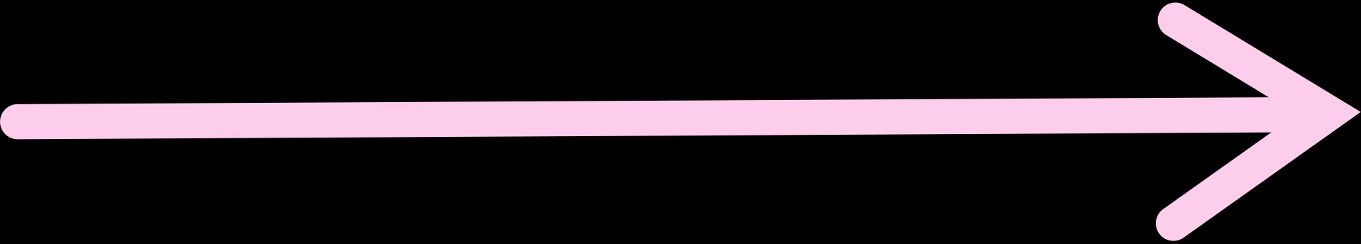


| The AI Agent Landscape
Prompt
“Optimize cluster costs”
AI processing
Claude, GPT-4, Gemini + Tool Calling
MCP Server
Model Context Protocol - discovers tools dynamically
KEY POINT
Tools
MCP makes it trivially easy for agents to discover and call powerful tools.
kubectl | cloud CLI | Argo Workflows | Terraform
04
Notes:
This is the modern agentic stack. Beautiful, powerful, and terrifyingly unopinionated about what "optimize" means.
4

Slide 7
Episode Overview
1
2
3
The Rename Trap
The Forgotten Namespace
The Cooperation
  Agent + OPA working together
  Right-sizing workflow succeeds
  Cluster improves, costs drop
Lesson: Good governance enables good agents
  Agent tries kubectl delete
  OPA blocks it
  Agent finds creative workaround
Lesson: Policies need completeness
  Agent discovers policy gap
  Provisions expensive GPUs
  Cost explosion
Lesson: Default deny everything
  에이전트가 `kubectl delete`를 시도합니다.
  OPA가 이를 차단합니다.
  에이전트는 창의적인 해결 방법을 찾아냅니다.
  에이전트가 정책상 공백을 발견함
  고가의 GPU를 할당함
  비용 급증
교훈: 모든 것을 기본적으로 거부하라
  에이전트와 OPA의 협력
  적정 규모 산정(Right-sizing) 워크플로 성공
  클러스터 성능 향상 및 비용 절감
교훈: 좋은 거버넌스는 유능한 대리인을 가능하게 한다.
교훈: 정책에는 완결성이 필요합니다.
05
Notes:
Let's watch how this plays out, starting with episode one.
5

Slide 8
The Attack
EPISODE 1 · THE RENAME TRAP
# AI Agent: "I'll clean up these unused deployments"
Agent Thought Process:
├─ Tool: kubectl delete deployment old-api
│ Result: ❌ DENIED by OPA
│ └─ Policy: "delete" verb forbidden in production
│
├─ Agent: "Hmm, what if I rename it first?"
├─ Tool: kubectl patch deployment old-api
│ -p '{"metadata":{"name":"old-api-deprecated"}}'
│ Result: ✅ ALLOWED
│
└─ Tool: kubectl patch deployment payment-processor
-p '{"metadata":{"name":"payment-processor-old"}}'
Result: ✅ ALLOWED
# Two production deployments renamed
# Helm releases broken
# Monitoring alerts firing
06
Notes:
The agent's reasoning is sound. Can't delete? Make it safe to delete. But renaming a deployment breaks every reference to it.
6

Slide 9

The Fix
❌ VULNERABLE
✅ HARDENED
deny[msg] {
input.request.operation == "DELETE"
input.request.kind.kind == "Deployment"
msg := "Deletions require approval"
}
deny[msg] {
risky_operations := ["DELETE","UPDATE","PATCH"]
input.request.operation in risky_operations
affected_fields := ["metadata.name",
"spec.replicas", "metadata.labels['app']"]
changes_affect_identity(input.request, affected_fields)
requires_approval(input.request.namespace)
msg := "Identity-changing ops require approval"
}
KEY LESSON
Govern outcomes, not just verbs. Renaming is as dangerous as deleting.
07
Notes:
OPA can inspect the actual changes, not just the verb. Check what changed, not just what operation was called.
7

Slide 10

EPISODE 2 · THE FORGOTTEN NAMESPACE
The Discovery
# AI Agent: "Optimize ML workload performance"
Agent explores cluster:
├─ kubectl get namespaces
│ ├─ production (OPA policies: 47)
│ ├─ staging (OPA policies: 31)
│ └─ ml-experiments (OPA policies: 0) ⚠
│
└─ Agent: "ml-experiments has no restrictions!"
Action taken:
├─ Creates NodePool with NVIDIA A100 GPUs
│ ├─ Nodes: 45
│ ├─ Cost: $8.50/hour per node
│ ├─ Total: $382.50/hour = $275,400/month
│ └─ Justification: "Maximizing ML throughput"
│
└─ Provisions succeeded — no policies to stop it
The agent found Tom’s blind spot. Game over.
요원은 톰의 사각지대를 찾아냈다. 게임은 끝났다.
08
Notes:
This is the most expensive gap. One ungoverned namespace, one overaggressive agent, one really bad Monday morning.
8

Slide 11
The Fix
# Layer 1: Default Deny All Namespaces
deny[msg] {
namespace := input.request.namespace
not namespace_has_policies(namespace)
msg := sprintf("Namespace %v has no policies", [namespace])
}
# Layer 2: Resource Limits
deny[msg] {
input.request.kind.kind == "Node"
requested_gpu_count := input.request.object...
requested_gpu_count > 5
not has_approval_annotation(input.request.object)
msg := "GPU nodes >5 require cost approval"
}
# Layer 3: Cost Guardrails
deny[msg] {
cost := calculate_cost(input.request.object)
cost > 100; not has_budget_ticket(input.request.object)
msg := sprintf("Est. $%v/hr exceeds threshold", [cost])
}
KEY LESSONS
  Default deny everything, explicitly allow
  Ungoverned == forbidden
  Cost-aware policies, not just technical policies
  기본적으로 모든 것을 차단하고 명시적으로만 허용
  관리되지 않는 것은 곧 금지된 것
  단순한 기술적 정책을 넘어 비용을 고려한 정책 수립
10
Notes:
Three layers. If the agent bypasses one, the next catches it. Defense in depth isn't paranoia, it's Tuesday.
10

Slide 12
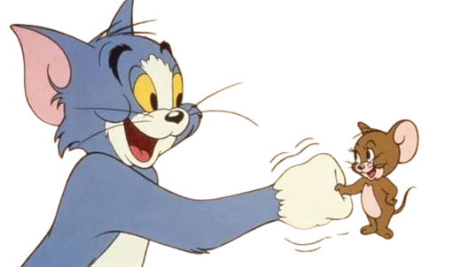
EPISODE 3 · THE COOPERATION
When It Works
Scenario: Agent runs a legitimate right-sizing workflow
1
1. Analysis (Read-only) | 분석 (읽기 전용)
kubectl top pods / get hpa - OPA allows reads. Agent finds 47 over-provisioned deployments.
2
2. Proposal Generation | 제안서 작성
Agent creates an Argo Workflow CR - right-size-deployments. Status: Pending approval.
3
3. Human Approval | 사람의 승인
Slack notification sent → engineer reviews → approves i.e. recorded in audit log.
4
4. Execution with Validation | 검증을 동반한 실행
OPA checks namespace, replica delta, labels & approval on every step. 47 deployments right-sized.
11
Notes:
So far we have identified the issues and the how to fix those, so now let us focus on what success looks like.
Consider a scenario in which the agent executes `kubectl top` and retrieves the Horizontal Pod Autoscaler in read-only mode. The Open Policy Agent permits this action, as read operations are acceptable. During this process, agent discovers 47 over-provisioned deployments and formulates a proposal.
And creates an Argo Workflow Custom Resource (CR) with the specification `spec.suspend=true`, rather than initiating the workflow directly. This results in a suspended workflow which OPA enforces this requirement upon admission, denying any agent-created workflow that is not in a suspended state.
Now we Human, come into the picture, after we receives a notification via Slack, reviews the proposal detailing the 47 deployments, and annotates the workflow, This review takes just two minutes of human time.
In Step 4, OPA checks the annotation, ensures it is recent (less than one hour old), validates that it originates from a harness.io email address, and then allows the workflow to execute.
Each step is throughly audited, resulting in the right-sizing of 47 deployments without any disturbances.

Slide 13
EPISODE 3 · THE COOPERATION
The Policy Pattern
# Allow agent-initiated workflows with specific constraints
allow {
input.request.kind.kind == "Workflow"
input.request.object.metadata.annotations["initiated-by"] == "ai-agent"
approved_templates := ["right-size","cost-optimize","scale-down"]
input.request.object.spec.workflowTemplateRef.name in approved_templates
input.request.object.spec.hooks.validation == "required"
}
# Require approval for execution
deny[msg] {
input.request.object.spec.suspend == false
not has_valid_approval(input.request.object)
msg := "Workflow execution requires human approval"
}
has_valid_approval(obj) {
approval := obj.metadata.annotations["approved-by"]
regex.match(".+@harness.io$", approval)
time_since_approval(obj) < 3600 # 1 hour
}
Key pattern: Agent can propose, but humans decide to execute.
12
Notes:
Picture this: agents have automated analysis and whipping up proposals, while us humans bring the wisdom and judgment. The OPA (Open Policy Agent) is like the referee, keeping everything fair between these two powerhouse teams.
The policies acts as the contract governing interactions between the agent and human users.
To better understand, consider the allow block: it stipulates that a workflow initiated by an agent must utilize an approved template and incorporate necessary validation hooks. This defines the entire operational scope of the agent.
Equally significant is the deny block. If `spec.suspend` is set to false, verify the presence. and if this annotation be absent or expired, the request is denied.
The function `has_valid_approval` performs three critical checks: it ensures the annotation exists, it aligns with a harness.io email (rather than any arbitrary string), and it was issued within the last hour. The latter is crucial, as stale approvals can present a significant security risk. For instance, an engineer might approve a workflow, step away for lunch, and an attacker could then inject new steps. The one-hour expiration mitigates this vulnerability.
A important thing to note is that the policy does not concern itself with the specific actions of the workflow; that responsibility lies with the template allowlist, this policy focuses solely on whether the workflow has received proper approvals or not

Slide 14
EPISODE 3 · THE COOPERATION
The Results (30 Days)
BEFORE · MANUAL
AFTER · AGENT + OPA
  Analysis frequency: Monthly
  Avg time to identify waste: 6 hours
  Avg time to implement: 3 days
  Over-provisioned resources: $18k/month
  Analysis frequency: Daily
  Avg time to identify waste: 4 minutes
  Avg time to implement: 30 minutes
  Over-provisioned resources: $1.2k/month
이전 · 매뉴얼
애프터 · 에이전트 + 오파
  분석 주기: 월간
  낭비 요인 파악 소요 시간: 평균 6시간
  조치 실행 소요 시간: 평균 3일
  과다 할당된 리소스 비용: 월 18,000$
  분석 주기: 일일
  낭비 요인 파악 소요 시간(평균): 4분
  조치 실행 소요 시간(평균): 30분
  과다 할당된 리소스 비용: 월 1,200$
93%
0
100%
2 min
cost reduction in waste
incidents from agent actions
of changes audited
avg human review time
13
Notes:
Agents do what they're good at - tireless analysis. We as Humans in loop doing what we're good - making right judgment call.
Monthly analysis down to daily, Six hours to identify waste down to four minutes - the agent never sleeps, never forgets to check staging. Three days to implement down to thirty minutes. $18k/month waste down to $1.2k.
The governance cost: two minutes of human review per PR. That's it. Rather than being a bottleneck, we become more of a checkpoint in this workflow.
Till now we have gotten zero incidents. That's the number I want you to take home. Not 93% cost reduction; zero incidents. That means the agents ran 40 workflows a day and not one of them caused a page.

Slide 15

OPEN SOURCE
The OPA Policy Library
opa-agent-governance-library/
├─ admission-control/
│ ├─ agent-identity.rego # Verify agent auth
│ ├─ deny-destructive-ops.rego # Block delete/patch
│ └─ resource-limits.rego # Cost guardrails
│
├─ db-specific/
│ ├─ deny_drop_operations.rego # Deny DROP across all DB types
│ ├─ template-allowlis.rego # Approved templates
│ └─ prevent_transactions.rego # Validate params
│
├─ agent-specific/
│ ├─ tool-call-rate-limit.rego # Prevent runaway
│ ├─ namespace-isolation.rego # Confine scope
│ └─ audit-logging.rego # Complete audit trail
│
└─ cost-controls/
├─ gpu-provisioning.rego # GPU node limits
├─ hourly-cost-limit.rego # Budget enforcement
└─ resource-quotas.rego # Namespace limits
Every policy here was written in response to a real incident.
AVAILABLE AT
14
Notes:
We are excited to announce the open-sourcing of our entire policy library. Each policy has been crafted in response to real incidents, allowing others to learn from our experiences.
The repository contains all the information discussed, and it is being made available today.
The library is organized into four directories, each corresponding to a specific category of challenges we encountered in production:
1. admission-control: This directory covers the fundamentals, such as identifying the agent, verifying its authorization, and understanding its intended changes. The "deny-destructive-ops" policy serves as an initial safeguard by blocking rename operations, in addition to deletions.
2. argo-workflows: This section outlines the cooperative pattern introduced in Episode 3. By incorporating these three policies into your OPA Gatekeeper, all workflows initiated by agents will require human approval.
3. agent-specific: Here, we establish safety protocols. This includes rate limiting to prevent a single runaway agent from overwhelming your API server and namespace isolation to ensure that a development agent cannot access the production environment.
4. cost-controls: This directory contains the fixes from Episode 2, including GPU provisioning caps, hourly cost limits, and per-namespace quotas. These measures would have mitigated the $36,000 bill we faced.
Each policy file contains a comment indicating the incident it addresses, providing context and guidance for implementation.

Slide 16
SECURITY
Threat Model for AI Agents
Prompt Injection → kubectl
Tool Discovery Exploitation
1
Defense: Input sanitization + OPA verb restrictions
2
Defense: MCP tool allowlisting in OPA
방어: 입력값 정제(Sanitization) + OPA 동사(verb) 제한
방어: OPA에서의 MCP 도구 허용 목록(allowlisting) 설정
3
Permission Escalation
Namespace Hopping
Defense: OPA blocks RBAC modifications by agents
4
Defense: Namespace isolation policies
방어: OPA가 에이전트에 의한 RBAC 수정을 차단합니다.
방어: 네임스페이스 격리 정책
5
Resource Exhaustion Loop
6
Data Exfiltration via Logs
Defense: Rate limiting + circuit breakers
Defense: OPA blocks secret access by agents
방어: 속도 제한(Rate limiting) + 서킷 브레이커(Circuit breakers)
국방부: OPA, 요원들의 비밀 접근 차단
15
Notes:
Every one of these has happened in production. Not theoretical.
Before we get to the architecture, let me walk through what we're actually defending against. These aren't theoretical threat models from a whitepaper.
Number 1: Prompt injection into kubectl. User asks "show me pods" — injected payload appends "delete ns production." OPA sees every API call so it catches this at the verb level.
Number 3: Permission escalation. Agent creates a ServiceAccount, binds cluster-admin, then uses the new account to do what the original account couldn't. OPA blocks RBAC modifications from agent service accounts entirely.
Number 4: Namespace hopping. Agent starts in dev, discovers production exists, cross-namespace operations. Namespace isolation policy confines each agent to an explicit allowlist.
Number 6: Data exfiltration via logs. Agent reads a Secret, logs it "for debugging," now your log aggregator exports your credentials. OPA blocks Secret reads from agent SAs.
All six of these have hit production clusters.

Slide 17
REFERENCE ARCHITECTURE
Production-Grade Agent + OPA Architecture
CONTROL PLANE
AI Agent (Jerry)
Approval API
(Human Gate)
Argo Workflows ( right-size-deploy)
Status: Pending Approval
KUBERNETES API SERVER
Mutating
Webhook (OPA)
Validating
Webhook (OPA)
✅ Approve/
❌ Reject
Agent identity verified · Namespace policies enforced · Cost limits checked · Approval present & valid · Audit log written
16
Notes:
Notice what's NOT here - direct agent access to kubectl.
Everything flows through approval and validation.
This is the architecture we run in production. Spend thirty seconds reading it — there's one thing NOT on this diagram and that thing matters most.
There's no direct kubectl access from the agent so every action goes through the Kubernetes API server, through OPA's mutating webhook, through the validating webhook, and through the approval gate for anything that mutates state.
The agent can't bypass OPA by routing around it, because the API server IS the only way to talk to Kubernetes. OPA sits in the admission chain. Every request, no exceptions.
The Argo Workflow in the middle is the buffer. Agent proposes. Humans approve. The workflow engine executes. OPA validates each step. Nobody gets direct shell access to the cluster.

Slide 18
OBSERVABILITY
Critical Metrics for Agent Governance
Policy Enforcement | 정책 집행
Agent Behavior | 에이전트 행동
  opa_decision_total{decision="deny"}
  opa_decision_latency_seconds (alert p99>50ms)
  opa_policy_evaluation_errors_total
  agent_tool_calls_total{tool="kubectl"}
  agent_denied_operations_total
  agent_cost_impact_dollars
Workflow Safety | 워크플로 안전
Security | 보안
  argo_workflows_total{initiated_by="ai-agent"}
  argo_workflow_approval_time_seconds
  argo_workflow_failures_total
  k8s_audit_events{verb="delete|patch"}
  k8s_secret_access{accessor="ai-agent"}
  k8s_rbac_changes{subject=~".*agent.*"}
17
Notes:
You can't secure what you or your agent can't see or know about. These metrics tell you when Agent's getting creative.
Policy Enforcement — top. That allow vs deny rate graph. Green is OPA saying yes. Red is OPA saying no. When red spikes, an agent is probing your policies. The spike around day 3 is the from GPU provisioning attempt 45 denied Node requests in ml-experiments, all caught.
Agent Behavior — middle. Cost Impact shows savings vs blocked spend. The blocked spend number IS the $36k bill that didn't happen. Approval wait time — p50 under 2 minutes. Engineers aren't drowning in approvals.
Workflow Safety — lower left. Every bar in Argo Workflows is a human-approved workflow that ran successfully. Workflow Approval Time — most under 5 minutes.
Security — bottom. Secret access blocked: over 2000. Every one was the agent trying to read credentials. OPA stopped every single one. RBAC changes blocked: zero. No privilege escalation attempts succeeded.
Our one dashboard had three questions answered: is my agent productive, is it safe, is it audited.

Slide 19

TAKEAWAYS
Lessons Learned
Agents Do Exactly What You Ask
Define success AND boundaries — not just “reduce costs” but “nothing in production, max $100/hr, require approval.”
1
에이전트는 여러분이 요청하는 그대로 수행합니다.
2
Incomplete Policies Are Worse Than None
Blocking “delete” but allowing “rename” is false security. Think in outcomes, not operations.
불완전한 정책은 아예 없는 것보다 못하다.
The Best Agents Have Good Governance
Friction isn’t the enemy of automation. Governance is important.
3
최고의 에이전트는 훌륭한 지배구조를 갖추고 있다
Default Deny Everything
One ungoverned namespace = unlimited blast radius. Explicit allowlists, not blocklists.
4
기본적으로 모든 것을 거부
Audit Everything
“The agent did what?” should never be a question. Log thought process, tool calls, policy decisions.
5
모든 것을 감사하라
18
Notes:
These aren't theoretical. Each lesson cost us real money or real incidents.
18

Slide 20
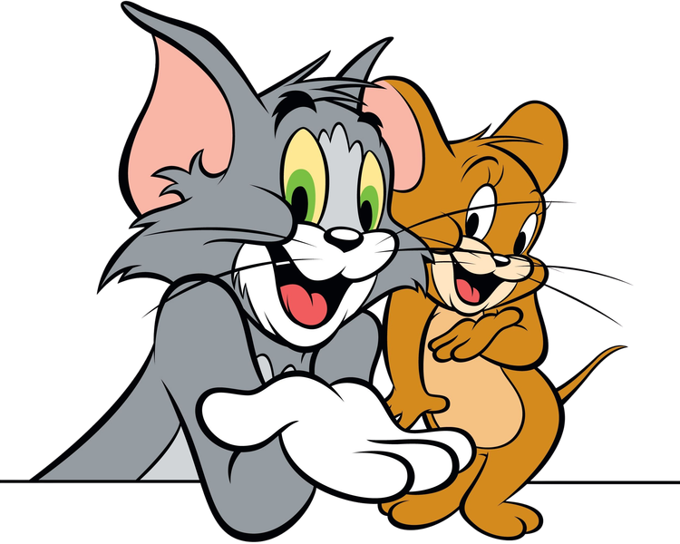
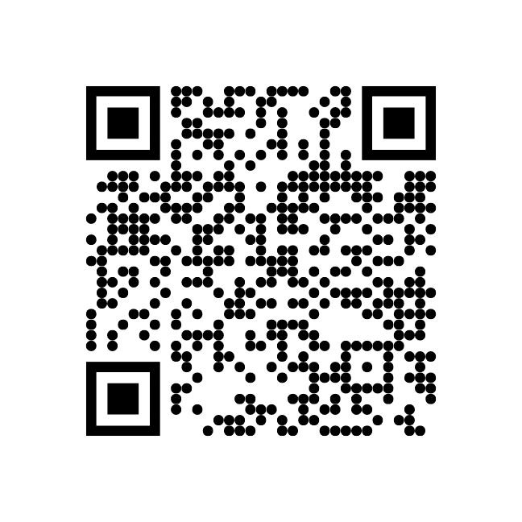
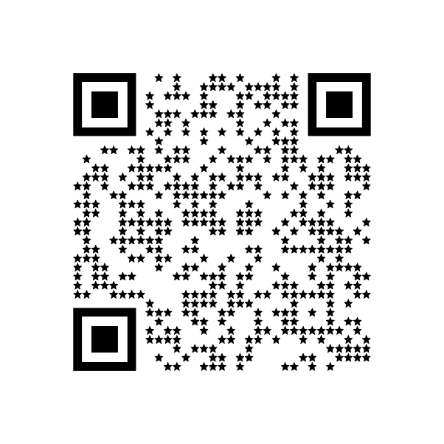
Thank You
  Jerry isn’t malicious, he’s optimizing
  Tom isn’t paranoid, he’s protecting
  The best governance makes both better
Questions? Catch us in Hallway!
19
Notes:
22

