Slide 1


From Advocacy To Action: Helping Governments Build National Address Systems

Slide 2
Advocacy Work:
Results

Slide 3
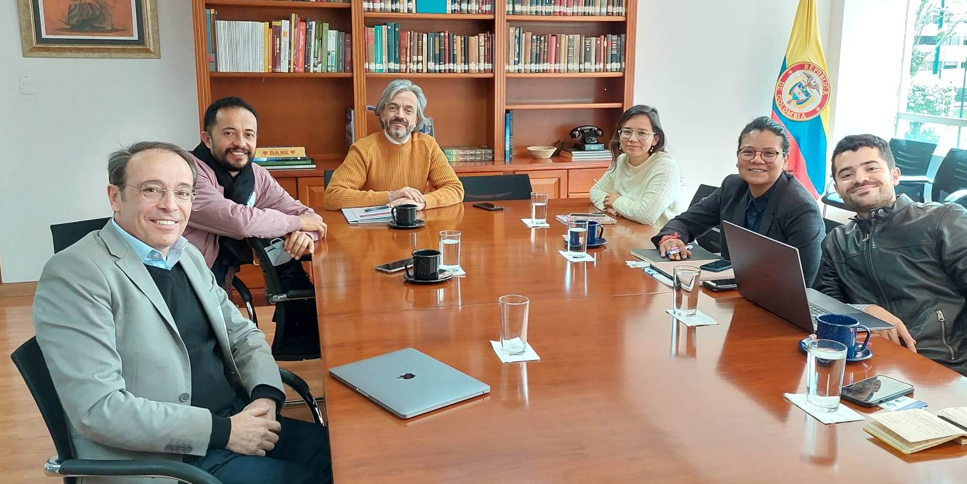

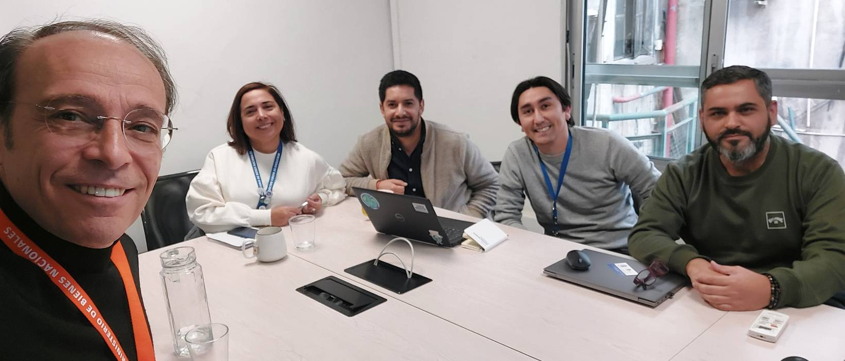
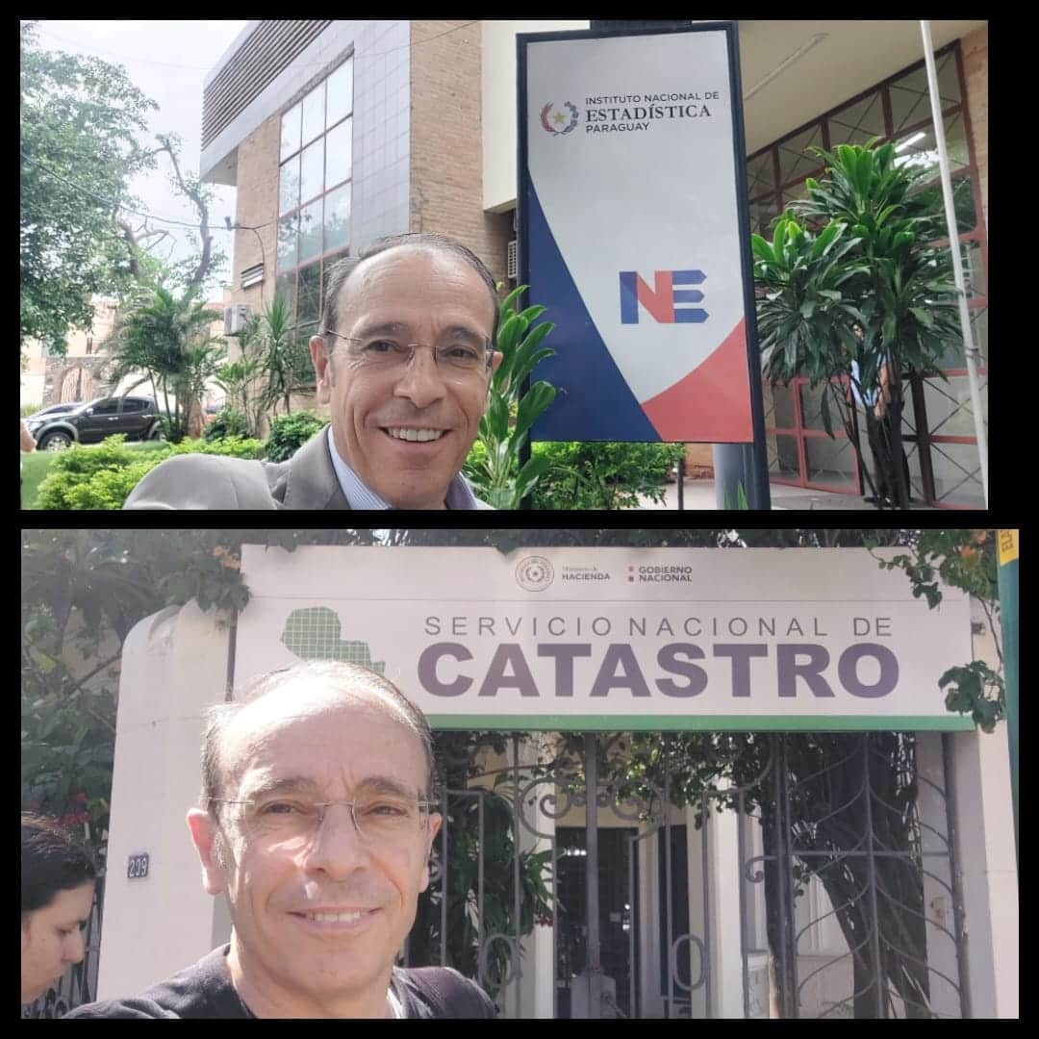
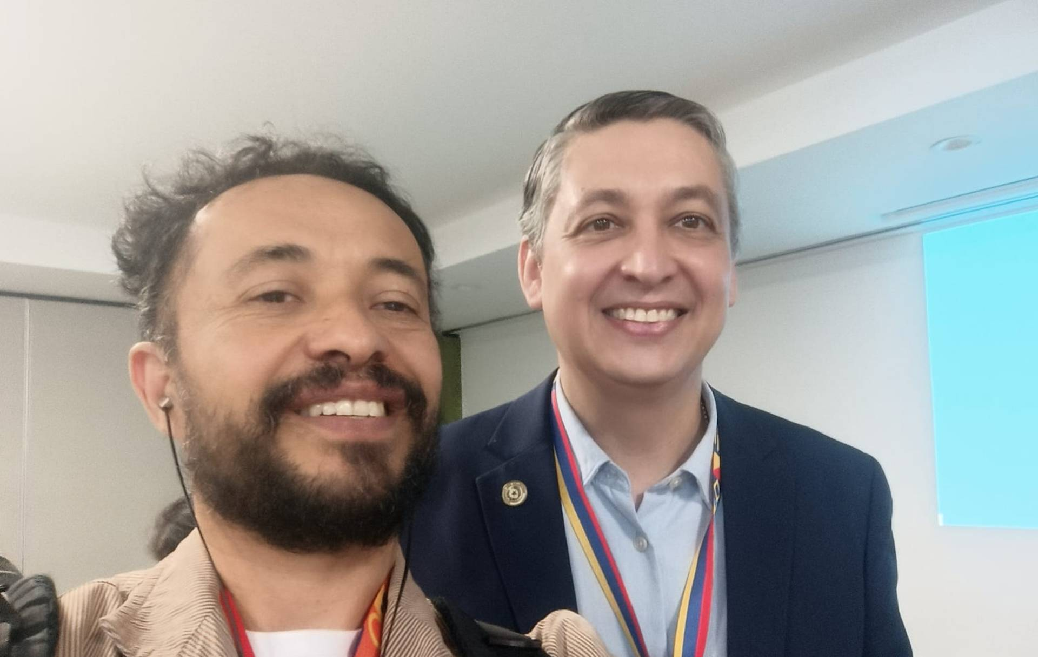
We would have no data in these countries without AddressForAll’s work:
Colombia:
After 1.5 years of negotiation and an in-person meeting with DANE President Juan Daniel Oviedo, we succeeded in having 22 million addresses released in September 2022.
Chile:
After 3 years of effort, Raúl Ponce, GEO Director at the National Institute of Statistics, told me during a face-to-face meeting: “We still cannot publish the data, but if you request it through the transparency law, we will provide it.”
Paraguay:
After 3 years of efforts, we managed to motivate the INE to publish their address data. My trip to Paraguay allowed me to forge ties with the National cadastre authority and we are planning to enrich the INE database with their attributes.

Slide 4
We would have no improved data in these countries without AddressForAll’s work:
Mexico:
AddressForAll merged 2,475 individual address databases into a single national database.
At Uber’s request, AddressForAll identified a postal code polygon database and enriched the national database with missing postal codes.
AddressForAll also identified an administrative boundaries database which allowed to enrich the database with city names which were missing in many cases.
Brazil:
AddressForAll cleaned a database of 105 million address points and reduced it to 95 million validated address points.

Slide 5


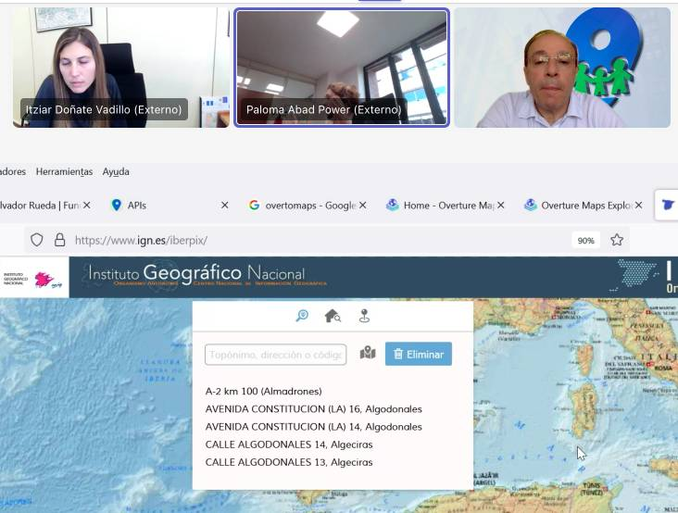
Online meetings organized by AddressForAll were necessary to obtain data which was listed on Openaddresses.io, but not actually available
Updates for these countries were “stuck” on OpenAddresses.io due to broken links or other issues. AddressForAll had to contact national institutions directly to identify the correct datasets to ingest.
Uruguay: Although Uruguay has a good Address project, their website was outdated in 2023 and we had several meetings with them (Pablo Brugnoni & team) and they sent over to us updated database regularly. Overture Github.
Portugal: Thierry had to have a meeting with Francisco Caldeira to identify what data to download. Details on Overture Github.
Spain: Thierry had a meeting with Paloma Abad & team to identify which of the 3 databases we identified we should download. Details on Overture Github.

Slide 6

A webinar we held produced positive results, and several countries are now meeting with us, motivated to set up address projects in their own countries.
https://www.youtube.com/live/oNizYdzDoT4?si=Qm13s576Qs-iRhUz

Slide 7
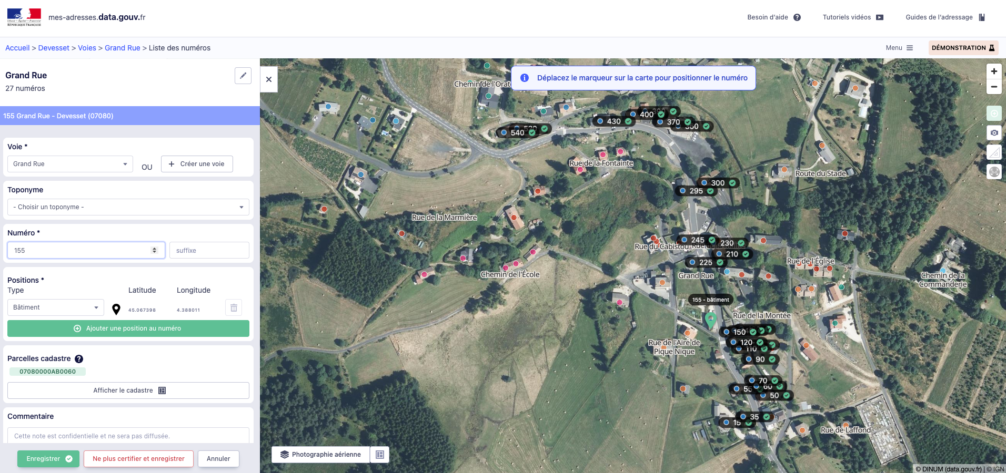
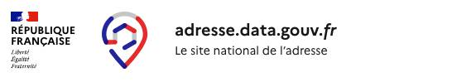
French BAN Project
The project has evolved to allow 27.000 municipalities out of 35.000 to update their addresses directly in the BAN open database, in 5 years!

Slide 8

Giving a talk is good.

Slide 9

Convincing the people to do something is necessary
CRM
E-mailing
Calling
Meetings
More Meetings
Closing the deal

Slide 10

Thank you !
Thierry Jean
+55 11 996.071.319 (WhatsApp)
thierry@addressforall.org

Slide 11
Appendix
Here follow some slides showing our advocacy work in the countries

Slide 12
We now focus our work at the national level
In 2021, with the support of Apple and Microsoft, we began contacting all municipalities in Brazil to obtain address data.
This was a massive “ant-like” effort carried out by a team of three people and allowed us to build a reasonably complete database.
However, this work was later overshadowed when IBGE published the national address database collected during the 2022 census in 2024.
Since then, the Institute only focuses to convince national governments to:
publish data when there is
set up address projects in their countries

Slide 13
Here follow the countries where our last contacts were very encouraging

Slide 14
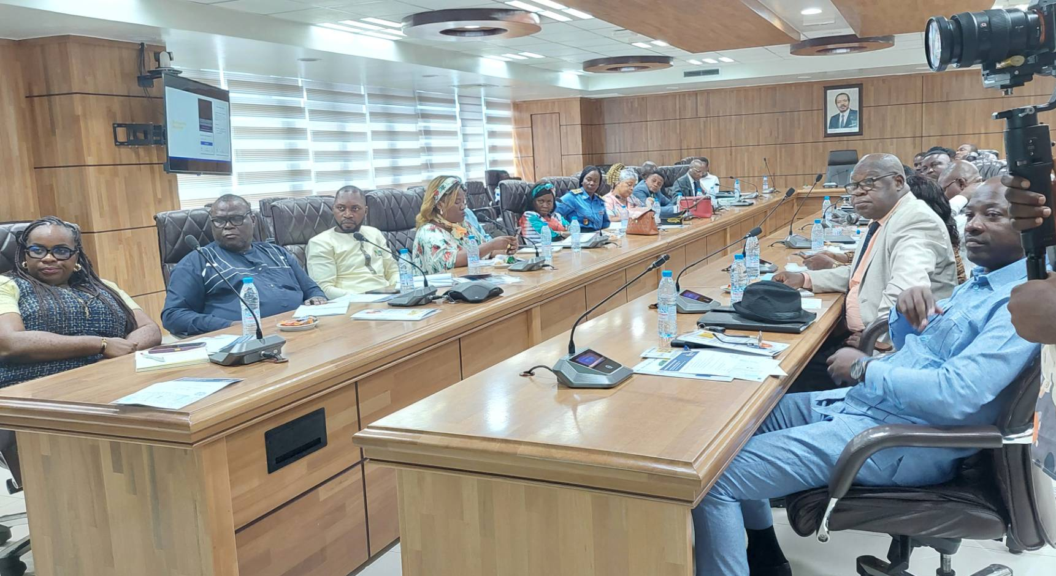
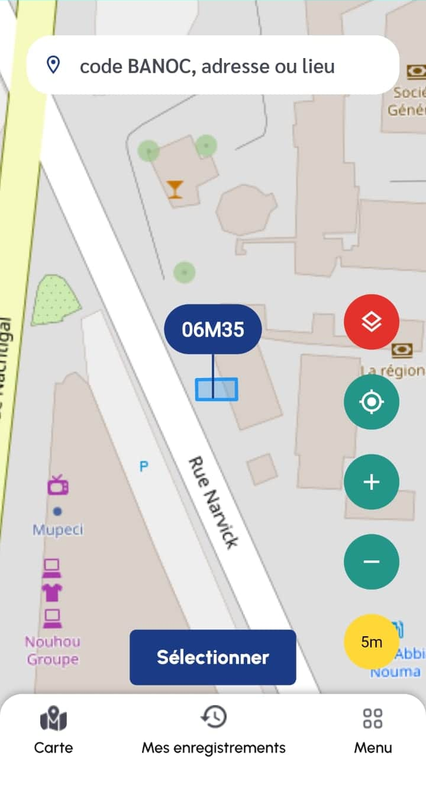
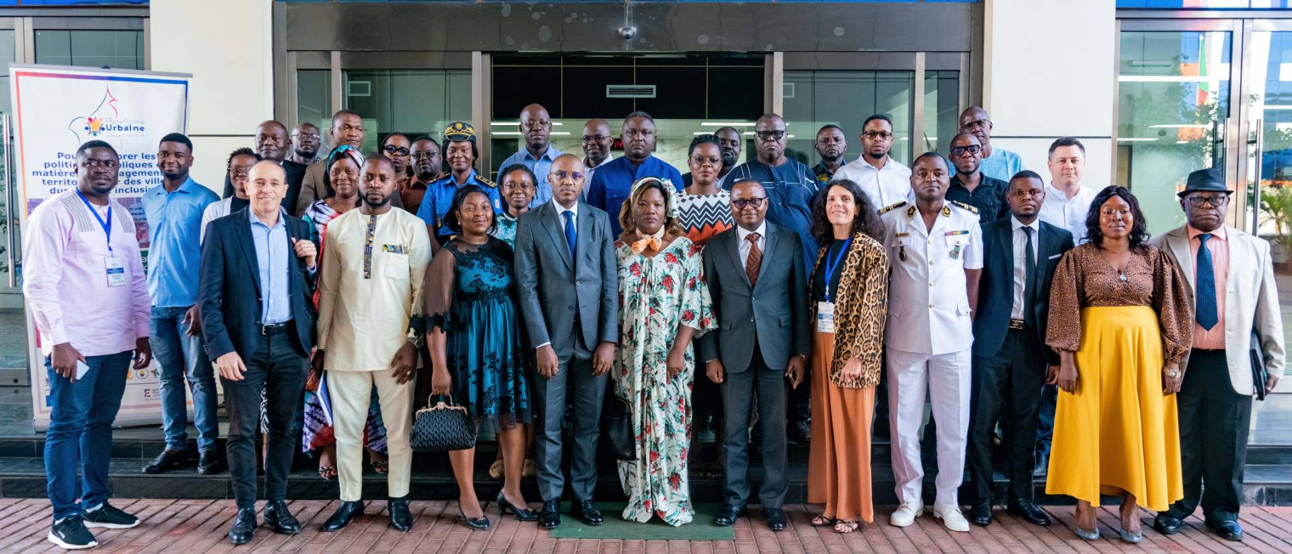
Cameroon
AddressForAll was hired to implement its Geocode methodology called AFA Codes. In Cameroon, these code are called BANOC Codes and are slowly but surely being put in place by the government.
Soon, Cameroon will be the first African country with a complete address database on Overture.

Slide 15
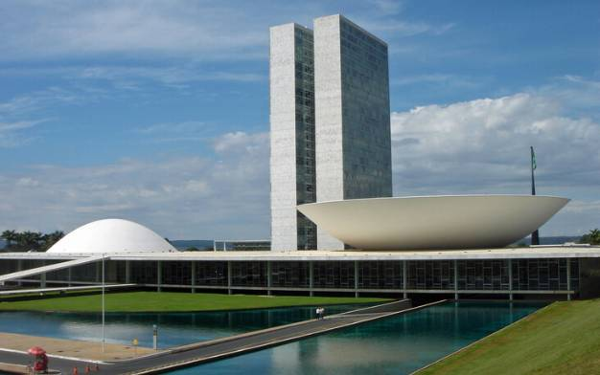

Brazil
AddressForAll was hired by a state-owned company in December 2025 to help set up a Digital Public Infrastructure (DPI) for addresses, together with the implementation of the AFA Codes methodology. Within a few months, Brazil will be able to update its 95 million addresses regularly, with no additional work required by Overture.

Slide 16
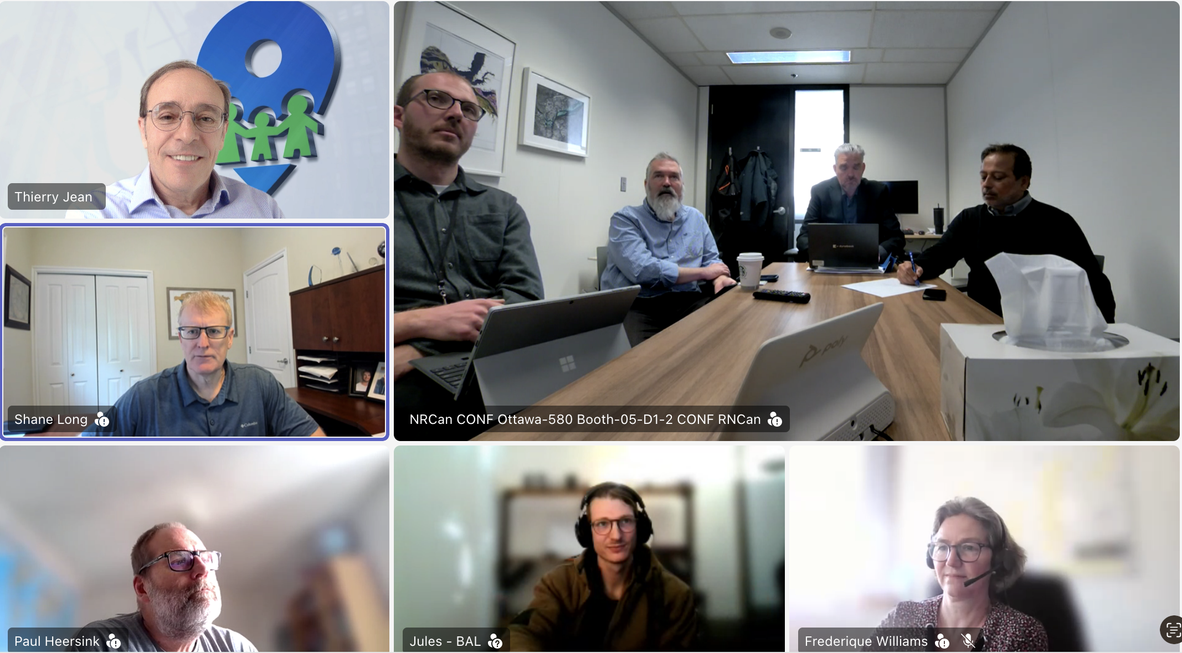
Canada

Slide 17


USA
Github Ryan Lopez - porting the BAN/BAL
https://github.com/Loprz/national-address-platform
https://mes-adresses-production.up.railway.app/

Slide 18
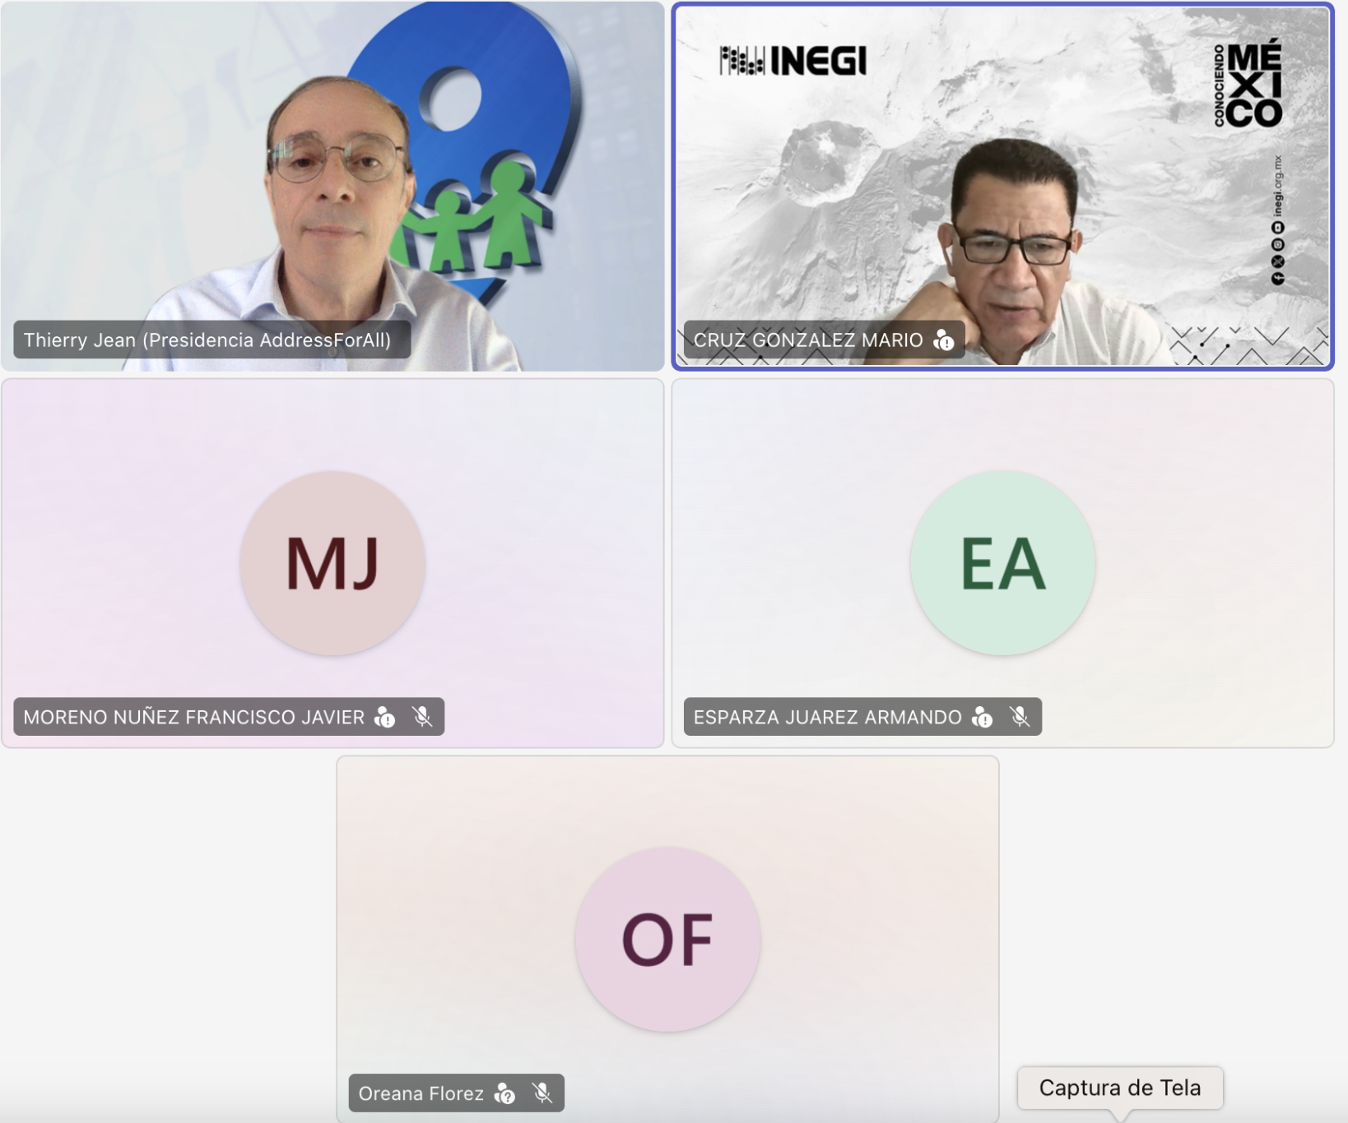
Mexico

Slide 19

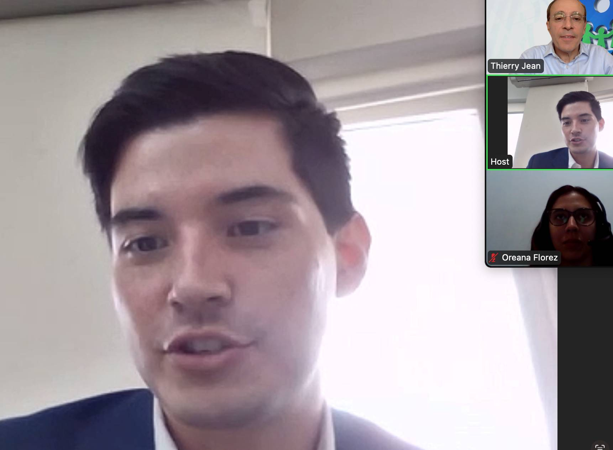
Panama

Slide 20
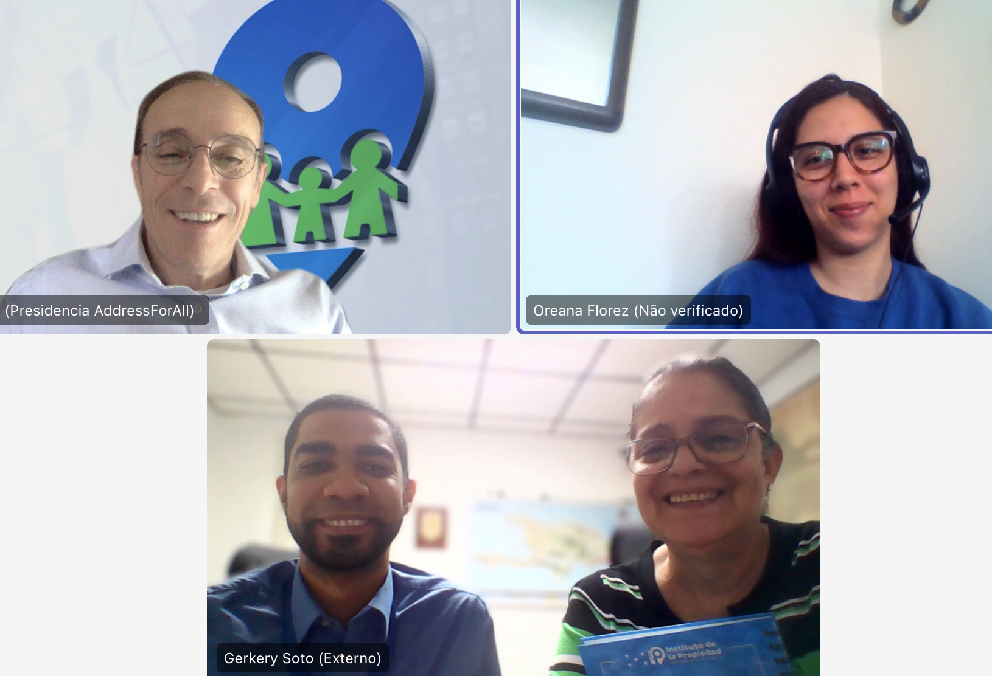

Dominican Republic

Slide 21


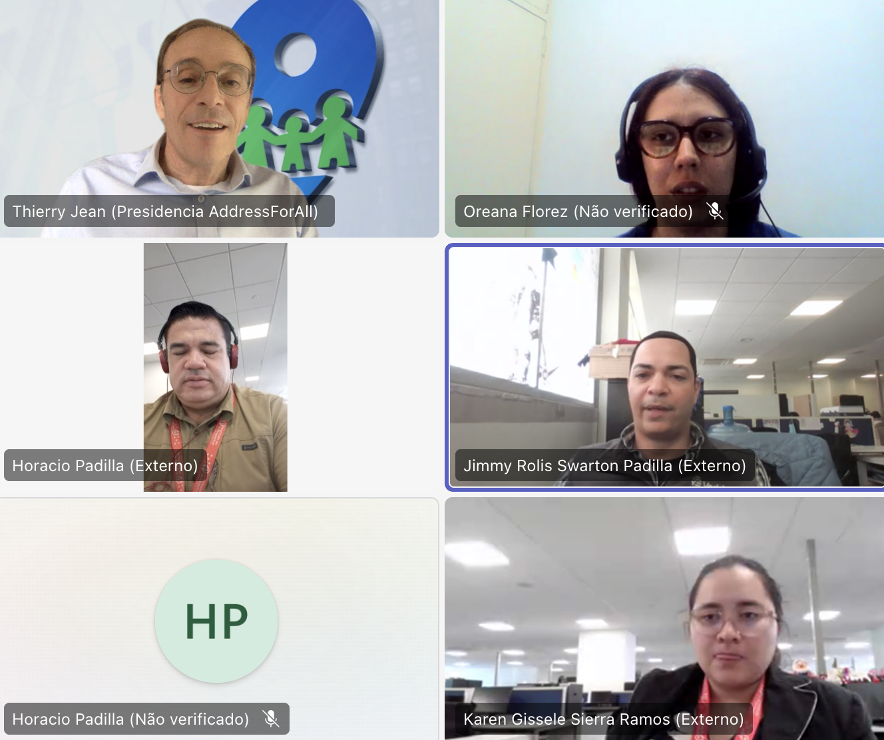
Honduras

Slide 22
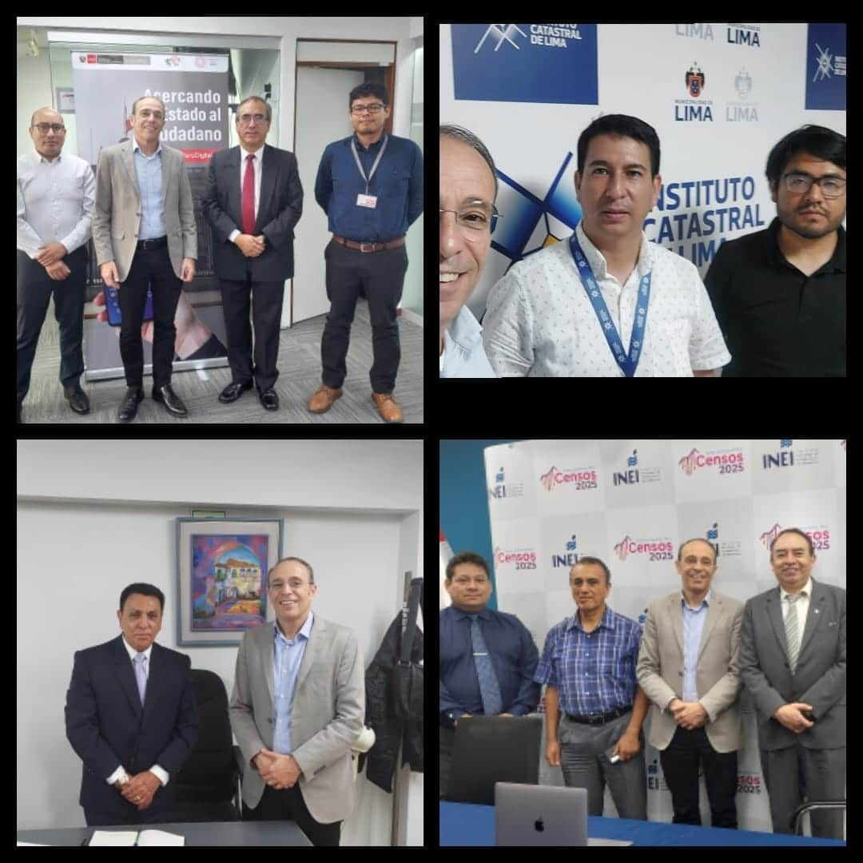
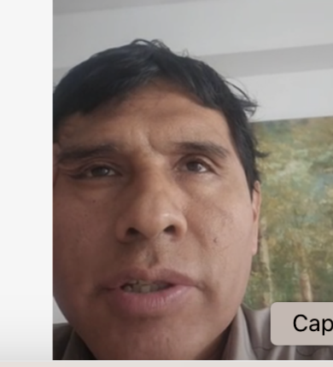
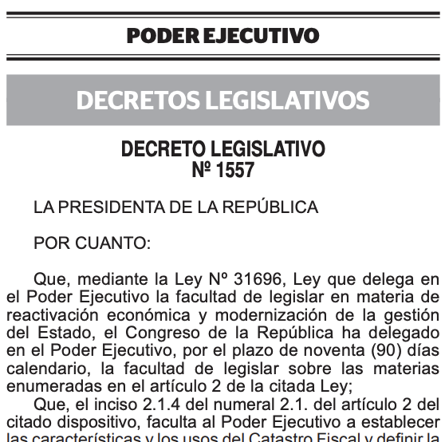

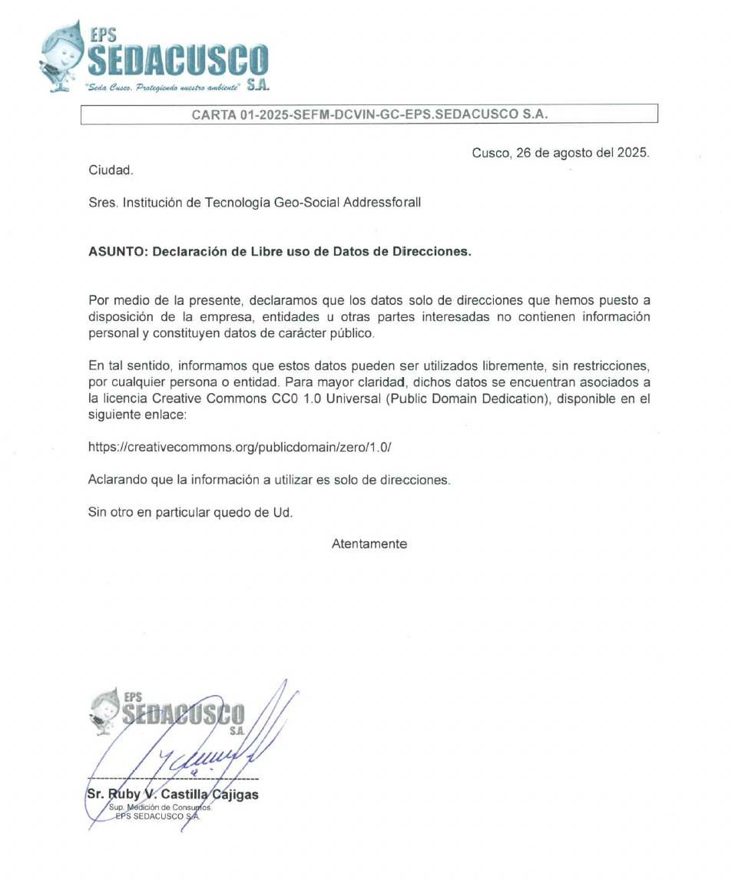
Peru

Slide 23

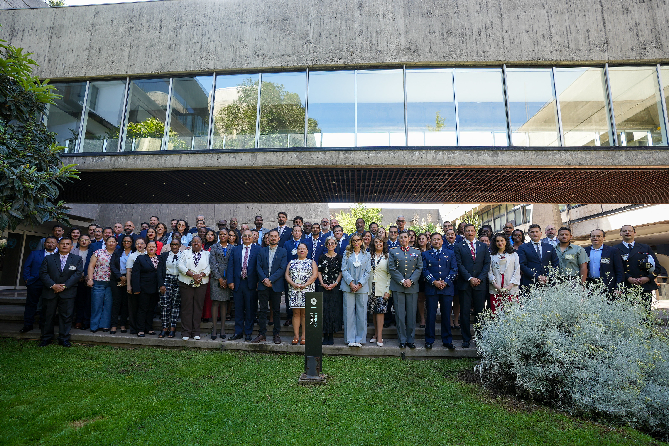
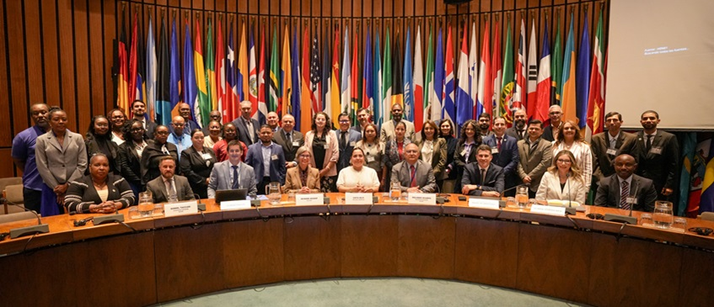
UN-GGIM

Slide 24

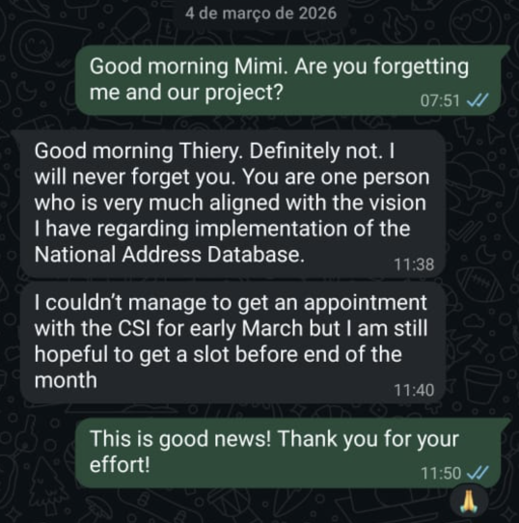
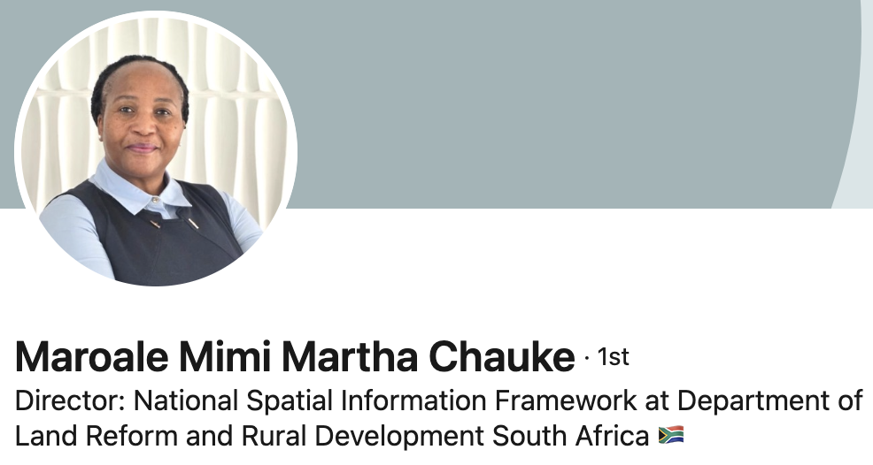
South Africa

Slide 25

Indonesia

Slide 26

Mozambique

Slide 27
Summary-LATAM-Contacts-AddressForAll.xlsx Country | Does a DB of addresses exist? | Is this DB published? | Is there a Unique Address DB Project? | Comments
Uruguay | Yes | Yes | Yes | They are reflecting on implementing the AFA Codes methodology
Colombia | Yes | Yes | We are close | Elkin Ramirez (DANE) got motivated to relaunch the idea of a permanent Address after UN-GGIM event in Nov 25
Brazil | Yes | Yes | Yes Contract signed | They have decided to create DPI for addresses. Contract dec 25
Mexico | Yes | Yes | Yes | We are in discussions with INEGI to provide technical assistance for the implementation of an open address database.
Peru | Yes | No but we are close | We are close | Ongoing work is being carried out in coordination with the Ministry of Economy.
Ecuador | Yes & No | Decepetion! | No | We were very optimistic after meeting the new CEO , Eva Mera last June. Unfortunately, they maintained their position.
Chile | Yes | Yes (june 24) | Yes | The INE sent over to us their address data. Sofia Nilo explained in our March Webinar their planning for the address project
Paraguay | Yes | Yes ( feb 25) | No | The INE published the address point DB with no atribute, but we are having meetings with the cadaster to enrich the data
Argentina | No | No | Yes | They have launched the project GEOref for addresses! But they lack addresses. Working on convincing INDEC to publish
Bolivia | Yes with coordinates and no address | No | No | New hope with recent election in September
Costa Rica | No | No | No | An address project seems on track with UN
Guatemala | Yes | No | No | We thought they had data, but we are not sure now. Waiting to meet the new team
República Dominicana | Yes | No | We are close | IGN team motivated for an addresss project. We expect ONE to publish their base
El Salvador | We are investigating | No | Yes | They have shown great interest in the AFA Codes and wish to launch an address project
Venezuela | No | No | No | Not much hope because of Political situation. No building numbers in the country. Just names.
Honduras | No | No | We are close | 5 meetings since since November. We expect they’ll launch an address project
Panama | Yes | They gave us the data but it was bad | We are close | Several meetings with top executives of INE and AIG. Good chances to have an address project there.

Slide 28










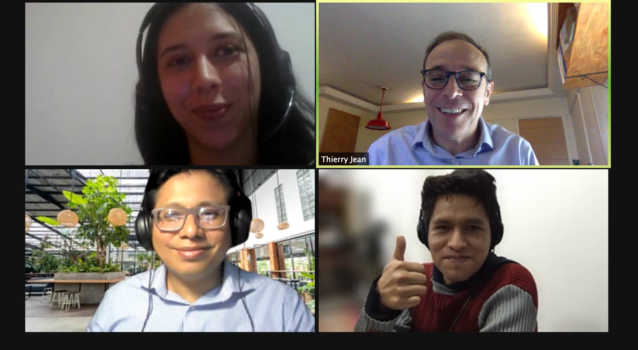





Founders: (NGO created in Jun 2020)
We are an NGO that advocates the publication of address databases and the creation of collaborative address database projects in the countries.
Consultive Board
Thierry Jean Cofounder & Sponsor
Peter Krauss Cofounder & Sponsor
Filipe Rocha Cofounder & Sponsor
Roberto Olinto, Former President of the IBGE & Professor at FGV
Rafael Siqueira, co-founder at Apontador/
Maplink
Silvana Camboim, Professor at UFPR
Team in Brazil
Team in LATAM
Claiton Nesse
SW Development
Edy
Communication
Carlos Rebollo Servers
Oreana Florez
Venezuela
Fredy Rivera
Colombia
Eduardo Francisco, Professor at FGV and Counselor at SEADE foundation
Clodoveu Davis, Professor at UFMG
Luiz Ugeda, PHD in Geography and law
Felipe Reis – GIS/SQL

Slide 29

All our databases are now provided to Overture Maps Foundation

Slide 30


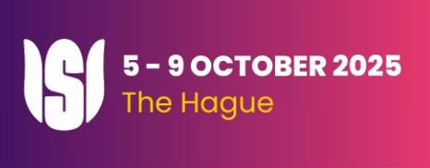





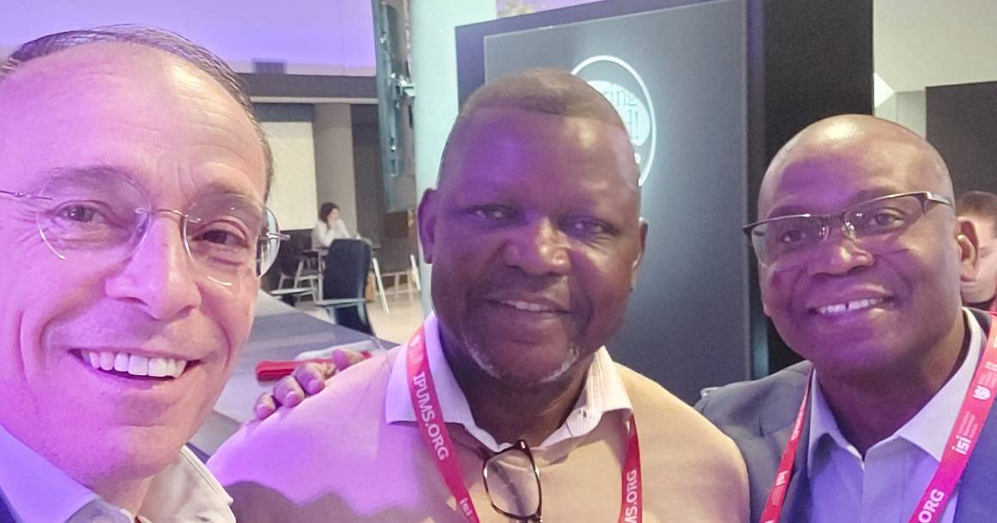



ISI – World Statistics Congress Oct 25

Slide 31


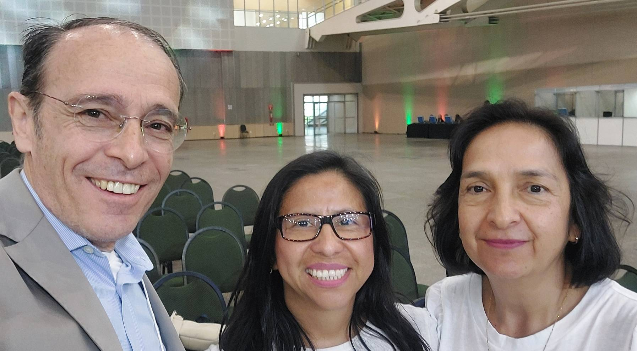

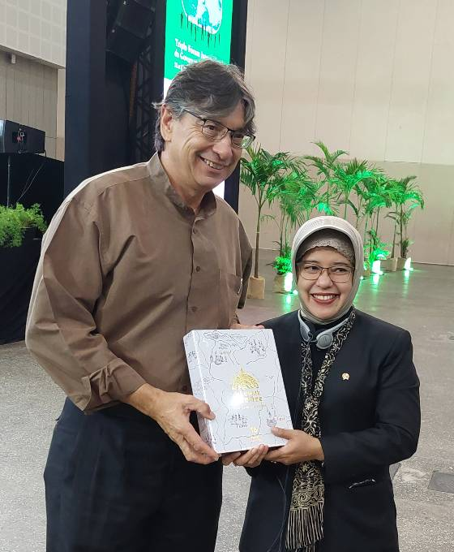

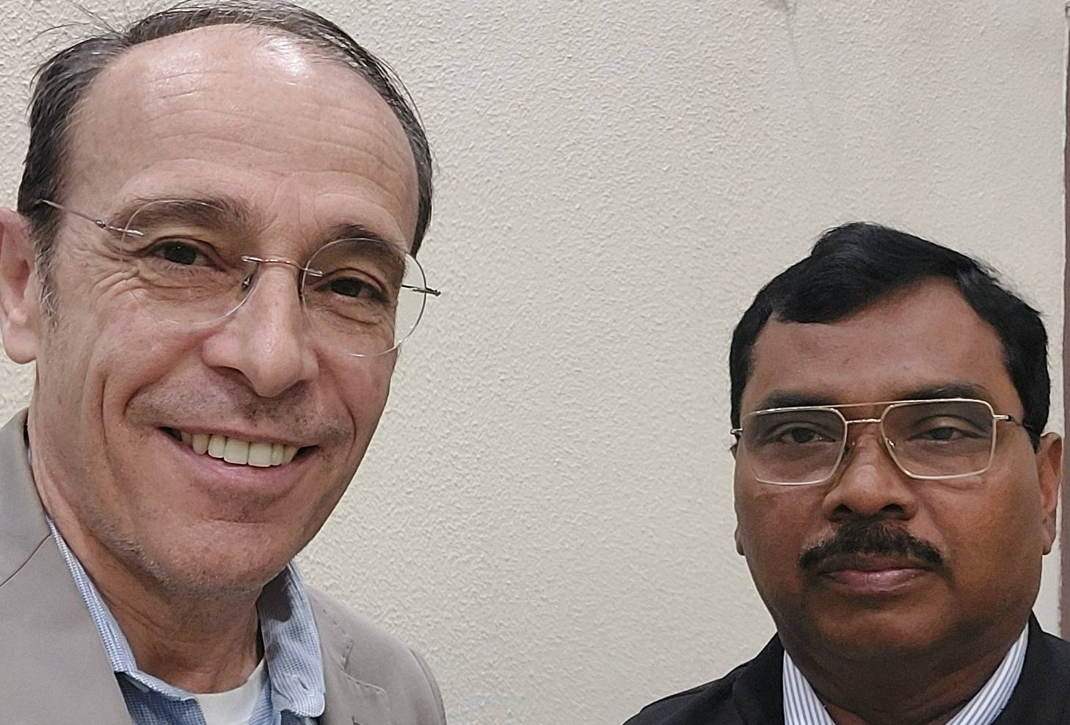

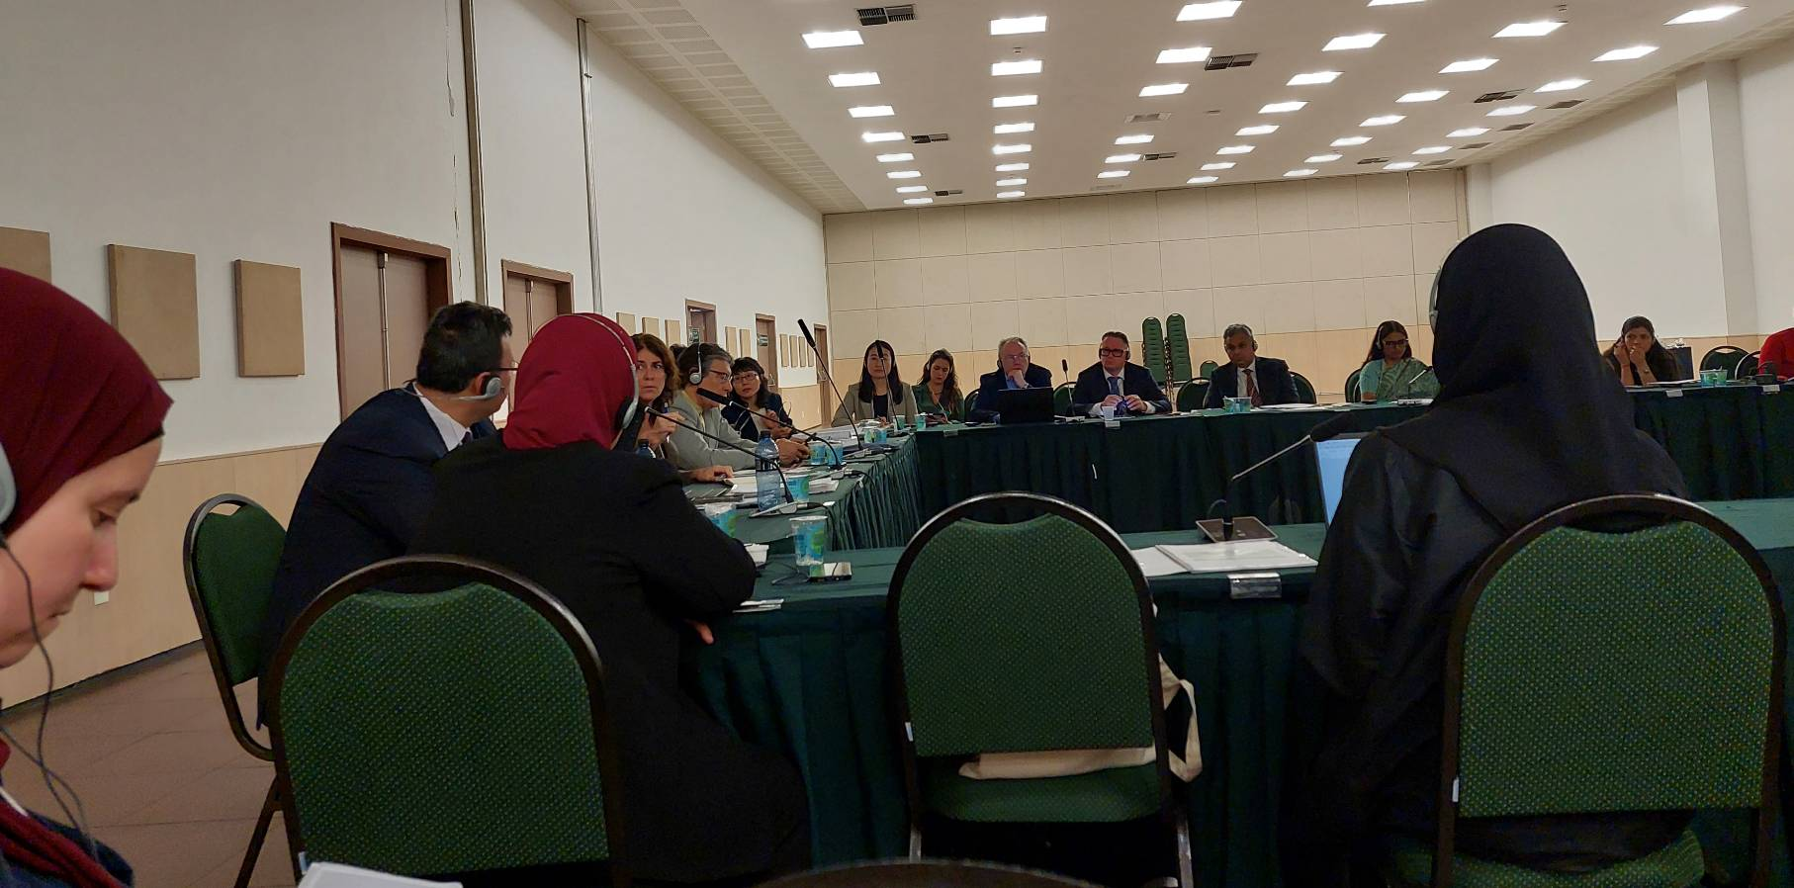

Triple International Forum on the Governance of the Global South

Slide 32


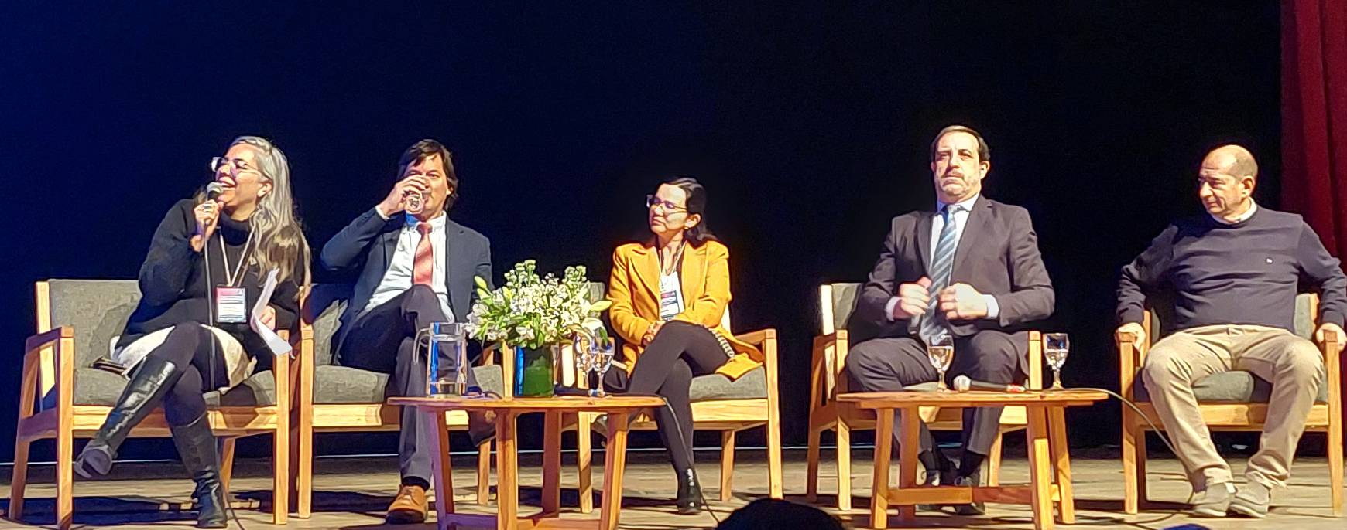

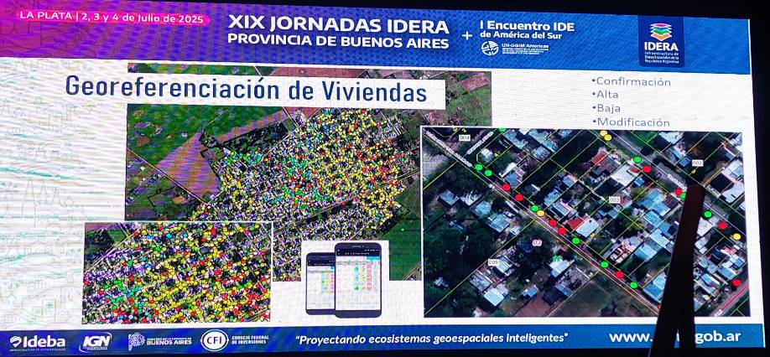

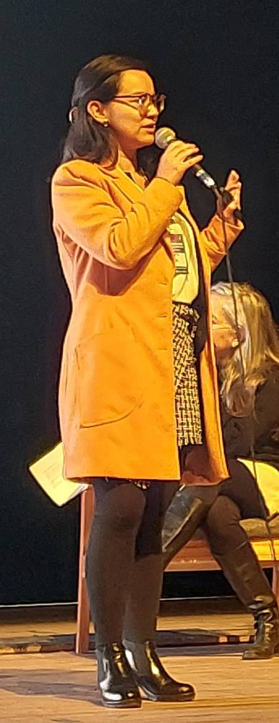

XIX jornadas IDERA and Latam NSDIs meeting

Slide 33
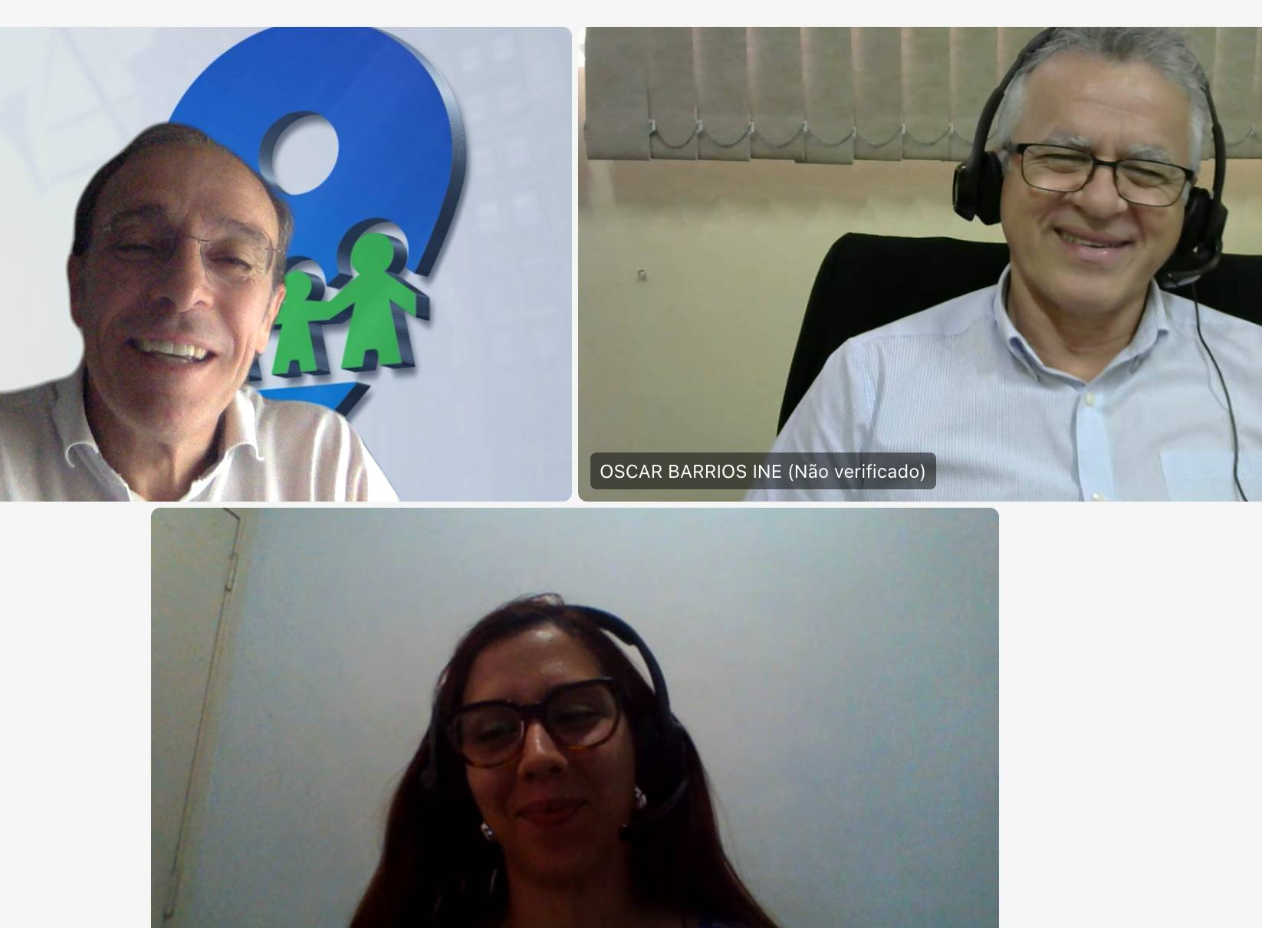
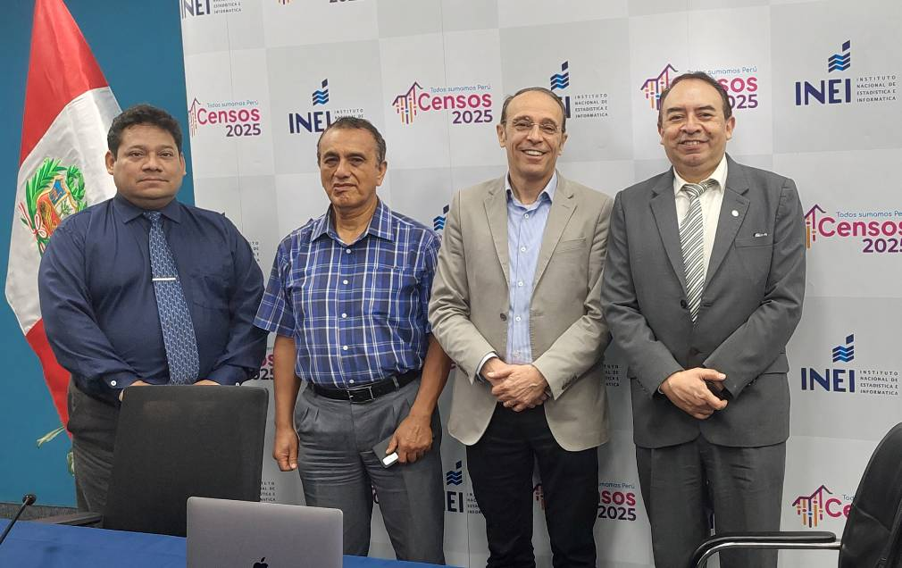
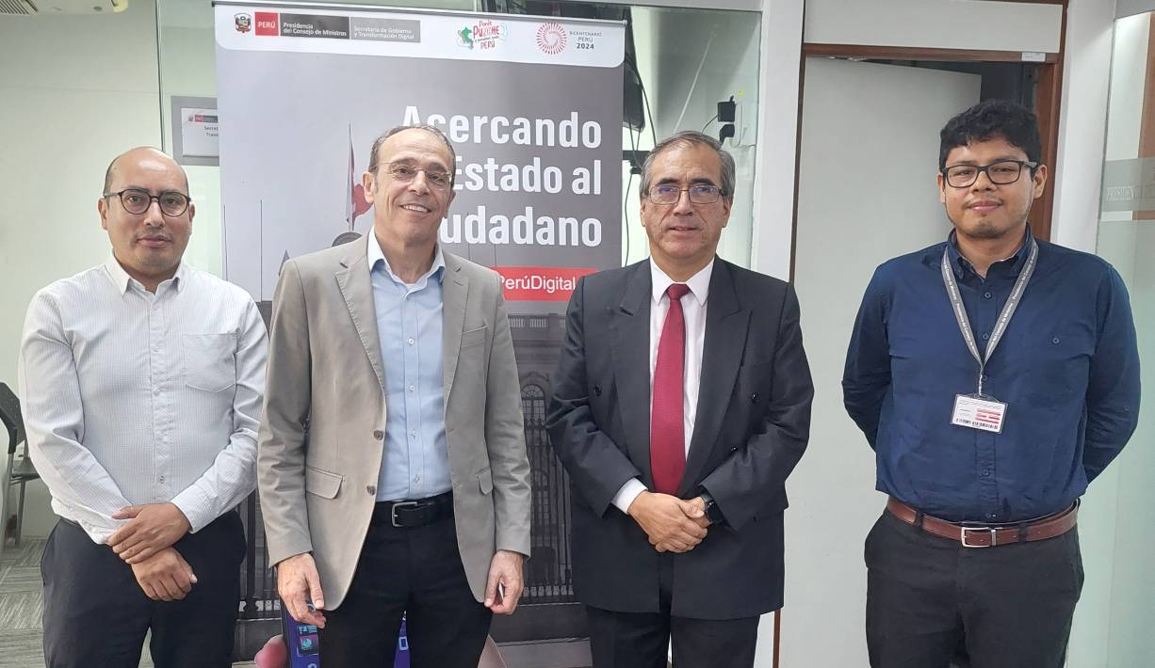
Trip to Paraguay and Peru 10 days in March

Slide 34

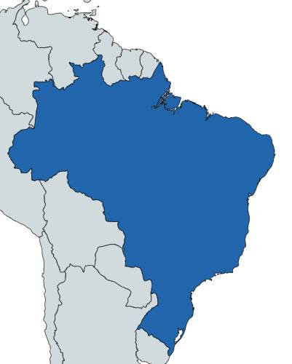
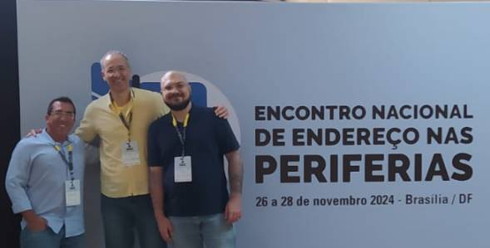
Brazil
Marcio Pochmann
IBGE President

Slide 35

Uruguay

Slide 36
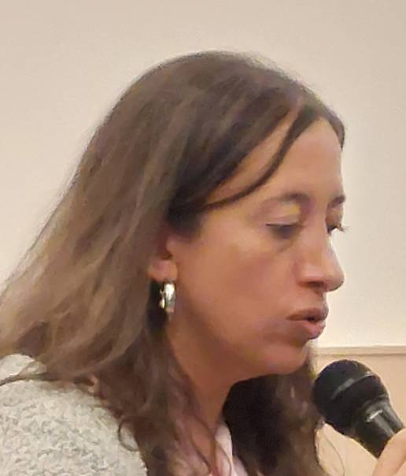
Colombia

Slide 37

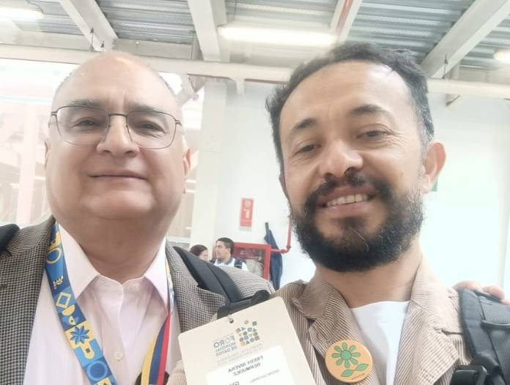
Colombia – World Data Forum (UN)
Ivan Ojeda - CEO INE Paraguay
Hannes Reuter - EuroStat
Rolando Ocampo - Director Statistics Division LATAM CEPAL (UN)

Slide 38
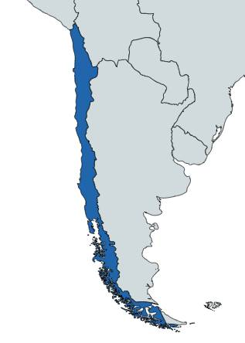
Chile

Slide 39
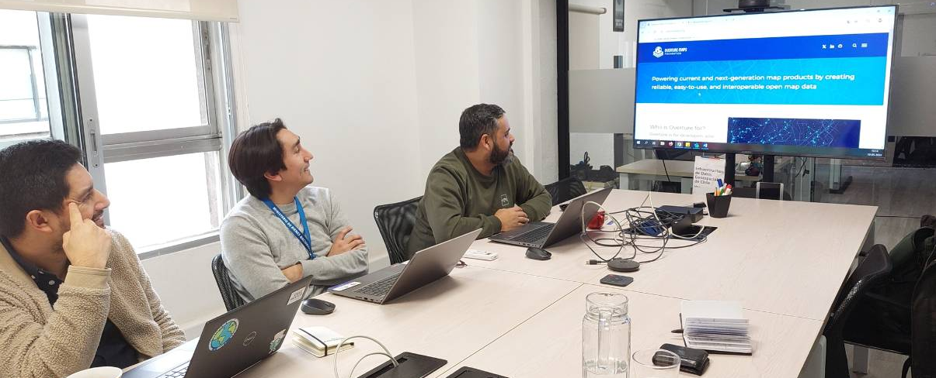
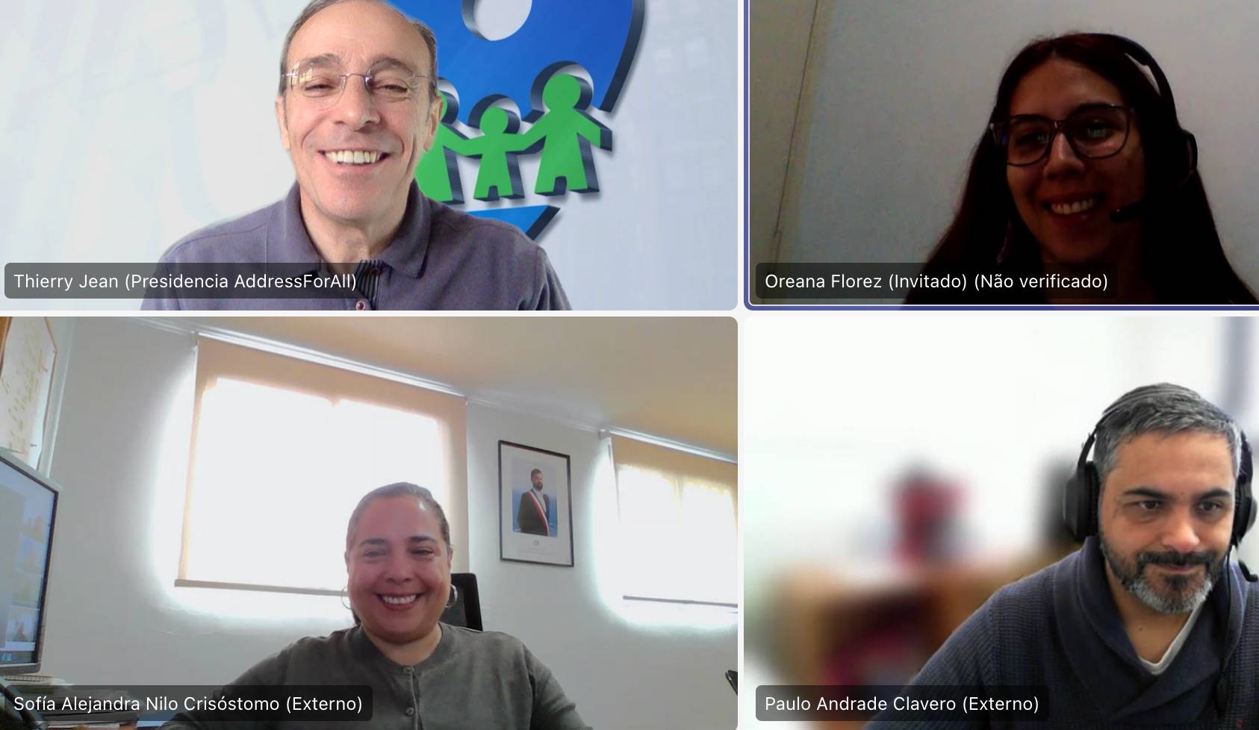
Chile

Slide 40
Peru

Slide 41
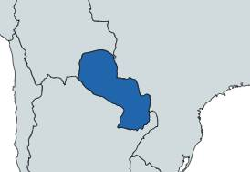
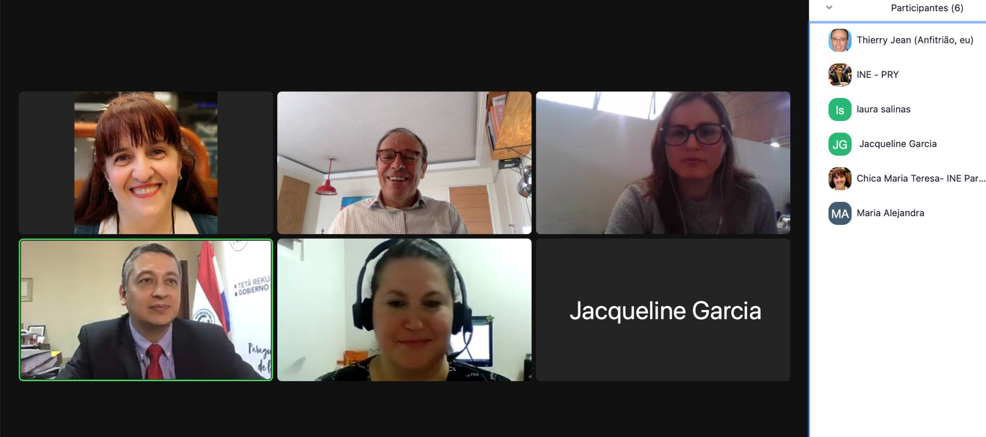
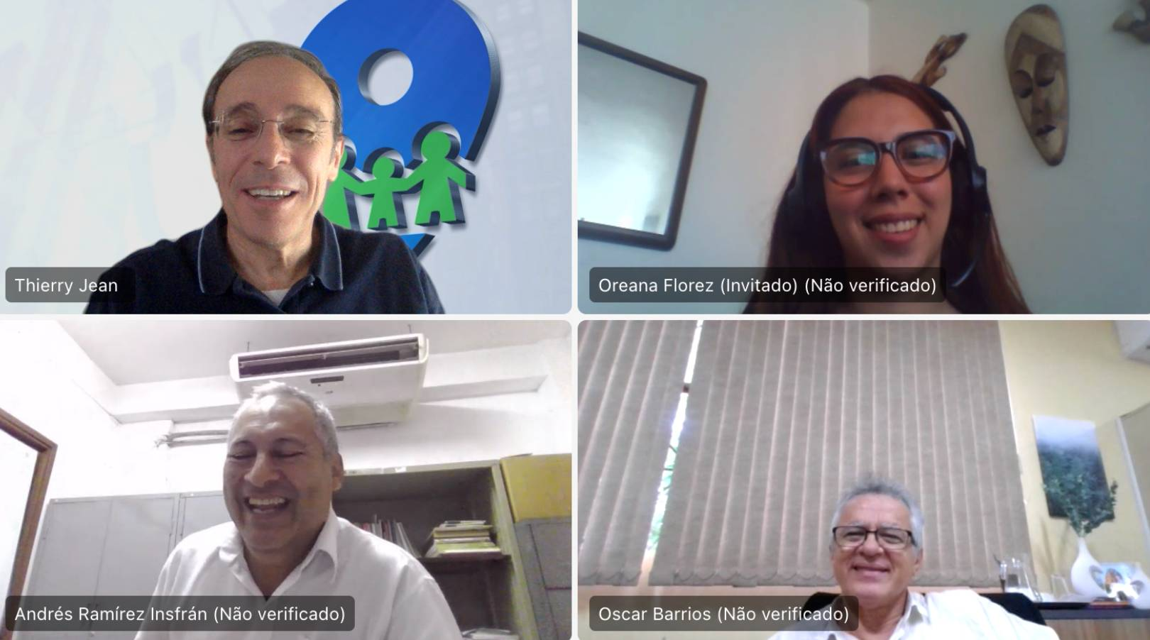
Paraguay
Ivan Ojeda - CEO INE Paraguay

Slide 42
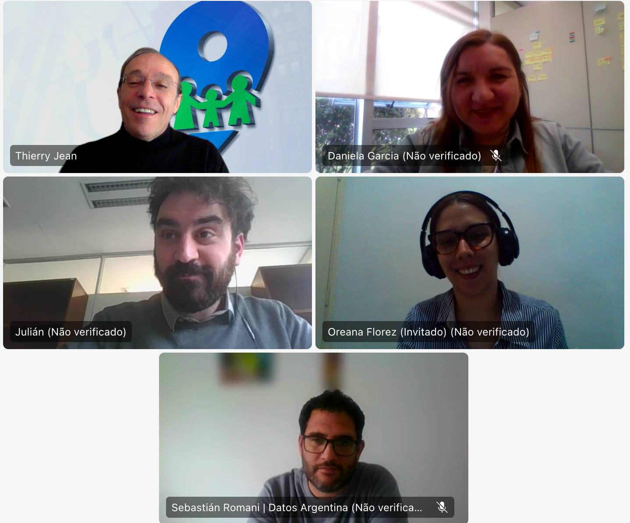
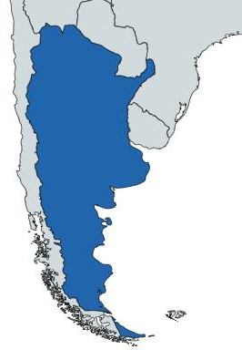
Argentina

Slide 43

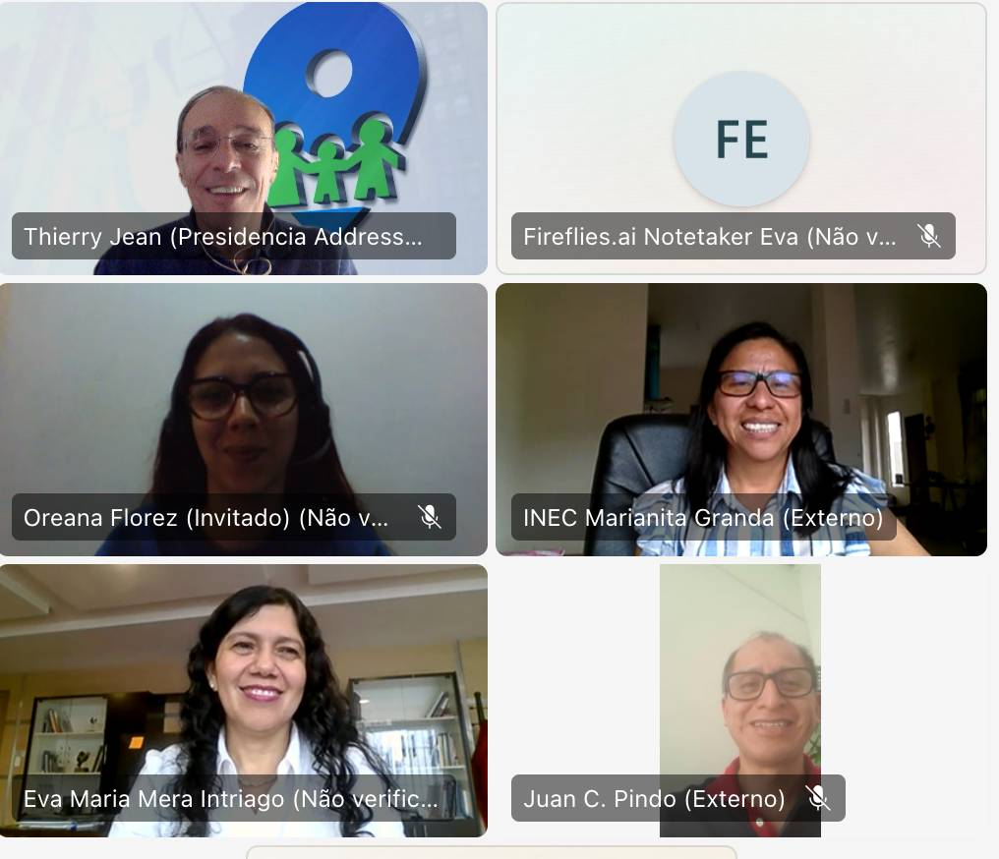


Ecuador

Slide 44


Mexico

Slide 45



Costa Rica

Slide 46

El Salvador

Slide 47

Guatemala

Slide 48


Republica Dominicana

Slide 49
Panama

Slide 50

Honduras

Slide 51



United Nations

Slide 52



United Nations

Slide 53


Specific meetings for Overture upload
- Uruguay: Pablo Brugnoni – IDE coordinator in Uruguay
- Portugal: Francisco Caldeira – INE geographic information
- Spain: Sistema de Cartografia Nacional
Mexico
Belgium

Slide 54


Specific meetings for Overture upload
- European Commission:
- Eurostat: Hannes Reuter:

Slide 55



AFA Code delivery in Cameroon
The challenge, now, is adoption

Slide 56


Cameroon Electricity company
BANOC code
6XNJKB

Slide 57

Cuba. An opportunity?

Slide 58
Thank you !
Thierry Jean
+55 11 996.071.319 (WhatsApp)
thierry@addressforall.org

