Slide 1

Hack Your Own Dockerfiles
Before Someone Else Does
Hands-On Container Security with OWASP DockSec
OWASP Global AppSec Vienna 2026
Advait Patel — Senior Cloud Security & SRE | Docker Captain | Google Developer Expert | OWASP Founding Member
OWASP LAB PROJECT
MIT LICENSE
22,000+ PYPI DOWNLOADS

Slide 2
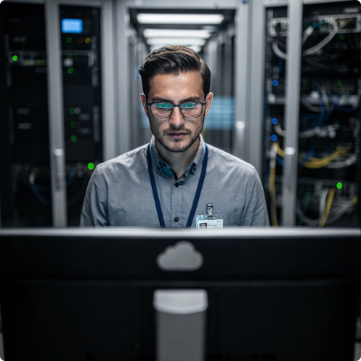
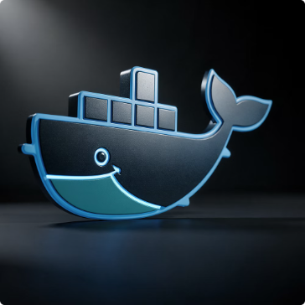
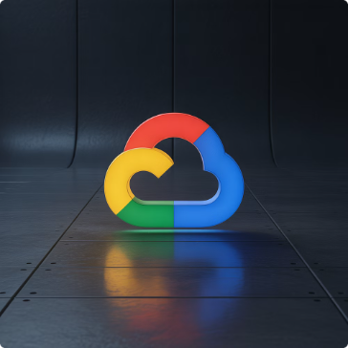
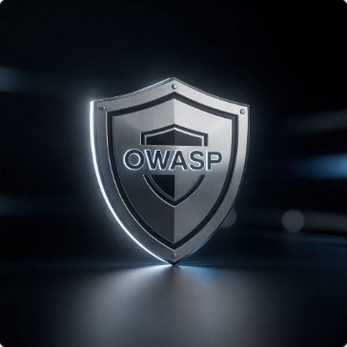

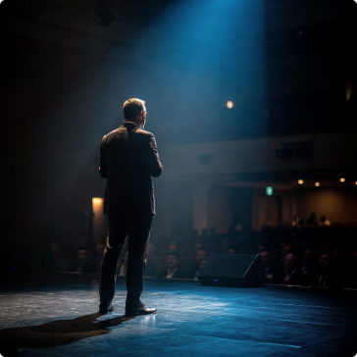

Who Is This Guy?
Senior Cloud Security & SRE
Docker Captain
Google Developer Expert
OWASP Founding Member
Experienced in securing container infrastructure at scale across enterprise environments.
Recognized by Docker Inc. for deep container expertise and community leadership.
GDE in Google Cloud — specializing in architecture and security.
Author of OWASP AIVSS Framework; active contributor to global security standards.
Published Author & Researcher
Conference Speaker
6 books (Springer, Apress, Wiley). Best Paper Award — IEEE ICAIC 2025.
OWASP AppSec · QCon AI Boston · SANS CloudSecNext · Linux Security Summit NA · PlatformCon
Creator of DockSec — OWASP Lab Project | 22,000+ PyPI Downloads

Slide 3
What We Are Covering Today
The Container Security Crisis
1
Why scanners alone are failing your teams.
2
What DockSec Is and How It Works
Architecture, pipeline, and design philosophy.
Live Demo — Scan a Real Vulnerable Dockerfile
3
Score drops from 75 to 2 when we include the base image.
4
Hands-On Workshop — Scan Your Own Dockerfile
Bring your Dockerfile. We scan it live today.
Q&A and Next Steps
5
Open floor, integrations, and community resources.

Slide 4
84% of Production Container Images Have a HIGH or CRITICAL CVE
Source: Sysdig 2026 State of Cloud Native Security Report
The Volume Problem
The Context Gap
The Remediation Gap
A single scan returns 200+ CVEs. Teams get desensitized. Alert fatigue sets in. Nothing gets fixed.
Scanners tell you what is vulnerable — never what it means for your specific Dockerfile or pipeline.
Which of the 200 CVEs actually matter? What exact line do you change? No scanner answers that — so fixes never ship.

Slide 5
What You Get vs. What You Actually Need
Raw Trivy Output
What You Actually Need
Plain English explanation per critical issue
The 3 issues needing immediate action, ranked by real risk
The exact Dockerfile line to change — with the corrected version
A security score to measure improvement over time
CVE-2023-0464 HIGH openssl 3.0.2
CVE-2023-2650 HIGH openssl 3.0.2
CVE-2022-4899 MEDIUM libzstd1 1.4.8
CVE-2023-1667 MEDIUM libssh-4 0.9.6
CVE-2022-3715 MEDIUM bash 5.1-6ubuntu1
CVE-2023-0361 HIGH libgnutls30 3.7.3
... 197 more vulnerabilities

Slide 6
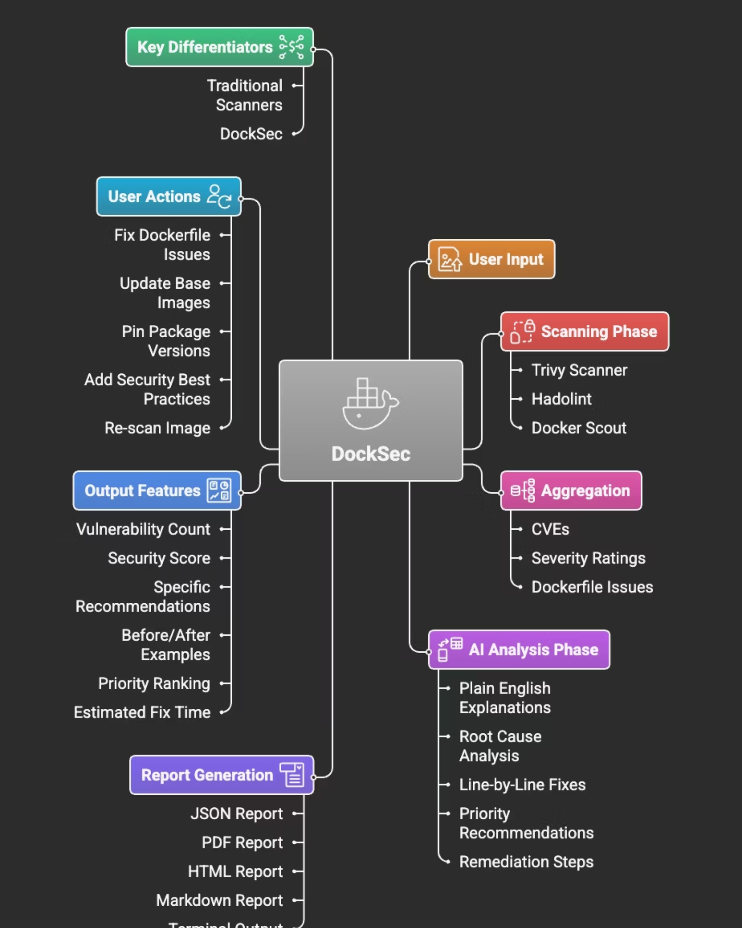
DockSec — AI-Powered Docker Security Analysis
22,000+ PyPI Downloads
Organic growth since February 2025. No paid promotion.
One Command to Start
pip install docksec — zero complex setup required.
Fully Open Source
MIT License, OWASP-governed. No black boxes.
No API Key Required
Scan-only mode works fully offline — no data leaves your machine.
"Think of it as having a security expert review your Dockerfile — one who reads the whole context before giving advice."
OWASP LAB PROJECT
MIT LICENSE
PYTHON 3.12+

Slide 7





Four-Stage Pipeline — Scan to Actionable Fix
SCAN
ANALYZE
Runs Trivy, Hadolint, and Docker Scout locally on your machine.
AI correlates findings, removes duplicate noise, assesses real-world impact.
RECOMMEND
REPORT
Generates plain English explanations and specific line-level Dockerfile fixes.
Exports as HTML, PDF, JSON, CSV, or Markdown.
All scanning runs locally. Only structured scan results go to the AI provider. Your source code never leaves your machine.

Slide 8
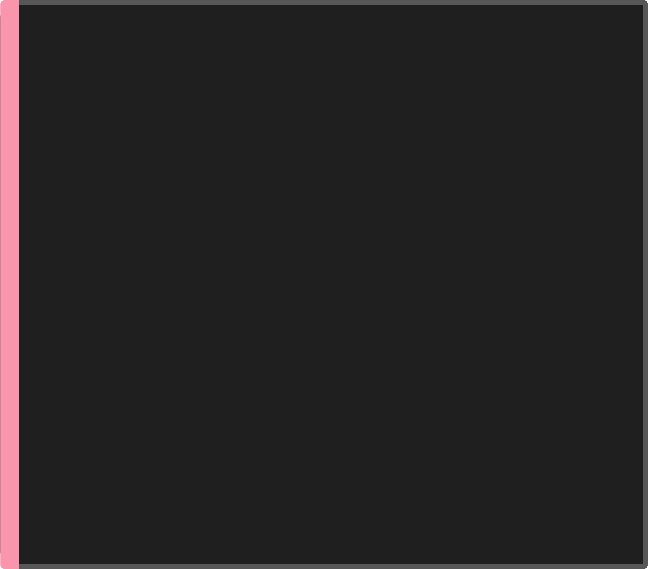

Three Scanners Unified — DockSec Combines and Deduplicates
Trivy — Aqua Security
Hadolint — Dockerfile Linting
Docker Scout — Image Intelligence
CVE scanning for OS packages and language dependencies
Finds vulnerabilities across all severity levels
Detects hardcoded secrets and misconfigurations
Lints against Docker best practices and CIS guidelines
Catches: ADD instead of COPY, missing USER, untagged base images
Maps to DL3XXX rule codes
Vulnerability tracking across image layers
Policy evaluation against defined security baselines
Tracks CVE exposure across image history
DockSec deduplicates findings across all three and passes one clean structured summary to the AI layer.

Slide 9
Bring Your Own Model — No Vendor Lock-In
OpenAI (Default)
Anthropic Claude
GPT-4o, GPT-4 Turbo
Claude 4.x, Claude 3.5 Sonnet
export OPENAI_API_KEY="your-key"
export ANTHROPIC_API_KEY="your-key"
export LLM_PROVIDER="anthropic"
Google Gemini
Ollama — Local / Air-Gapped
Gemini 1.5 Pro, Gemini 1.5 Flash
Llama 3.1, Mistral, Phi-3 — runs entirely on your machine.
export GOOGLE_API_KEY="your-key"
export LLM_PROVIDER="google"
export LLM_PROVIDER="ollama"
export LLM_MODEL="llama3.1"
Switch providers at runtime with --provider and --model flags. No code changes needed.

Slide 10

Security Score — A Single Number Your Team Can Track
Score Breakdown
Score Bands
22/100
90–100 Excellent
70–89 Good
Strong posture. Minor monitoring needed.
Minor improvements. Not critical.
POOR
50–69 Fair
0–49 Poor
50% weight — Vulnerability Severity (CRITICAL / HIGH / MEDIUM / LOW)
30% weight — Dockerfile Quality (linting violations, bad patterns)
20% weight — Configuration Checks (root user, secrets in ENV, exposed ports)
Structured remediation sprint needed.
Do not ship — immediate action required.
Going from 22 to 89 is a story leadership understands.

Slide 11






Six Dockerfile Checks That Cost You Points
No USER Directive −25 pts
Hardcoded Credentials −30 pts
Container runs as root. Host compromise if breakout occurs.
ENV vars with PASSWORD, SECRET, API_KEY are visible in every docker inspect.
Using :latest Tag −15 pts
Missing HEALTHCHECK −10 pts
Non-reproducible builds. Unpredictable CVE surface area.
Orchestrators cannot detect unhealthy containers. Silent failures in production.
Sensitive Ports Exposed −10 pts
--privileged Flag −20 pts
Ports 22, 3306, 5432, 27017, 6379, 9200 have no place in app containers.
Full host access. Disables all container isolation.

Slide 12

Where DockSec Fits — Honest Comparison
Capability
DockSec
Trivy (standalone)
Snyk Container
Aikido
License
Free MIT
Free Apache 2.0
Commercial
Commercial
Governance
OWASP, vendor neutral
Open source, Aqua
Single vendor
Single vendor
Line-level Dockerfile fix
✅ Yes
❌ Detection only
⚠️ Partial
⚠️ Partial
Fully offline / air-gapped
✅ Yes (Ollama)
⚠️ Scan only
❌ No
❌ No
Your data stays local
✅ Yes
✅ Yes
❌ No
❌ No
Bring your own LLM
✅ Yes
N/A
❌ No
❌ No
DockSec is the only open source, locally-runnable tool combining scanner precision with line-level AI remediation.

Slide 13
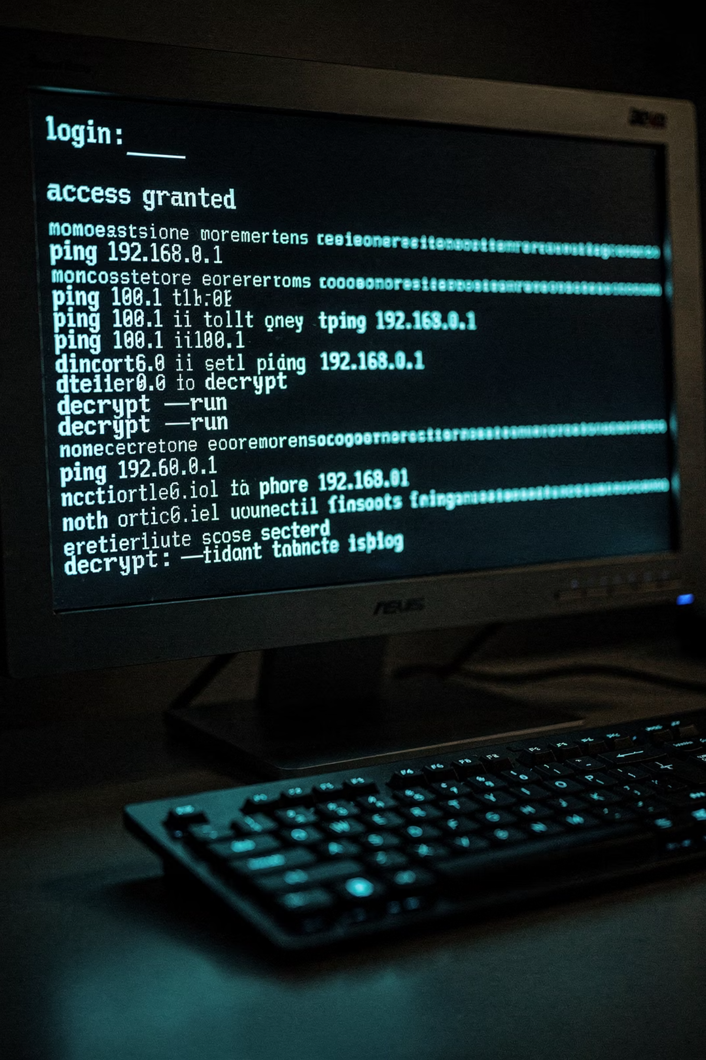


Live Demo
Let's Scan a Real Vulnerable Dockerfile
A Dockerfile with 6 intentional security problems
DockSec run from the terminal — one command
Score climbs from 22 → 89 after applying the fixes
Full HTML report rendered live in the browser
Follow along — the Dockerfile is on the workshop repo: github.com/OWASP/DockSec

Slide 14
The Dockerfile We Are About to Scan
The Vulnerable Dockerfile
Annotated Problems
python:3.9 — untagged minor version, 47 known CVEs
Lines 2–3 — hardcoded credentials, visible in docker inspect
ADD instead of COPY — unnecessary remote URL risk
openssh-server installed — SSH has no place in an app container
EXPOSE 22 — SSH port publicly exposed
No USER directive — container runs as root
No HEALTHCHECK — orchestrator cannot detect failures
FROM python:3.9
ENV API_KEY=sk-prod-abc123secret
ENV DB_PASSWORD=SuperSecret99
ADD ./app /app
WORKDIR /app
RUN apt-get update && apt-get install -y \
openssh-server vim curl
EXPOSE 22
EXPOSE 8080
RUN pip install -r requirements.txt
CMD ["python", "app.py"]

Slide 15

After DockSec — Score Goes from 22 to 89
BEFORE: 75/100 (SCAN-ONLY) VS BEFORE: 2/100 (WITH IMAGE)
AFTER: CLEAN AI FINDINGS
FROM python:3.9
ENV API_KEY=sk-prod-abc123secret
ENV DB_PASSWORD=SuperSecret99
ADD ./app /app
WORKDIR /app
RUN apt-get update && apt-get install -y \
openssh-server vim curl
EXPOSE 22
EXPOSE 8080
RUN pip install -r requirements.txt
CMD ["python", "app.py"]
FROM python:3.9.18-slim-bookworm
COPY ./app /app
WORKDIR /app
RUN apt-get update && apt-get install -y --no-install-recommends curl \
&& rm -rf /var/lib/apt/lists/*
RUN pip install --no-cache-dir -r requirements.txt && useradd -m appuser
EXPOSE 8080
HEALTHCHECK CMD curl -f \
http://localhost:8080/ || exit 1
USER appuser
CMD ["python", "app.py"]
Credentials moved to runtime secrets. Root eliminated. SSH gone. Image pinned. 47 CVEs reduced to 4.

Slide 16
Gate Every Dockerfile Change in CI — One Step
GitHub Actions
Why Gate on Dockerfiles?
Catches regressions before merge — not after production deploy
--scan-only means zero LLM cost and zero data egress in CI
Works with Jenkins, CircleCI, GitLab CI — anywhere Python runs
name: Docker Security Scan
on:
pull_request:
paths: ['Dockerfile']
jobs:
security-scan:
runs-on: ubuntu-latest
steps:
- uses: actions/checkout@v4
- name: Install DockSec
run: pip install docksec
- name: Run Security Scan
run: docksec Dockerfile --scan-only
env:
OPENAI_API_KEY: ${{ secrets.OPENAI_API_KEY }}
Security gates on Dockerfiles are as important as gates on application code.

Slide 17
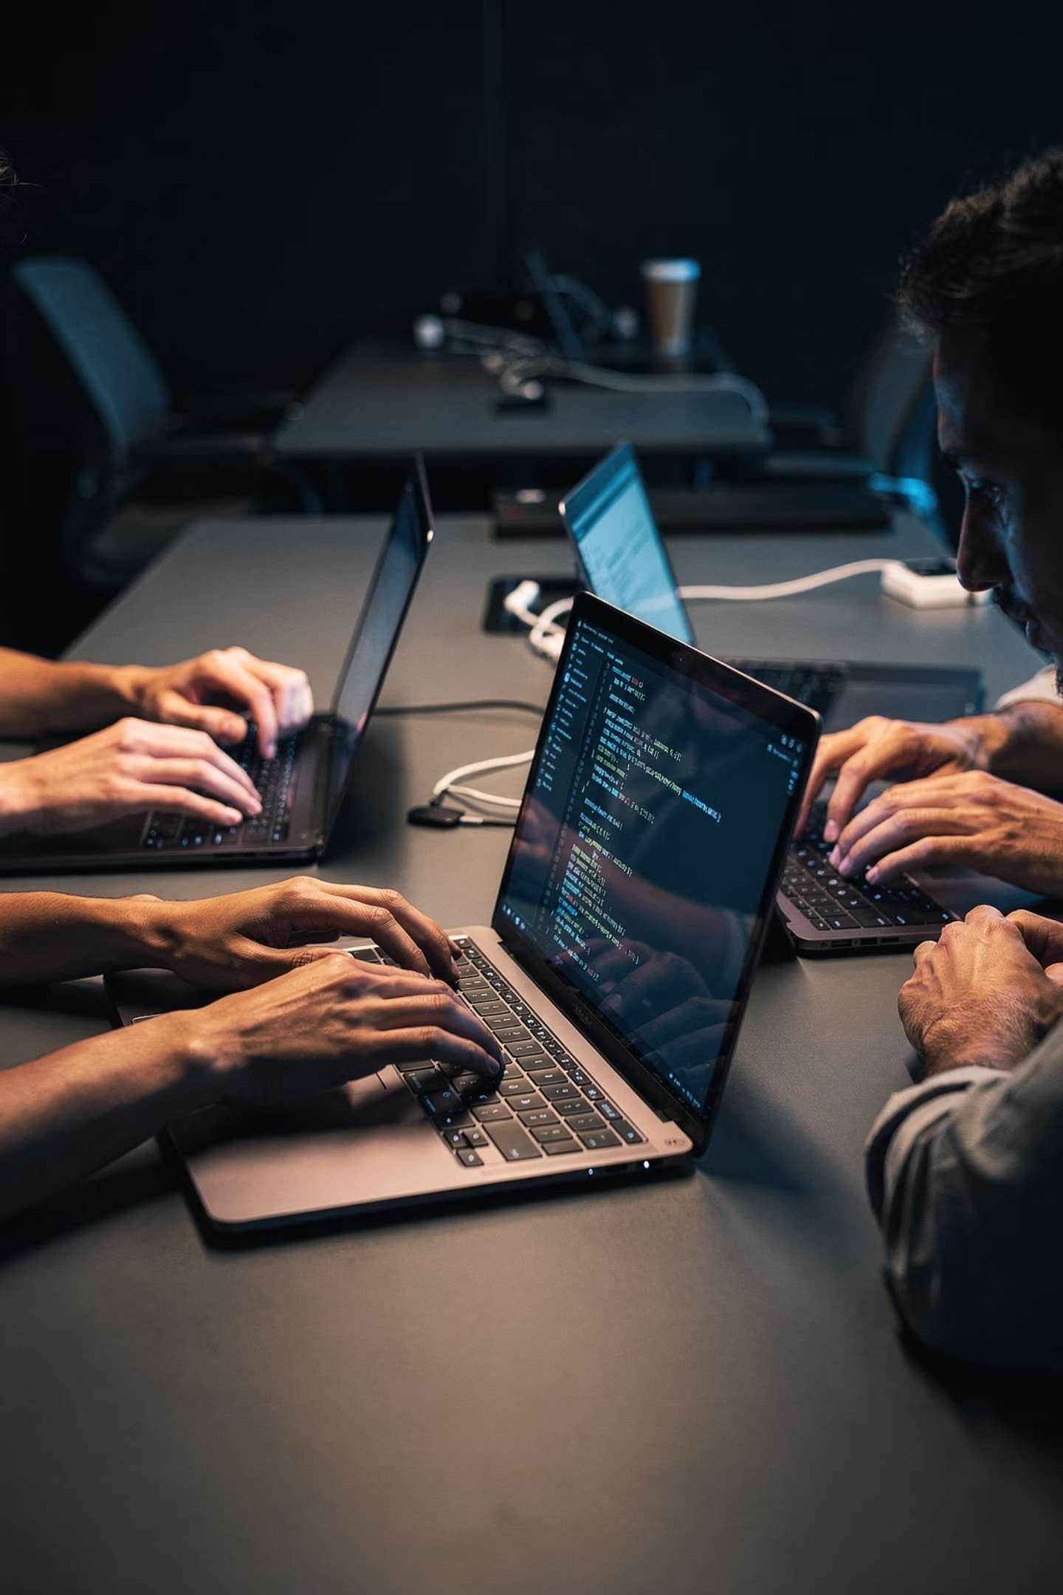



Hands-On Workshop — Scan Your Own Dockerfile
Bring your Dockerfile. Let's go.
Install
Scan (choose your mode)
pip install docksec
# With AI
docksec Dockerfile
# Offline / no key needed
docksec Dockerfile --scan-only
# Scan image too
docksec Dockerfile -i yourimage:tag
# Docker Compose
docksec --compose docker-compose.yml
Review & Fix
Open the HTML report. Find your top 3 issues. Apply the suggested fixes. Re-scan and watch your score improve.
Workshop repo: github.com/OWASP/DockSec | No API key required for --scan-only mode

Slide 18
DockSec in the Media
Featured and published by leading cybersecurity and cloud-native publications worldwide.
Help Net Security
Reversing Labs
Cloud Native Now
Security Week
CyberSecurity News
SC World
The Cyber Express
Under Code News

Slide 19
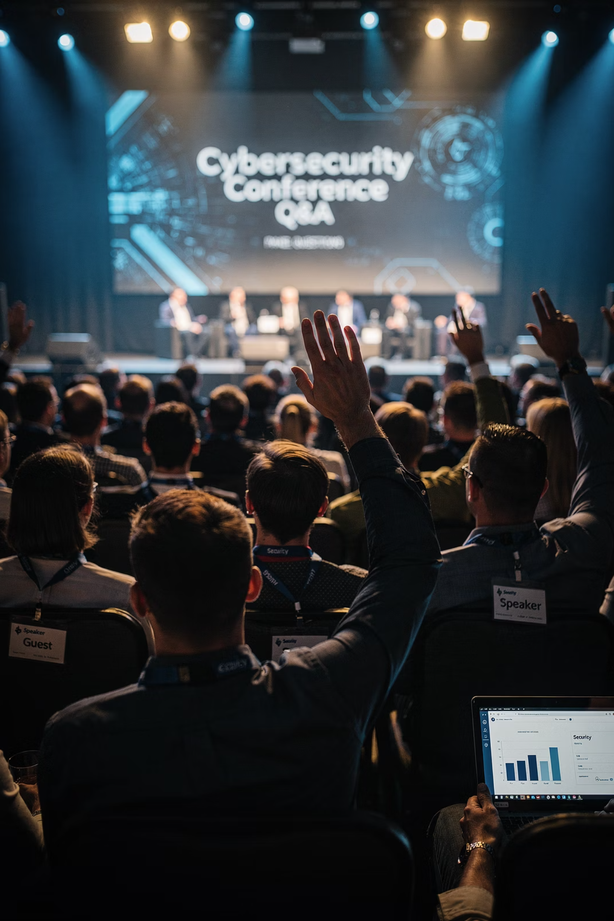






Questions? Let's Dig In
"What vulnerabilities did you find in your Dockerfile just now?"
"What would it take to add DockSec to your pipeline this week?"
"What scanner or integration is missing that you need?"
GitHub
github.com/OWASP/DockSec
PyPI
pypi.org/project/docksec
OWASP Slack
#project-docksec
OWASP Page
owasp.org/DockSec

Slide 20
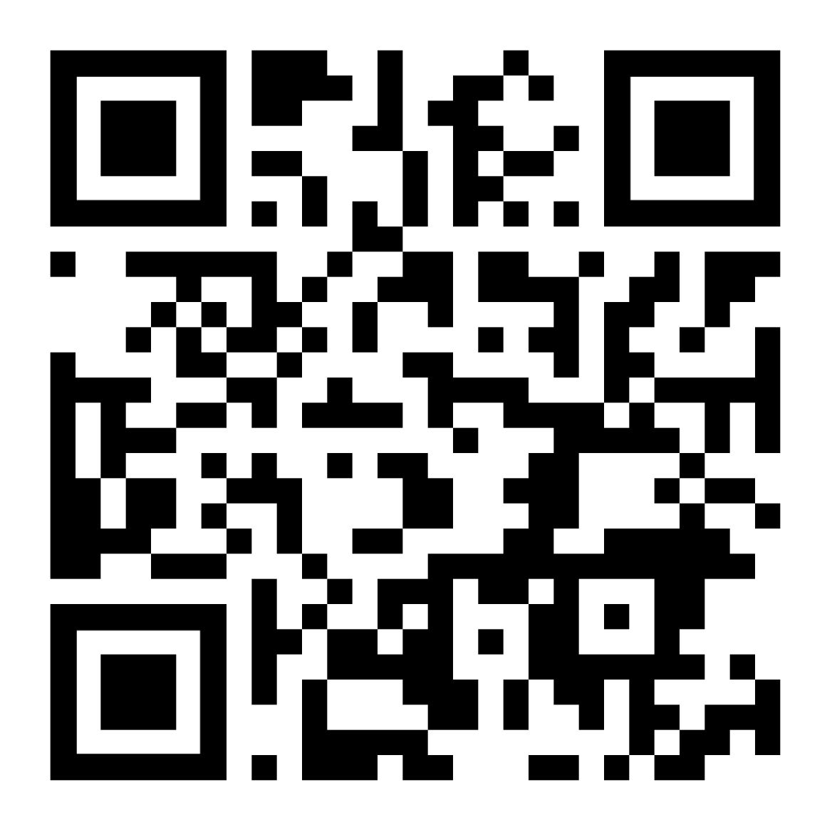
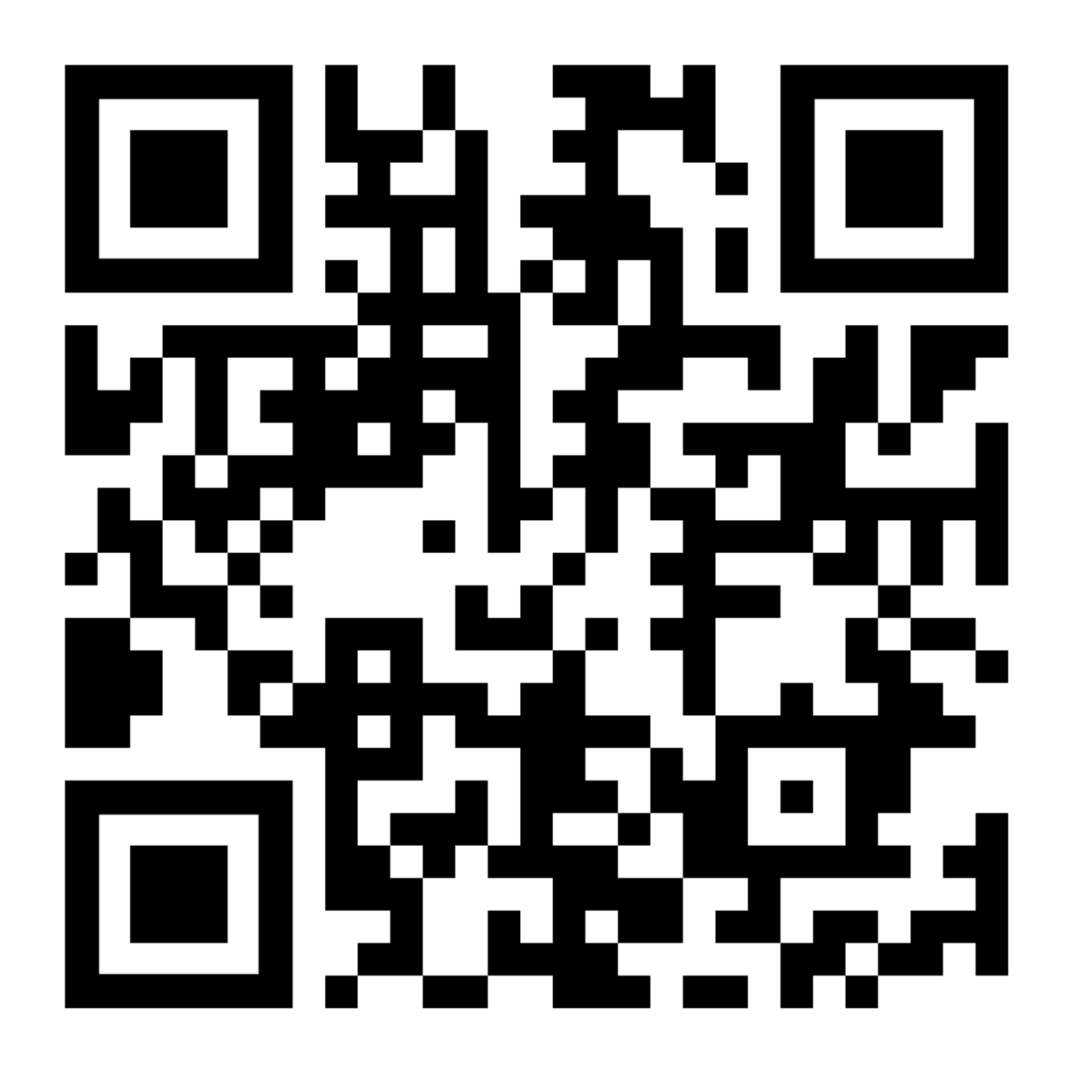

Stay Connected — This Project Belongs to the Community
Connect with Advait
DockSec Resources
LinkedIn: linkedin.com/in/advaitpatel
GitHub: github.com/advaitpatel
OWASP Slack: @advaitpatel in #project-docksec
Email: advait.patel@owasp.org
GitHub: github.com/OWASP/DockSec
PyPI: pypi.org/project/docksec
OWASP Page: owasp.org/DockSec
Slack: #project-docksec
LinkedIn Profile
GitHub Repo
⭐ If DockSec helped you today, give it a star on GitHub — it helps others in the community discover it.

