Slide 1
Insecurity as Code:
How Modern Software Scaled the Attack Surface
Igor Stepansky

Slide 2

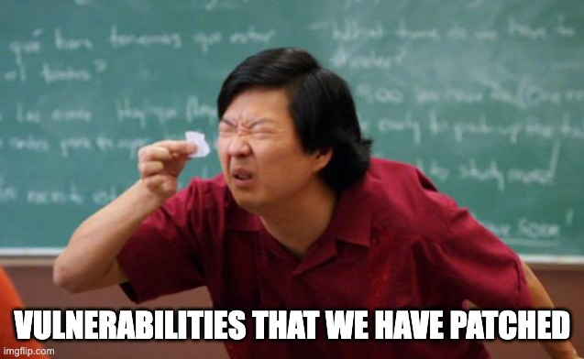

DETECTION ≠ REMEDIATION
Finding the bug was never the hard part
Share of orgs still carrying HIGH / CRITICAL container vulnerabilities, by age:
30%
60%
90%
Unpatched 30+ days
86%
Unpatched 60+ days
81%
Unpatched 90+ days
77%

Slide 3
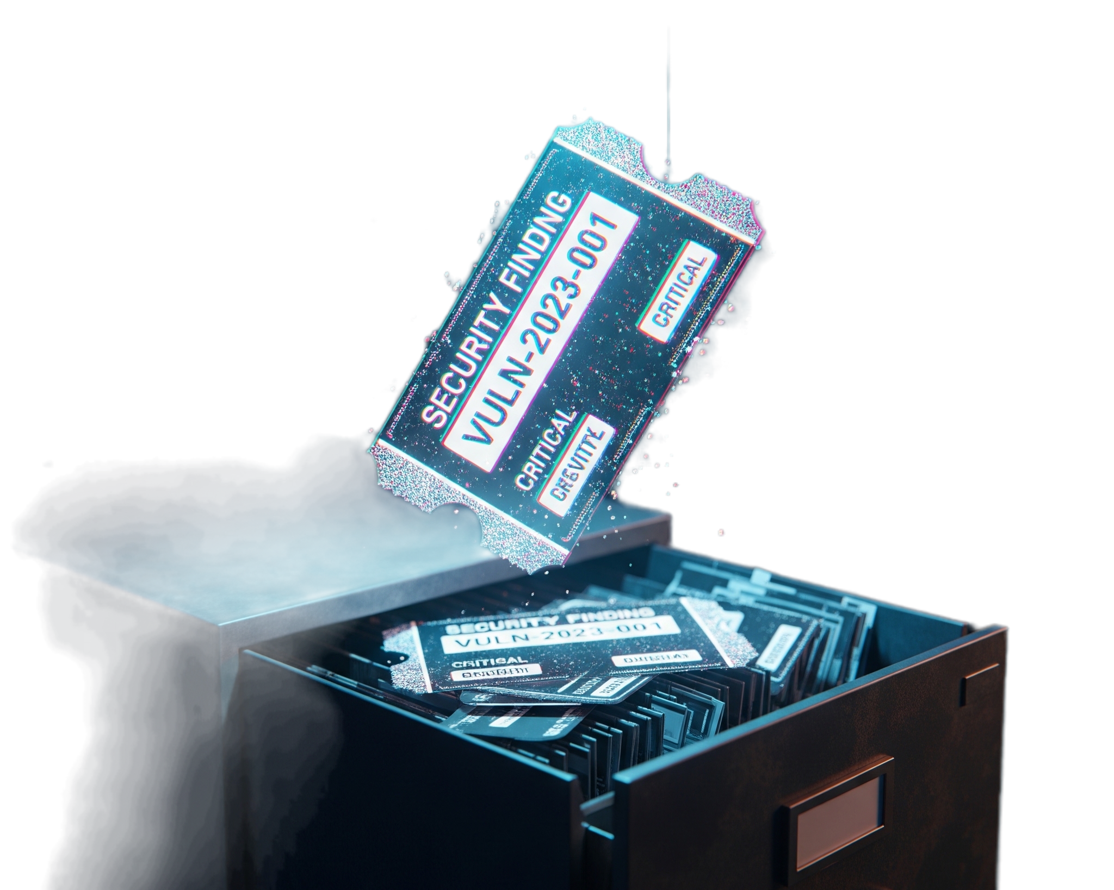
The assumption everyone makes
" It's scanned, it's triaged,
it's in the backlog
Job done "
The moment a finding stops
being treated as a risk

Slide 4
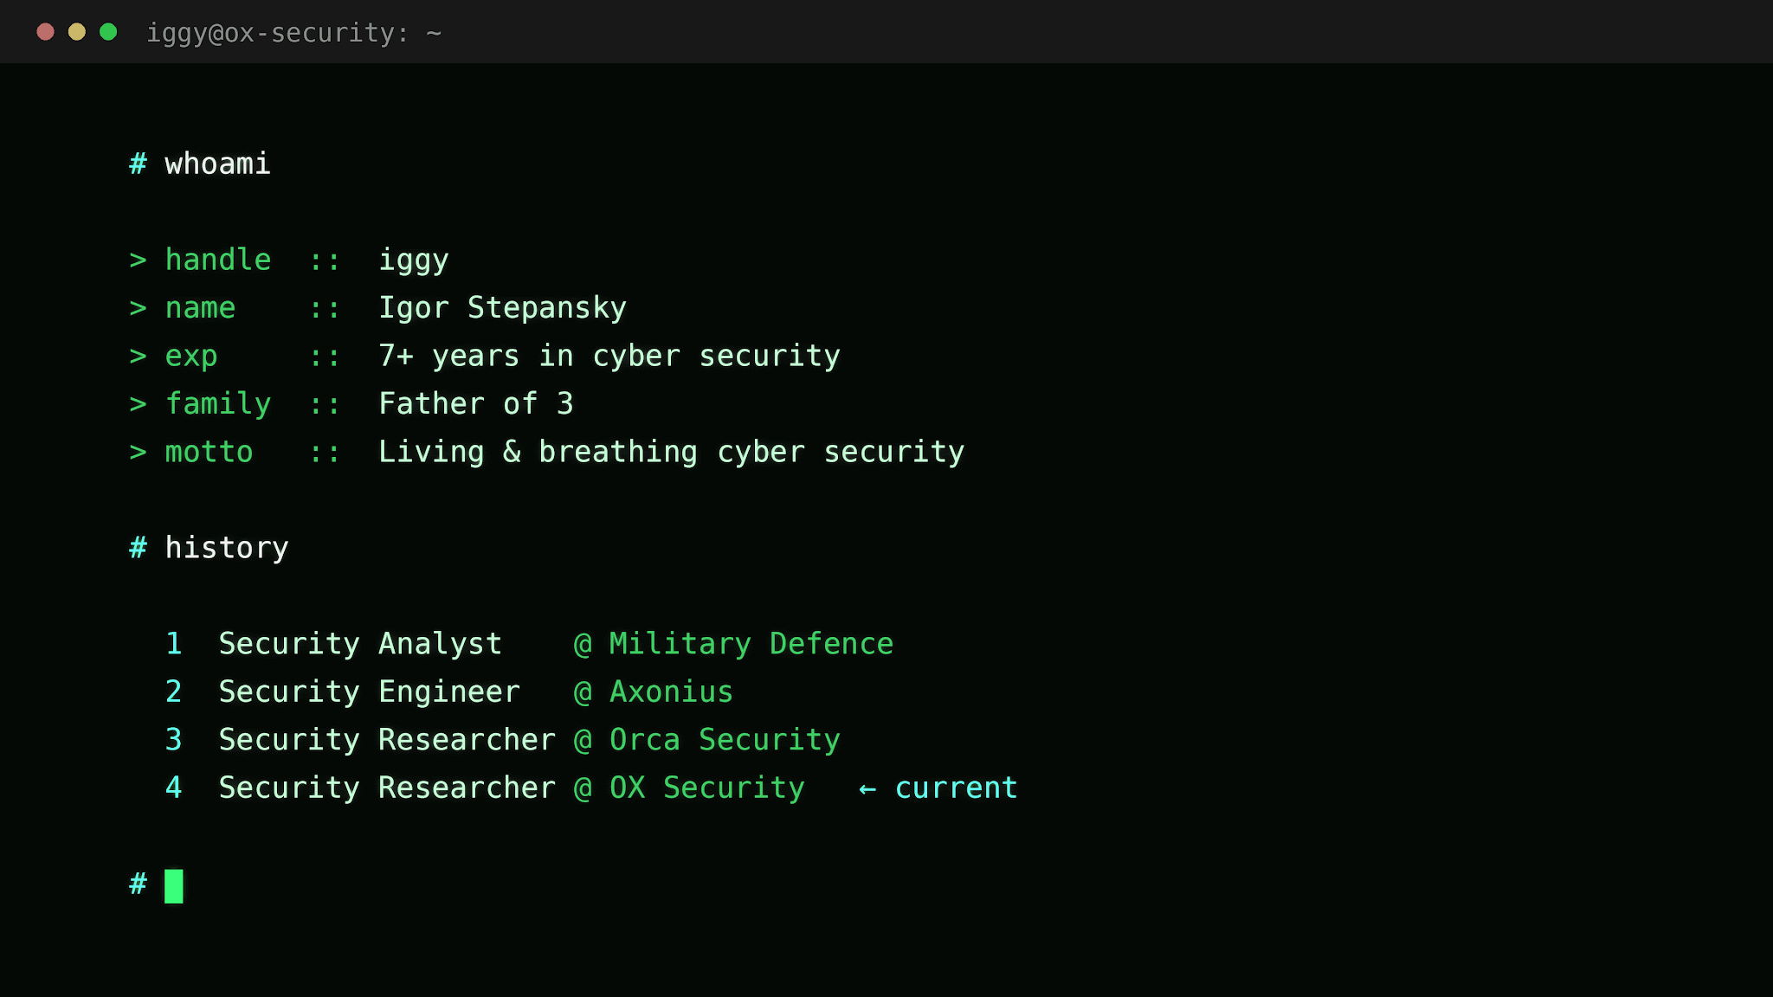


Slide 5
Agenda
01
The assumption everyone makes
06
CI/CD: where trust goes to die
THE GAP
02
Security at modern velocity
07
IaC: codifying insecurity at scale
Where attackers win
03
Supply chain is the new perimeter
08
What actually works
What works
04
Vulnerabilities that never die
09
Security as a property of software
05
Secrets: the silent breach vector

Slide 6

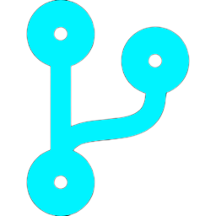



SECURITY AT MODERN VELOCITY
The attack surface isn’t “the app” anymore
›
›
›
›
Code
CI/CD
Packages
IaC
Runtime
AI-generated,
fast, unreviewed
Tokens, unpinned
third-party actions
Thousands of pkgs,
deep transitive trees
Misconfig copied
across every env
Secrets, public
buckets, open ports
75% of organizations now ship infrastructure as code

Slide 7
THE VOLUME PROBLEM
Everyone is already drowning
OX Security 2026 Benchmark · 216M findings · 250 organizations · 90 days (Q4 2025)
865,398
Raw alerts / org
+52% YoY
11,651
Raw critical / org
+93% YoY
48,185
CVEs disclosed in 2025
+20% YoY

Slide 8
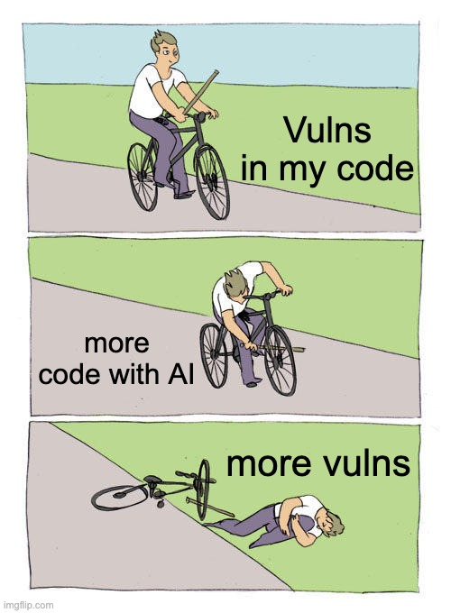
THE ACCELERANT
AI didn’t make code worse. It made far more of it
SAME DEVELOPER + AI
HUMAN PACE
1,000 lines / day
200 lines / day
● 1 finding / day
● = one vulnerability · same vertical spacing in both files
● 5 findings / day
vulns per KLOC × far more KLOC shipped = 52% alert explosion

Slide 9
SUPPLY CHAIN IS THE NEW PERIMETER
One compromise. Thousands of victims.
2020
2023
2025
SolarWinds
MOVEit
tj-actions
18,000+ downstream orgs
600+ organizations
23,000+ repos
2021
2024
2025
Log4Shell
XZ Utils
Shai-Hulud 2.0
CVSS 10 ·
billions of devices
2-yr maintainer con ·
CVSS 10
796 pkgs · self-replicating

Slide 10
THE ECONOMICS OF TRUST
Attackers don’t breach you.
They breach who you trust.
Shai-Hulud 2.0
796
14,000
487
25,000+
npm packages backdoored
secrets exposed
organizations hit
malicious GitHub repos
npm install
Steals npm tokens and cloud credentials

Slide 11
REMOVED YEARS AGO. STILL RUNNING.
The threat is already inside the house.
Package | Ecosystem | Attack type | % orgs
faker 6.6.6 | npm | Maintainer sabotage | 7%
event-stream 3.3.6 | npm | Account takeover / crypto stealer | 4%
flatmap-stream 0.1.1 | npm | Malicious dependency injection | 3%
colors 1.4.x | npm | Maintainer sabotage | 2%
ctx 0.2.x | PyPI | AWS credential stealer | 1%
larpexodus 0.1 | PyPI | Typosquatting / infostealer | <1%
11%
faker and colors came from the same maintainer. Sometimes the attacker is someone you already trusted.
of orgs run a known-malicious package in production

Slide 12
VULNERABILITIES THAT NEVER DIE
They don’t get fixed. They get tolerated.
Apache Tomcat · CVE-2025-24813
50%
Log4j (additional) · CVE-2021-45046
47%
Log4Shell · CVE-2021-44228
46%
Apache Commons Text · CVE-2022-42889
44%
Spring4Shell · CVE-2022-22965
44%
React2Shell · CVE-2025-55182
29%
Apache Struts · CVE-2024-53677
17%
n8n Workflow · CVE-2025-68613
9%
Erlang/OTP · CVE-2025-32433
6%

Slide 13

A NEW CLASS: EXPLOITABLE BY DEFAULT
You’re vulnerable before you write a line
React2Shell - CVE-2025-55182 · disclosed by Meta/Vercel, Dec 3, 25
Unauthenticated RCE in React Server Components
Affects default React 19 / Next.js server-action deployments
  a freshly generated app is exposed
10.0
29%
Hours
0
CVSS score
of orgs
to in-the-wild exploits
auth required
Patch velocity stops being hygiene and becomes survival

Slide 14
THE SILENT BREACH VECTOR
Deleting a secret is not rotating a secret
Most-leaked credential types:
AWS secret access keys
14%
31%
30%
Slack webhooks
11%
GitHub personal access tokens
9%
of orgs expose VALID, active secrets in source code
secrets in git history only - “deleted” but trivially recoverable
Secrets in CI/CD workflow files
9%
Secrets echoed to logs
4%

Slide 15
THE AI/ML SECRETS CRISIS
The newest keys are the most expensive to lose
Hugging Face
29%
OpenAI
18%
43%
Databricks
12%
Anthropic
10%
Replicate
6%
of production orgs have leaked AI / ML credentials
Modal
6%
AWS Bedrock
4%
Google Vertex AI
4%
+ MLflow 3% · SageMaker 2% · Mistral 2% · Cohere 1%

Slide 16
CI/CD: WHERE TRUST GOES TO DIE
The pipeline has prod access -
and the weakest controls
Overly permissive default GITHUB_TOKEN
22%
Actions not pinned to verified / trusted sources
18%
GitHub Actions can auto-approve PRs
13%
tj-actions/changed-files, 2025
And the merge gates are just as open
A mutable version tag was swapped for malicious code - 23,000+ repos exposed overnight.
No code review required at all
26%
Branch protection not enabled
25%
Unrestricted push to main
24%

Slide 17
IAC: CODIFYING INSECURITY AT SCALE
When a misconfiguration becomes the infrastructure.
75% manage their infrastructure as code
Storage - unencrypted at rest
84%
Network - no logging / monitoring
80%
Identity - IAM allows *:* admin
60%
Containers - running as root
46%
Every apply ships these defects to every environment - at once.

Slide 18
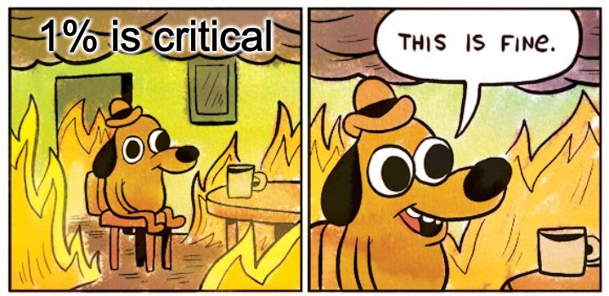
THE REFRAME
You’re not behind. You’re buried.
865,398
raw alerts / org
▼
8,081
actionable after prioritization
▼
795
truly critical
≈ 99% is noise that can be safely deprioritized. The hard part isn’t the 865,000 - it’s reliably finding the 795.

Slide 19
WHAT ACTUALLY MAKES A FINDING MATTER
It’s not what it scores. It’s what it touches.
1
Can it be exploited?
Low EPSS or no public exploit drops it. Active exploits raise it
2
Can it be reached?
Code that never ships to production is filtered out
3
What does it touch?
Business-critical systems and PII go to the top of the stack
CVSS severity answers none of them. A 9.8 you can’t reach or exploit is just noise

Slide 20
WHAT ACTUALLY WORKS
Don't fix more findings.
Remove the attacker's leverage.
A hundred controls exist.
A handful actually move risk - and each one breaks an attack you just saw.

Slide 21
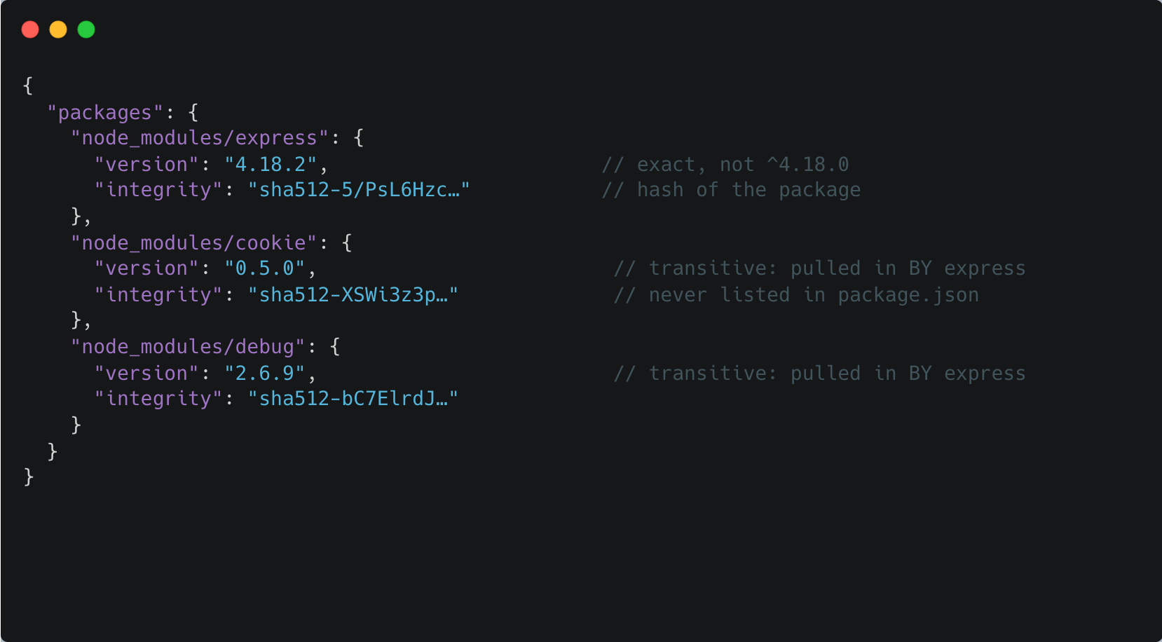
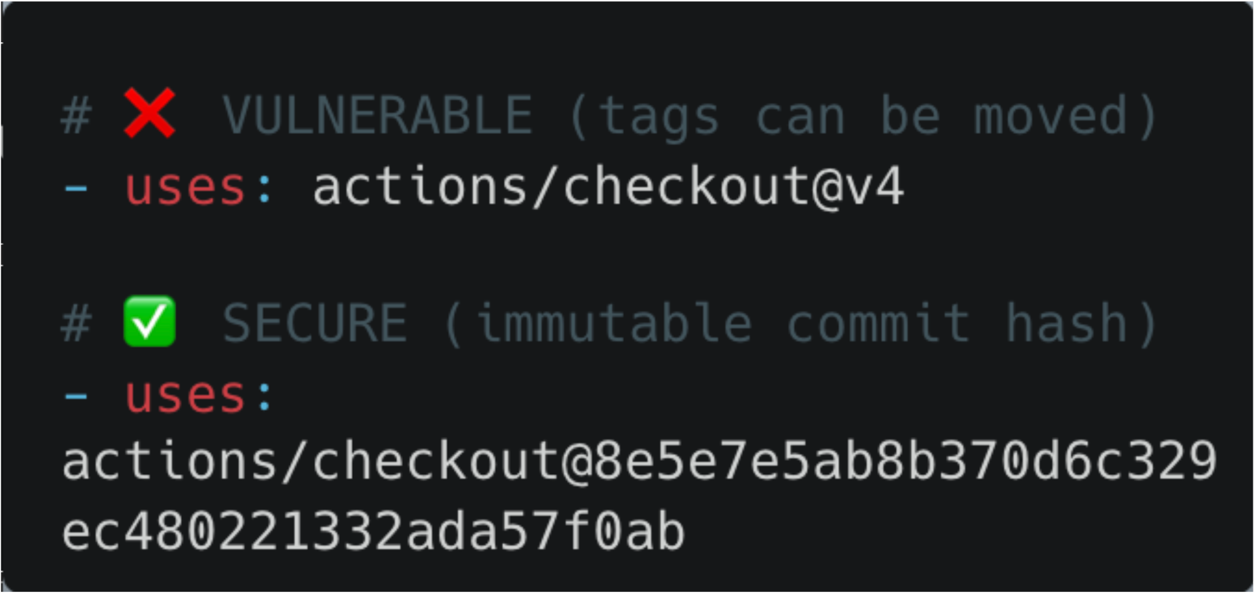


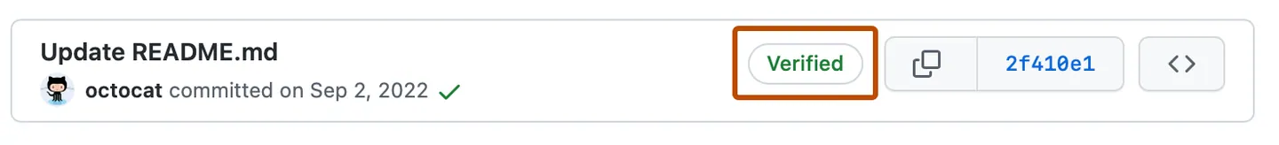

BREAK THE LEVERAGE
Four controls. Four attacks they stop.
Rotate secrets,
don't just delete
Pin Actions to a commit SHA
stops → keys stay live in git history
stops → tj-actions · 23,000 repos
Signed commits + review + MFA
Lockfiles + block bad packages
stops → XZ Utils ·
the patient maintainer
stops → Shai-Hulud worm · the 11%

Slide 22
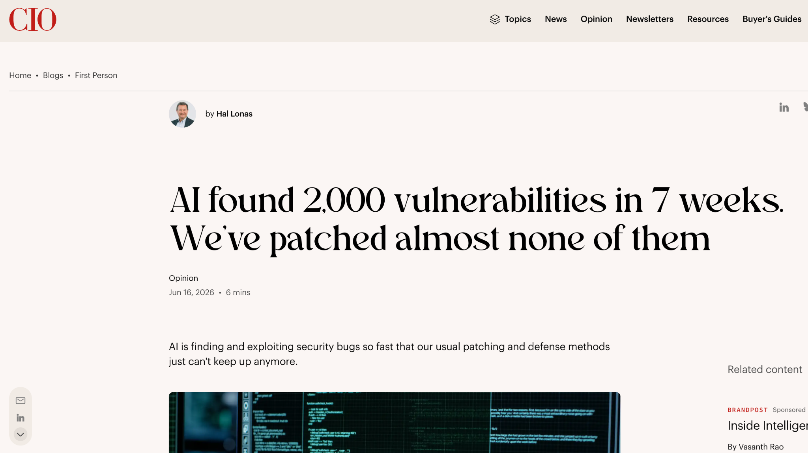


SPEND TIME WHERE IT MATTERS
Then fix what's reachable, triage what it touches
Patch by reachability - fast
The internet-facing React2Shell beats the CVSS-10 buried in a dev container.
Triage on reachability + business impact
So the 795 that matter stop drowning in the other 99%.
Not more scanners. Not more bugs.
FOCUS ON WHAT MATTERS

Slide 23
START EARLY, STAY CONSISTENT
And the results will naturally follow
1
This week - rotate exposed secrets + turn on push protection · set GITHUB_TOKEN read-only · patch internet-reachable critical severities
2
This quarter - pin Actions to a commit SHA · require review + branch protection + signed commits + MFA - lockfiles + block install scripts · gate IaC in CI
3
Always - triage by reachability + business impact, not CVSS · rotate, don’t delete - measure time-to-patch + signal-to-noise

Slide 24
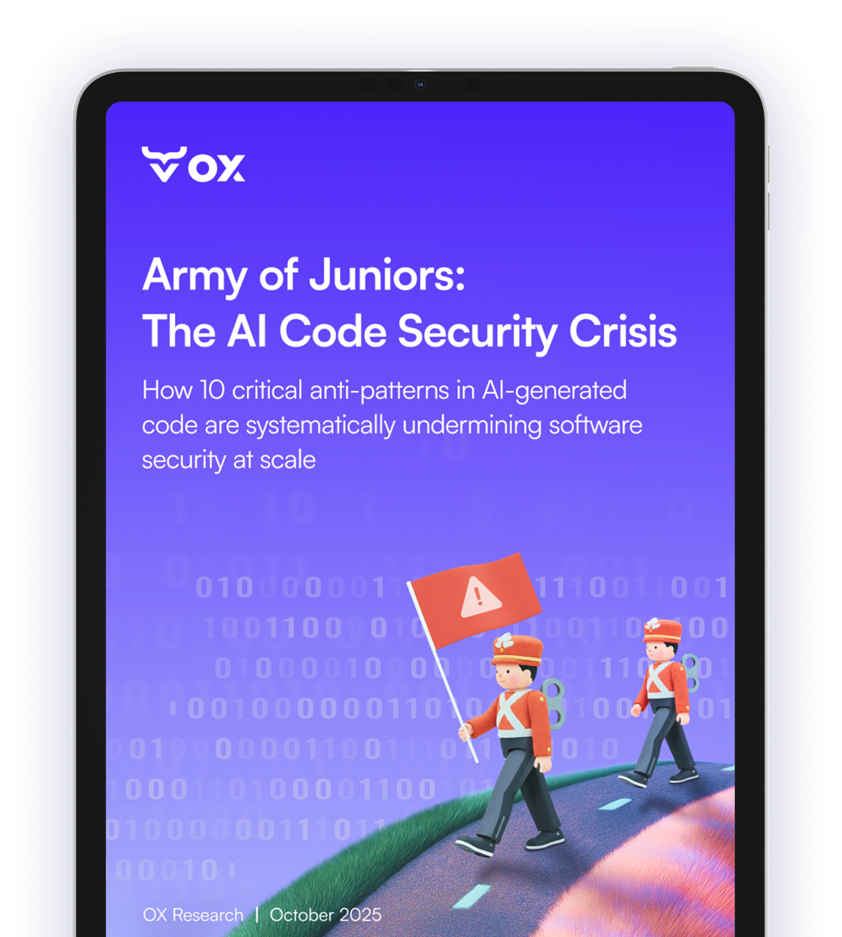







HOMEWORK

Slide 25





Questions?
Igor Stepansky
Security Researcher
@ OX Security

