Slide 1
OSHA 10: The Credential of Value for CTE Students Entering the Workforce
A South Carolina Workforce Readiness and Classroom Integration Strategies
Justin Williamson, Sales Executive
Notes:
Before joining CareerSafe, I spent 16 years in public education, including time as an assistant principal and instructional coach. Today's session is designed from the perspective of what I would have wanted as an educator attending a conference.

Slide 2
OSHA Safety Training:
A Credential of Value
Notes:
Industry-recognized
Portable across careers
Lifetime credential
Classroom-integrated
South Carolina Universal Certification
“When we talk about a credential of value, we’re really talking about three things: recognition, portability, and usability in schools. OSHA 10 checks all three boxes.”

Slide 3
Why OSHA 10 Matters in South Carolina
Recognized statewide
Universal Certification
Supports multiple career clusters
Supports work-based learning preparation
Recognized by employers across industries
Portable credential students keep after graduation
Notes:
How many of your students participate in work-based learning, internships, apprenticeships, or clinical experiences?

Slide 4
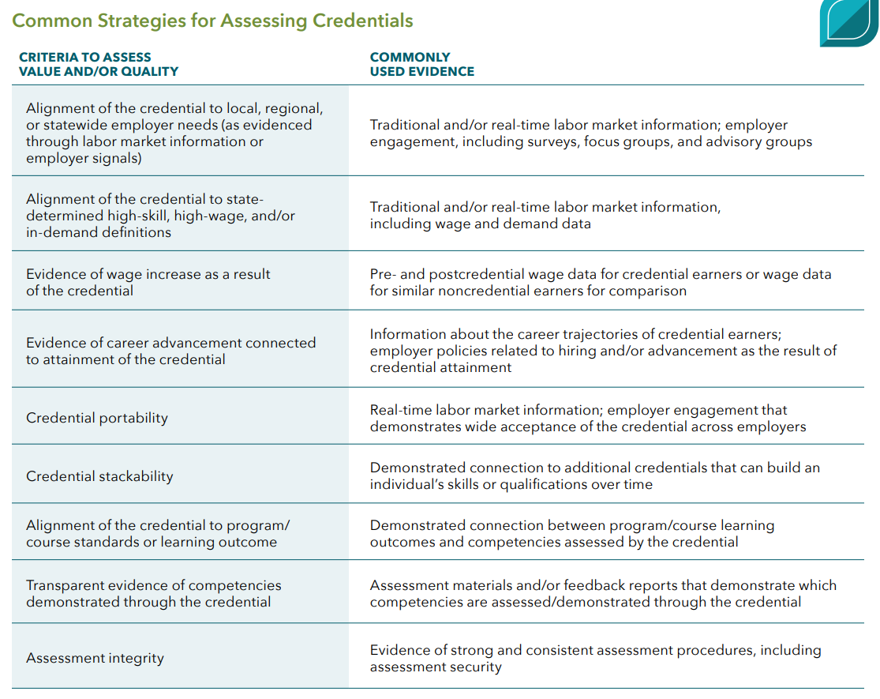
OSHA as Credential of Value
✓
✓
✓
✓
✓
✓
✓
✓
✓
Notes:
Safety credentials reduce barriers to entry in skilled trades and technical careers
“This isn’t about promising salaries. It’s about access. Many programs and job sites won’t even allow students or new hires without basic safety training.”
What makes a credential valuable?
Abbreviated Notes:
OSHA 10 fully meets all nine Advance CTE criteria for a credential of value
Industry-recognized — national safety standard across sectors
Employer validated — preferred/required for many entry-level roles
Aligned to high-value careers — especially in high-growth, high-need industries
Portable + stackable credential; follows students into workforce
Assessment-verified — students must demonstrate competency
Improves workforce outcomes — safer practices, higher employability
Accessible + scalable — widely used in high schools nationwide
Transparent outcomes — OSHA card clearly signals training completed
Data + employer feedback support its impact
Bottom line: OSHA 10 isn’t just valuable — it checks every box.
Full Text:
When we talk about a credential of value, we’re really looking at whether it meets a very high bar — not just in recognition, but in relevance, rigor, portability, and impact. Advance CTE outlines nine criteria for determining which credentials truly matter for student outcomes and workforce readiness. OSHA 10 meets every one of them.
First, it is industry-recognized and grounded in national workplace safety standards. Whether a student enters construction, healthcare, hospitality, manufacturing, agriculture, or any other pathway, OSHA training is aligned to real expectations and regulations that exist in the workplace today.
Second, it’s validated by employers. Businesses across the country require or prefer OSHA 10 for entry-level hiring because it reduces risk, builds foundational safety awareness, and helps ensure new workers enter the job site prepared.
Third, it supports alignment to high-value careers. Nearly every high-growth industry prioritizes safety-trained workers, and many sectors — including construction and manufacturing — are facing workforce shortages where safe, skilled employees are in high demand.
Fourth, OSHA 10 is portable and stackable. Students can take this credential with them from school to work to future employment. It does not expire at graduation, and it sets the stage for future certifications, apprenticeships, and skill development.
Fifth, the content is validated through assessment, ensuring that learners are not just exposed to content, but must demonstrate knowledge to earn the card.
Sixth, it improves learning and labor-market outcomes. OSHA-trained students demonstrate safer practices, reduced incident risk, and greater employability — especially in pathways that place them on real worksites.
Seventh, OSHA 10 is scalable and accessible, used by schools nationwide and designed for high school–age learners — which means students can earn a nationally recognized credential before ever graduating.
Eighth, it is transparent in outcomes, providing a clear signal to industry that the holder has completed 10 hours of foundational safety training.
And finally, OSHA 10 is supported by data and feedback from employers, industries, and educators, who consistently report improved readiness, professionalism, and safety culture among students who hold this credential.
In short — OSHA 10 is a credential of value not because it meets one or two of these criteria, but because it meets all nine fully and consistently. It is one of the strongest foundational credentials we can offer students preparing for work.

Slide 5
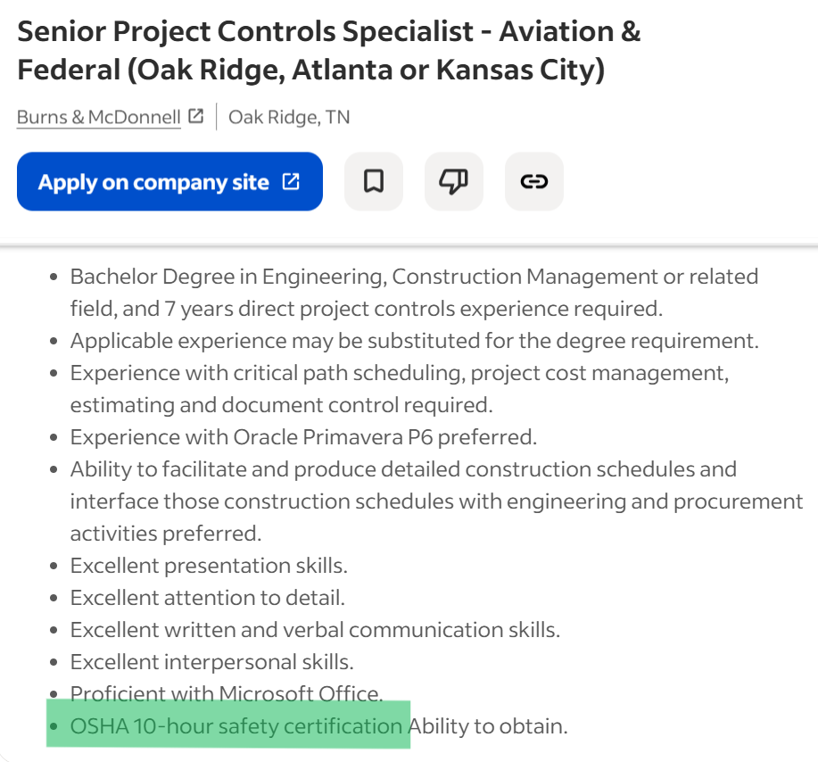
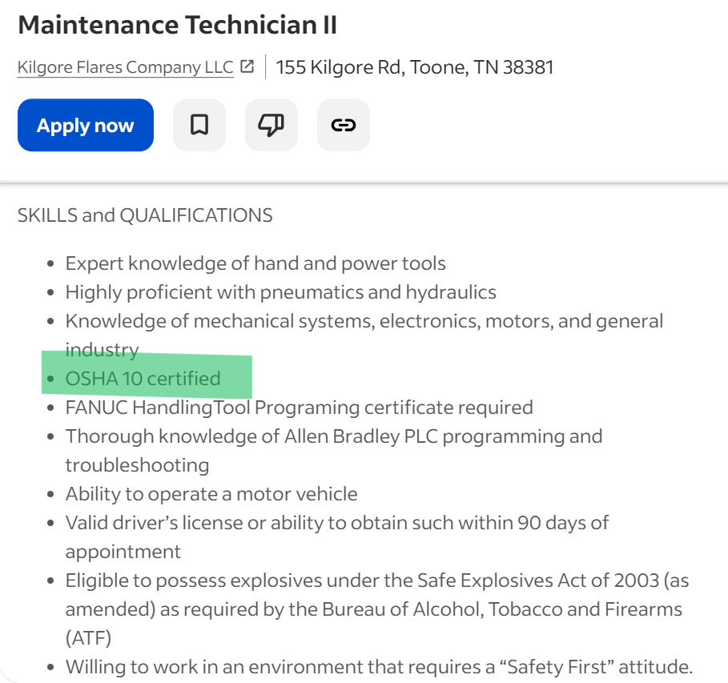
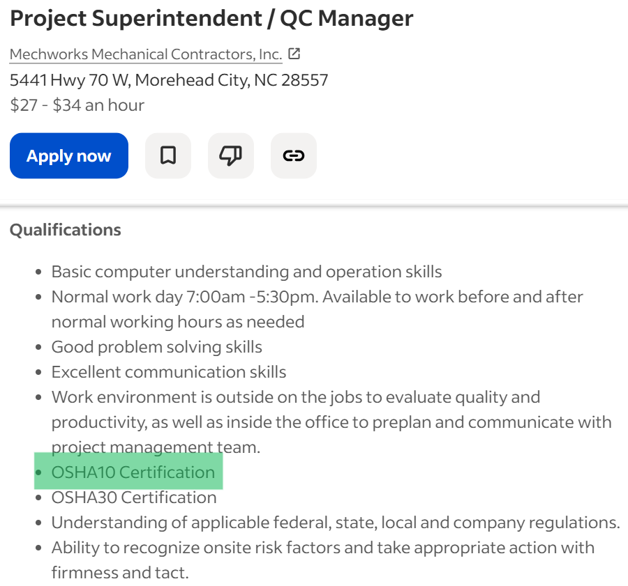
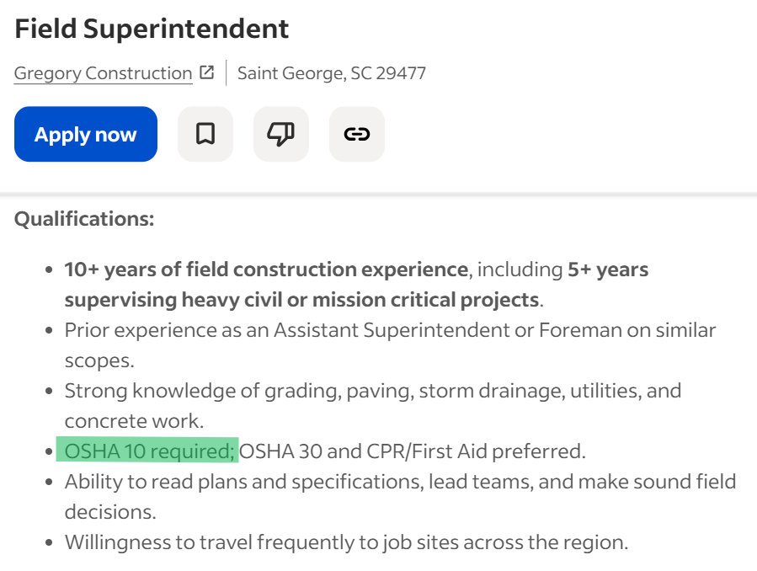
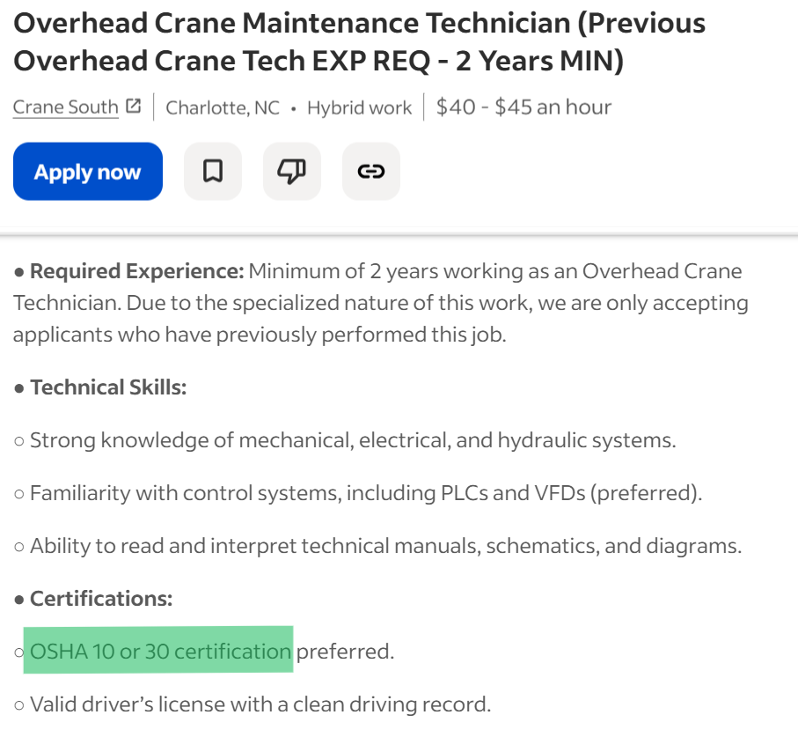
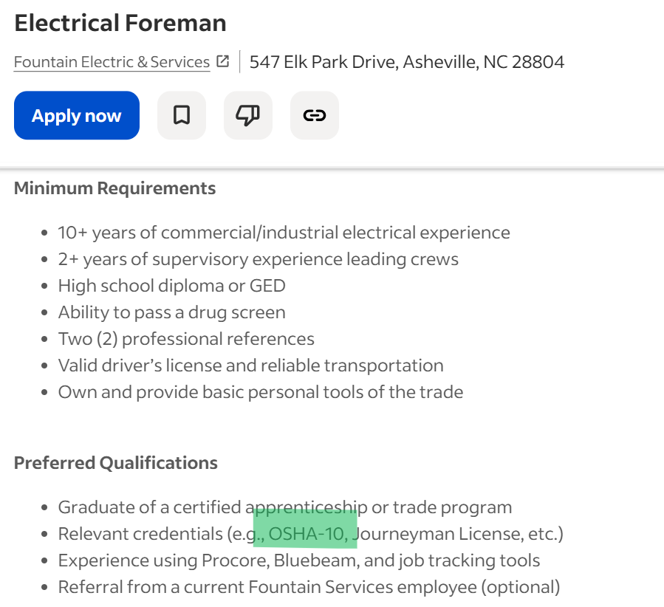
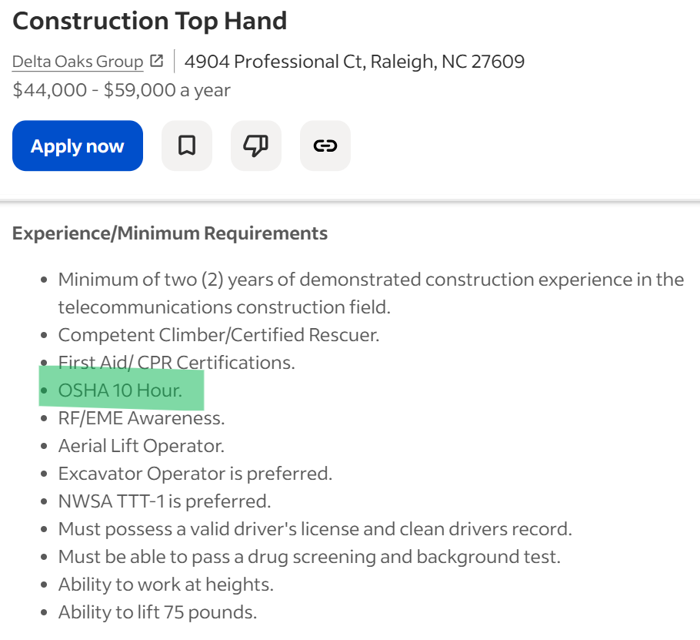
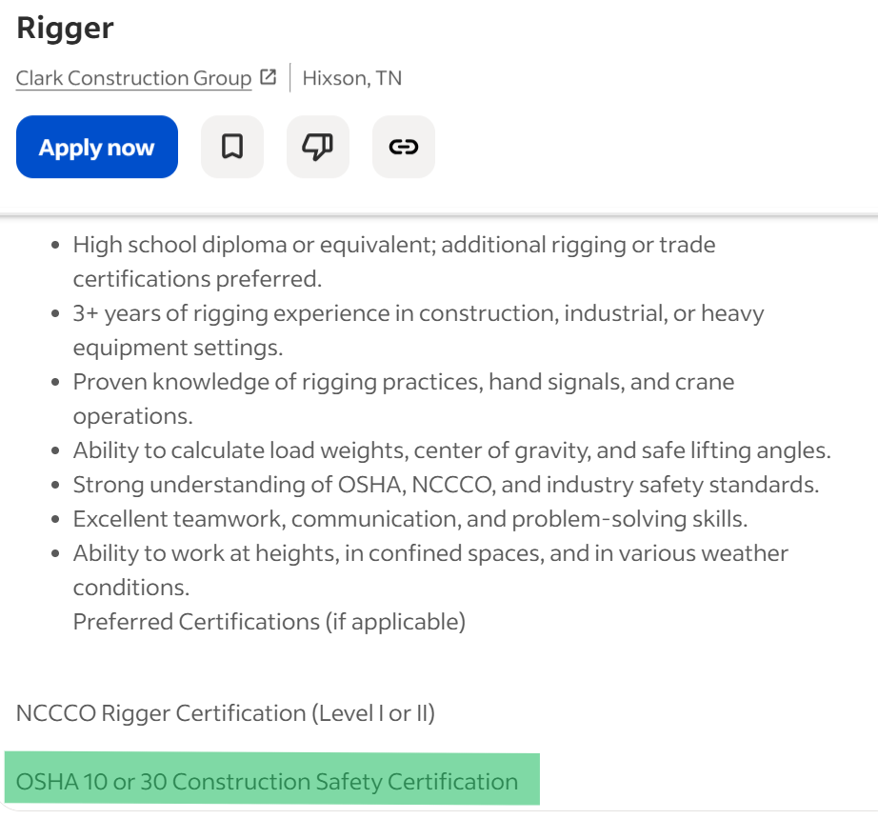
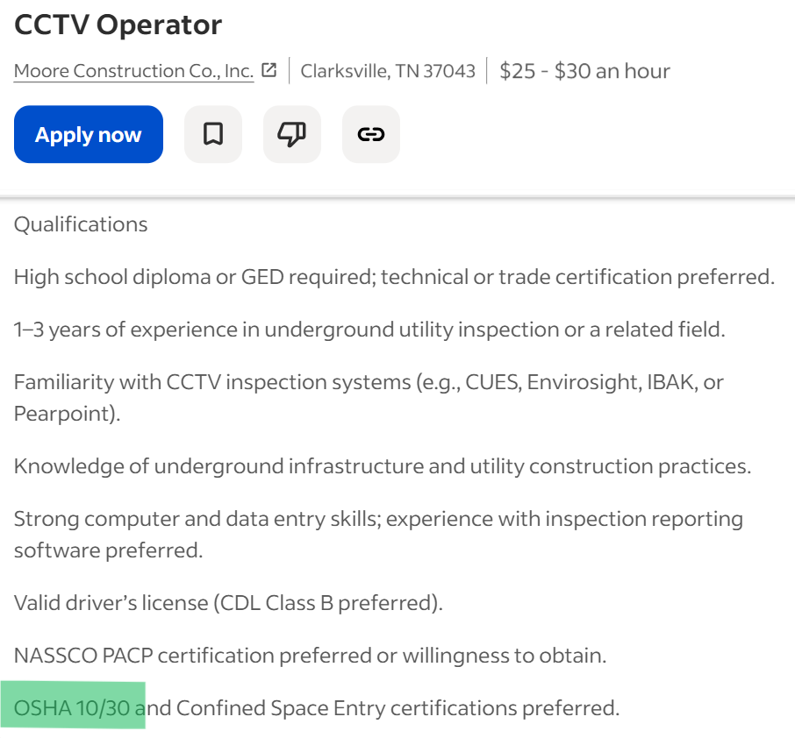
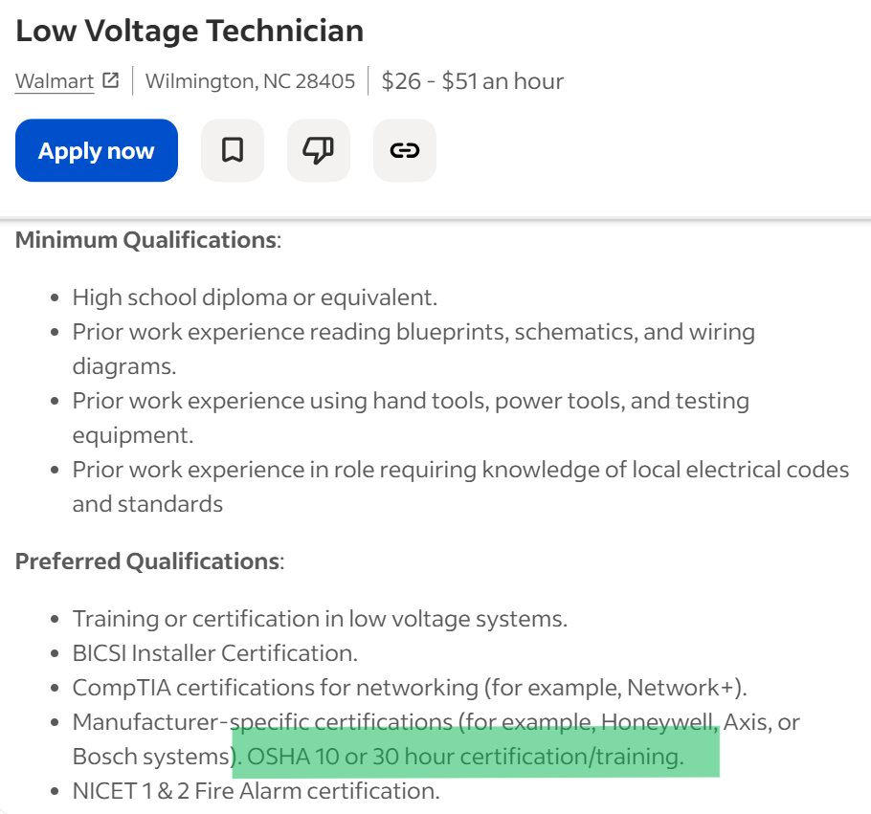
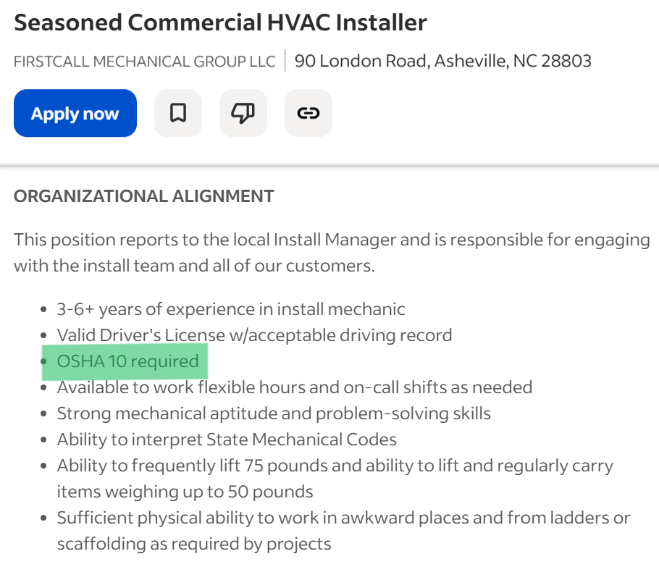
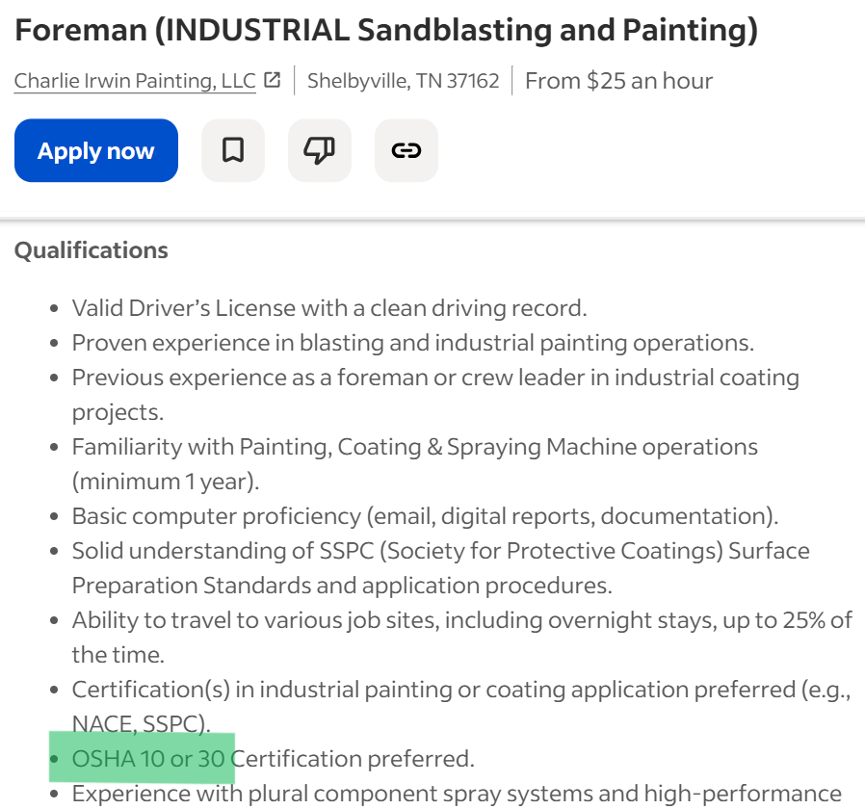
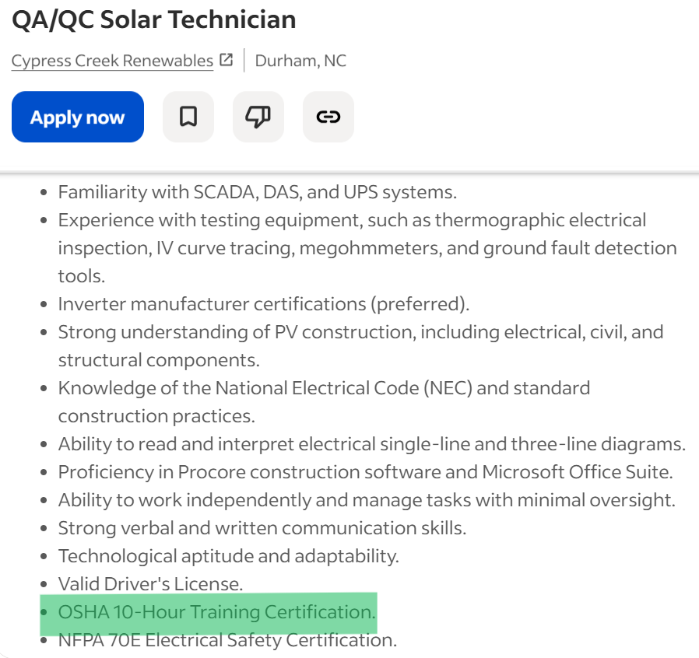
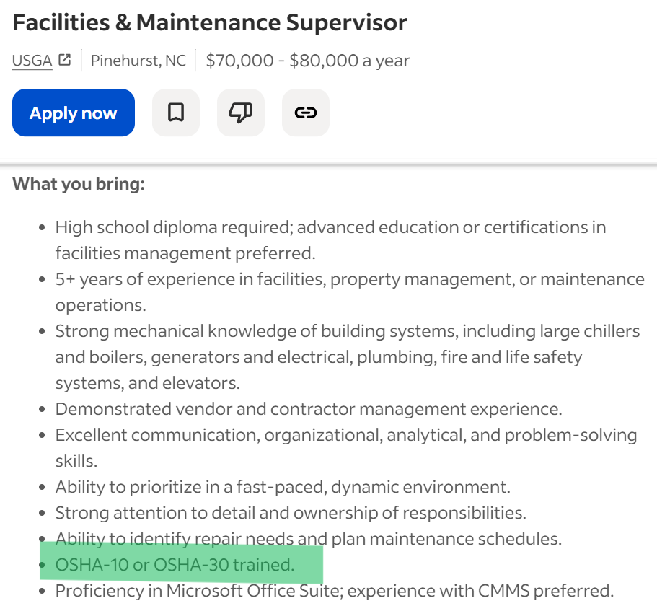
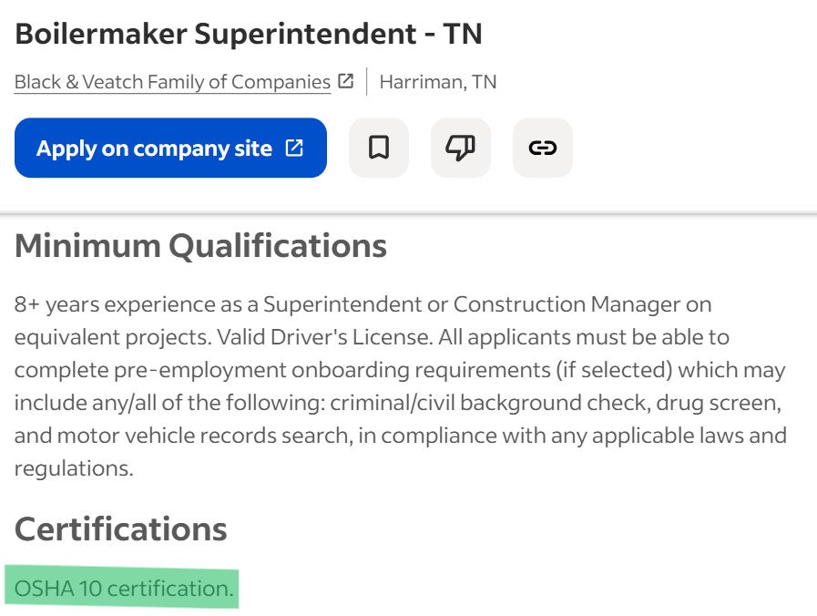
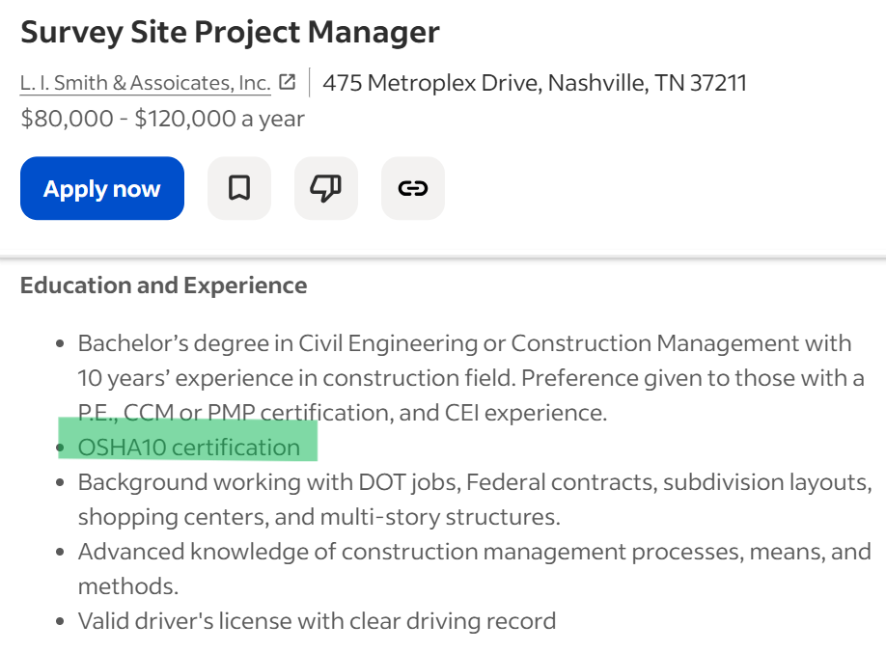
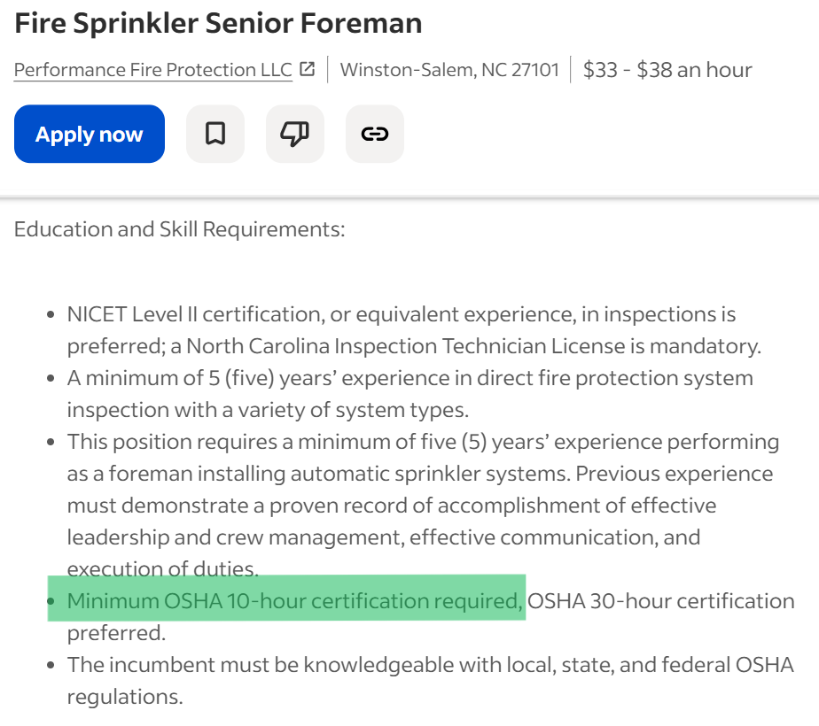
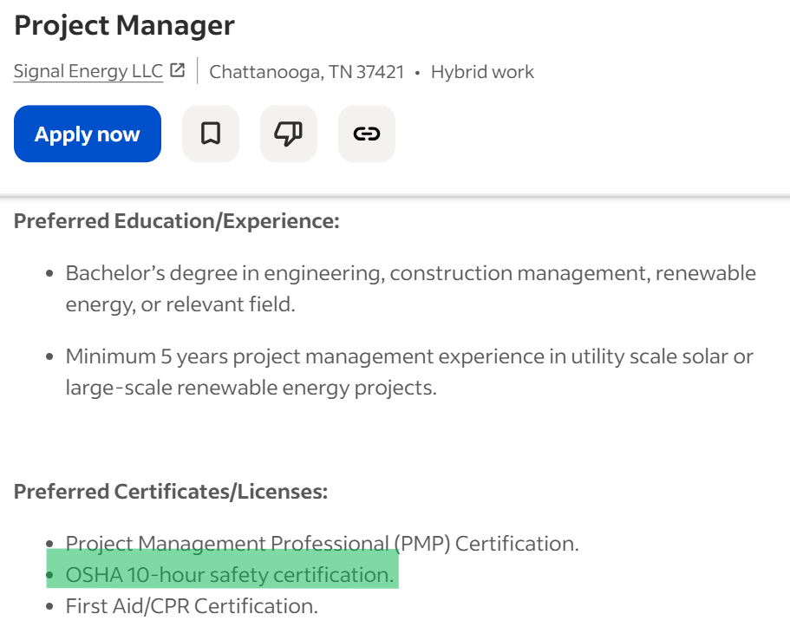
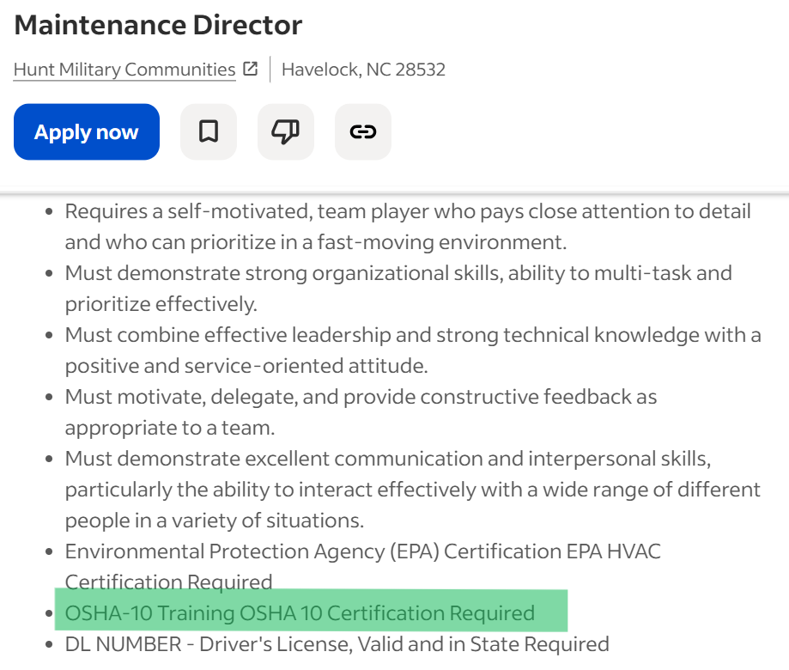
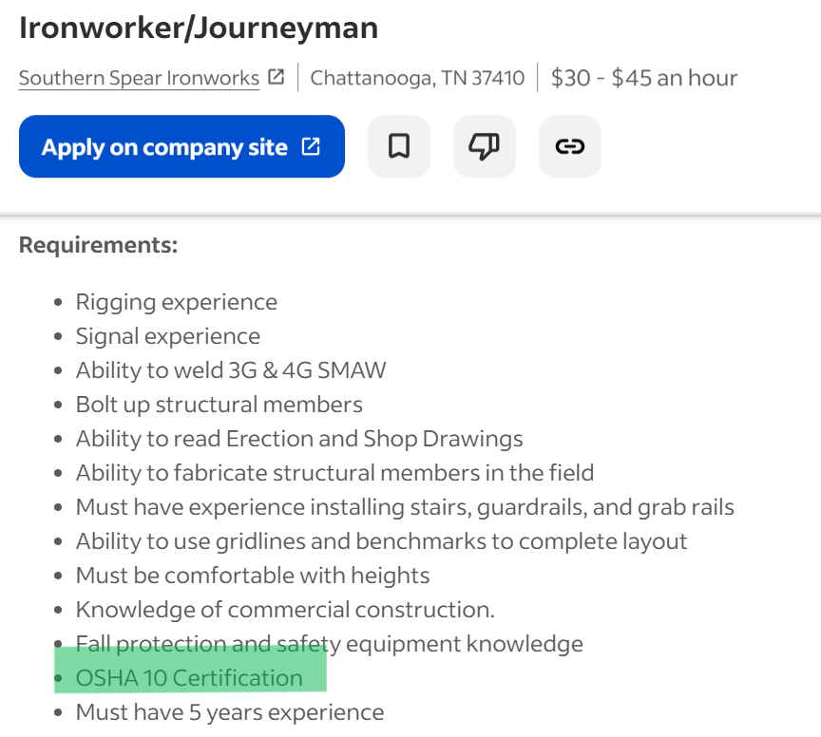
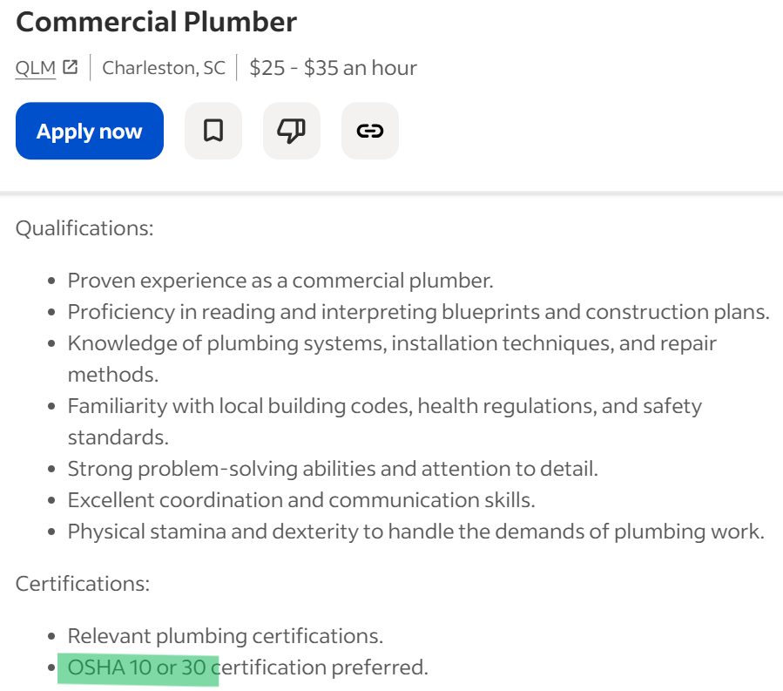
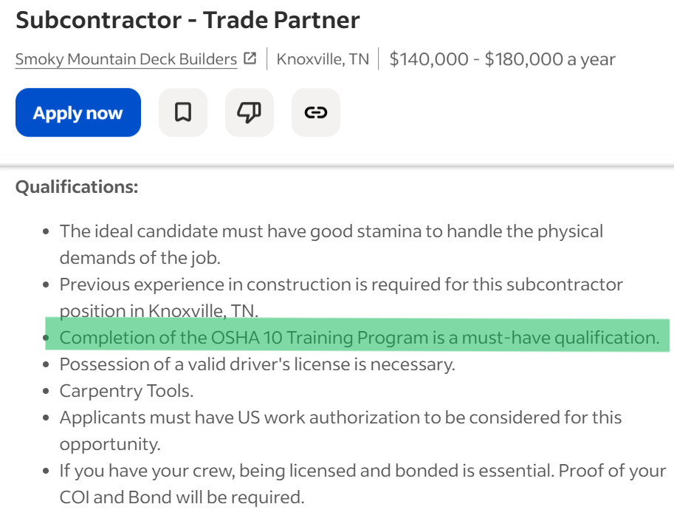
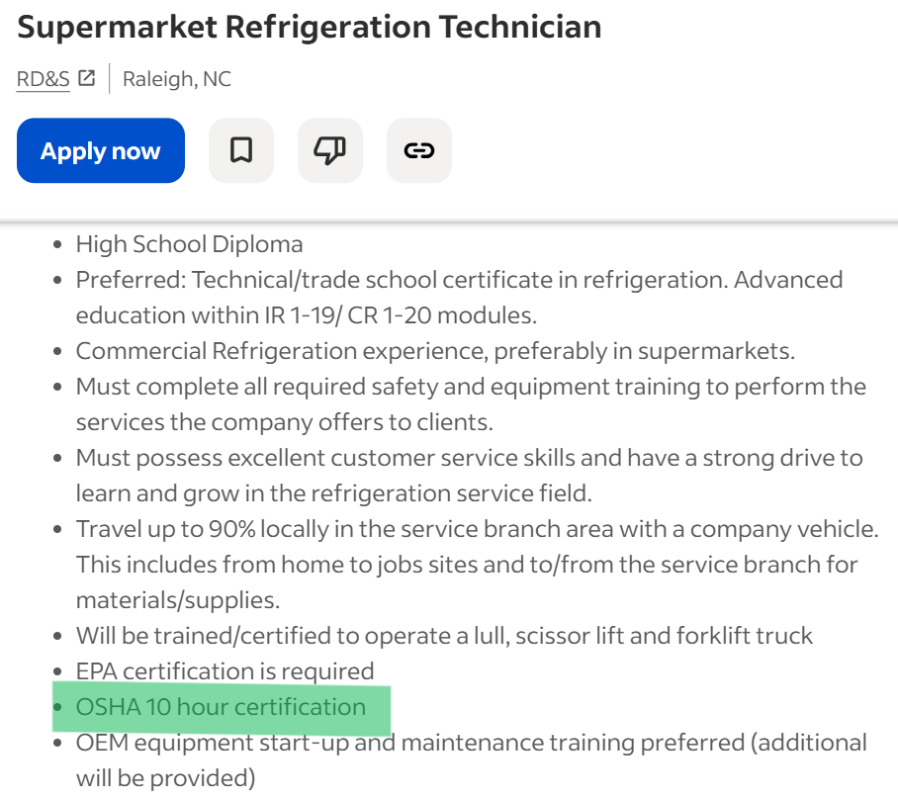
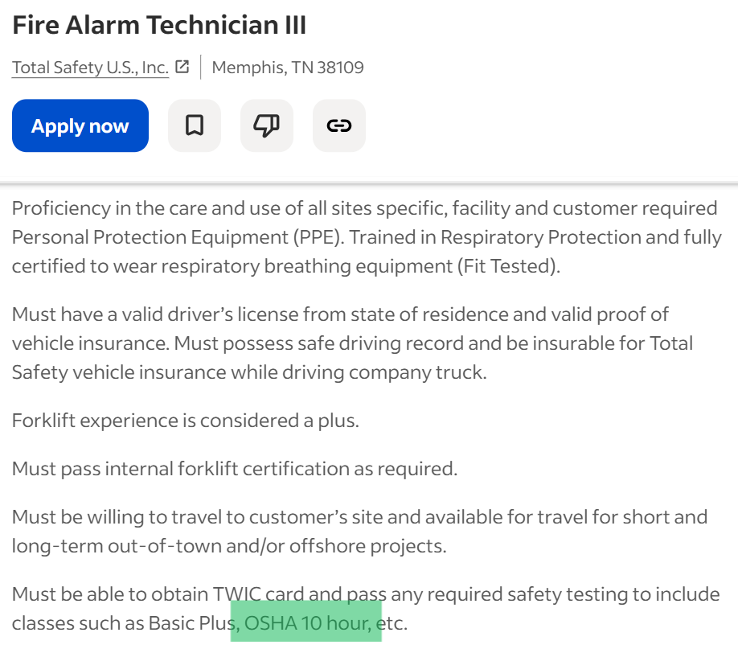
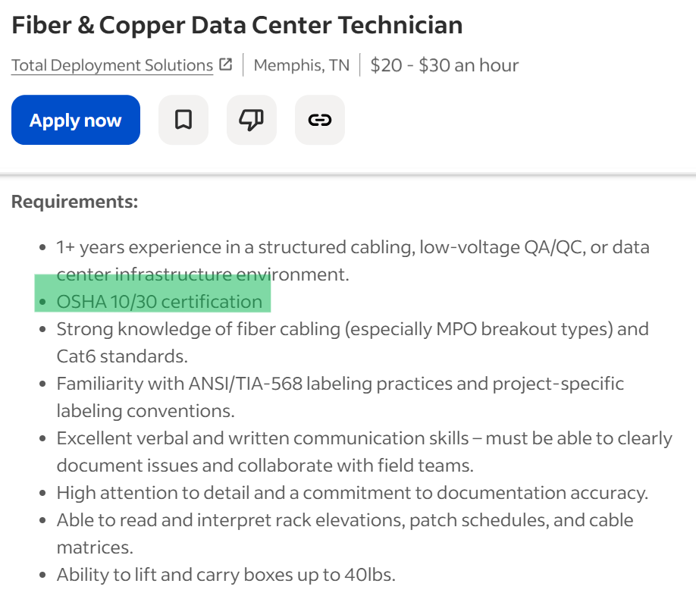
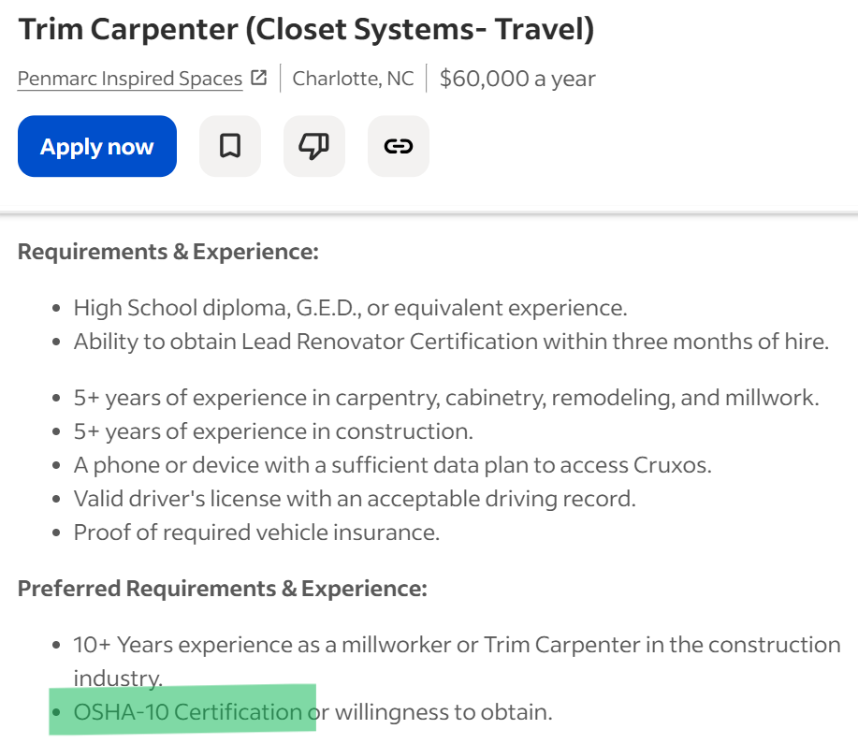
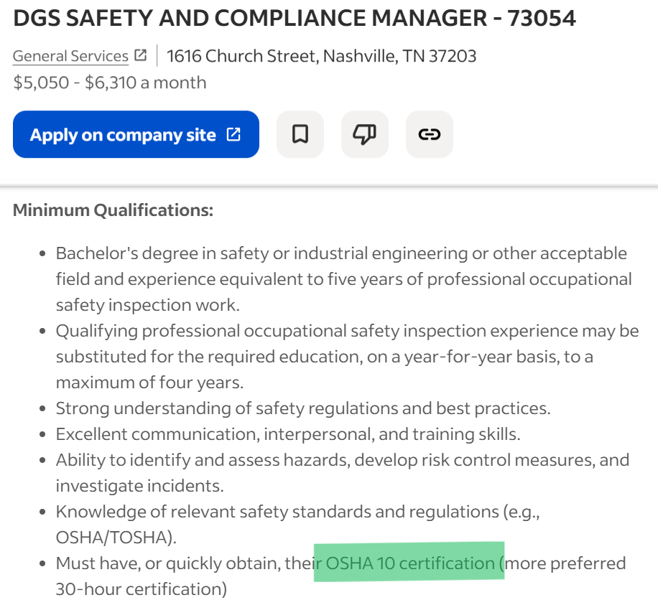
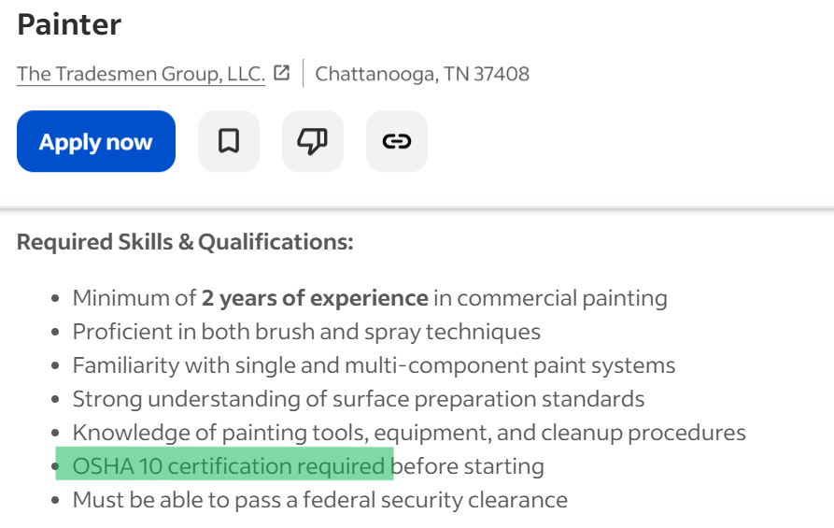
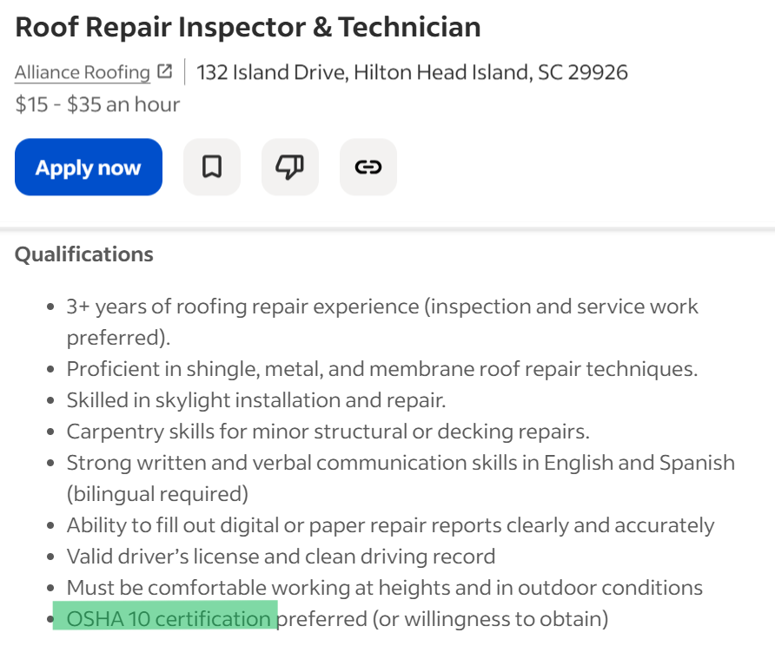
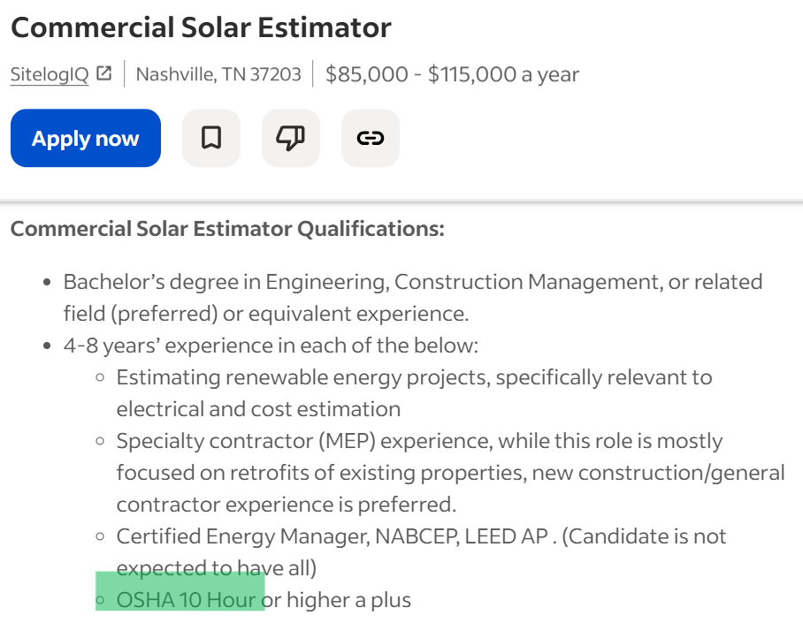
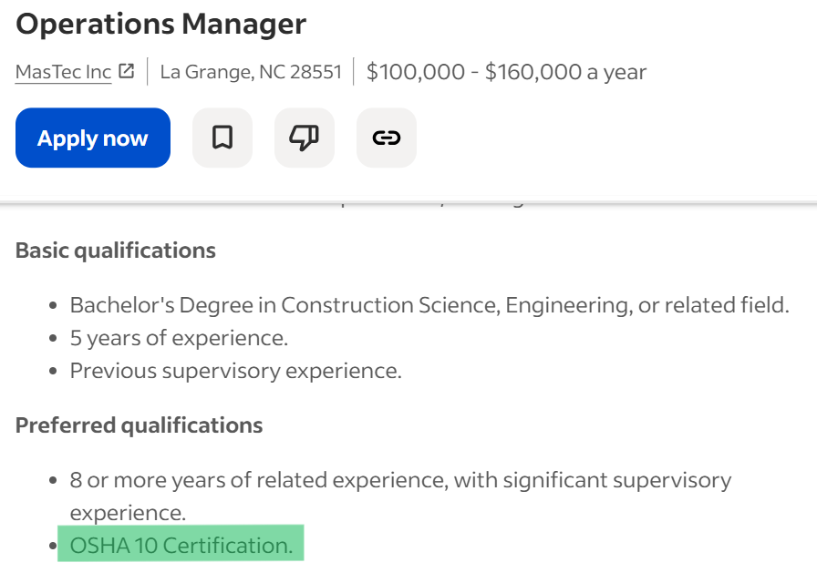
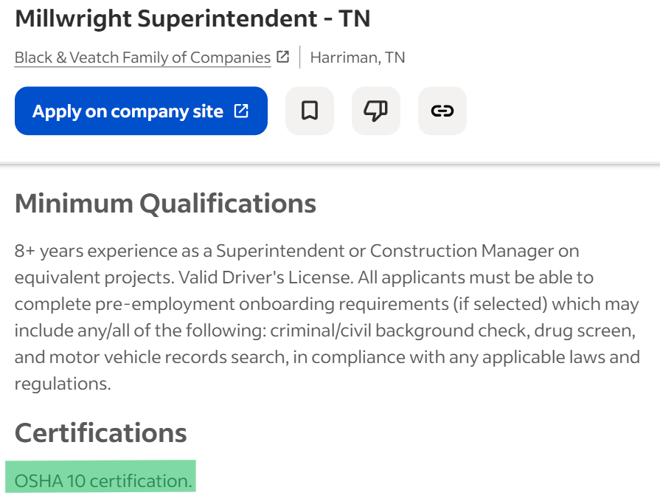
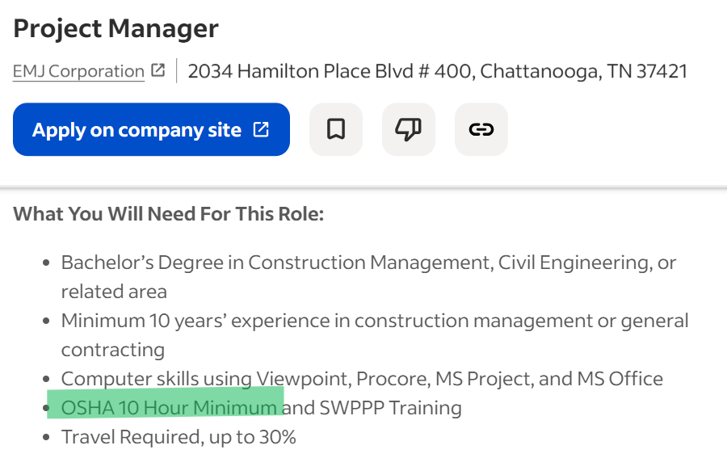
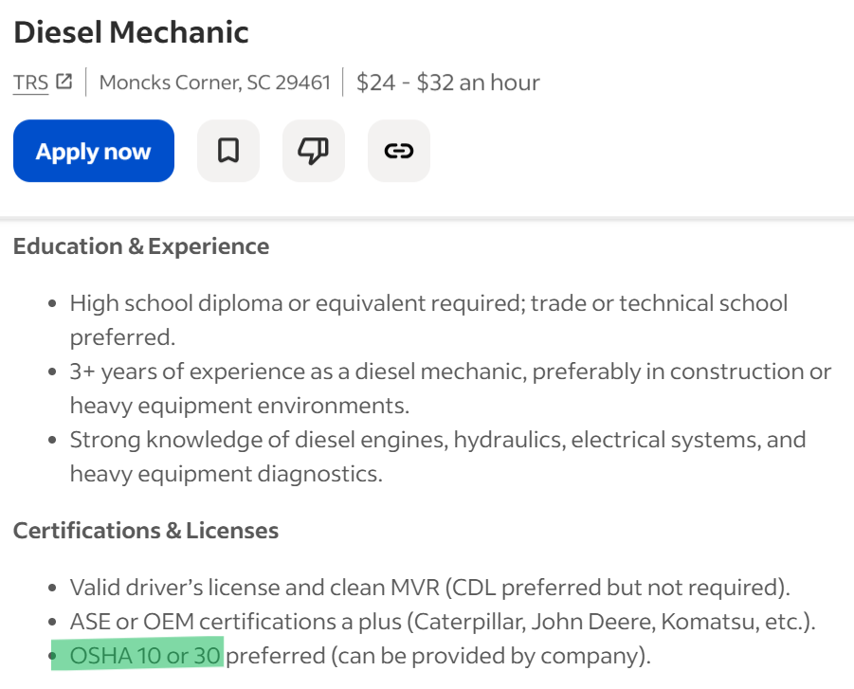
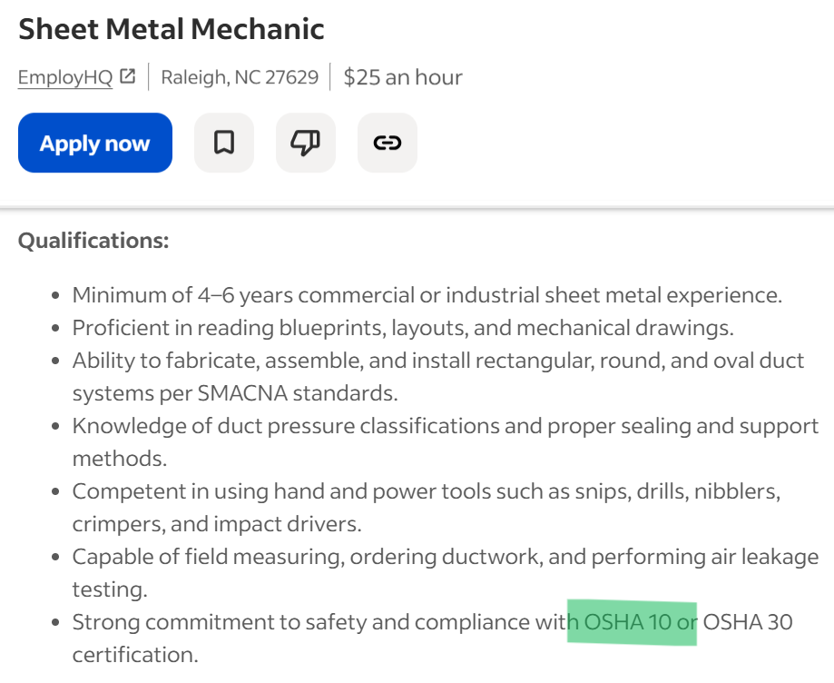
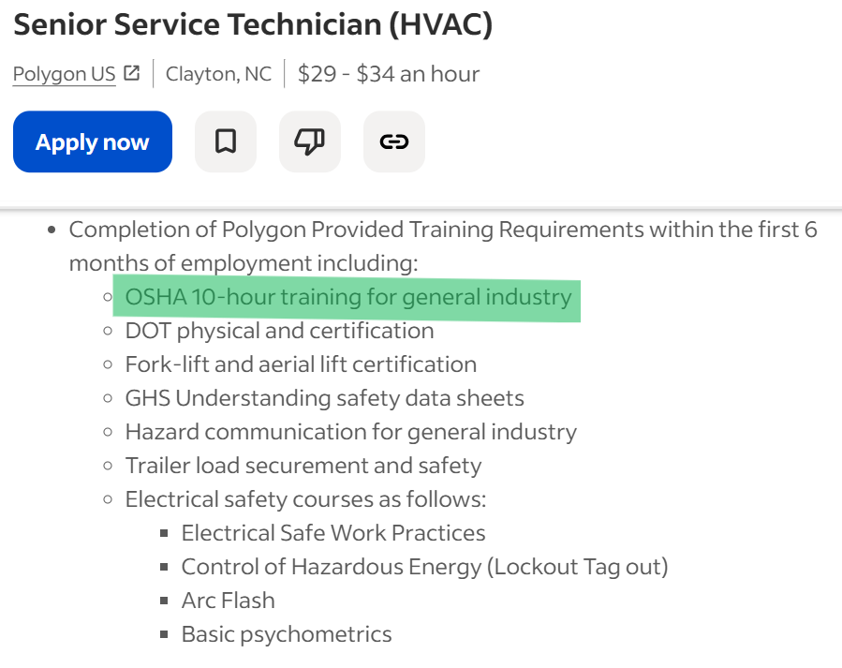
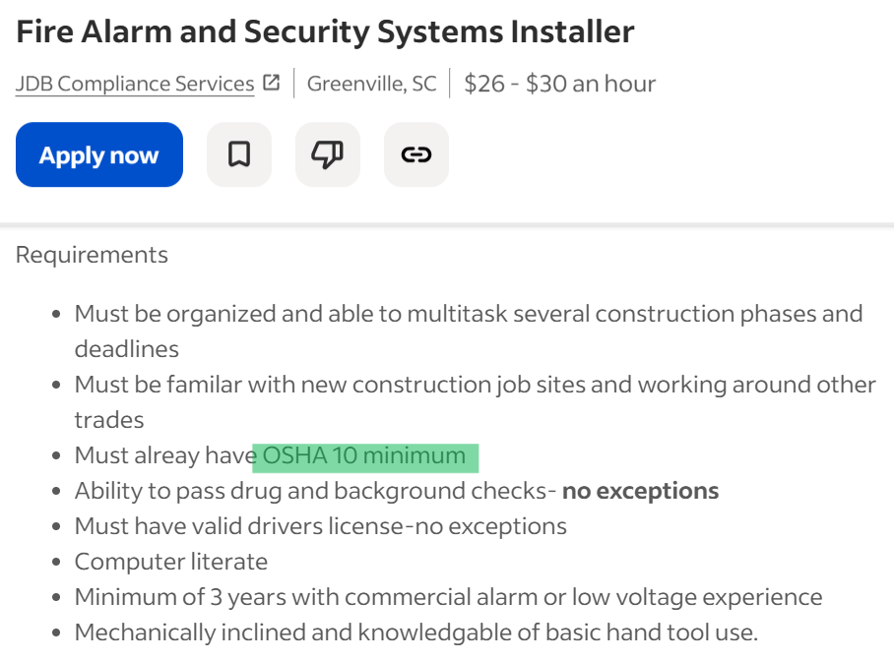
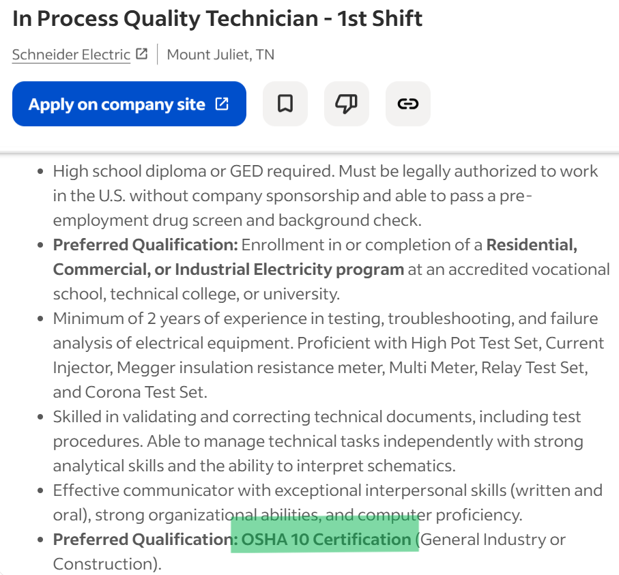
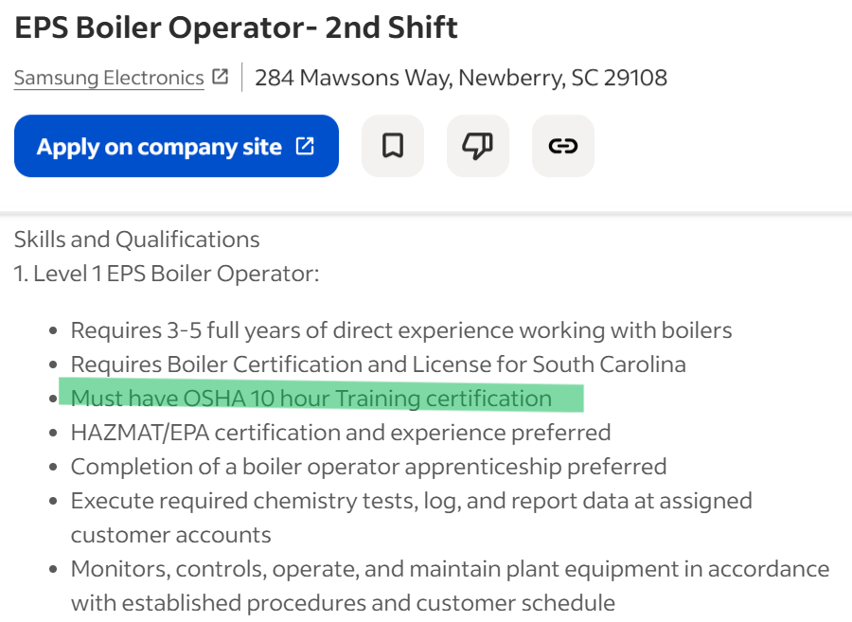
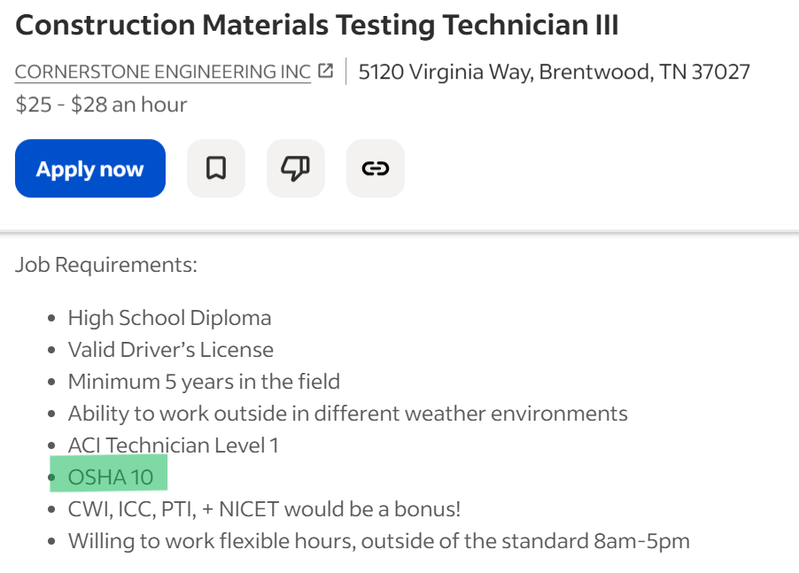
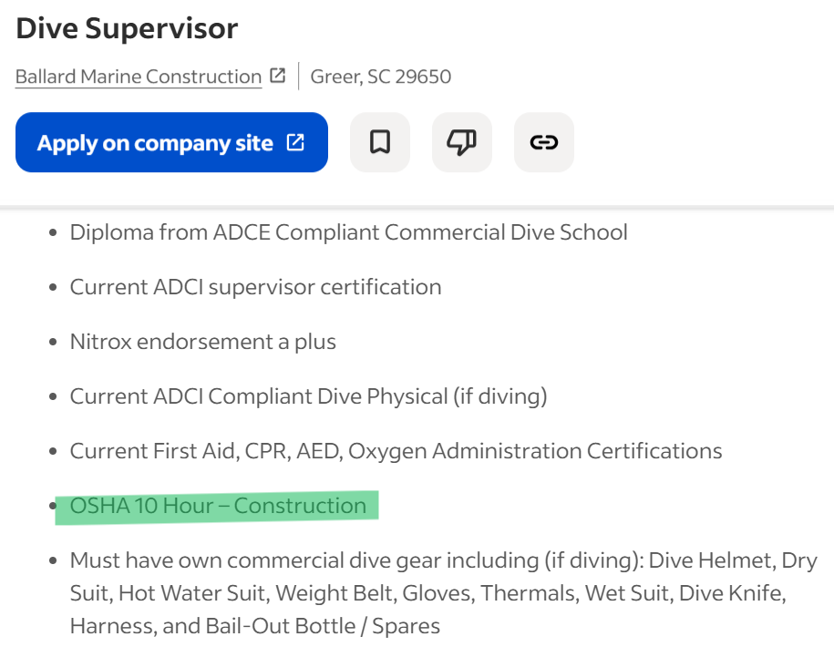
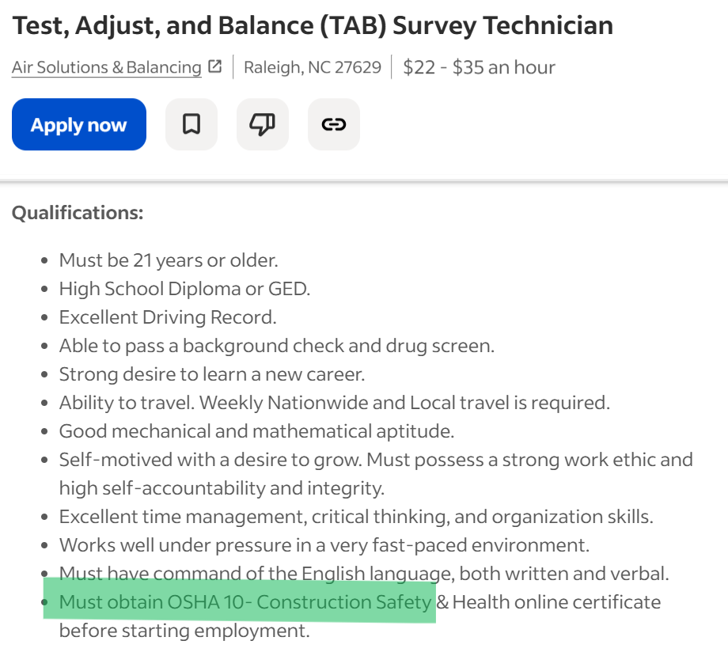
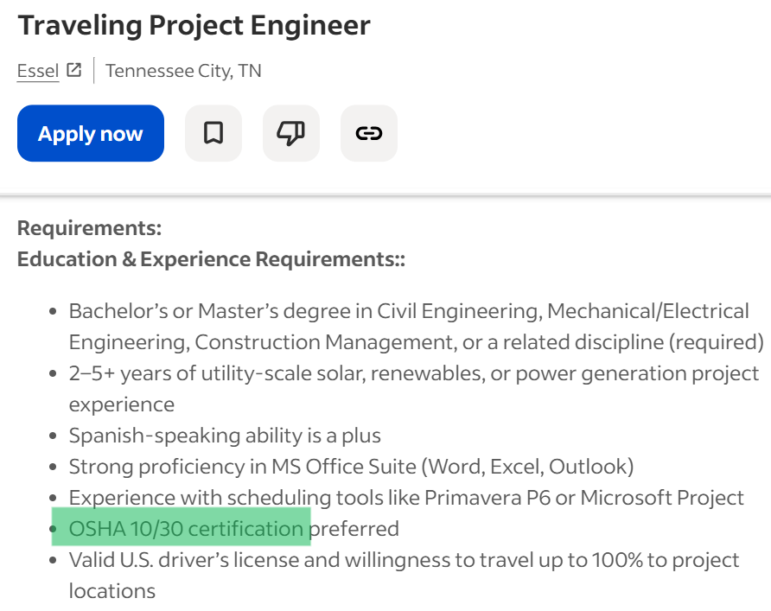
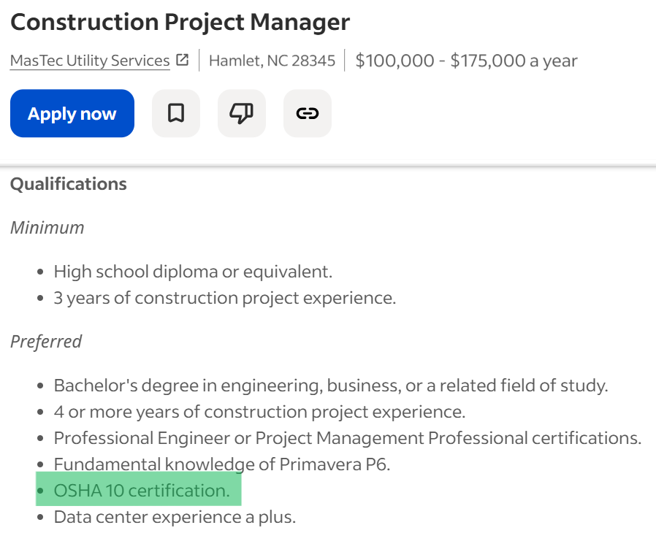
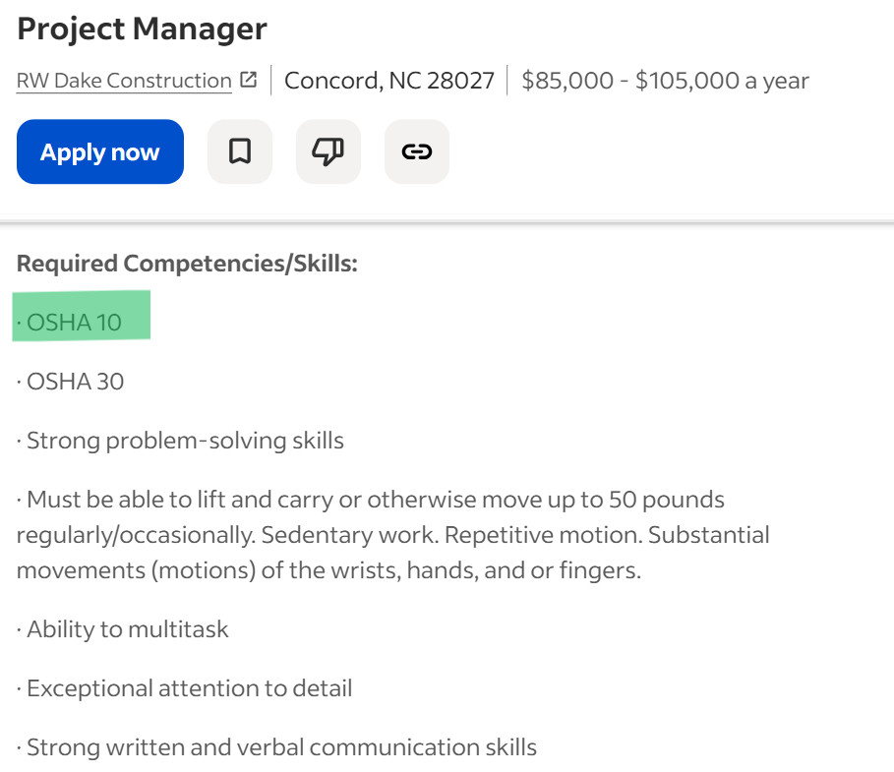
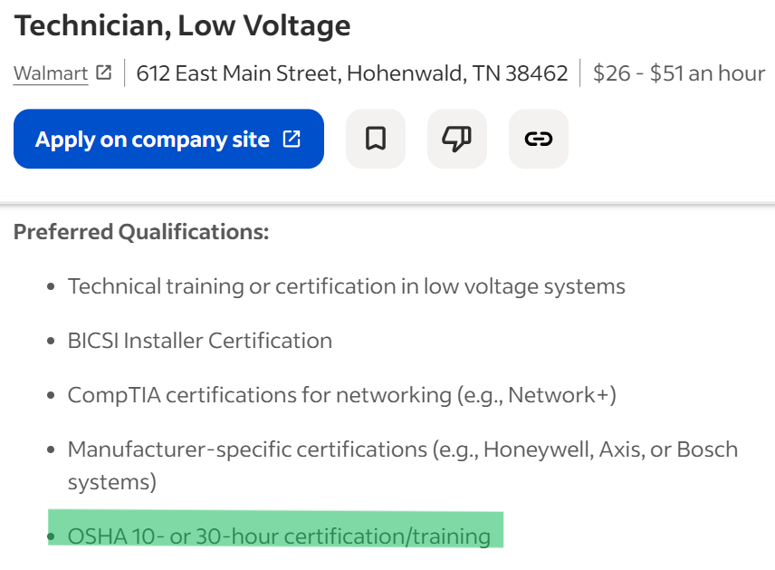
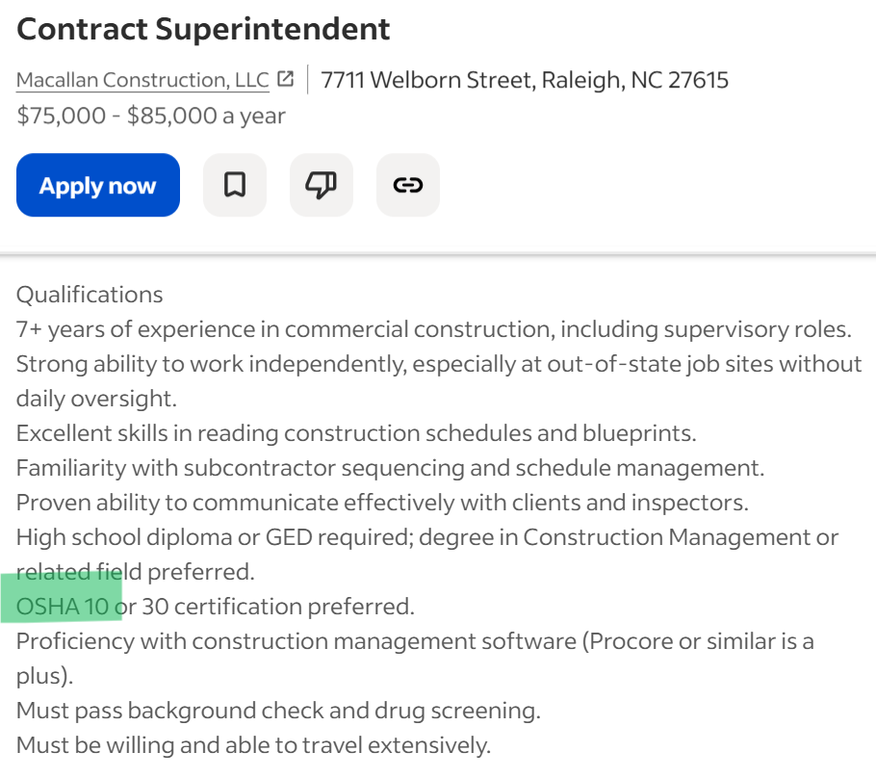
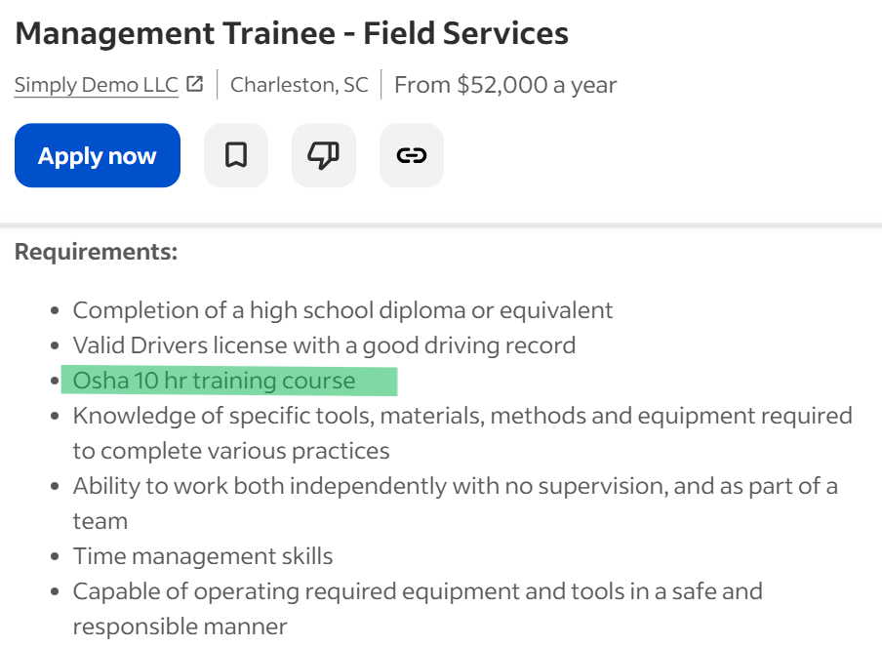
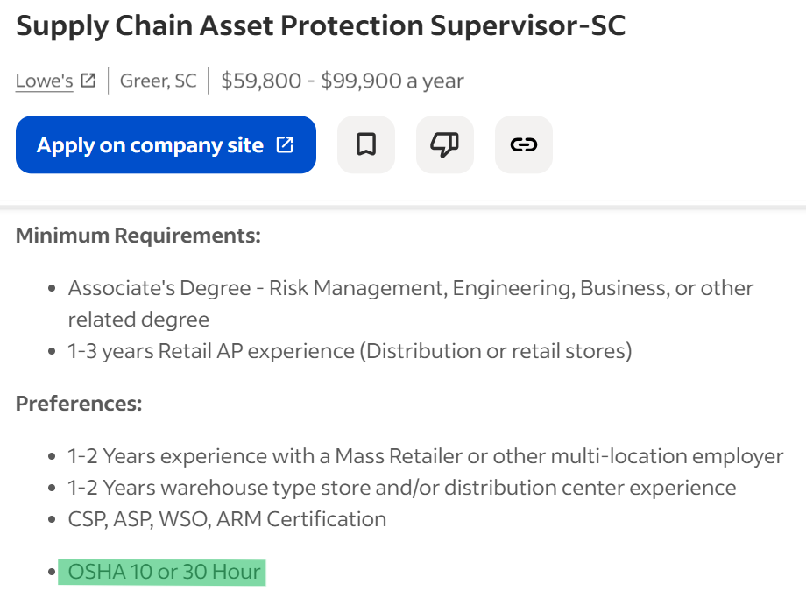

































































Industry Recognized and Employer Validated
Tennessee
North Carolina
South Carolina
Notes:
Abbreviated Notes:
120 active postings — all requiring OSHA 10
Demand is constant across time and geography
Found in diverse fields: construction, manufacturing, healthcare, biomedical, environmental services, public safety, warehousing, transportation, facilities
Not limited to entry-level roles — includes supervisory + technical positions
OSHA 10 = safety fluency → signals readiness to employers
Provides broad employment access + boosts advancement potential
One credential opens doors across multiple workforce pathways
Full Text:
What you’re seeing here is a live picture of the workforce: 120 active job postings across Tennessee, North Carolina, and South Carolina, all requiring OSHA 10. And this is just a slice in time. If we ran this same search tomorrow, next week, or next month, we would see more listings just like these.
These postings aren’t confined to one sector, either. We expect to see OSHA 10 in construction and manufacturing, but it shows up just as frequently in healthcare, biomedical labs, environmental services, public safety, warehousing, transportation, facilities management, and municipal roles. Wherever people work around equipment, chemicals, biological material, or physical hazards, OSHA certification signals preparedness.
And these aren’t only entry-level positions. Many mid-level and senior postings call for OSHA 10 or OSHA 30: supervisors, shift leads, lab coordinators, compliance officers, utilities technicians, field service managers. Employers see value in hiring workers who already understand hazard communication, PPE, exposure risk, and safe operating procedures. Safety awareness is leadership readiness.
So when we talk about OSHA 10 as a credential of value, this visual makes the case clearly. The labor market demands it, consistently, across multiple industries, at multiple levels of employment. And for students, that means one credential can unlock opportunities across fields they may not have even considered.
OSHA 10 isn’t just recognized. It’s required, requested, and rewarded in the real world, and that is the definition of value.

Slide 6
OSHA Training as Stacked Credential
Traditional Academic Framework
High School Diploma
Associate Degree
Bachelor’s Degree
Graduate Degree
Horizontal Stacking
Employability
Credential
Credential
Credential
Value-Added Stacking
Opportunity
High School
CTE Diploma
OSHA 10-Hour Industry Credential
Notes:
Universal certifications are most powerful when paired with pathway-specific credentials.
“This is how districts are thinking about credentials now. OSHA 10 isn’t replacing coursework. It strengthens it and travels with the student.”
Abbreviated Notes:
OSHA 10 works as a stackable credential
Slide shows 3 stacking models → OSHA 10 strongest in value-added stacking
When earned with a CTE diploma → immediate opportunity signal
Opens doors to:
Apprenticeships
Technical + higher-ed pathways
Skilled employment with advancement potential
Forms foundation for future stack: OSHA 30, NCCER, NIMS, ASE, healthcare/biotech, licensure, degrees
Students don’t wait to learn safety — they start prepared
Result: higher earning potential + accelerated career mobility
Full Text:
When we think about preparing students for the workforce, we often think in terms of education first, career second. But credentials give us the ability to connect those two pieces more intentionally, and OSHA 10 is one of the most effective examples of a stackable credential that builds value over time.
On this slide, you’ll see three forms of credential stacking: the transitional academic pathway, horizontal stacking, and value-added stacking. OSHA 10 lives most powerfully in that third category, value-added stacking, because when students earn OSHA 10 alongside their high school CTE diploma, they’re not just graduating with knowledge. They’re graduating with proof of workforce readiness.
This means they can enter an apprenticeship with a head start. They can apply to advanced training programs with safety fundamentals already mastered. They can step into employment with a credential employers immediately recognize and respect. And as we saw in the previous slide, that opens doors not just to first jobs, but to six-figure roles as experience grows.
OSHA 10 becomes the foundation that other credentials can build on, OSHA 30, NCCER, ASE, NIMS, healthcare or biotech certifications, trade licensure, even postsecondary technical degrees. Instead of waiting to gain safety awareness later, students begin their careers already prepared. That accelerates advancement. It changes earning potential. It shifts their trajectory.
So when we talk about value, we’re talking about students walking across the graduation stage with more than a transcript. We’re talking about graduates entering the workforce with a credential stacked with opportunity, and ready to keep stacking as far as they choose to go.

Slide 7



Notes:
STUDENT VALUE + INDUSTRY IMPACT
When students finish, they get a card that travels with them. That OSHA 10 card is a credential employers immediately recognize.
Employers value OSHA 10 because students arrive understanding safety expectations before their first day.
Ask: How many of your industry partners ask about safety training before placement?
Question to Ask: How many of your local industry partners have asked about safety credentials or OSHA training before students start? (Use this to reinforce demand.)

Slide 8




OSHA 10-Hour
CareerSafe’s OSHA 10-Hour General Industry course consists of interactive topics covering safety and health knowledge and procedures appropriate for non-construction, general industry careers.
OSHA 10-Hour Cards are mailed within two business days of course completion.
General Industry Unique Focus Courses:
Agriculture
Automotive
Cosmetology
Culinary
Healthcare
Manufacturing
Veterinary
Public Safety
Public Safety: EMS
Public Safety: Law Enforcement,
Corrections, & Security

Slide 9






Designed for Educators and Students
  Pathway-specific OSHA courses
  Accessible course design
  Support for classroom implementation
  Pre- and Post- test assessment data
  CTE teacher recognition programs
  Investment in CTE students
Notes:
Abbreviated Notes:
CareerSafe = built for CTE classrooms, not retrofitted
4.1+ million trained → proven scale + trusted by educators
US-based Customer Care → fast, knowledgeable, responsive
OSHA cards shipped in 3 business days → immediate credential use
Education-centric differentiators:
Only pathway-specific OSHA provider
Section 508 + WCAG compliant for accessible learning
We know that educators often need assessment data, so we’ve built that in
CTE teacher recognition + investment in student success
Classroom integration tools + pacing support
The message: CareerSafe is the first-choice OSHA provider for CTE

Slide 10


CareerSafe Products
The CareerSafe program is an entirely online learning experience that’s available any time, from anywhere. Our courses are unique, interactive, and designed with educators in mind.
Online Libraries Available for Purchase:
1
OSHA 10-Hour
OSHA 30-Hour
Health and Safety Topics
Employability Skills
StartSafe: Preparing for Work-Based Learning
2
3
4
5
Interested in learning more about our courses? Scan this QR code to visit our website:

Slide 11

Alignment to Learning Standards
Tennessee Learning Standard | CareerSafe Enabling Learning Outcome
1.3 Materials Safety: Follow procedures to work safely around materials. Adhere to responsibilities for employees in material safety as outlined by the Hazard Communication Standard (HazCom), such as locating and interpreting material safety data sheets (MSDS). Demonstrate safe procedures to move materials by planning the movement, properly lifting, stacking, and storing materials, and selecting proper materials-handling equipment. | • Identify the employer’s responsibilities under the HCS, including training requirements. • Identify components of a Hazard Communication program. • Describe requirements of the different types of Hazard Communication labels. • Locate pertinent information about chemicals on labels, including other forms of hazard communication, to ensure “right to understanding” provisions of GHS requirements. • Identify types of material handling equipment. • Describe hazards associated with material handling activities (e.g., storage, use, and disposal). • Identify methods to prevent hazards associated with material handling equipment. • Recognize employer requirements to protect workers from material handling hazards. • Recognize risk factors associated with work-related musculoskeletal disorders (MSD)s. • Identify good posture. • Describe safe lifting techniques. • Identify ergonomic control methods for eliminating/reducing work-related MSDs.
Notes:
Abbreviated Notes:
Crosswalk shows TN DOE construction standards aligned to CareerSafe OSHA 10
CareerSafe = OSHA Authorized Training Provider
Outcomes mapped directly to OSHA and state CTE standards
Designed for secondary learners, not retrofit adult material
Supports teachers → meets required competencies through credential delivery
Students get classroom credit and a workforce-recognized credential
Competitors often lack clear mapping → CareerSafe stands out
Key message: alignment ensures relevance, rigor, and instructional value
Full Text:
On this slide, you’re looking at a crosswalk between the Tennessee Department of Education’s Fundamentals of Construction standards and CareerSafe’s OSHA 10 learning outcomes. This isn’t accidental alignment. It’s intentional. CareerSafe is an OSHA Authorized Training Provider, which means our curriculum is built directly from OSHA’s regulatory framework and competency expectations. But we’ve gone a step further.
Unlike many general-purpose safety programs, CareerSafe’s OSHA 10 training is designed specifically for secondary CTE learners, and we map our enabling learning outcomes to state-mandated competencies, not just content in the OSHA standard itself. That means students are not only earning a credential, they are simultaneously meeting the learning objectives required for their coursework and program of study.
This alignment matters for teachers, it matters for administrators, and it matters for students. When educators integrate OSHA 10 through CareerSafe, they are not adding content, they are delivering required content through a credential that holds value beyond the classroom. It supports instructional planning, ensures standard coverage, and creates a direct pathway from theory to practical workforce application.
And this is where CareerSafe stands apart. Many safety courses cover isolated topics. Many offer concepts without skill verification. But CareerSafe’s OSHA 10 training is intentionally structured to match and support state CTE standards, ensuring that every learner can move from instruction to credential attainment with clarity, consistency, and confidence.
This isn’t just compliance, it’s relevance. It’s alignment. And it’s one more reason OSHA 10 through CareerSafe is a credential of real value.

Slide 12
The CareerSafe Difference
Notes:
“We built CareerSafe intentionally for education. That’s why alignment and flexibility matter so much in how districts use it.”
As we move into the second half of the presentation, I want to shift from why OSHA 10 is valuable to why CareerSafe is the best provider for delivering it — especially within secondary CTE.

Slide 13
CareerSafe Campus
Educator Features and Student Benefits
Notes:
“Built to fit bell schedules, pacing, and diverse learners. This is where most online programs fall apart. Ours was built around how schools actually run.”
From lesson plans and study guides to gradebooks and pre/post testing it’s all included. You don’t have to build anything from scratch unless you want to.
The CareerSafe Campus offers unique features for educators, like pre- and post-tests and a detailed gradebook, that enhance the experience of teaching essential safety and employability skills. There are also a variety of student benefits, like built-in accessibility features and study guides, that ensure student success.

Slide 14



A Campus Created for Schools
Notes:
Abbreviated notes:
CareerSafe Campus = LMS built for secondary educators
Features designed for CTE workflow:
Progress tracking + reporting
Enrollment + pacing management
Instructional resources + supplemental materials
Not a repurposed platform — it’s built for schools
Educator support includes:
Recorded tutorials + live training
Webinars + PD for instructional integration
Admin + teacher onboarding assistance
Outcome: OSHA training is easy to manage, easy to teach, and impactful for students
Reinforces CareerSafe as the first choice OSHA provider in secondary CTE
Full text:
The platform you see here, the CareerSafe Campus, isn’t a generic LMS repurposed for schools. It is a learning environment designed specifically for educators, with tools that match the way CTE classrooms function day to day. Teachers can track student progress in real time, pull completion reports with one click, manage enrollment, monitor pacing, and support learners who need additional time or accommodations. Everything is built around usability, clarity, and instructional efficiency.
Beyond that, we provide educators with the instructional tools that make integration seamless: pacing guides, lesson ideas, supplemental activities, digital tracking, and ongoing teaching resources. Teachers shouldn’t have to figure out how to make OSHA training fit into their course. With CareerSafe, it fits naturally.
And we don’t leave educators to navigate the platform alone. We support them through recorded tutorials, live walkthroughs, onboarding sessions, and training webinars. Admins and teachers also have access to professional development presentations focused on integrating online learning into traditional classrooms, because we know that great tools only matter if educators feel confident using them.
All of this (the campus design, the reporting systems, the integration support, the professional development) reinforces why CareerSafe stands apart. We make safety training easy to administer, easy to track, and meaningful for students. We aren’t just the first choice provider because of what we teach. We’re the first choice because of how well we support the people who teach it.

Slide 15

Customizable Lesson Plans
Lesson Plan Key Features
Notes:
“You’re not starting from scratch. Everything is there, and you can use as much or as little as you want.”
The Lesson Plans in CareerSafe® Teacher Tools provide all the necessary information to support you in utilizing the course material in purposeful ways. The document is customizable for convenience, structured to maximize space, and designed to minimize printer ink use. Consider it a one-stop document for creating and documenting your instructional strategies. The enabling learning objectives found here can be easily cross-walked to the terminal learning objectives identified in state curriculum.

Slide 16

PowerPoint Presentations
The Presentation Bundle for each topic in a CareerSafe course includes:
  Estimated/Required Topic Duration
  Learning Objectives
  Key Module Content
  Practice Questions with Answer Keys
  Printable Handout Format for Study Guide Use
Notes:
CareerSafe® has crafted our Presentation Bundles to provide detailed information that reflects the content contained in our online course material while also adding avenues for content reinforcement, easy assignment creation, and meeting student accommodation needs. Each Presentation Bundle contains a Teacher PowerPoint file in addition to two PDF files, one with a 6-slide per page view and another with 3-slides with notes sections for each.
Our Teacher PowerPoints are customizable for your convenience and designed to minimize printer ink use so you can utilize them as student handouts or to monitor student progress. Think of these PowerPoints and their matching PDFs as your personal access to CareerSafe’s course material and the perfect tool to meet your instructional needs.

Slide 17

Pre- and Post-Testing
All courses in the CareerSafe Campus include a pre-test to use for benchmark data of student learning compared to the final assessment.
Notes:
“Supports documentation and accountability.”
“This matters when you’re asked to show outcomes. The data is already there.”
Each CareerSafe course contains a required pre-test, providing educators with baseline data for each student. This data can be utilized to quantify learning gains from pre- to post-test.

Slide 18

Gradebook
View Seat Time, Last Visited, and Complete By date
The Warning icon indicates an upcoming deadline
Notes:
The Gradebook with the CareerSafe Campus offers features for educators to ensure student engagement and course completion and to access assessment data. Through the gradebook, educators can view each student’s seat time, date last visited, and the date by which students must complete the course. It also features warning icons for upcoming deadlines.

Slide 19

Intentional Accommodations
Curricula designed to be flexible and adapt to the needs of students
Supplemental materials that can be used as is or adapted to meet the needs of students
Courses designed to meet international Web Content Accessibility Guidelines (WCAG)
Assessments that can be saved and later resumed for students who need additional time
Sampling of Accessibility Tools of Disability Type:
Notes:
Ask:
What accommodation has made the biggest difference for one of your students?
Allow discussion.
Then connect to accessibility features.
This will create engagement.
“This is one of the reasons districts adopt CareerSafe district-wide. It works for all learners.”
Abbreviated notes:
Accessibility = built intentionally, not added later
Accommodations exist for:
Visual impairment + blindness
Dyslexia + reading processing differences
Hearing impairment + deafness
Motor impairment
ADHD + executive functioning needs
English language learners
Supports general ed + special ed + IEP implementation
Helps teachers ensure students can access + succeed in training
Reinforces CareerSafe as the leader in secondary CTE OSHA training
Credential becomes reachable for all students — not just some
Full text:
This slide highlights something we take very seriously. Accessibility is not an afterthought in CareerSafe training. It’s a design principle.
Our campus and courses are built with intentional accommodations integrated throughout, so every learner (regardless of ability, learning profile, or language background) can engage meaningfully with OSHA content. We don’t wait to retrofit accessibility; we architect for it from the beginning.
CareerSafe supports students with visual impairment, including blindness, with screen reader compatibility and clear text hierarchy. We support learners with dyslexia through readable typefaces, color contrast, and pacing control. For those with hearing impairments, including deafness, we provide captions, transcripts, and visual communication cues. Students with motor impairment can navigate the platform without precision mouse control, and learners with ADHD can benefit from modular content, short-form segments, and self-paced progression.
These accommodations aren’t just features; they are classroom support tools. They help CTE teachers meet IEP requirements with confidence. They help special educators collaborate more effectively. They help English language learners access content without falling behind. And they help students build workplace safety knowledge without barriers.
Accessibility and inclusion strengthen student outcomes. They make the credential attainable for more learners. And they reinforce why CareerSafe continues to stand out as the leading OSHA training provider for secondary CTE. We don’t just teach safety. We ensure that students have a safe, supportive path to earning the credential.
That is intentional design. That is educational alignment. And that is value.

Slide 20
OSHA 10-Hour Lesson Preview
Fall Hazards
Notes:
The Fall Hazards module in the OSHA-10 Construction Pathway has a 90-minute seat time and provides essential knowledge to help your students start and stay safe. Today, we will explore what is taught in this module and discuss the CareerSafe interactive learning experience.
Here’s what the classroom experience can look like these are not dry, compliance-based videos. These are interactive modules that teach through storytelling and decision-making.
And our Employability Skills content especially lessons like “effective listening” is spot on for preparing students for work-based learning or internships.

Slide 21



CareerSafe Campus
Customizable Lesson Plan
Interactive Learning
PowerPoint Presentation
Note: Digital copies of Fall Hazards customizable Lesson Plan and PowerPoint Presentation are available
Notes:
“This is what students actually see. Interactive, visual, and paced for learning, not memorization.”
CareerSafe is dedicated to ensuring educators have the tools they need to guide their students in successful completion of their OSHA-10 training.

Slide 22
OSHA 10-Hour Lesson Preview
Fall Hazards
Notes:
The Fall Hazards module in the OSHA-10 Construction Pathway has a 90-minute seat time and provides essential knowledge to help your students start and stay safe. Today, we will explore what is taught in this module and discuss the CareerSafe interactive learning experience.
Here’s what the classroom experience can look like these are not dry, compliance-based videos. These are interactive modules that teach through storytelling and decision-making.
And our Employability Skills content especially lessons like “effective listening” is spot on for preparing students for work-based learning or internships.

Slide 23
CareerSafe and NCCER
Notes:
If your students are already earning NCCER credentials, this is a great value add. Our OSHA 10 Construction course is embedded into the NCCER Core curriculum. So, one course, multiple credentials, more value. You can stack credentials and reinforce safety while meeting program standards again adding more value.
Especially in New Mexico, where Construction and Manufacturing are high-demand pathways this is a win-win.

Slide 24

NCCER Partnership
CareerSafe is partnering with the National Center for Construction Education & Research (NCCER) to ensure trainees and students have access to affordable safety training. Our collaboration allows OSHA credentials to be tracked within NCCER’s credentialing system.
The 6th Edition of NCCER Core: Introduction to Basic Construction Skills incorporates CareerSafe’s OSHA 10-Hour Construction training into the lesson plan. These two courses are a great companion to one another.
Notes:
“For construction programs, this creates a natural credential pathway.”

Slide 25

How it Works
OSHA 10
Construction Site Safety Orientation
NCCER Core
By completing both the NCCER Core and CareerSafe OSHA 10-Hour training, students and trainees will earn a total of three credentials.
To earn NCCER credit for CareerSafe OSHA 10-Hour training, students will need to link their CareerSafe and NCCER accounts.
Notes:
The key here is flexibility and credential stacking. We make it easy to link CareerSafe and NCCER accounts so students can get credit on both ends.
This type of alignment is exactly what employers are asking for students who are cross-trained and credentialed before they ever apply.

Slide 26
Benefits
NCCER Core: Introduction to Basic Construction Skills provides the basics in hand and power tools, construction math, materials handling, construction drawings, rigging and employability skills.
CareerSafe OSHA 10-Hour training provides the foundational knowledge of essential occupational safety and health standards appropriate for construction industry careers.
The CareerSafe Difference:
Online training
Flexibility to complete training on a customized schedule
Many educator features and student benefits!
Notes:
“This is optional, but for programs using NCCER, the alignment is powerful.”
Online doesn’t mean alone. Our courses are interactive, engaging, and built with real student needs in mind.
Mississippi students often have part-time jobs, athletics, or family responsibilities. Online flexibility helps keep training accessible for all learners.

Slide 27
Employability Skills
Lesson Preview
Communication - Effective Listening
Notes:
Effective Listening
Ask:
What soft skill do your students struggle with most before work-based learning?
Get responses.
Likely answers:
Communication
Professionalism
Attendance
Initiative
Tie responses back to Employability Skills.
Question to Ask: “When your students go into interviews or WBL, what’s the #1 soft skill they’re missing?”
(Quick feedback—tie answers to CareerSafe modules)
Ask: “What’s one soft skill your students consistently need more of before work-based learning?”

Slide 28



CareerSafe Campus
Customizable Lesson Plan
Interactive Learning
PowerPoint Presentation
Note: Digital copies of Bloodborne Pathogens customizable Lesson Plan, PowerPoint Presentation, and Suggested Activities are available
Notes:
Customizable lessons, pre/post tests, printable study guides, gradebook views all designed to make your life easier.
We also built in accessibility features to support all learners.

Slide 29
Enabling Learning Objectives
The student will be able to:
Describe the elements of effective listening.
Explain the benefits of effective listening.
Identify the barriers to effective communication.
Explain the role body language plays in creating and conveying a positive listening attitude.
Describe how to create a listening mindset using framing, positive intent, and focus.
Engage in and model active listening skills.
Notes:
The Effective Listening module guides students through:
Defining Effective Listening
Benefits of Effective Listening
Barriers to Effective Listening

Slide 30
Suggested Classroom Activities
Communication Charades
Objective: Recognize nonverbal communication and body language.
Activity: Students act out workplace scenarios using only gestures; classmates guess the situation and discuss what nonverbal cues were present.
"Say It Another Way" Game
Objective: Practice rephrasing for clarity and tone.
Activity: Students receive phrases with unclear, rude, or vague wording and must reword them into clear, respectful, and professional statements.
Active Listening Pairs
Objective: Strengthen listening skills and accurate interpretation.
Activity: One student shares a story or explains a process; the listener summarizes it back. Switch roles and reflect on how well each person listened.
"Telephone" with a Twist
Objective: Show the importance of clarity, effective listening, and minimizing miscommunication.
Activity: One student creates a short, silly sentence and whispers it to the next player. The second student whispers what they heard to the third player. The third student acts it out silently for the fourth player. The students then alternate whispering and silently acting it out. At the end, compare the original message to the final version and discuss how details were lost or changed.
Communication Barrier Challenge
Objective: Identify challenges to effective communication and how to overcome them.
Activity: Pairs sit back-to-back; one describes a shape or image while the other draws it without looking. Compare drawings and reflect on what made communication effective or difficult.
Notes:
These activities build upon the enabling learning objectives taught in the CareerSafe Effective Listening module. The activities provide the opportunity for your students to display agency through understanding, application, and analysis of their effective listening knowledge.
If you want to add hands-on or group activities, these are included and ready to go. And they’re tied directly to STATE and national standards.”
“I know some of you use bell ringers or Friday flex days these activities work great in those windows.”

Slide 31



Slide 32
Classroom Integration
Notes:
There is no one-size-fits-all for how to integrate the OSHA-10 Hour training in the classroom. Here, we provide a sampling of pacing options for how to intentionally guide your students through the safety training they need to start safe and stay safe in the classroom and in their careers.

Slide 33




Ideas for OSHA 10-Hour Implementation
Independent Completion – Students complete modules asynchronously
Hybrid Instruction – Online coursework paired with classroom discussion and activities
Bellringer/Warm-Up Model – Short OSHA segments integrated into daily instruction
Lab/Shop Integration – Safety concepts reinforced during technical skill practice
Work-Based Learning Preparation – Used before internships, clinicals, apprenticeships, or job placement

Slide 34
OSHA-10 Hour Classroom Integration
The OSHA 10-Hour curriculum should be integrated into the classroom based on the needs of the students, the structure of the learning time, and/or use of the training as a prerequisite.
Sample of pacing options for integration:
15 school days – Full class periods (40 minutes) during every class
6 Weeks – Half of class period (25 minutes) during every class
7.5 Weeks – Two full class periods (40 minutes) twice per week
12 Weeks – Half of class period (25 minutes) twice per week
Additional options for integration:
Flipped classroom
Learning stations in small groups
Flexibility for learning situations (e.g., change in schedule, substitute plans, remote learning)
Use of Supplemental Topic Modules for additional instruction or enrichment
Notes:
“There’s no single right way. Districts choose what works for their students.”
You don’t have to fit this into a rigid 2-week block. Many teachers in Mississippi are integrating OSHA 10 over six or even 12 weeks, with half-day pacing or as part of flipped learning.
The point is there’s no wrong way to do this, as long as students are engaged and progressing.
Flexible models are key:
Full class for 15 days
6–12 week pacing
Flipped classrooms or stations”
Adaptable to block schedules, sub plans, remote days whatever you’ve got.

Slide 35
Trusted, Proven, and Preferred
Our partnership with CareerSafe has been seamless, supportive, and highly effective in delivering safety training to students. The platform’s flexibility and user-friendly design allows students to work at their own pace with built-in accommodations that support diverse learning needs. CareerSafe’s responsive customer support ensures educators have the resources needed for student success.
– Kendra Hendry, Instructional Facilitator, Daniel Morgan Technology Center, South Carolina
We use CareerSafe because it meets the unique needs of our CTE programs. The platform’s flexibility helps teachers accommodate different class lengths, student IEP needs, and pacing. CareerSafe’s teacher and student support is unmatched. Whenever we have a question, they respond immediately.
– Matt MacKay, CTE Coordinator, Career Technical Education & Signature Programs, Washoe County School District, Nevada
We chose CareerSafe because it offers a student-centered, flexible, and educator-friendly platform designed specifically for secondary learners. Its interactive modules, real-world scenarios, and built-in assessments help ensure students truly understand safety concepts rather than simply memorizing them. Overall, CareerSafe delivers high-quality training that meets industry requirements while fitting seamlessly into a school-based CTE environment.
– Natalie Street, Instructional Coordinator of PD and CTE, Isle of Wight County Schools, Virginia
Notes:
Abbreviated notes:
Testimonials highlight:
flexibility, accommodations, pacing
support unmatched, responsive, user-friendly
student-centered, educator-friendly
supplements curriculum, fits instruction
interactive, real-world, high-quality, meets industry needs
CareerSafe is a partner — not just a provider
Schools trust us to deliver safety training that works in real classrooms
We make teaching easier, learning relevant, and credential attainment possible
Key message: trusted, proven, preferred — and built to support student success
Full text:
As we look at these testimonials, we’re seeing more than praise. We’re seeing the qualities of a true partnership reflected back to us.
Across four states, CTE leaders describe CareerSafe with words like flexibility, accommodations, and pacing. They highlight our unmatched support, our user-friendly design, and the responsiveness of our team when teachers need help. They note that the training supplements curriculum, that it is student-centered, educator-friendly, high quality, and grounded in real-world scenarios. Not abstract theory, but the kind of learning that moves seamlessly from classroom to workplace.
These qualities matter because they speak to trust. Schools don’t just adopt CareerSafe, they rely on us. We’re not a vendor that disappears once a purchase is made. We are a partner in preparing students for safe, successful entry into the workforce. We work alongside educators as they guide learners toward a credential of value, one that carries weight in industry and credibility in career pathways.
And that is why CareerSafe continues to be preferred. Not because we meet the minimum, but because we support the full picture: instruction, accessibility, classroom integration, technical assistance, credential delivery, and career relevance. We make teaching easier; we make learning meaningful; and we help students walk away with an achievement that opens real doors.
These testimonials reflect who we are. We are not just a training provider, but a partner in building safer, stronger futures for the next generation of workers.

Slide 36
Recap
OSHA 10-Hour meets all the criteria for a credential of value
CareerSafe’s OSHA 10-Hour training is built for students
Our Campus is designed for classroom integration
We designed the campus and courses with intentional accommodations
CareerSafe is trusted, proven, and preferred
Notes:
“Recognized and valued within New Mexico’s credential landscape. If you take one thing away, it’s this: OSHA 10 works because it fits education.”
As we conclude, I want to bring this presentation back to the core message: OSHA 10 is a credential of value — and CareerSafe is the first-choice provider to deliver it.
We’ve seen how OSHA 10 meets every benchmark for a high-value credential.
We’ve seen live labor-market demand, not in theory, but in real postings requiring this training.
We’ve seen how OSHA 10 opens doors — from entry-level employment to six-figure leadership roles — and how stacking it with a CTE diploma amplifies opportunity for students.
We’ve explored the ways CareerSafe stands apart — pathway-specific OSHA, state-aligned learning outcomes, rapid credential delivery, unmatched customer care, accessibility and accommodations built with intention, and a campus purpose-designed for educators and students.
CareerSafe isn’t just a provider of OSHA training.
We are a partner in workforce development — powering classrooms, supporting teachers, and preparing students to step confidently into the future.

Slide 37
Questions?

Slide 38

Contact Information
Justin Williamson, Sales Executive
justin.williamson@careersafeonline.com
(214) 420-8118
To receive more information, use the QR code below to submit your contact information and select ‘SC ACTE’ under Event ID.

Slide 39

Contact Information
Justin Williamson, Sales Executive
Justin.Williamson@careersafeonline.com
(214) 420-8118
To receive more information, use the QR code below to submit your contact information and select ‘SC ACTE’ under Event ID.
Notes:
“Even if you don’t use OSHA 10 today, scan the code, select SC ACTE, and I’ll follow up after the conference.”

