Slide 1


Slide 2
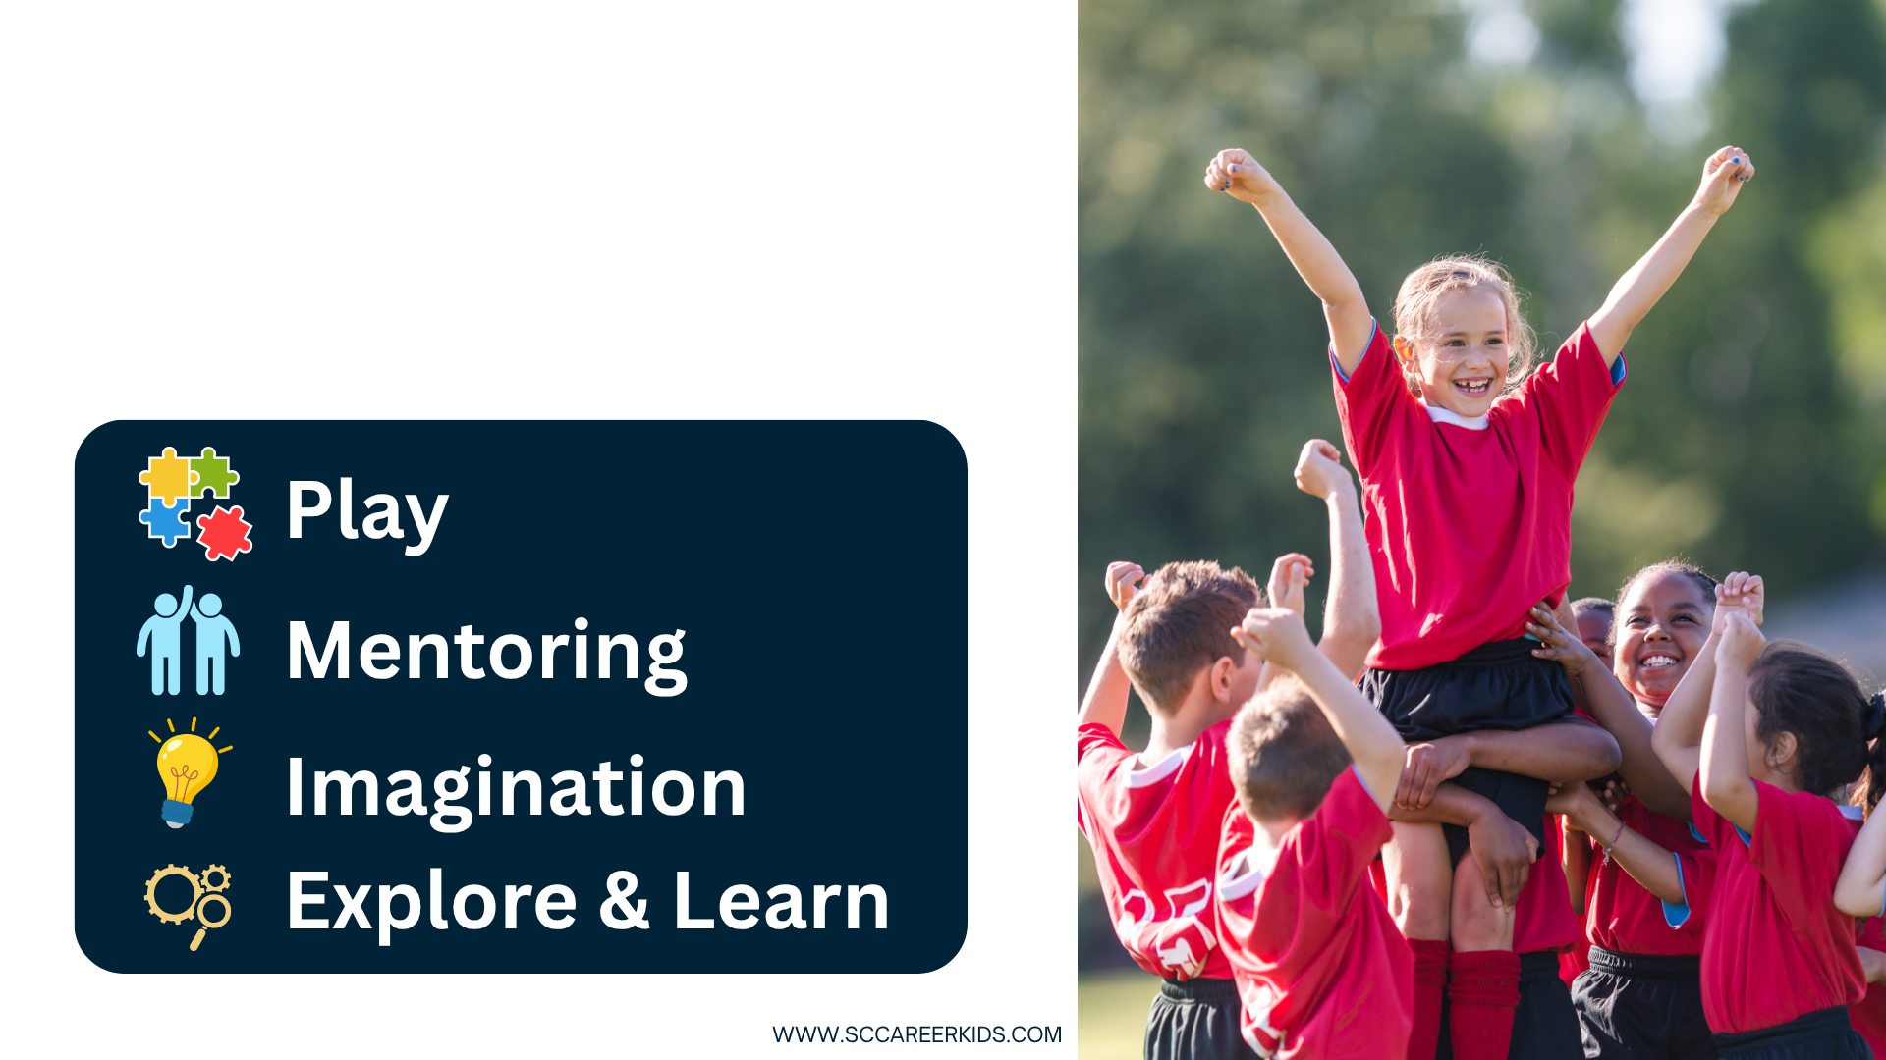
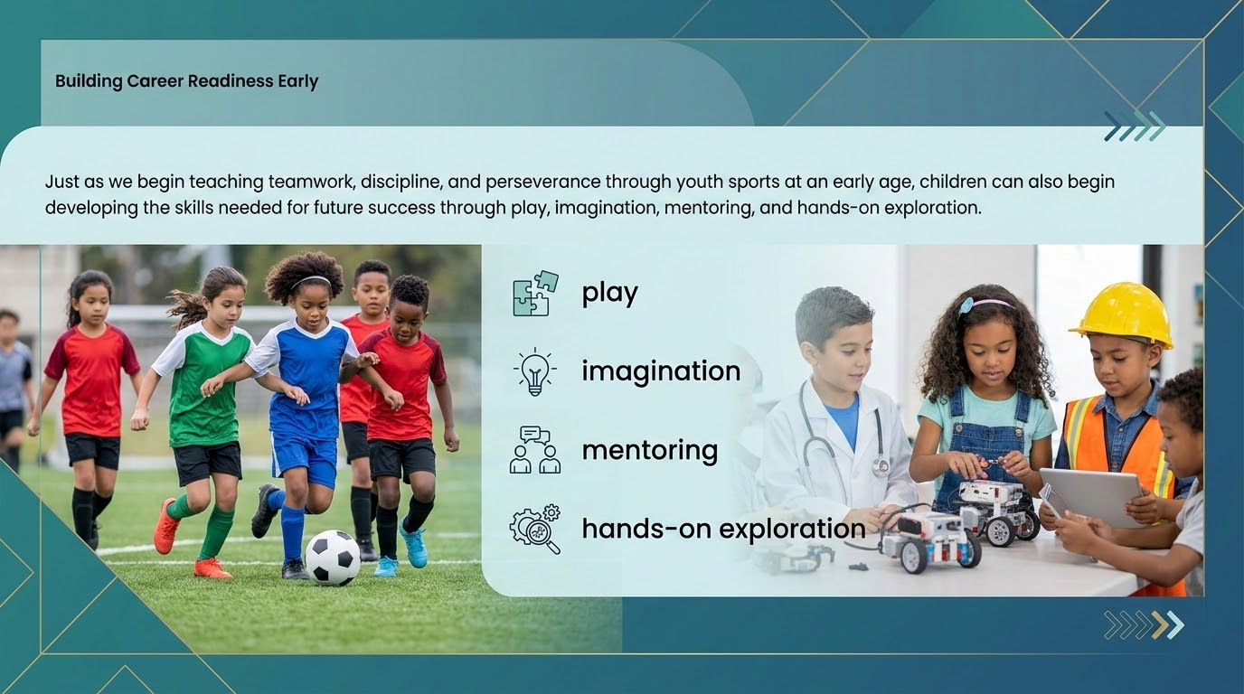
Building Foundations for Future Success
Just as youth sports build teamwork, discipline, and perseverance, play, imagination, mentoring, and hands-on learning help children develop skills for future success.

Slide 3
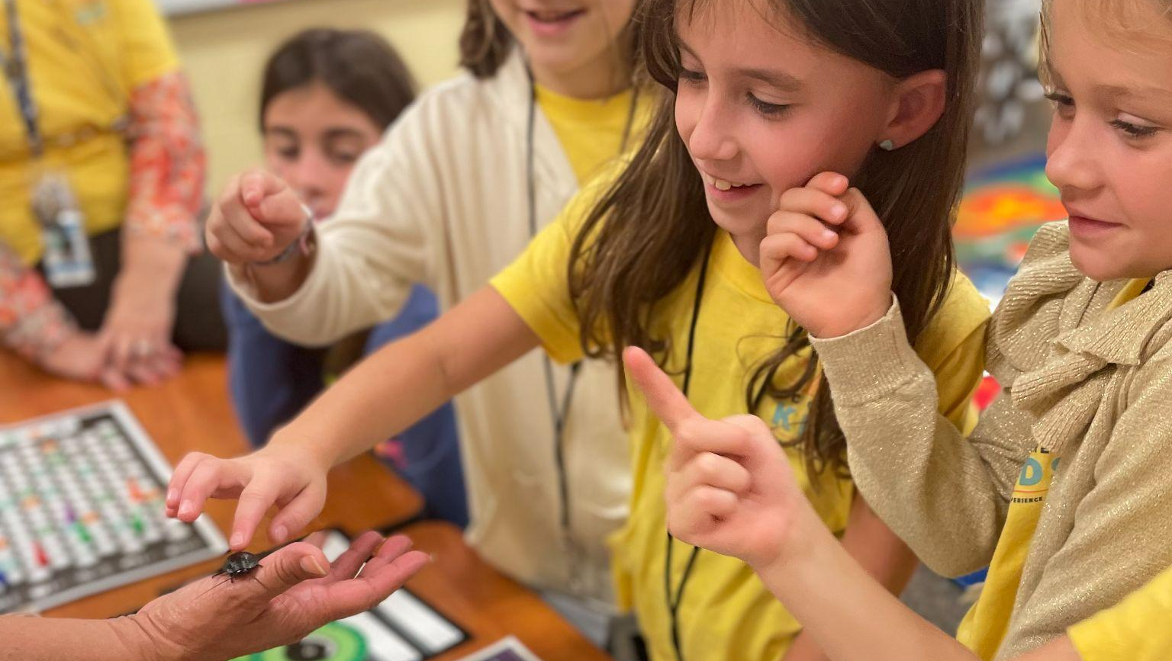

SCCK
“Born out the pandemic, providing students with career exploration during uncertain times.”
SC Career Kids is a 501(c)(3) nonprofit organization.

Slide 4

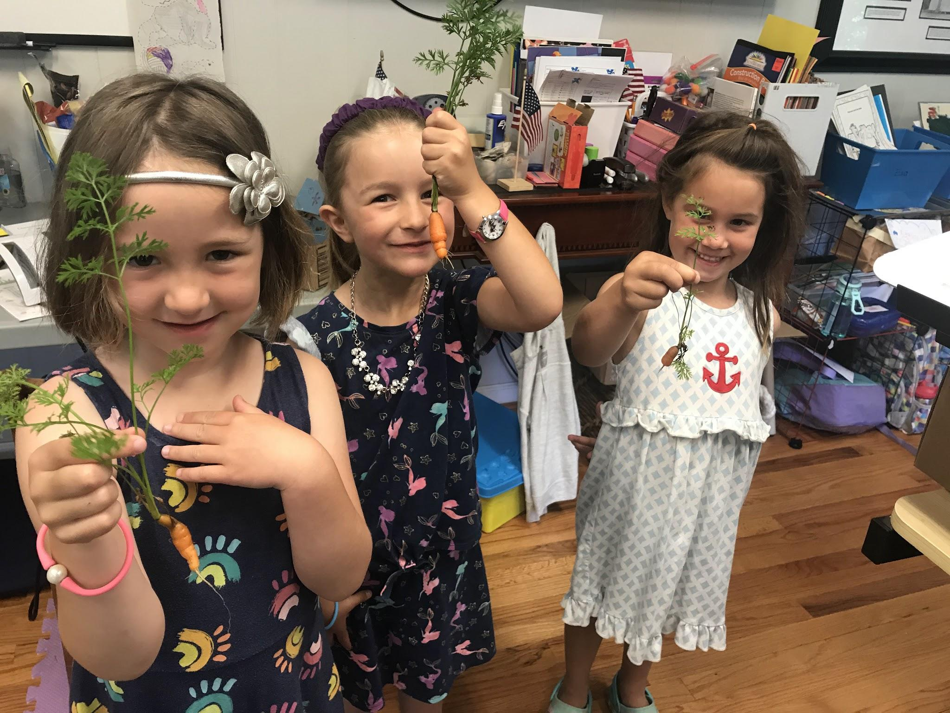
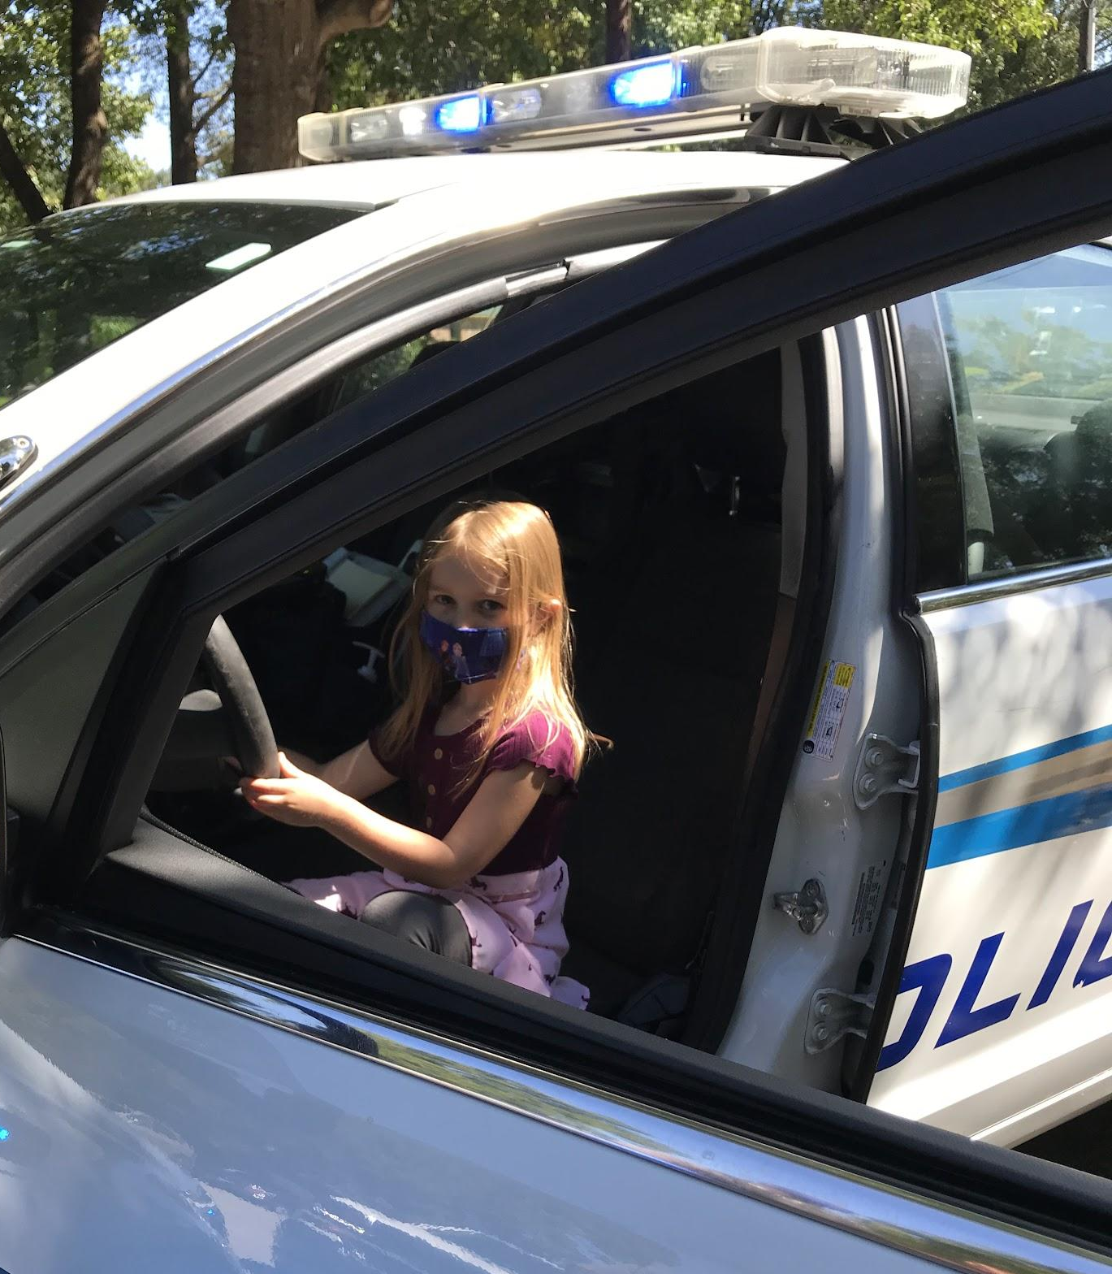
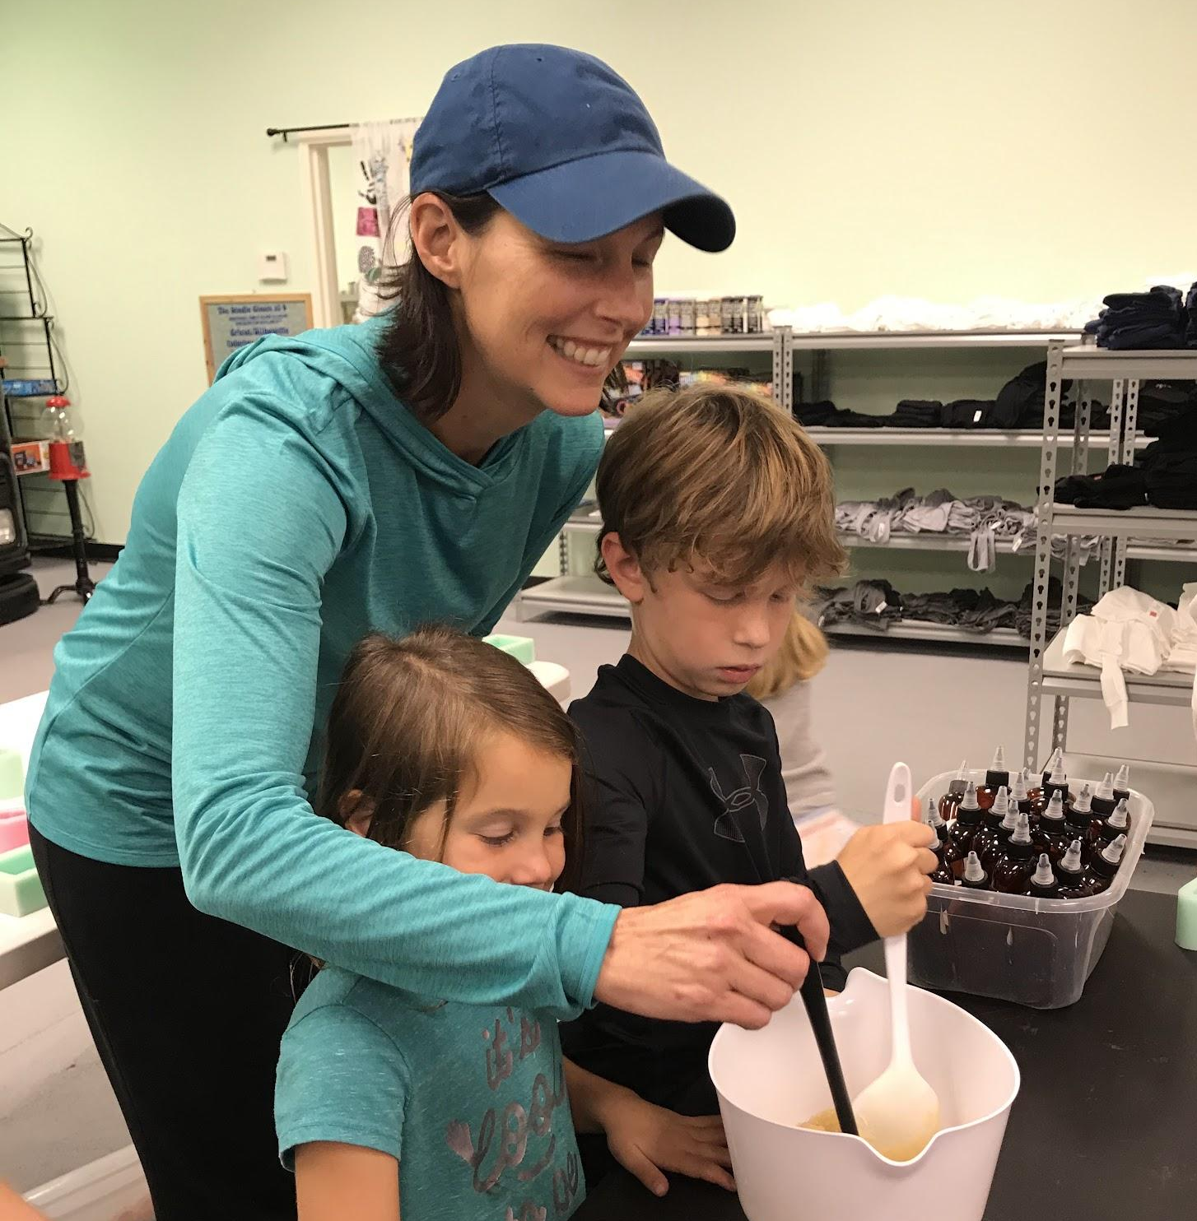
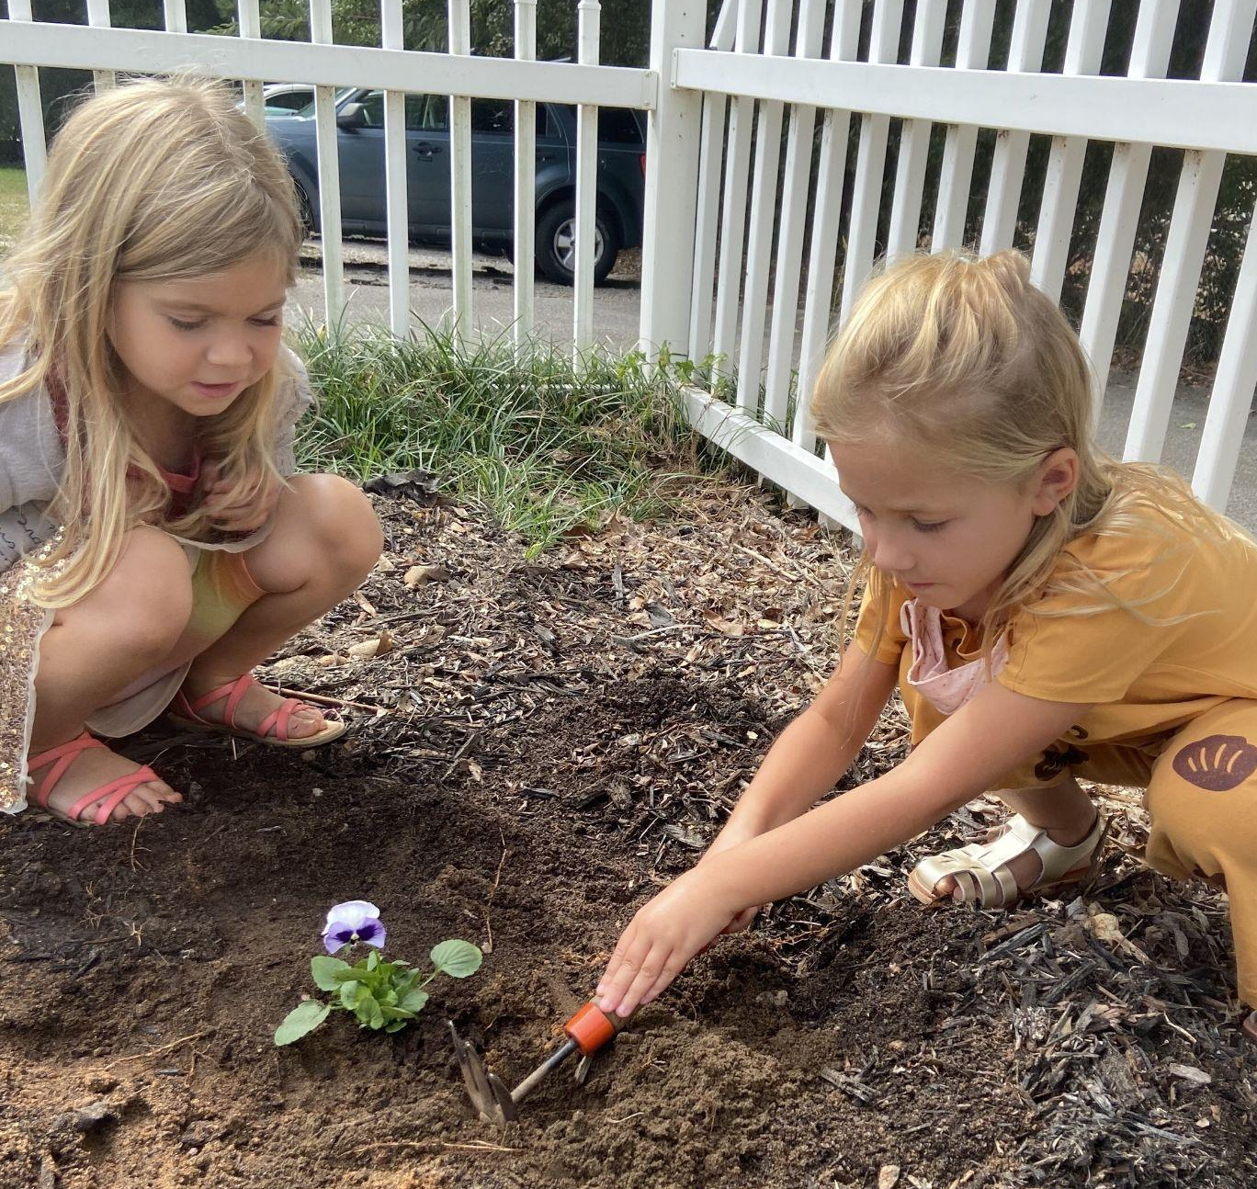
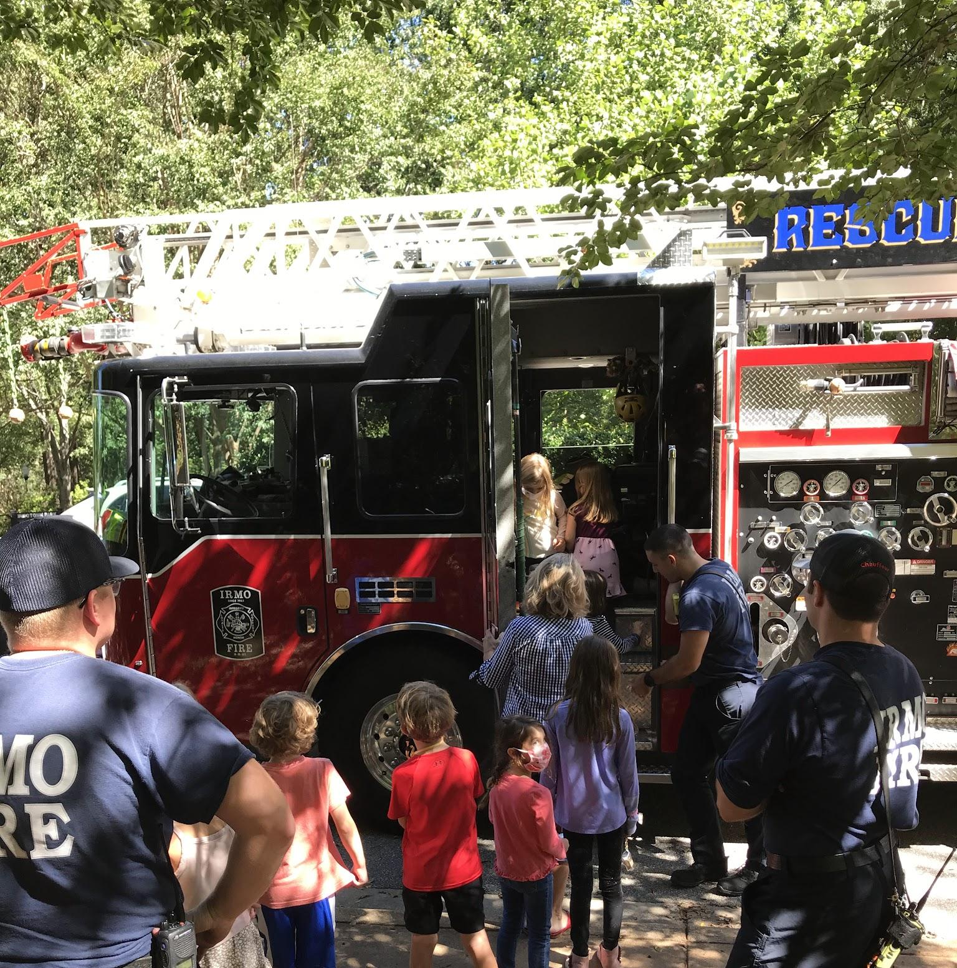
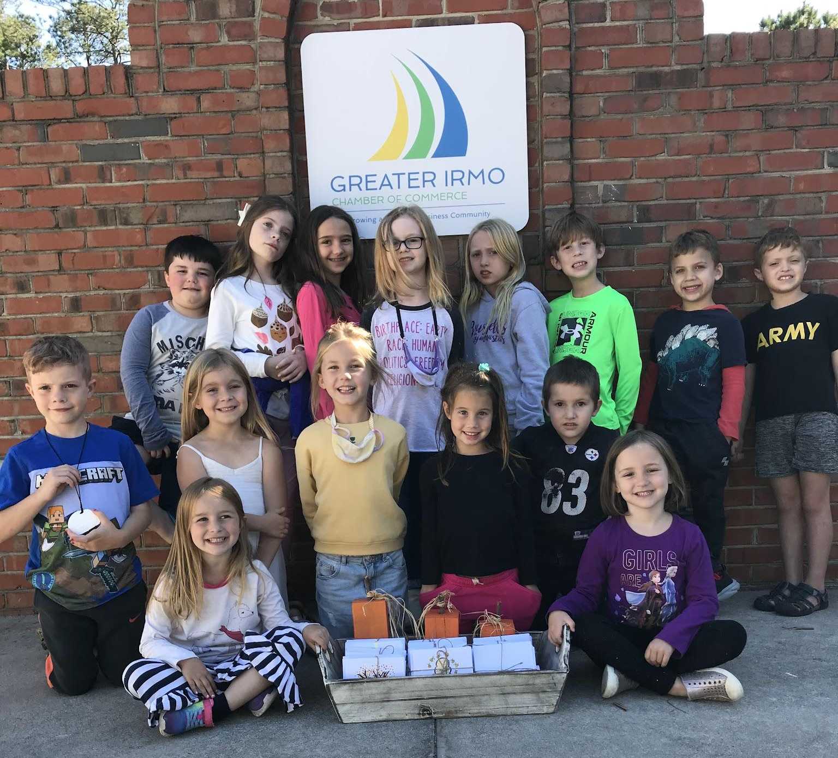
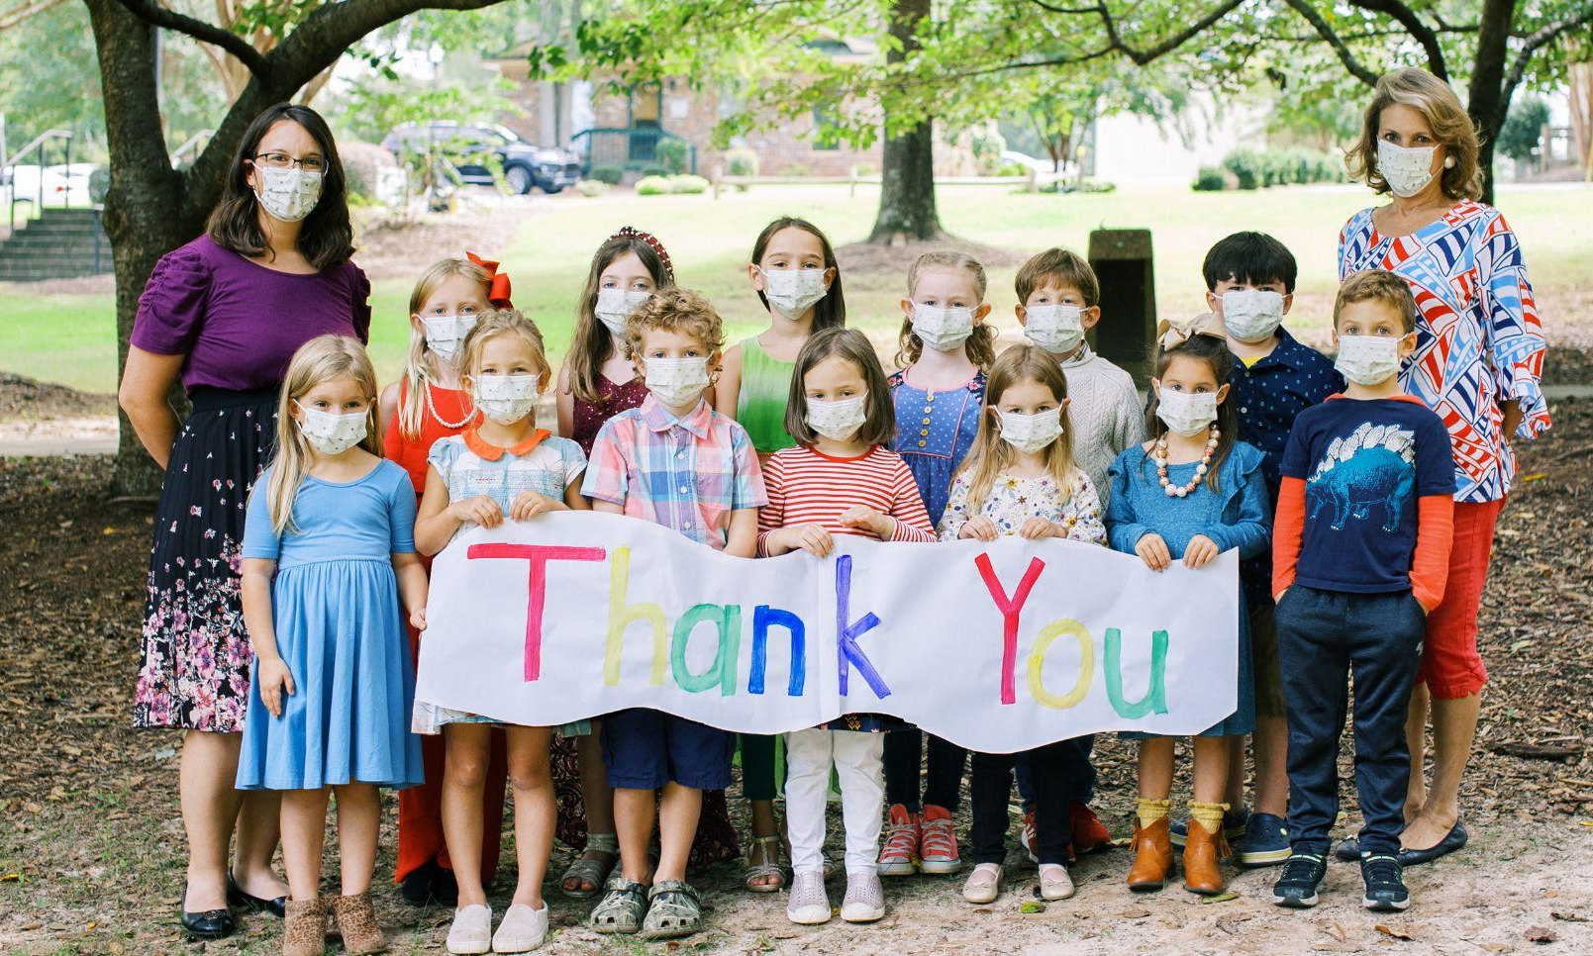
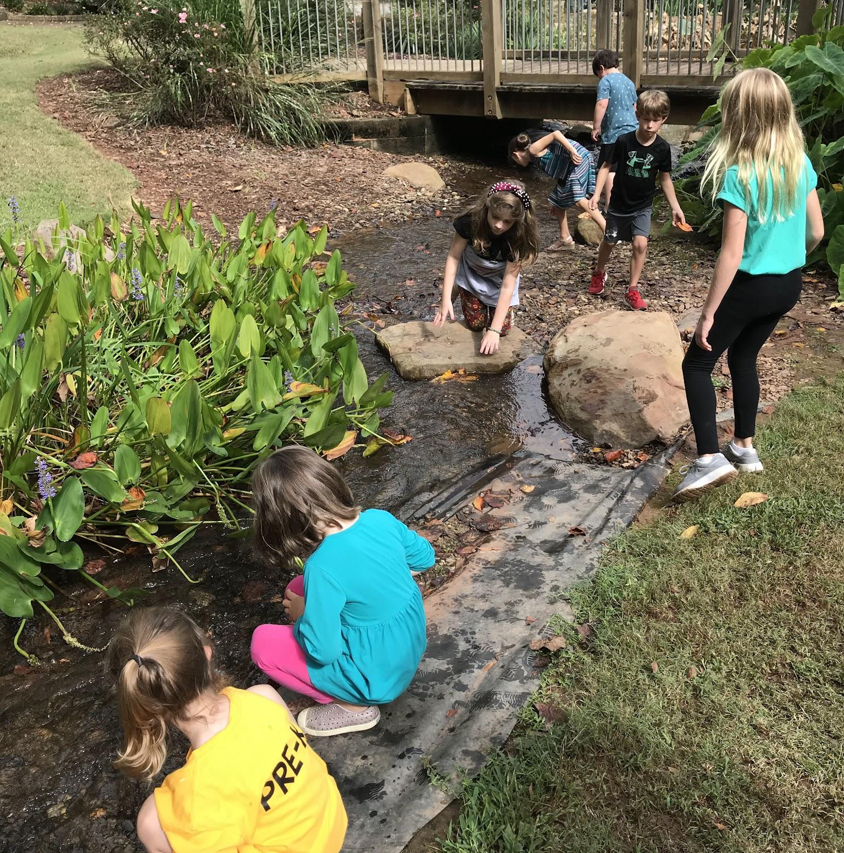
HOW WE BEGAN:
A SOLUTION TO THE PANDEMIC

Slide 5
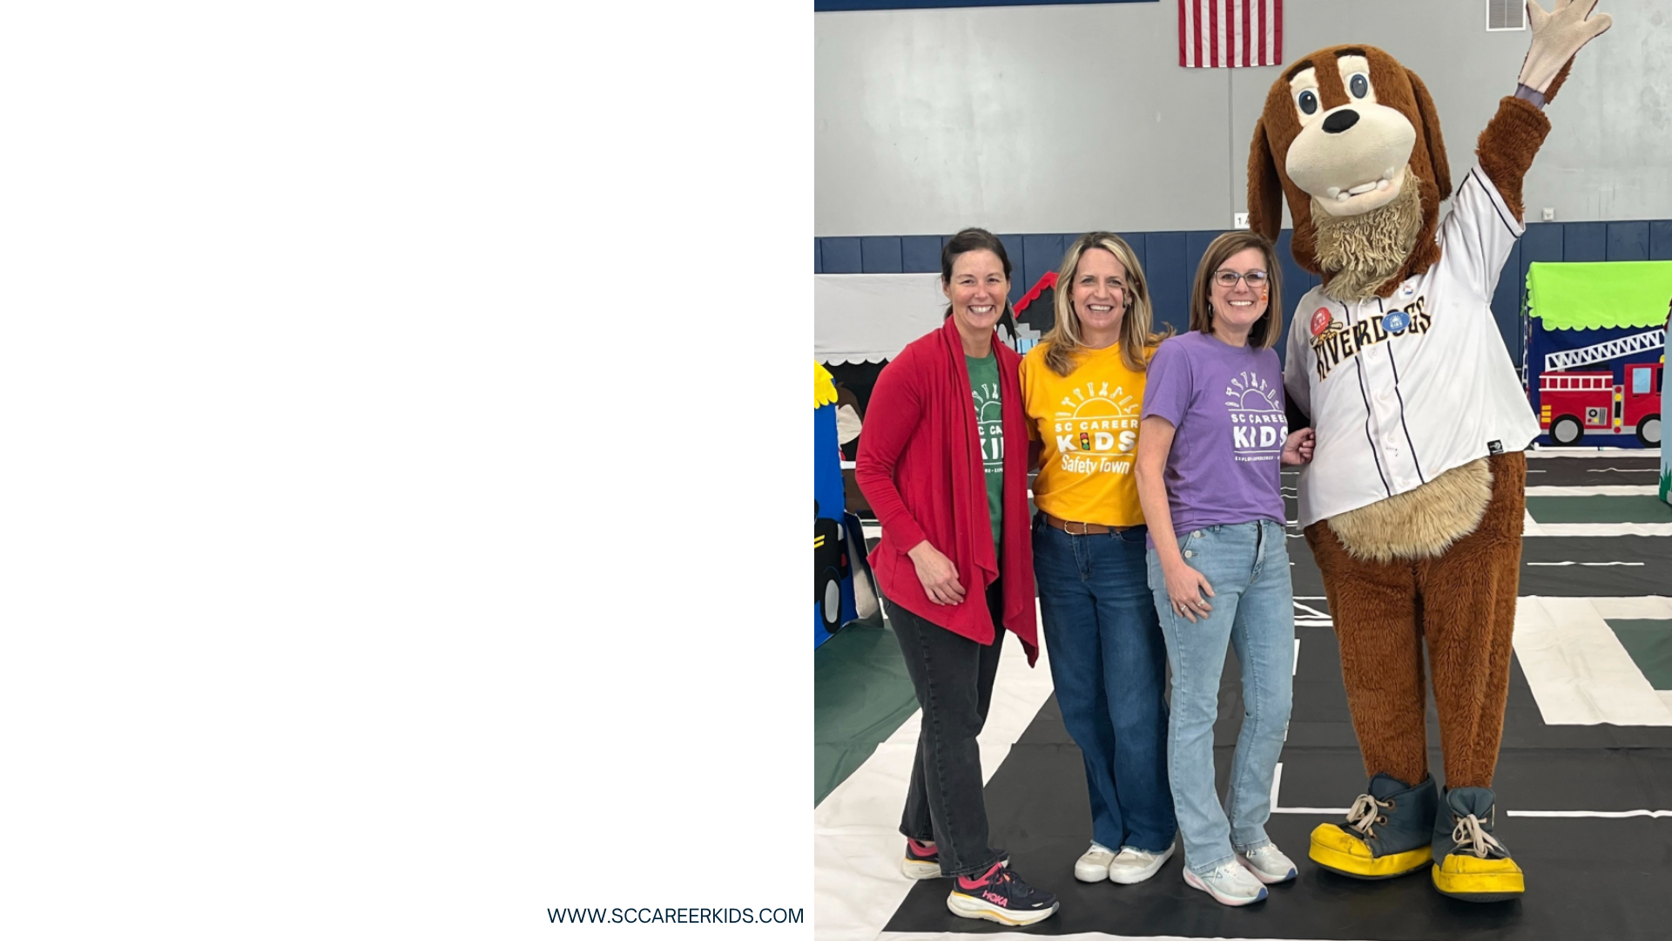
SC Career Kids
The SC Career Kids team is made up of experienced, certified early childhood and elementary educators who understand how young children learn best.
Katy Wiggs- Founder and Executive Director
Beth Lechner- Career Club/Career Camp Program Director
Pollyanna Buff- Safety Town Program Director

Slide 6
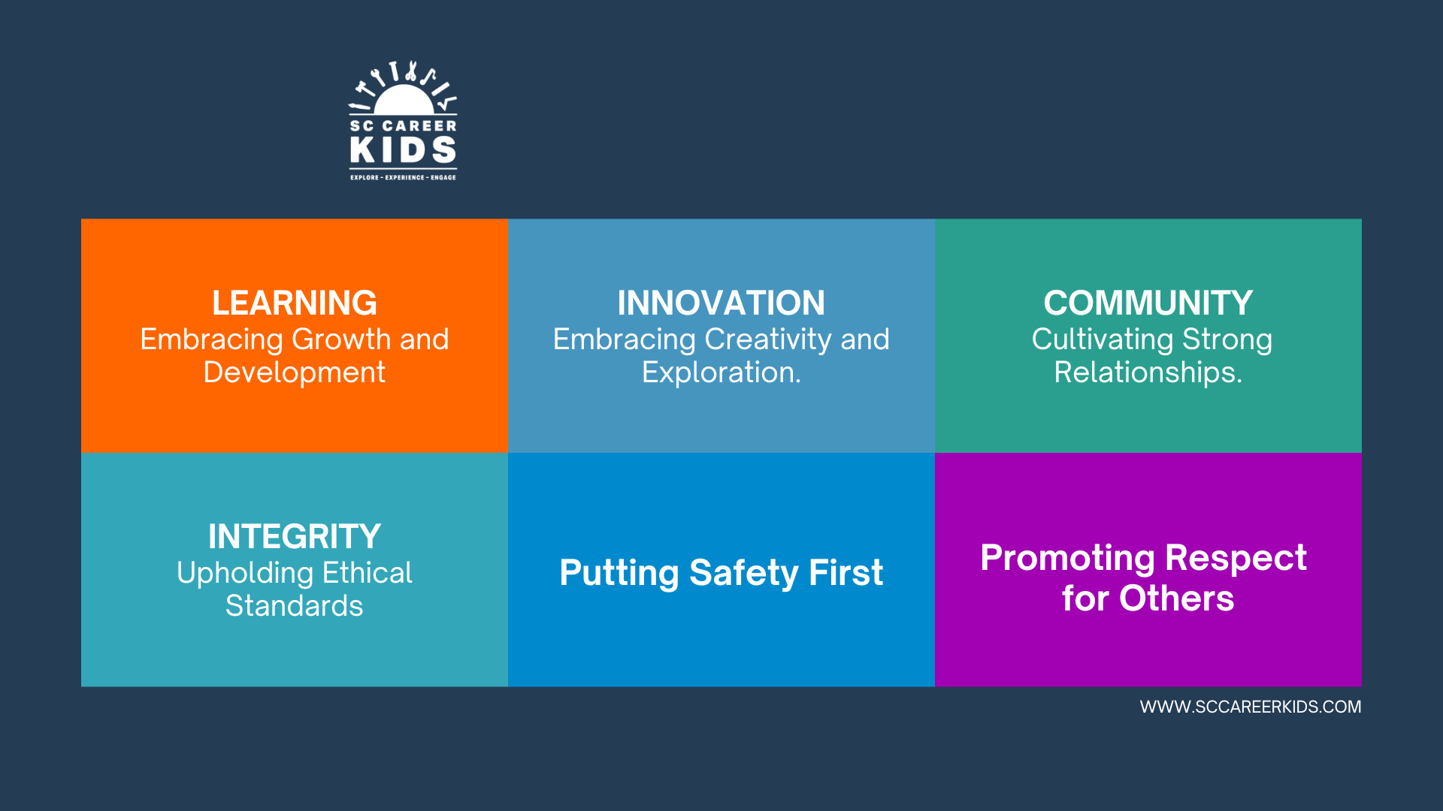
Core Values

Slide 7


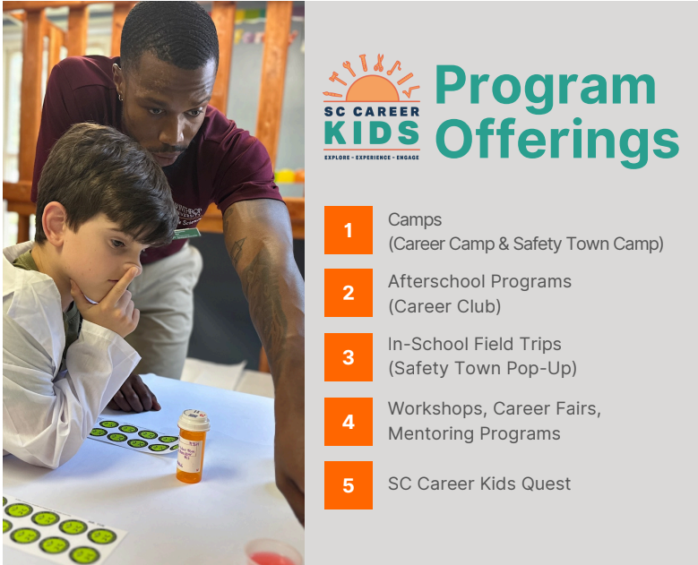
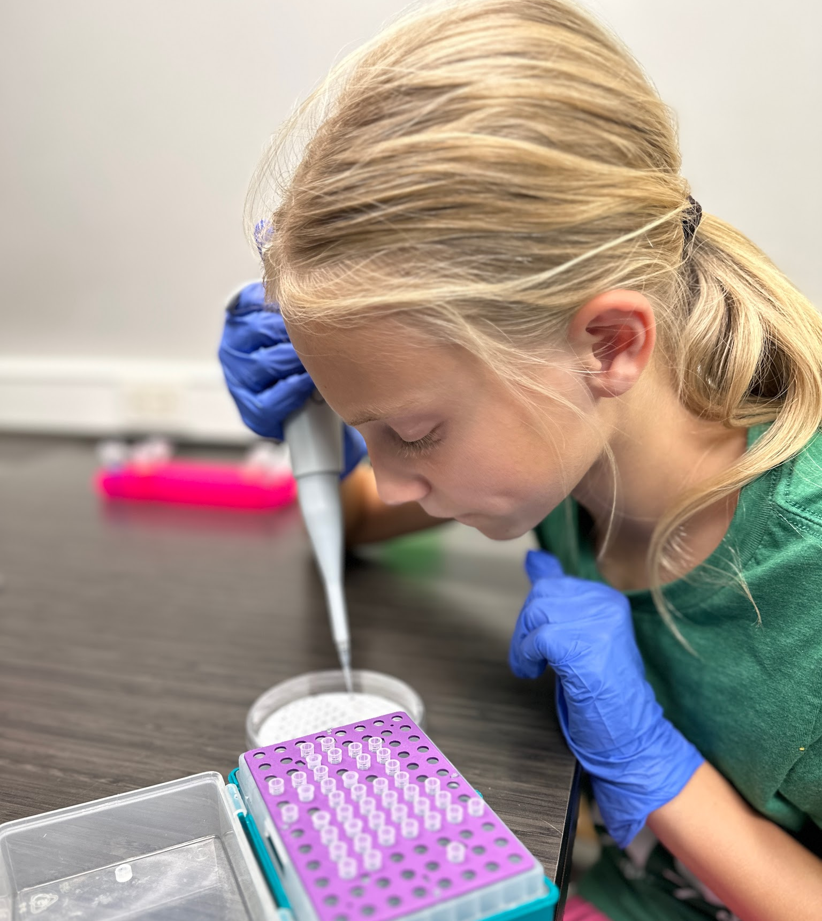
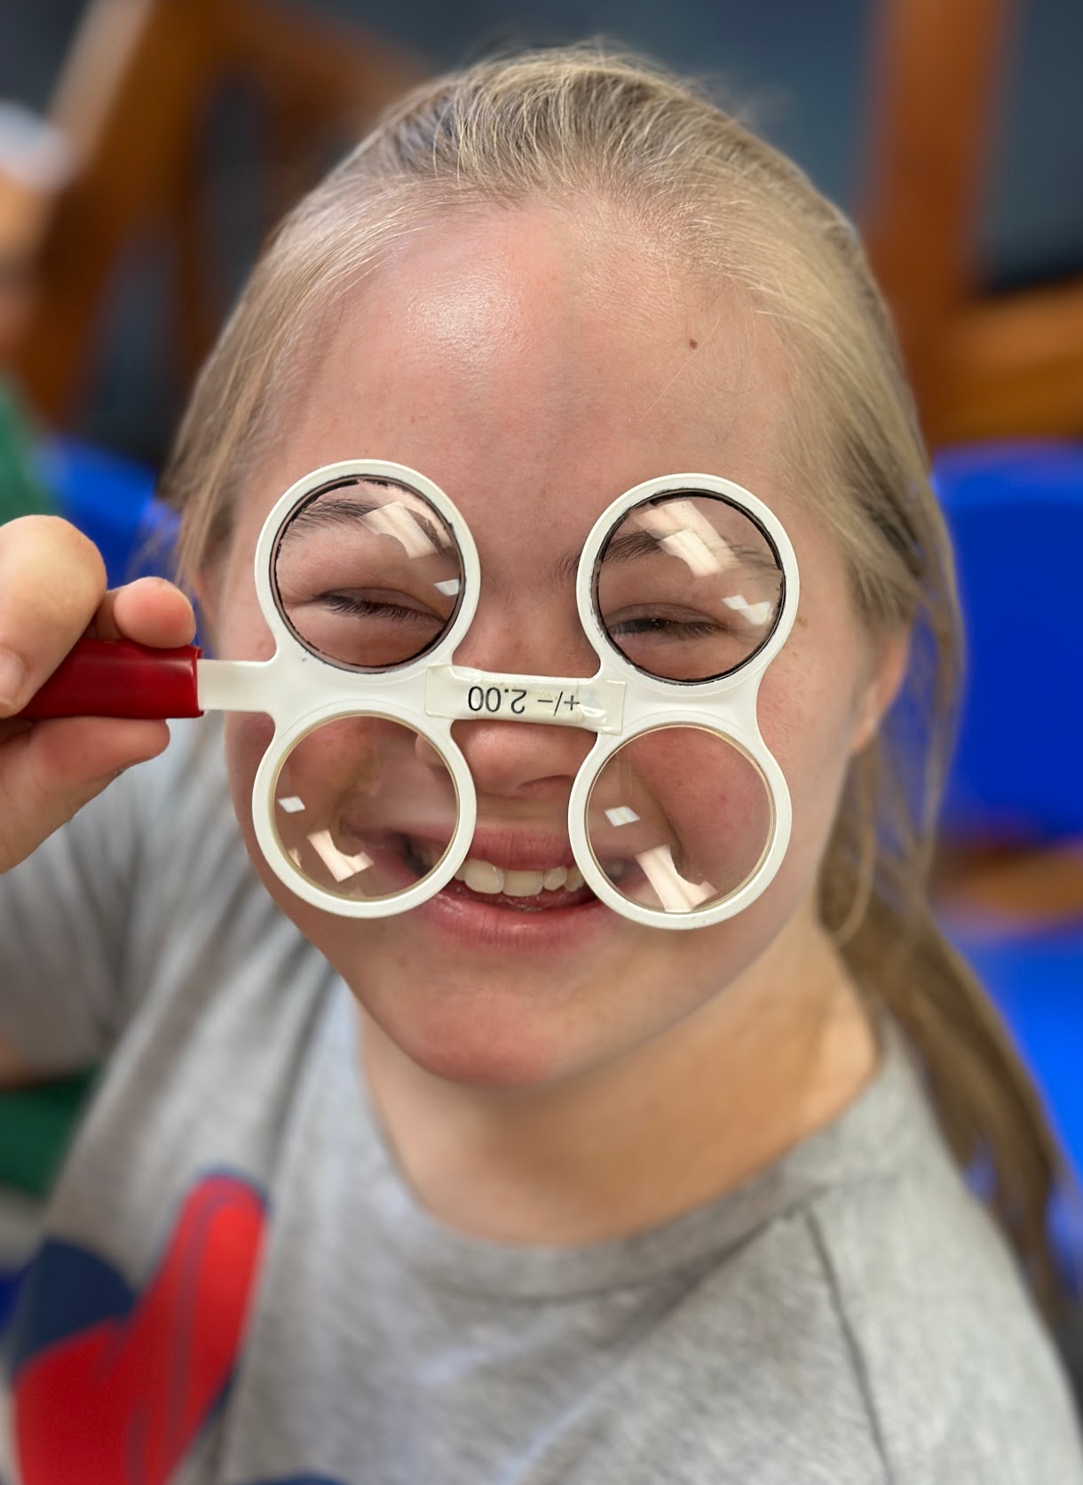
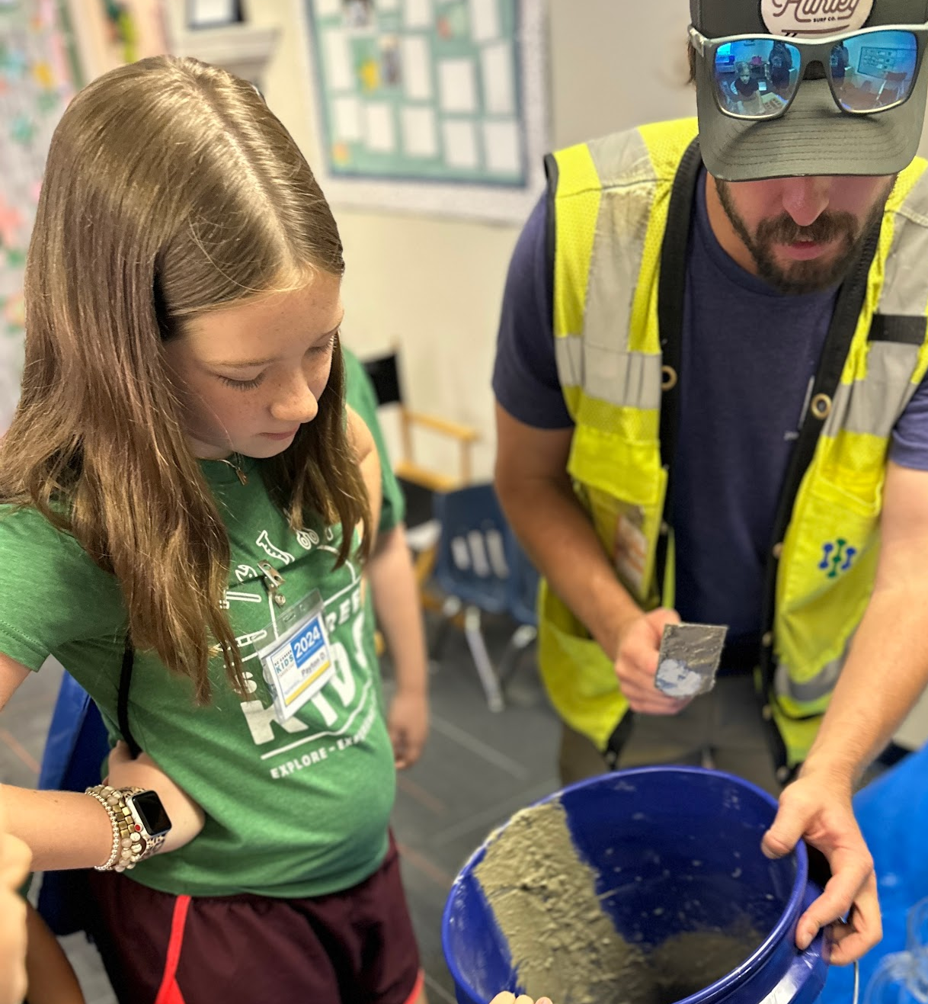
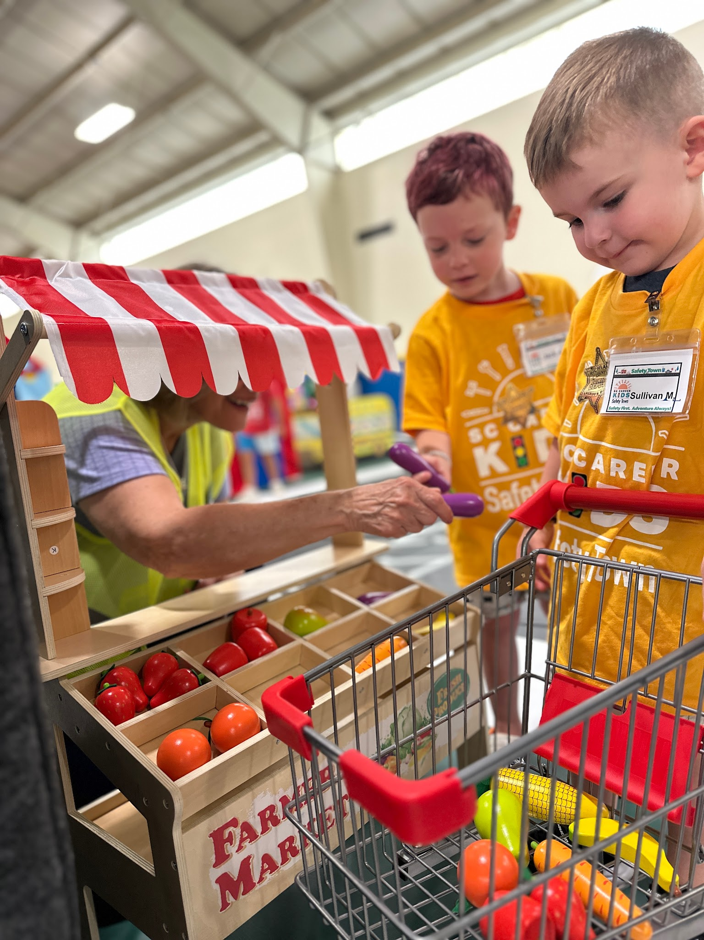

Slide 8
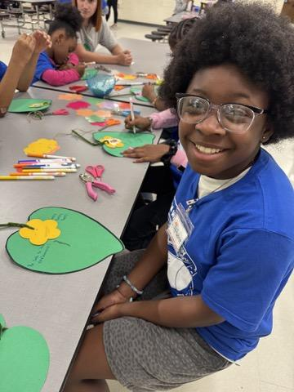
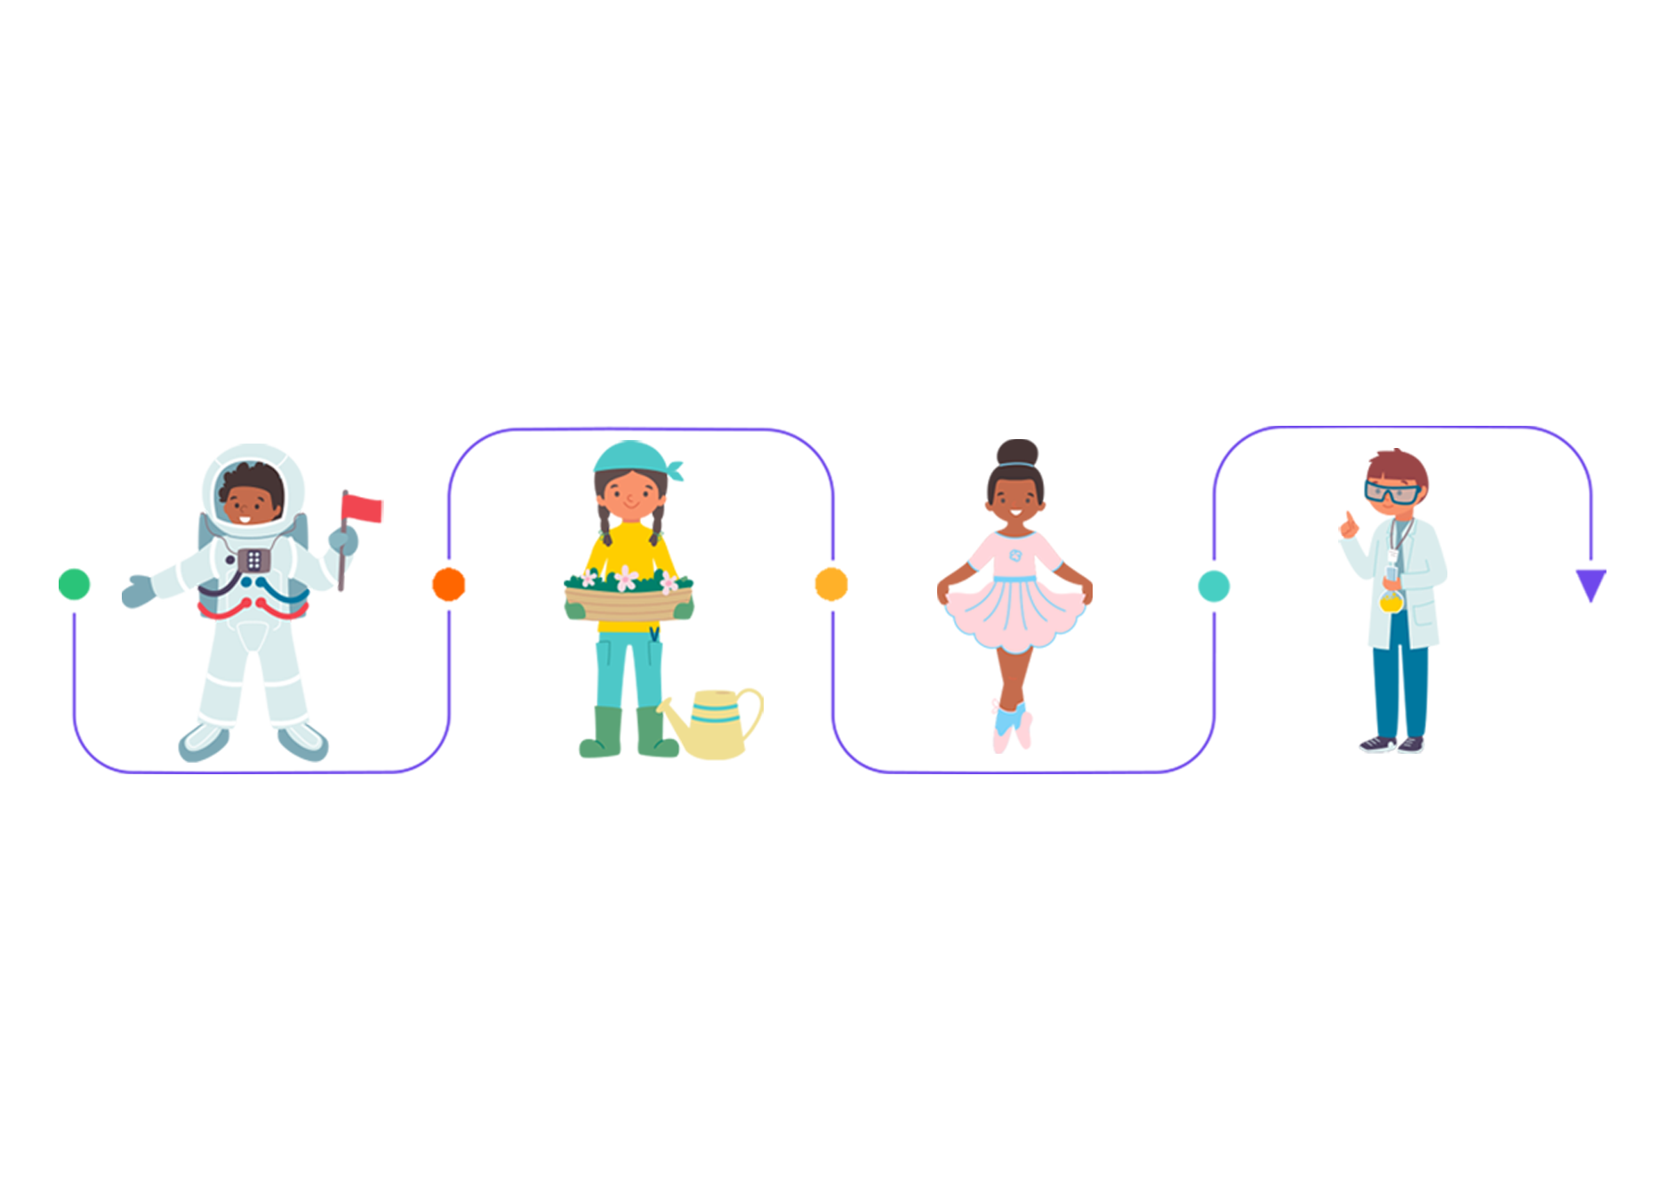
After school career club & camps
Hands on exploration of careers and career ready practices
Aligned with State Standards
Building the Talent Pipeline
Bridging Education & Workforce Needs
Full day camps on teacher workdays focused on different career clusters
-Build It Camp
-Taste of Careers Culinary Arts Camp
-Career Camp-Healthcare Edition
After School Clubs around the Midlands
Notes:
After-school sessions offer extended learning opportunities where children can delve deeper into specific career interests. These programs may include skill-building activities, mentorship opportunities, and career exploration exercises tailored to the children’s interests and abilities.

Slide 9
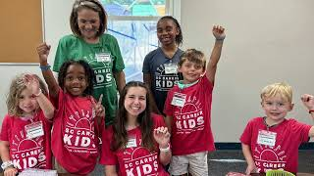
Safety town: in-school field trips
Hands on safety & career awareness to schools through immersive field trips.
Students interact with local police, firefighters, EMTs & community professionals.
PK - 2nd grade
Standards - SC College & Career Ready standards
Standard Connections to Safety Town
Notes:
Safety Town Pop-Ups is an exciting and interactive field trip program designed to educate children about important safety topics in a fun and engaging way. Our pop-up events bring the concepts of Safety Town directly to schools and community centers, making learning accessible and enjoyable for children of all ages.

Slide 10


https://sccareerkidsquest.com/
Interactive platform guiding students through SC Career Pathways.
Explore careers through 360 virtual tours & expert videos.
Aligns with SC Career Clusters & provides educators with tailored lesson plans.
Supporting Future-Ready Students
Sc career Kids quest:
Virtual career exploration

Slide 11

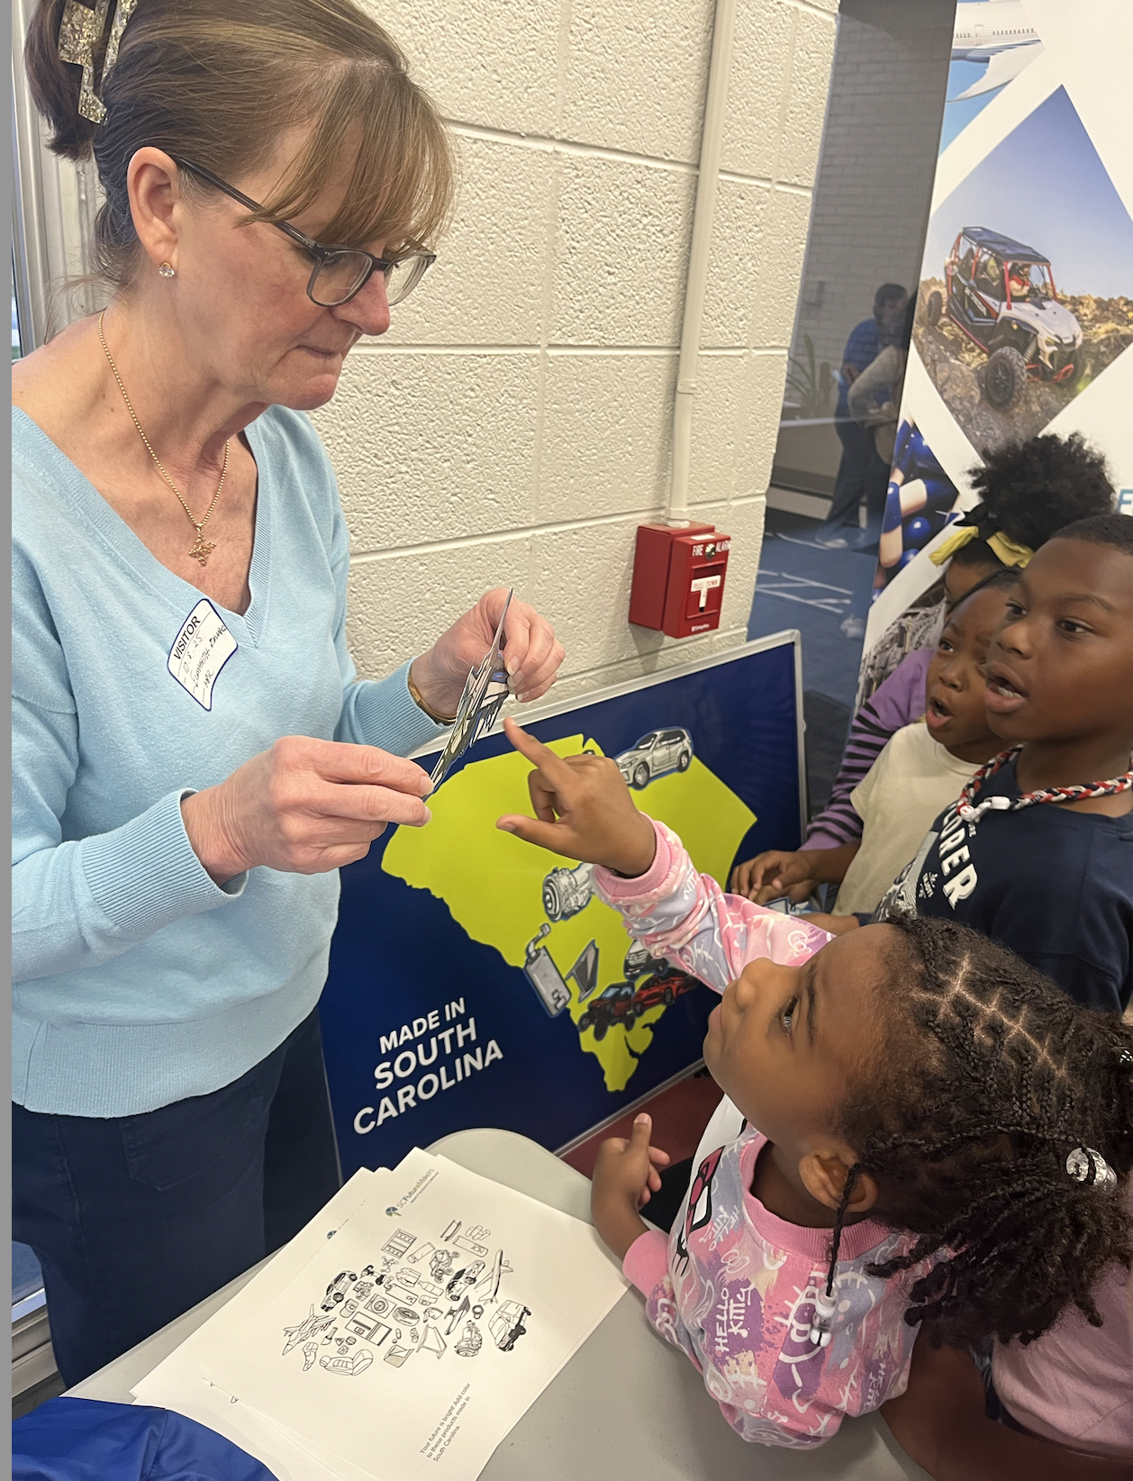
Community Partnership in Action
Partnerships with Richland School District 2 in NE Columbia and Daniel Morgan Technology Center in Spartanburg have brought SC Career Kids Town to life. Elementary students of all ages have had the opportunity to explore careers within their community through games, career ready activities, and conversations with career professionals.

Slide 12

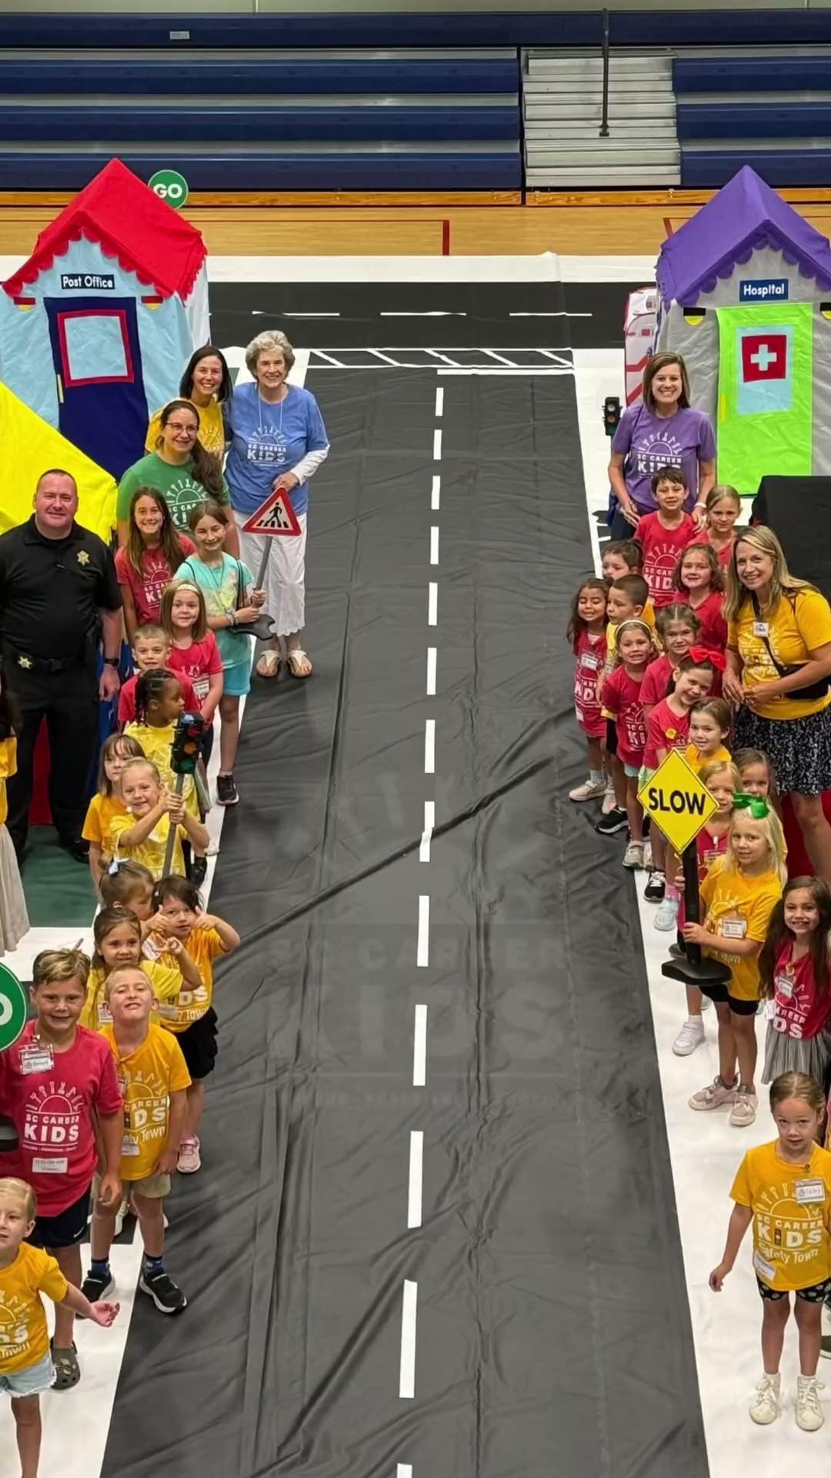
Community Partnership in Action

Slide 13

































Partners and collaborators

Slide 14
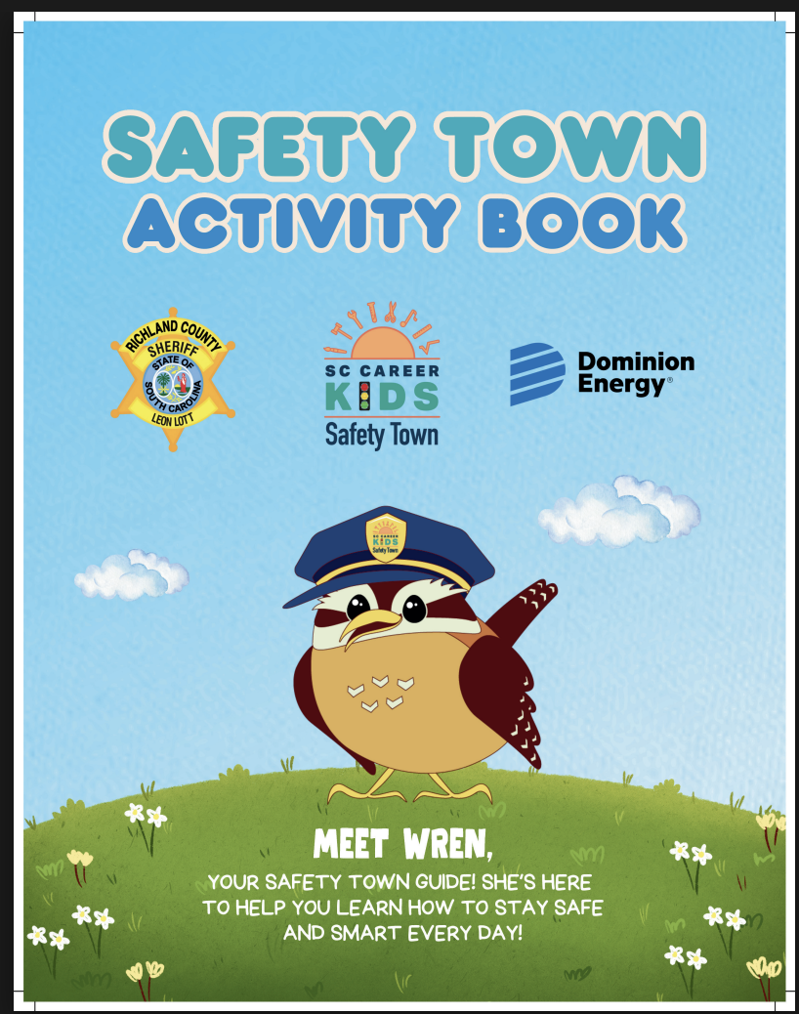
Safety Town Workbook

Slide 15

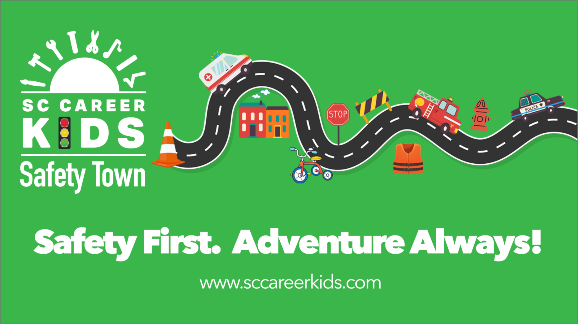
Before you arrive at Safety Town

Slide 16
Typical Safety Town Schedule
Safety Town - Full Day Pop Up
Each group can accommodate three classes or the equivalent of 60 students. During our Full Day - In School Field Trip, we can accommodate 15 classes or the equivalent of 300 students.
8:00-9:00 | Group One
9:15-10:15 | Group Two
10:30-11:30 | Group Three
11:30-12:00 - Lunch and Reset for Safety Team Members
12:00-1:00 | Group Four
1:15-2:15 | Group Five

Slide 17
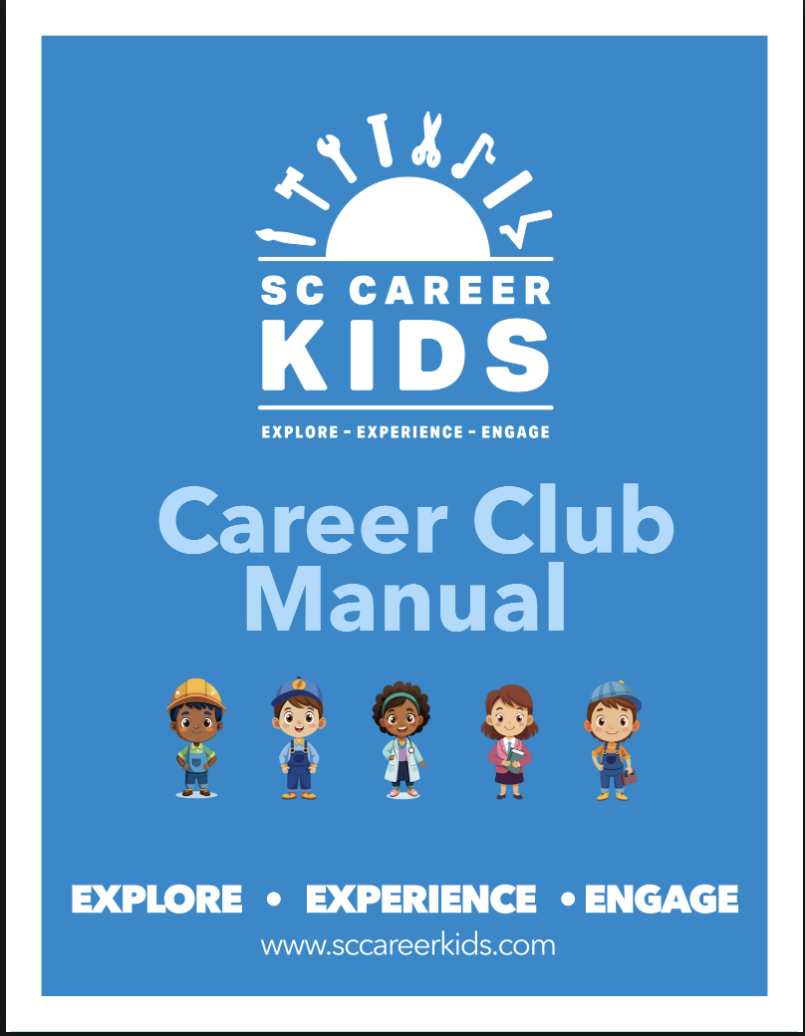
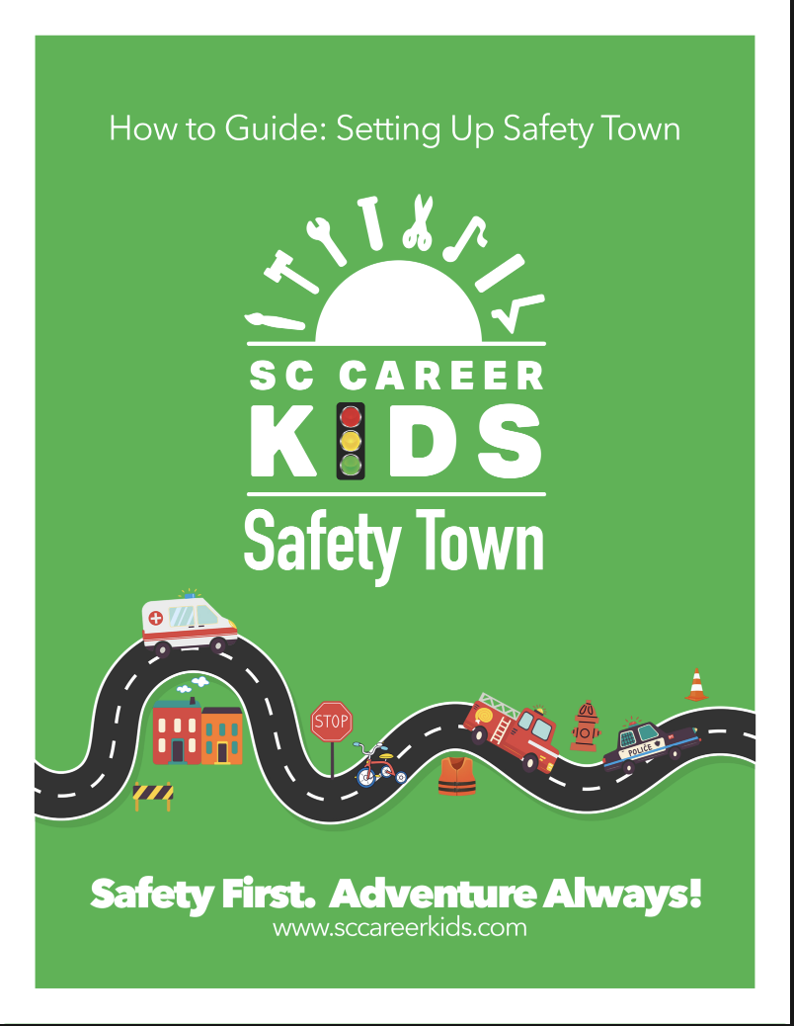
How To Manuals

Slide 18
Let’s Collaborate!
Serve as a Career Expert – Share your knowledge and experience by visiting a club, camp, or SC Career Kids Town to introduce students to your profession.
Sponsor a Town Building – Showcase your business through a branded, hands-on learning space where children can explore how your organization serves the community.
Support Career Exploration – Sponsor an SC Career Kids Town event in your school or community and help provide meaningful career awareness experiences for local students.
Inspire Future Talent – Connect with young learners early and help spark curiosity about careers in your industry.
Strengthen Community Connections – Partner with educators, families, and local organizations to build career awareness and workforce readiness from an early age.

Slide 19
Impacts in our communities
We have met with over 5,000 4K - 5th grade students since May 2024!
Boosts academic performance
Develops workforce skills
Supports at risk youth - low achieving students
Expands career exploration
Supports diverse learning styles - engaging, hands-on experiences
Prepares students for the future
Empowers students with life saving skills and community involvement

Slide 20
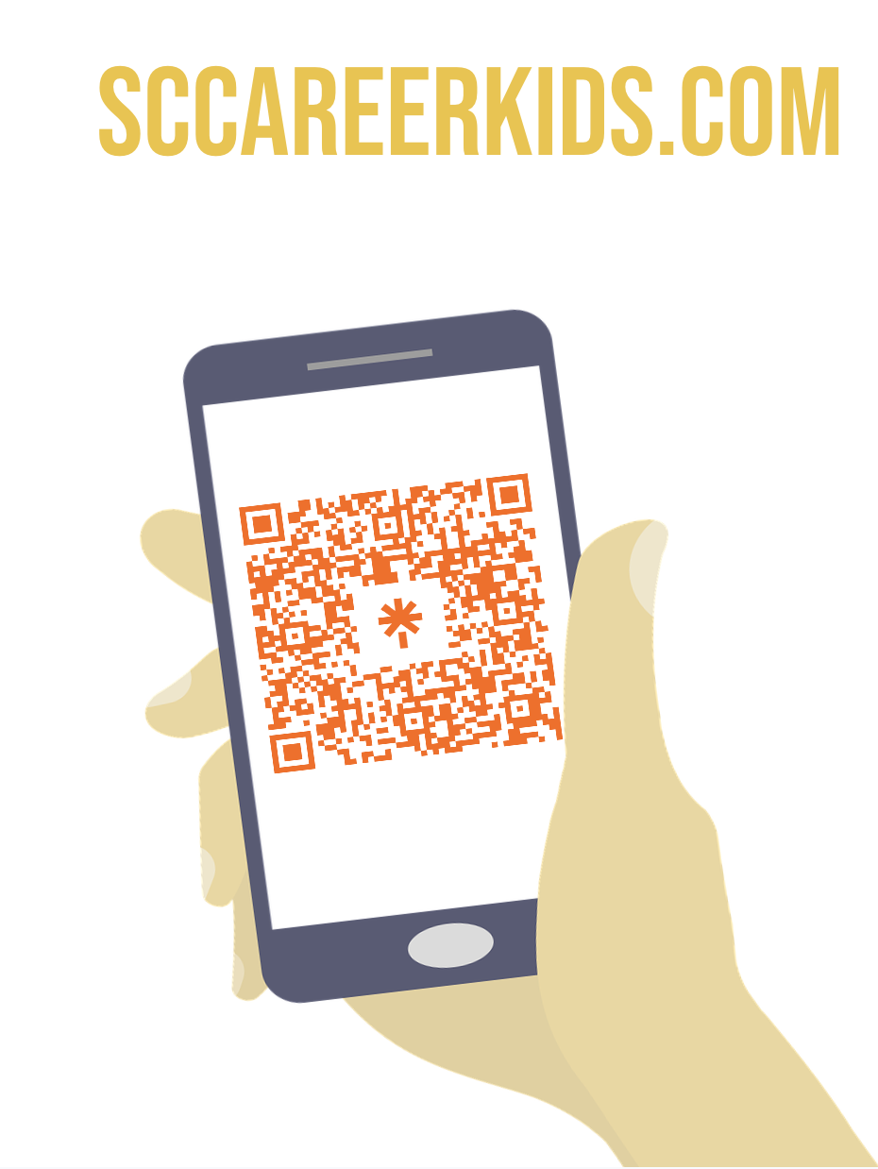
Let’s Stay in Touch
Katy Wiggs Founder and Executive Director
803-331-9956
info@sccareerkids.com
Beth Lecher- Career Club/Career Camp Program Director
803-237-6439
careerkidsdirector@sccareerkids.com
Pollyanna Buff- Safety Town Program Director
803-603-1740
programdirector@sccareerkids.com

Slide 21
