Slide 1




Innovative. Relevant. Rigorous.
How to Redefine the South Carolina Career Center
Presented by
Dr. Nikki Honeycutt
Daniel Morgan Technology Center

Slide 2


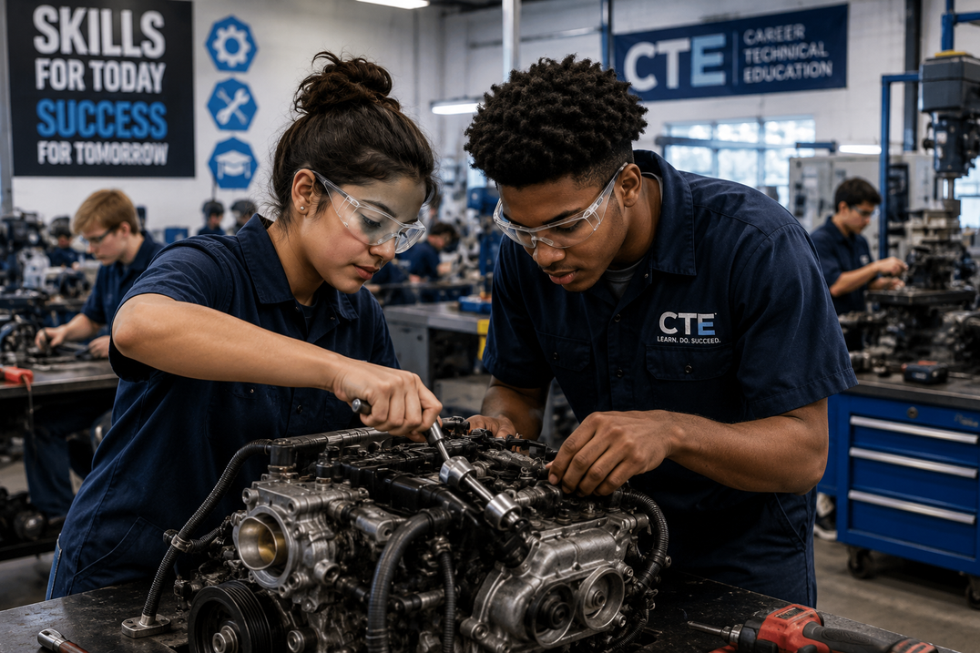
Brief Background
I have been in the following roles:
  Student
  Business Owner
  High School and College English teacher
  Middle and High School Administrator
  CTE Director at Daniel Morgan Technology Center
I’m also a:
  Parent
  Grandparent
PERCEPTIONS ABOUT CTE
  It was for students who didn’t value education
  It was limited
  It was only for students who wanted to work
  Students loved it and were engaged
  It made learning ALIVE!
  The workforce is aging...WHO IS GOING TO DO THE WORK?
  The world has evolved rapidly
  Students need OPTIONS, SELF-EFFICACY, and AN UNDENIABLE FUTURE that is resilient!

Slide 3

The Story of Robert
  Misidentified and placed in non-diploma track
  Interested in Electricity and Welding programs through inclusive strategies
  Became a double completer
  Attained industry credentials
  Is now employed making $20/hr as a welder and working on his diploma

Slide 4

The Value of CTE
“SOUTH CAROLINA’S ECONOMY IS NO LONGER ASKING WHETHER CAREER CENTERS MATTER. IT IS ASKING WHETHER CAREER CENTERS CAN MOVE FAST ENOUGH.”
  By 2031, nearly 72% of jobs will require education or training beyond high school, but less than 40% will require a bachelor's degree.
  South Carolina has more than 250,000 manufacturing employees, making manufacturing one of the state’s largest industries.
  Manufacturing contributes over $38 billion annually to South Carolina’s economy.
  South Carolina consistently ranks among the nation’s top states for advanced manufacturing and automotive production.
  By 2030, as many as 30% of current work activities could be automated.
  Nearly every industry pathway will be impacted by AI, automation, robotics, and digital systems.
These are jobs in which the current workforce are not trained, BUT THEY ARE JOBS CAREER CENTERS CAN TRAIN STUDENTS FOR!

Slide 5
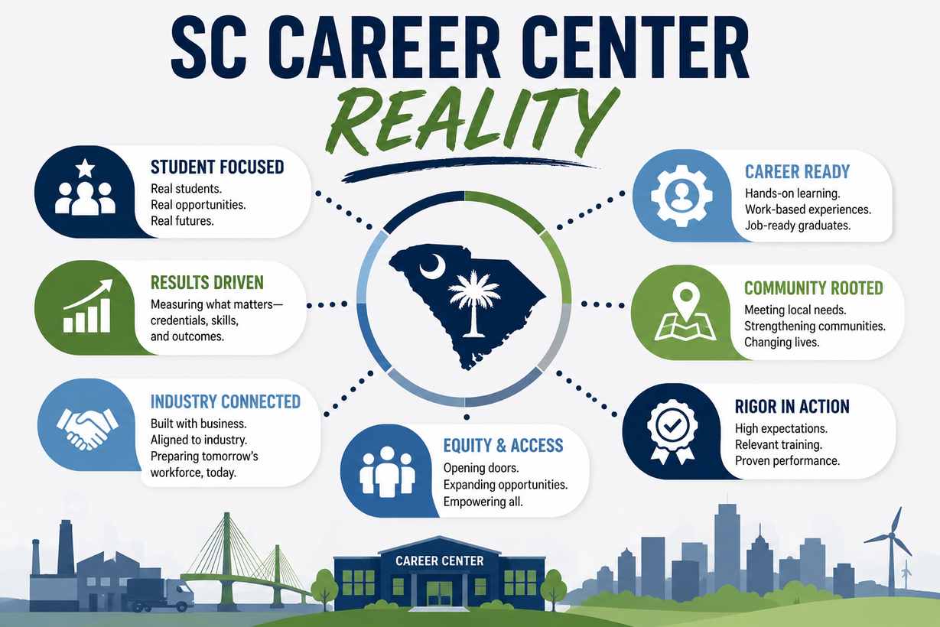
The South Carolina Career Center Reality
  There are approximately 40+ career centers statewide
  Tens of thousands of students served annually
  Hundreds of pathways offered
  Millions in state investment
We are present with long-standing reputations of training students...BUT...
"ARE WE PREPARING STUDENTS FOR THE WORKFORCE WE HAVE—OR THE WORKFORCE WE'RE BUILDING?"

Slide 6

Daniel Morgan Technology Center: Case Study
In two years:
  DMTC went from 1279 students to 1976 students
  They started 9 new pathways
  Increased credentials from 119 to 500+ and earned a 99.1% Perkins Indicator Rating
  Maintained a 97% post-program placement rating
  Selected as one of the most innovative businesses by INNOVATE SC
  First Career Center to bring SME PRIME to SC
  Using the Academy Model, DMTC is the first career center to have a fully inclusive Transportation, Distribution, and Logistics center.
  Developed Honors Frameworks for EVERY LEVEL in EVERY Pathway
Today’s presentation isn’t about theory, it’s about a transformation that took the need to be innovative, relevant, and rigorous to the next level.

Slide 7
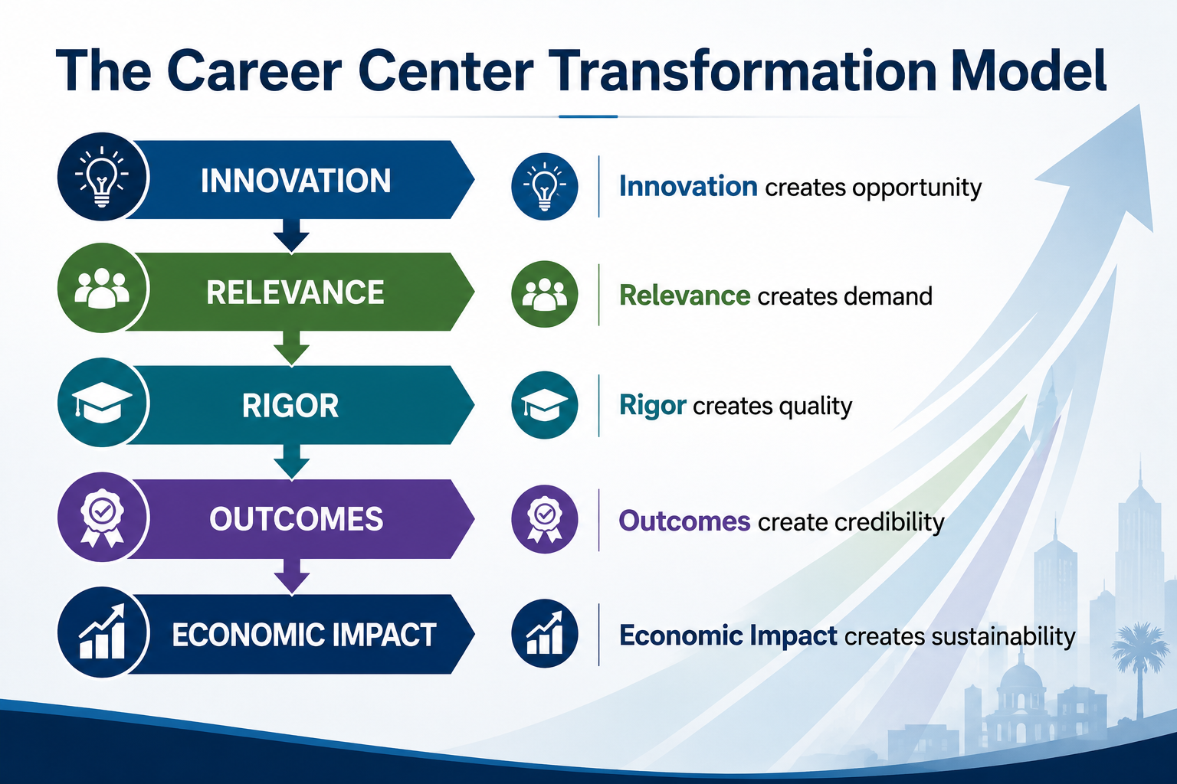

Slide 8
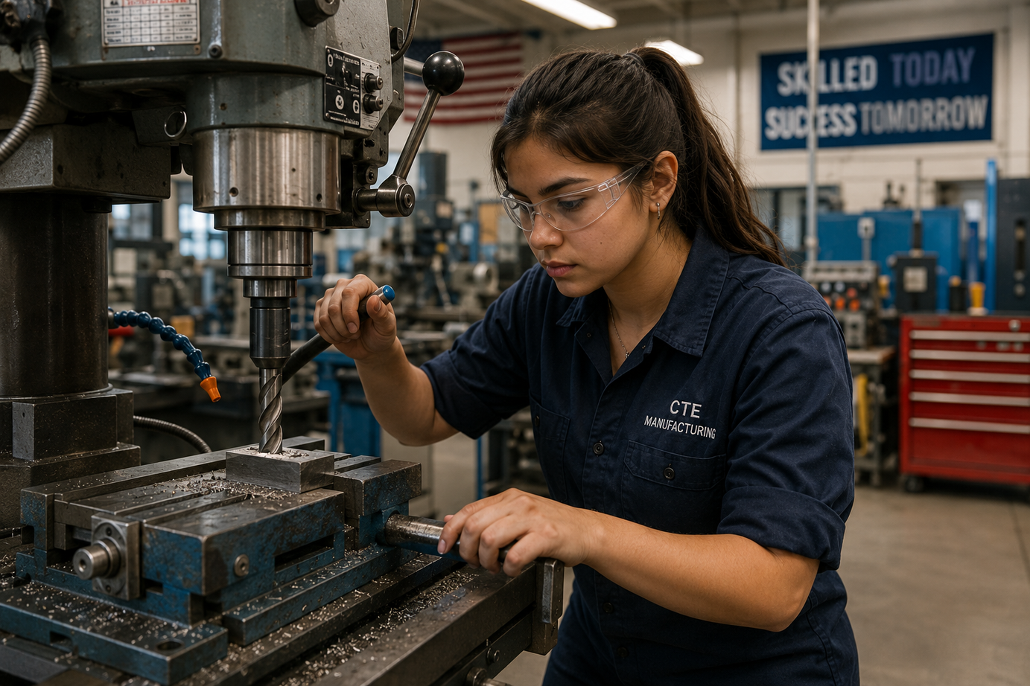
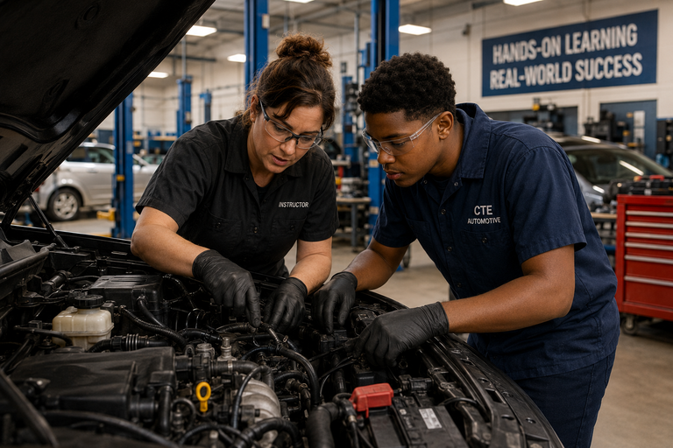
INNOVATIVE CAREER CENTERS
DISRUPT THE NORM
  Build Academies that Cluster Pathways
  Solve Regional Problems
  Solve Community Problems
  Act Like a Start-Up
OFFER INDUSTRY-DRIVEN PATHWAYS
  Turn Industry into Co-Designers
  Engage in Pilots
  Stack RELEVANT Credentials
  Build Experiences
ALIGN THEMSELVES TO THE REGION
  Triangulate Data
  Blur the lines between High School, College, and Workforce
  Become the most relevant center in your region and market what you have to offer

Slide 9

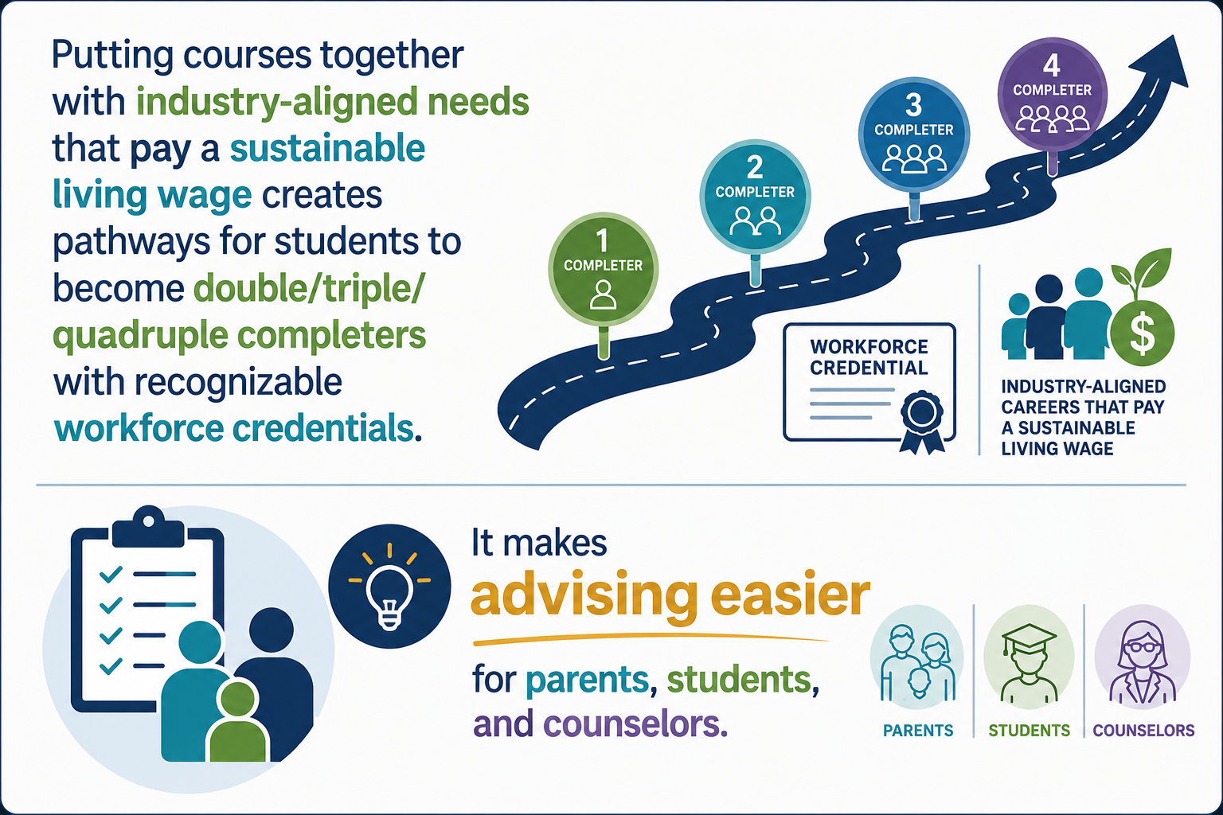
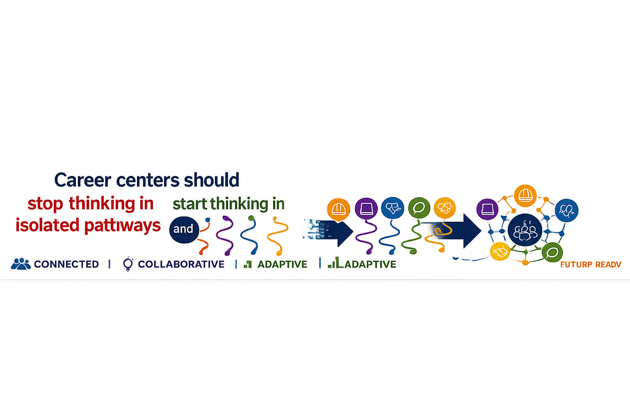
Academy Models
The Academy Advantage
Transportation, Distribution & Logistics Academy
  CDL
  Diesel Engine Technology
  Drone Technology
  Global Logistics and Supply Chain Management
Advanced Manufacturing Academy
  Welding
  Mechatronics
  Machine Tool Technology
Digital Technology Academy
  Artificial Intelligence
  Computer and Information Systems Security/Information
  Assurance (AKA Cybersecurity)
  Programming and Software Development
  (Computer Programming 1 & 2 with Java, Game Design 7 Development)

Slide 10
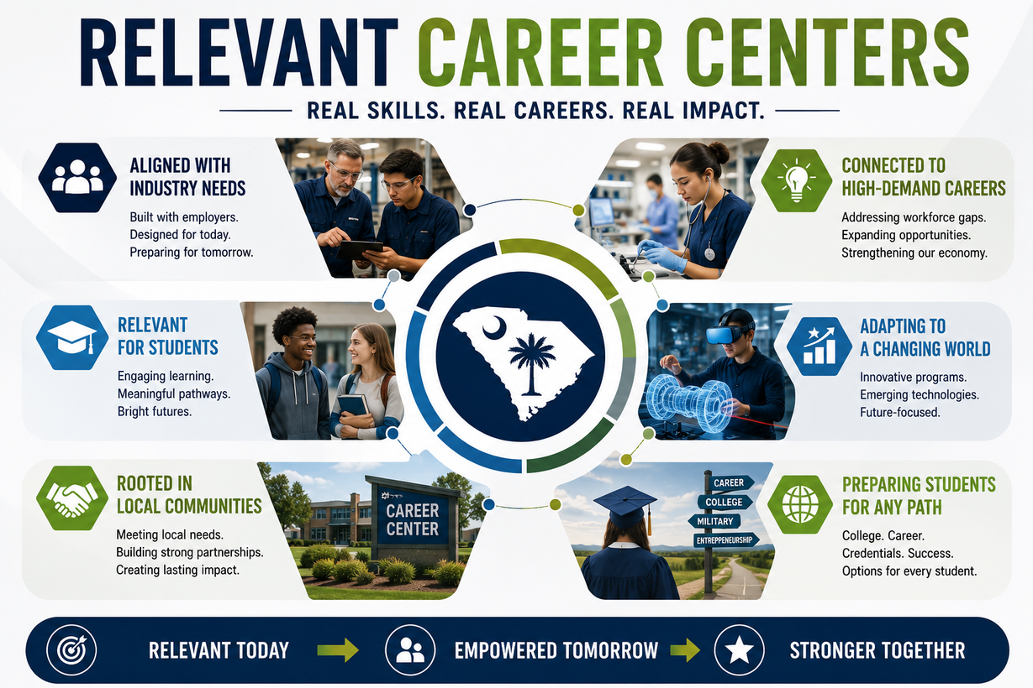
Relevant Career Centers
ARE WE TEACHING WHAT EMPLOYERS NEED TODAY AND WHAT THEY WILL NEED TOMORROW?
  Triangulated data + Current World Events
    SC tech sector alone supports more than $143,000 jobs, generates $51.7 billion in economic output, and has grown employment by 56.7% since 2020.
CREDENTIALS +
  Beyond OSHA...
    If an employer would not pay extra for a credential, why are we offering it?
  Dual Enrollment Credit (College AND (not OR) Ready
  WBL Experiences
  PROFESSIONALISM SKILLS!!!
    SC’s technical and workforce development system contributes aproximately $6.4 billion annually to the state’s economy.
MAKE AN ECONOMIC IMPACT
  Support economic development recruitment
  Market your progress in reducing workforce shortages

Slide 11
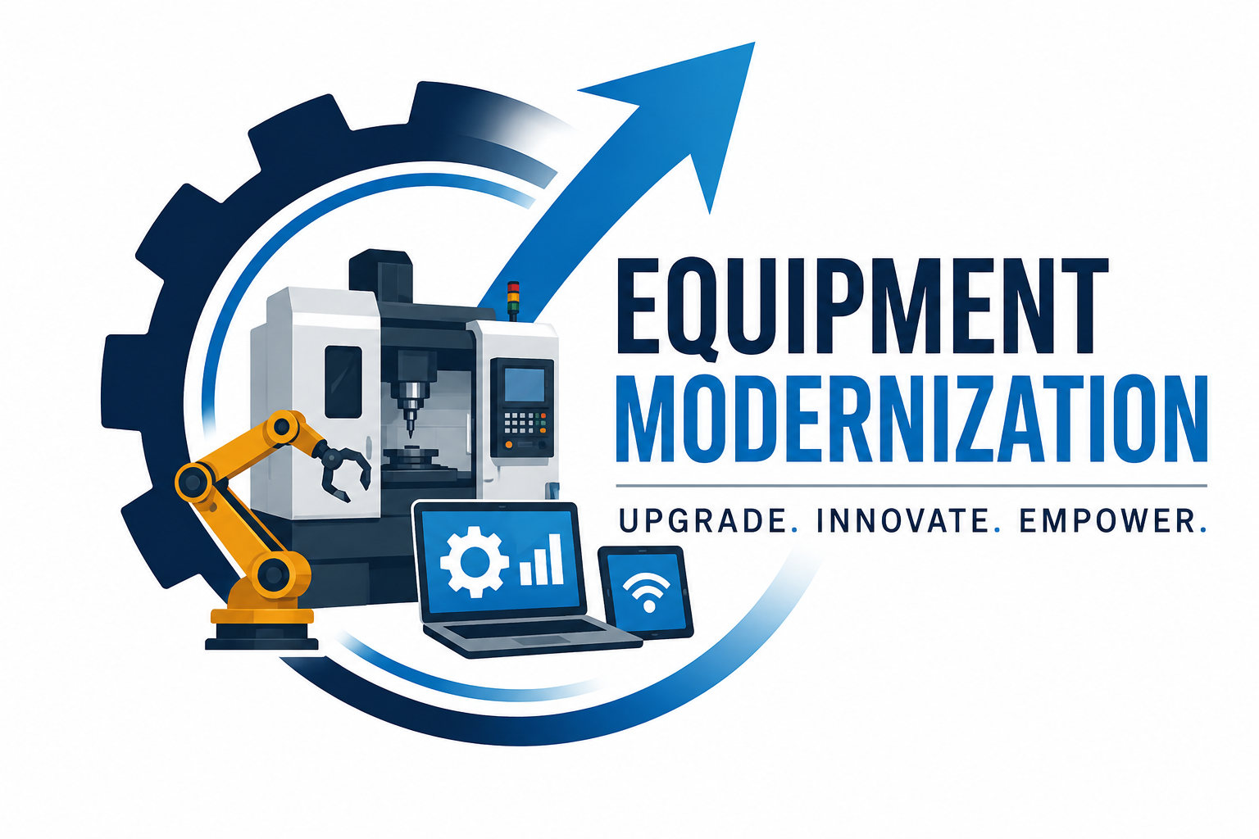
Equipment Modernization
ARE WE TEACHING ON THE SAME EQUIPMENT THAT EMPLOYERS USE IN ORDER TO HAVE WORKFORCE READY GRADUATES?
  Audit equipment
    Use advisory boards to guide purchase/grant writing
    Look for modern equivalents
    Train students on the manual and electronic equipment as this helps them in competitions and in entry-level positions
    Take advantage of programs like SME PRIME-free to high schools, equipment upgrades with industry credentials, professional development for staff including educator ‘train the trainer’ certifications.

Slide 12
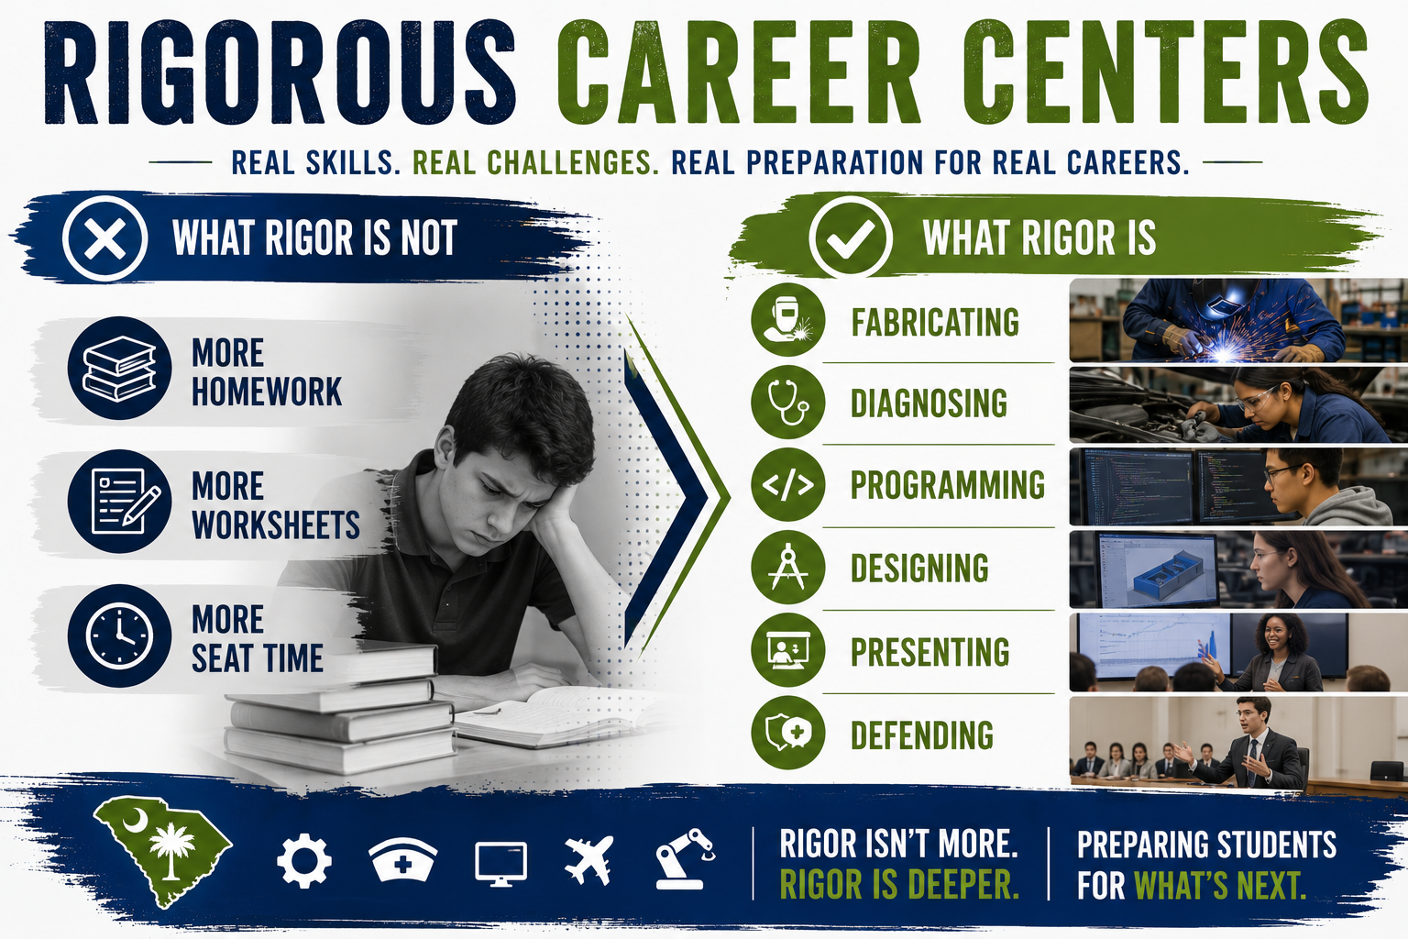

Slide 13
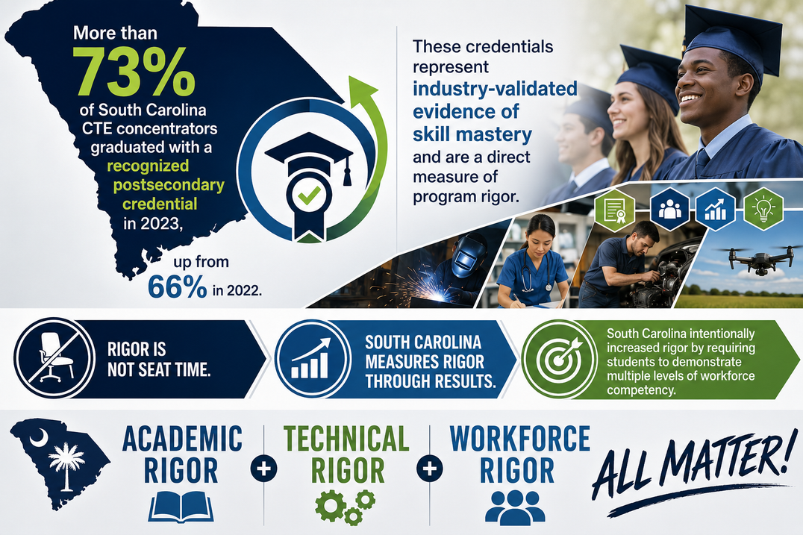
Rigorous Career Centers
STUDENTS DO THE WORK OF PROFESSIONALS, NOT THE WORK OF STUDENTS
  Honors frameworks
  Bloom’s Taxonomy & Webb’s Depth of Knowledge
    programming, fabricating, threat analyses, designing
    From activity-based learning to performance-based learning
  Capstone demonstrations
  Professionalism rubrics
DATA TRANSPARENCY
  Enrollment growth
  Completer data
  Credential attainment
  Placement outcomes
  Wage data
WHAT GETS MEASURED GETS IMPROVED!
METRICS MATTER!

Slide 14
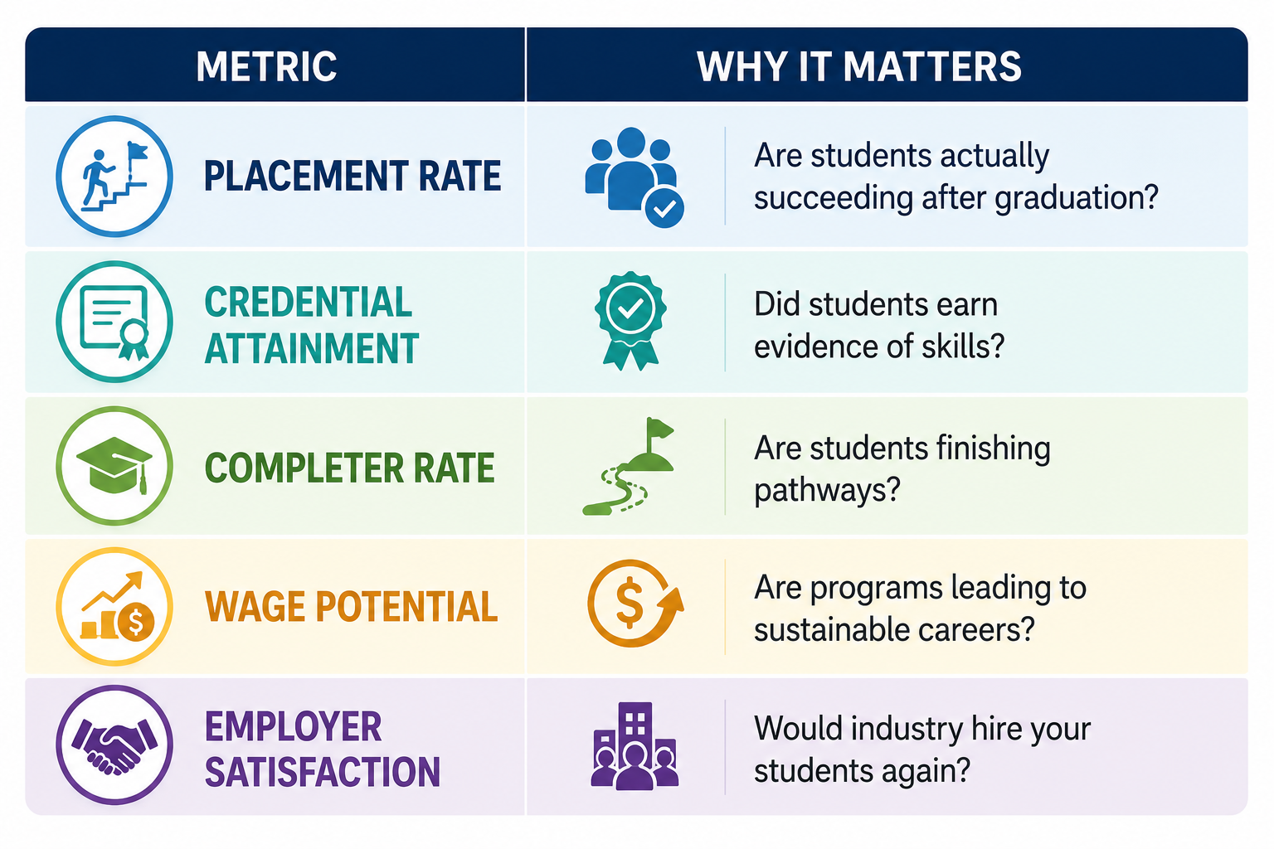
THE FIVE METRICS THAT MATTER

Slide 15
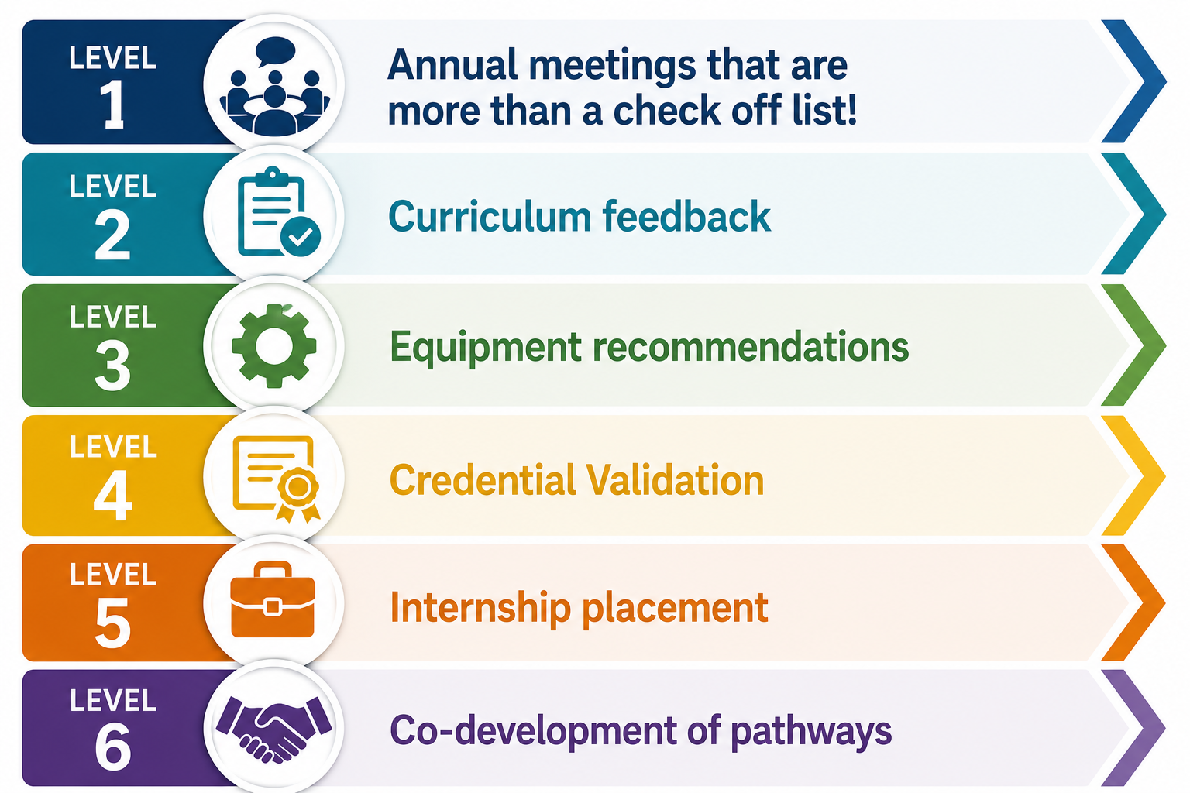
INDUSTRY ALIGNMENT STRUCTURE
Turn industry into co-designers

Slide 16
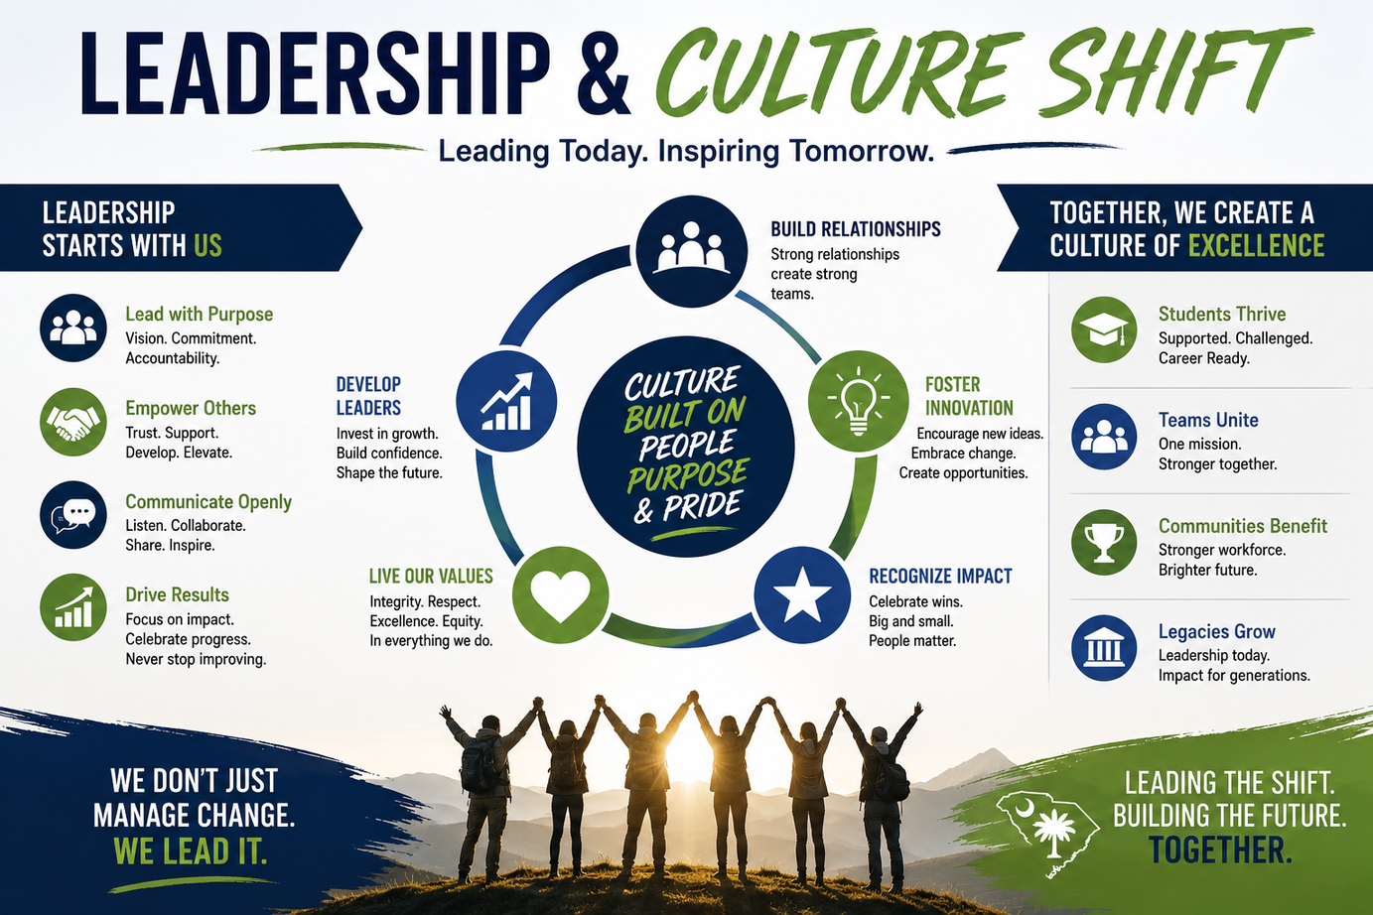
Leadership and Culture Shift
INTERNAL RESISTANCE
  ““We’ve always done it this way”
  Traditional vs Technical Divide
  Fear of Change
LEADERSHIP RESISTANCE
  Courageous Resistance
  Alignment Over Comfort
    What programs should we stop offering?
    What programs should we start offering?
    What equipment should we retire?
    What credentials no longer matter?
    What workforce need are we ignoring?
  Workforce-focused leadership

Slide 17
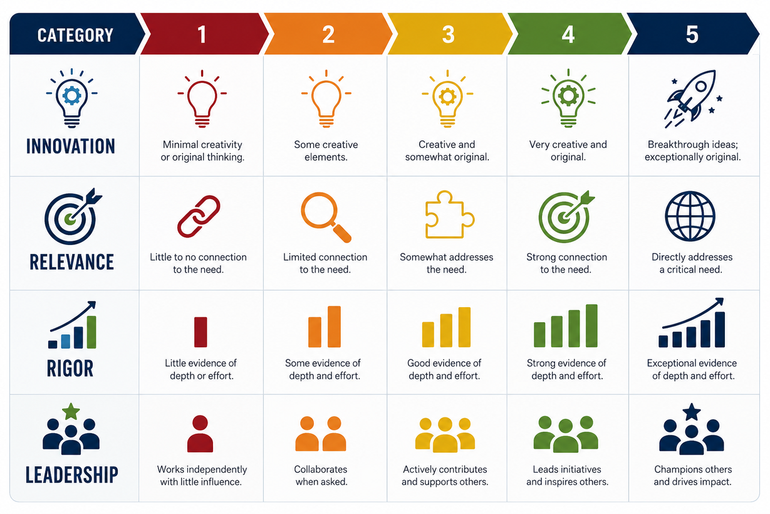
Rate Your Center
TAKE 5 MINS TO ANSWER THE FOLLOWING:
TALK WITH SOMEONE NEXT TO YOU:
What’s your score?
What is your area of weakness?
What is your area of strength?
What is your first action step?

Slide 18
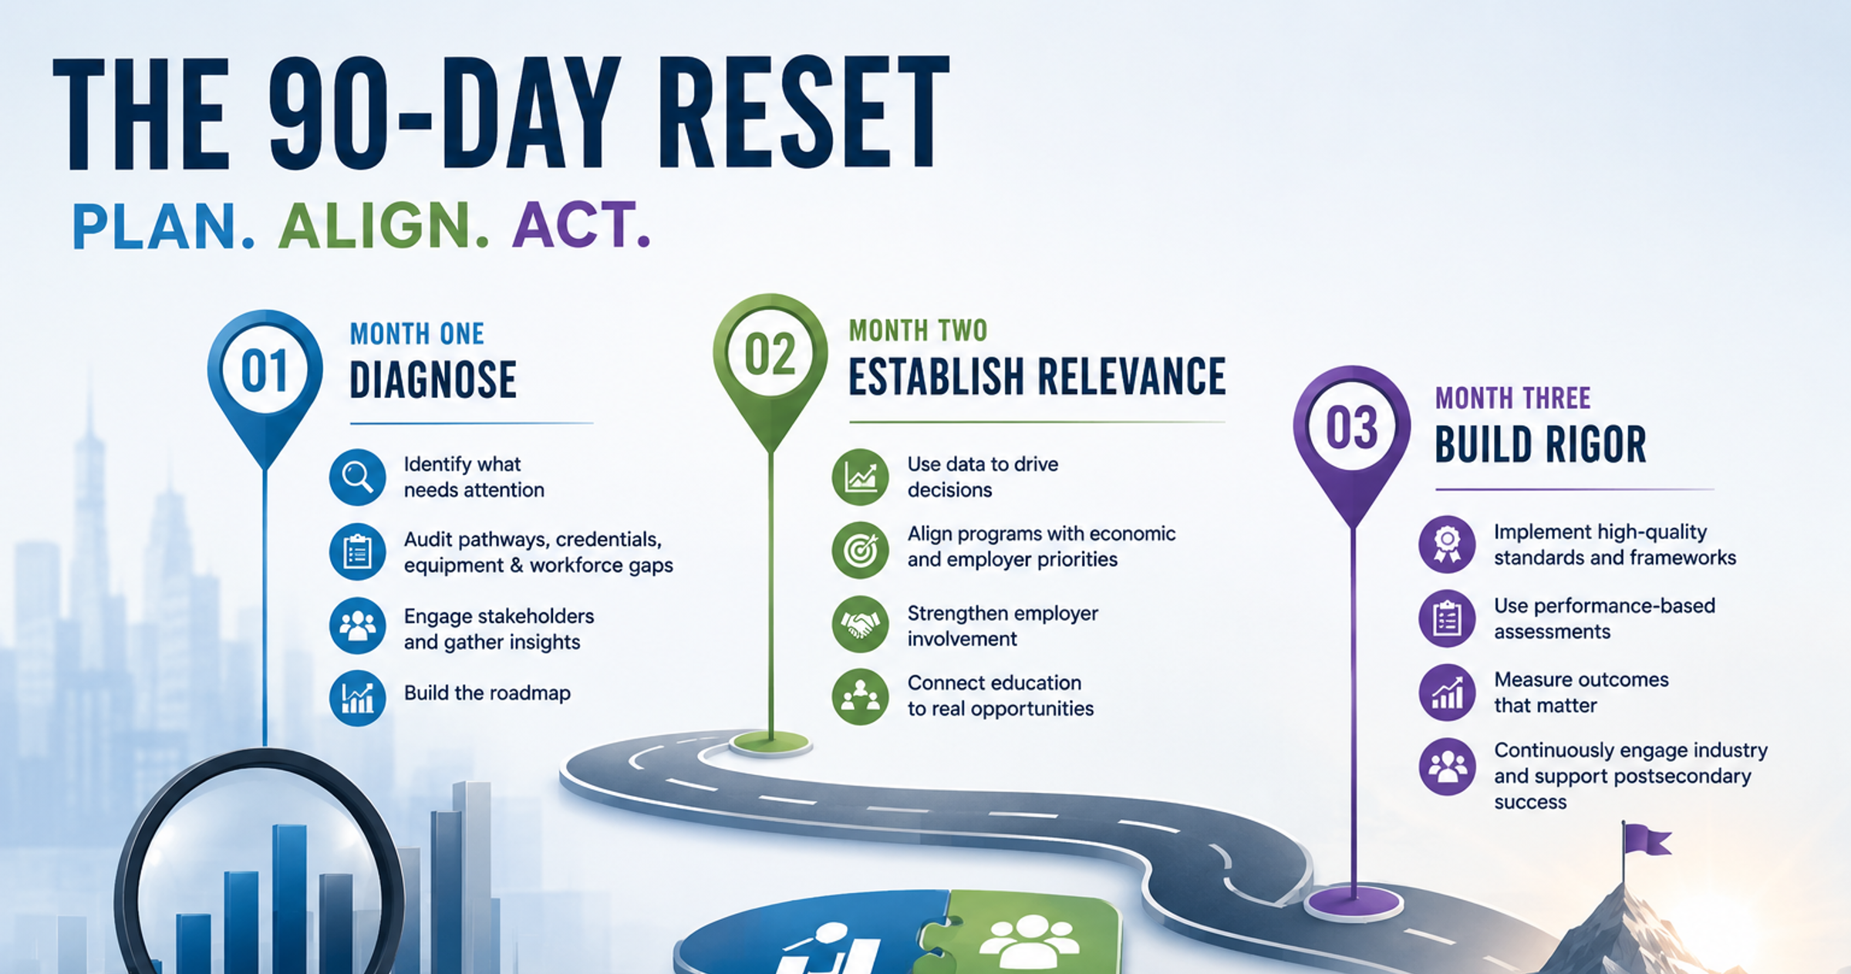

Slide 19

The 90-Day Reset Plan
MONTH ONE: Diagnose Reality
  Which pathways need development or need to be sunset?
    Create innovation audit/roadmap
  Which credentials will give students the most acceleration?
  Which equipment is obsolete?
  Which workforce needs are underserved?
MONTH TWO: Establish Relevance
  Regional labor market data
  Economic development priorities
  Postsecondary alignment
  Employer involvement
MONTH THREE: Build Rigor
  Honors Frameworks
  Performance-based assessments
  Measure Everything
    Industry credential value/attainment
    Enrollment
    Industry engagement & postsecondary continuation
MAKE THE TOUGH DECISIONS! TALK WITH YOUR FACULTY AND LISTEN TO THEM.

Slide 20
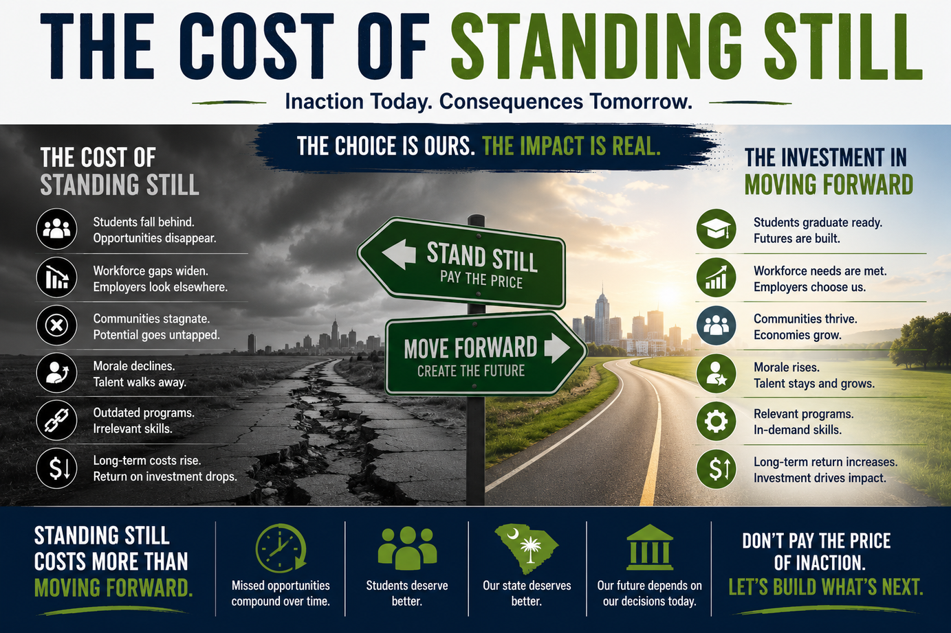
The Cost of Standing Still
WHAT HAPPENS IF WE DON’T CHANGE
  Students choose other options.
  Industry builds training elsewhere.
  Economic developers stop calling.
  Credentials lose value.
  Enrollment stagnates.
  Funding follows relevance.
"THE BIGGEST THREAT TO SOUTH CAROLINA CAREER CENTERS ISN'T FUNDING. IT'S BECOMING IRRELEVANT."
COMFORT BUILDS TRADITION.
COURAGE BUILDS AND SUSTAINS ECONOMIES

Slide 21
