Slide 1

Skills for Hire – Embedding Employability in Every CTE Classroom
Palmetto Education Summit
Dr. Herb Bocchino & Heather Harmon
6/15/2026
Notes:
Slide title should be Aptos Bold font, left-aligned, not smaller than 44pt
Audience – To whom/group you are presenting to
Speaker – Who is giving the presentation (may be by name or by department)
Date – Date of presentation

Slide 2
01
Welcome!
Notes:
Agenda is 88 pt
Line item is 66 pt

Slide 3

Musical Introductions
The idea is like Musical Chairs, but to introduce yourself!
Walk around the room as the music plays.
When the music stops, STOP!
Grab a partner close to you.
Introduce yourself:
  Name (with a handshake)
  Work location and what you do
  Why are you attending Palmetto Education Summit?

Slide 4
Reflection
  How did the Musical Introduction activity make you feel?
  How might this be related to skills employers want for our students to have?
  Is this an activity you could incorporate in your classroom?

Slide 5
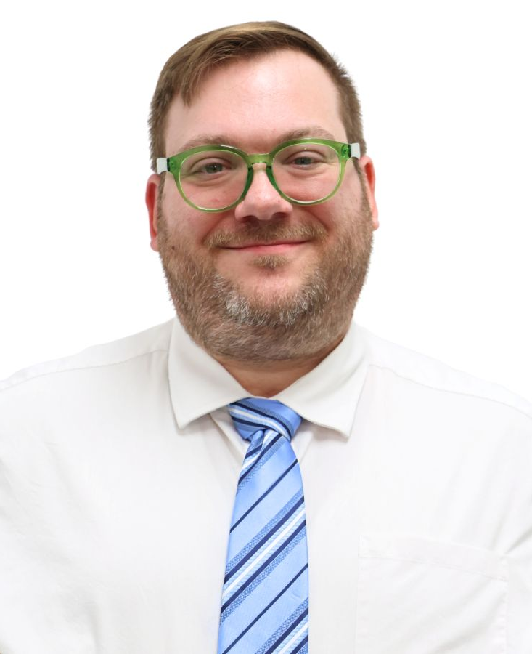
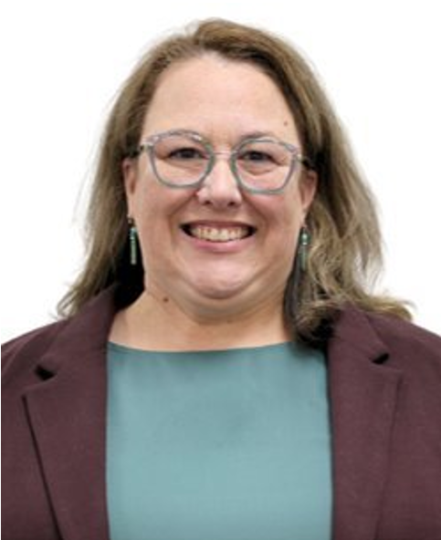
Today’s Presenters
Dr. Herb Bocchino
Heather Harmon
hsbocchino@ed.sc.gov
haharmon@ed.sc.gov

Slide 6
Agenda
01 Welcome
Today’s Purpose
Quick Card Sort
02 Shifting Employability Instruction
Walkthrough of Career Ready standards
How to shift Employability Instruction
03 Interactive Ideas
Share ideas for how to shift YOUR instruction
Closure
Notes:
Left aligned
Title font is 88pt
Numbered line item 66 pt
Detail/slide item 36 pt

Slide 7

Today’s Purpose
      Your learning today will be successful if you leave:
        more familiar with the Career Ready standards included in CTE courses;
        confident in your ability to embed employability skills into your instruction;
        inspired and connected to your peers.

Slide 8

Quick Card Sort
  Review your 4 skill cards.
  Reflect: How intentionally do you teach each skill?
  Tape each card where it best fits your current practice:
    ✅ Already Doing
    ⚠️ Could Do More Intentionally
    ❌ Not Doing

Slide 9
02
Shifting Employability Instruction

Slide 10

Profile of the South Carolina Graduate

Slide 11
Career Ready Standards
  80% of SC CTE courses already list the Career Ready standards.
    The latest version of the standards are aligned to Profile of the SC Graduate.
  The goal is for 100% of SC CTE courses to list the Career Ready standards.
  Usually Standards A – E
    A – Safety
    B – Student Organizations
    C – Technology Knowledge
    D – Personal Qualities and Employability Skills
    E – Professional Knowledge
Notes:
Emphasize – D.2 – Critical Thinking and Problem Solving
E.11 – Reading and Writing Skills
E.3 – Demonstrate continuous learning and adaptability skills to changing job requirements.
We purposefully included example activities that address the top areas that industry has identified as major areas for growth as reported by DEW:
Adaptability
Problem solving and decision making
Reading and writing
It is our responsibility to WEAVE employability skills into every day instruction.

Slide 12
Evaluating Employability Skills
  A common practice is that teachers cannot grade “professional behaviors” such as:
    Turning in work on time
    Showing up to class
    Communicating absences
    Dress code
  CTE course teachers have a responsibility to teach evaluate and provide feedback on these durable skills.

Slide 13
Teaching Career Ready Standards
  Career Ready standards are not intended to be taught in isolation.
    E.g., one lesson on goal setting on the first day of class
  These standards are intended to be embedded in instruction throughout the course in your working classroom.
    Routine-based
    Task-based
    Reflection-based
Notes:
Emphasize the three areas: routine, task, reflection

Slide 14
Embedding Career Ready Instruction – Routine-Based
  SLANT
  Essential Team Roles
  “Shift Briefing”
  Daily “Curveball” Question
  Think-Pair-Switch
  Soft Start / Choice Warm-Ups

Slide 15
Embedding Career Ready Instruction – Task-Based
Missing Assignment / Request for Extension Form
Identify the Problem Quick Task
“What If?” Scenarios
Professional Communication Task
Peer Instruction Sheets
“Say It Like a Professional” Practice
“Explain it to Client” Add-In
Consensus Challenge

Slide 16
Embedding Career Ready Instruction – Reflection-Based
“Workplace Reflection Logs”
Mistake Analysis Discussion Add-In
Quality Control Peer Check

Slide 17
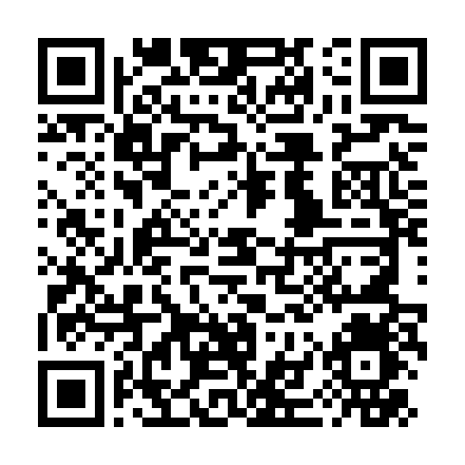
Resources in Google Drive
Please see this shared Google Drive folder for more resources:
  PES 2026 – Skills for Hire Resources
  https://bit.ly/4fxF1SE

Slide 18
WIN Courseware Option
  The Office of Career Readiness has purchased WIN courseware for every high school student in South Carolina.
  WIN courseware includes preparation for the WIN Reading, Math, Data, and Soft Skills subtests.
    Durable skills = Employability skills
  See your School Counseling Department or Career Development Facilitator for access to WIN courseware.
Notes:
Students can also advocate for themselves in job interviews by highlighting their scores on the WIN test.

Slide 19
03
Interactive Ideas

Slide 20
Planning Stage
  What are you already doing?
  What suggestions from this presentation can you incorporate?
  What new ideas do you have?
Notes:
What change(s) can you make to more purposefully integrate employability skills into your daily instruction?

Slide 21


Instructional Idea “Speed Dating”
  Partner up with someone and form two single-file lines.
  Introduce yourself
  Share your talking points
  Switch roles
  After time is called:
    The OUTER line stays in place
    The INNER line rotates one person to the left.
  Repeat the process.

Slide 22

Share Out!
What new ideas are you excited to try out?
What key takeaways have you learned?
How will today impact your instruction in the future?

Slide 23
Revisit Today’s Purpose
Your learning today was successful if you leave:
  more familiar with the Career Ready standards included in CTE courses;
  confident in your ability to embed durable skills into your instruction;
  feeling inspired and connected to your peers.

Slide 24
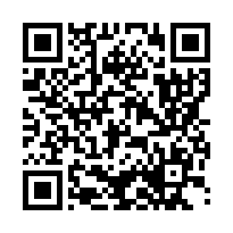
OCR PD Feedback Survey
Presenters:
Dr. Herb Bocchino
hsbocchino@ed.sc.gov
Heather Harmon
haharmon@ed.sc.gov
https://bit.ly/sc_ocr_pd_feedback

Slide 25
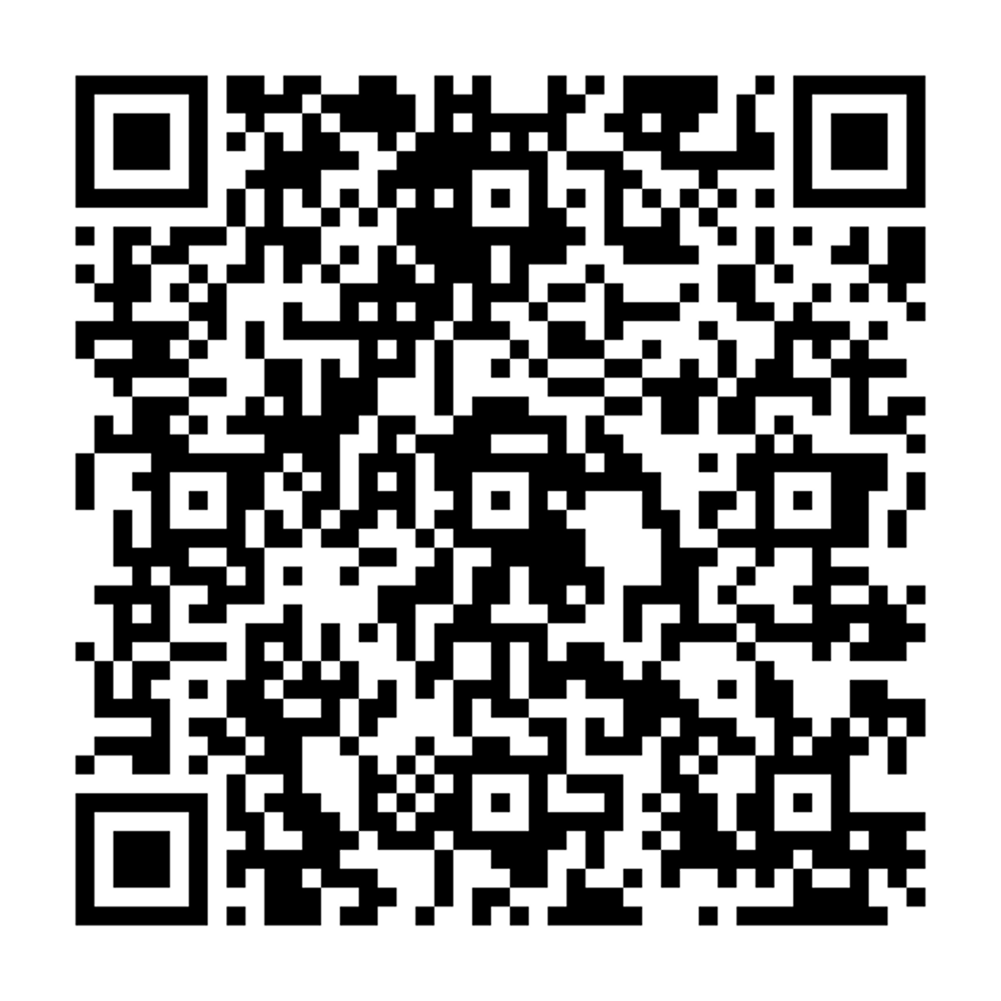
We Want Your Input
  We’d love your suggestions on the Career Readiness standards!
Access the following form to give your feedback and ideas about the current version of the Career Ready standards.
    https://forms.gle/H7f15FTqfS91eZC4A

Slide 26
ed.sc.gov
Notes:
Slide title is hidden from display

