Slide 1

All Really Means ALL!
How a Multi-District Career Center Supports Feeder High Schools with Getting All Students Career Ready
Dr. Tiffany LaFerrara-Estes Mrs. Haley Stollar
Executive Director Transition Instructor
Anderson Institute of Technology

Slide 2
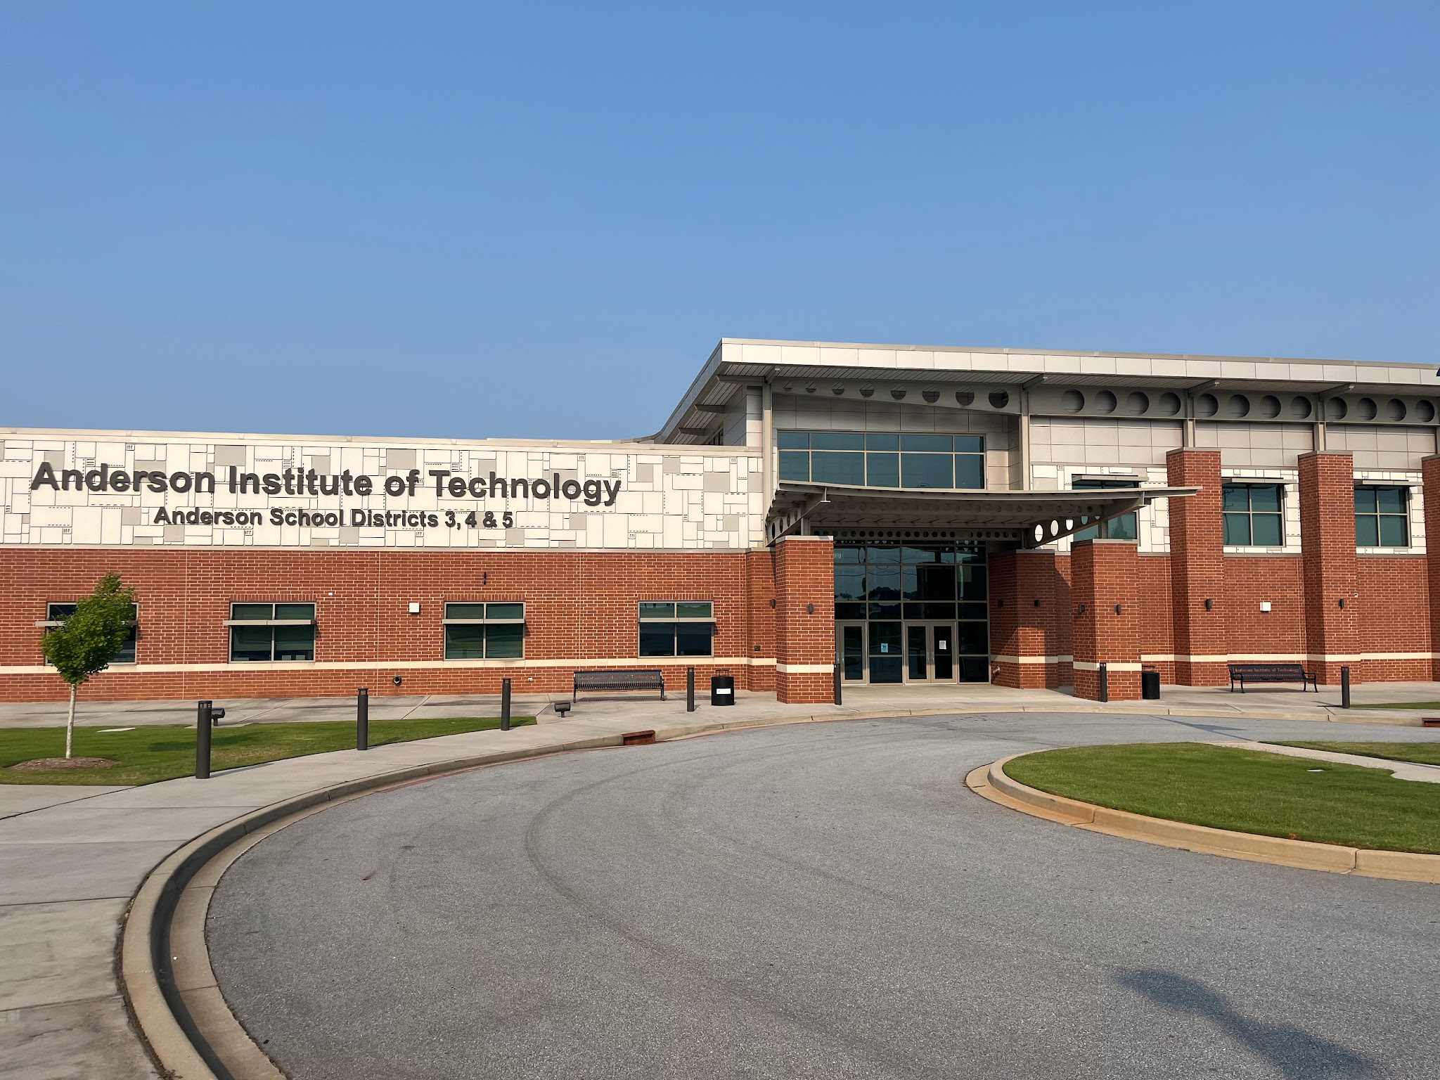




Slide 3
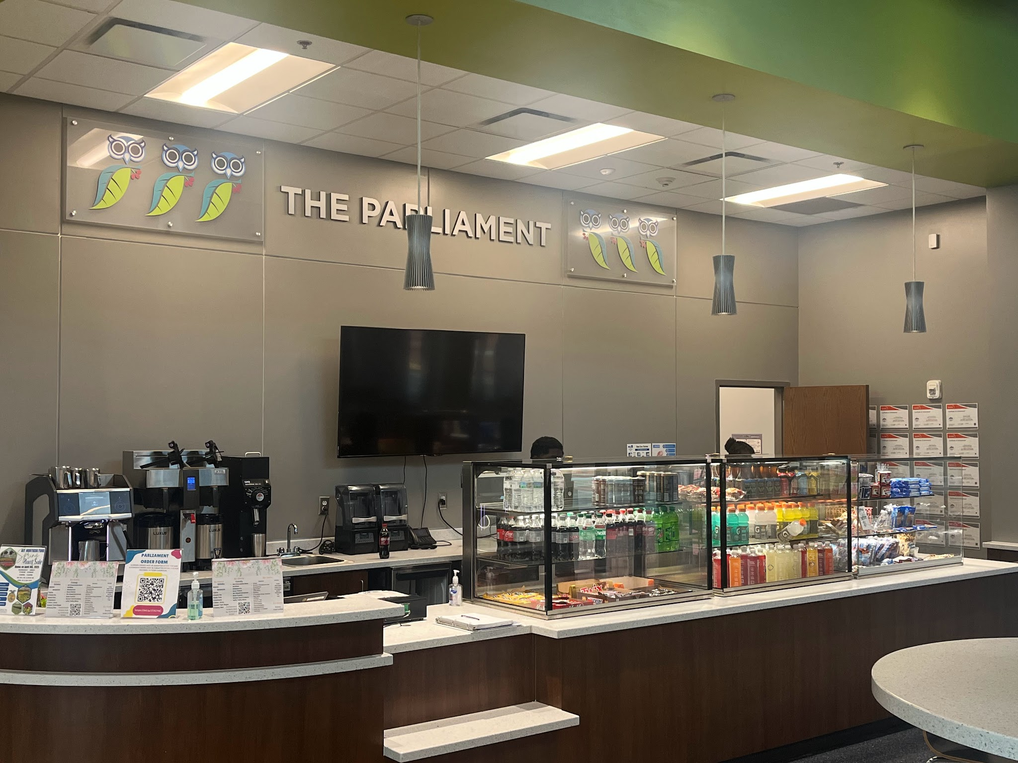
Vision

Slide 4
Transition Instructor
Proposed position in budget meeting for 2024-2025 school year
Rationale:
  Direct/Indirect support for students with IEPs, 504s and ILAPs (Prerequisite review for courses)
  Supervise/develop Parliament Internship Program
  Provide training/support for instructors
  Primary contact for accommodations
  Communicate with feeder high schools
  Attend IEP/504 meetings as needed/requested
  Explore opportunities for internship participants (certifications, inclusive opportunities in various CTE courses etc.)
  Address barriers for students (3rd Party Permit Testing site)

Slide 5
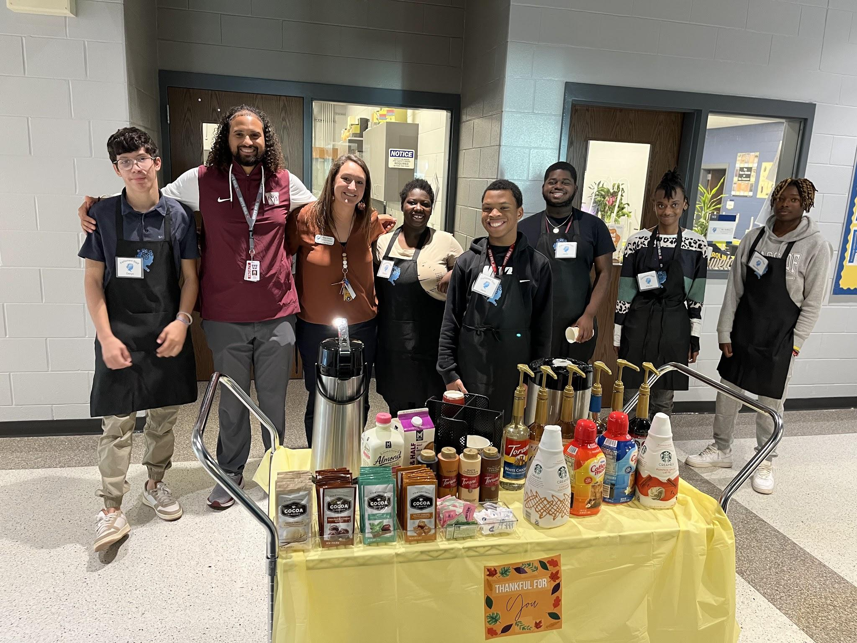
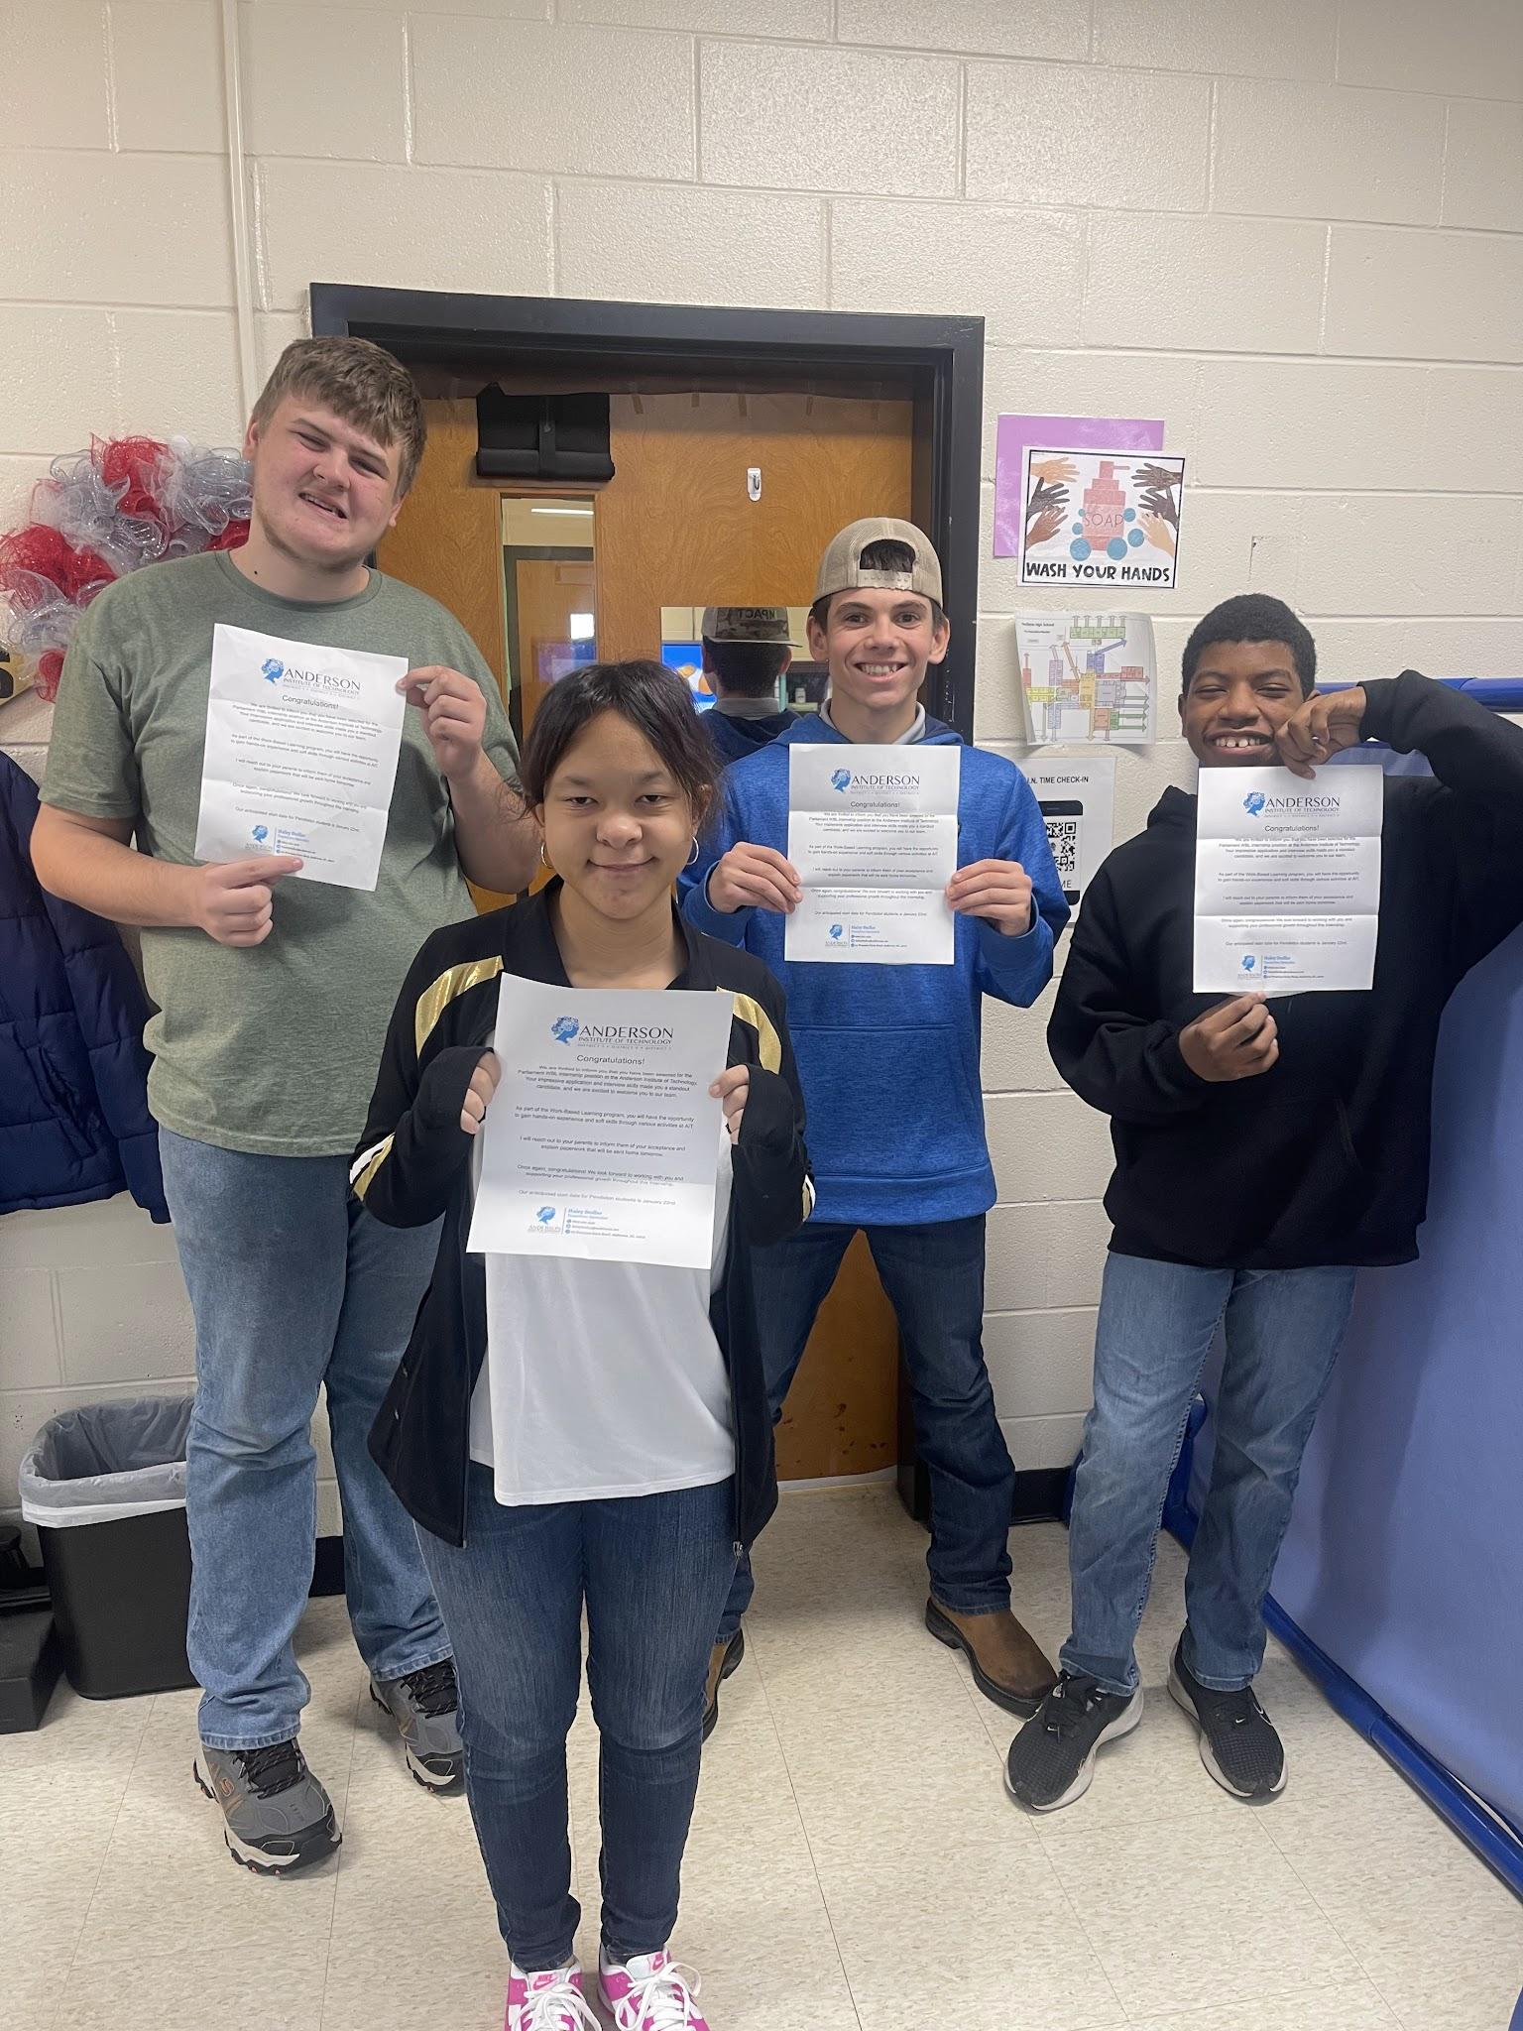
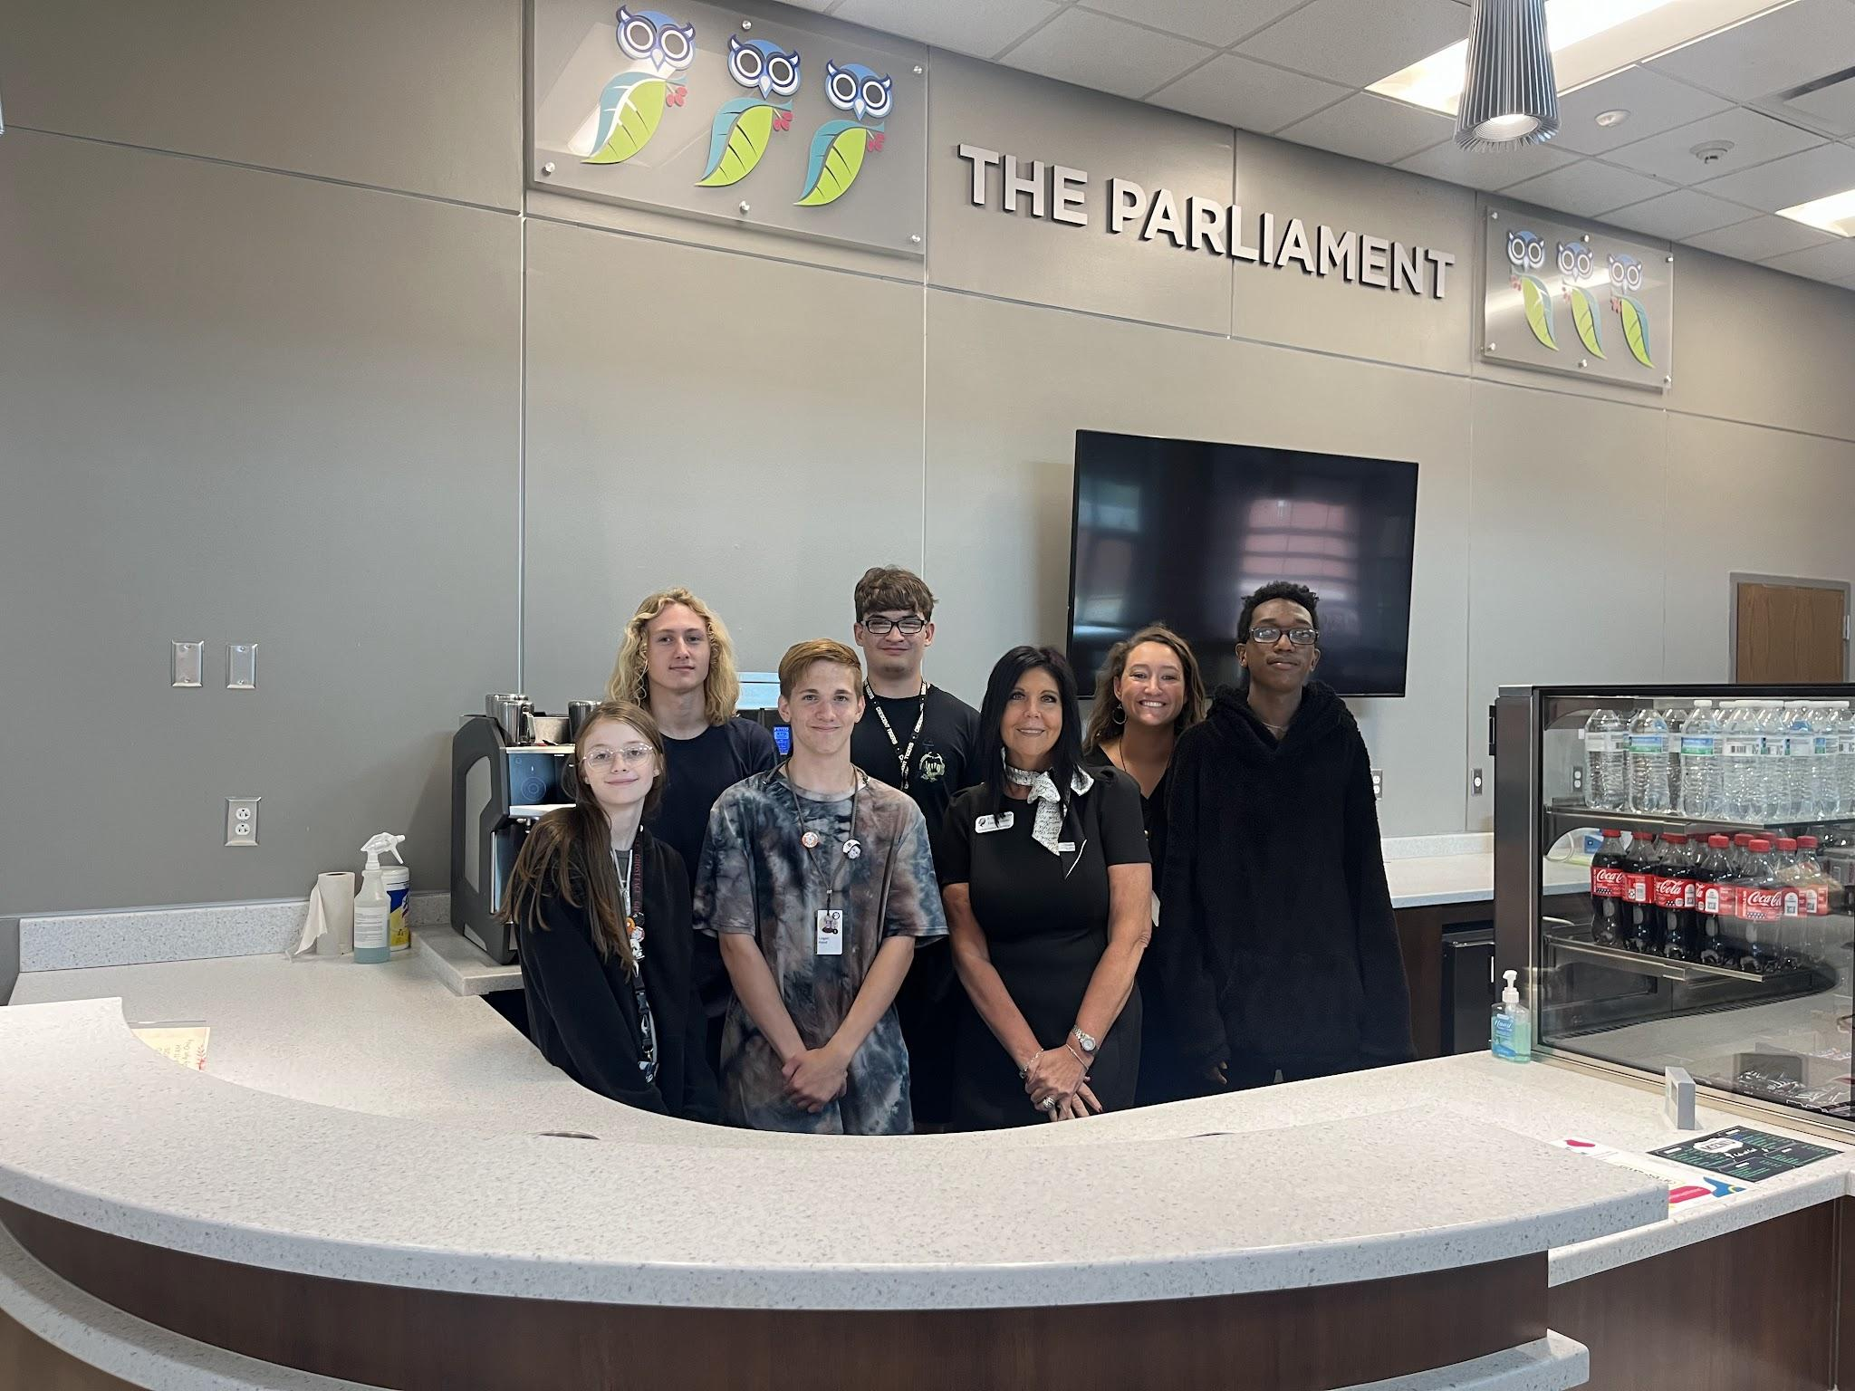
Our Why

Slide 6
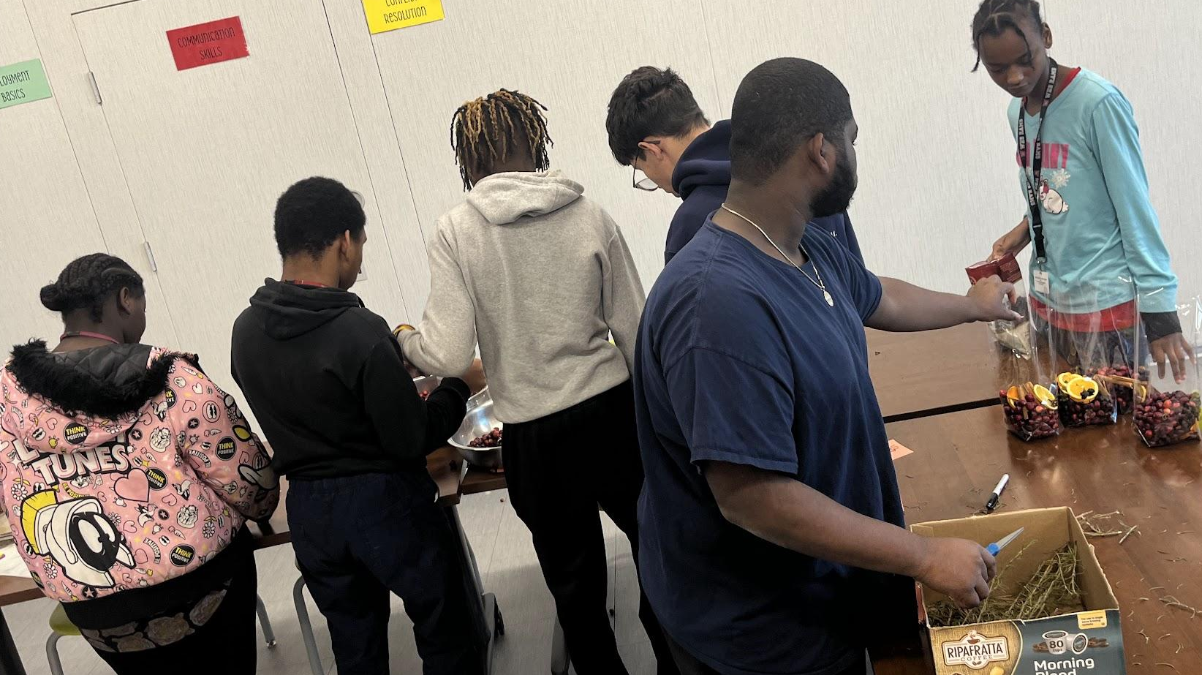
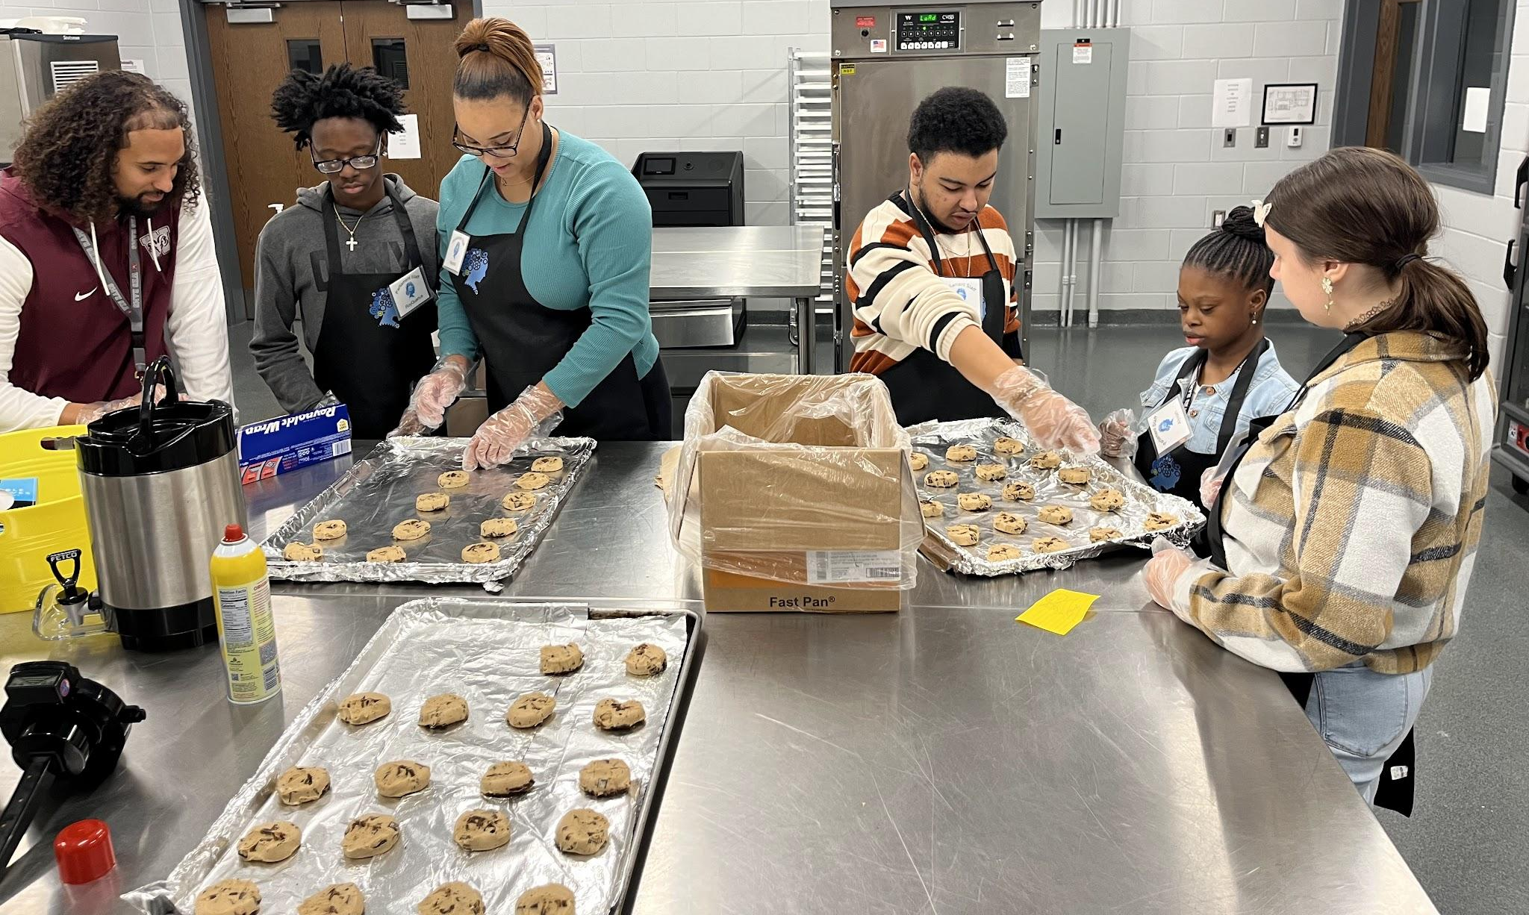
Who?
Who was involved in the Planning Process
  District Level
  Outside Agencies: VR
  School Level- Identifying the individual needs for each school.
Student Participants
Job Coach from Each school

Slide 7
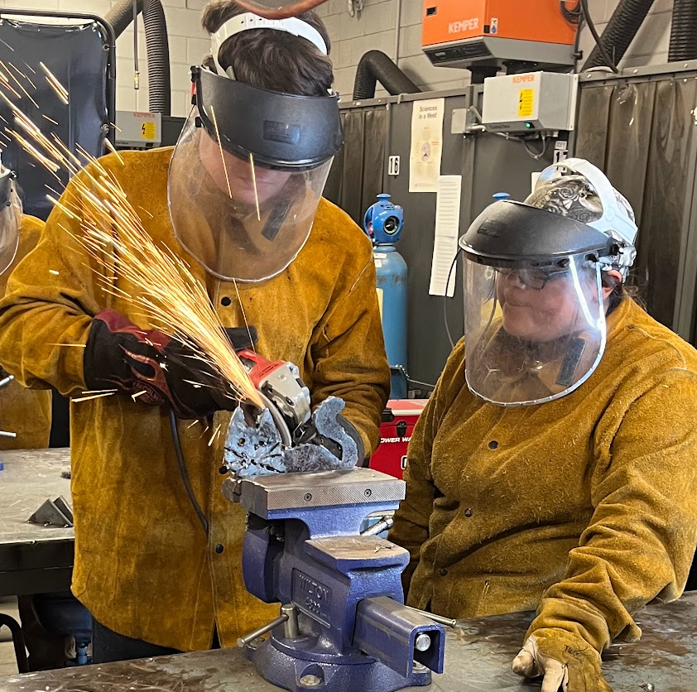
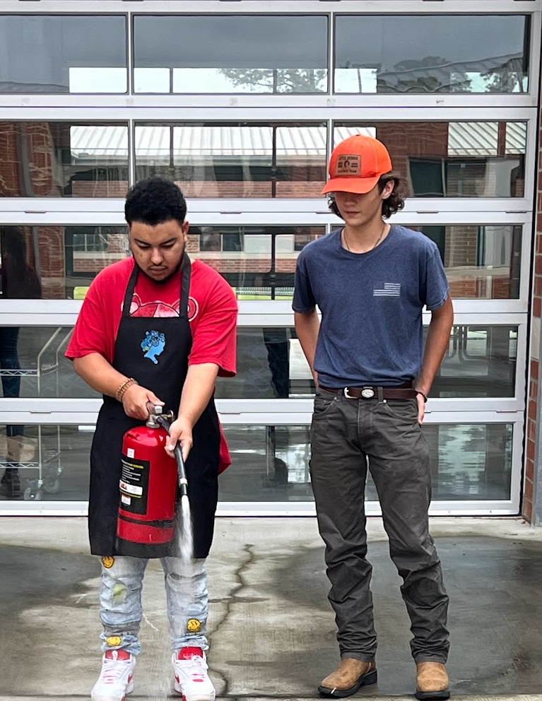
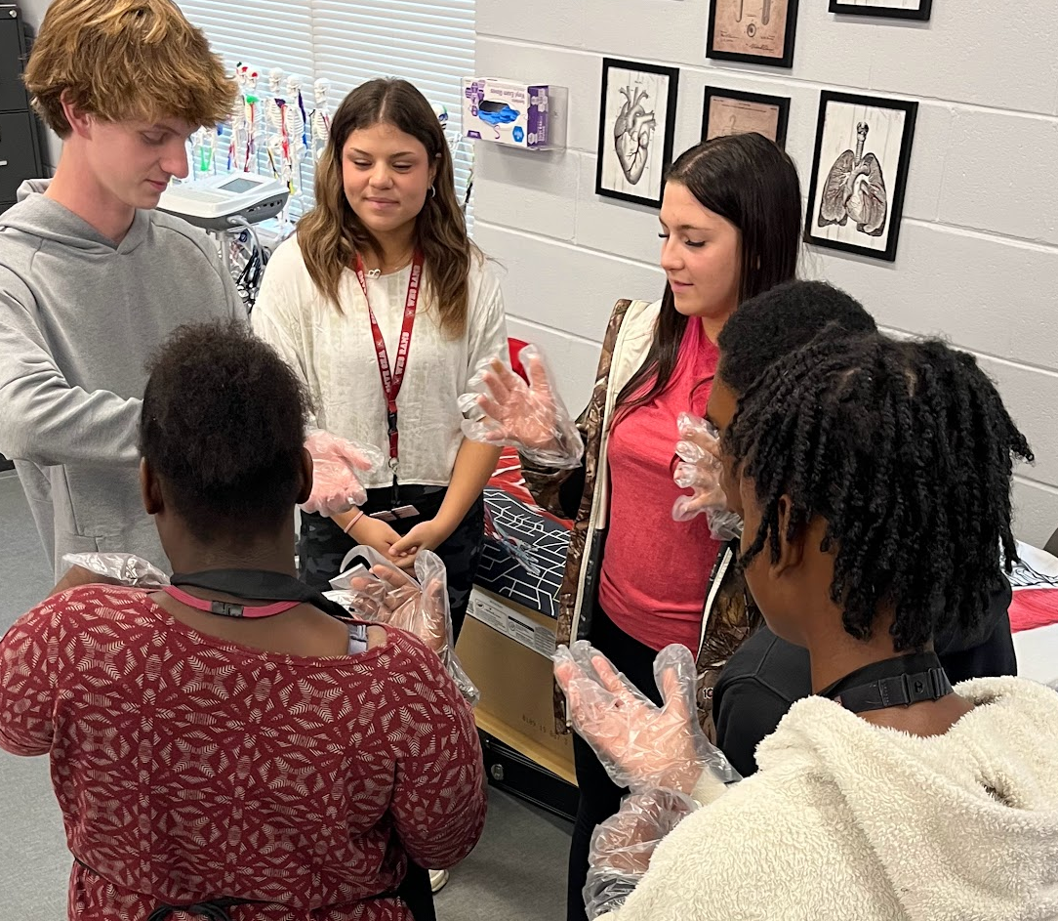
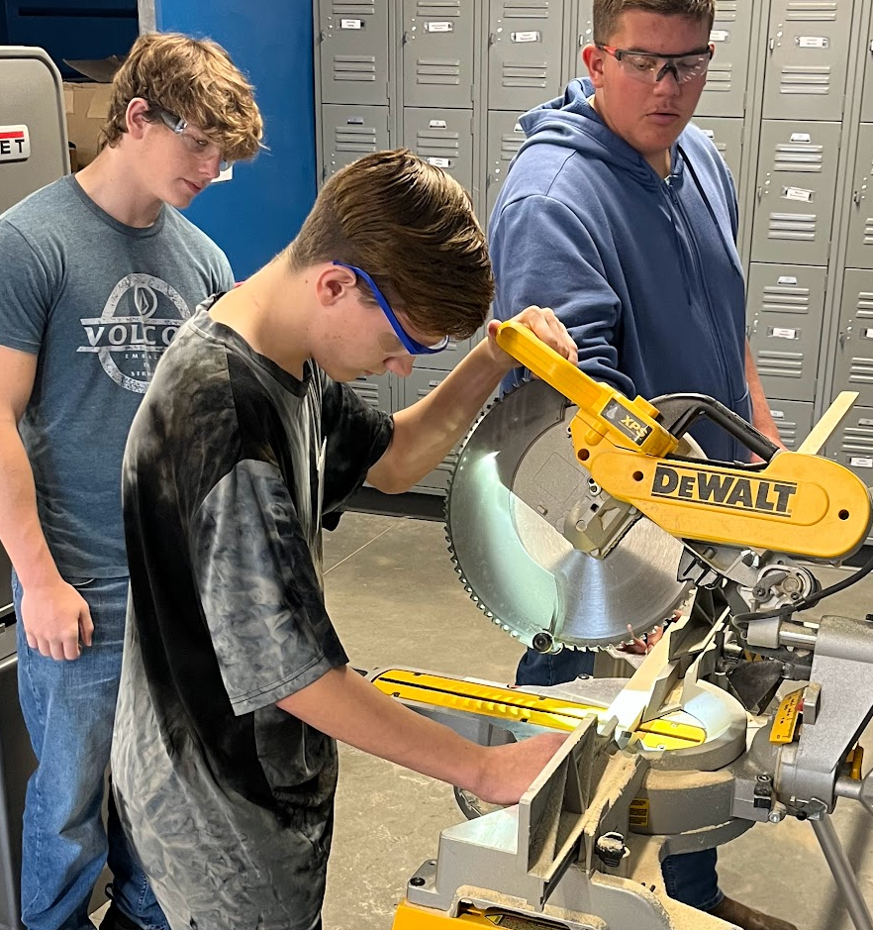
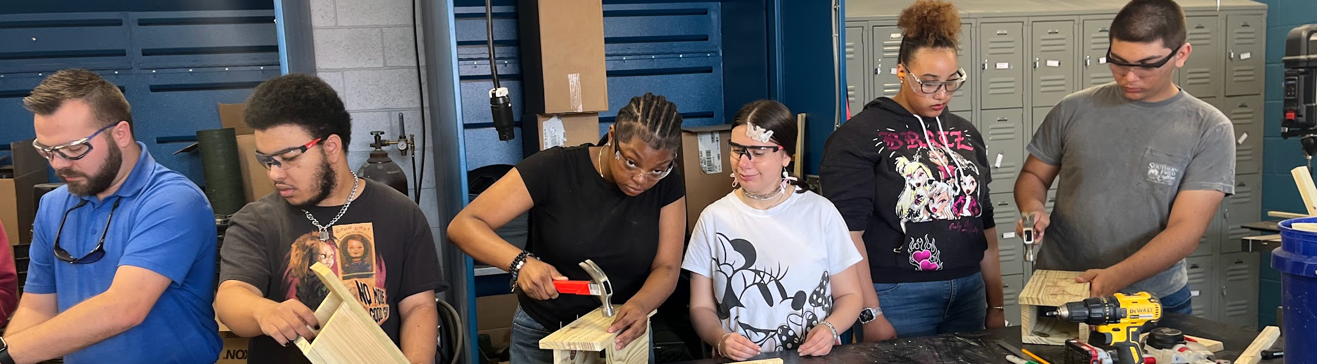
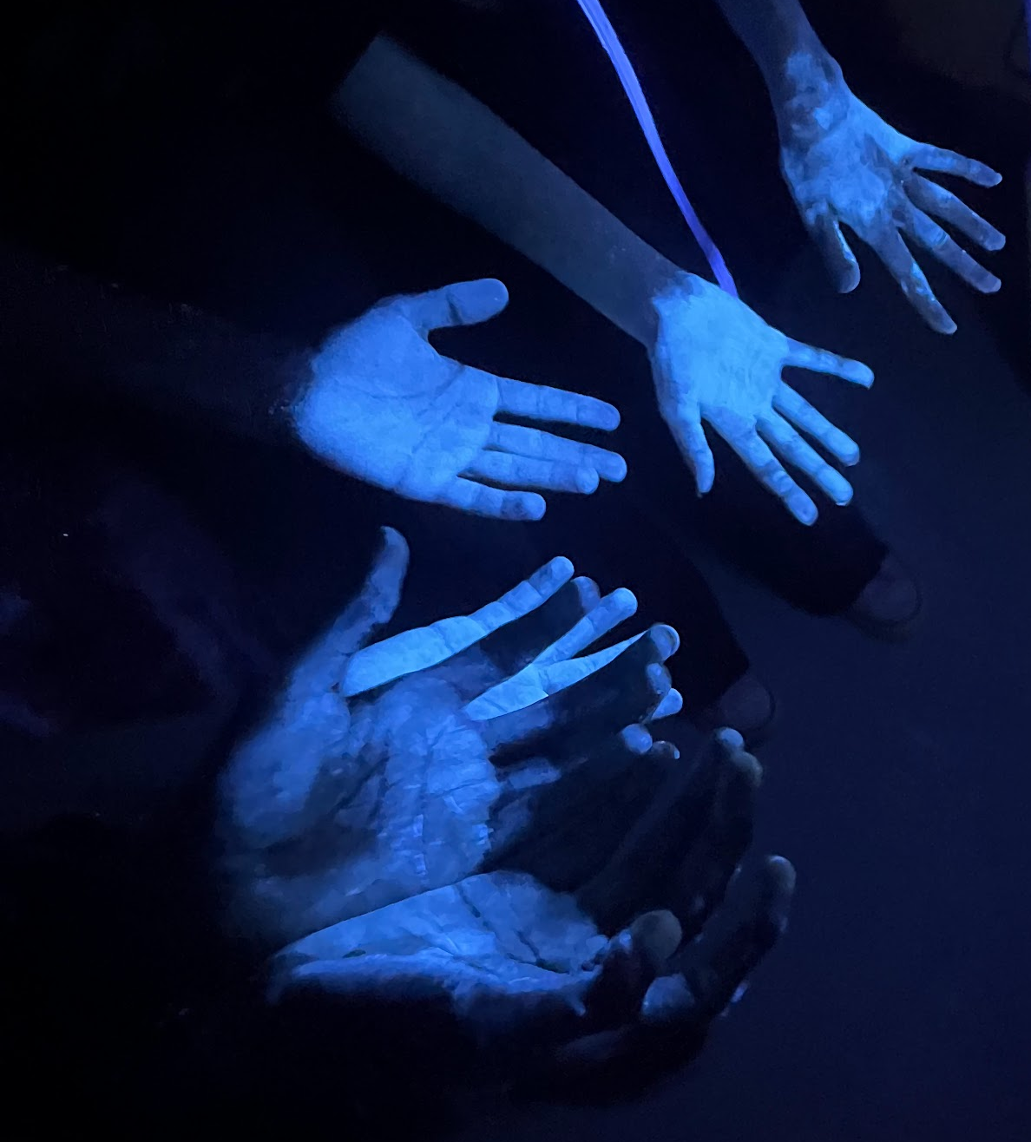



What?
CTE 40 Hour Internship
  Not a School Based Enterprise.
  Not a requirement for the SC High School Credential
Inclusion Opportunities
  Welding, Horticulture, Aerospace Engineering, Health Science (Cadaver Lab).
Training Opportunities
  Fire & Safety- Student Led
  Hand washing and wound care- Student Led
  Microburst Employability soft skills
  DMV 3rd Party testing for Permit test
  Servsafe Food handler- 3 year certificate

Slide 8
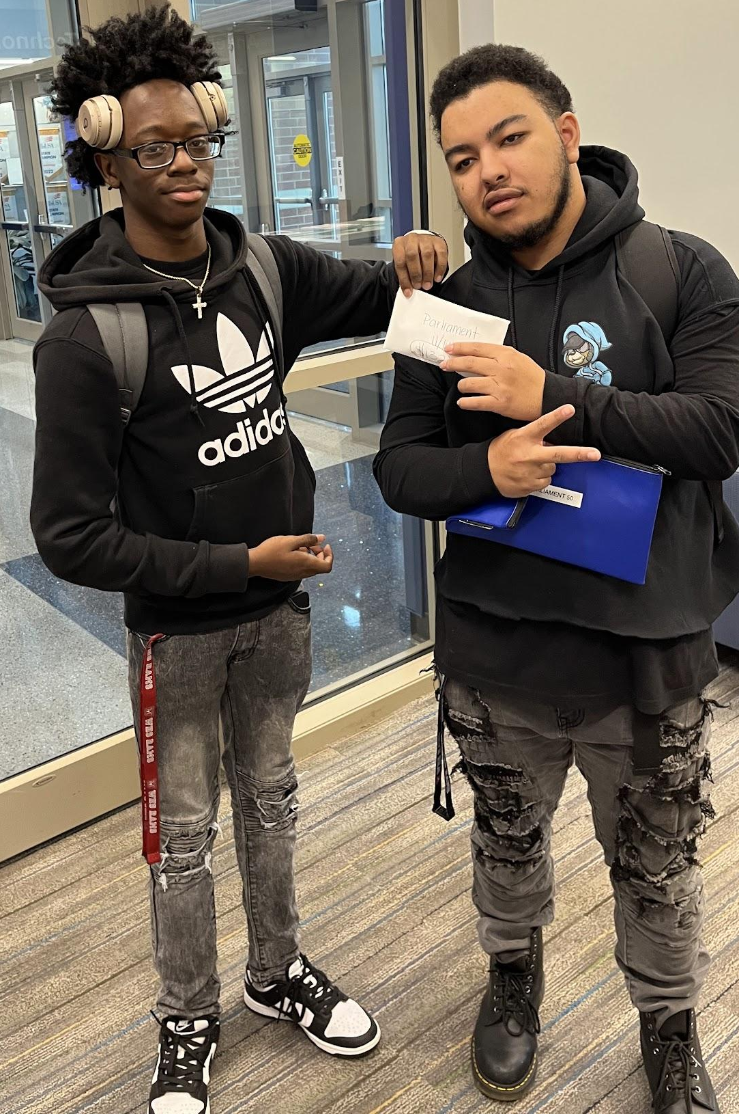
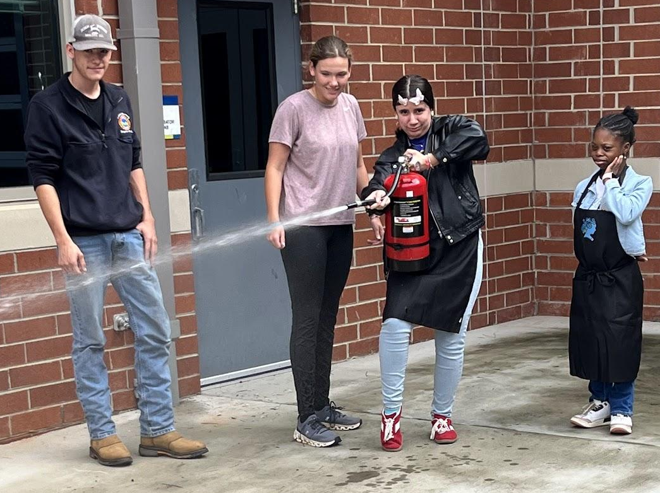
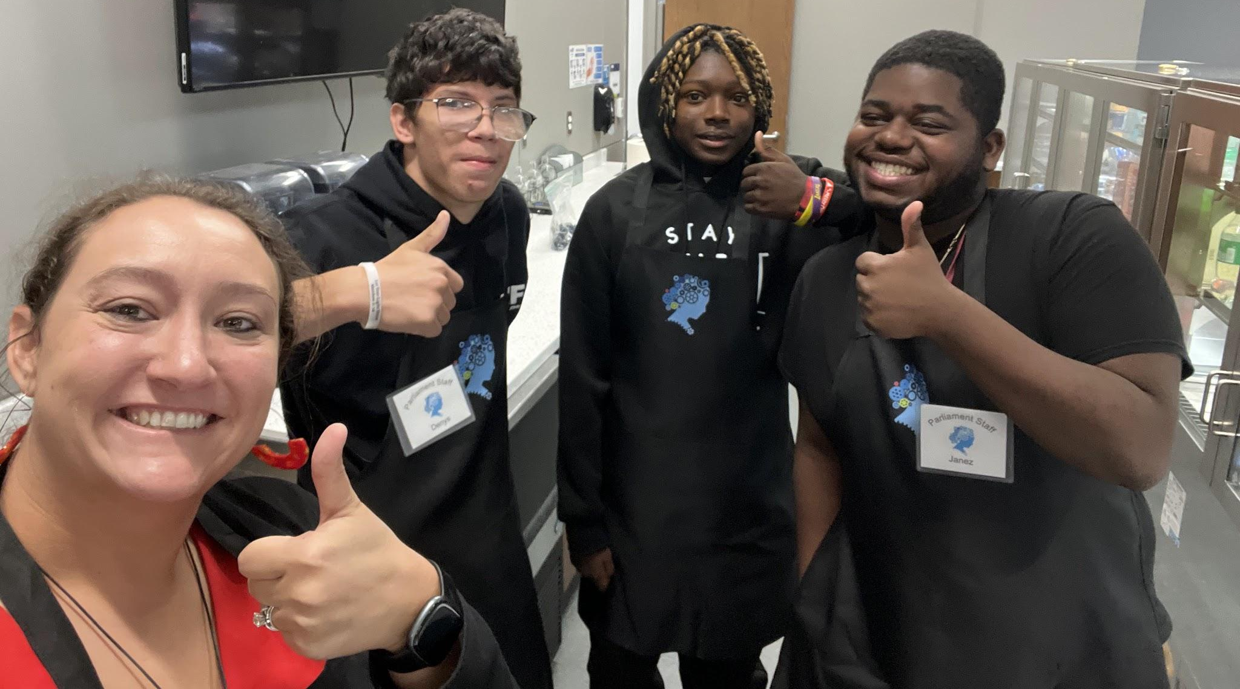
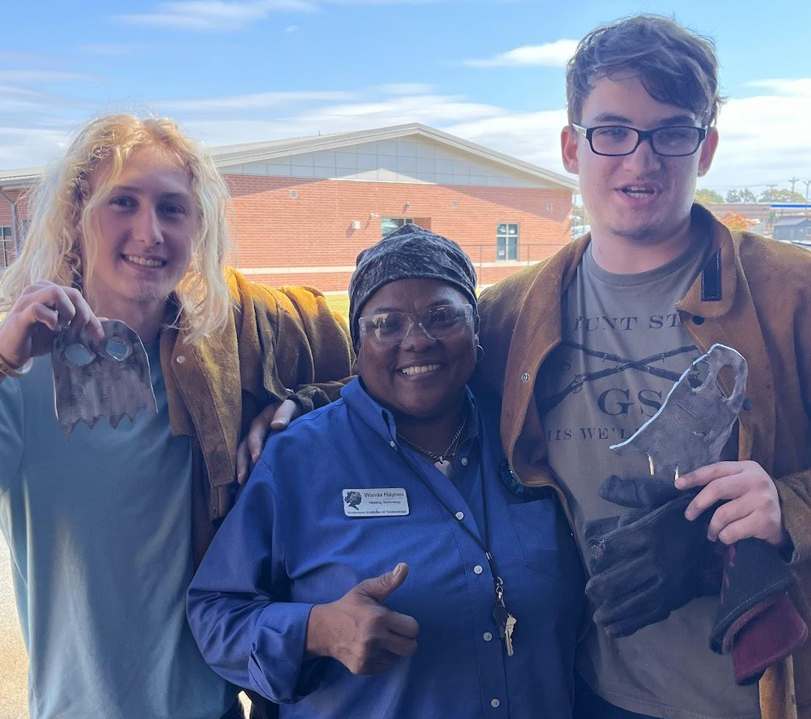
Where?
Set up process
  Student Presentation of program
  Interview Process
  Parent meetings
  Paperwork
  Tours
  Orientation to Worksite
  Evaluations
Giving back
  AIT Students
  AIT Staff Members
  Parliament Staff Members
  Business/ Industry Partners

Slide 9
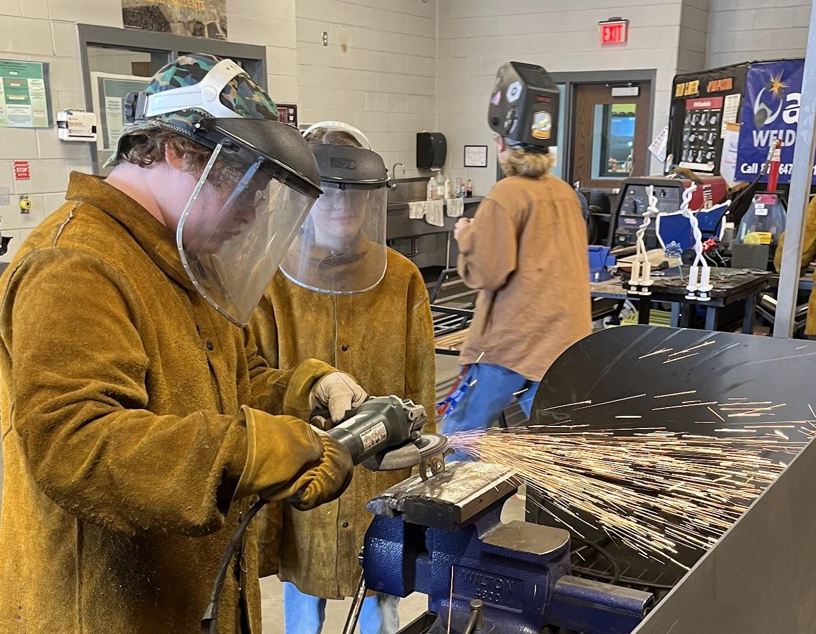
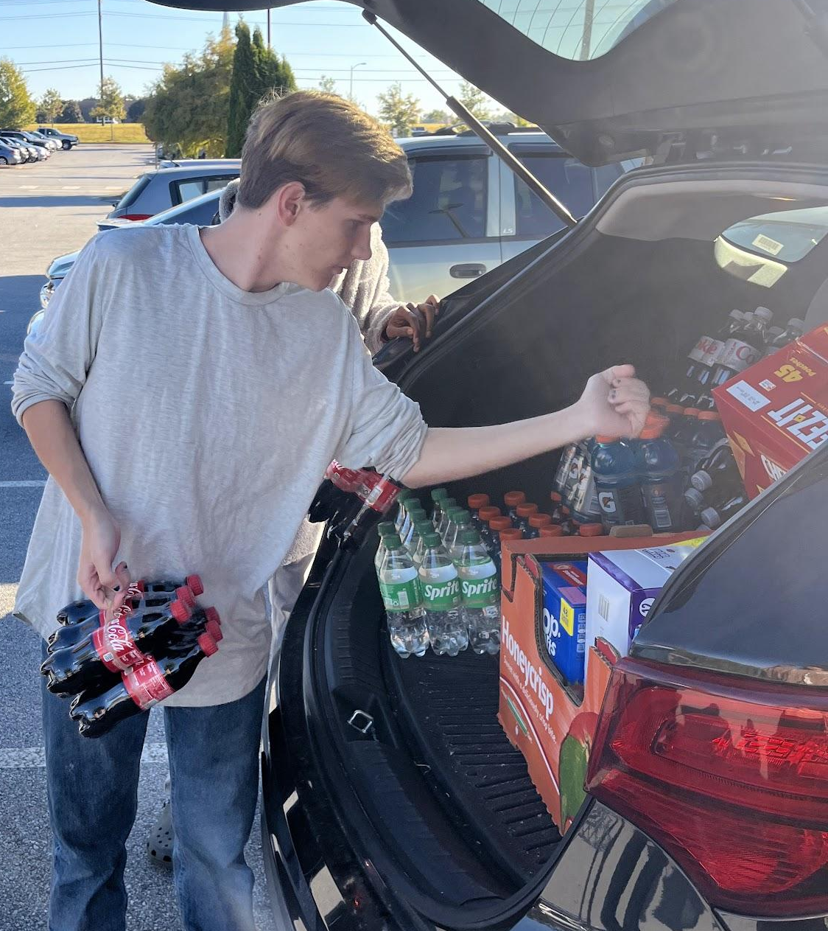
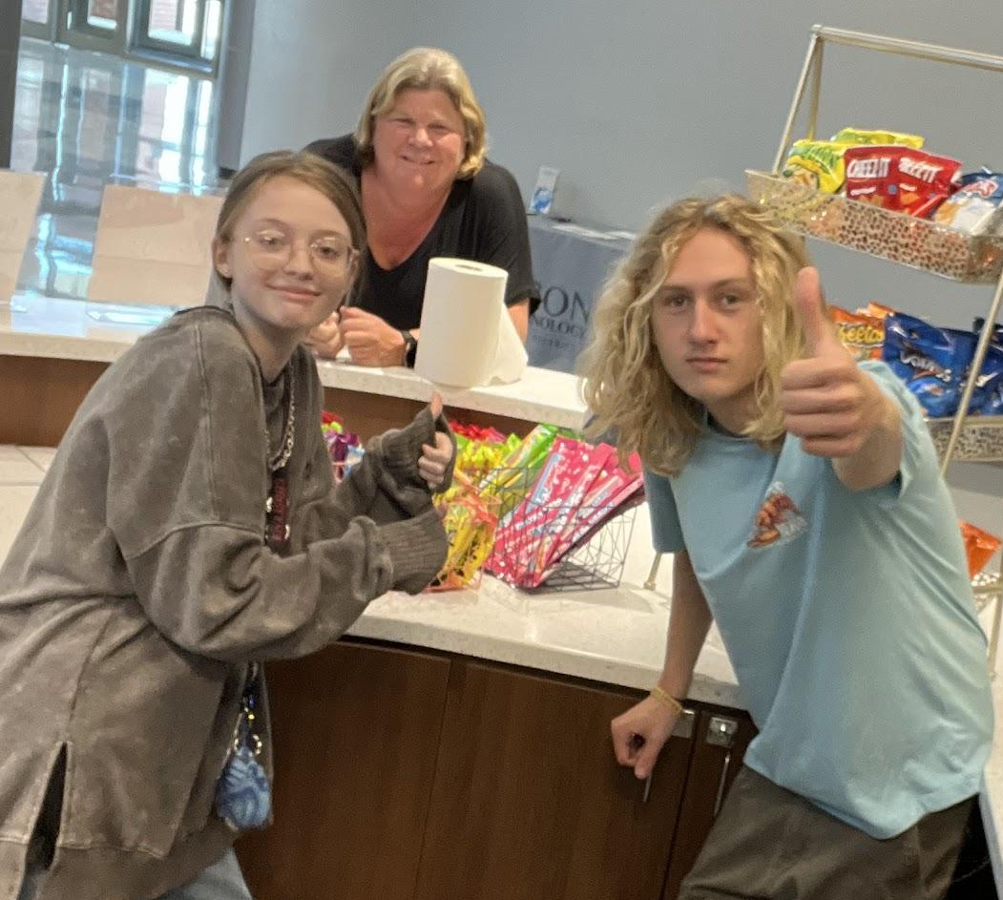
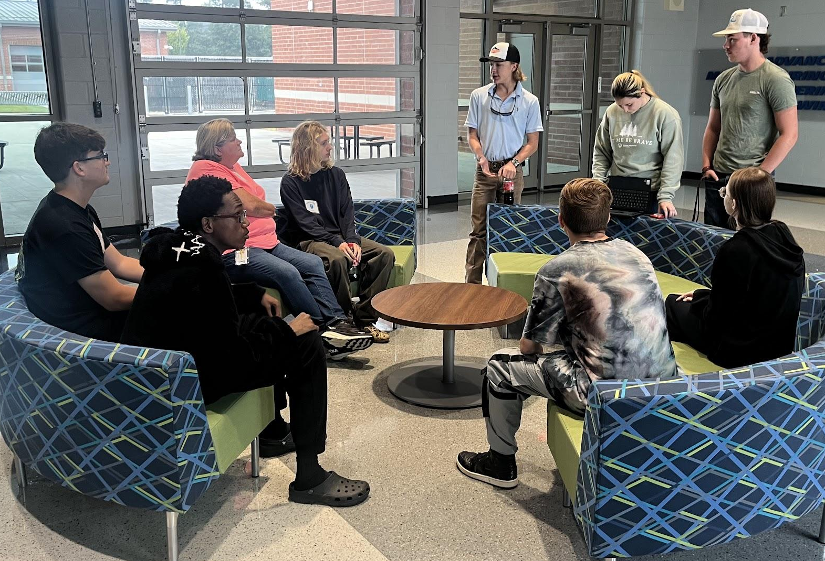
When?
1 Day a week
  8:45-11:30 (Transportation Provided)
  12:15-3:00 (Transportation Provided)
  CHS- 8:30-1:30 (Provided their own transportation)
Staggered Start based on school needs/ buy in

Slide 10
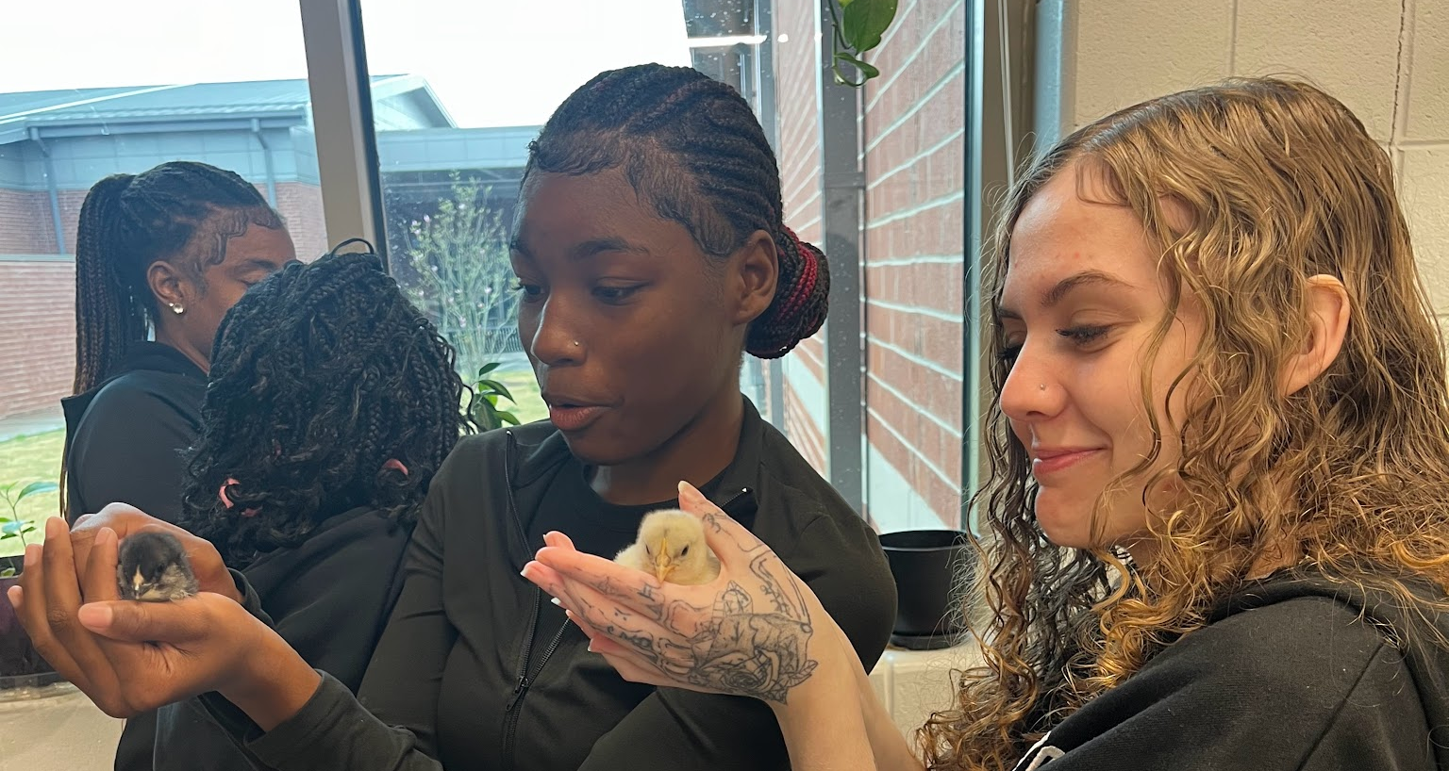
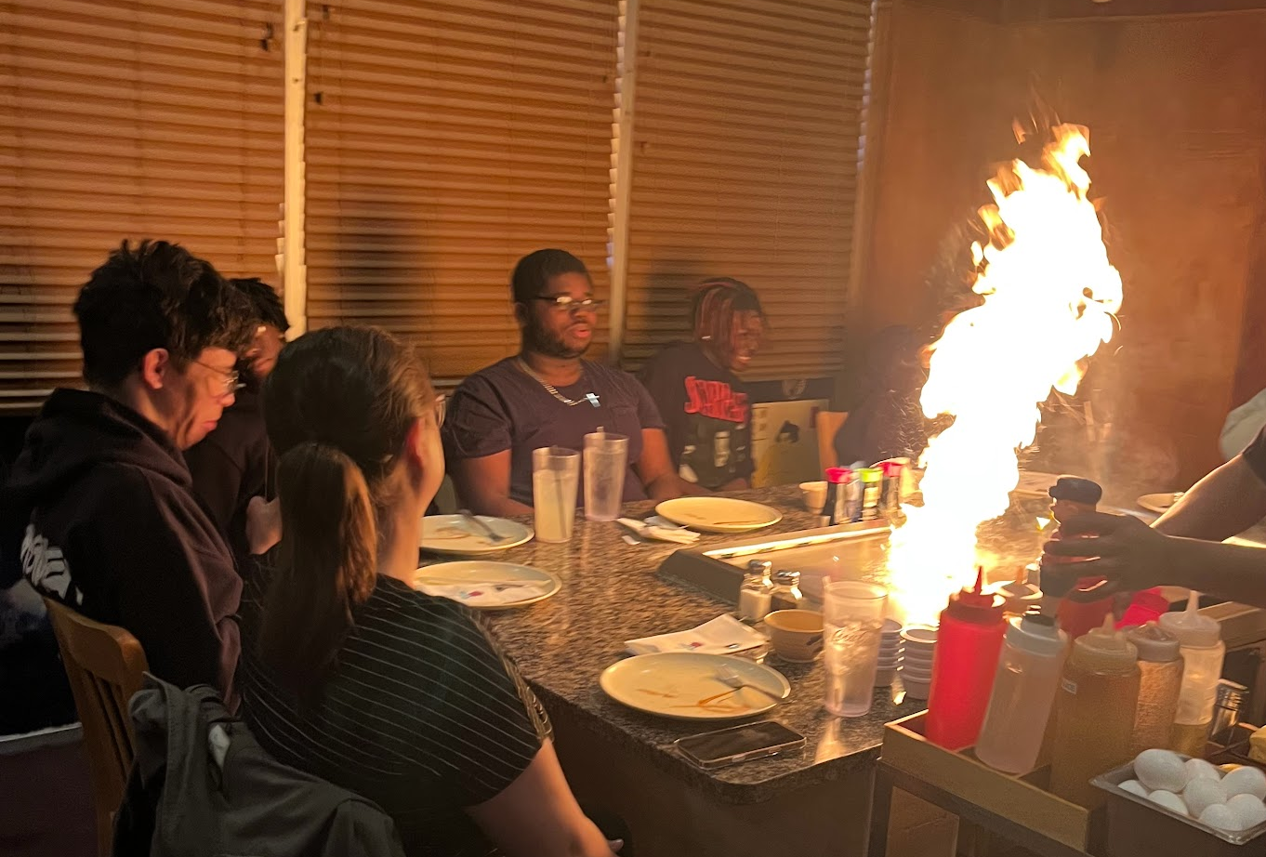
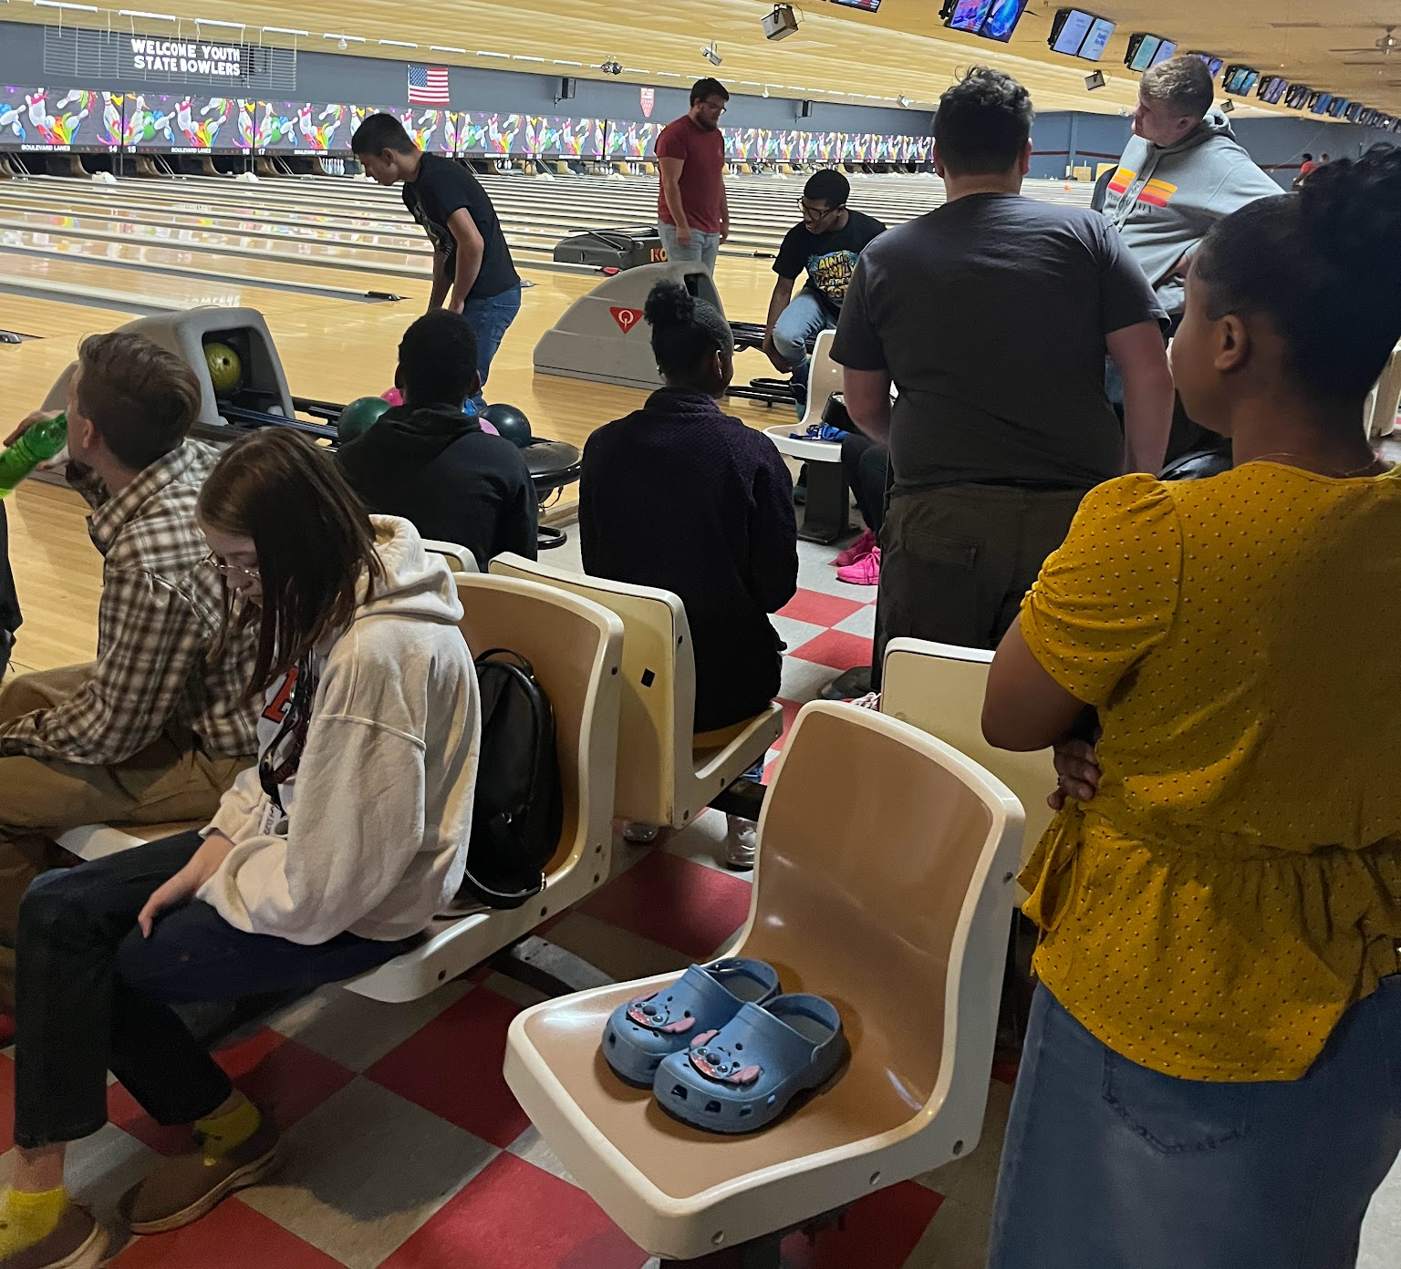
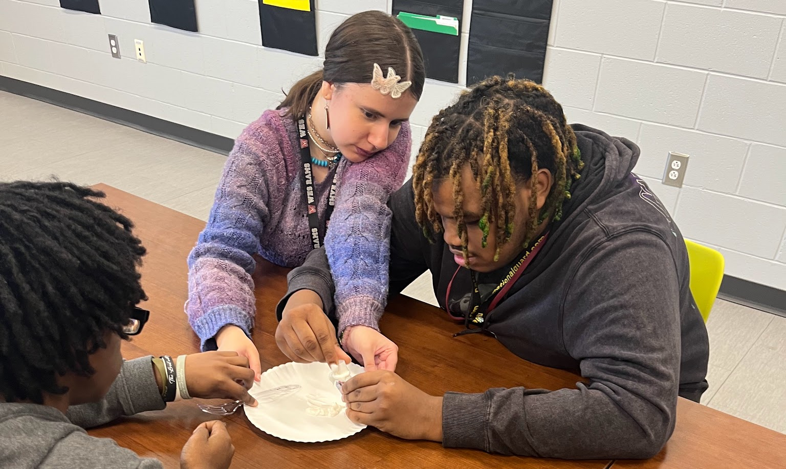
How?
Become knowledgeable of the CCR requirements
Transportation
Financial
Students are NOT enrolled in a course at AIT, they are employed to work in in the Parliament.
Day to Day operations
Communication

Slide 11
Career Readiness
https://ed.sc.gov/districts-schools/special-education-services/post-secondary-outcomes/employability-credential-south-carolina-high-school-credential/memo-guidance-on-career-ready-qualifier/
Training agreement with objectives and minimum of 40 practical experience hours.
Successful WBL exit evaluation form from employer.
Be aligned with IEP and IGP career clusters.
Industry evaluation created from training agreement and includes world class skills from the profile of the SC graduate.
Minimum of one unit in the pathway related WBL placement or completed a personal pathway of study.

Slide 12
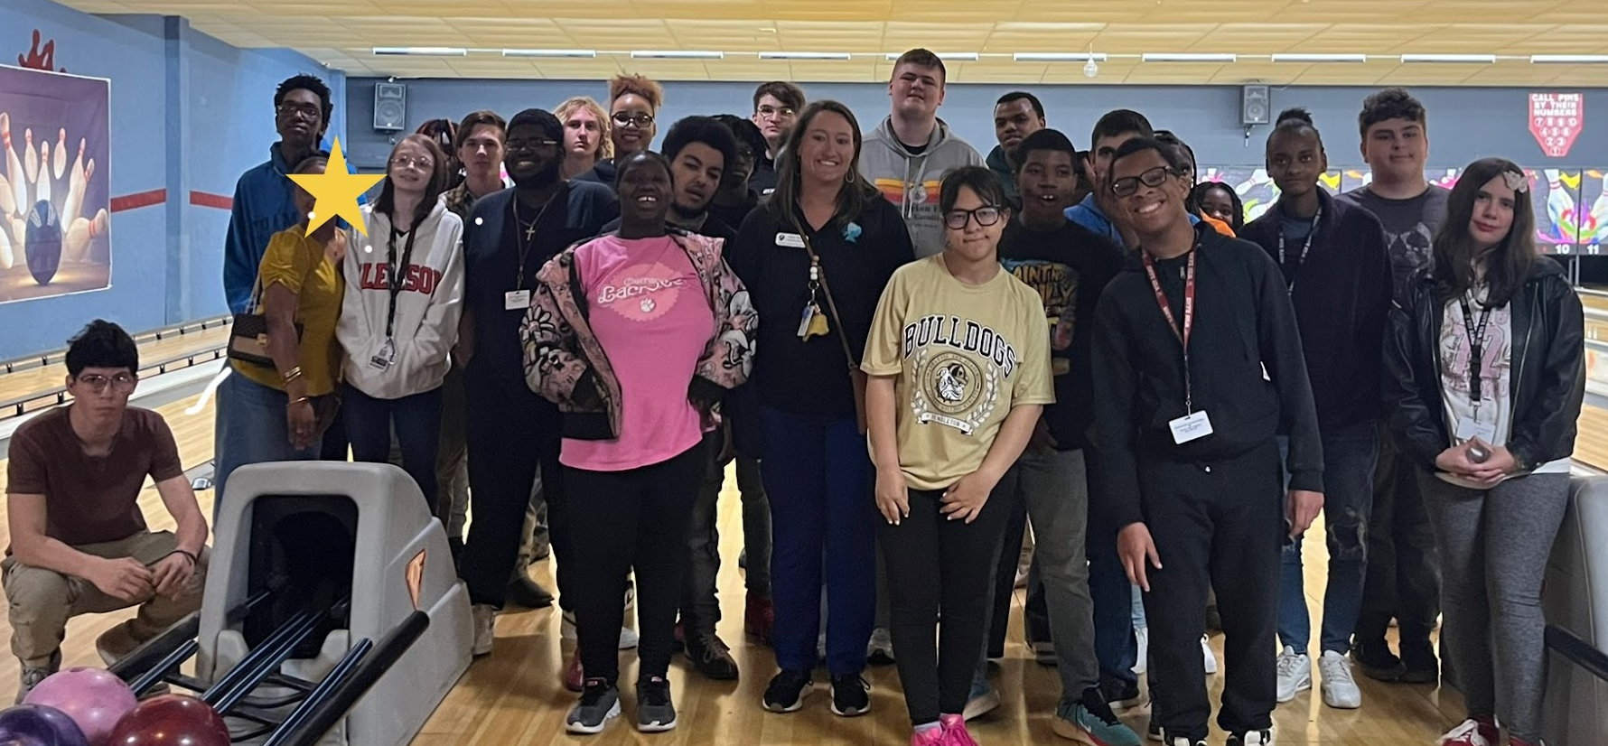

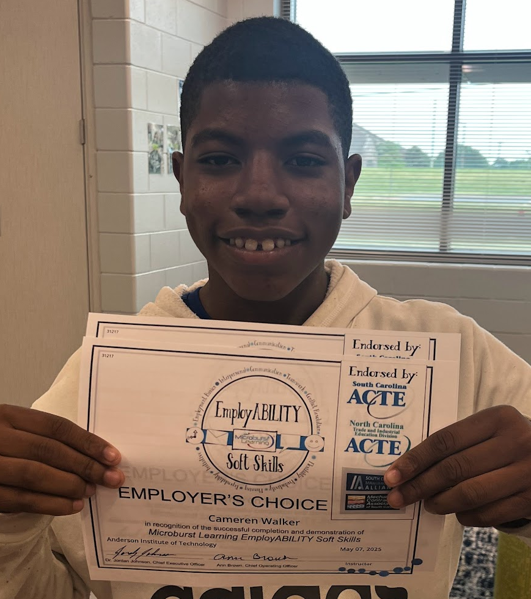
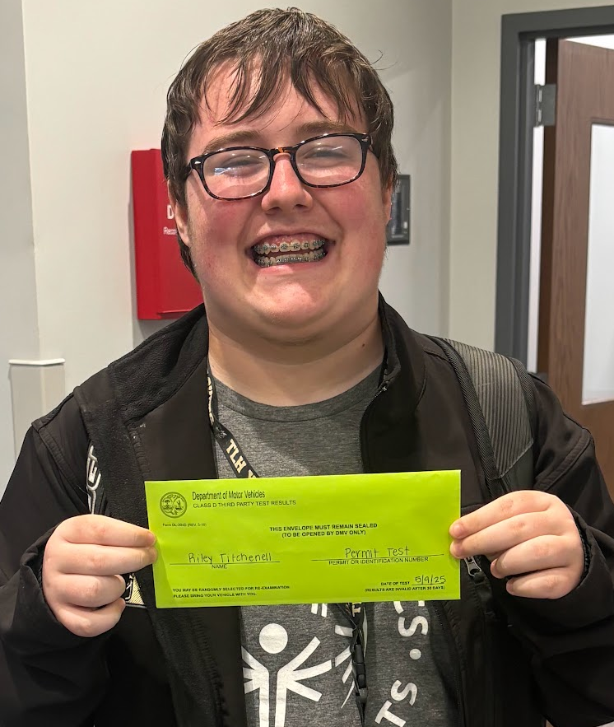
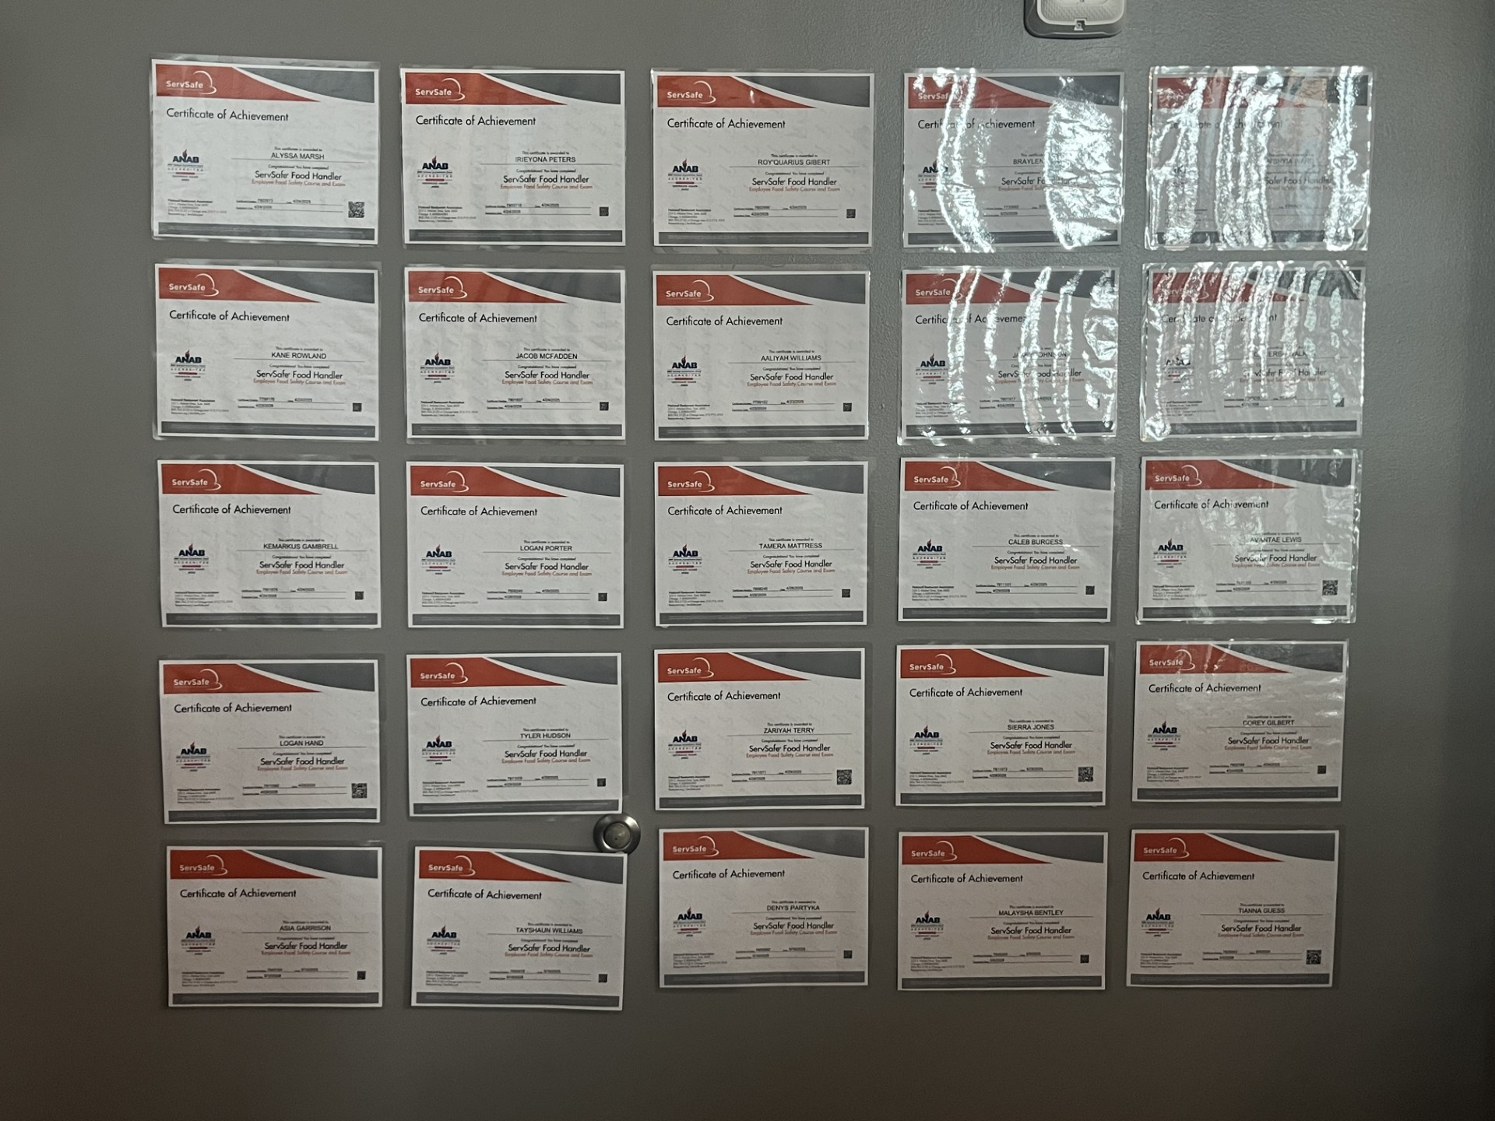
Year 1 Successes (2024-2025)
27 Students completed the 40 hour internship which makes them a Career Ready Qualifier.
23 Students earned their ServSafe Food Handler Certificate
13 Students earned their Employer’s Choice Certificate through the Microburst platform.
6 Students passed their Drivers Permit test
4 Parliament Work Based Learning Participants will be returning to AIT in 2025-2026 to take a course

Slide 13
Key Takeaways from Year 1
Communication is key!
Build relationships with home schools.
9GR cohort placement for CCR awareness
Students must have taken a CTE course that aligns with their IGP and IEP.
Seat-time for Diploma Track Students

Slide 14
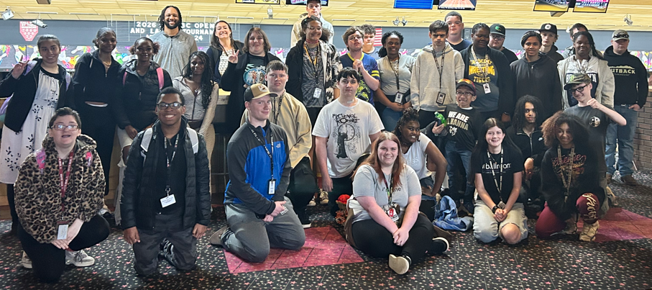
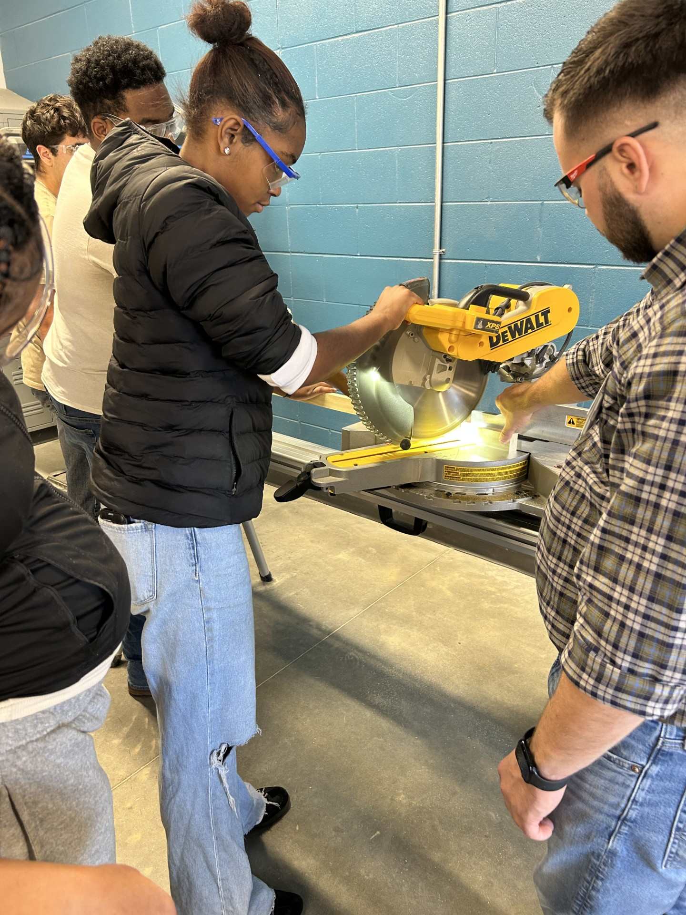
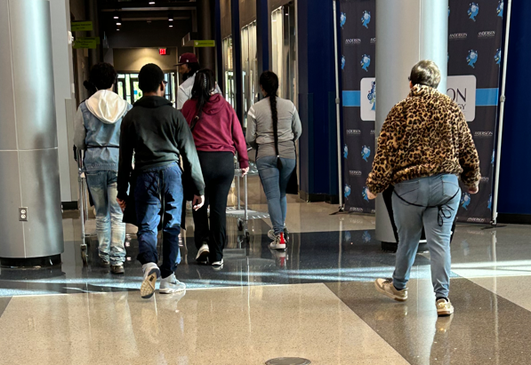
Year 2 Successes (2025-2026)
39 Students completed the 40 hour internship.
  CHS- 12 students
  PHS- 10 students
  WHS- 7 students
  TLH- 10 students
31 Students earned their ServSafe Food Handler Certificate
8 Students passed their Drivers Permit test
1 student earned her Stop the Bleed and CPR Certification
4 prior Parliament employees were successful in their AIT courses and plan to return next school year to become a completer.

Slide 15
Key Takeaways from Year 2
Development of WBL Internship Handbook
Continuous review of IEP & IGP goals, objectives and post-secondary considerations
Upgraded equipment and procedures
Prioritize program goals
Multi-district Student Leadership Council (2026-2027)

Slide 16
Questions/Comments?
Thank you for attending our presentation. We hope you have a fabulous 2026-2027 school year!!

Slide 17
Haley Stollar
Transition Instructor
HaleyStollar@anderson5.net
Contact Information
Tiffany LaFerrara-Estes
Executive Director
TiffanyEstes@anderson5.net
Palmetto Education Summit Participant Folder 6.16.26
Anderson Institute of Technology Website

