Slide 1


Helping Young Children
Build Skills for the Future:
Connecting SC Early Learning
Standards, Play, and Career
Readiness
Palmetto Education Summit
Dr. Tammy Graham & Jennifer Stock
June 15-17, 2026

Slide 2
01
Opening & Session Overview
02
Why Early Childhood IS Workforce Development
03
SC Early Learning Standards as the Foundation for Career Readiness & Play Based Learning as a Workforce-Aligned Instructional Approach
Agenda
04
Connecting Early Learning to Future CTE Pathways
05
Reflection & Closing

Slide 3
Why Early Childhood IS Workforce Development
South Carolina’s talent pipeline begins in early learning settings.
Early Learning Programs Support Families and Strengthen Labor Force Participation
Builds the
Foundational Skills: Problem
solving, Communication,
Self-regulation,
early Literacy, and
Numeracy
Notes:
1. Early Childhood Builds the Foundational Skills Employers Rely On
Economists and workforce leaders consistently emphasize that the competencies needed in South Carolina’s future workforce—problem-solving, communication, collaboration, self-regulation, and early literacy/numeracy—originate well before kindergarten. Federal Reserve Bank of Richmond President Tom Barkin recently highlighted that both hard and soft skills essential to later workforce success are formed in the earliest years, long before formal K–12 instruction begins.
These foundational skills directly influence students’ long-term learning trajectories, employability, and capacity to meet evolving skill demands in a changing labor market. [scfirststeps.org]
2. Kindergarten Readiness Is a Workforce Indicator
Each year, approximately 56,000 children enter kindergarten in South Carolina, yet only 39% demonstrated readiness when assessed in fall 2024.
Readiness at school entry is highly predictive of third-grade reading proficiency, high school graduation, and long-term workforce participation. Increasing readiness rates is therefore not just an educational goal—it is a workforce development imperative. [scfirststeps.org]
South Carolina First Steps has set a bold target: 75% readiness by 2030, linking early learning directly with the state’s long-term economic health. [scfirststeps.org]
3. Early Learning Programs Support Families and Strengthen Labor Force Participation
High-quality early childhood programs do more than nurture child development—they also enable parents to participate reliably in the workforce. Access to early care and education reduces absenteeism, increases job retention, and stabilizes household income. South Carolina’s Birth–5 system and statewide data initiatives are structured to support families in navigating childcare and early learning options so they can remain engaged in the workforce. [earlychildhoodsc.org]
4. The Early Childhood Workforce Itself Is Part of the Talent Pipeline
South Carolina’s early education sector employs more than 23,000 early childhood educators, forming a critical segment of the state’s workforce infrastructure.
However, this workforce faces significant wage and retention challenges, with median pay far below a living wage. Investment in this workforce strengthens the quality and stability of early learning environments, directly influencing child outcomes and long-term workforce readiness. [cscce.berkeley.edu]
Local initiatives like the Early Education Career Institute (EECI) are addressing shortages through registered apprenticeships, achieving 88% completion and 100% job placement—clear evidence that developing the early childhood workforce is also developing the state’s broader economic base. [issuewire.com]
5. Expanding High-Quality Pre-K Strengthens Long-Term Workforce Outcomes
South Carolina continues to expand access and quality in programs such as CERDEP and EIA 4K. In 2023–2024, the state enrolled 27,171 preschoolers, increased per-child spending, and met 7 of 10 national quality benchmarks—evidence of a system increasingly aligned with long-term workforce goals.
New initiatives like statewide LETRS-EC training for early childhood teachers strengthen instructional quality, particularly in early literacy, a critical workforce competency. [nieer.org]

Slide 4
Why Early Childhood IS Workforce Development
Foundational skills developed in ages 0–8 shape later academic, technical, and employability skills.
Brain development and foundational skill-building occur most rapidly from birth to age five.
-
Neural pathways
responsible for:
Language, Reasoning,
Self-Regulation, and
social interaction
form.
Notes:
1. Early Brain Development Creates the Foundation for All Later Learning
Neuroscience shows that neural connections—the basis of all thought, communication, and learning—form most rapidly in early childhood, especially in the first three years. These early neural pathways shape later cognitive abilities, language development, reasoning, memory, and social-emotional skills. [naeyc.org]
More than one million neural connections form every second in the early years, establishing the architecture upon which academic and workforce skills are later built. [unicef.org]
2. High-Quality Early Experiences Directly Shape Cognitive, Behavioral & Social Skills
Responsive “serve and return” interactions (e.g., talking, babbling, playing, turn-taking) strengthen brain architecture and develop communication and social-emotional skills essential for academic and workforce success. [naeyc.org]
When children experience chronic stress, poverty, or lack of responsive caregiving, development of cognitive and self-regulatory functions can be delayed—impacting future learning and problem-solving. [naeyc.org]
3. Foundational Early Skills Become the Precursors to Essential Employment Skills (EES)
Independent research identifies early cognitive and behavioral skills as precursors to later employability skills such as:
Communication
Collaboration
Problem-solving
Planning & organization
Information literacy
Creative thinking
These foundational skills begin forming before age 8 and later translate directly into the competencies needed for the future workforce. [nfer.ac.uk]
4. Gaps in Early Foundational Skills Become Harder to Close Over Time
Studies show that cognitive and behavioral skill gaps emerging in early childhood become more entrenched with age if not addressed early. Children who start behind often stay behind unless early interventions occur. [nfer.ac.uk]
Inequities in children’s material, emotional, or educational environments significantly influence their early skill development and academic progress, which later affects employability and long-term economic stability. [nfer.ac.uk]
5. Early Childhood Education Strengthens Academic Skills Essential for Later Technical Training
Research shows early learning fosters:
Language and literacy foundations that build reading comprehension and communication skills.
Numeracy and early problem-solving that evolve into technical and analytic skills used in STEM and CTE pathways.
Social and emotional skills (self-regulation, empathy, cooperation) that support teamwork and workplace readiness.
These early skills increase a child’s ability to succeed in school and complete higher-level training. [linkedin.com]
6. Early Skill Development Supports Lifelong Health, Behavior, and Decision-Making
The quality of early experiences influences lifelong learning, behavior, mental health, and resilience—all of which impact employability and workplace success. [unicef.org]
Brains are built “from the bottom up,” meaning early developmental disruptions can impact all later learning systems. Conversely, strong early foundations boost long-term academic and workforce outcomes. [developing...arvard.edu]
7. Early Childhood Development Is Directly Linked to National Workforce Preparedness
Workforce research shows that without early skill development, millions of future workers may lack essential skills needed for jobs by 2035, worsening skills shortages. Early childhood skill-building is considered a core strategy for preparing the future labor force. [nfer.ac.uk]
Governments and education systems are encouraged to adopt “cradle-to-career” approaches, acknowledging that employability begins with early cognitive and behavioral skill development. [nfer.ac.uk]
8. Missing This Early Window Leads to Long-Term Economic Losses
When children lack foundational early skills, they are more likely to struggle academically, experience reduced earning potential, and face employment challenges—leading to reduced economic productivity and persistent cycles of poverty. [unicef.org]
Delayed intervention requires more extensive remediation later, which is less effective and more costly than early investment. [naeyc.org]

Slide 5
Why Early Childhood IS Workforce Development
Early learning investments = long-term economic and workforce returns for the state.
-Communication
-Collaboration
-Problem-solving
-Planning & Organization
-Information Literacy
-Creative
thinking
Early cognitive and behavioral skills are precursors to later employability skills such as:
Notes:
1. Early Childhood Investments Strengthen the Future Talent Pipeline
High‑quality early learning environments build the foundational cognitive, social‑emotional, and language skills that drive long‑term academic achievement and workforce preparedness. These foundational skills are widely recognized as essential not only for learning but also for future economic productivity and employability. [cscce.berkeley.edu]
2. Economic Analysis Shows Large Long‑Term Returns
South Carolina faces a significant economic burden due to shortages in childcare access. Recent state-level analysis estimates that the 10‑year economic loss tied to childcare gaps ranges from $1.2 to $1.9 billion, due to parents’ inability to participate fully in the workforce and businesses experiencing turnover and productivity disruptions. Investing in early childhood programs helps close access gaps, boosting labor force participation and reducing these long‑term losses. [ffyf.org]
3. Early Learning Supports Workforce Participation Today
Early learning programs do not just prepare future workers—they also stabilize the current labor force by enabling parents to work or attend training. Federal COVID‑19 relief investments (CARES, CRRSA, and ARPA) directed nearly $955 million into South Carolina’s childcare sector between 2020–2024 to keep centers open, retain staff, and ensure families had access to care. These investments supported parents’ employment continuity and strengthened the broader economic ecosystem. [dss.sc.gov]
4. Investments Improve the Quality and Stability of the Early Childhood Workforce
A strong early childhood workforce is itself an economic asset. South Carolina’s early educators form a critical segment of the talent pipeline, yet low wages and high turnover undermine program quality. Research shows that high‑quality early education depends heavily on a skilled, stable workforce. Strengthening pay, training, and recruitment efforts improves early learning outcomes and has long‑term economic benefits for the state. [education.ced.org]
5. Early Learning Investments Reduce Long‑Term Social Costs
Children who participate in high‑quality early learning programs are more likely to succeed academically, graduate high school, and enter skilled occupations. This reduces long‑term public expenditures on remediation, social services, and corrections—savings that contribute to net economic gains. Additional research shows that family economic security and reduced disparities in early childhood directly shape state‑level economic vitality. [earlysuccess.org]
6. Strong Early Learning Systems Attract and Retain Business Investment
A reliable childcare infrastructure is essential for economic growth. Businesses require predictable workforce participation, and parents rely on accessible, high‑quality childcare to maintain stable employment. South Carolina’s investments in expanding childcare supply—such as increasing licensed centers and family childcare homes—help strengthen the business environment and deepen the labor pool. [ffyf.org]

Slide 6
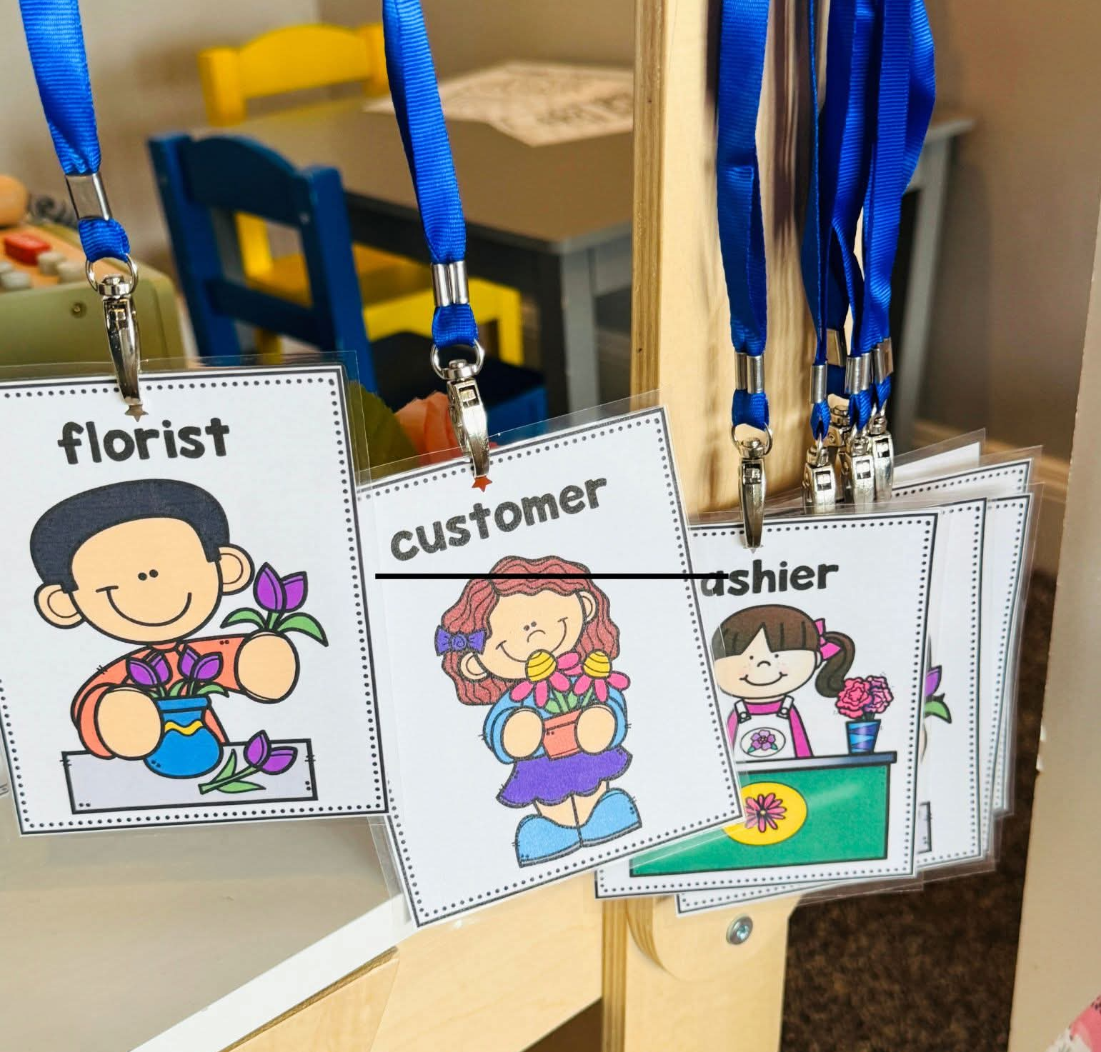
Why Early Childhood IS Workforce Development
What do children pretend to be when they play?

Slide 7
SC Early Learning Standards as the
Foundation for Career Readiness
SC Early Learning Standards build the foundation for career readiness by developing the early cognitive, social‑emotional, language, mathematical, and behavioral skills that evolve into the communication, collaboration, problem‑solving, and adaptability competencies demanded by South Carolina’s modern workforce.
Notes:
1. SC‑ELS Establish the Core Competencies Needed for Future Workplace Success
SC‑ELS outline developmental expectations across key domains—Approaches to Play & Learning, Emotional & Social Development, Language & Communication, Mathematical Thinking, Cognitive Development, and Health & Physical Development. These domains map tightly to the soft skills and foundational cognitive abilities employers identify as essential for long‑term workforce success, such as communication, collaboration, problem‑solving, self‑regulation, and early numeracy. [ed.sc.gov]
2. SC‑ELS Provide a Shared Vision for the Knowledge & Skills That Lead to Success in School and Life
The standards explicitly answer the question: “What foundational skills do children need to experience success in school?”—and those same skills are the building blocks of employability. By giving families, educators, and policymakers a common framework, SC‑ELS ensure consistency in building early skills that lead to later academic mastery and career preparedness. [ed.sc.gov]
These early skills support later mastery of South Carolina College‑ and Career‑Ready Standards in elementary and secondary school, creating a seamless pipeline from early childhood to workforce‑aligned competencies. [ed.sc.gov]
3. The Standards Build the Early Cognitive and Behavioral Skills That Become Essential Employment Skills (EES)
Workforce research shows that early cognitive and behavioral skills formed in ages 0–8 become the precursors to essential employment skills, including:
communication,
collaboration,
problem-solving,
planning & organization,
creative thinking, and
information literacy.
High‑quality early learning environments—guided by SC‑ELS—intentionally foster these skills, preparing children for the technical and interpersonal demands of future workplaces. [scfirststeps.org]
4. SC‑ELS Align With South Carolina’s Long‑Term Workforce Development Goals
The state’s academic standards in ELA, math, and science are explicitly designed to prepare students for economically viable career opportunities. SC‑ELS form the starting point of that trajectory by ensuring children enter school ready to access rigorous learning in later grades that leads to CTE pathways, STEM programs, apprenticeships, and postsecondary training. [ed.sc.gov]
5. SC‑ELS Strengthen Workforce Participation by Supporting Early Skill Development
High‑quality early learning guided by SC‑ELS not only develops future workers but also supports current workforce stability:
families can participate in the workforce when children are in high‑quality programs, and
children develop essential early competencies that predict long‑term employment outcomes.
The standards contribute to a statewide ecosystem that reduces long‑term skill gaps and supports South Carolina’s economic growth. [scfirststeps.org]

Slide 8
SC Early Learning Standards as the
Foundation for Career Readiness
How Play Supports Career Readiness
SC‑ELS Domains foster curiosity, persistence, and initiative—the early forms of innovation and problem‑solving.
Collaborative play builds teamwork, empathy, negotiation, and other interpersonal skills needed in today’s workplaces.
Notes:
Key Message:
Play‑based learning isn’t just developmentally appropriate—it is directly aligned with the skills today’s and tomorrow’s workforce demands.
Why Play = Workforce Preparation
Play naturally strengthens communication, collaboration, problem‑solving, creativity, and flexible thinking—the same Essential Employment Skills (EES) workforce researchers identify as critical for jobs by 2035. [cscce.berkeley.edu]
Through hands‑on, exploratory activities, children practice planning, organization, information processing, and independent decision‑making, all foundational to technical learning later in CTE and STEM pathways. [developing...arvard.edu]
How Play-Based Learning Connects to Career Readiness
Approaches to Play & Learning in SC‑ELS directly support curiosity, persistence, and initiative—early versions of innovation and problem‑solving skills that employers consistently rank as essential. [earlychildhoodsc.org]
Social and emotional competencies developed through collaborative play (negotiation, empathy, teamwork) map to the interpersonal skills today’s workforce requires. [unicef.org]
Why This Matters for South Carolina
A workforce-ready pipeline begins long before kindergarten; play builds the cognitive and behavioral architecture that remains stable over time and predicts later employment success. [unicef.org]
NFER research shows that early cognitive and behavioral skills are direct precursors to employability skills, and addressing skill gaps early prevents long-term workforce shortages. [cscce.berkeley.edu]
Bottom Line for the Audience
Play-based learning isn’t “extra” — it is the instructional method that best prepares young children for the complex, adaptive, team‑based work environments they will enter in South Carolina’s future economy.

Slide 9
SC Early Learning Standards as the
Foundation for Career Readiness
How SC ELS Support Career Readiness: Play is the vehicle; standards are the destination.
Domains of Development
Approaches to Play and Learning (APL)
Emotional and Social Development (ESD)
Health and Physical Development (HPD)
Language Development and Communication (LDC)
Mathematical Thinking and Expression (MTE)
Cognitive Development (CD)
Notes:
Highlight that:
Children are pretending, experimenting, and collaborating during purposefully planned play experiences
The play is child‑led but teacher‑supported
“When children engage in this type of play, they are exploring real‑world roles in a way that makes sense for their development.”
Briefly name key domains (do not list all):
Approaches to Learning
Children plan, persist, and problem‑solve during play
Language Development & Communication
They use new vocabulary and explain their thinking
Social & Emotional Development
They negotiate roles, take turns, and work together
Reassure Teachers
Make this point clearly and directly:
“This does not require a new lesson or extra planning time.”
Teachers are already doing this
The shift is being intentional:
Naming the career/career cluster
Adding related materials
Asking purposeful questions

Slide 10
Play Based Learning as a Workforce-Aligned Instructional Approach
Why Play = Workforce Preparation
Builds communication, collaboration, problem‑solving, creativity, and flexible thinking—skills identified as essential for jobs by 2035.
Strengthens planning, organization, information processing, and independent decision‑making, which support later STEM and CTE learning.
Notes:
Key Message:
Play‑based learning isn’t just developmentally appropriate—it is directly aligned with the skills today’s and tomorrow’s workforce demands.
Why Play = Workforce Preparation
Play naturally strengthens communication, collaboration, problem‑solving, creativity, and flexible thinking—the same Essential Employment Skills (EES) workforce researchers identify as critical for jobs by 2035. [cscce.berkeley.edu]
Through hands‑on, exploratory activities, children practice planning, organization, information processing, and independent decision‑making, all foundational to technical learning later in CTE and STEM pathways. [developing...arvard.edu]
How Play-Based Learning Connects to Career Readiness
Approaches to Play & Learning in SC‑ELS directly support curiosity, persistence, and initiative—early versions of innovation and problem‑solving skills that employers consistently rank as essential. [earlychildhoodsc.org]
Social and emotional competencies developed through collaborative play (negotiation, empathy, teamwork) map to the interpersonal skills today’s workforce requires. [unicef.org]
Why This Matters for South Carolina
A workforce-ready pipeline begins long before kindergarten; play builds the cognitive and behavioral architecture that remains stable over time and predicts later employment success. [unicef.org]
NFER research shows that early cognitive and behavioral skills are direct precursors to employability skills, and addressing skill gaps early prevents long-term workforce shortages. [cscce.berkeley.edu]
Bottom Line for the Audience
Play-based learning isn’t “extra” — it is the instructional method that best prepares young children for the complex, adaptive, team‑based work environments they will enter in South Carolina’s future economy.

Slide 11
Play Based Learning as a Workforce-Aligned Instructional Approach
What High-Quality Play Looks Like in 4K
Child-initiated
Open-ended materials
Teacher as facilitator (questioning, modeling vocabulary)
Reflection and conversation
Notes:
Key Message:
Play‑based learning isn’t just developmentally appropriate—it is directly aligned with the skills today’s and tomorrow’s workforce demands.
Why Play = Workforce Preparation
Play naturally strengthens communication, collaboration, problem‑solving, creativity, and flexible thinking—the same Essential Employment Skills (EES) workforce researchers identify as critical for jobs by 2035. [cscce.berkeley.edu]
Through hands‑on, exploratory activities, children practice planning, organization, information processing, and independent decision‑making, all foundational to technical learning later in CTE and STEM pathways. [developing...arvard.edu]
How Play-Based Learning Connects to Career Readiness
Approaches to Play & Learning in SC‑ELS directly support curiosity, persistence, and initiative—early versions of innovation and problem‑solving skills that employers consistently rank as essential. [earlychildhoodsc.org]
Social and emotional competencies developed through collaborative play (negotiation, empathy, teamwork) map to the interpersonal skills today’s workforce requires. [unicef.org]
Why This Matters for South Carolina
A workforce-ready pipeline begins long before kindergarten; play builds the cognitive and behavioral architecture that remains stable over time and predicts later employment success. [unicef.org]
NFER research shows that early cognitive and behavioral skills are direct precursors to employability skills, and addressing skill gaps early prevents long-term workforce shortages. [cscce.berkeley.edu]
Bottom Line for the Audience
Play-based learning isn’t “extra” — it is the instructional method that best prepares young children for the complex, adaptive, team‑based work environments they will enter in South Carolina’s future economy.

Slide 12
Play Based Learning as a Workforce-Aligned Instructional Approach
Activity:
Match a play center (blocks, dramatic play, art, sensory) to a standard and Career Cluster (Agriculture, Food & Natural Resources, Architecture & Construction, STEM, Hospitality & Tourism, etc.)

Slide 13
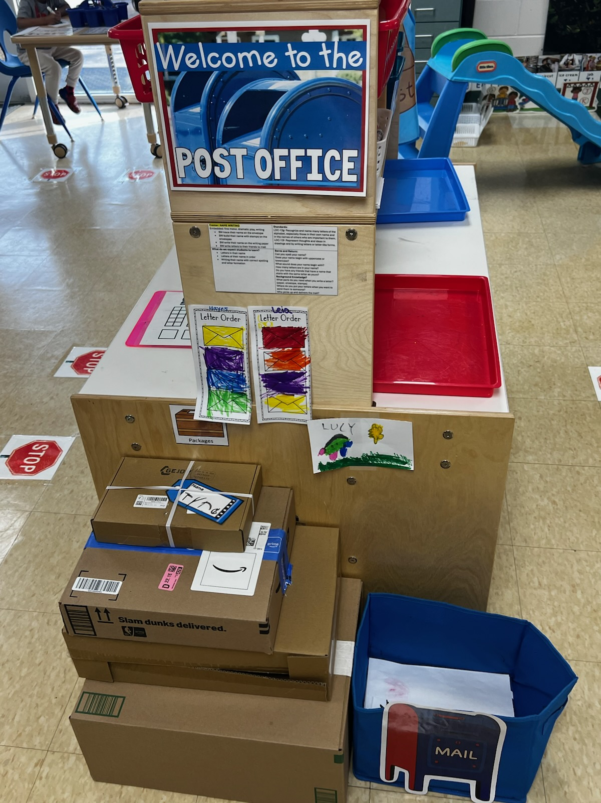
Play Based Learning as a Workforce-Aligned Instructional Approach
Notes:
Writing Center=Transportation/Logisitics

Slide 14
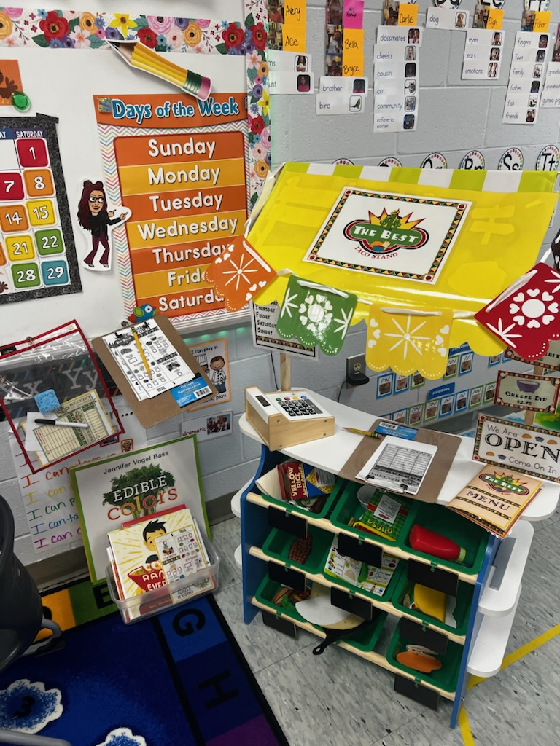
Play Based Learning as a Workforce-Aligned Instructional Approach
Notes:
Dramatic Play Taco Stand=Hospitality & Tourism, Marketing, Agriculture, Food & Natural Resources, Business Management

Slide 15
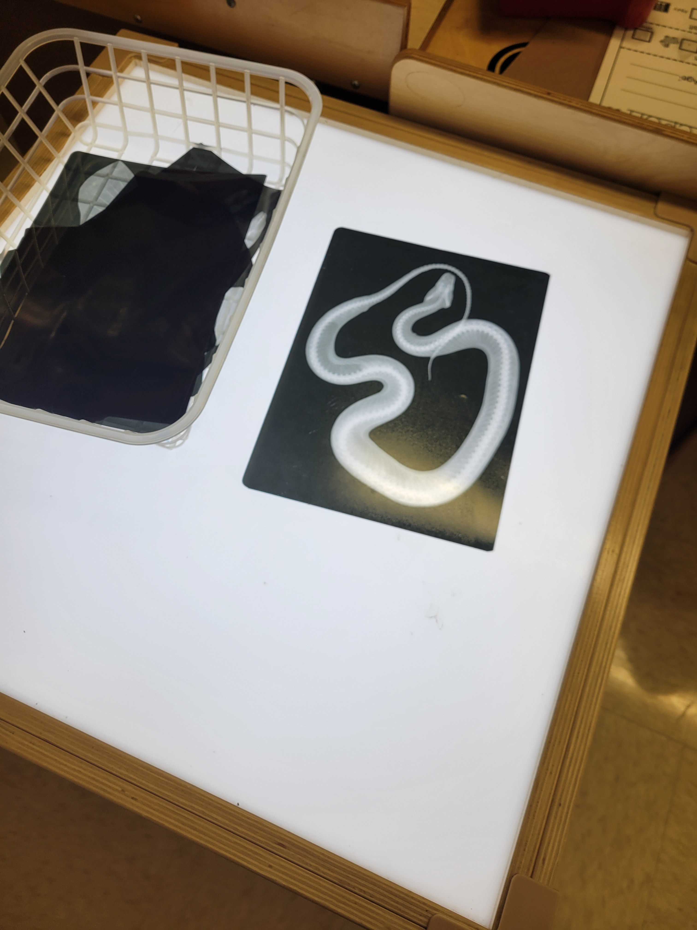
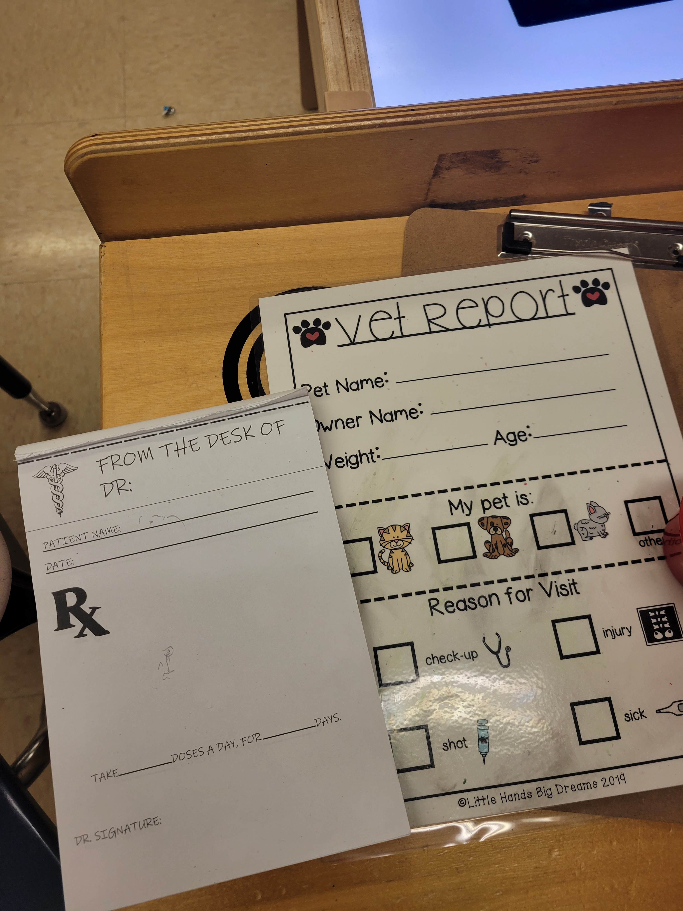
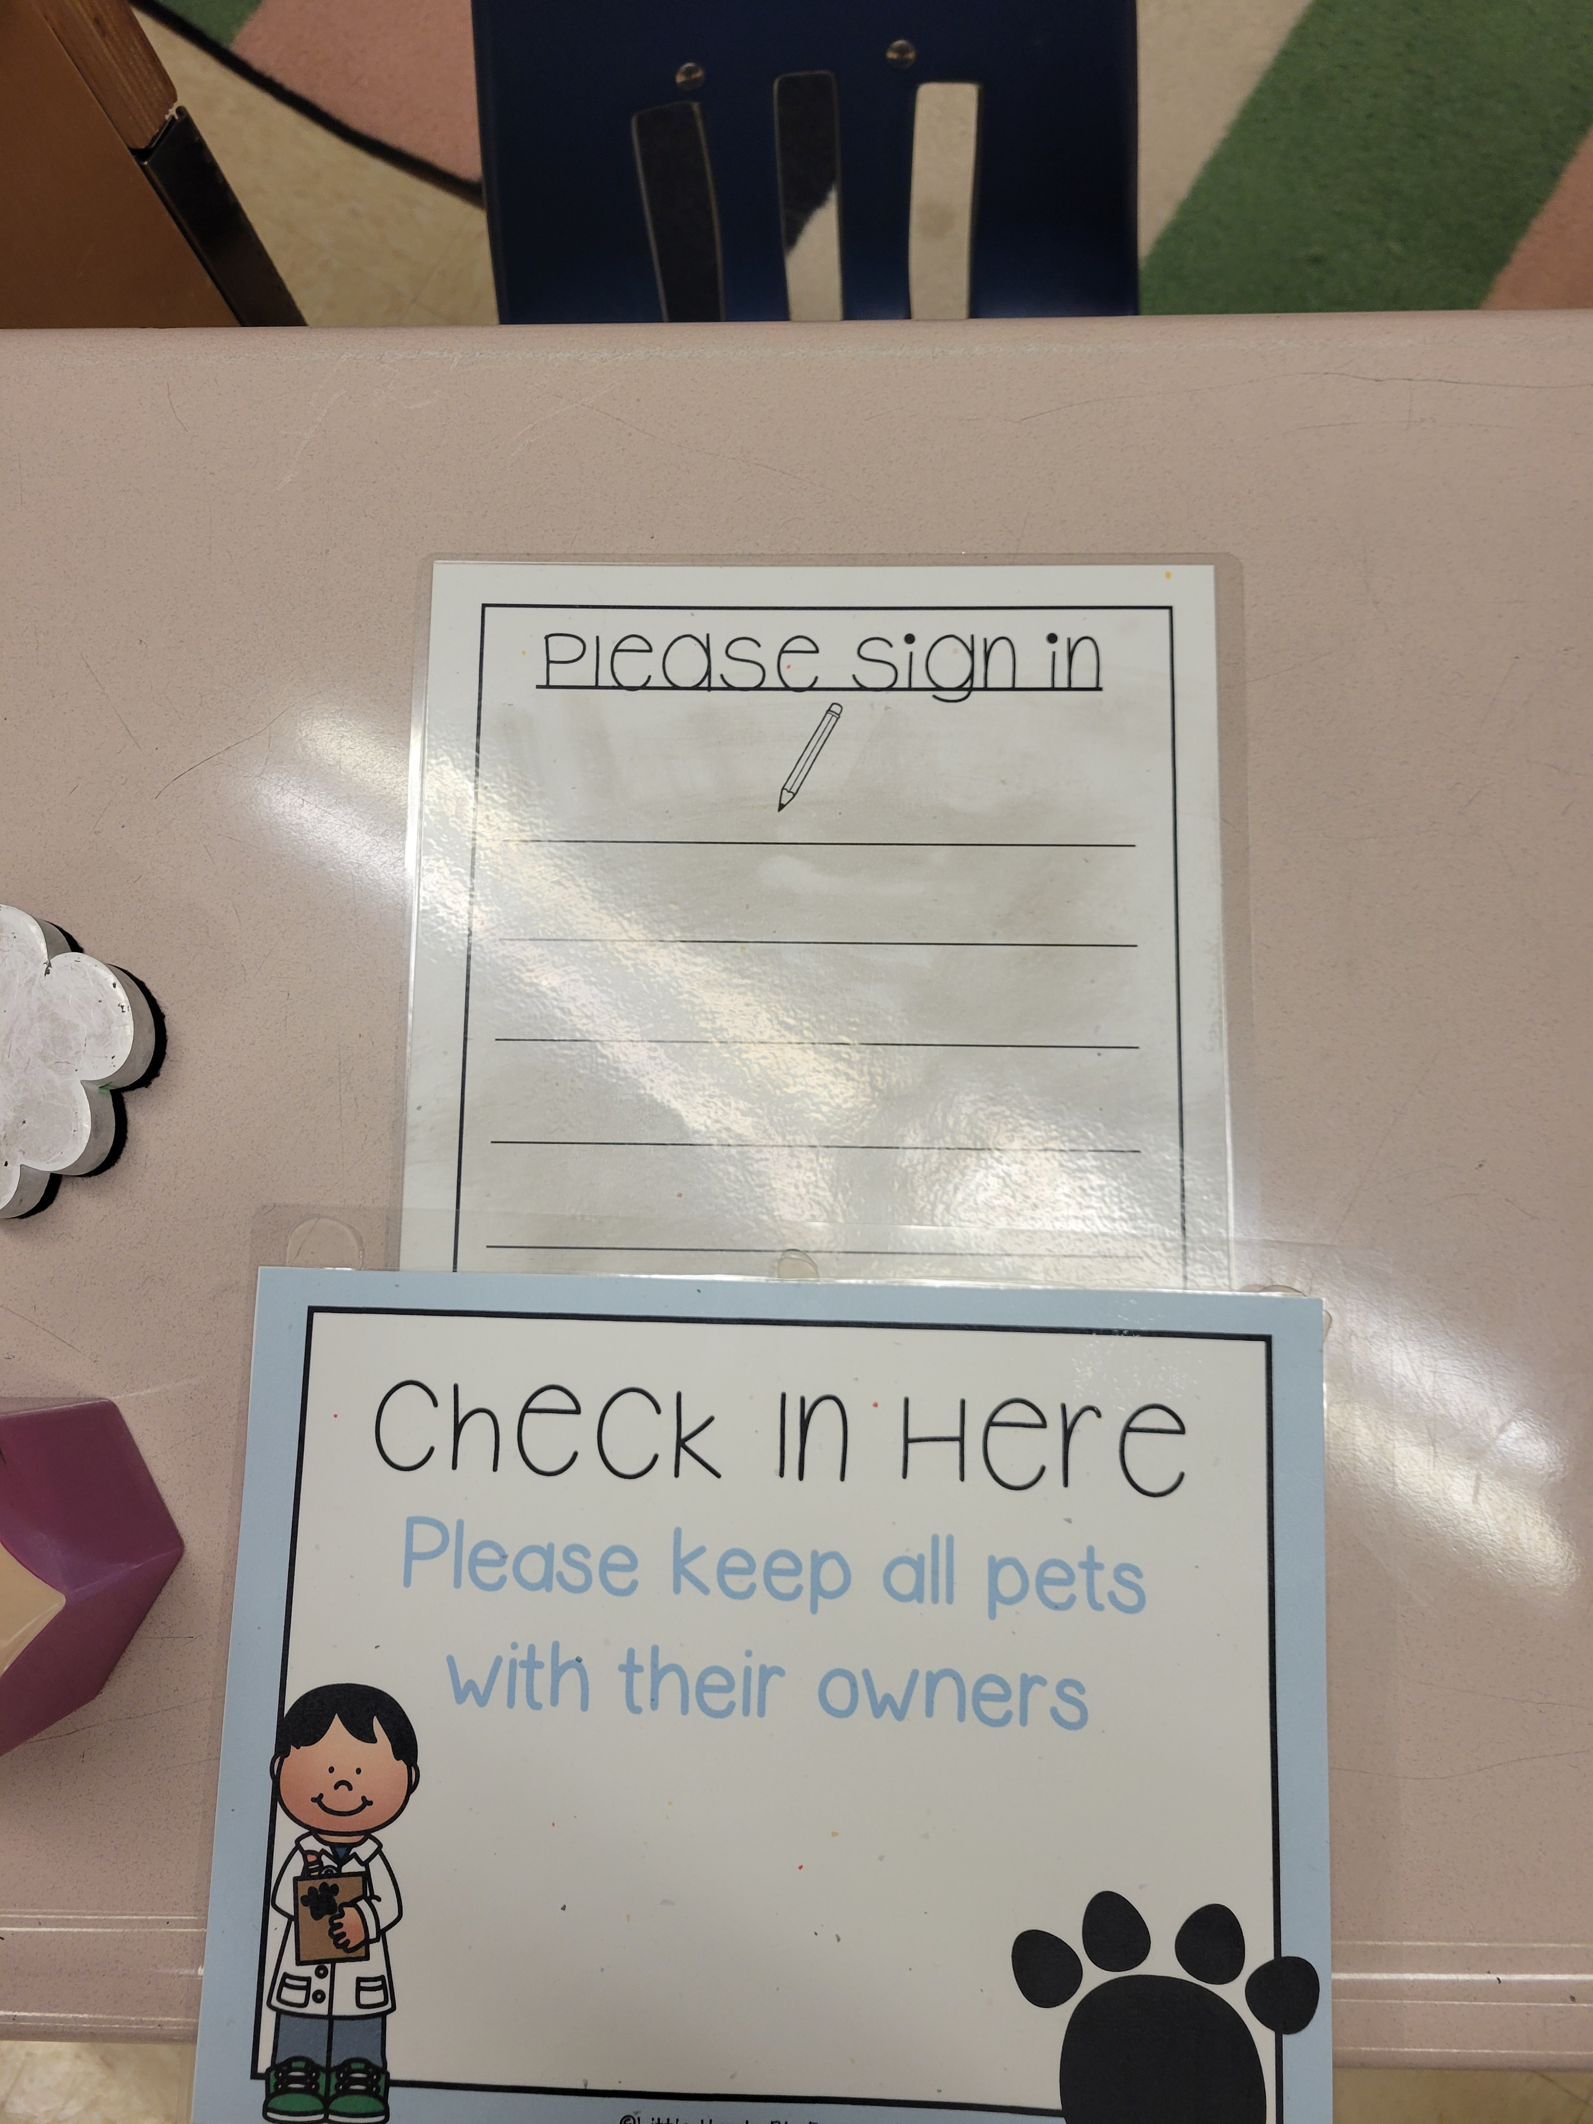
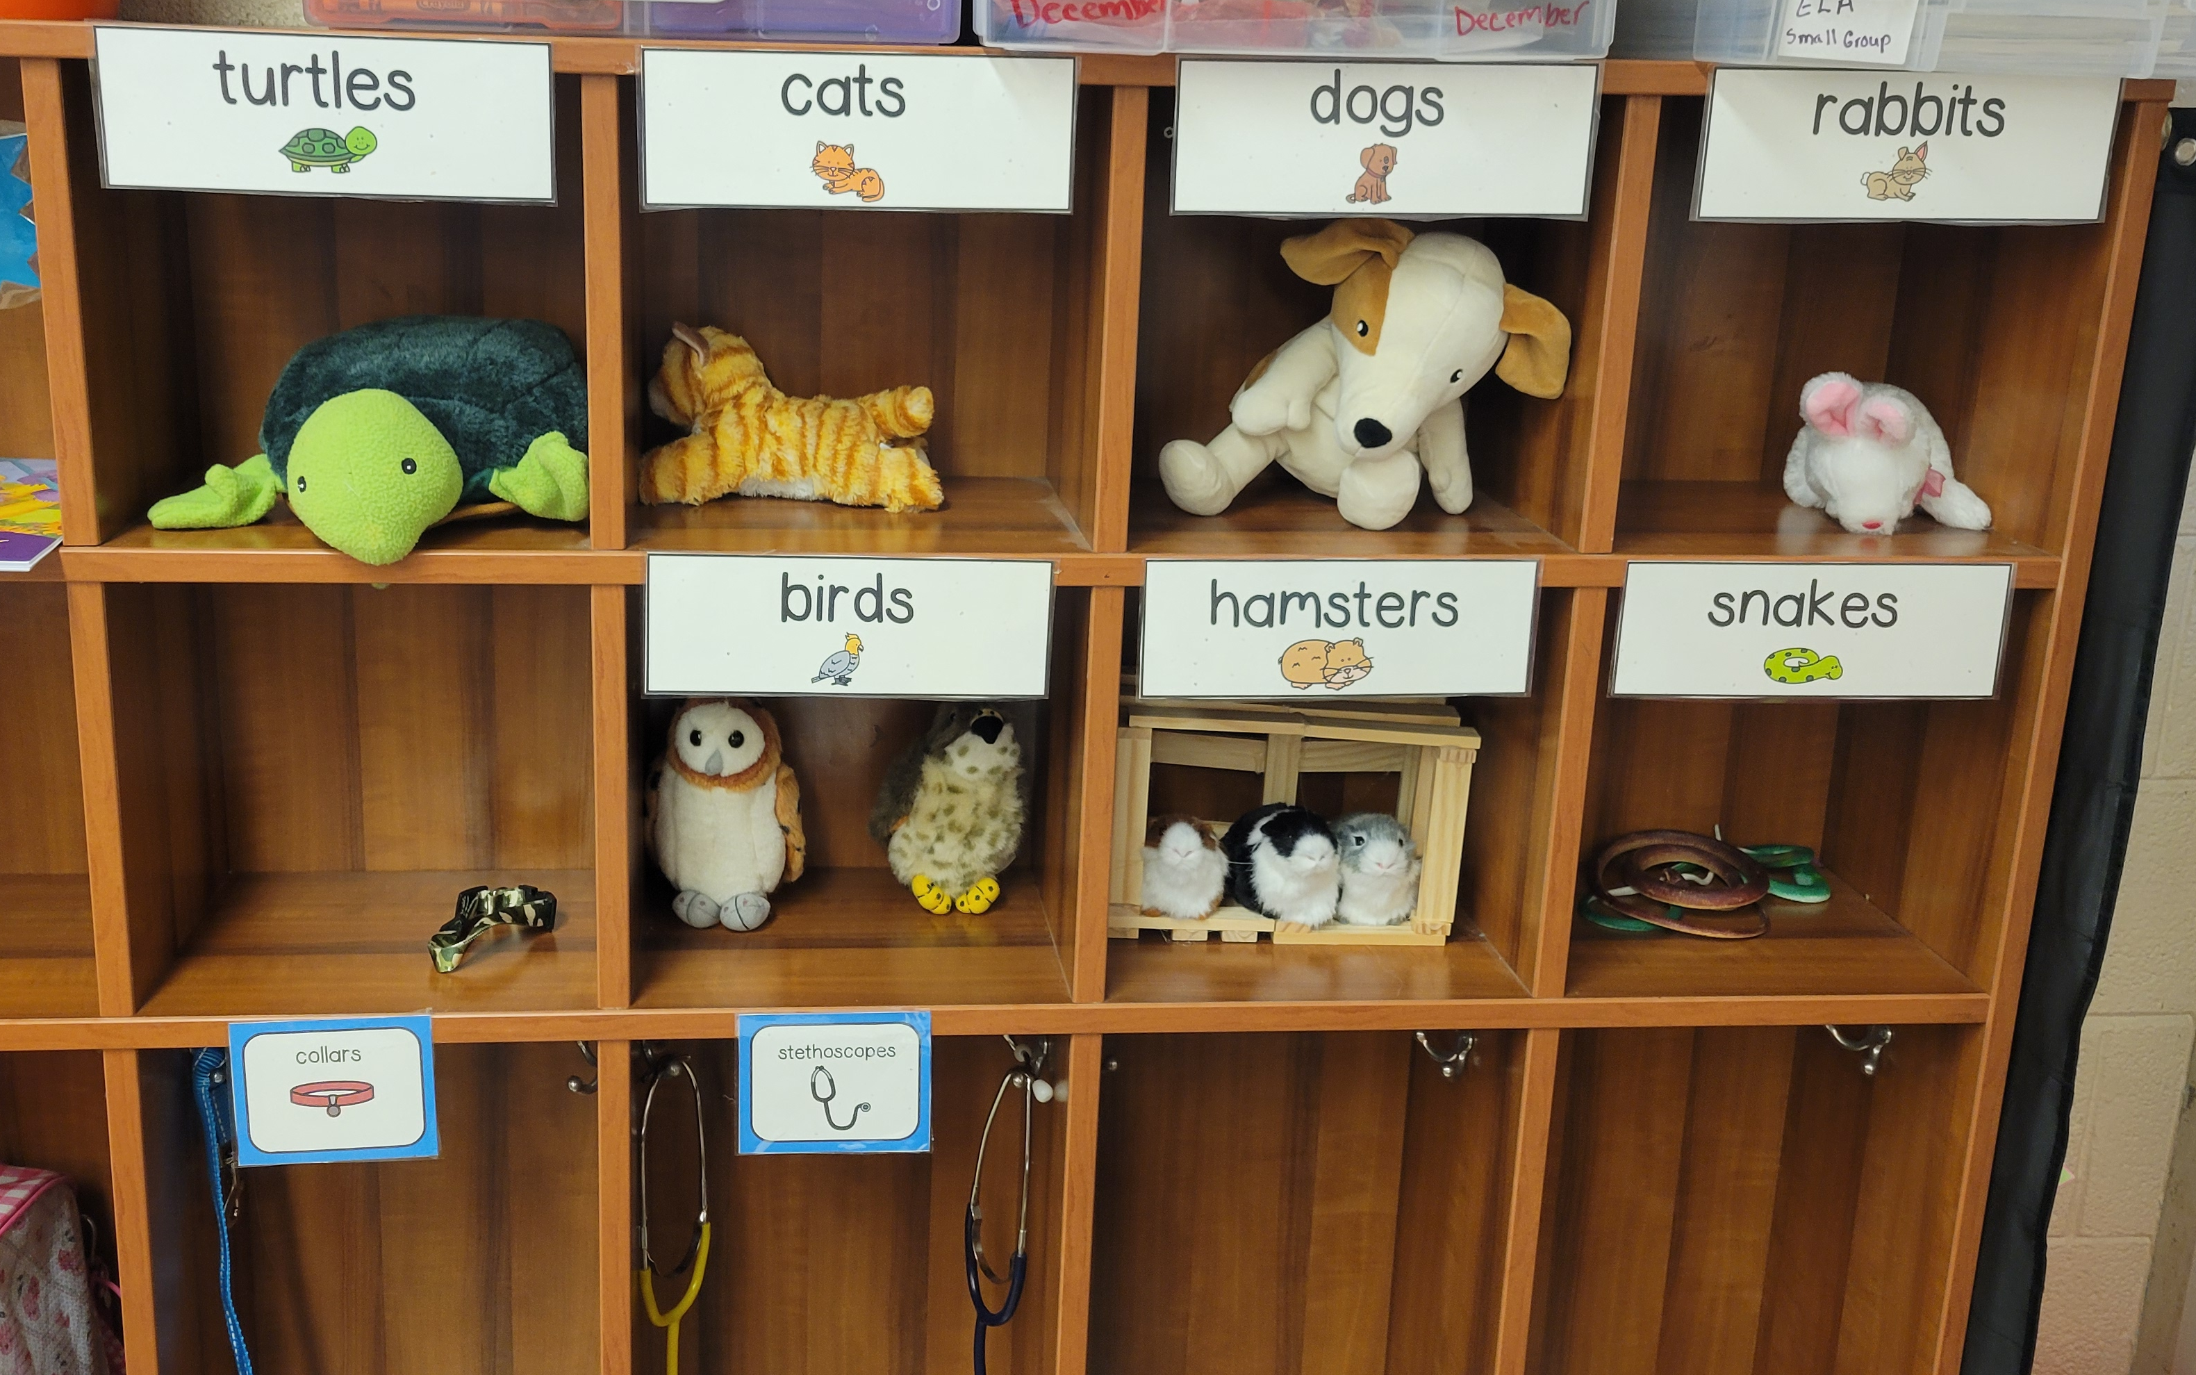
Play Based Learning as a Workforce-Aligned Instructional Approach
Notes:
Dramatic Play Vet Clinic=Agriculture, Food & Natural Resources, Business Management, Health Science, Marketing

Slide 16
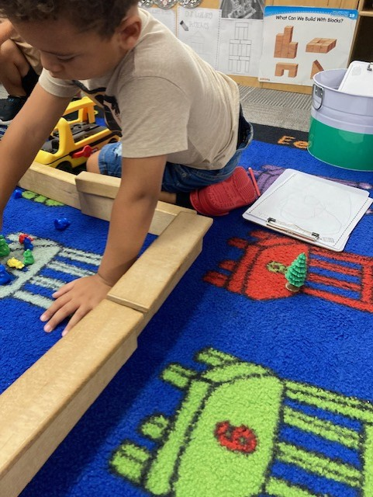
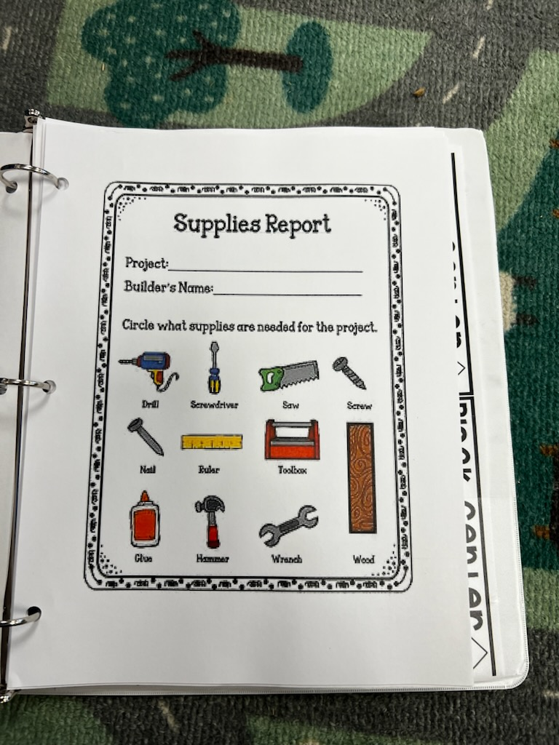
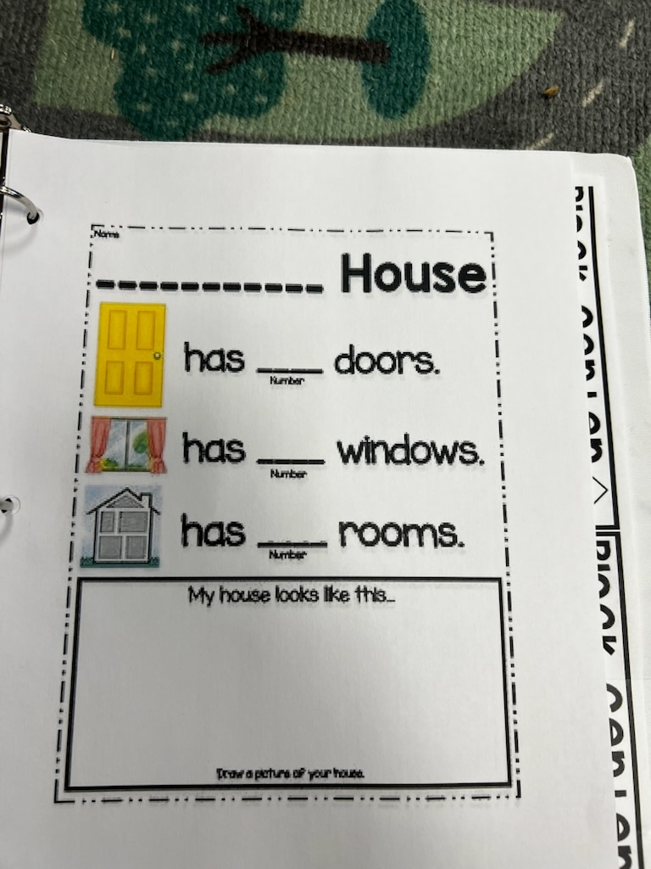
Play Based Learning as a Workforce-Aligned Instructional Approach
Notes:
Block Center=STEM, Transportation & Logistics, Architecture & Construction

Slide 17
Play Based Learning as a Workforce-Aligned Instructional Approach
Why This Matters for South Carolina
Early play experiences shape cognitive and behavioral development that predicts long‑term employability.
Addressing early skill gaps through play helps prevent future workforce shortages and strengthens the state’s talent pipeline.
Notes:
Key Message:
Play‑based learning isn’t just developmentally appropriate—it is directly aligned with the skills today’s and tomorrow’s workforce demands.
Why Play = Workforce Preparation
Play naturally strengthens communication, collaboration, problem‑solving, creativity, and flexible thinking—the same Essential Employment Skills (EES) workforce researchers identify as critical for jobs by 2035. [cscce.berkeley.edu]
Through hands‑on, exploratory activities, children practice planning, organization, information processing, and independent decision‑making, all foundational to technical learning later in CTE and STEM pathways. [developing...arvard.edu]
How Play-Based Learning Connects to Career Readiness
Approaches to Play & Learning in SC‑ELS directly support curiosity, persistence, and initiative—early versions of innovation and problem‑solving skills that employers consistently rank as essential. [earlychildhoodsc.org]
Social and emotional competencies developed through collaborative play (negotiation, empathy, teamwork) map to the interpersonal skills today’s workforce requires. [unicef.org]
Why This Matters for South Carolina
A workforce-ready pipeline begins long before kindergarten; play builds the cognitive and behavioral architecture that remains stable over time and predicts later employment success. [unicef.org]
NFER research shows that early cognitive and behavioral skills are direct precursors to employability skills, and addressing skill gaps early prevents long-term workforce shortages. [cscce.berkeley.edu]
Bottom Line for the Audience
Play-based learning isn’t “extra” — it is the instructional method that best prepares young children for the complex, adaptive, team‑based work environments they will enter in South Carolina’s future economy.

Slide 18
Play Based Learning as a Workforce-Aligned Instructional Approach
Research-Aligned Benefits:
--Deep learning through authentic engagement
--Exploration that builds flexible thinking
--Long-term knowledge retention

Slide 19
Play Based Learning as a Workforce-Aligned Instructional Approach
Play-Based Practices That Build Career Skills
• Industry-themed centers: construction, health, etc.
• Dramatic play tied to real-world roles
• Engineering play (ramps, blocks, simple machines)
• Collaborative problem-solving tasks
Notes:
“This is a strong example of how multiple SC ELS domains are addressed at the same time through purposeful play.”

Slide 20
Play Based Learning as a Workforce-Aligned Instructional Approach
Agriculture, Food & Natural Resources:
Garden center, farmers’ market, animal care, etc.
SC ELS Indicators
Approaches to Learning: Shows curiosity and eagerness to explore living things and environments
Cognitive Development – Science: Observes, compares, and describes plants, animals, and natural materials
Social & Emotional Development: Demonstrates responsibility for materials and living things
Language & Communication: Uses descriptive language to explain observations

Slide 21
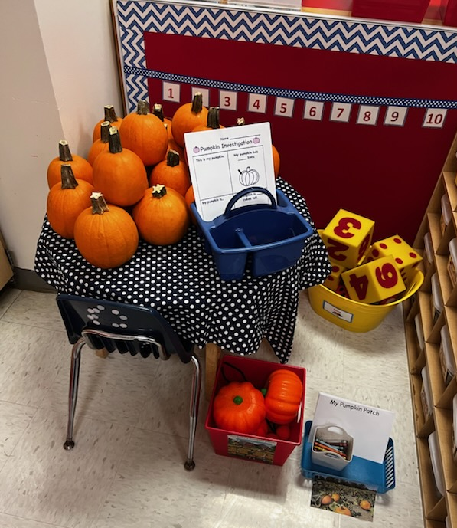
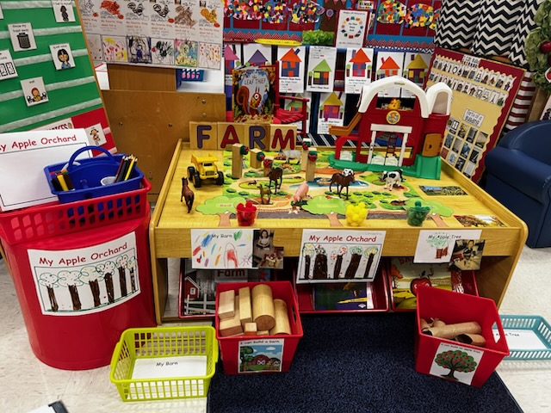
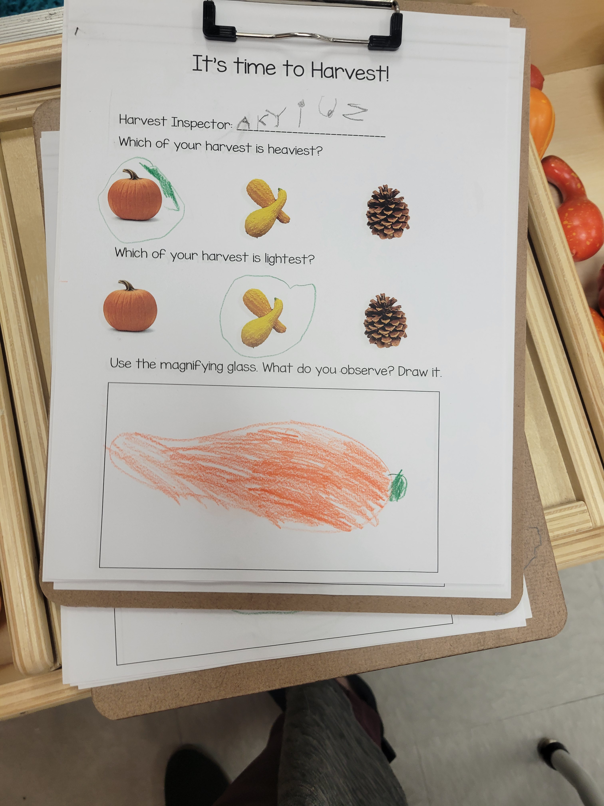
Play Based Learning as a Workforce-Aligned Instructional Approach
Agriculture, Food & Natural Resources:

Slide 22
Play Based Learning as a Workforce-Aligned Instructional Approach
Architecture & Construction
Block building, blueprint drawing, tool exploration
SC ELS Indicators
Approaches to Learning: Plans, persists, and problem-solves during building activities
Cognitive Development – Math: Demonstrates spatial awareness, shapes, and measurement concepts
Physical Development: Uses fine motor skills and hand‑eye coordination when building
Social & Emotional Development: Works cooperatively with peers to complete structures

Slide 23
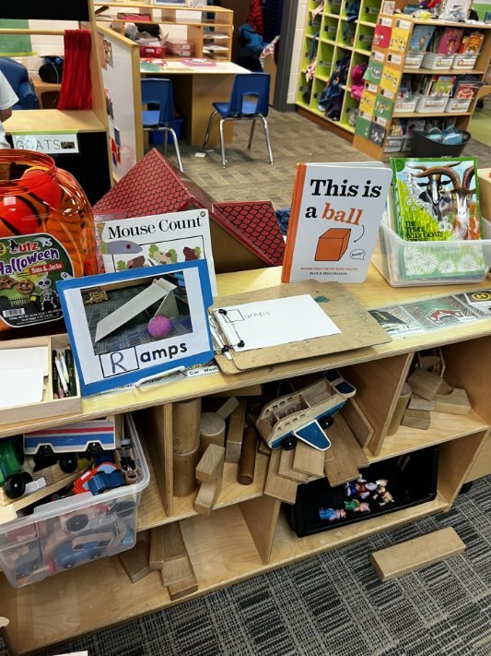
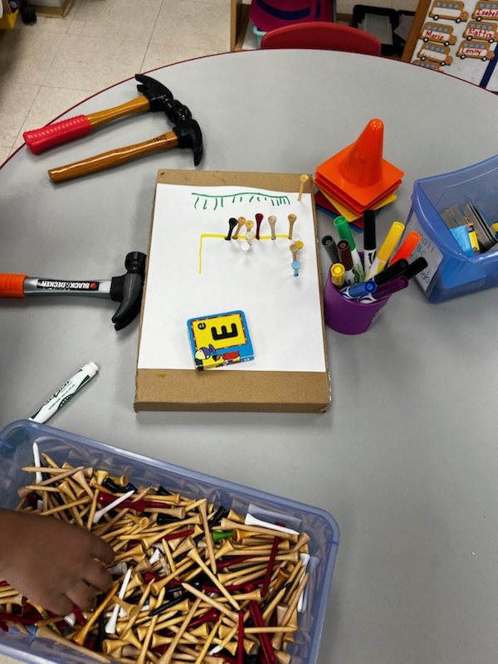
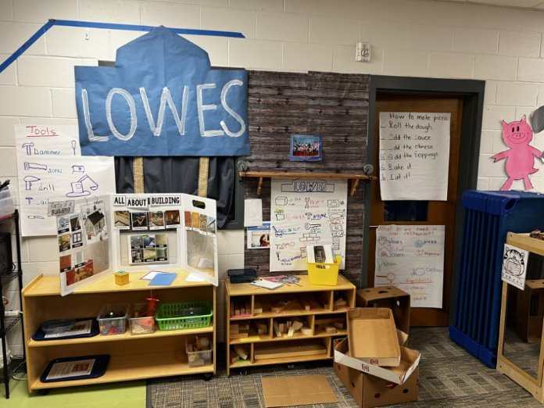
Play Based Learning as a Workforce-Aligned Instructional Approach
Architecture & Construction

Slide 24
Play Based Learning as a Workforce-Aligned Instructional Approach
Arts, AV Technology & Communications
Music, art studio, puppet shows, class news station
SC ELS Indicators
Creative Expression: Uses art, music, movement, and drama to communicate ideas
Language & Communication: Expresses thoughts, stories, and emotions through multiple modes
Approaches to Learning: Shows initiative and creativity in representing ideas
Social & Emotional Development: Builds confidence by sharing creative work

Slide 25
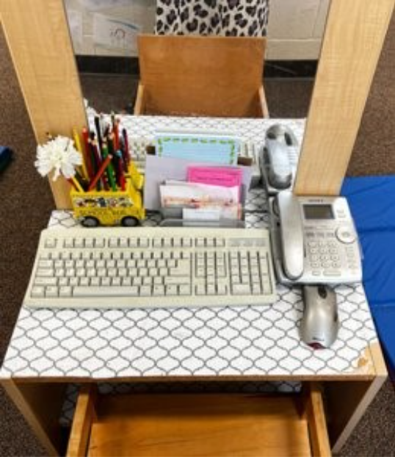
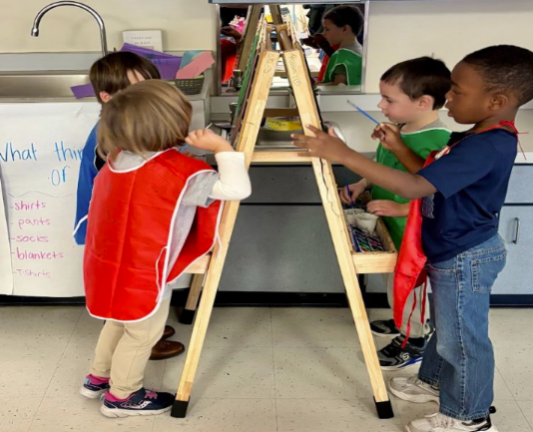
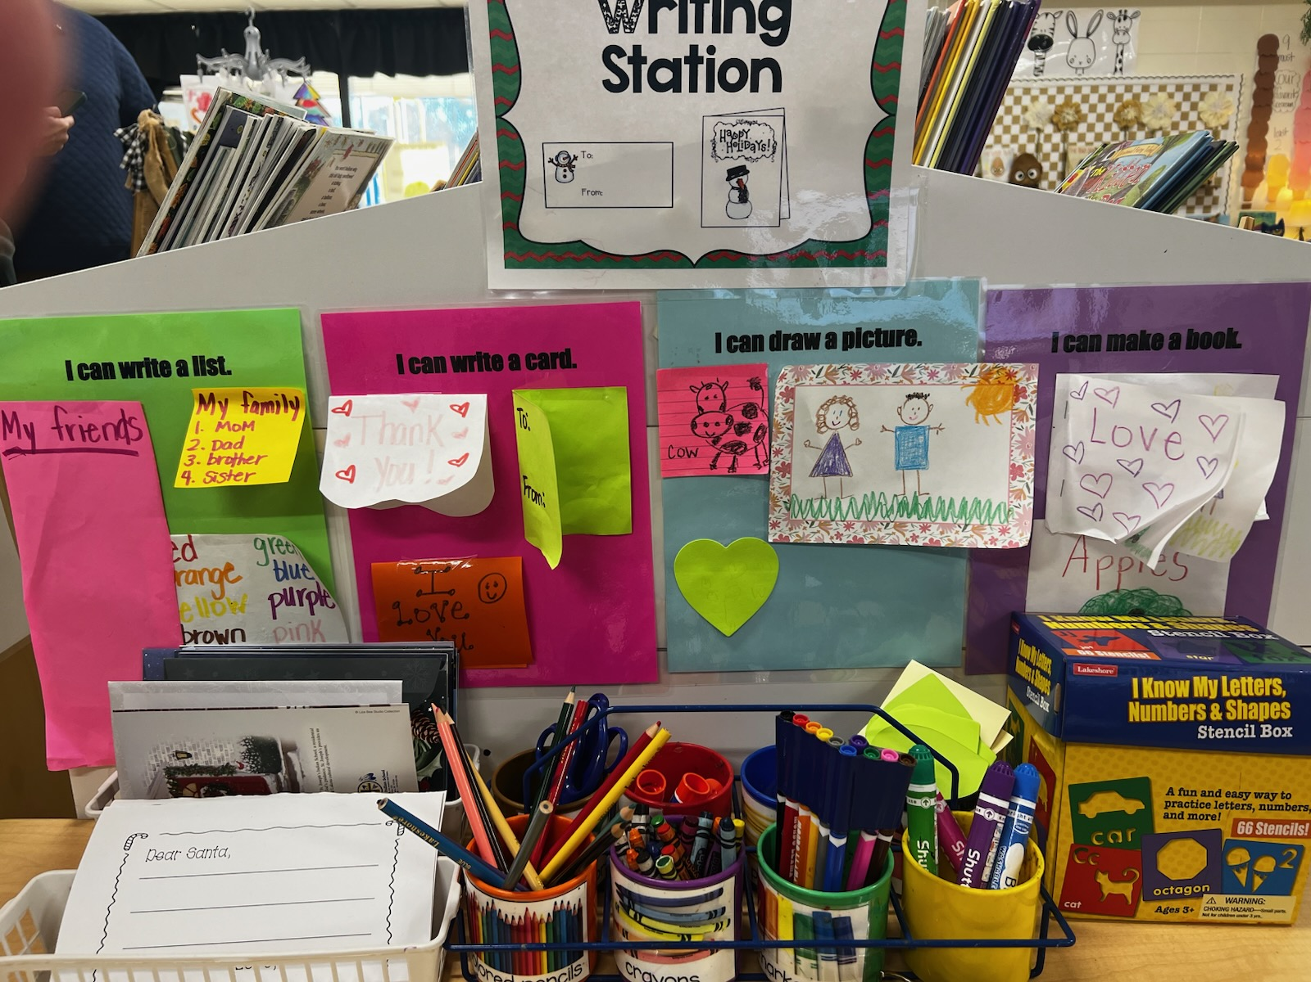
Play Based Learning as a Workforce-Aligned Instructional Approach
Arts, AV Technology & Communications

Slide 26
Play Based Learning as a Workforce-Aligned Instructional Approach
Business Management & Administration
Store, classroom jobs, pretend office
SC ELS Indicators
Approaches to Learning: Demonstrates organization and planning during role play
Cognitive Development – Math: Counts, sorts, and uses numbers in meaningful contexts
Social & Emotional Development: Takes leadership roles and follows classroom expectations
Language & Communication: Engages in purposeful conversations to solve problems

Slide 27

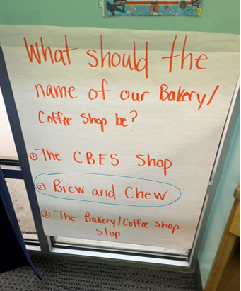
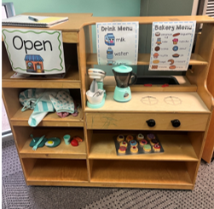
Play Based Learning as a Workforce-Aligned Instructional Approach
Business Management & Administration
Store, classroom jobs, pretend office

Slide 28
Play Based Learning as a Workforce-Aligned Instructional Approach
Education & Training
"Classroom within a classroom,” role-playing teachers
SC ELS Indicators
Language & Communication: Speaks clearly and listens attentively to others
Social & Emotional Development: Demonstrates empathy and supports peers
Approaches to Learning: Shows initiative and confidence in leading play
Cognitive Development: Demonstrates understanding by explaining ideas to others

Slide 29
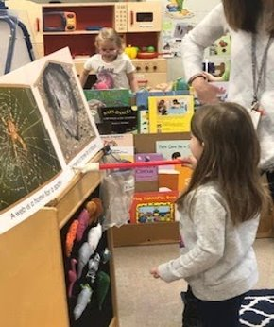
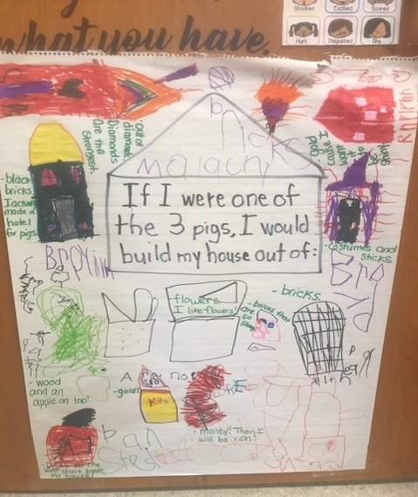
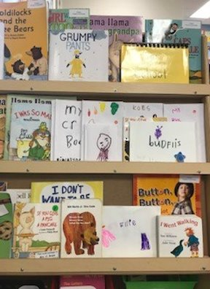
Play Based Learning as a Workforce-Aligned Instructional Approach
Education & Training

Slide 30
Play Based Learning as a Workforce-Aligned Instructional Approach
Finance
Pretend bank, shopping, saving jars
SC ELS Indicators
Language & Communication: Speaks clearly and listens attentively to others
Social & Emotional Development: Demonstrates empathy and supports peers
Approaches to Learning: Shows initiative and confidence in leading play
Cognitive Development: Demonstrates understanding by explaining ideas to others

Slide 31
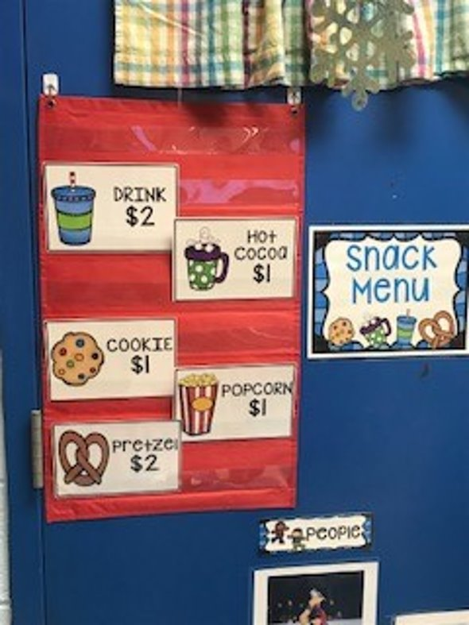
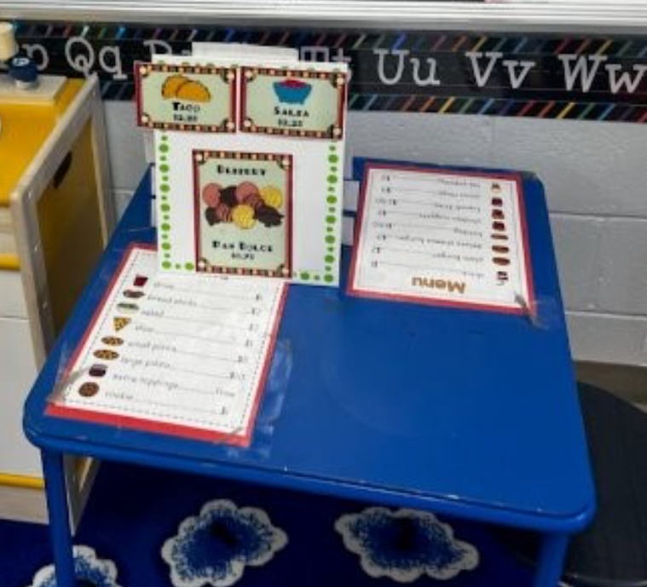

Play Based Learning as a Workforce-Aligned Instructional Approach
Finance
Pretend bank, shopping, saving jars

Slide 32
Play Based Learning as a Workforce-Aligned Instructional Approach
Health Science
Doctor’s office, hospital, wellness center
SC ELS Indicators
Health & Physical Development: Demonstrates healthy habits and body awareness
Language & Communication: Uses vocabulary related to health and the human body
Social & Emotional Development: Shows care and concern for others
Cognitive Development – Science: Understands basic cause‑and‑effect related to health

Slide 33
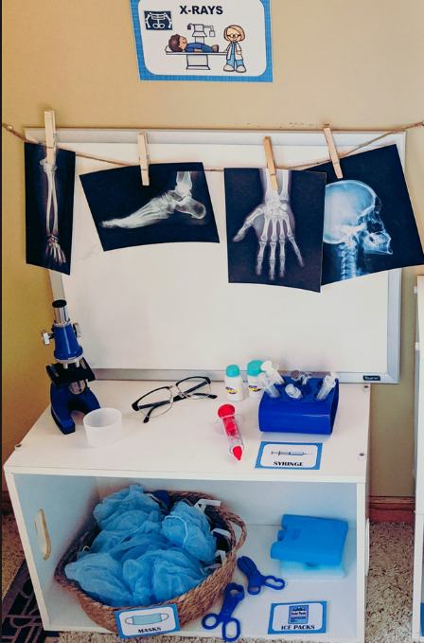
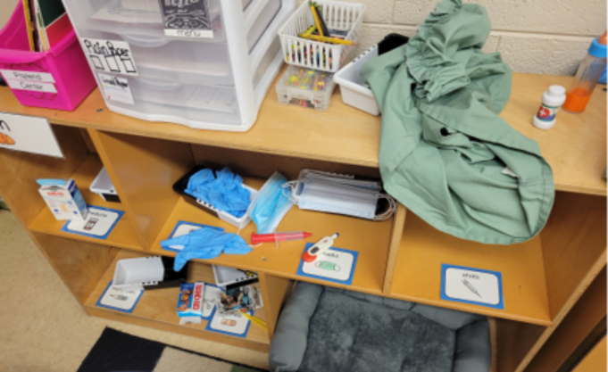
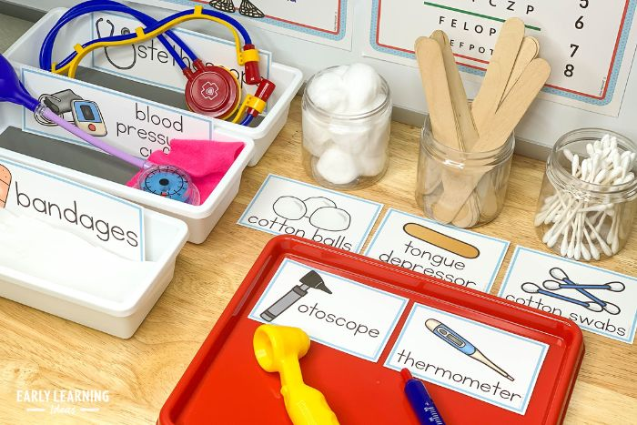
Play Based Learning as a Workforce-Aligned Instructional Approach
Health Science

Slide 34
Play Based Learning as a Workforce-Aligned Instructional Approach
Hospitality & Tourism
Restaurant, hotel, travel center
SC ELS Indicators
Social & Emotional Development: Demonstrates positive social skills and cooperation
Language & Communication: Engages in role‑play conversations using courteous language
Approaches to Learning: Follows routines and sequences events
Cognitive Development: Understands roles and responsibilities in a community setting

Slide 35
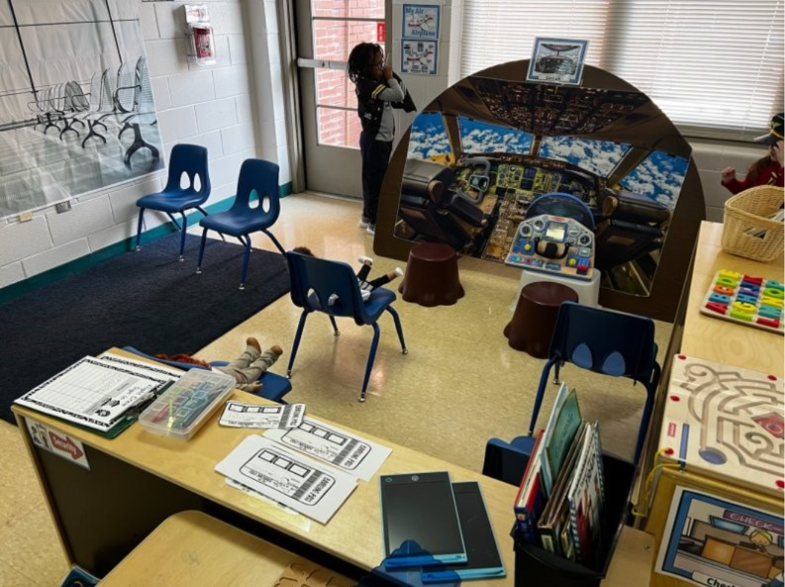
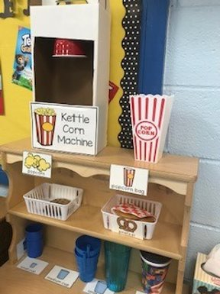
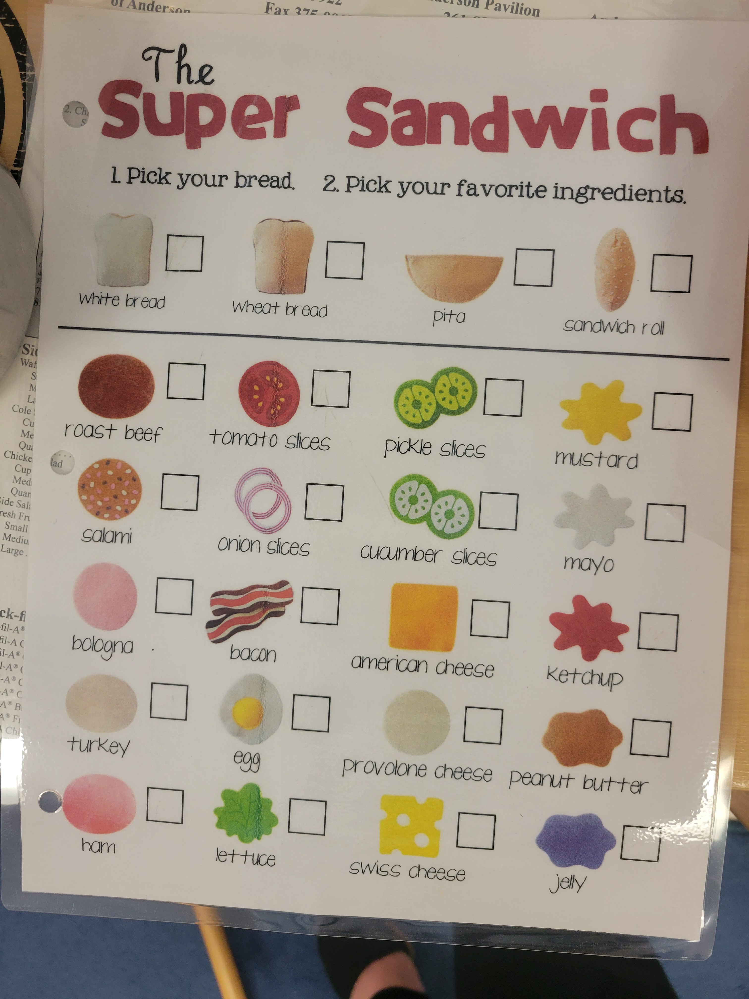
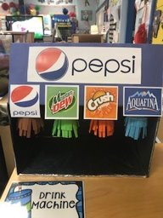
Play Based Learning as a Workforce-Aligned Instructional Approach
Hospitality & Tourism
Restaurant, hotel, travel center

Slide 36
Play Based Learning as a Workforce-Aligned Instructional Approach
Human Services
Family center, childcare, helpers role-play
SC ELS Indicators
Social & Emotional Development: Identifies emotions and responds empathetically
Language & Communication: Uses words to express feelings and needs
Approaches to Learning: Shows initiative in helping behaviors
Cognitive Development: Demonstrates understanding of family and community roles

Slide 37
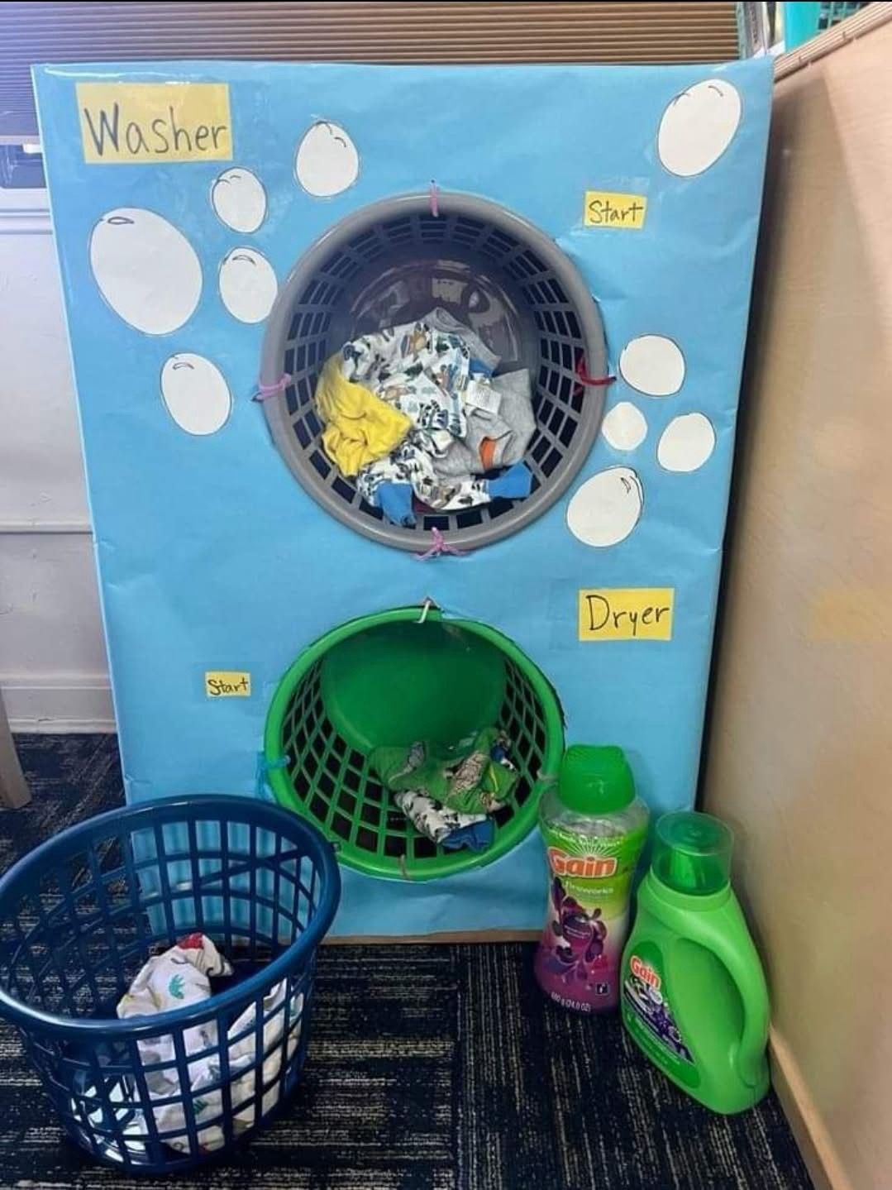
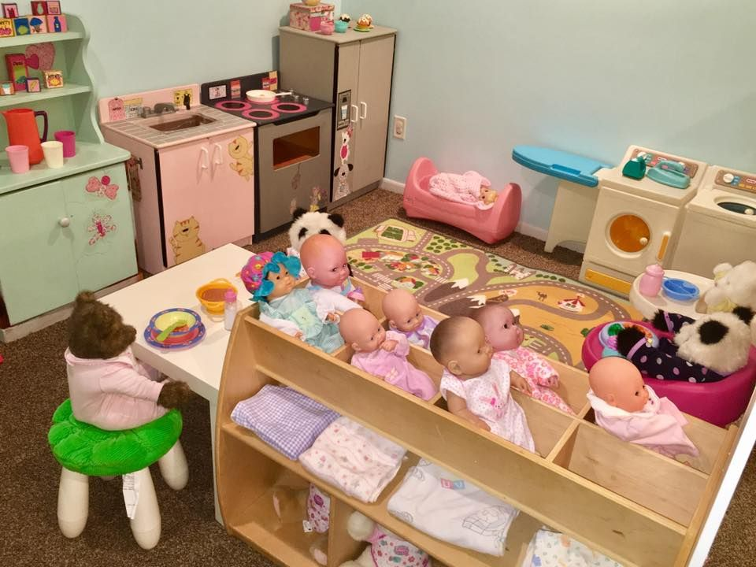
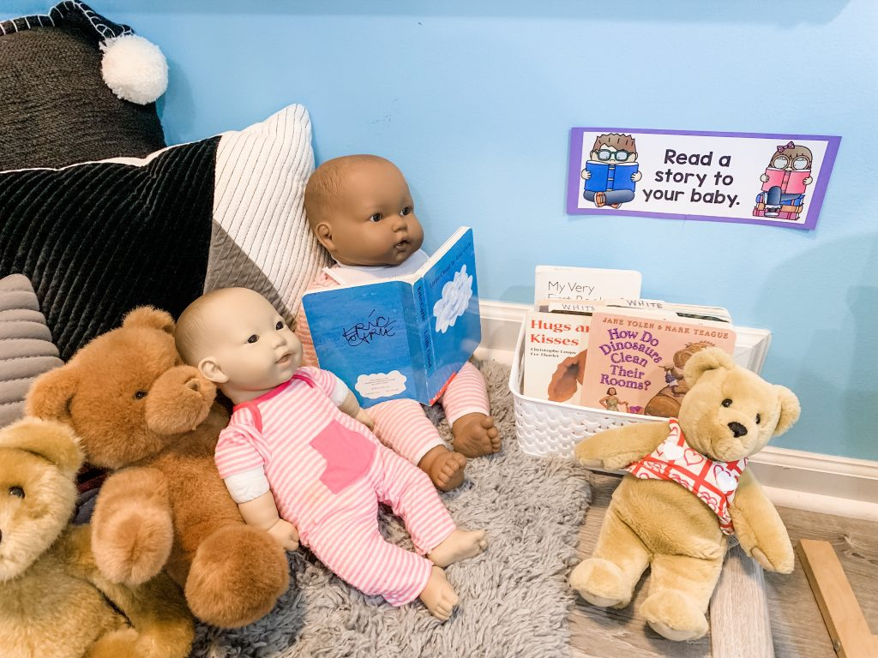
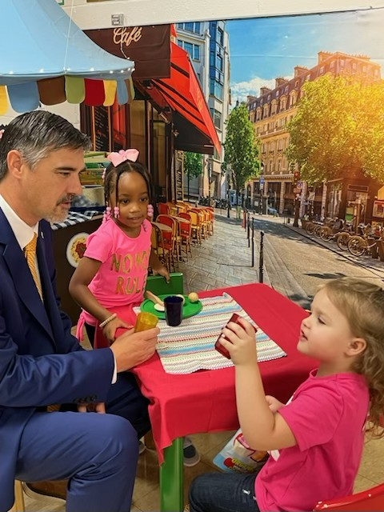
Play Based Learning as a Workforce-Aligned Instructional Approach
Human Services
Family center, childcare, helpers role-play

Slide 38
Play Based Learning as a Workforce-Aligned Instructional Approach
Information Technology
Pretend computers, coding toys, digital storytelling
SC ELS Indicators
Approaches to Learning: Uses logical thinking to solve problems
Cognitive Development – Math/Logic: Recognizes patterns and sequences
Language & Communication: Uses appropriate vocabulary to describe processes
Technology Use: Uses tools appropriately under adult guidance

Slide 39
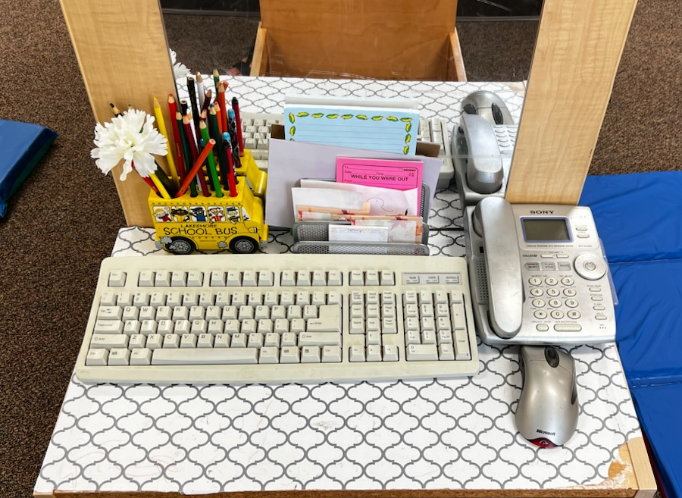
Play Based Learning as a Workforce-Aligned Instructional Approach
Information Technology
Pretend computers, coding toys, digital storytelling

Slide 40
Play Based Learning as a Workforce-Aligned Instructional Approach
Law, Public Safety, Corrections & Security
Police, firefighters, safety officers
SC ELS Indicators
Social & Emotional Development: Understands rules and expectations
Cognitive Development: Identifies community helpers and their roles
Approaches to Learning: Demonstrates responsible decision-making
Language & Communication: Asks and answers questions about safety

Slide 41
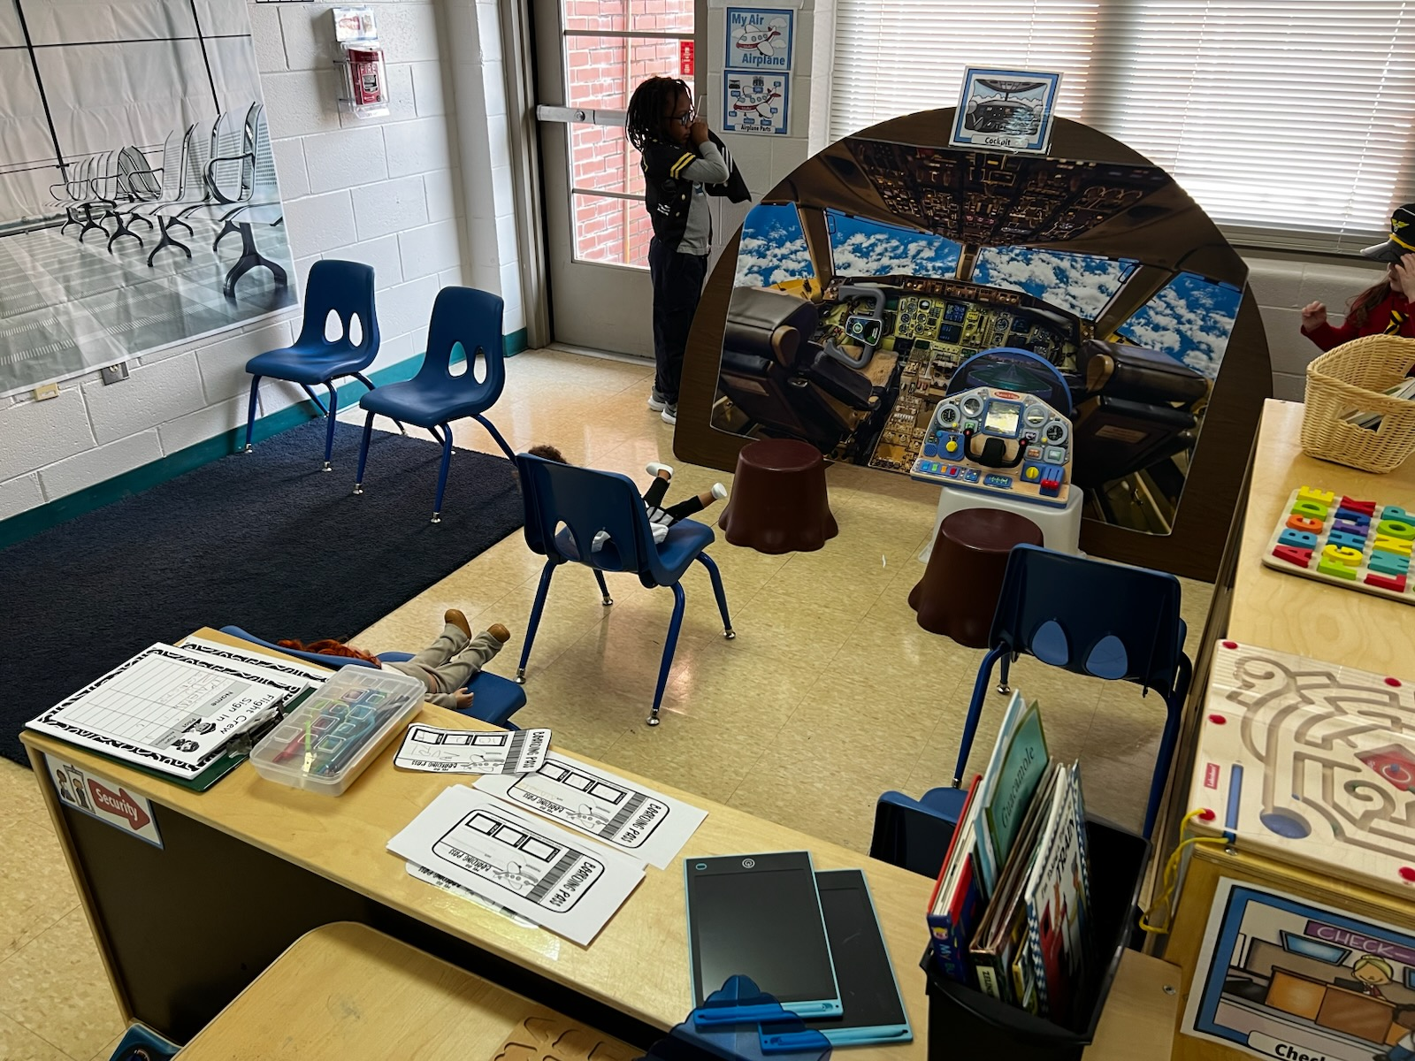
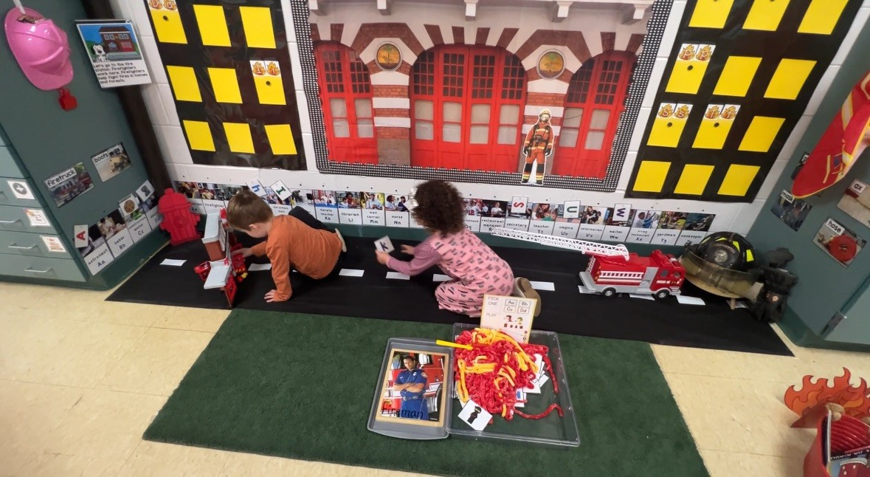
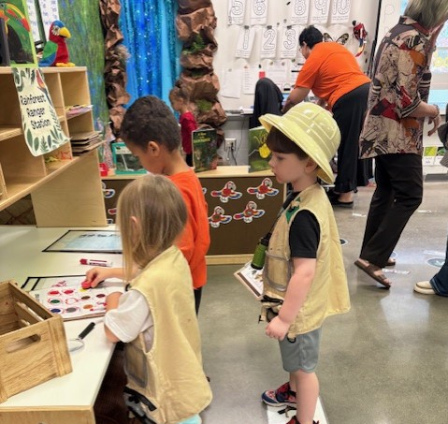
Play Based Learning as a Workforce-Aligned Instructional Approach
Law, Public Safety, Corrections & Security
Police, firefighters, safety officers

Slide 42
Play Based Learning as a Workforce-Aligned Instructional Approach
Manufacturing
Assembly lines with recycled materials
SC ELS Indicators
Approaches to Learning: Plans, follows steps, and persists through tasks
Cognitive Development: Understands sequencing and cause‑and‑effect
Physical Development: Uses fine motor skills to assemble materials
Language & Communication: Describes processes and outcomes

Slide 43
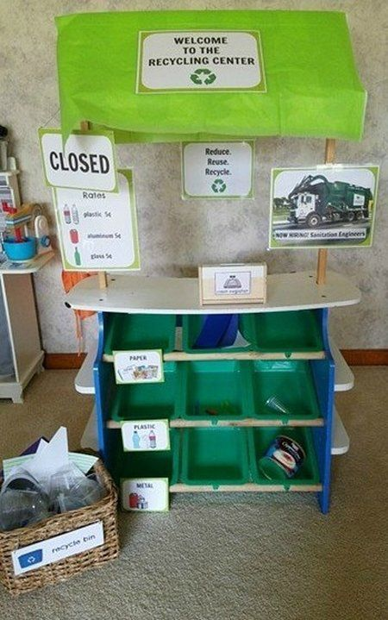
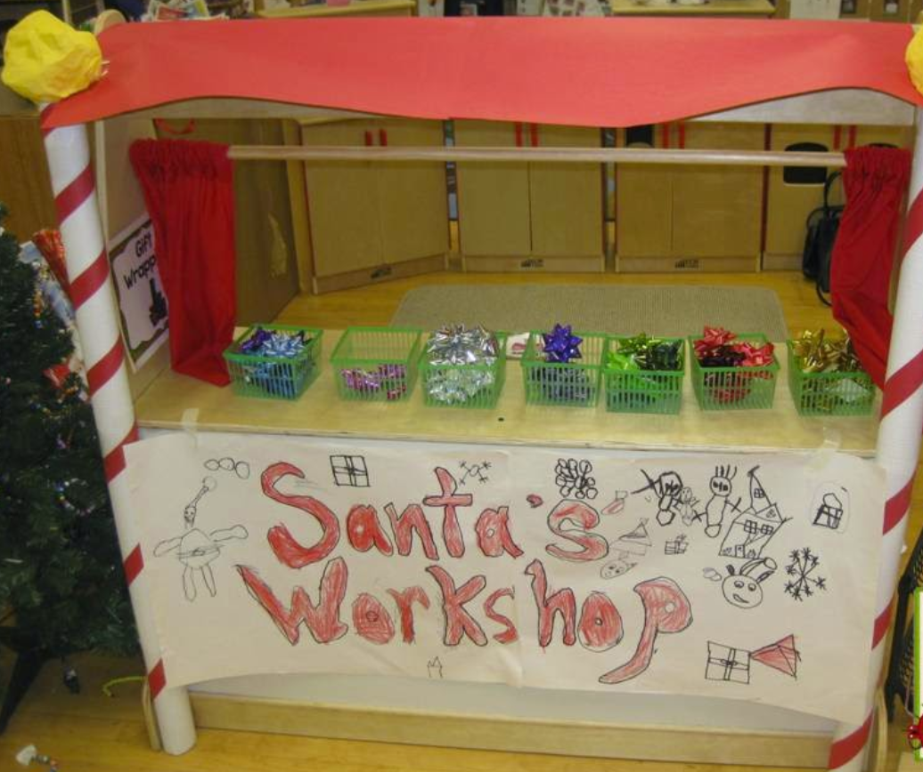
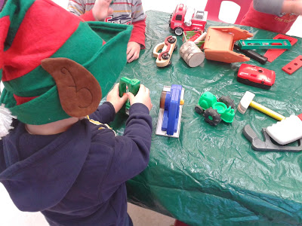
Play Based Learning as a Workforce-Aligned Instructional Approach
Manufacturing
Assembly lines with recycled materials
Architecture & Construction

Slide 44
Play Based Learning as a Workforce-Aligned Instructional Approach
Marketing
Creating signs, commercials, packaging
SC ELS Indicators
Language & Communication: Uses persuasive and descriptive language
Creative Expression: Designs signs, symbols, and representations
Approaches to Learning: Shows creativity and flexibility in ideas
Cognitive Development: Understands choices and audience purpose

Slide 45
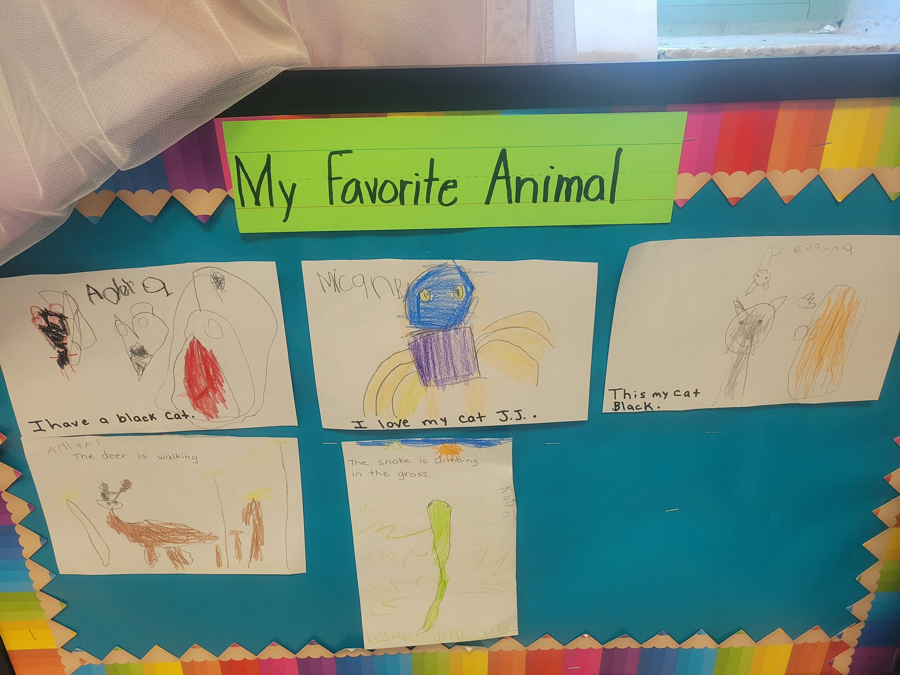
Play Based Learning as a Workforce-Aligned Instructional Approach
Marketing
Creating signs, commercials, packaging

Slide 46
Play Based Learning as a Workforce-Aligned Instructional Approach
Science, Technology, Engineering & Mathematics (STEM)
Building challenges, experiments, measuring tools
SC ELS Indicators
Approaches to Learning: Demonstrates inquiry, persistence, and curiosity
Cognitive Development – Science & Math: Investigates, measures, predicts, and experiments
Language & Communication: Explains thinking and results
Social & Emotional Development: Collaborates and problem-solves with peers

Slide 47
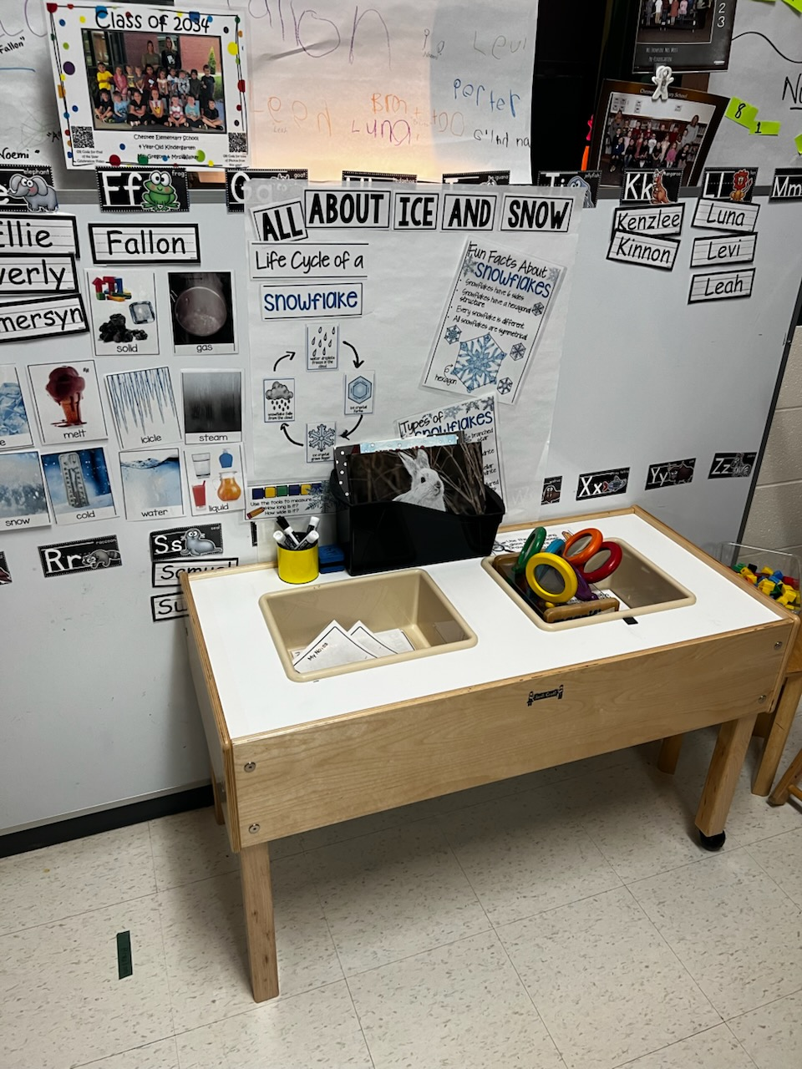
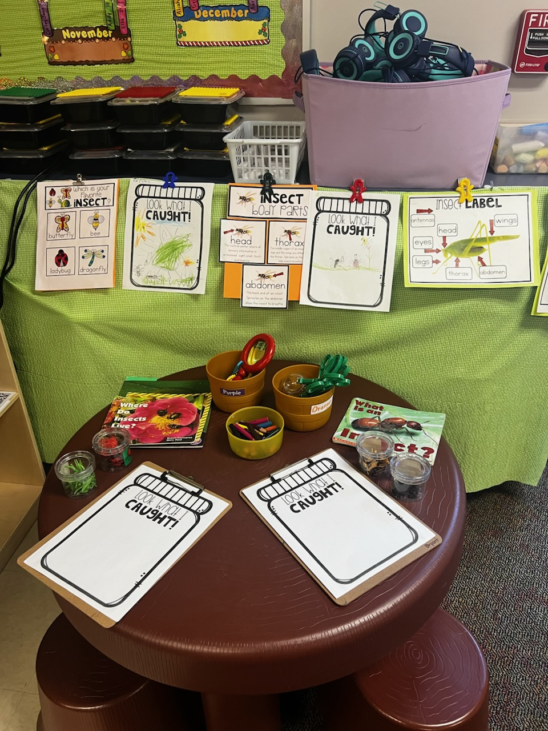
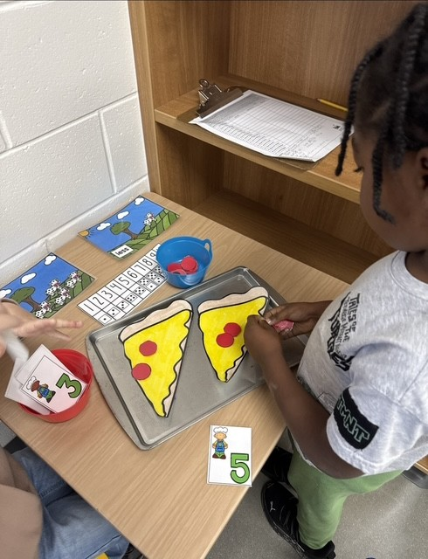
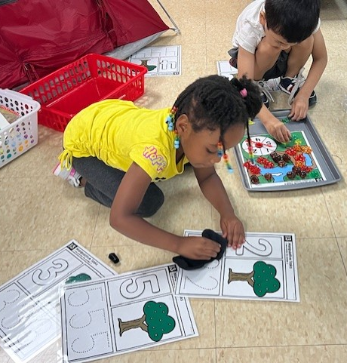
Play Based Learning as a Workforce-Aligned Instructional Approach
Science, Technology, Engineering & Mathematics (STEM)
Building challenges, experiments, measuring tools

Slide 48
Play Based Learning as a Workforce-Aligned Instructional Approach
Transportation, Distribution & Logistics
Roads, maps, delivery systems
SC ELS Indicators
Cognitive Development – Math/Spatial: Uses spatial language and mapping concepts
Approaches to Learning: Plans routes and sequences actions
Physical Development: Demonstrates coordination during movement play
Language & Communication: Explains routes, directions, and roles

Slide 49
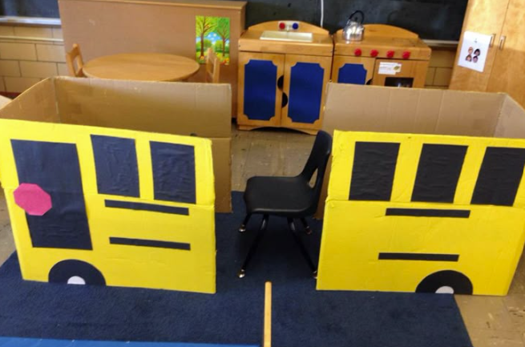
Play Based Learning as a Workforce-Aligned Instructional Approach
Transportation, Distribution & Logistics
Roads, maps, delivery systems

Slide 50
Play Based Learning as a Workforce-Aligned Instructional Approach
Persistence
Early Math
STEM
Advanced Manufacturing
Early Literacy
Communication
Documentation & Technical Reading
Emotional and Social Development
Workplace Collaboration
Leadership
Executive Function
Career Adaptability
Notes:
Play‑based learning is not extra—it is the most effective instructional method for preparing young children for the complex, team‑based work environments of South Carolina’s future economy.
Early math → STEM & advanced manufacturing
Early literacy → communication, documentation, technical reading
Social-emotional skills → workplace collaboration & leadership
Executive function → career adaptability & persistence

Slide 51
Play Based Learning as a Workforce-Aligned Instructional Approach
Key Takeaways
No separate “career lesson” required
Use what you already have
Rotate materials, add vocabulary, ask intentional questions
Teacher Strategies
Career-rich language (“engineer,” “chef,” “designer”)
Photos of real community workers
Books tied to play centers
Family/community connection

Slide 52
Reflection & Closing
Reflection Prompt
Which center could you enhance tomorrow with a career connection?
Play builds future-ready skills
Career awareness starts with imagination
When aligned with SC ELS, play is powerful and purposeful
Career awareness in 4K is not an add‑on.
When children engage in intentional, play-based experiences, they are actively meeting multiple SC Early Learning Standards indicators at once—while building curiosity about the world of work.

Slide 53


Exit Ticket & Attendance Verification
Please use the QR Code to complete an exit ticket for your attendance.
Dr. Tammy Graham & Jennifer Stock
Palmetto Education Summit

