Slide 1


Slide 2


Acceleration Potential
Ignite Possibilities'
Andrea Niesse
aniesse@ed.sc.gov

Slide 3
Learning
Outcomes
Clarity on the importance of acceleration.
Guidance on how to use strategies to design lesson plans to accelerate ALL students.
Making shifts in mindsets to make it happen

Slide 4
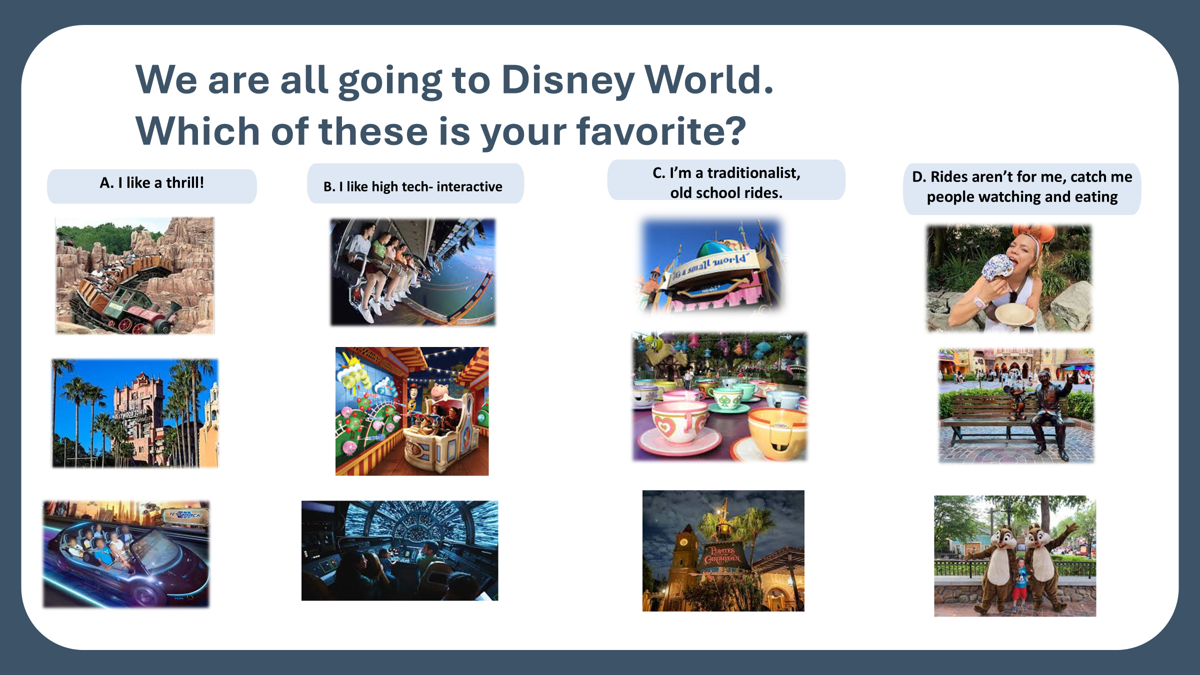

Slide 5
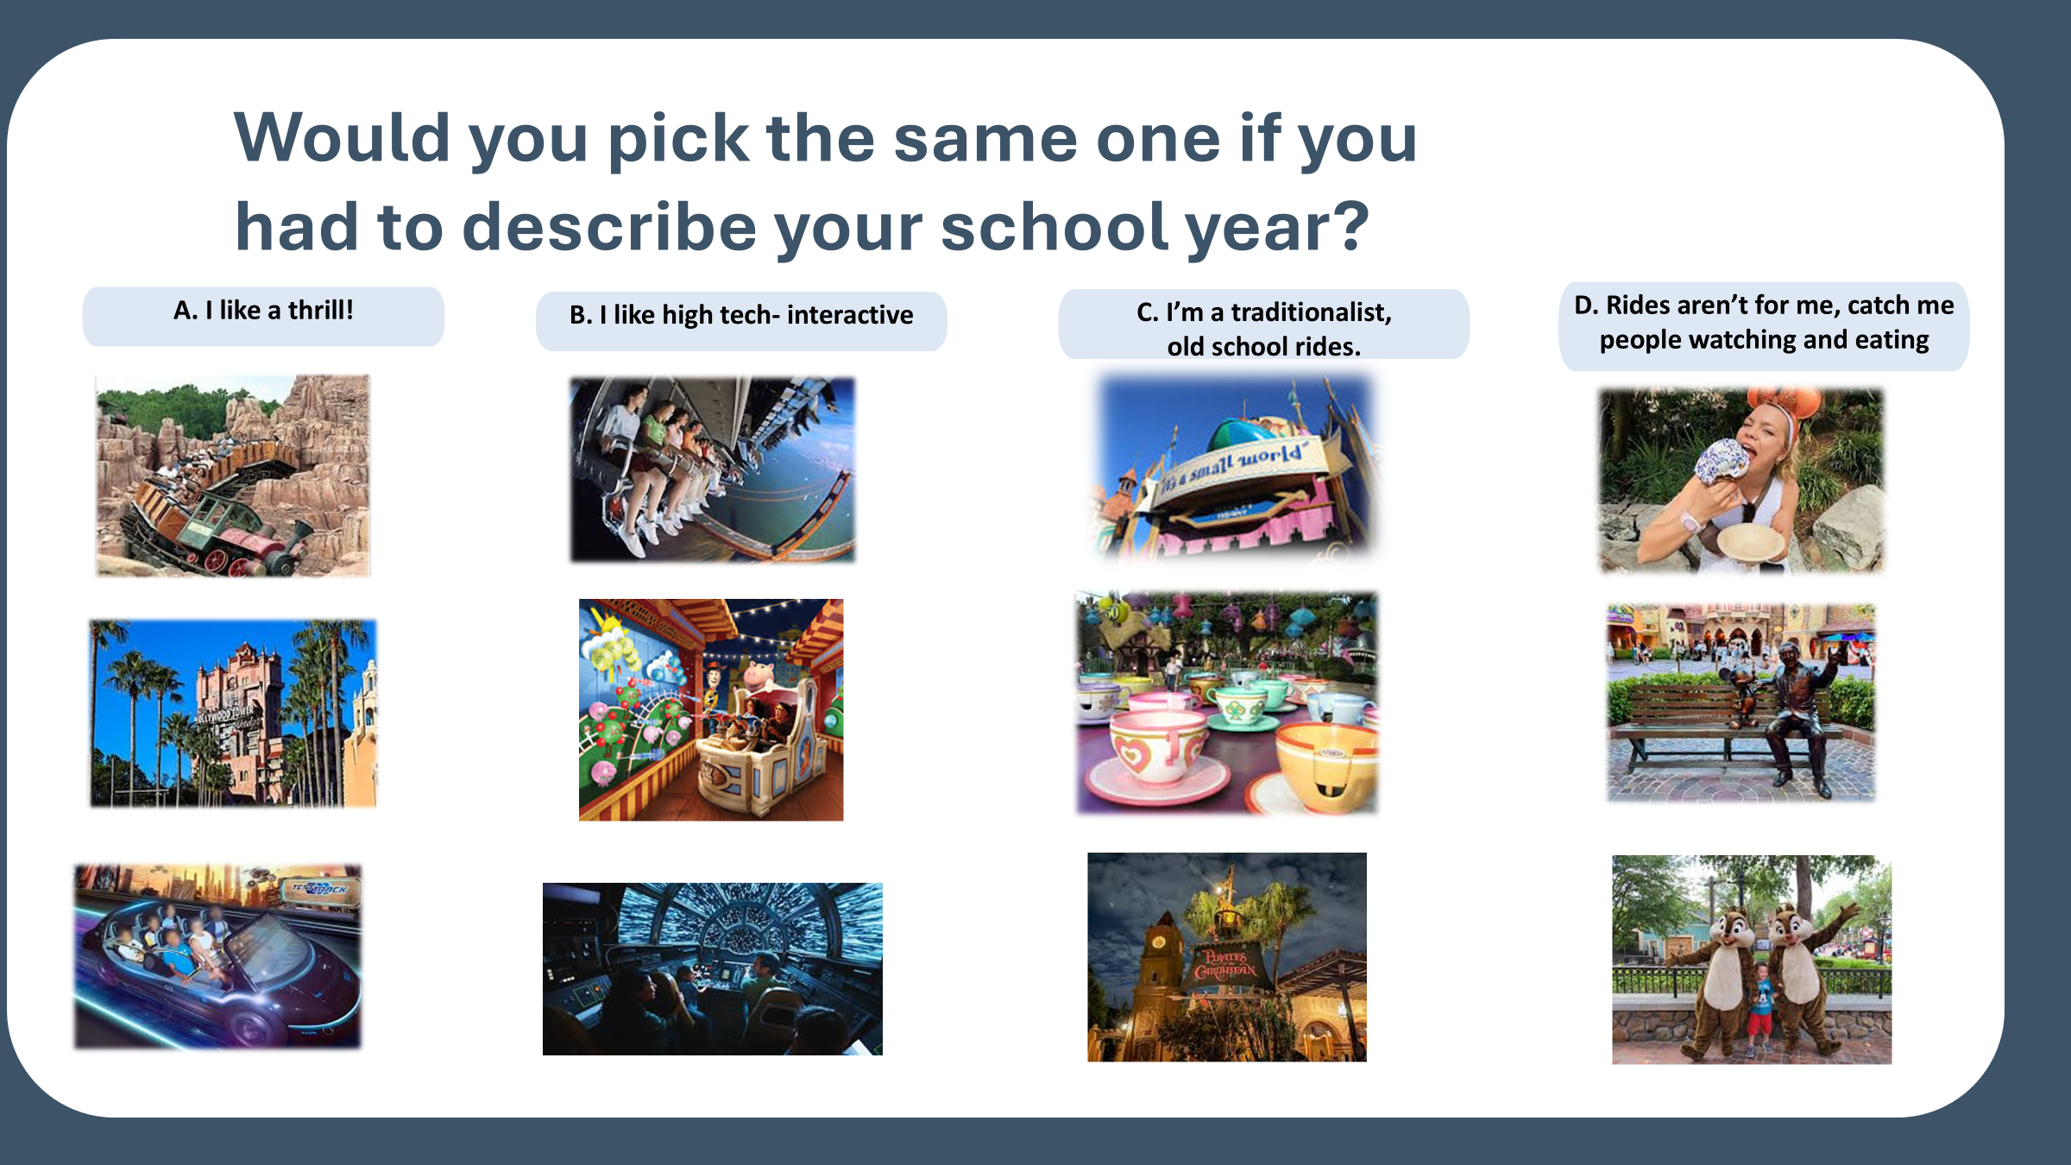

Slide 6

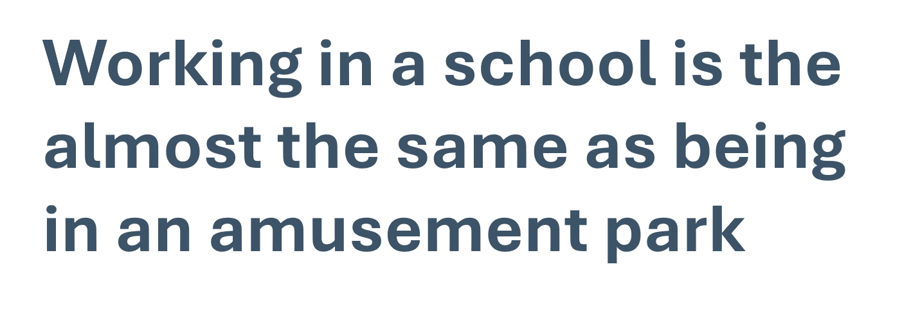


Slide 7
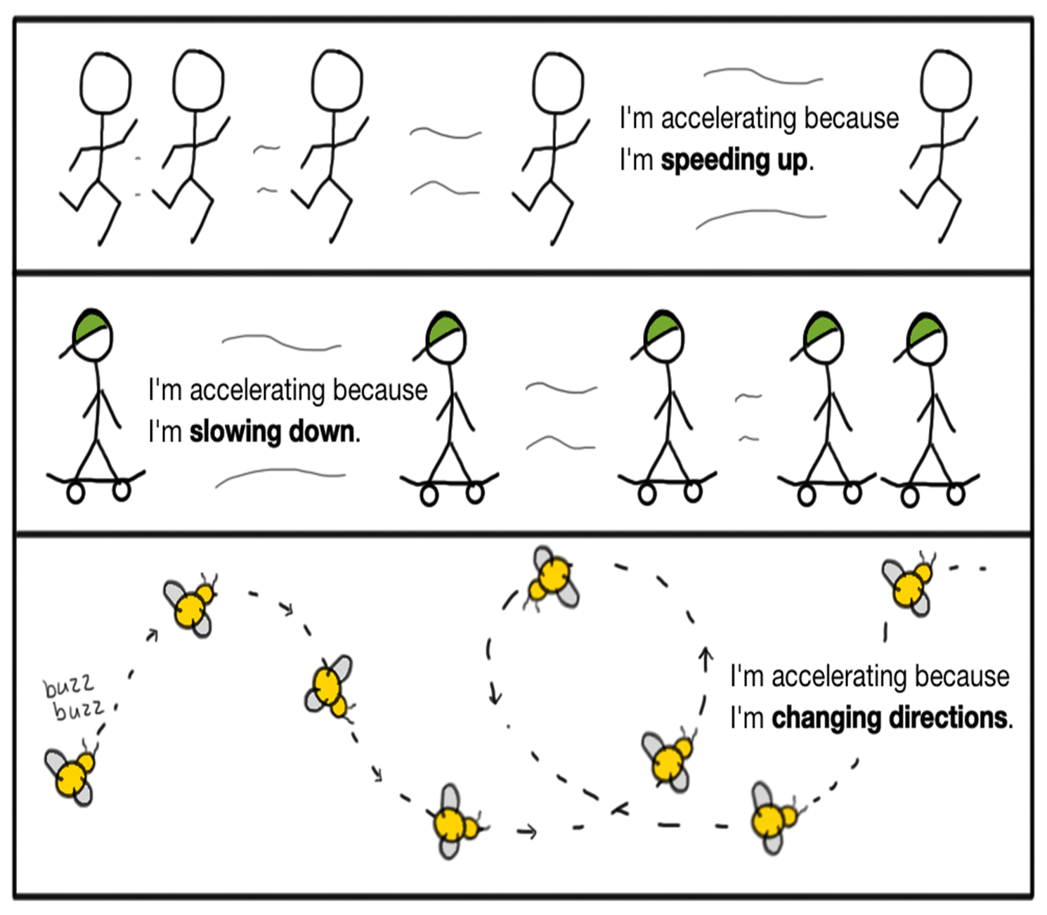
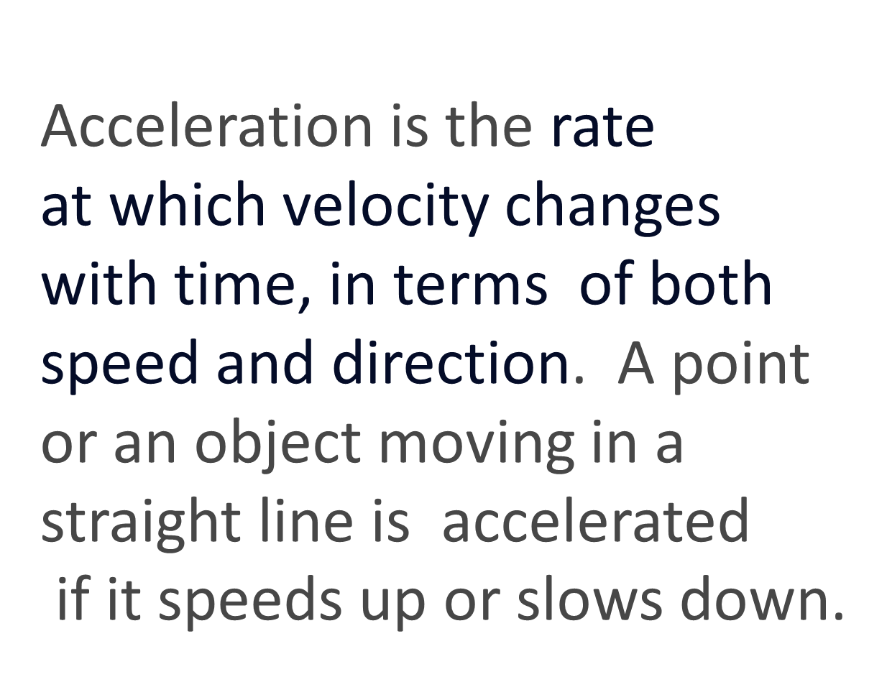
What is acceleration?

Slide 8

Acceleration Builds Momentum.
For Struggling Students (Gaps & Recovery):
It focuses on "scaffolding up" rather than remediating. Instead of holding students back to re-learn previous years’ material, educators provide targeted, just-in-time support. This ensures students spend maximum time accessing grade-level content without lowering expectations. [1, 2, 3, 4]
https://www.carnegie.org/our-work/article/how-implement-accelerated-learning-successfully/
Notes:
Acceleration focuses on preparing students for success with upcoming new learning and lays the foundation for continued academic growth.

Slide 9

Why This Matters
Key Findings
The "A" Illusion: About 80% of students get mostly A's and B's, but they only meet grade-level standards on those same assignments 17% of the time. [1]
Wasted Time: Students spend the equivalent of six months of class time per core subject on assignments that are below their grade level. [1]
Systemic Inequity: The opportunity gap is significantly worse for students of color, low-income students, English language learners, and students with disabilities. [1]
Citation: TNTP. (2018). The Opportunity Myth: What Students Can Show Us About How School Is Letting Them Down—and How to Fix It. https://tntp.org/tntp_the-opportunity-myth_web/
Notes:
"The Opportunity Myth" is a major 2018 report by TNTP (formerly The New Teacher Project) that exposes a false promise in American education: that doing well in school will prepare students for college and careers. It reveals that schools constantly fail students by denying them the four core resources they need to succeed: [1, 2, 3, 4, 5] The report followed nearly 4,000 students and found that while most students try hard, have big goals, and earn good grades, they are severely underprepared for life after high school. This is because they consistently miss out on four crucial classroom resources: [1, 2, 3]

Slide 10
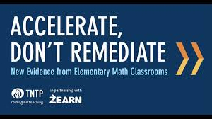
Why This Matters
Key Findings
Students who experienced learning acceleration struggled less and learned more than students who started at the same level but experienced remediation instead.
Students of color and those from low-income backgrounds were more likely than their white, wealthier peers to experience remediation—even when they had already demonstrated success on grade-level content.
Learning acceleration was particularly effective for students of color and those from low-income families.
https://tntp.org/wp-content/uploads/2023/02/TNTP_Accelerate_Dont_Remediate_FINAL.pdf
Notes:
Our work with Zearn uncovered striking findings. An analysis of data from Zearn encompassing more than two million students in more than 100,000 elementary math classrooms1 shows:

Slide 11
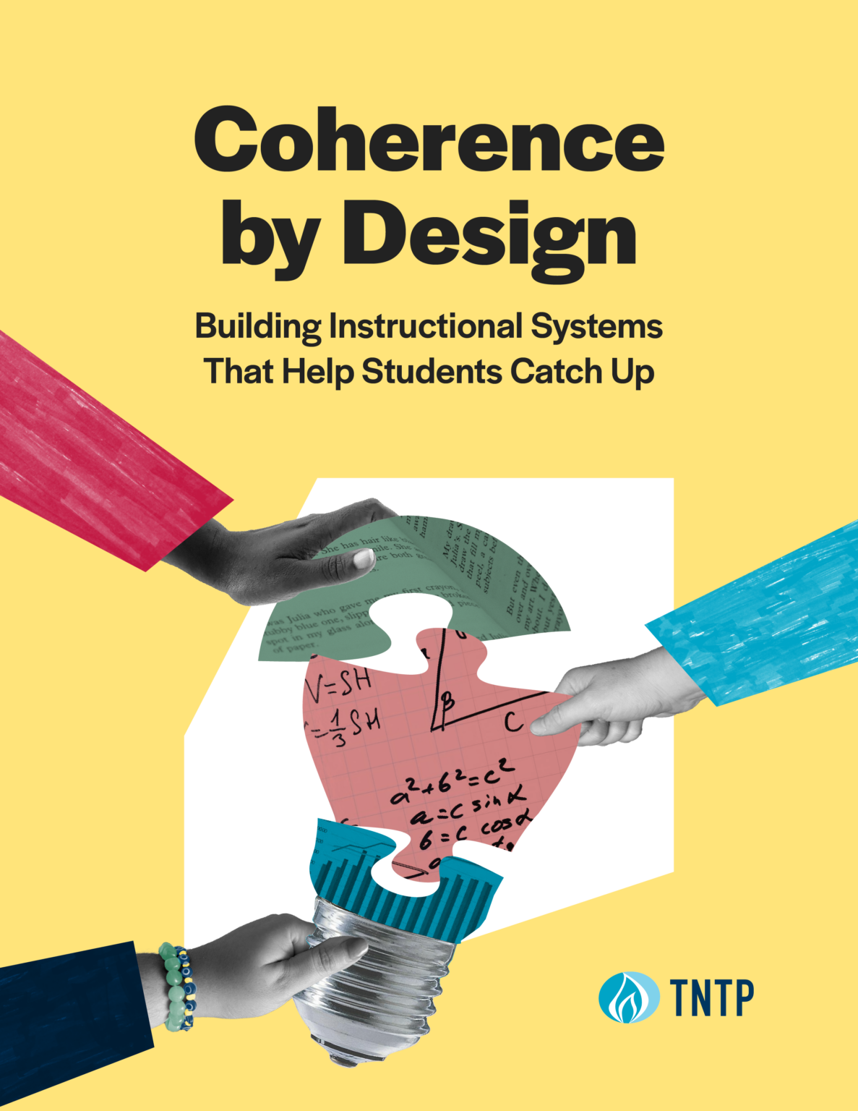
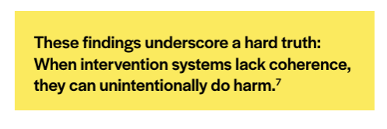
Why This Matters
Most concerning, the lowest-performing students made less progress in Tier III intervention, the most intensive support available, than similarly low performing peers who received no intervention at all.
This means that these students would have been better off getting no additional support whatsoever than being sent to intervention.
https://tntp.org/publication/coherence-by-design/
Notes:
In the four Tennessee districts studied, that strain showed up clearly in practice. Many students who qualified for intervention did not receive it at all. Among those who did, relatively few made sufficient progress over the course of the school year to move to a less intensive tier or exit intervention entirely.

Slide 12

Why This Matters
If we are not teaching on grade level all day every day and we are constantly pushing students to remediation, and the interventions are not coherent, we are essential contributing educational neglect.
Moves the focus from student deficits to educator agency.
https://testing123.education.mn.gov/test/action/data/TEST000533
Notes:
By recognizing that student behavior and engagement are direct reflections of the learning environment, educators gain the power to proactively adjust their methods to reach every learner.

Slide 13
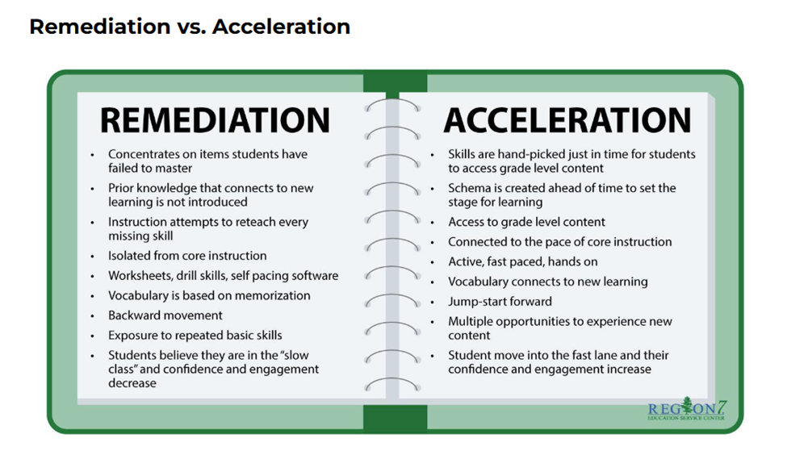

Slide 14
Why Acceleration
Increased challenge and rigor
Enabling students to access grade-level or advanced content
Fostering deeper learning by removing unnecessary delays
It is necessary because:
•It can close achievement gaps
•Focuses on students’ strengths, not deficits
•Forces a shift in mindsets
•Student-centered learning becomes the focal point
Notes:
A big push for acceleration rather than remediation came after COVID, trying to make up for lost learning. Too much to cover to go back, so instead of going back... go forward strategically.

Slide 15
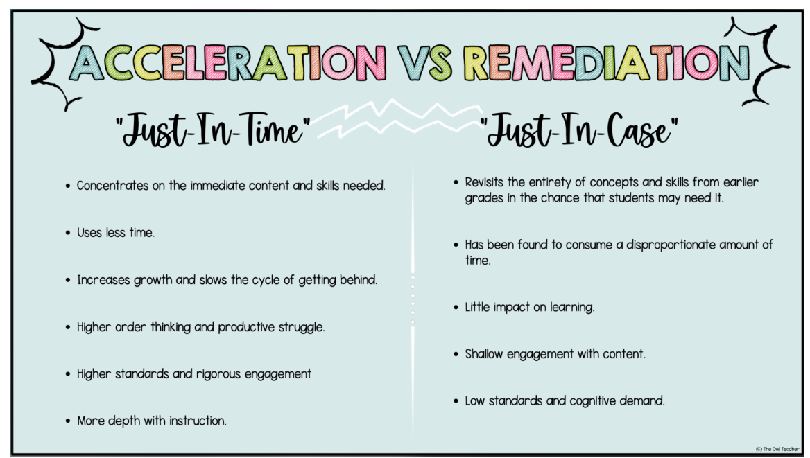
Providing Just–in-Time Supports Rather than Just in Case Supports
Notes:
what we do in response to those thoughts that either supports or inhibits students’ achievement. It is all about the scaffolding.

Slide 16
Let’s look at this problem for a group of 5th graders
Alex used up all of the money she had saved from her lawn care job to buy a skateboard. She then borrowed $17 from her mother to go to the movies with her friends. After she went to the movies she bought a soccer ball for $15. She borrowed that money from her mother as well. Alex keeps track of her money in her notebook. What should she write in her notebook to indicate her balance now? Explain your reasoning.
What are your thoughts as you read the problem?
Are you thinking that the wording might be confusing for your readers who struggle?
Are you thinking about issues students often have when computing with integers?
https://www.hmhco.com/blog/just-in-time-vs-just-in-case-scaffolding-how-to-foster-productive-perseverance?srsltid=AfmBOorpk1a72TLgzoYKylj0icFRbNH1PWE9Rgy9SiusP6WVsSPCmgYn
Notes:
It might sound something like this:
Teacher: Would the $17 be positive or negative?
Students: Negative.
Teacher: What about the $15?
Students: Negative.
Teacher: What do we do when we add negative numbers?
The cognitive demand of the task is greatly diminished by this “scaffolding.”
The students are no longer left to make sense of the context and determine the operation to be performed. The teacher is providing supports for students in anticipation of a struggle. This is what we mean by just-in-case scaffolding.
In contrast, imagine a classroom where the teacher provides space for students to do the sense making. It might sound something like this:
Teacher (after reading the problem to the students): Class, spend 2 minutes thinking about this problem and then share your ideas with your partner.
(Teacher waits 2 minutes before circulating the room to listen to discussions of students as they work in small groups)
Student (addressing teacher): We don’t know how to solve it.
Teacher: What is the problem asking?
Student: What Alex should write in her notebook to show how much money she has.
Teacher: What do you know?
Student: We know that she spent all her money and then borrowed money from her mom.
Teacher: Now work with your partner to see how you might represent the money she borrowed. (Teacher walks away.)
What you probably notice is that the teacher provides processing time for students to do the sense making. When students indicate a struggle, the teacher provides just enough information so that students can re-engage with the task without lowering the cognitive demand of the task (Boston, Candela, & Dixon, 2019). Which classroom description most closely represents the opportunities you or the teachers you support are affording students? How would you describe your classroom?
The shifts in practice I suggest have the goals of ensuring that the students are doing the sense making and the teacher is supporting them to meet the learning goal through the task that is chosen and the questions that are used to support the implementation of that task. We can transition our unproductive practices to be productive by keeping the learning goal and student engagement at the foreground of our planning and by critically analyzing our instructional decisions and structures.
The views expressed in this article are those of the author and do not necessarily represent those of HMH.
***
Dr. Juli Dixon is an author of HMH’s K–8 core mathematics program, Into Math. This blog, originally published in 2018, was updated in 2024.

Slide 17
Acceleration in Action
Betsy had never tackled the Cement Mixer before. Although many fears cycled through her mind, her two main concerns were handling the backdoor and the lip. Her confidence rose, however, as she reminded herself that if she could just get into the barrel she had a good chance of winning, especially if conditions were cooking. She stared out at the horizon, shook her fist triumphantly in the air and shouted. "I'm ready for you, Meat Grinder! I can handle the biggest Macker you can deliver!

Slide 18

Creating Schema, Providing Vocabulary, Using Visuals
Cement Mixer or Meat Grinder are nicknames for the "Banzai Pipeline" a famous surf spot in Hawaii- waves can reach up to 30 ft. high
Backdoor -A term used when a surfer is riding a wave and enters a barrel that is already barreling from a deep position.
Lip The very top part of the wave that plunges forward as the wave breaks.
Barrel -A wave that is hollow, or cylindrical, and plunges forward creating an air pocket inside of it. Examples of usage include “he is in the barrel” or “that person got barreled.”
Macker- a really big wave (like a Mack truck)

Slide 19

Why are so many learners struggling?
They are often overwhelmed by:
• Inconsistent access to explicit teaching
• Spending too much time off grade level material
• Low expectations
• Not enough frontloading of information
• Cognitive Overload
• Weak working memory supports in instruction
•Slow Processing Speed

Slide 20

Poverty in South Carolina
In South Carolina, approximately 19% of children under 18 live below the federal poverty line. [1, 2]
Broader Financial Hardship
While 19% live below the poverty line, studies indicate that over half (53%) of South Carolina's children live in households experiencing financial hardship. These families fall below the ALICE (Asset Limited, Income Constrained, Employed) threshold, meaning they struggle to afford basic necessities like housing and childcare even when employed. [1, 2, 3, 4]
https://scchildren.org/our-work/policy-and-advocacy/kids-count-south-carolina/
Notes:
Children’s Trust Breaks down by count poverty levels, ace scores

Slide 21
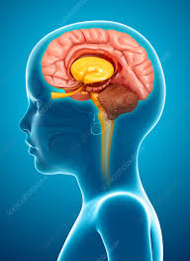
Poverty and the Brain
Poverty creates measurable brain changes
Poverty doesn't just stress you out - it physically rewires your brain in ways that show up on brain scans.
Financial scarcity depletes cognitive bandwidth, shrinks brain regions responsible for planning and memory, and creates lasting changes that persist even after circumstances improve.
Notes:
beyond stress responses, depleting cognitive bandwidth equivalent to losing 13 IQ points while physically altering brain structures responsible for memory, decision-making, and emotional regulation, but these neurological effects can heal through financial stability and therapeutic support.

Slide 22



THREE BIG IDEAS FROM NEUROSCIENCE
A Struggling Learners Brain: A Simple View
Slow Processing Speed
Small Working Memory
Attention is Limited Cognitive Overload
The pace at which you can take in information (visually or audibly), understand it, and formulate a response.
Too much information at once overwhelms capacity and reduces retention.
Student’s mental ‘workspace’ to hold and manipulate ideas
Learning improves when students can process efficiently, hold key information in mind, and connect new ideas before overload takes over.
Notes:
Think hat allows us to hold and of it as your brain’s workspace where you actively process data for various mental tasks. It’s like your mental notepad, where you jot down and perform mental operations on important information.

Slide 23

CLASSROOM STRATEGIES
How to Support Working Memory
Design for memory limits:
• Keep directions short
• Post steps visually
• Ask students to repeat directions back
• Use checklists
• Provide partially completed examples
• Externalize memory with graphic organizers
• Reduce simultaneous demands
• Teach note-taking routines
If students must remember everything, they will remember almost nothing.
https://ctl.stanford.edu/students/strategies-improving-working-memory
https://www.edutopia.org/article/supporting-students-working-memory/
Notes:
Working Memory vs. Short-Term Memory
While the terms are often used interchangeably, there is a key distinction: [1]
Short-term memory is solely the temporary storage of information (e.g., remembering a phone number just long enough to write it down).
Working memory involves both storing and actively manipulating or working with that information (e.g., receiving a phone number and mentally repeating it backward). [1, 2, 3]
Working memory is a cognitive system that temporarily holds and manipulates information in your mind. Often called a "mental scratchpad", it allows you to process thoughts, follow directions, reason, and learn in real

Slide 24

CLASSROOM STRATEGIES
How to Improve Processing Speed
You cannot force speed by saying "hurry up."
You can improve efficiency by:
• Teaching routines until they become automatic
• Pre-teaching vocabulary and concepts
• Using consistent instructional formats
• Reducing clutter on slides and handouts
• Providing models before independent work
• Giving processing time before responses
• Using guided repeated practice
Goal = more efficient processing, not more pressure.

Slide 25
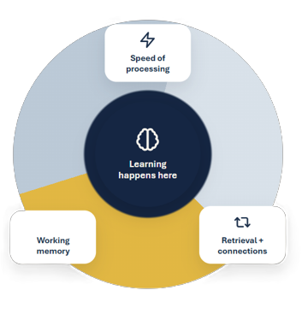

A Quick Trip Inside the Brain
Brains learn best when challenge
is reachable
1
Processing Speed
Faster recognition frees attention for meaning making
2
Working Memory
Students need mental ‘workspace’ to hold and manipulate ideas
3
Cognitive Load
Too much at once shuts down learning before it can stick

Slide 26

Elements of an Accelerated Lesson
Start by using high quality instructional materials
Clearly state the goal for the lesson
Providing student’s opportunity for reflection
Address prior knowledge needs.
Actively Engage the students.
Time for feedback from the teacher and peers
Student discourse
Differentiation or small groups
CLOSURE
Questions to Guide Lesson Design
Notes:
Consider a student led closure…it ensures that students leave the lesson knowing what they learned and what questions they still have. Exit tickets, pair share, journal
Feedback– FAST Fair Accurate Specific Timely

Slide 27
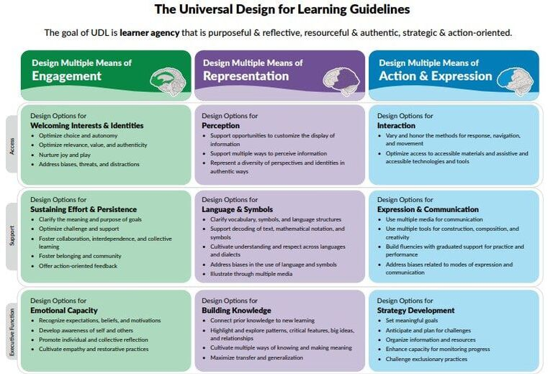
Similarities in the guidelines of UDL
Universal Design for Learning Guidelines

Slide 28
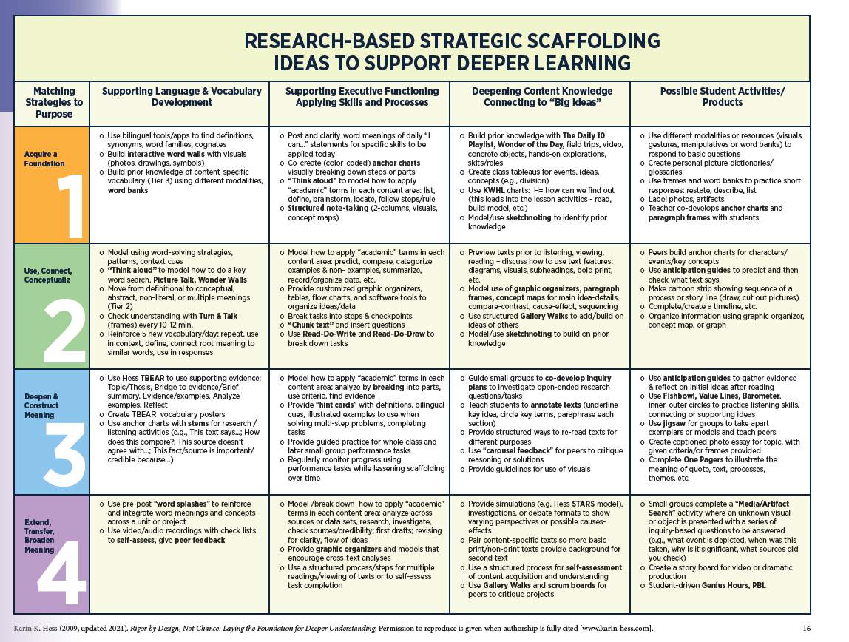
Scaffolding Ideas

Slide 29

Acceleration Mindset Shifts
1. Schools and districts are learning organizations.
All Students can learn grade- and course- level standards
Formative assessment is integral to learning.
Schools must systematically intervene to accelerate learning.
Instructional strategies should create forward learning.
Everyone is a leader of learning.
Notes:
Learning must be the intentional outcome of everything done in the classroom.
Student efficacy is often the missing piece in learning. Students owning their learning and not participating is the key to accelerating their learning
A balanced system of formative and summative assessments
Intervention groups should begin at the beginning of the school year (pre-planning)
Prerequisite knowledge ahead of time, enabling students to understand new information
Leaders must empower and grow the capacity of the group

Slide 30


Learning is not attained by chance, it must be sought for with ardor and attended with diligence.
--Abigail Adams
1. A Shift in Culture to Accelerate Learning
Notes:
Schools are learning communities in which everyone is a teacher, everyone is a learner, everyone is a leader.
Do you have a mission and vision that truly represents your school?
Does everyone in your building and community treat learning as required?
Do you prioritize what needs to be done so that learning can be the focus?

Slide 31

2. A Shift in Planning to Accelerate Learning.
A goal without a plan is just a wish.
--Antoine de Saint-Exupery
Notes:
Accelerating student learning begins with a plan--- one that guarantees student’s experience grade-level standards every day and ensures students learn priority standards to grade level (or beyond)
Do teachers embed prior knowledge into relevant units and teaching pre-requisites WITH grade level content?
Do you have a proficiency map to teach priority standards?
How do you utilize instruction time to support learning without falling behind pace?

Slide 32

3. A Shift in Assessments to Accelerate Learning
Of all the influences on student learning, feedback is among the top-ranked- and there is also the case for teacher learning.
---John Hattie
Notes:
Do you have common formative assessments?
Do teachers view assessments as a source of feedback for themselves?
Do teacher use multiple measures to assess students?

Slide 33

4. A Shift in Intervention to Accelerate Learning
Intervention must be provided in addition to effective grade level core instruction. Not in place of it.
Richard DuFour
Notes:
Are you analyzing data as a team?
Are your most high quality teachers providing the learning supports?
Are you using daily formative assessments to determine and target interventions?

Slide 34

5. A Shift in Instruction to Accelerate Learning
If a student’s core instruction is focused on below grade
level standards then he or she will learn well below grade level.
Mike Mattos

Slide 35

6. A Shift in Leadership to Accelerate Learning
(Leaders in gap-closing schools and districts) have seen the
power schools have to change lives…They aren’t waiting for
the cavalry to teach the kids; they are the cavalry. --Karin Chenoweth
Notes:
Is clear rationale and research being used tp make decisions?
Is the majority of your time spent on important issues related to learning?
Do you share the leadership?

Slide 36

Use the Continuous Improvement Cycle to Accelerate Learning
Excellence is a continuous journey that never ends.
--Brian Tracy

Slide 37
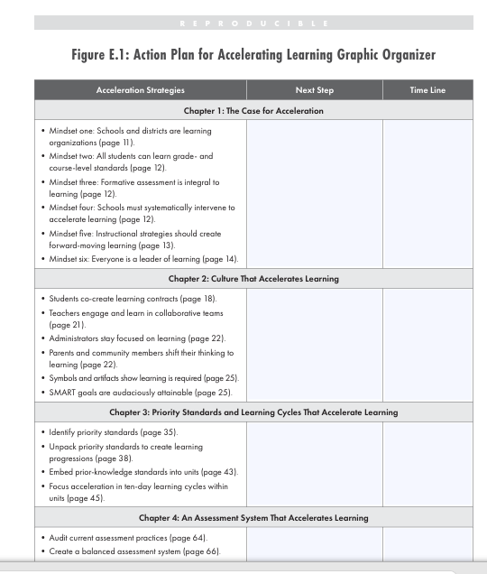
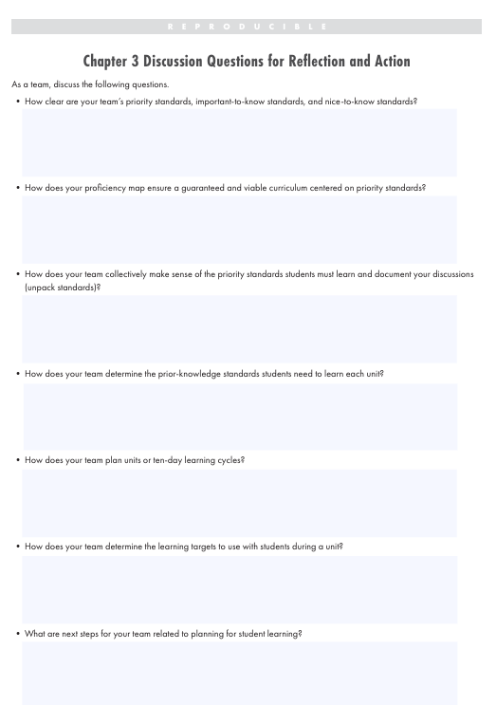
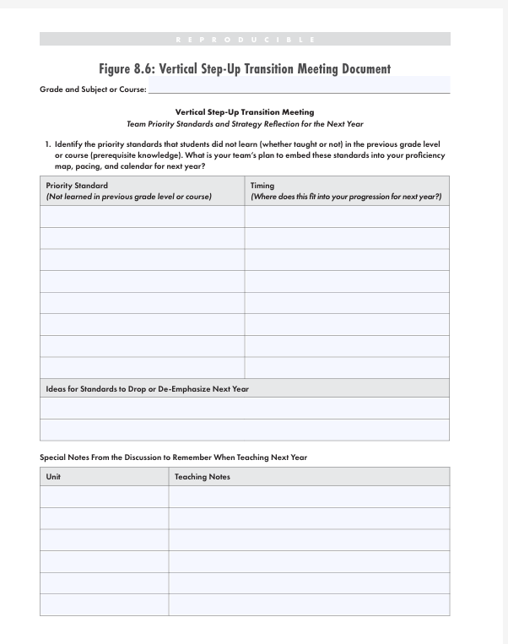
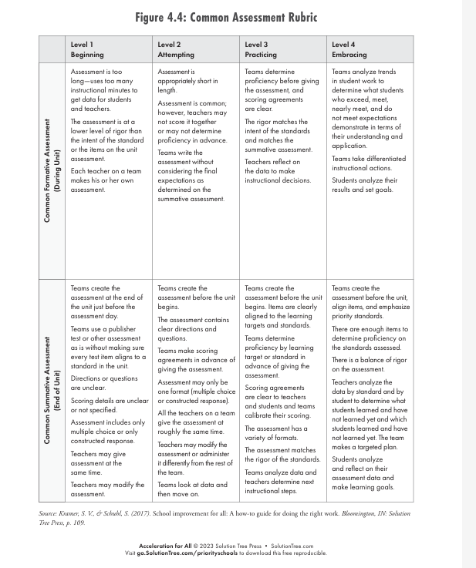

Slide 38
Resources for Discussions
Culture of L earning
Planning & Standards
Assessments
Instruction
Intervention
Leadership
Continuous Improvement
Click the book to find all Resources
Notes:
Header font 50pt
Content/body text font 26pt

Slide 39
Key Takeaways:
Acceleration is not about faster pacing but maintaining forward momentum.
ALL Students deserve access to grade level content and appropriate supports EVERYDAY.
Teachers MUST intentionally plan ways to incorporate prior knowledge, scaffolds, and ways to empower learners for self efficacy.
Notes:
Going backwards is not an option

Slide 40


How do you prioritize daily grade-level instruction that accelerates learning?
This Photo by Unknown Author is licensed under CC BY-SA

Slide 41

Additional Resources:
Acceleration vs Remediation
Scaffolding Strategies
Learning Acceleration
Unlocking learning acceleration for Multilingual Learners
Unlocking Acceleration
Opportunity Makers
TNTP Learning Acceleration Guide
Accelerate Don't Remediate: Math
From Gatekeeper to Gateway: Algebra 1

Slide 42
Thank you! Questions?
Notes:
Slide title is hidden from display

