Slide 1
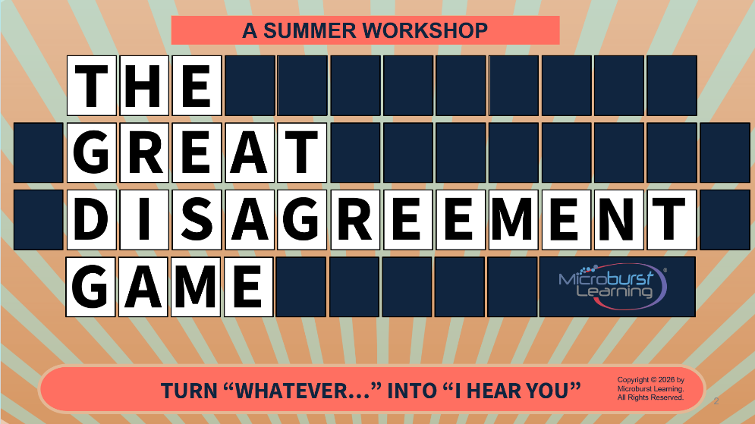
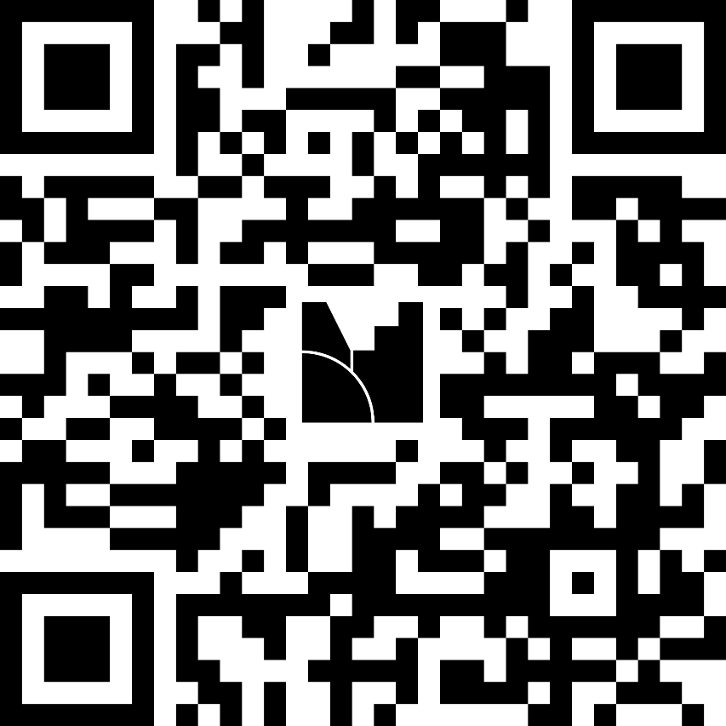
We want to hear from you!
Welcome!
Start our game by answering a few simple questions!
menti.com
code: 7384 8478

Slide 2

G R E A T
A SUMMER WORKSHOP
T H E
D I S A G R E E M E N T G A M E
Copyright © 2026 by Microburst Learning. All Rights Reserved.
TURN “WHATEVER…” INTO “I HEAR YOU”

Slide 3
Our Experience
ACS Technologies Amana Amazon Bertram Yachts Carolina Filters Colonial Life Dayton Superior Diamond Crystal Brands EMS Chemie Energizer Federal Mogul Fuji | General Electric GlaxoSmithKline Hargray Communications International Paper Intertape Polymer Group Kaydon Kimberly Clark Lincoln Electric Masonite MeadWestvaco Milliken | Nestle PEBA Roche SCANA SC Firefighter Association Scotsman Ice Sonoco Products Thompson Industrial University of South Carolina Wabtec Westinghouse
Over 40 years of delivering soft skills training for organizations on a global basis.

Slide 4
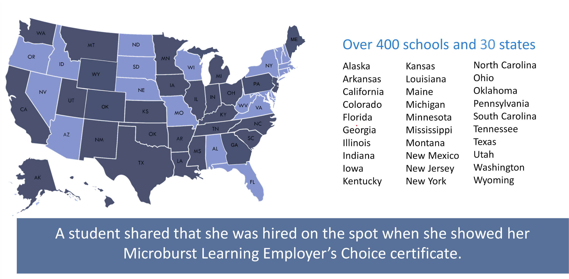
Where we are

Slide 5
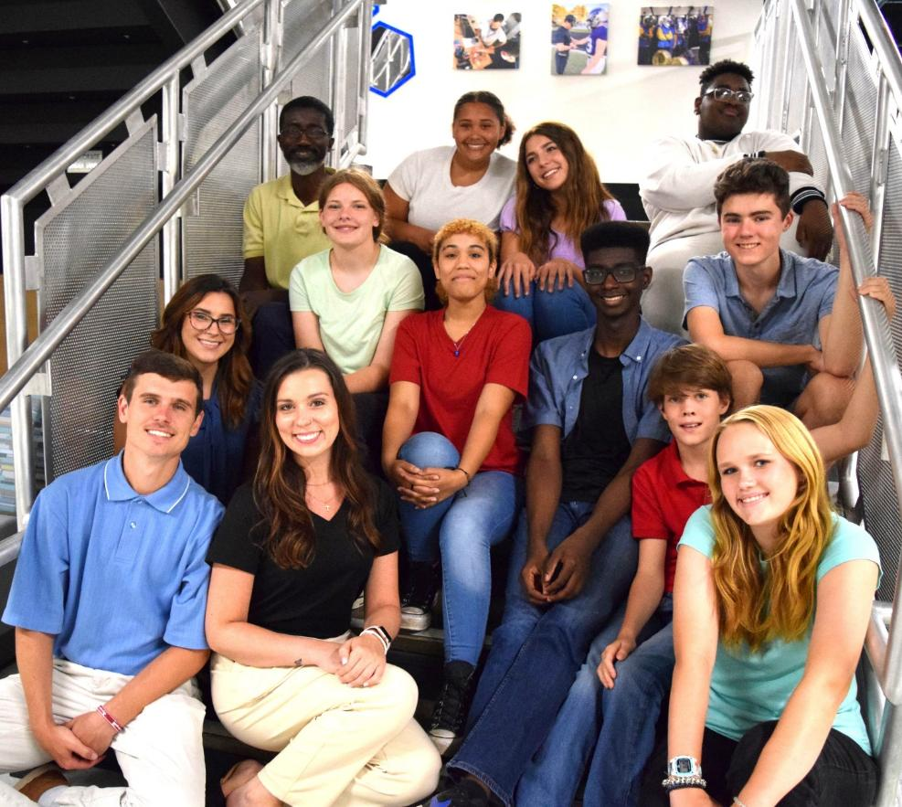
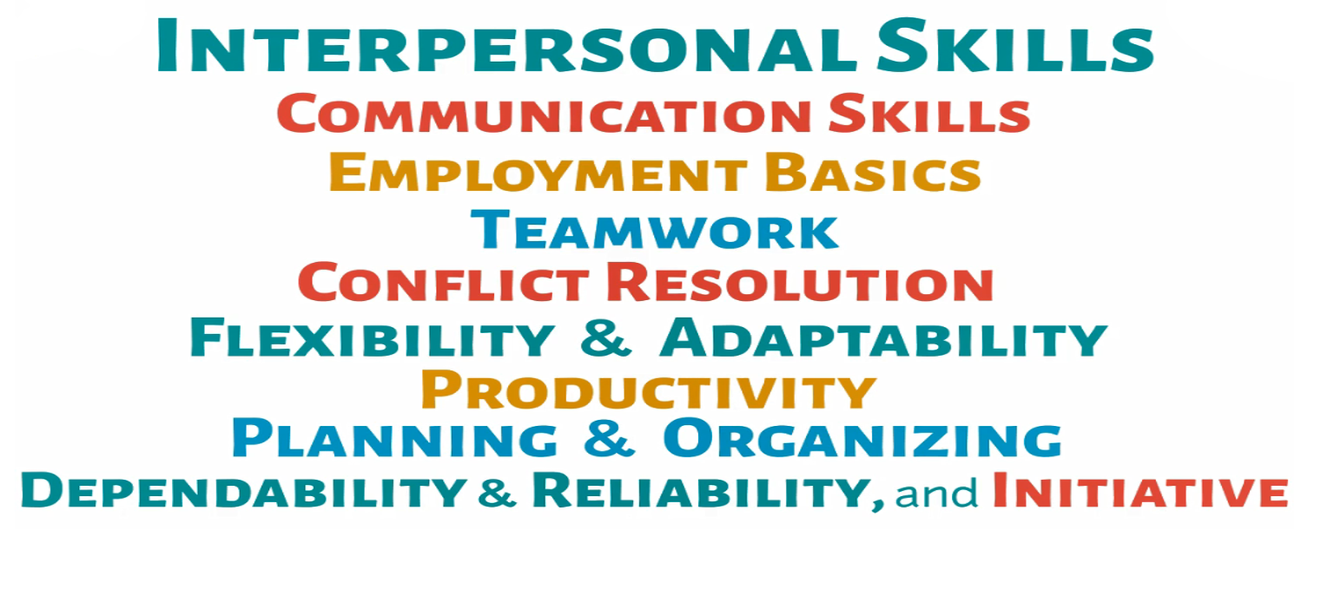
Our Program

Slide 6
Percentage Ups and Downs
Conflict costs more than we think.
60%
65%
People that said they avoid conflict.
7%
40%
What percentage of communication is made up of words?
45%
Have taken sick leave due to workplace conflict.
22%
98%
Employees that believe conflict resolution training is crucial.
33%

Slide 7
TODAY'S PRIZE PACK
1
Discover how teaching active listening will improve behavior.
2
Learn how conflict resolution tools will help students find success in the world of work.
3
Acquire practical strategies to help students navigate differing opinions.
4
Walk away with ready-to-use tools and activities.

Slide 8
TWO KINDS OF CONFLICT
Not all conflict is bad
✖ NEGATIVE
✔ POSITIVE
Attacks the person
Built on assumptions
No one seeks a solution
Attacks the problem
Built on observed facts
Everyone wants a fix
Round 6 of 22

Slide 9
THE EMPLOYABILITY BREAKDOWN
CONFLICT RESOLUTION
ACTIVE
LISTENING
CONSTRUCTIVE
COMMUNICATION
EMOTIONAL
REGULATION
PERSONAL
ACCOUNTABILITY

Slide 10
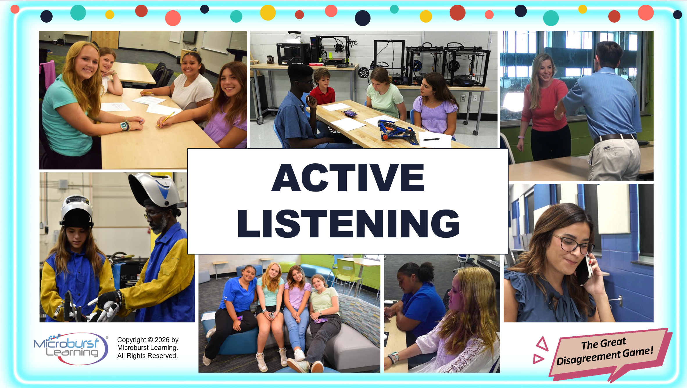

Slide 11
ACTIVITY • 8 MIN • EVERYONE
Instructions
Mind your
P’s and Q’s
Write that Alphabet

Slide 12

ACTIVITY • 8 MIN • EVERYONE
CHALLENGE
Mind your
P’s and Q’s
Write that Alphabet

Slide 13
ACTIVITY • 8 MIN • EVERYONE
DEBRIEF
Mind your
P’s and Q’s
Write that Alphabet

Slide 14
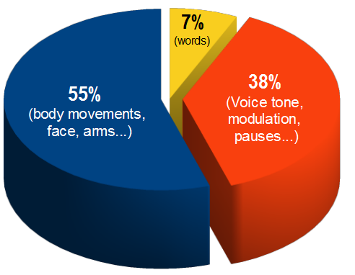
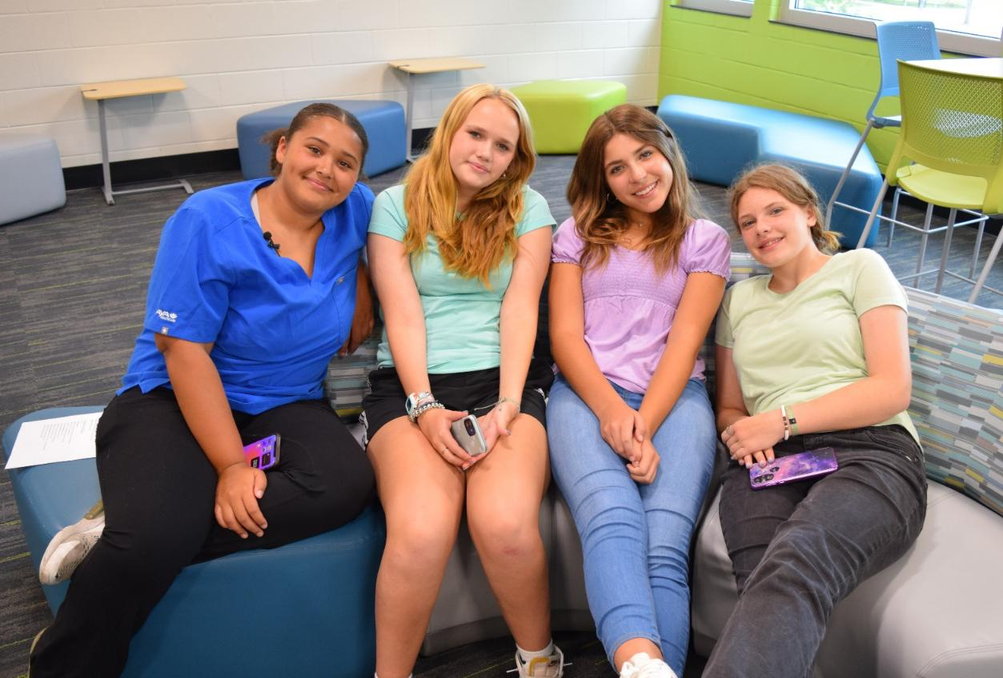
3 Parts of a Message
7%
(words)
38%
(Voice tone, modulation, pauses…)
55%
(body movements, face, arms…)

Slide 15
Communication Process
Sender
Receiver

Slide 16


Types of Communication
Verbal
Nonverbal
Written

Slide 17
ACTIVE LISTENING: KEY CONCEPTS
Listening is a skill. It can be taught.
✓
Listen to UNDERSTAND, not to reply.
✓
Be fully present: eyes up, phone down.
✓
Reflect what you heard before responding.
✓
Ask questions. Don't assume.
Good listeners aren't quiet , they're curious.

Slide 18


Slide 19
ACTIVITY • 8 MIN • EVERYONE
ACTIVITY
SAY IT BACK!
Trivia All Play
Up next…

Slide 20
Say It Back
Choose a category, pair up and respond
What Are They REALLY Saying?
Name That Feeling
Say It Back
In the Midst of Conflict
$100
$200
$300
$400
Notes:
Click on the money amounts to go to a category.
Click on the dollar amount on each slide to return to this one.

Slide 21
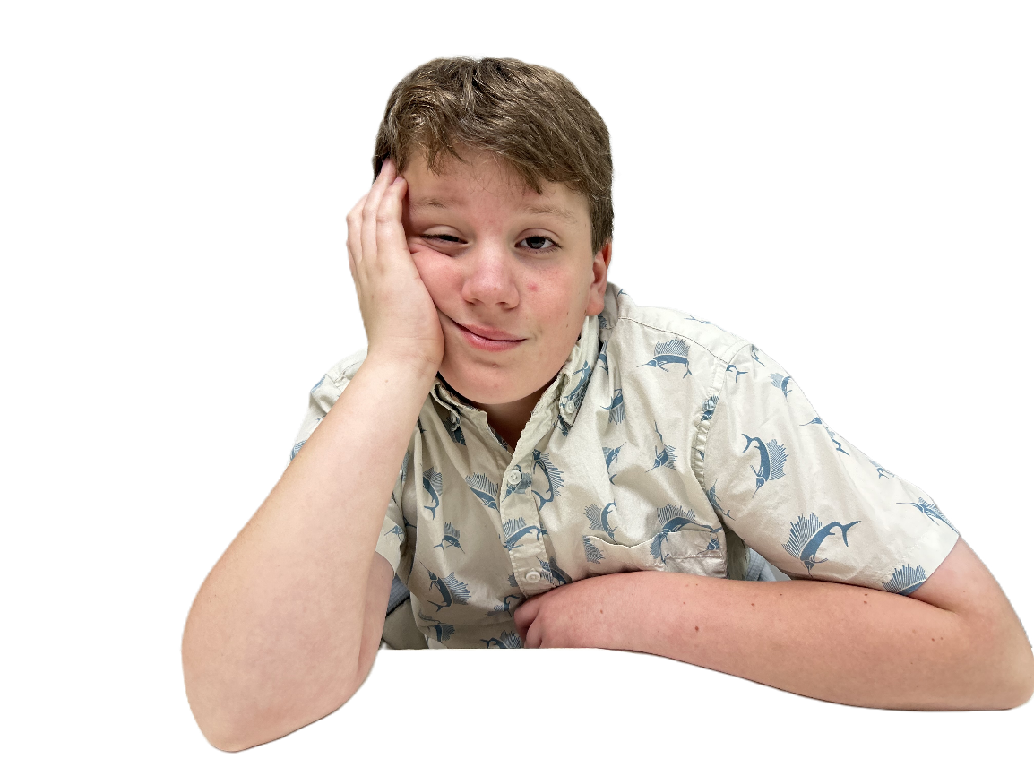
WHAT ARE THEY REALLY SAYING?
$100
“I don’t see the value in this.”
“I’m frustrated.”
“I don’t understand this.”
“I’m disengaged.”
“This feels pointless to me.”
“I’m struggling and don’t want to say it.”
STUDENT SAYS
“This is stupid.”
Task for pairs
What is this student really communicating?

Slide 22
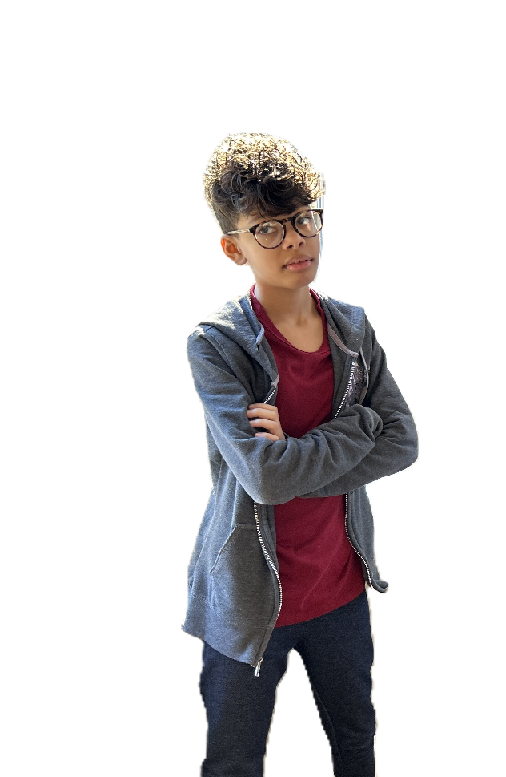
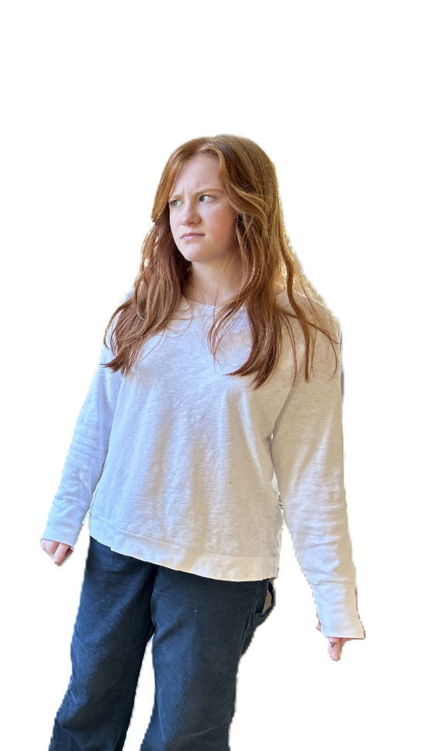
NAME THAT FEELING
$200
Body language charades
Angry
Partner Choice
Hurt
Confused
Respond using
It looks/seems like you feel ______.

Slide 23
SAY IT BACK
$300
“So, you’re feeling frustrated because it seems like you didn’t get a chance to contribute.”
“It sounds like you’re upset because you weren’t included in the work.”
“You feel frustrated because your role in the project was taken over.”
“So, you’re feeling left out because you didn’t get to participate.”
STUDENT SAYS
“You took over the whole project, I didn’t get to do anything.”
Respond using
Respond with both a Reflection and an Emotion.
Reflection
Emotion

Slide 24
IN THE MIDST OF CONFLICT
$400
Student A Response:
“So, you feel left out. What did you want to work on?”
“So, you’re frustrated because you feel like I didn’t give you a chance.”
“It sounds like you feel left out of the work.”
“You’re upset because you wanted to contribute but couldn’t.”
STUDENT SAYS
Student A: “You didn’t do anything!”
Student B: “Because you wouldn’t let me!”
Task for pairs
What should Student A say to show they’re listening?

Slide 25
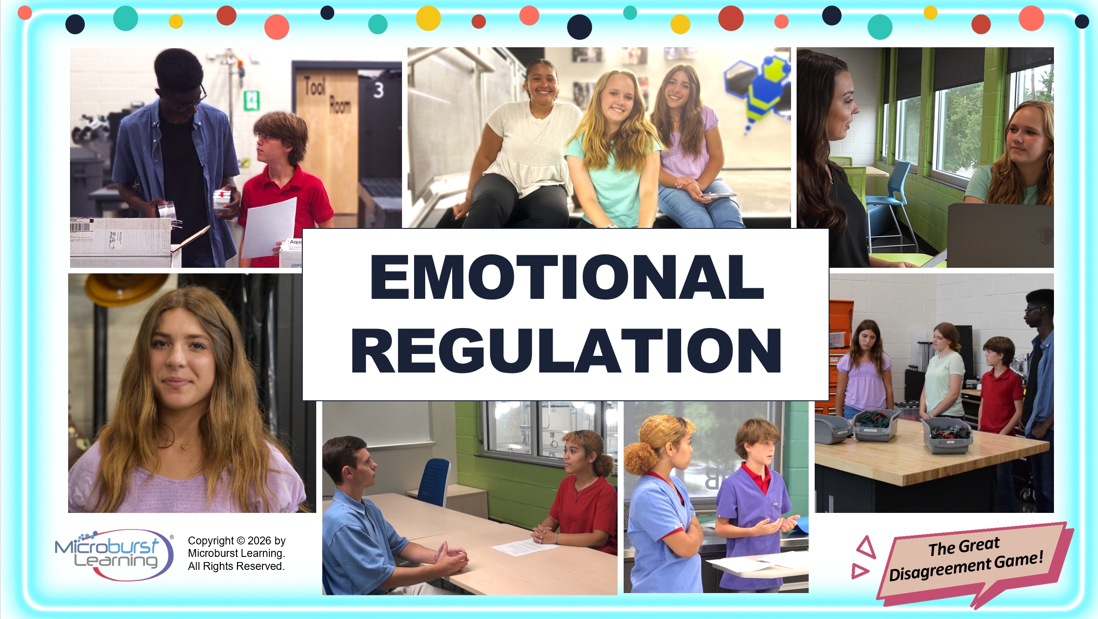

Slide 26
PHONE A FRIEND: GUIDED CONVERSATION TIPS
Phrases that change the temperature
LISTEN
“What I'm hearing is…”
REGULATE
“I need a minute.”
SPEAK UP
“I felt ___ when ___.”
OWN IT
“My part in this was…”

Slide 27

READ THE LIGHT, WHEN TO ENGAGE
Conflict has a stoplight.
RED
ATTACK
STOP.
YELLOW
EMOTIONS
SLOW DOWN. Calm first.
GREEN
IDEAS
GO. Talk it through.

Slide 28
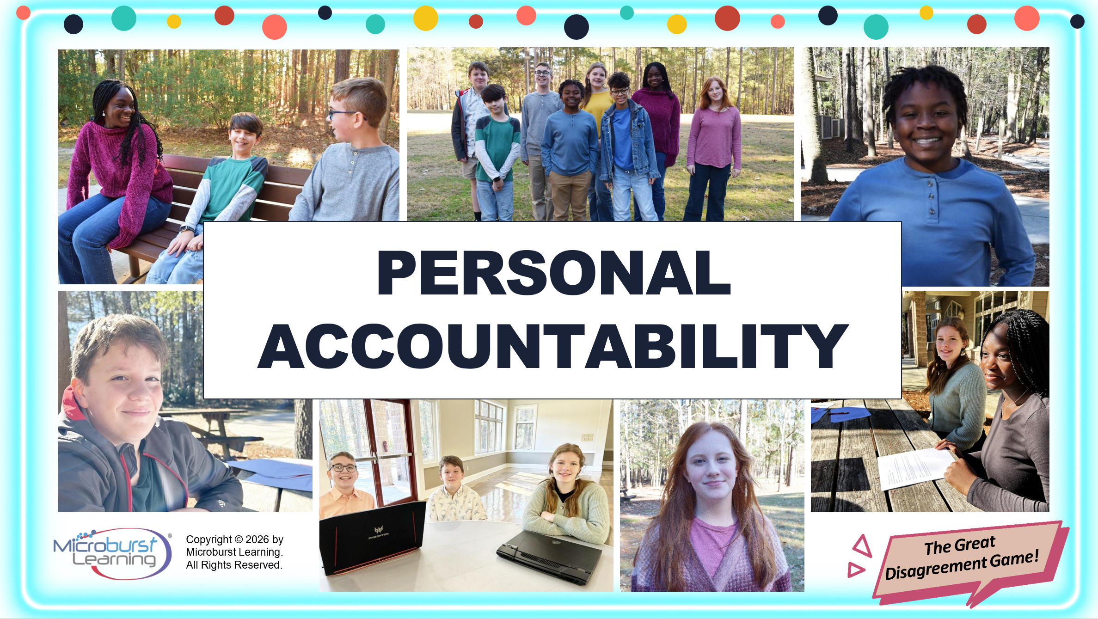
Notes:
You have all heard… you can’t control what happens but you can control your response… Lets give your students a tool to use.

Slide 29
READ THE LIGHT, WHEN TO ENGAGE
Conflict has a stoplight. Teach students to read it.
RED
ATTACK
P
PREPARE.
O
OWN.
YELLOW
EMOTIONS
P
PROCEED.
GREEN
IDEAS
Notes:
The POP method is proven to help those in the middle of conflict de-escalate any situation and come to a solution.
P: Prepare what you are going to say.
What do you want to say to the person?
How should you say it?
Where should you say it?
O: Own what you say.
Reread what you want to say to the person.
Does it express how you feel in a respectful way? Yes or no?
P: Proceed with what you have to say.
Should you say this to the other person? Yes or no?
If you are unsure, ask a trusted friend, teacher or colleague and talk it through.

Slide 30
POP
P | Prepare what you are going to say. What do you want to say to the person? How should you say it? Where should you say it?
O | Own what you say. Reread what you want to say to the person. Does it express how you feel in a respectful way? Yes or no?
P | Proceed with what you have to say. Should you say this to the other person? Yes or no? If you are unsure, ask a trusted friend, teacher or colleague and talk it through.
Notes:
Practice with your students. Give them secnarios… have them write down what they want to say… Prepare… besure to think about body language and tone of voice!

Slide 31
PREVENT EMOTIONAL RESPONSES
Calm → POP → Listen …. Make a Plan
CALM
POP
(PREPARE, OWN,
PROCEED)
ACTIVELY
LISTEN
Three slow breaths.
“I feel ___ because ___.”
Hear what the other person has to say.
Make a Plan

Slide 32
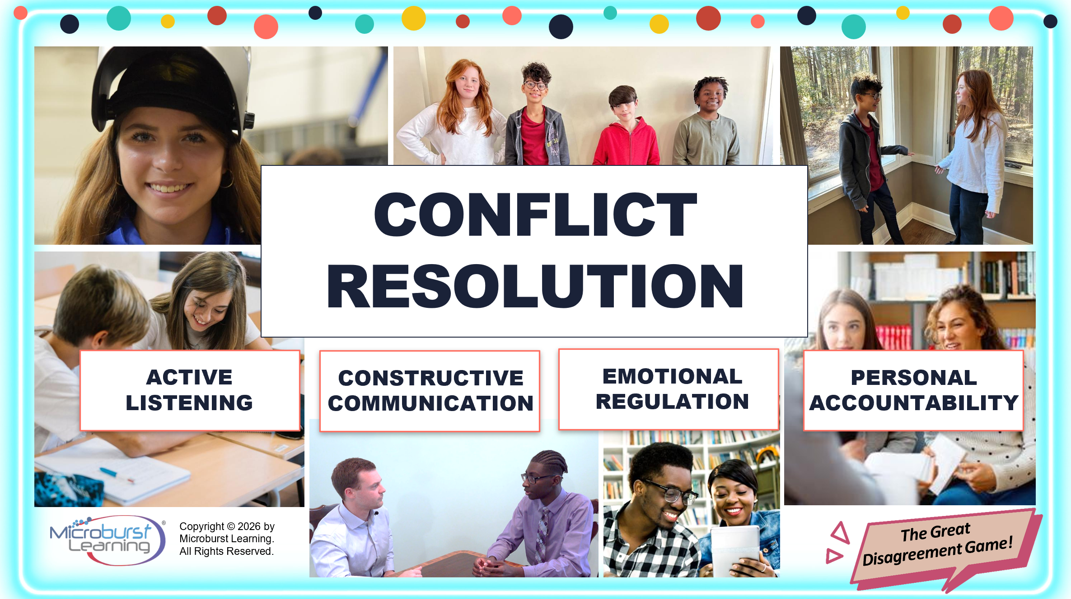

Slide 33
ACTIVITY • 8 MIN • EVERYONE
ACTIVITY
Head, Shoulders, Knees & No’s!
Role Play
Up next…

Slide 34
P
Head, Shoulders, Knees and No’s!
Prepare: How will you respond?
Your friend is upset.
"Why did you tell Fred what I said?!?"
YES: Head NO: Nose
You shouldn't have told me…
if you didn't want him to know.
You know I can't keep a secret!
I'm sorry,
I didn't realize you wanted to talk to him first.
OP
Prepare | Own | Proceed

Slide 35
O
Head, Shoulders, Knees and No’s!
Own: Consider the Consequences
Your friend is upset.
"Why did you tell Fred what I said?!?"
YES: Shoulder NO: Nose
Your friend is angrier than ever.
Your friendship is restored.
Your friend invites you to hang out.
Your friend doesn't trust you anymore.
P P
Prepare | Own | Proceed

Slide 36
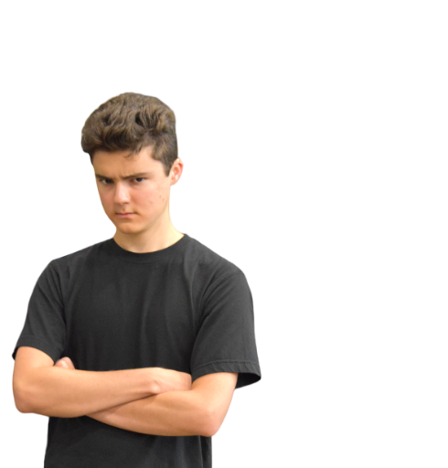

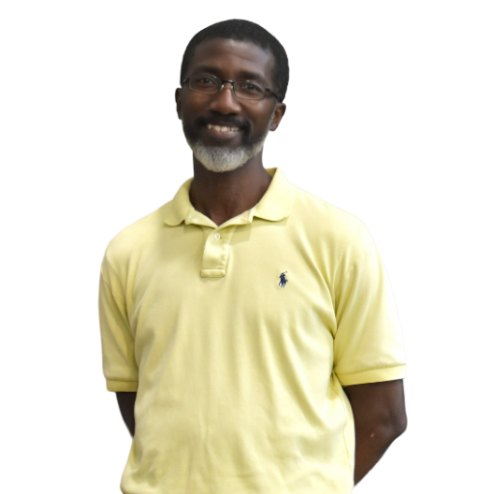

P
Head, Shoulders, Knees and No’s!
Proceed: Go ahead with your response?
"Why did you tell Fred what I said?!?"
YES: Knees NO: Nose
You know I can't keep a secret!
OP
Prepare | Own | Proceed

Slide 37
Head, Shoulders, Knees and No’s! Debrief
"Why did you tell Fred what I said?!?"
PREPARE
I'm sorry, I didn't realize you wanted to talk to him first.
OWN
You know I can't keep a secret!
Your friendship is restored.
Your friend invites you to hang out.
PROCEED
Positive Tone of Voice
Neutral or Smiling Body Language
Planned Word Choice
Prepare | Own | Proceed

Slide 38
FINAL ROUND • TAKEAWAYS
Five things to take with you
★
Conflict is not a “bad” thing. It can lead to strong ideas!
★
Encourage active listening and paraphrase.
★
Remember to read the conflict stop sign and POP.
★
Practice through role play and non stressful situations.
★
Accountability = prevention or repair, not negative

Slide 39
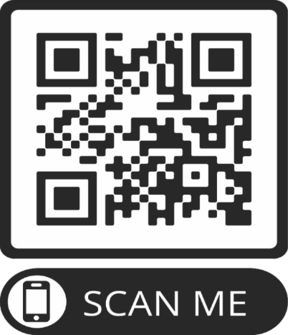
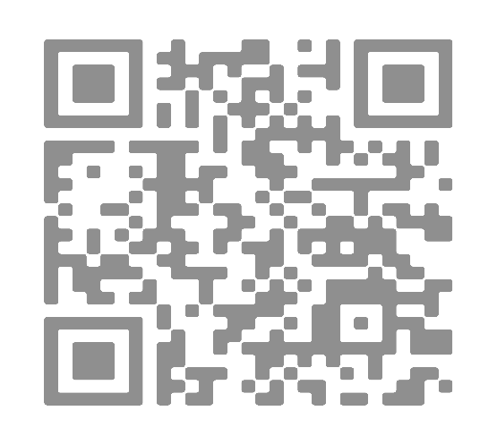

SWEET VICTORY!
AND THE WINNER IS…
YOUR STUDENTS.
QUESTIONS?
& LEARN MORE
ACTIVITIES
www.microburstlearning.org
Teach one tool Monday. That's the assignment.

Slide 40
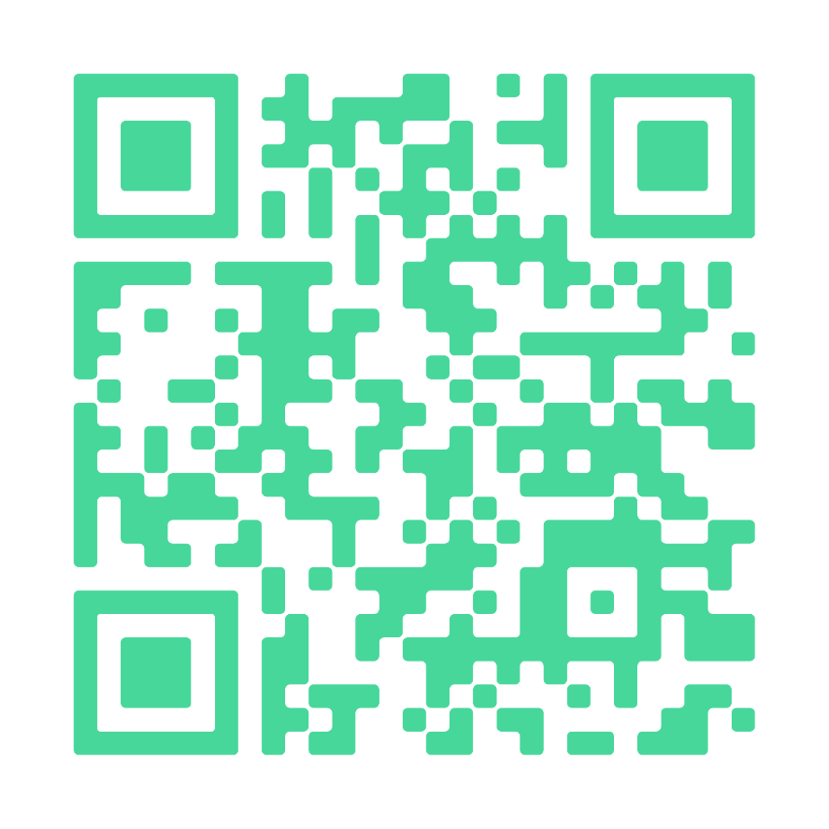
TAKE IT HOME • CLASSROOM PLAYBOOK
4 game-style activities for your students
1
Mind your P’s & Q’s
2
Say it Back
3
Point at your Chin
4
POP!

