Slide 1

Connecting Core and Career Learning
Bridging Core Disciplines with Career and Technical Education Pathways to Enhance Student Learning

Slide 2

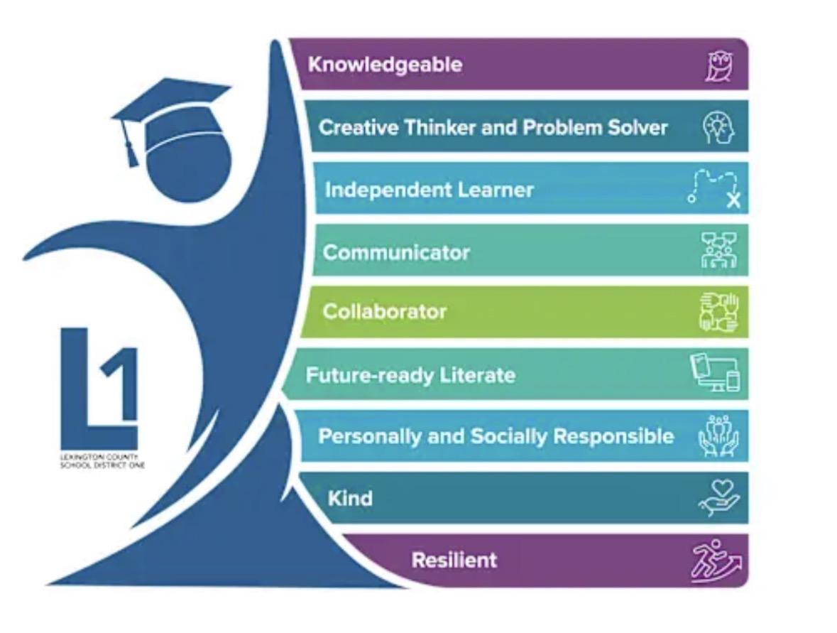
Bryce Myers, Director
Career & Technical Education
Lexington County School District One
Lexington Technology Center
Bmyers@lexington1.net 803-821-3001

Slide 3
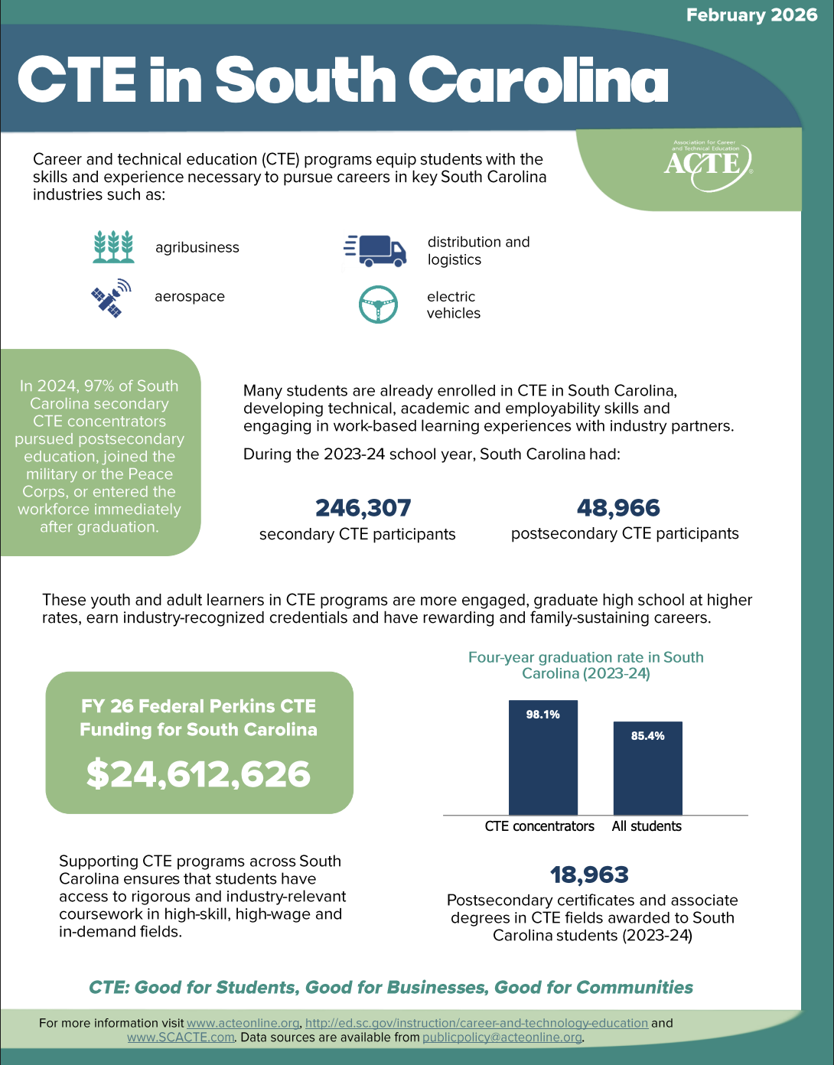
What is CTE?
Career & Technical Education
Include 14 CTE Career Clusters
94 CTE Pathways in South Carolina
CareerTech.Org/CareerClusters/

Slide 4
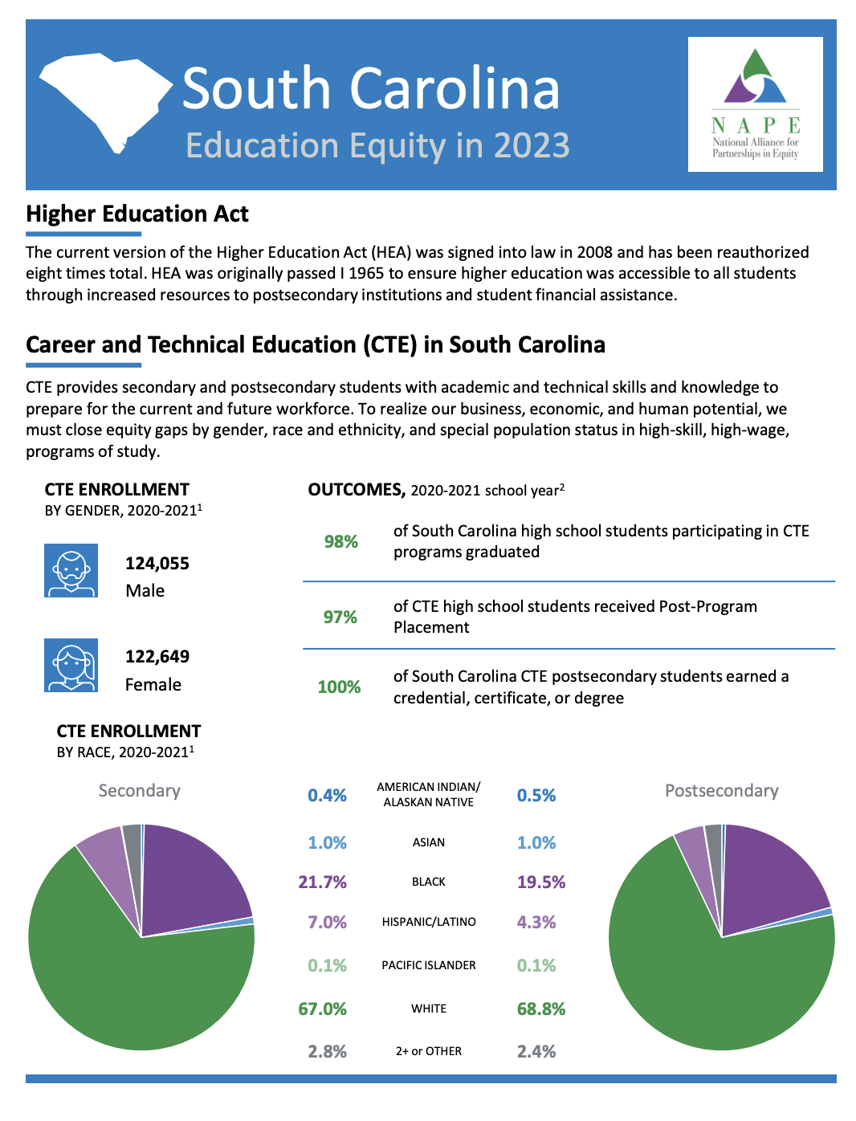
Why CTE?
98.1% graduation rate in SC for CTE concentrators
97% placement in college, career, or military
Increased wages with skills and certifications
Exposure to industry technologies and workforce partners
Gives students an opportunity to explore special interest and potential college majors and careers.

Slide 5

The Impact on Graduation Rate
Did you know?
Closing the Engagement Gap
98+%
While the overall national graduation rate is approximately 80%, integrating core academics with CTE elevates completion course completion and academic success dramatically.
Connecting “Real-World Learning” to academic concepts ignites relevance and meaning for students who in return remain in school because they understand why the academic principle is important.
Midlands Region
Graduation Rate for CTE Concentrators

Slide 6
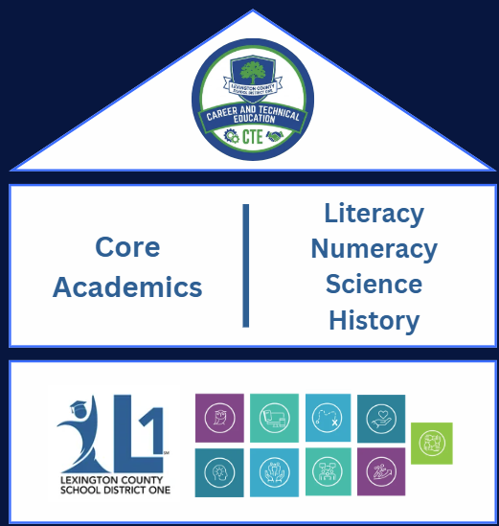
Building Blocks for
Student Success
Career & Technical Education
Core Academics
Character - Graduate Profile

Slide 7
Why are these connections important?
Retention and Purpose - High-risk students are up to 8 to 10 times less likely to dropout of high school if enrolled in an integrated academic-CTE curriculum.
Colleges are Mostly CTE Experiences: More than 80% of students taking an academic track alongside high-rigor CTE satisfy standard college and career outcomes.
Enhanced Workforce Preparation: Graduating with approved, stackable industry-recognized certifications provides immediate labor market advantages and higher entry salaries.
Career & Technical Education is for ALL students. Students are best prepared for the workforce when they combine rigorous academic core content with challenging, hands-on Career & Technical Education courses and skill work.

Slide 8
Why are these connections important? (continued)
Increases awareness of CTE and recruitment and retention opportunities
Provides sense of purpose & impacts students’ value of their own education
Brings relevance to core material & answers “Why?” and “How?”
Enhances instruction, teacher collaboration, & cross-curricular collaboration
Broadens the students’ perspective and practical experience
Impacts the employability of the student
Provides lab experience to enhance Core Courses
CTE IS THE LEARNING LAB FOR CORE ACADEMICS!

Slide 9
Why do we work in “SILOS”?
How do we promote cross-curricular opportunities?
For generations, traditional models separated academic instruction from career training. Academics is for one group of students, and Career and Technical Education is for this group of students. When in actuality the academics principles are connected and necessary to complete project based, CTE experiences. When we fail to make the connection, it limits student engagement and workplace preparation.

Slide 10






Examples of Integration and Collaboration
Standard Crosswalks
Co-Teaching Models
Dual Credit Pathways
Mapping general education requirements precisely onto professional and vocational skill frameworks to dual-qualify content.
Pairing content-area generalists with CTE educators to design authentic, interdisciplinary lessons and units.
Allowing coursework to fulfill standard academic core markers while simultaneously building technical credentials.
Joint Professional Learning
Classroom Observations & Tours
Teacher Industry Tours

Slide 11
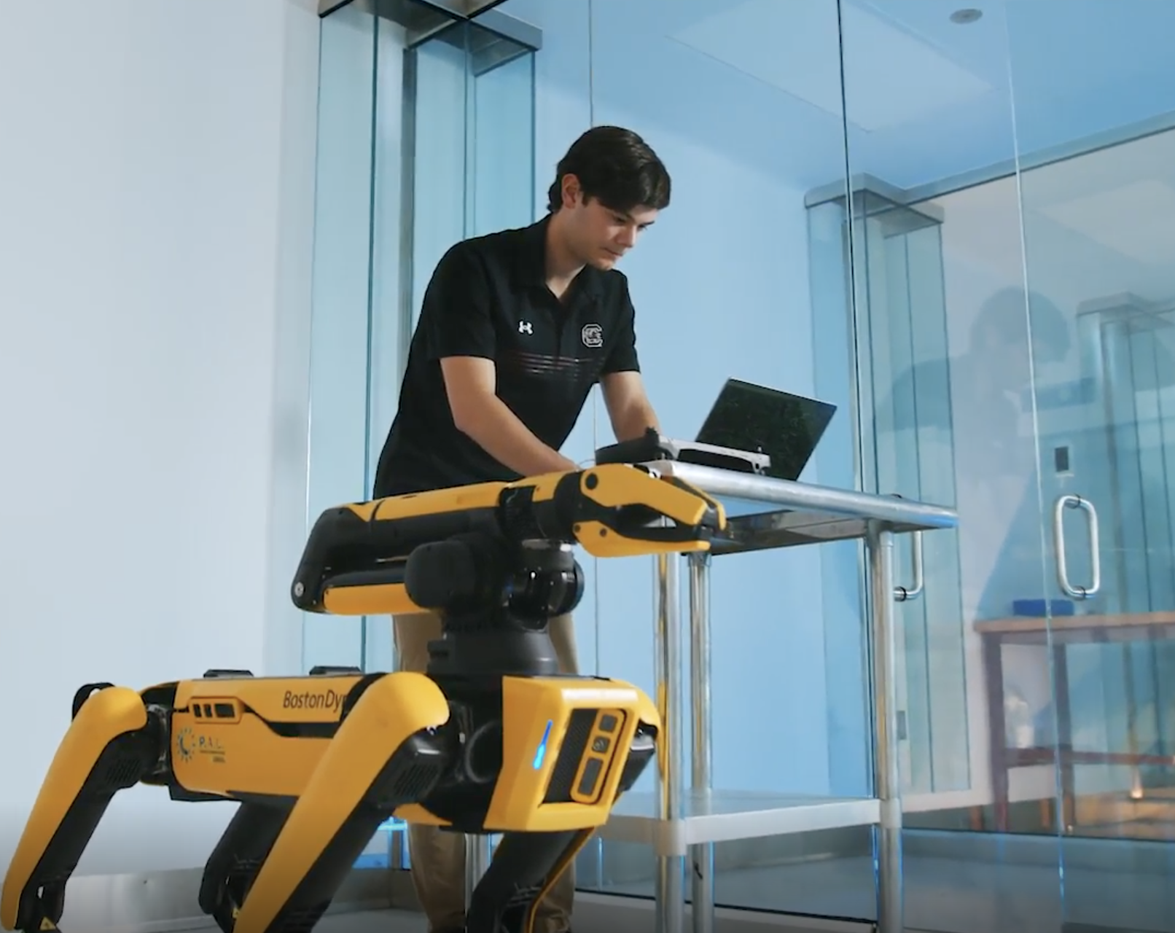
STEM is CTE, CTE is STEM
While Career and Technical Education (CTE) and STEM (Science, Technology, Engineering, and Math) originated from different educational movements, today they are two sides of the same coin. CTE provides the hands-on application, while STEM provides the theoretical framework. When they intersect, the distinction between them virtually disappears.
1. Advanced Manufacturing is Applied Materials Science and Engineering
In a CTE Advanced Manufacturing or Robotics track, students don't just learn how to run machinery; they engage directly with STEM principles.
2. Biomedical Sciences and Allied Health are Living Laboratories
High school CTE pathways in sports medicine, nursing, or biomedical technology are often classified as "vocational," but their entire curriculum is rooted in pure STEM.
3. Agricultural Technology (AgTech) is Environmental Science and Data Analytics
Modern agriculture CTE programs have evolved far beyond traditional farming. They are now hubs for cutting-edge ecological and technological research.
4. Cybersecurity and Networking are Pure Computer Science
Information Technology (IT) pathways in CTE are designed to get students certified and into the workforce quickly, but the day-to-day work is pure STEM.

Slide 12
Discussion Points
Braden Giuliano - Computer Science and STEM
CTE Capstone Day
Pictures and Rubrics
Perkins Performance Indicators

Slide 13
Academic & Career Crosswalk Examples
CTE SUBJECT AREA | MATH | ENGLISH | SCIENCE
Agriculture | Calculating fertilizer application rates per acre and tracking livestock growth metrics. | Writing technical grant proposals for sustainable farming equipment or environmental conservation initiatives. | Utilizing botany, chemistry, and soil science to manage crop genetics, soil pH, and pest control.
Automotive Technology | Using precision measurements (micrometers, torque specs) and ratios to balance engines or align wheels. | Reading, comprehending, and troubleshooting via dense, multi-page manufacturer service manuals. | Applying thermodynamics, fluid dynamics, and electrical circuitry to diagnose powertrain systems.
Building Construction | Using geometry, trigonometry, and spatial reasoning to calculate structural load balances and roof pitches. | Reading, decoding, and interpreting highly detailed building codes, OSHA regulations, and blueprints. | Applying physics (force, stress, and strain vectors) and material science to test structural integrity.
Business | Calculating compound interest, profit margins, break-even analysis, and cash flow projections. | Drafting a comprehensive, written business plan and pitching it to investors. | Analyzing data-driven consumer behavior trends using psychological and behavioral science principles
Computer Programming | Utilizing Boolean algebra, discrete mathematics, and algorithms for software and database structure. | Writing technical documentation, user guides, and clear, syntax-exact command lines or scripts. | Applying electrical physics principles to understand data transmission, semiconductor limits, and hardware circuitry.
Health Science | Calculating precise medication dosages based on patient body weight and fluid conversion ratios. | Charting accurate electronic health records (EHRs) and interpreting complex medical terminology. | Understanding human anatomy, physiology, pathogens, and the chemical reactions of pharmaceuticals.
Machine Technology & Welding | Precision measurements, fractions, X-Y-Z Axis, and Linear Equations. Angles, degrees | Must read technical manuals in understanding machine operations and functions. Customer and internal communications and operations. | Students must understand the periodic tables which contain gases and metals to understand which material is stronger to perform needed cuts.

Slide 14
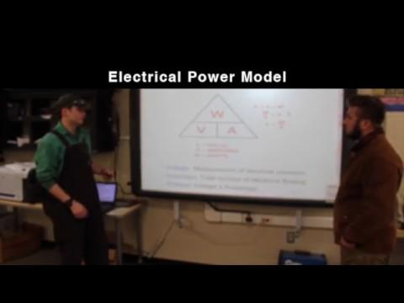
Shared CTE Lessons Implementing Core
Academic Concepts
Electrical Power in Welding

Slide 15
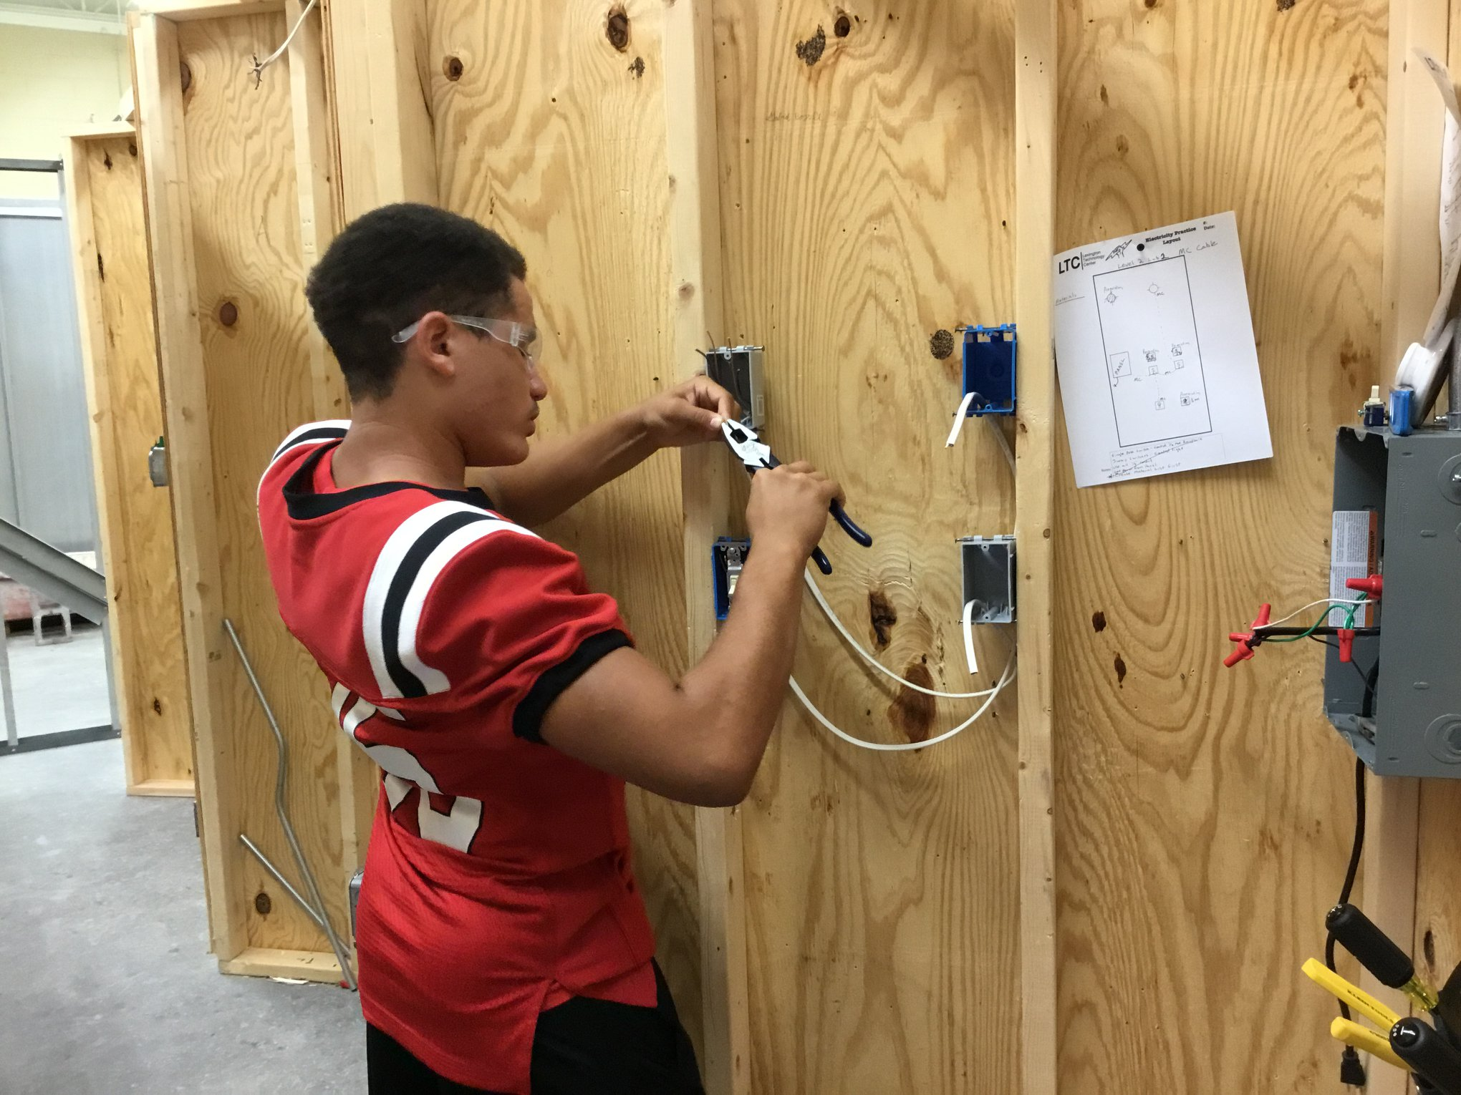
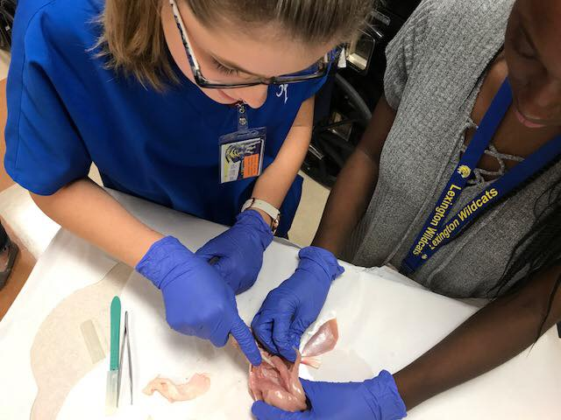
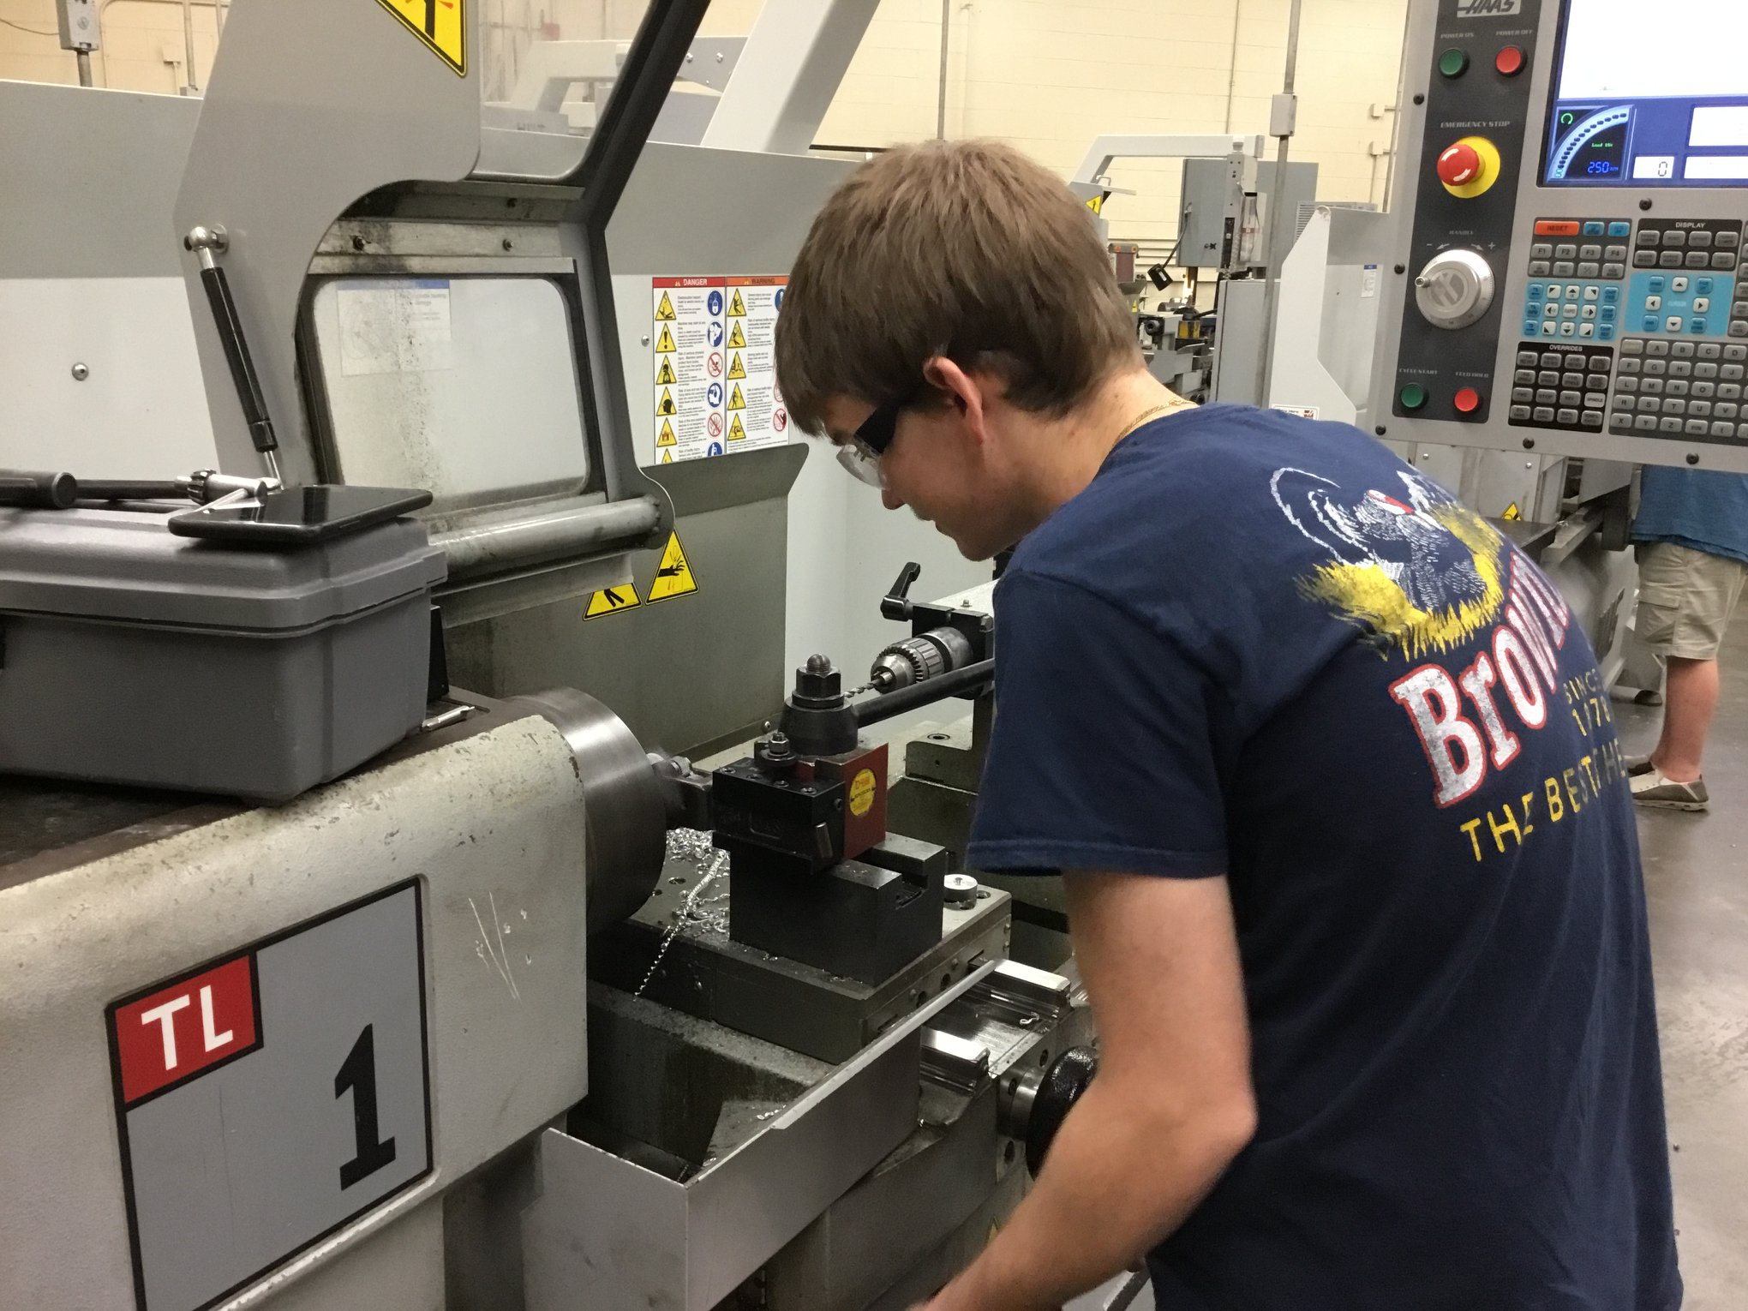
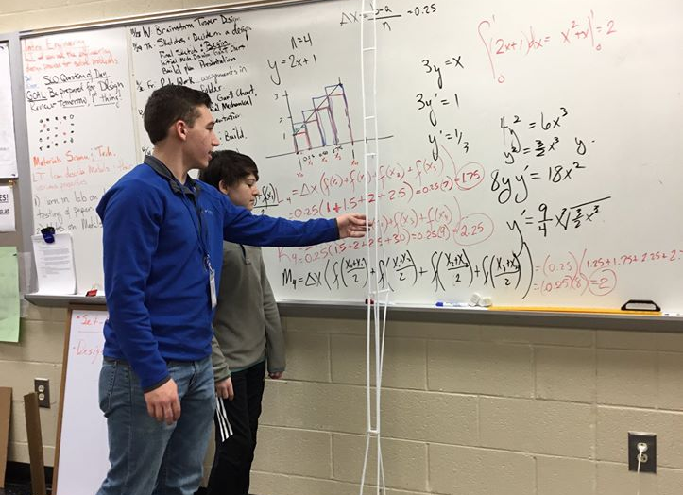

Slide 16
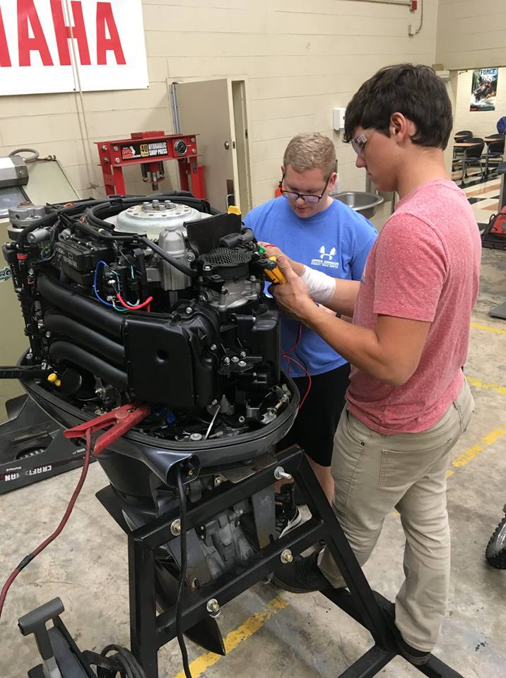
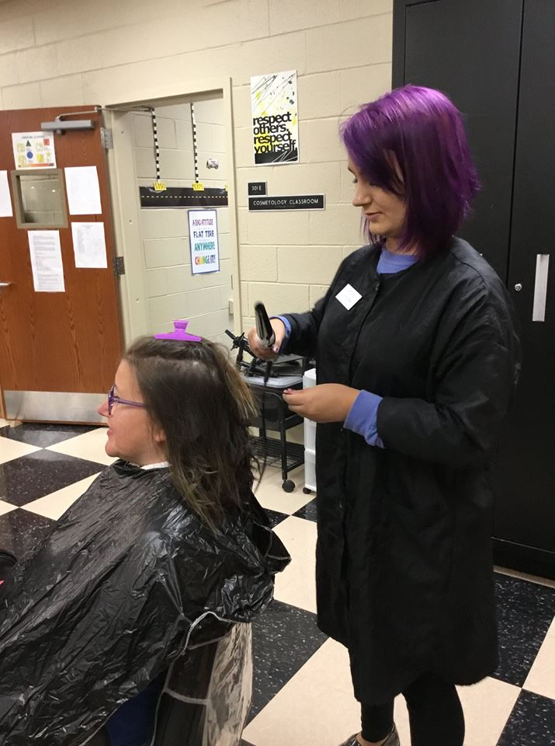


Slide 17
Discussion
Think of a student in your school or program who is a model for the integration of core academics and CTE. Tell their story to your neighbor.
How can your school system encourage the intentional integration of core academics and CTE?
If you are an academic teacher, do you have any suggestions for CTE teachers in integrating academic principles into CTE?

Slide 18
"It is time to dismantle the silos that have long separated Career Technical Education (CTE) from core academics and build a system where every learner, at every level, experiences career-connected learning as the norm... Every classroom can be a launchpad to college and career readiness."
-Association of Career and Technical Education (ACTE)

Slide 19
Career & Technical Education and Core Academics are not separate and unequal.
It is time we work together for student good.

