Slide 1

Beyond Tracking to Transformation:
Using Palmetto Pathways to Drive Meaningful IGP Conversations
Palmetto Education Summit
Dr. Erin Clarke, SCDE
Traci Shigley, Panorama Education
June 17, 2026
Notes:
Slide title should be Aptos Bold font, left-aligned, not smaller than 44pt
Audience – To whom/group you are presenting to
Speaker – Who is giving the presentation (may be by name or by department)
Date – Date of presentation

Slide 2
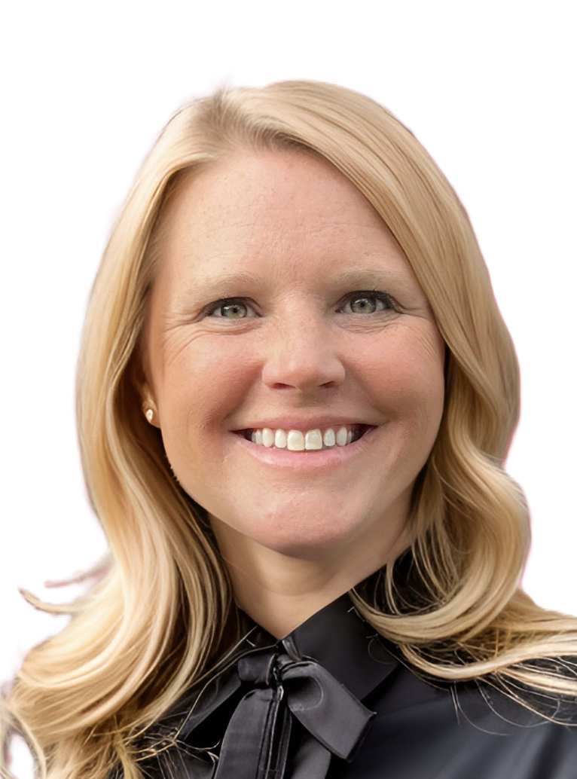


Facilitators
Dr. Erin Clarke
Traci Shigley
Professional Learning
Director

Slide 3
SCDE Office of Career Readiness
Mission: The Office of Career Readiness exists to ensure that every learner in SC can access a high-quality, workforce-aligned education pathway that leads to personal success and economic mobility.
Vision: To lead the nation in delivering transformative systems that empower every South Carolinian, regardless of background or age, to thrive in a dynamic, opportunity-rich workforce.
Notes:
Left aligned
Title font is 88pt
Numbered line item 66 pt
Detail/slide item 36 pt

Slide 4
Agenda
01 Lessons
02 What’s New
03 IGP Tool
04 Professional Learning
05 Fall Regional Workshops
Notes:
Left aligned
Title font is 88pt
Numbered line item 66 pt
Detail/slide item 36 pt

Slide 5



Big Picture: Lessons from Year 1 Rollout Across SC
Positive outcome trends
Engagement and results are growing across the state.
Counselor Feedback
Ongoing improvements are shaped by counselor input.
Implementation support
SCDE + Panorama Partnership to navigate challenges and scale success.
A common theme statewide: clearer workflows, stronger counseling tools, and support that makes the work manageable.
Notes:
Header font 50pt
Content/body text font 26pt

Slide 6
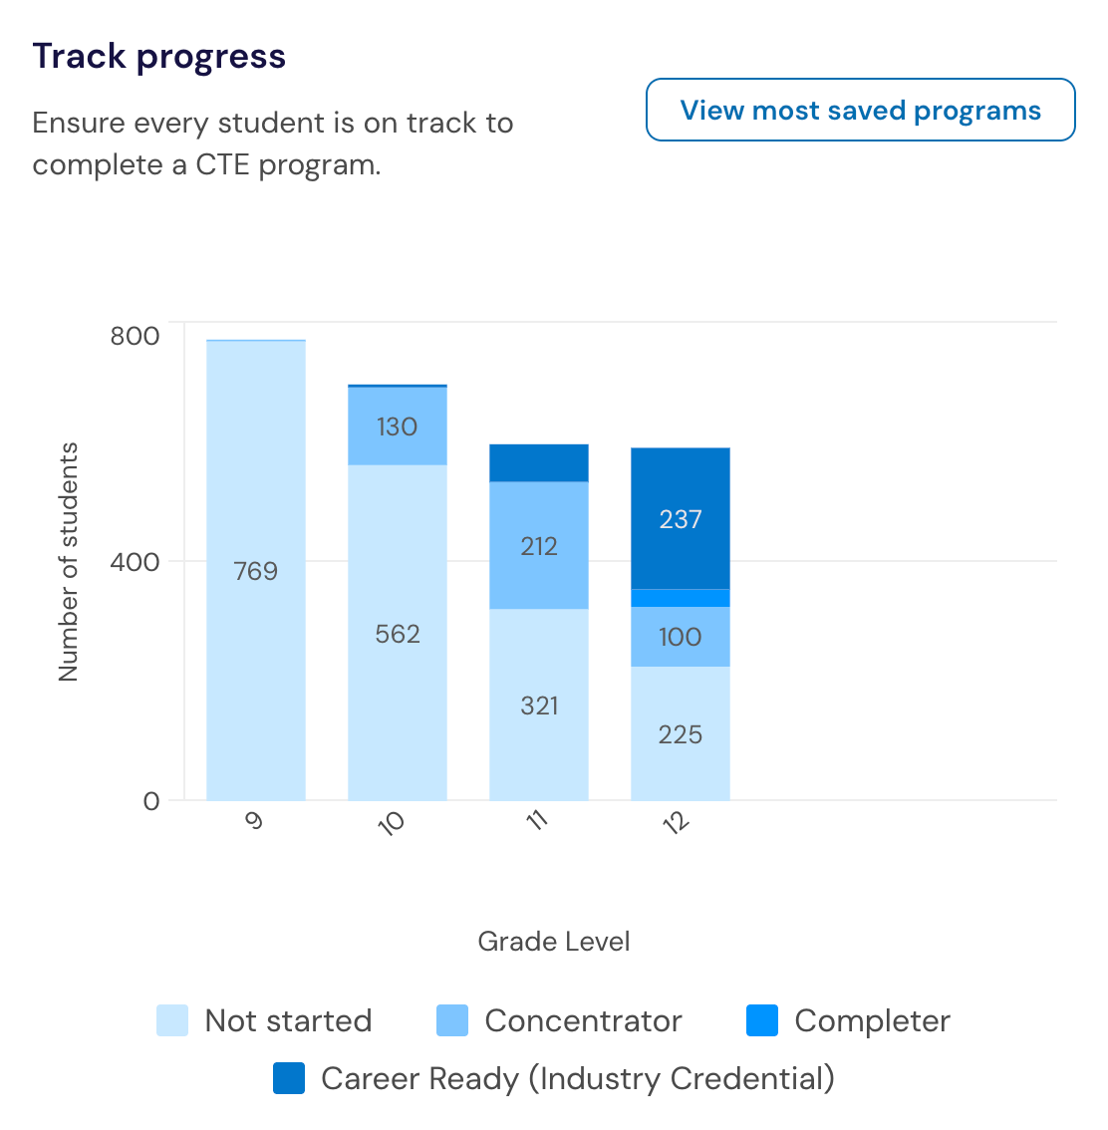
What’s New in Palmetto Pathways?
Insert and format picture to fit allotted box frame
CTE Aggregate Reports
Seals of Distinction Aggregate Reports
9GR Calculation
Notes:
Adjust yellow box outline as needed height wise, not width wise
Header font 50pt
Content left is 26pt

Slide 7
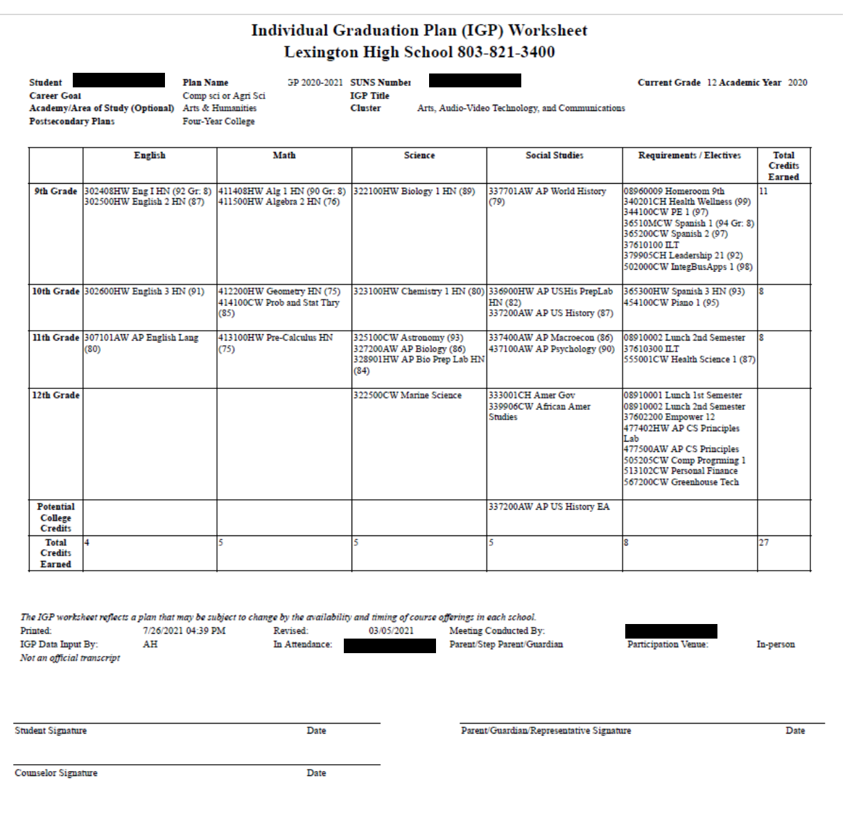
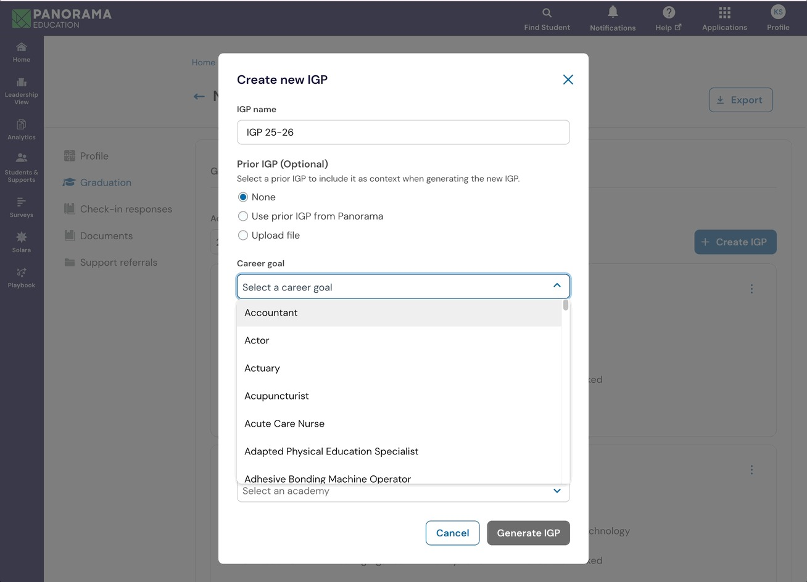
Introducing the IGP Tool
From this…
To this…
Notes:
Header font 50pt
Content/body text font 26pt

Slide 8


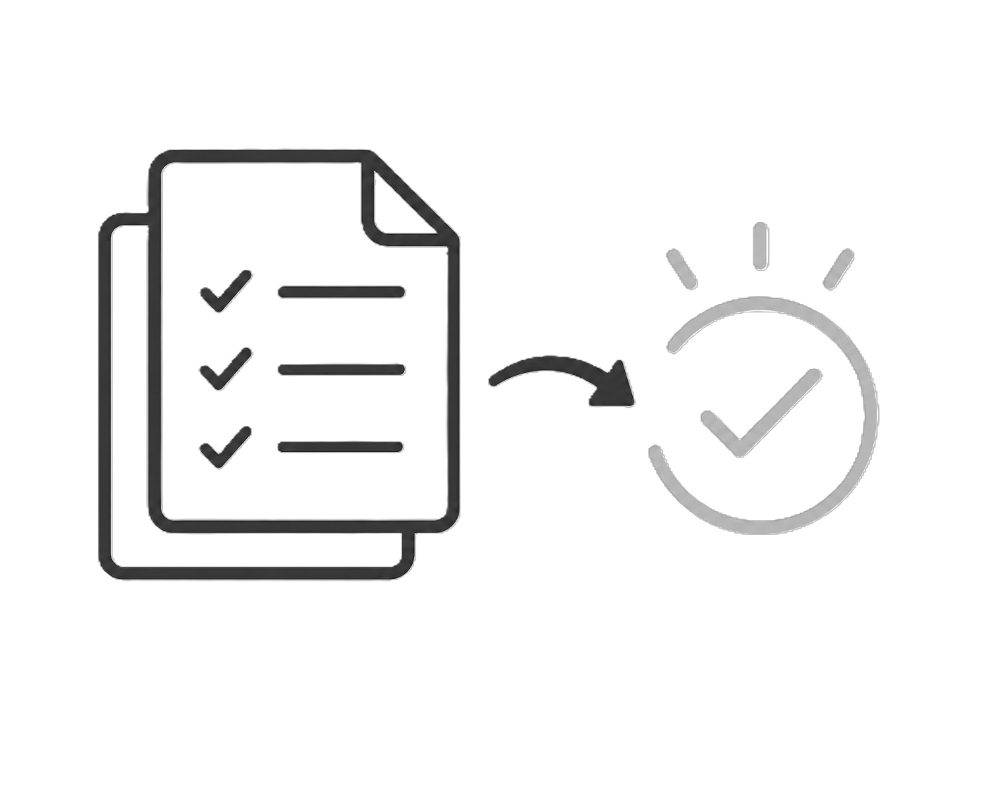
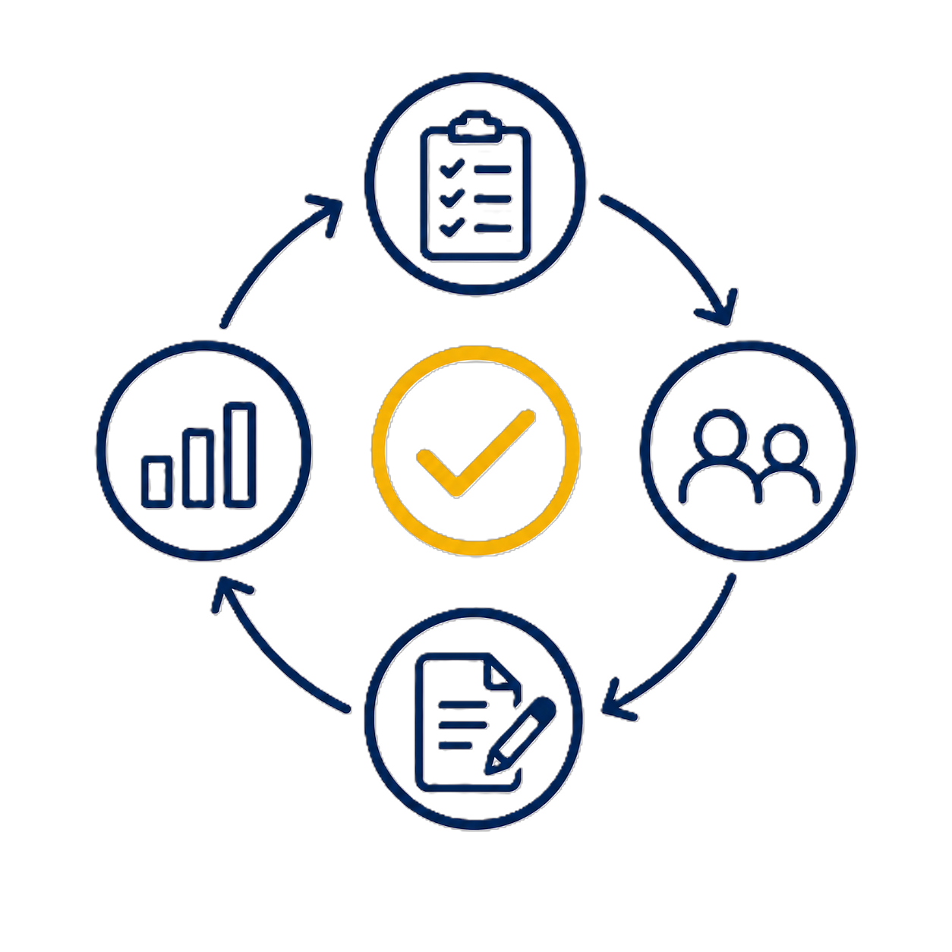
Why Build the IGP Tool with Panorama?
Reduce manual work
Create a consistent workflow
Keep planning student- centered
Increase student outcomes
Counselors lead the conversation; the IGP Tool makes it more efficient, consistent, and impactful.

Slide 9
What the IGP Tool Can Do: DEMO
Transform planning conversations from a required task into a meaningful opportunity to help students envision and achieve their future.
Notes:
Header font 50pt
Content/body text font 28pt

Slide 10
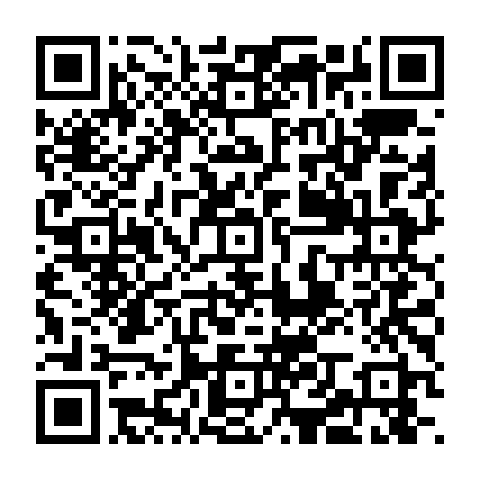
Phased Rollout + Interest Survey
Phased Approach
Interested in becoming an IGP Tool Early Explorer?
Phase 1: Early explorers — pilot the tool, shape improvements, and receive PD support
Phase 2: Expand — bring in additional districts, with continued PD support
Phase 3: Broader rollout — scale across the state with differentiated PD support
*8th grade counselors may be included in any phase of the rollout
Notes:
Header font 50pt
Content Header is 28pt bold
Content/body text font 26pt

Slide 11
Ongoing Professional Learning Support
Regional Workshops | Deepen Palmetto Pathways workflows and support IGP implementation through statewide, in-person learning
Dual-Track Webinar Series | Statewide virtual support for both Pathways workflows and IGP rollout; product updates
Differentiated Virtual Support | Targeted support aligned to district readiness and implementation patterns
Notes:
Header font 50pt
Content left is 26pt
Content right is 28pt

Slide 12
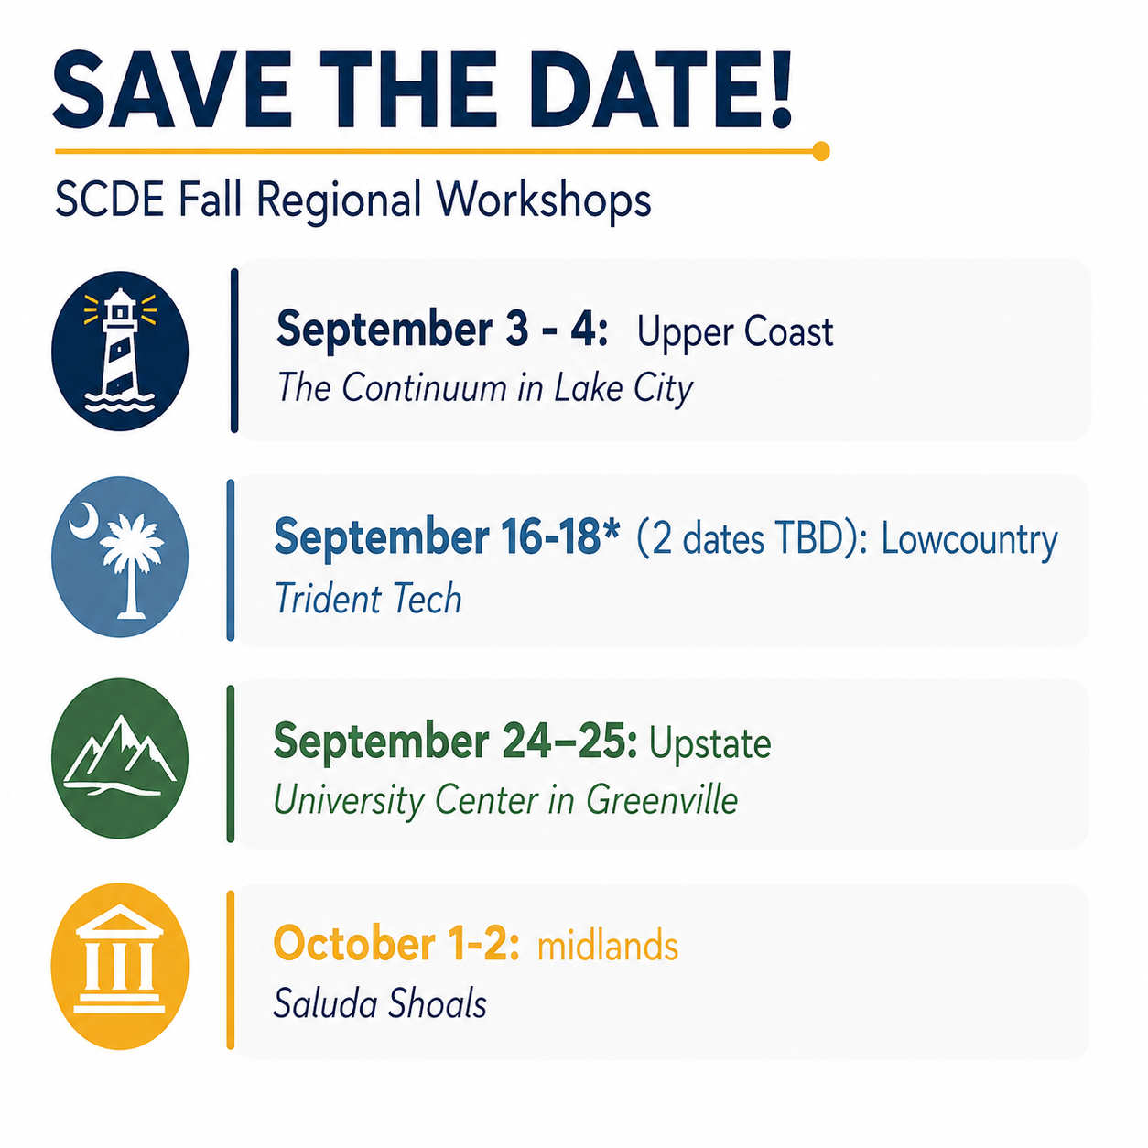
Fall Regional Workshops
Notes:
Do not pin more than 5 locations per slide
Header font 50pt
Content left is 26pt

Slide 13
ed.sc.gov
Notes:
Slide title is hidden from display

