Slide 1

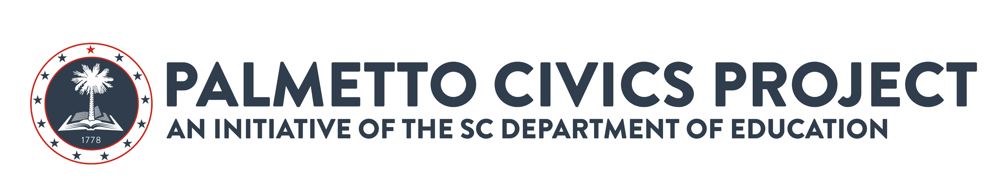
Overview
Corey M. Bedenbaugh

Slide 2
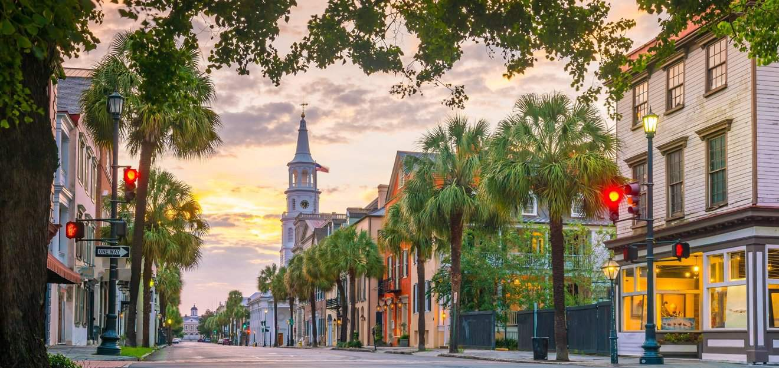
Civic Hero Challenge
Who is someone from SC, past or present, that has made a difference in our communities?
What qualities made them effective civic leaders?
This Photo by Unknown Author is licensed under CC BY-NC-ND

Slide 3
Overview
The Palmetto Civics Project is a statewide initiative focused on helping South Carolina students better understand American history, government, and citizenship. By providing free, standards-aligned resources to schools, educators, and families, the project aims to prepare every graduate to understand both the privileges and responsibilities of being an American citizen. Through lessons centered on liberty, self-government, and the Constitution, the initiative works to strengthen civic literacy and equip students to engage thoughtfully in civic life and help preserve our democracy.

Slide 4
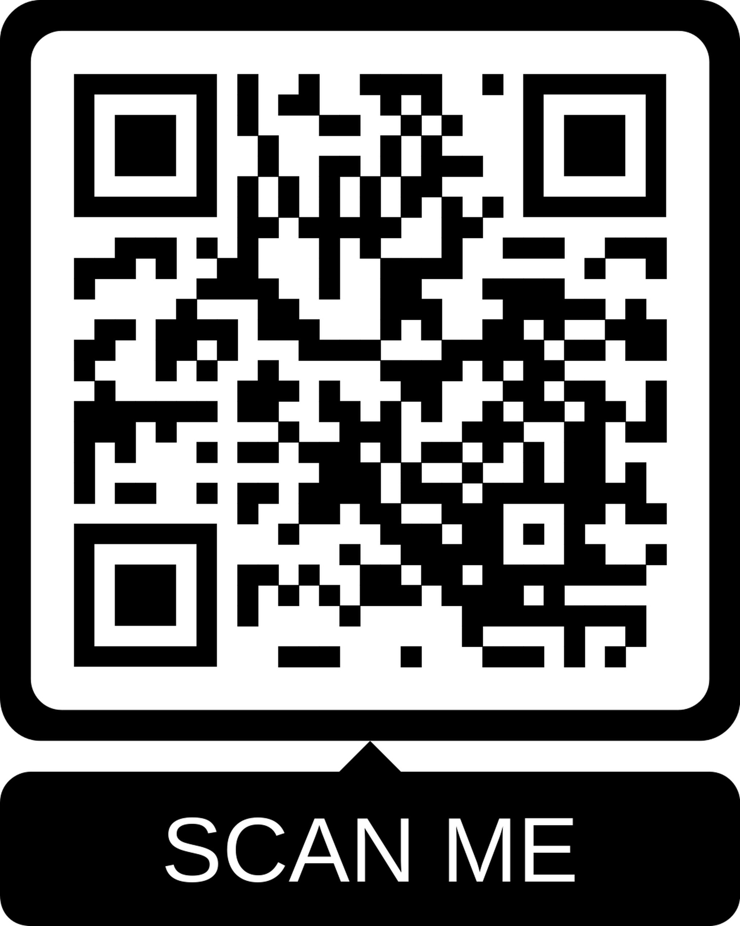
Link:
https://ed.sc.gov/palmettocivics/

Slide 5
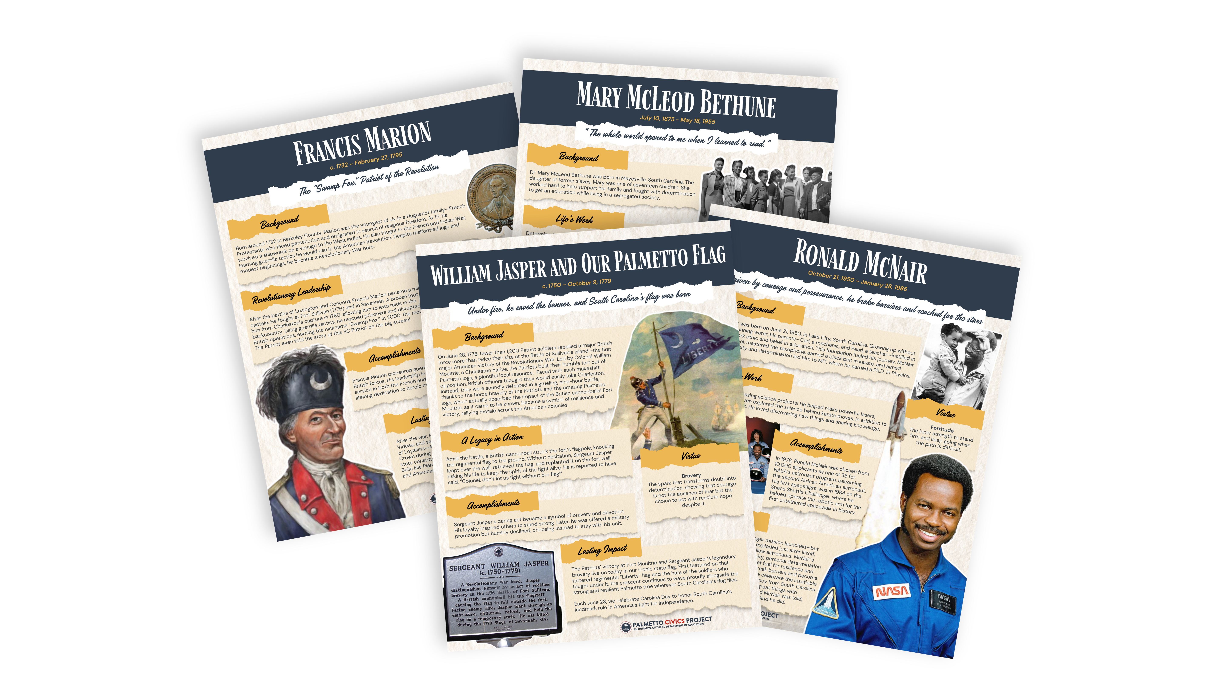
Palmetto Pioneers
The Palmetto Pioneers highlights influential South Carolinian's whose leadership, courage, sacrifice, and perseverance helped shape America's history.
Their stories model the character and virtues students can learn from as they grow into responsible citizens and community leaders.
Featured figures include Mary McLeod Bethune, Francis Marion, Ron McNair, Maude Callen, William Jasper, Briggs v. Elliott, and Ann Pamela Cunningham.

Slide 6
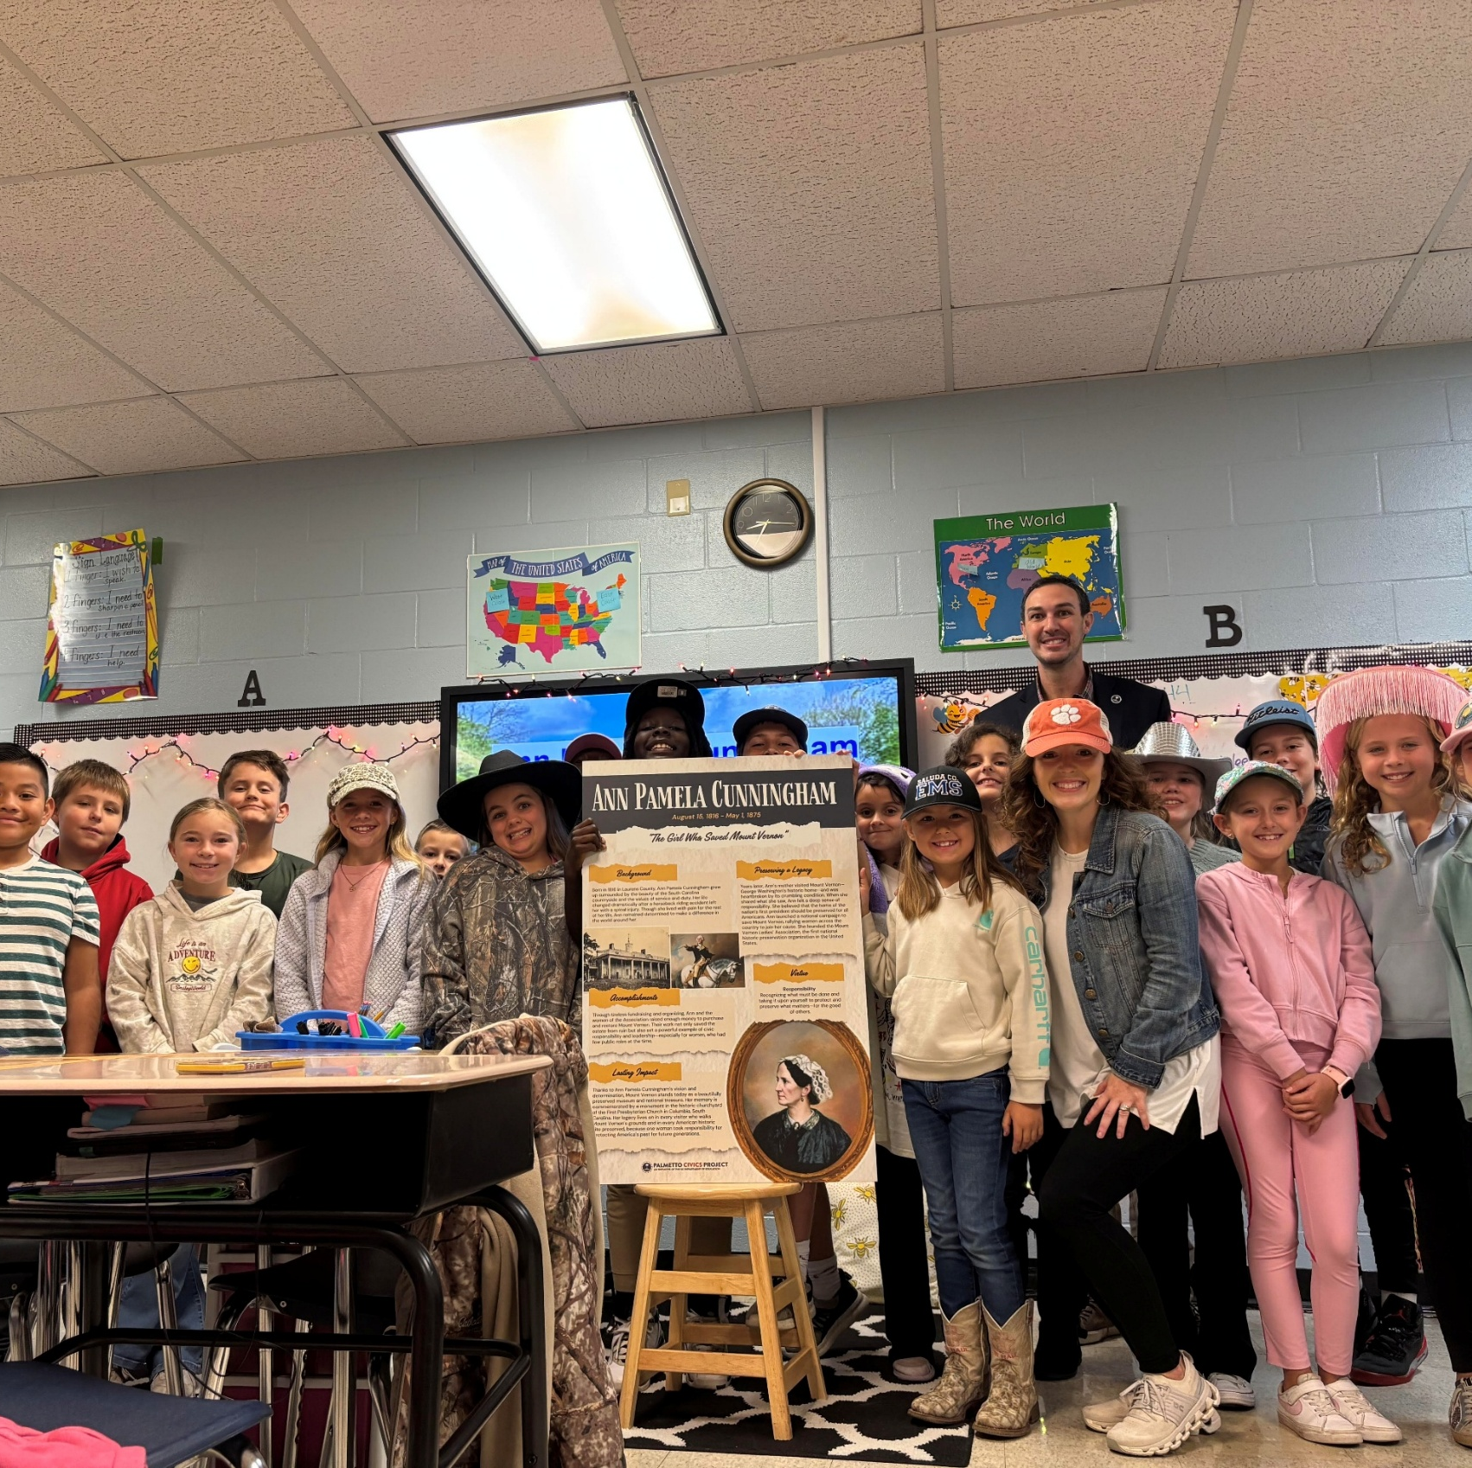
Palmetto Pioneers
Character Education can be embedded naturally into history instruction
Historical Figures help students connect virtues to real people and real choices (Relevance)
Resources encourage discussion around leadership, resilience, and service
Classroom Connections:
Character Trait Analysis
Student Biography Projects
Civic Virtue Discussions
Leadership Reflective Writing

Slide 7

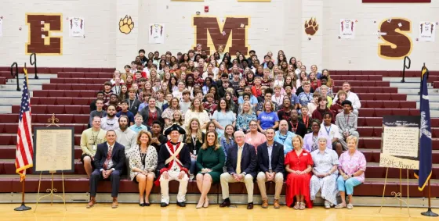
The American Battlefield Trust
This partnership highlights South Carolina’s major role in the Revolutionary War through standard aligned lessons about battle such as Cowpens, Camden, and Sullivan’s Island.
Students explore how South Carolinians helped shape America’s fight for Independence.
One of the most powerful ways to bring history and civics to life is to connect students to the places where history happened.

Slide 8
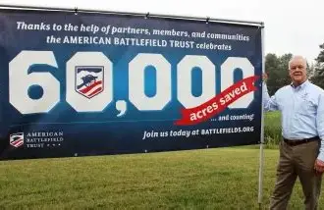
Resources Available
Lessons Tied to Both North and South Carolina Standards
  Lesson plans are adaptable, but focus on 4th and 8th grades
  Each lesson has embedded resources such as presentations, videos, worksheets, graphic organizers, and Primary Sources.
Traveling Educational Trunk Exhibits
In-Person and Virtual Teacher Trainings
School Field-Trips (Grants)
Youth Leadership Program
Interactive Maps

Slide 9
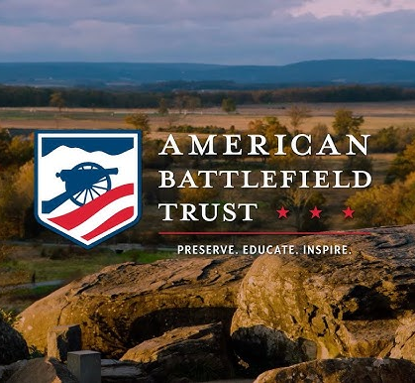
The American Battlefield Trust
Local History increases student engagement.
Students better connect with history when they see the connection to them and their communities.
The resources encourage inquiry-based and place-based learning.
Classroom Connections:
Revolutionary War mapping Activities
Primary Source analysis
History simulations
Virtual battlefield explorations

Slide 10
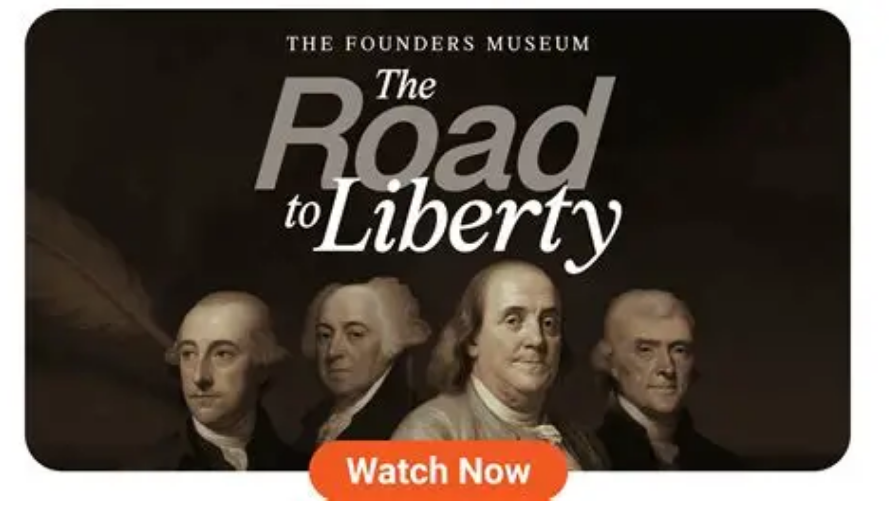
The Founders Museum
This America 250 resource invites students to explore South Carolina’s role in America’s founding by learning about the four South Carolinians who signed the Declaration of Independence, as well as key people and events that shaped America’s fight for freedom.
The resource incorporates historical storytelling so students can experience the Revolution and the road to Independence in an engaging and meaningful way that is brought to life.
Categories: Signers, Major Events, Ladies of the Revolution, Founding Fathers, Create Your Own Founders Museum

Slide 11
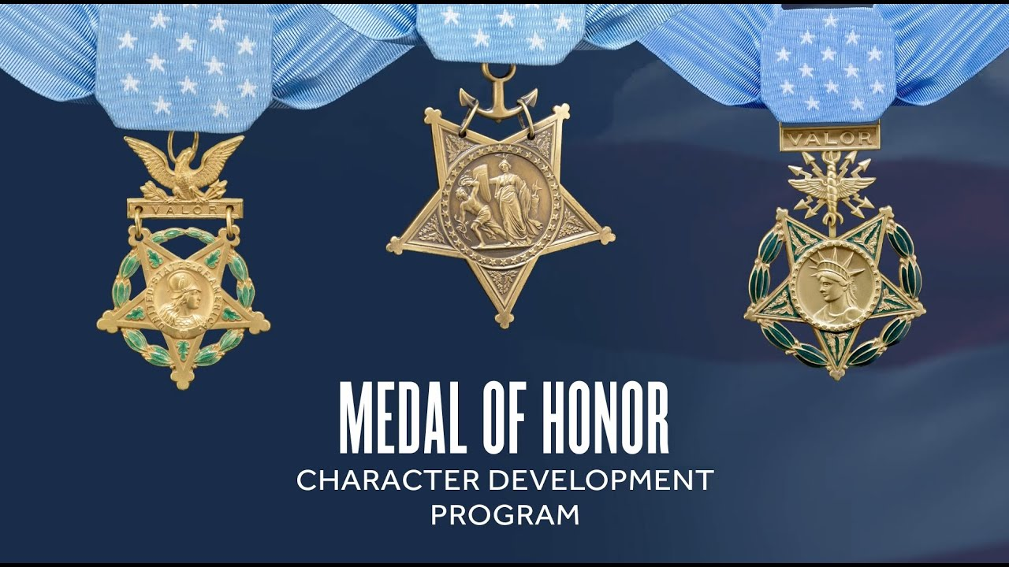
Medal of Honor
Character Development Program
This is a partnership with the Congressional Medal of Honor Foundation.
This initiative brings the stories and values of Medal of Honor recipients into South Carolina classrooms.
Students learn character traits like courage, integrity, sacrifice, citizenship, and patriotism.
Encourages students to look beyond the heroic acts of each recipient and to deeply look at their character traits that made those actions possible for each recipient.

Slide 12
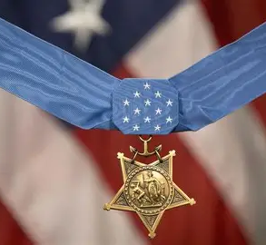
Resources Available
Lessons and videos broken down into elementary and secondary levels
Reading lists
State specific standards alignments
Students can earn a certificate
Can request speakers to your school
Free teacher trainings

Slide 13
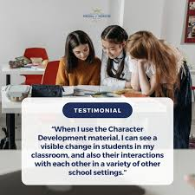
Medal of Honor
Character Development Program
Character development can support school culture and classroom relationships.
Students benefit from examples of service and sacrifice.
Civic value connect directly to leadership and community engagement.
Classroom Connections:
Character lessons
Classroom discussion on ethical decision making
Leadership Activities

Slide 14

Upcoming Training – June 30th @ SCDE
Core Values Teachers say students need most: Integrity (70%), Commitment ( 61%), Service ( 55%)
99% of teachers surveyed valued using real-life stories to teacher character
“Real life examples of people doing brave things, like Medal of Honor Recipients, help students learn how they sacrificed for the good of others. Students need to see that it is a mindset, not just a moment, that changes the world for the better.” —Georgia Educator

Slide 15
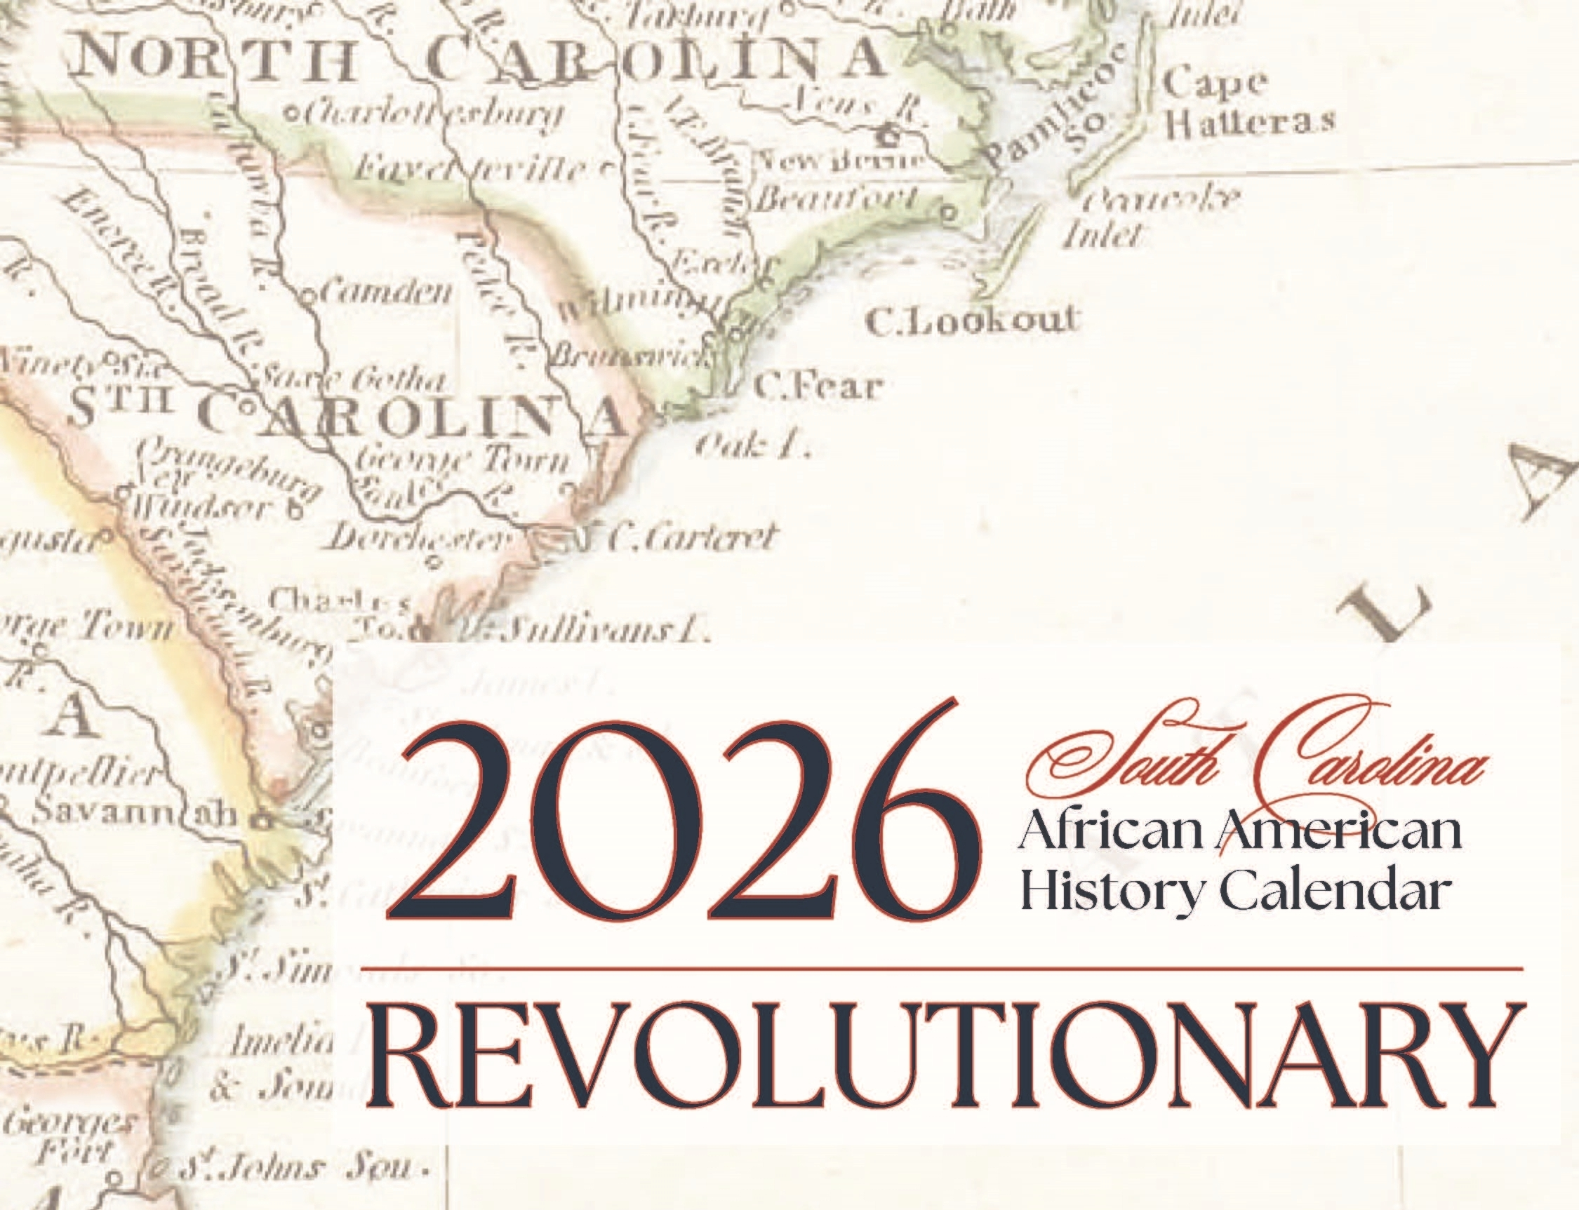
The SC African American History Calendar
One of our longest running initiatives ( 37 years)
A main goal of the Palmetto Civics Project is to help students understand the individuals, events, and experiences that have helped to shape both South Carolina and our nation.
This initiative does that through highlighting the achievements, contributions, and impact of African Americans throughout our state's history.
Along with its educational curriculum, it provides valuable resources that help students, educators, and communities learn and be inspired by our shared South Carolina history.
Notes:
This should be one each of you have seen each year when you get your own calendar.. Link to request copies of it.. Humor with getting to be in same room as Judi Gatson at the unveiling
.
Highlights individuals in wide rage of areas from education, government, civil rights, business, science, faith communities and many others
The resources and lesson plans help teachers bring their stories to life
Link to request copies of

Slide 16
Resources Available
Lesson Plans by Year
Activities by Subject Area and Age
State Standards Tie-ins
Helpful Links to further learning and engagement
“As we look ahead to our nation’s 250th anniversary, the stories featured in this calendar highlight the essential and often unsung contributions of African Americans to America’s founding. We’re honored to present these exemplars of quiet courage and unshakeable conviction as real-life heroes to students in every South Carolina classroom.”
– State Superintendent of Education Ellen Weaver

Slide 17
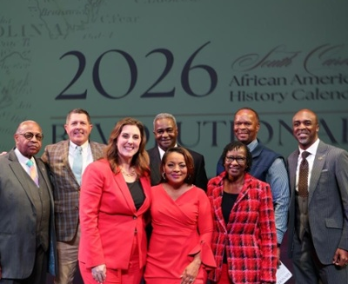
The SC African American History Calendar
A shared history helps to strengthen student understanding and representation.
Historical role models help ensure all students see themselves reflected in the learning.
Resources help support year-around integration, not just for one month.
Classroom Connections:
Biography Spotlights
Research projects
Cross-Curricular literacy integration
Wax Museum

Slide 18
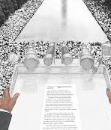
Civil Rights: A Global Perspective
This resource helps high-school students explore Dr. King’s message of hope, courage, compassion, and nonviolent civic progress.
Brings the Civil Rights Movement to life through a global perspective with meaningful historical insights.
Helps students see how local events in SC connect to larger national movements as well as struggles for rights and freedoms around the world that are still ongoing.
Notes:
interconnected rather than isolated.

Slide 19
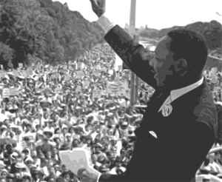
Helps students view history as being interconnected rather than isolated events.
Dr. King’s message still reminds us today, that our history is the story of people coming together to build a better tomorrow.
Classroom Connections:
Civil Rights discussions
Primary Source exploration
Socratic Seminars
Case Studies
How to engage in respectful dialogue

Slide 20
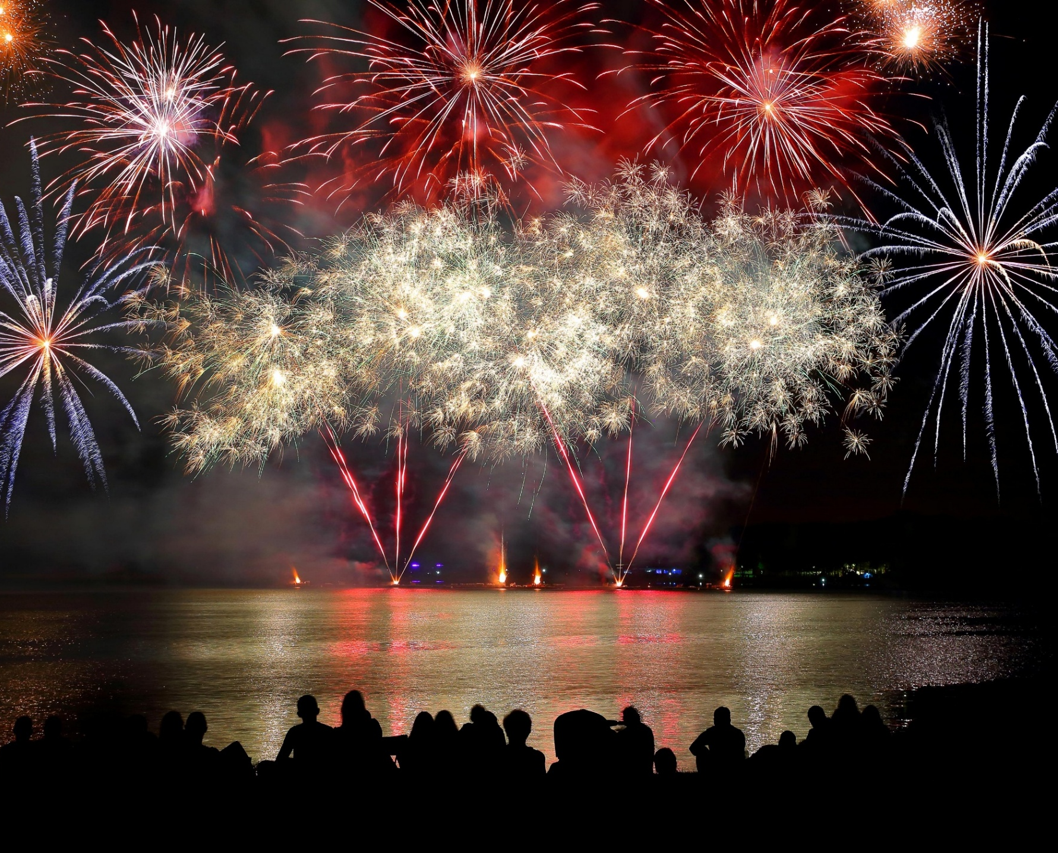
Summer SC 250
The Palmetto Civics project extends beyond the classroom through Summer SC 250 activities, civic challenges, essay contest, reading lists, and family engagement opportunities.
It encourages students to stay connected to history, citizenship, and community participation in authentic ways beyond the school year.
Family and community engagement strengthen civic understanding.

Slide 21
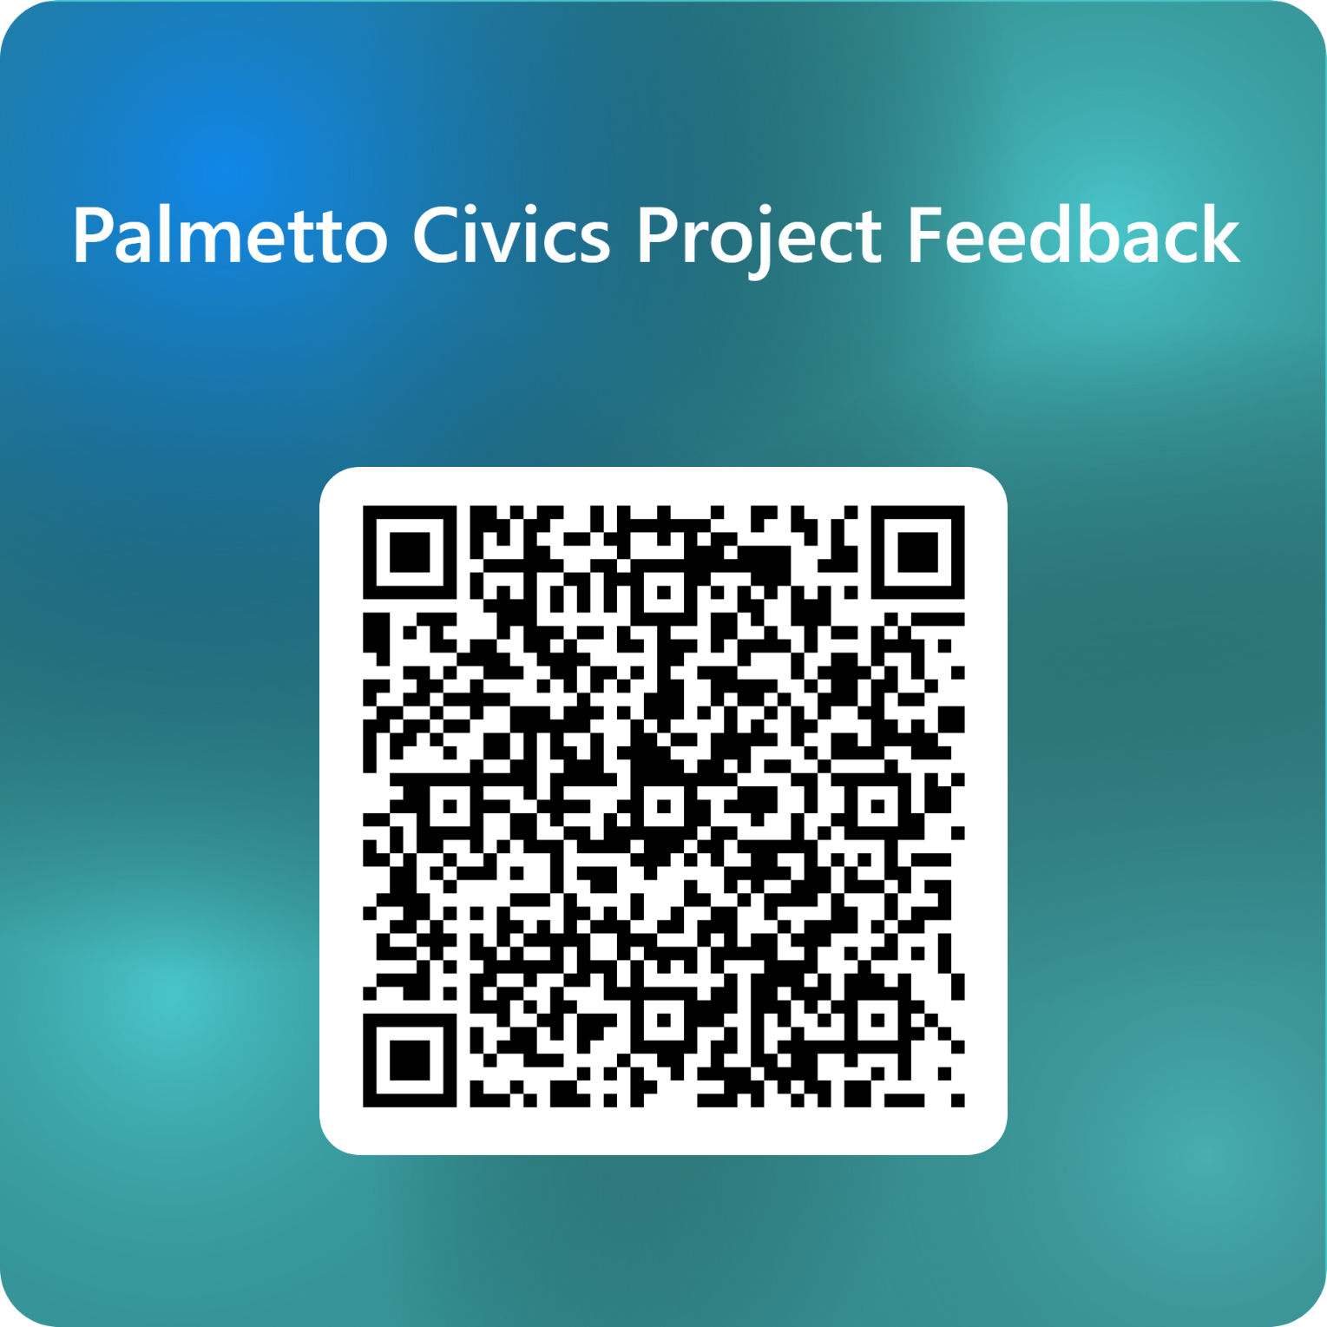

Feedback

Slide 22
Palmettocivicsproject.com

Slide 23

Corey M. Bedenbaugh
Social Studies and Civics Education Associate
(803) 734-4771
cmbedenbaugh@ed.sc.gov

