Slide 1

A Shared Approach to Improve Literacy Skills of Learners in South Carolina with Evidence-Based Practices

Slide 2

Academic Alliance of South Carolina
Mission
Vision
The mission of the Alliance is to research and disseminate evidence-based practices to inform, implement, and sustain an integrated academic and behavioral framework within a multi-tiered system of supports (MTSS) to improve the academic achievement and social competence of students with disabilities
The purpose of the Alliance is to provide expert instruction, coaching, consultation, and support to build the capacity of district and state level implementers to improve outcomes for students with disabilities by using evidence-based tiered instructional practices in reading, language, and mathematics.

Slide 3


Our Team
Dr. Mitch Yell,
Senior Advisor
Dr. Deanna Parish,
Program Director
Jenny Saunders,
Program Coordinator
Dr. Susan Thomas,
Lead Facilitative Coach
Ginger Catoe,
Facilitative
Coach

Slide 4
Objectives for Our Time
Learn an instructional strategy for reading aloud to youth at all grade and content levels to improve vocabulary, comprehension, and language skills regardless of the reading level,
Gain insight into using repeated reading as a strategy to improve reading fluency and comprehension as one of the key critical components in the science of reading, and
Acquire the skills to implement a cognitive strategy called, Get the Gist, to enable youth to identify the main idea at the sentence, paragraph, or complete text level, which are key skills for summarizing information efficiently.

Slide 5
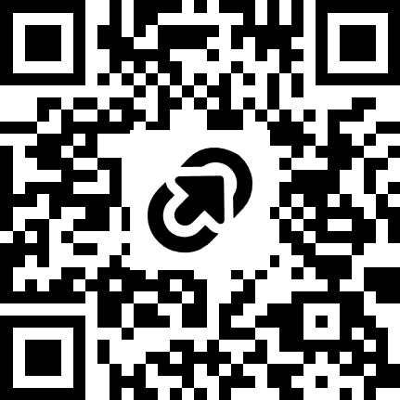
Materials for Today

Slide 6

We Are All In
Notes:
These are strategies that we all can do to support reading at home or in the community.

Slide 7

Strategy for All Students

Slide 8

Read Alouds for All Learners by Molly Ness

Slide 9
Read Alouds
The International Literacy Associaton states:
Effective read-alouds increase children’s vocabulary,
listening comprehension, story schema, background
knowledge, word recognition skills, and cognitive development.
Retrieved from: https://tinyurl.com/4ay8xpbn
Molly Ness (2024) defines read alouds as “a shared literacy experience engaging children and adults in conversation and engagement around the high-quality text”.

Slide 10
Three Step Process
Evaluate: Evaluate the text for the background knowledge it assumes the reader brings.
Explain: Use think-alouds to model how to make meaning from the text.
Engage and Extend: Lead students to inquire and reflect about the text.

Slide 11
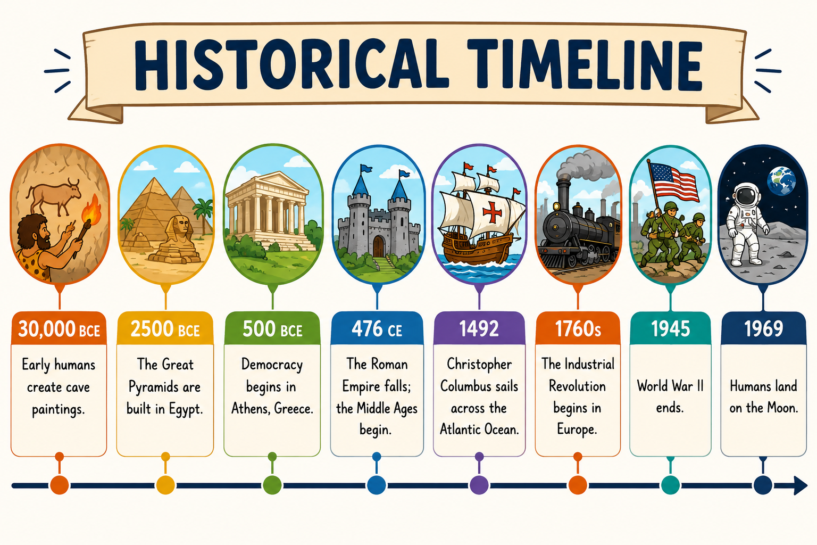
Evaluate Background Knowledge
Evaluate the text for background knowledge that the reader should bring to the text.
1. What do students need to know about the topic before reading this book?
2. Are there locations, references, interactions, events, or experiences the students might be unfamiliar knowledge?
Notes:
For example, if you are reading historical fiction…you may need a reference to the historical events and timelines.

Slide 12
Evaluate: Funds of Knowledge
Students’ own understanding of social norms and cultural elements.
What does the book assume readers bring on the page with them?
Are there elements of a character’s background, culture, or community that might be unfamiliar?

Slide 13
Evaluate Potential Stumbling Blocks
Potential Stumbling Blocks: Multiple timelines, flashbacks, changing the point of view, etc.
Where else in the text might readers struggle?
What experiences, knowledge, explanation, or exposure can I build upon in advance of reading?
What ways (example, pictures, videos, etc.) can I use to enhance the background knowledge and funds of knowledge?

Slide 14
Evaluate for Instructional Opportunities
Think about the standards. Are there opportunities to integrate the indicator skills within the standards students need to know?

Slide 15
Explain: Find the Problematic Places in the Story
Unfamiliar Vocabulary:
Words to Teach: Useful for students every day and across content areas
Words to Explain: Not useful long term. Usually explained as you are reading.
Think-aloud: First Person
I’m confused here, I’m wondering, This makes me think....
Stopping or Pausing Points | I language
I

Slide 16
Engage or Extend
Social or Emotional Skills
Cross-Curricular Extensions
Extensions to Support Reading and Writing
What might we want to read next?

Slide 17
Websites with Read Aloud Suggestions
https://readaloud.org/bookselections.html
https://www.readbrightly.com/
https://www.indiebound.org/kids-indie-next-list

Slide 18
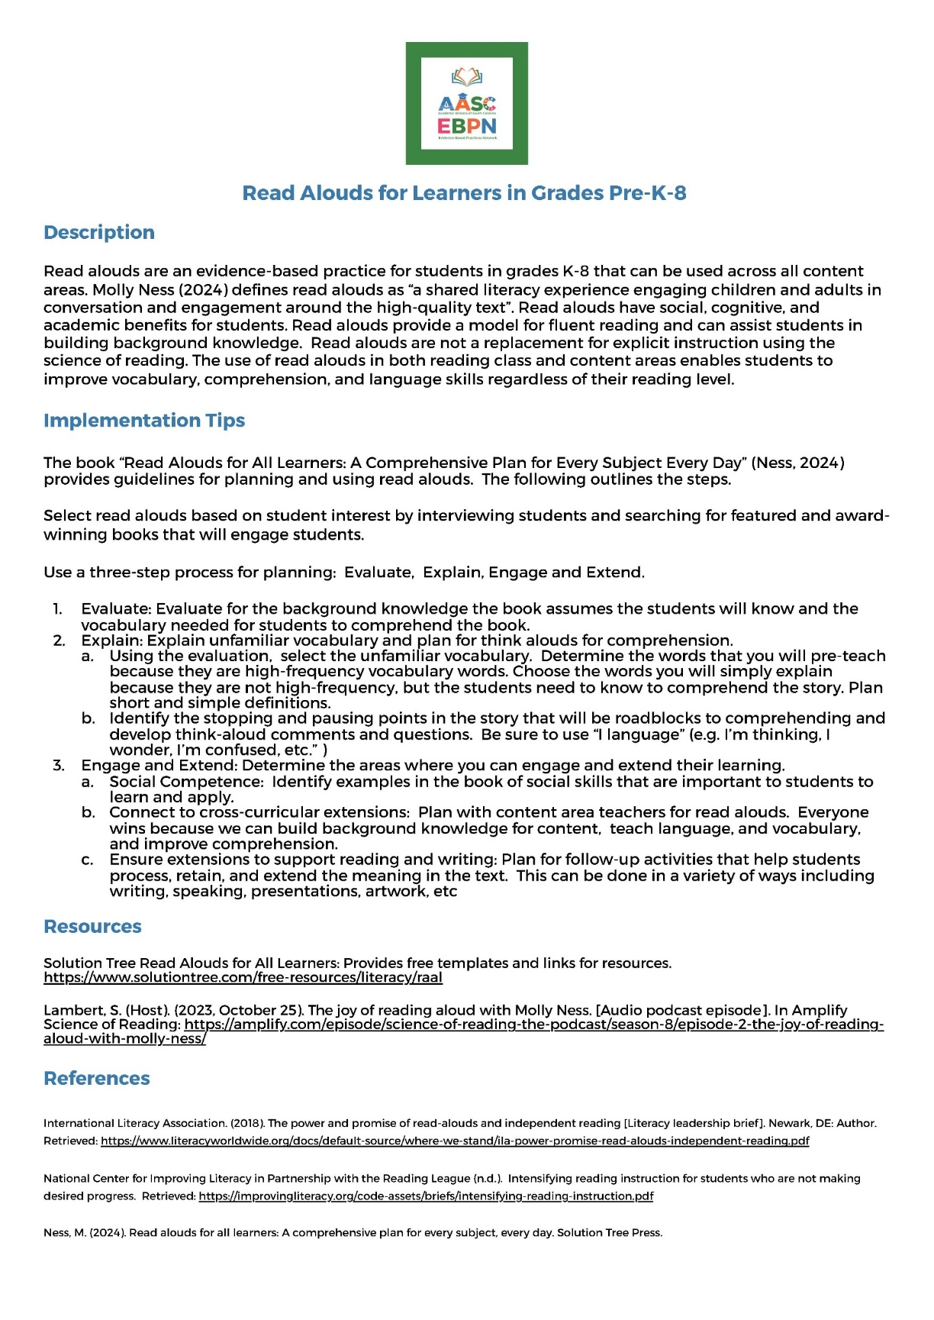
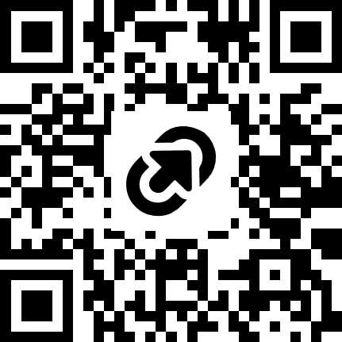
Resources for You
https://tinyurl.com/et5wyd4z

Slide 19
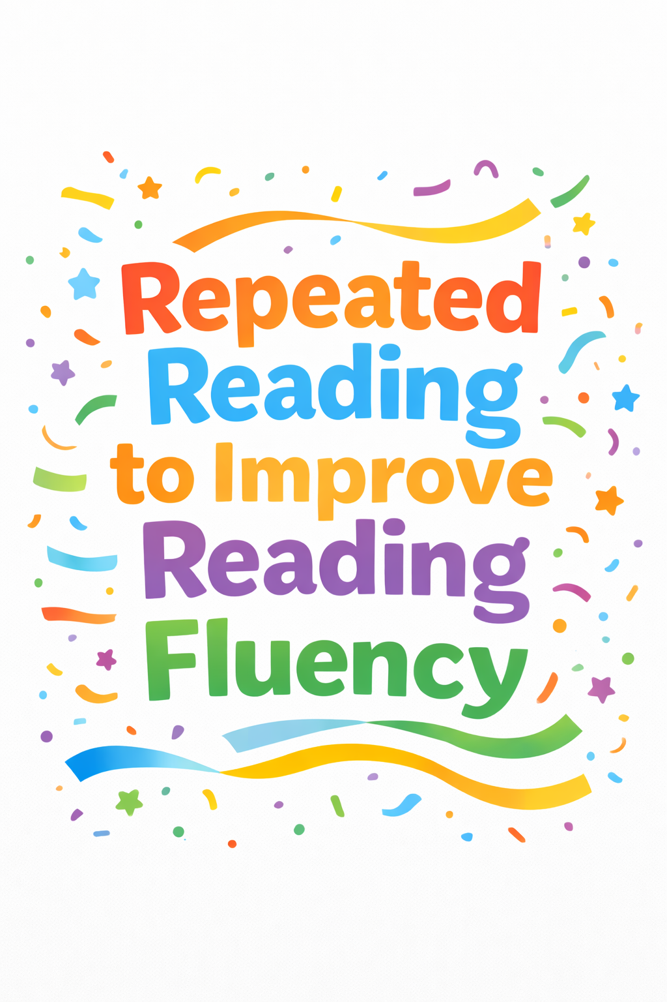
A Great Easy to Implement Strategy

Slide 20
Why Repeated Reading
It improves the rate
It improves accuracy
Fluency leads to better comprehension
Shanahan, T. (2017, August 4). Everything you wanted to know about repeated reading. Reading Rockets. Everything You Wanted to Know about Repeated Reading from Reading Rockets

Slide 21
Steps for Repeated Reading
Select a passage the student can read with 95% accuracy.
Time the student for one minute and count the number of words correctly.
Set a goal to improve 30% after the 4th reading.
Have the student read the passage 4 times and graph their words read correctly in a minute after each reading. The reading of passages does not have to take place at one time.
Discuss with students their progress and set goals for improvement.
Increase the level of the passages as students increase their skills.
Continue to progress monitor fluency with a valid and reliable curriculum-based measurement tool during the school year and celebrate success.

Slide 22
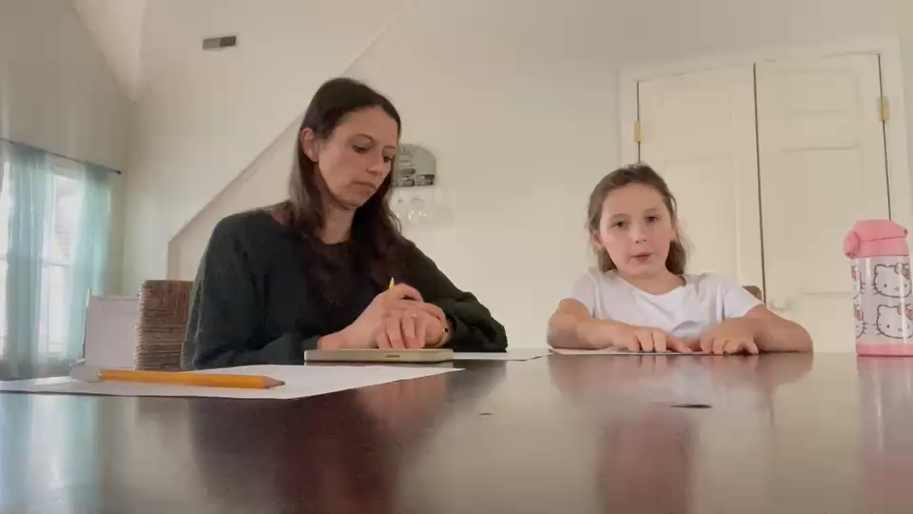
Jolie Reads!

Slide 23
Where to Get Passages?
Easy CBM: https://www.easycbm.com/ (CAUTION)
Fluency A-Z: https://www.readinga-z.com/fluency/fluency-practice-passages/ and
https://www.readinga-z.com/assessments/fluency-timed-reading/
Reading Passages at ReadWorks: https://www.readworks.org
Oral Reading Passage Generator: https://www.interventioncentral.org/teacher-resources/oral-reading-fluency-passages-generator

Slide 24
Protocol for Administration
Materials: (passage for student and scorer, timer, pencil for scoring)
Remind student that they are not speed reading and want to read carefully and with prosody( rhythm, pitch, phrasing, etc.)
Begin timer for one minute.
Score as student reads.
Have student graph score.
You may want to score together for reliability when beginning to use repeated reading.

Slide 25
You Must Train Scoring Rules
Words read correctly
  Pronounced correctly (read)
  Rereads are not errors
  Self correct are not errors
  Additions are not errors
Words read incorrectly
  Mispronunciations
  Substitutions (home for house)
  Omissions (if they skip a line every word is an error)
  Reversals (Words read out of order)
3 Second Rule: If the student doesn’t read the word in 3 seconds, tell them the word and move on. It’s an error.
Reread: If they finish the passage, they start over.
Pronunciation errors due to dialect or articulation are not counted as errors.

Slide 26
Who Can Help Us with This Intervention?
Paraprofessionals
Volunteers
Parents
Older Students: Teacher Cadets, Interns

Slide 27
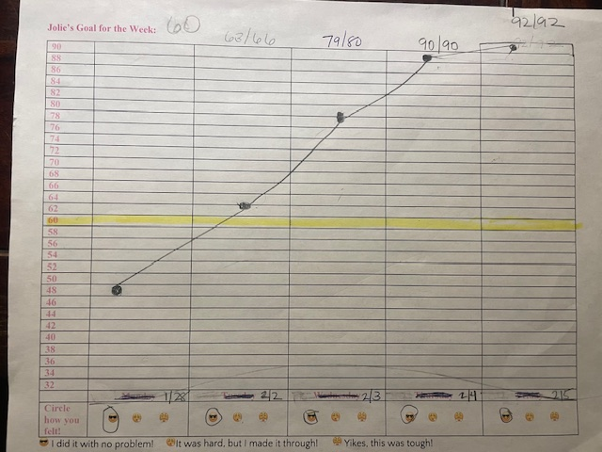
Graphing: Real Life Examples

Slide 28
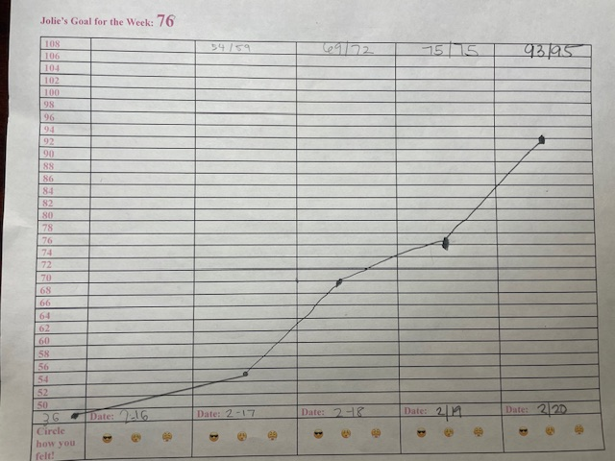
Real Life Example

Slide 29
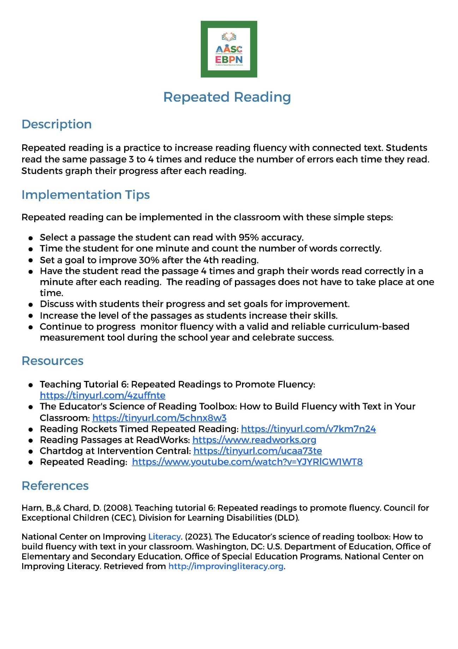
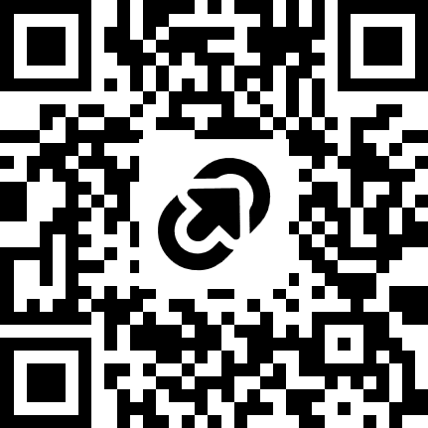
Repeated Reading One Pager
https://tinyurl.com/3cha8w4j

Slide 30
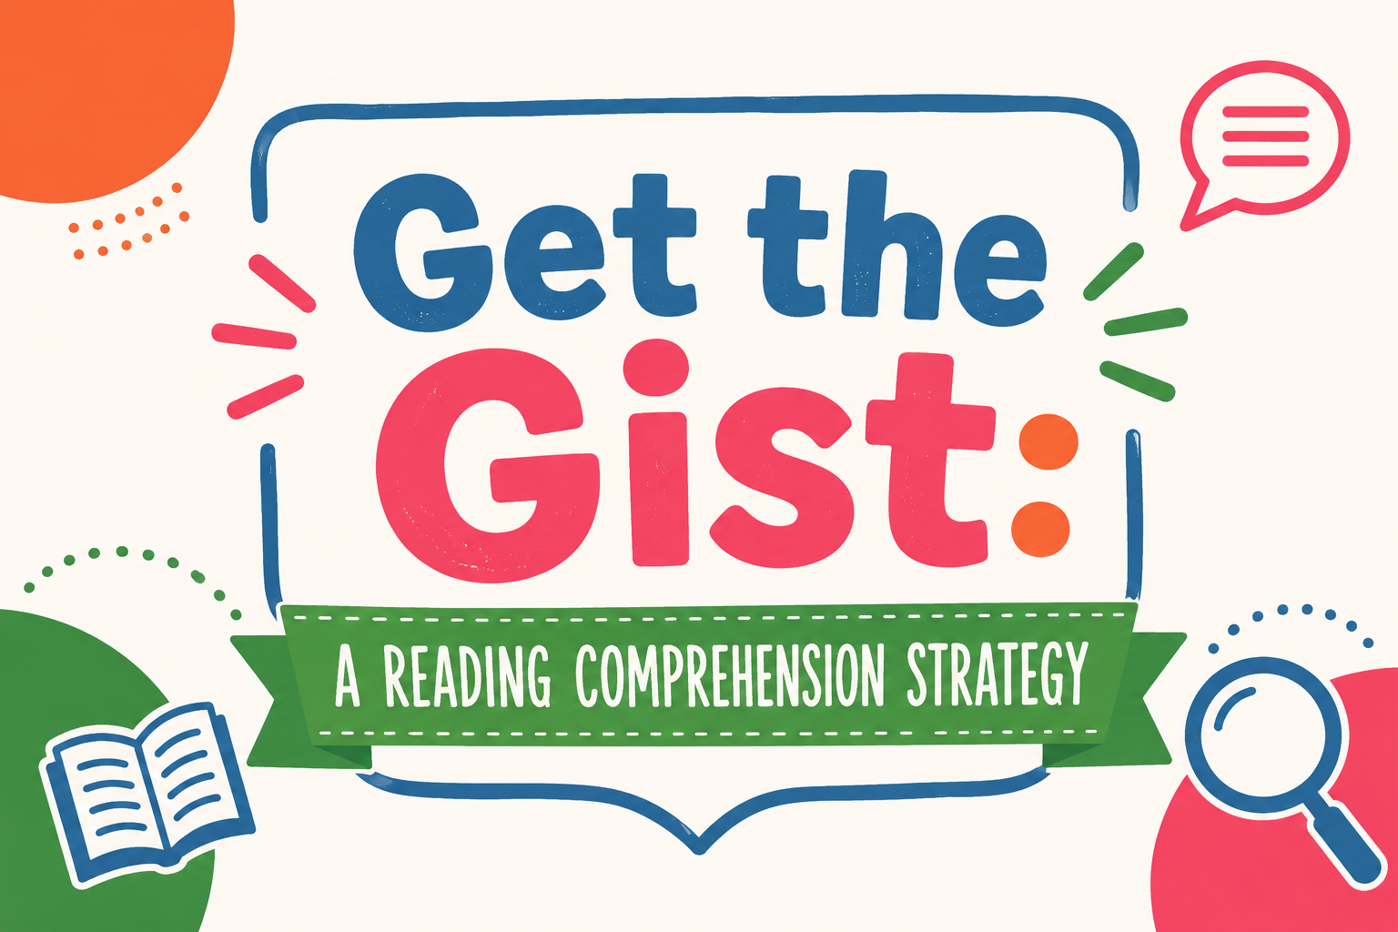
Last One

Slide 31
What Is “Get the Gist”?
Get the Gist is a strategy that can help students identify the main ideas as they read. When students are continuing to apply this strategy as they read, they are more likely to understand the text.

Slide 32
What Are the Steps for Get The Gist?
Select a sentence level, paragraph, or entire text depending on the student level.
Have students complete the following:
  Identify who or what the selection is mostly about
  Identify the most important information about the who or what
  Write a gist statement of about 10 words
3. Students can use this on each paragraph as they read an entire text to promote understanding of the main ideas through out the passage.

Slide 33
How Do We Teach?
Introduce students to the 3 steps of the strategy.
Model for students with text using a think aloud with them using a graphic organizer.
Have students do a guided practice with the teacher.
Use think-pair-share for additional practice.
Extend by having students complete sections to give the major ideas of a longer text.

Slide 34
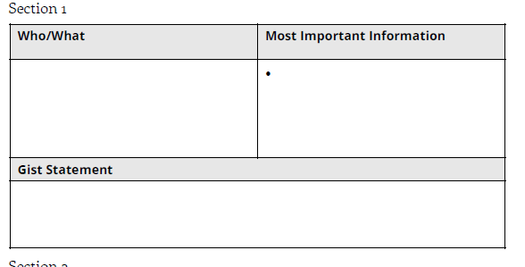
Graphic Organizer

Slide 35
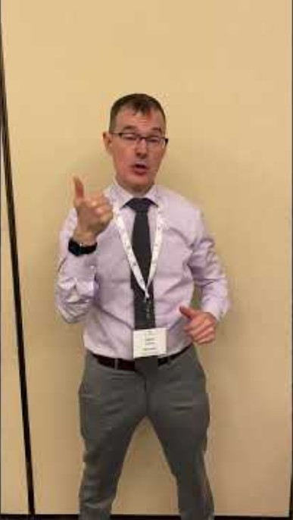
Let’s Watch Dr. Kearns Give a Quick Overview

Slide 36
Let’s Practice One
The Palmetto Education Summit brings together South Carolina’s education, business, and community leaders to foster collaboration, align strategies, and advance excellence across the state. By connecting key stakeholders around shared goals and innovative solutions, the Summit drives measurable impact, strengthens educational outcomes, and helps unlock the full potential of every student in South Carolina (chagpt)

Slide 37
Here Was Mine
Who/What: The Palmetto Education Summer
Important Information:
  Educators, community leaders, and business leaders
  Goal to collaborate to improve educational outcomes for all students in SC
Gist Statement: The Palmetto Education Summit brings together leaders to improve outcomes for SC students. (13 words)

Slide 38
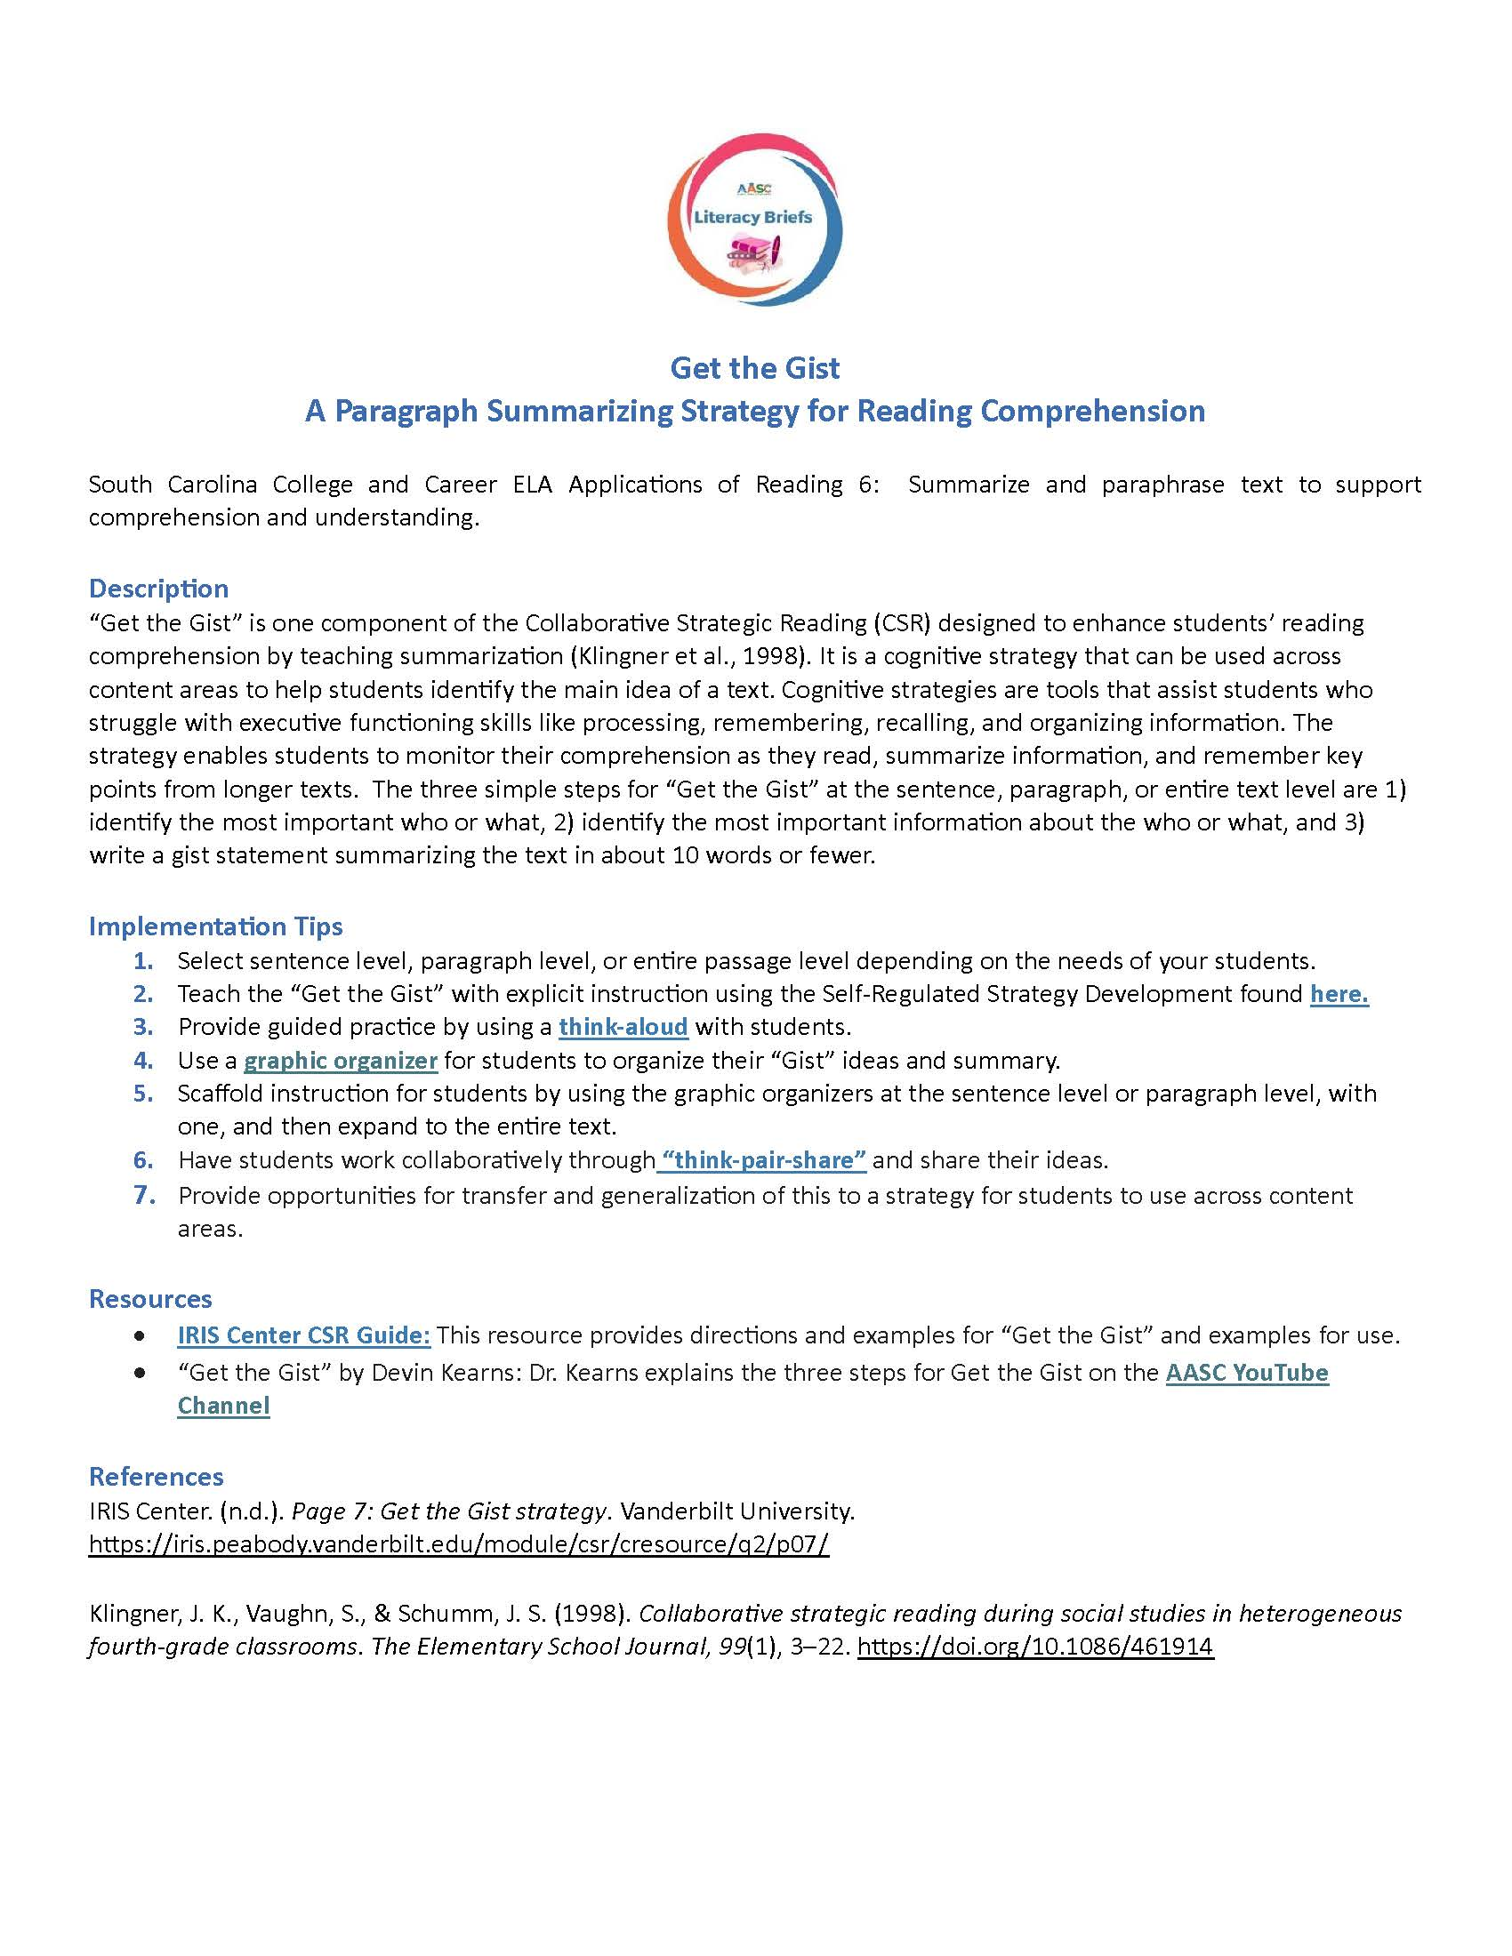
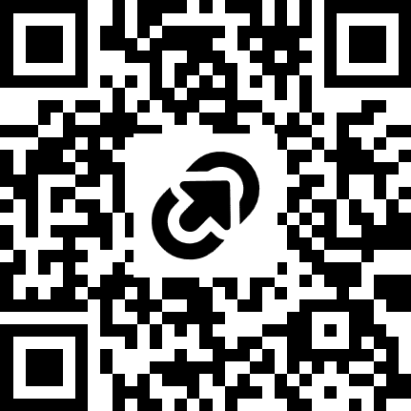
An Additional Resource

Slide 39
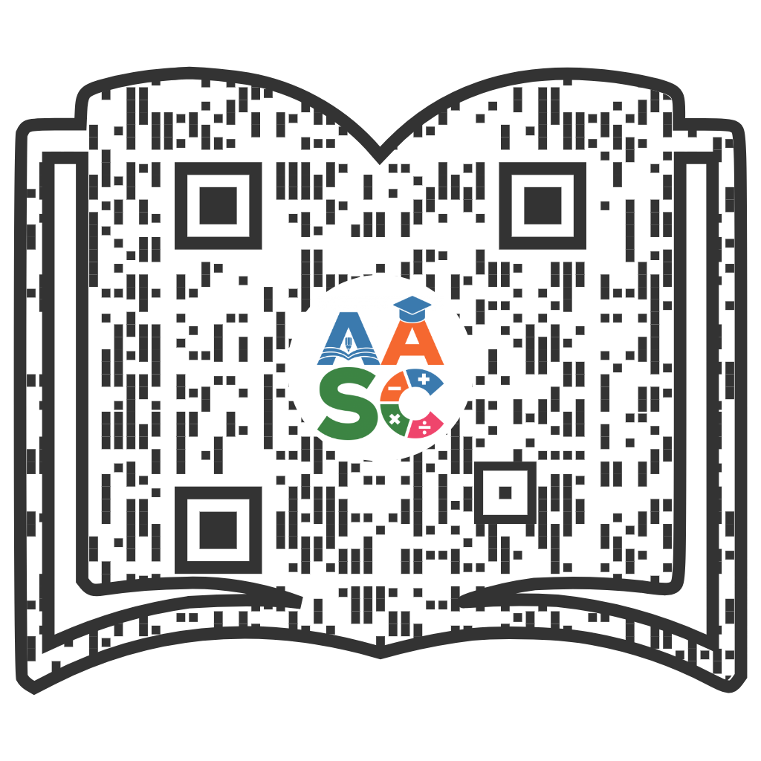

Evidence-Based Practices Network
Features Different Topics each month.
Hear from fellow educators implementing Evidence-Based Practices via live webinars
Find resources
Network with SC educators
Scan above to find one-page resources on
Reading, Writing,
and Math strategies
to support
student
achievement!

Slide 40
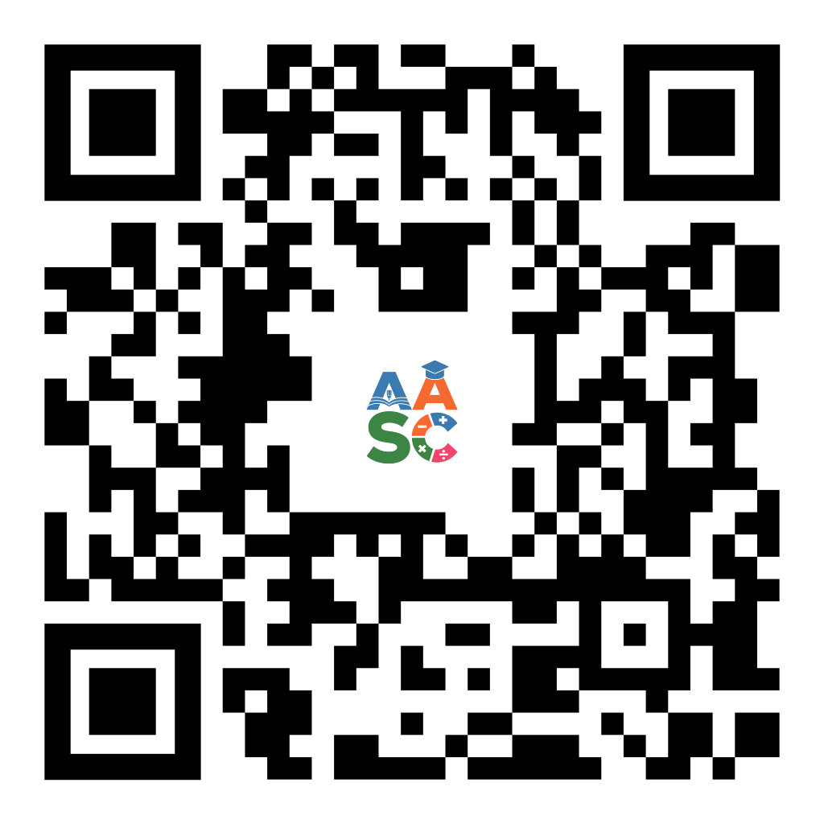
Connect with us!
Join our mailing list for updates and events.

Slide 41
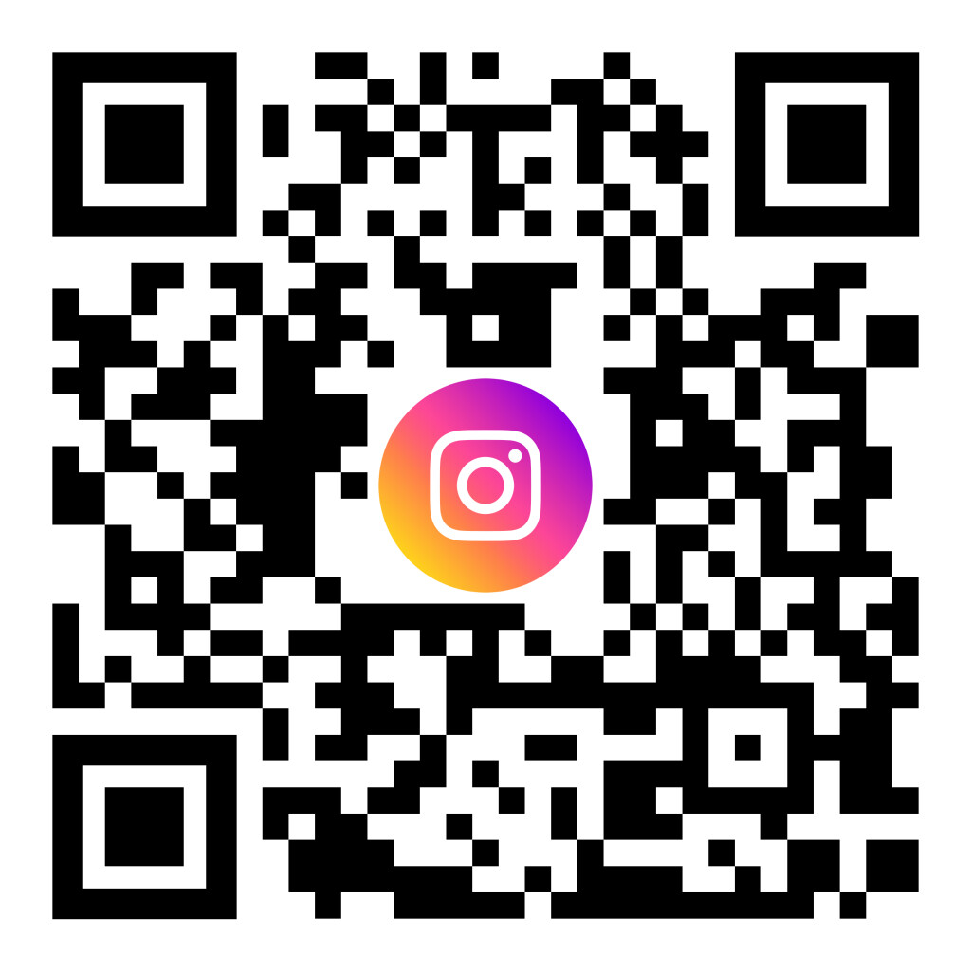
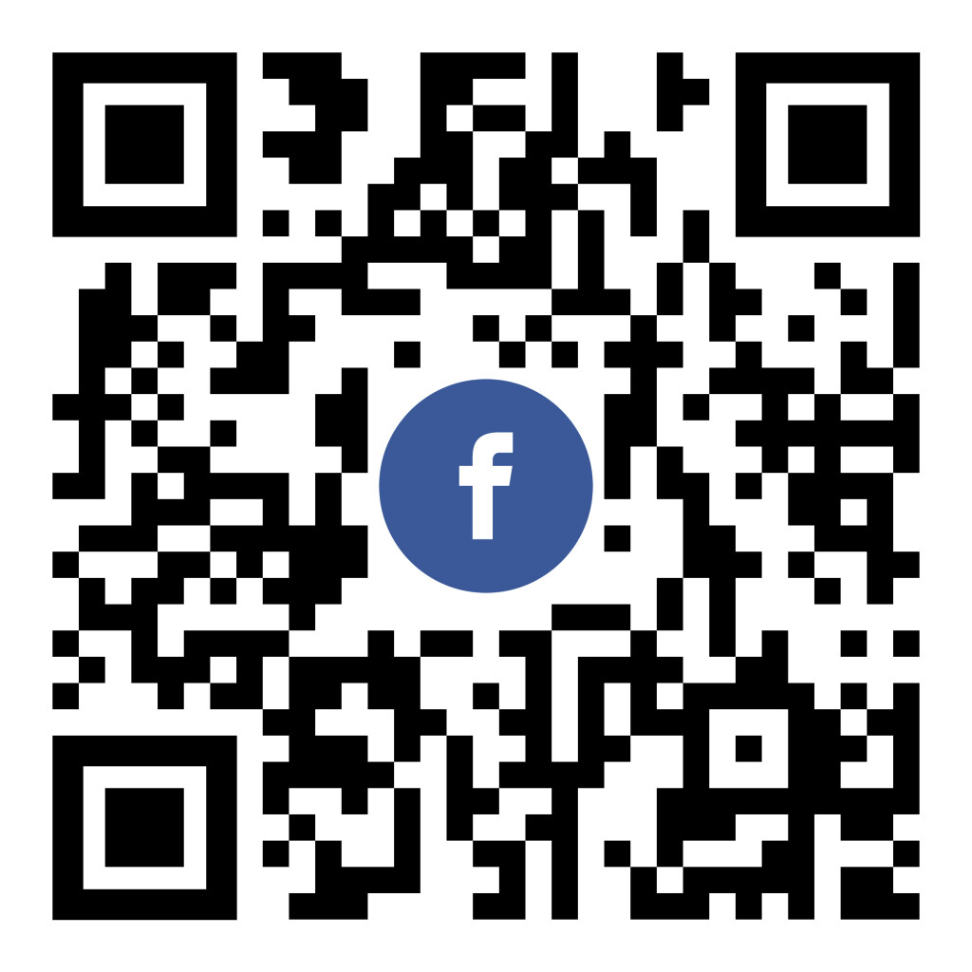

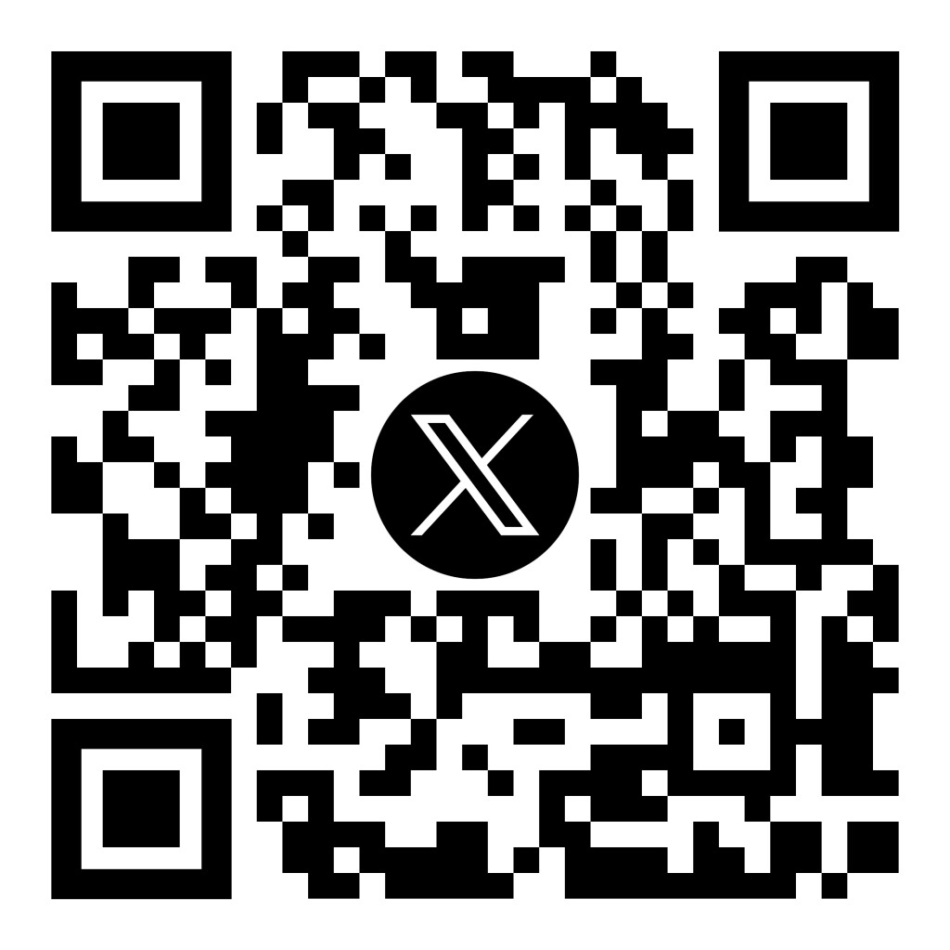
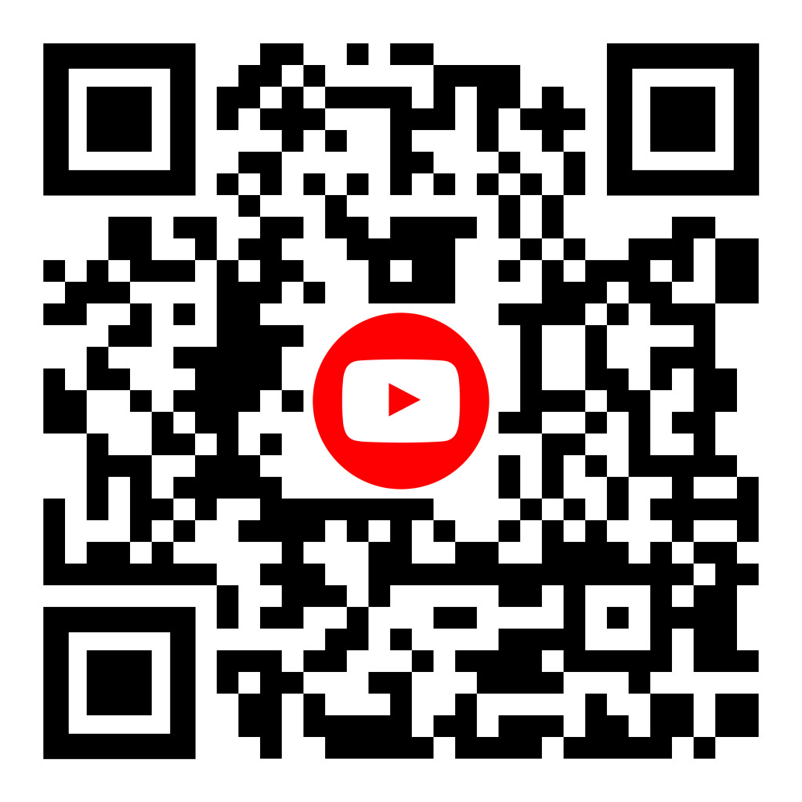
Follow Us with Your Favorite

Slide 42

Contact Us!
Deanna Parish, Ph.D.
parishdeanna@sc.edu
Susan Thomas, Ph.D.
thomasss@mailbox.sc.edu
Jenny Saunders
js293@mailbox.sc.edu
AASC@mailbox.sc.edu
academicalliancesc@gmail.com

