Slide 1

South Carolina
Work-Based Learning
K-12
2026 Palmetto Education Summit
Notes:
Slide title should be Aptos Bold font, left-aligned, not smaller than 44pt
Audience – To whom/group you are presenting to
Speaker – Who is giving the presentation (may be by name or by department)
Date – Date of presentation

Slide 2
SC Work-Based Learning
SC Work- Based Learning (WBL) is a school-coordinated, sponsored, sustained interaction serving students, K-12, with business/industry in a real worksite environment. The experiences or placements allow firsthand exposure and observation for the student while applying academic learning and exploring career goals and interests.
Each WBL coordinated experience maintains the credibility and integrity of the placement. This cultivation and development of a skilled workforce helps meet the needs of business and industry leading to sustainable growth, economic prosperity, and global competitiveness for South Carolina.
The SC Regional Career Specialist Team through SC Proviso 1A.5 serves as a liaison to each district to build business/industry partnerships for effective WBL implementation.
Notes:
Before deep dive into the work-based learning career ready qualifier, let’s first discuss What is WBL in SC, what is looks like, and levels of participation.
Point: WBL is school coordinated, school sponsored. It is not a part time job that the student does without school involvement. The SC RCS Team are assigned to service regions that mirror the SC WIOA regions. Explain RCS role.

Slide 3
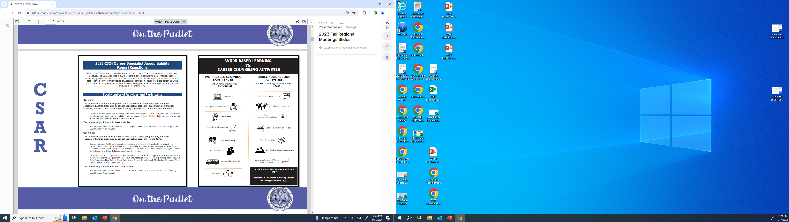
Is it a Work-Based Learning experience?
Is it a Career Counseling Activity?
Where do I report what? PowerSchool vs. CSAR
Great resource located on the
SC Work-Based Learning Padlet. K.Staton
Notes:
To alleviate confusion with school counseling and career specialist personnel, we differentiate between Within the classroom wall ‘career guidance activities’ and WBL

Slide 4
Levels
Elementary Level
Job Shadowing
(On-Site or Virtual)
Mentoring
Structured Field Study
Middle Level
Job Shadowing
(On-Site or Virtual)
Mentoring
Service Learning
Structured Field Study
High School Level
Apprenticeship
Co Op
Internship
Job Shadowing (On-Site or Virtual)
Mentoring
School-Based Enterprise
Service Learning
Structured Field Study
CTE Work-Baed Internship Credit Bearing Courses
Notes:
Levels of participation in WBL experiences

Slide 5
When, Where and How
When can student participate?
This is a district/school specific decision. Based on your liability and certificate of insurance coverage, it is to your discretion if the student participates before or after school, weekends, holidays, school break , or a specified block scheduling time.
Where can student participate?
This is a district/school specific decision. Based on your liability and certificate of insurance coverage, it is to your discretion if the WBL placement is on –campus, off-campus, within the district attendance zone, family business, etc.
Know the US Dept of Labor. Youth Rules
How can the student participate?
This is a district/school specific decision. Based on your liability and certificate of insurance coverage, it is to your discretion if the student provides their own transportation to site. It is to your discretion with the business if the placement is paid or non-paid. The WBL placement may or may not be tied to course credit based on your curriculum offerings.
Notes:
Read each thoroughly ; overall take away- district/school/career center looks different region to region, within a region. All is based on their needs and implementation methods that best suits their district/school/career center

Slide 6
SC WBL Career Ready Qualifier
South Carolina formally integrated components of work-based learning (WBL) as a career-ready qualifier in its state accountability system for high school report cards in 2018 through the ESSA state plan.
This solidified its role in school accountability with oversight through the SC Education Oversight Committee.
The initiative aims to connect student experiences with career-ready indicators, reflecting the Profile of the SC Graduate.
Accountability Impact: WBL serves as a key measure to ensure students are prepared for workforce demands.
Policy Foundation: The Education and Economic Development Act (EEDA) of 2005 originally mandated that all K-12 students have opportunities to participate in WBL.
Notes:
Policy – EEDA- that mandates WBL and the ESSA state plan added it to the state’s accountability plan

Slide 7
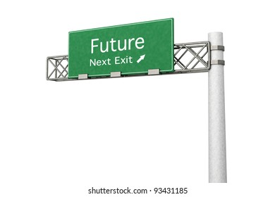
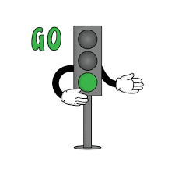

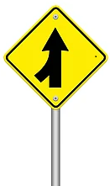




South Carolina
Work-Based Learning Career Ready Roadmap
Blue is the colour of the clear sky and the deep sea
Red is the colour of danger and courage
Black is the color of ebony and of outer space
Student is placed at worksite!
Apprenticeship, internship, or co-op are a career ready qualifier
Student must have earned a minimum 1 unit of credit in pathway related to WBL placement
Industry evaluation plan is created from training agreement on a scale 1-5, aligned to Profile of SC Graduate. Evaluation score average of 3,4, or 5 for career ready qualifier
Report WBL placement in PowerSchool on the WBL page in the RED box for career ready!
WBL placement must be aligned to student’s IGP/Career Goals
SC Career Ready WBL Training Agreement/Evaluation Plan is created with worksite supervisor outlining objectives and skills to be mastered during WBL placement. Min. 40 hrs to qualify
Student successfully completes the WBL placement in its’ entirety
Yellow is the color of gold, butter and ripe lemons
White is the color of milk and fresh snow
Blue is the colour of the clear sky and the deep sea
K.Staton 4.2024
Notes:
When WBL was added to the HS report card rating, credibility and integrity was key!
So, all of these indicators must be met to qualify for the state’s accountability system

Slide 8

Weighting and Calculation
Total Rating Points Available for the Indicator:
19 points of 100 total points
Students Included in the Indicator: 9GR”year”
The CCR metric reports results based on 4-year graduation cohort base files for the school (or the district or the state, as appropriate for comparison metrics or for district or state report cards) as described in the INDICATOR: Graduation Rate (pgs. 72-75) in the SC Education Oversight Accountability Manual.

Slide 9
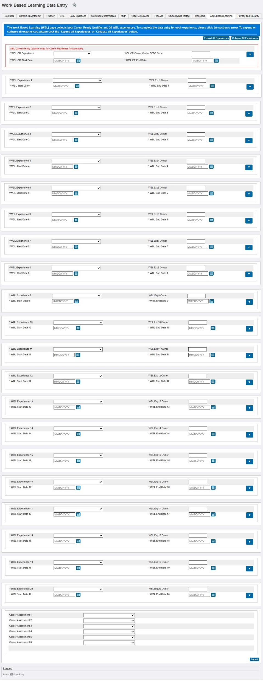
Where is it reported?
PowerSchool- SC Student Management System
Insert and format picture to fit allotted box frame
WBL has a stand-alone reporting page in PowerSchool.
Career Ready qualifier is entered in the red box at the top of the WBL page.
All other WBL experiences for K-12 are reported below the red box.
PowerSchool is attached to the student.
Notes:
Adjust yellow box outline as needed height wise, not width wise
Header font 50pt
Content left is 26pt

Slide 10
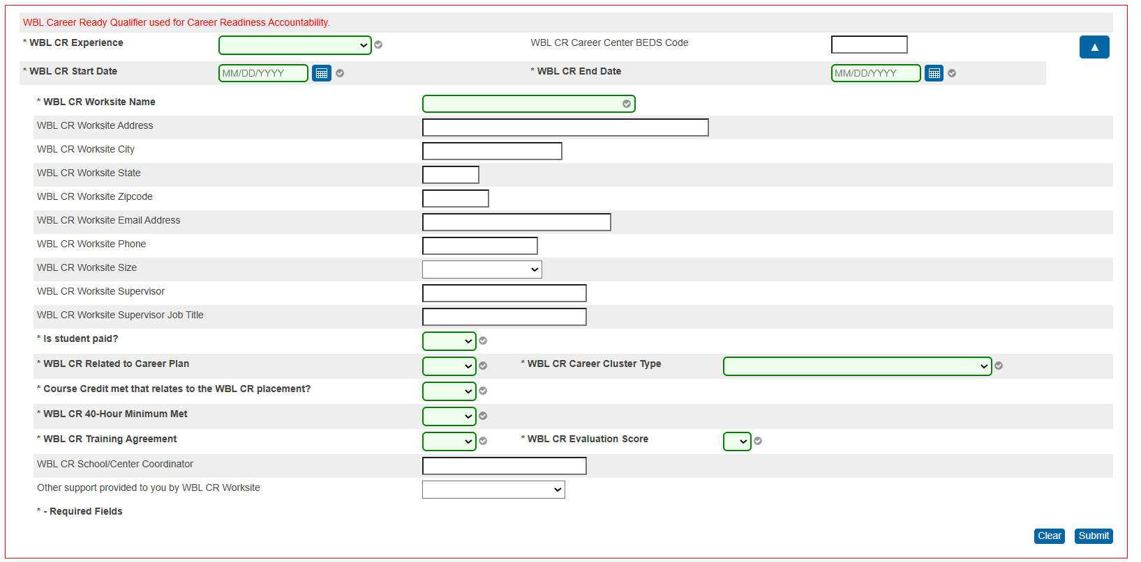
WBL Career ready Red Box
Insert and format picture to fit allotted box frame
View of ‘red box’ for reporting WBL Career ready qualifier with all required entry fields noted so accountability data team can capture for the high school report card.
Career Centers do not currently have a separate report card
All career center WBL reporting qualifiers default to the student’s home high school.
( WBL CR Career Center BEDS Code) created to still capture their numbers reporting great work provided for students.
NOTE: Clear button has been added- Be mindful!
Notes:
Adjust yellow box outline as needed height wise, not width wise
Header font 50pt
Content left is 26pt

Slide 11
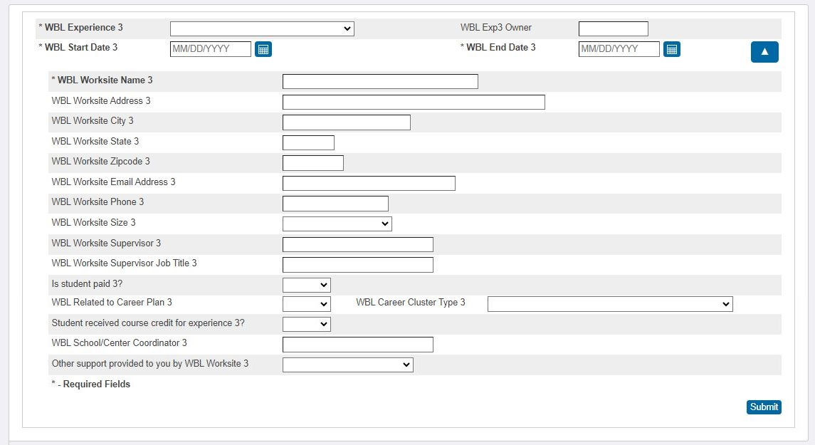
WBL 1-20 Entries View
Insert and format picture to fit allotted box frame
View of WBL ‘regular’ experience field for all WBL experiences completed for K-12 student cohorts.
Notes:
Adjust yellow box outline as needed height wise, not width wise
Header font 50pt
Content left is 26pt

Slide 12
Data Validation update
Data validation for data field terms has been removed!
What does this mean?
You will no longer receive an error prompt when entering WBL experience outside the current academic year range.
Why does this matter?
Transfer student that has completed a WBL Career Ready Internship previous academic year.
Summer Internships crossing over two academic years simultaneously.
Note: Yearly data will still capture July 1-June 30th for all WBL experiences reported ( below the red box)
The RED box:
The WBL Career Ready qualifier captures as the following stated in the 2025-26 Education Oversight Accountability Manual “the percent of students in the 9GR cohort shall be accompanied by the number of students demonstrating readiness displayed as the numerator of a fraction with the total number of students in the 9GR cohort displayed in the denominator”
Thus, the WBL Career Ready qualifier may be reported from a previous year but captured according to the 9GR cohort reporting for the applicable year report card.

Slide 13
Success and Growth
Total WBL over 3-year span:
25% increase
Total Career Ready WBL over 3- year span:
312% increase

Slide 14
Deadline to enter all WBL experiences
State deadline to enter all Work-Based Learning experiences in PowerSchool
for the 2026-27 academic year
is
Friday, May 28, 2027
Notes:
Annual deadline typically at end of May– this ensures all data is entered and provides a 2 week window for reports and checks and balances before the final data is sent over to SCDE.

Slide 15
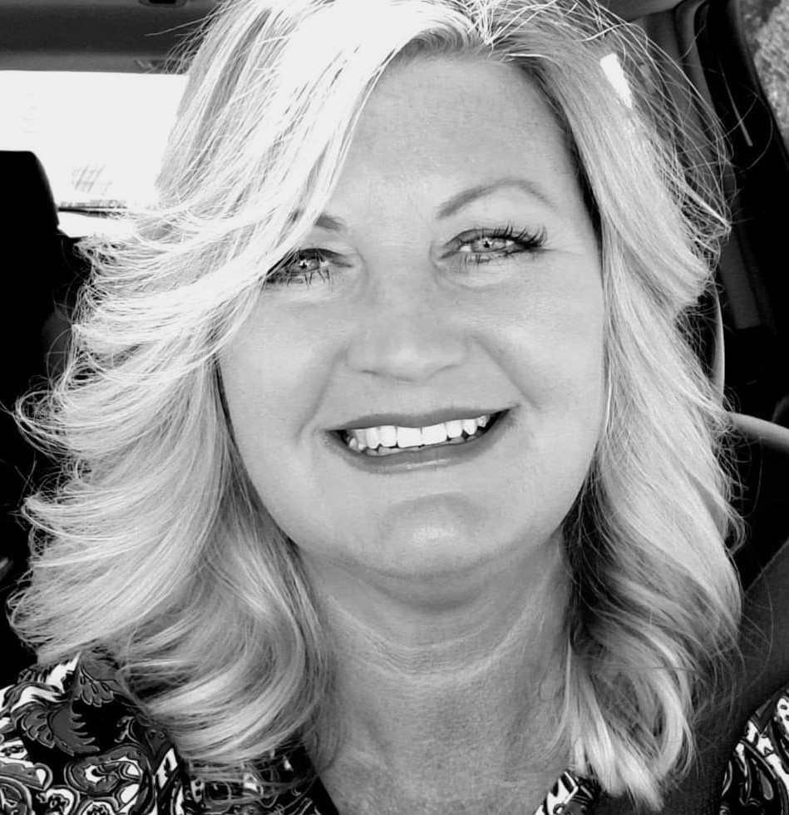
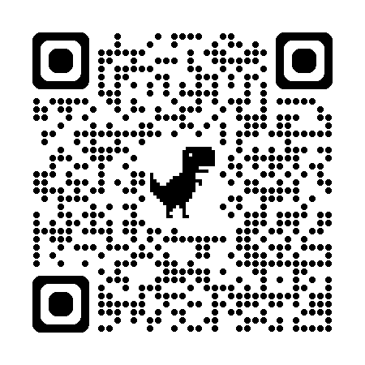
Kama Staton
Team Lead
(803) 734-8415
kstaton@ed.sc.gov
https://padlet.com/kstaton10/sc-work-based-learning-padlet-k-staton-f11xmmbzdkpk8vmc
Notes:
Insert your picture within the yellow circle (replace the SCDE logo inside circle)
Speaker/person photo should be in a circle frame
Should have a yellow outline
Should be 6 x 6 inches
Firstname/Lastname is font 80pt
Title, Copmany is 36pt (italic)

Slide 16
ed.sc.gov
Notes:
Slide title is hidden from display

