Slide 1
Esports in SC
A Guide to Creating Standards, Building Teams, and Joining SCSE
Notes:
Welcome, everyone! The purpose of this session is to do three things: explain what scholastic Esports is, show how Esports can become a standards-based CTE pathway, and give schools a practical starting point for building teams and joining the South Carolina Scholastic Esports League.

Slide 2

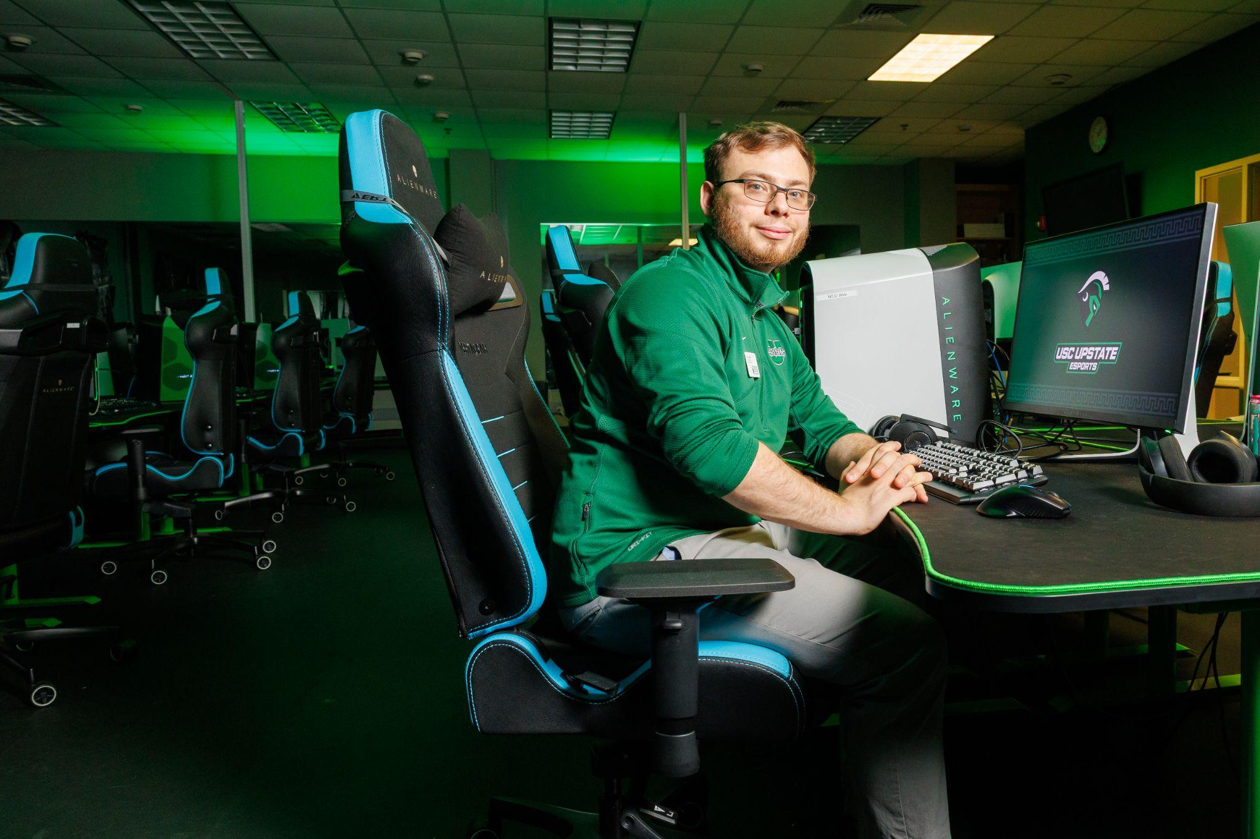

Who are we?
Seth Pruitt
Instructor/Coach
ACTC
Nick Matawa
Head Coach
USC Upstate
David Griggs
Vice Chair
SC Scholastic Esports
Notes:
Seth: The Esports Promotion and Management Instructor at the Anderson I & II Career and Technology Center where I also serve as the head coach for the Esports teams.
Nick:
David:

Slide 3
Part 1: What is Esports?

Slide 4
Defining Esports
The Routledge Handbook of Esports defines Esports as an “organized and codified competition between human players using video games” (Jenny et al., 2024). Esports, however, is much more than that.
In schools, Esports can include:
Media Production
Event Management
Leadership Development
Notes:
Gaming is the holistic activity closely associated with Esports. Esports is the blending of curricular and co-curricular activities through the studies of Information Technology, Journalism, Marketing, and some Game Design.
In a school setting, Esports should not be framed as “letting students play video games.” It is structured, supervised, team-based, standards-aligned, and full of opportunities for students to learn technical, professional, and interpersonal skills.

Slide 5
Why Student Connect with Esports
Students are drawn to Esports because it is:
Relevant to their interests
Social and team-oriented
Competitive
Notes:
Many students already identify with gaming culture. Schools can use that interest as a bridge into academic and career-connected learning. Esports can help us reach students who may not already be involved in clubs, sports, or leadership programs.

Slide 6
85%
40%
Teens Play Video Games
*US
(Gottfried & Sidoti, 2024)
Play Daily
*US
(Gottfried & Sidoti, 2024)
approximately 212 million gamers in the *U.S (Armstrong, 2023)

Slide 7
Educational Benefits
Esports can support:
Collaboration
Leadership
School belonging
Notes:
The educational value of an esports program is found in the way the program is set up. Students are not left to simply play games while other learning opportunities are missed. Instead, students can explore many different learning opportunities including communication, strategy analysis, the production of media, event management, and much more while using technology to solve problems and be engaged in a powerful learning environment where they play games in an educational setting.

Slide 8
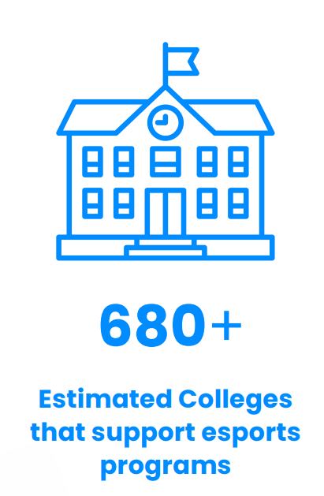
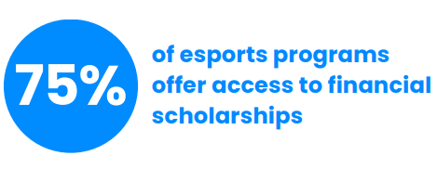

*These are not limited to competitive and extend to industry skills like broadcast and management
(Postell & Narayan, 2025)
Notes:
This means that approximately 90 colleges in the United States are offering full rides for Esports.

Slide 9

(Postell & Narayan, 2025)
Notes:
This means that approximately 90 colleges in the United States are offering full rides for Esports.

Slide 10
Real-World Local Examples

Slide 11
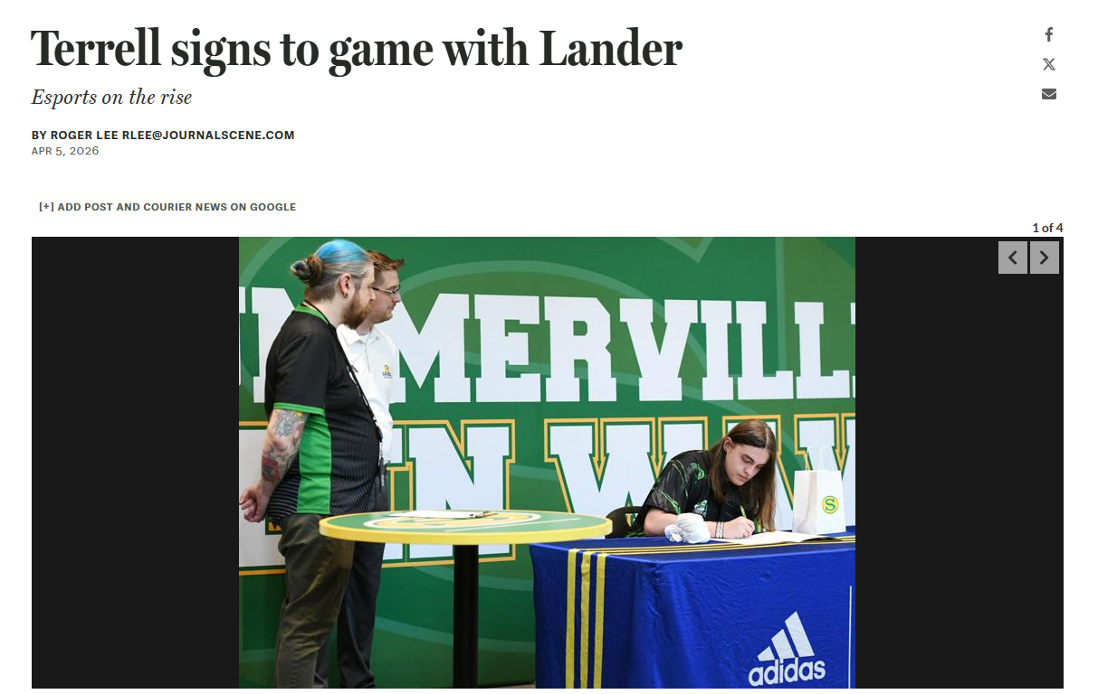
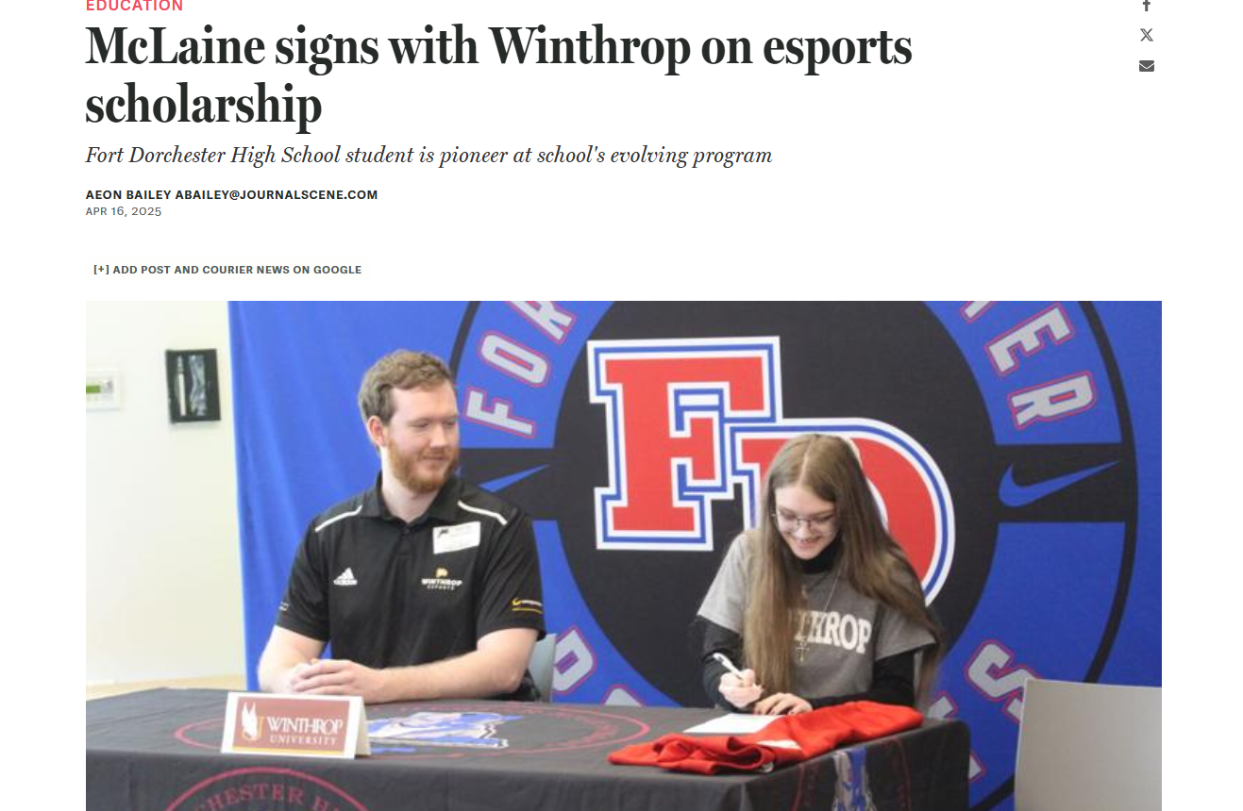
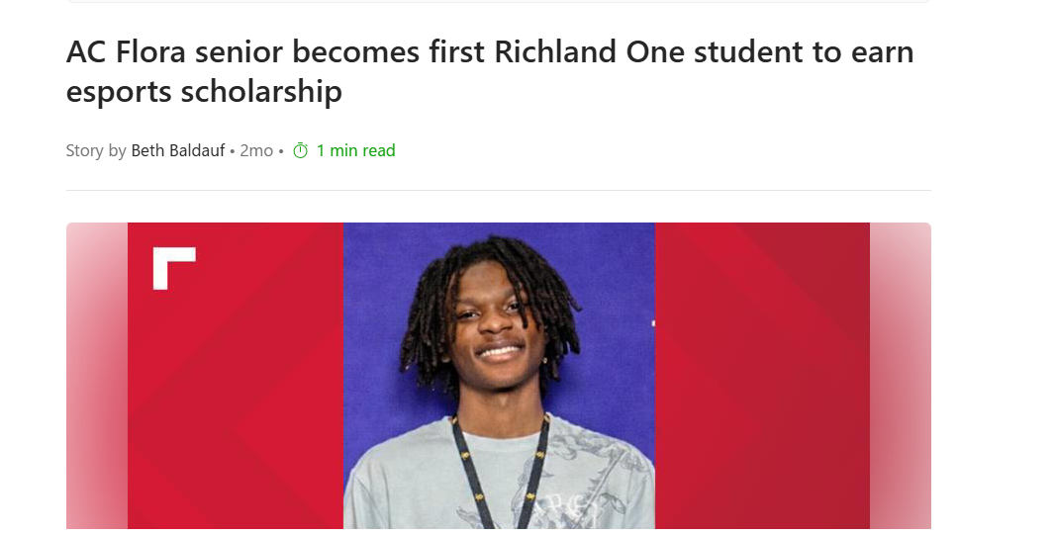

Slide 12
Part 2: Innovative Pathway

Slide 13

Pathway Resources
The following link is to a Google Drive Seth has set up to share his standards and application from two years ago, to help anyone who may be interested in setting up their own CTE pathway.

Slide 14
What are Esports Courses?
Esports courses are CTE (Career and Technical Education) courses focusing in on the building blocks that support the competitive gaming aspect. The industries targeted in these courses typically include, but are not limited to, information technology, journalism, and marketing.
Esports courses can, however, be virtually anything provided the proper focus. This could even include Game Design & Development.
Notes:
Esports courses are not simply “playing games for credit.” They focus on the professional skills and industries surrounding Esports. The competitive gaming environment becomes the context for teaching technology, business, media, communication, and management.

Slide 15
Why Creating a Pathway Matters
Creating an Esports pathway matters because it:
Supports CTE funding conversations
Connects Esports to career readiness
Builds sustainability beyond one coach or one club
Notes:
Having a club is nice but having a program with a clear path is even better. A program with a clear path allows for the continuation of the program when the coach or club leader leaves, when funding cycles are over, when interest in the program waxes and wanes. It gives a clear reason for the district and state leaders support of the program.

Slide 16
Why Creating a Pathway Matters (cont.)
Creating a pathway, specific to Esports, is very important because of the continued growth of the industry.
The 2019 League of Legends World Championship drew in more viewership (100 million viewers) than the previous year’s Super Bowl (98 million viewers).
With the continued growth, the industry will have need for a wide variety of professionals in several key career clusters. This calls for a structured framework that allows students to explore the career paths available in the Esports industry.

Slide 17
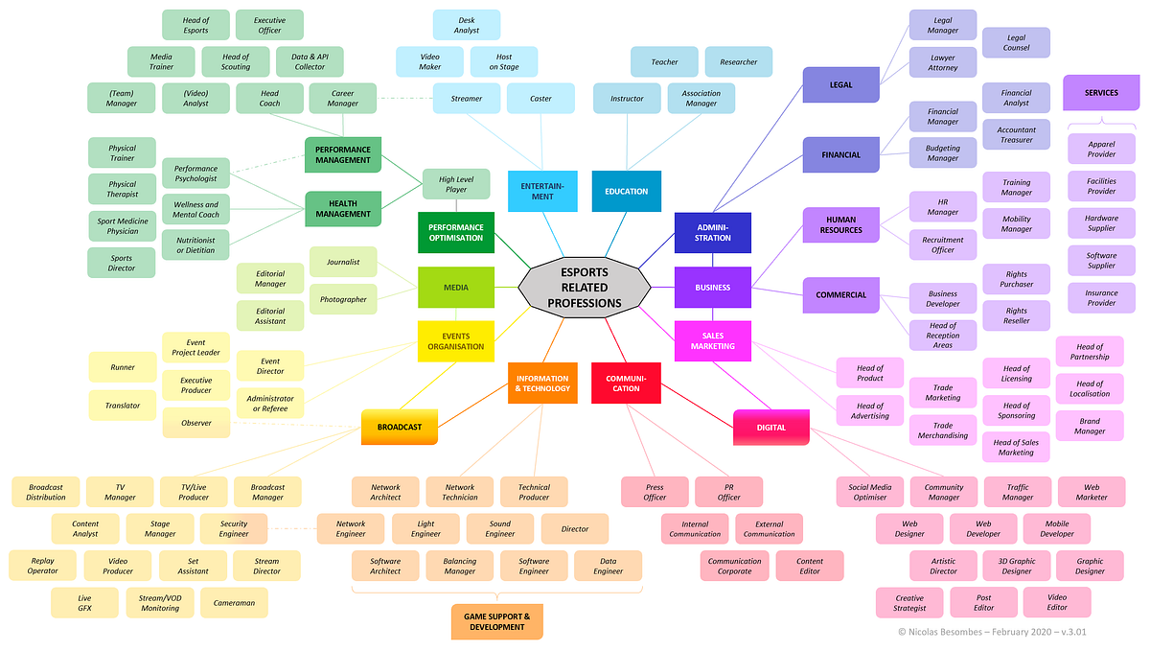

Slide 18
My Innovative Pathway
Pathway Title: Esports Promotion and Management
CIP Code: 5200IN
Completer Structure: 3-Unit Completer Pathway
Courses Available: 5
Notes:
My goal was to create a pathway broad enough to include multiple career areas, but focused enough to remain coherent. The pathway is built around promotion, management, performance, media, and technology.

Slide 19
Course Sequence
68D1 Introduction to Esports
10th Grade | Q3 or Q4 | Optional
68D2 Esports Management and Operations
11th Grade | Q1 | Required
68D3 Esports Performance and Health
11th Grade | Q2 | Required
68D4 Media and Journalism in Esports
12th Grade | S1 | Optional
68D5 Technology in Esports
12th Grade | S1 | Optional
Notes:
The 12th grade options allow students to specialize in media or technology

Slide 20
Esports Industry Overview | Intro to Broadcasting | Career Paths
68D1 Introduction to Esports
68D2 Esports Management and Operations
Business Models | Team Management | Event Management
68D3 Esports Performance and Health
Coaching Methods | Player Development | Ethics and Legal Issues
68D4 Media and Journalism in Esports
Audience Engagement | Multimedia Storytelling | Data Analysis
68D5 Technology in Esports
Streaming Infrastructure | Broadcast Tools | Emerging Technologies
Notes:
The Intro course is meant to set the foundation for the students. They will learn about all the different facets of the esport industry (games that are played competitively, broadcast, technology and cultural shift etc.). Students can also get an idea of all the possible career paths in the esport industry.
In this course you first learn how to organize an Esports team, league and event. As well as how organizations and sponsors are presented. Many connections to business, marketing and especially to to project management are shown.
The program covers an important aspect. The wellness of students engaged in the world of esports. In addition to their physical health, players of competitive games also need mental discipline, responsible use of screens, good posture when playing with appropriate ergonomics, effective teamwork and good ethics.
The course would suit students with interests in Media, Communication, Broadcasting, Social Media and Content Creation. The student would report on an Esport event in the style and format of how a traditional athlete/sport/entertainment event would be reported by the media.
This course is a mix of Esports and IT. You learn more about the technical parts of competitions and broadcasting of Esports in lectures and practical labs, e.g. about networking, servers, hardware, security and tools for live streaming.

Slide 21
The Innovative Pathway Process
General process:
Identify the need
Collect student interest data
Collect employer data
Build the course sequence
Write course descriptions
Write course standards
Create scope and sequence documents
Identify the certifications and/or postsecondary alignment
Secure local approvals
Submit to the SCDE
Notes:
Developing a new course or pathway is not a matter of submitting an idea and having it become a new course or pathway. Rather, the process of developing new courses or pathways involves making a strong case that a new course or pathway is needed; that proposed courses or pathways will be delivered in a standards-based manner; that proposed courses or pathways will yield positive student outcomes; and that there is support for new courses or pathways from local stakeholders. The stronger the documentation that is provided as part of the process, the stronger the case will be.

Slide 22
Current SCDE Submission Process
Important update:
If you are building out an entire pathway, you will need to submit an application for each course in the pathway.
Herbert Bocchino is the Ed. Associate in charge of innovative courses and pathways.
Applications are now digital.
You may submit applications through the official SCDE Formstack found here:
https://scde.formstack.com/forms/cte_innovative_course_application
Notes:
I have provided my original application in the Google Drive, as well as my current standards to be used as a resource for anyone who is interested in submitting a proposal of their own.

Slide 23
What the Application Needs
Be prepared with:
Course name(s)
Units of credit
Prerequisites
Narrative course descriptions
Course standards
Scope and sequence
Instructional materials
Evaluation methods
Student survey data
Advisory committee approval
Local board approval
Notes:
This application should read as a complete plan for the school, not a proposal. It should outline the school’s thought process regarding the following: curriculum, need for the school, staffing, resources required, and methods of assessment as well as local support for the school.

Slide 24
How CTE Pathways Unlock Access to Esports
CTE can help Esports programs by providing:
A career-readiness framework
Standards-based instruction
Pathway completion opportunities
Funding justification
Equipment justification
Certification alignment
Advisory committee support
Employer connection
Long-term sustainability
Notes:
This is the main argument for CTE. Esports can start as a club, but CTE gives it structure. It also helps schools explain why equipment, space, staff time, and curriculum development are worthwhile investments.

Slide 25
What I Would Tell a School Starting the Process
Start with these questions:
What careers are we connecting to?
What students are we trying to reach?
What local workforce needs can this support?
What courses already exist that Esports can complement? *Funding Potential
What standards can be taught through Esports?
What projects will students complete?
What evidence will show success?
Notes:
You don’t necessarily need to start with game titles. Start with purpose. The game titles and league options matter, but the pathway should be built around skills, careers, standards, and student outcomes.

Slide 26
Part 3: Setting Up a Program

Slide 27
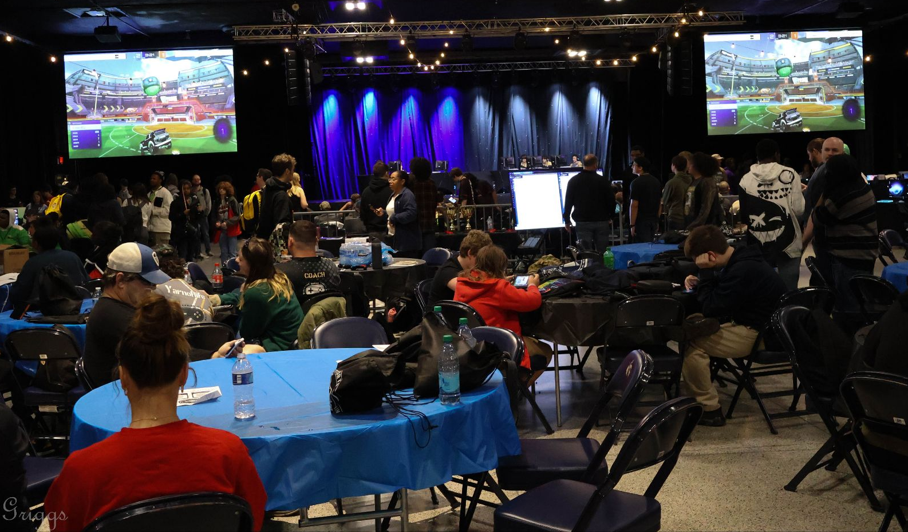
Program Models
Schools can start with:
An Esports club
Competitive team
CTE course
Full CTE pathway
Notes:
When building a school program you don’t have to start with a full pathway. Sometimes launching a school with a club or team is a great way to launch and then add corresponding courses in the future. Sometimes a career center launches with corresponding courses and then adds competitive teams to enhance student learning in that area. The key is quality staffing, sufficient student interest, appropriate physical space and administrative support.

Slide 28
Recruitment and Competitive Leagues
Tips for Recruiting
Recruit from existing clubs or programs (gaming, STEM, coding)
Host a low-pressure Interest Meeting
Post flyers, morning announcements, and weekly newsletters
Competitive Leagues:
Join a state or regional league
Play against other schools in your area
Options include PlayVS, SCSE, and others
Notes:
While tools like PlayVS can assist in running competitions for organizations, school programs have their own cultures and a coach typically would look to use a set of expectations, practices, ways to handle student registration and verification for eligibility, a number of ways to communicate, and a number of student leaders for different roles on the team.

Slide 29


South Carolina Scholastic Esports
How to Join
Memberships run from July 1 to June 30
$20 per year
Go to https://www.sc-esports.org/
Membership Benefits
Help getting started
Coaching Resources
Quarterly Roundtable Calls
Discount on the State Championship

Slide 30
Equipment and Space
Minimum Needs:
Reliable Internet
Approved Devices or gaming PCs
Monitors
Headsets
Controllers/Keyboards/Mice
Supervised Room
Secure Storage
Growth Needs:
Broadcast station
Cameras
Microphones
Lighting
Production Software
Notes:
Schools do not need a professional arena on day one. Start with a safe, supervised, reliable setup. Then grow into broadcasting, event hosting, and media production as the program matures.

Slide 31
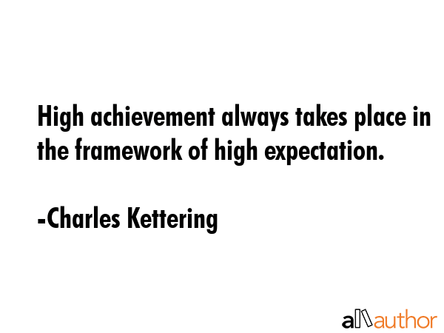
Policies and Expectations
Every program needs expectations for:
Eligibility
Attendance
Practice behavior
Academic standing
Equipment care
Parent communication
Notes:
Scholastic Esports is just another activity that the school offers, and thus all of the same guidelines, rules, and school policy should apply to protect the students, coaches, the school’s equipment, and the school’s reputation. Most online Esports events have a monitored text chat between teams, and thus online behavior is part of the competition.

Slide 32
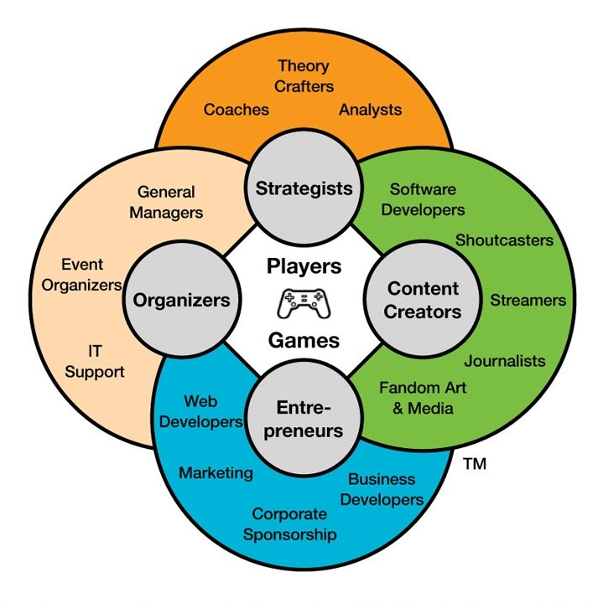
Building the Team Structure
Recommended roles:
Head coach
Assistant coach
Team captain
Broadcast crew
Social Media Team
Notes:
A sustainable esports program should not depend on one adult doing everything. Create student leadership roles. Give students ownership. Build a system where students help run the program responsibly.

Slide 33
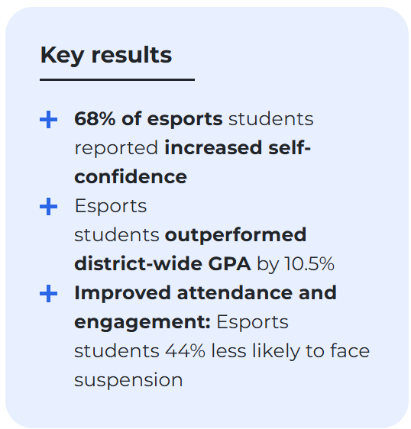
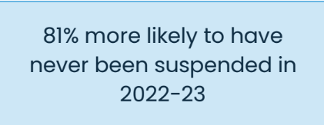
Getting Family and Administrator Buy-In
 | 2022-23 | 2023-24 | 2024-25
Attendance | +7.3 days | +9.0 days | +7.8 days
ADA Capture | ~$352,070 | ~$544,824 | ~$901,284
(Whitmore & Chitwood, 2024)
Notes:
Moreno Valley United School District, 2025

Slide 34
Common Challenges for Startups
Consistent Transportation (Off-site teams)
IT Restrictions
Setting Standards - Create a player handbook
Understanding the differences of being a teacher and a coach
Space and equipment
Limited game pool (Explaining the inability to play games like CoD at school)

Slide 35
Q&A

Slide 36
Thank You!

Slide 37
References
Armstrong, C. (2023, July 10). Video Games Remain America’s Favorite Pastime With More Than 212 Million Americans Playing Regularly. ESA. https://www.theesa.com/video-games-remain-americas-favorite-pastime-with-more-than-212-million-americans-playing-regularly/
Gottfried, J., & Sidoti, O. (2024, May 9). Teens and video games Today. Pew Research Center. https://www.pewresearch.org/internet/2024/05/09/teens-and-video-games-today/
Jenny, S. E., Besombes, N., Brock, T., Cote, A. C., & Scholz, T. M. (2024). Routledge Handbook of Esports. Taylor et Francis Group.
Postell, C., & Narayan, K. (2025). Trends in Collegiate Esports Report Volume 5. Dublin, Ohio; Esports Foundry.
Whitmore, P., & Chitwood, N. (2024, April). SCHOLASTIC ESPORTS A “SMASH”FOR STUDENT OUTCOMES IN MORENO VALLEY UNIFIED SCHOOL DISTRICT. Riverside, California; Moreno Valley Unified School District.

