Slide 1
Crafting Leadership Alongside Skills: Embedding Leadership into Student Experience
Dr. Lee Green, Director
Floyd D. Johnson Technology Center
Dr. Nikki Honeycutt, Director
Daniel Morgan Technology Center

Slide 2
End in Mind – Essential Question
How do we credential the two-thirds of the profile of the SC Graduate that employers consistently say matter most—skills like leadership, communication, resilience, professionalism, and character?

Slide 3
End in Mind – Learning Targets
In this session you will:
  Discover how we can prepare our students today with the workforce of tomorrow
  See how our students can be leaders in a continuously innovative job market.
  See how we prepare students not only for their first job, but for a lifetime of leadership, adaptability, resiliency, and success in a rapidly changing workforce.

Slide 4
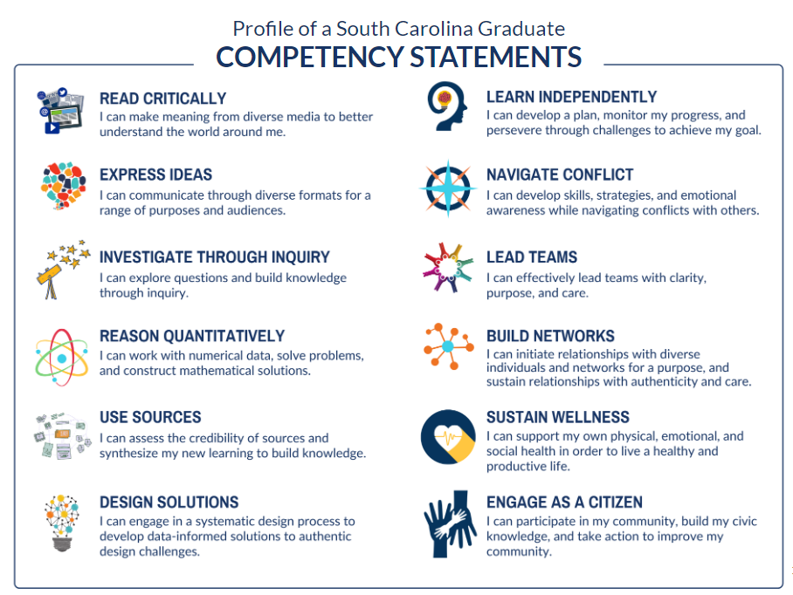
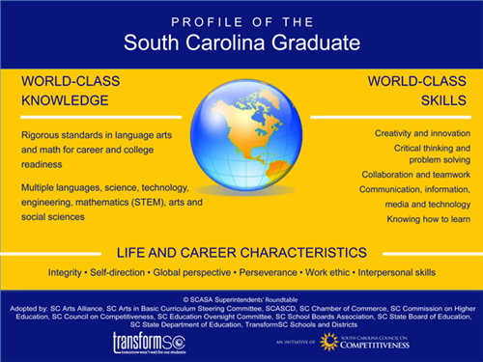
Profile of the SC Graduate
Competencies

Slide 5
So, what is our why?

Slide 6
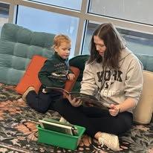
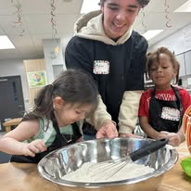
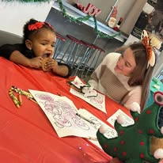
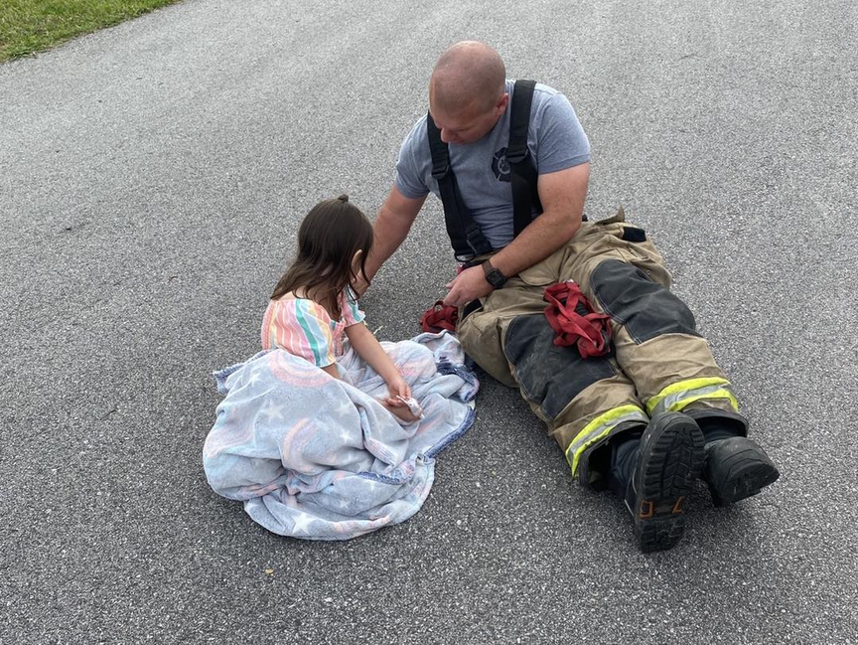
So That We Can Prepare Our Students for Tomorrow

Slide 7
Profile of Today’s Youth

Slide 8

Growing Up Digital
97% of teens aged 13 to 17 report that they use the internet daily
95% of teens have a smartphone or access to one at home
88% to 90% have access to a desktop or laptop
40% to 46% of teens report being online “almost constantly”
Data compiled by the Pew Research Center and the U.S. Department of Health and Human Services

Slide 9
Effects
Severe sleep disruption
Heightened anxiety and depression
Skewed self-image and social comparison
Atrophy of face-to-face social skills
Increased exposure to cyberbullying exploitation
Deterioration of physical health
Data compiled by the U.S. Surgeon General and the Centers for Disease Control and Prevention

Slide 10
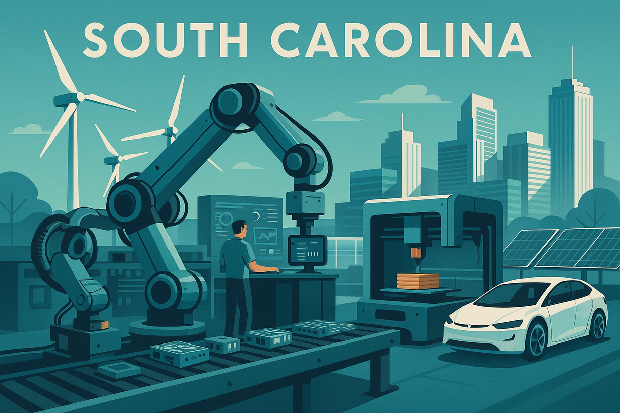
The Changing Landscape of
v

Slide 11

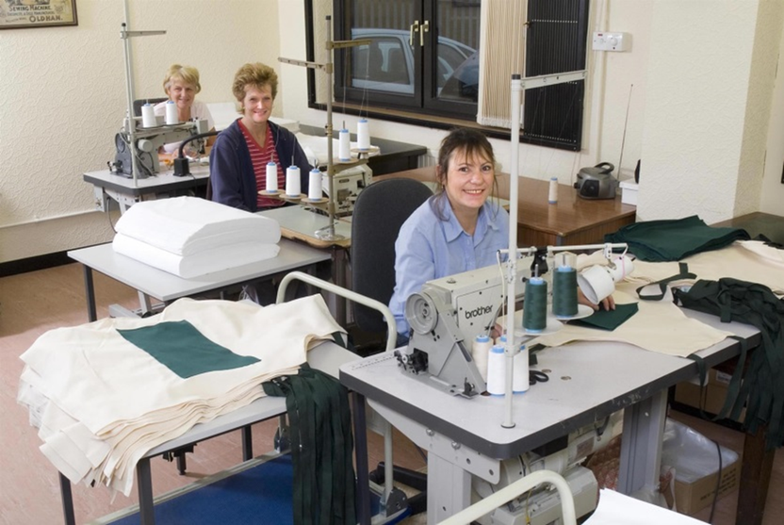
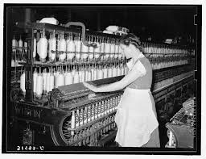
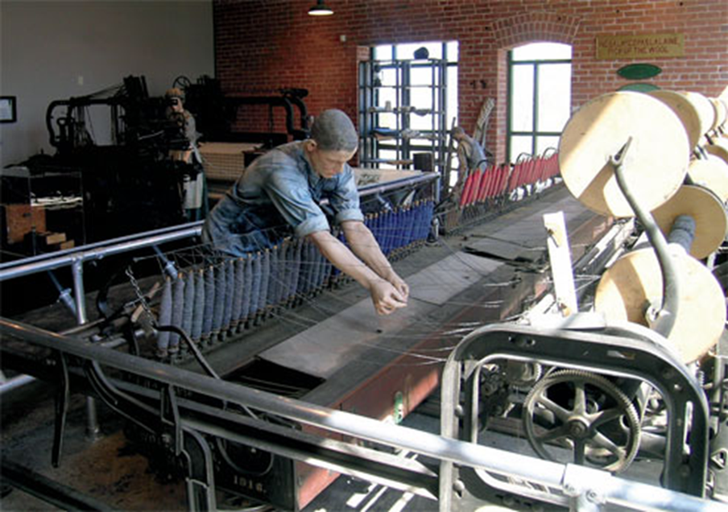
Industry in South Carolina used to look like…
Notes:
By the early 1960's, South Carolina was shifting from a predominantly agricultural economy to anindustrial one.
Dominant industries:
Textiles
Accounted for over half of all manufacturing jobs.
Production was labor-intensive, low-wage and organized around mill villages.
Agriculture and Agribusiness
Paper Lumber, and Forest Products
Ports, Shipping, and Chemical Processing
Workforce and Labor Conditions:
Wages were among the lowest in the nation, especially in textilles.
Anti-union state, which suppressed wage growth.
Factory work was often repetitive, physically demanding, and offered limited upward mobility.

Slide 12
By the early 1960's, South Carolina was shifting from a predominantly agricultural economy to an industrial one.
Dominant industries:
  Textiles
    Accounted for over half of all manufacturing jobs.
    Production was labor-intensive, low-wage and organized around mill villages.
  Agriculture and Agribusiness
  Paper Lumber, and Forest Products
  Ports, Shipping, and Chemical Processing
Workforce and Labor Conditions:
  Wages were among the lowest in the nation, especially in textilles.
  Anti-union state, which suppressed wage growth.
  Factory work was often repetitive, physically demanding, and offered limited upward mobility.

Slide 13









But now…
Notes:
Will not be a story of decline or replacement, but a story of evolution toward advanced,capital-intensive, technology-driven production.
Manufacturing will remain the backbone:
Generates over $300 billion in economic output
30% of all jobs
Wages are about 24% above the state average
Fewer but more highly skilled jobs
Mechatronics
Industrial AI and data analytics
Robotics maintenance
Advanced quality and system engineers
Logistics, Ports, and Distribution
Will expand with global trade
Construction, Infrastructure, and Energy
Growth will be strongest in:
Industrial construction
Power generation and gridup grades
Site development for megaprojects
Automotive, EVs, and Mobility
SC leads the nation in tire and passenger vehicle exports.
Major investments are already flowing into:
EV battery components
Lightweight materials
E-mobility systems
Aerospace and Defense
Growth will be strongest in:
Precision composites
Aircraft systems
Defense-related manufacturing
Life Sciences and Bioscience
SC is targeting biomedical manufacturing, research and deviceproduction

Slide 14
Future of Industry in South Carolina
Will not be a story of decline or replacement, but a story of evolution toward advanced, capital-intensive, technology-driven production.
Manufacturing will remain the backbone:
  Generates over $300 billion in economic output
  30% of all jobs
  Wages are about 24% above the state average
  Fewer but more highly skilled jobs
    Mechatronics
    Industrial AI and data analytics
    Robotics maintenance
    Advanced quality and system engineers

Slide 15
Logistics, Ports, and Distribution
  Will expand with global trade
Construction, Infrastructure, and Energy
  Growth will be strongest in:
    Industrial construction
    Power generation and grid upgrades
    Site development for megaprojects

Slide 16
Automotive, EVs, and Mobility
  SC leads the nation in tire and passenger vehicle exports.
  Major investments are already flowing into:
    EV battery components
    Lightweight materials
    E-mobility systems
Aerospace and Defense
  Growth will be strongest in:
    Precision composites
    Aircraft systems
    Defense-related manufacturing
Life Sciences and Bioscience
  SC is targeting biomedical manufacturing, research and device production

Slide 17
Biggest Challenges
  Skills gap
  Aging workforce challenges
  Competition for technical talent
Industry in SC’s future will be:
  Less labor-intensive
  More technical
  More globally integrated
  More resilient to trade swings
Jobs will increasingly favor:
  Technicians over operators
  Engineers over assemblers
  Systems thinkers over single-task roles
Notes:
Say this content on slides 18 and 19

Slide 18
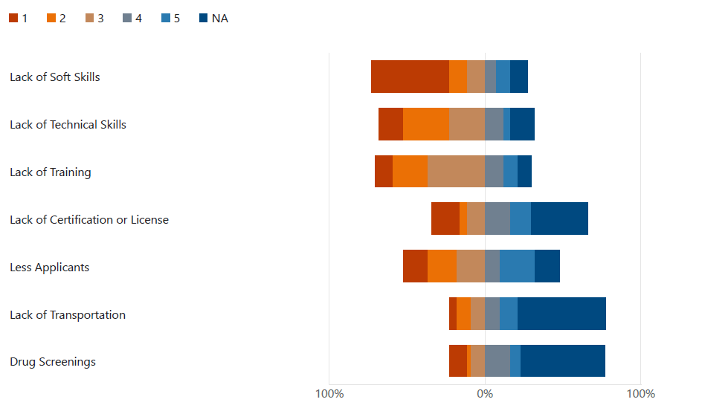
Taken from Catawba Region CLNA Employer Survey
“The greatest obstacles identified are not a lack of degrees, but rather a lack of soft skills, insufficient workplace training, and inadequate technical preparation. Employers also noted a limited applicant pool and challenges related to transportation and pre-employment screening as additional barriers to hiring. Collectively, these findings point to a disconnect between basic employability expectations and the skills many applicants bring to the labor market.”
Notes:
Intro these things....
Biggest Challenges
Skills gap
Aging workforce challenges
Competition for technical talent
Industry in SC’s future will be:
Less labor-intensive
More technical
More globally integrated
More resilient to trade swings
Jobs will increasingly favor:
Technicians over operators
Engineers over assemblers
Systems thinkers over single-task roles
Explain the Catawba Region Employer Survey

Slide 19
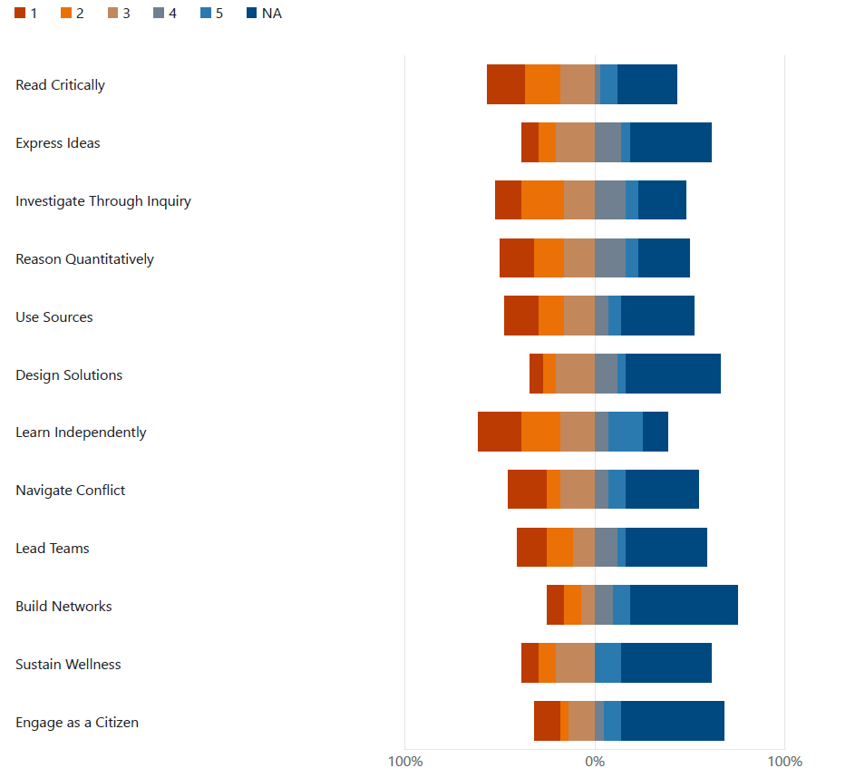
Taken from Catawba Region CLNA Employer Survey
“When asked to identify the most important skills for their organizations, employers consistently emphasized foundational competencies. Communication skills—both written and verbal—critical thinking, quantitative reasoning, and the ability to learn independently were ranked highly. Equally important were the interpersonal skills such as teamwork, leadership conflict management, and professionalism. These responses indicate that employers value transferable, durable skills that support adaptability and long-term success across occupations, regardless of industry.”

Slide 20
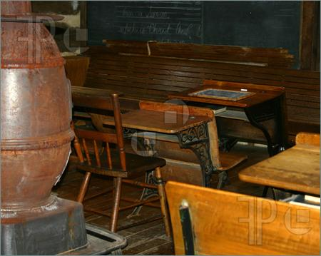


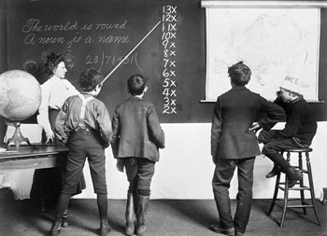

How do we close…
Notes:
Published in 2008
Gathered qualitative and quantitative data by:
Executive and workforce interviews with corporate leaders and military leaders
Extensive classroom observations
Student and graduate focus groups
Review of corporate and educational studies

Slide 21
Published in 2008
Gathered qualitative and quantitative data by:
  Executive and workforce interviews with corporate leaders and military leaders
  Extensive classroom observations
  Student and graduate focus groups
  Review of corporate and educational studies

Slide 22



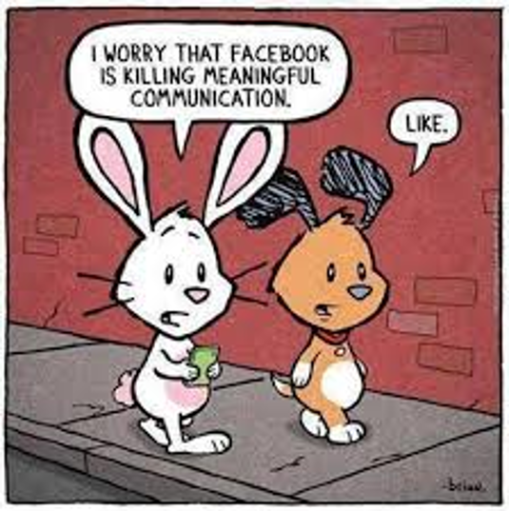
The New World of Work and the Seven Survival Skills
Critical Thinking and Problem Solving
Collaboration Across Networks and Leading by Influence
Agility and Adaptability
Initiative and Entrepreneurialism
Effective Oral and Written Communication
Accessing and Analyzing Information
Curiosity and Imagination
Notes:
Critical Thinking and Problem Solving
Ability to think clearly and rationally
Ability to engage in reflective and independent thinking
Able to understand the logical connections between ideas
Solve problems systematically
Collaboration Across Networks and Leading by Influence
Two or more people work together toward a common goal
Sharing knowledge
Learning
Building consensus
Quick overview then get (or give) examples. – multi-program projects Ag + Culinary
Agility and Adaptability
Quick overview then get (or give) examples. – Cosmetology performs “Flash Mob” type of hair / makeup show during lunch.
Initiative and Entrepreneurialism
Refers to an individual’s ability to
turn ideas into action.
Creativity
Innovation
Risk-taking
Quick overview then get (or give) examples. – Web Design/Graphic Communications students have yearly design contest for school theme.
Effective Oral and Written Communication
Ability to communicate one’s thoughts clearly and concisely.
Quick overview then get (or give) examples. – senior projects with presentation
Accessing and Analyzing Information
The skill of gathering information on a certain topic and analyzing the quality of that information.
Curiosity and Imagination
Curiosity is the desire to know or learn and a desire to know about people or things that do not concern one.
Imagination is the formation of amental image or something that is neither perceived as real nor present.

Slide 23

Critical Thinking and Problem Solving
Ability to think clearly and rationally
Ability to engage in reflective and independent thinking
Able to understand the logical connections between ideas
Solve problems systematically
Foundation of Critical Thinking, 2013
Notes:
Quick overview then get (or give) examples. – Carpentry students meet potential clients, collect material costs etc.

Slide 24

Collaboration Across Networks and Leading by Influence
Two or more people work together toward a common goal
  Sharing knowledge
  Learning
  Building consensus
Notes:
Quick overview then get (or give) examples. – multi-program projects Ag + Culinary

Slide 25

Agility and Adaptability
Agility is the ability and willingness to learn from experience and then apply that learning to perform successfully under new situations (Assessing and Developing Adaptable Leaders for an Age of Uncertainty, 2010).
Adaptability is the ability to embrace change.
  According to Ellen Kumata of Cisco, “you have to be able to take in all sorts of new information, new situations, and be able to operate in ambiguous and unpredictable ways. You have to thrive in this environment and deliver results (Wagner, 2008).”
Notes:
Quick overview then get (or give) examples. – Cosmetology performs “Flash Mob” type of hair / makeup show during lunch.

Slide 26
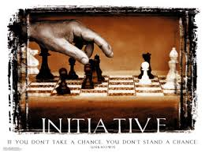
Initiative and Entrepreneurialism
Refers to an individual’s ability to
turn ideas into action.
  Creativity
  Innovation
  Risk-taking
Notes:
Quick overview then get (or give) examples. – Web Design/Graphic Communications students have yearly design contest for school theme.

Slide 27
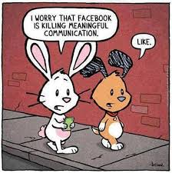
Effective Oral and Written Communication
Ability to communicate one’s thoughts clearly and concisely.
Notes:
Quick overview then get (or give) examples. – senior projects with presentation

Slide 28

Accessing and Analyzing Information
The skill of gathering information on a certain topic and analyzing the quality of that information.

Slide 29

Curiosity and Imagination
Curiosity is the desire to know or learn and a desire to know about people or things that do not concern one.
Imagination is the formation of a mental image or something that is neither perceived as real nor present.

Slide 30
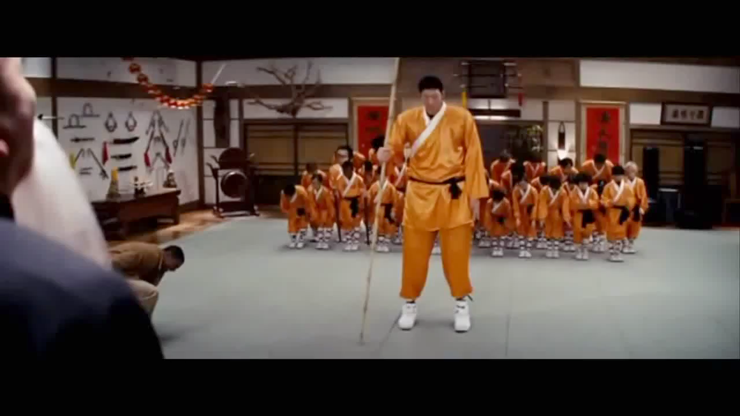
Effective Oral and Written Communication
CTE – Uncommon to the Core

Slide 31
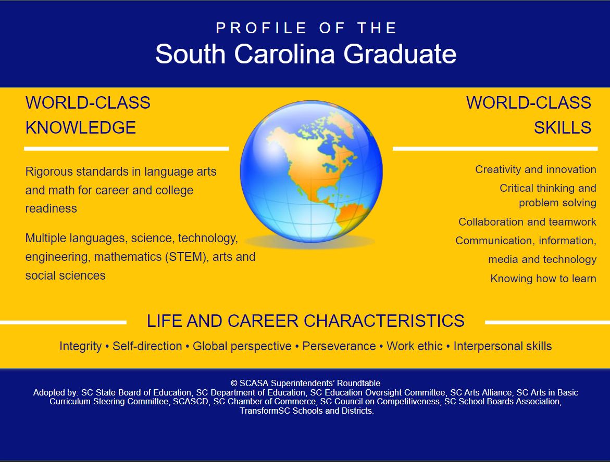
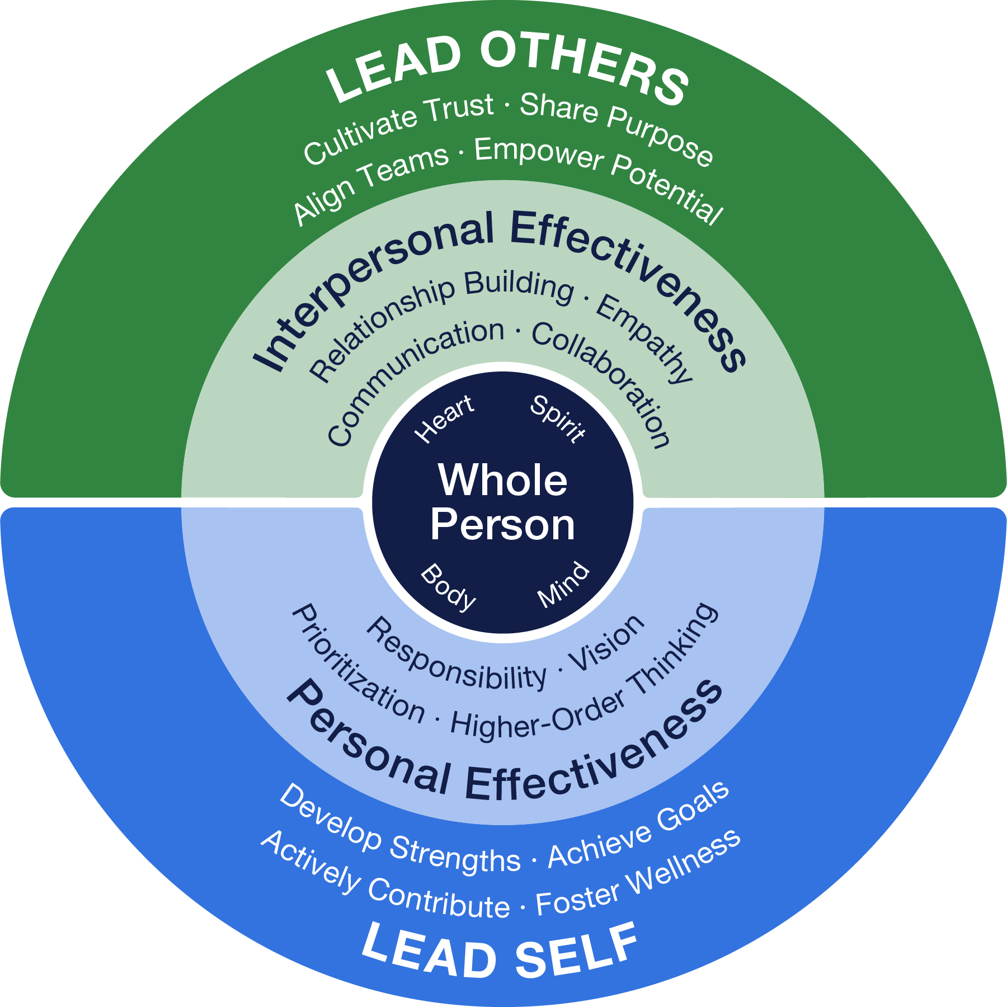
Aligning Vision With Practice to Address the Skills Gap
The Profile of the South Carolina Graduate captures the shared vision of world-class knowledge, skills, and characteristics we seek to develop in every student.
The Student Leadership Portrait represents the continuum of workforce-readiness competencies students develop through the integrated application of core leadership principles in Leader in Me schools.

Slide 32

From Concept to Culture:
Leadership Must be Embedded, Not Added
Leadership development should become part of daily instruction
Students should practice leadership behaviors in authentic settings
CTE classrooms already provide real-world environments ideal for leadership development
Leader in Me integrates naturally into existing instructional models.
We are teaching them the Continuous Improvement model that industry demands.

Slide 33
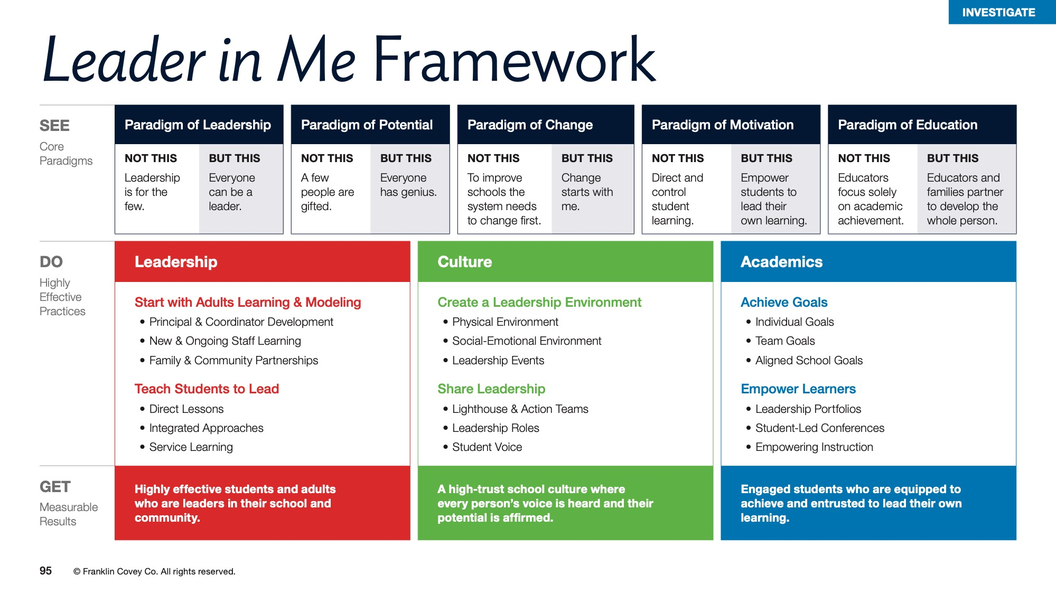

Slide 34
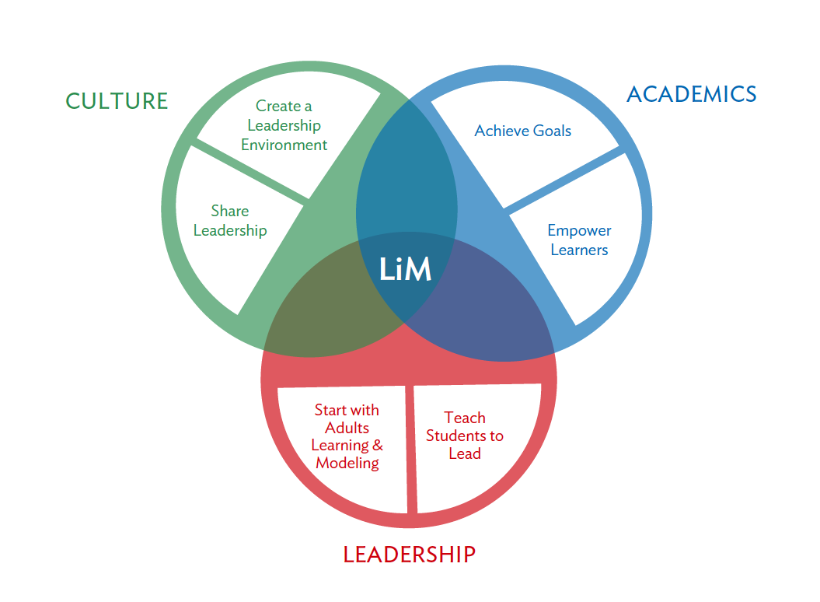

Slide 35
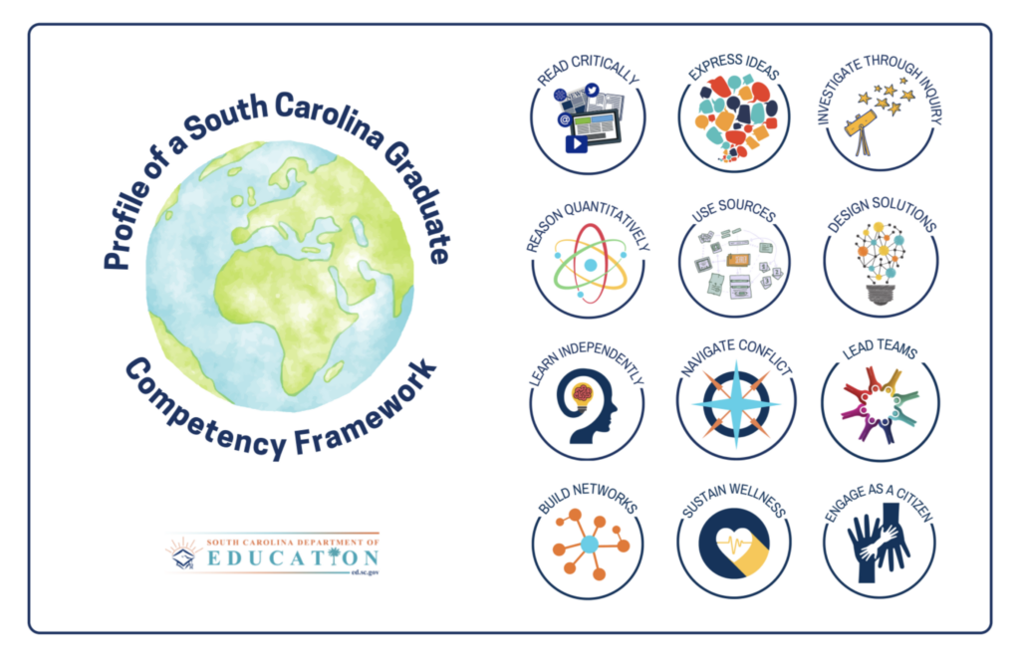

How does Leader in Me align with the Profile of a South Carolina Graduate?
 |  | Profile of a South Carolina Graduate Competencies
 |  | Read Critically | Express Ideas | Investigate Through Inquiry | Reason Quantitatively | Design Solutions | Build Networks | Use Sources | Learn Independently | Lead Teams | Navigate Conflict | Sustain Wellness | Engage as a Citizen
Start With Adults Learning & Modeling | Principal & Coordinator Development |  | ✔ |  |  |  | ✔ |  |  |  | ✔
 | New & Ongoing Staff Learning |  | ✔ |  |  |  | ✔ |  |  | ✔ | ✔
 | Family & Community Partnerships |  | ✔ |  |  |  | ✔ |  |  | ✔ | ✔ |  | ✔
Teach Students to Lead | Direct Lessons | ✔ | ✔ | ✔ | ✔ | ✔ | ✔ | ✔ | ✔ | ✔ | ✔ | ✔ | ✔
 | Integrated Approaches |  |  |  |  |  |  |  | ✔ | ✔ | ✔ | ✔ | ✔
 | Service Learning |  | ✔ | ✔ |  | ✔ | ✔ |  | ✔ | ✔ | ✔ |  | ✔
Create a Leadership Environment | Physical Environment | ✔ |  |  |  | ✔ |  |  | ✔ | ✔ |  | ✔ | ✔
 | Social-Emotional Environment |  |  |  |  | ✔ | ✔ |  | ✔ | ✔ | ✔ | ✔ | ✔
 | Leadership Events |  | ✔ | ✔ |  | ✔ | ✔ |  | ✔ | ✔ |  |  | ✔
Share Leadership | Lighthouse & Action Teams | ✔ | ✔ | ✔ |  | ✔ | ✔ |  | ✔ | ✔ | ✔ |  | ✔
 | Leadership Roles |  | ✔ | ✔ |  | ✔ | ✔ |  | ✔ | ✔ | ✔ |  | ✔
 | Student Voice |  | ✔ | ✔ |  | ✔ | ✔ |  | ✔ | ✔ | ✔ | ✔ | ✔
Achieve Goals | Individual Goals |  | ✔ | ✔ | ✔ | ✔ |  |  | ✔
 | Team Goals |  | ✔ | ✔ | ✔ | ✔ |  |  | ✔ | ✔ | ✔ |  | ✔
 | Aligned School Goals |  | ✔ |  | ✔ | ✔ |  |  | ✔ | ✔ | ✔ |  | ✔
Empower Learners | Leadership Portfolios | ✔ | ✔ | ✔ | ✔ | ✔ |  | ✔ | ✔
 | Student-Led Conferences |  | ✔ | ✔ |  | ✔ | ✔ |  | ✔ |  | ✔ |  | ✔
 | Empowering Instruction | ✔ | ✔ | ✔ |  | ✔ | ✔ |  | ✔ | ✔ | ✔ |  | ✔

Slide 36
Foundation: Establishing the Framework
Staff training and mindset development
Introduction of shared leadership language
Understanding The 7 Habits® framework
Modeling leadership behaviors as adults
Building consistency across classrooms and programs
Examples:
Shared expectations for professionalism
Leadership vocabulary posted in labs and classrooms
Daily leadership reflections or bell ringers
Staff modeling workplace communication and accountability

Slide 37
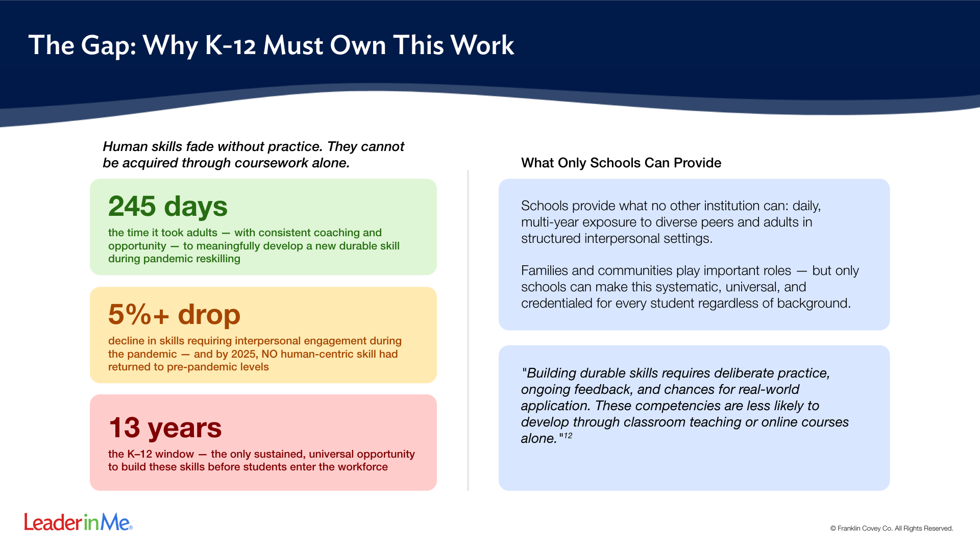
Notes:
This slide answers the 'why us' question before it's asked. Skills-based hiring is rising. But the window to build these skills is K–12. After graduation, access to capability-building drops dramatically — only 19% of adults without a HS diploma participate in professional training vs. 61% of college graduates.

Slide 38
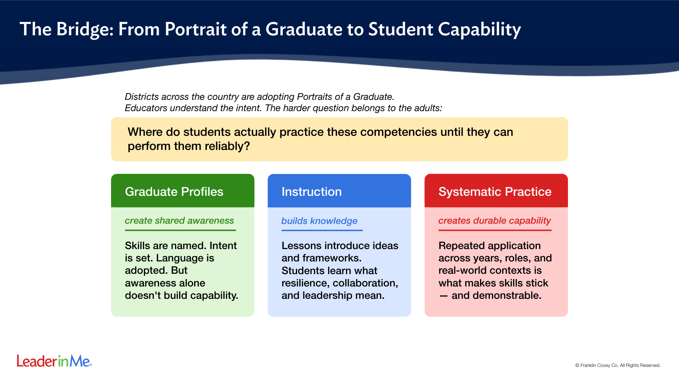
Notes:
This is the central argument of the whole document. Portraits define the destination. But they don't build the road. Leader in Me is designed specifically to fill the space between knowing what students should become and actually getting them there.

Slide 39
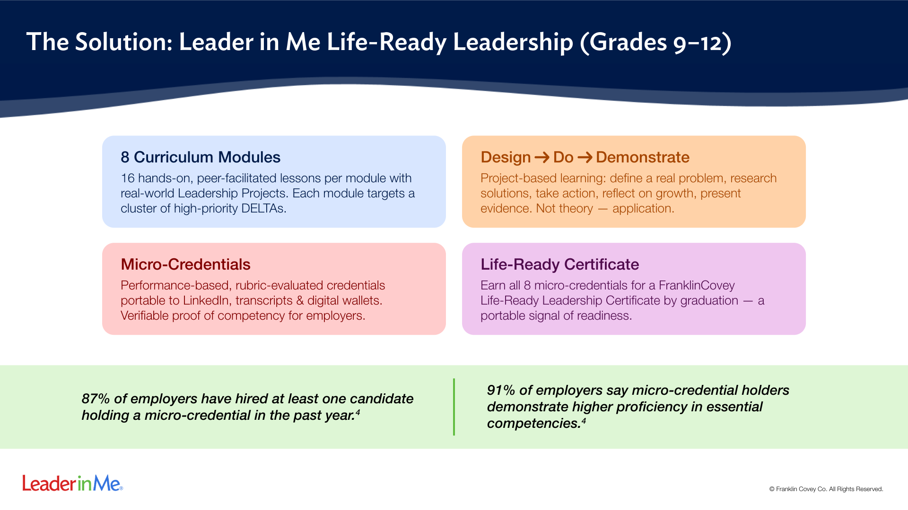
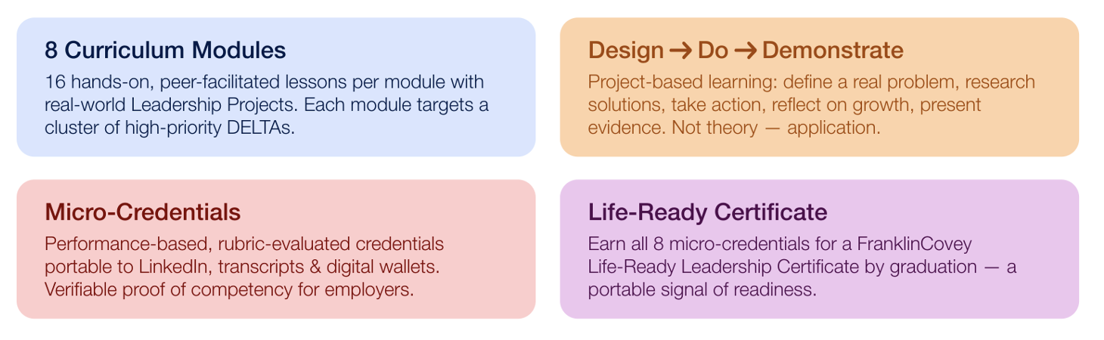
Portraits define the destination. But portraits do not build the road. Schools
Need systems that intentionally teach students how to become the graduate
We say we want.
Notes:
The micro-credential data from Lumina Foundation (2025) is particularly powerful for district leaders: 94% of employers believe micro-credentials reduce first-year training costs, and 85% of students who earn them report greater confidence. This connects student outcomes to both employer demand and district accountability goals.

Slide 40
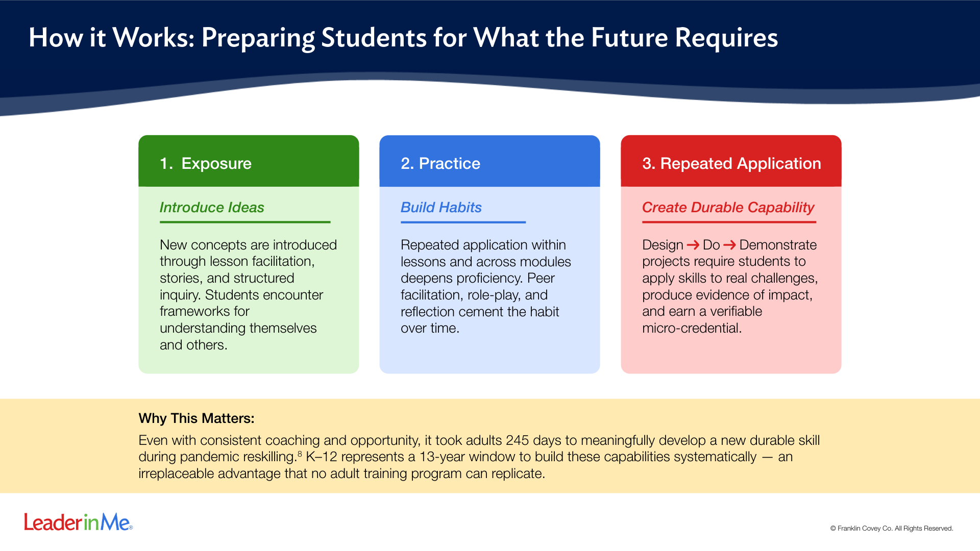
Notes:
The 245-day finding from WEF is one of the most powerful data points in the Kim Start Here compilation. It reframes K-12 not as a place where students happen to be, but as a unique developmental window that closes permanently. No other institution has 13 years.

Slide 41
Integration: Embedding Leadership into Student Learning
Student goal-setting practices
Leadership roles within labs and project teams
Team accountability systems
Student ownership of learning and outcomes
Reflection and growth tracking
Examples:
Welding Safety Captains
Automotive Diagnostic Team Leads
Construction Project Managers
Robotics Troubleshooting Leaders
Health Science Patient Care Leaders

Slide 42
Sustainability: Creating a Lasting Leadership Culture
Leadership embedded across all pathways
Student-led collaboration and accountability
Leadership expectations normalized across campus
Recognition of leadership growth and achievement
Continuous reflection and improvement
Outcomes:
Increased student confidence
Improved professionalism
Stronger Classroom culture
Higher student ownership
Better workforce readiness

Slide 43
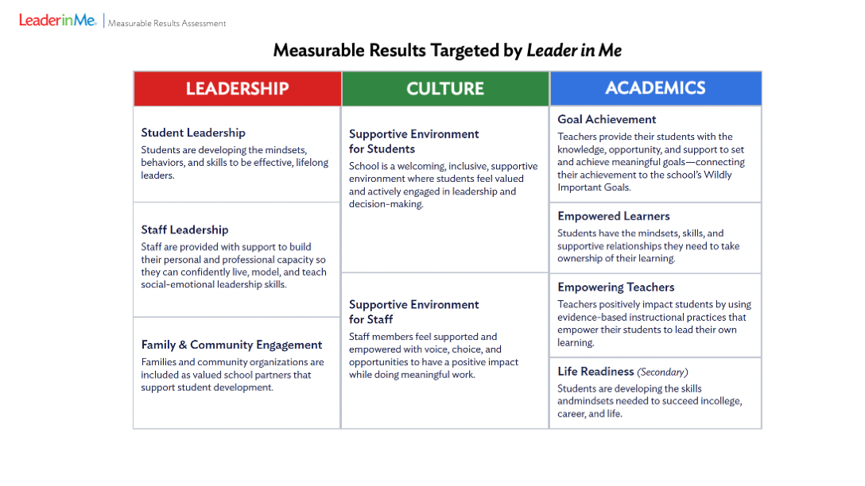

Slide 44
What Leadership Looks Like in CTE
Students leading project teams
Peer mentoring and tutoring
Student-led presentations and demonstrations
Goal-setting and progress monitoring
Team-based troubleshooting and collaboration
Workplace simulations with leadership expectations

Slide 45





Why Leader in Me?
Provides a consistent leadership framework
Focuses on transferable workforce skills
Builds leadership habits through repetition and application
Supports both personal growth and workplace readiness
Aligns with the mission of career and technical education

Slide 46

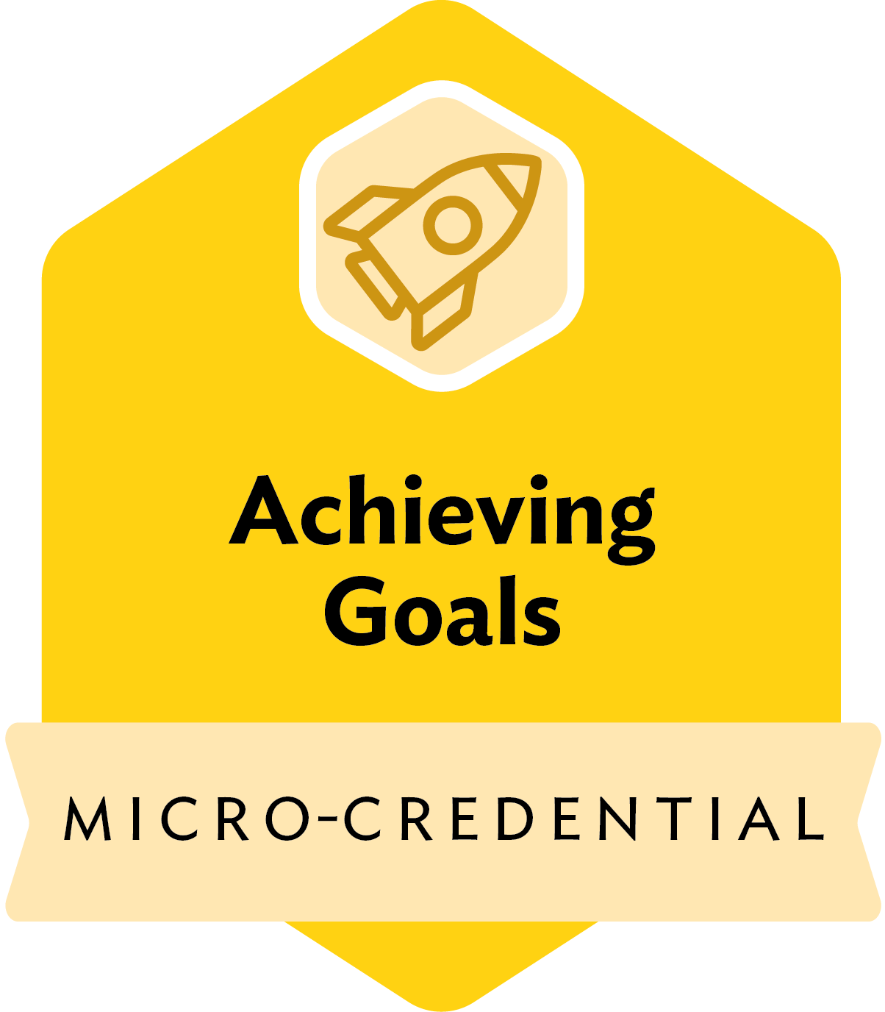





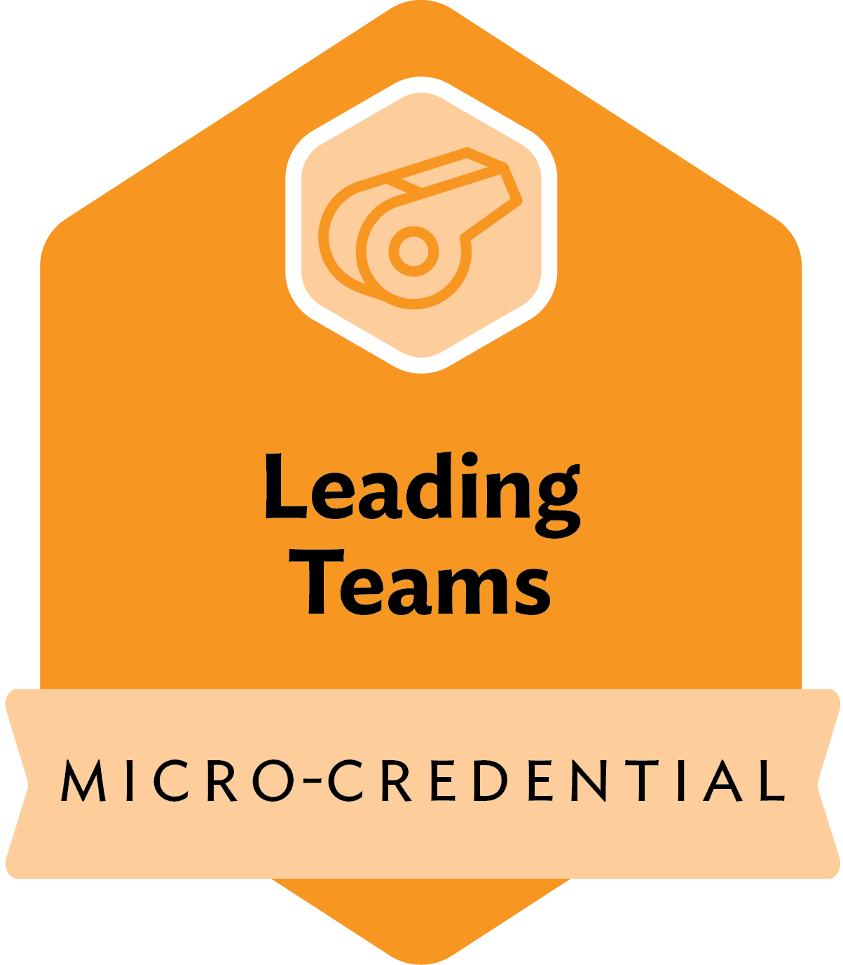
Micro-Credentials Overview
Each module in the Life-Ready Leadership Curriculum culminates in a performance-based micro-credential that verifies key leadership competencies.
Micro-Credential | Focus Area
Living The 7 Habits® | Self-leadership, mindset, and personal responsibility
Achieving Goals | Vision-setting, planning, and perseverance
Strengthening Wellness | Balance, time management, and personal renewal
Finding Your Voice | Purpose, passion, and initiative
Developing High-Trust Relationships | Trust-building, mutual respect, and clear communication
Contributing to the Community | Civic engagement, collaboration, and service
Succeeding with People | Collaboration, listening, and conflict resolution
Leading Teams | Shared vision, empowerment, and team alignment

Slide 47



Slide 48
Alignment with Workforce Needs
Workforce Skills Reinforced
Communication
Accountability
Collaboration
Initiative
Professionalism
Problem-Solving
Adaptability
Industry Impact
Better workplace readiness
Improved employee retention
Stronger teamwork and collaboration
Increased leadership potential in entry-level employees

Slide 49
Alignment with Educational Goals
Supports for Student Success
Student engagement
Career readiness
Student ownership
Positive school culture
Leadership development
Work-based learning readiness
CTSO leadership opportunities
Educational Impact
Increased confidence and participation
Stronger classroom accountability
Greater student motivation
Improved professional behavior

Slide 50
Alignment with State Priorities
Supports State Goals
  Workforce readiness
  Career preparedness
  Graduation success
  Postsecondary readiness
  Economic development
  Workforce pipeline sustainability

Slide 51
Why CTE Centers are the Perfect Fit
CTE already emphasizes
  Teamwork
  Problem-solving
  Accountability
  Hands-on learning
  Workplace simulation
  Industry expectations

Slide 52




The Vision for Students: Preparing Students for Career and Life
Leadership skills create long-term success
Technical skills remain essential
Workforce readiness requires both—college alone does not emphasize or credential these necessary skills
CTE has the opportunity to lead this work

Slide 53
Endorsements for Leader in Me
From South Carolina Leaders

Slide 54
“Students with strong foundational life skills are better prepared for long-term career progression.”
“This credential provides meaningful value to both students and employers.”
—Jacob Bouchillon
Tech Scholar/Maintenance Early Scholar Program Manager, U.S., Michelin North America

Slide 55
“A workforce that is not only skilled, but truly ready to contribute on day one.”
“Greater alignment between education and industry.”
—Allen Smith
President & CEO, OneSpartanburg

Slide 56
“Technical skills are essential, but durable skills are what ultimately determine long-term success.
—Dr. Ron Garner
Chief Talent Officer, OneSpartanburg

Slide 57
“Students demonstrate these essential skills through real-world application—not just content knowledge.”
“A scalable and relevant Tier 2 option for students statewide.”
—Dr. Burke Royster
Superintendent, Greenville County Schools

Slide 58
“A meaningful, measurable solution.”
“Students build and demonstrate competencies directly tied to workplace readiness.”
—Dean Faile
President & CEO, York County Regional Chamber

Slide 59
“A shared, trusted standard for employability skills.”
“Reduces hiring risk, improves retention, and enhances productivity.”
—Celeste Tiller
VP, Talent & Workforce Development, York County Regional Chamber

Slide 60
“Students can demonstrate
real-world competence.”
“These competencies are universally valued across industries.”
—Dr. Lee Green
CTE Director, Floyd D. Johnson Technology Center

Slide 61
“Students can translate their skills into meaningful action.”
“Experiential learning fosters deeper engagement.”
—Rodney K. Miller
CTE Director, Lancaster County School District Career Center

Slide 62
“Leader in Me is a proven example of what we seek to platform, and I am fully committed to supporting its expansion in schools across our state, in strong, collaborative partnership with local education leaders.”
—Ellen Weaver
South Carolina State Superintendent of Education
Notes:
For nearly two decades, employers, military leaders, university leaders, and workforce researchers have consistently identified the same durable skills as essential for success.
South Carolina has an opportunity to move beyond simply teaching those skills.
We have an opportunity to define them, assess them, validate them, and credential them.
Technical credentials validate proficiency.
The Life-Ready Leadership Credential validates application.
And in the workforce, application is what employers hire for.

